Slide 2
vol 2 Table i.1 Summary statistics on reported ESRD therapy in the United States, by age, race, ethnicity, sex, & primary diagnosis, 2012
 | Incidence ª |  |  | December 31 point prevalence |  |  |  |  |  |  | Kidney transplants
 | Count | % | Adj. rate^{b} | Count | % | Adj. rate ^{b} | Dialysis ^{c} | % | Tx ^{c} | % | Deceased donor | Living donor | ESRD deaths ^{d}
0-19 ^{e} | 1,163 | 1.0 | 13.1 | 7,545 | 1.2 | 83.1 | 2,060 | 0.5 | 5,485 | 2.9 | 549 | 350 | 84
20-44 | 13,162 | 11.5 | 122.2 | 101,994 | 16.0 | 938.0 | 59,045 | 13.1 | 42,949 | 23.1 | 2,918 | 1,925 | 3,929
45-64 | 45,069 | 39.3 | 570.2 | 283,021 | 44.4 | 3,550.1 | 188,571 | 41.8 | 94,450 | 50.7 | 5,851 | 2,549 | 26,555
65-74 | 27,933 | 24.3 | 1,270.1 | 140,238 | 22.0 | 6,301.8 | 106,101 | 23.5 | 34,137 | 18.3 | 1,928 | 696 | 24,563
75+ | 27,486 | 23.9 | 1,618.4 | 104,107 | 16.3 | 6,261.1 | 94,825 | 21.0 | 9,282 | 5.0 | 247 | 76 | 33,507
Unknown age | . | . | . | . | . | . | . | . | . | . | 42 | 21
White | 76,089 | 66.3 | 279.2 | 383,534 | 60.2 | 1,431.8 | 252,053 | 55.9 | 131,481 | 70.6 | 6,892 | 4,450 | 59,868
Black/African American | 31,398 | 27.3 | 908.0 | 200,797 | 31.5 | 5,670.5 | 164,211 | 36.4 | 36,586 | 19.6 | 3,547 | 718 | 23,868
Native American | 1,273 | 1.1 | 411.5 | 8,154 | 1.3 | 2,599.5 | 6,310 | 1.4 | 1,844 | 1.0 | 135 | 41 | 1,012
Asian | 5,840 | 5.1 | 378.9 | 35,878 | 5.6 | 2,271.8 | 25,230 | 5.6 | 10,648 | 5.7 | 809 | 352 | 3,400
Other | 50 | 0.0 |  | 5,860 | 0.9 |  | 2,515 | 0.6 | 3,345 | 1.8 | 75 | * | 490
Unknown | 163 | 0.1 |  | 2,682 | 0.4 |  | 283 | 0.1 | 2,399 | 1.3 | 77 | 48 | .
Hispanic | 17,024 | 14.8 | 501.3 | 106,308 | 16.7 | 2,931.9 | 79,352 | 17.6 | 26,956 | 14.5 | 1,956 | 804 | 11,433
Non-Hispanic | 97,789 | 85.2 | 340.5 | 530,597 | 83.3 | 1,857.8 | 371,250 | 82.4 | 159,347 | 85.5 | 9,579 | 4,813 | 77,205
Male | 65,842 | 57.3 | 446.0 | 363,497 | 57.1 | 2,396.7 | 252,526 | 56.0 | 110,971 | 59.6 | 6,973 | 3,483 | 49,939
Female | 48,971 | 42.7 | 278.0 | 273,312 | 42.9 | 1,558.4 | 198,006 | 43.9 | 75,306 | 40.4 | 4,520 | 2,113 | 38,696
Unknown gender | . | . | . | 96 | 0.0 | . | 70 | 0.0 | 26 | 0.0 | 42 | 21 | *
Data Source: Reference tables: A, B, D, E &H. a Incident counts: include all known ESRD patients, regardless of any incomplete data on patient characteristics and of U.S. residency status; b Includes only residents of the 50 states and Washington D.C. Rates are adjusted for age, race, and/or sex using the estimated 2011 U.S. resident population as the standard population. All rates are per million population. Rates by age are adjusted for race and sex. Rates by sex are adjusted for race and age. Rates by race are adjusted for age and sex. Rates by disease group and total adjusted rates are adjusted for age, sex, and race. Adjusted rates do not include patients with other or unknown race. c Patients are classified as receiving dialysis or having a functioning transplant. Those whose treatment modality on December 31 is unknown are assumed to be receiving dialysis. Includes all Medicare and non-Medicare ESRD patients, and patients in the U.S. territories and foreign countries. d Deaths are not counted for patients whose age is unknown. e Age is computed at the start of therapy for incidence, on December 31 for point prevalence, at the time of transplant for transplants, and on the date of death for death. . Zero values in this cell. Abbreviations: Adj., adjusted; ESRD, end-stage renal disease; Tx, transplant.

Slide 3
vol 2 Table i.1 Summary statistics on reported ESRD therapy in the United States, by age, race, ethnicity, sex, & primary diagnosis, 2012 (continued)
 | Incidence ª |  |  | December 31 point prevalence |  |  |  |  |  |  | Kidney transplants
 | Count | % | Adj. rate^{b} | Count | % | Adj. rate ^{b} | Dialysis ^{c} | % | Tx ^{c} | % | Deceased donor | Living donor | ESRD deaths ^{d}
Diabetes | 50,534 | 44.0 | 154.3 | 239,837 | 37.7 | 731.0 | 197,079 | 43.7 | 42,758 | 23.0 | 3,355 | 1,081 | 40,795
Hypertension | 32,610 | 28.4 | 101.1 | 159,049 | 25.0 | 489.4 | 129,092 | 28.6 | 29,957 | 16.1 | 2,505 | 833 | 24,975
Glomerulonephritis | 9,115 | 7.9 | 28.3 | 106,012 | 16.6 | 325.8 | 52,841 | 11.7 | 53,171 | 28.5 | 2,549 | 1,679 | 6,828
Cystic kidney disease | 2,530 | 2.2 | 7.9 | 29,881 | 4.7 | 92.4 | 11,526 | 2.6 | 18,355 | 9.9 | 832 | 620 | 1,548
Urologic disease | 538 | 0.5 | 1.6 | 7,447 | 1.2 | 22.9 | 3,576 | 0.8 | 3,871 | 2.1 | 133 | 91 | 589
Other known cause | 12,281 | 10.7 | 38.2 | 59,714 | 9.4 | 184.7 | 37,458 | 8.3 | 22,256 | 11.9 | 1,356 | 783 | 9,935
Unknown cause | 3,506 | 3.1 | 10.8 | 25,977 | 4.1 | 78.2 | 15,883 | 3.5 | 10,094 | 5.4 | 423 | 216 | 3,101
Missing cause | 3,699 | 3.2 | 10.6 | 8,988 | 1.4 | 18.1 | 3,147 | 0.7 | 5,841 | 3.1 | 382 | 314 | 867
All | 114,813 | 100.0 | 353.2 | 636,905 | 100.0 | 1,942.9 | 450602 ^{f} | 100.0 | 186,303 | 100.0 | 11,535 | 5,617 | 88,638
Unadjusted rate ^{g} |  |  | 358.6 |  |  | 1,968.2 |  |  |  |  | Total transplants^{h} | 17,330
Data Source: Reference tables: A, B, D, E &H. a Incident counts: include all known ESRD patients, regardless of any incomplete data on patient characteristics and of U.S. residency status; b Includes only residents of the 50 states and Washington D.C. Rates are adjusted for age, race, and/or sex using the estimated 2011 U.S. resident population as the standard population. All rates are per million population. Rates by age are adjusted for race and sex. Rates by sex are adjusted for race and age. Rates by race are adjusted for age and sex. Rates by disease group and total adjusted rates are adjusted for age, sex, and race. Adjusted rates do not include patients with other or unknown race. c Patients are classified as receiving dialysis or having a functioning transplant. Those whose treatment modality on December 31 is unknown are assumed to be receiving dialysis. Includes all Medicare and non-Medicare ESRD patients, and patients in the U.S. territories and foreign countries. d Deaths are not counted for patients whose age is unknown. f Includes patients whose modality is unknown. g Unadjusted total rates include all ESRD patients in the 50 states and Washington D.C. h Total transplants as known to the USRDS * Values for cells with ten or fewer patients are suppressed. . Zero values in this cell. Abbreviations: Adj., adjusted; ESRD, end-stage renal disease; Tx, transplant.

Slide 4
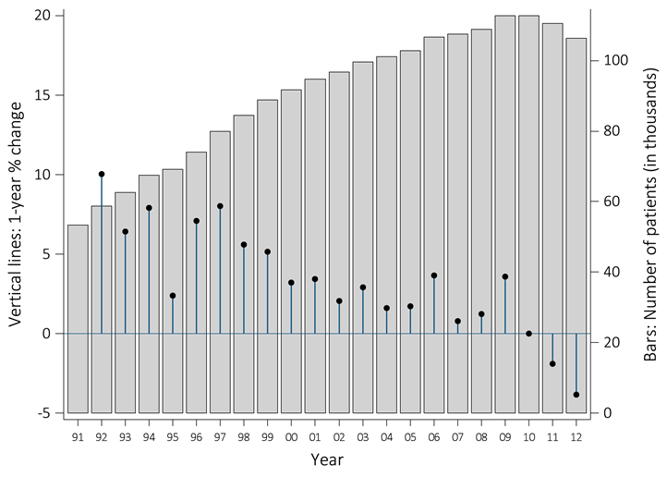
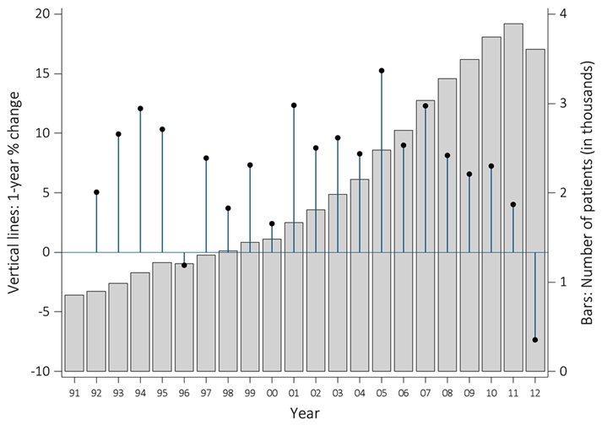
vol 2 Figure i.1 Counts of new & returning dialysis patients, 1991–2012
(a) New patients
(b) Patients restarting dialysis
Data Source: CMS Form 2744, Annual Facility Survey. Patients restarting dialysis (Panel B) are those who had temporarily recovered kidney function, had discontinued dialysis or had been lost to follow-up but restarted routine dialysis during the survey period.

Slide 5
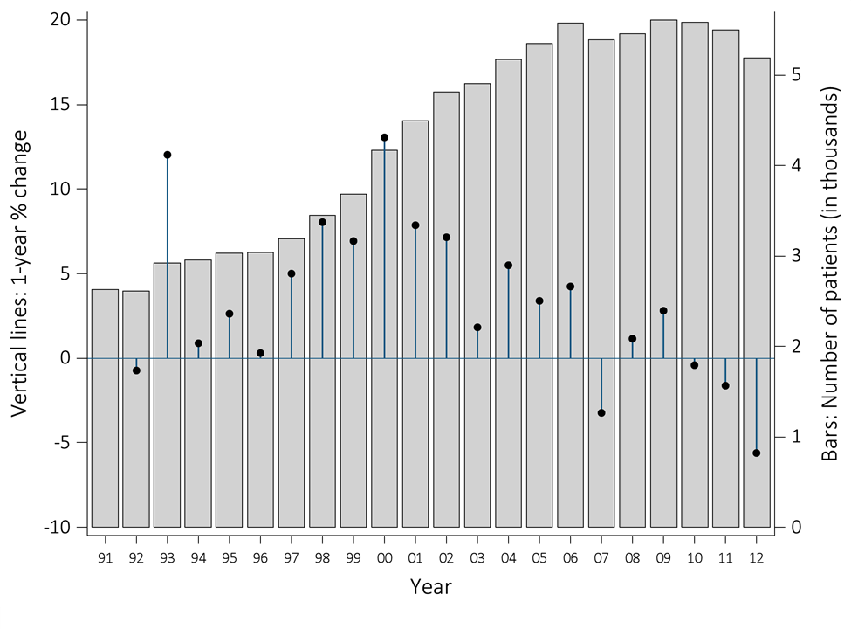
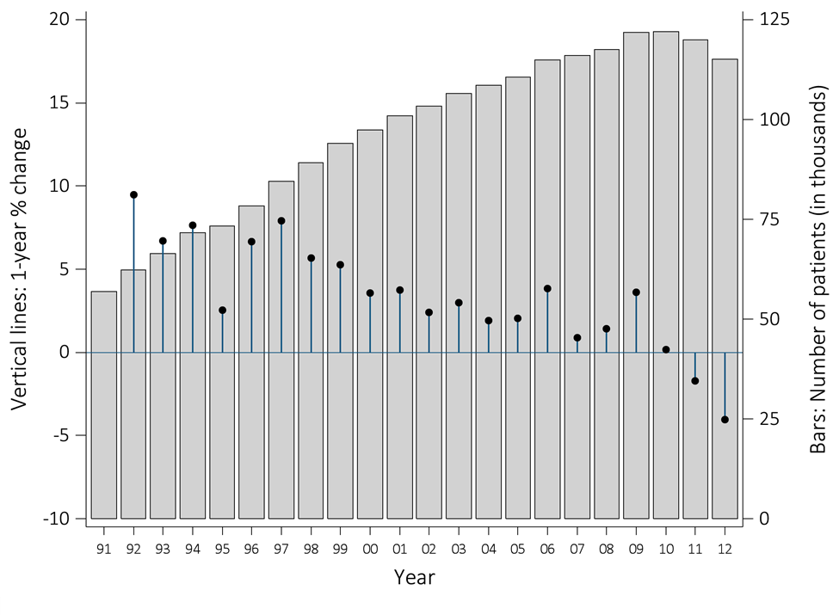
vol 2 Figure i.1 Counts of new & returning dialysis patients, 1991–2012 (continued)
(c) Patients returning from transplant
(d) Total patients starting /restarting
Data Source: CMS Form 2744, Annual Facility Survey

Slide 6
vol 2 Table i.2 ESRD-certified patients on the waiting list for kidney and kidney/pancreas transplants
 | New listings in 2012 | N (as of 12/31/2012) | Median time on list (years) ª
0-17 | 633 | 564 | 0.30
18-44 | 8,195 | 20,547 | 3.19
45-64 | 15,336 | 45,159 | 3.55
65-74 | 4,271 | 14,088 | 3.76
75+ | 432 | 1,623 | 4.98
Unknown | . | . | .
Male | 17,750 | 49,230 | 3.21
Female | 11,117 | 32,751 | 3.53
White | 17,537 | 44,248 | 2.61
African American | 8,895 | 29,987 | 4.14
Native American | 364 | 996 | 4.49
Asian | 1,843 | 6,006 | 5.21
Other | 228 | 744 | 4.59
Unknown | . | . | .
Hispanic | 5,413 | 16,080 | 4.49
Non-Hispanic | 23,454 | 65,901 | 3.15
Data source: Reference Table E. ª patients listed for a kidney-alone transplant during 2007.* cells with ten or fewer patients are suppressed. .zero patients in this cell. Abbreviations: ESRD, end-stage renal disease.

Slide 7
vol 2 Table i.2 ESRD-certified patients on the waiting list for kidney and kidney/pancreas transplants (continued)
 | New listings in 2012 | N (as of 12/31/2012) | Median time on list (years) ª
Diabetes | 10,323 | 28,240 | 4.47
Hypertension | 6,385 | 19,764 | 3.56
Glomerulonephritis | 6,061 | 18,331 | 2.46
Cystic kidney disease | 1,515 | 4,582 | 1.92
Urologic disease | 273 | 850 | 2.47
Other known cause | 2,964 | 7,026 | 1.33
Unknown cause | 877 | 2,729 | 2.36
Missing cause | 469 | 459 | .
A | 9,317 | 22,964 | 2.23
B | 4,224 | 13,375 | 4.20
AB | 1,127 | 2,267 | 1.36
O | 14,199 | 43,375 | 4.18
PRA <10% | 26,529 | 67,518 | 3.04
10% or greater | 2,338 | 14,394 | 4.33
Unknown | . | 69 | .
Total | 28,867 | 81,981 | 3.31
Data source: Reference Table E. ª patients listed for a kidney-alone transplant during 2007.* cells with ten or fewer patients are suppressed. . zero patients in this cell. Abbreviations: A, blood group A; AB, blood group AB, B, Blood group B; ESRD, end-stage renal disease; O, blood group O; PRA, panel reactive antibody.

Slide 8
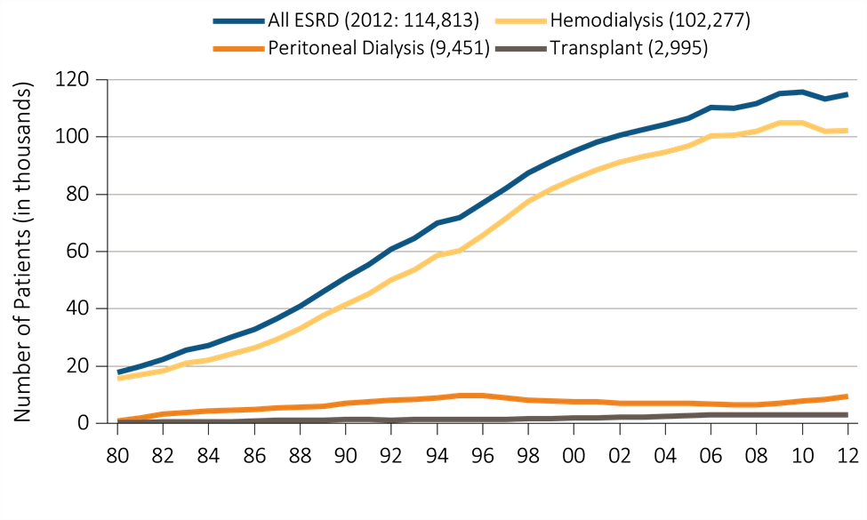
vol 2 Figure i.2 Trends in the number of incident cases of ESRD, in thousands, by modality, in the U.S. population, 1980-2012
Data Source: Reference table D1. Abbreviations: ESRD, end-stage renal disease. This graphic is also presented as Figure 1.1.

Slide 9
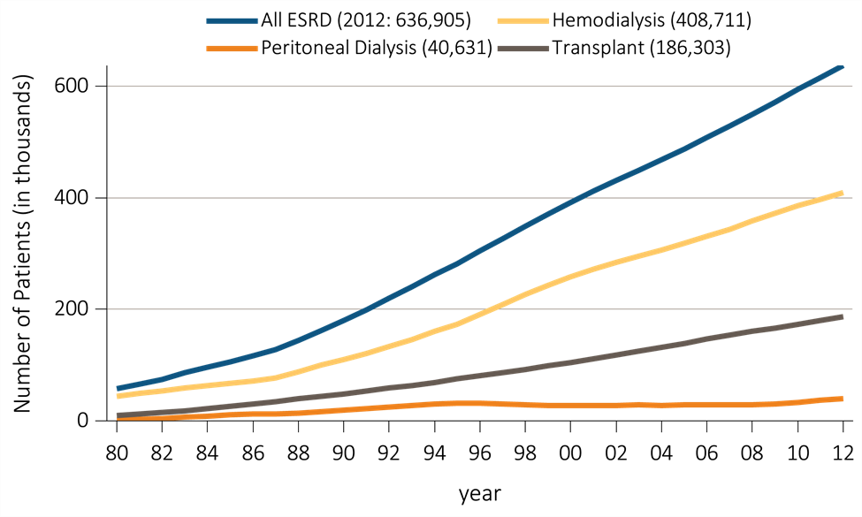
vol 2 Figure i.3 Trends in the number of prevalent cases of ESRD, in thousands, by modality, in the U.S. population, 1980-2012
Data Source: Reference table D.1. Abbreviations: ESRD, end-stage renal disease. This graphic is also presented as Figure 1.10.

Slide 10
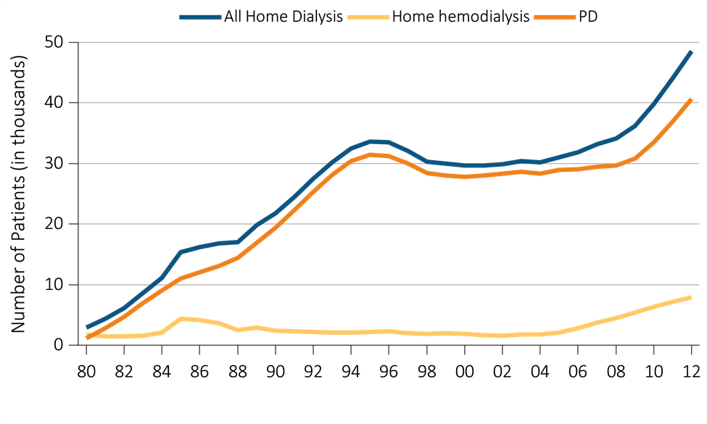
vol 2 Figure i.4 Trend in the number of prevalent ESRD patients using home dialysis, in thousands, by type of therapy, in the U.S. population, 1980-2012
Data Source: Reference table: D.1. December 31 prevalent ESRD patients; peritoneal dialysis consists of CAPD & CCPD only. Abbreviations: CAPD, continuous ambulatory peritoneal dialysis; CCPD, continuous cycler peritoneal dialysis; ESRD, end-stage renal disease. This graphic is also presented as Figure 1.18.

Slide 11
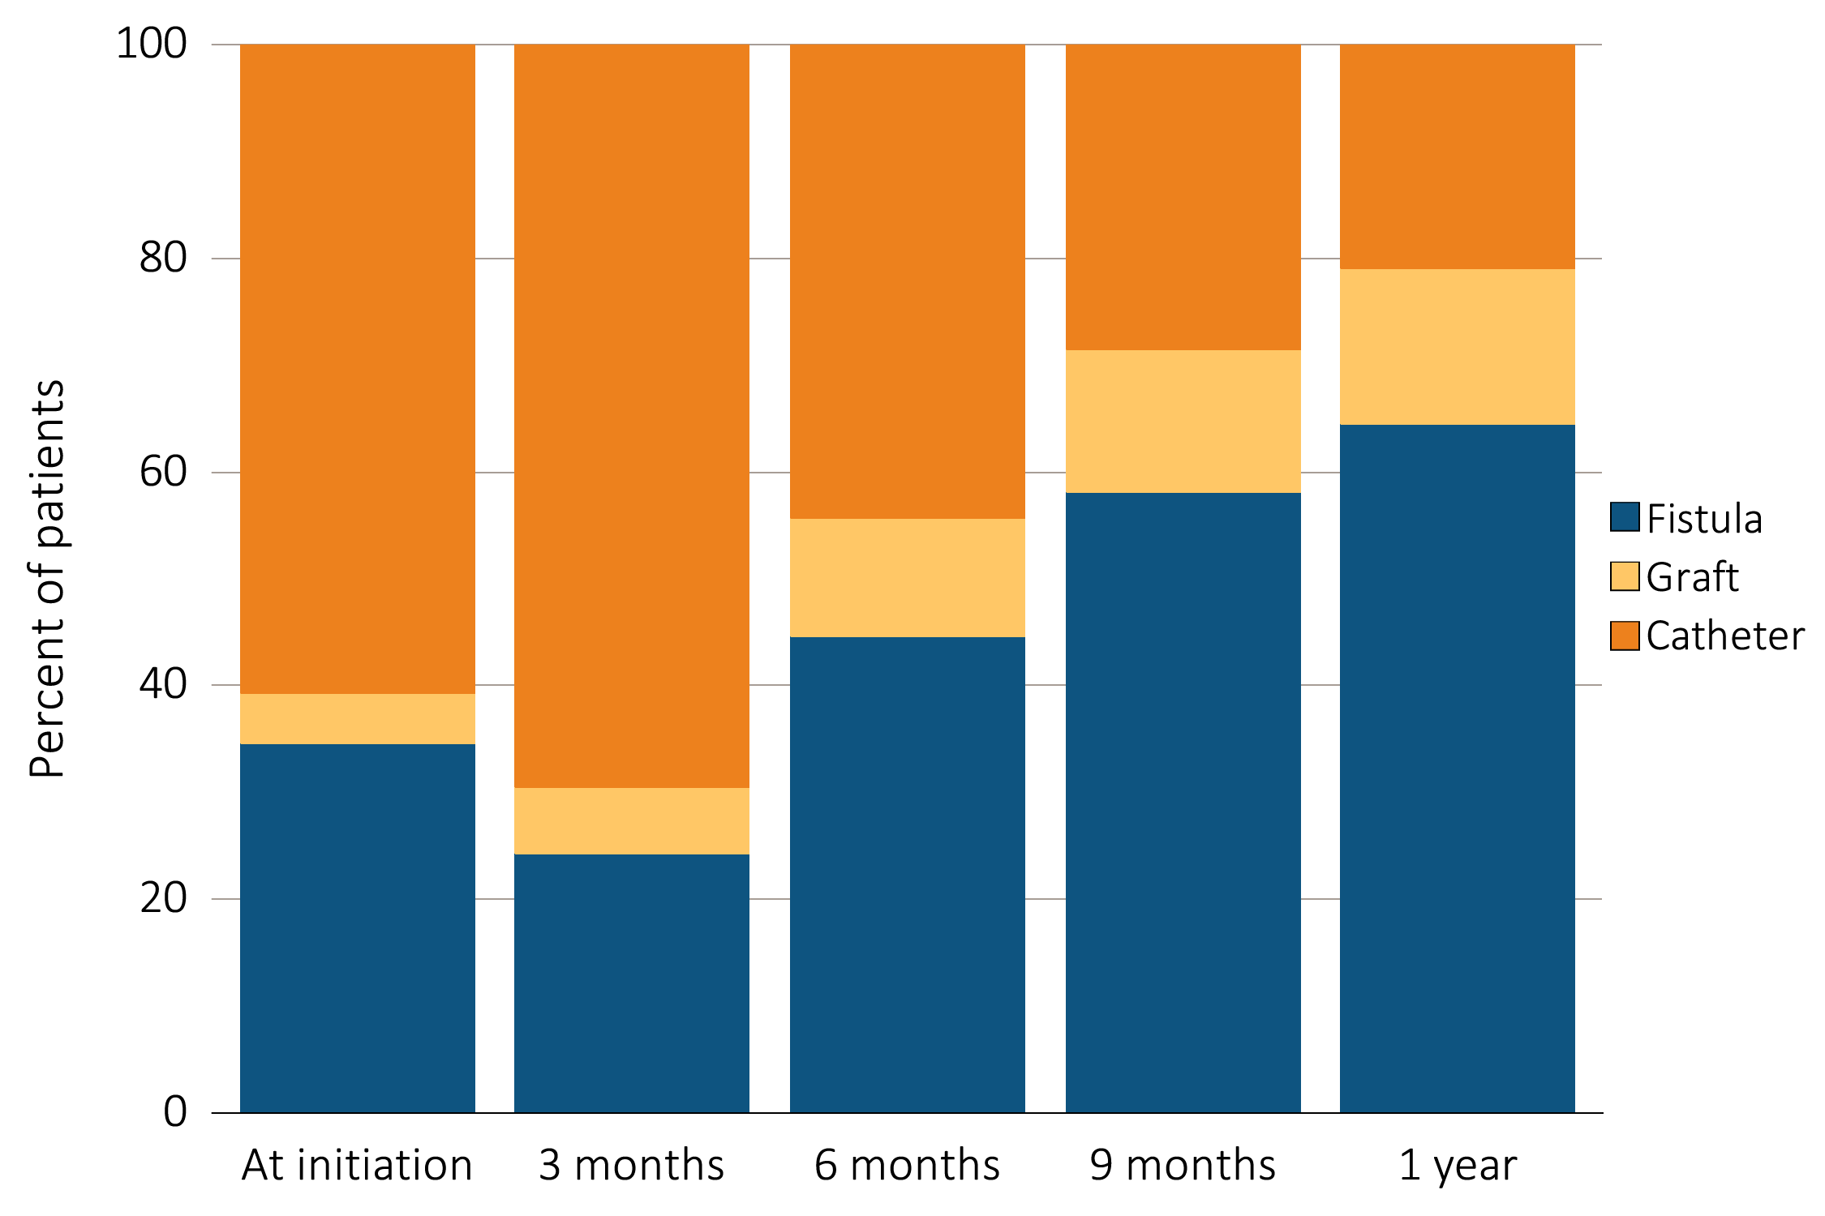
vol 2 Figure i.5 VA use during the first year of HD by time since initiation of ESRD treatment, among patients new to HD in 2012, from the ESRD Medical Evidence 2728 Form and CROWNWeb data
Data Source: Special analyses, USRDS ESRD Database and CROWNWeb. ESRD patients initiating HD in 2012. Abbreviations: ESRD, end-stage renal disease; HD, hemodialysis; VA, vascular access. This graphic is also presented as Figure 3.15.

Slide 12
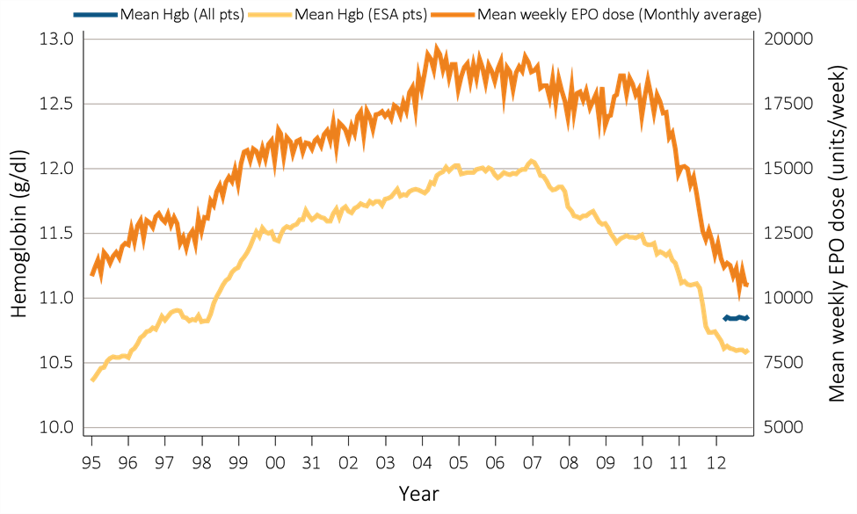
vol 2 Figure i.6 Mean monthly Hgb level and mean weekly EPO dose (monthly average, expressed in units/week) in adult HD patients on dialysis ≥90 days, from Medicare claims: time trend from 1995-2012
Data Source: Data Source: Special analyses, USRDS ESRD Database. Panel a: Mean monthly Hgb level among ESA-treated HD patients within a given month (1995 through 2012) or all HD patients irrespective of ESA use (April to December 2012 only) if, within the given month, the patient had an Hgb claim, was on dialysis ≥90 days, and was ≥18 years old at the start of the month. Mean monthly EPO (epoetin alfa) dose among HD patients within a given month who had an EPO claim, were on dialysis ≥90 days, and were ≥18 years old at the start of the month. EPO dose is expressed as mean EPO units per week averaged over all EPO claims within a given month. Panel b: Monthly IV iron use among HD patients on dialysis ≥90 days and ≥18 years old at the start of the given month. Abbreviations: EPO, erythropoietin; ESA, erythropoiesis-stimulating agents; HD, hemodialysis; Hgb, hemoglobin; IV, intravenous. This graphic is adapted from Figure 3.2.

Slide 13
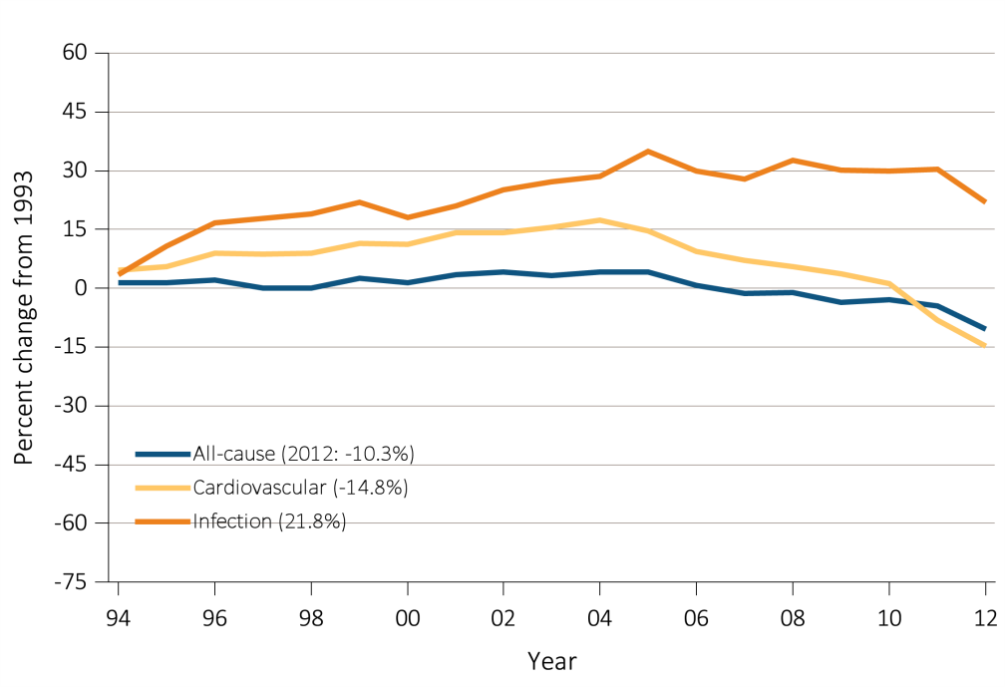
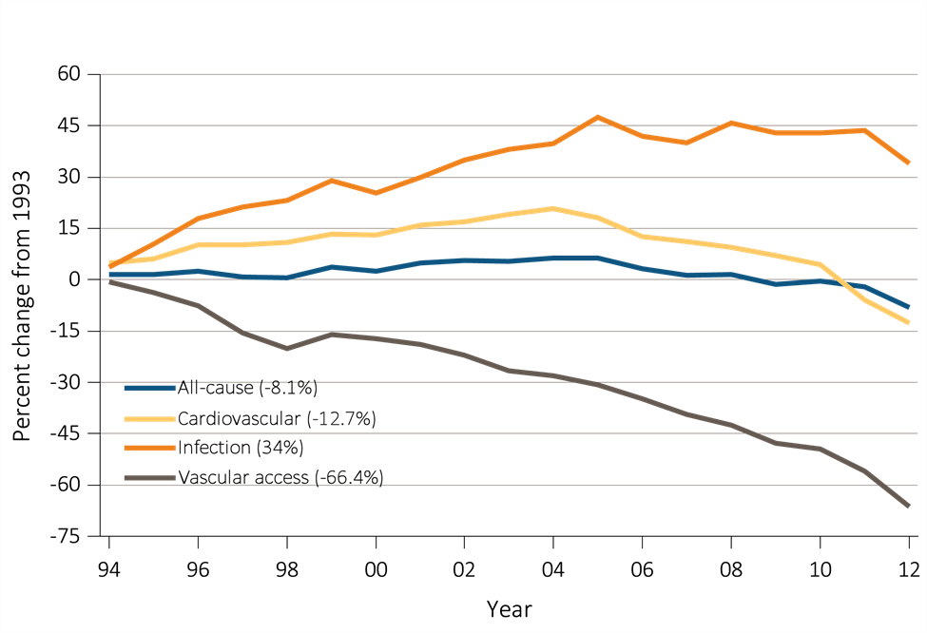
vol 2 Figure i.7 Trends in adjusted all-cause & cause-specific hospitalization rates, by modality
(a) All ESRD
(b) Hemodialysis
Data Source: Reference tables: G.1, G.3, G.4, G.5, and special analyses, USRDS ESRD Database. Period prevalent ESRD patients; adjusted for age, sex, race, & primary diagnosis; ref: ESRD patients, 2010. Percent changes from 1993 for the year 2012 are shown in parentheses. Abbreviations: ESRD, end-stage renal disease. This graphic is also presented as Figure 4.1.

Slide 14
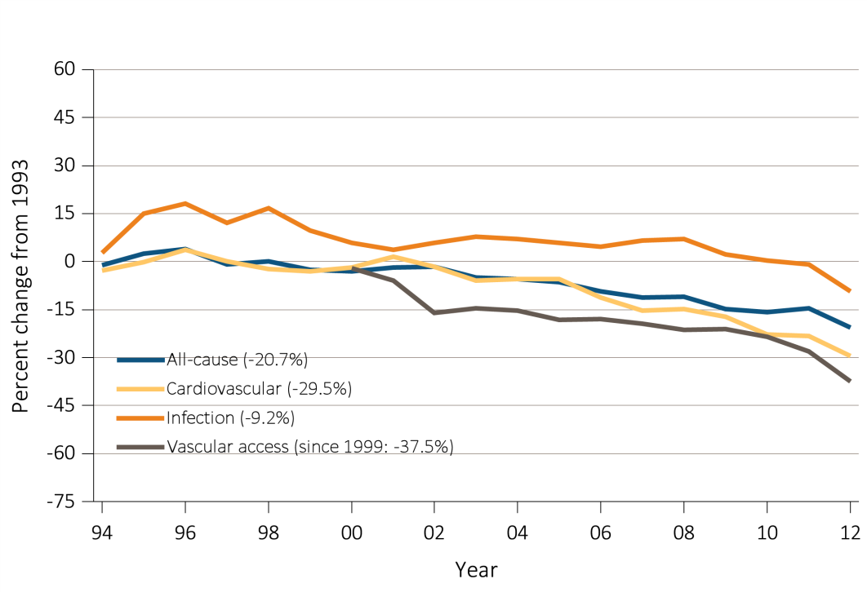
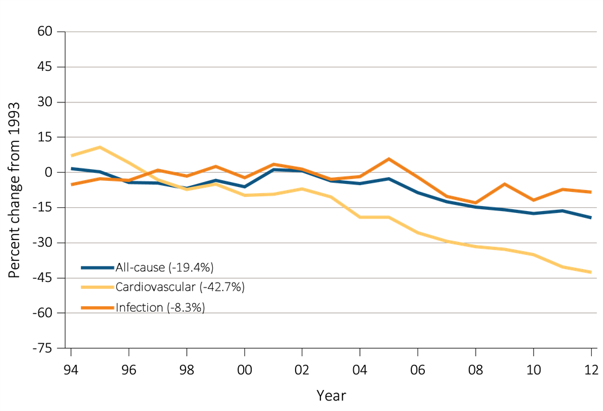
vol 2 Figure i.7 Trends in adjusted all-cause & cause-specific hospitalization rates, by modality (continued)
(c) Peritoneal dialysis
(d) Transplant
Data Source: Reference tables: G.1, G.3, G.4, G.5, and special analyses, USRDS ESRD Database. Period prevalent ESRD patients; adjusted for age, sex, race, & primary diagnosis; ref: ESRD patients, 2010. Percent changes from 1993 for the year 2012 are shown in parentheses. Abbreviations: ESRD, end-stage renal disease. This graphic is also presented as Figure 4.1.

Slide 15
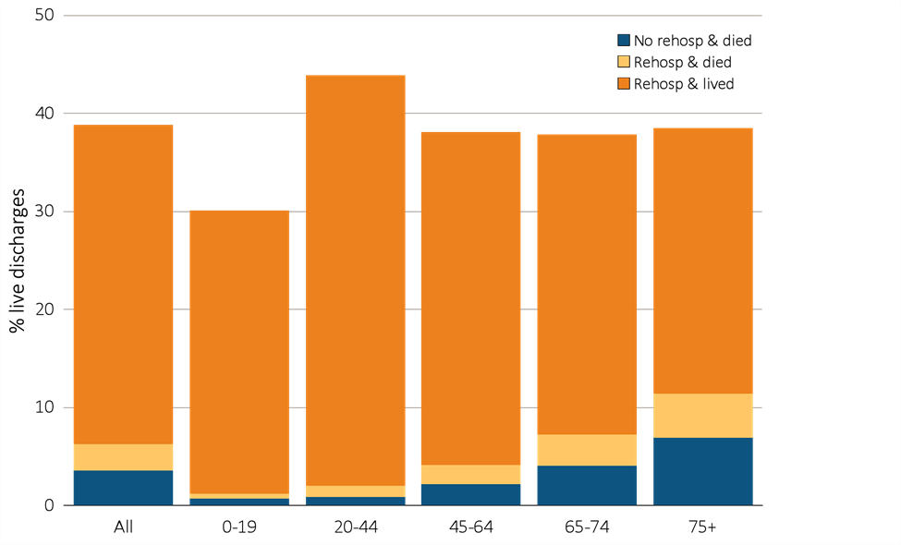
vol 2 Figure i.8 Rehospitalization or death within 30 days from live hospital discharge, by age, 2012
Data Source: Special analyses, USRDS ESRD Database. Period prevalent hemodialysis patients, all ages, 2012; unadjusted. Includes live hospital discharges from January 1 to December 1, 2012. Cause-specific hospitalizations are defined by principal ICD-9-CM codes. See Vol. 2, ESRD Analytical Methods for principal ICD-9-CM diagnosis codes included in each cause of hospitalization category. Abbreviations: ESRD, end-stage renal disease; rehosp, rehospitalization. This graphic is also presented as Figure 4.3.

Slide 16
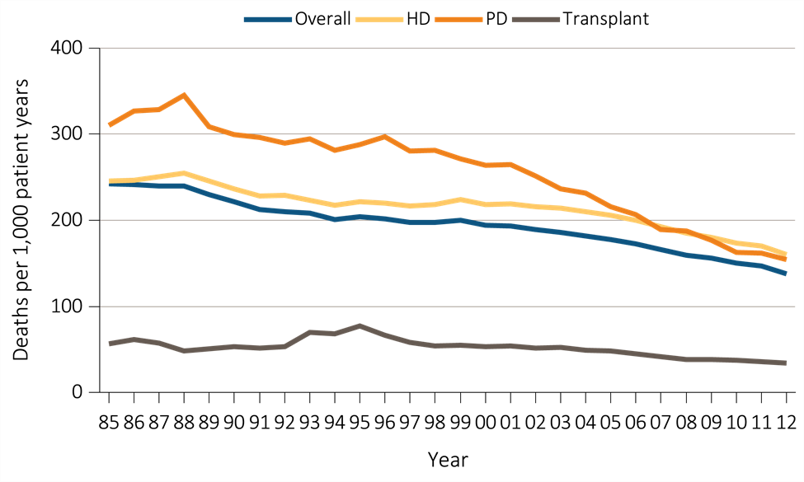
vol 2 Figure i.9 Adjusted all-cause mortality rates, overall and by modality
Data Source: Reference Tables H.2, H.8, H.9, and H.10, and special analyses, USRDS ESRD Database. Adjusted for age, sex, race, and primary diagnosis. Ref: 2011 patients. Abbreviations: HD, hemodialysis; PD, peritoneal dialysis. This graphic is also presented as Figure 5.1.

Slide 17
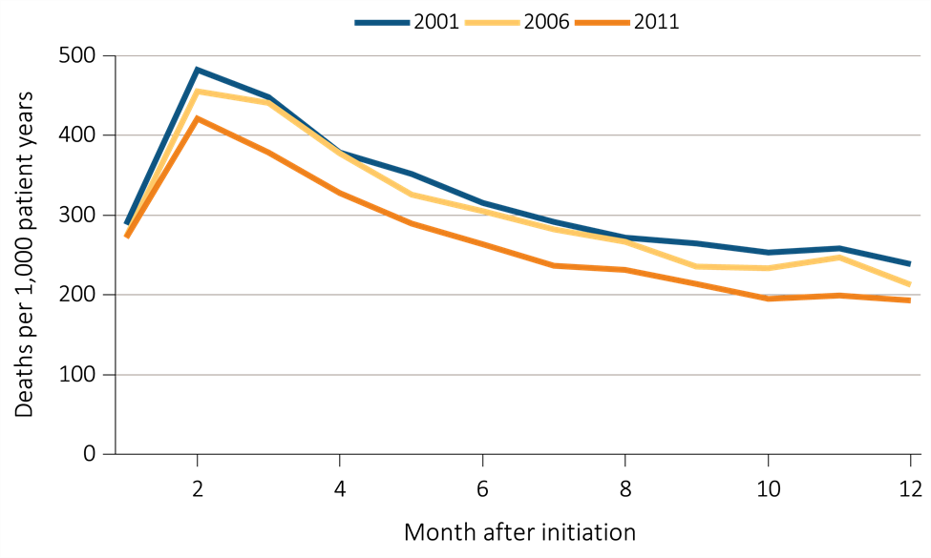
vol 2 Figure i.10 Adjusted all-cause mortality in the first year of hemodialysis, by year of initiation of dialysis
Data Source: Special analyses, USRDS ESRD Database. Adjusted (age, race, sex, ethnicity, and primary diagnosis) all-cause & cause-specific mortality in the first year of hemodialysis. Ref: incident hemodialysis patients, 2011. This graphic is also adapted from Figure 5.3.

Slide 18
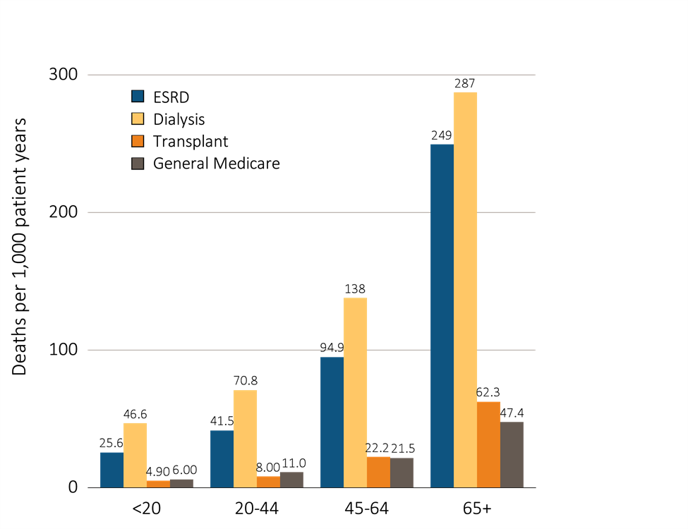
vol 2 Figure i.11 Adjusted all-cause mortality in the ESRD & general populations, by age, 2012
Data Source: Special analyses, USRDS ESRD Database and Medicare 5 Percent Sample. Adjusted for sex and race. Medicare data limited to patients with at least one month of Medicare eligibility in 2012. Ref: Medicare patients, 2012. Abbreviation: ESRD, end-stage renal disease. This graphic is also presented as Figure 5.4.

Slide 19
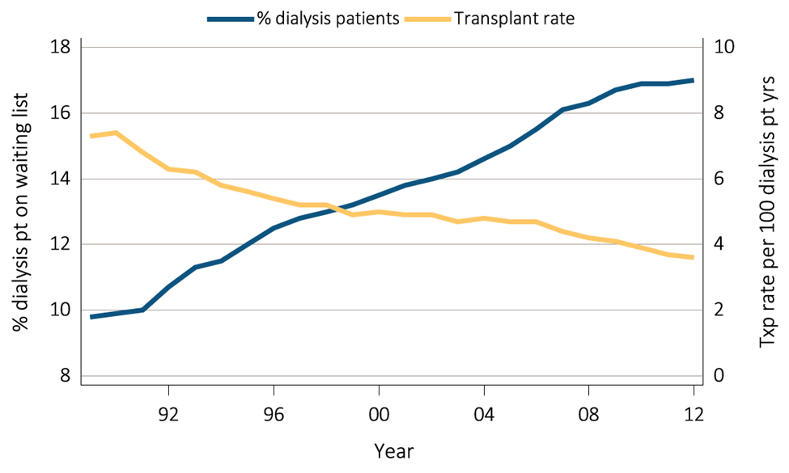
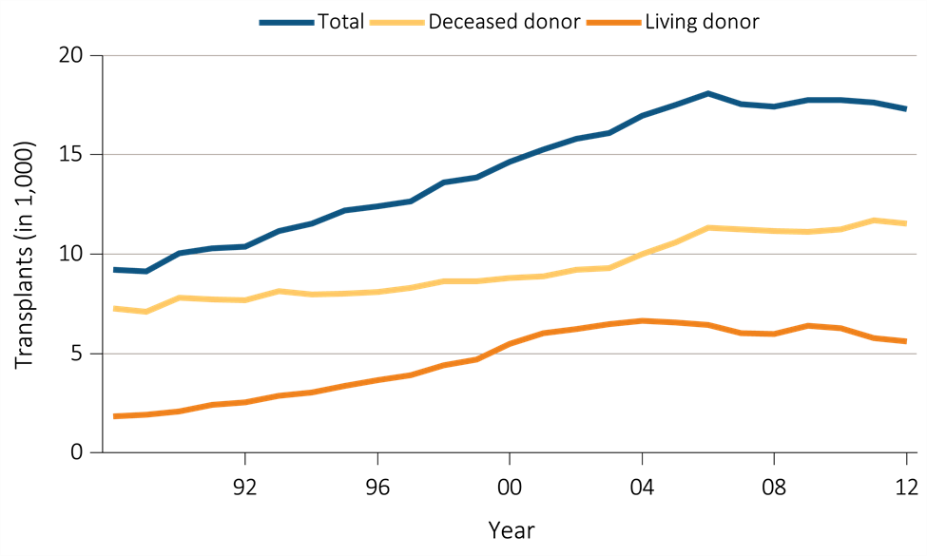
vol 2 Figure i.12 Trends in transplantation: unadjusted rates, waiting list counts, waiting time, counts of transplants per year.
(a) Percent of dialysis patients wait-listed and unadjusted and transplant rates
(b) Counts of total transplants
Data Source: Reference Tables E4, E9; E2, E3; E8, E8(2), E8(3); D9. Percent of dialysis patients on the kidney waiting list is for all dialysis patients. Unadjusted transplant rates are for all dialysis patients. Waiting list counts include all candidates listed for a kidney transplant on December 31 of each year. Waiting time is calculated for all recipients enrolled on the waiting list in a given year. Functioning transplant is the annual status on December 31 of each year of all patients who received a kidney transplant, regardless of transplant date. This graphic is adapted from Figure 6.1.

Slide 20
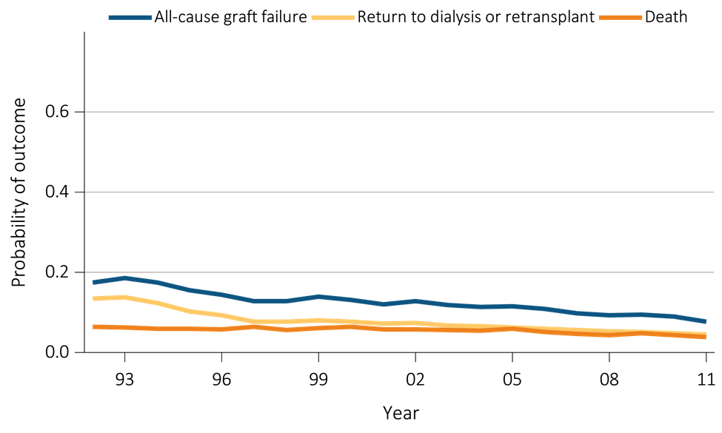
vol 2 Figure i.13 Outcomes: deceased donor transplants at one year
Data Source: Reference Tables F2, F14, I26; F5, F17, I29; F6, F18, I30. Outcomes among recipients of a first-time deceased donor kidney transplant; unadjusted. This graphic is adapted from Figure 6.8.

Slide 21
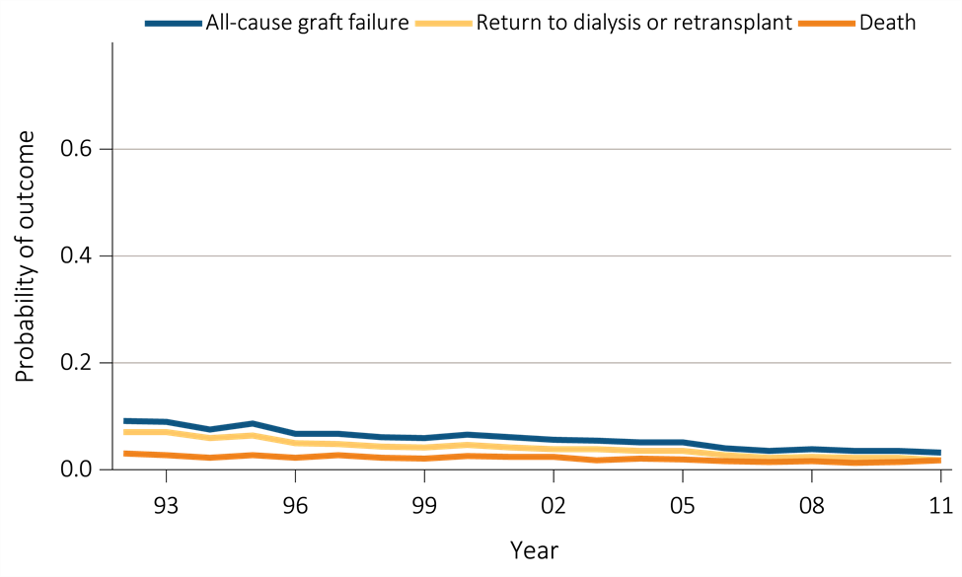
vol 2 Figure i.14 Outcomes: living donor transplants at one year
Data Source: Reference Tables F8, F20, I32; F11, F23, I35; F12, F24, I36. Outcomes among recipients of a first-time live donor kidney transplant; unadjusted. This graphic is adapted from Figure 6.9.

Slide 22
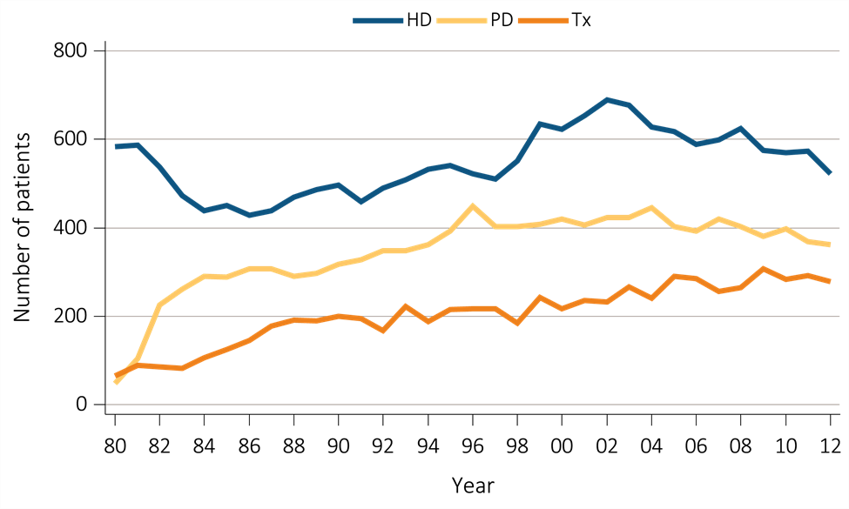
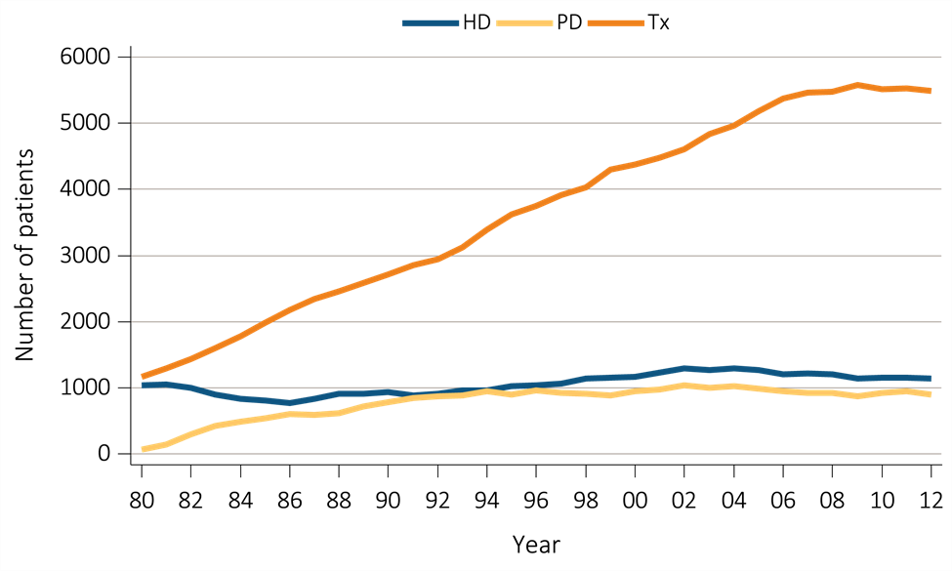
vol 2 Figure i.15 Incident & December 31 point prevalent ESRD patients (aged 0–19 years)
(a) Incidence of ESRD in children (aged 0-19 years)
(b) Prevalence of ESRD in children (aged 0-19 years)
Data Source: Reference tables D3-D5, D7-D9, and special analyses, USRDS ESRD Database. Peritoneal dialysis consists of continuous ambulatory peritoneal dialysis and continuous cycling peritoneal dialysis. Abbreviations: ESRD, end-stage renal disease; HD, hemodialysis; PD, peritoneal dialysis; Tx, transplant. This graphic is also presented as Figure 7.1.

Slide 23
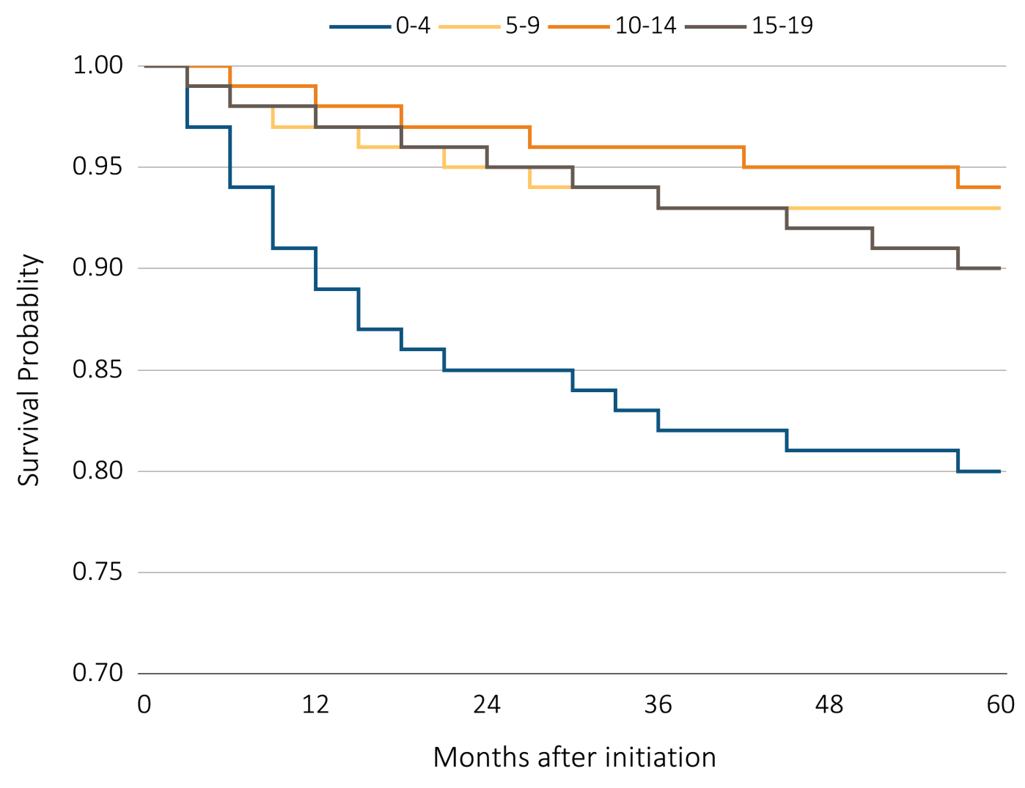
vol 2 Figure i.16 Adjusted 5 year survival in pediatric ESRD patients from day 1 by age (aged 0-19 years), 2003-2007
Data Source: Special analyses, USRDS ESRD Database. Incident dialysis and transplant patients defined at the onset of dialysis or the day of transplant without the 60-day rule; followed to December 31, 2012. Adjusted for age, sex, race, Hispanic ethnicity, and primary diagnosis. Ref: incident ESRD patients age 0-19, 2010-2011. Abbreviations: HD, hemodialysis; PD, peritoneal dialysis, Tx,transplant. This graphic is also presented as Figure 7.11.

Slide 24
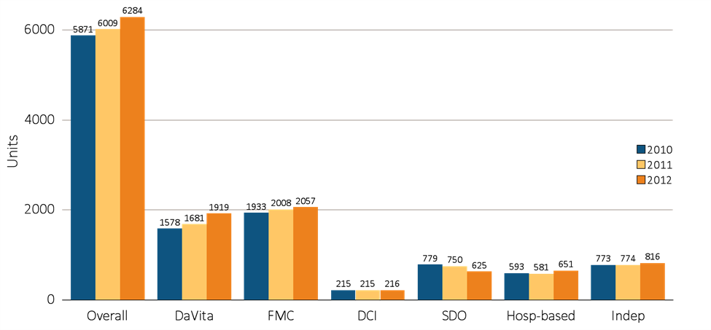
vol 2 Figure i.17 Dialysis units & patient counts, by unit affiliation, 2010–2012
(a) Dialysis units
Data source: Special analyses, USRDS ESRD Database. Abbreviations: DCI, Dialysis Clinic, Inc.; FMC, Fresenius; Hosp-based, hospital-based dialysis centers; Indep, independent dialysis providers; SDO, small dialysis organizations. This graphic is also presented as Figure 8.1.

Slide 25
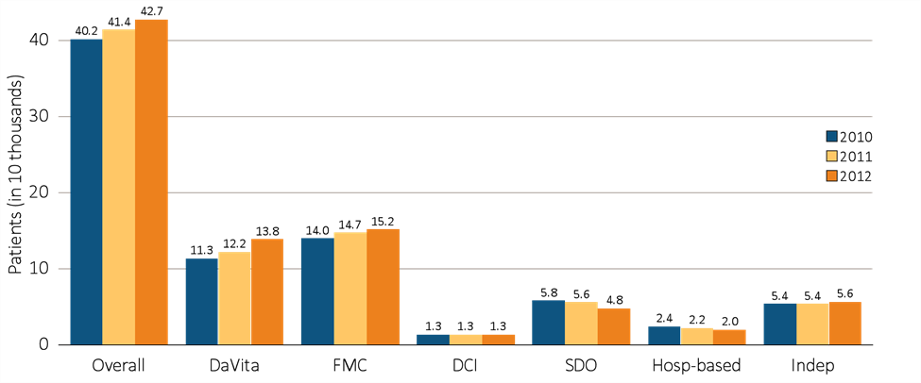
vol 2 Figure i.17 Dialysis units & patient counts, by unit affiliation, 2010–2012 (continued)
(b) Patient counts
Data source: Special analyses, USRDS ESRD Database. Abbreviations: DCI, Dialysis Clinic, Inc.; FMC, Fresenius; Hosp-based, hospital-based dialysis centers; Indep, independent dialysis providers; SDO, small dialysis organizations. This graphic is also presented as Figure 8.1.

Slide 26
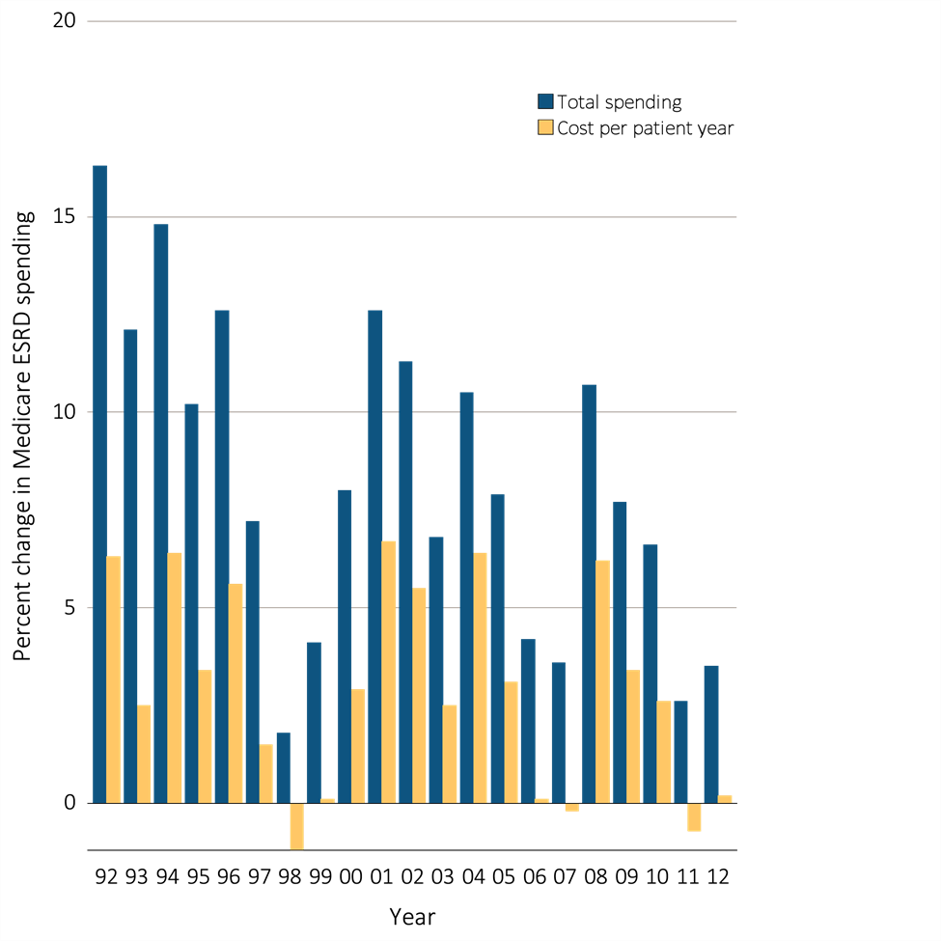
vol 2 Figure i.18 Annual percent change in Medicare ESRD spending
Data Source: USRDS ESRD Database. Total Medicare ESRD costs from claims data; includes all Medicare as primary payer claims as well as amounts paid by Medicare as secondary payer. Abbreviations: ESRD, end-stage renal disease. This graphic is also presented as Figure 9.4.

Slide 27
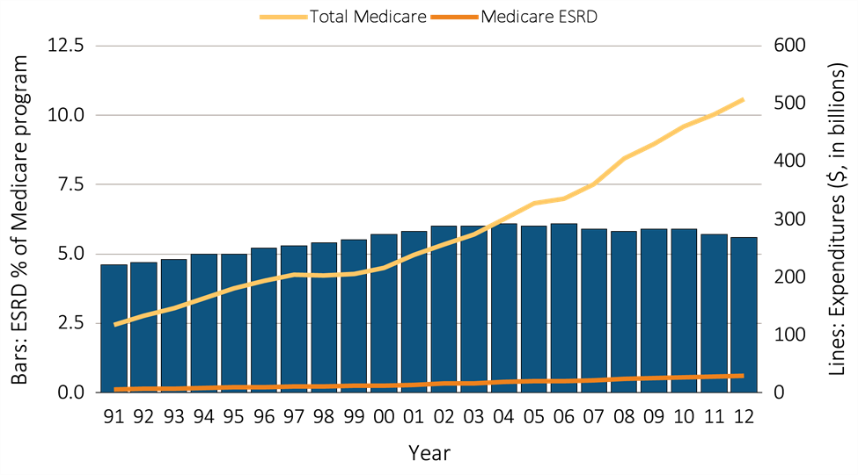
vol 2 Figure i.19 Costs of the Medicare & ESRD programs (excluding Part D)
Data Source: USRDS ESRD Database. Total Medicare expenditures obtained from http://CMS.gov. Abbreviations: ESRD, end-stage renal disease. This graphic is also presented as Figure 9.2.

Slide 28
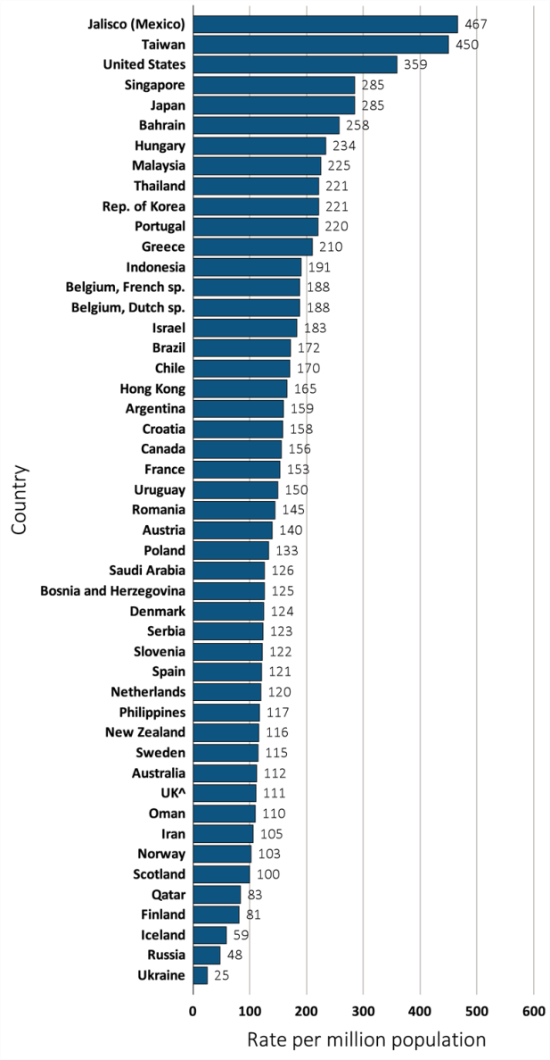
vol 2 Figure i.20 Incidence rate of ESRD, per million population, by country, in 2012
Data source: Special analyses, USRDS ESRD Database. Data presented only for countries from which relevant information was available. All rates are unadjusted. ^UK: England, Wales, Northern Ireland (Scotland data reported separately). Japan and Taiwan are dialysis only. Data for Belgium do not include patients younger than 20. Data for Indonesia represent the West Java region. Data for France include 22 regions. Data for Spain include 18 of 19 regions. Abbreviations: ESRD, end-stage renal disease; sp., speaking. This graphic is also presented as Figure 10.1.

Slide 29
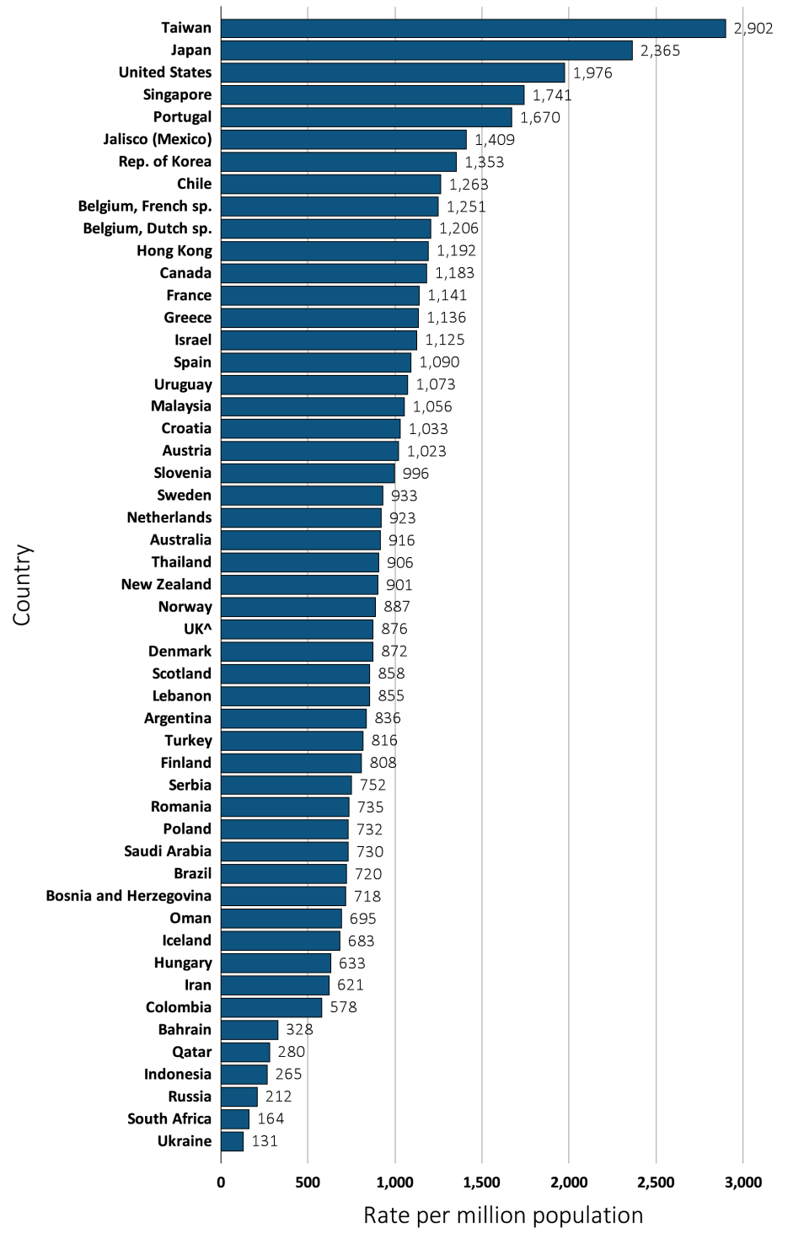
vol 2 Figure i.21 Prevalence of ESRD, per million population, by country, in 2012
Data source: Special analyses, USRDS ESRD Database. Data presented only for countries from which relevant information was available. All rates are unadjusted and reflect prevalence at the end of 2012; rates for Colombia and Lebanon reflect prevalence at the end of June 2012. ^UK: England, Wales, & Northern Ireland (Scotland data reported separately). Japan and Taiwan include dialysis patients only. Data for Belgium do not include patients younger than 20. Data for Indonesia represent the West Java region. Data for Spain include 18 of 19 regions. Data for France include 22 regions. Data for Turkey in 2012 was collected with the collaboration of the Ministry of Health, which collects patient-based data; however, in previous years center-based data were reported. This graphic is also presented as Figure 10.5.

