Slide 2
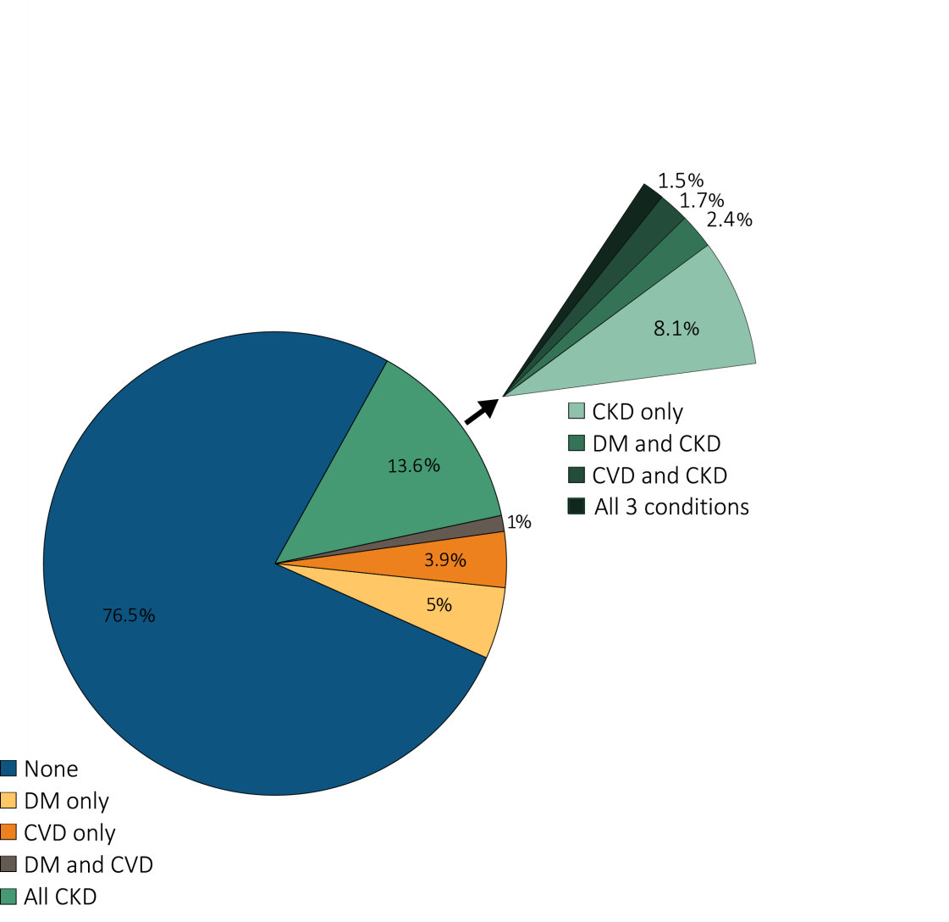
Figure 1.1 Distribution of NHANES participants with diabetes, self-reported cardiovascular disease, & single-sample markers of CKD, 2007-2012
Data Source: National Health and Nutrition Examination Survey (NHANES), 1988–1994, 1999-2004 & 2007–2012 participants aged 20 & older. Note: Cardiovascular disease designation is based on self-report of any CVD condition (see CKD Analytical Methods chapter for detail); CKD is defined as eGFR <60 or ACR ≥30. Abbreviations: ACR, urine albumin/creatinine ratio; CKD, chronic kidney disease; SR CVD, self-reported cardiovascular disease; DM, diabetes mellitus; eGFR, estimated glomerular filtration rate.

Slide 3
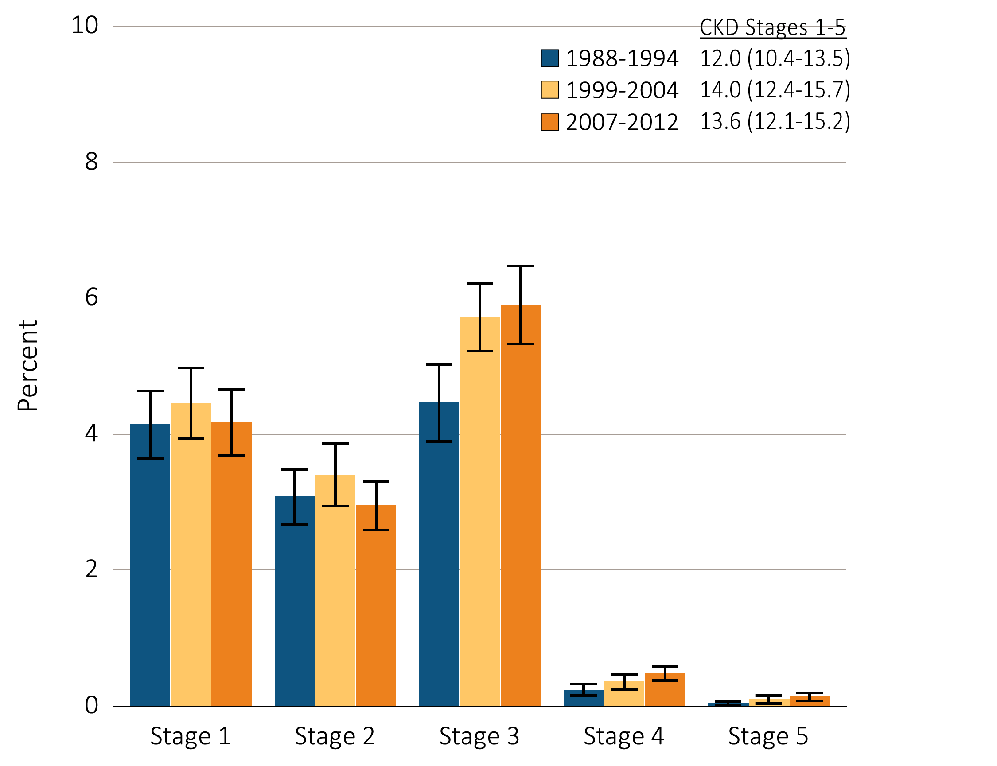
Figure 1.2 Prevalence of CKD by stage among NHANES participants, 1988-2012
Data Source: National Health and Nutrition Examination Survey (NHANES), 1988–1994, 1999-2004 & 2007–2012 participants aged 20 & older. Whisker lines indicate 95% confidence intervals. Abbreviations: CKD, chronic kidney disease.

Slide 4
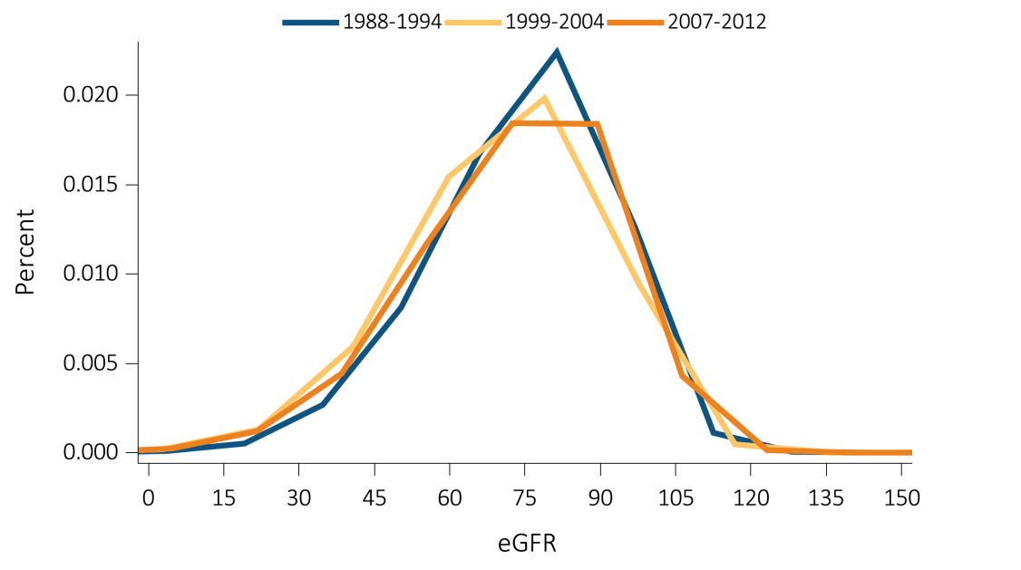
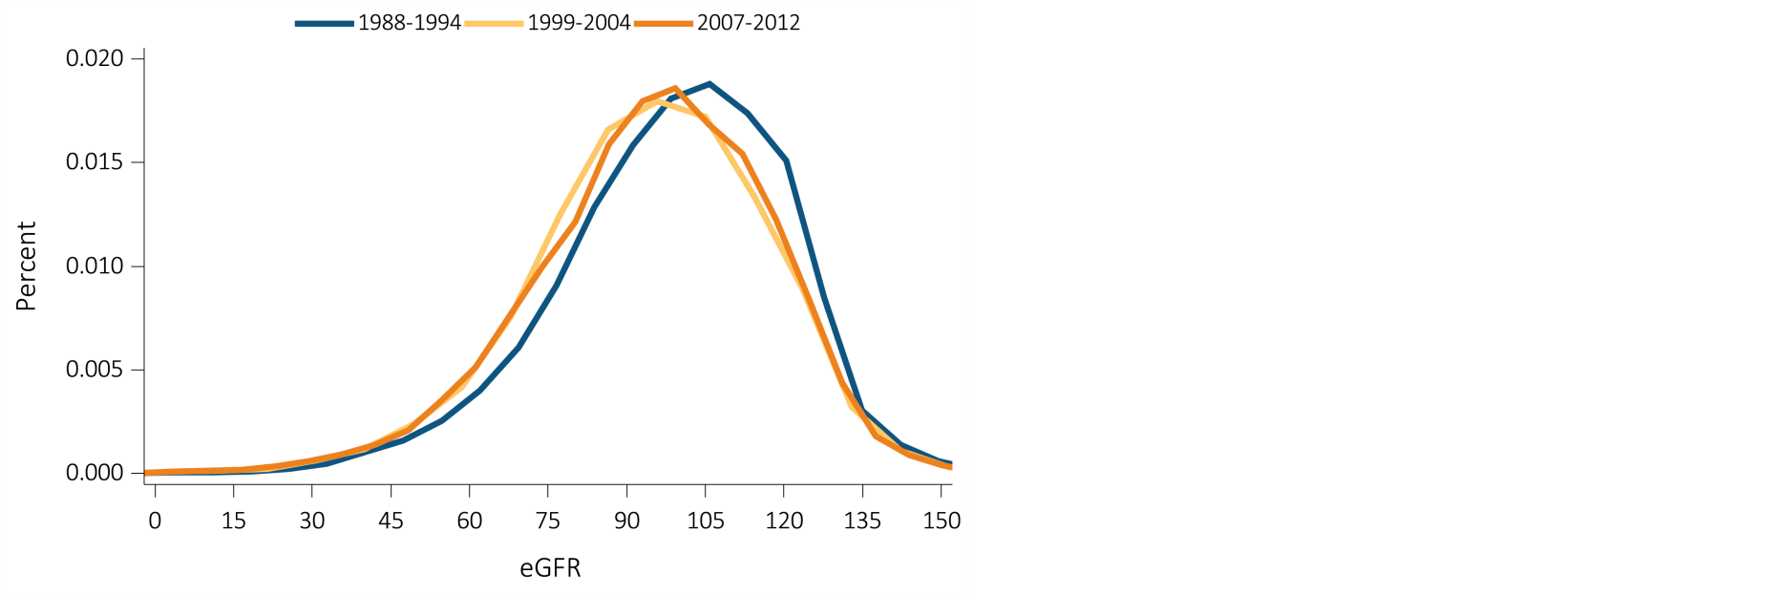
Figure 1.3 eGFR distribution among NHANES participants, 1988-2012
All Individuals
Individuals 60+ years
Data Source: National Health and Nutrition Examination Survey (NHANES), 1988–1994, 1999-2004 & 2007–2012 participants aged 20 & older. Single-sample estimates of eGFR; eGFR calculated using the CKD-EPI equation. Abbreviations: eGFR, estimated glomerular filtration rate. Accounts for change in serum creatinine assays.

Slide 5
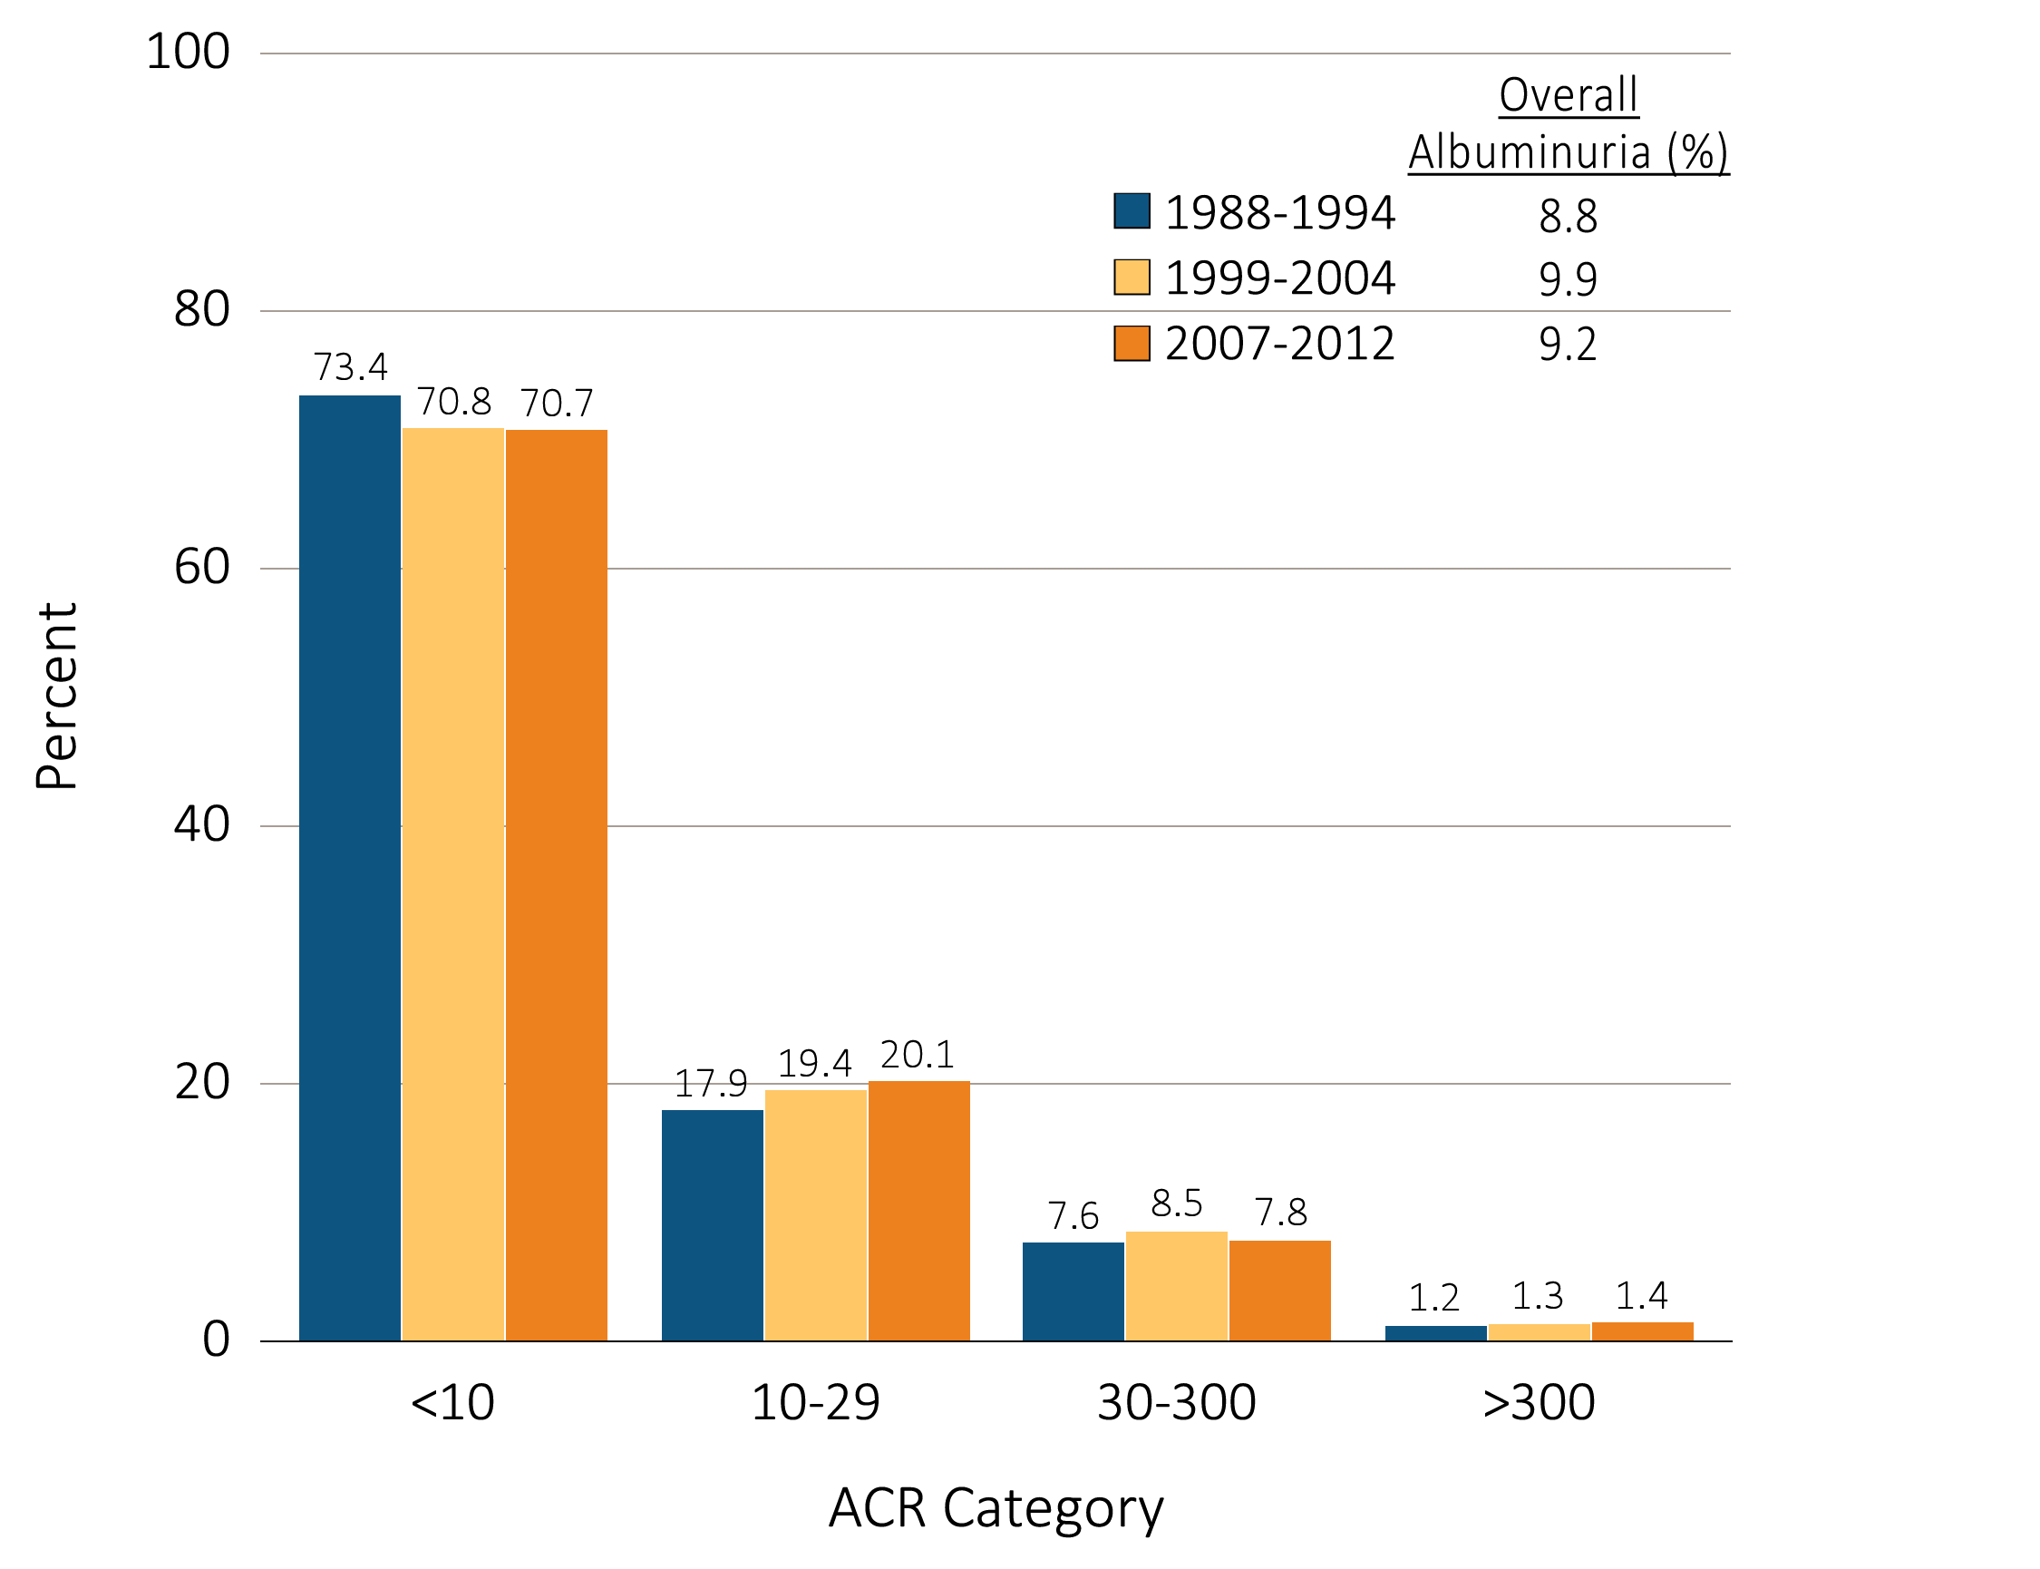
Figure 1.4 Urine albumin/creatinine ratio distribution among NHANES participants,
¹⁹⁸⁸⁻²⁰¹²
Data Source: National Health and Nutrition Examination Survey (NHANES), 1988–1994, 1999-2004 & 2007–2012 participants aged 20 & older. Single-sample estimates of ACR. Abbreviations: ACR, urine albumin/creatinine ratio.

Slide 6
Table 1.1 Prognosis of CKD by KDIGO 2012 eGFR and albuminuria categories,
percentage of NHANES participants, 1988-2012
Data Source: National Health and Nutrition Examination Survey (NHANES), 1988-1994, 1999-2004 & 2007-2012 participants aged 20 and older. Single-sample estimates of eGFR and ACR; eGFR calculated using the CKD-EPI equation. Abbreviations: ACR, urine albumin/creatinine ratio; CKD, chronic kidney disease; eGFR, estimated glomerular filtration rate; GFR, glomerular filtration rate; KDIGO, Kidney Disease: Improving Global Outcomes CKD Work Group. Low risk: eGFR ≥ 60 ml/min/1.73m² and ACR < 30 mg/g; moderately high risk: eGFR 45-59 ml/min/1.73m² or eGFR ≥ 60 ml ml/min/1.73m² and ACR 30-300 mg/g; high risk: eGFR 30-44 ml/min/1.73m² or eGFR 45-59 ml/min/1.73m² and ACR 30-300 mg/g or eGFR ≥ 60 ml/min/1.73m² and ACR > 300 mg/g; very high risk: eGFR < 30 ml/min/1.73m² or eGFR 30-44 ml/min/1.73m² and ACR 30-300 mg/g or eGFR ≥ 60 ml/min/1.73m² and ACR > 300 mg/g.

Slide 7
Table 1.2 Prevalence (%) of CKD in NHANES population within age, sex,
race/ethnicity, & risk-factor categories, 1988-2012
(Continued on the next slide)

Slide 8
Table 1.2 Prevalence (%) of CKD in NHANES population within age, sex,
race/ethnicity, & risk-factor categories, 1988-2012 (Continued)
Data Source: National Health and Nutrition Examination Survey (NHANES), 1988-1994, 1999-2004 & 2007-2012 participants aged 20 & older. Single-sample estimates of eGFR & ACR; eGFR calculated using the CKD-EPI equation. Diabetes defined as either HbA1c >7%, self-reported (SR), or currently taking glucose-lowering medications. Hypertension defined as BP ≥130/≥80 for those with diabetes or CKD, otherwise BP ≥140/≥90, or taking medication for hypertension. Values in Figure 1.12 cannot be directly compared to those in Table 1.2 due to different Survey cohorts. The table represents NHANES participants who are classified as hypertensive (measured/treated) but some of those are at target blood pressure. Abbreviations: ACR, urine albumin/creatinine ratio; BMI, body mass index; BP, blood pressure, CKD, chronic kidney disease; eGFR, estimated glomerular filtration rate; HbA1c, glycosylated hemoglobin.

Slide 9
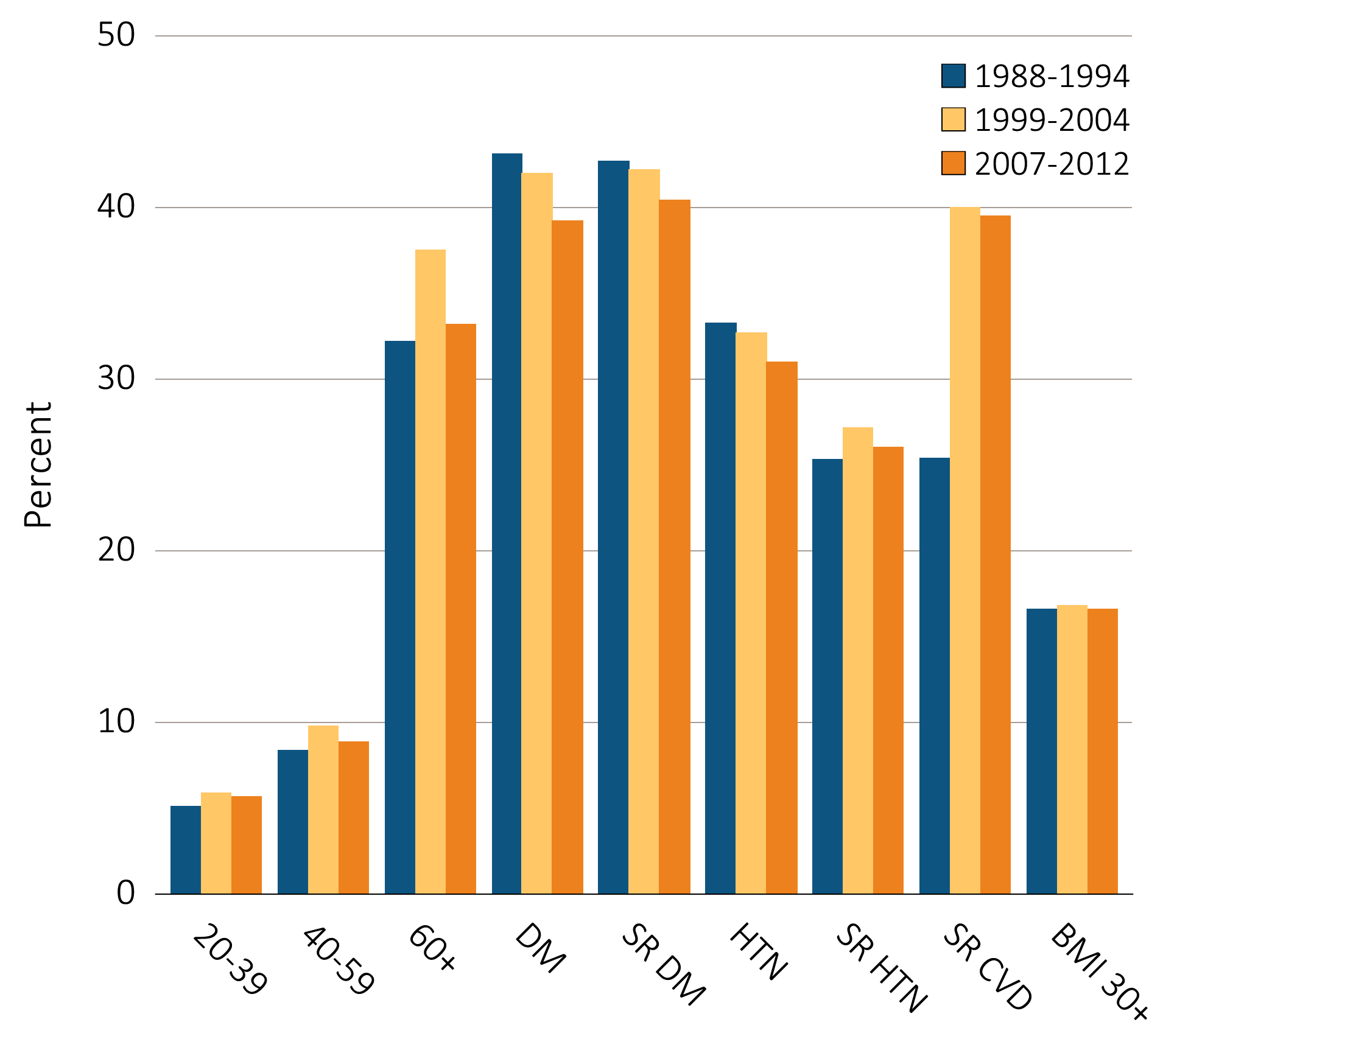
Figure 1.5 Prevalence of CKD by age & risk factor among NHANES participants,
¹⁹⁸⁸⁻²⁰¹²
Data Source: National Health and Nutrition Examination Survey (NHANES), 1988–1994, 1999-2004 & 2007–2012 participants aged 20 & older. Diabetes defined as either HbA1c >7%, self-reported, or currently taking glucose-lowering medications. Hypertension defined as BP ≥130/≥80 for those with diabetes or CKD, otherwise BP ≥140/≥90, or taking medication for hypertension. Abbreviations: BMI, body mass index; CKD, chronic kidney disease; CVD, cardiovascular disease; DM, diabetes mellitus; HbA1c, glycosylated hemoglobin; HTN, hypertension; SR, self-reported.

Slide 10
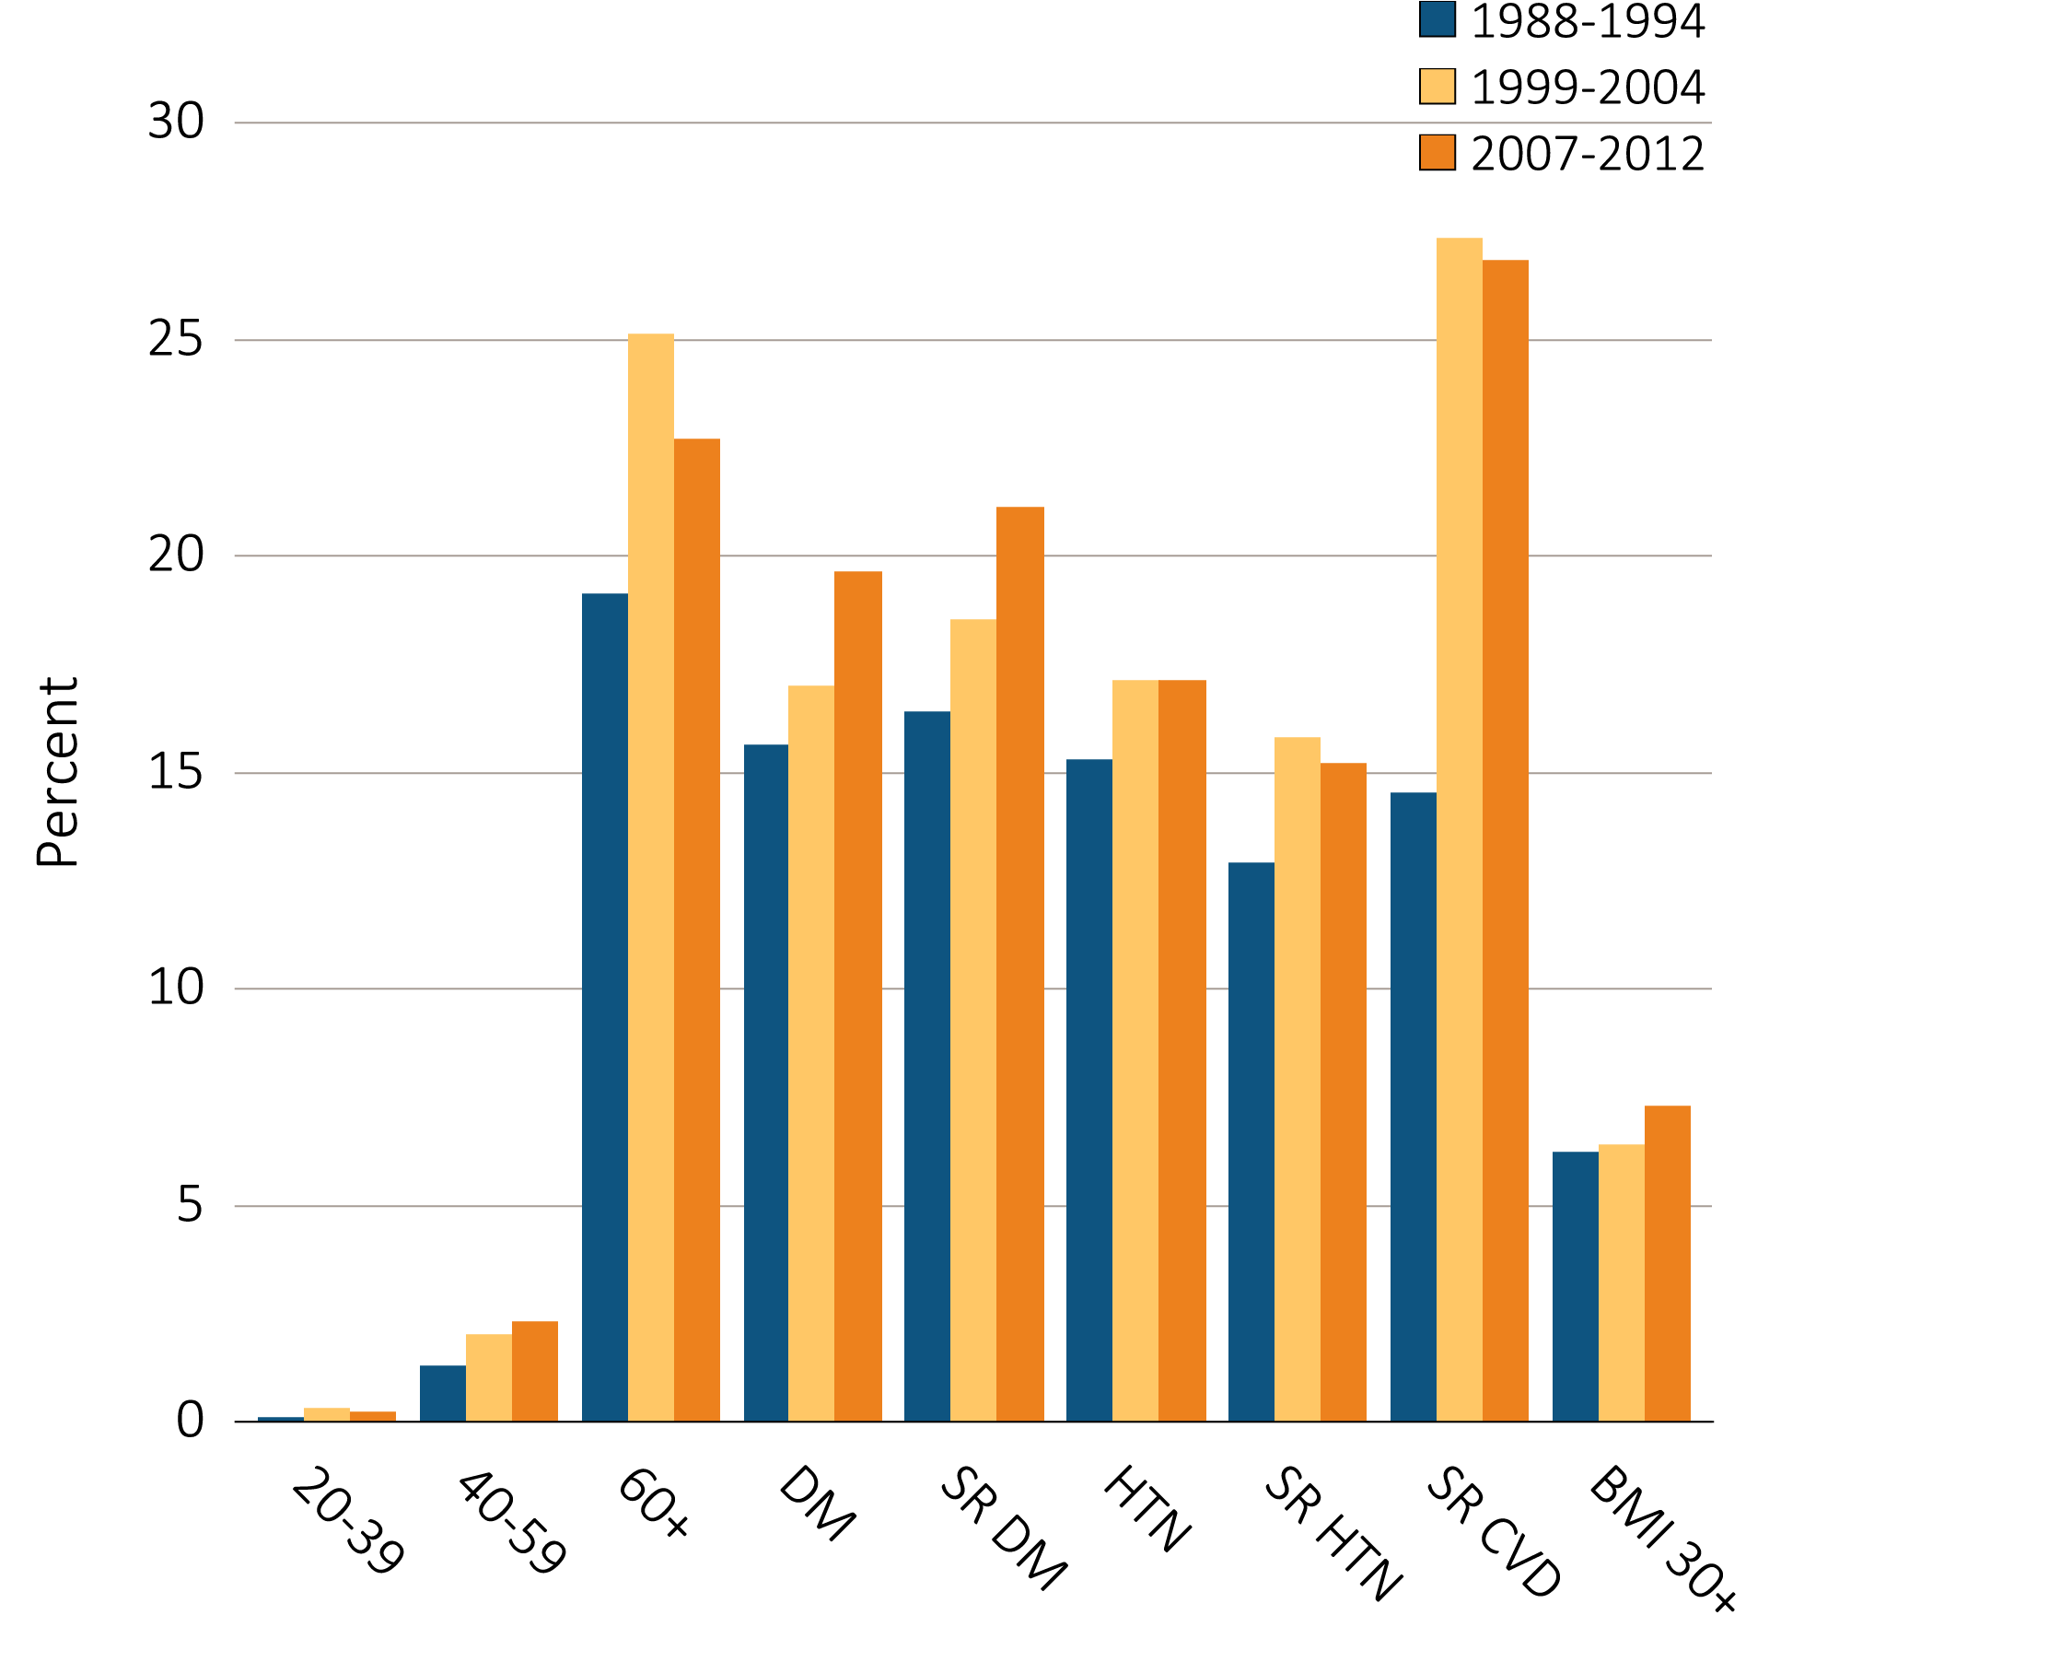
Figure 1.6 NHANES participants with eGFR <60 ml/min/1.73 m2,
by age & risk factor, 1988-2012
Data Source: National Health and Nutrition Examination Survey (NHANES), 1988–1994, 1999-2004 & 2007–2012 participants aged 20 & older. Single-sample estimates of eGFR; eGFR calculated using the CKD-EPI equation. Diabetes defined as either HbA1c >7%, self-reported (SR), or currently taking glucose-lowering medications. Hypertension defined as BP ≥130/≥80 for those with diabetes or CKD, otherwise BP ≥140/≥90, or taking medication for hypertension. Abbreviations: BMI, body mass index; CVD, cardiovascular disease; DM, diabetes mellitus; eGFR, estimated glomerular filtration rate; HbA1c, glycosylated hemoglobin; HTN, hypertension; SR, self-reported.

Slide 11
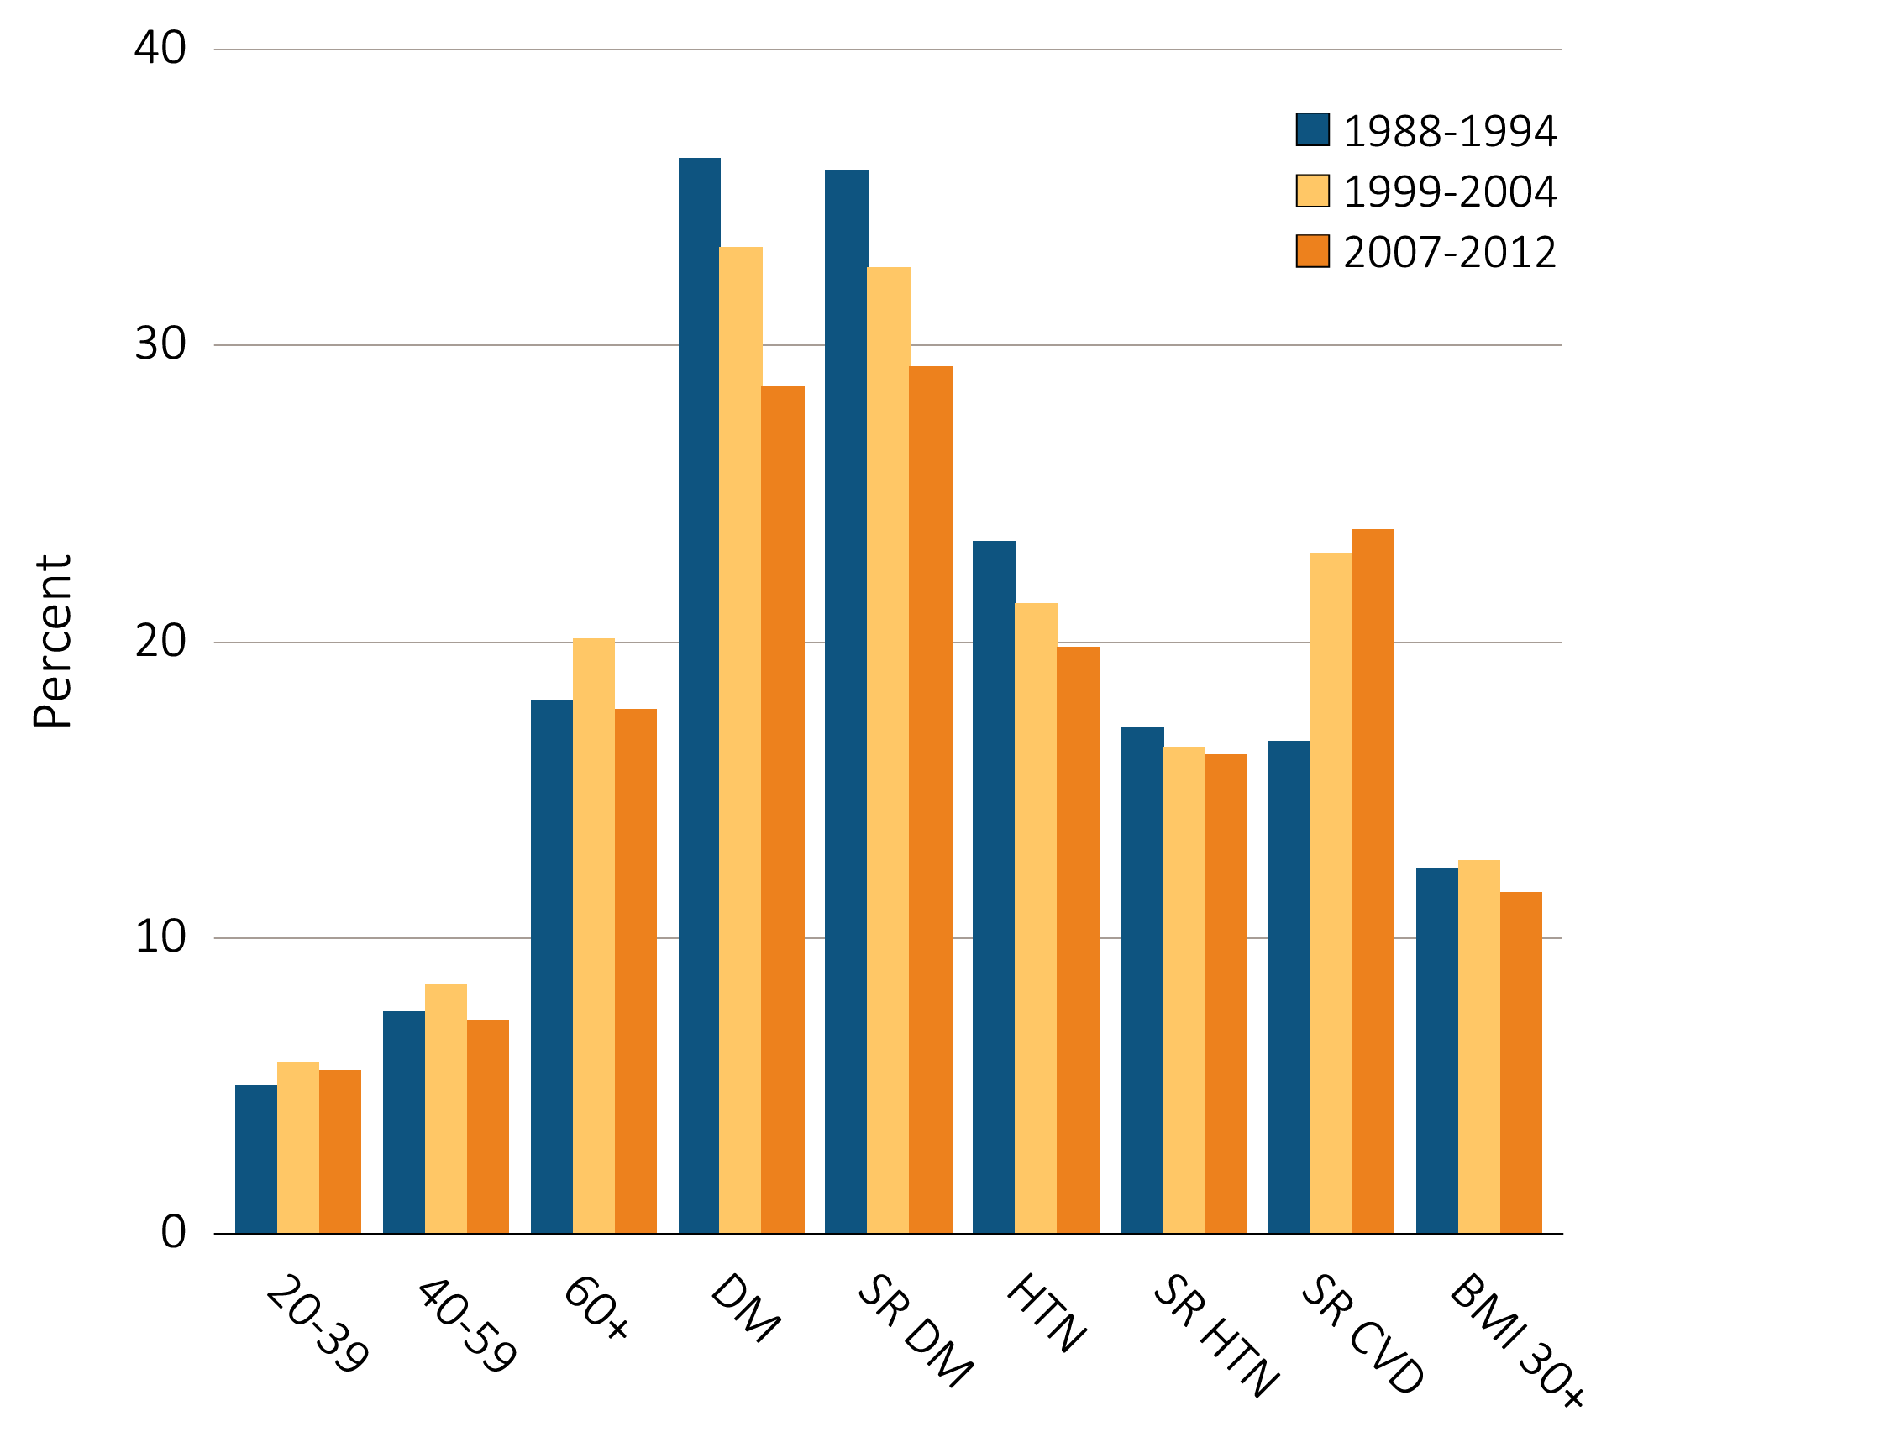
Figure 1.7 NHANES participants with urine albumin/creatinine ratio ≥30 mg/g,
by age & risk factor, 1988-2012
Data Source: National Health and Nutrition Examination Survey (NHANES), 1988–1994, 1999-2004 & 2007–2012 participants aged 20 & older. Single-sample estimates of ACR. Diabetes defined as either HbA1c >7%, self-reported (SR), or currently taking glucose-lowering medications. Hypertension defined as BP ≥130/≥80 for those with diabetes or CKD, otherwise BP ≥140/≥90, or taking medication for hypertension. Abbreviations: BMI, body mass index; CKD, chronic kidney disease; CVD, cardiovascular disease; DM, diabetes mellitus; HbA1c, glycosylated hemoglobin; HTN, hypertension; SR, self-report.

Slide 12
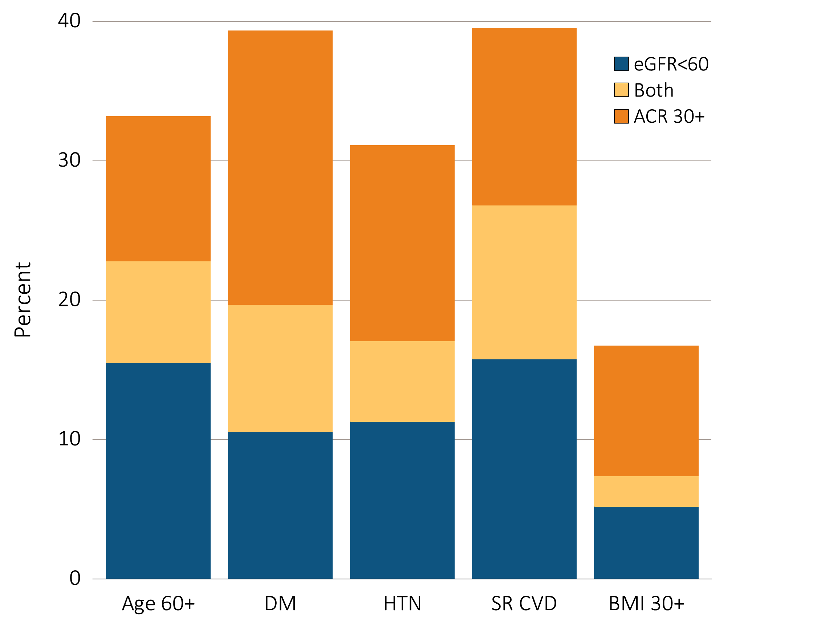
Figure 1.8 Distribution of markers of CKD in NHANES participants with diabetes, hypertension, self-reported cardiovascular disease, & obesity, 2007–2012
Data Source: National Health and Nutrition Examination Survey (NHANES), 2007–2012 participants aged 20 & older. Single-sample estimates of eGFR & ACR; eGFR calculated using the CKD-EPI equation. Abbreviations: ACR, urine albumin/creatinine ratio; BMI, body mass index; CKD, chronic kidney disease; DM, diabetes mellitus; SR CVD, self-reported cardiovascular disease; eGFR, estimated glomerular filtration rate; HTN, hypertension.

Slide 13
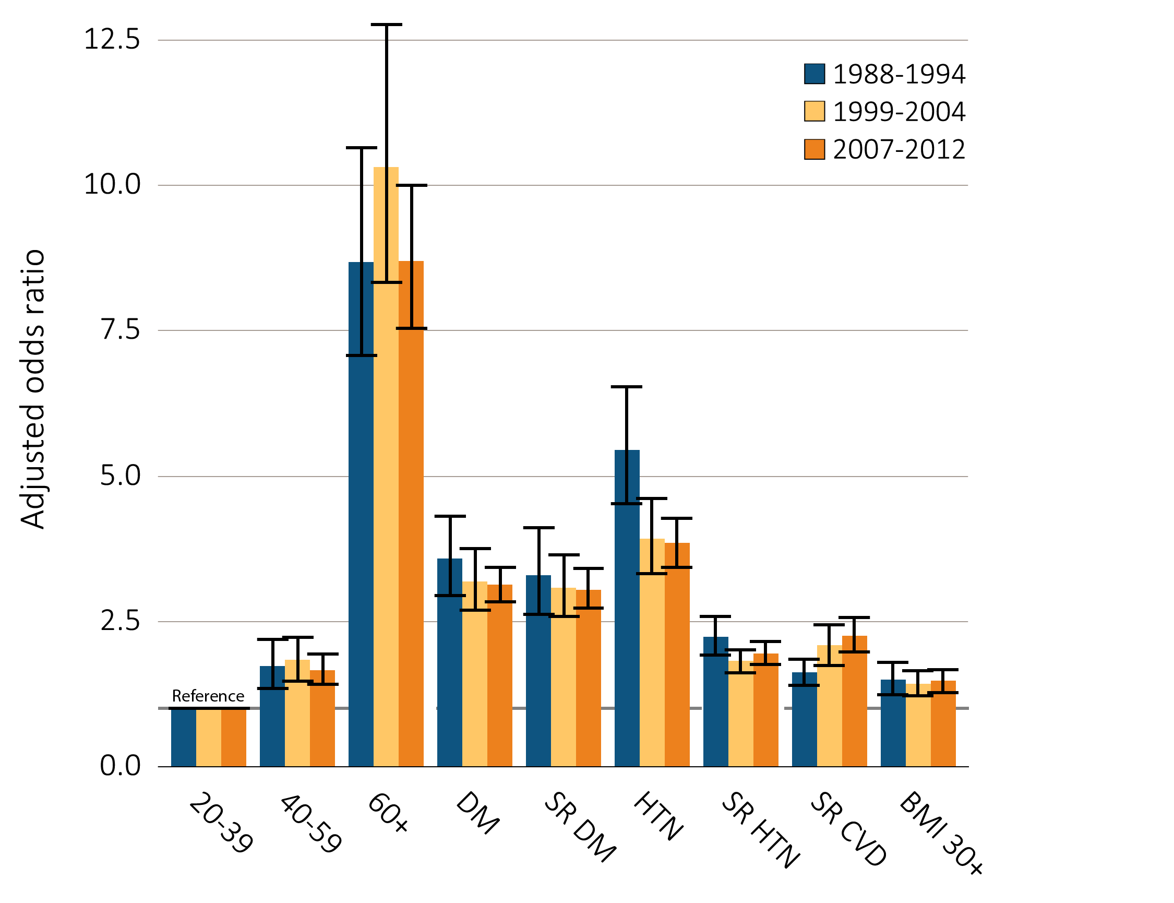
Figure 1.9 Adjusted odds ratios of CKD in NHANES participants by risk factor, 1988-2012
Data Source: National Health and Nutrition Examination Survey (NHANES), 1988–1994, 1999-2004 & 2007–2012 participants aged 20 & older. CKD defined as presence of eGFR <60 ml/min/1.73 m², ACR ≥ 30 mg/g, and either eGFR <60 or ACR ≥30 for each of the comorbid conditions. Adjusted for age, sex, & race; single-sample estimates of eGFR & ACR; eGFR calculated using the CKD-EPI equation. Whisker lines indicate 95% confidence intervals. Abbreviations: ACR, urine albumin/creatinine ratio; BMI, body mass index; CKD, chronic kidney disease; CVD, cardiovascular disease; DM, diabetes mellitus; eGFR, estimated glomerular filtration rate; HTN, hypertension; SR, self-report.

Slide 14
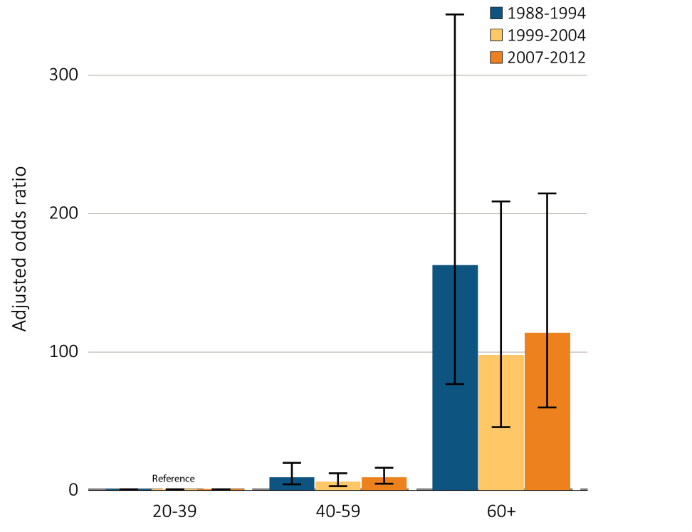
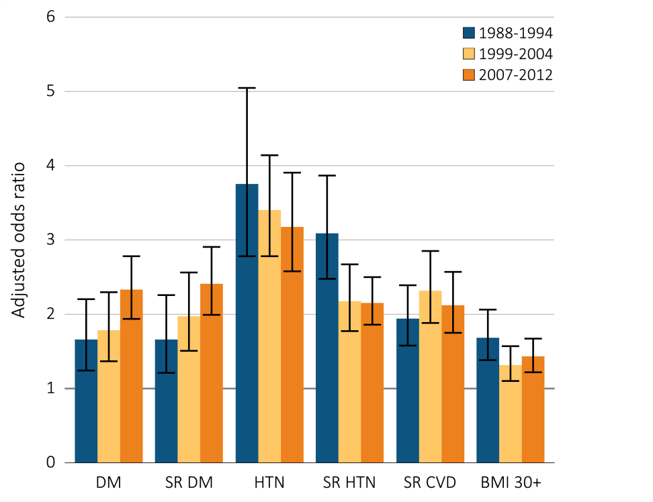
Figure 1.10 Adjusted odds ratios of eGFR <60 ml/min/1.73m2 in NHANES participants,
by age & risk factor, 1988-2012
Age category
CKD risk factor
Data Source: National Health and Nutrition Examination Survey (NHANES), 1988–1994, 1999-2004 & 2007–2012 participants aged 20 & older; single-sample estimates of eGFR. Adjusted for age, sex, & race; eGFR calculated using the CKD-EPI equation. Whisker lines indicate 95% confidence intervals. Abbreviations: BMI, body mass index; CKD, chronic kidney disease; CVD, cardiovascular disease; DM, diabetes mellitus; eGFR, estimated glomerular filtration rate; HTN, hypertension; SR, self-report.

Slide 15
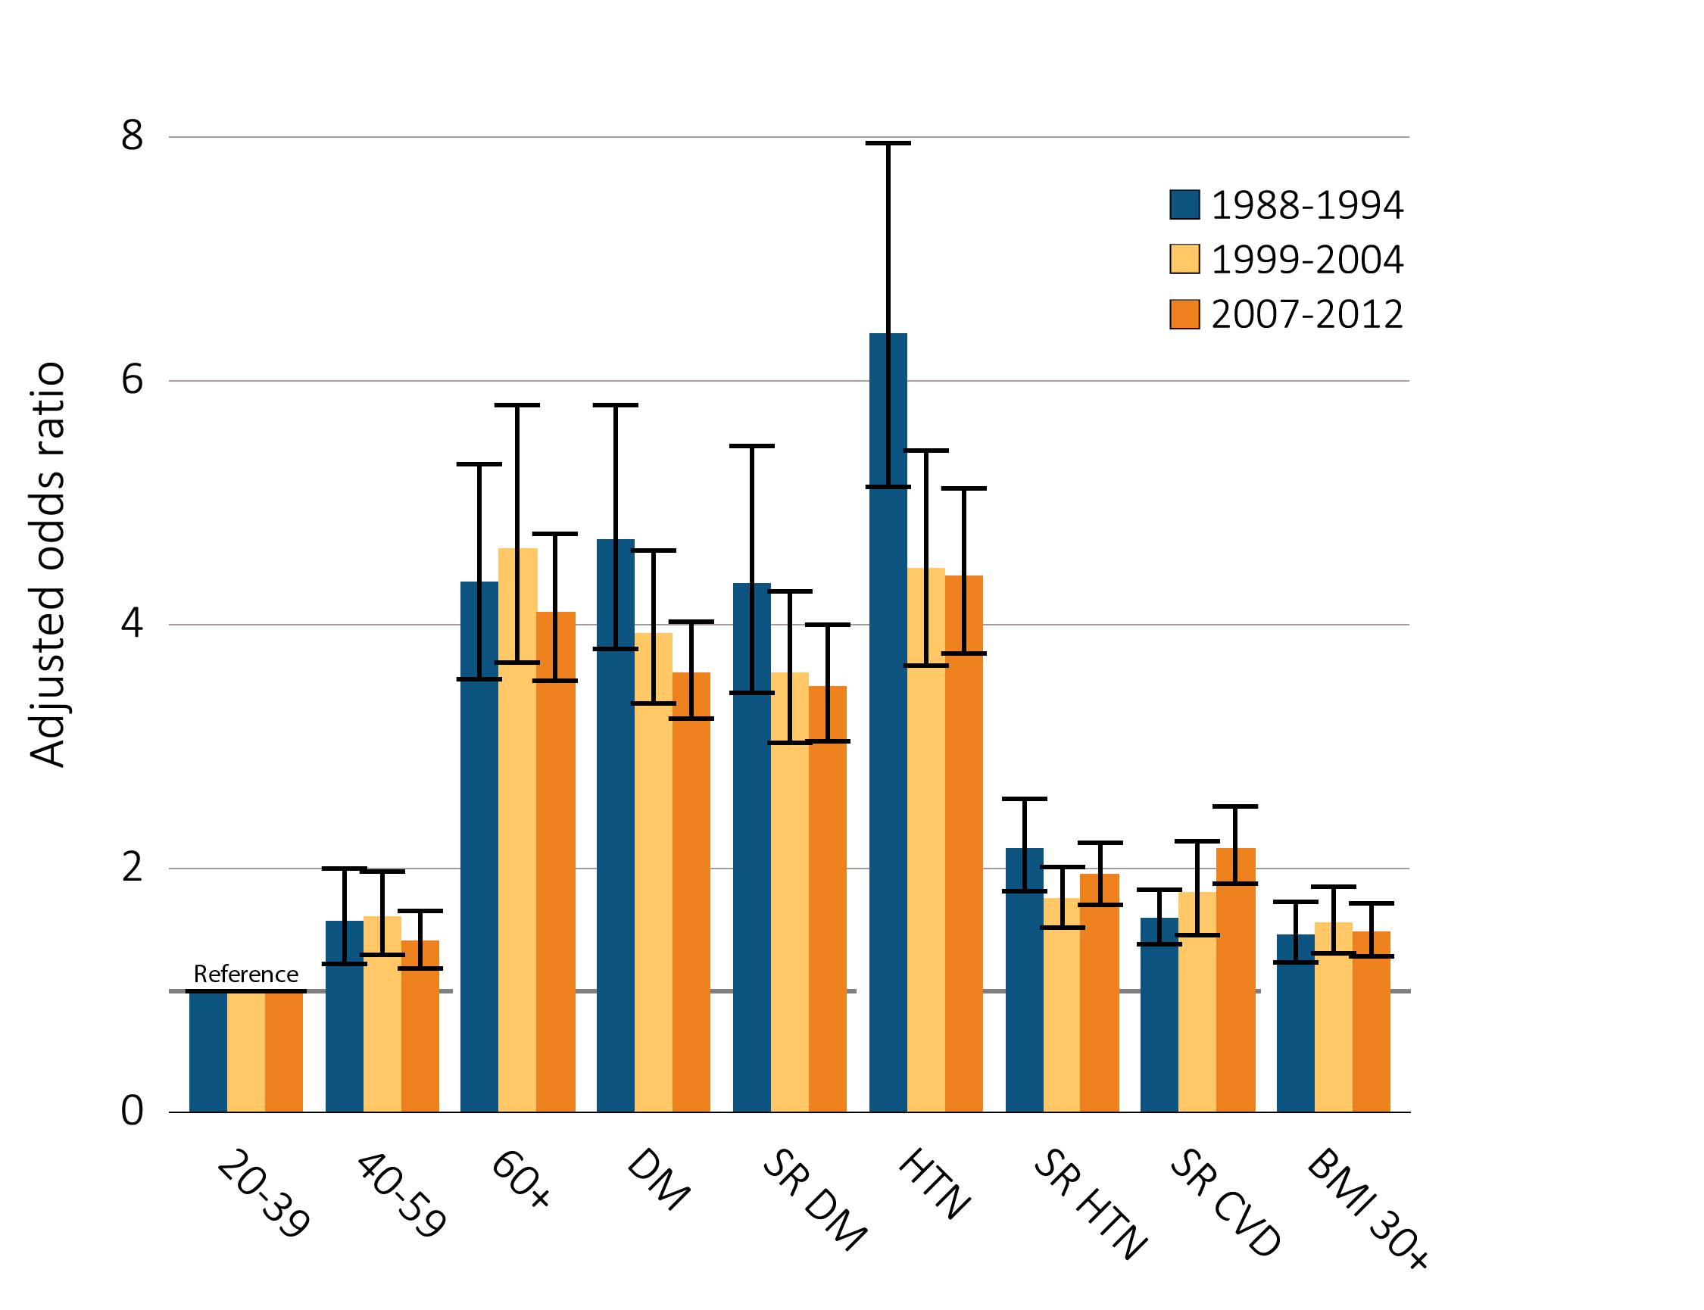
Figure 1.11 Adjusted odds ratios of urine albumin/creatinine ratio ≥30 mg/g
in NHANES participants by age & risk factor, 1988-2012
Data Source: National Health and Nutrition Examination Survey (NHANES), 1988–1994, 1999-2004 & 2007–2012 participants aged 20 & older; single-sample estimates of ACR. Adjusted for age, sex, & race. Whisker lines indicate 95% confidence intervals. Abbreviations: ACR, urine albumin/creatinine ratio; BMI, body mass index; CKD, chronic kidney disease; CVD, cardiovascular disease; DM, diabetes mellitus; HTN, hypertension; SR, self-report.

Slide 16
Table 1.3 Awareness, treatment, & measures of control of CKD risk factors,
percent of NHANES participants, 1988-2012
 | All CKD |  |  |  | eGFR <60 ml/min/1.73m² |  |  |  | ACR ≥30
 | 1988-1994 | 1999-2004 | 2007-2012 | Trend p-value | 1988-1994 | 1999-2004 | 2007-2012 | Trend p-value | 1988-1994 | 1999-2004 | 2007-2012 | Trend p-value
Hypertension, by current hypertensive statusª |  |  |  | 0.01 |  |  |  | 0.29 |  |  |  | 0.07
Non-hypertensive status | 30.7 | 26.5 | 26.0 |  | 18.4 | 14.3 | 15.9 |  | 32.0 | 30.4 | 29.1
Hypertensive (measured/treated) | 69.3 | 73.5 | 74.0 |  | 81.6 | 85.7 | 84.1 |  | 68.0 | 69.6 | 70.9
Control of hypertension among hypertensive patients^{b} |  |  |  | <0.001 |  |  |  | <0.001 |  |  |  | <0.001
Unaware | 33.4 | 50.6 | 22.5 |  | 22.8 | 44.2 | 16.4 |  | 36.0 | 54.7 | 25.1
Aware, not treated | 14.7 | 6.3 | 6.5 |  | 12.1 | 4.2 | 2.8 |  | 15.7 | 7.1 | 8.7
Aware, treated, uncontrolled | 39.2 | 31.5 | 43.9 |  | 47.8 | 36.4 | 46.6 |  | 38.4 | 30.2 | 44.8
Aware, treated, controlled | 12.7 | 11.5 | 27.2 |  | 17.3 | 15.2 | 34.2 |  | 9.9 | 8.0 | 21.4
Total cholesterol^{c} |  |  |  | <0.001 |  |  |  | <0.001 |  |  |  | <0.001
<200 (desirable) | 35.1 | 46.6 | 58.7 |  | 27.2 | 45.6 | 62.1 |  | 38.2 | 47.5 | 58.2
200–239 (borderline high) | 33.5 | 32.6 | 26.4 |  | 32.7 | 33.7 | 23.5 |  | 32.8 | 31.9 | 27.3
240+ (high) | 31.4 | 20.8 | 14.9 |  | 40.0 | 20.7 | 13.4 |  | 29.0 | 20.6 | 14.5
Uric Acid |  |  |  | 0.84 |  |  |  | 0.84 |  |  |  | 0.45
Normal | 69.6 | 69.2 | 69.2 |  | 54.4 | 55.2 | 55.1 |  | 73.9 | 74.0 | 75.4
High | 30.4 | 30.8 | 30.8 |  | 45.6 | 44.8 | 44.9 |  | 26.1 | 26.0 | 24.6
Smoking |  |  |  | <0.001 |  |  |  | 0.03 |  |  |  | <0.001
Current | 22.2 | 16.9 | 14.6 |  | 11.9 | 7.8 | 8.2 |  | 27.0 | 21.3 | 17.6
Former | 35.2 | 32.3 | 32.6 |  | 43.2 | 39.4 | 40.1 |  | 31.5 | 29.1 | 29.7
Never | 42.6 | 50.7 | 52.8 |  | 44.9 | 52.8 | 51.6 |  | 41.5 | 49.6 | 52.6
Control of diabetes among patients with diabetes^{d} |  |  |  | <0.001 |  |  |  | 0.003 |  |  |  | 0.04
Glycohemoglobin <7% (controlled) | 31.5 | 39.2 | 45.3 |  | 37.1 | 50.9 | 55.0 |  | 29.6 | 33.6 | 37.9
Glycohemoglobin 7% or higher (uncontrolled) | 68.5 | 60.8 | 55.7 |  | 62.9 | 49.1 | 45.0 |  | 70.4 | 66.4 | 62.1
(Continued on the next slide)

Slide 17
Table 1.3 Awareness, treatment, & measures of control of CKD risk factors,
percent of NHANES participants, 1988-2012 (Continued)
Data Source: National Health and Nutrition Examination Survey (NHANES), 1988–1994, 1999-2004 & 2007–2012 participants aged 20 & older. Single-sample estimates of all biologic markers; eGFR calculated using the CKD-EPI equation. Abbreviations: ACR, urine albumin/creatinine ratio; CKD, chronic kidney disease; eGFR, estimated glomerular filtration rate. a. Hypertension defined as blood pressure ≥130/≥80 for those with CKD and diabetes, otherwise ≥140/≥90, or self- reported treatment for hypertension. b. Awareness and treatment are self-reported. Control defined as <130/<80 for those with CKD and diabetes; otherwise <140/<90. c. Total cholesterol classified according to Adult Treatment Panel III blood cholesterol guidelines (ATP III). d. Glycosylated hemoglobin classified according to American Diabetes Association guidelines. Trend tests for control of hypertension compares unaware to the three aware categories, total cholesterol tests < 200 vs. 200+, smoking tests any current or past smoking vs. never.

Slide 18
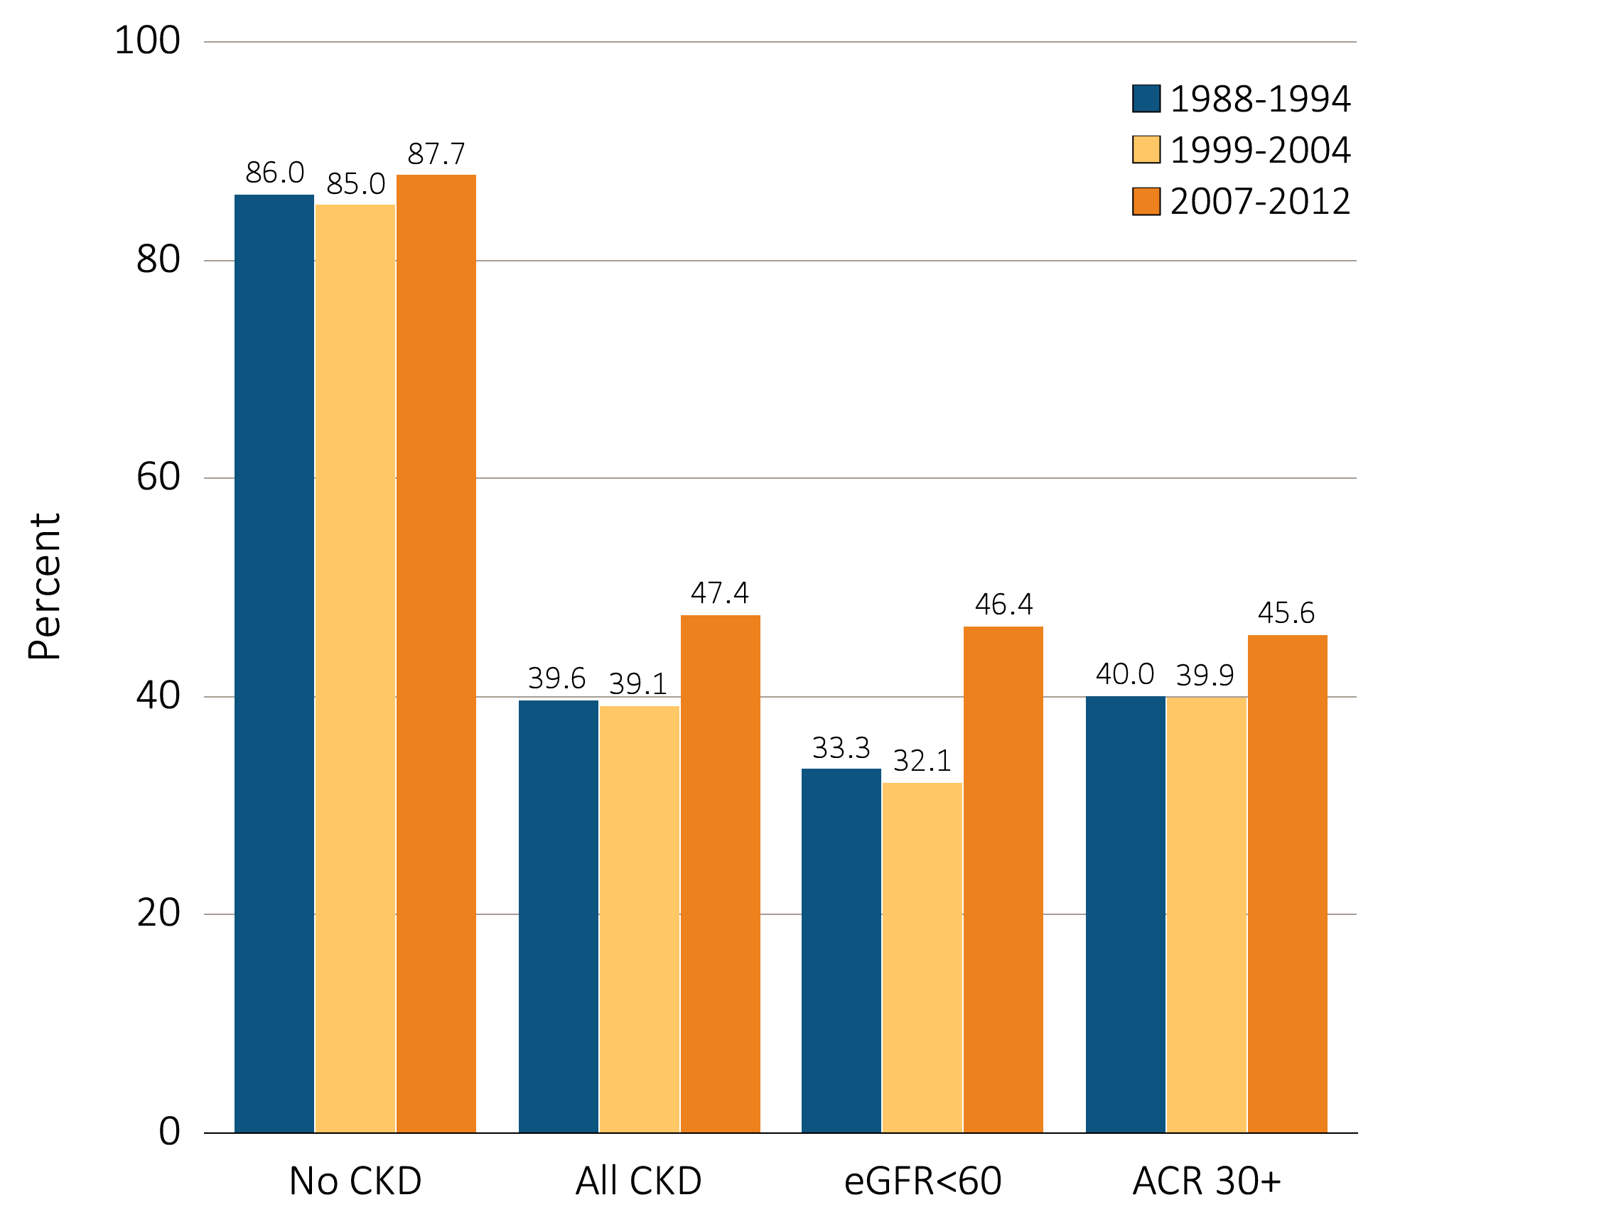
Figure 1.12 NHANES participants at target blood pressure, 1988-2012
Data Source: National Health and Nutrition Examination Survey (NHANES), 1988–1994, 1999-2004 & 2007–2012 participants aged 20 & older. Single-sample estimates of eGFR & ACR; eGFR calculated using the CKD-EPI equation. Figure represents all hypertensive participants including those who were at target blood pressure, probably due to medication. Abbreviations: ACR, urine albumin/creatinine ratio; CKD, chronic kidney disease; eGFR, estimated glomerular filtration rate.

Slide 19
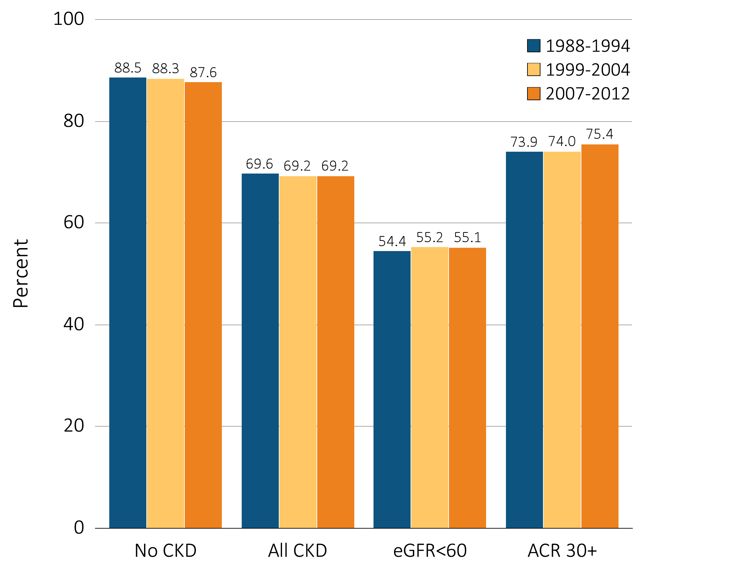
Figure 1.13 NHANES participants within uric acid normal range, 1988-2012
Data Source: National Health and Nutrition Examination Survey (NHANES), 1988–1994, 1999-2004 & 2007–2012 participants aged 20 & older. Single-sample estimates of eGFR & ACR; eGFR calculated using the CKD-EPI equation. Abbreviations: ACR, urine albumin/creatinine ratio; CKD, chronic kidney disease; eGFR, estimated glomerular filtration rate.

Slide 20
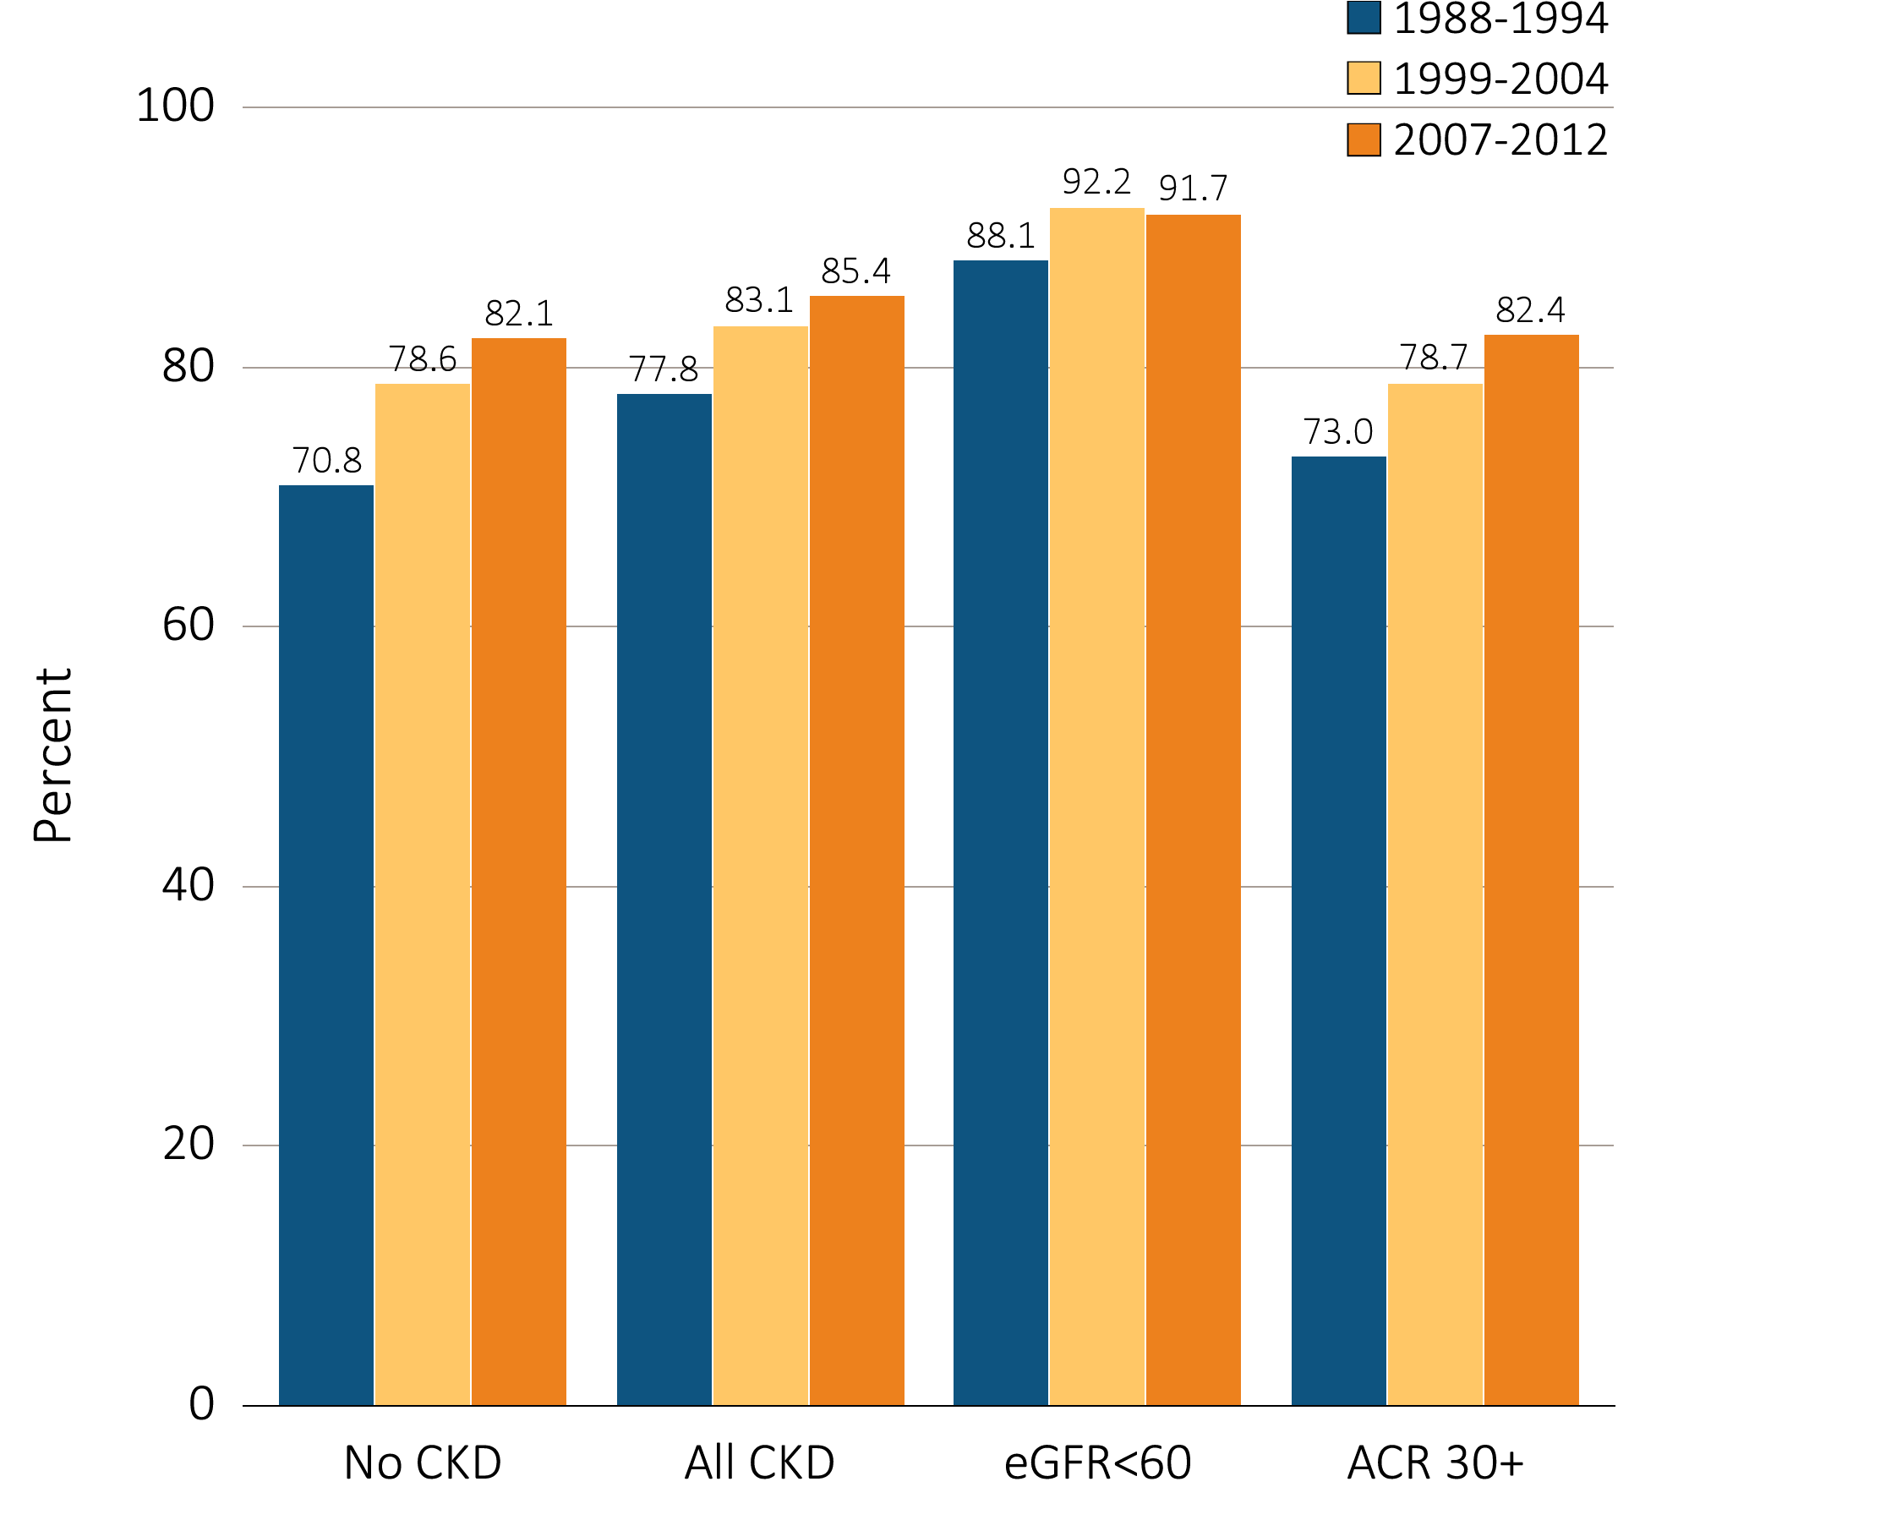
Figure 1.14 NHANES participants not currently smoking, 1988-2012
Data Source: National Health and Nutrition Examination Survey (NHANES), 1988–1994, 1999-2004 & 2007–2012 participants aged 20 & older. Single-sample estimates of eGFR & ACR; eGFR calculated using the CKD-EPI equation. Abbreviations: ACR, urine albumin/creatinine ratio; CKD, chronic kidney disease; eGFR, estimated glomerular filtration rate.

Slide 21
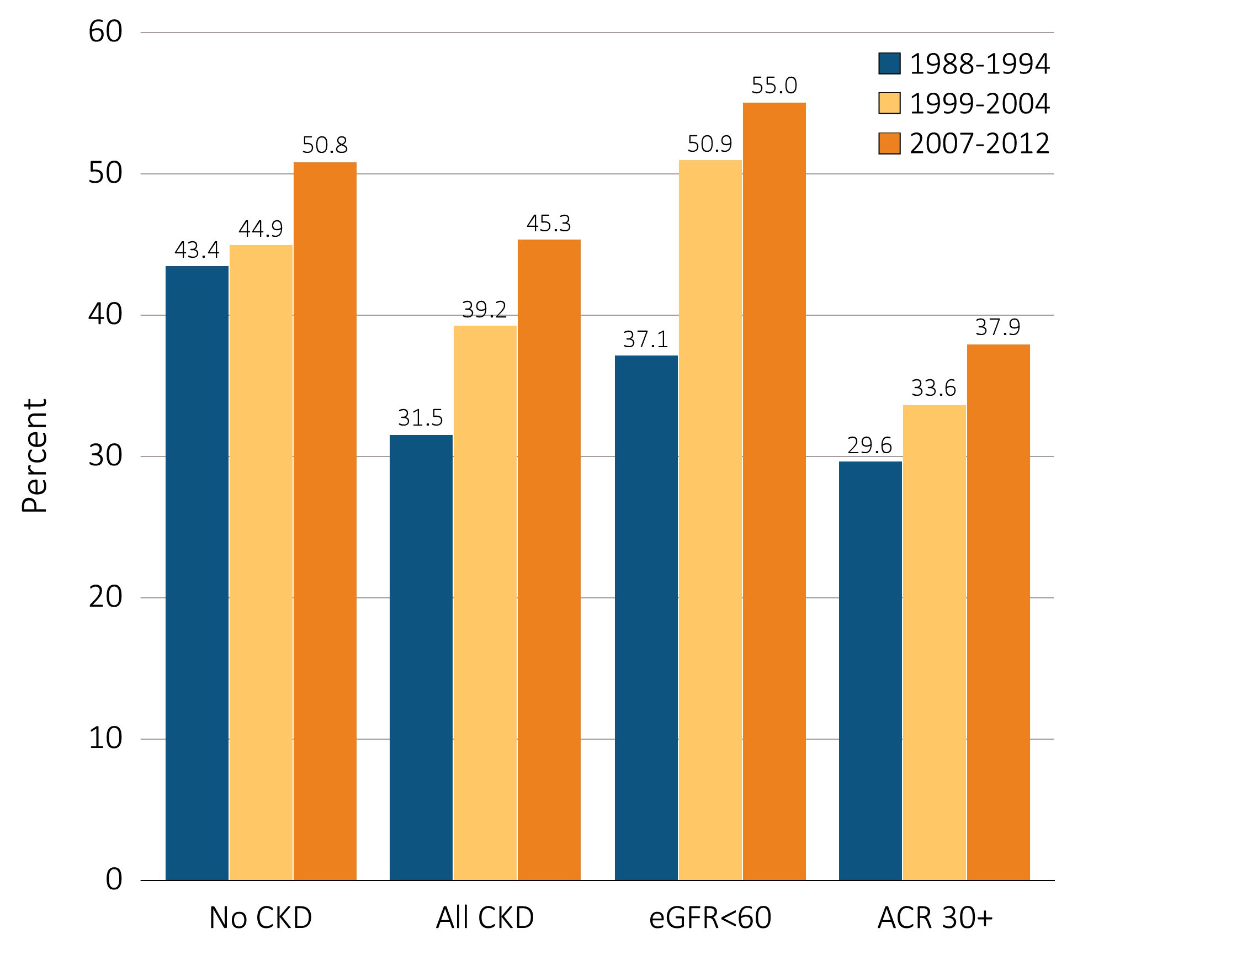
Figure 1.15 Diabetic NHANES participants with glycosylated hemoglobin <7%, 1988-2012
Data Source: National Health and Nutrition Examination Survey (NHANES), 1988–1994, 1999-2004 & 2007–2012 participants aged 20 & older. Single-sample estimates of eGFR & ACR; eGFR calculated using the CKD-EPI equation. Abbreviations: ACR, urine albumin/creatinine ratio; CKD, chronic kidney disease; eGFR, estimated glomerular filtration rate.

Slide 22
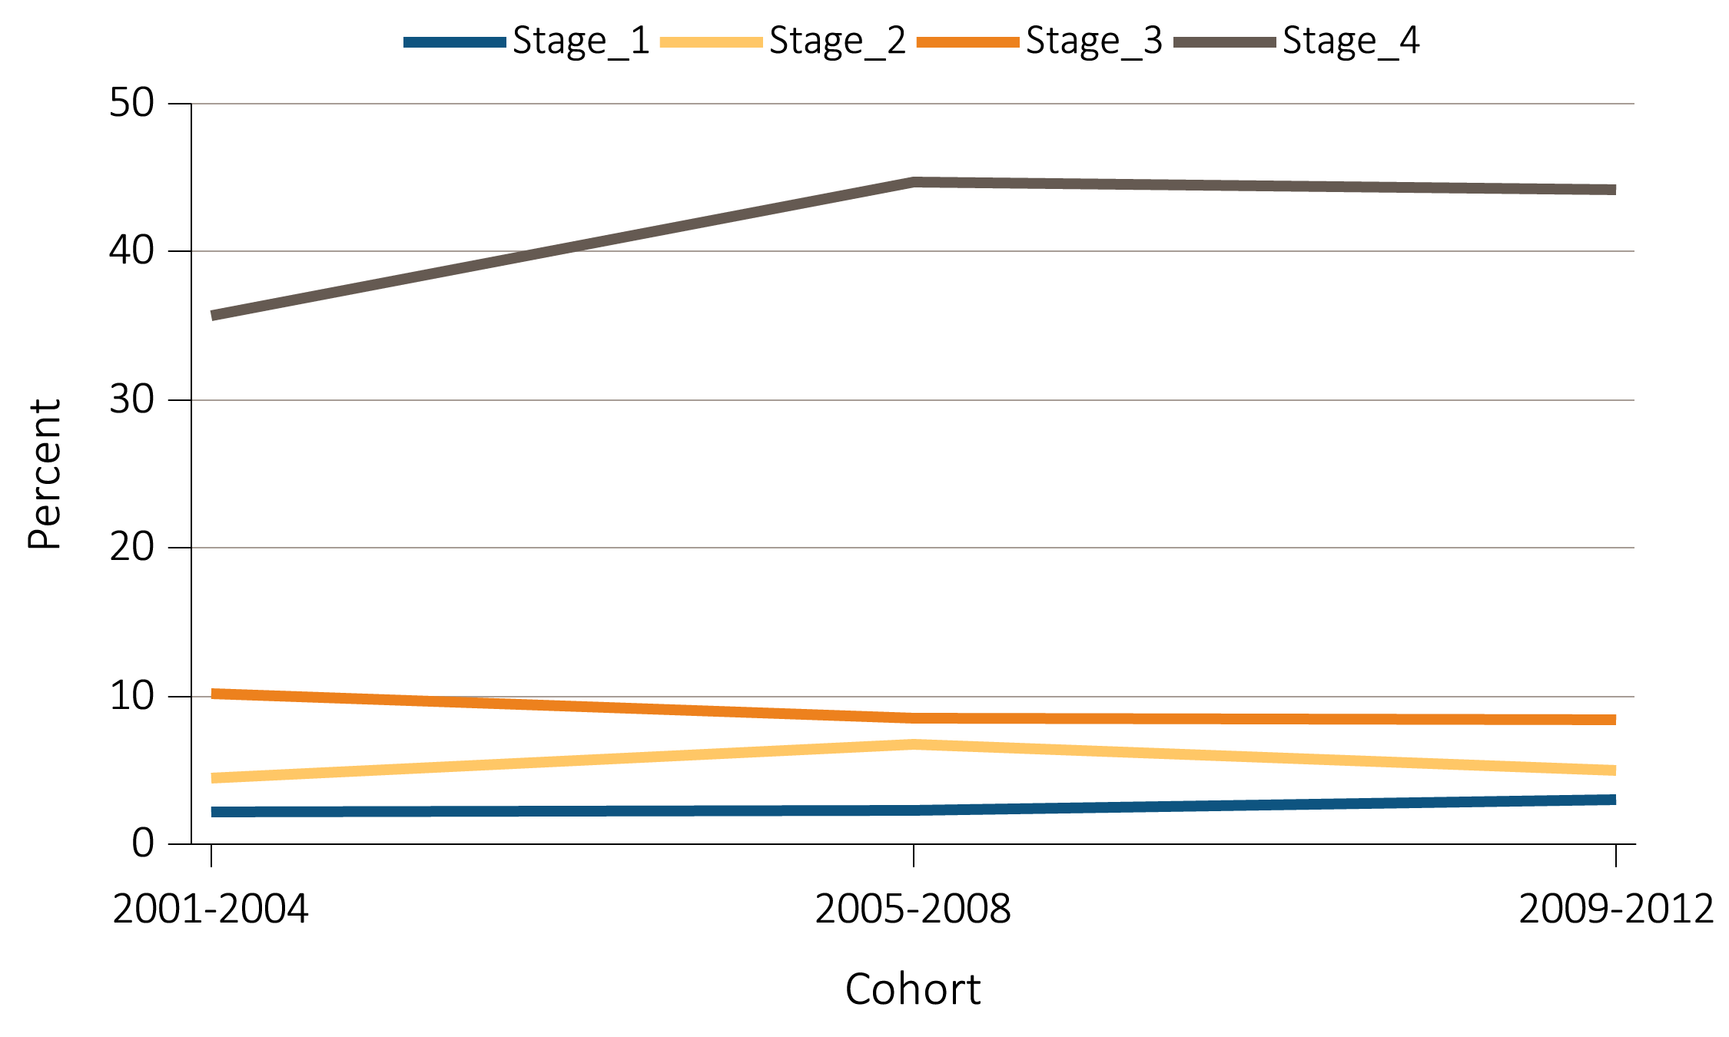
Figure 1.16 NHANES participants with CKD aware of their kidney disease, 2001-2012
Data Source: National Health and Nutrition Examination Survey (NHANES), 2001-2012 participants aged 20 & older. Abbreviations: CKD, chronic kidney disease.

Slide 23
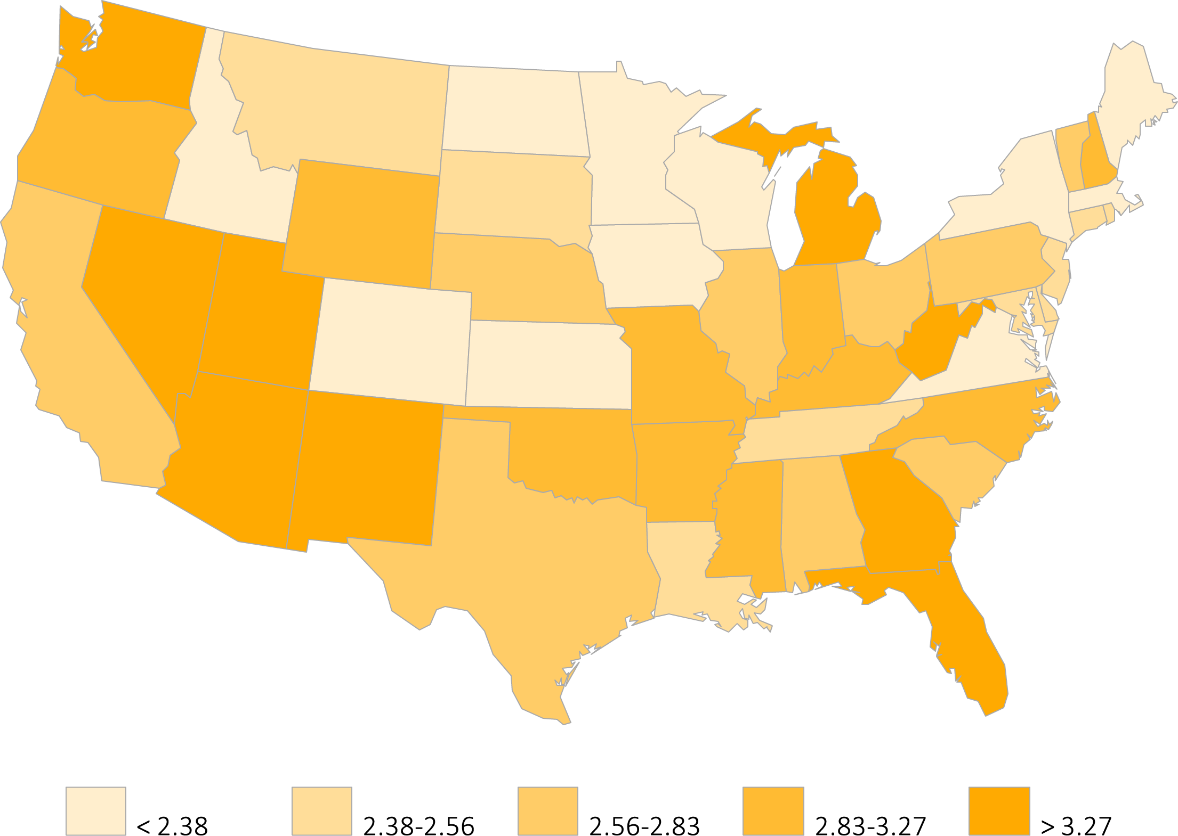
Figure 1.17 Estimated prevalence of self-reported kidney disease by state,
BRFSS participants, 2012 (N = 464,494)
Data Source: Behavioral Risk Factors Surveillance System (BRFSS), 2012 participants aged 20 & older.

