Slide 2
Table A. ICD-9-CM Codes
Table A. ICD-9-CM codes for Chronic Kidney Disease (CKD) stages
ICD-9-CM codeª | Stage
585.1 | CKD, Stage 1
585.2 | CKD, Stage 2 (mild)
585.3 | CKD, Stage 3 (moderate)
585.4 | CKD, Stage 4 (severe)
585.5 | CKD, Stage 5 (excludes 585.6: Stage 5, requiring chronic dialysis^{b})
CKD Stage-unspecified | For these analyses, identified by multiple codes including 585.9, 250.4x, 403.9xm & others
ª For analyses in this chapter, CKD stage estimates require at least one occurrence of a stage-specific code, and the last available CKD stage in a given year is used.
^{b} In USRDS analyses, patients with ICD-9-CM code 585.6 & with no ESRD 2728 form or other indication of end-stage renal disease (ESRD) are considered to have code 585.5.

Slide 3
Table 2.1 Prevalence of coded comorbid conditions (CKD, CVD & DM),
(a) total, and (b) one or more, among Medicare patients aged 65+, 2013
(a)
 | N | %
5% Medicare patients | 1,260,903 | 100
Total CKD | 134,254 | 10.6
Total CVD | 499,135 | 39.6
Total DM | 301,308 | 23.9
(b)
 | N |  | %
5% Medicare patients |  | 1,260,903 | 100
Only CKD |  | 22,310 | 1.8
Only CVD |  | 285,628 | 22.6
Only DM |  | 117,892 | 9.3
CKD & DM, no CVD |  | 17,030 | 1.3
CKD & CVD, no DM |  | 47,121 | 3.7
DM & CVD, no CKD |  | 118,593 | 9.4
CKD & CVD & DM |  | 47,793 | 3.8
No CKD, no CVD, no DM |  | 604,536 | 47.9
Data Source: Special analyses, Medicare 5 percent sample. Period prevalent patients, 2013, without ESRD, aged 65 and older (Medicare). Abbreviations: CKD, chronic kidney disease; CVD, cardiovascular disease; DM, diabetes mellitus. CVD is defined as presence of any of the following comorbidities: cerebrovascular accident, peripheral vascular disease, atherosclerotic heart disease, congestive heart failure, dysrhythmia or other cardiac comorbidities.

Slide 4
Table 2.2 Demographic characteristics of all patients and of CKD patients, among Medicare patients aged 65+, 2013
 | All patients |  | Patients with CKD
 | N | (%) | N | (%)
All | 1,260,903 | 100 | 134,254 | 100
Age
65-74 | 693,399 | 55.0 | 50,417 | 37.6
75-84 | 396,086 | 31.4 | 53,005 | 39.5
85+ | 171,418 | 13.6 | 30,832 | 23.0
Sex
Male | 543,687 | 43.1 | 63,674 | 47.4
Female | 717,216 | 56.9 | 70,580 | 52.6
Race
White | 1,086,649 | 86.2 | 111,527 | 83.1
Black/African American | 95,465 | 7.6 | 14,606 | 10.9
Native American | 5,296 | 0.4 | 598 | 0.5
Asian | 23,890 | 1.9 | 2,739 | 2.0
Other | 41,786 | 3.3 | 4,359 | 3.3
Unknown | 7,817 | 0.6 | 425 | 0.3
Comorbidity
DM | 301,308 | 23.9 | 64,823 | 48.3
HTN | 755,850 | 60.0 | 123,821 | 92.2
CVD | 499,135 | 39.6 | 94,914 | 70.7
Data Source: Special analyses, Medicare 5 percent sample. Period prevalent patients, 2013, without ESRD, aged 65 and older (Medicare). Abbreviations: CKD, chronic kidney disease; CVD, cardiovascular disease; DM, diabetes mellitus; HTN, hypertension. CVD is defined as presence of any of the following comorbidities: cerebrovascular accident, peripheral vascular disease, atherosclerotic heart disease, congestive heart failure, dysrhythmia or other cardiac comorbidities.

Slide 5
Table 2.3 Prevalence of CKD, and adjusted odds ratios of CKD among Medicare patients aged 65+, 2013
 | Prevalence of CKD (% of overall) | Adjusted odds ratios of CKD
Overall | 10.7
Age
65-74 | 7.3 | Ref.
75-84 | 13.4 | 1.5
85+ | 18.0 | 2.1
Sex
Male | 11.7 | 1.3
Female | 9.8 | Ref.
Race
White | 10.3 | Ref.
Black/African American | 15.3 | 1.4
Native American | 11.3 | 1.1
Asian | 11.5 | 1.1
Other/Unknown | 10.4 | 1.0
Comorbidity
DM | 21.5 | 2.2
HTN | 16.4 | 3.8
CVD | 19.0 | 2.2
Data Source: Special analyses, Medicare 5 percent sample. Period prevalent patients, 2013, without ESRD, aged 65 and older (Medicare). Adjustments included are age, gender, race, and comorbidities. Abbreviations: CKD, chronic kidney disease; CVD, cardiovascular disease; DM, diabetes mellitus; HTN, hypertension. CVD is defined as presence of any of the following comorbidities: cerebrovascular accident, peripheral vascular disease, atherosclerotic heart disease, congestive heart failure, dysrhythmia or other cardiac comorbidities.

Slide 6
Table 2.4 Percent of patients with CKD by demographic characteristics, among patients overall and with DM, HTN, or CVD, in NHANES (2011-2012) and Medicare (2013) datasets
 | Overall |  | DM (No HTN) |  | HTN (No DM) |  | Any CVD
 | NHANES | Medicare | NHANES | Medicare | NHANES | Medicare | NHANESª | Medicare^{b}
Age
65-74 | 26.4 | 7.3 | 7.5 | 9.8 | 31.4 | 12.9 | 40.9 | 21.6
75-79 | 50.4 | 13.4 | * | 14.0 | 45.4 | 20.1 | 66.7 | 27.7
80+ | 65.2 | 18.0 | * | 18.7 | 67.2 | 27.5 | 80.5 | 32.4
Race
White | 38.3 | 10.3 | 24.9 | 12.0 | 44.5 | 17.9 | 55.6 | 25.2
Black/ African American | 49.9 | 15.3 | * | 11.9 | 46.6 | 22.2 | 68.3 | 35.9
Native American | - | 11.3 | - | 11.8 | - | 19.0 | - | 29.4
Asian | - | 11.5 | - | 12.8 | - | 17.8 | - | 30.2
Other/Unknown | 42.4 | 10.4 | 18.3 | 11.7 | 47.0 | 16.2 | 70.1 | 28.1
Sex
Male | 37.9 | 11.7 | 29.5 | 13.6 | 41.7 | 20.5 | 44.3 | 27.6
Female | 41.3 | 9.8 | 20.7 | 10.4 | 47.2 | 16.6 | 75.9 | 24.9
All | 39.7 | 10.7 | 26.6 | 12.0 | 44.9 | 18.1 | 58.5 | 26.2
Data Source: Special analyses, Medicare 5 percent sample, aged 65 and older alive & eligible for all of 2013 and NHANES 2011-2012 participants, aged 65 and older. CKD claims as well as other diseases identified in 2013. Abbreviations: CKD, chronic kidney disease; CVD, cardiovascular disease; DM, diabetes mellitus; HTN, hypertension.
* Values for cells with 10 or fewer patients are suppressed. ª CVD defined as any of the self-report diseases: angina, myocardial infarction, stroke, coronary heart disease, or congestive heart failure.
^{b} CVD defined as either one of the following comorbidities: cerebrovascular accident, peripheral vascular disease, atherosclerotic heart disease, congestive heart failure, dysrhythmia or other cardiac comorbidities. - No available data.

Slide 7
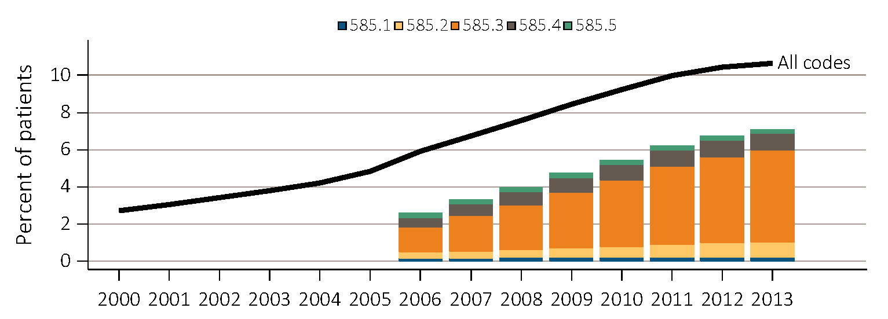
Figure 2.1 Trends in prevalence of recognized CKD, overall and by CKD stage, among Medicare patients aged 65+, 2000-2013
Data Source: Special analyses, Medicare 5 percent sample. Known CKD stages presented as bars; curve showing “All codes” includes known CKD stages (codes 585.1-585.5) and the CKD-stage unspecified codes (585.9, and remaining non-585 CKD codes). Note: In previous years, this graph reported 585.9 codes as a component of the stacked bars. Abbreviation: CKD, chronic kidney disease.

Slide 8
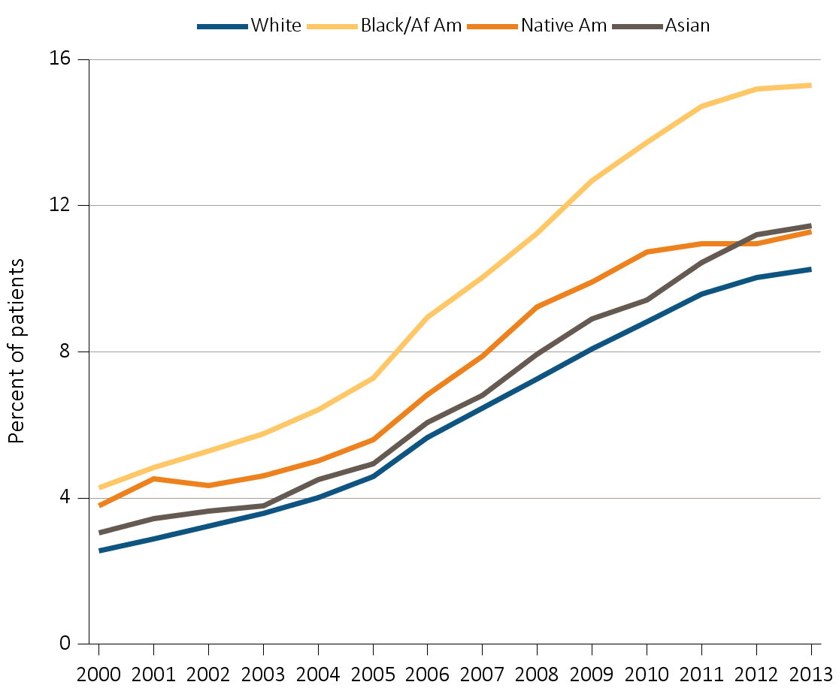
Figure 2.2 Trends in prevalence of recognized CKD, by race, among Medicare patients aged 65+, 2000-2013
Data Source: Special analyses, Medicare 5 percent sample. Abbreviation: CKD, chronic kidney disease; Af Am, African American; Native Am, Native American.

Slide 9
Table 2.5. Progression of CKD from 2008 to 2013,
Medicare 5% cohort alive and not yet ESRD in 2008
 |  |  | 2012-2013 Status
 |  |  | Total | No CKD diagnosis | CKD Stage 1 | CKD Stage 2 | CKD Stage 3 | CKD Stage 4 | CKD Stage 5 | CKD Stage-Unspecified | ESRD | Death | Lost to follow-up
2008 status | No CKD diagnosis | N | 1,132,034 | 643,787 | 2,241 | 8,074 | 43,180 | 5,904 | 1,459 | 42,226 | 1,449 | 246,410 | 137,304
 |  | % |  | 56.9 | 0.2 | 0.7 | 3.8 | 0.5 | 0.1 | 3.7 | 0.1 | 21.8 | 12.1
 | CKD Stage 1 | N | 2,462 | 384 | 109 | 85 | 342 | 84 | 12 | 155 | 41 | 1,033 | 217
 |  | % |  | 15.6 | 4.4 | 3.5 | 13.9 | 3.4 | 0.5 | 6.3 | 1.7 | 42.0 | 8.8
 | CKD Stage 2 | N | 5,249 | 831 | 50 | 430 | 1,102 | 144 | 31 | 314 | 45 | 1,860 | 442
 |  | % |  | 15.8 | 1.0 | 8.2 | 21.0 | 2.7 | 0.6 | 6.0 | 0.9 | 35.4 | 8.4
 | CKD Stage 3 | N | 29,329 | 2,410 | 113 | 518 | 7,745 | 1,764 | 206 | 1,242 | 629 | 12,439 | 2,263
 |  | % |  | 8.2 | 0.4 | 1.8 | 26.4 | 6.0 | 0.7 | 4.2 | 2.1 | 42.4 | 7.7
 | CKD Stage 4 | N | 8,774 | 251 | 22 | 48 | 753 | 1,010 | 149 | 176 | 700 | 5,197 | 468
 |  | % |  | 2.9 | 0.3 | 0.6 | 8.6 | 11.5 | 1.7 | 2.0 | 8.0 | 59.2 | 5.3
 | CKD Stage 5 | N | 2,632 | 185 | 10 | 14 | 206 | 67 | 55 | 93 | 217 | 1,637 | 148
 |  | % |  | 7.0 | 0.4 | 0.5 | 7.8 | 2.6 | 2.1 | 3.5 | 8.2 | 62.2 | 5.6
 | CKD Stage-Unspecified | N | 44,479 | 8,620 | 221 | 600 | 4,397 | 1,077 | 184 | 4,857 | 313 | 20,773 | 3,437
 |  | % |  | 19.4 | 0.5 | 1.4 | 9.9 | 2.4 | 0.4 | 10.9 | 0.7 | 46.7 | 7.7
 | Any CKD | N | 92,925 | 12,681 | 525 | 1,695 | 14,545 | 4,146 | 637 | 6,837 | 1,945 | 42,939 | 6,975
 |  | % |  | 13.7 | 0.6 | 1.8 | 15.7 | 4.5 | 0.7 | 7.4 | 2.1 | 46.2 | 7.5
 | Total | N | 1,224,959 | 656,468 | 2,766 | 9,769 | 57,725 | 10,050 | 2,096 | 49,063 | 3,394 | 289,349 | 144,279
 |  | % | 100 | 53.6 | 0.2 | 0.8 | 4.7 | 0.8 | 0.2 | 4.0 | 0.3 | 23.6 | 11.8
Data Source: Special analyses, Medicare 5 percent sample. Patients alive & eligible for all of 2008. Death and ESRD status were examined yearly between 2009-2013, and carried forward if present. If ESRD occurred before death, the death information was used. Among patients without death or ESRD by 2013 the last CKD diagnosis claim was used; if not available, then the last CKD diagnosis claim from 2012 was used. Lost to follow-up represents the patients that did not have 2013 data available. Abbreviations: CKD, chronic kidney disease; ESRD, end-stage renal disease.

Slide 10
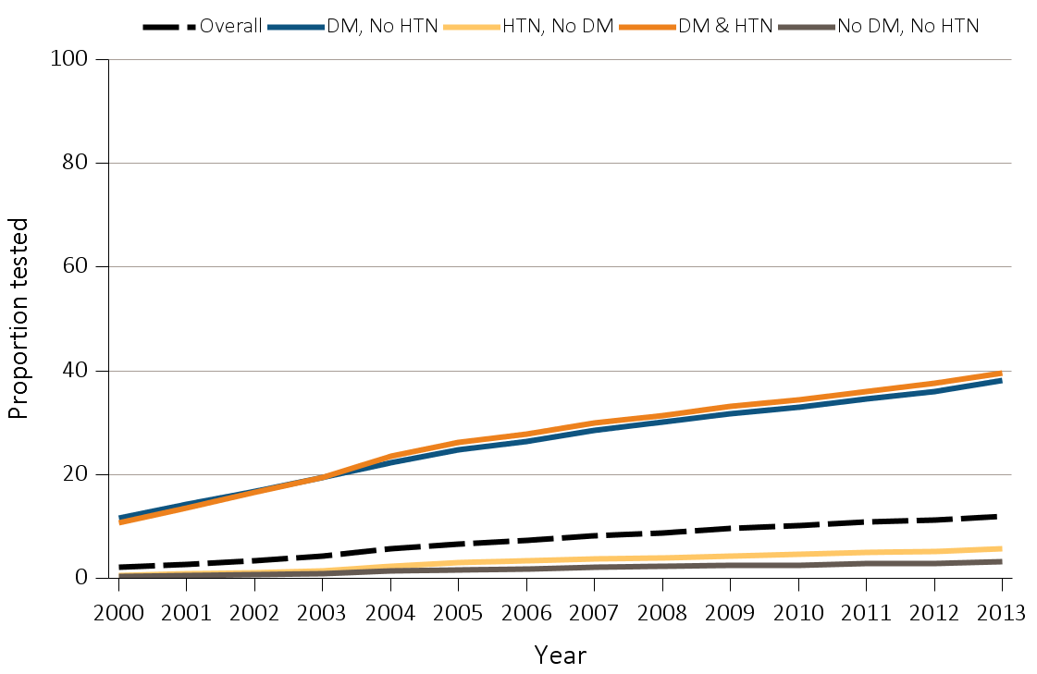
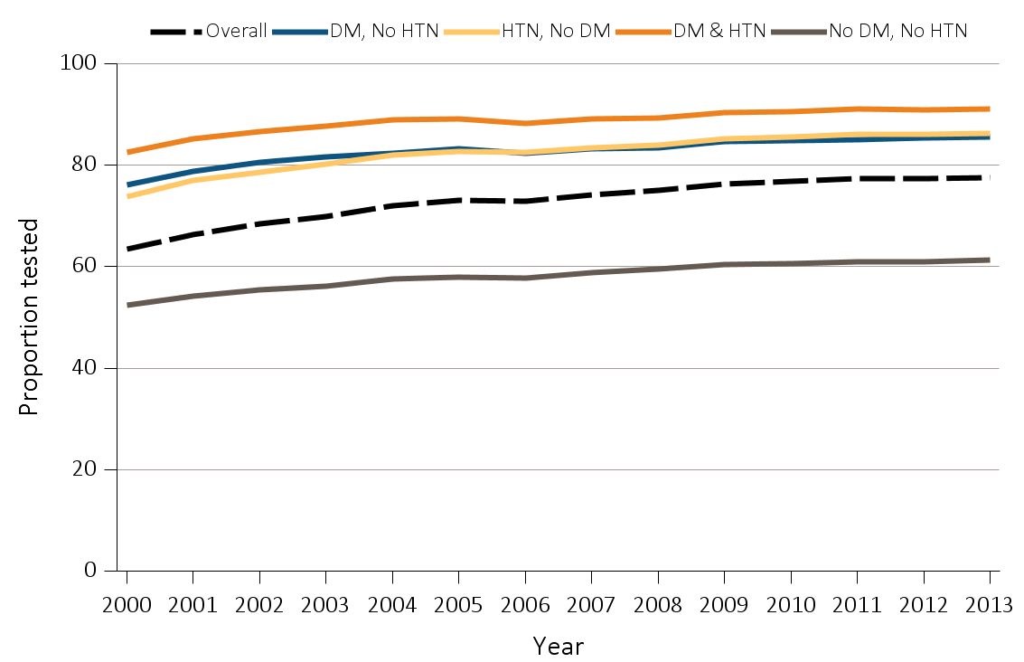
Figure 2.3 Trends in proportion of patients with (a) urine albumin &
(b) serum creatinine testing, by year, among Medicare patients aged 65+ WITHOUT a diagnosis of CKD, 2000-2013
(a) Urine albumin
(b) Serum creatinine
Data Source: Special analyses, Medicare 5 percent sample, aged 65 and older with Part A & B coverage in the prior year. Tests tracked during each year. Abbreviations: CKD, chronic kidney disease; DM, diabetes mellitus; HTN, hypertension.

Slide 11
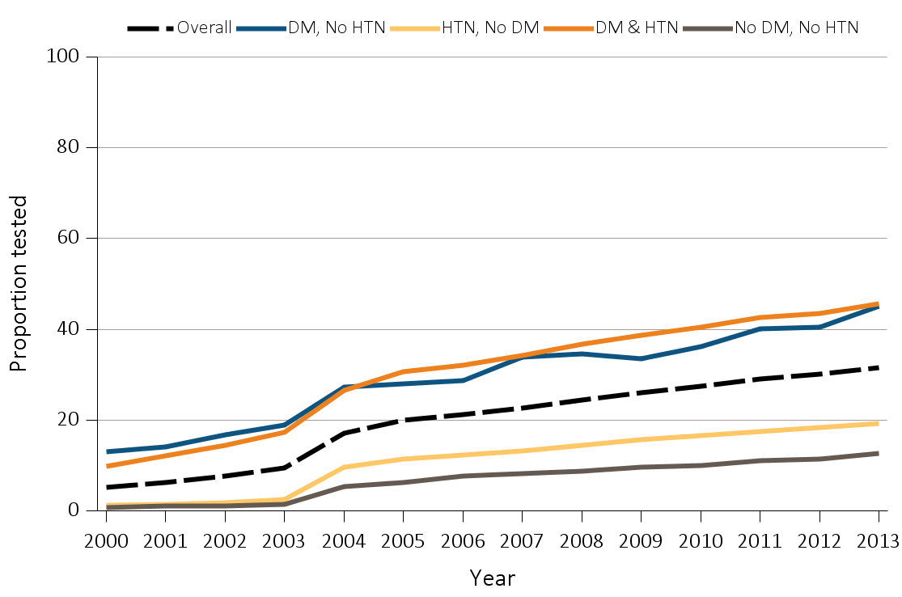
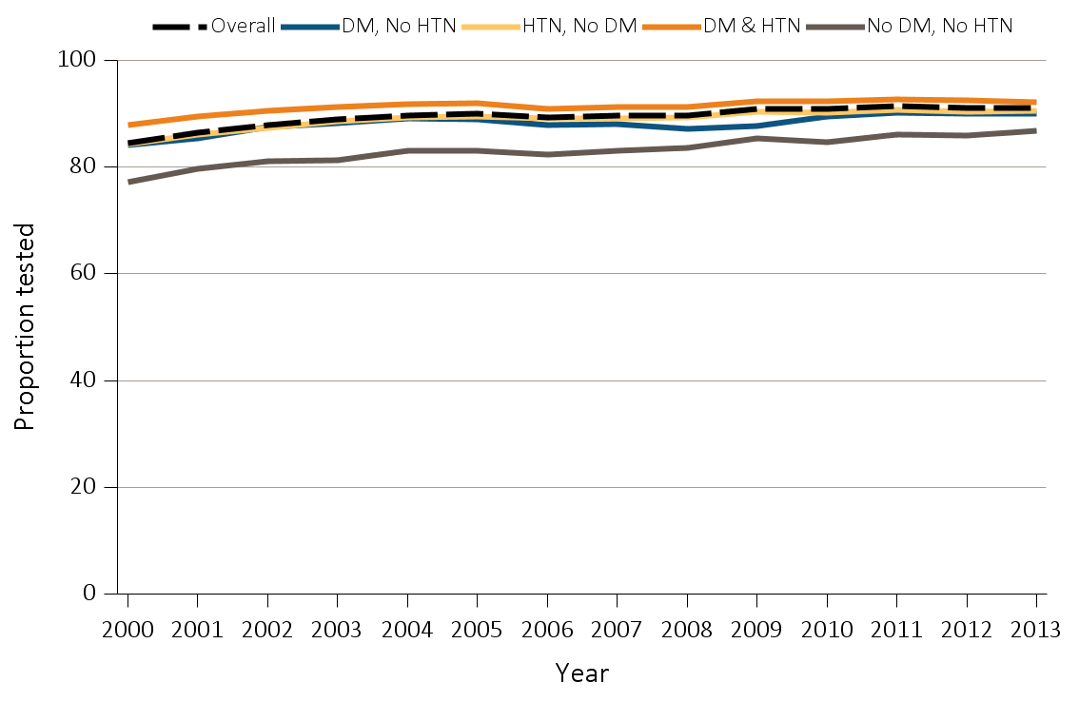
Figure 2.4 Trends in Proportion of patients with (a) urine albumin &
(b) serum creatinine testing, by year, among Medicare patients aged 65+ WITH a diagnosis of CKD, 2000-2013
(a) Urine albumin
(b) Serum creatinine
Data Source: Special analyses, Medicare 5 percent sample, aged 65 and older with Part A & B coverage in the prior year. Tests tracked during each year. Abbreviations: CKD, chronic kidney disease; DM, diabetes mellitus; HTN, hypertension.

Slide 12
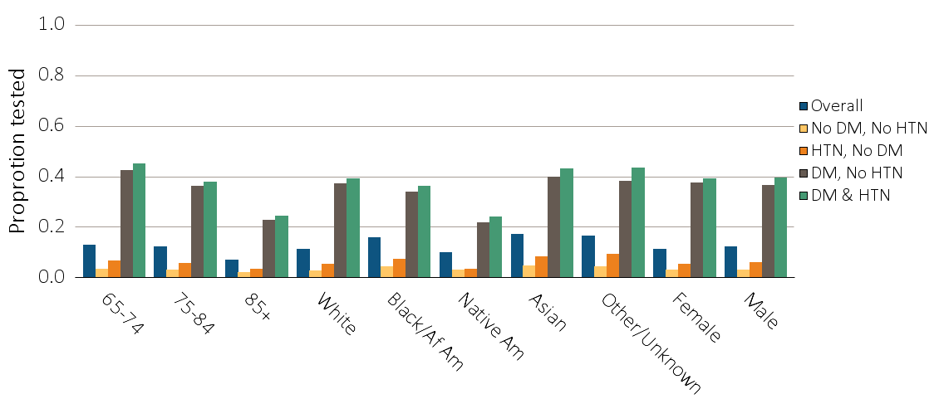
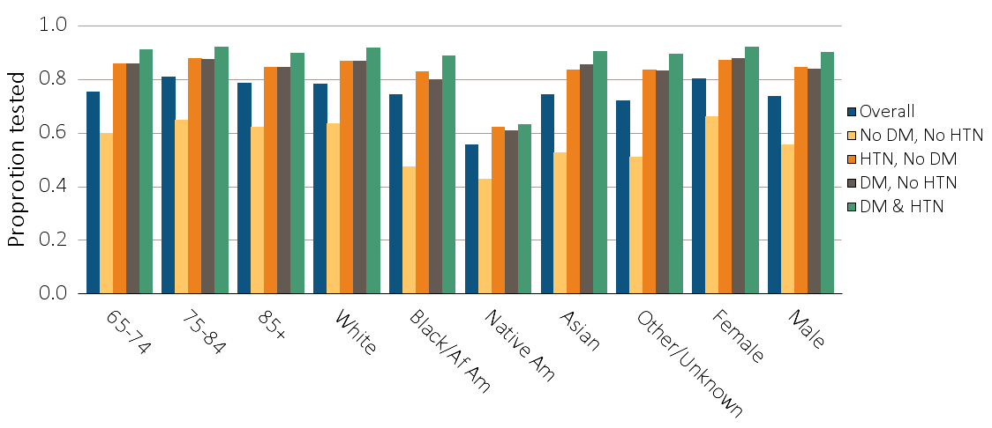
Figure 2.5 Proportion of patients with (a) urine albumin & (b) serum creatinine testing by demographic characteristics, adjusted for age, race and gender, among Medicare patients aged 65+ WITHOUT a diagnosis of CKD, 2013
(a) Urine albumin
(b) Serum creatinine
Data Source: Special analyses, Medicare 5 percent sample. Models are adjusted for age, race, and gender. Abbreviations: CKD, chronic kidney disease; DM, diabetes mellitus; HTN, hypertension. Af Am, African American; Native Am, Native American.

Slide 13
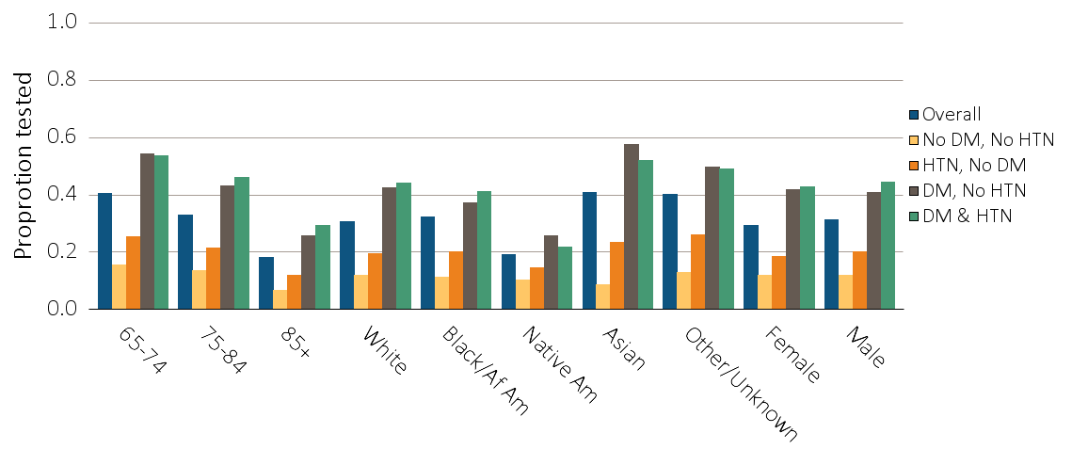
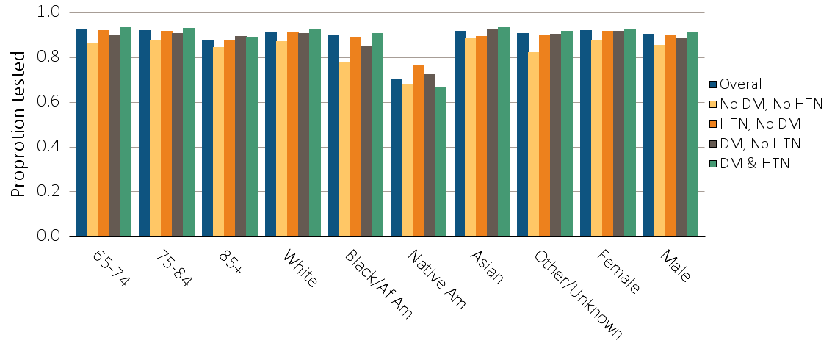
Figure 2.6 Proportion of patients with (a) urine albumin & (b) serum creatinine testing by demographic characteristics, adjusted for age, race and gender, among Medicare patients aged 65+ WITH a diagnosis of CKD, 2013
(a) Urine albumin
(b) Serum creatinine
Data Source: Special analyses, Medicare 5 percent sample. Models are adjusted for age, race, and gender. Abbreviations: CKD, chronic kidney disease; DM, diabetes mellitus; HTN, hypertension. Af Am, African American; Native Am, Native American.

Slide 14
Table 2.6 Percent of patients with a physician visit in 2013 after a CKD diagnosis in 2012, among Medicare patients aged 65+
 | Any CKD diagnosis |  |  | CKD diagnosis code of 585.3 (Stage 3) |  |  | CKD diagnosis code of 585.4 (Stage 4) or higher
 | Primary care | Cardiologist | Nephrologist | Primary care | Cardiologist | Nephrologist | Primary care | Cardiologist | Nephrologist
Age
65-74 | 89.1 | 54.9 | 32.3 | 89.3 | 54.4 | 55.4 | 81.0 | 49.3 | 70.7
75-84 | 92.3 | 63.3 | 31.0 | 92.0 | 62.1 | 48.5 | 84.0 | 55.0 | 69.1
85+ | 93.7 | 64.7 | 24.4 | 93.6 | 63.0 | 36.1 | 87.4 | 54.4 | 57.7
Sex
Male | 91.4 | 60.1 | 29.4 | 91.6 | 59.5 | 48.0 | 83.8 | 53.2 | 66.5
Female | 91.2 | 60.3 | 36.2 | 90.8 | 59.6 | 55.4 | 83.4 | 51.1 | 70.2
Race
White | 90.2 | 54.0 | 29.6 | 89.9 | 53.0 | 46.3 | 84.6 | 48.8 | 68.1
Black/Af Am | 91.8 | 56.9 | 29.5 | 91.7 | 55.8 | 46.9 | 84.6 | 49.6 | 65.6
Other | 90.6 | 62.9 | 31.0 | 91.0 | 62.7 | 50.9 | 82.7 | 56.1 | 69.0
Overall | 91.2 | 59.7 | 30.4 | 91.3 | 59.1 | 48.9 | 83.6 | 52.6 | 67.1
Data Source: Special analyses, Medicare 5 percent sample. Patients alive & eligible for all of 2012. CKD diagnosis is at date of first CKD claim in 2012; claims for physician visits were searched during the 12 months following that date. CKD diagnosis code of 585.4 or higher represents CKD Stages 4-5. Abbreviation: CKD, chronic kidney disease. Af Am, African American.

Slide 15
Table 2.7 Proportion of CKD patients in 2012 with physician visit (nephrologist, PCP, both and neither) in 2012, with lab testing in the following year (2013), by comorbidity
 | PCP Only |  |  |  |  |  | Nephrologist with and without PCP |  |  |  |  |  | Neither
 |  | Urine albumin testing |  | Serum creatinine testing |  |  |  | Urine albumin testing |  | Serum creatinine testing |  |  |  | Urine albumin testing |  | Serum creatinine testing
 | N | n | % | n | % |  | N | n | % | n | % |  | N | n | % | n | %
Overall | 63,914 | -- | 23.4 | -- | 90.3 |  | 32,131 | -- | 50.4 | -- | 94.5 |  | 5,970 | -- | 16.5 | -- | 79.5
No DM, No HTN | 4,008 | 318 | 7.9 | 3,450 | 86.1 |  | 937 | 346 | 36.9 | 858 | 91.6 |  | 667 | 35 | 5.3 | 482 | 72.3
HTN, No DM | 30,449 | 3,143 | 10.3 | 27,180 | 89.3 |  | 14,144 | 5,794 | 41.0 | 13,353 | 94.4 |  | 2,913 | 212 | 7.3 | 2,309 | 79.3
DM, No HTN | 1,647 | 683 | 41.5 | 1,498 | 91.0 |  | 410 | 228 | 55.6 | 383 | 93.4 |  | 190 | 58 | 30.5 | 155 | 81.6
DM & HTN | 27,810 | 10,835 | 39.0 | 25,596 | 92.0 |  | 16,640 | 9,813 | 59.0 | 15,773 | 94.8 |  | 2,200 | 681 | 31.0 | 1,798 | 81.7
Data Source: Special analyses, Medicare 5 percent sample. Patients alive & eligible for all of 2013 with a CKD diagnosis claim in 2012. Abbreviations: CKD, chronic kidney disease; DM, diabetes mellitus; HTN, hypertension; PCP, primary care physician.

