Slide 2
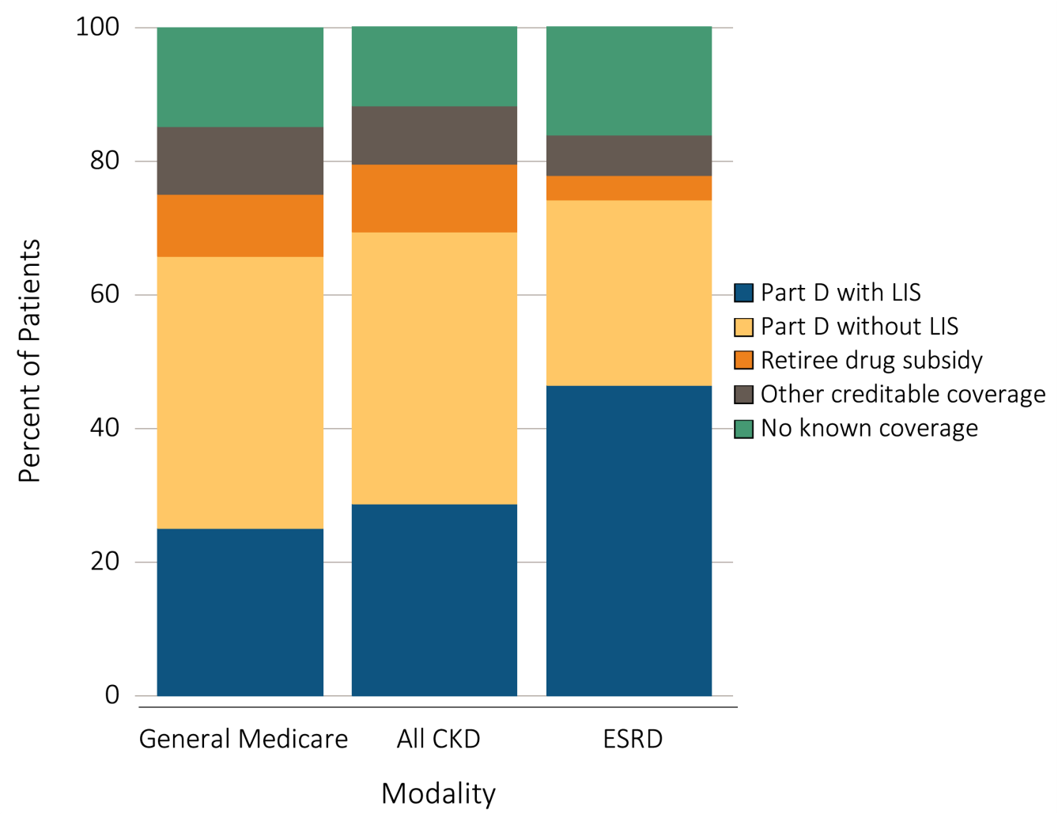
Figure 7.1 Sources of prescription drug coverage in Medicare enrollees,
^{by population, 2013}
Data Source: Data source: Medicare 5% sample. Point prevalent Medicare enrollees alive on January 1, 2013. Abbreviations: CKD, chronic kidney disease; ESRD, end-stage renal disease; LIS, Medicare Low-income Subsidy; Part D, Medicare prescription drug coverage benefit. Data source: Medicare 5% sample. Point prevalent Medicare enrollees alive on January 1, 2013. Abbreviations: CKD, chronic kidney disease; ESRD, end-stage renal disease; LIS, Medicare Low-income Subsidy; Part D, Medicare prescription drug coverage benefit.

Slide 3
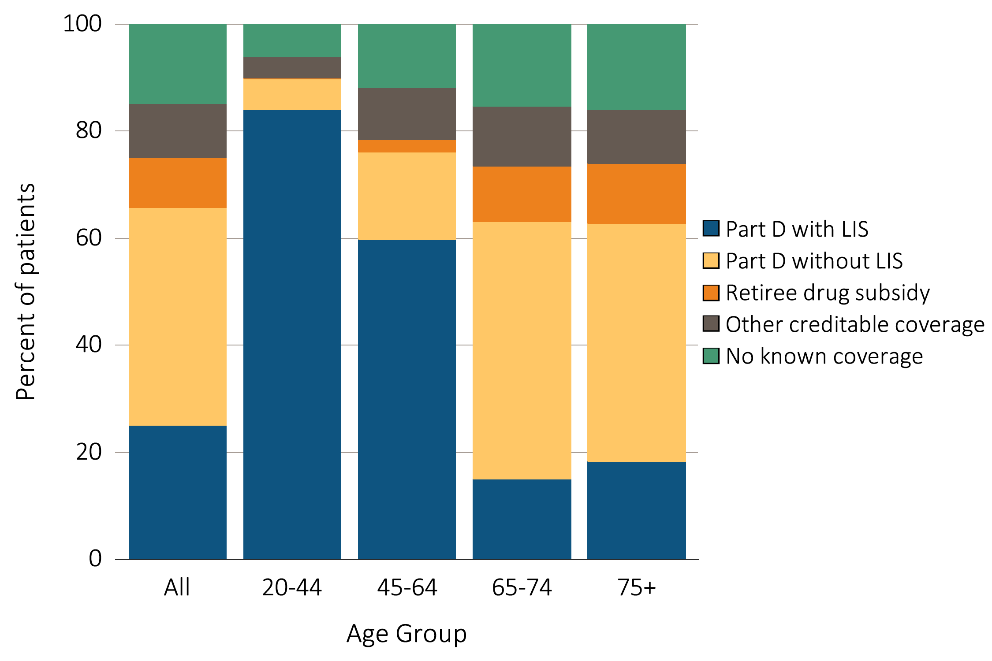
Figure 7.2 Sources of prescription drug coverage in Medicare enrollees, by age, 2013
(a) All general Medicare enrollees
Data Source: Data source: Medicare 5% sample. Point prevalent Medicare enrollees alive on January 1, 2013. Abbreviations: CKD, chronic kidney disease; ESRD, end-stage renal disease; LIS, Medicare low income subsidy; Part D, Medicare prescription drug coverage benefit.

Slide 4
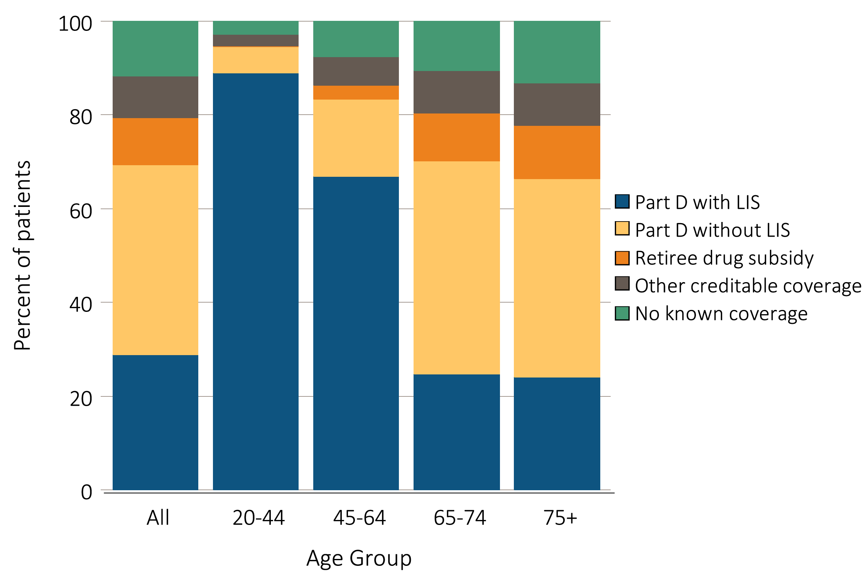
Figure 7.2 Sources of prescription drug coverage in Medicare enrollees, by age, 2013
^{(b) Enrollees with CKD}
Data Source: Data source: Medicare 5% sample. Point prevalent Medicare enrollees alive on January 1, 2013. Abbreviations: CKD, chronic kidney disease; ESRD, end-stage renal disease; LIS, Medicare low income subsidy; Part D, Medicare prescription drug coverage benefit.

Slide 5
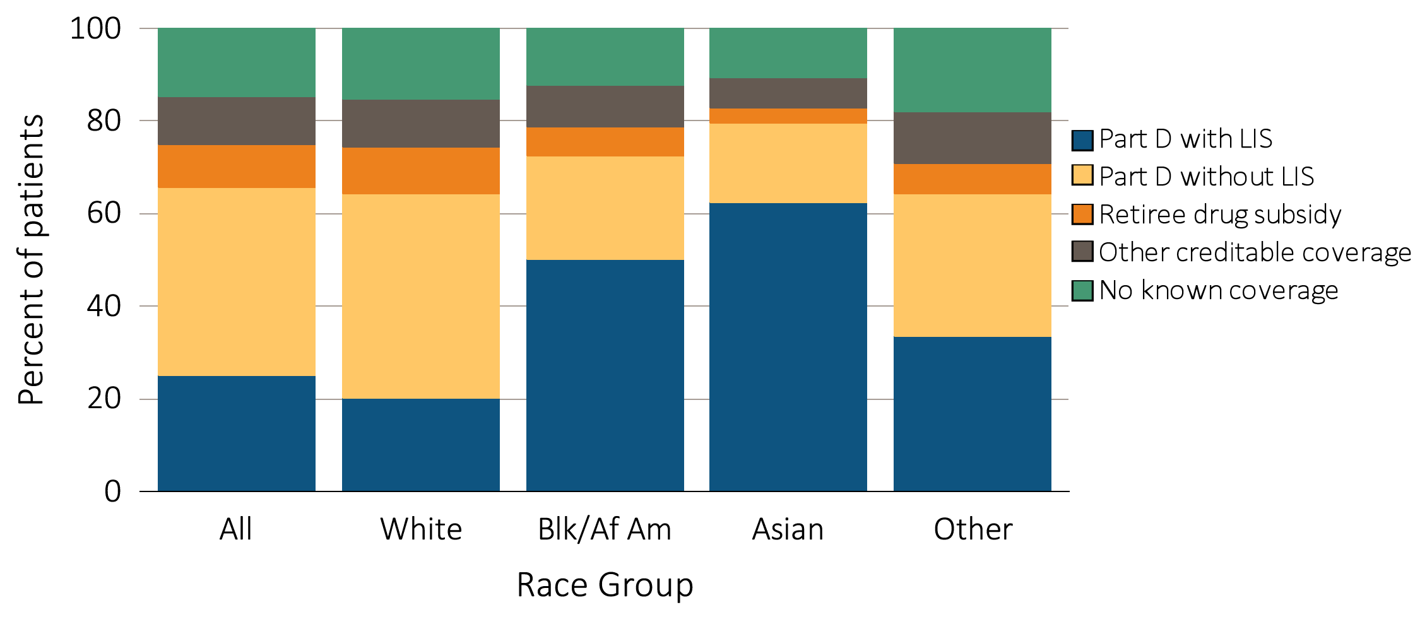
Figure 7.3 Sources of prescription drug coverage in Medicare enrollees, by race, 2013
(a) All general Medicare enrollees
Data Source: Data source: Medicare 5% sample. Point prevalent Medicare enrollees alive on January 1, 2013. Abbreviations: Blk/Af Am, Black/African American; CKD, chronic kidney disease; LIS, Medicare Low-income Subsidy; Part D, Medicare prescription drug coverage benefit.

Slide 6
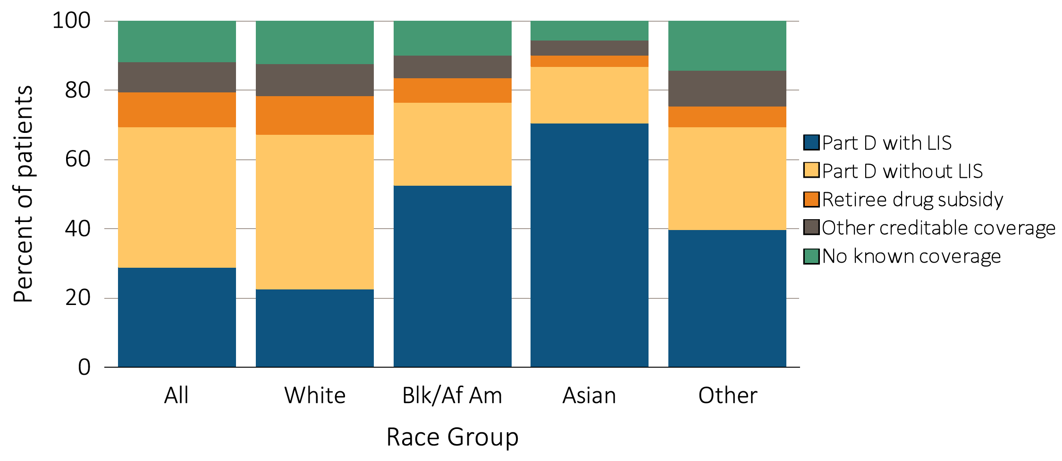
Figure 7.3 Sources of prescription drug coverage in Medicare enrollees, by race, 2013
^{(b) Enrollees with CKD}
Data Source: Data source: Medicare 5% sample. Point prevalent Medicare enrollees alive on January 1, 2013. Abbreviations: Blk/Af Am, Black/African American; CKD, chronic kidney disease; LIS, Medicare Low-income Subsidy; Part D, Medicare prescription drug coverage benefit.

Slide 7
Table 7.1 Medicare Part D enrollees (%) with or without the Low-income Subsidy, by age & race, 2013
 | General Medicare |  | All CKD
 | Part D with Low- income Subsidy | Part D remaining enrollees | Part D with Low- income Subsidy | Part D remaining enrollees
White
All ages | 31.4 | 68.6 | 33.8 | 66.2
20-44 | 93.0 | 7.0 | 93.9 | 6.1
45-64 | 76.1 | 23.9 | 77.8 | 22.2
65-74 | 18.3 | 81.7 | 28.1 | 71.9
75+ | 23.0 | 77.0 | 28.9 | 71.1
Black/African American
All ages | 69.2 | 30.8 | 68.9 | 31.1
20-44 | 95.5 | 4.5 | 94.5 | 5.5
45-64 | 85.9 | 14.1 | 84.7 | 15.3
65-74 | 51.4 | 48.6 | 59.9 | 40.1
75+ | 60.2 | 39.9 | 65.5 | 34.5
Asian
All ages | 78.3 | 21.7 | 81.3 | 18.7
20-44 | 92.3 | 7.7 | 100.0 | 0.0
45-64 | 85.5 | 14.6 | 85.4 | 14.6
65-74 | 71.7 | 28.3 | 77.1 | 22.9
75+ | 80.9 | 19.1 | 82.4 | 17.6
Other race
All ages | 52.1 | 47.9 | 57.3 | 42.7
20-44 | 93.0 | 7.0 | 93.8 | 6.3
45-64 | 78.1 | 21.9 | 81.9 | 18.1
65-74 | 36.8 | 63.2 | 43.9 | 56.1
75+ | 49.9 | 50.1 | 59.0 | 41.0
Data source: Medicare 5% sample. Point prevalent Medicare enrollees alive on January 1, 2013. Abbreviations: CKD, chronic kidney disease; Part D, Medicare prescription drug coverage benefit.

Slide 8
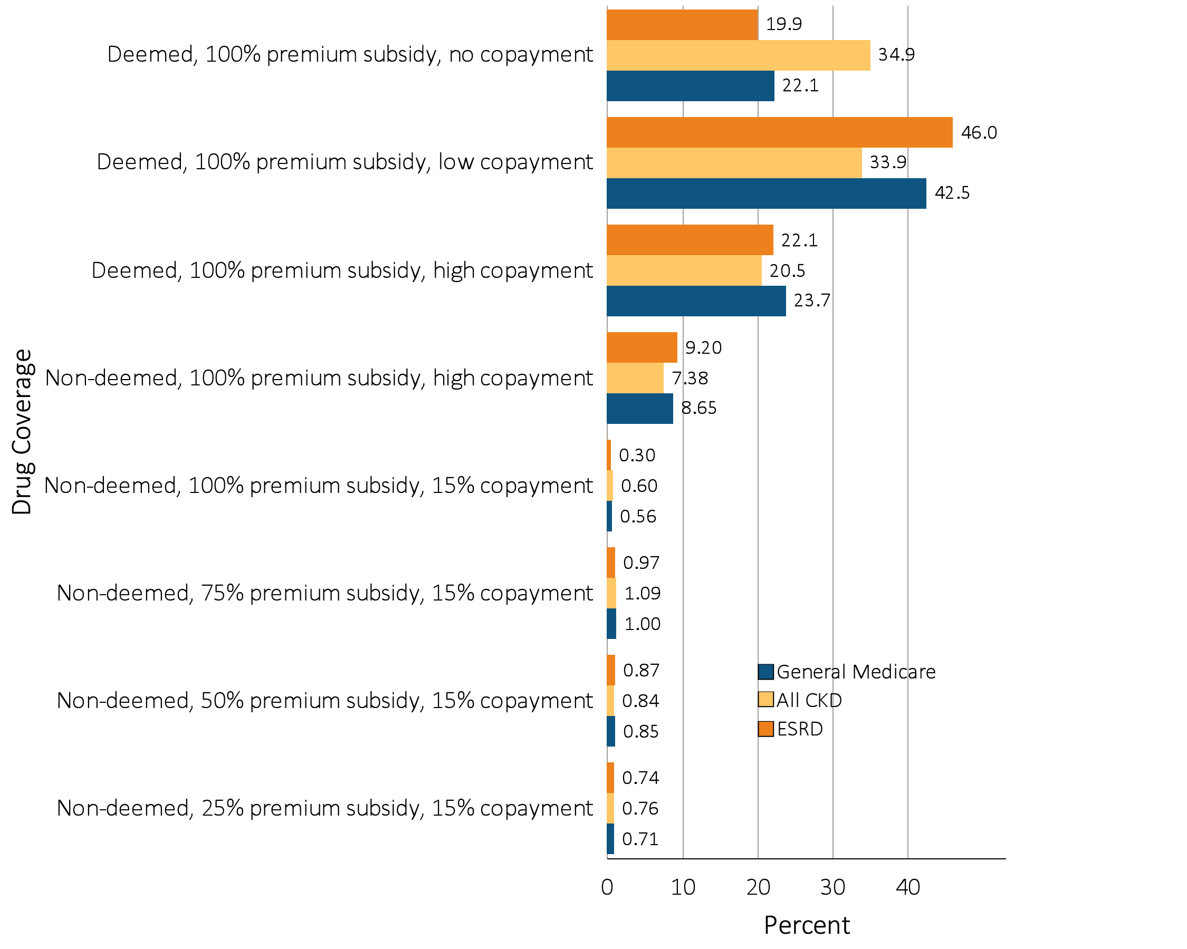
Figure 7.4 Distribution of Low-income Subsidy categories in Part D
general Medicare, CKD, & ESRD patients, 2013
Data source: Medicare 5% sample. Point prevalent Medicare enrollees alive on January 1, 2013. Abbreviations: CKD, chronic kidney disease; ESRD, end-stage renal disease; Part D, Medicare prescription drug coverage benefit.

Slide 9
Table 7.2 Medicare Part D parameters for defined standard benefit, 2008 & 2013
 | 2008 | 2013
Deductible | $275 | $325
After the deductible is met, the beneficiary pays 25% of total prescription costs up to the initial coverage limit.
Initial coverage limit | $2,510 | $2,970
The coverage gap (“donut hole”) begins at this point.
The beneficiary pays 100% of their prescription costs up to the out-of-pocket threshold
Out-of-pocket threshold | $4,050 | $4,750
The total out-of-pocket costs including the “donut hole”
Total covered Part D prescription out-of-pocket spending: | $5,726.25 | $6,733.75
(including the coverage gap). Catastrophic coverage begins after this point.
Catastrophic coverage benefit
Generic/preferred multi-source drug | $2.25 | $2.65¹
Other drugs | $5.60 | $6.60¹
¹plus a 52.50% brand name medication discount
2013Example:
$325 (deductible) | $275 | $325
+(($$2970-$325)*25%)(initial coverage) | $558.75 | $652.50
+(($6733.75-$2970)*100%)(coverage gap) | $3,216.25 | $3,763.75
Total | $4,050.00 | $4,750.00
(maximum out-of-pocket costs prior to catastrophic coverage, excluding plan premium)
The catastrophic coverage amount is the greater of 5% of medication cost or the values shown in the chart above. In 2013, beneficiaries were charged $2.65 for those generic or preferred multisource drugs with a retail price less than $53, and 5% for those with a retail price over $53. For brand name drugs, beneficiaries paid $6.60 for those drugs with a retail price less than $132, and 5% for those with a retail price over $132. Table adapted from http://www.q1medicare.com/PartD-The-2013-Medicare-Part-D-Outlook.php.

Slide 10
Table 7.3 General Medicare, CKD, & ESRD patients enrolled in Part D (%)
 | General Medicare | All CKD | All ESRD
2011 | 55.8 | 59.4 | 68.9
2012 | 57.6 | 60.5 | 71.9
2013 | 65.7 | 69.4 | 74.2
Data source: Medicare 5% sample. Point prevalent Medicare enrollees alive on January 1. Abbreviations: CKD, chronic kidney disease; ESRD, end-stage renal disease; Part D, Medicare prescription drug coverage benefit.

Slide 11
Table 7.4 Total estimated Medicare Part D costs for enrollees, 2011 & 2013
 | General Medicare | All CKD | All ESRD
2011 | 41.39 | 5.38 | 1.80
2013 | 47.45 | 7.11 | 2.30
Data source: Medicare Part D claims. Medicare totals include Part D claims for Part D enrollees with traditional Medicare (Parts A & B). CKD totals include Medicare CKD patients, as determined from claims. ESRD totals include all Part D claims for Medicare ESRD patients with Medicare Part D stand-alone prescription drug plans. Abbreviations: CKD, chronic kidney disease; ESRD, end-stage renal disease; Part D, Medicare prescription drug coverage benefit.

Slide 12
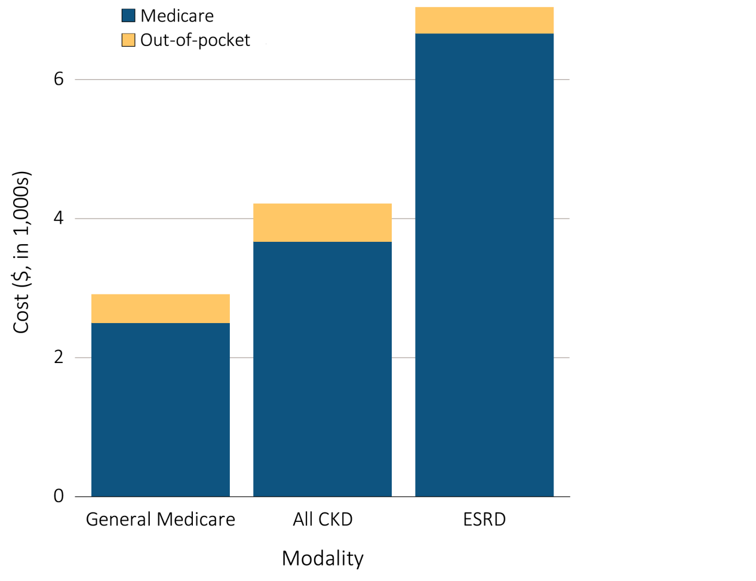
Figure 7.5 Per person per year Medicare & out-of-pocket Part D costs for enrollees, 2013
^{(a) All Part D enrollees}
Data source: Medicare Part D claims. Medicare totals include Part D claims for Part D enrollees with traditional Medicare (Parts A & B). CKD totals include Medicare CKD patients as determined from claims. ESRD totals include all Part D claims for Medicare ESRD patients with Medicare Part D stand-alone prescription drug plans. Costs are per person per year for calendar year 2013. Medicare total is the sum of Medicare net payment plus Low-income Supplement amount. Abbreviations: CKD, chronic kidney disease; ESRD, end-stage renal disease; Part D, Medicare prescription drug coverage benefit.

Slide 13
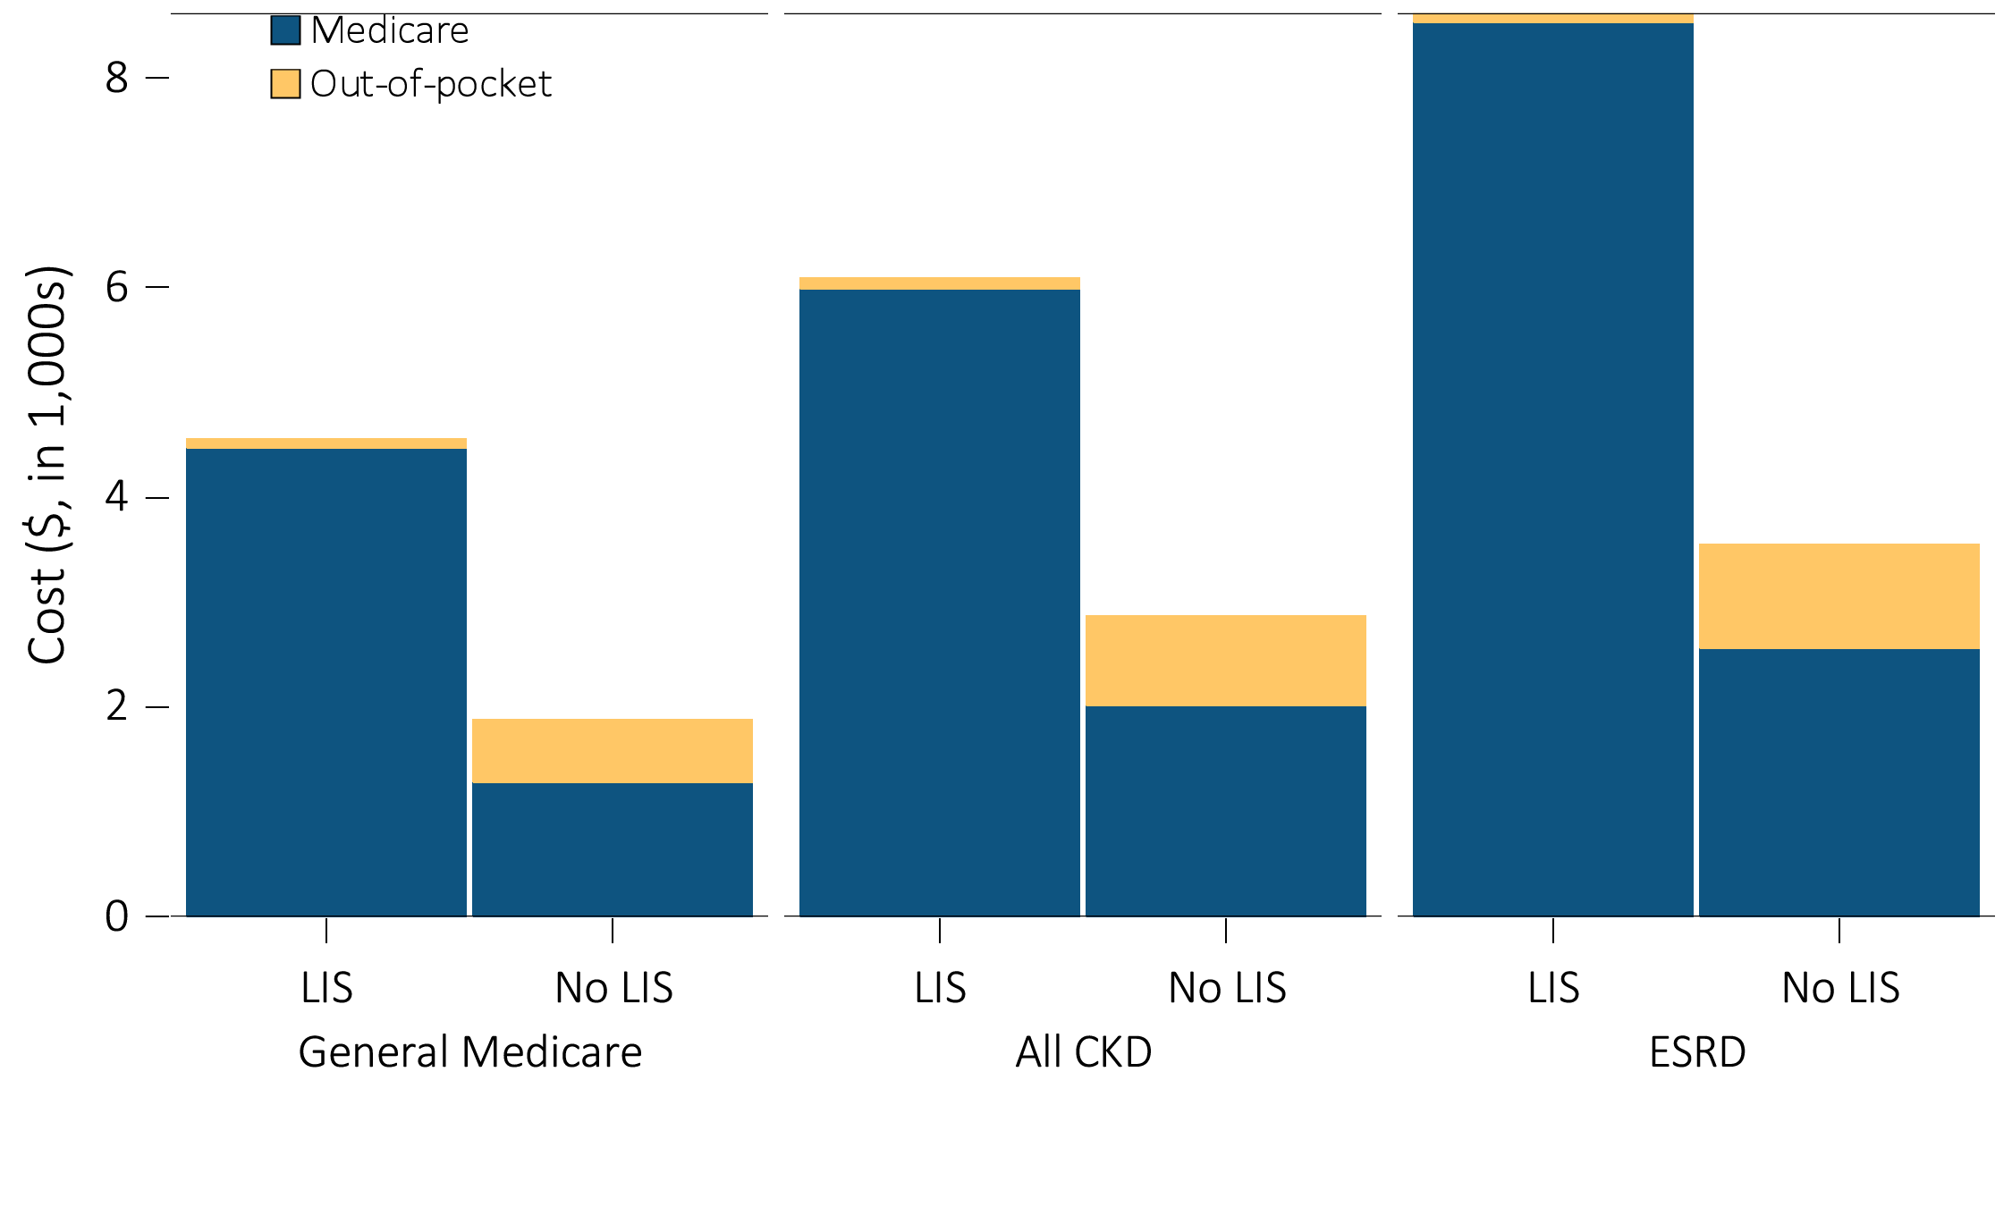
Figure 7.5 Per person per year Medicare & out-of-pocket Part D costs for enrollees, 2013
(b) Part D enrollees by Low-income Subsidy status
Data source: Medicare Part D claims. Medicare totals include Part D claims for Part D enrollees with traditional Medicare (Parts A & B). CKD totals include Medicare CKD patients as determined from claims. ESRD totals include all Part D claims for Medicare ESRD patients with Medicare Part D stand-alone prescription drug plans. Costs are per person per year for calendar year 2013. Medicare total is the sum of Medicare net payment plus Low-income Supplement amount. Abbreviations: CKD, chronic kidney disease; ESRD, end-stage renal disease; Part D, Medicare prescription drug coverage benefit.

Slide 14
Table 7.5 Per person per year Part D costs ($) for enrollees,
by Low-income Subsidy status, 2013
 | General Medicare |  | All CKD |  | All ESRD
 | Part D with Low-income Subsidy | Part D remaining enrollees | Part D with Low-income Subsidy | Part D remaining enrollees | Part D with Low-income Subsidy | Part D remaining enrollees
Age
All | 4,476 | 1,282 | 5,985 | 2,018 | 8,522 | 2,552
20-44 | 4,592 | 1,653 | 8,603 | 2,754 | 9,251 | 2,177
45-64 | 5,921 | 2,395 | 8,786 | 3,800 | 9,315 | 2,851
65-74 | 3,925 | 1,237 | 6,317 | 2,361 | 7,499 | 2,785
75+ | 3,424 | 1,204 | 4,479 | 1,733 | 5,889 | 2,049
Sex
Male | 4,380 | 1,339 | 6,215 | 2,149 | 8,554 | 2,548
Female | 4,539 | 1,241 | 5,845 | 1,891 | 8,488 | 2,558
Race
White | 4,682 | 1,282 | 6,120 | 1,996 | 8,175 | 2,556
Black | 4,021 | 1,338 | 5,541 | 2,230 | 9,039 | 2,539
Asian | 4,229 | 1,133 | 6,418 | 2,038 | 8,816 | 2,663
Other race | 4,001 | 1,270 | 5,918 | 2,163 | 6,162 | 2,065
Data source: Medicare Part D claims. All Medicare patients with Medicare Part D stand-alone prescription drug plans. CKD determined from claims. ESRD patients with Medicare Part D stand-alone prescription drug plans. Costs are per person per year for calendar year 2013. Medicare PPPY is the sum of Medicare net payment and the Low-income Supplement amount. LIS status is determined from the Part D enrollment. A person is classified as LIS if they are eligible for the LIS for at least one month during 2013. Abbreviations: CKD, chronic kidney disease; ESRD, end-stage renal disease; Part D, Medicare prescription drug coverage benefit.

Slide 15
Table 7.6 Common drug classes used by Part D-enrolled CKD patients,
by percent of patients, drug class, and net cost, 2013
 | Percent of patients (%) | Net costs ($)
Statins | 60.1% | 230,603,390
Calcium channel blockers | 34.6% | 72,740,048
Beta blockers | 57.8% | 109,500,131
Angiotensin II receptor blockers | 59.3% | 235,885,110
Data source: Medicare Part D claims. CKD patients with Medicare Part D stand-alone prescription drug plans in the Medicare 5% sample. Net Part D spending represents the sum of the Medicare covered amount and the Low- income Subsidy amount.

