Slide 2
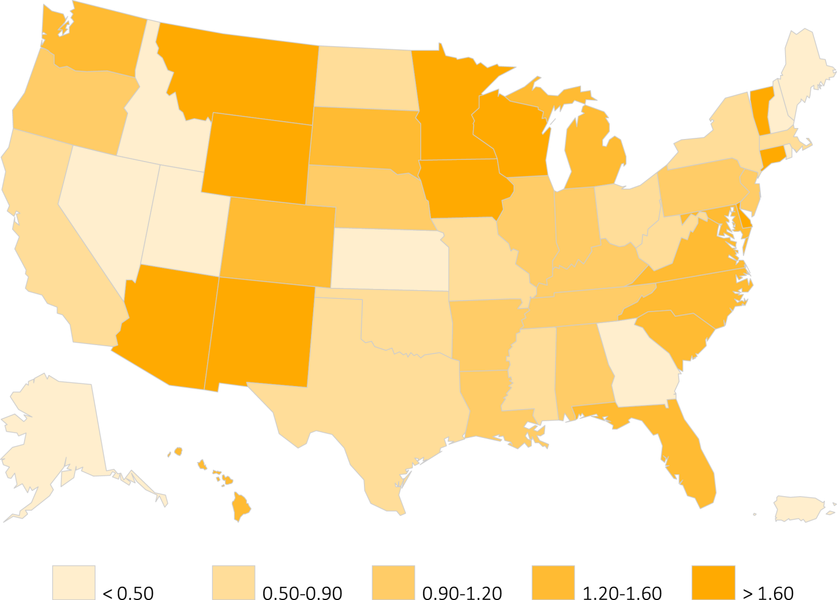
Figure 8.1 Distribution of preemptive kidney transplant rates among 52,172 incident
ESRD veterans across the states and territories of the United States, 10/1/2007-9/30/2011
Data source: VHA Administrative data, USRDS ESRD Database. States and territories of the United States of America. Abbreviations: ESRD, end-stage renal disease.

Slide 3
Table 8.1 Rates and ratios of incident ESRD among veterans and in U.S. adults,
^{10/1/2007-9/30/2011}
 | 55-64 years |  |  |  | 65-74 years |  |  | 75 years or older
 |  | 2008 | 2009 | 2010 | 2008 | 2009 | 2010 | 2008 | 2009 | 2010
Incident ESRD veterans |  | 3180 | 3292 | 3115 | 3054 | 3187 | 3080 | 5924 | 5787 | 5740
All veterans |  | 5718302 | 5441739 | 5340529 | 4148572 | 4152331 | 4294221 | 4911012 | 4851671 | 4839173
ESRD rate in veterans, per million |  | 556 | 605 | 583 | 736 | 768 | 717 | 1206 | 1193 | 1186
ESRD rate in the U.S., per million |  | 773 | 778 | 752 | 1297 | 1311 | 276 | 545 | 1559 | 1582
ESRD rate ratio (Vet: U.S.)ª |  | 0.72 | 0.78 | 0.78 | 0.57 | 0.59 | 0.56 | 0.78 | 0.76 | 0.75
Data source: VHA Administrative data, USRDS ESRD Database, CMS Medicare Inpatient and Outpatient data, U.S. Census Bureau; data derived from U.S. veteran incident dialysis patients. ª Veterans to U.S. rate ratios. Abbreviations: ESRD, end-stage renal disease; PM; per million; Vet, veterans.

Slide 4
Table 8.2 Status of 52,172 incident ESRD veterans on Day 1 and Day 90
after transition to ESRD, 10/1/2007-9/30/2011
 | Day 1 |  | Day 90
 | n | % | n | %
Dialysis Modality
In-center | 43,256 | 82.9 | 40,918 | 78.4
Home HD | 260 | 0.5 | 258 | 0.5
CAPD | 1,405 | 2.7 | 1,302 | 2.5
CCPD | 1,174 | 2.2 | 1.395 | 2.7
Uncertainª | 5287 | 10.1 | 447 | 0.9
Outcomes^{b}
Death | 201 | 0.4 | 5,348 | 10.3
Transplant | 589 | 1.1 | 701 | 1.3
Lost to follow-up |  |  | 5 | <0.1
Recovered |  |  | 1,798 | 3.5
Total | 52,172 | 100 | 52,172 | 100
Data source: USRDS ESRD Database. Table adapted from the 2014 USRDS Annual Data Report. ª Uncertain groups have no know dialysis modality, ^{b} n for outcomes is cumulative for subsequent periods after Day 1. Abbreviations: CAPD, continuous ambulatory peritoneal dialysis; CCPD, continuous cycling peritoneal dialysis; ESRD, end-stage renal disease; HD hemodialysis.

Slide 5
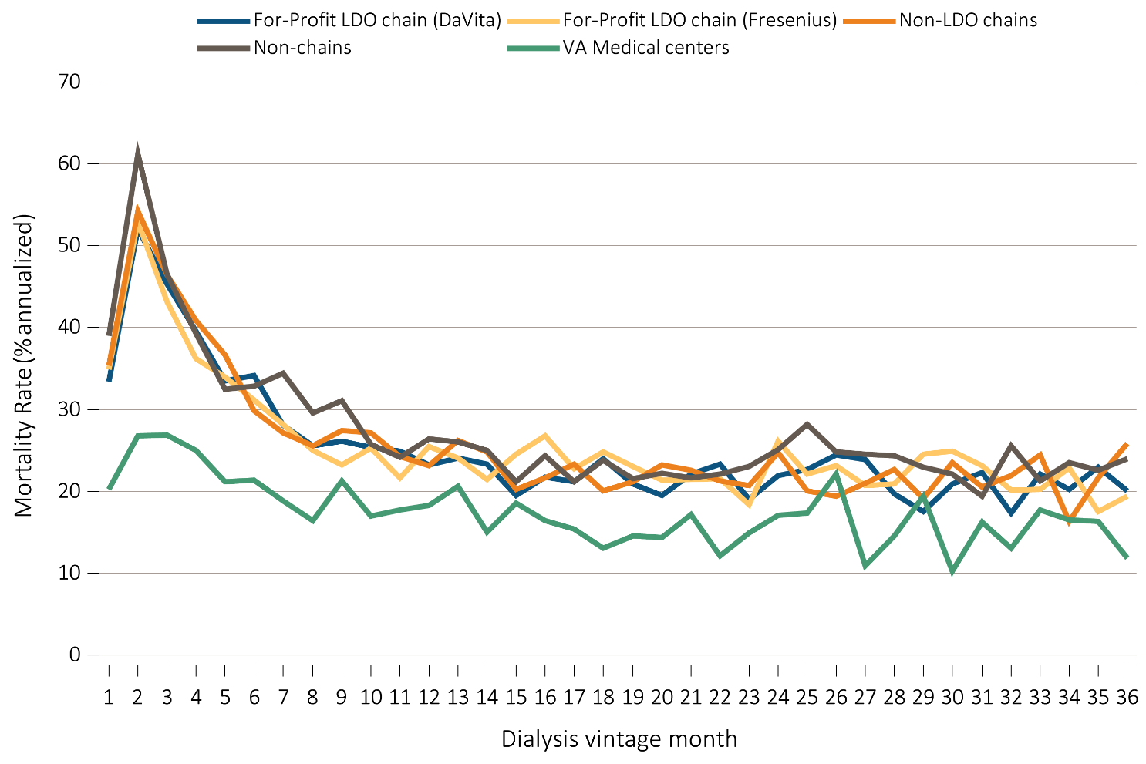
Figure 8.2 Annualized monthly unadjusted mortality of incident ESRD veterans who transitioned to ESRD during 10/1/2007-9/30/2011 and who were followed for
up to 36 months, by dialysis provider
Data source: VHA Administrative data, USRDS ESRD Database, CMS Medicare Inpatient and Outpatient data. Abbreviation: DaVita, DaVita Kidney Care; ESRD, end-stage renal disease; LDO, large dialysis organization; VA, Veterans' Affairs.

Slide 6
Table 8.3 Annualized month-by-month unadjusted mortality in 52,172 incident
ESRD veterans during the first 24 months after transition to ESRD by dialysis provider, 10/1/2007-9/30/2011
 | DVT |  |  | FMC |  |  | Other Chains |  |  | Non-Chain |  |  | VHA
Month | Died | Alive | Rate % | Died | Alive | Rate % | Died | Alive | Rate % | Died | Alive | Rate % | Died | Alive | Rate %
1 | 355 | 12763 | 33.38 | 418 | 14376 | 34.89 | 202 | 6847 | 35.4 | 358 | 11005 | 39.04 | 86 | 5100 | 20.24
2 | 538 | 12408 | 52.03 | 615 | 13958 | 52.87 | 300 | 6645 | 54.18 | 543 | 10647 | 61.2 | 112 | 5014 | 26.8
3 | 449 | 11870 | 45.39 | 480 | 13343 | 43.17 | 246 | 6345 | 46.52 | 392 | 10104 | 46.56 | 110 | 4902 | 26.93
4 | 377 | 11421 | 39.61 | 388 | 12863 | 36.2 | 208 | 6099 | 40.92 | 318 | 9712 | 39.29 | 100 | 4792 | 25.04
5 | 308 | 11044 | 33.47 | 353 | 12475 | 33.96 | 180 | 5891 | 36.67 | 254 | 9394 | 32.45 | 83 | 4692 | 21.23
6 | 306 | 10736 | 34.2 | 315 | 12122 | 31.18 | 142 | 5711 | 29.84 | 250 | 9140 | 32.82 | 82 | 4609 | 21.35
7 | 244 | 10430 | 28.07 | 277 | 11807 | 28.15 | 126 | 5569 | 27.15 | 255 | 8890 | 34.42 | 71 | 4527 | 18.82
8 | 217 | 10186 | 25.56 | 240 | 11530 | 24.98 | 116 | 5443 | 25.57 | 213 | 8635 | 29.6 | 61 | 4456 | 16.43
9 | 217 | 9969 | 26.12 | 219 | 11290 | 23.28 | 122 | 5327 | 27.48 | 218 | 8422 | 31.06 | 78 | 4395 | 21.3
10 | 206 | 9752 | 25.35 | 233 | 11071 | 25.26 | 118 | 5205 | 27.2 | 176 | 8204 | 25.74 | 61 | 4317 | 16.96
11 | 198 | 9546 | 24.89 | 196 | 10838 | 21.7 | 103 | 5087 | 24.3 | 162 | 8028 | 24.22 | 63 | 4256 | 17.76
12 | 181 | 9348 | 23.23 | 226 | 10642 | 25.48 | 96 | 4984 | 23.11 | 173 | 7866 | 26.39 | 64 | 4193 | 18.32
13 | 184 | 9167 | 24.09 | 209 | 10416 | 24.08 | 107 | 4888 | 26.27 | 167 | 7693 | 26.05 | 71 | 4129 | 20.63
14 | 175 | 8983 | 23.38 | 183 | 10207 | 21.51 | 99 | 4781 | 24.85 | 157 | 7526 | 25.03 | 51 | 4058 | 15.08
15 | 143 | 8808 | 19.48 | 205 | 10024 | 24.54 | 79 | 4682 | 20.25 | 130 | 7369 | 21.17 | 62 | 4007 | 18.57
^{(Continued on next slide)}

Slide 7
Table 8.3 Annualized month-by-month unadjusted mortality in 52,172 incident
ESRD veterans during the first 24 months after transition to ESRD by dialysis provider, 10/1/2007-9/30/2011 (Continued)
 | DVT |  |  | FMC |  |  | Other Chains |  |  | Non-Chain |  |  | VHA
Month | Died | Alive | Rate % | Died | Alive | Rate % | Died | Alive | Rate % | Died | Alive | Rate % | Died | Alive | Rate %
16 | 157 | 8665 | 21.74 | 219 | 9819 | 26.76 | 83 | 4603 | 21.64 | 147 | 7239 | 24.37 | 54 | 3945 | 16.43
17 | 150 | 8508 | 21.16 | 182 | 9600 | 22.75 | 88 | 4520 | 23.36 | 125 | 7092 | 21.15 | 50 | 3891 | 15.42
18 | 167 | 8358 | 23.98 | 195 | 9418 | 24.85 | 74 | 4432 | 20.04 | 138 | 6967 | 23.77 | 42 | 3841 | 13.12
19 | 143 | 8191 | 20.95 | 177 | 9223 | 23.03 | 77 | 4358 | 21.2 | 123 | 6829 | 21.61 | 46 | 3799 | 14.53
20 | 131 | 8048 | 19.53 | 161 | 9046 | 21.36 | 83 | 4281 | 23.27 | 124 | 6706 | 22.19 | 45 | 3753 | 14.39
21 | 146 | 7917 | 22.13 | 159 | 8885 | 21.47 | 79 | 4198 | 22.58 | 119 | 6582 | 21.7 | 53 | 3708 | 17.15
22 | 151 | 7771 | 23.32 | 157 | 8726 | 21.59 | 73 | 4119 | 21.27 | 119 | 6463 | 22.1 | 37 | 3655 | 12.15
23 | 121 | 7620 | 19.06 | 131 | 8569 | 18.35 | 70 | 4046 | 20.76 | 122 | 6344 | 23.08 | 45 | 3618 | 14.93
24 | 137 | 7499 | 21.92 | 184 | 8438 | 26.17 | 82 | 3976 | 24.75 | 130 | 6222 | 25.07 | 51 | 3573 | 17.13
Data source: VHA Administrative data, USRDS ESRD Database, CMS Medicare Inpatient and Outpatient data. Provider is based on the patient's provider on Day 1. Rates represent the 12-month annualized rate. Abbreviations: DVT, DaVita Kidney Care; ESRD, end-stage renal disease; FMC, Fresenius Medical Care; VHA, Veterans' Health Administration.

Slide 8
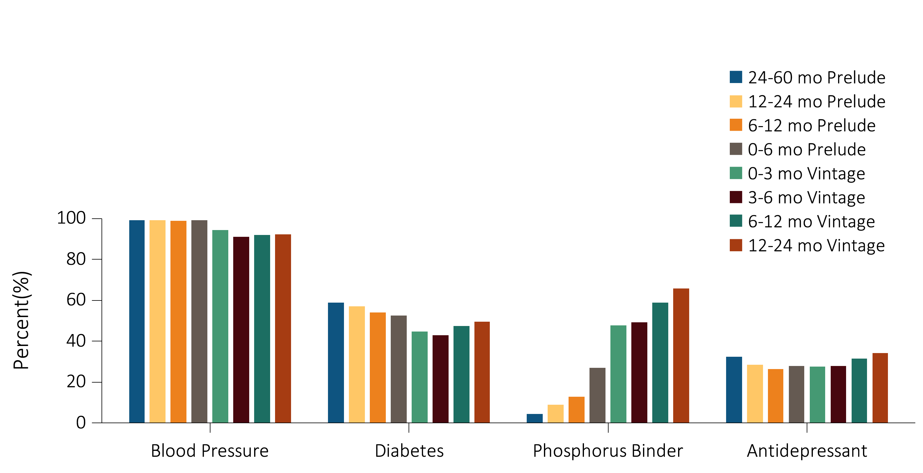
Figure 8.3 Medications prescribed to 52,172 incident ESRD veterans who
transitioned to ESRD from 10/1/2007-9/30/2011
Data source: VHA Administrative data, CMS Medicare Inpatient and Outpatient data. An individual's data includes the period from 60 months prior to transition (prelude) to 24 months following transition (vintage). Abbreviations: ESRD, end-stage renal disease; mo, month.

Slide 9
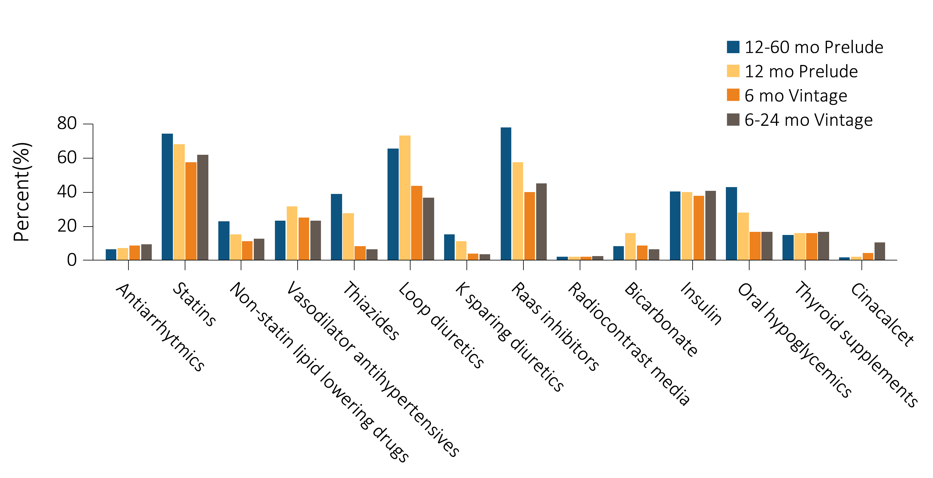
Figure 8.4 Detail of the medications prescribed to 52,172 incident ESRD veterans who transitioned to ESRD during 10/1/2007-9/30/2011
Data source: VHA Administrative data, USRDS ESRD Database, CMS Medicare Inpatient and Outpatient data. An individual's data includes the period from 60 months prior to transition (prelude) to 24 months following transition (vintage). Abbreviations: ESRD, end-stage renal disease; K, potassium; mo, month.

Slide 10
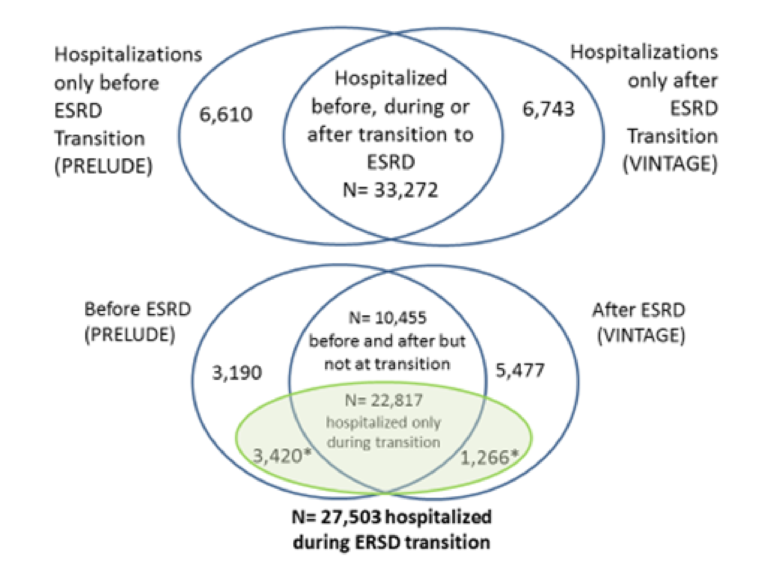
Figure 8.5 Hospitalization events in 46,625 incident ESRD veterans who
transitioned to ESRD during 10/1/2007-9/30/2011
Data source: VHA Administrative data, USRDS ESRD Database, CMS Medicare Inpatient and Outpatient data. An individual's data includes the period from 60 months prior to transition (prelude) to 24 months following transition (vintage). Upper Venn diagram: three major hospitalization categories; Lower Venn diagram: focus of hospital events during transition to ESRD. Abbreviations: ESRD, end-stage renal disease.

Slide 11
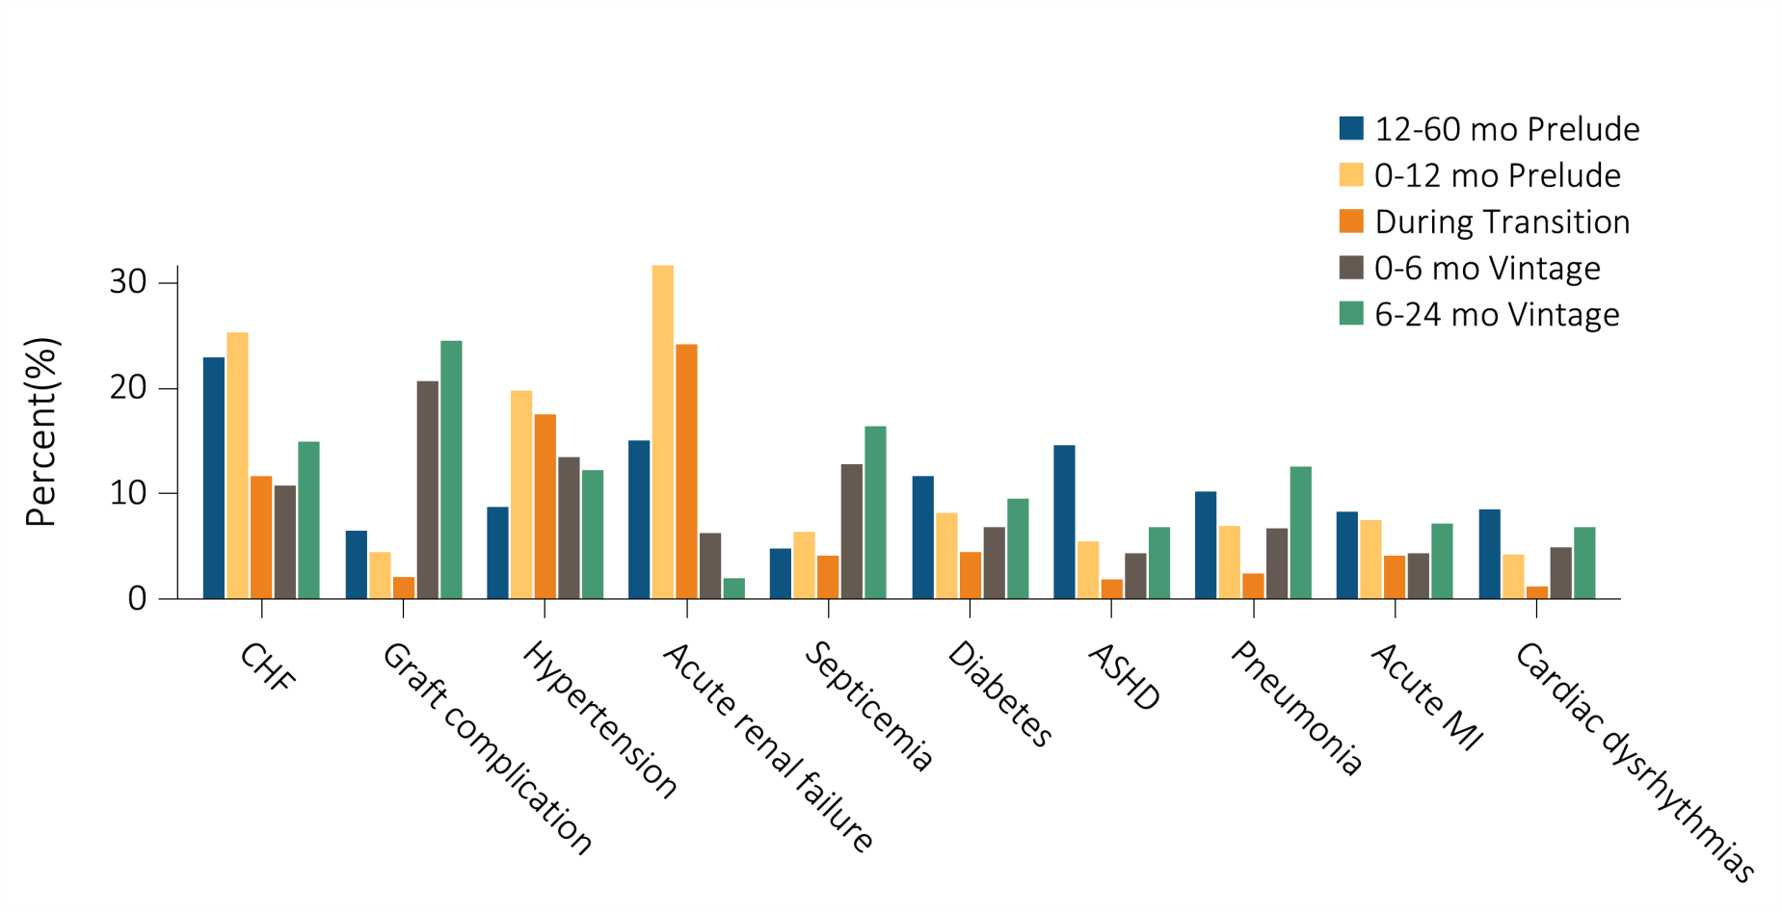
Figure 8.6 The top 20 causes of hospitalizations in 46,625 incident ESRD veterans who were hospitalized at least once during the period between 60 months prior to ESRD transition (prelude) and 24 months following ESRD transition (vintage)
(a) 10 of the top 20 causes of hospitalizations

Slide 12
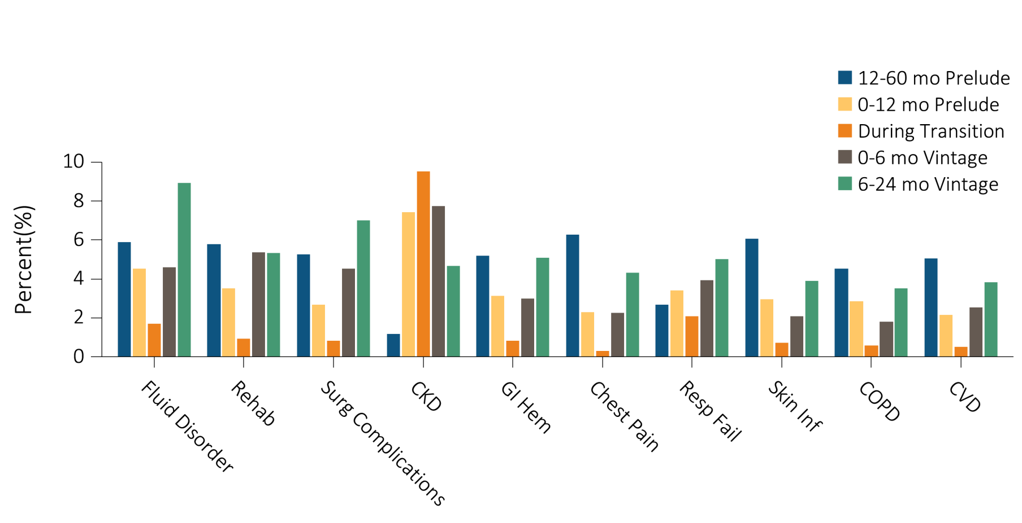
Figure 8.6 The top 20 causes of hospitalizations in 46,625 incident ESRD veterans who were hospitalized at least once during the period between 60 months prior to ESRD transition (prelude) and 24 months following ESRD transition (vintage)
(b) 10 of the top 20 causes of hospitalizations
Data source: VHA Administrative data, USRDS ESRD Database, CMS Medicare Inpatient and Outpatient data. Abbreviations: ASHD, astherosclerotic heart disease; CHF, congestive heart failure; CKD, chronic kidney disease; COPD, chronic obstructive pulmonary disease; CVD, acute cerebrovascular disease; GI Hem, gastrointestinal hemorrhage; MI, myocardial infarction; mo, month; Resp Fail, respiratory failure; Skin Inf, skin infection; surg, surgical.

Slide 13
Table 8.4 Ranking of the top 20 causes of hospitalization in 46,625 incident ESRD veterans who were hospitalized at least once during the period between 60 months prior to
ESRD transition (prelude) and 24 months following ESRD transition (vintage)
Hospitalization Event | Overall (7 year cohort) | -60 to -12 months of prelude | Last 12 months of prelude | During ESRD transition | First 6 months of vintage | +6 to +24 months of vintage
Congestive heart failure | 1 | 1 | 1 | 3 | 4 | 2
Dialysis access (graft) complication | 2 | 9 | 10 | 10 | 1 | 1
Hypertension | 3 | 7 | 3 | 2 | 3 | 4
Acute renal failure | 4 | 3 | 2 | 1 | 8
Septicemia | 5 | 18 | 8 | 7 | 2 | 3
Diabetes | 6 | 4 | 4 | 5 | 6 | 6
Atherosclerotic heart disease | 7 | 2 | 9 | 12 | 15 | 10
Pneumonia | 8 | 5 | 7 | 8 | 7 | 5
Acute myocardial infarction | 9 | 6 | 5 | 6 | 13 | 8
Cardiac dysrhythmias | 10 | 8 | 12 | 13 | 10 | 11
Fluid disorder/fluid overload | 11 | 13 | 11 | 11 | 12 | 7
Rehabilitation | 12 | 12 | 15 | 14 | 9 | 12
Surgical complications | 13 | 14 | 19 | 15 | 11 | 9
Chronic kidney disease | 14 |  | 6 | 4 | 5 | 15
^{(Continued on next slide)}

Slide 14
Table 8.4 Ranking of the top 20 causes of hospitalization in 46,625 incident ESRD veterans who were hospitalized at least once during the period between 60 months prior to ESRD transition (prelude) and 24 months following ESRD transition (vintage) (Continued)
Hospitalization Event | Overall (7 year cohort) | -60 to -12 months of prelude | Last 12 months of prelude | During ESRD transition | First 6 months of vintage | +6 to +24 months of vintage
Gastrointestinal hemorrhage | 15 | 16 | 16 | 16 | 17 | 14
Chest pain | 16 | 10 |  |  |  | 16
Respiratory failure | 17 |  | 14 | 9 | 14 | 13
Skin infection | 18 | 11 | 18 | 18 |  | 18
Chronic obstructive pulmonary disease | 19 | 15 | 17 |  |  | 17
Acute cerebrovascular disease | 20 | 17 |  |  | 19 | 19
Peripheral and visceral atherosclerosis |  | 19
Anemia |  |  | 13
Urinary tract infection |  | 20 | 20 |  | 18 | 20
Other circulatory disease |  |  |  |  | 16
Intestinal infection |  |  |  |  | 20
Aortic; peripheral, visceral artery aneurysm |  |  |  | 19
Multiple myeloma |  |  |  | 20
Data source: VHA Administrative data, USRDS ESRD Database, CMS Medicare Inpatient and Outpatient data. Abbreviation: ESRD, end-stage renal disease.

Slide 15
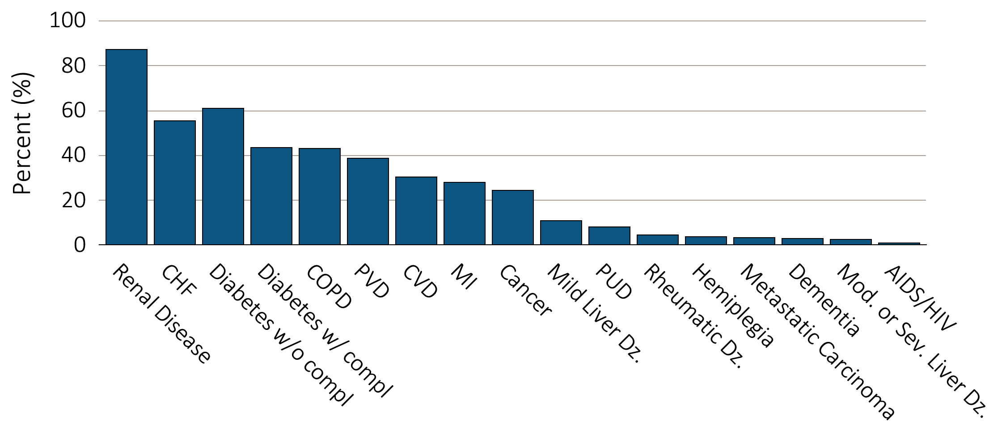
Figure 8.7 Selected comorbid conditions for calculation of the Charlson Comorbidity Index prior to transition to ESRD in 47,555 incident ESRD veterans
(a) Common comorbidities among veterans prior to transition to ESRD

Slide 16
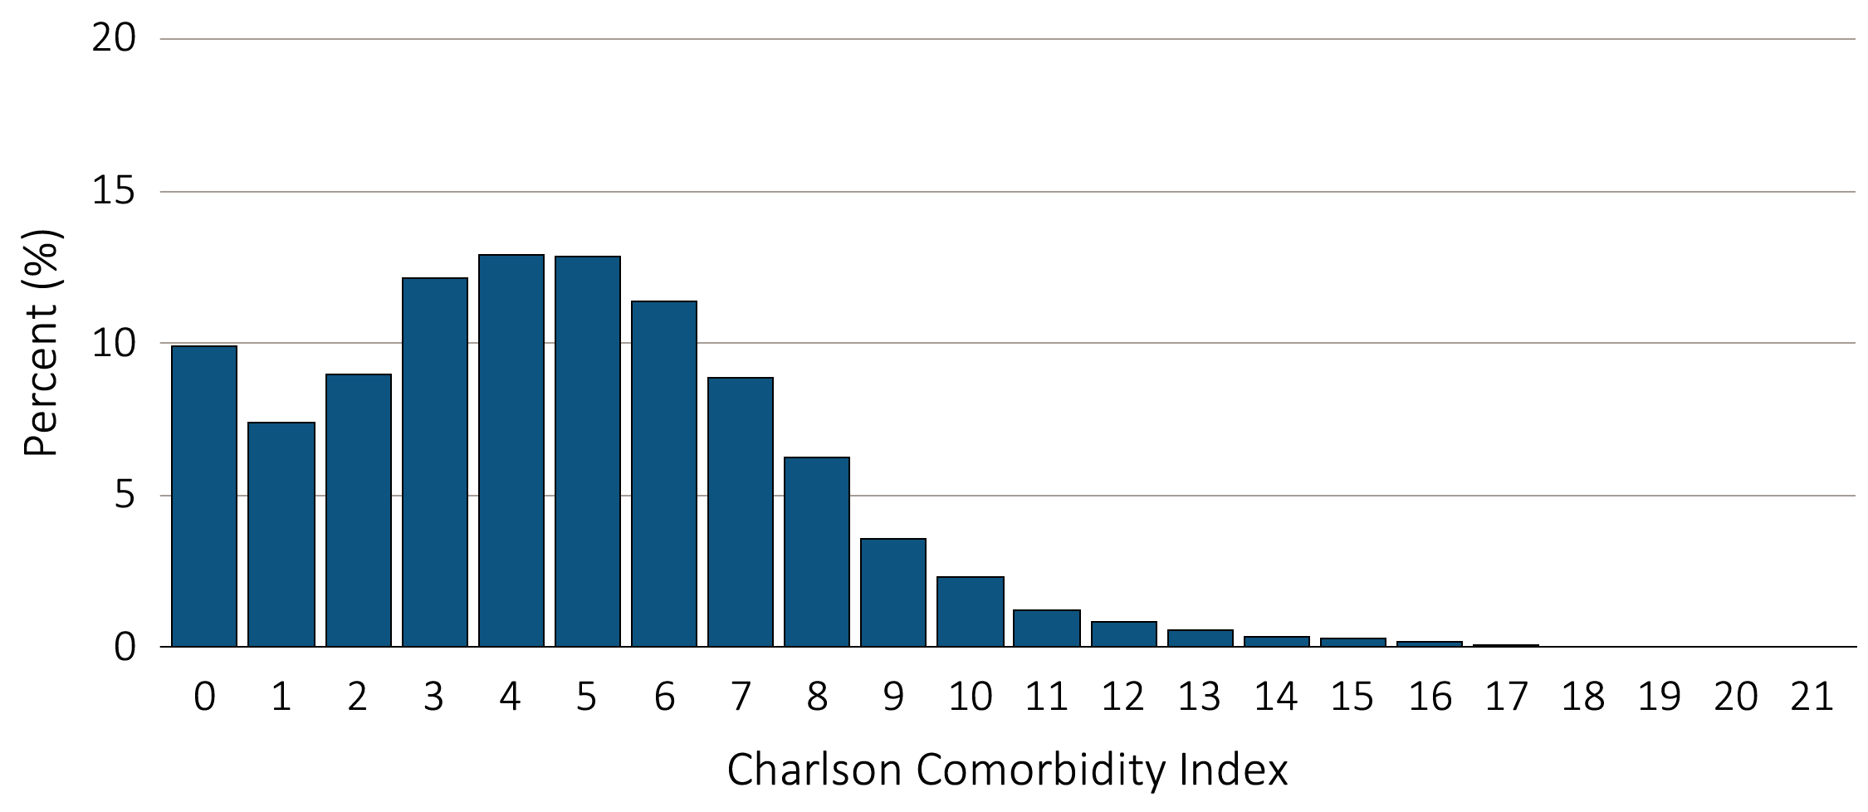
Figure 8.7 Selected comorbid conditions for calculation of the Charlson Comorbidity Index prior to transition to ESRD in 47,555 incident ESRD veterans
(b) Charlson Comorbidity Index Score
Data source: VHA Administrative data, USRDS ESRD Database. Abbreviations: CHF, congestive heart failure; compl, complications; COPD, chronic obstructive pulmonary disease; CVD, cerebrovascular disease; Dz, disease; ESRD, end-stage renal disease; MI, myocardial infarction; Mod, moderate; PVD, periphral vascular disease; PUD, peptic ulcer disease; Sev, Severe.

Slide 17
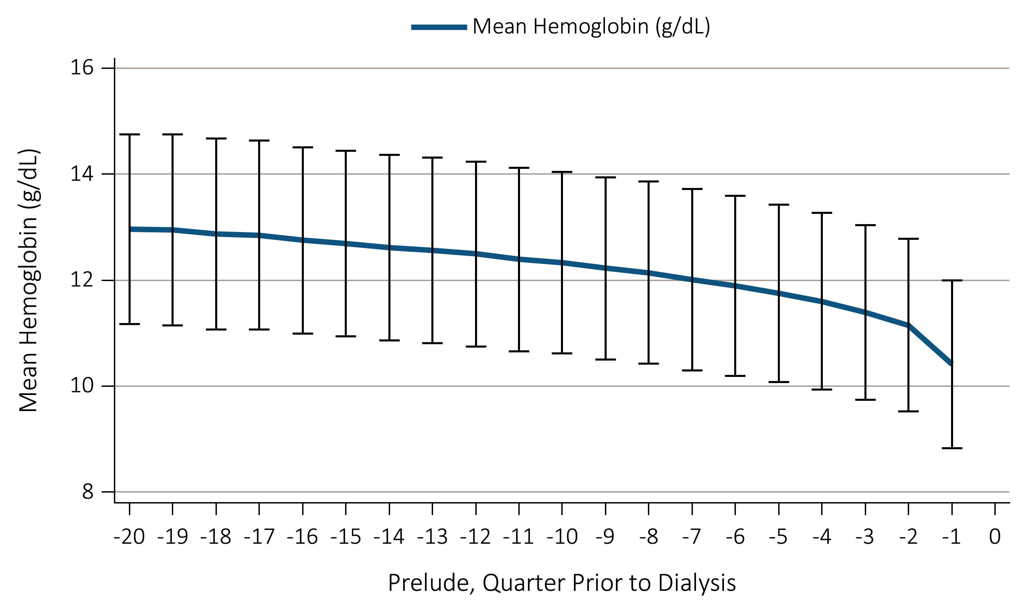
Figure 8.8 Trend in blood hemoglobin levels during the prelude (pre-ESRD) period,
over 20 calendar quarters in 28,717 veterans who later transitioned to ESRD
^{during 10/1/2007-9/31/2011}
Data source: VHA Administrative data, USRDS ESRD Database. Abbreviations: ESRD, end-stage renal disease; g/dL, grams per deciliter.

Slide 18
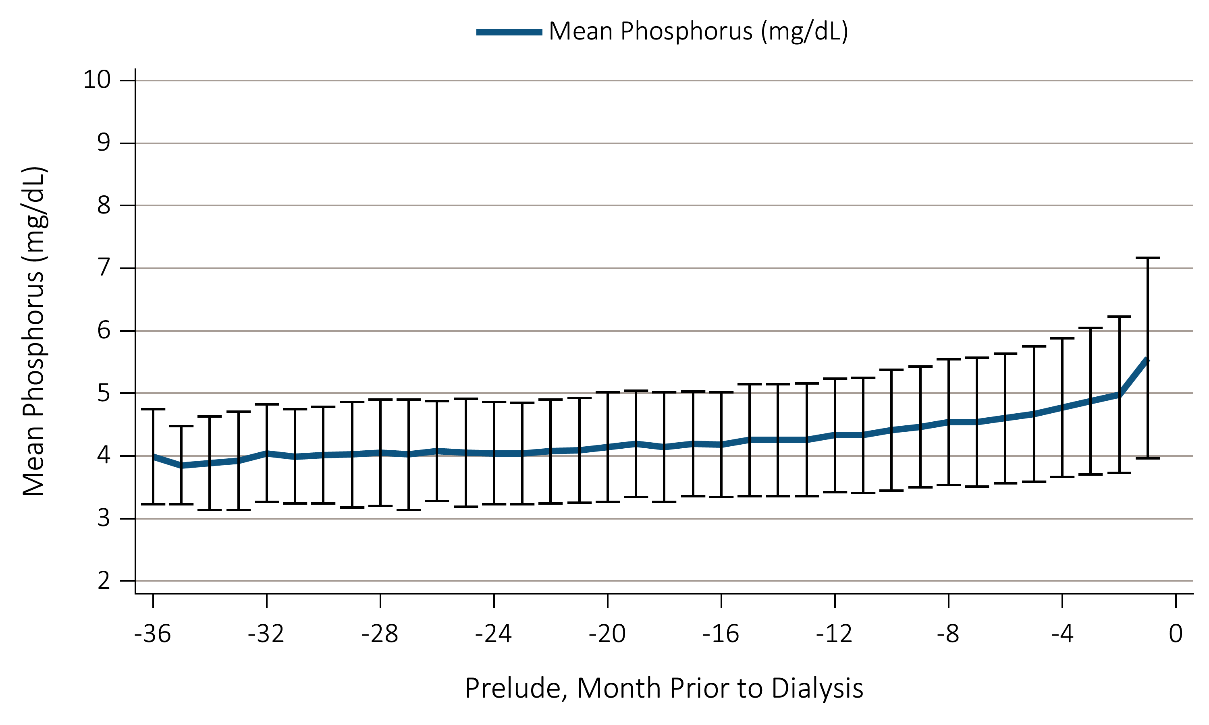
Figure 8.9 Trend in serum phosphorus level during the prelude (pre-ESRD) period,
over 36 months in 11,896 veterans who later transitioned to ESRD
^{during 10/1/2007-9/31/2011}
Data source: VHA Administrative data, USRDS ESRD Database. Abbreviations: ESRD, end-stage renal disease; g/dL, grams per deciliter.

Slide 19
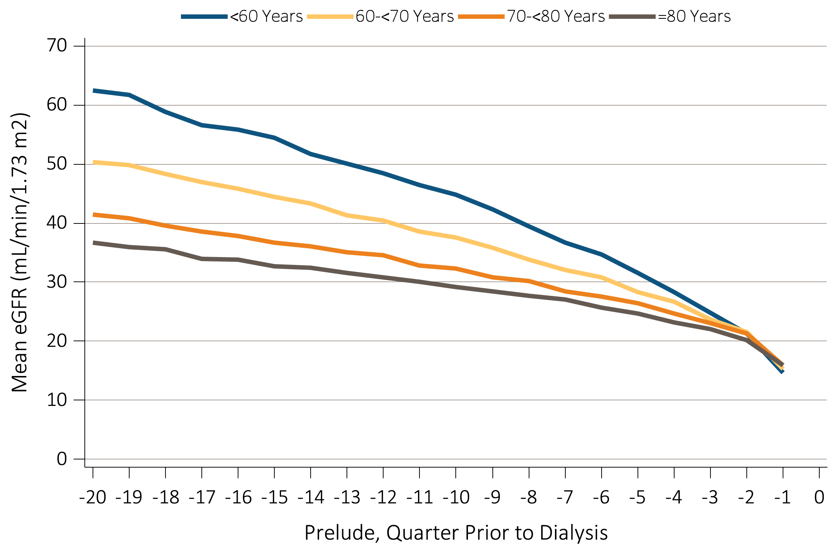
Figure 8.10 Trend in eGFR during the prelude (pre-ESRD) period, over 20 calendar quarters in 30,245 veterans who later transitioned to ESRD during 10/1/2007-9/31/2011
^{(a) Stratified by age}
^{(Continued on next slide)}

Slide 20
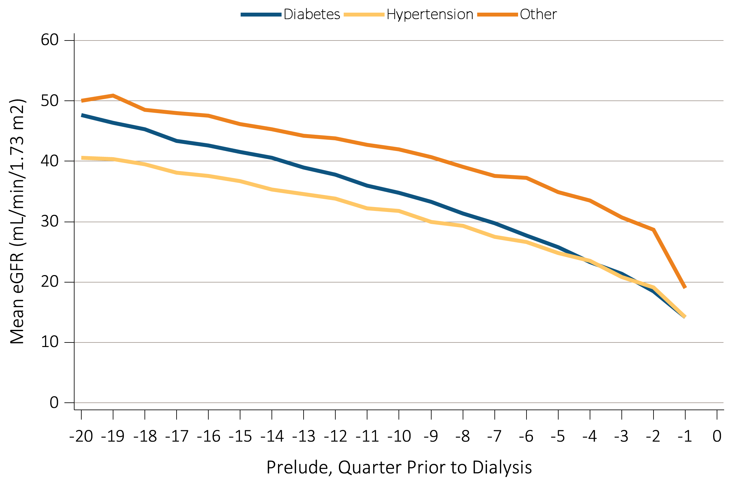
Figure 8.10 Trend in eGFR during the prelude (pre-ESRD) period, over 20 calendar quarters in 30,245 veterans who later transitioned to ESRD during 10/1/2007-9/31/2011
(b) Stratified according to ESRD etiology
Data source: VHA Administrative data, USRDS ESRD Database. Abbreviations: eGFR, estimated glomerular filtration rate; ESRD, end-stage renal disease.

Slide 21
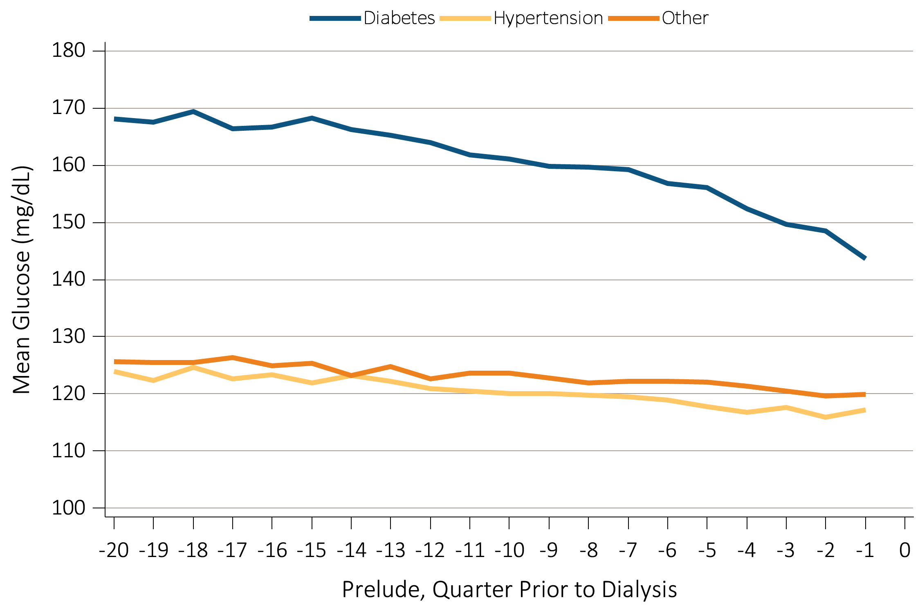
Figure 8.11 Trend in blood glucose level during the prelude (pre-ESRD) period,
over 20 calendar quarters in 29,920 veterans who later transitioned to ESRD
^{during 10/1/2007-9/31/2011}
Data source: VHA Administrative data, USRDS ESRD Database. Abbreviations: ESRD, end-stage renal disease. .

Slide 22
^{Table} 8.5 Age distribution of 5,989 KP-SC patients who transitioned to ESRD,
^{1/1/2007-12/31/2011}
Age group | Frequency | Percent (%)
<20 | 23 | 0.38
20-24 | 48 | 0.8
25-29 | 67 | 1.12
30-34 | 117 | 1.95
35-39 | 167 | 2.79
40-44 | 278 | 4.64
45-49 | 369 | 6.16
50-54 | 550 | 9.18
55-59 | 712 | 11.89
60-64 | 767 | 12.81
65-69 | 770 | 12.86
70-74 | 748 | 12.49
75-79 | 673 | 11.24
80-84 | 432 | 7.21
85-89 | 222 | 3.71
90-94 | 41 | 0.68
95+ | 5 | 0.08
Data source: Kaiser Permanente Southern California Electronic Health Records. Also see Figure 8.12. Abbreviations: ESRD, end-stage renal disease; KP-SC, Kaiser Permanente Southern California.

Slide 23
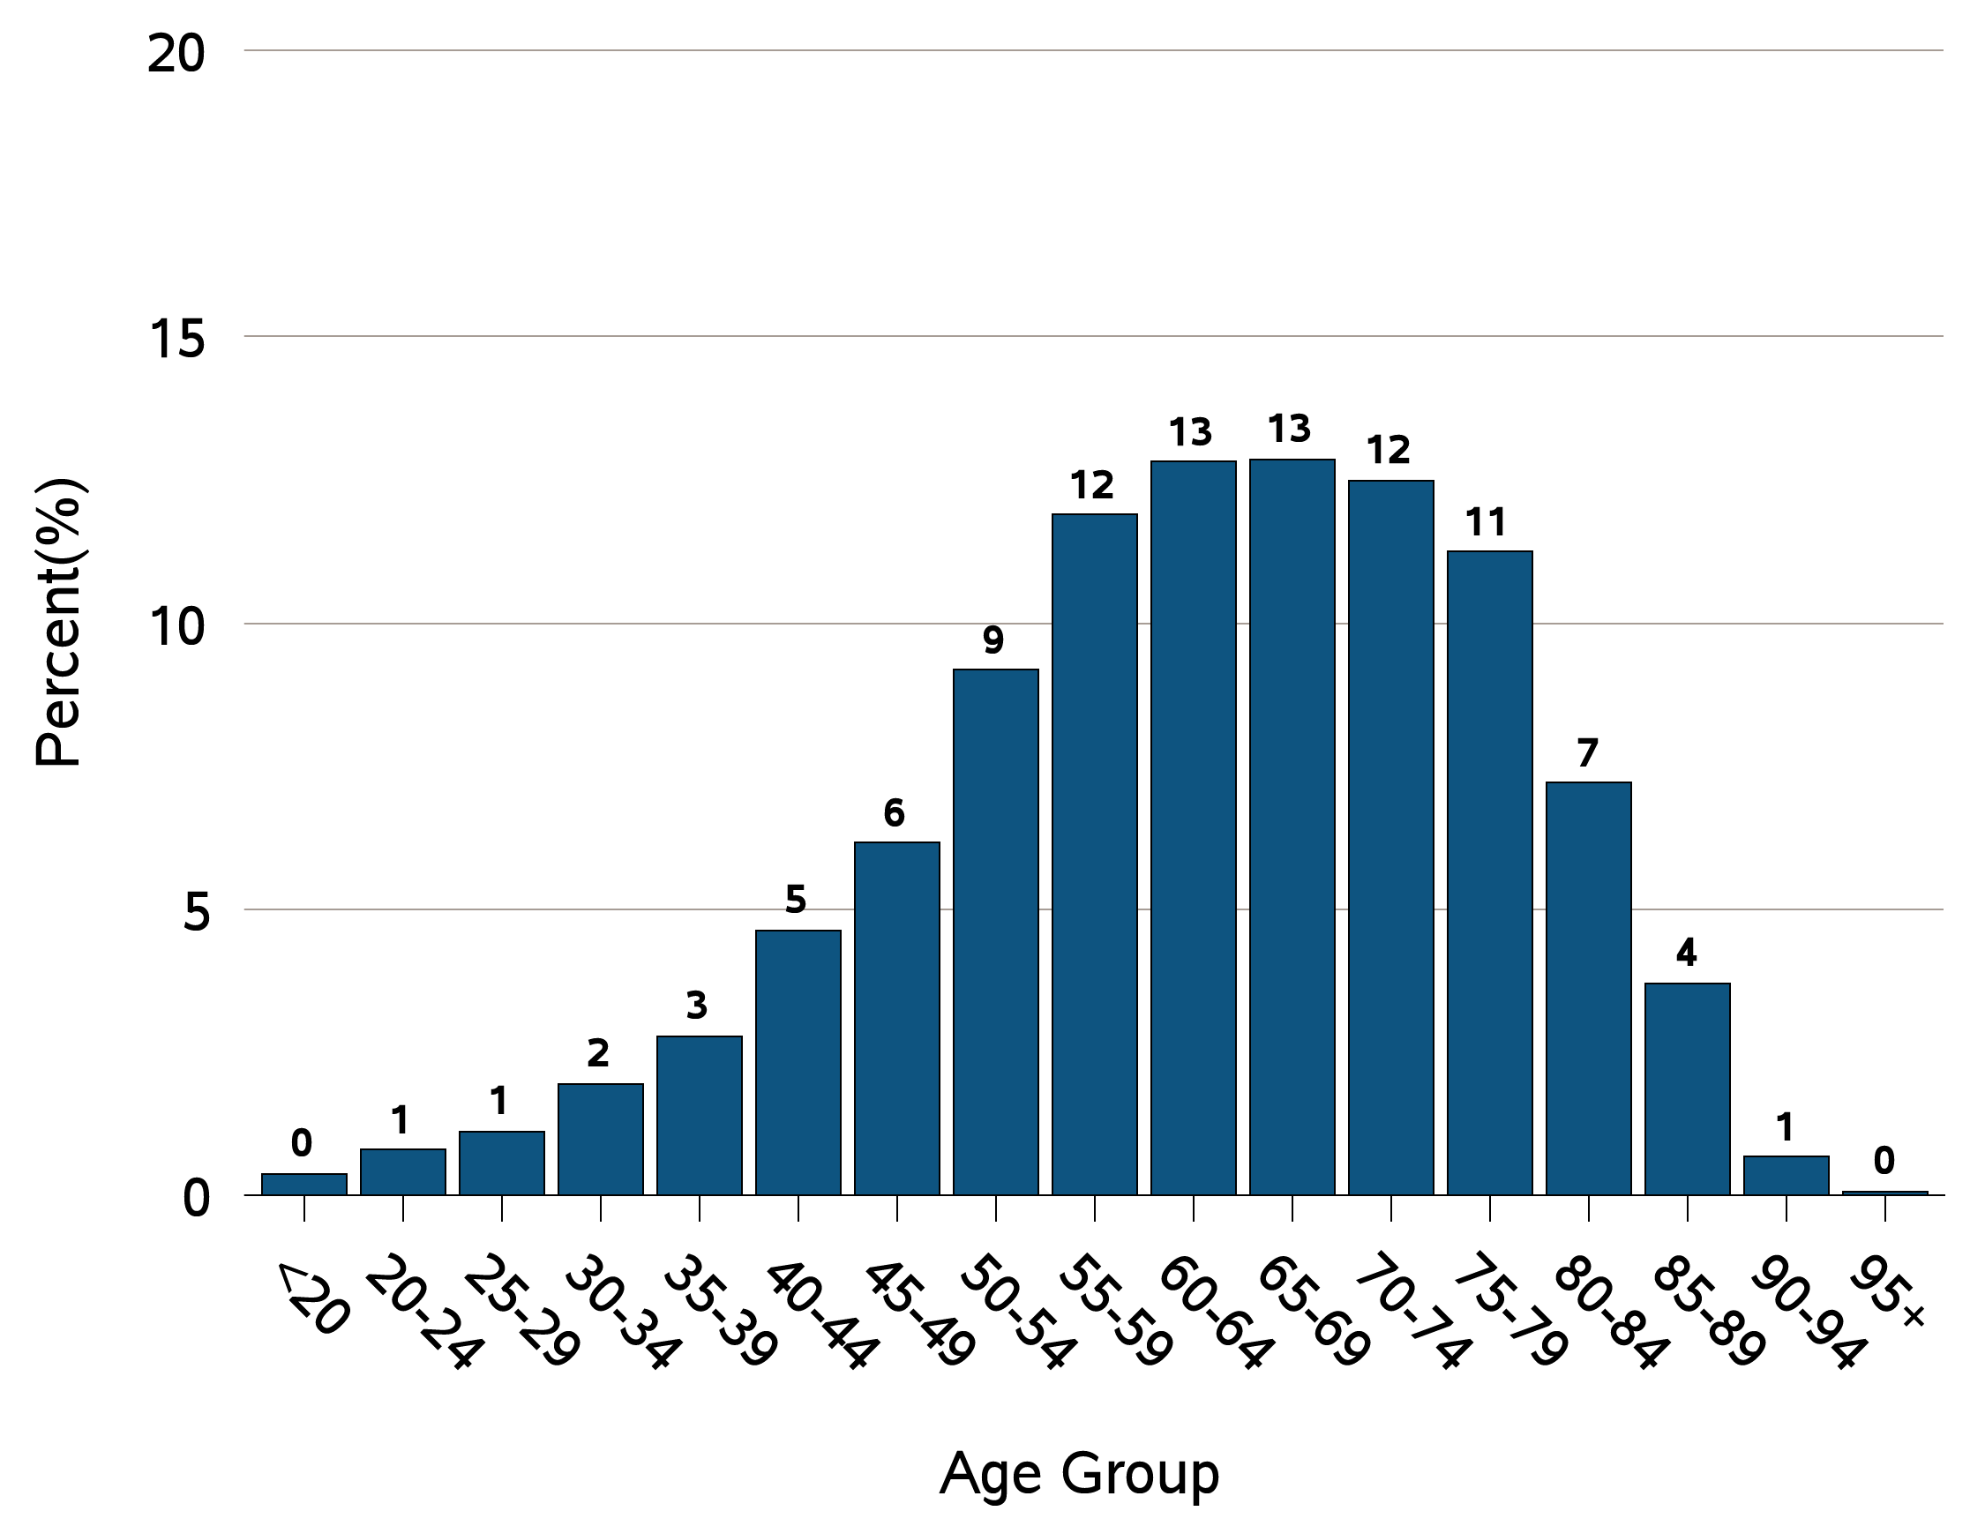
Figure 8.12 Age distribution of 5,989 KP-SC patients who transitioned to ESRD,
^{1/1/2007-12/31/2011}
Data source: Kaiser Permanente Southern California Electronic Health Records. Also see Figure 8.6. Abbreviations: ESRD, end-stage renal disease; KP-SC, Kaiser Permanente Southern California.

Slide 24
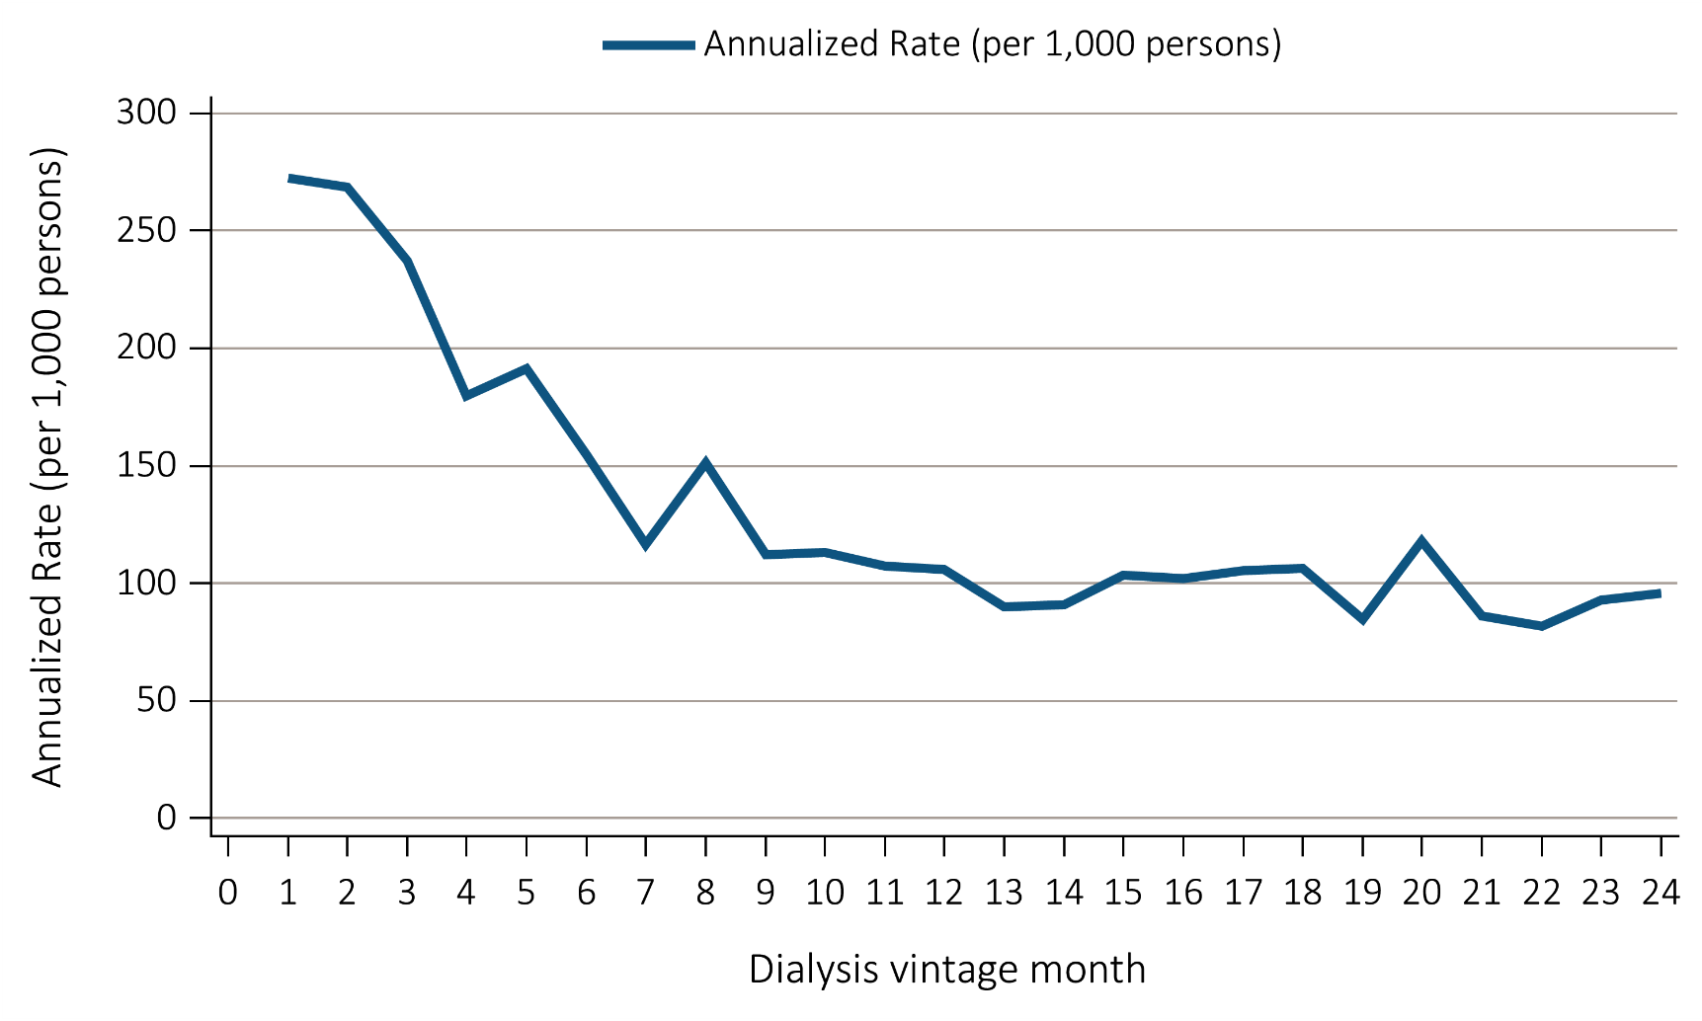
Figure 8.13 Annualized mortality rate of the 5,989 incident dialysis patients
over the first 24 months after ESRD transition (vintage)
Data source: Kaiser Permanente Southern California Electronic Health Records. Abbreviation: ESRD, end-stage renal disease.

Slide 25
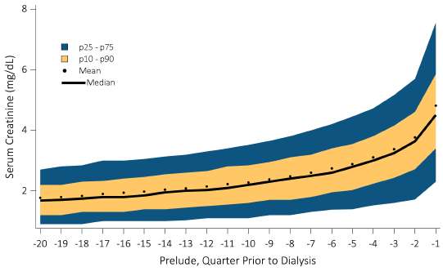
Figure 8.14 Gradual rise in serum creatinine level during the period prior to
ESRD transition (prelude) of 20 calendar quarters,
among 5,989 patients who would transition to dialysis
Data source: Kaiser Permanente Southern California Electronic Health Records. Abbreviation: ESRD, end-stage renal disease; mg/dL, milligrams per deciliter.

Slide 26
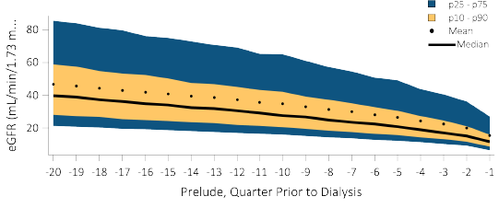
Figure 8.15 eGFR during the period prior to ESRD transition (prelude) of
20 calendar quarters, among 5,989 patients who would transition to dialysis
Data source: Kaiser Permanente Southern California Electronic Health Records. Abbreviation: eGFR, estimated glomerular filtration rate; ESRD, end-stage renal disease; mL/min, milliliters per minute.

Slide 27
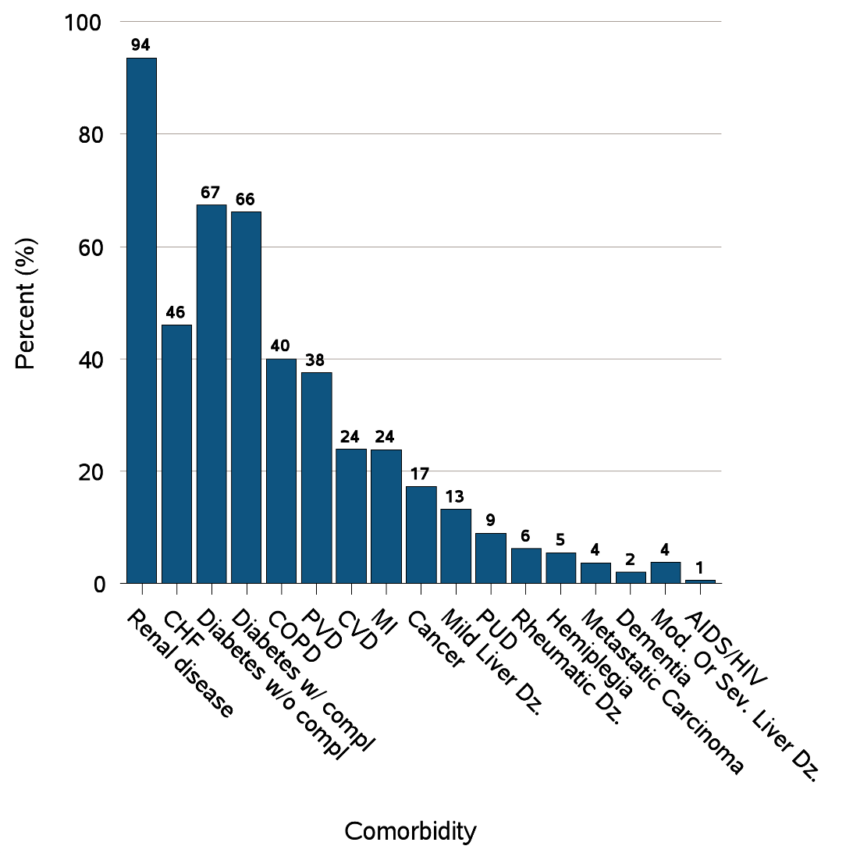
Figure 8.16 Selected comorbid conditions for calculation of the Charlson
Comorbidity Index prior to transition to ESRD in 5,858 KP-SC patients
(a) Common comorbidities among veterans prior to transition to ESRD

Slide 28
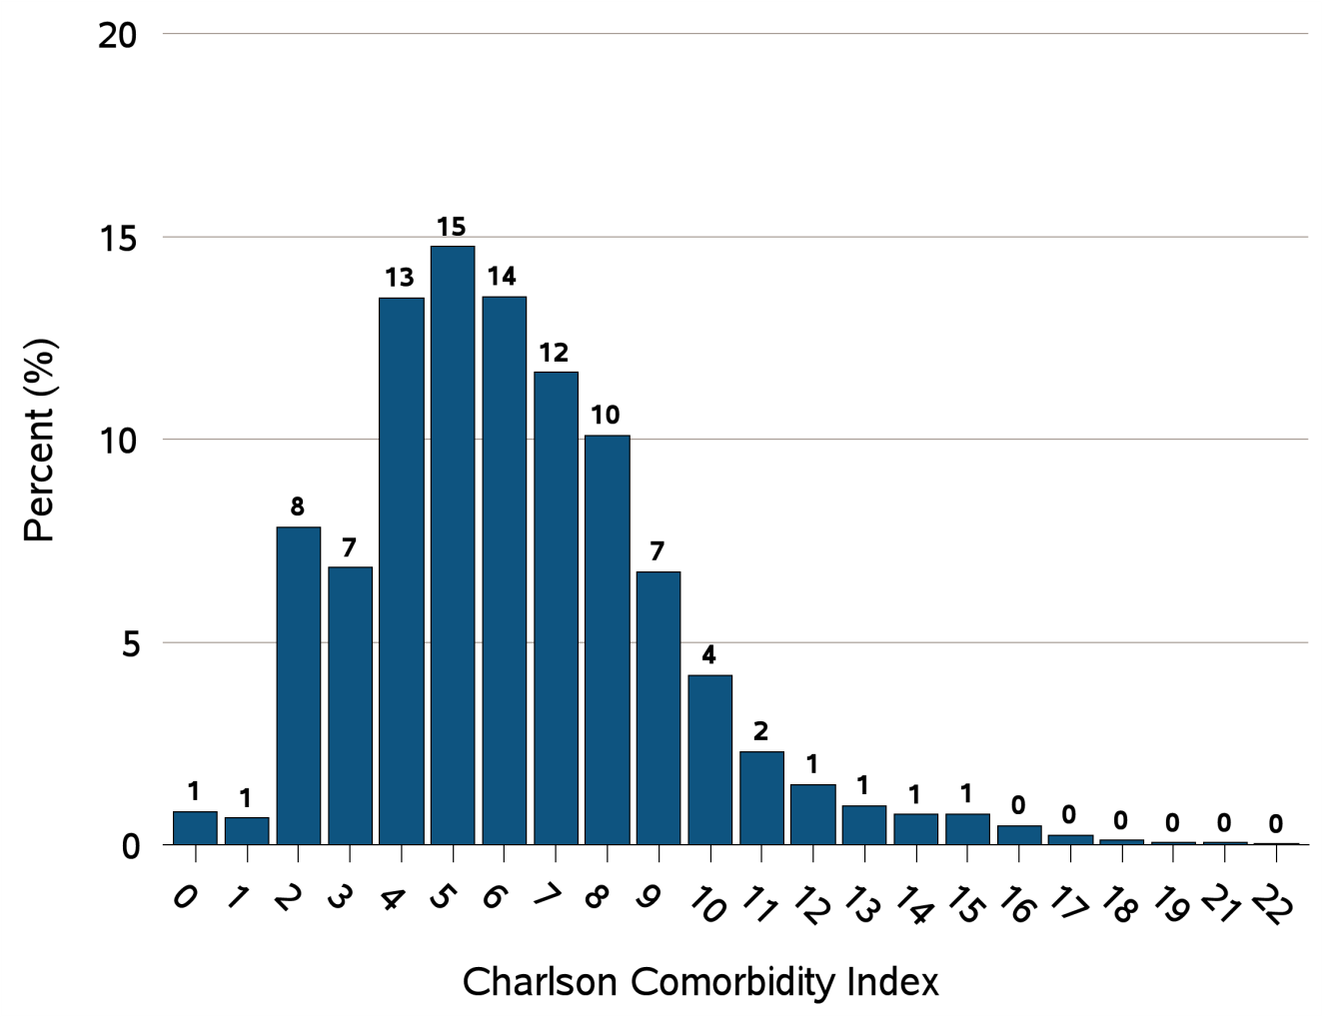
Figure 8.16 Selected comorbid conditions for calculation of the Charlson
Comorbidity Index prior to transition to ESRD in 5,858 KP-SC patients
(b) Charlson Comorbidity Index Score
Data source: Kaiser Permanente Southern California Electronic Health Records. Abbreviations: CHF, congestive heart failure; compl, complications; COPD, chronic obstructive pulmonary disease; CVD, cerebrovascular disease; Dz, disease; ESRD, end-stage renal disease; KP-SC, Kaiser Permanente Southern California; MI, myocardial infarction; Mod, moderate; PVD, periphral vascular disease; PUD, peptic ulcer disease; Sev, Severe.

