Slide 2
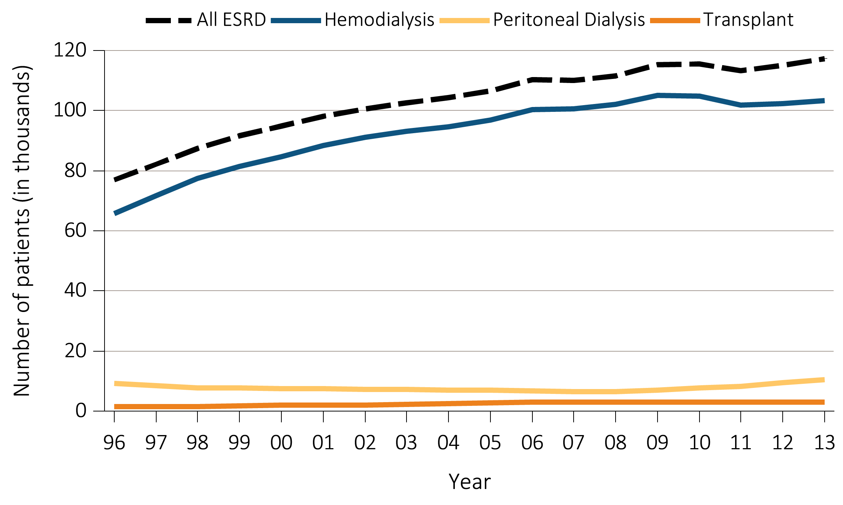
Figure 1.1 Trends in the annual number of ESRD incident cases (in thousands)
by modality, in the U.S. population, 1996-2013
Data Source: Reference Table D1. Abbreviation: ESRD, end-stage renal disease.

Slide 3
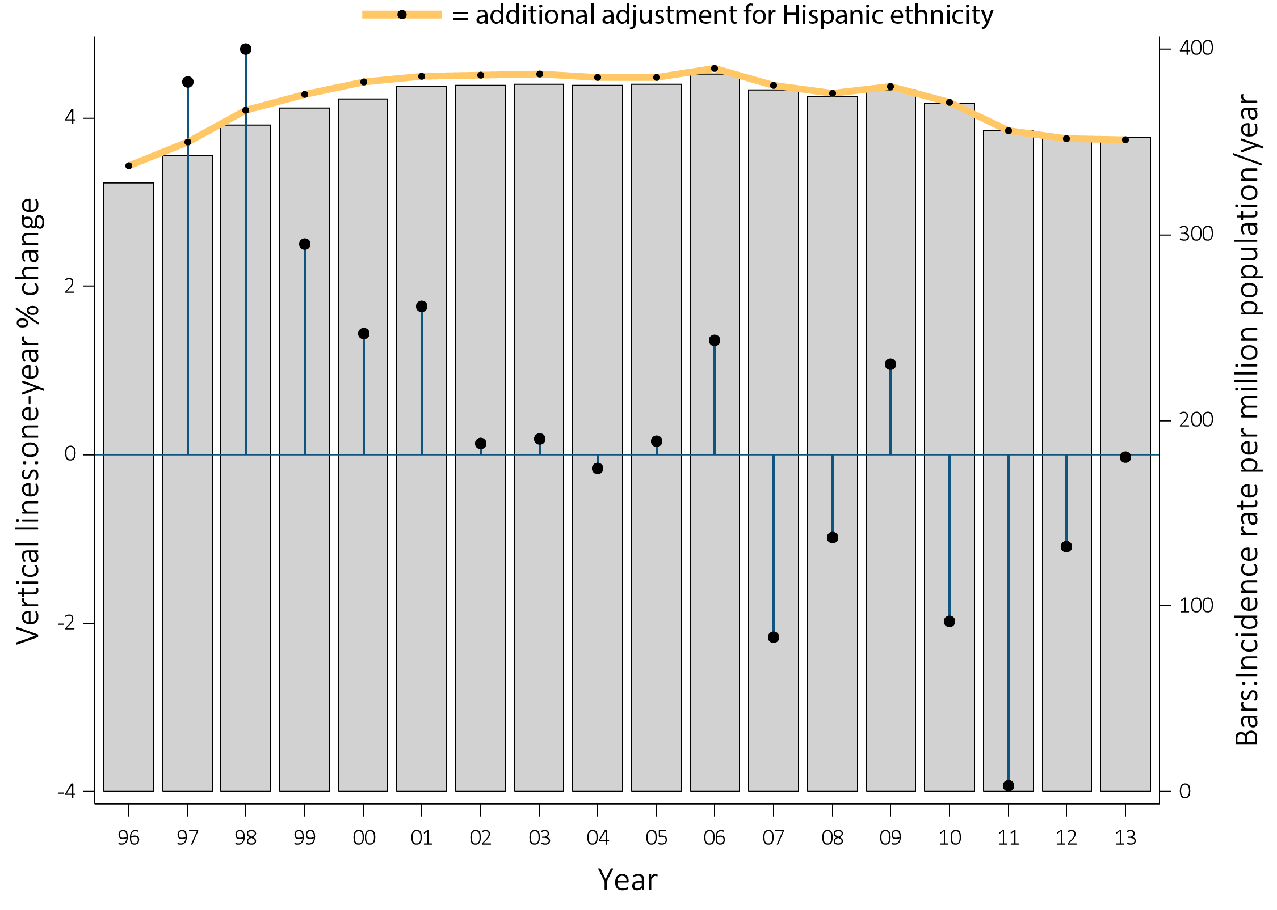
Figure 1.2 Trends in the adjusted* incidence rate (per million/year) of ESRD
(bars; scale on right), and annual change (%) in the adjusted* incidence rate of ESRD
(lines; scale on left) in the U.S. population, 1996-2013
Data Source: Reference Table A.2(2) and special analyses, USRDS ESRD Database. *Adjusted for age, sex, and race.
The standard population was the U.S. population in 2011. Abbreviation: ESRD, end-stage renal disease.

Slide 4
Table 1.1 Adjusted* incidence rate (per million/year) of ESRD in the U.S. population,
and distribution (%) of age, diabetes, sex, race, and ethnicity among incident ESRD cases
^{by ESRD Network, 2013}
Network | States in network | Rate per million / year | Total no. incident cases | % of incident cases | Mean age | % Diabetic | % Male | Race |  |  |  |  | Ethnicity
 |  |  |  |  |  |  |  | % White | % Black /Af Am | % N Am | % Asian |  | % Hisp
1 | CT, MA, ME, NH, RI, VT | 244 | 3,600 | 3.1 | 64.3 | 41.6 | 61.1 | 83.4 | 13.3 | 0.1 | 3.1 |  | 8.8
16 | AK, ID, MT, OR, WA | 270 | 3,461 | 3.0 | 61.8 | 43.8 | 59.1 | 83.5 | 6.1 | 2.9 | 7.2 |  | 7.7
15 | AZ, CO, NV, NM, UT, WY | 294 | 5,519 | 4.7 | 61.3 | 47.0 | 58.3 | 81.5 | 6.8 | 7.5 | 3.8 |  | 24.5
7 | FL | 317 | 7,523 | 6.4 | 63.8 | 39.9 | 59.4 | 68.1 | 29.2 | 0.2 | 2.3 |  | 16.8
2 | NY | 323 | 7,005 | 6.0 | 64.0 | 43.9 | 60.0 | 63.5 | 29.5 | 0.2 | 6.4 |  | 14.5
5 | MD, DC, VA, WV | 326 | 6,508 | 5.6 | 62.7 | 37.6 | 57.3 | 52.5 | 43.9 | 0.0 | 3.3 |  | 2.8
6 | NC, SC, GA | 327 | 10,103 | 8.6 | 60.3 | 40.0 | 55.3 | 46.1 | 52.0 | 0.4 | 1.3 |  | 2.7
11 | MI, MN, ND, SD, WI | 335 | 7,329 | 6.3 | 63.5 | 39.2 | 58.4 | 73.4 | 21.5 | 2.5 | 2.4 |  | 3.3
12 | IA, KS, MO, NE | 336 | 4,358 | 3.7 | 63.3 | 41.2 | 56.9 | 77.7 | 20.4 | 0.4 | 1.4 |  | 4.3
17 | N. CA, HI, GUAM, AS | 344 | 5,665 | 4.8 | 62.4 | 50.6 | 57.7 | 56.8 | 11.5 | 0.4 | 30.9 |  | 20.4
4 | DE, PA | 353 | 5,403 | 4.6 | 64.7 | 41.8 | 58.5 | 74.2 | 24.3 | 0.0 | 1.3 |  | 3.9
8 | AL, MS, TN | 363 | 6,387 | 5.5 | 60.7 | 41.6 | 55.9 | 53.3 | 45.5 | 0.2 | 0.8 |  | 1.3
3 | NJ, PR | 374 | 5,091 | 4.3 | 64.1 | 48.4 | 59.6 | 72.4 | 23.7 | 0.0 | 3.6 |  | 36.1
13 | AR, LA, OK | 376 | 4,796 | 4.1 | 60.8 | 43.6 | 55.2 | 56.4 | 39.0 | 3.1 | 1.2 |  | 3.2
10 | IL | 389 | 5,211 | 4.4 | 63.8 | 40.2 | 56.6 | 68.6 | 28.3 | 0.0 | 2.6 |  | 10.4
9 | IN, KY, OH | 390 | 9,119 | 7.8 | 63.5 | 43.8 | 57.9 | 78.6 | 20.5 | 0.0 | 0.8 |  | 2.2
14 | TX | 436 | 10,336 | 8.8 | 60.4 | 53.3 | 57.0 | 74.5 | 22.8 | 0.1 | 2.4 |  | 39.9
18 | S. CA | 438 | 9,310 | 7.9 | 63.2 | 48.8 | 58.0 | 74.6 | 11.9 | 0.2 | 13.1 |  | 41.0
 | All | 352 | 117,162 | 100.0 | 62.5 | 43.9 | 57.8 | 67.7 | 26.2 | 0.9 | 4.9 |  | 14.8
Data Source: Reference Table A.10 and special analyses, USRDS ESRD Database. *Adjusted for age, sex, race, and ethnicity. The standard population was the U.S. population in 2011. Listed from lowest to highest rate per million/year. Abbreviations: Af Am, African American; ESRD, end-stage renal disease; Hisp, Hispanic; N Am, Native American.

Slide 5
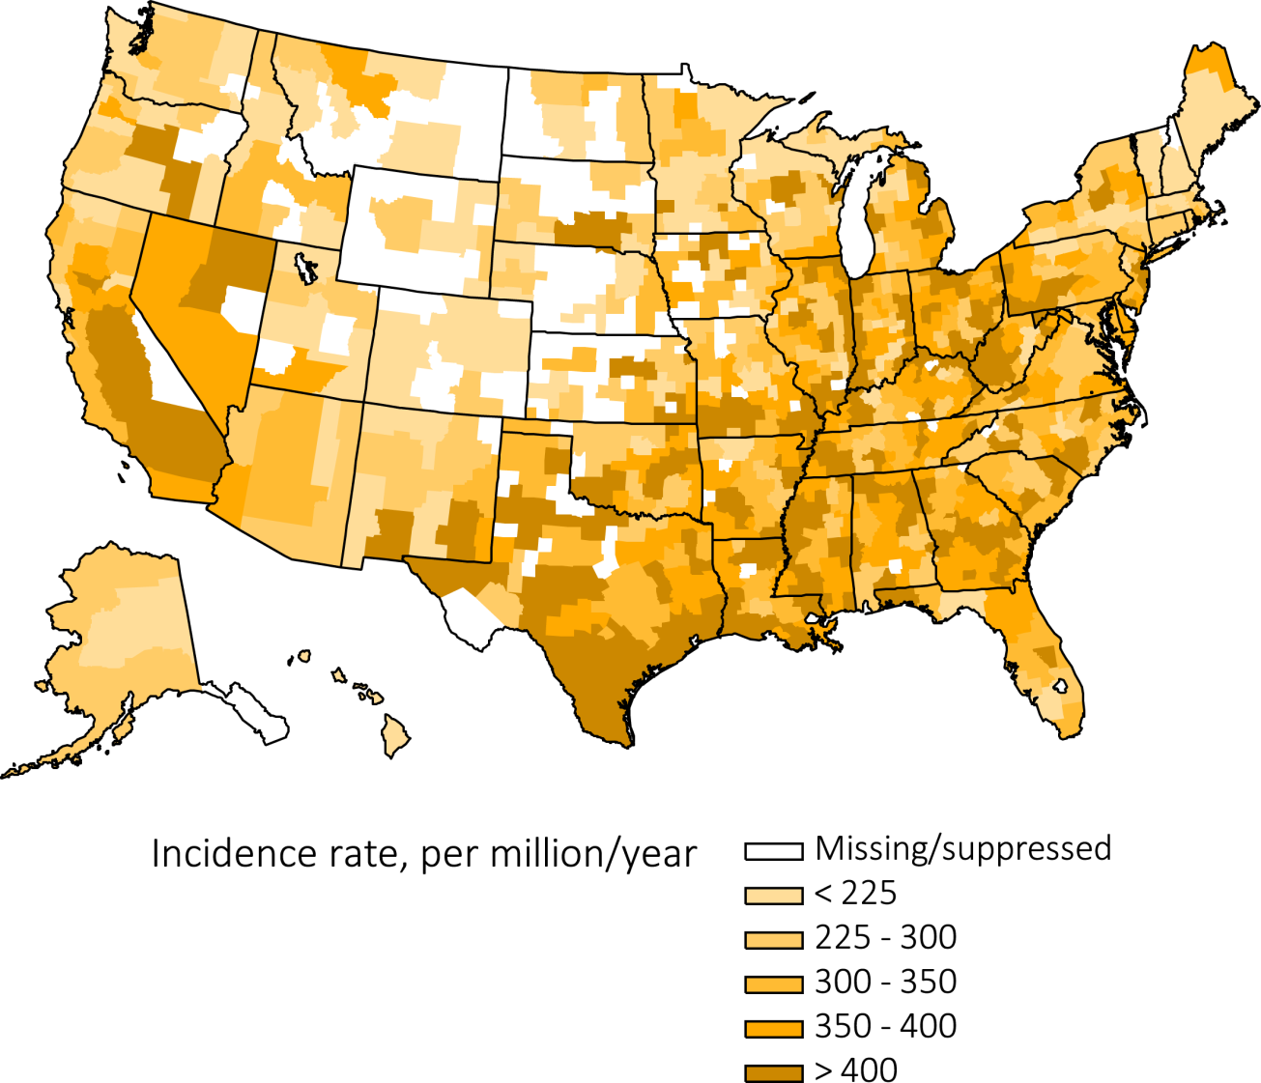
Figure 1.3 Map of the adjusted* incidence rate (per million/year) of ESRD,
by Health Service Area, in the U.S. population, 2013
Data Source: Special analyses, USRDS ESRD Database. *Adjusted for age, sex, and race. The standard population
was the U.S. population in 2011. Abbreviation: ESRD, end-stage renal disease.

Slide 6
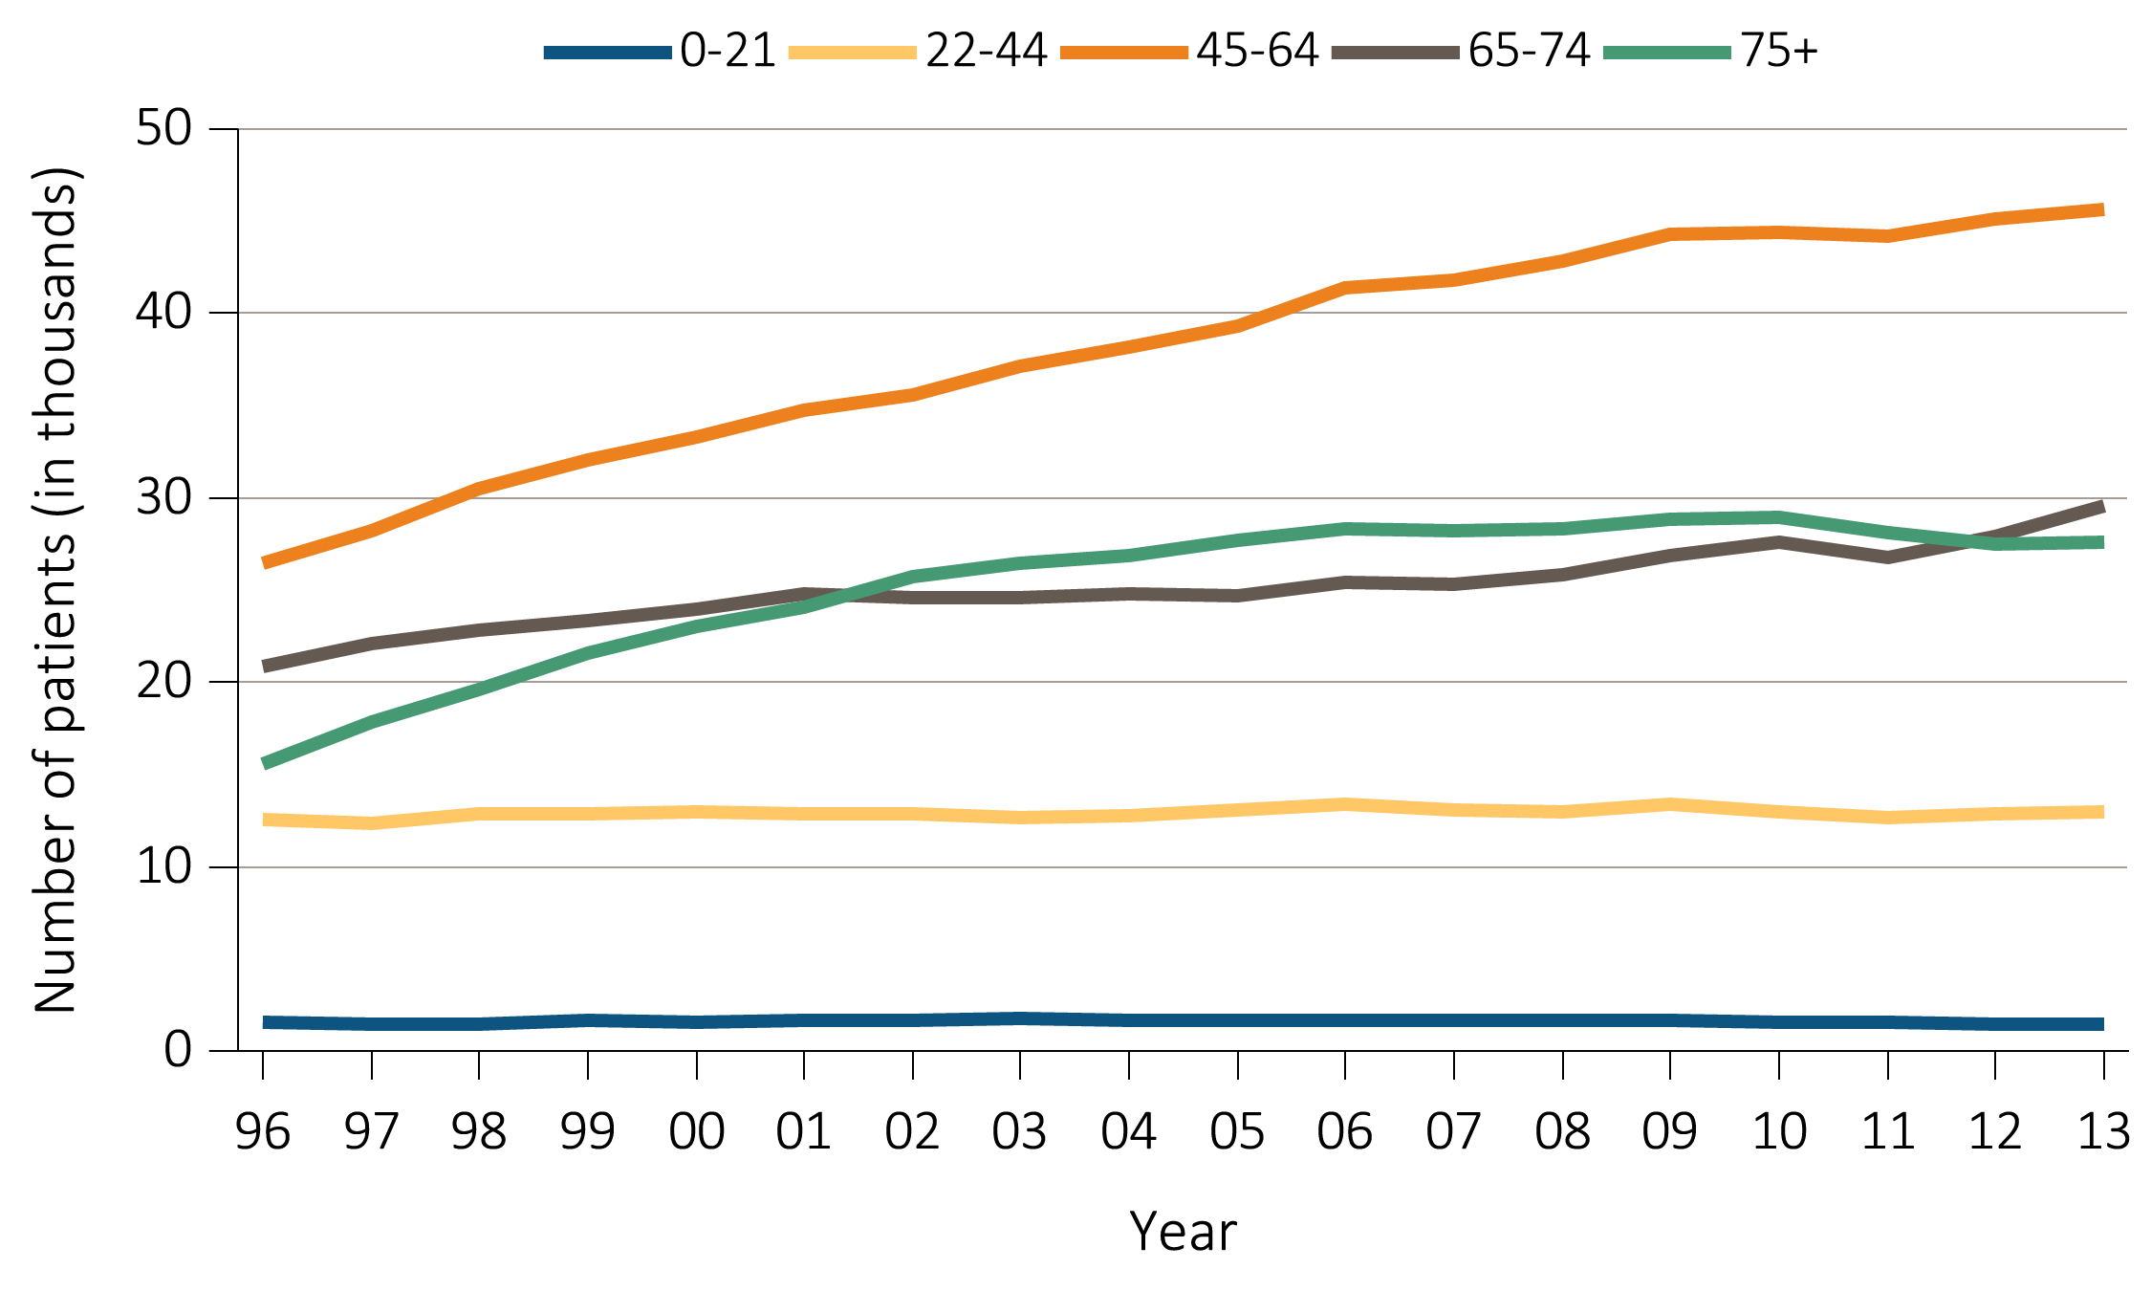
Figure 1.4(a) Trends in annual number of ESRD incident cases (in thousands),
by age group, in the U.S. population, 1996-2013
Data Source: Reference Table A.1. Abbreviation: ESRD, end-stage renal disease.

Slide 7
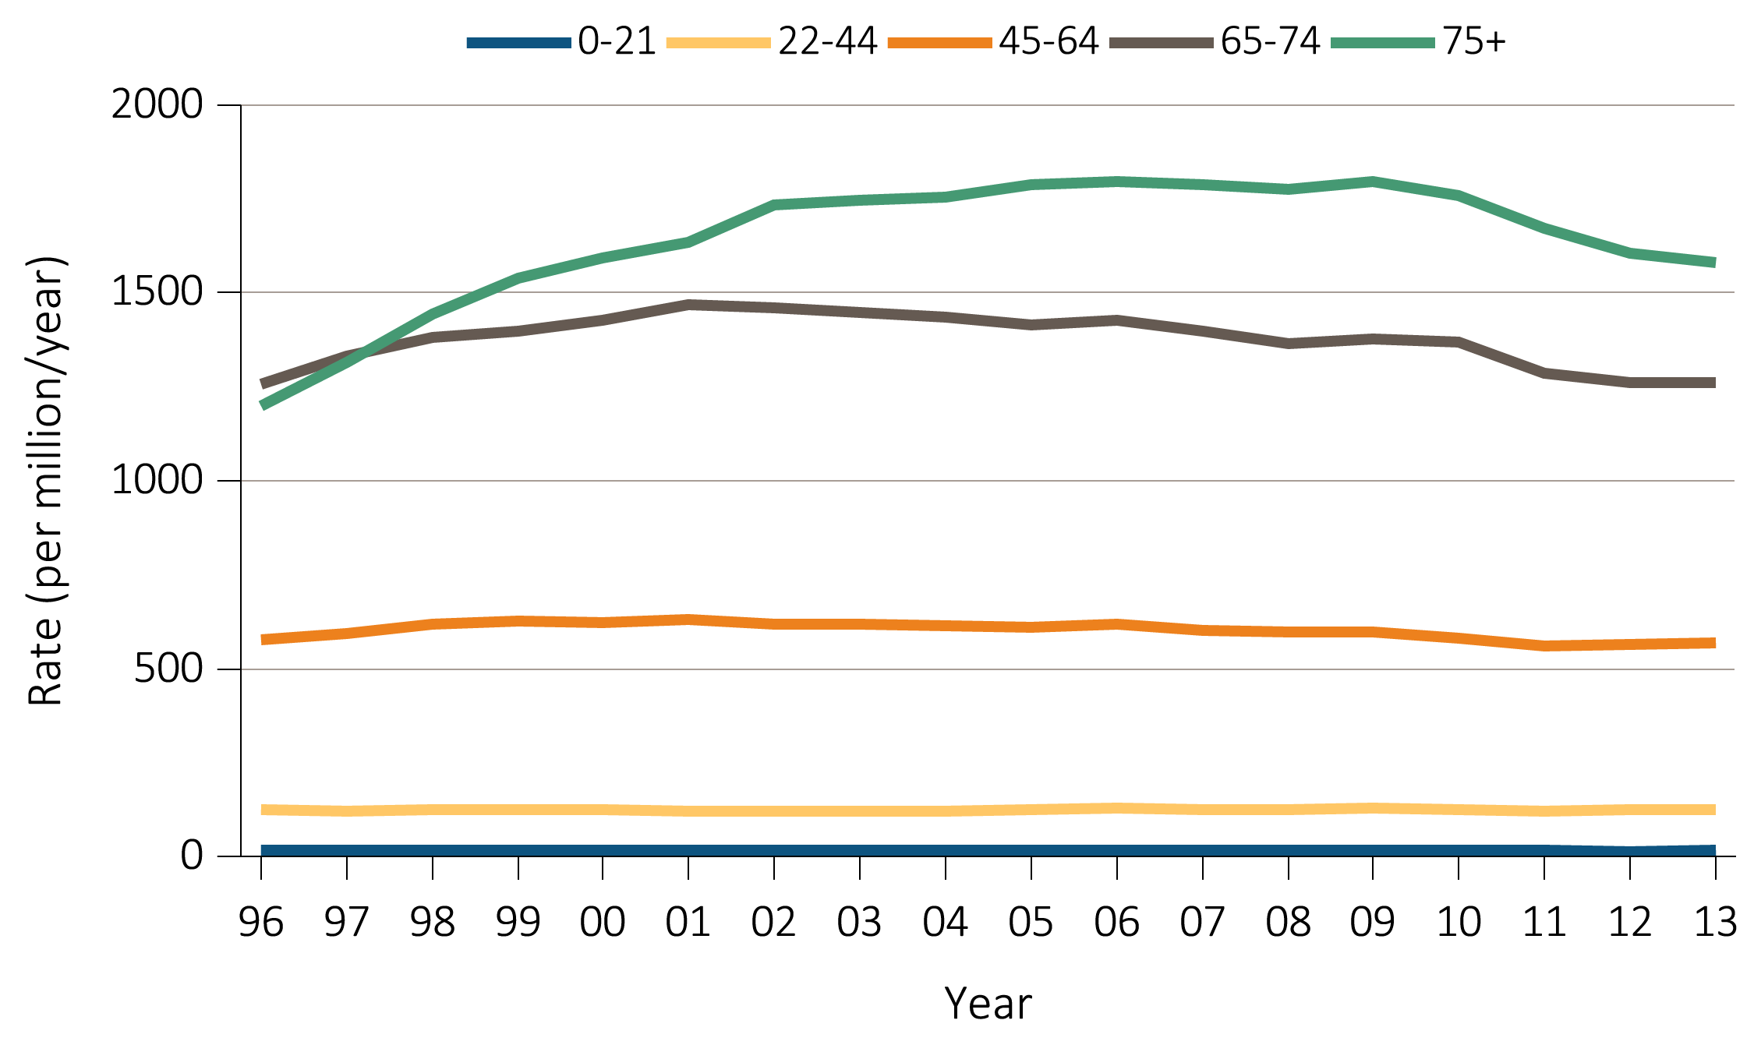
Figure 1.4(b) Trends in adjusted* ESRD incidence rate (per million/year),
by age group, in the U.S. population, 1996-2013
Data Source: Special analyses, USRDS ESRD Database. *Adjusted for sex and race.
The standard population was the U.S. population in 2011. Abbreviation: ESRD, end-stage renal disease.

Slide 8
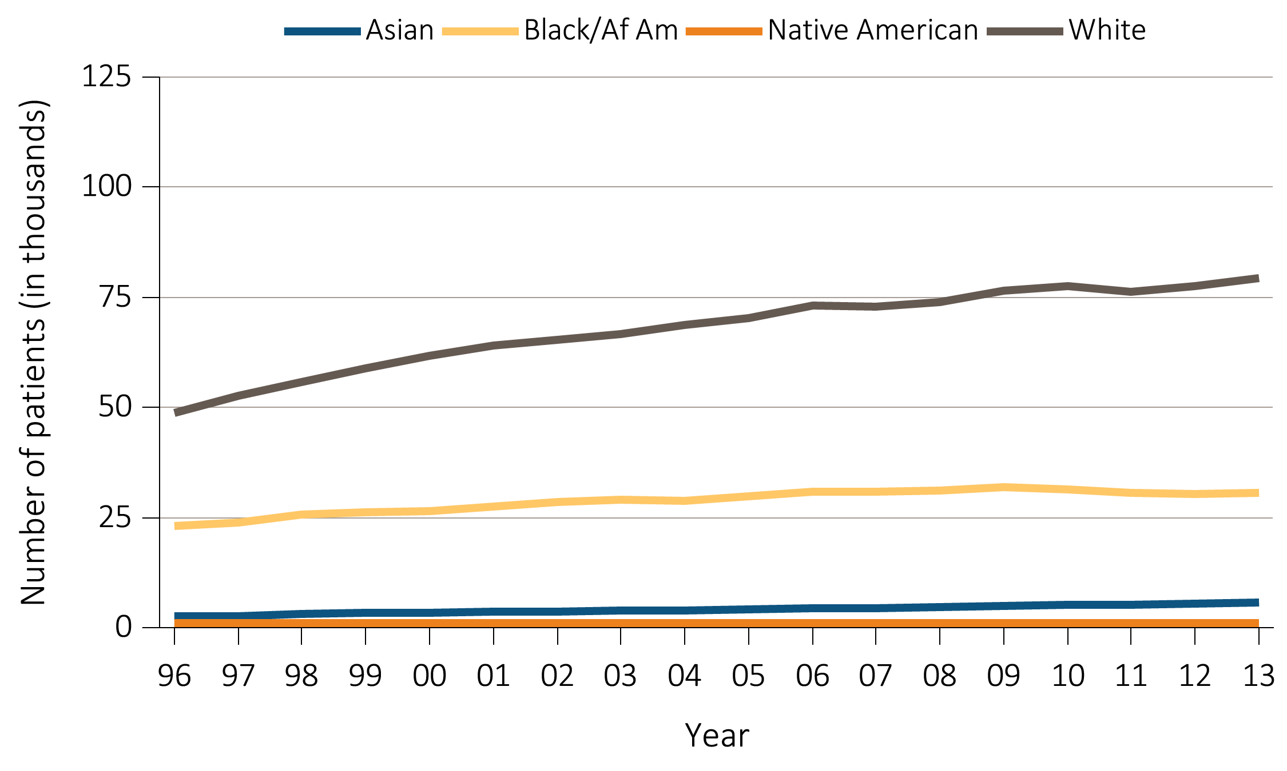
Figure 1.5(a) Trends in annual number of ESRD incident cases (in thousands),
by race, in the U.S. population, 1996-2013
Data Source: Reference Table A.1. Abbreviations: Af Am, African American; ESRD, end-stage renal disease.

Slide 9
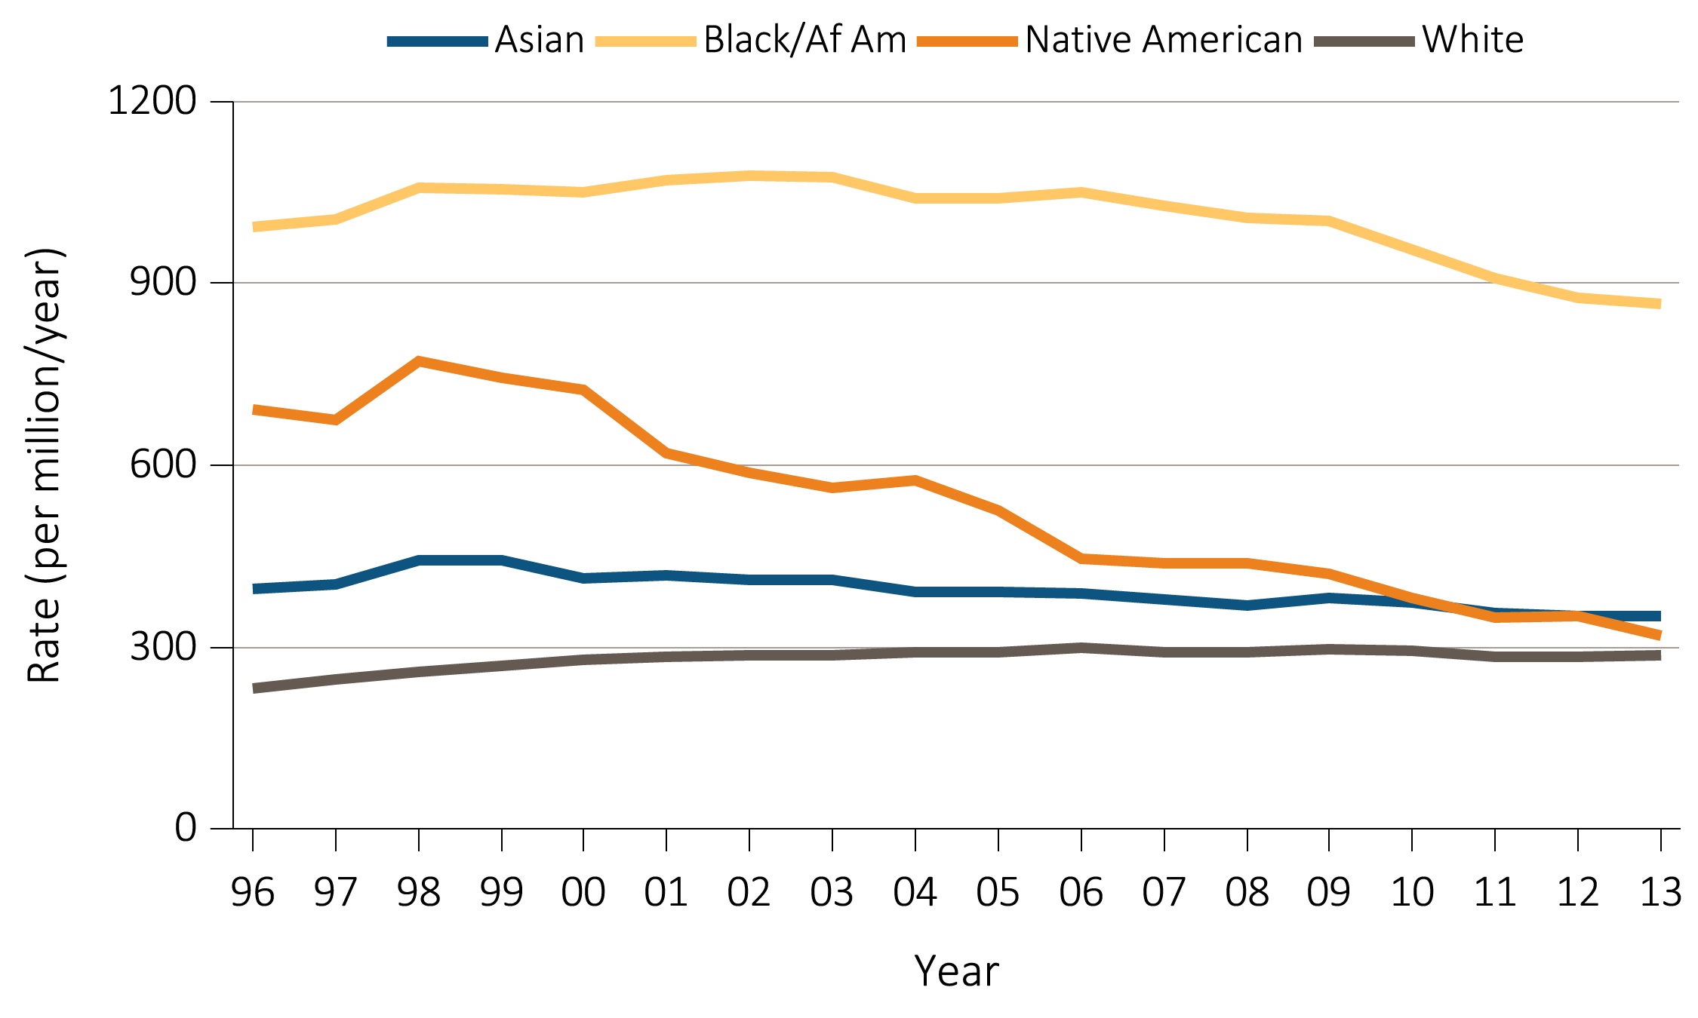
Figure 1.5(b) Trends in adjusted* ESRD incidence rate (per million/year),
by race, in the U.S. population, 1996-2013
Data Source: Special analyses, USRDS ESRD Database. *Adjusted for age and sex. The standard population was the U.S. population in 2011. Abbreviations: Af Am, African American; ESRD, end-stage renal disease.

Slide 10
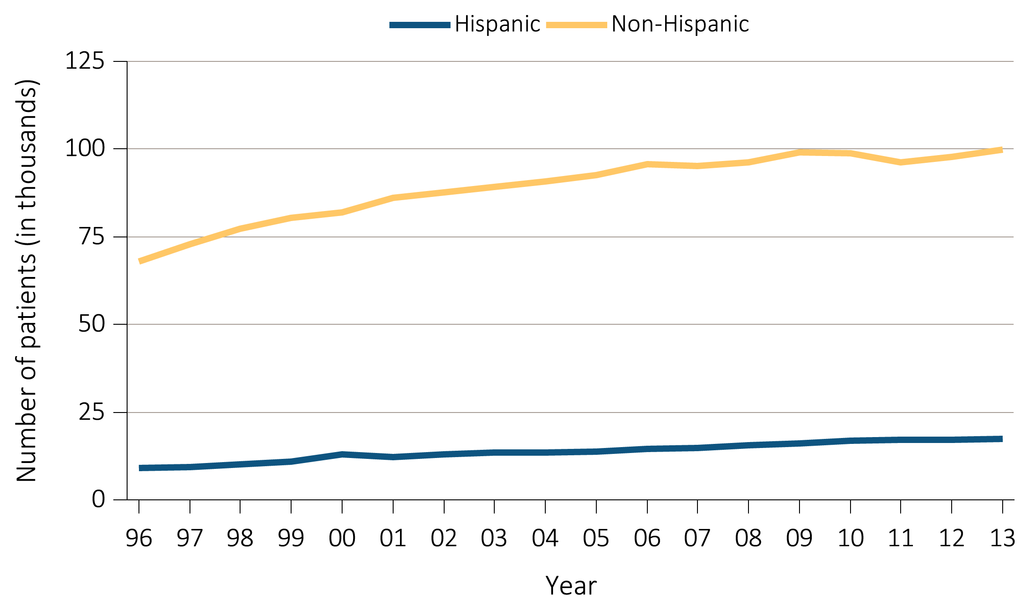
Figure 1.6(a) Trends in annual number of ESRD incident cases (in thousands),
by Hispanic ethnicity, in the U.S. population, 1996-2013
Data Source: Reference Tables A.1. Abbreviation: ESRD, end-stage renal disease.

Slide 11
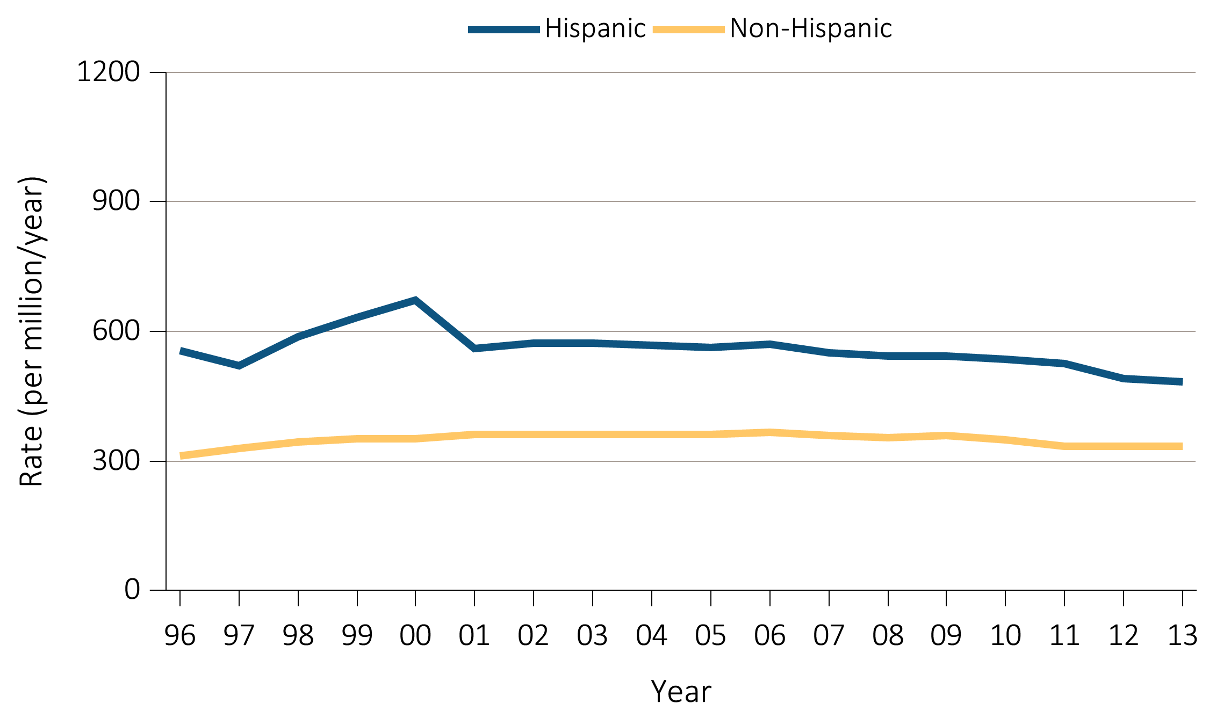
Figure 1.6(b) Trends in adjusted* ESRD incidence rate (per million/year),
by Hispanic ethnicity, in the U.S. population, 1996-2013
Data Source: Reference Tables A.2(2). *Adjusted for age, sex, and race. The standard population was the U.S. population in 2011. Abbreviation: ESRD, end-stage renal disease.

Slide 12
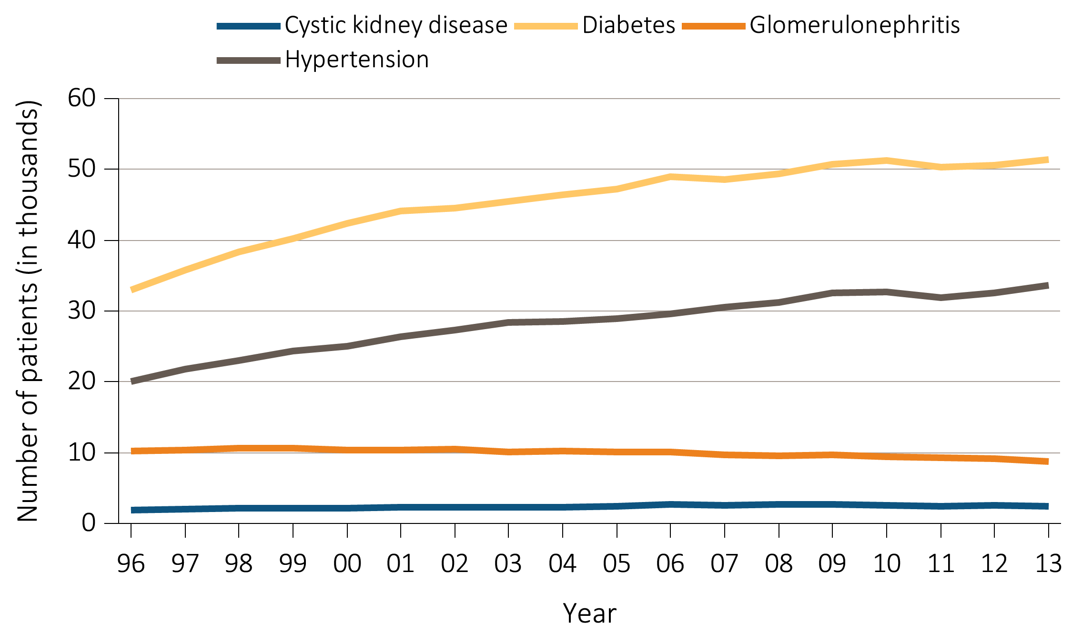
Figure 1.7(a) Trends in annual number of ESRD incident cases (in thousands),
by primary cause of ESRD, in the U.S. population, 1996-2013
Data Source: Reference Table A.1. Abbreviation: ESRD, end-stage renal disease.

Slide 13
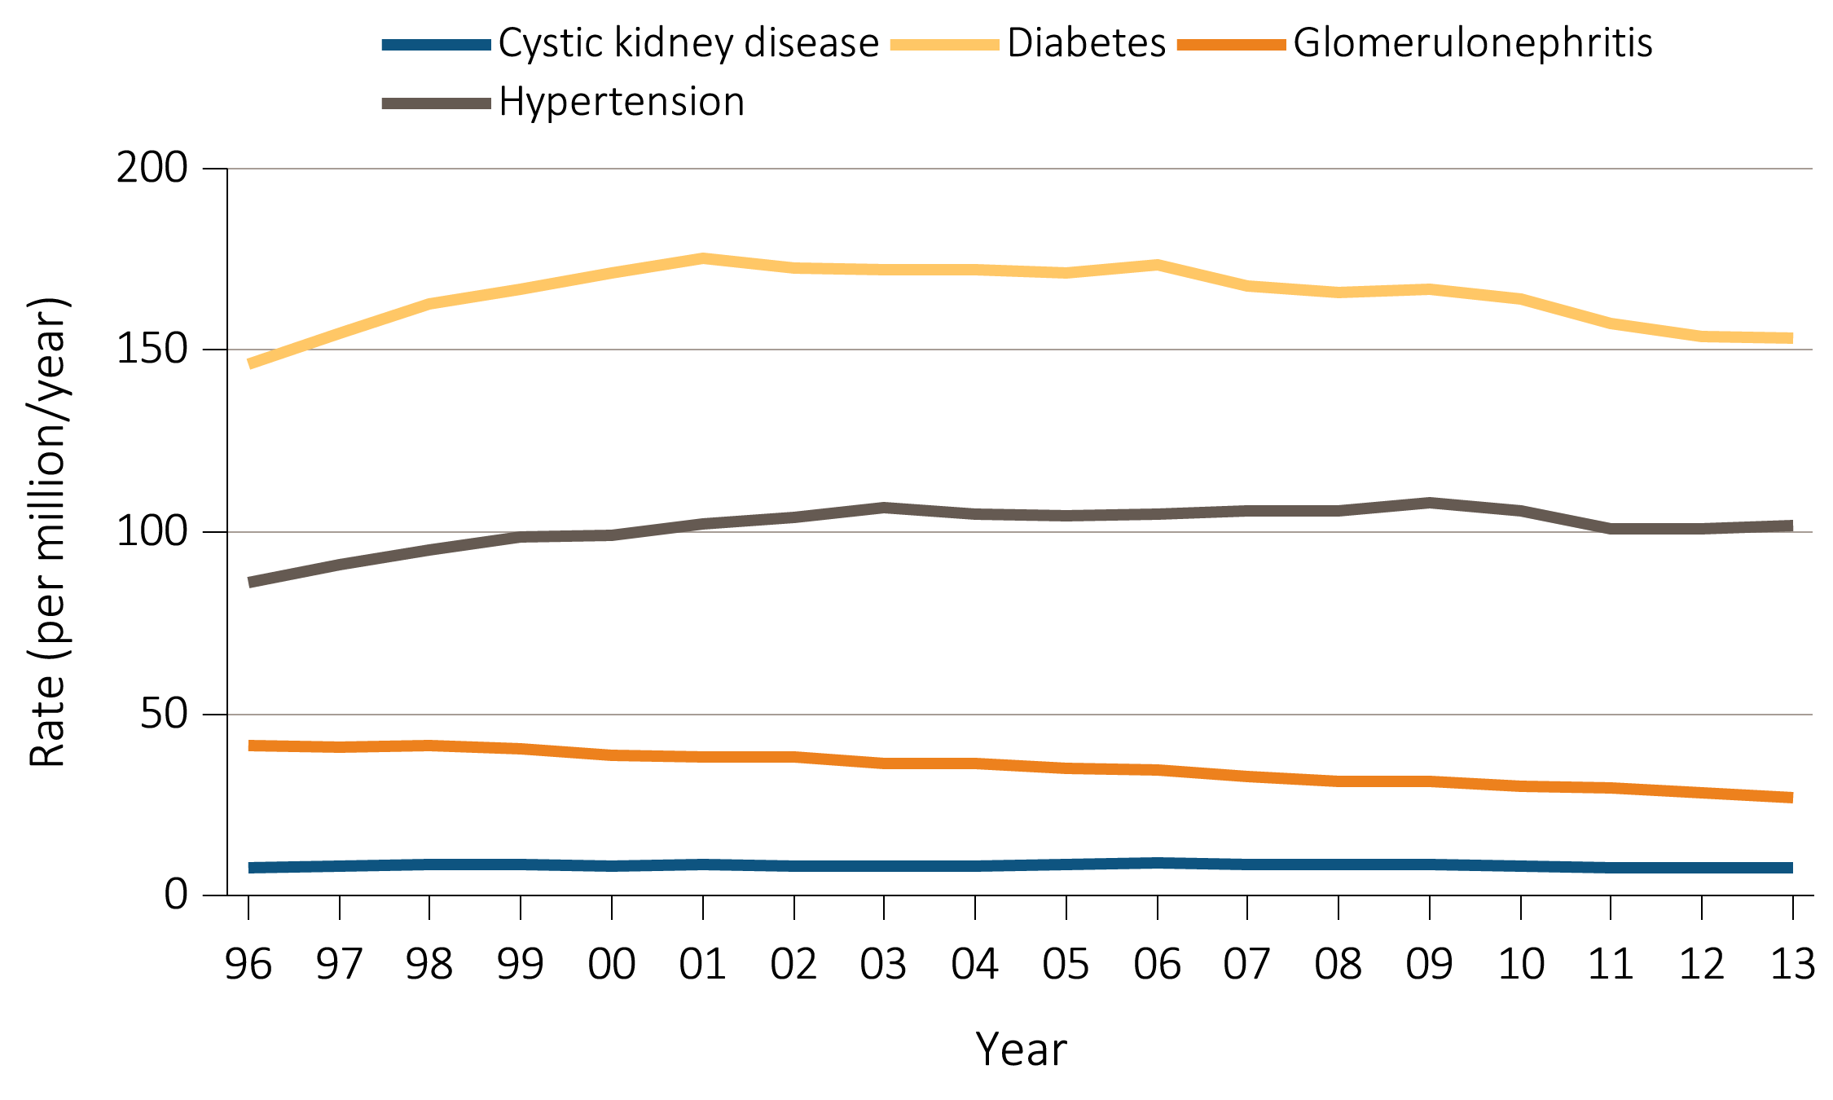
Figure 1.7(b) Trends in adjusted* ESRD incidence rate (per million/year),
by primary cause of ESRD, in the U.S. population, 1996-2013
Data Source: Special analyses, USRDS ESRD Database. *Adjusted for age, sex, and race.
The standard population was the U.S. population in 2011. Abbreviation: ESRD, end-stage renal disease.

Slide 14
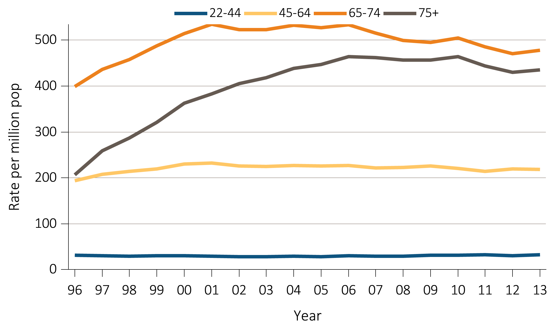
Figure 1.8 Trends in the sex-adjusted incidence rate (per million/year) of ESRD due to diabetes as the primary cause, by age and race, in the U.S. population, 1996-2013
^{(a) White}
Data Source: Special analyses, USRDS ESRD Database. *Adjusted for sex. The standard population was the U.S. population in 2011. Abbreviations: ESRD, end-stage renal disease.

Slide 15
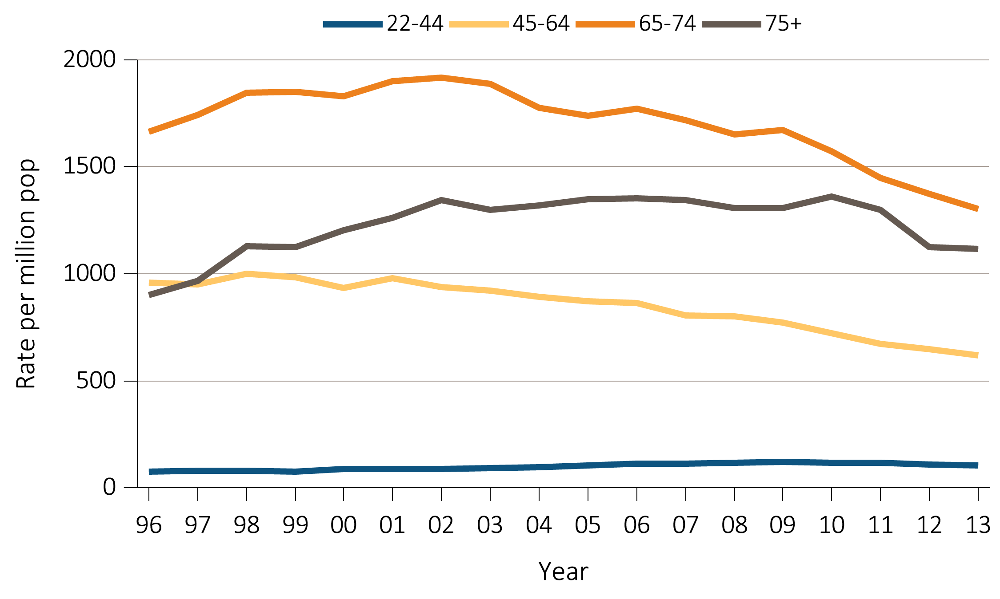
Figure 1.8 Trends in the sex-adjusted incidence rate (per million/year) of ESRD due to diabetes as the primary cause, by age and race, in the U.S. population, 1996-2013
^{(b) Black}
Data Source: Special analyses, USRDS ESRD Database. *Adjusted for sex. The standard population was the U.S. population in 2011. Abbreviations: ESRD, end-stage renal disease.

Slide 16
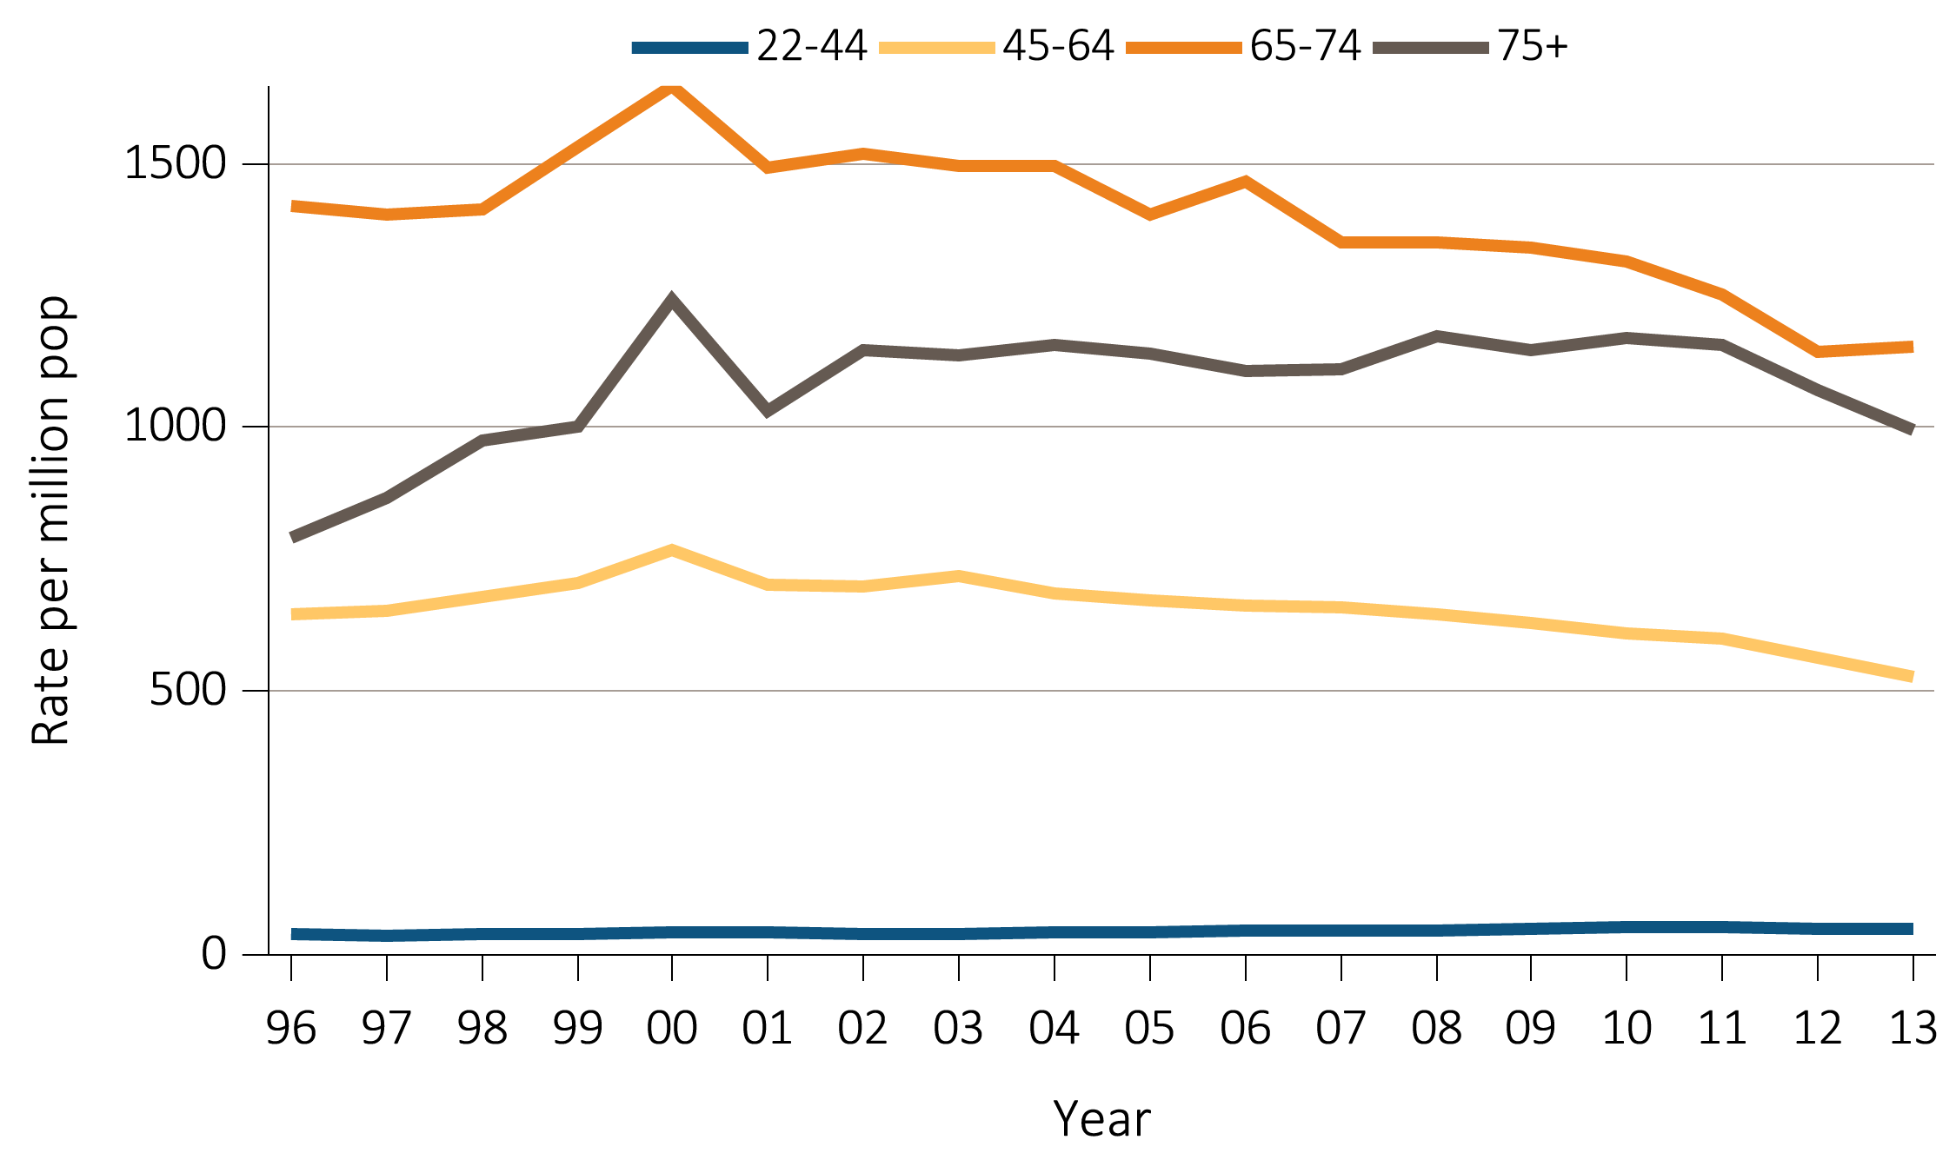
Figure 1.8 Trends in the sex-adjusted incidence rate (per million/year) of ESRD due to diabetes as the primary cause, by age and ethnicity, in the U.S. population, 1996-2013
^{(c) Hispanic}
Data Source: Special analyses, USRDS ESRD Database. *Adjusted for sex. The standard population was the U.S. population in 2011. Abbreviations: ESRD, end-stage renal disease.

Slide 17
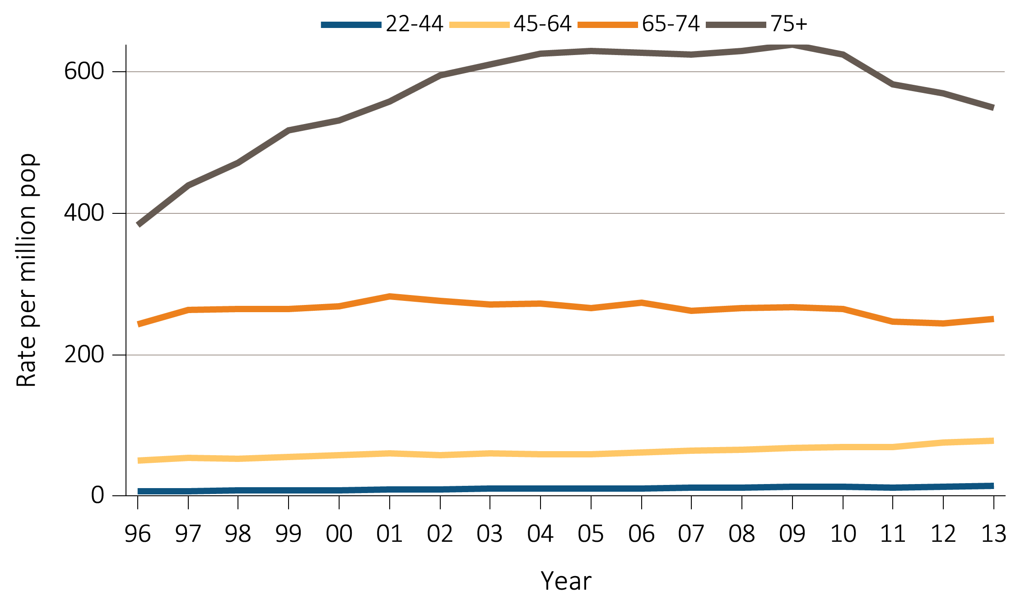
Figure 1.9 Trends in the sex-adjusted incidence rate (per million/year) of ESRD due to hypertension as the primary cause, by age and race, in the U.S. population, 1996-2013
^{(a) White}
Data Source: Special analyses, USRDS ESRD Database. *Adjusted for sex. The standard population was the U.S. population in 2011. Abbreviations: ESRD, end-stage renal disease.

Slide 18
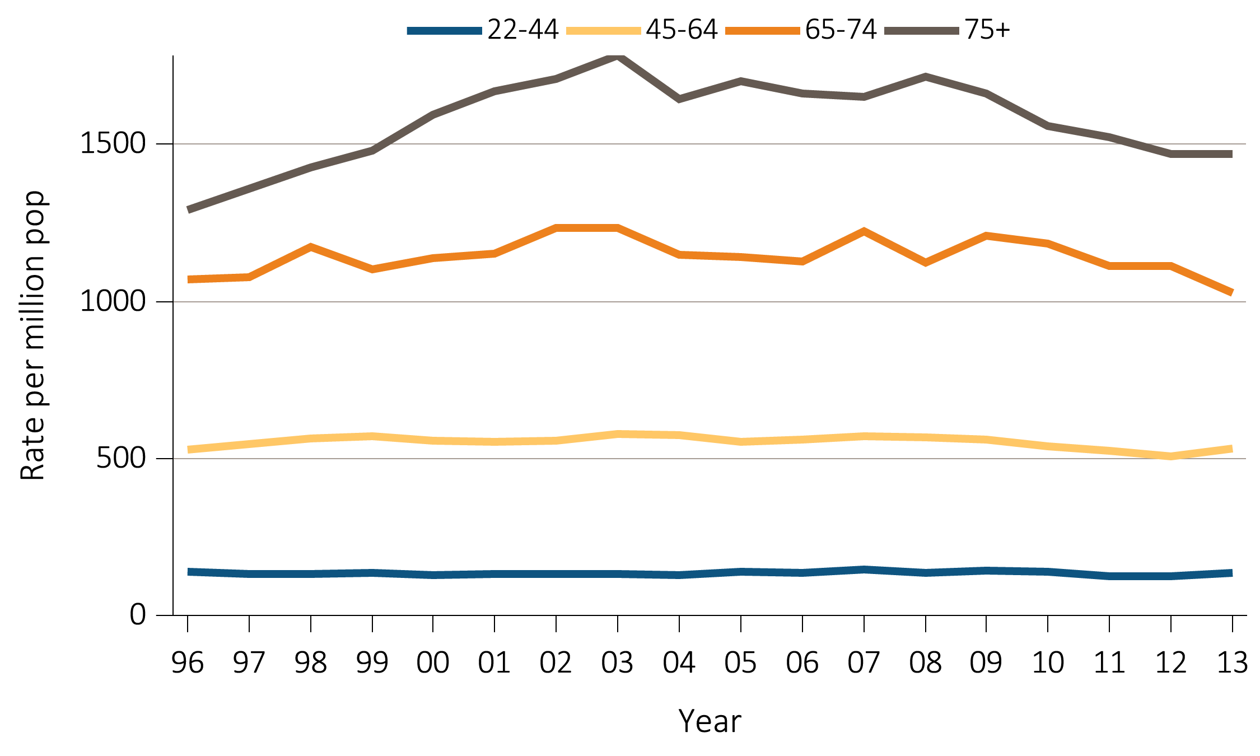
Figure 1.9 Trends in the sex-adjusted incidence rate (per million/year) of ESRD due to hypertension as the primary cause, by age and race, in the U.S. population, 1996-2013
^{(b) Black}
Data Source: Special analyses, USRDS ESRD Database. *Adjusted for sex. The standard population was the U.S. population in 2011. Abbreviations: ESRD, end-stage renal disease.

Slide 19
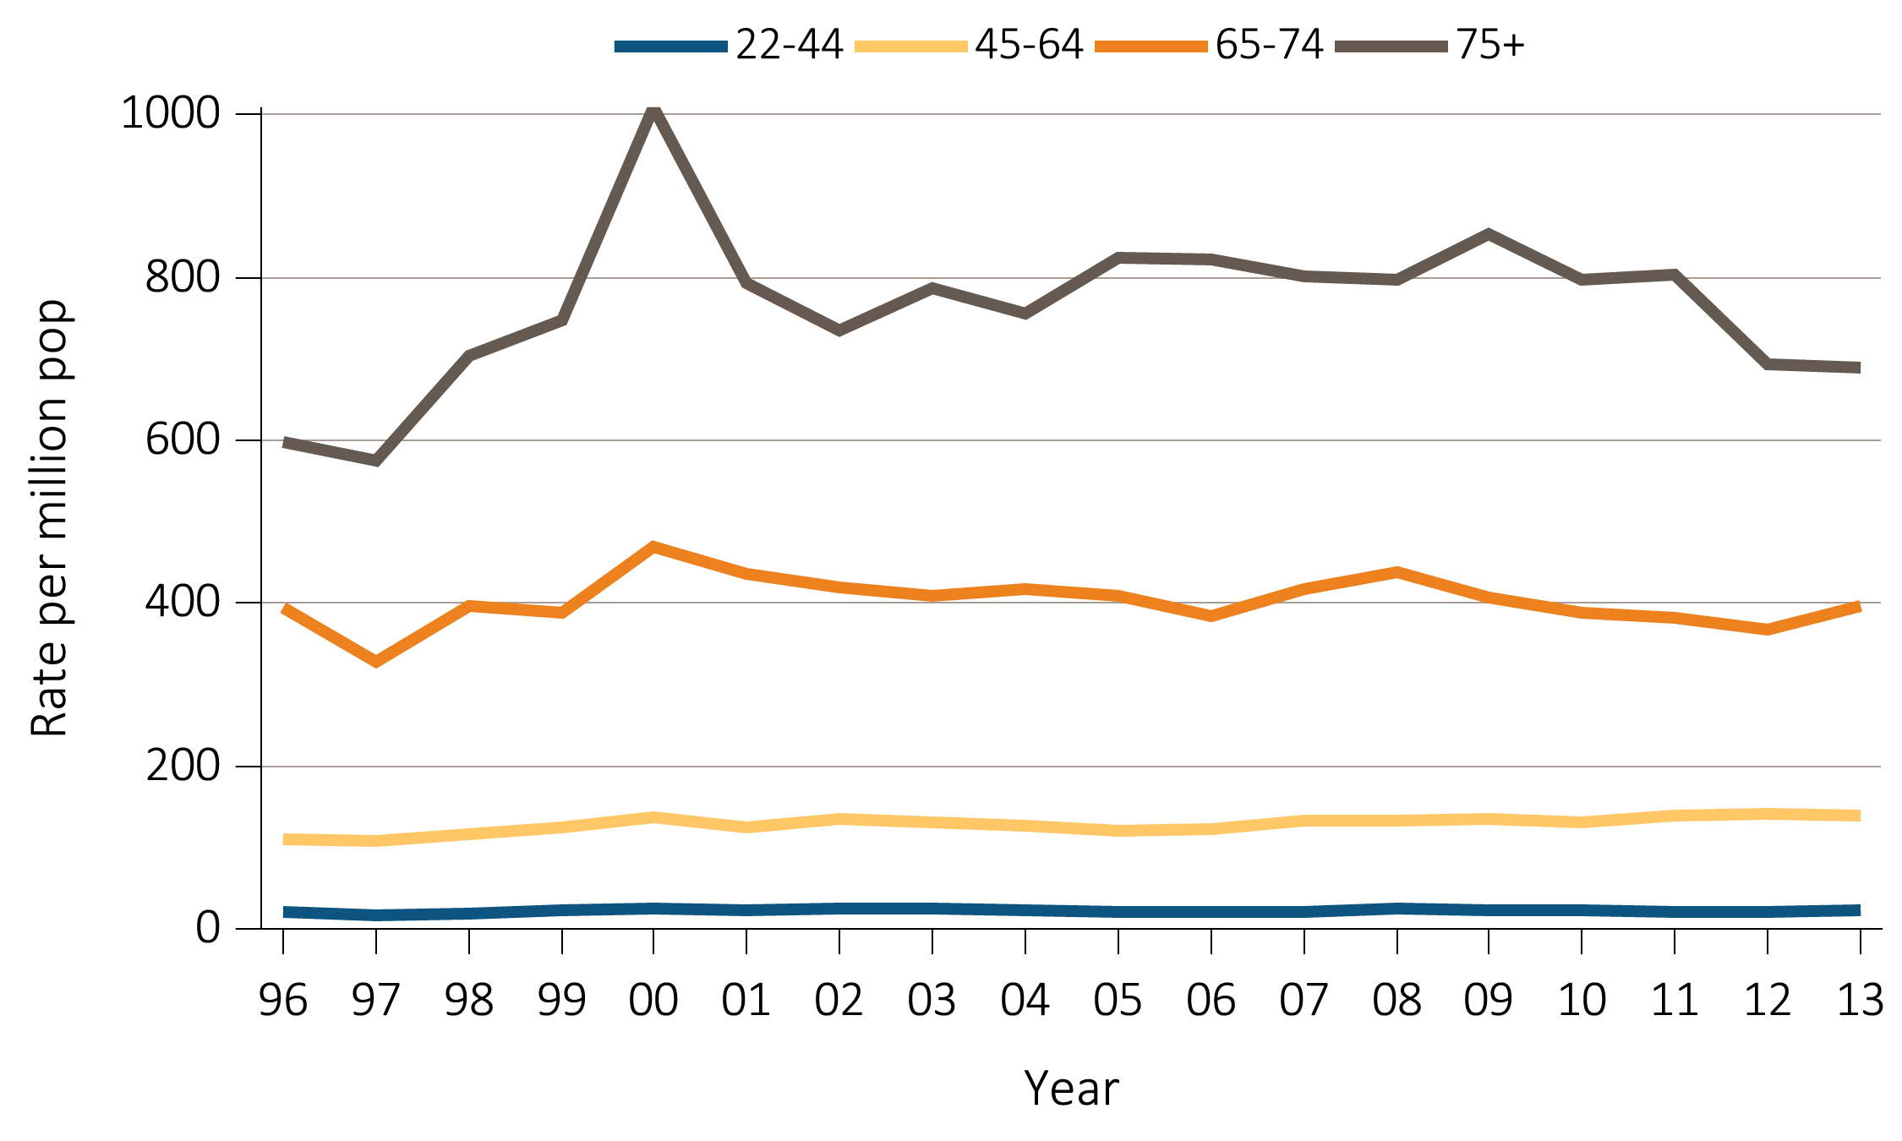
Figure 1.9 Trends in the sex-adjusted incidence rate (per million/year) of ESRD due to hypertension as the primary cause, by age and ethnicity, in the U.S. population, 1996-2013
^{(c) Hispanic}
Data Source: Special analyses, USRDS ESRD Database. *Adjusted for sex. The standard population was the U.S. population in 2011. Abbreviations: ESRD, end-stage renal disease.

Slide 20
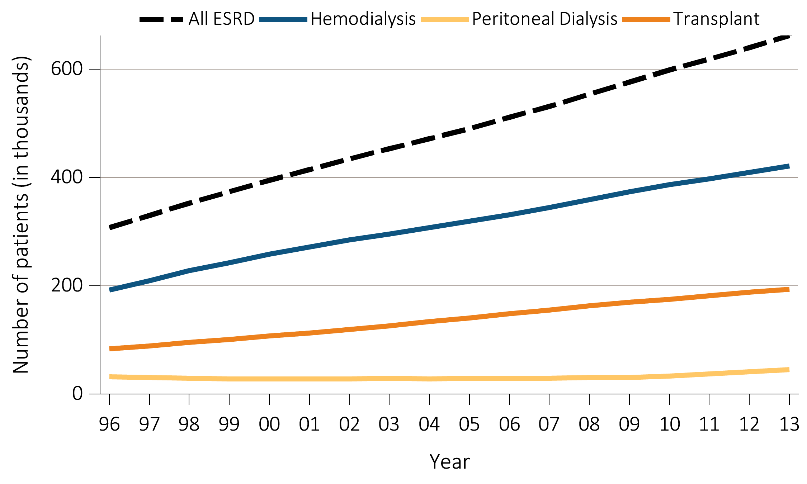
Figure 1.10 Trends in the number of ESRD prevalent cases (in thousands) by modality,
in the U.S. population, 1996-2013
Data Source: Reference Table D.1. Abbreviation: ESRD, end-stage renal disease.

Slide 21
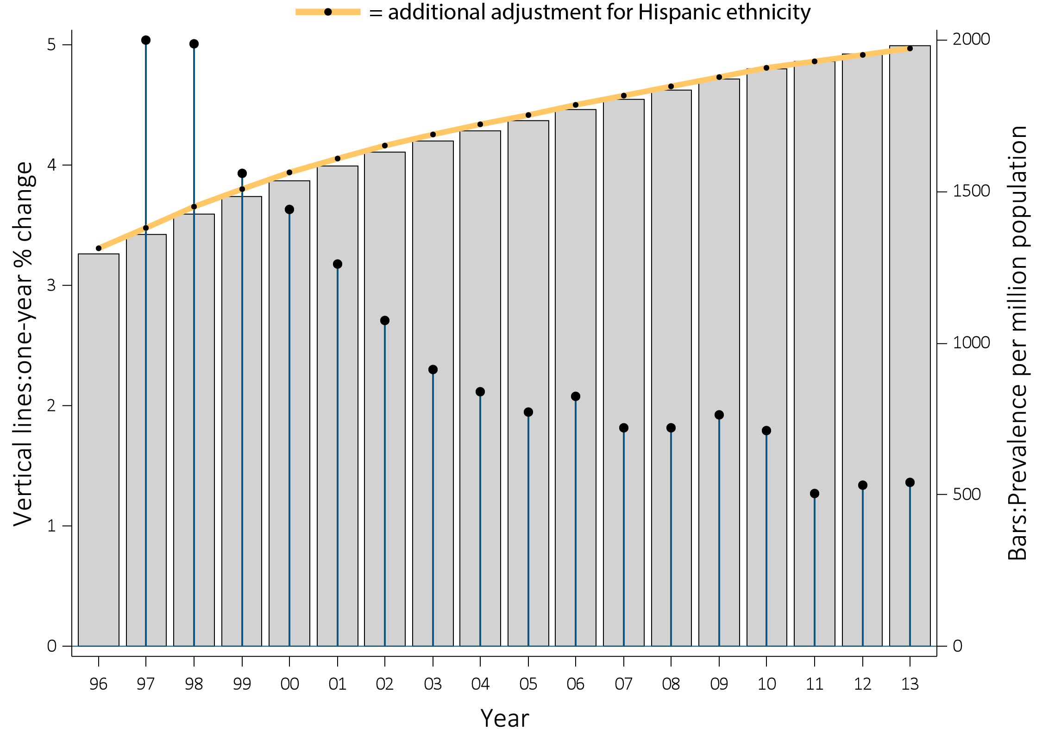
Figure 1.11 Trends in the adjusted* ESRD prevalence (per million)
(bars; scale on left), and annual change (%) in adjusted* prevalence of ESRD
(lines; scale on right), in the U.S. population, 1996-2013
Data Source: Reference Table B.2(2) and special analyses, USRDS ESRD Database. *Adjusted for age, sex, and race.
The standard population was the U.S. population in 2011. Abbreviation: ESRD, end-stage renal disease.

Slide 22
Table 1.2 Adjusted* prevalence (per million) of dialysis in the U.S. population,
and distribution (%) of age, diabetes, sex, race, and ethnicity
among prevalent dialysis patients, by ESRD Network, 2013
Network | States in network | Prevalence per million | Total no. prevalent dialysis cases | % of prevalent dialysis cases | Mean age | % Diabetic | % Male | Race |  |  |  |  | Ethnicity
 |  |  |  |  |  |  |  | % White | % Black / Af Am | % N Am | % Asian |  | % Hisp
16 | AK, ID, MT, OR, WA | 944 | 13,373 | 2.9 | 56.5 | 43.1 | 57.1 | 79.1 | 8.4 | 3.2 | 9.1 |  | 11.2
1 | CT, MA, ME, NH, RI VT | 982 | 14,042 | 3.0 | 59.2 | 39.9 | 58.2 | 75.3 | 20.6 | 0.2 | 3.5 |  | 12.0
15 | AZ, CO, NV, NM, UT, WY | 1,095 | 22,233 | 4.7 | 56.6 | 50.6 | 57.3 | 73.8 | 10.1 | 11.5 | 4.5 |  | 31.0
12 | IA, KS, MO, NE | 1,128 | 15,683 | 3.3 | 57.7 | 40.7 | 56.4 | 68.7 | 29.0 | 0.6 | 1.6 |  | 5.8
11 | MI, MN, ND, SD, WI | 1,188 | 27,191 | 5.8 | 58.0 | 40.9 | 56.7 | 63.0 | 31.0 | 2.8 | 3.1 |  | 4.7
9 | IN, KY, OH | 1,415 | 32,196 | 6.9 | 57.6 | 43.7 | 56.2 | 66.3 | 32.6 | 0.1 | 0.9 |  | 2.9
4 | DE, PA | 1,420 | 19,325 | 4.1 | 58.6 | 40.5 | 57.7 | 63.4 | 34.7 | 0.1 | 1.7 |  | 5.2
7 | FL | 1,434 | 28,218 | 6.0 | 57.9 | 39.8 | 57.6 | 57.3 | 40.1 | 0.2 | 2.2 |  | 17.6
2 | NY | 1,485 | 29,272 | 6.2 | 58.1 | 40.7 | 57.5 | 53.4 | 38.1 | 0.4 | 7.1 |  | 16.4
10 | IL | 1,555 | 19,987 | 4.3 | 57.5 | 38.8 | 56.2 | 56.9 | 39.3 | 0.0 | 3.5 |  | 14.8
5 | MD, DC, VA, WV | 1,588 | 26,760 | 5.7 | 56.6 | 38.1 | 56.0 | 39.2 | 57.3 | 0.1 | 3.3 |  | 4.1
17 | N. CA, HI, GUAM, AS | 1,607 | 26,043 | 5.6 | 57.0 | 49.3 | 55.6 | 51.7 | 14.1 | 0.6 | 33.1 |  | 25.0
13 | AR, LA, OK | 1,620 | 18,543 | 4.0 | 55.0 | 42.3 | 53.8 | 43.4 | 51.4 | 3.8 | 1.3 |  | 3.9
14 | TX | 1,656 | 44,189 | 9.4 | 55.2 | 52.8 | 54.8 | 68.9 | 28.5 | 0.1 | 2.4 |  | 45.2
18 | S. CA | 1,672 | 40,522 | 8.7 | 57.0 | 48.8 | 57.9 | 70.9 | 14.7 | 0.3 | 13.8 |  | 48.1
3 | NJ, PR | 1,674 | 19,203 | 4.1 | 58.7 | 46.7 | 59.2 | 64.3 | 30.9 | 0.0 | 3.6 |  | 38.2
6 | NC, SC, GA | 1,780 | 44,475 | 9.5 | 54.8 | 39.3 | 54.5 | 32.5 | 65.7 | 0.5 | 1.3 |  | 3.0
8 | AL, MS, TN | 1,855 | 26,114 | 5.6 | 55.1 | 40.5 | 54.2 | 38.2 | 60.6 | 0.3 | 0.8 |  | 1.3
 | All | 1,425 | 468,386 | 100.0 | 56.9 | 43.6 | 56.3 | 57.8 | 35.2 | 1.2 | 5.5 |  | 17.9
Data Source: Special analyses, USRDS ESRD Database. *Adjusted for age, sex, and race. The standard population was the U.S. population in 2011. Listed from lowest to highest prevalence per million. Abbreviations: Af Am, African American; ESRD, end-stage renal disease; Hisp, Hispanic; N Am, Native American.

Slide 23
Table 1.3 Adjusted* prevalence (per million) of kidney transplant patients in the
U.S. population, and distribution (%) of age, diabetes, sex, race, and ethnicity
among prevalent transplant patients, by ESRD Network, 2013
Network | States in network | Prevalence per million | Total no. prevalent kidney transplant cases | % of prevalent kidney transplant cases | Mean age | % Diabetic | % Male | Race |  |  |  |  | Ethnicity
 |  |  |  |  |  |  |  | % White | % Black / Af Am | % N Am | % Asian |  | % Hisp
13 | AR, LA, OK | 512 | 5,779 | 3.0 | 41.4 | 23.6 | 60.2 | 65.5 | 30.1 | 2.2 | 2.0 |  | 3.6
14 | TX | 512 | 13,553 | 7.0 | 40.7 | 25.4 | 58.3 | 77.7 | 18.0 | 0.2 | 3.7 |  | 37.8
18 | S. CA | 521 | 12,319 | 6.4 | 40.3 | 20.8 | 59.0 | 75.7 | 10.4 | 0.3 | 13.0 |  | 41.1
6 | NC, SC, GA | 522 | 13,061 | 6.8 | 41.8 | 21.8 | 58.4 | 55.2 | 41.2 | 0.7 | 2.2 |  | 3.2
7 | FL | 535 | 10,578 | 5.5 | 43.9 | 21.3 | 59.1 | 72.1 | 23.1 | 0.3 | 3.6 |  | 19.5
16 | AK, ID, MT, OR, WA | 539 | 7,664 | 4.0 | 42.1 | 23.0 | 58.9 | 83.8 | 5.3 | 1.6 | 8.7 |  | 7.5
15 | AZ, CO, NV, NM, UT, WY | 552 | 11,101 | 5.7 | 42.5 | 28.4 | 58.8 | 84.4 | 5.7 | 5.1 | 4.4 |  | 23.6
8 | AL, MS, TN | 571 | 8,099 | 4.2 | 40.7 | 20.8 | 59.8 | 60.5 | 37.8 | 0.1 | 1.3 |  | 1.6
9 | IN, KY, OH | 579 | 13,151 | 6.8 | 41.9 | 24.0 | 60.5 | 80.2 | 17.7 | 0.1 | 1.4 |  | 2.6
1 | CT, MA, ME, NH, RI VT | 599 | 8,737 | 4.5 | 42.6 | 20.2 | 61.1 | 83.4 | 11.5 | 0.3 | 3.6 |  | 8.5
2 | NY | 618 | 12,519 | 6.5 | 42.7 | 21.1 | 59.5 | 65.8 | 23.5 | 0.7 | 7.0 |  | 18.5
12 | IA, KS, MO, NE | 618 | 8,547 | 4.4 | 42.0 | 23.0 | 60.6 | 83.2 | 13.9 | 0.4 | 2.1 |  | 5.2
17 | N. CA, HI, GUAM, AS | 652 | 10,489 | 5.4 | 41.8 | 22.1 | 58.9 | 63.5 | 9.2 | 0.6 | 24.6 |  | 24.9
4 | DE, PA | 662 | 9,049 | 4.7 | 43.3 | 22.6 | 60.2 | 75.4 | 21.1 | 0.2 | 2.5 |  | 4.3
3 | NJ, PR | 666 | 7,527 | 3.9 | 43.1 | 23.7 | 62.0 | 65.3 | 20.4 | 0.2 | 5.6 |  | 29.7
5 | MD, DC, VA, WV | 667 | 11,098 | 5.7 | 43.1 | 21.9 | 59.4 | 55.6 | 38.6 | 0.2 | 4.9 |  | 4.7
10 | IL | 725 | 9,317 | 4.8 | 42.0 | 23.2 | 59.5 | 71.0 | 23.0 | 0.3 | 4.3 |  | 14.9
11 | MI, MN, ND, SD, WI | 737 | 16,706 | 8.6 | 42.5 | 25.6 | 60.6 | 80.2 | 14.2 | 1.8 | 3.5 |  | 3.4
 | All | 582 | 193,262 | 100.0 | 42.0 | 22.6 | 59.7 | 71.3 | 19.8 | 0.9 | 5.8 |  | 14.5
Data Source: Special analyses, USRDS ESRD Database. *Adjusted for age, sex, and race. The standard population was the U.S. population in 2011. Listed from lowest to highest prevalence per million. Abbreviations: Af Am, African American; ESRD, end-stage renal disease; Hisp, Hispanic; N Am, Native American.

Slide 24
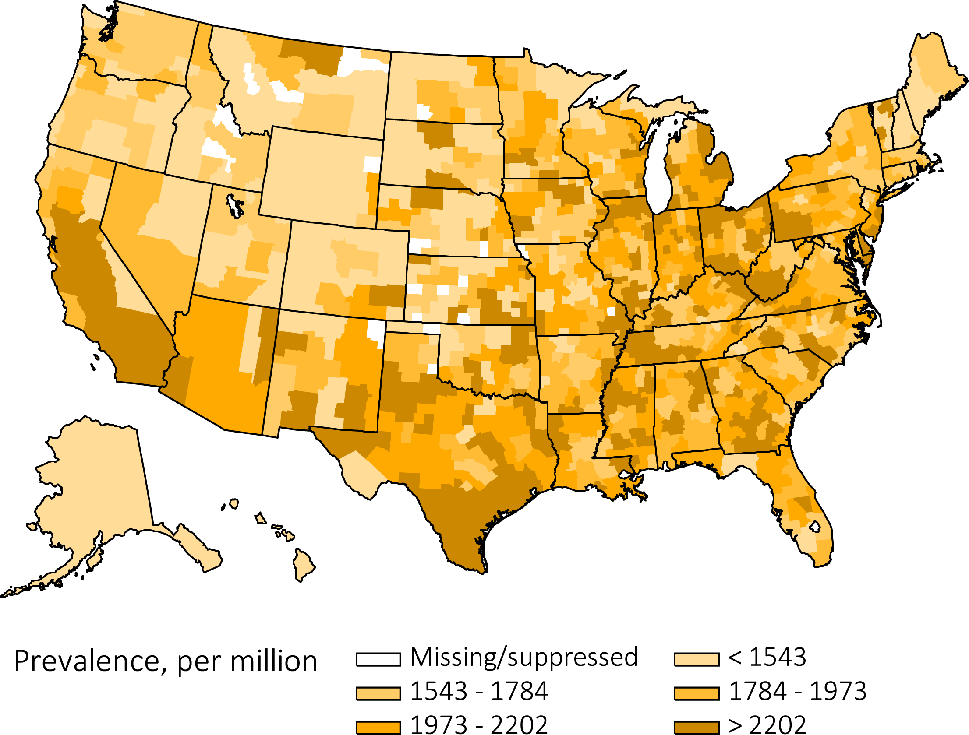
Figure 1.12 Map of the adjusted* prevalence (per million) of ESRD,
by Health Service Area, in the U.S. population, 2013**
Data Source: Special analyses, USRDS ESRD Database. *Adjusted for age, sex, and race. The standard population was the U.S. population in 2011. **Three Health Service Areas were suppressed because the ratio of unadjusted rate to adjusted rate or adjusted rate to unadjusted rate was greater than 3. Abbreviation: ESRD, end-stage renal disease.

Slide 25
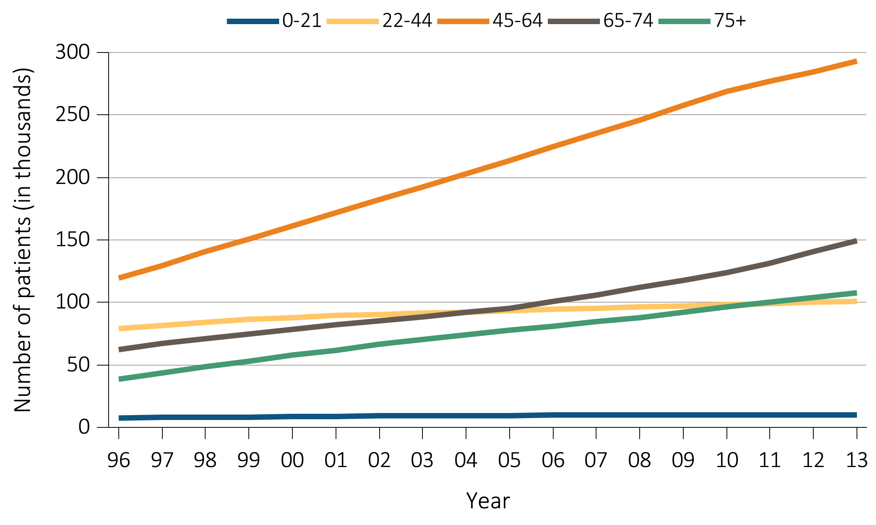
Figure 1.13(a) Trends in number of prevalent ESRD cases (in thousands),
by age group, in the U.S. population, 1996-2013
Data Source: Reference Table B.1. *Point prevalence on December 31 of each year. Abbreviations: ESRD, end-stage renal disease.

Slide 26
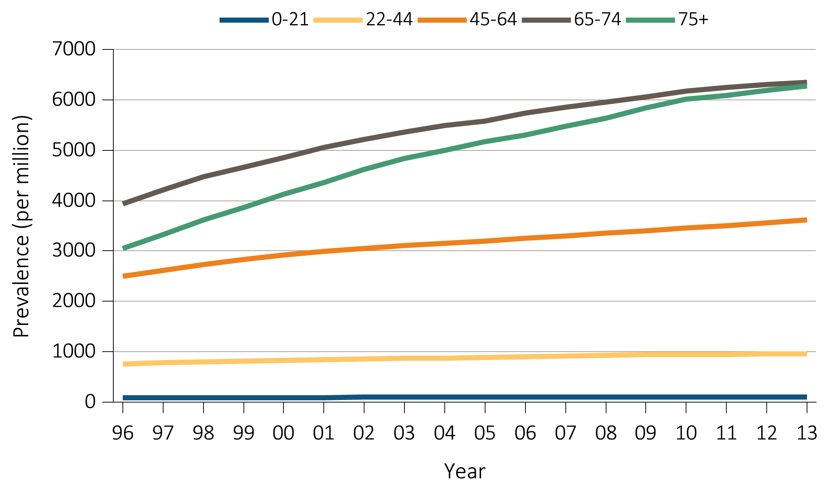
Figure 1.13(b) Trends in the adjusted* prevalence (per million) of ESRD,
by age group, in the U.S. population, 1996-2013
Data Source: Special analyses, USRDS ESRD Database. *Point prevalence on December 31 of each year. Adjusted for sex and race. The standard population was the U.S. population in 2011. Abbreviations: ESRD, end-stage renal disease.

Slide 27
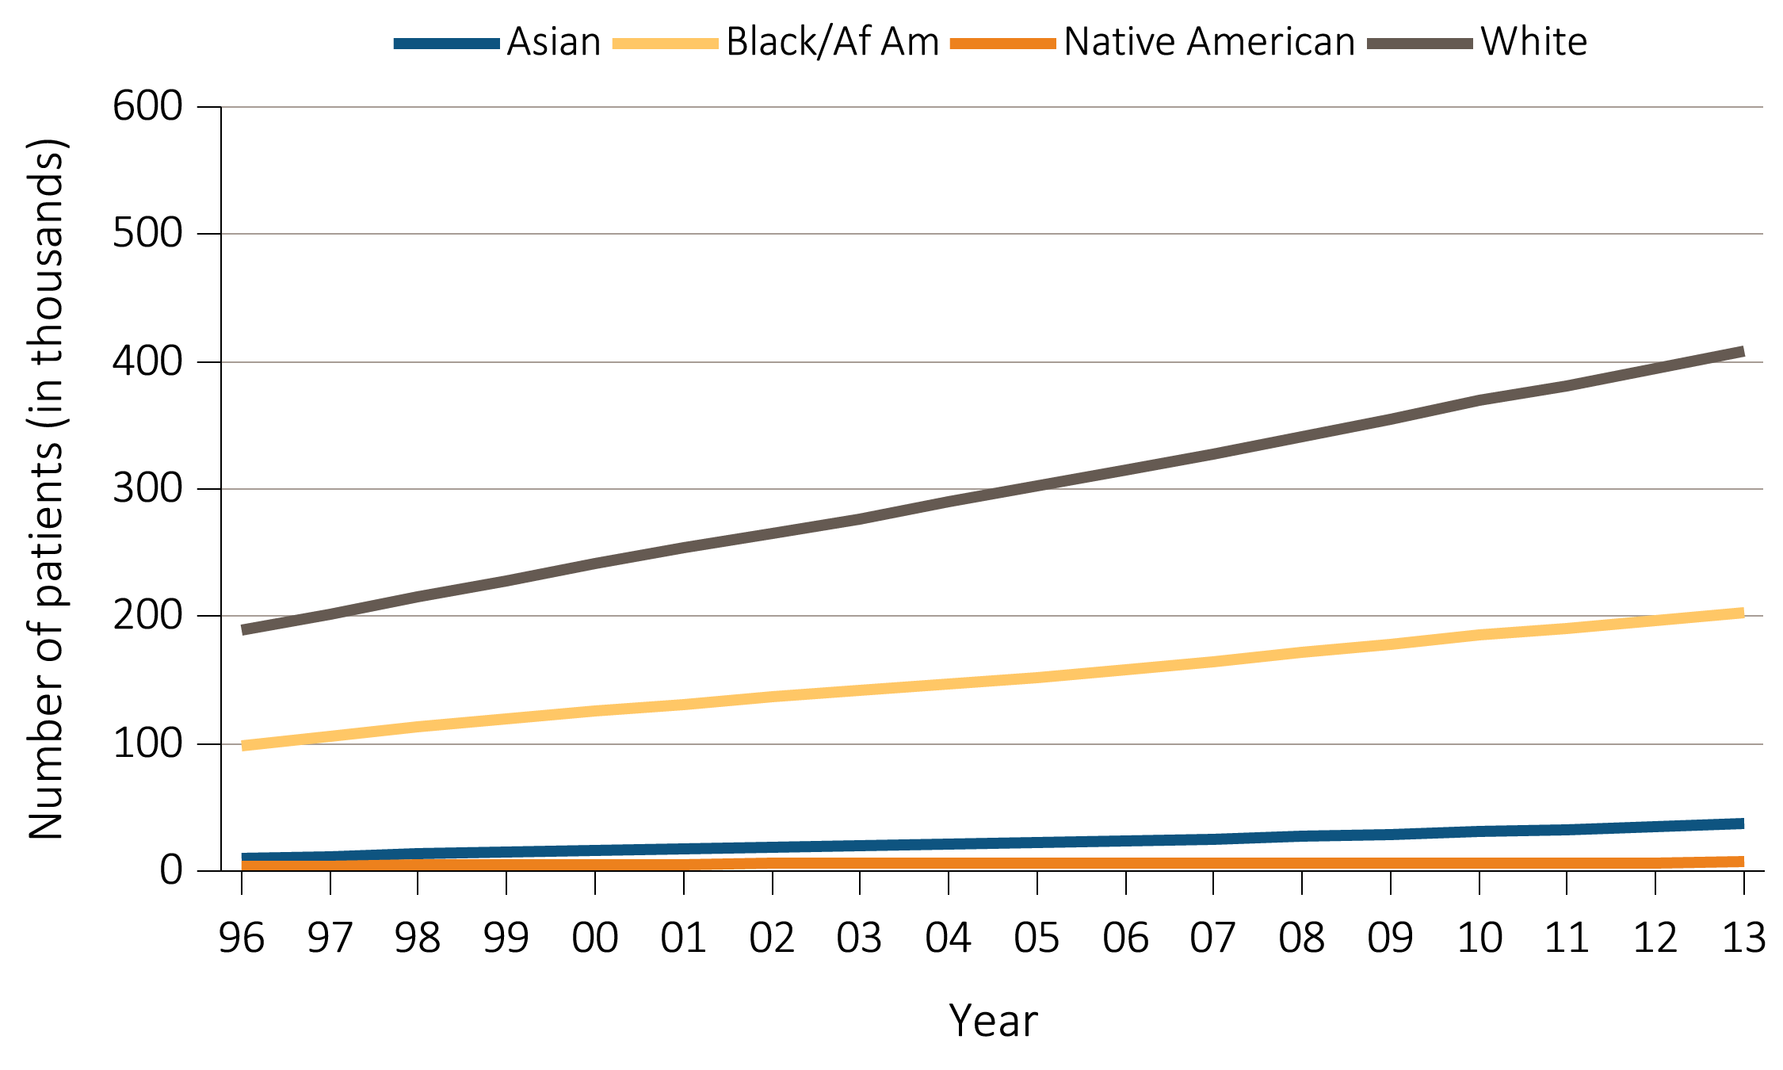
Figure 1.14(a) Trends in number of prevalent ESRD cases (in thousands),
by race, in the U.S. population, 1996-2013
Data Source: Reference Table B.1. *Point prevalence on December 31 of each year. Abbreviations: Af Am, African American; ESRD, end-stage renal disease.

Slide 28
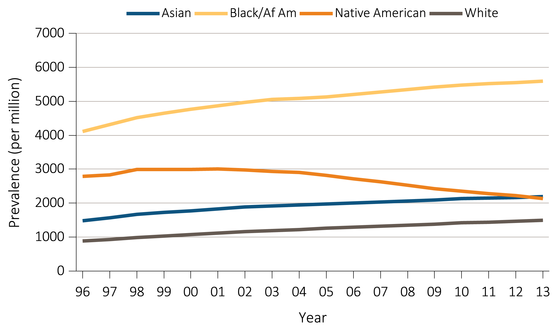
Figure 1.14(b) Trends in the adjusted* prevalence (per million) of ESRD,
by race, in the U.S. population, 1996-2013
Data Source: Special analyses, USRDS ESRD Database. *Point prevalence on December 31 of each year. Adjusted for age and sex. The standard population was the U.S. population in 2011. Abbreviations: Af Am, African American; ESRD, end-stage renal disease.

Slide 29
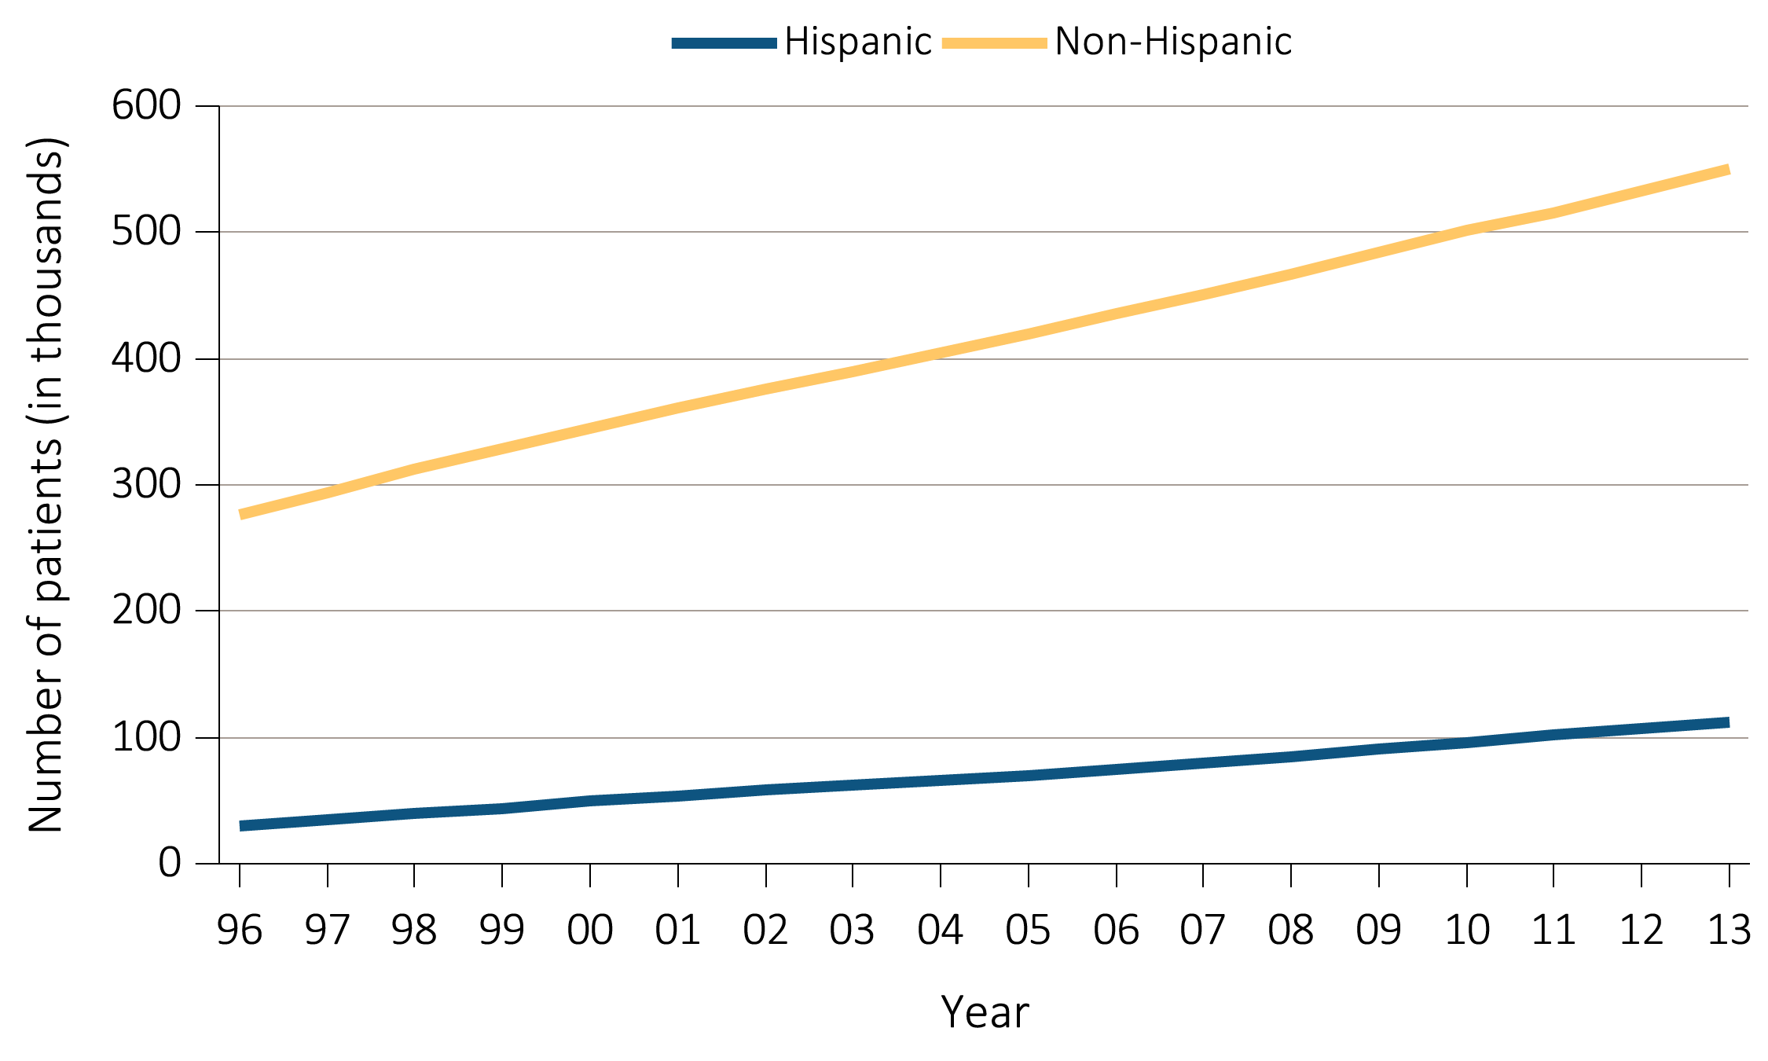
Figure 1.15(a) Trends in number of prevalent ESRD cases (in thousands),
by Hispanic ethnicity, in the U.S. population, 1996-2013
Data Source: Reference Tables B.1.*Point prevalence on December 31 of each year. Abbreviation: ESRD, end-stage renal disease.

Slide 30
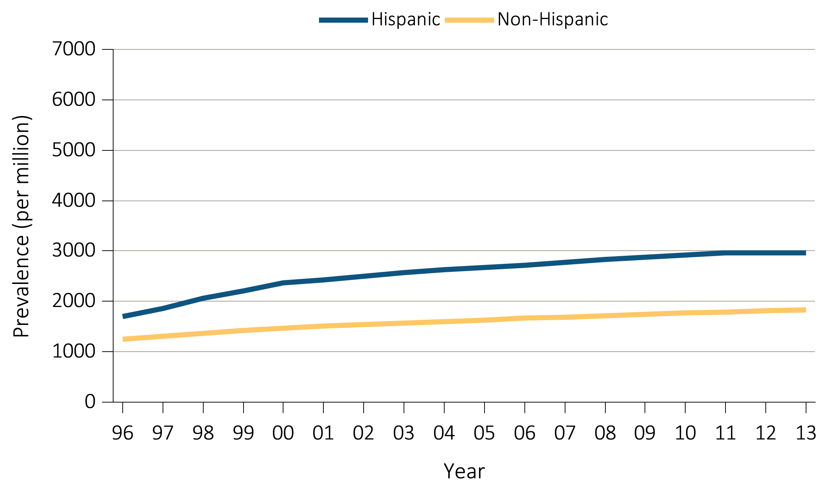
Figure 1.15(b) Trends in the adjusted* prevalence (per million) of ESRD,
by Hispanic ethnicity, in the U.S. population, 1996-2013
Data Source: Reference Tables B.2(2). *Point prevalence on December 31 of each year. Adjusted for age, sex, and race. The standard population was the U.S. population in 2011. Abbreviation: ESRD, end-stage renal disease.

Slide 31
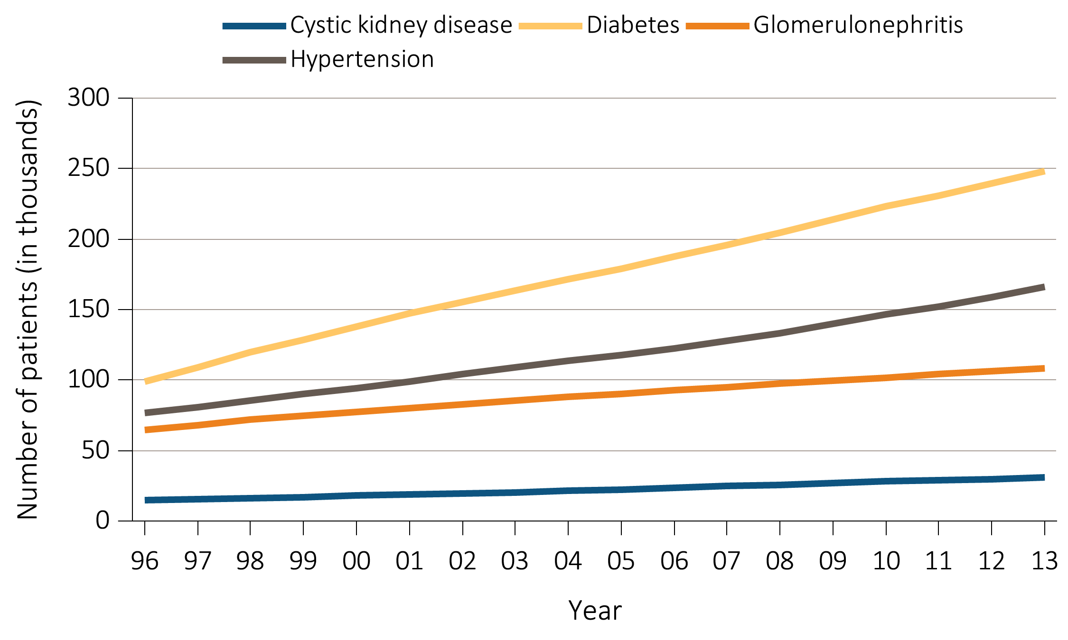
Figure 1.16(a) Trends in number of prevalent ESRD cases (in thousands),
by primary cause of ESRD, in the U.S. population, 1996-2013
Data Source: Reference Table B.1. *Point prevalence on December 31 of each year. Abbreviation: ESRD, end-stage renal disease.

Slide 32
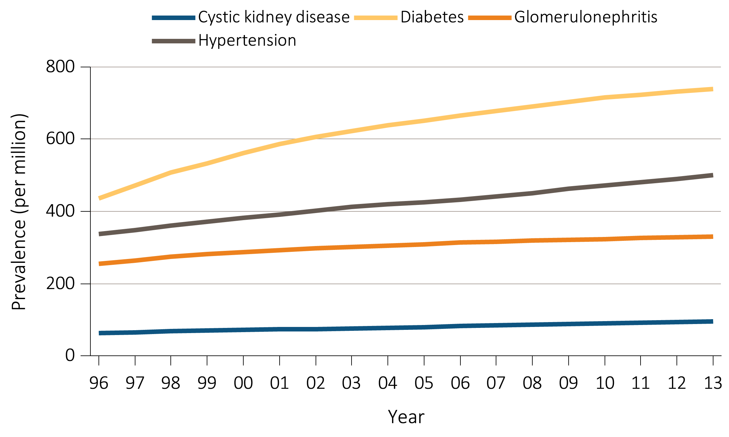
Figure 1.16(b) Trends in adjusted* prevalence (per million) of ESRD,
by primary cause of ESRD, in the U.S. population, 1996-2013
Data Source: Special analyses, USRDS ESRD Database. *Point prevalence on December 31 of each year. Abbreviation: ESRD, end-stage renal disease.

Slide 33
Table 1.4 Distribution (%) of the reported duration of pre-ESRD nephrology care,
among incident ESRD cases in the U.S. population, 2013
(a) Demographic characteristics (% within row)
 | n | >12 mo. | 6-12 mo. | 0-6 mo. | None | Unknown
Total | 114,417 | 30.0 | 18.6 | 13.2 | 25.3 | 12.6
Age
0-21 | 1,550 | 42.8 | 14.6 | 14.2 | 21.9 | 6.3
22-44 | 12,946 | 26.7 | 16.9 | 13.6 | 31.1 | 11.5
45-64 | 44,268 | 27.9 | 18.6 | 13.5 | 27.3 | 12.4
65-74 | 28,554 | 31.8 | 19.5 | 13.1 | 22.5 | 12.7
75+ | 27,099 | 32.4 | 18.6 | 12.7 | 22.3 | 13.7
Sex
Female | 48,833 | 30.1 | 18.8 | 13.3 | 24.6 | 12.9
Male | 65,584 | 30.0 | 18.5 | 13.2 | 25.7 | 12.4
Race
Native American | 1,147 | 28.2 | 20.3 | 17.0 | 26.1 | 8.4
Asian | 5,785 | 30.1 | 19.9 | 13.8 | 22.7 | 13.2
Black | 31,202 | 25.9 | 18.5 | 12.9 | 28.0 | 14.5
White | 76,271 | 31.8 | 18.6 | 13.3 | 24.3 | 11.9
Other/Unknown | 12 | * | * | * | * | *
Ethnicity
Non-Hispanic | 98,367 | 31.2 | 18.7 | 13.2 | 24.4 | 12.2
Hispanic | 16,050 | 23.1 | 17.9 | 13.8 | 30.2 | 14.9
Primary Diagnosis
Diabetes | 52,354 | 30.9 | 20.7 | 13.7 | 22.2 | 12.3
Hypertension | 34,104 | 26.6 | 18.2 | 13.1 | 26.8 | 15.2
Glomerulonephritis | 9,016 | 39.8 | 17.5 | 12.7 | 22.5 | 7.4
Cystic kidney | 2,557 | 57.9 | 16.5 | 9.8 | 9.5 | 6.0
Other/Unknown | 16,386 | 24.5 | 13.6 | 12.8 | 35.8 | 12.3
Data Source: Special analyses, USRDS ESRD Database. Population only includes incident cases with CMS form 2728. *Count ≤10. eGFR calculated using the CKD-EPI equation (CKD-EPI eGFR (ml/min/1.73 m^2) for those aged ≥18 years and the Schwartz equation for those aged <18 years. Abbreviations: CKD-EPI, chronic kidney disease epidemiology calculation; eGFR, estimated glomerular filtration rate; ESA, erythropoiesis-stimulating agents; RRT, renal replacement therapy.

Slide 34
Table 1.4 Distribution (%) of the reported duration of pre-ESRD nephrology care,
among incident ESRD cases in the U.S. population, 2013
(b) Clinical characteristics (% within column)
 | n | >12 mo. | 6-12 mo. | 0-6 mo. | None | Unknown
Total | 114,417 | 30.0 | 18.6 | 13.2 | 25.3 | 12.6
Dietary care
No | 105,311 | 85.7 | 89.2 | 88.3 | 99.7 | 99.8
Yes | 9,106 | 14.3 | 10.8 | 11.7 | 0.3 | 0.2
ESA use
No | 96,661 | 72.0 | 78.9 | 80.6 | 98.2 | 98.9
Yes | 17,756 | 28.0 | 21.1 | 19.4 | 1.8 | 1.1
eGFR at RRT start
<5 | 15,660 | 11.1 | 11.5 | 12.4 | 19.0 | 13.7
5-<10 | 52,610 | 48.8 | 47.6 | 45.8 | 43.2 | 42.9
10-<15 | 31,548 | 29.2 | 29.4 | 29.1 | 24.0 | 26.7
≥15 | 14,436 | 10.8 | 11.5 | 12.7 | 13.6 | 16.5
Vascular Access
AV fistula | 17,115 | 26.9 | 20.1 | 11.2 | 2.5 | 8.1
AV graft | 2,884 | 3.7 | 3.2 | 2.4 | 1.0 | 1.8
CV Catheter only | 60,908 | 32.2 | 41.6 | 55.4 | 77.4 | 70.3
CVC with maturing fistula/graft | 20,233 | 18.1 | 20.7 | 19.3 | 15.2 | 15.6
Other/Unknown | 13,277 | 19.1 | 14.4 | 11.7 | 3.8 | 4.2
Data Source: Special analyses, USRDS ESRD Database. Population only includes incident cases with CMS form 2728. *Count ≤10. eGFR calculated using the CKD-EPI equation (CKD-EPI eGFR (ml/min/1.73 m^2) for those aged ≥18 years and the Schwartz equation for those aged <18 years. Abbreviations: CKD-EPI, chronic kidney disease epidemiology calculation; eGFR, estimated glomerular filtration rate; ESA, erythropoiesis-stimulating agents; RRT, renal replacement therapy.

Slide 35
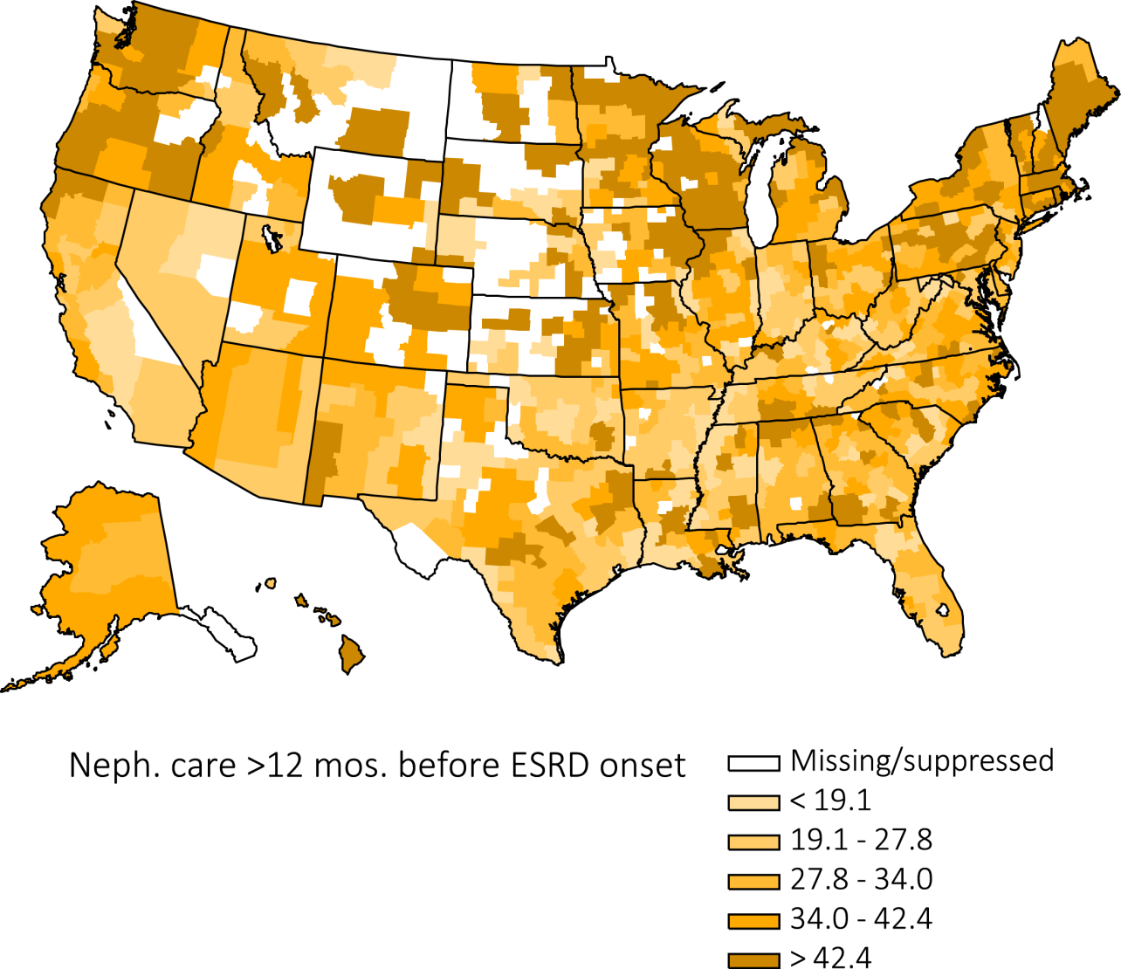
Figure 1.17 Percent of incident cases who had received >12 months
of pre-ESRD nephrology care, by Health Service Area, 2013
Data Source: Special analyses, USRDS ESRD Database. Population only includes incident cases with CMS form 2728. Abbreviations: ESRD, end-stage renal disease; Neph., nephrology.

Slide 36
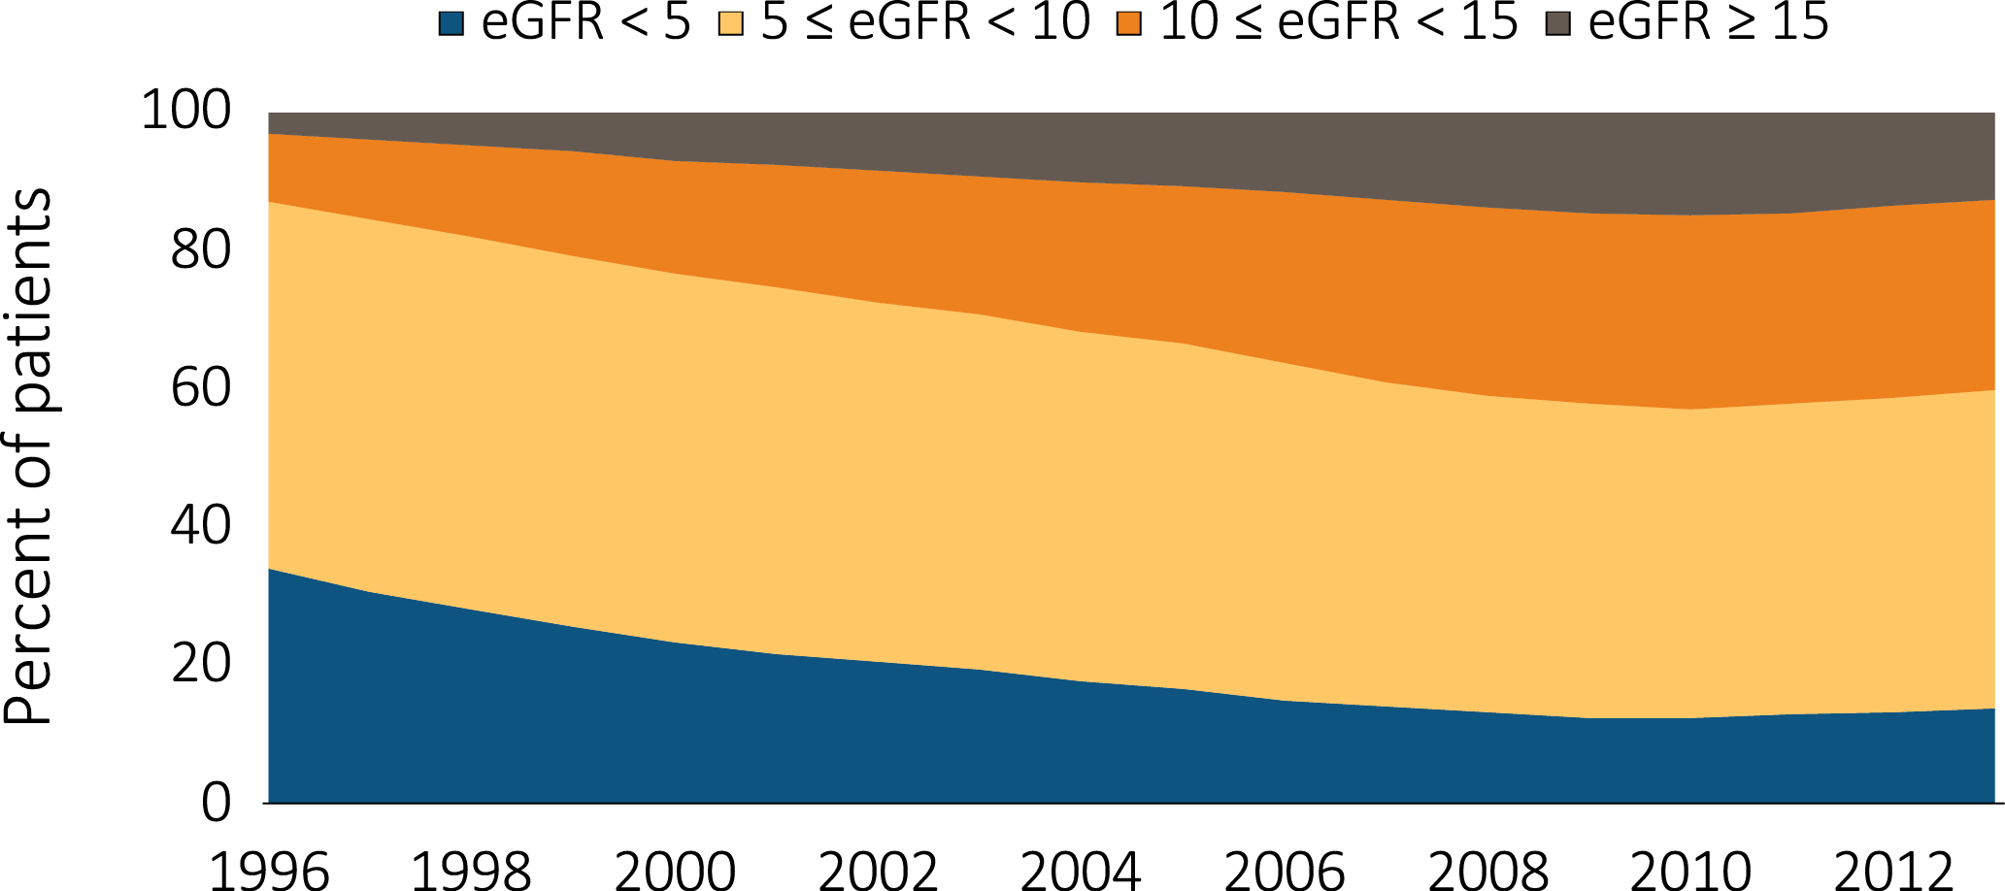
Figure 1.18 Trends in the distribution (%) of eGFR (ml/min/1.73 m^2)
among incident ESRD patients, 1996-2013
Data Source: Special analyses, USRDS ESRD Database. Population only includes incident cases with CMS form 2728.
eGFR calculated using the CKD-EPI equation (CKD-EPI eGFR (ml/min/1.73 m^2) for those aged ≥18 and the Schwartz equation for those aged <18. Abbreviations: CKD-EPI; chronic kidney disease epidemiology calculation; eGFR, estimated glomerular filtration rate; ESRD, end-stage renal disease.

Slide 37
Table 1.5 Distributions of laboratory values (mean) and treatment characteristics (%),
by age, sex, race, ethnicity, and primary cause of ESRD, among incident ESRD cases, 2013
 | eGFR (ml/min/1.73 m^2) | Anemia |  |  | Nutrition |  |  | Lipids |  |  | Diabetes
 |  | Serum albumin (g/dl) | Dietary Care (%) |  | Hemoglobin (g/dl) | ESA Use (%) |  | Total Cholesterol (mg/dl) | LDL (mg/dl) |  | HbA1c (%)
Age
0-21 | 13.15 | 3.4 | 36.4 |  | 9.7 | 27.6 |  | 184 | 107.1 |  | 5.35
22-44 | 9.48 | 3.2 | 7.2 |  | 9.5 | 10.9 |  | 173 | 102.1 |  | 6.95
45-64 | 10.12 | 3.2 | 7.8 |  | 9.6 | 12.7 |  | 161 | 93.0 |  | 6.85
65-74 | 10.44 | 3.3 | 7.8 |  | 9.7 | 15.9 |  | 147 | 81.8 |  | 6.68
75+ | 10.54 | 3.3 | 6.9 |  | 9.7 | 17.4 |  | 142 | 77.9 |  | 6.46
Sex
Male | 10.59 | 3.3 | 8.1 |  | 9.7 | 13.4 |  | 149 | 85.0 |  | 6.69
Female | 9.84 | 3.2 | 7.5 |  | 9.5 | 16.3 |  | 165 | 92.9 |  | 6.79
Race
White | 10.53 | 3.3 | 8.2 |  | 9.7 | 14.9 |  | 152 | 85.9 |  | 6.76
Black | 9.84 | 3.2 | 6.5 |  | 9.3 | 13.1 |  | 162 | 94.5 |  | 6.67
Native American | 9.77 | 2.8 | 7.7 |  | 9.5 | 15.1 |  | 152 | 81.8 |  | 6.83
Asian | 8.95 | 3.4 | 10.7 |  | 9.6 | 19.7 |  | 160 | 88.7 |  | 6.68
Ethnicity
Hispanic | 9.75 | 3.2 | 7.3 |  | 9.5 | 12.6 |  | 157 | 88.2 |  | 6.83
Non-Hispanic | 10.35 | 3.3 | 7.9 |  | 9.7 | 15.0 |  | 155 | 88.2 |  | 6.71
Primary Cause of ESRD
Diabetes | 10.47 | 3.2 | 7.6 |  | 9.6 | 16.6 |  | 153 | 86.7 |  | 7.05
Hypertension | 9.80 | 3.3 | 6.0 |  | 9.6 | 12.8 |  | 153 | 87.8 |  | 6.20
Glomerulonephritis | 9.37 | 3.3 | 12.3 |  | 9.6 | 19.5 |  | 176 | 101.3 |  | 5.76
Cystic kidney | 9.48 | 3.8 | 15.8 |  | 11.1 | 16.1 |  | 164 | 94.0 |  | 5.72
All | 10.27 | 3.3 | 7.9 |  | 9.6 | 14.6 |  | 155 | 88.2 |  | 6.73
Data Source: Special analyses, USRDS ESRD Database. Population only includes incident cases with CMS form 2728. eGFR calculated using the CKD-EPI equation (CKD-EPI eGFR (ml/min/1.73 m^2) for those aged ≥18 years and the Schwartz equation for those aged <18 years. Abbreviations: CKD-EPI; chronic kidney disease epidemiology calculation; eGFR, estimated glomerular filtration rate; ESA, erythropoiesis-stimulating agents; ESRD, end-stage renal disease; HbA1c, glycosylated hemoglobin; Hgb, hemoglobin; LDL, low-density lipoprotein.

Slide 38
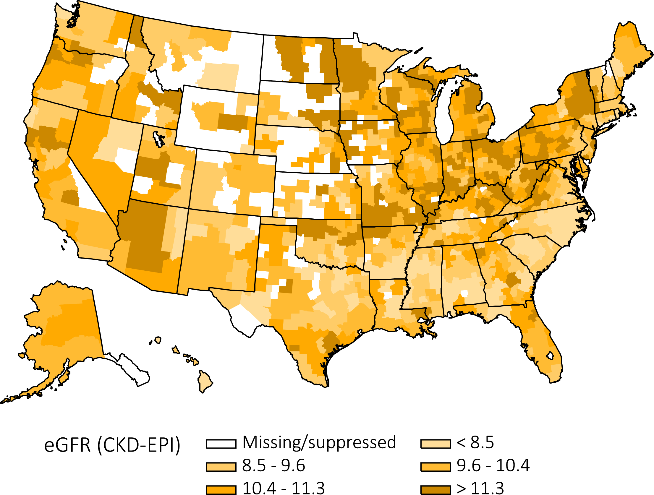
Figure 1.19 Map of average eGFR at initiation of renal replacement therapy,
^{by Health Service Area, 2013}
Data Source: Special analyses, USRDS ESRD Database. Population only includes incident cases with CMS form 2728.
eGFR calculated using the CKD-EPI equation (CKD-EPI eGFR (ml/min/1.73 m^2) for those aged ≥18 and the Schwartz equation for those aged <18. Abbreviations: eGFR, estimated glomerular filtration rate; CKD-EPI, chronic kidney disease epidemiology calculation.

Slide 39
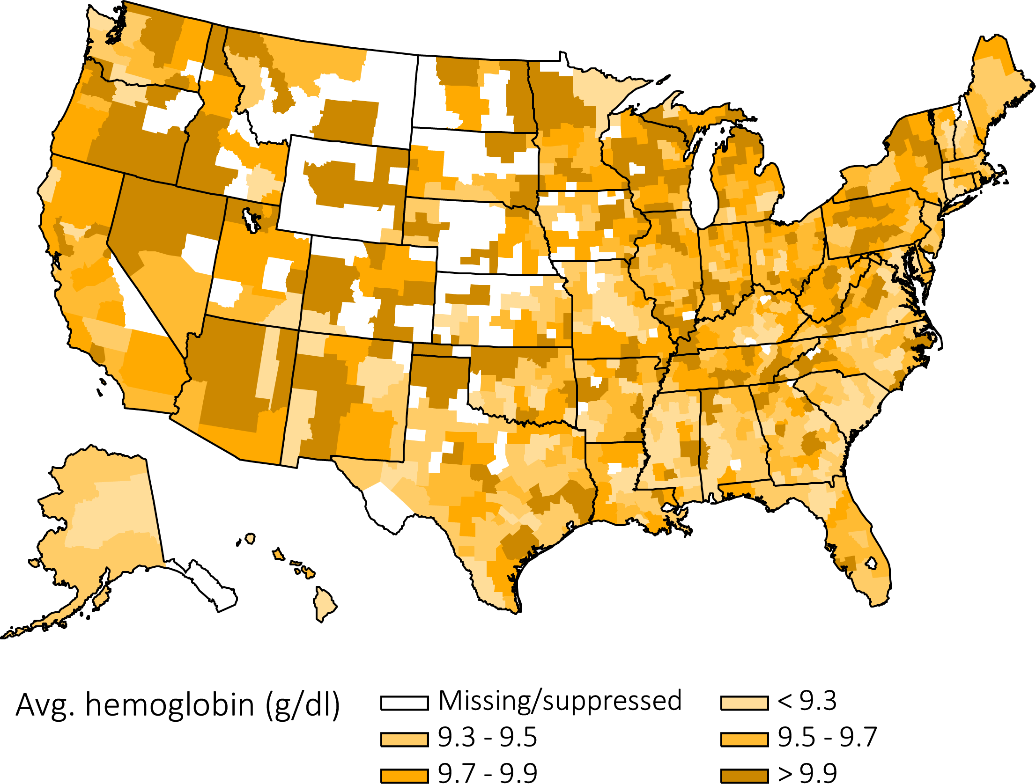
Figure 1.20 Map of average hemoglobin level at initiation of renal replacement therapy,
^{by Health Service Area, 2013}
Data Source: Special analyses, USRDS ESRD Database. Population only includes incident cases with CMS form 2728. Abbreviation: ESRD, end-stage renal disease.

Slide 40
Table 1.6 Distribution (%) of mean duration of pre-ESRD nephrology care, mean hemoglobin level, eGFR, by ESRD Network, among incident ESRD cases, 2013
Network | States in network | Mean duration of ore-ESRD nephrology care |  |  |  |  | eGFR (ml/min/ 1.73 m²) | Hgb (g/dl)
 |  | >12 months | 6-12 months | 0-6 months | None | Unknown
18 | S. CA | 18.7 | 16.0 | 17.2 | 25.2 | 22.9 | 10.4 | 9.8
10 | IL | 24.1 | 17.2 | 13.1 | 22.7 | 22.8 | 10.3 | 9.7
14 | TX | 25.2 | 18.5 | 13.3 | 30.5 | 12.5 | 9.5 | 9.4
13 | AR, LA, OK | 25.6 | 20.1 | 11.9 | 28.4 | 14.0 | 9.7 | 9.6
5 | MD, DC, VA, WV | 25.8 | 21.7 | 13.3 | 26.7 | 12.4 | 9.7 | 9.4
7 | FL | 26.8 | 17.7 | 12.7 | 29.0 | 13.8 | 10.1 | 9.6
3 | NJ, PR | 28.6 | 19.2 | 9.4 | 35.6 | 7.2 | 9.8 | 9.7
9 | IN, KY, OH | 29.4 | 21.1 | 11.9 | 21.9 | 15.7 | 10.8 | 9.6
17 | N. CA, HI, GUAM, AS | 29.6 | 19.6 | 15.7 | 21.9 | 13.2 | 10.0 | 9.6
8 | AL, MS, TN | 29.9 | 18.6 | 13.4 | 27.8 | 10.3 | 9.2 | 9.5
2 | NY | 32.4 | 17.3 | 12.1 | 24.7 | 13.4 | 9.5 | 9.5
15 | AZ, CO, NV, NM, UT, WY | 32.8 | 19.0 | 15.7 | 22.1 | 10.4 | 10.5 | 10.2
6 | NC, SC, GA | 33.2 | 19.2 | 13.5 | 23.8 | 10.3 | 9.0 | 9.5
12 | IA, KS, MO, NE | 35.8 | 18.3 | 12.2 | 24.8 | 8.9 | 10.7 | 9.6
4 | DE, PA | 36.1 | 18.7 | 14.1 | 21.7 | 9.4 | 10.5 | 9.7
11 | MI, MN, ND, SD, WI | 38.6 | 16.1 | 12.2 | 24.6 | 8.5 | 10.7 | 9.6
16 | AK, ID, MT, OR, WA | 41.4 | 18.4 | 14.7 | 21.8 | 3.8 | 10.1 | 10.1
1 | CT, MA, ME, NH, RI VT | 45.3 | 20.5 | 10.3 | 15.9 | 8.0 | 9.4 | 9.5
All |  | 30.1 | 18.7 | 13.3 | 25.3 | 12.6 | 10.0 | 9.6
Data Source: Special analyses, USRDS ESRD Database. Population only includes incident cases with CMS form 2728. eGFR calculated using the CKD-EPI equation (CKD-EPI eGFR (ml/min/1.73 m^2) for those aged ≥18 and the Schwartz equation for those aged <18. Abbreviations: ESRD, end-stage renal disease; eGFR, estimated glomerular filtration rate; CKD-EPI, chronic kidney disease epidemiology calculation; Hgb, hemoglobin.

Slide 41
Table 1.7 Number and percentage of incident cases of hemodialysis, peritoneal dialysis, and transplantation by age, sex, race, ethnicity, and primary cause of ESRD,
^{in the U.S. population, 2013}
 |  |  |  |  | HD |  | PD |  | Transplant
 |  |  |  | Total | n | % | n | % | n | %
Age
 | 0-21 |  |  | 1,470 | 832 | 56.6 | 371 | 25.2 | 267 | 18.2
 | 22-44 |  |  | 12,977 | 10,472 | 80.7 | 1,793 | 13.8 | 712 | 5.5
 | 45-64 |  |  | 45,566 | 39,593 | 86.9 | 4,515 | 9.9 | 1,458 | 3.2
 | 65-74 |  |  | 29,453 | 26,598 | 90.3 | 2,296 | 7.8 | 559 | 1.9
 | 75+ |  |  | 27,524 | 25,887 | 94.1 | 1,587 | 5.8 | 50 | 0.2
Sex
 | Male |  |  | 67,580 | 59,865 | 88.6 | 5,992 | 8.9 | 1,723 | 2.5
 | Female |  |  | 49,410 | 43,517 | 88.1 | 4,570 | 9.2 | 1,323 | 2.7
Race
 | White |  |  | 79,244 | 69,447 | 87.6 | 7,479 | 9.4 | 2,318 | 2.9
 | Black / African American |  |  | 30,664 | 28,038 | 91.4 | 2,292 | 7.5 | 334 | 1.1
 | Native American |  |  | 1,040 | 932 | 89.6 | 71 | 6.8 | 37 | 3.6
 | Asian |  |  | 5,714 | 4,721 | 82.6 | 698 | 12.2 | 295 | 5.2
 | Other/Unknown |  |  | 328 | 244 | 74.4 | 22 | 6.7 | 62 | 18.9
Ethnicity
 | Hispanic |  |  | 17,276 | 15,527 | 89.9 | 1,460 | 8.5 | 289 | 1.7
 | Non-Hispanic |  |  | 99,714 | 87,855 | 88.1 | 9,102 | 9.1 | 2,757 | 2.8
Primary cause of ESRD
 | Diabetes |  |  | 51,339 | 46,502 | 90.6 | 4,392 | 8.6 | 445 | 0.9
 | Hypertension |  |  | 33,585 | 30,459 | 90.7 | 2,850 | 8.5 | 276 | 0.8
 | Glomerulonephritis |  |  | 8,802 | 6,801 | 77.3 | 1,444 | 16.4 | 557 | 6.3
 | Cystic kidney |  |  | 2,482 | 1,547 | 62.3 | 485 | 19.5 | 450 | 18.1
 | Other/Unknown |  |  | 20,782 | 18,073 | 87.0 | 1,391 | 6.7 | 1,318 | 6.3
All |  |  |  | 116,990 | 103,382 | 88.4 | 10,562 | 9.0 | 3,046 | 2.6
Data Source: Special analyses, USRDS ESRD Database. The numbers in this table exclude “Other PD” and “Uncertain Dialysis.” Abbreviations: ESRD, end-stage renal disease; HD, hemodialysis; PD, peritoneal dialysis.

Slide 42
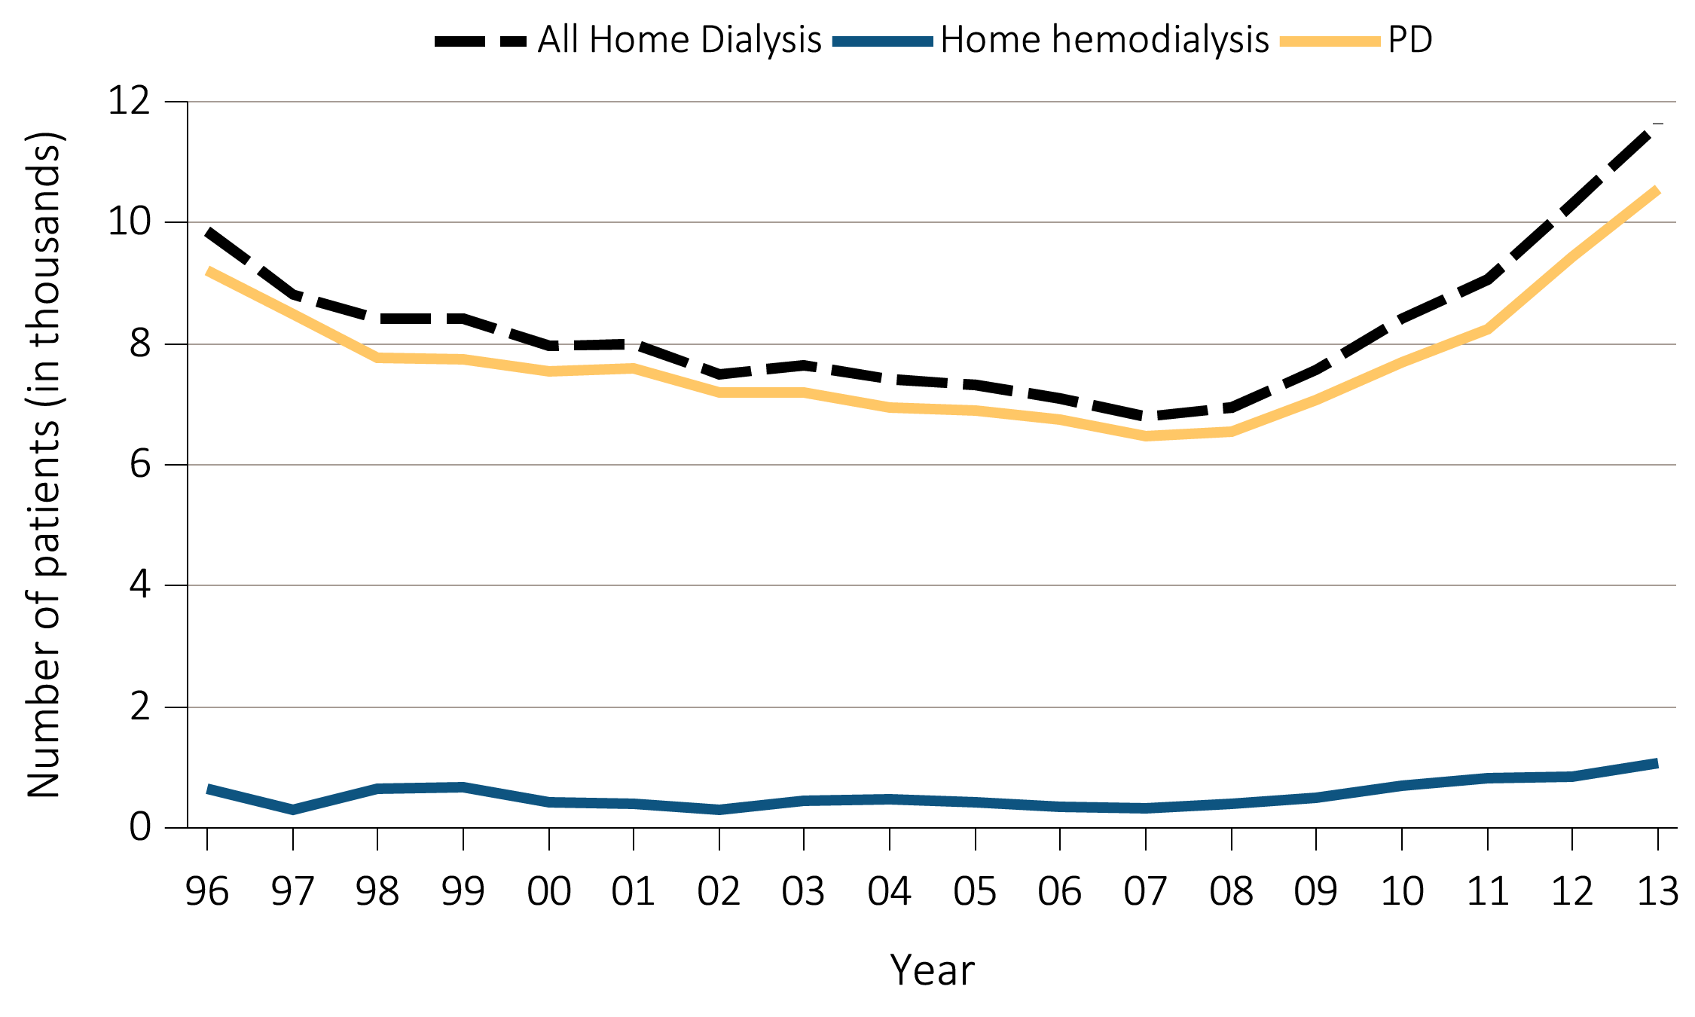
Figure 1.21 Trends in the number of incident ESRD cases (in thousands)
using home dialysis, by type of therapy, in the U.S. population, 1996-2013
Data Source: Reference Table D.1. PD consists of CAPD and CCPD only. Abbreviations: CAPD, continuous ambulatory peritoneal dialysis ; CCPD, continuous cycler peritoneal dialysis; ESRD, end-stage renal disease; PD, peritoneal dialysis.

Slide 43
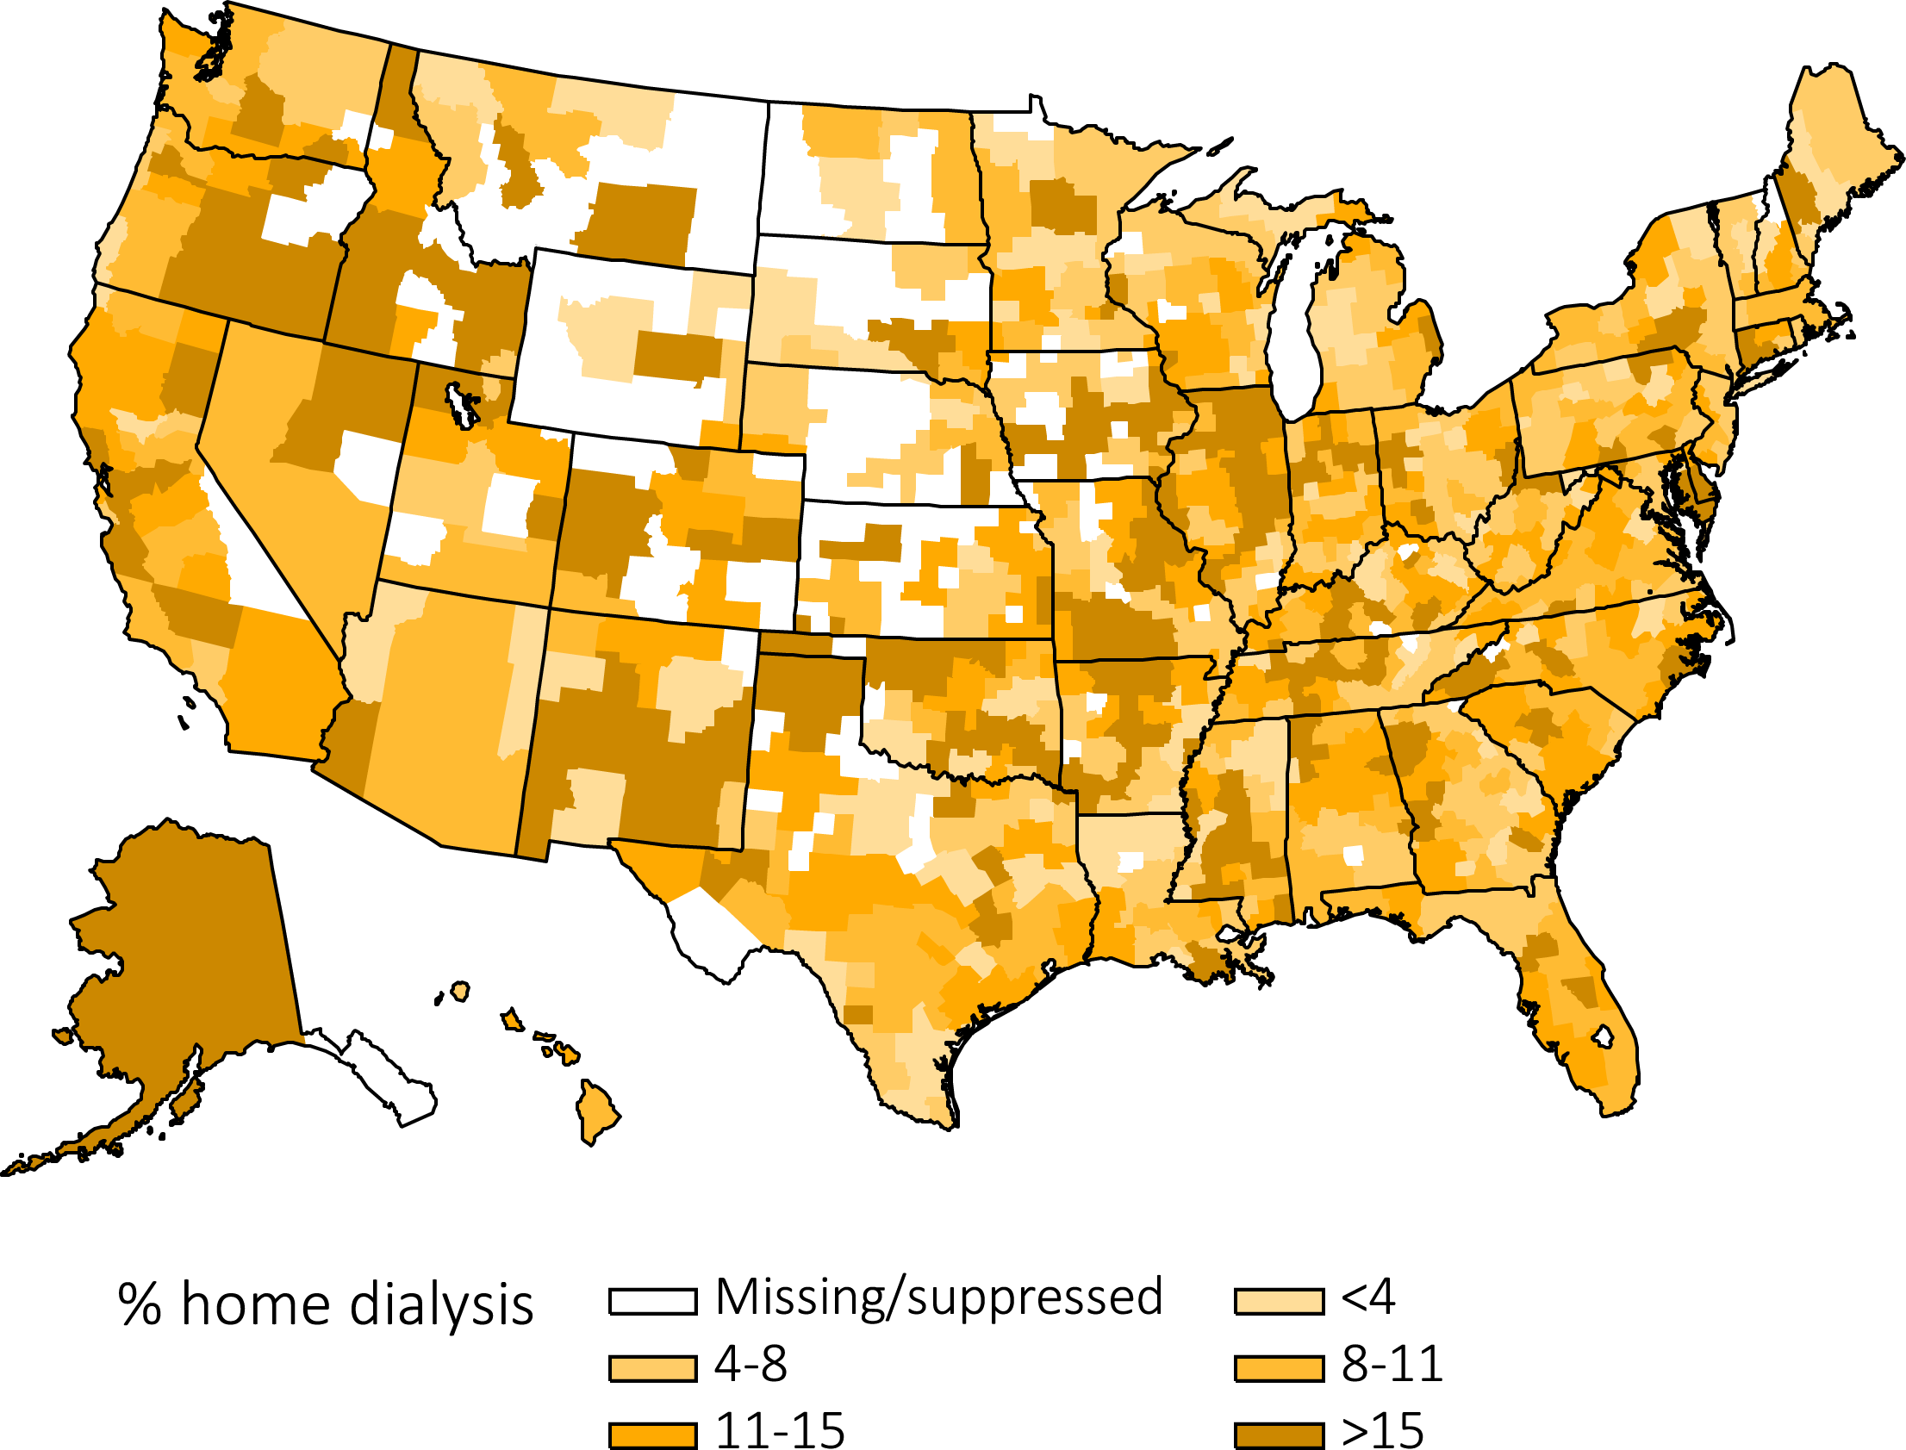
Figure 1.22 Map of the percentage of incident dialysis cases using home dialysis,
^{by Health Service Area, 2013}
Data Source: Special analyses, USRDS ESRD Database.

Slide 44
Table 1.8 Number and percentage of prevalent cases of hemodialysis, peritoneal dialysis, and transplantation by age, sex, race, ethnicity, and primary ESRD diagnosis,
^{in the U.S. population, 2013}
 |  |  | HD |  |  | PD |  |  | Transplant
 |  | Total | n | % |  | n | % |  | n | %
Age
 | 0-21 | 9,979 | 1,993 | 20.0 |  | 1,206 | 12.1 |  | 6,780 | 67.9
 | 22-44 | 100,836 | 50,973 | 50.6 |  | 8,751 | 8.7 |  | 41,112 | 40.8
 | 45-64 | 292,344 | 174,610 | 59.7 |  | 20,051 | 6.9 |  | 97,683 | 33.4
 | 65-74 | 149,225 | 102,609 | 68.8 |  | 9,368 | 6.3 |  | 37,248 | 25.0
 | 75+ | 107,485 | 91,164 | 84.8 |  | 5,882 | 5.5 |  | 10,439 | 9.7
Sex
 | Male | 378,185 | 238,277 | 63.0 |  | 24,602 | 6.5 |  | 115,306 | 30.5
 | Female | 281,604 | 183,009 | 65.0 |  | 20,651 | 7.3 |  | 77,944 | 27.7
Race
 | White | 407,377 | 239,192 | 58.7 |  | 30,323 | 7.4 |  | 137,862 | 33.8
 | Black / African American | 202,843 | 153,406 | 75.6 |  | 11,169 | 5.5 |  | 38,268 | 18.9
 | Native American | 7,188 | 5,000 | 69.6 |  | 438 | 6.1 |  | 1,750 | 24.3
 | Asian | 36,882 | 22,548 | 61.1 |  | 3,195 | 8.7 |  | 11,139 | 30.2
 | Other/Unknown | 5,579 | 1,203 | 21.6 |  | 133 | 2.4 |  | 4,243 | 76.1
Ethnicity
 | Hispanic | 111,622 | 76,790 | 68.8 |  | 6,901 | 6.2 |  | 27,931 | 25.0
 | Non-Hispanic | 548,247 | 344,559 | 62.8 |  | 38,357 | 7.0 |  | 165,331 | 30.2
Primary cause of ESRD
 | Diabetes | 247,257 | 187,520 | 75.8 |  | 16,060 | 6.5 |  | 43,677 | 17.7
 | Hypertension | 165,634 | 122,624 | 74.0 |  | 11,962 | 7.2 |  | 31,048 | 18.7
 | Glomerulonephritis | 107,853 | 45,012 | 41.7 |  | 8,557 | 7.9 |  | 54,284 | 50.3
 | Cystic kidney | 30,977 | 9,810 | 31.7 |  | 1,990 | 6.4 |  | 19,177 | 61.9
 | Other/Unknown | 108,148 | 56,383 | 52.1 |  | 6,689 | 6.2 |  | 45,076 | 41.7
All |  | 659,869 | 421,349 | 63.9 |  | 45,258 | 6.9 |  | 193,262 | 29.3
Data Source: Special analyses, USRDS ESRD Database. The numbers in this table exclude “Other PD” and “Uncertain Dialysis.” Abbreviation: ESRD, end-stage renal disease; HD, hemodialysis; PD, peritoneal dialysis.

Slide 45
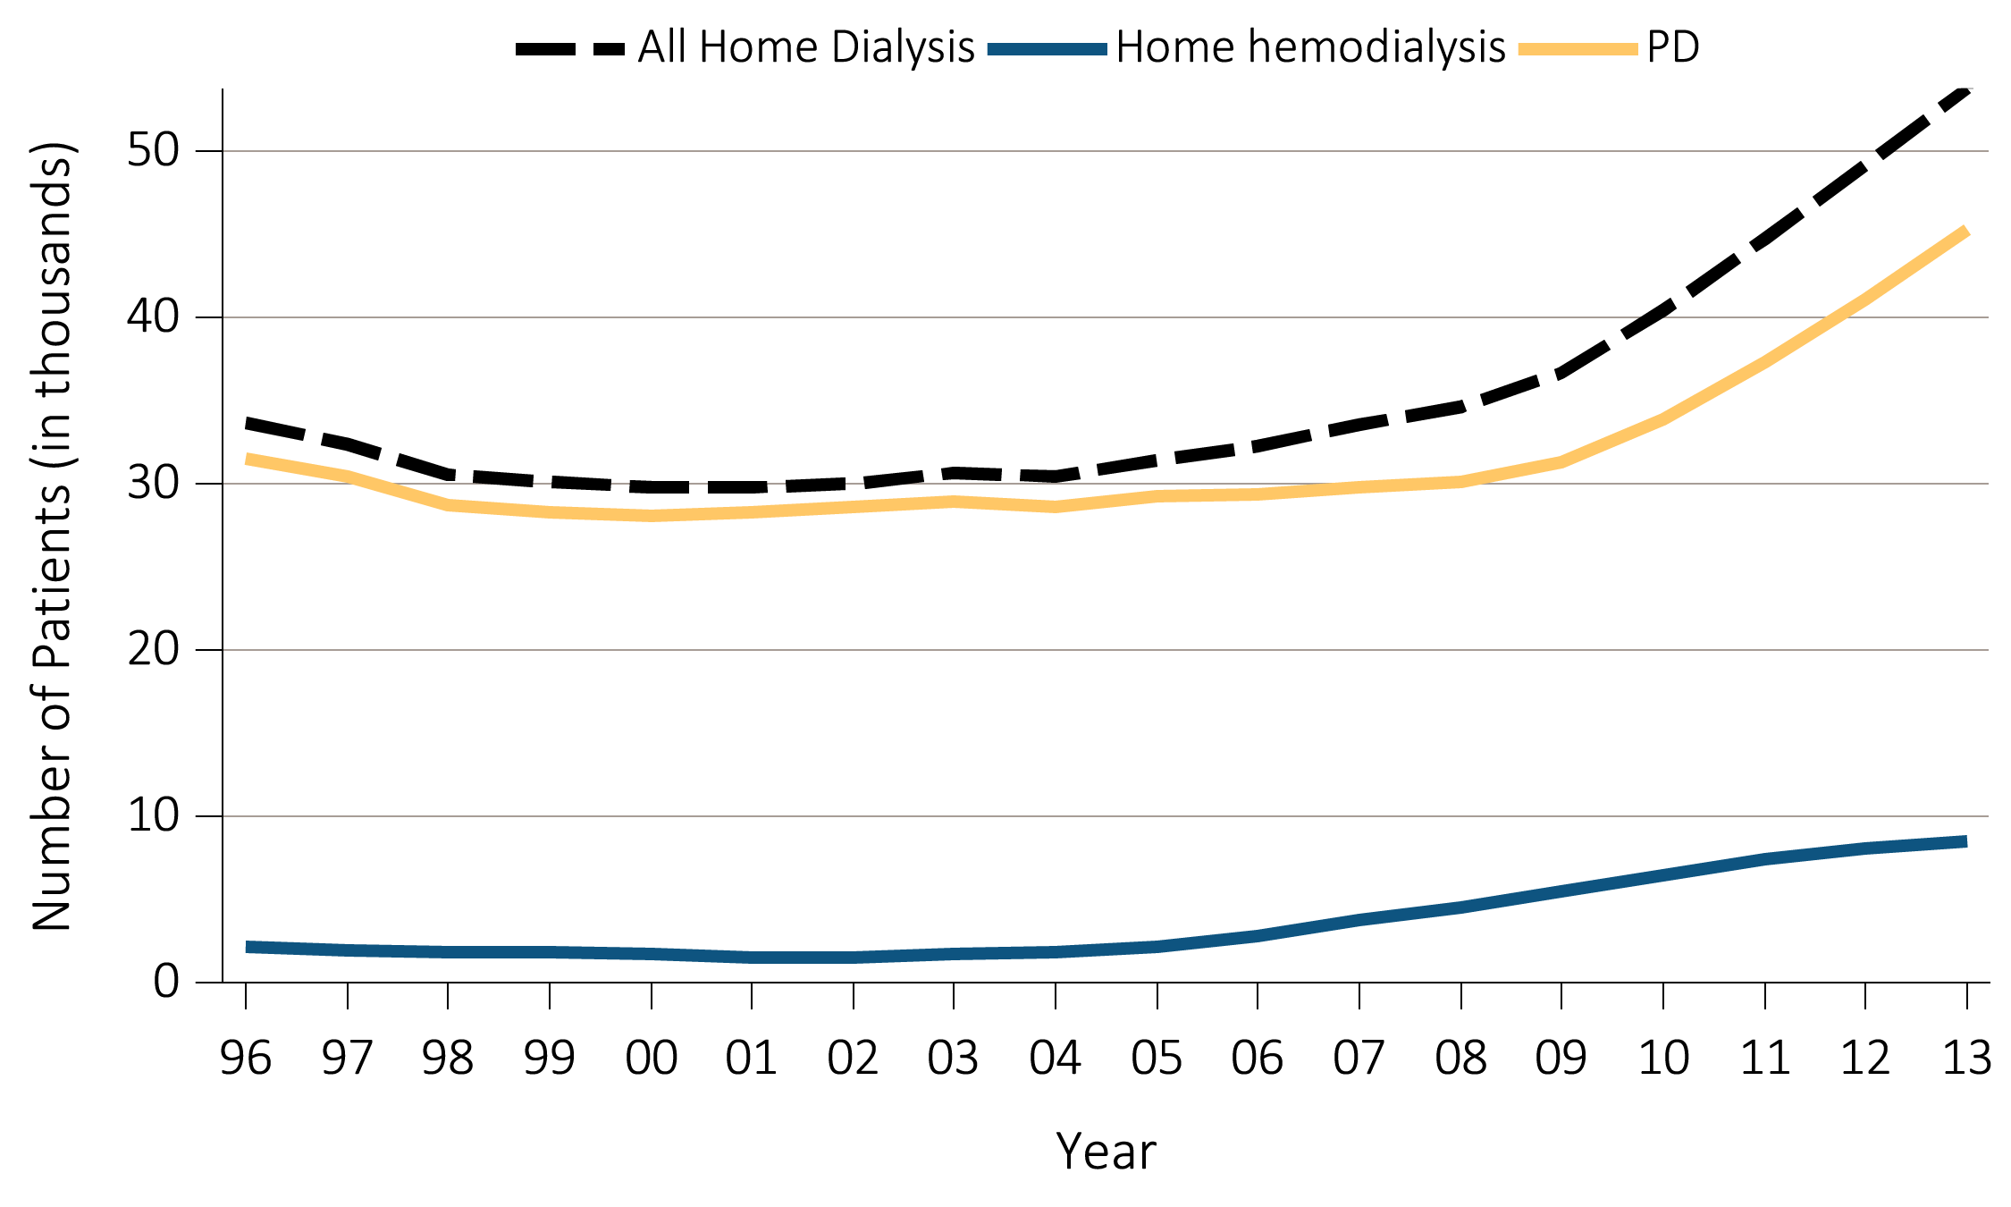
Figure 1.23 Trends in number of prevalent ESRD cases (in thousands)
using home dialysis, by type of therapy, in the U.S. population, 1996-2013
Data Source: Reference Table D.1. December 31 prevalent ESRD patients; PD consists of CAPD and CCPD only. Abbreviations: CAPD, continuous ambulatory peritoneal dialysis; CCPD, continuous cycler peritoneal dialysis;
ESRD, end-stage renal disease; PD, peritoneal dialysis.

Slide 46
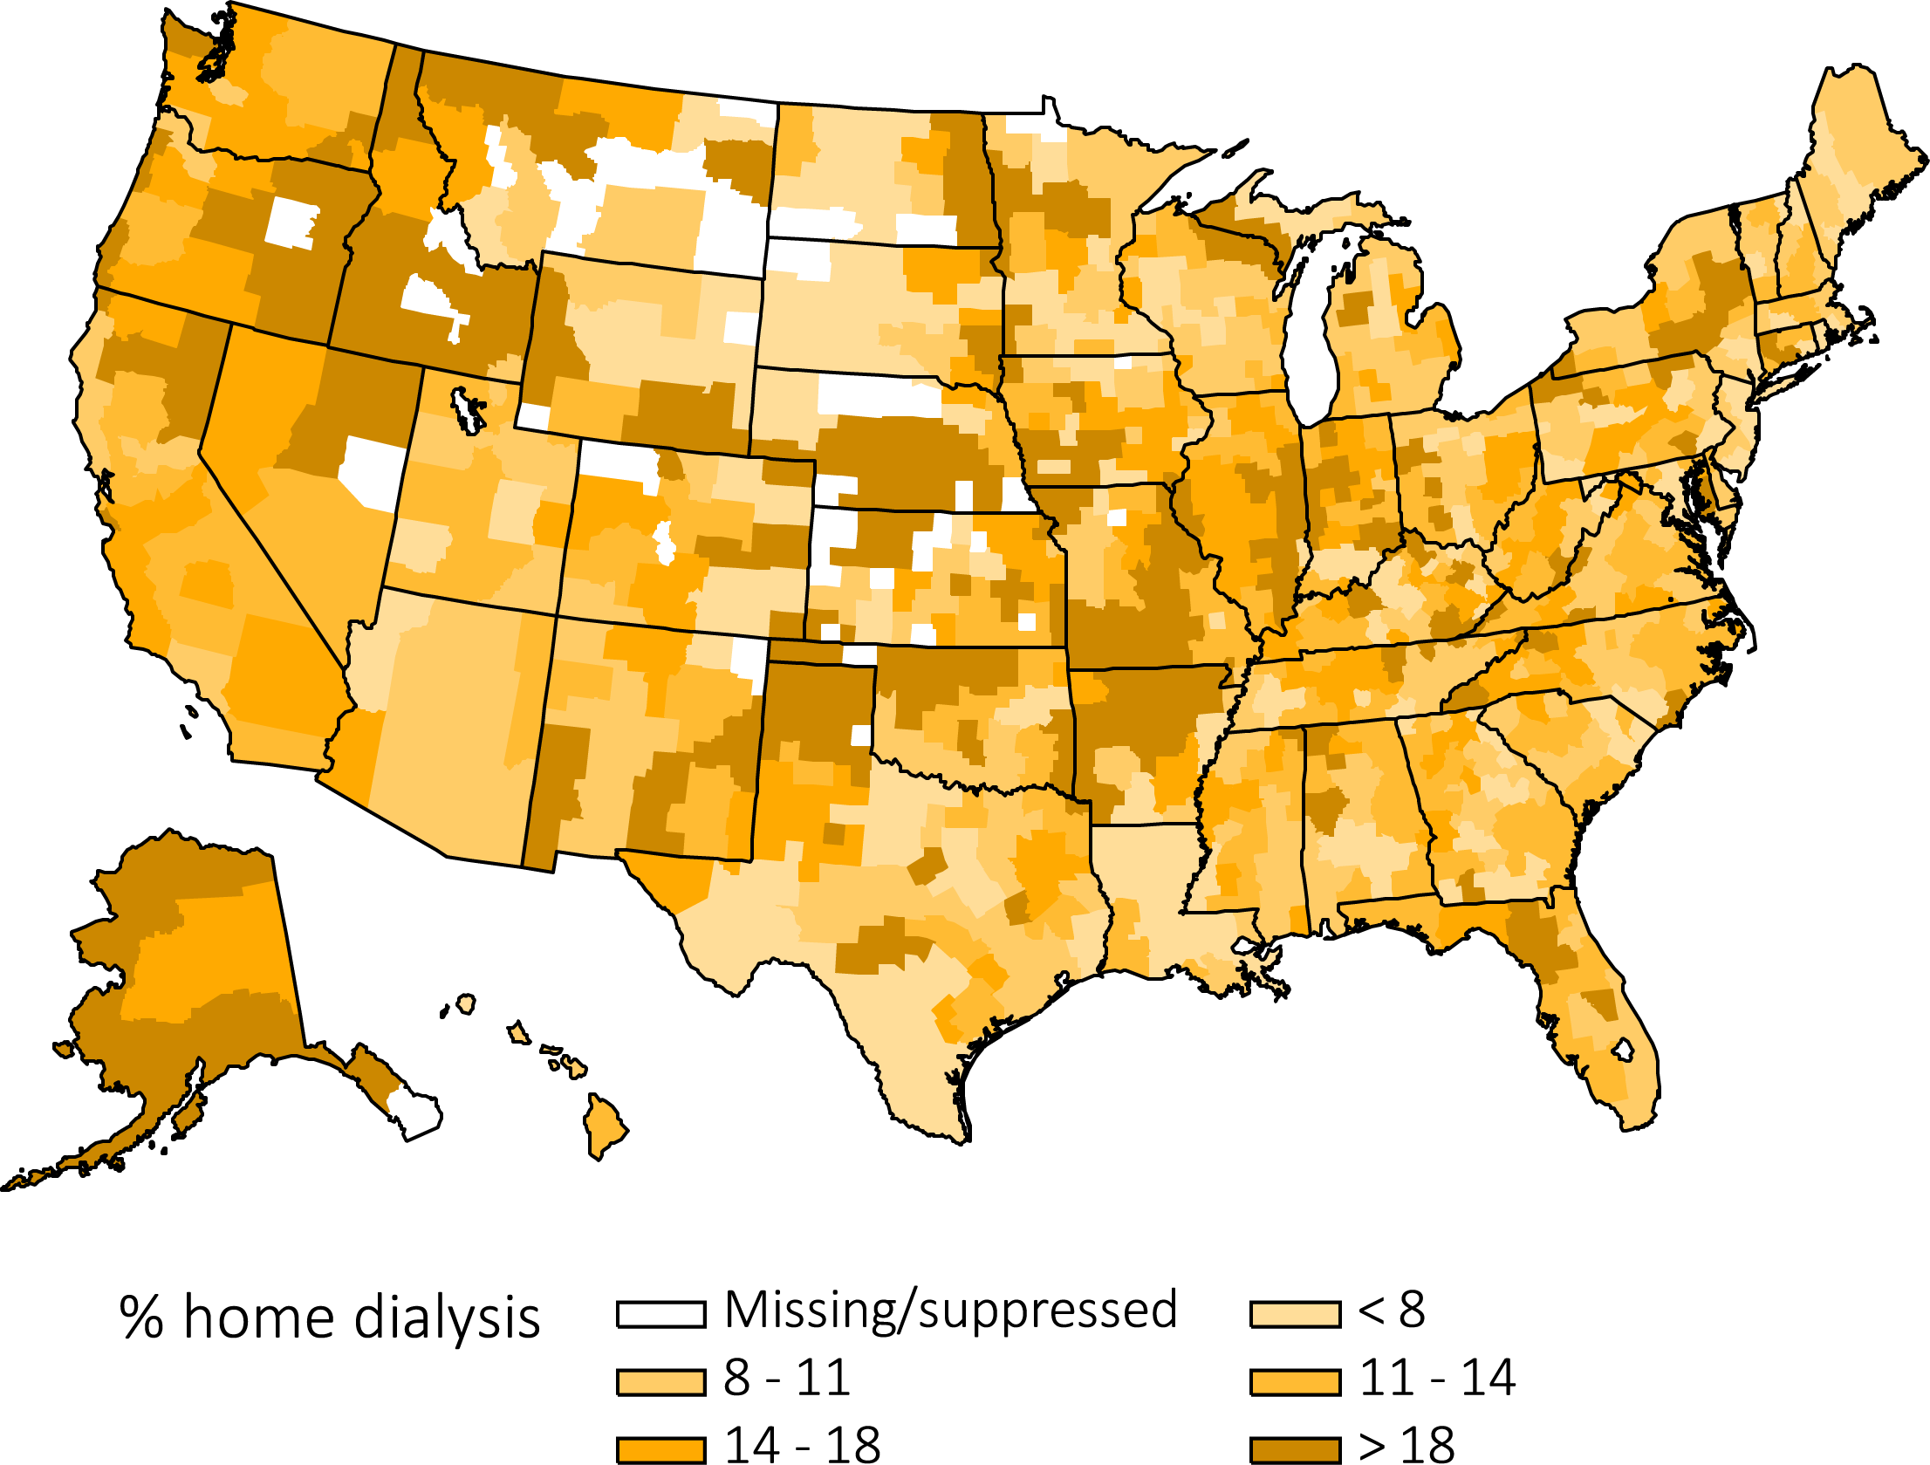
Figure 1.24 Map of the percentage of prevalent dialysis cases using home dialysis,
^{by Health Service Area, 2013}
Data Source: Special analyses, USRDS ESRD Database.

