Slide 2
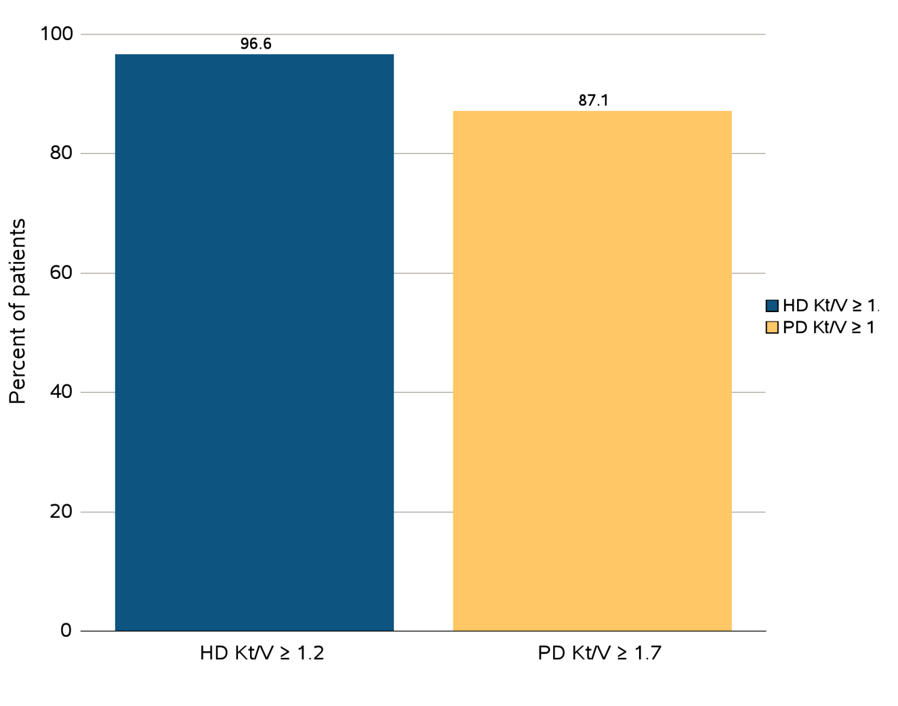
Figure 3.1 ESRD clinical indicators, CROWNWeb data, December 2014
(a) Percentage of prevalent hemodialysis and peritoneal dialysis patients meeting
clinical care guidelines for dialysis adequacy by modality
Data Source: Special analyses, USRDS ESRD Database. Results shown are for laboratory values reported to CROWNWeb for December 2014, restricted to patients as follows: Panel a: Dialysis patients initiating treatment for ESRD at least 1 year prior to December 1, 2014, and who were alive through December 31, 2014. Abbreviations: ESRD, end-stage renal disease; HD, hemodialysis; Hgb, hemoglobin; Kt/V, see Glossary; PD, peritoneal dialysis.

Slide 3
Figure 3.1 ESRD clinical indicators , CROWNWeb data, December 2014
(b) percentage distribution of achieved mean Hgb among prevalent hemodialysis
and peritoneal dialysis patients
Data Source: Special analyses, USRDS ESRD Database. Results shown are for laboratory values reported to CROWNWeb for December 2014, restricted to patients as follows: Panel b: Dialysis patients initiating treatment for ESRD at least 90 days prior to December 1, 2014, who were ≥18 years old as of December 1, 2014, and who were alive through December 31, 2014. Abbreviations: ESRD, end-stage renal disease; HD, hemodialysis; Hgb, hemoglobin; Kt/V, see Glossary; PD, peritoneal dialysis.

Slide 4
Figure 3.1 ESRD clinical indicators, CROWNWeb data, December 2014
(c) percentage of patients with serum calcium >10.2 mg/dL by modality
Data Source: Special analyses, USRDS ESRD Database. Results shown are for laboratory values reported to CROWNWeb for December 2014, restricted to patients as follows: Panel c: Hemodialysis and peritoneal dialysis patients initiating treatment for ESRD at least 1 year prior to December 1, 2014, who were ≥18 years old as of December 1, 2014, and who were alive through December 31, 2014. Abbreviations: ESRD, end-stage renal disease; HD, hemodialysis; Hgb, hemoglobin; Kt/V, see Glossary; PD, peritoneal dialysis.

Slide 5
Figure 3.2 Mean monthly Hgb level and mean monthly EPO dose (expressed as units/week) in adult hemodialysis patients on dialysis ≥90 days, Medicare claims, 1995-2013
Data Source: Special analyses, USRDS ESRD Database. Mean monthly Hgb level among ESA-treated hemodialysis patients within a given month (1995 through 2013) or all hemodialysis patients (April 2012 to December 2013 only) who, within the given month, had a Hgb claim, were on dialysis ≥90 days, and were ≥18 years old at the start of the month. Mean monthly EPO (epoetin alfa) dose is shown for hemodialysis patients within a given month who had an EPO claim, were on dialysis ≥90 days, and were ≥18 years old at the start of the month. EPO dose is expressed as mean EPO units per week averaged over all EPO claims within a given month. Abbreviations: EPO, erythropoietin; ESA, erythropoiesis-stimulating agents; Hgb, hemoglobin.

Slide 6
Figure 3.3 Distribution of monthly Hgb (g/dL) levels in ESA-treated adult hemodialysis patients on dialysis ≥90 days, Medicare claims, 1995-2013
Data Source: Special analyses, USRDS ESRD Database. Distribution among hemodialysis patients within a given month who had claims for Hgb level and ESA use, were on dialysis ≥90 days, and were ≥18 years old at the start of the month. Abbreviations: ESA, erythropoiesis-stimulating agents; Hgb, hemoglobin.

Slide 7
Figure 3.4 Monthly IV iron use and mean monthly IV iron dose in adult hemodialysis patients on dialysis ≥90 days, Medicare claims, 2005-2013
Data Source: Special analyses, USRDS ESRD Database. Monthly IV iron use is among hemodialysis patients on dialysis ≥90 days and ≥18 years old at the start of the given month. Mean IV iron dose was calculated as the average does of IV iron a patient received, among patients receiving iron during the month. Abbreviation: IV, intravenous.

Slide 8
Figure 3.5 Distribution of TSAT levels (%) in adult hemodialysis patients on dialysis for at least 1 year, CROWNWeb data, December 2012, 2013, 2014
^{Data Source:} Special analyses, USRDS ESRD Database. CROWNWeb clinical extracts for December 2012, December 2013 and December 2014. Dialysis patients on treatment for ESRD at least 1 year at the time of measurement of TSAT level for that year, ≥18 years old as of December 1 of that year and who were alive through December 31 of that year. Abbreviation: TSAT, transferrin saturation.

Slide 9
Figure 3.6 Distribution of the most recent value of serum ferritin (ng/mL) level taken between October and December in adult hemodialysis patients on dialysis for at least 1 year, CROWNWeb data, 2012-2014
^{Data Source:} Special analyses, USRDS ESRD Database. CROWNWeb clinical extracts for October to December for years 2012, 2013 and 2014. Dialysis patients initiating treatment for ESRD at least 1 year at the time of measurement of serum ferritin for that year, ≥18 years old as of December 1 of that year and who were alive through December 31 of that year.

Slide 10
Figure 3.7 Percentage of all adult hemodialysis patients, from Medicare claims data, 2010-2013
(a) by number of red blood cell transfusions received in a year
Data Source: Special analyses, USRDS ESRD Database. The percentage of hemodialysis patients ≥18 years old at the start of the month with ≥1 red blood cell transfusion claims in a given month among hemodialysis patients having a claim for at least one dialysis session during the month. Abbreviation: RBC, red blood cell.

Slide 11
Figure 3.7 Percentage of all adult hemodialysis patients, from Medicare claims data, 2010-2013
(b) with ≥1 claims for a red blood cell transfusion in a month by race
Data Source: Special analyses, USRDS ESRD Database. The percentage of hemodialysis patients ≥18 years old at the start of the month with ≥1 red blood cell transfusion claims in a given month among hemodialysis patients having a claim for at least one dialysis session during the month. Abbreviation: RBC, red blood cell.

Slide 12
Figure 3.8 Mean monthly Hgb level and mean monthly EPO dose (expressed as units/week) in adult peritoneal dialysis patients on dialysis ≥90 days, ^{Medicare claims, 1995-2013}
Data Source: Special analyses, USRDS ESRD Database. The percentage of hemodialysis patients ≥18 years old at the start of the month with ≥1 red blood cell transfusion claims in a given month among hemodialysis patients having a claim for at least one dialysis session during the month. Abbreviation: RBC, red blood cell.

Slide 13
Figure 3.9 Distribution of monthly Hgb (g/dL) levels in ESA-treated adult (≥18 years old) peritoneal dialysis patients on dialysis ≥90 days, Medicare claims, 1995-2013
Data Source: Special analyses, USRDS ESRD Database. Distribution of Hgb levels among peritoneal dialysis patients within a given month who had claims for Hgb level and ESA use, were on dialysis ≥90 days, and were ≥18 years old at the start of the month. Abbreviations: ESA, erythropoiesis-stimulating agents; Hgb, hemoglobin.

Slide 14
Figure 3.10 Monthly IV iron use and mean monthly IV iron dose in adult peritoneal dialysis patients on dialysis ≥90 days, Medicare claims, 2005-2013
Data Source: Special analyses, USRDS ESRD Database. Monthly IV iron use is among peritoneal dialysis patients on dialysis ≥90 days and ≥18 years old at the start of the given month. Mean IV iron dose was calculated as the average does of IV iron a patient received, among patients receiving iron during the month. Abbreviation: IV, intravenous.

Slide 15
Figure 3.11 Distribution of TSAT levels (%) in adult peritoneal dialysis patients on dialysis for at least 1 year, CROWNWeb data, December 2012, 2013, and 2014
Data Source: Special analyses, USRDS ESRD Database. CROWNWeb clinical extracts for October to December for years 2012, 2013 and 2014. Dialysis patients on treatment for ESRD at least 1 year at the time of measurement of TSAT level for that year, ≥18 years old as of December 1st of that year, and who were alive through December 31 of that year. Abbreviation: TSAT, transferrin saturation.

Slide 16
Figure 3.12 Distribution of the most recent serum ferritin (ng/mL) level taken between October and December in adult peritoneal dialysis patients on dialysis for at least 1 year, CROWNWeb data, December 2012, 2013, and 2014
Data Source: Special analyses, USRDS ESRD Database. CROWNWeb clinical extracts for October to December for years 2012, 2013 and 2014. Dialysis patients on treatment for ESRD at least 1 year at the time of measurement of serum ferritin for that year, ≥18 years old as of December 1 of that year, and who were alive through December 31 of that year

Slide 17
Figure 3.13 Percentage of all adult peritoneal dialysis patients from Medicare claims data, 2010-2013
(a) by number of red blood cell transfusions received in a year
Data Source: Special analyses, USRDS ESRD Database. The percentage of peritoneal dialysis patients with ≥1 red blood cell transfusion claims in a given month was among peritoneal dialysis patients having a claim for at least one dialysis session during the month, and who were ≥18 years old at the start of the month. Abbreviation: RBC, red blood cell.

Slide 18
Figure 3.13 Percentage of all adult peritoneal dialysis patients from Medicare claims data, 2010-2013
(b) with ≥1 claims for a red blood cell transfusion in a month by race
Data Source: Special analyses, USRDS ESRD Database. The percentage of peritoneal dialysis patients with ≥1 red blood cell transfusion claims in a given month was among peritoneal dialysis patients having a claim for at least one dialysis session during the month, and who were ≥18 years old at the start of the month. Abbreviation: RBC, red blood cell.

Slide 19
Figure 3.14 Distribution of serum calcium levels in adult hemodialysis patients on dialysis for at least 1 year, CROWNWeb data, December 2012, 2013, and 2014
Data Source: Special analyses, USRDS ESRD Database. CROWNWeb clinical extracts for October to December for years 2012, 2013 and 2014. Dialysis patients on treatment for ESRD at least 1 year at the time of measurement of serum calcium for that year, ≥18 years old as of December 1 of that year and who were alive through December 31 of that year.

Slide 20
Figure 3.15 Distribution of serum calcium (levels in adult peritoneal dialysis patients on dialysis for at least 1 year, CROWNWeb data, ^{December 2012, 2013, and 2014}
Data Source: Special analyses, USRDS ESRD Database. CROWNWeb clinical extracts for October to December for years 2012, 2013 and 2014. Dialysis patients on treatment for ESRD at least 1 year at the time of measurement of serum calcium for that year, ≥18 years old as of December 1 of that year and who were alive through December 31 of that year.

Slide 21
Figure 3.16 Distribution of serum phosphorus (%) levels in adult hemodialysis patients on dialysis for at least 1 year, CROWNWeb data, ^{December 2012, 2013, and 2014}
Data Source: Special analyses, USRDS ESRD Database. CROWNWeb clinical extracts for December 2012, December 2013, and December 2014. Dialysis patients on treatment for ESRD at least 1 year at the time of measurement of serum phosphorus for that year, ≥18 years old as of December 1 of that year and who were alive through December 31 of that year.

Slide 22
Figure 3.17 Distribution of serum phosphorus (%) levels in adult peritoneal dialysis patients on dialysis for at least 1 year, CROWNWEB data, ^{December 2012, 2013, and 2014}
Data Source: Special analyses, USRDS ESRD Database. CROWNWeb clinical extracts for December 2012, December 2013, and December 2014. Dialysis patients on treatment for ESRD at least 1 year at the time of measurement of serum phosphorus for that year, ≥18 years old as of December 1 of that year and who were alive through December 31 of that year.

Slide 23
Figure 3.18 Diabetes-related care among ESRD patients with diabetes mellitus aged 18-75 years, Medicare claims, 2004-2013
Data Source: Special analyses, USRDS ESRD Database. Point prevalent Medicare ESRD patients aged 18 to 75 years with a diagnosis claim for diabetes mellitus in the previous year; diabetes-related care in the measurement year. Abbreviations: ESRD, end-stage renal disease; HbA1C, glycosylated hemoglobin.

Slide 24
Figure 3.19 Percentage of ESRD patients with a claim for seasonal influenza vaccination (August 1-April 30 of subsequent year)
^{(a) Overall}
Data Source: Special analyses, USRDS ESRD Database. ESRD patients initiating treatment for ESRD at least 90 days before seasonal period: August 1-April 30 for influenza. Abbreviations: Af Am, African American; ESRD, end-stage renal disease; HD, hemodialysis; Nat Am, Native American; PD, peritoneal dialysis; Tx, transplant..

Slide 25
Figure 3.19 Percentage of ESRD patients with a claim for seasonal influenza vaccination (August 1-April 30 of subsequent year)
^{(b) Age}
Data Source: Special analyses, USRDS ESRD Database. ESRD patients initiating treatment for ESRD at least 90 days before seasonal period: August 1-April 30 for influenza. Abbreviations: Af Am, African American; ESRD, end-stage renal disease; HD, hemodialysis; Nat Am, Native American; PD, peritoneal dialysis; Tx, transplant..

Slide 26
Figure 3.19 Percentage of ESRD patients with a claim for seasonal influenza vaccination (August 1-April 30 of subsequent year)
^{(c) Race/Ethnicity}
Data Source: Special analyses, USRDS ESRD Database. ESRD patients initiating treatment for ESRD at least 90 days before seasonal period: August 1-April 30 for influenza. Abbreviations: Af Am, African American; ESRD, end-stage renal disease; HD, hemodialysis; Nat Am, Native American; PD, peritoneal dialysis; Tx, transplant..

Slide 27
Figure 3.19 Percentage of ESRD patients with a claim for seasonal influenza vaccination (August 1-April 30 of subsequent year)
^{(d) Modality}
Data Source: Special analyses, USRDS ESRD Database. ESRD patients initiating treatment for ESRD at least 90 days before seasonal period: August 1-April 30 for influenza. Abbreviations: Af Am, African American; ESRD, end-stage renal disease; HD, hemodialysis; Nat Am, Native American; PD, peritoneal dialysis; Tx, transplant..

