Slide 2
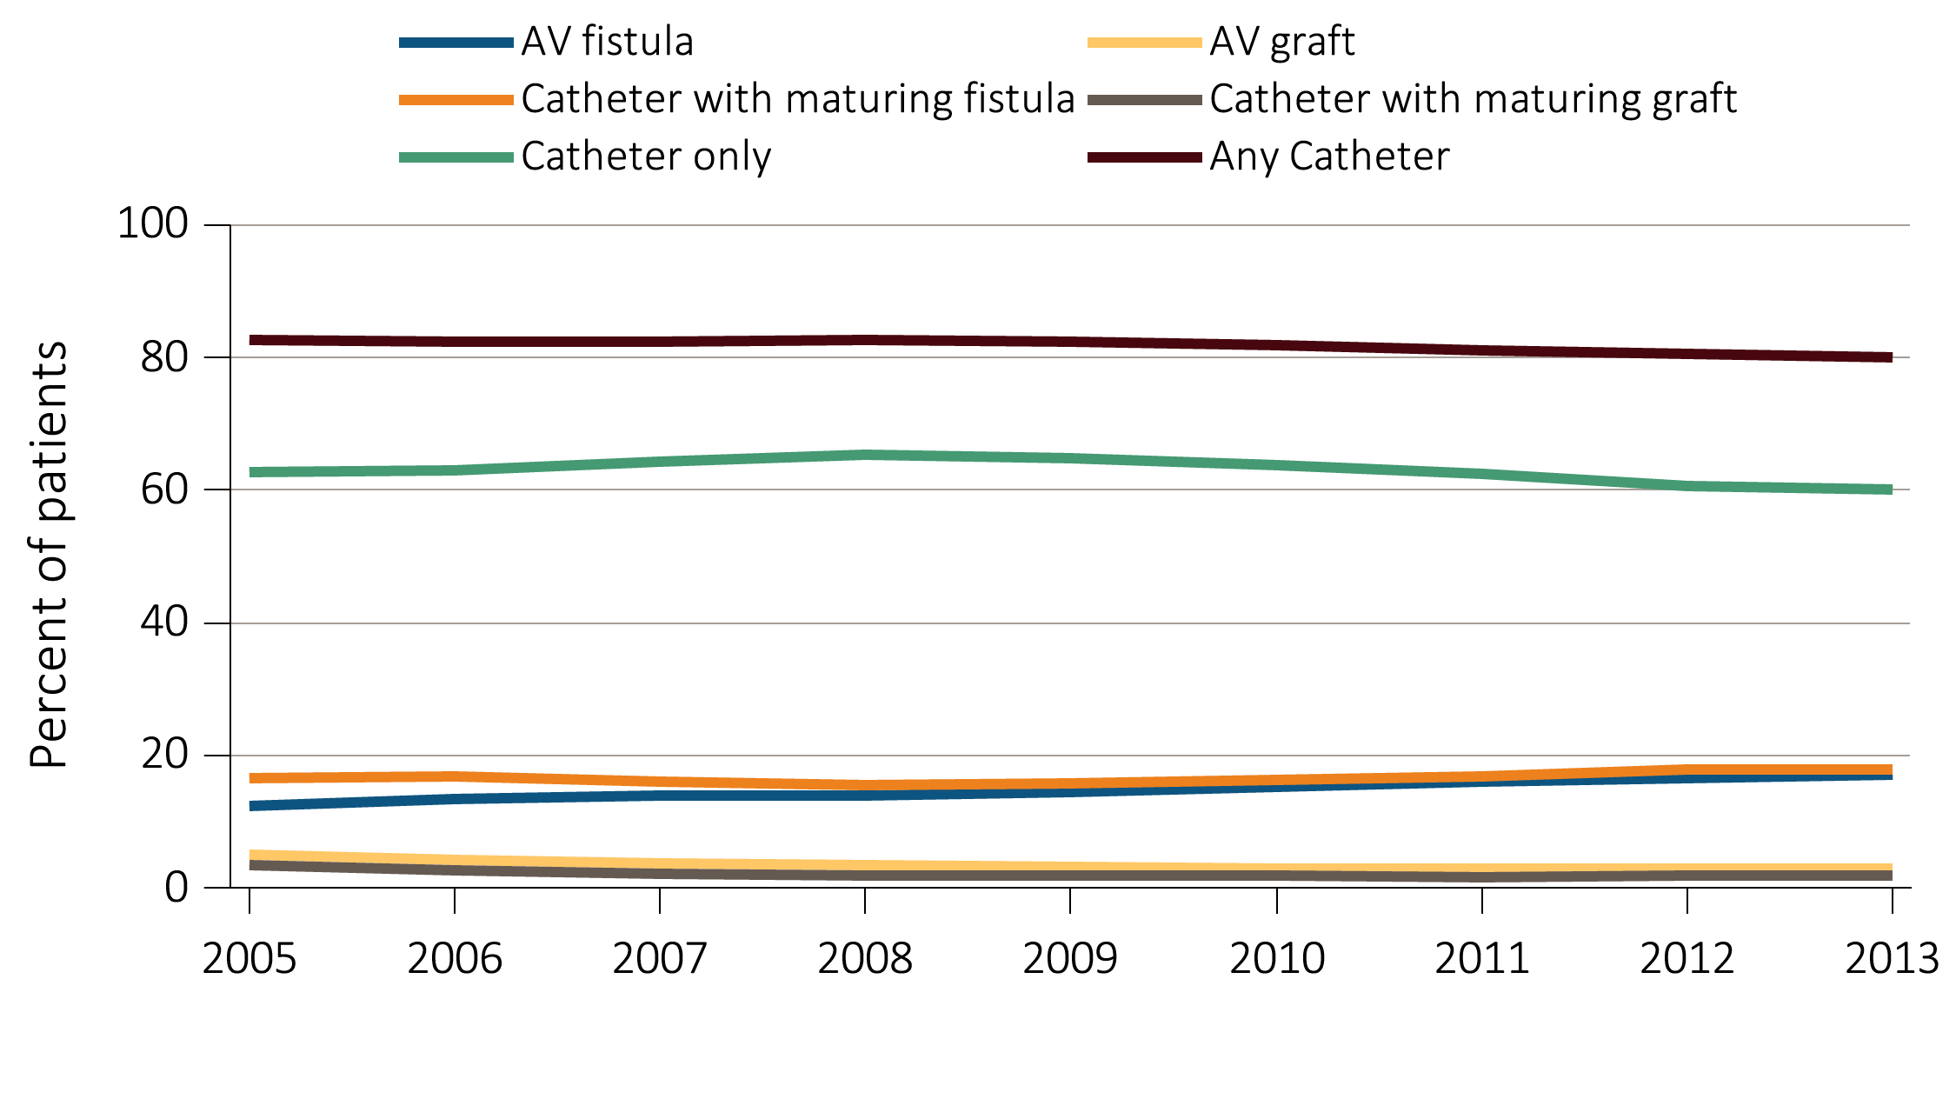
Figure 4.1 Vascular access use at hemodialysis initiation,
from the ESRD Medical Evidence form (CMS 2728), 2005-2013
Data Source: Special analyses, USRDS ESRD Database. ESRD patients initiating hemodialysis in 2005-2013. Abbreviations: AV, arteriovenous; CMS, Centers for Medicare & Medicaid; ESRD, end-stage renal disease.

Slide 3
Table 4.1 Vascular access used at hemodialysis initiation by patient characteristics from the ESRD Medical Evidence form (CMS 2728), 2013
 | AV fistula | AV graft | Catheter with maturing fistula | Catheter with maturing graft | Catheter only
All | 17.1 | 2.8 | 18.0 | 2.0 | 60.2
Age
0-21 | 7.6 | 0.6 | 9.9 | 1.0 | 80.9
22-44 | 13.2 | 1.9 | 18.3 | 1.6 | 65.0
45-64 | 17.1 | 2.6 | 19 | 1.7 | 59.5
65-74 | 18.6 | 3.0 | 18.4 | 2.1 | 57.9
75+ | 17.3 | 3.5 | 16.1 | 2.3 | 60.8
Sex
Male | 18.7 | 2.1 | 18.4 | 1.6 | 59.2
Female | 14.9 | 3.8 | 17.4 | 2.4 | 61.4
Race
White | 17.9 | 2.3 | 17.6 | 1.7 | 60.5
Black/African American | 15.5 | 4.2 | 18.5 | 2.7 | 59.0
Native American | 14.9 | 2.8 | 25 | 1.4 | 55.9
Asian | 20.0 | 2.9 | 19.3 | 1.8 | 56.0
Ethnicity
Hispanic | 12.4 | 1.2 | 16.7 | 1.4 | 68.3
Primary Cause of ESRD
Diabetes | 17.7 | 2.9 | 20.9 | 2.0 | 56.4
Hypertension | 17.5 | 3.2 | 16.6 | 2.0 | 60.6
Glomerulonephritis | 18.6 | 2.3 | 16.5 | 1.8 | 60.7
Cystic Kidney | 43.6 | 4.0 | 15.2 | 1.5 | 35.8
Other Urologic | 14.2 | 3.3 | 14.4 | 2.1 | 66.0
Other Cause | 9.2 | 1.8 | 11.5 | 1.7 | 75.9
Unknown/Missing | 11.1 | 2.4 | 13.9 | 2.0 | 70.5
Comorbidities
Diabetes | 16.8 | 2.9 | 19.8 | 2.0 | 58.5
Congestive heart failure | 13.3 | 2.4 | 19.3 | 2.2 | 62.8
Atherosclerotic heart disease | 17 | 2.6 | 20.6 | 2.1 | 57.7
Cerebrovascular disease | 15 | 3.4 | 18.9 | 2.5 | 60.2
Peripheral vascular disease | 14.8 | 2.5 | 20.8 | 2.1 | 59.7
Hypertension | 17.8 | 2.9 | 18.4 | 2.0 | 58.9
Other cardiac disease | 14.5 | 2.4 | 17.9 | 2.1 | 63.1
Data Source: Special analyses, USRDS ESRD Database. Abbreviations: AV, arteriovenous; CMS, Centers for Medicare & Medicaid; ESRD, end-stage renal disease.

Slide 4
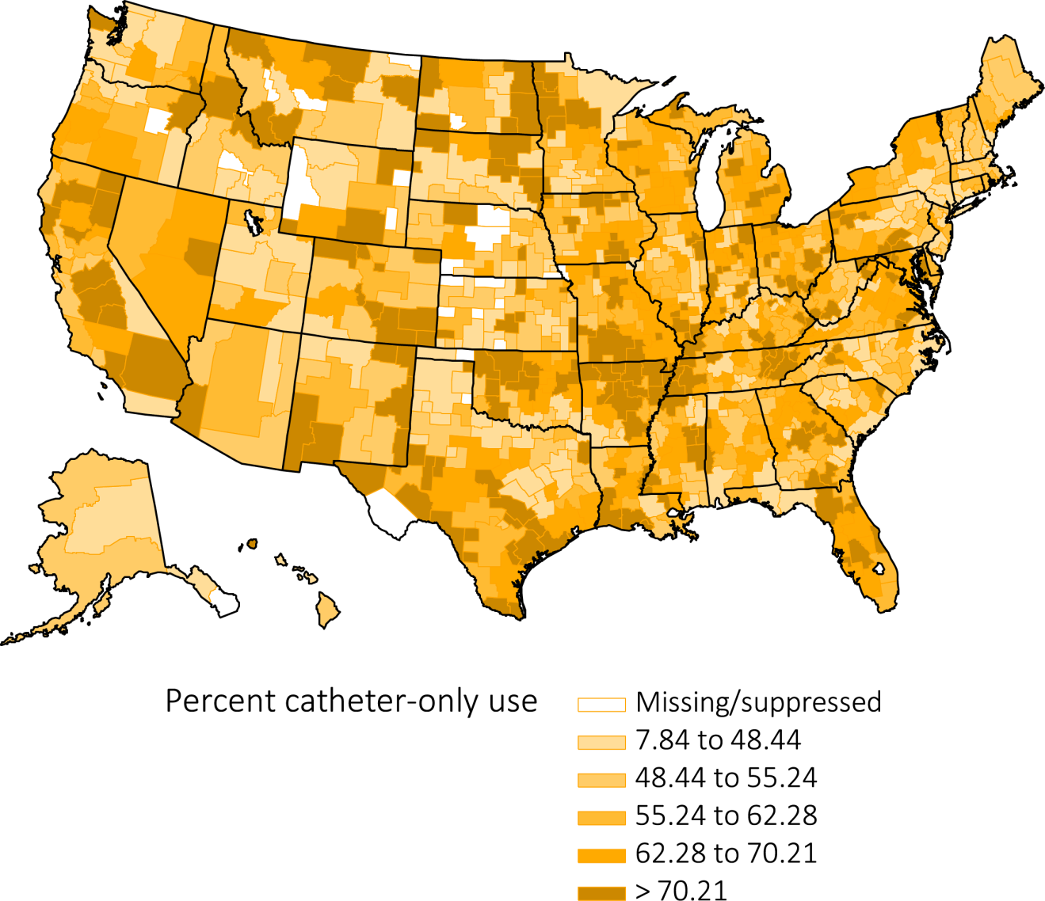
Figure 4.2 Geographic variation in percentage of catheter-only use at hemodialysis initiation, from the ESRD Medical Evidence form (CMS 2728), 2013
Data Source: Special analyses, USRDS ESRD Database. Abbreviations: CMS, Centers for Medicare & Medicaid; ESRD, end-stage renal disease.

Slide 5
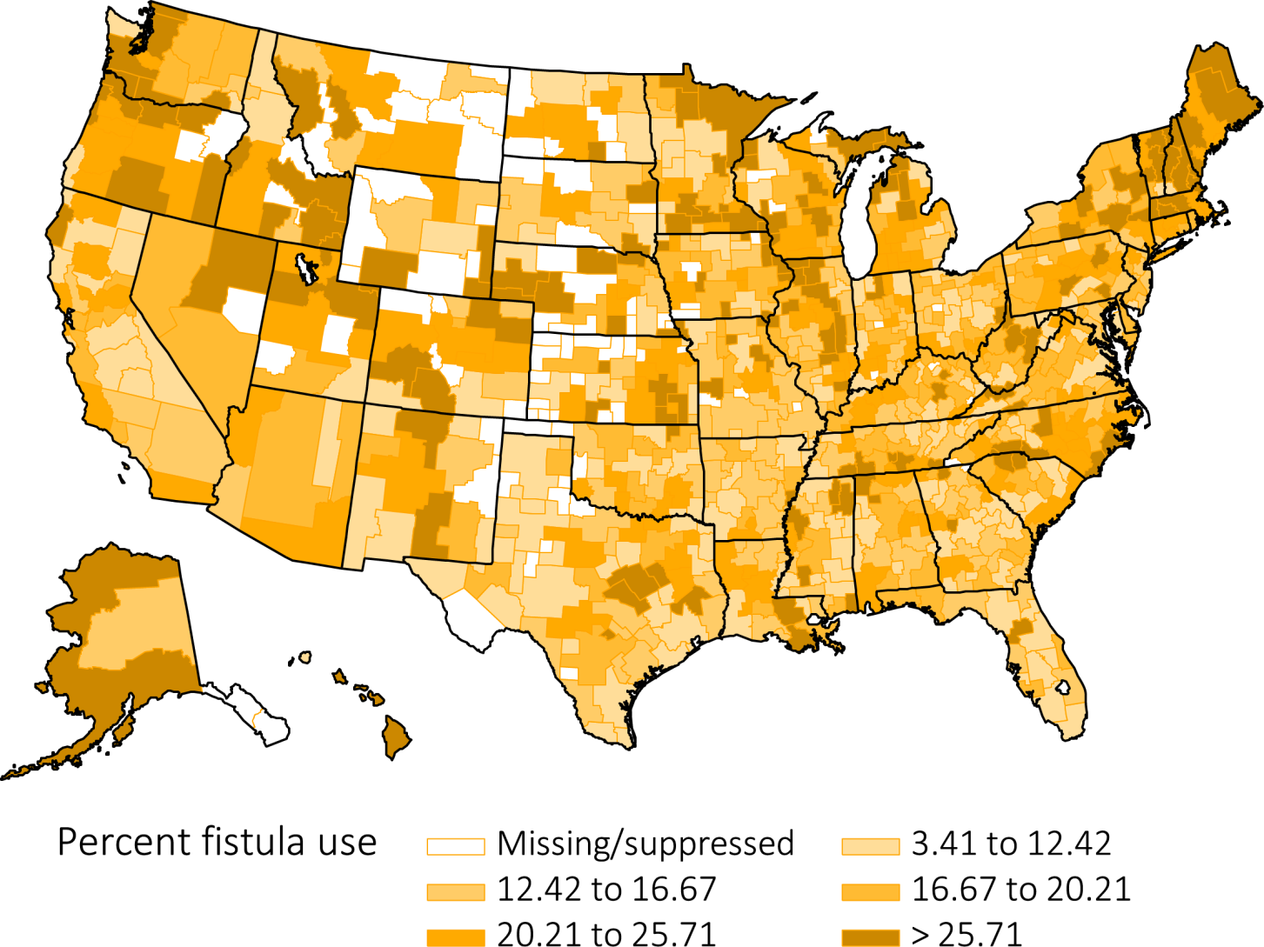
Figure 4.3 Geographic variation in percentage of AV fistula use at hemodialysis initiation, from the ESRD Medical Evidence form (CMS 2728), 2013
Data Source: Special analyses, USRDS ESRD Database. Abbreviations: AV, arteriovenous; CMS, Centers for Medicare & Medicaid; ESRD, end-stage renal disease.

Slide 6
Table 4.2 Distribution of type of vascular access in use among prevalent hemodialysis patients in 2013, from CROWNWeb data, December 2013
 | AV fistula | AV graft | Catheter
All | 62.5 | 18.4 | 19.2
Age
0-21 | 47.0 | 6.8 | 46.1
22-44 | 64.8 | 15.7 | 19.6
45-64 | 64.2 | 17.7 | 18.1
65-74 | 61.9 | 19.3 | 18.8
75+ | 58.7 | 20.4 | 20.9
Sex
Male | 68.7 | 14.2 | 17.1
Female | 54.5 | 23.7 | 21.8
Race
White | 64.3 | 13.6 | 22.1
Black/African American | 56.9 | 25.4 | 17.7
Native American | 73.3 | 12.1 | 14.6
Asian | 67.2 | 16.7 | 16.1
Ethnicity
Hispanic | 67.5 | 15.4 | 17.1
Primary Cause of ESRD
Diabetes | 62.7 | 18.2 | 19.1
Hypertension | 61.9 | 19.3 | 18.8
Glomerulonephritis | 64.8 | 18.1 | 17.2
Cystic Kidney | 69.5 | 16.9 | 13.7
Other Urologic | 61.9 | 17.6 | 20.4
Other Cause | 57.5 | 17.2 | 25.3
Unknown/Missing | 61.4 | 17.6 | 21.0
Data Source: Special analyses, USRDS ESRD Database. CROWNWeb data catheter=any catheter use; fistula and graft use shown are without the use of a catheter. Abbreviations: AV, arteriovenous; ESRD, end-stage renal disease.

Slide 7
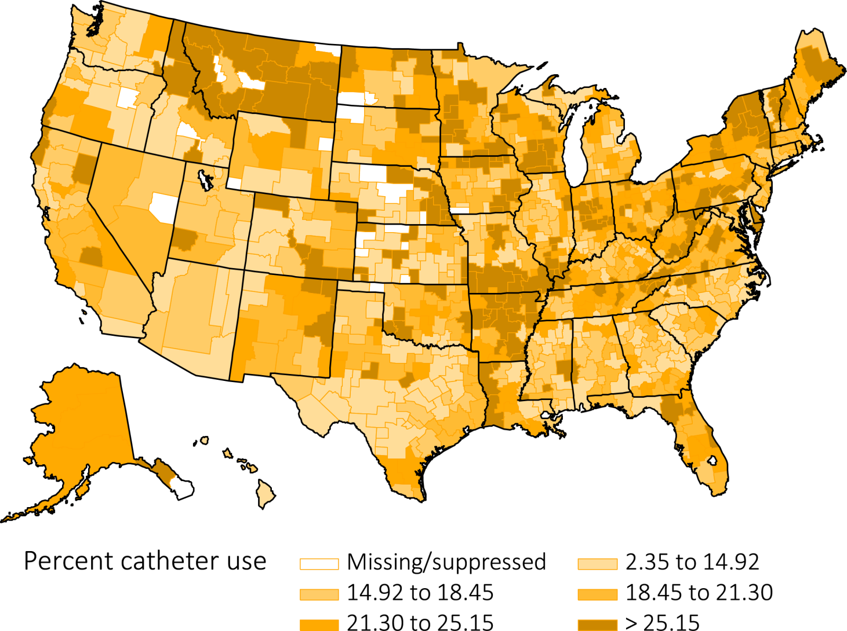
Figure 4.4 Geographic variation in percentage catheter use among prevalent hemodialysis patients by Health Service Area, from CROWNWeb data, December 2013
Data Source: Special analyses, USRDS ESRD Database. Abbreviation: ESRD, end-stage renal disease.

Slide 8
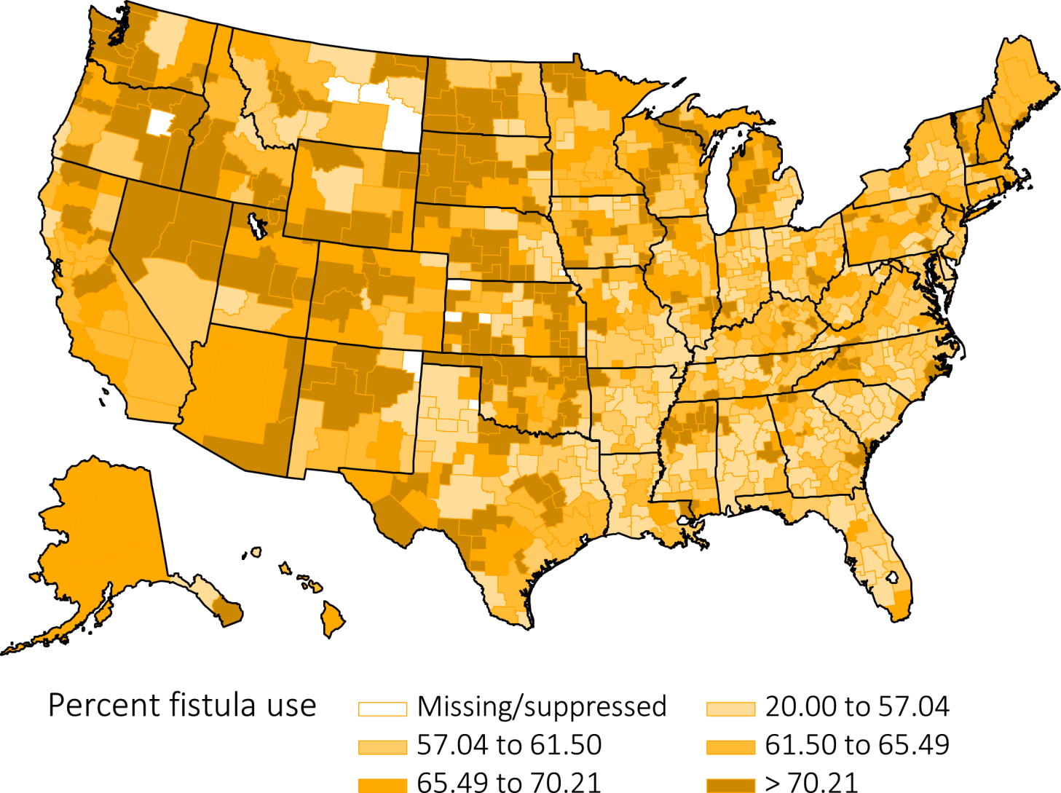
Figure 4.5 Geographic variation in percentage AV fistula use among prevalent hemodialysis patients by Health Service Area, from CROWNWeb data, December 2013
Data Source: Special analyses, USRDS ESRD Database. Abbreviations: AV, arteriovenous; ESRD, end-stage renal disease.

Slide 9
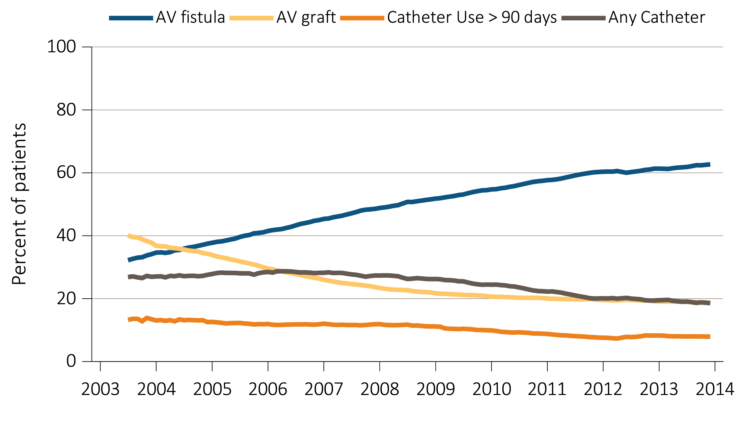
Figure 4.6 Trends in vascular access type use among ESRD prevalent patients, 2003-2014
Data Source: Special analyses, USRDS ESRD Database, and Fistula First data. Fistula First data reported from July 2003 through April 2012, CROWNWeb data are reported from June 2012 through December 2013. Abbreviations: AV, arteriovenous; ESRD, end-stage renal disease.

Slide 10
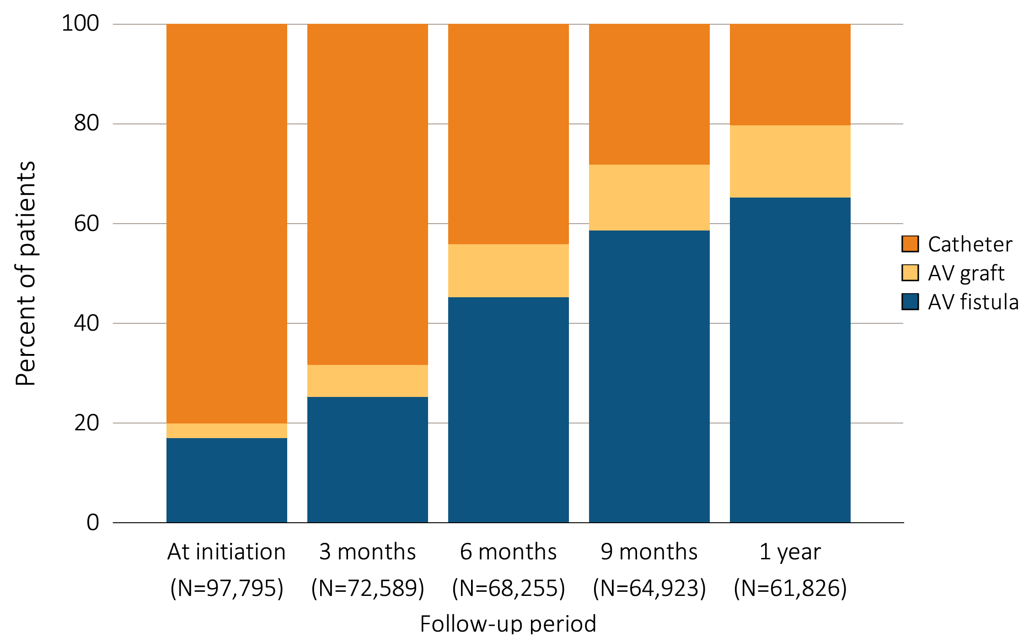
Figure 4.7 Vascular access use during the first year of hemodialysis by time since initiation of ESRD treatment, among patients new to hemodialysis in 2013, from the ESRD Medical Evidence form (CMS 2728) and CROWNWeb data, 2013-2014
Data Source: Special analyses, USRDS ESRD Database. Medical Evidence form (CMS 2728) at initiation and CROWNWeb for subsequent time periods. Abbreviations: CMS, Centers for Medicare & Medicaid; ESRD, end-stage renal disease.

Slide 11
Table 4.3 Cross-sectional distributions of vascular access use during the first year of hemodialysis therapy among patients new to hemodialysis in 2013, by age group, from the ESRD Medical Evidence form (CMS 2728) and CROWNWeb,
²⁰¹³⁻²⁰¹⁴
Age group | Access type | Time
 |  | At initiation | 3 months | 6 months | 9 months | 1 year
0-21 | AV fistula | 7.5 | 13.4 | 31.9 | 46.0 | 50.6
 | AV graft | 0.6 | 0.6 | 2.3 | 2.9 | 3.1
 | Catheter | 91.8 | 86.0 | 65.8 | 51.2 | 46.3
22-44 | AV fistula | 13.3 | 22.4 | 44.6 | 59.5 | 67.2
 | AV graft | 1.9 | 4.4 | 7.6 | 9.4 | 10.8
 | Catheter | 84.8 | 73.2 | 47.9 | 31.1 | 22.0
45-64 | AV fistula | 17.2 | 25.3 | 46.1 | 60.2 | 67.1
 | AV graft | 2.6 | 5.5 | 9.1 | 11.6 | 13.1
 | Catheter | 80.2 | 69.2 | 44.8 | 28.3 | 19.8
65-74 | AV fistula | 18.7 | 27.1 | 46.7 | 59.1 | 65.6
 | AV graft | 3.0 | 6.9 | 11.0 | 13.5 | 15.0
 | Catheter | 78.3 | 66.1 | 42.3 | 27.4 | 19.5
75+ | AV fistula | 17.4 | 24.9 | 43.6 | 56.1 | 61.5
 | AV graft | 3.5 | 8.5 | 14.0 | 16.9 | 18.5
 | Catheter | 79.1 | 66.6 | 42.4 | 27.1 | 20.0
Data Source: Special analyses, USRDS ESRD Database. Medical Evidence form (CMS 2728) at initiation and CROWNWeb for subsequent time periods. Abbreviations: AV, arteriovenous; CMS, Centers for Medicare &
Medicaid; ESRD, end-stage renal disease.

Slide 12
Table 4.4 Cross-sectional distributions of vascular access use during the first year of hemodialysis therapy among patients new to hemodialysis in 2013, by race, from the ESRD Medical Evidence form (CMS-2728) and CROWNWeb, 2013-2014
Race | Access type | Time
 |  | At initiation | 3 months | 6 months | 9 months | 1 year
Native American | AV fistula | 14.7 | 25.5 | 53.3 | 70.0 | 77.1
 | AV graft | 2.2 | 4.3 | 6.1 | 6.9 | 8.1
 | Catheter | 83.1 | 70.2 | 40.6 | 23.2 | 14.8
Asian | AV fistula | 20.2 | 29.4 | 51.6 | 64.3 | 70.5
 | AV graft | 2.8 | 6.5 | 9.4 | 11.8 | 13.5
 | Catheter | 77.0 | 64.1 | 39.0 | 23.9 | 16.0
Black | AV fistula | 15.4 | 22.5 | 40.1 | 52.8 | 58.8
 | AV graft | 4.2 | 8.9 | 14.7 | 17.9 | 19.8
 | Catheter | 80.4 | 68.5 | 45.3 | 29.3 | 21.4
White | AV fistula | 17.7 | 26.2 | 47.2 | 61.0 | 67.8
 | AV graft | 2.3 | 5.4 | 8.9 | 11.0 | 12.2
 | Catheter | 80.0 | 68.4 | 43.9 | 28.0 | 20.0
Other/Unknown | AV fistula | 16.5 | 12.3 | 39.5 | 57.3 | 62.5
 | AV graft | 4.1 | 6.2 | 2.6 | 4.0 | 5.6
 | Catheter | 79.3 | 81.5 | 57.9 | 38.7 | 31.9
Data Source: Special analyses, USRDS ESRD Database. Medical Evidence form (CMS 2728) at initiation and CROWNWeb for subsequent time periods. Abbreviations: AV, arteriovenous; CMS, Centers for Medicare &
Medicaid; ESRD, end-stage renal disease.
.

Slide 13
Table 4.5 Cross-sectional distributions of vascular access use during the first year of hemodialysis therapy among patients new to hemodialysis in 2013, by sex, from the ESRD Medical Evidence form (CMS 2728) and CROWNWeb, 2013-2014
Sex | Access type | Time
 |  | At initiation | 3 months | 6 months | 9 months | 1 year
Male | AV fistula | 18.8 | 28.6 | 51.0 | 65.1 | 71.5
 | AV graft | 2.1 | 4.9 | 8.0 | 9.9 | 11.0
 | Catheter | 79.1 | 66.5 | 41.0 | 25.0 | 17.5
Female | AV fistula | 15.0 | 20.8 | 37.9 | 50.2 | 56.9
 | AV graft | 3.8 | 8.6 | 14.0 | 17.4 | 19.3
 | Catheter | 81.2 | 70.6 | 48.1 | 32.4 | 23.7
Data Source: Special analyses, USRDS ESRD Database. Medical Evidence form (CMS 2728) at initiation and CROWNWeb for subsequent time periods. Abbreviations: AV, arteriovenous; CMS, Centers for Medicare &
Medicaid; ESRD, end-stage renal disease.
.

Slide 14
Table 4.6 Odds ratios and 95% confidence intervals from logistic regression models of fistula use at hemodialysis initiation and fistula or graft use at hemodialysis initiation, from the ESRD Medical Evidence form (CMS 2728), 2013
Data Source: Special analyses, USRDS ESRD Database. Abbreviations: AV, arteriovenous; CMS, Centers for Medicare & Medicaid; ESRD, end-stage renal disease.

Slide 15
Table 4.7 Distribution of number of days between AV fistula placement and first successful use*, overall and by patient characteristics, for new AV fistula created in 2013 (excludes patients not yet ESRD when fistula was placed), from Medicare claims and CROWNWeb, 2013-2014
 | Total AV fistula placements | Percentage of failed placements | Number of days between AV fistula placement and first use
 |  |  | Average | Median | 25th percentile | 75th percentile
Overall | 45,475 | 35.9 | 135 | 112 | 74 | 171
Age
0-21 | 230 | 31.7 | 139 | 110 | 71 | 174
22-44 | 5,429 | 32.3 | 132 | 106 | 70 | 169
45-64 | 17,184 | 33.9 | 134 | 111 | 72 | 169
65-74 | 12,191 | 36.6 | 137 | 115 | 76 | 174
75+ | 10,441 | 40.6 | 137 | 115 | 78 | 171
Race
Native American | 485 | 26.6 | 135 | 117 | 76 | 165
Asian | 1,857 | 27.8 | 128 | 106 | 67 | 168
Black/African American | 14,582 | 38.8 | 136 | 113 | 71 | 175
White | 28,501 | 35.2 | 135 | 112 | 76 | 170
Other/Unknown | 50 | 34.0 | 122 | 113 | 71 | 146
Sex
Male | 25,693 | 31.8 | 129 | 108 | 73 | 161
Female | 19,782 | 41.3 | 145 | 120 | 77 | 188
Primary Cause of ESRD
Diabetes | 21,303 | 36.2 | 137 | 115 | 76 | 174
Hypertension | 13,681 | 35.3 | 133 | 111 | 73 | 169
Glomerulonephritis | 4,037 | 33.4 | 130 | 104 | 68 | 167
Cystic kidney | 739 | 36.7 | 135 | 111 | 66 | 173
Other urologic | 687 | 34.6 | 128 | 109 | 71 | 161
Other cause | 3,714 | 38.4 | 134 | 111 | 72 | 168
Unknown cause | 1,314 | 39.1 | 153 | 120 | 78 | 195
Data Source: Special analyses, USRDS ESRD Database. *With follow-up through the end of 2014; date of first use was the date the given access was first reported in CROWNWeb to be in use in a particular patient. Abbreviations: AV, arteriovenous; ESRD, end-stage renal disease.

Slide 16
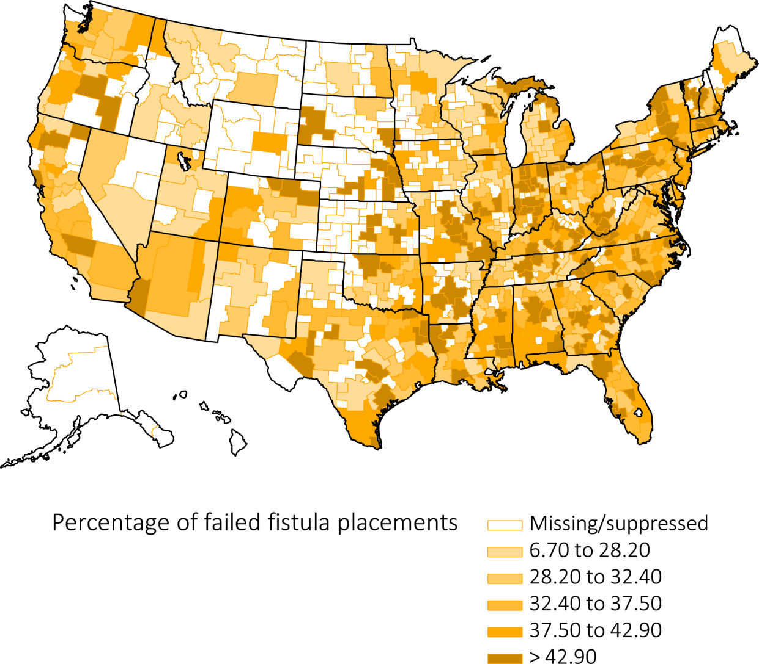
Figure 4.8 Percentage of failed fistula placements, by Health Service Area, for new AV fistulas created in 2013 (excludes patients not yet ESRD when fistula was placed), from Medicare claims and CROWNWeb, 2013-2014
Data Source: Special analyses, USRDS ESRD Database. Abbreviations: AV, arteriovenous; ESRD, end-stage renal disease.

