Slide 2
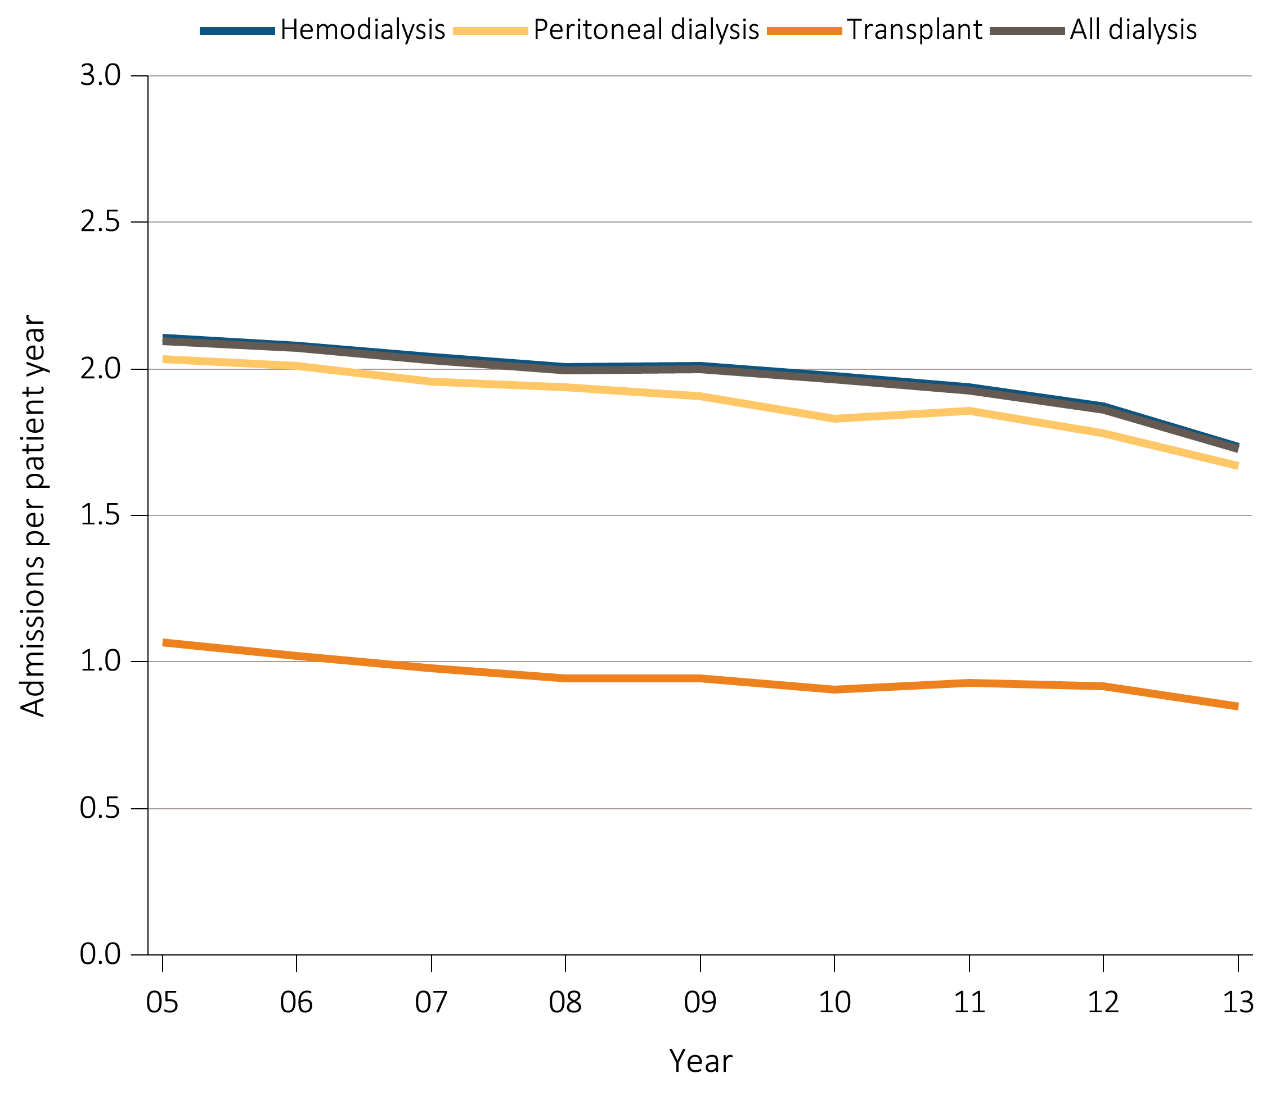
Figure 5.1 Adjusted hospitalization rates for ESRD patients,
by treatment modality, 2005-2013
Data Source: Reference tables: G.1, G.3, G.4, G.5, G.6, G.8, G.9, G.10, and special analyses, USRDS ESRD Database. Period prevalent ESRD patients; adjusted for age, sex, race, & primary diagnosis; ref: ESRD patients, 2011. Abbreviations: ESRD, end-stage renal disease.

Slide 3
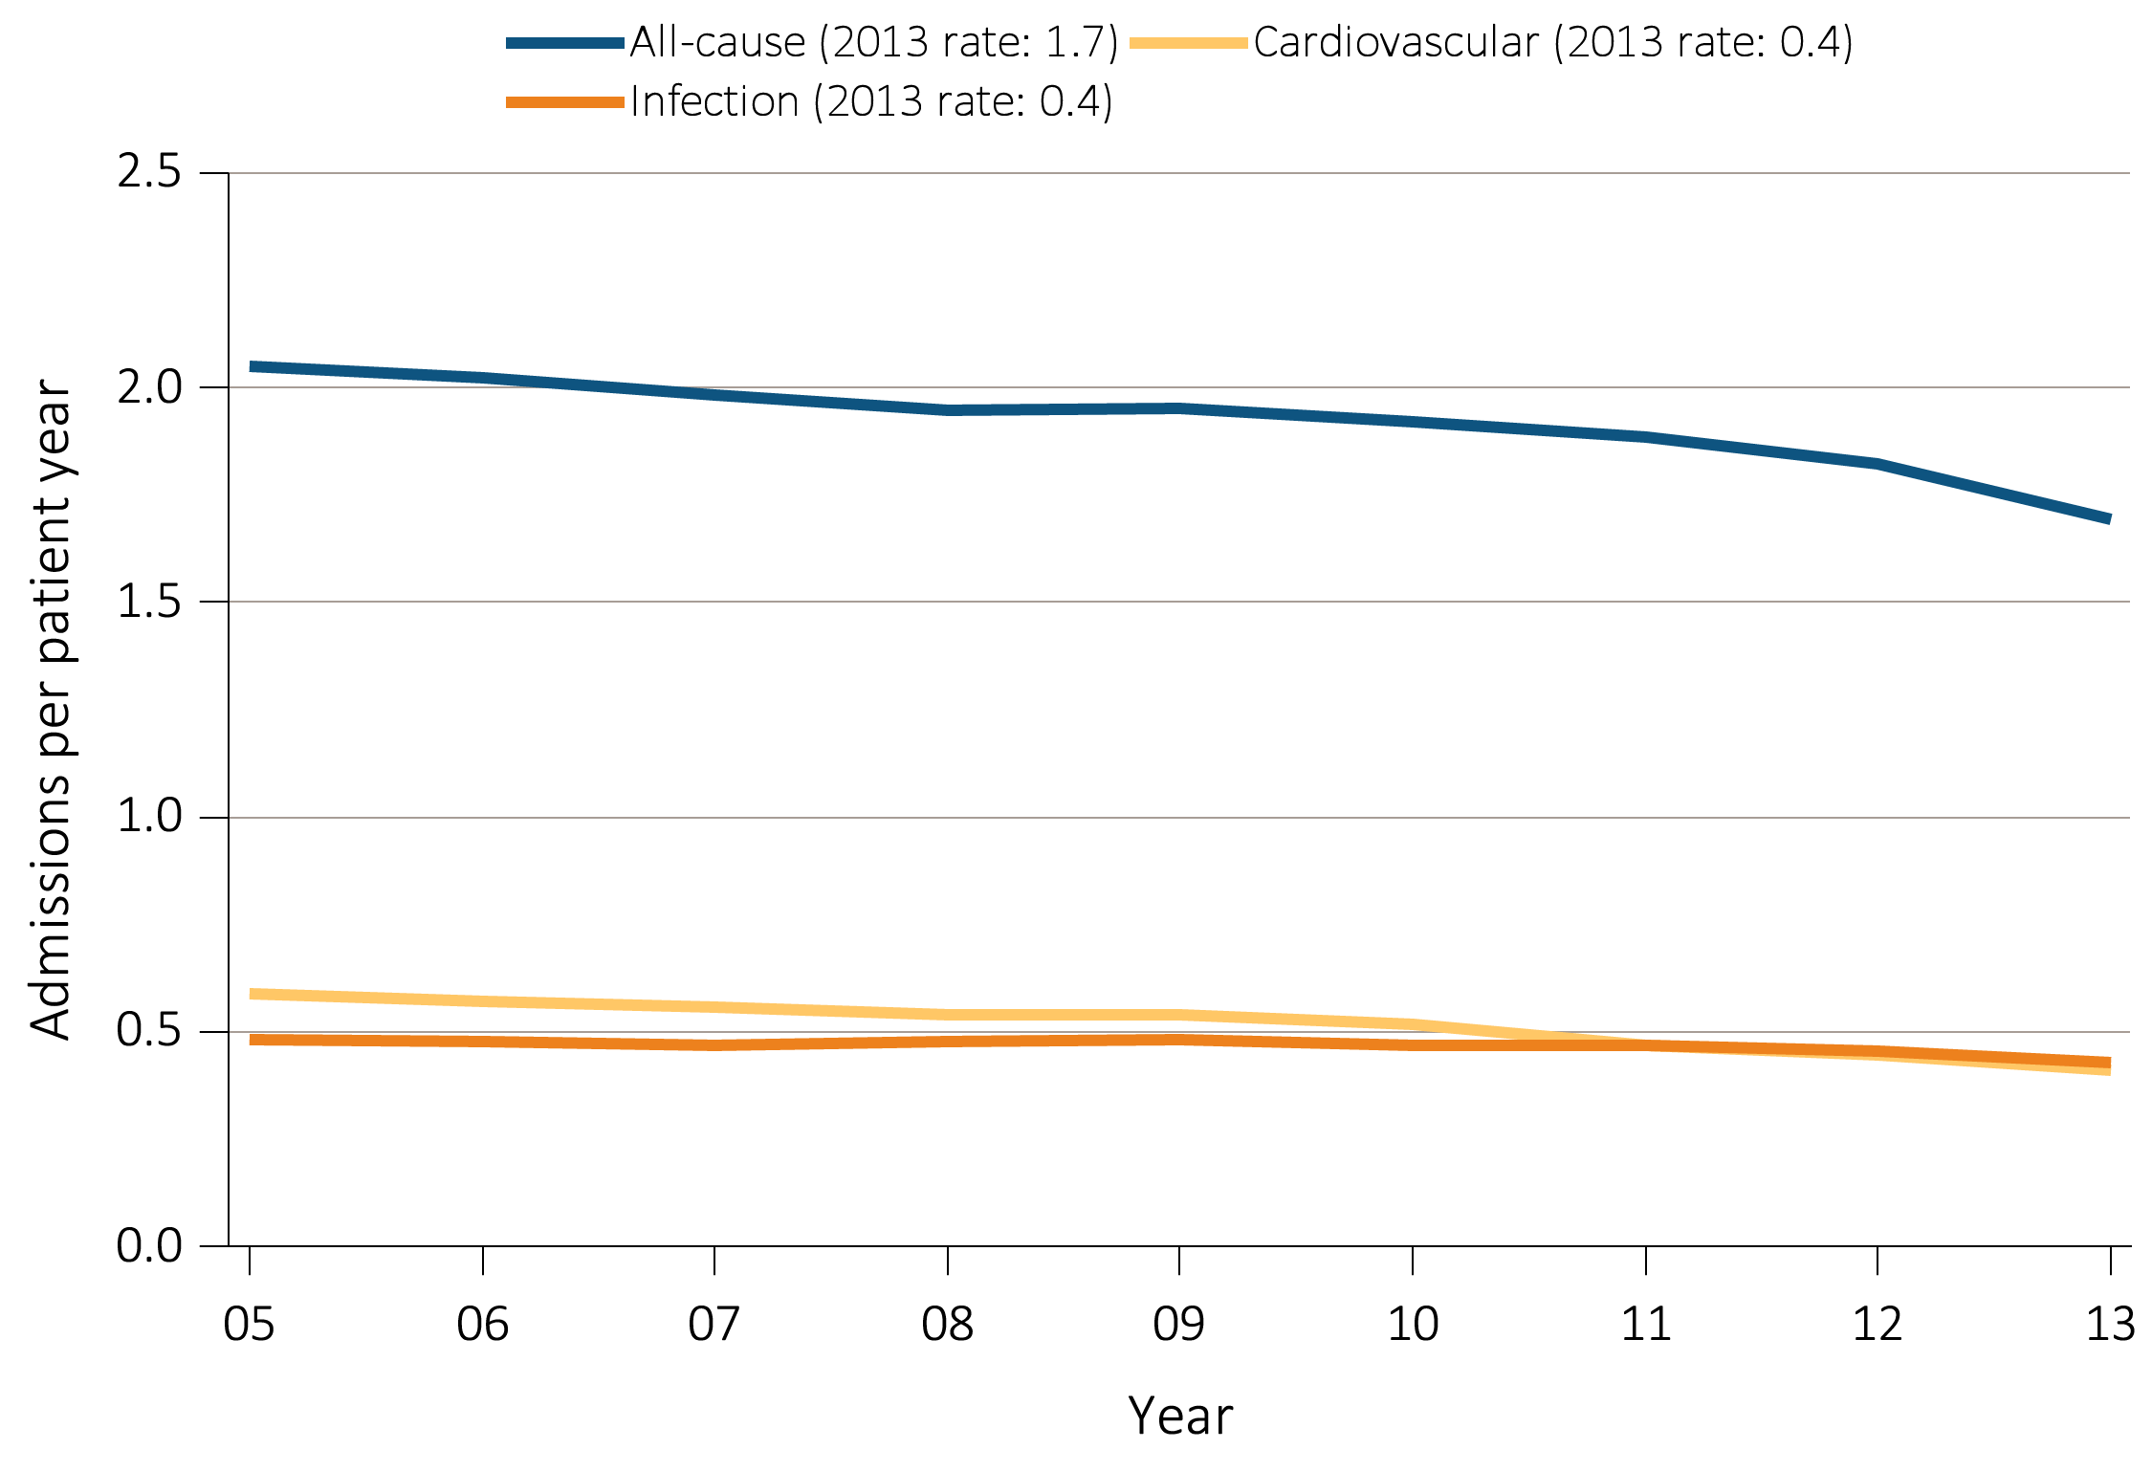
^{Figure 5.2} Adjusted all-cause & cause-specific hospitalization rates for ESRD patients,
by treatment modality, 2005-2013
^{(a) All ESRD}
Data Source: Reference tables: G.1, G.3, G.4, G.5, and special analyses, USRDS ESRD Database. Period prevalent ESRD patients; adjusted for age, sex, race, & primary diagnosis; ref: ESRD patients, 2011. Abbreviations: ESRD, end-stage renal disease.

Slide 4
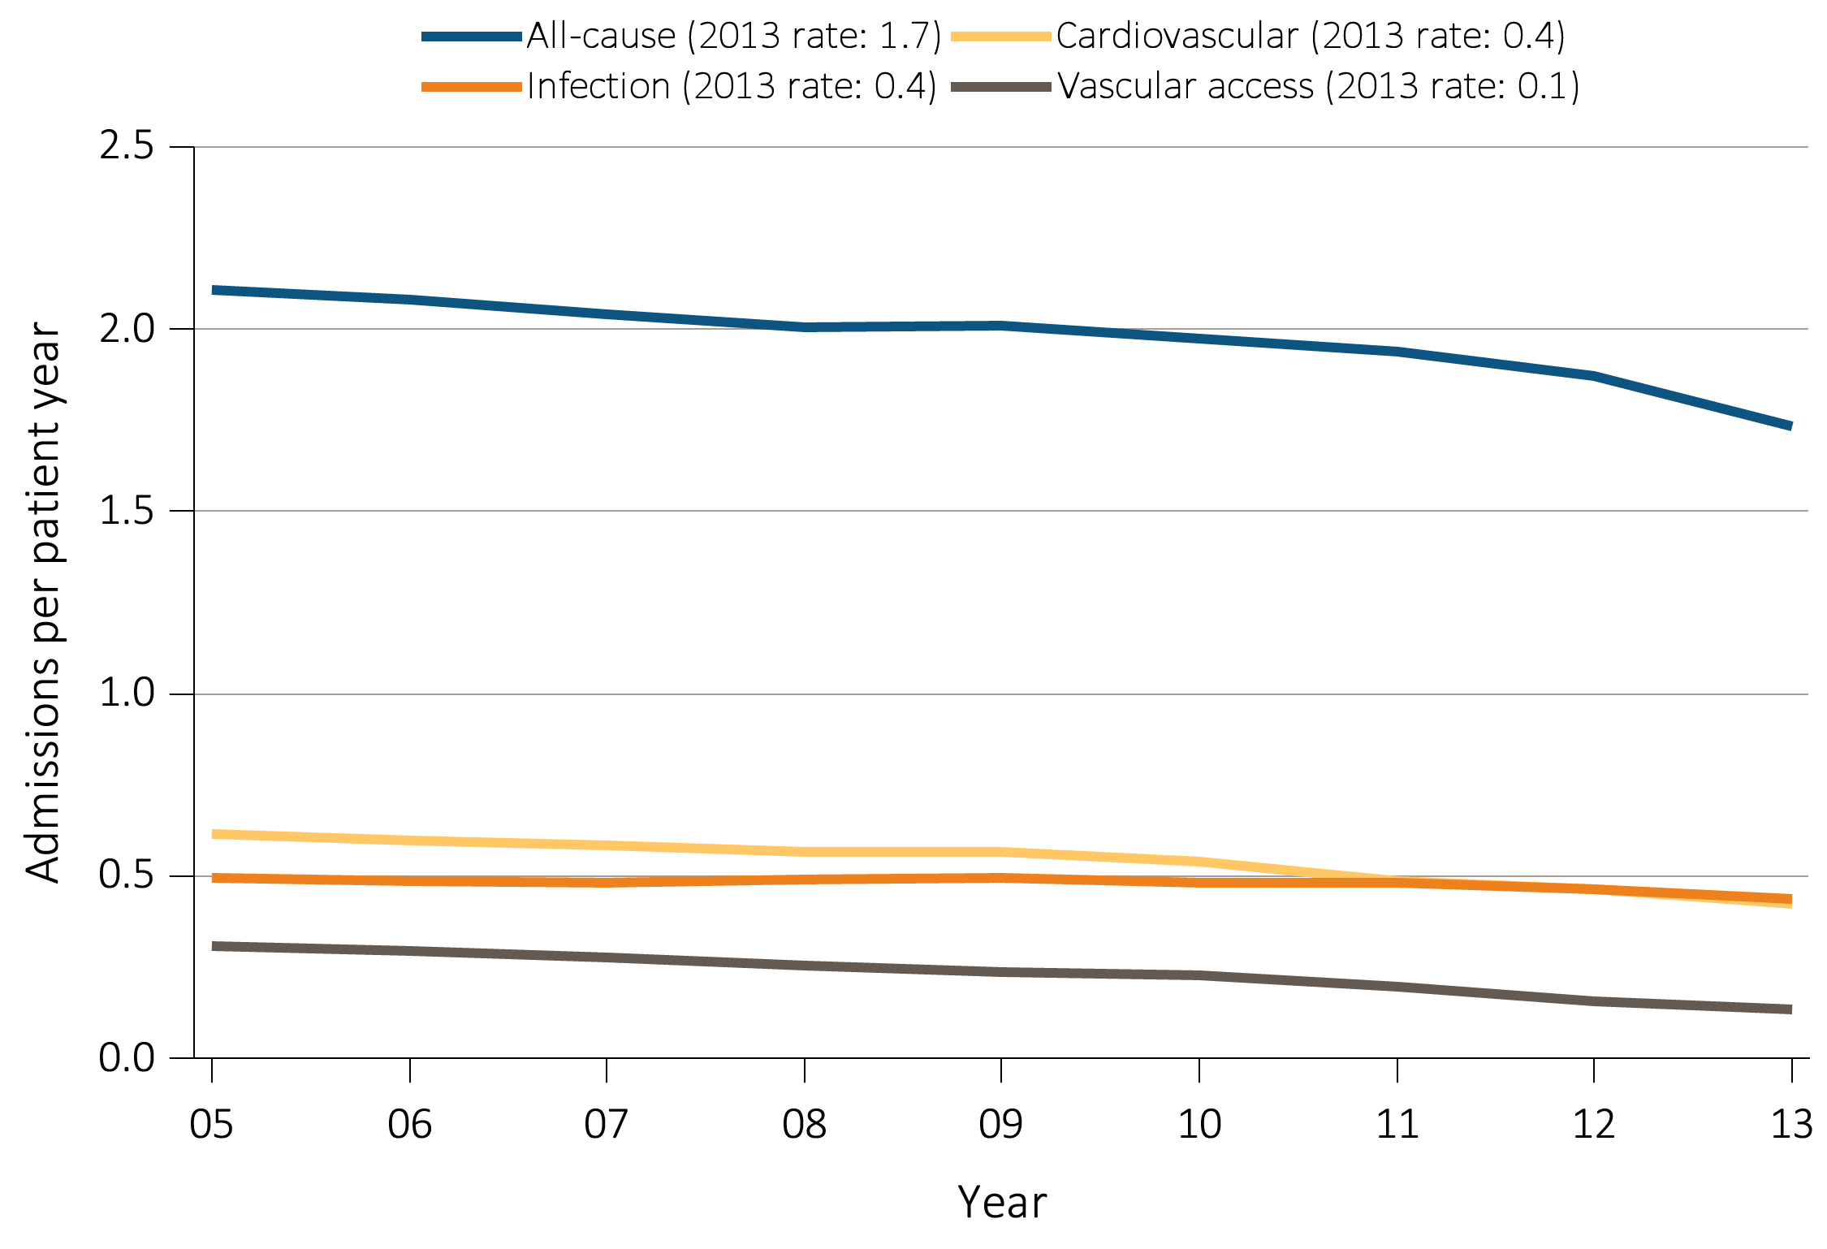
^{Figure 5.2} Adjusted all-cause & cause-specific hospitalization rates for ESRD patients,
by treatment modality, 2005-2013
^{(b) Hemodialysis}
Data Source: Reference tables: G.1, G.3, G.4, G.5, and special analyses, USRDS ESRD Database. Period prevalent ESRD patients; adjusted for age, sex, race, & primary diagnosis; ref: ESRD patients, 2011. Abbreviations: ESRD, end-stage renal disease.

Slide 5
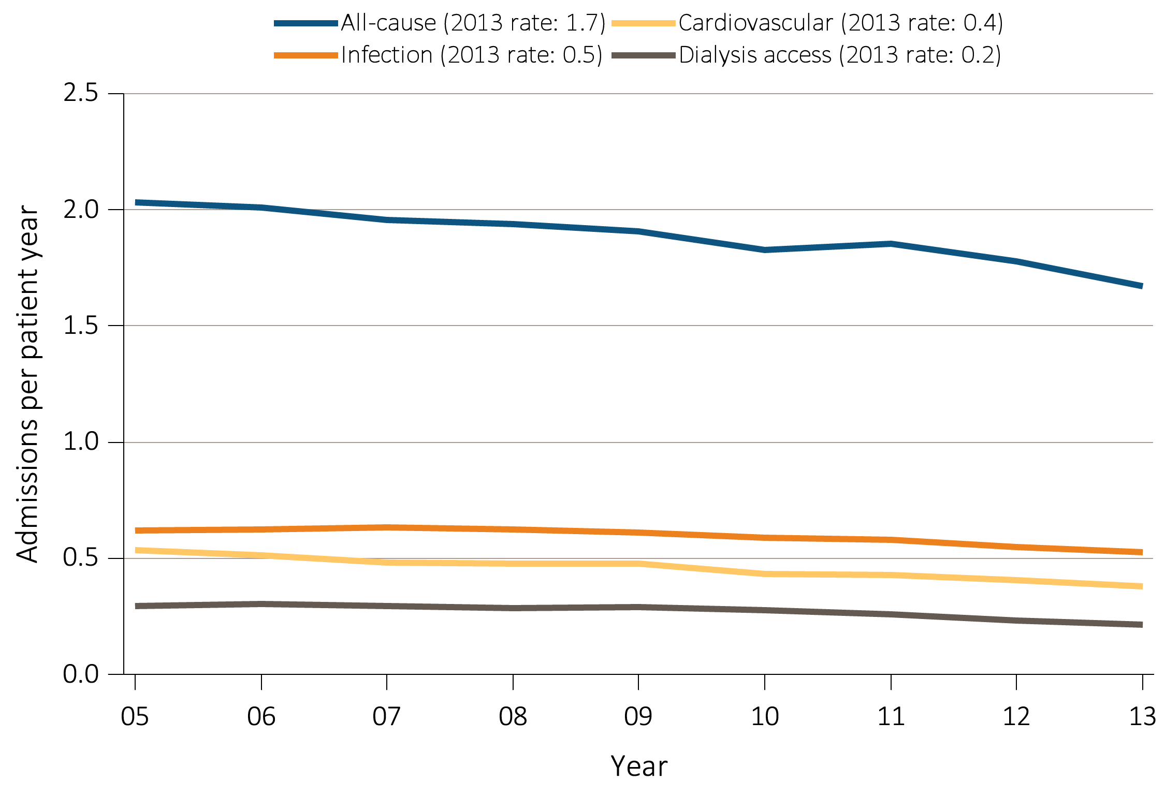
^{Figure 5.2} Adjusted all-cause & cause-specific hospitalization rates for ESRD patients,
by treatment modality, 2005-2013
^{(c) Peritoneal Dialysis}
Data Source: Reference tables: G.1, G.3, G.4, G.5, and special analyses, USRDS ESRD Database. Period prevalent ESRD patients; adjusted for age, sex, race, & primary diagnosis; ref: ESRD patients, 2011. Abbreviations: ESRD, end-stage renal disease.

Slide 6
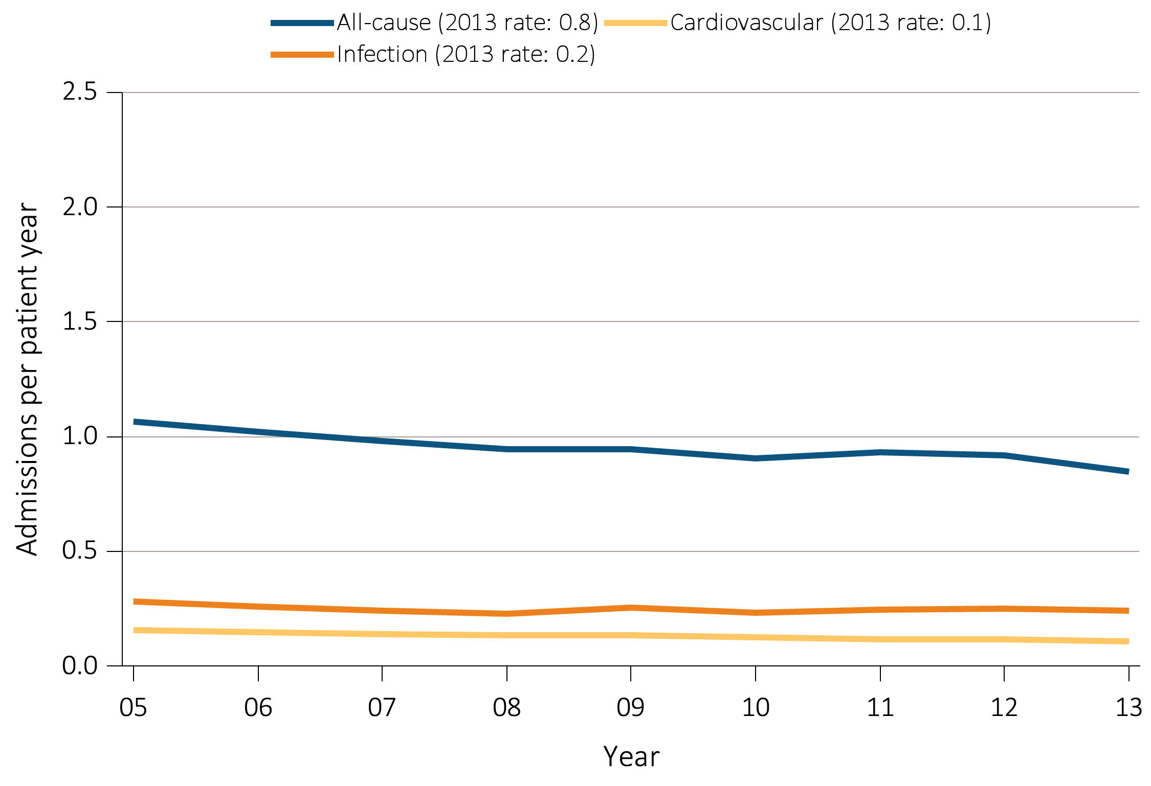
^{Figure 5.2} Adjusted all-cause & cause-specific hospitalization rates for ESRD patients,
by treatment modality, 2005-2013
^{(d) Transplant}
Data Source: Reference tables: G.1, G.3, G.4, G.5, and special analyses, USRDS ESRD Database. Period prevalent ESRD patients; adjusted for age, sex, race, & primary diagnosis; ref: ESRD patients, 2011. Abbreviations: ESRD, end-stage renal disease.

Slide 7
Table 5.1 Rates of all-cause & cause-specific hospitalization per patient year for
adult hemodialysis patients, 2004-2013
 | All |  |  | Cardiovascular |  | Infection (any) |  | Vascular access infection
 |  | Unadjusted | Adjusted | Unadjusted | Adjusted | Unadjusted | Adjusted | Unadjusted | Adjusted
2004-2005 |  | 2.12 | 2.13 | 0.63 | 0.63 | 0.48 | 0.48 | 0.14 | 0.14
2006-2007 |  | 2.08 | 2.08 | 0.60 | 0.60 | 0.49 | 0.49 | 0.13 | 0.13
2008-2009 |  | 2.02 | 2.02 | 0.58 | 0.58 | 0.49 | 0.49 | 0.12 | 0.12
2010-2011 |  | 1.97 | 1.97 | 0.52 | 0.52 | 0.48 | 0.48 | 0.10 | 0.10
2012-2013 |  | 1.81 | 1.81 | 0.45 | 0.45 | 0.45 | 0.45 | 0.05 | 0.05
2012-2013
Age
22-44 |  | 1.79 | 1.96 | 0.36 | 0.37 | 0.42 | 0.46 | 0.07 | 0.08
45-64 |  | 1.76 | 1.76 | 0.42 | 0.42 | 0.43 | 0.43 | 0.05 | 0.06
65-74 |  | 1.86 | 1.82 | 0.49 | 0.48 | 0.46 | 0.45 | 0.05 | 0.05
75+ |  | 1.88 | 1.87 | 0.51 | 0.50 | 0.50 | 0.49 | 0.04 | 0.05
Sex
Male |  | 1.68 | 1.68 | 0.42 | 0.43 | 0.42 | 0.42 | 0.05 | 0.05
Female |  | 1.99 | 1.98 | 0.48 | 0.48 | 0.49 | 0.49 | 0.06 | 0.06
Race
White |  | 1.86 | 1.85 | 0.46 | 0.45 | 0.49 | 0.48 | 0.05 | 0.05
Black/African American |  | 1.80 | 1.83 | 0.45 | 0.46 | 0.41 | 0.43 | 0.06 | 0.06
Other race |  | 1.43 | 1.40 | 0.35 | 0.34 | 0.39 | 0.38 | 0.04 | 0.04
Ethnicity
Hispanic |  | 1.70 | 1.70 | 0.41 | 0.41 | 0.44 | 0.44 | 0.05 | 0.05
Cause of Renal Failure
Diabetes |  | 2.00 | 2.03 | 0.49 | 0.49 | 0.50 | 0.50 | 0.05 | 0.06
Hypertension |  | 1.68 | 1.68 | 0.46 | 0.46 | 0.40 | 0.40 | 0.05 | 0.05
Glomerulonephritis |  | 1.55 | 1.56 | 0.36 | 0.38 | 0.39 | 0.39 | 0.05 | 0.05
Other |  | 1.69 | 1.72 | 0.37 | 0.38 | 0.46 | 0.46 | 0.05 | 0.05
Data Source: Reference Tables G.3, G.13, and special analyses, USRDS ESRD Database. Period prevalent hemodialysis patients aged 22 & older; adjusted for age, sex, race, ethnicity, & primary cause of kidney failure. Rates by one factor adjusted for the remaining three; reference group, hemodialysis patients, 2011. See Vol. 2, ESRD Analytical Methods for principal ICD-9-CM diagnosis codes included in each cause of hospitalization category.

Slide 8
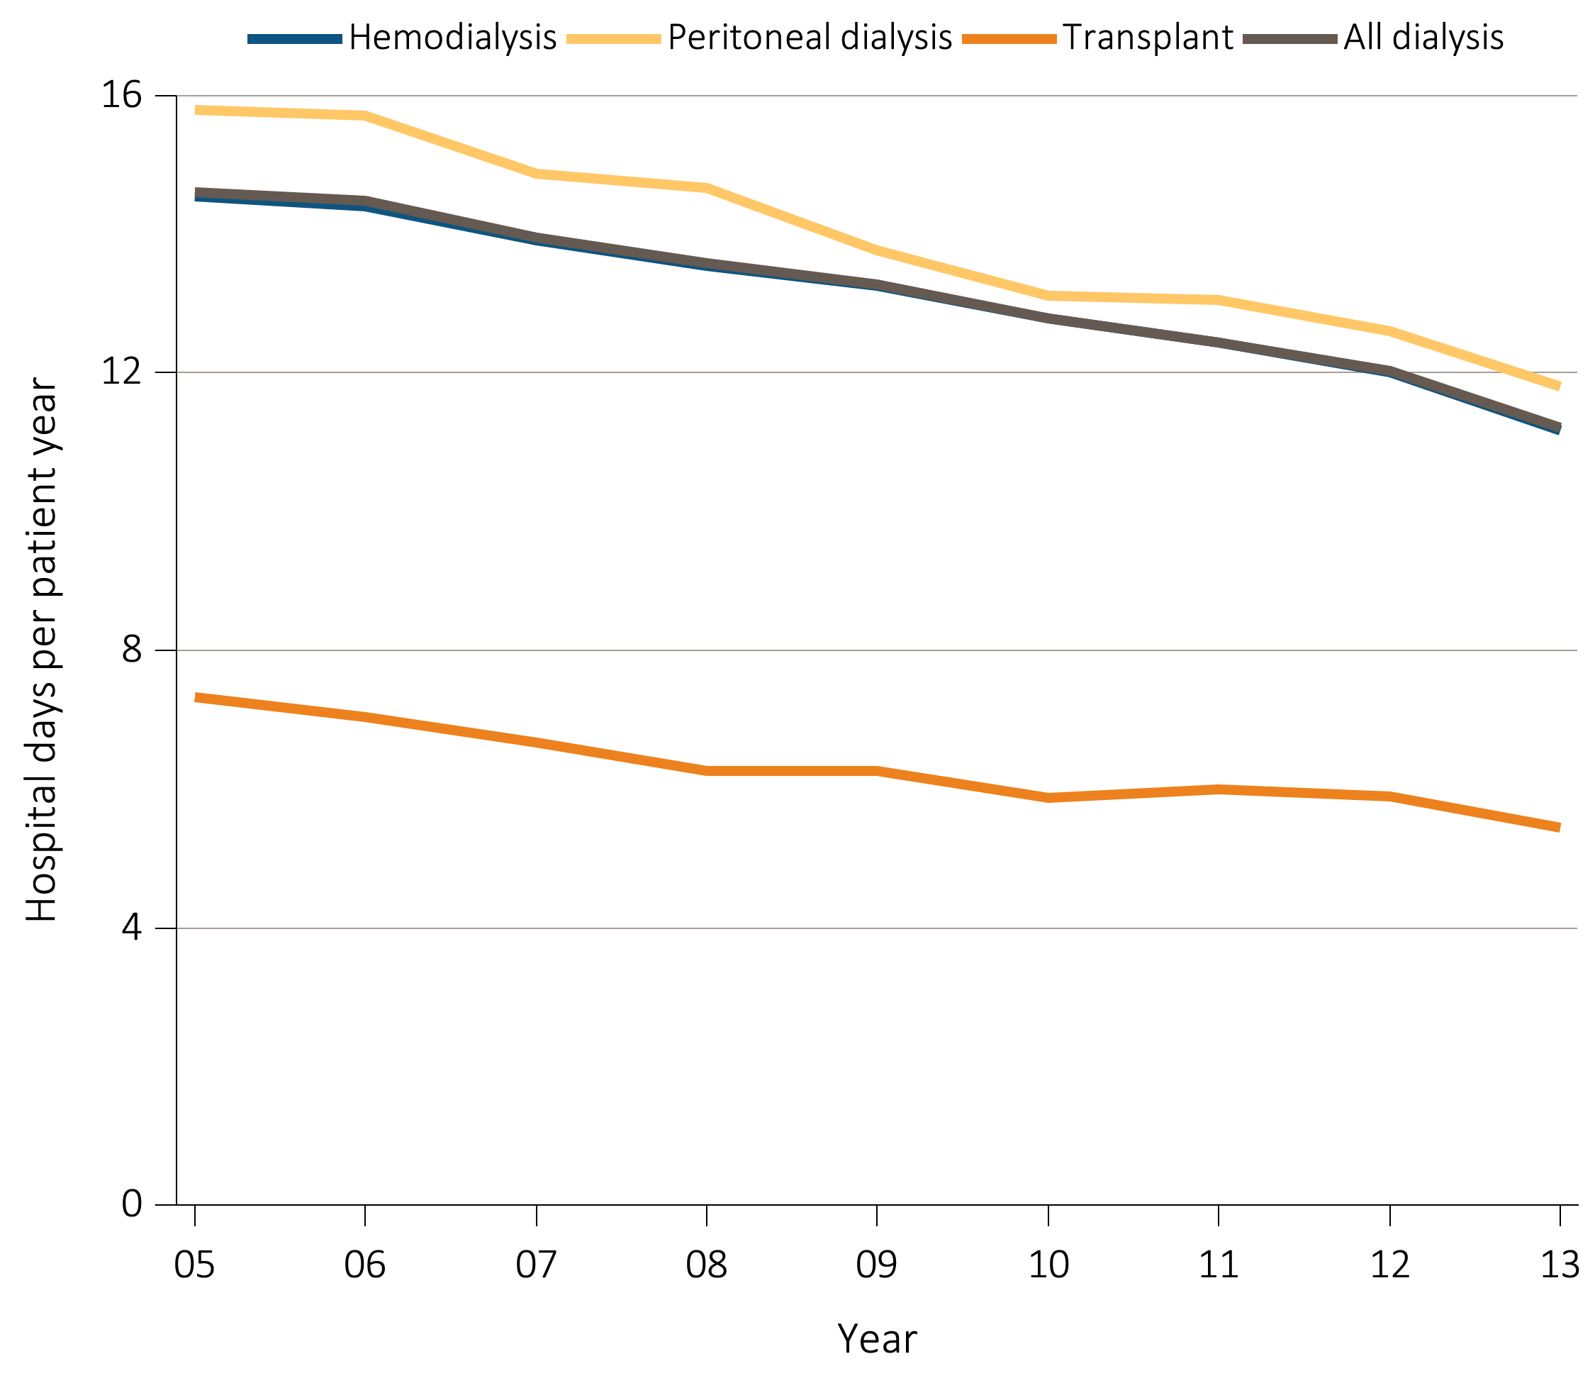
Figure 5.3 Adjusted hospital days for ESRD patients, by treatment modality, 2005-2013
Data Source: Reference Tables G.1, G.3, G.4, G.5, G.6, G.8, G.9, G.10, and special analyses, USRDS ESRD Database. Period prevalent ESRD patients; adjusted for age, sex, race, & primary cause of kidney failure. Reference group: ESRD patients, 2011. Abbreviation: ESRD, end-stage renal disease.

Slide 9
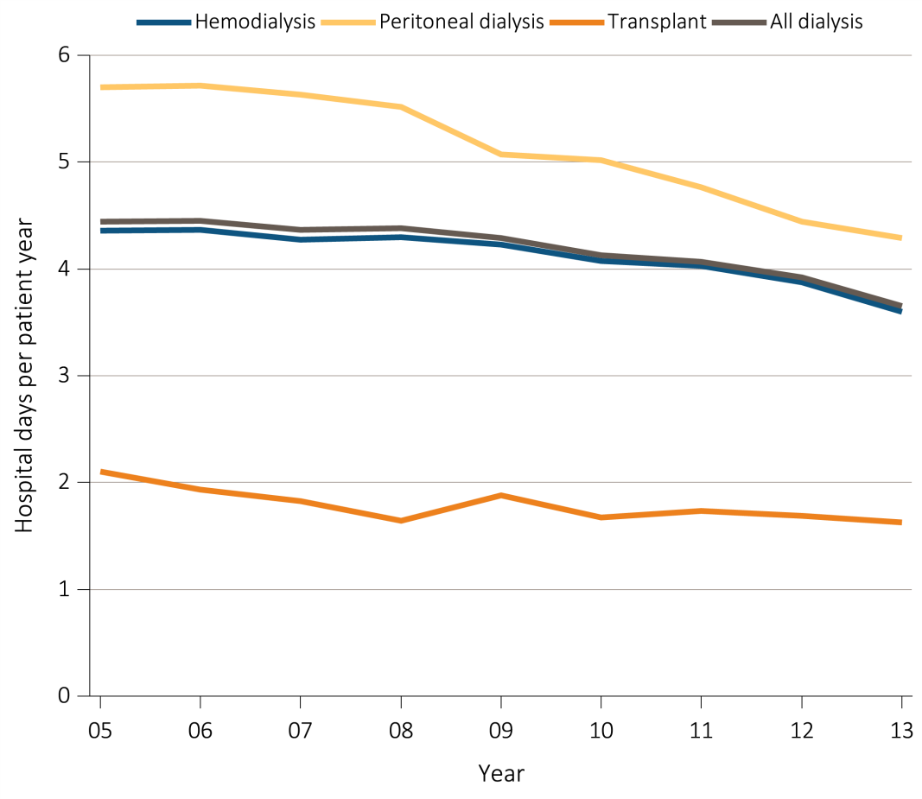
Figure 5.4 Adjusted hospital days for infection & cardiovascular causes, for ESRD patients by their treatment modality, 2005-2013
^{(a) Infection}
Data Source: Special analyses, USRDS ESRD Database. Period prevalent ESRD patients, adjusted for age, sex, race, & primary cause of kidney failure; reference group: ESRD patients, 2011. Abbreviation: ESRD, end-stage renal disease.

Slide 10
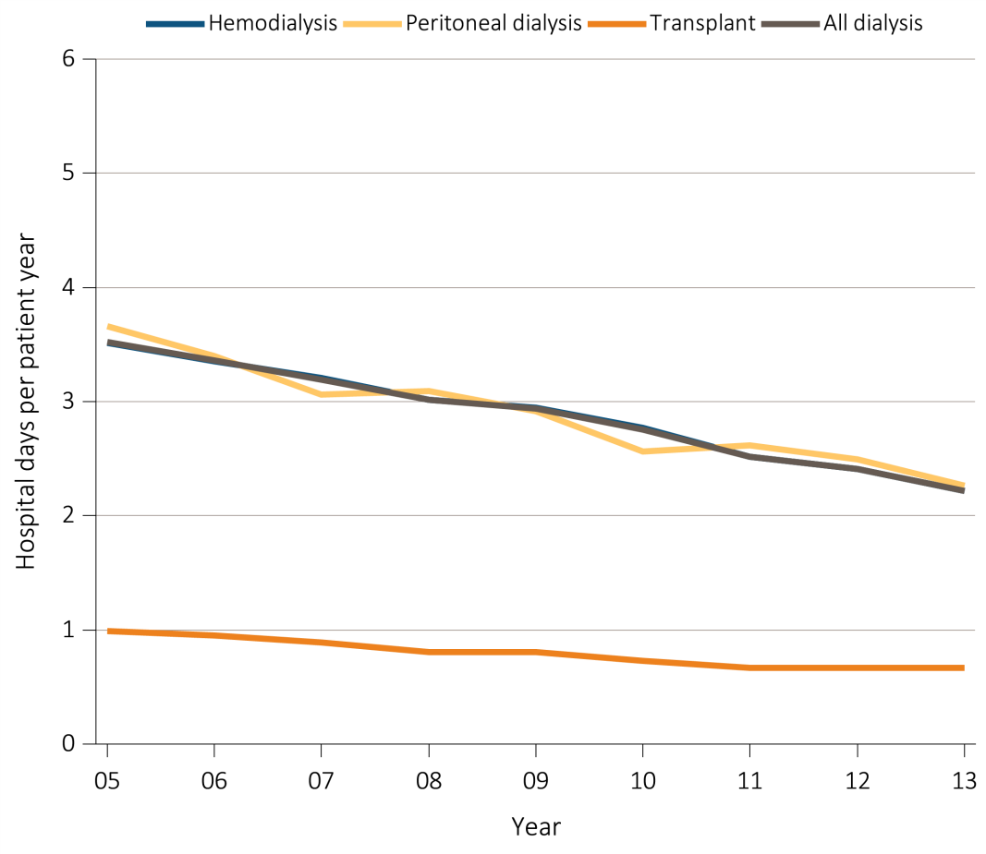
Figure 5.4 Adjusted hospital days for infection & cardiovascular causes, for ESRD patients by their treatment modality, 2005-2013
^{(b) Cardiovascular}
Data Source: Special analyses, USRDS ESRD Database. Period prevalent ESRD patients, adjusted for age, sex, race, & primary cause of kidney failure; reference group: ESRD patients, 2011. Abbreviation: ESRD, end-stage renal disease.

Slide 11
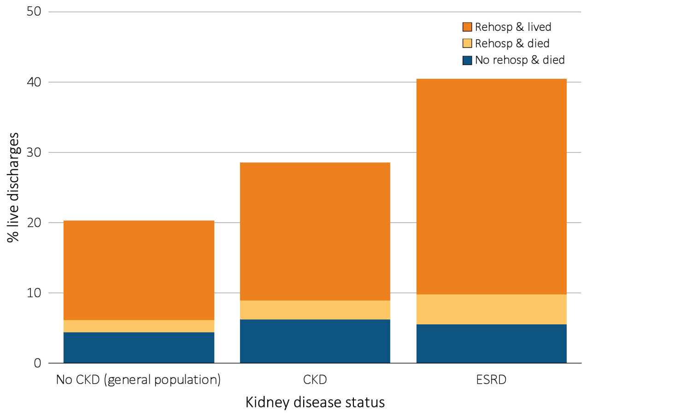
Figure 5.5 Proportion of patients aged 66 & older discharged alive from the hospital
who either were rehospitalized or died within 30 days of discharge,
^{by kidney disease status, 2013}
Data Source: Special analyses, USRDS ESRD Database and Medicare 5 percent sample. January 1, 2013 point prevalent Medicare patients aged 66 & older on December 31, 2012. For general Medicare: January 1, 2013 point prevalent, Medicare patients aged 66 & older, discharged alive from an all-cause index hospitalization between January 1, 2013, and December 1, 2013, unadjusted. CKD determined using claims for 2012. Abbreviations: CKD, chronic kidney disease; ESRD, end-stage renal disease; rehosp, rehospitalization.

Slide 12
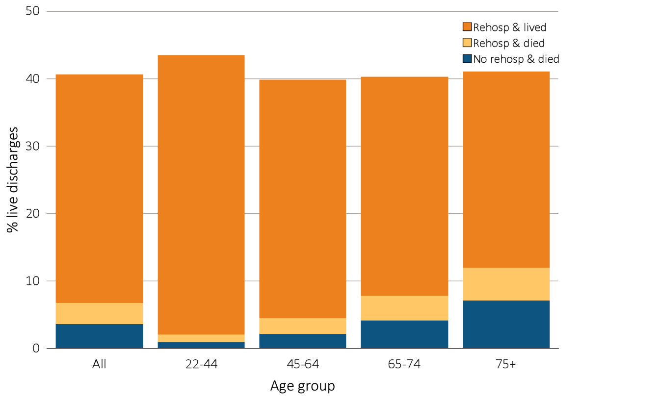
Figure 5.6 Proportion of hemodialysis patients discharged alive from the hospital
who either were rehospitalized or died within 30 days of discharge,
by demographic characteristics, 2013
^{(a) By age}
Data Source: Special analyses, USRDS ESRD Database. Period prevalent hemodialysis patients, all ages, 2013; unadjusted. Includes live hospital discharges from January 1 to December 1, 2013. Cause-specific hospitalizations are defined by principal ICD-9-CM codes. See Vol. 2, ESRD Analytical Methods for principal ICD-9-CM diagnosis codes included in each cause of hospitalization category. Abbreviations: Af Am, African American; ESRD, end-stage renal disease; Nat Am, Native American; Other, other or unidentified race; rehosp, rehospitalization.

Slide 13
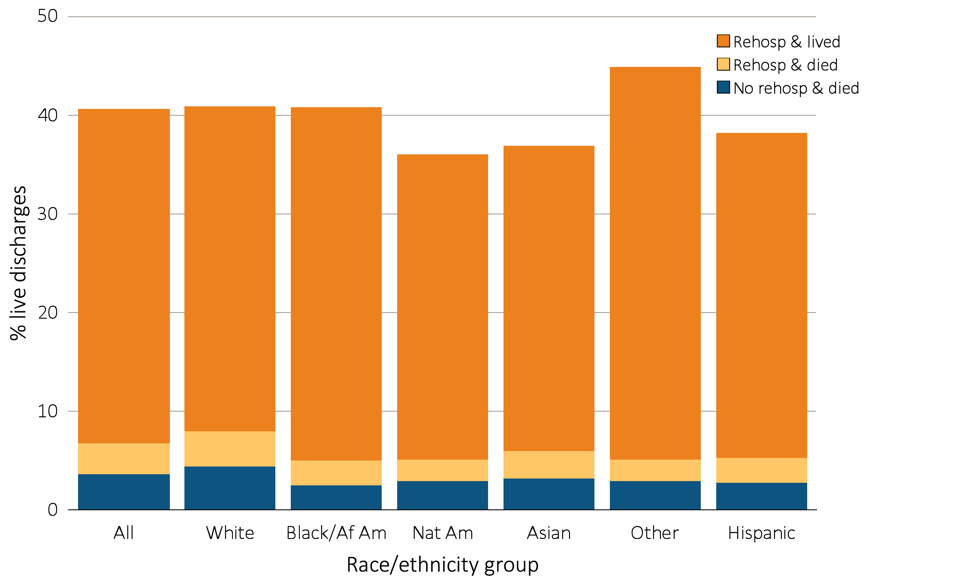
Figure 5.6 Proportion of hemodialysis patients discharged alive from the hospital
who either were rehospitalized or died within 30 days of discharge,
by demographic characteristics, 2013
^{(b) By race/ethnicity}
Data Source: Special analyses, USRDS ESRD Database. Period prevalent hemodialysis patients, all ages, 2013; unadjusted. Includes live hospital discharges from January 1 to December 1, 2013. Cause-specific hospitalizations are defined by principal ICD-9-CM codes. See Vol. 2, ESRD Analytical Methods for principal ICD-9-CM diagnosis codes included in each cause of hospitalization category. Abbreviations: Af Am, African American; ESRD, end-stage renal disease; Nat Am, Native American; Other, other or unidentified race; rehosp, rehospitalization.

Slide 14
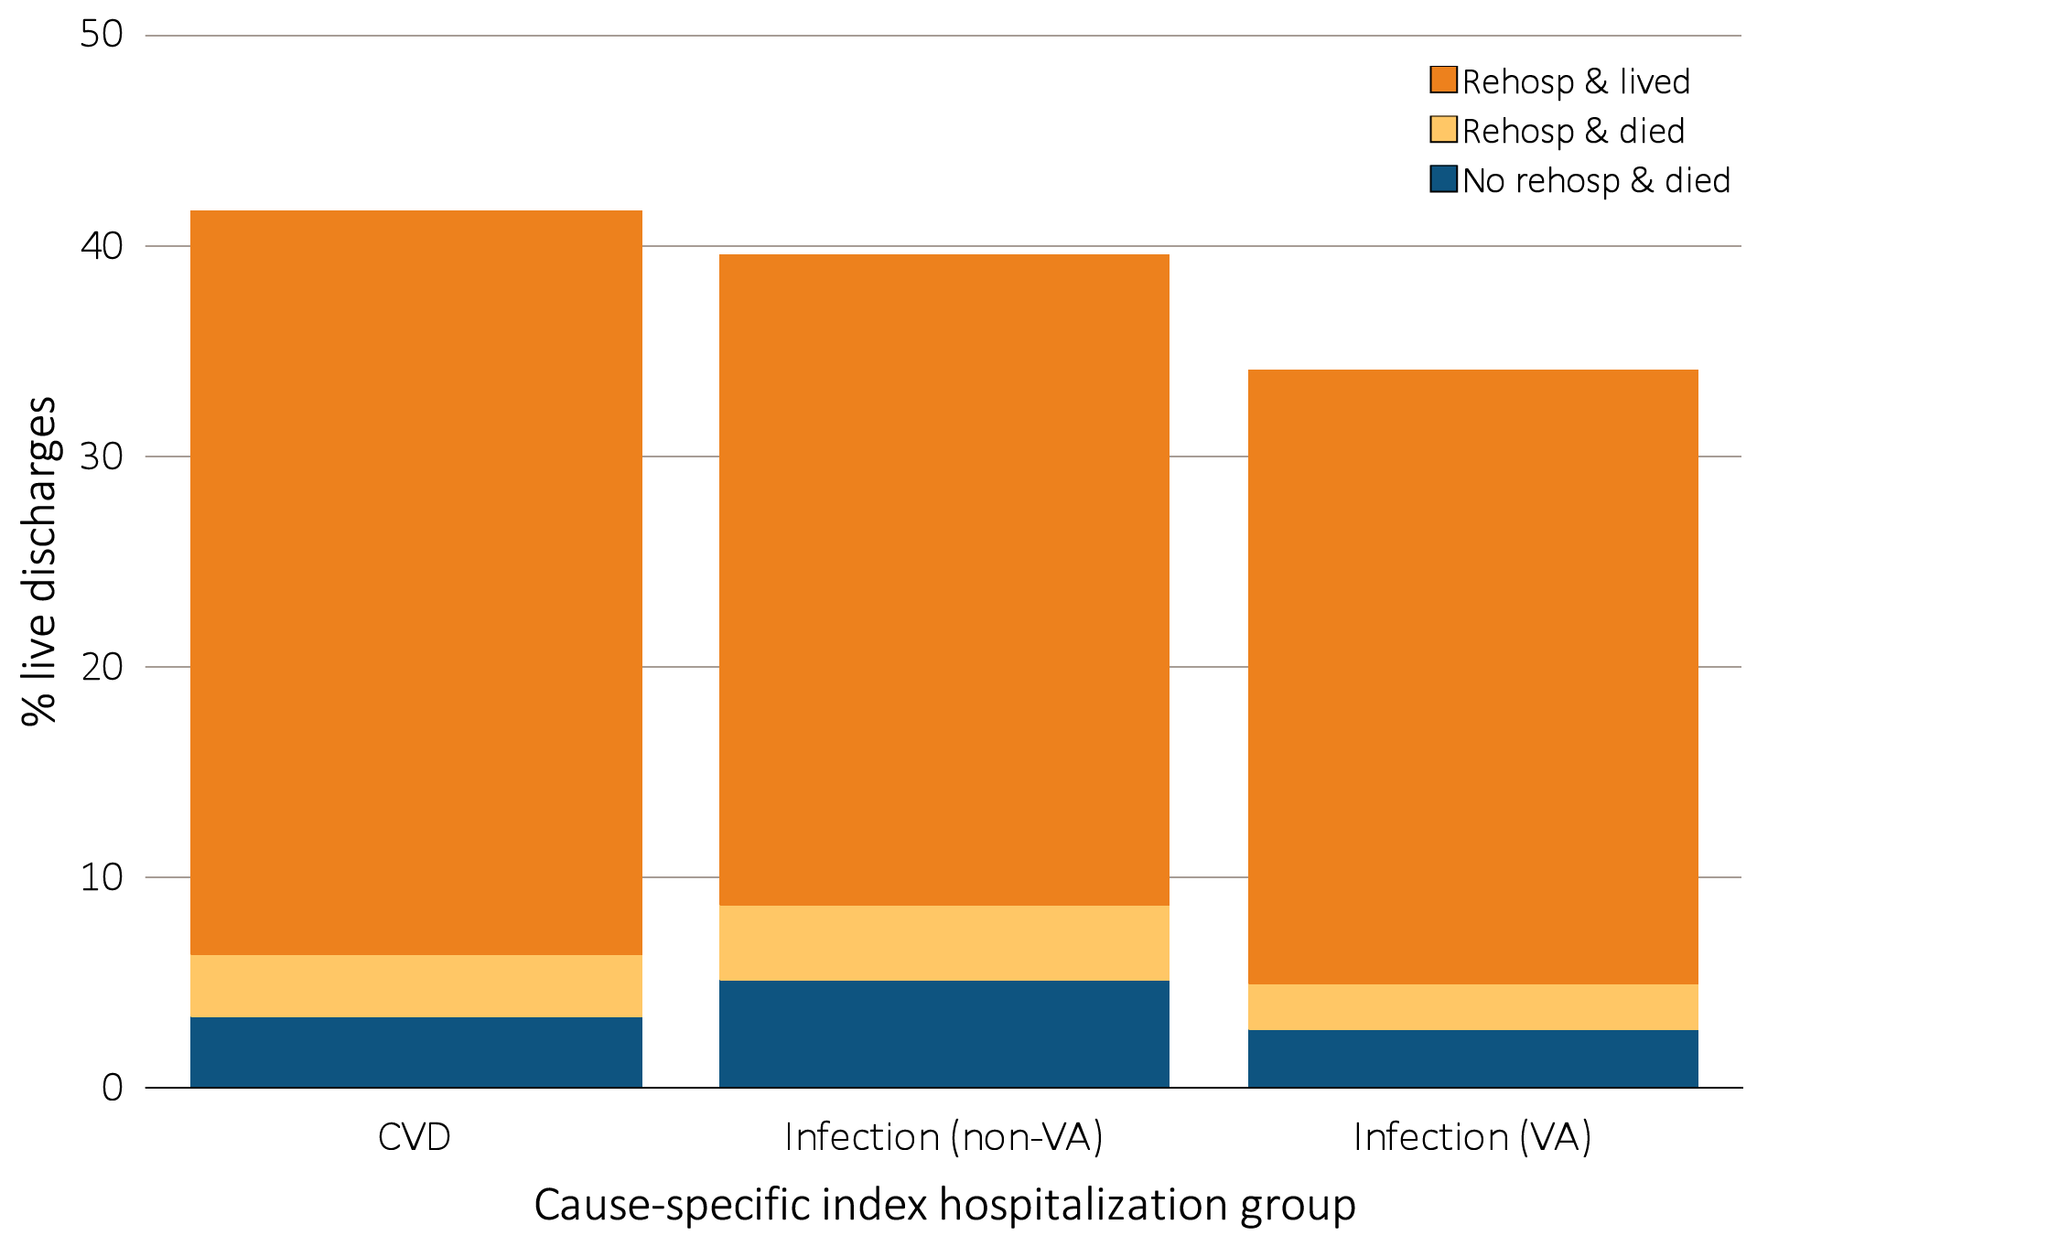
Figure 5.7 Proportion of hemodialysis patients discharged alive that either were rehospitalized or died within 30 days of discharge,
by cause of index hospitalization, 2013
Data Source: Special analyses, USRDS ESRD Database. Period prevalent hemodialysis patients, all ages, 2013, unadjusted. Includes live hospital discharges from January 1 to December 1, 2013. Cause-specific hospitalizations are defined by principal ICD-9-CM codes. See Vol. 2, ESRD Analytical Methods for principal ICD-9-CM diagnosis codes included in each cause of hospitalization category. Abbreviations: CVD, cardiovascular disease; ESRD, end-stage renal disease; rehosp, rehospitalization; VA, vascular access.

Slide 15
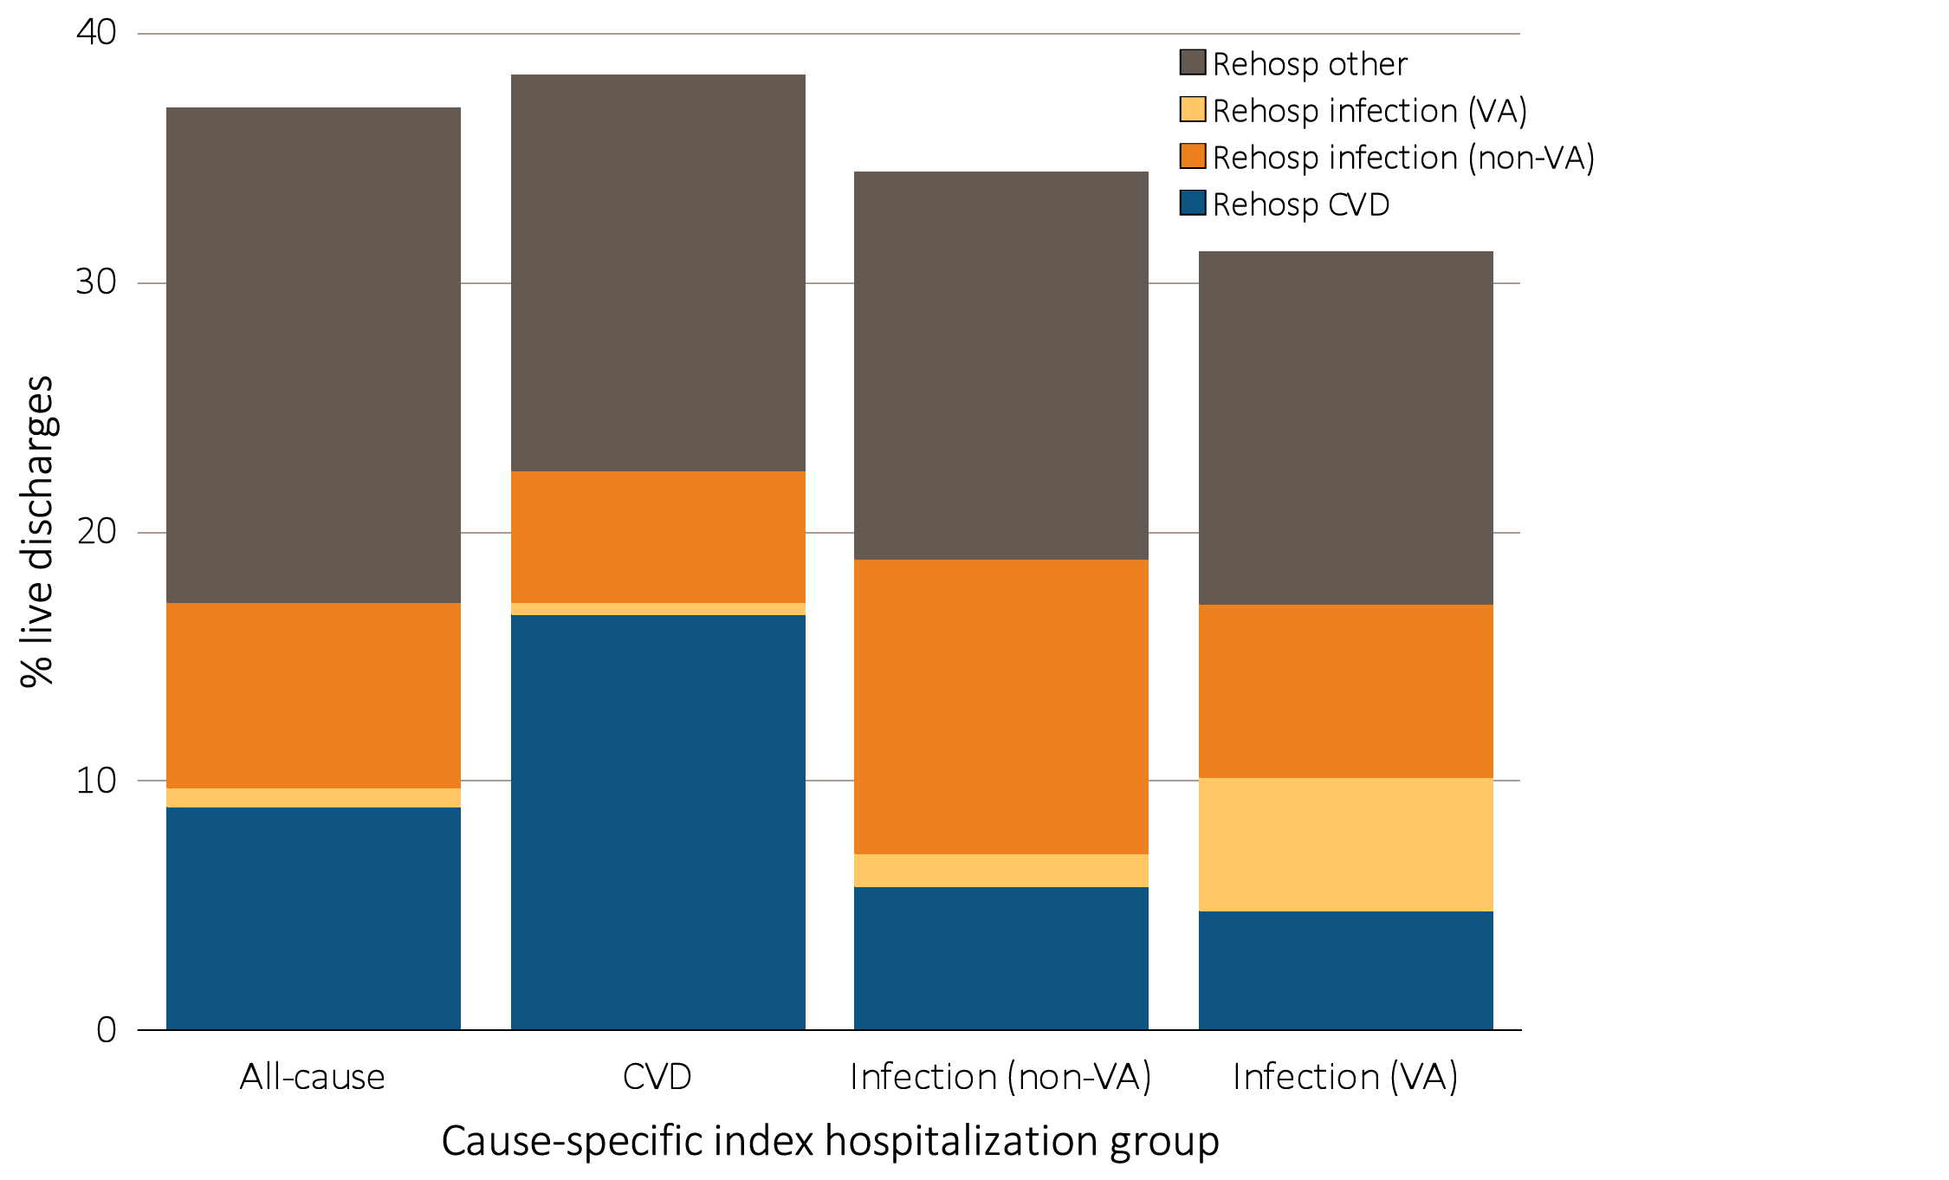
Figure 5.8 Proportion of hemodialysis patients with cause-specific rehospitalizations
within 30 days of discharge, by cause of index hospitalization, 2013
Data Source: Special analyses, USRDS ESRD Database. Period prevalent hemodialysis patients, all ages, 2013, unadjusted. Includes live hospital discharges from January 1 to December 1, 2013. Cause-specific hospitalizations are defined by principal ICD-9-CM codes. See Vol. 2, ESRD Analytical Methods for principal ICD-9-CM diagnosis codes included in each cause of hospitalization category. Abbreviations: CVD, cardiovascular disease; ESRD, end-stage renal disease; rehosp, rehospitalization; VA, vascular access.

Slide 16
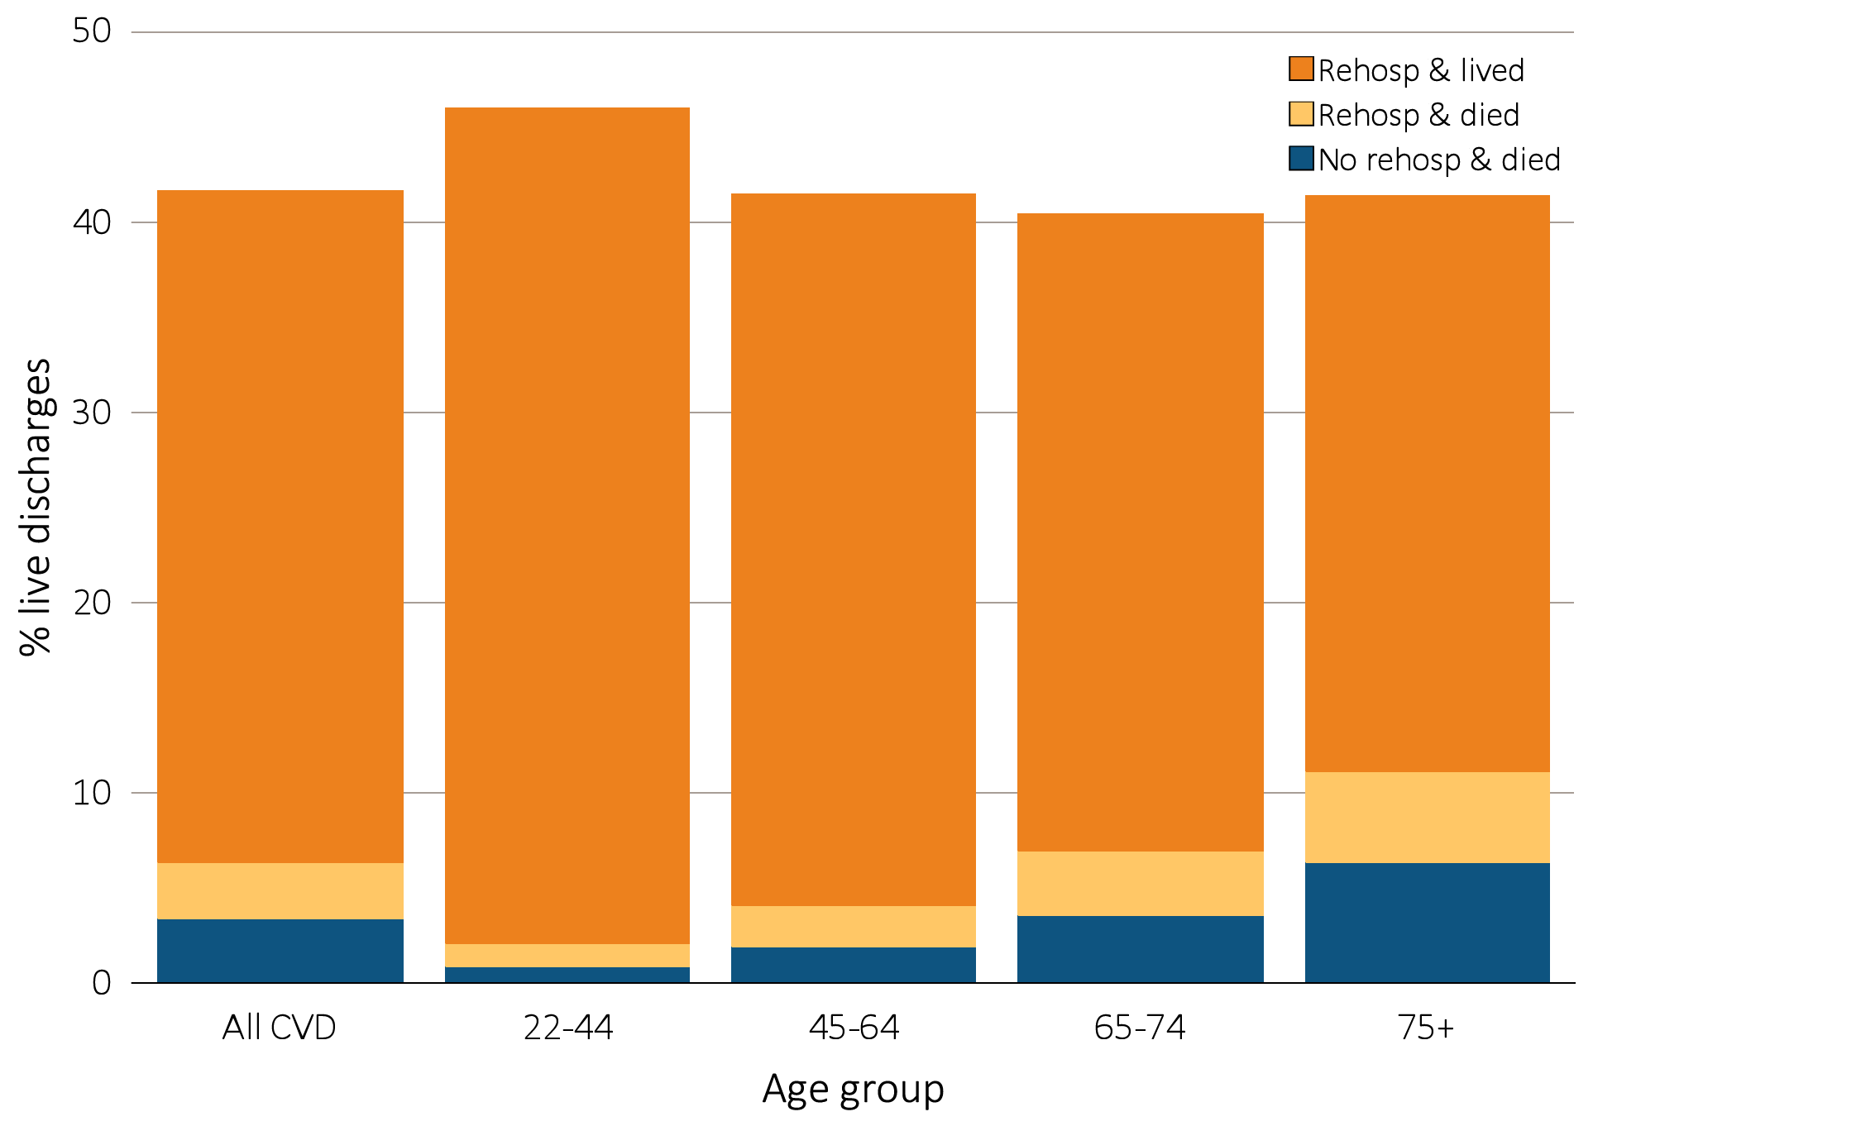
Figure 5.9 Proportion of hemodialysis patients discharged alive that either were rehospitalized or died within 30 days of discharge for cardiovascular index hospitalization, by age, 2013
Data Source: Special analyses, USRDS ESRD Database. Period prevalent hemodialysis patients, all ages, 2013, unadjusted. Patients less than age 22 are not represented as a group due to insufficient sample size. Includes live hospital discharges from January 1 to December 1, 2013. Cause-specific hospitalizations are defined by principal ICD-9-CM codes. See Vol. 2, ESRD Analytical Methods for principal ICD-9-CM diagnosis codes included in each cause of hospitalization category. Abbreviations: CVD, cardiovascular disease; ESRD, end-stage renal disease; rehosp, rehospitalization.

Slide 17
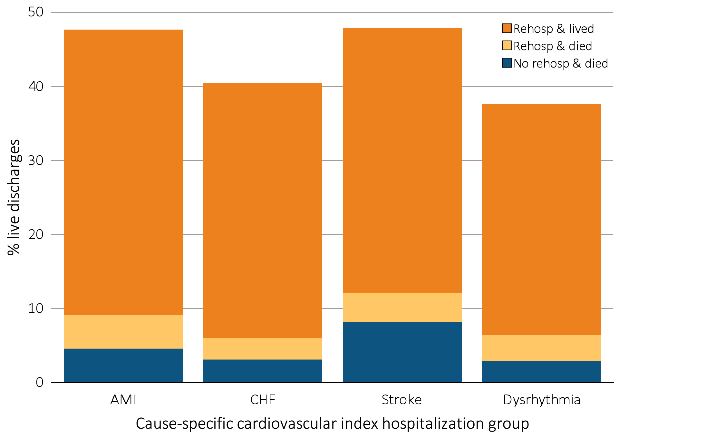
Figure 5.10 Proportion of hemodialysis patients discharged alive that either were rehospitalized or died within 30 days of discharge for cardiovascular index hospitalization, by cause-specific cardiovascular index hospitalization, 2013
Data Source: Special analyses, USRDS ESRD Database. Period prevalent hemodialysis patients, all ages, 2013, unadjusted. Includes live hospital discharges from January 1 to December 1, 2013. Cause-specific hospitalizations are defined by principal ICD-9-CM codes. See Vol. 2, ESRD Analytical Methods for principal ICD-9-CM diagnosis codes included in each cause of hospitalization category. Abbreviations: AMI, acute myocardial infarction; CHF, congestive heart failure; ESRD, end-stage renal disease; rehosp, rehospitalization.

