Slide 2
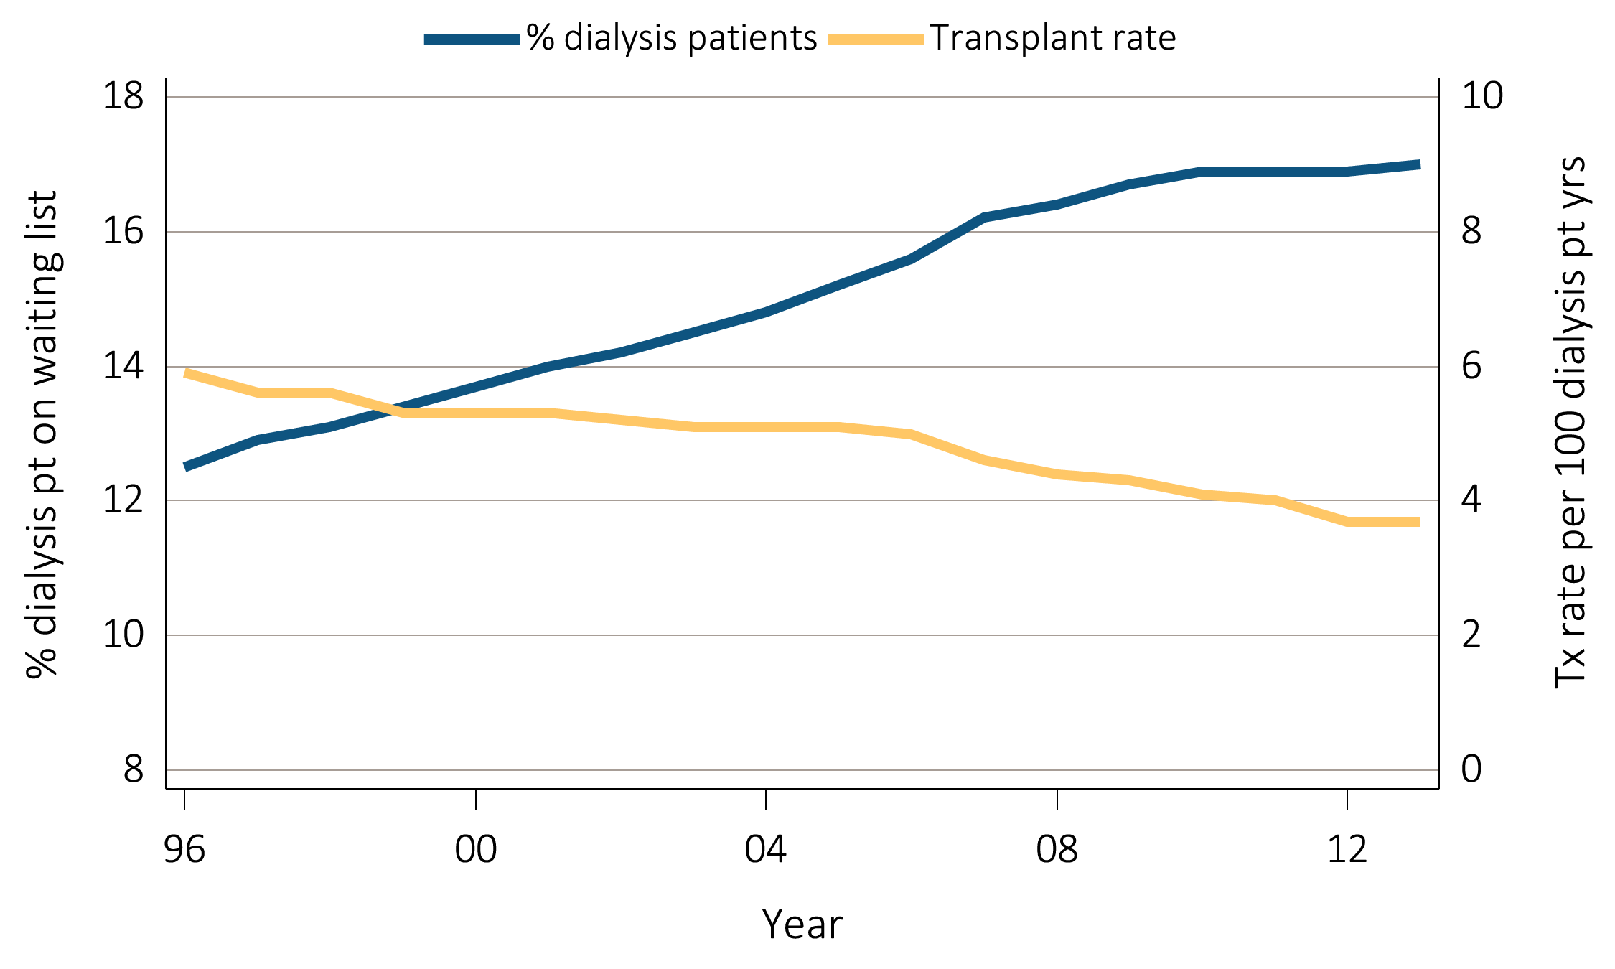
Figure 7.1 Percentage of dialysis patients wait-listed and
unadjusted kidney transplant rates, 1996-2013
Data Source: Reference Tables E4 and E9. Percentage of dialysis patients on the kidney waiting list is for all dialysis patients. Unadjusted transplant rates are for all dialysis patients. Abbreviations: Tx, transplant; pt yrs, patient years.

Slide 3
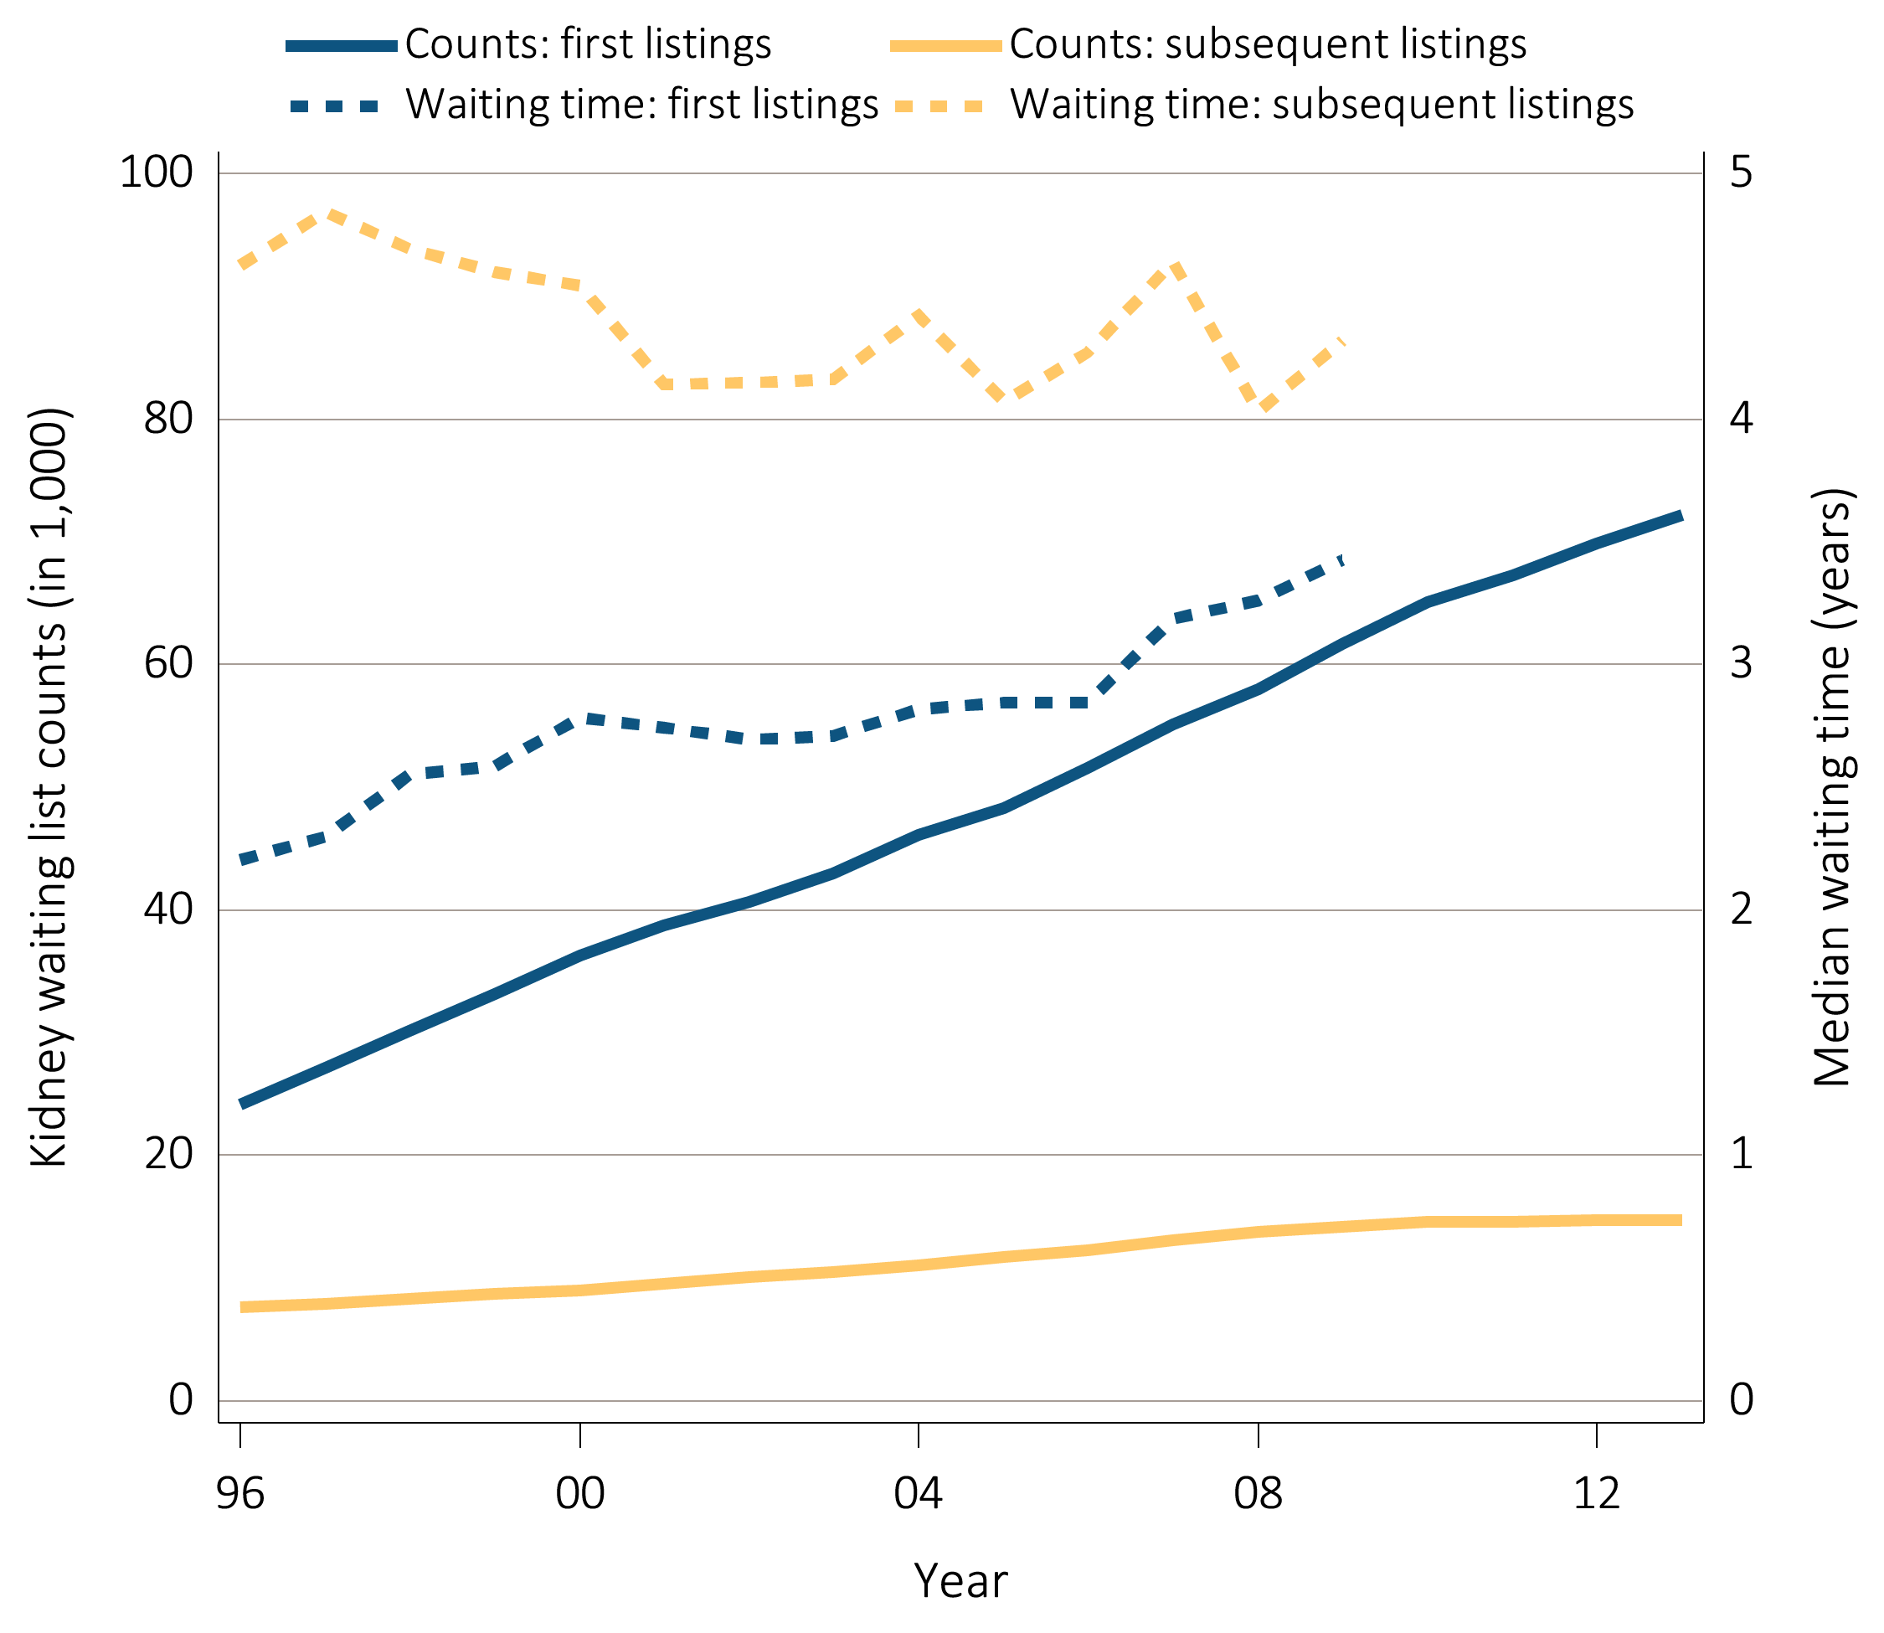
Figure 7.2 Number of patients wait-listed for kidney transplant, 1996-2013,
^{and waiting time, 1996-2010}
Data Source: Reference Tables E2 and E3. Waiting list counts include all candidates listed for a kidney transplant on December 31 of each year. Waiting time is calculated for all candidates enrolled on the waiting list in a given year.

Slide 4
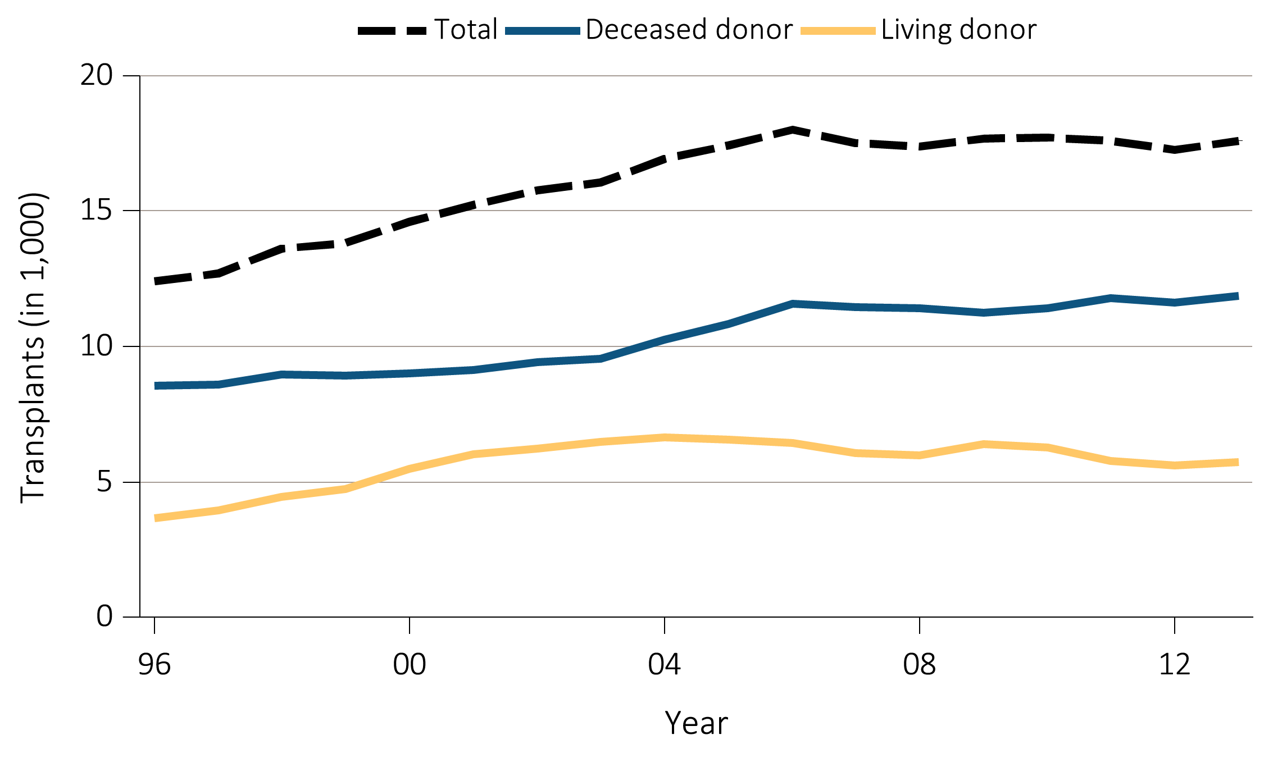
Figure 7.3 Number of kidney transplants, 1996-2013
Data Source: Reference Tables E8, E8(2), and E8(3). Counts of transplants are for all dialysis patients.

Slide 5
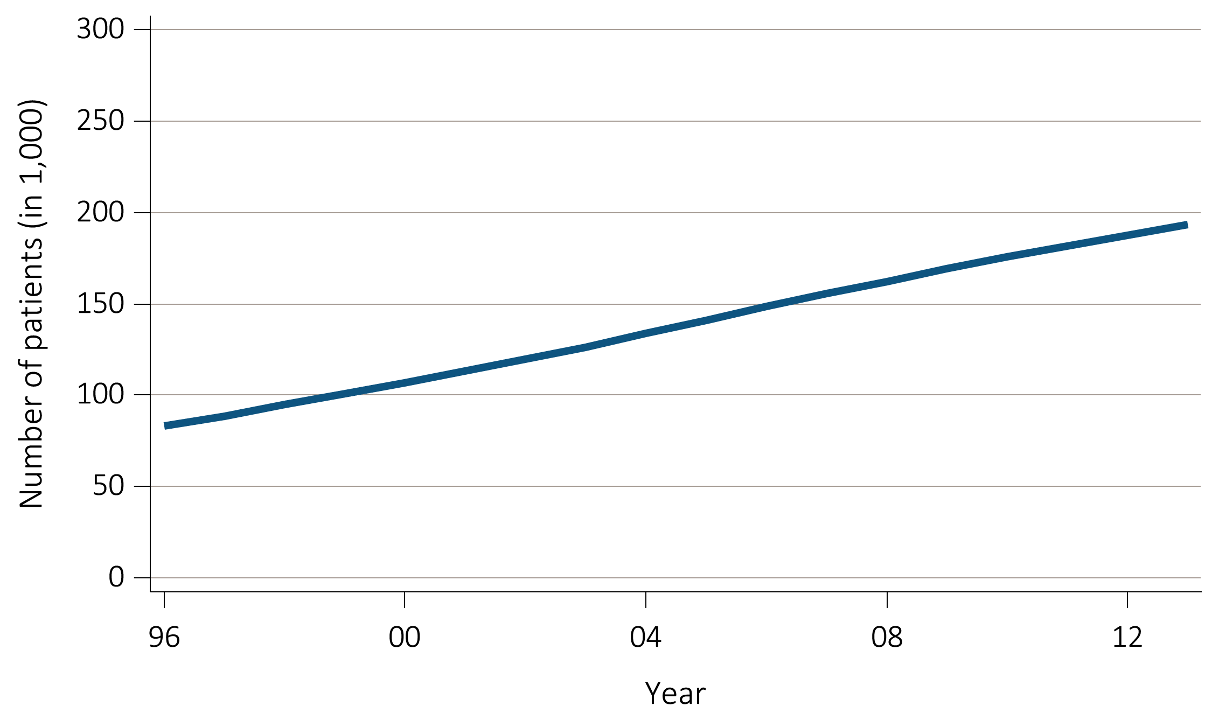
Figure 7.4 Number of patients with a functioning kidney transplant, 1996-2013
Data Source: Reference Table D9. Prevalent counts of patients with a functioning kidney transplant as of December 31 of each year.

Slide 6
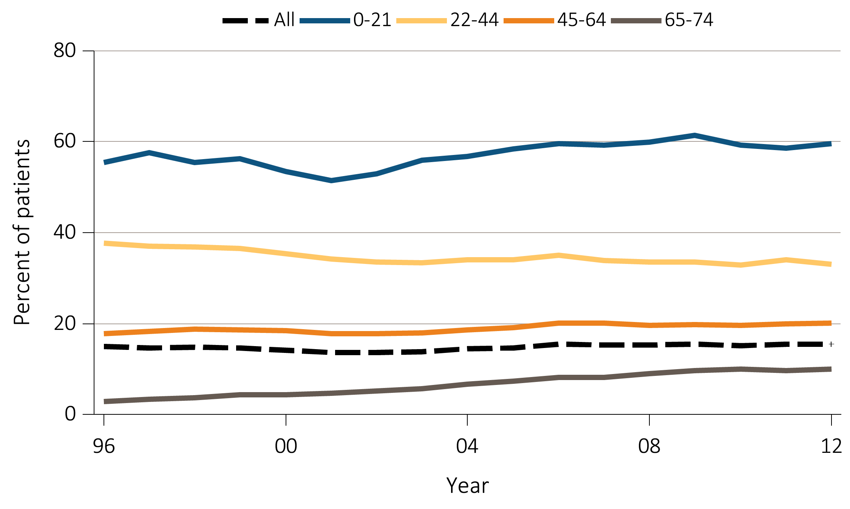
Figure 7.5 Percentage of incident patients being wait-listed or receiving
a kidney transplant within one year of ESRD initiation, by age, 1996-2012
Data Source: Reference Table E5(2). Waiting list or transplantation among incident ESRD patients by age (0-74 years).

Slide 7
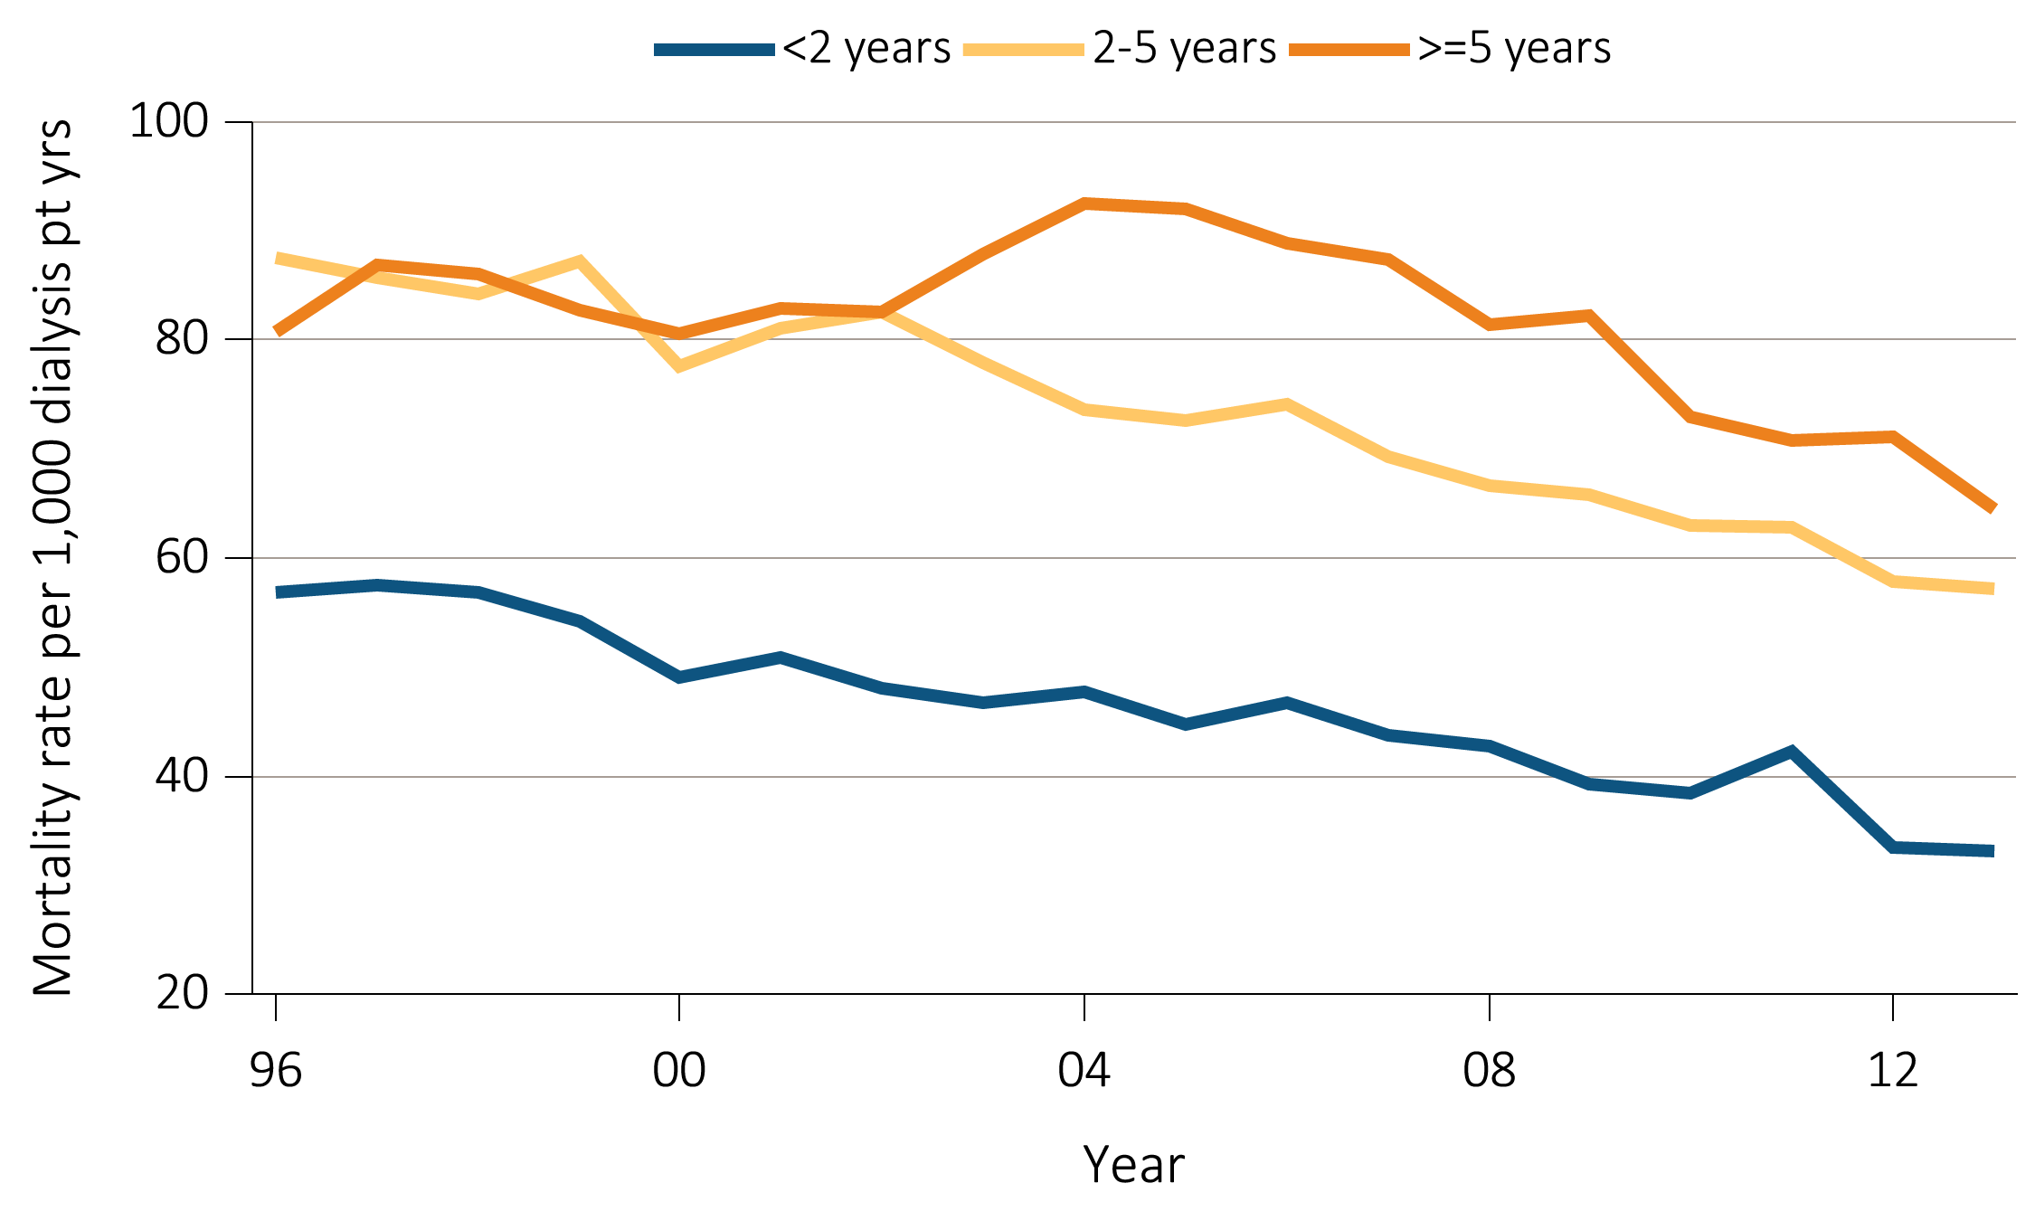
Figure 7.6 Annual mortality rates for dialysis patients on the kidney transplant
waiting list by time on the list, 1996-2013
Data Source: Reference Table H6. Annual mortality rates of dialysis patients on the kidney transplant waiting list per 1,000 dialysis patient years at risk, by patient vintage. Abbreviation: pt yrs, patient years.

Slide 8
^{Table} 7.1 Unadjusted kidney transplant rates, all donor types, by age, sex, race,
and primary cause of ESRD, per 100 dialysis patient years, 2004-2013
Age | 2004 | 2005 | 2006 | 2007 | 2008 | 2009 | 2010 | 2011 | 2012 | 2013
0-21 | 31.2 | 34.9 | 35.4 | 30.3 | 30.9 | 33.3 | 31.5 | 30.5 | 31.2 | 30.4
22-44 | 11.6 | 11.2 | 10.8 | 10.1 | 9.2 | 9.3 | 8.7 | 8.3 | 8.2 | 7.9
45-64 | 6.1 | 6.0 | 6.0 | 5.6 | 5.3 | 5.1 | 5.0 | 4.8 | 4.4 | 4.5
65-74 | 2.3 | 2.6 | 2.7 | 2.5 | 2.6 | 2.6 | 2.6 | 2.6 | 2.5 | 2.5
75 and up | 0.2 | 0.3 | 0.3 | 0.4 | 0.3 | 0.4 | 0.4 | 0.4 | 0.4 | 0.3
Sex
Male | 5.6 | 5.6 | 5.6 | 5.1 | 4.9 | 4.7 | 4.5 | 4.3 | 4.1 | 4.0
Female | 4.5 | 4.5 | 4.3 | 4.1 | 3.8 | 3.9 | 3.7 | 3.5 | 3.3 | 3.3
Race
White | 6.2 | 6.1 | 6.0 | 5.6 | 5.2 | 5.0 | 4.7 | 4.5 | 4.3 | 4.2
Black/African American | 3.2 | 3.3 | 3.3 | 3.1 | 3.0 | 3.0 | 3.0 | 2.9 | 2.6 | 2.6
Native American | 3.7 | 3.3 | 3.9 | 3.0 | 3.6 | 3.7 | 3.0 | 3.2 | 2.7 | 2.4
Asian | 5.4 | 5.5 | 5.3 | 4.8 | 5.0 | 4.6 | 4.7 | 4.4 | 4.5 | 4.5
Primary Cause of ESRD
Diabetes | 3.4 | 3.4 | 3.2 | 3.0 | 2.9 | 2.8 | 2.6 | 2.5 | 2.3 | 2.3
Hypertension | 3.1 | 3.2 | 3.2 | 3.1 | 2.9 | 2.9 | 2.8 | 2.6 | 2.6 | 2.5
Glomerulonephritis | 10.2 | 9.7 | 9.9 | 9 | 8.7 | 8.7 | 8.8 | 8.3 | 7.9 | 7.7
All | 5.1 | 5.1 | 5.0 | 4.7 | 4.4 | 4.3 | 4.1 | 4.0 | 3.7 | 3.7
Data Source: Reference Table E9.

Slide 9
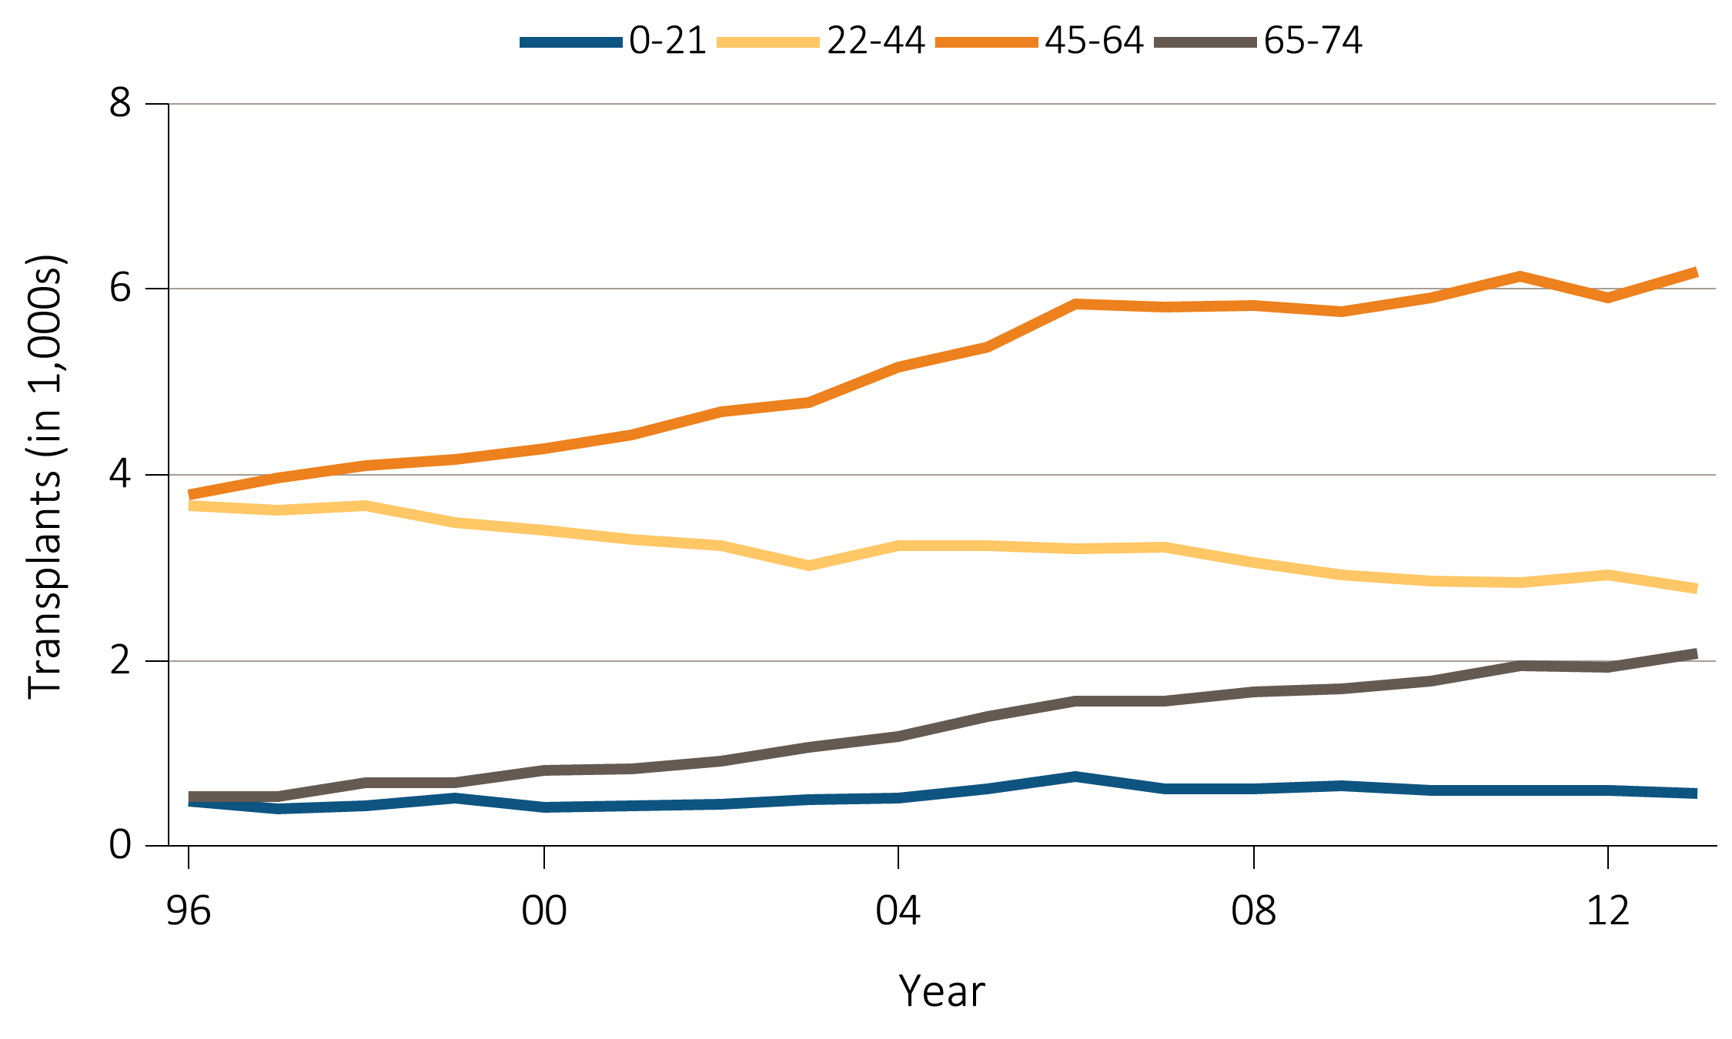
Figure 7.7 Number of deceased donor transplants and unadjusted transplant rates
among deceased donor kidney recipients, by recipient age, 1996-2013
^{(a)} ^{Number of transplants by age}
Data Source: Reference Table E8(2). Deceased donor kidney transplant counts by recipient age.

Slide 10
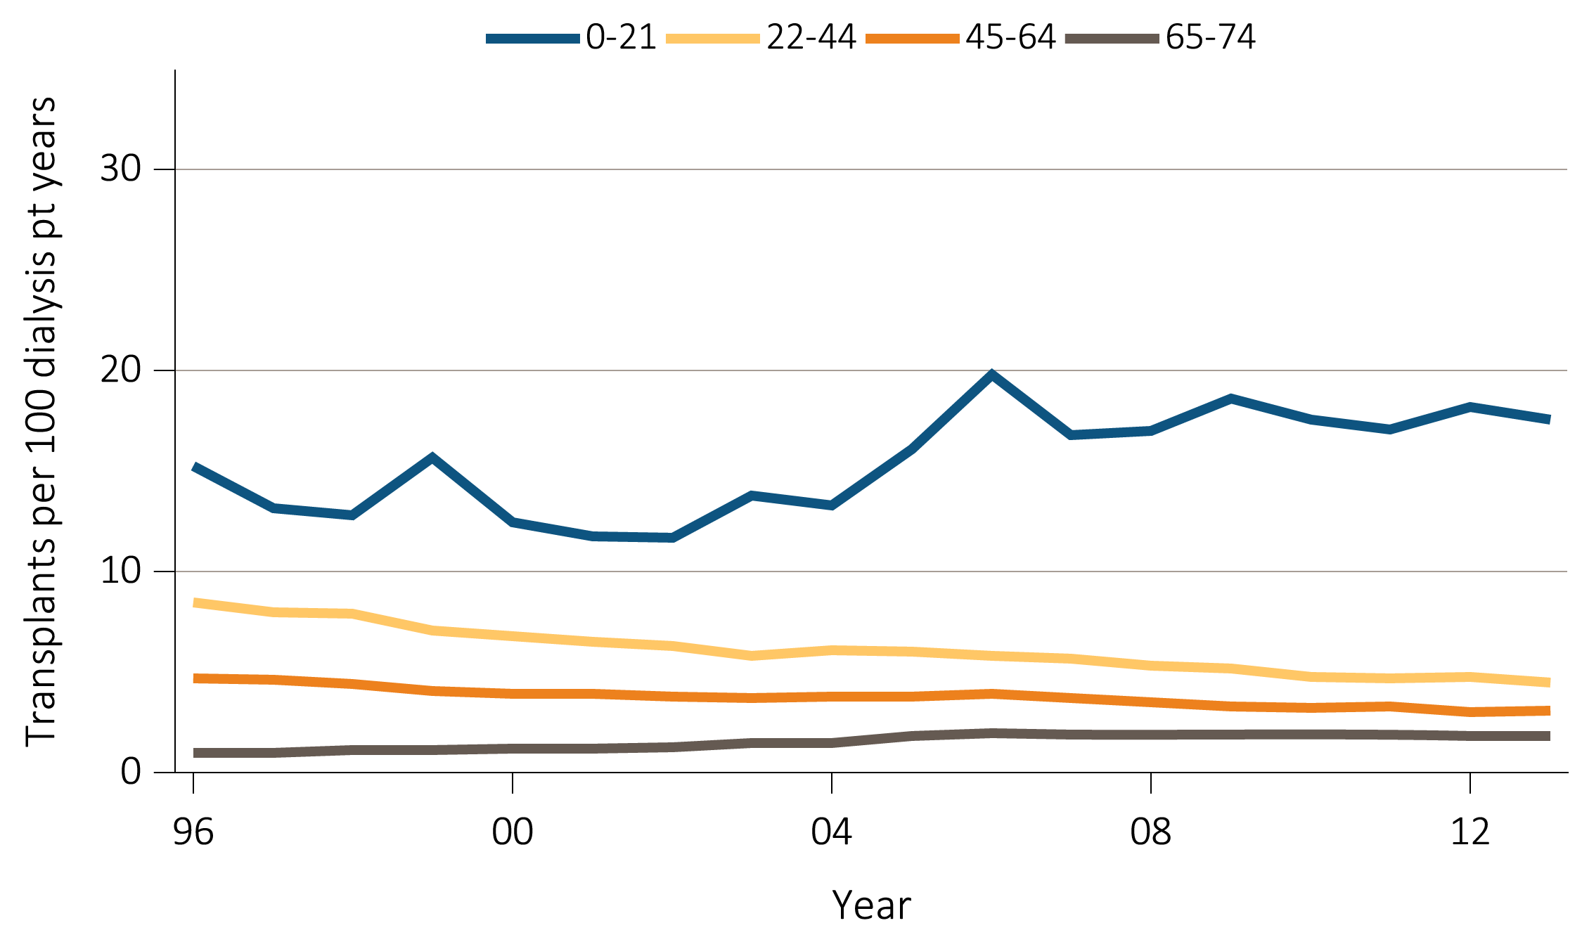
Figure 7.7 Number of deceased donor transplants and unadjusted transplant rates
among deceased donor kidney recipients, by recipient age, 1996-2013
^{(b) Transplant rates by age}
Data Source: Reference Table E9(2). Unadjusted deceased donor kidney transplant rates by recipient age. Abbreviation: pt, patient.

Slide 11
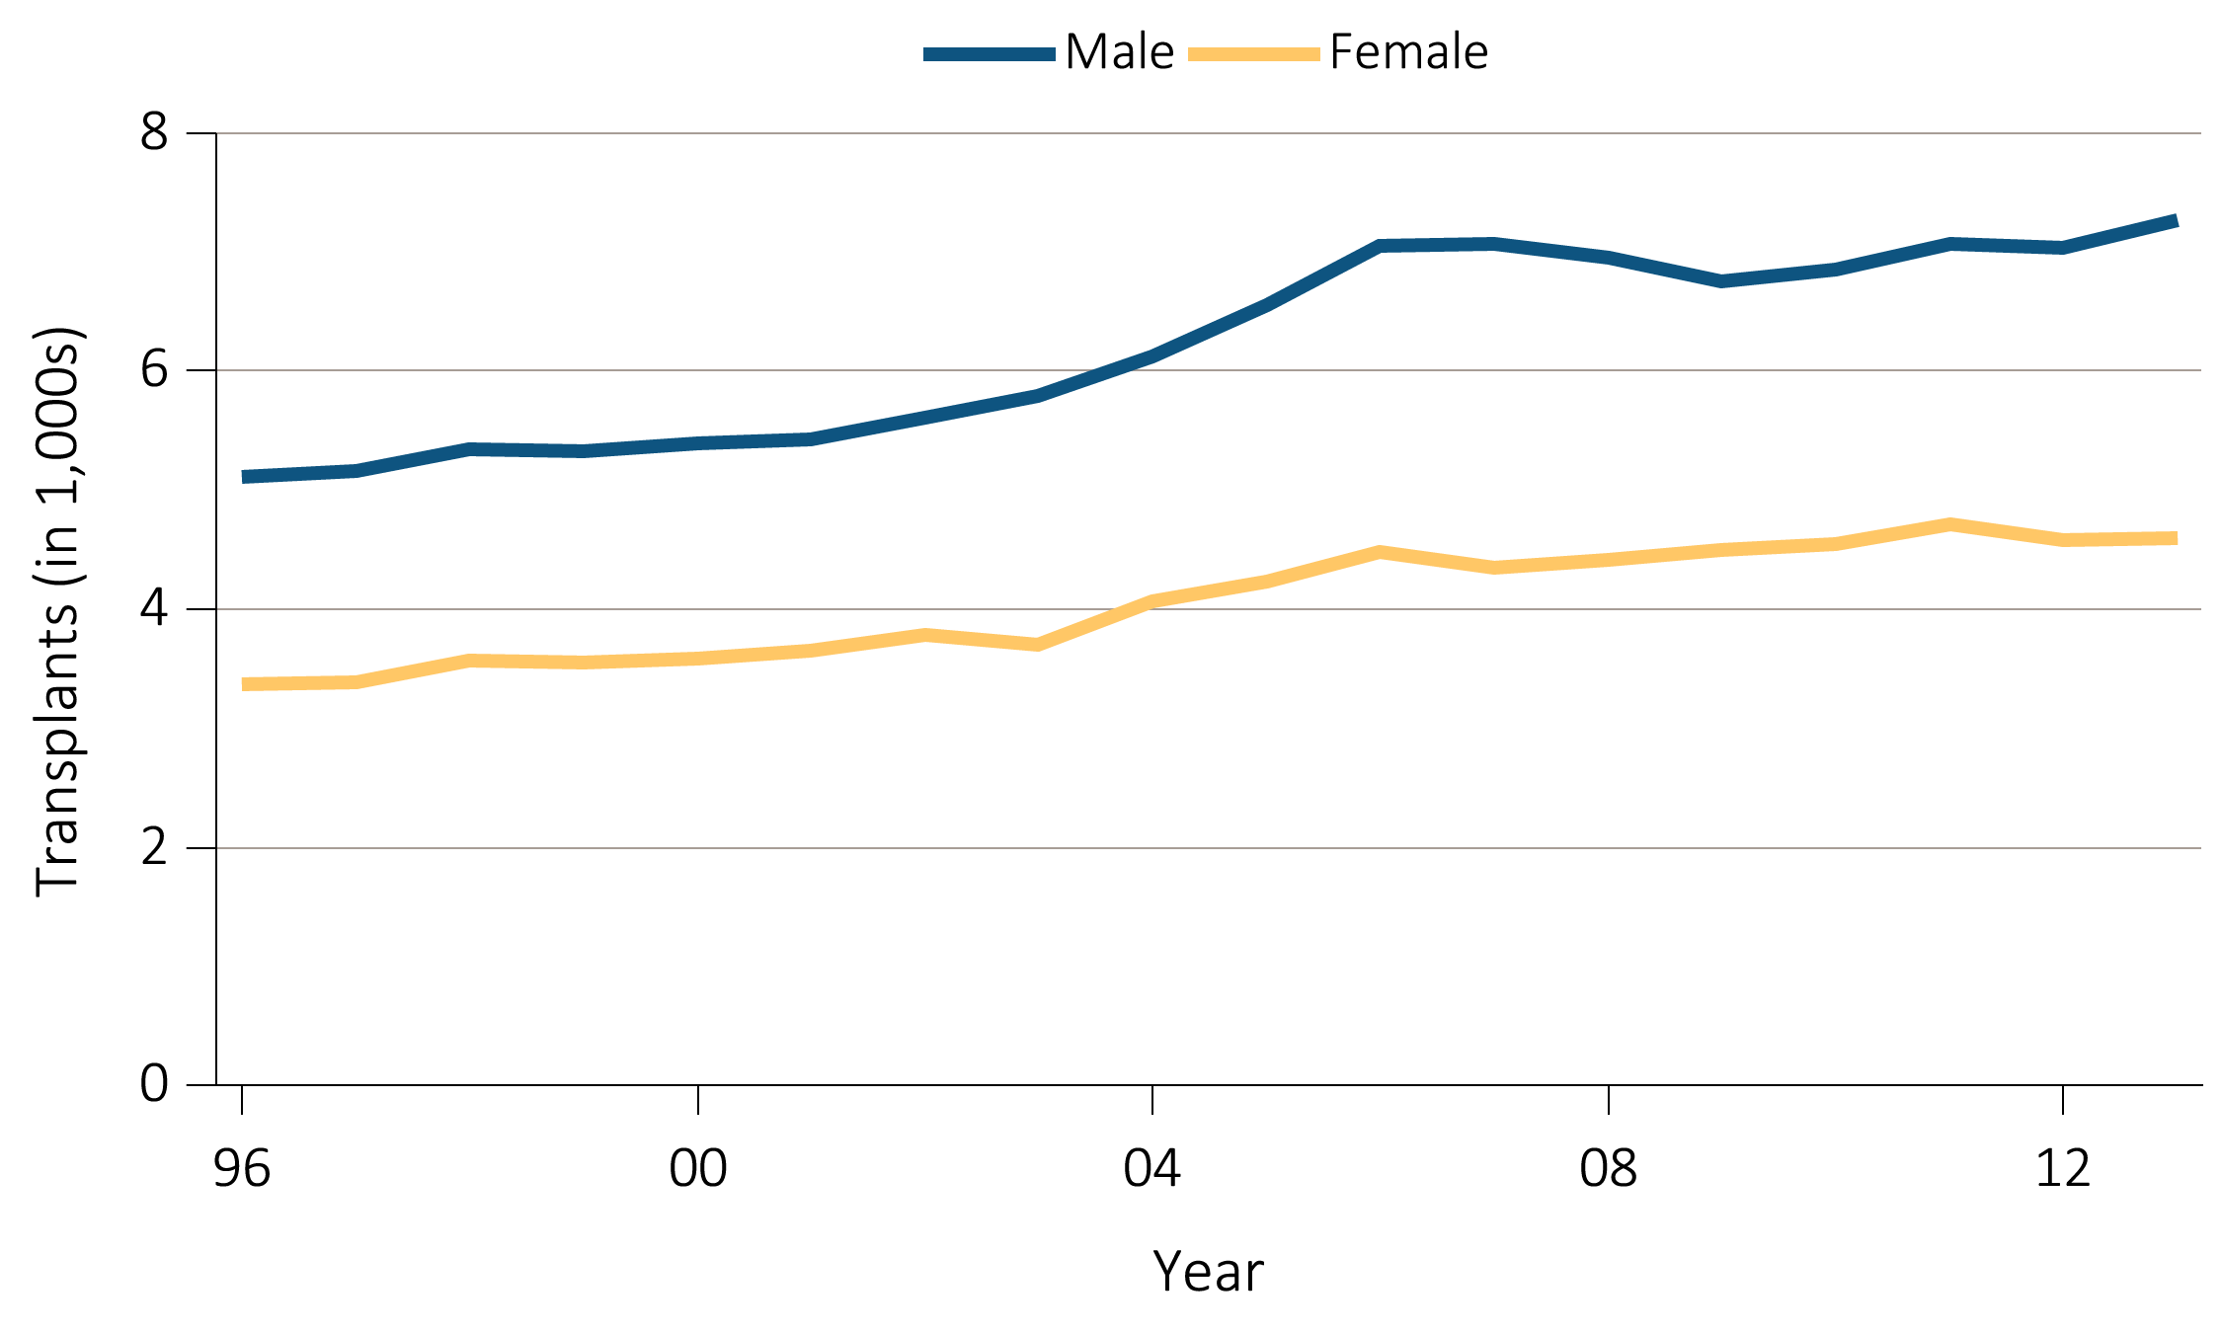
Figure 7.8 Number of deceased donor transplants and unadjusted transplant rates
among deceased donor kidney recipients, by recipient sex, 1996-2013
^{(a)} ^{Number of transplants by sex}
Data Source: Reference Table E8(2). Deceased donor kidney transplant counts by recipient sex.

Slide 12
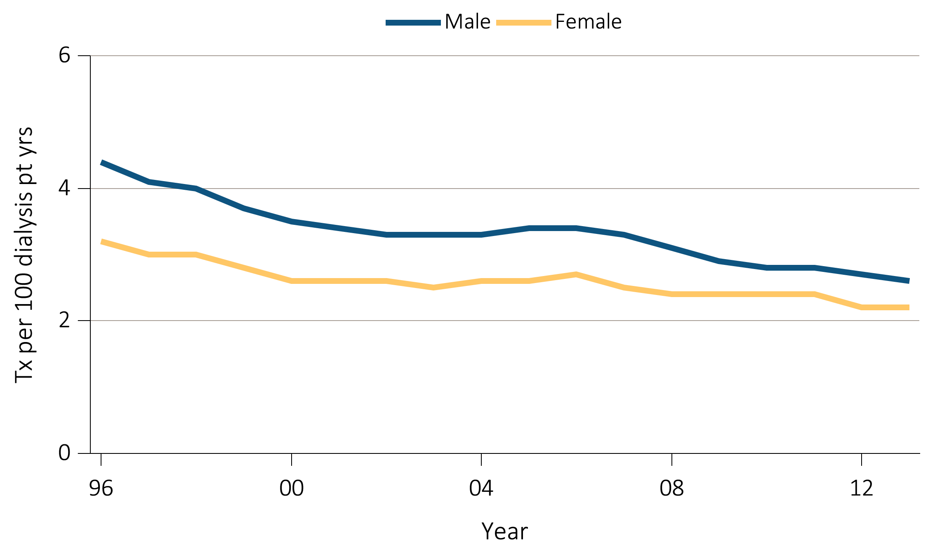
Figure 7.8 Number of deceased donor transplants and unadjusted transplant rates
among deceased donor kidney recipients, by recipient sex, 1996-2013
^{(b)} ^{Transplant rates by sex}
Data Source: Reference Table E9(2). Unadjusted deceased donor kidney transplant rates by recipient sex. Abbreviation: pt yrs, patient years.

Slide 13
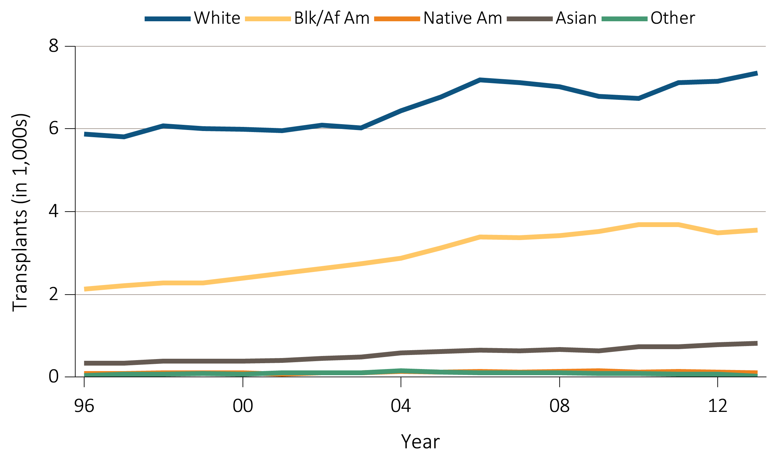
Figure 7.9 Number of deceased donor transplants and unadjusted transplant rates
among deceased donor kidney recipients, by recipient race, 1996-2013
^{(a)} ^{Number of transplants by race}
Data Source: Reference Table E8(2). Deceased donor kidney transplant counts by recipient race. Abbreviations: Blk/Af Am, Black/African American; Native Am, Native American.

Slide 14
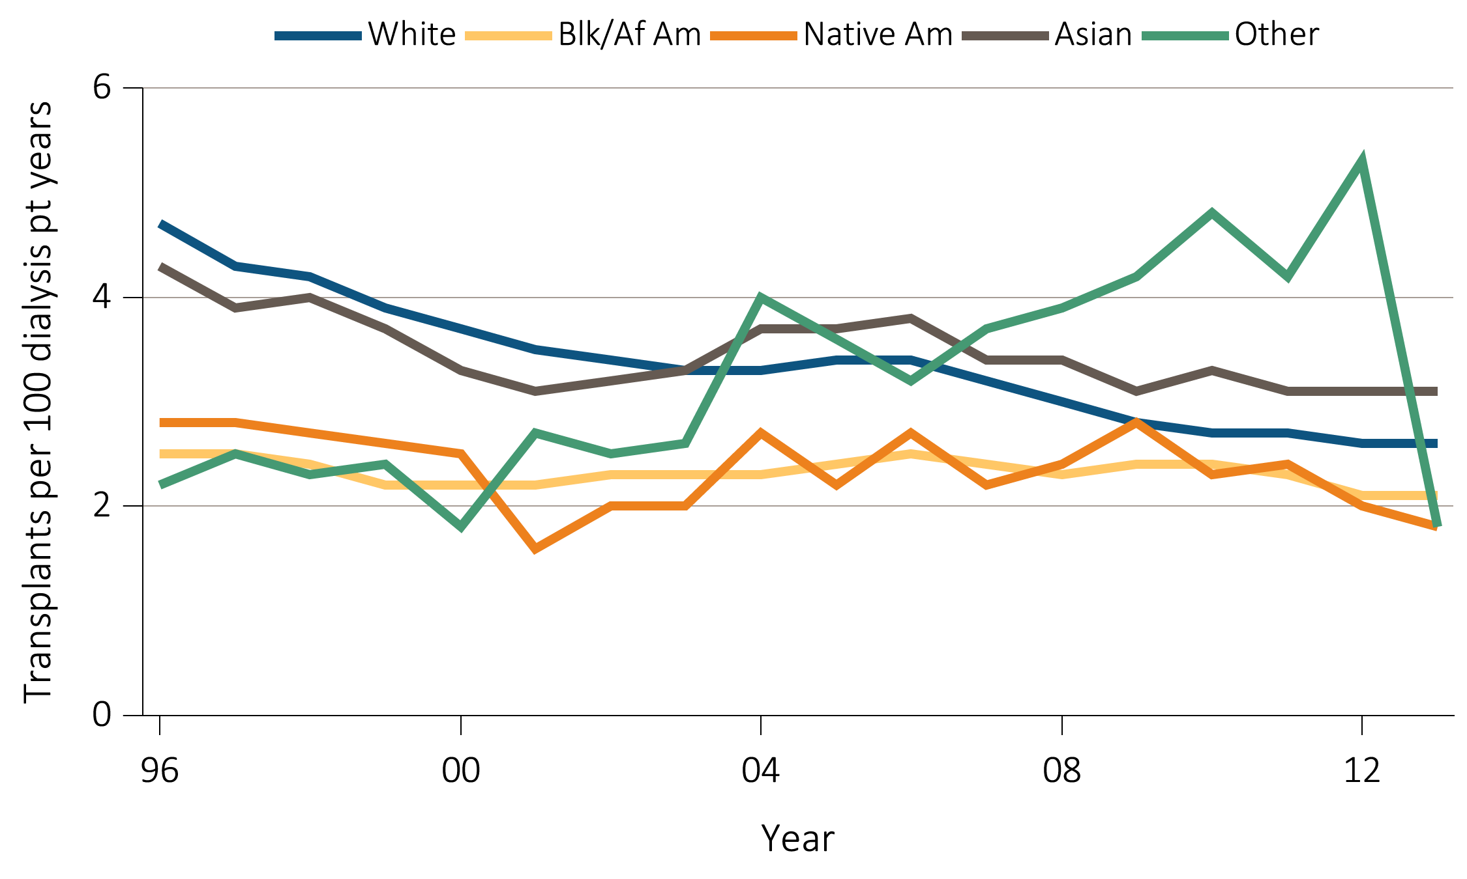
Figure 7.9 Number of deceased donor transplants and unadjusted transplant rates
among deceased donor kidney recipients, by recipient race, 1996-2013
^{(b)} ^{Transplant rates by race}
Data Source: Reference Table E9(2). Unadjusted deceased donor kidney transplant rates by recipient race. Abbreviations: Blk/Af Am, Black/African American; Native Am, Native American; pt, patient.

Slide 15
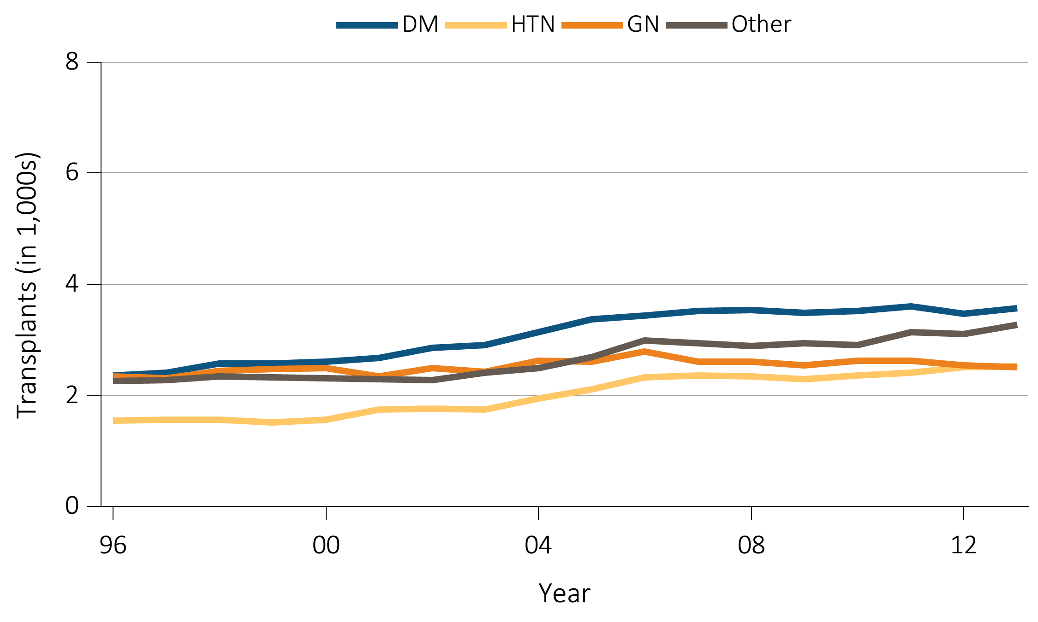
Figure 7.10 Number of deceased donor transplants and unadjusted transplant rates among deceased donor kidney recipients, by recipient primary cause of ESRD, 1996-2013
^{(a)} Number of transplants by primary cause of ESRD
Data Source: Reference Table E8(2). Deceased donor kidney transplant counts by recipient primary cause of ESRD. Abbreviations: DM, diabetes mellitus; ESRD, end-stage renal disease; GN, glomerulonephritis; HTN, hypertension.

Slide 16
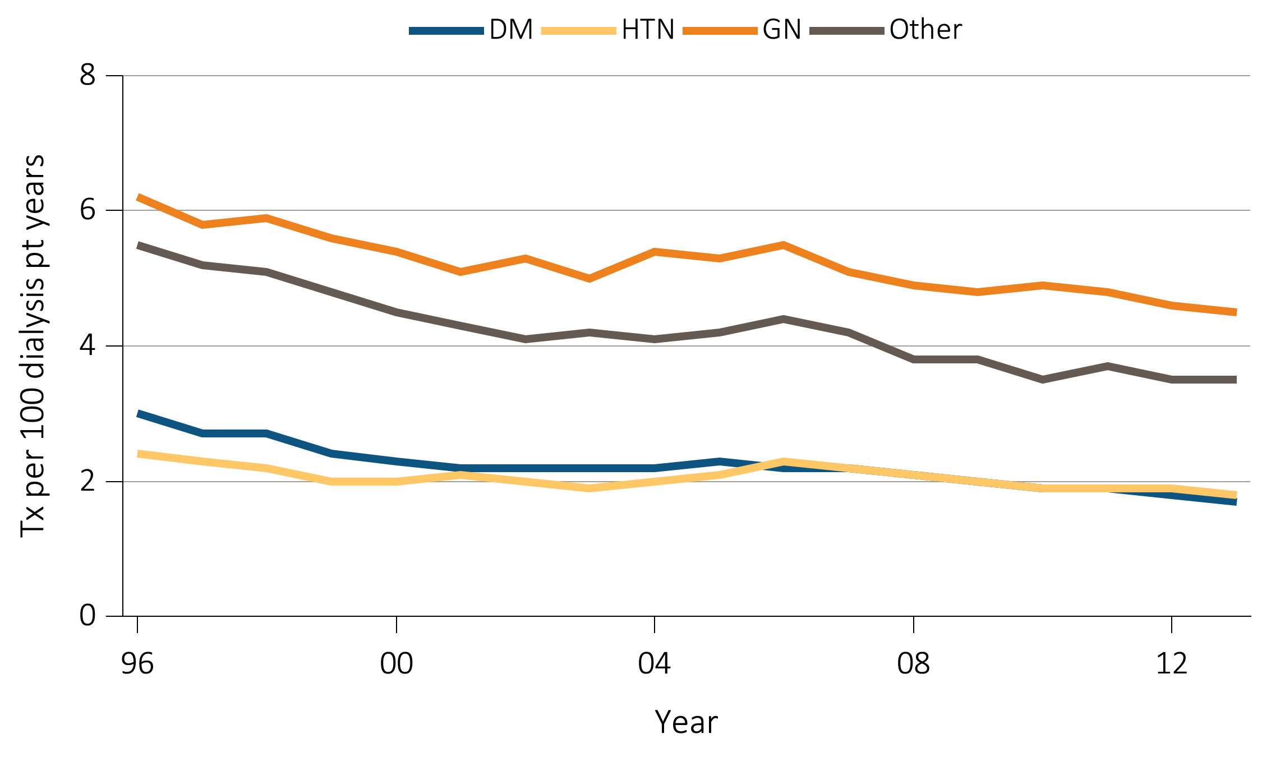
Figure 7.10 Number of deceased donor transplants and unadjusted transplant rates among deceased donor kidney recipients, by recipient primary cause of ESRD, 1996-2013
^{(b)} Transplant rates by primary cause of ESRD
Data Source: Reference Table E9(2). Unadjusted deceased donor kidney transplant rates by recipient primary cause of ESRD. Abbreviations: DM, diabetes mellitus; ESRD, end-stage renal disease; GN, glomerulonephritis; HTN, hypertension; pt, patient.

Slide 17
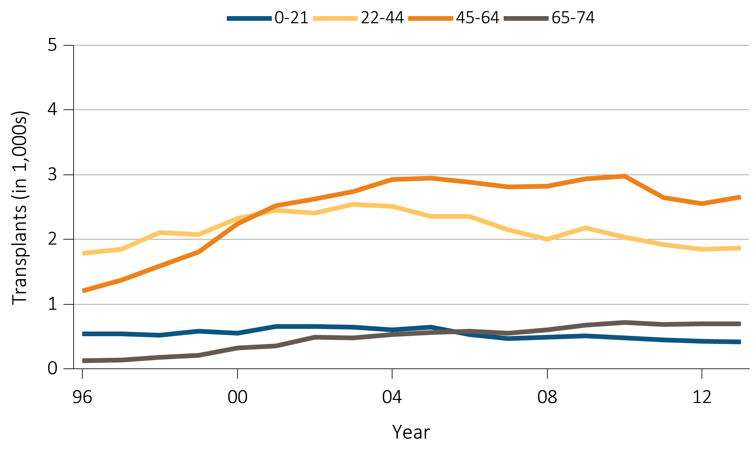
Figure 7.11 Number of living donor transplants and unadjusted transplant rates
among living donor kidney recipients, by recipient age, 1996-2013
^{(a)} ^{Number of transplants by age}
Data Source: Reference Table E8(3). Living donor kidney transplant counts by recipient age.

Slide 18
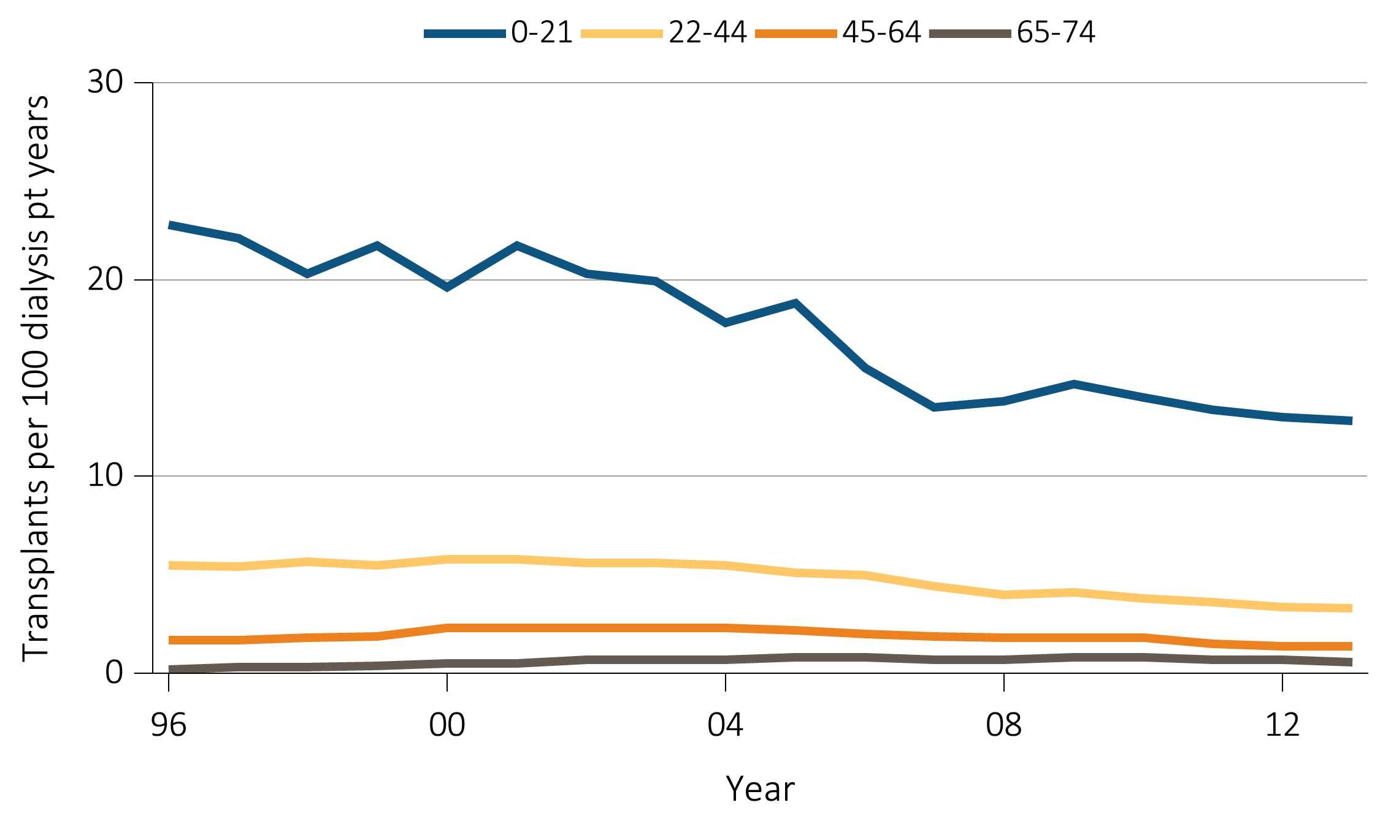
Figure 7.11 Number of living donor transplants and unadjusted transplant rates
among living donor kidney recipients, by recipient age, 1996-2013
^{(b)} ^{Transplant rates by age}
Data Source: Reference Table E9(3). Unadjusted living donor kidney transplant rates by recipient age. Abbreviation: pt, patient.

Slide 19
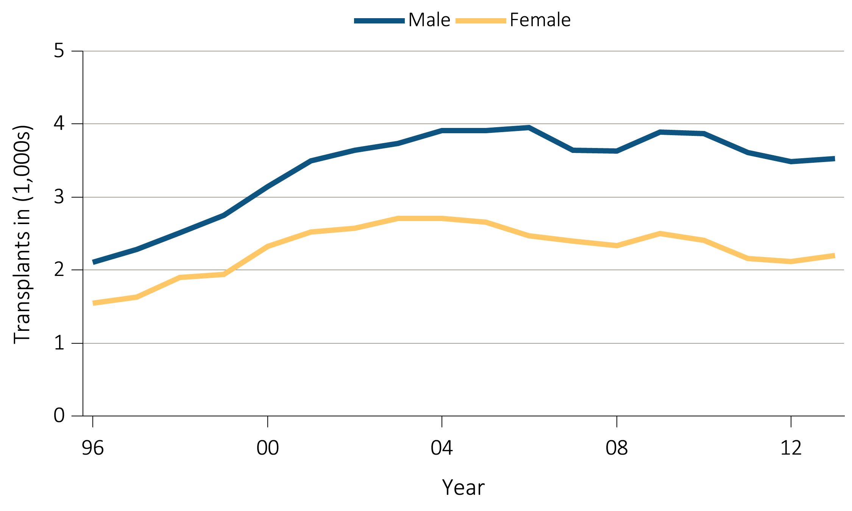
Figure 7.12 Number of living donor transplants and unadjusted transplant rates
among living donor kidney recipients, by recipient sex, 1996-2013
^{(a)} ^{Number of transplants by sex}
Data Source: Reference Table E8(3). Living donor kidney transplant counts by recipient sex.

Slide 20
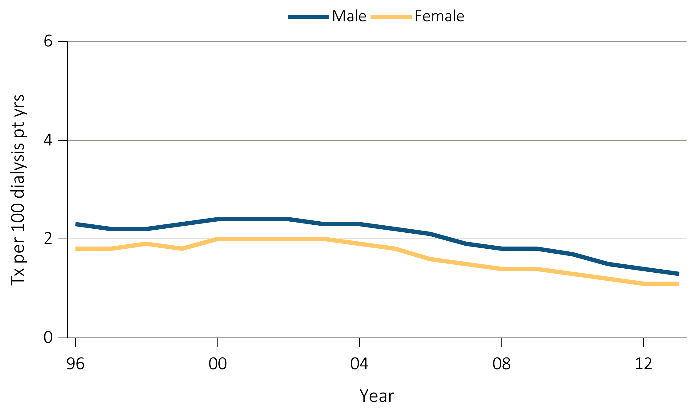
Figure 7.12 Number of living donor transplants and unadjusted transplant rates
among living donor kidney recipients, by recipient sex, 1996-2013
^{(b)} ^{Transplant rates by sex}
Data Source: Reference Table E9(3). Unadjusted living donor kidney transplant rates by recipient sex. Abbreviation: pt yrs, patient years.

Slide 21
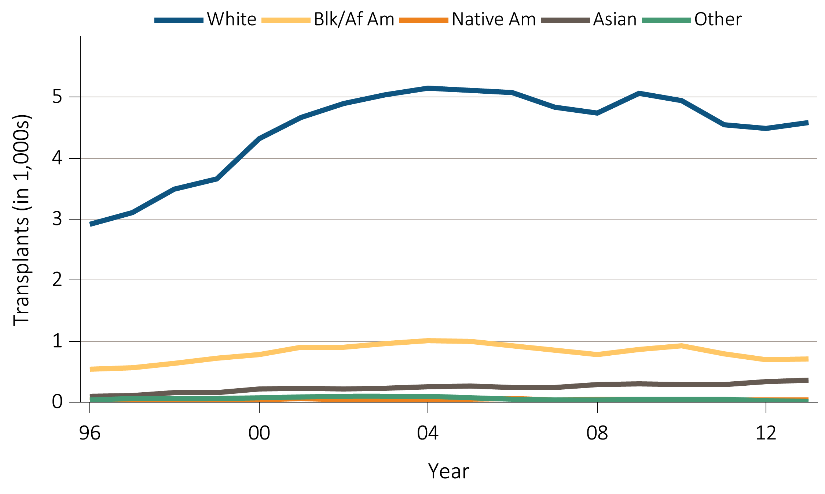
Figure 7.13 Number of living donor transplants and unadjusted transplant rates
among living donor kidney recipients, by recipient race, 1996-2013
^{(a)} ^{Number of transplants by race}
Data Source: Reference Table E8(3). Living donor kidney transplant counts by recipient race. Abbreviations: Blk/Af Am, Black/African American; Native Am, Native American.

Slide 22
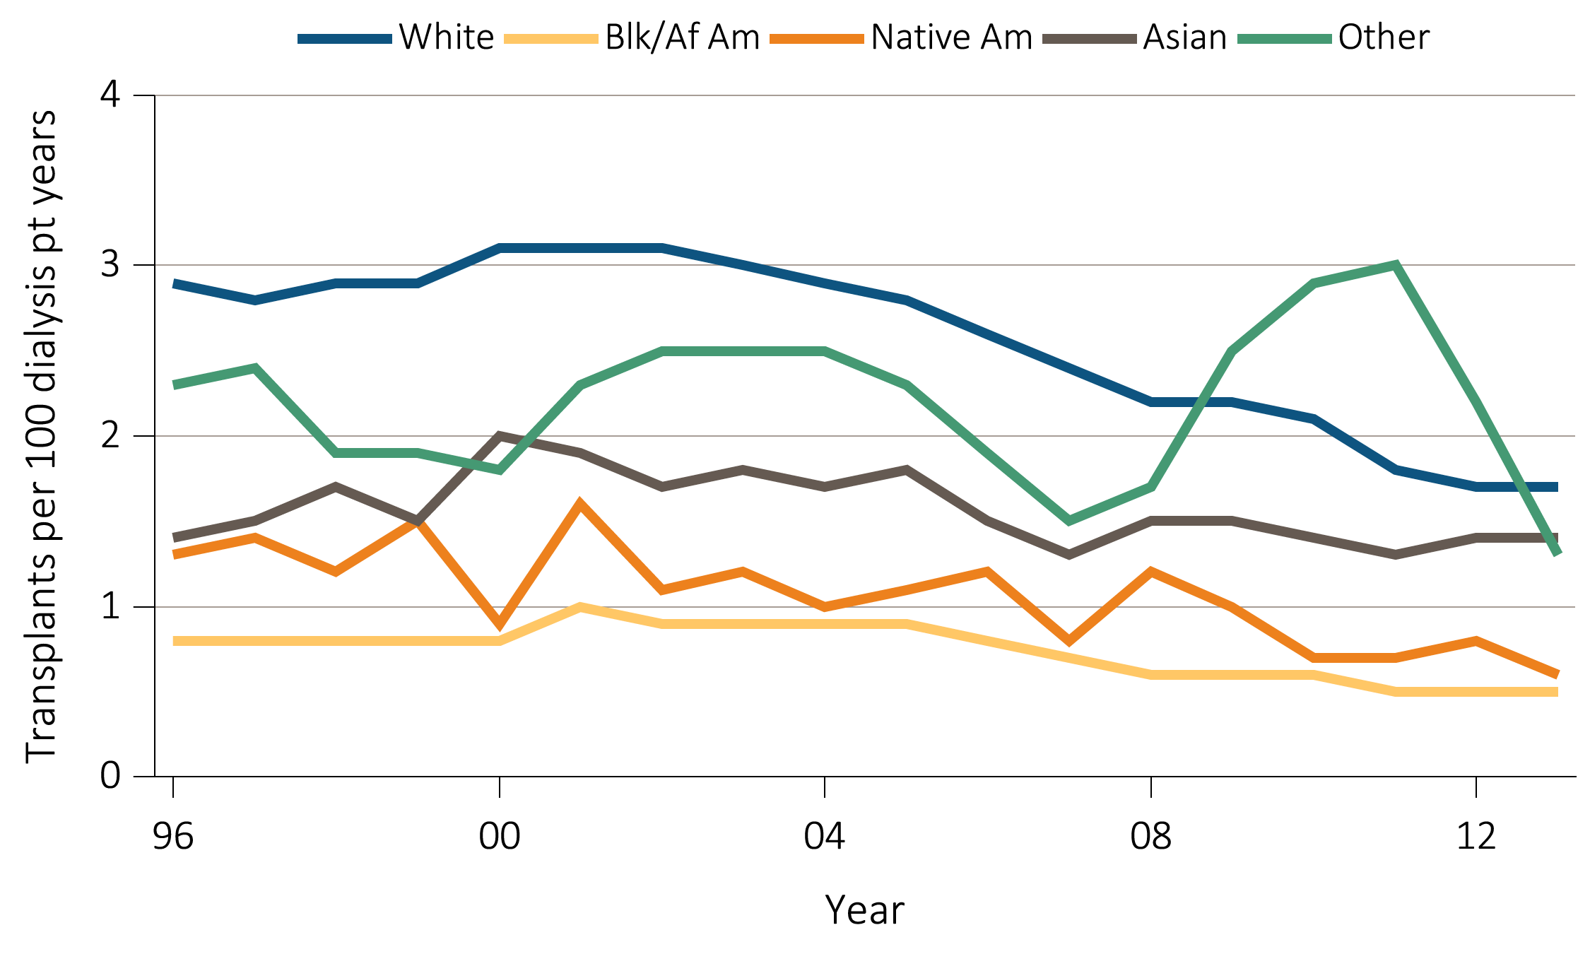
Figure 7.13 Number of living donor transplants and unadjusted transplant rates
among living donor kidney recipients, by recipient race, 1996-2013
^{(b)} ^{Transplant rates by race}
Data Source: Reference Table E9(3). Unadjusted living donor kidney transplant rates by recipient race. Abbreviations: Blk/Af Am, Black/African American; Native Am, Native American; pt, patient.

Slide 23
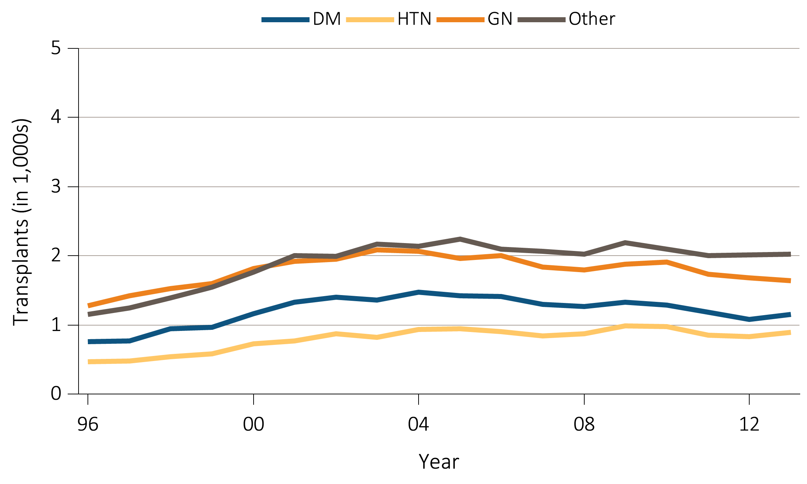
Figure 7.14 Number of living donor transplants and unadjusted transplant rates
among living donor kidney recipients, by recipient primary cause of ESRD, 1996-2013
^{(a)} Number of transplants by primary cause of ESRD
Data Source: Reference Table E8(3). Living donor kidney transplant counts by recipient primary cause of ESRD. Abbreviations: DM, diabetes mellitus; ESRD, end-stage renal disease; GN, glomerulonephritis; HTN, hypertension.

Slide 24
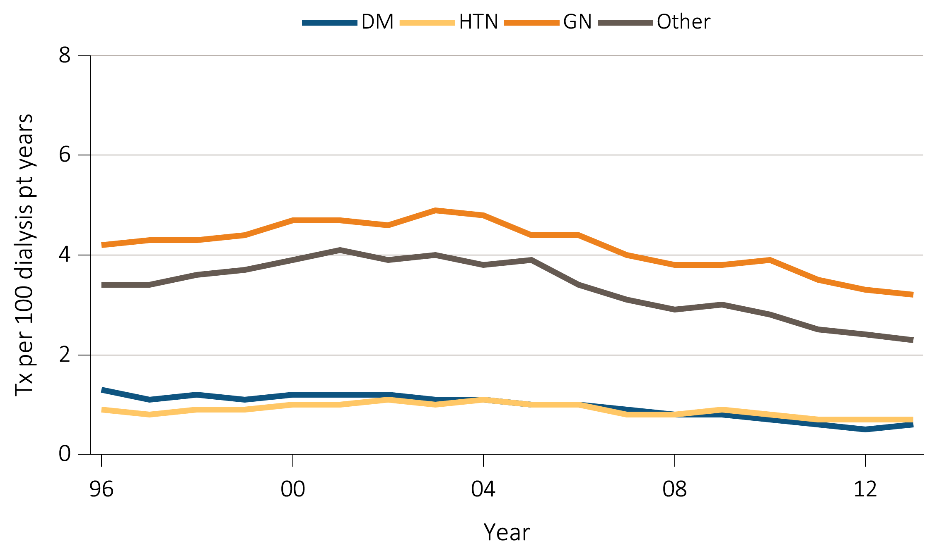
Figure 7.14 Number of living donor transplants and unadjusted transplant rates
among living donor kidney recipients, by recipient primary cause of ESRD, 1996-2013
^{(b)} Transplant rates by primary cause of ESRD
Data Source: Reference Table E9(3). Unadjusted living donor kidney transplant rates by recipient primary cause of ESRD. Abbreviations: DM, diabetes mellitus; ESRD, end-stage renal disease; GN, glomerulonephritis; HTN, hypertension; pt, patient.

Slide 25
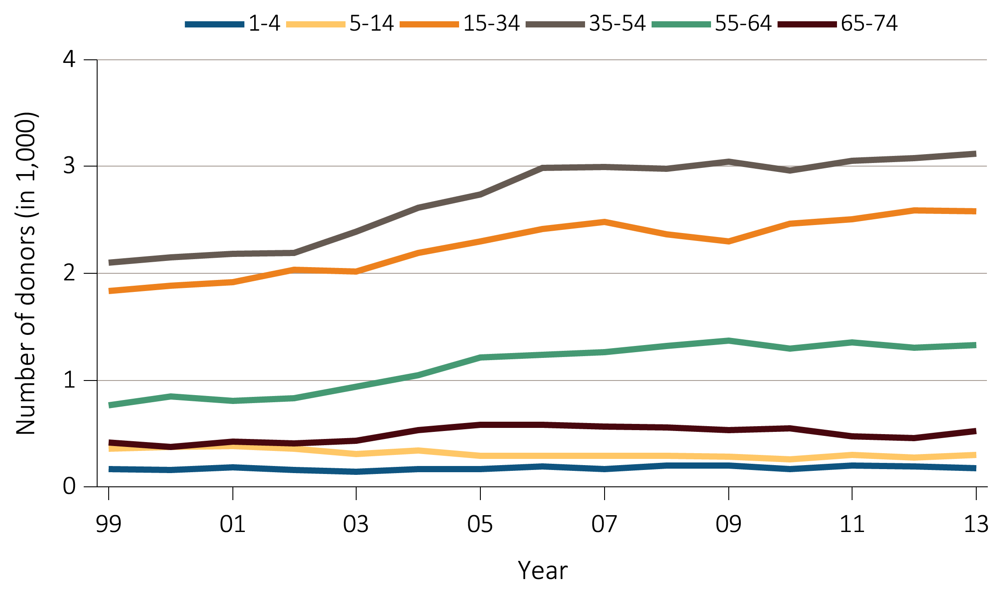
Figure 7.15 Number of deceased kidney donors and unadjusted kidney donation rates,
^{by donor age, 1999-2013}
^{(a)} ^{Number of donors by age}
Data Source: Data on the annual number of deaths in the US population are obtained from the Centers for Disease Control and Prevention; the deceased donor data are obtained from UNOS. Deceased donor kidney donation rates by donor age.

Slide 26
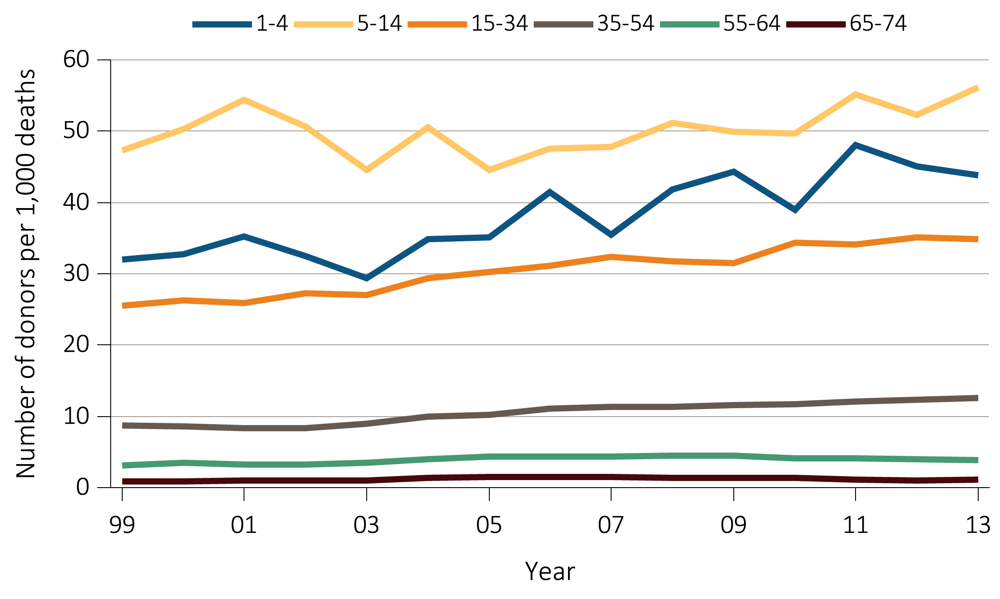
Figure 7.15 Number of deceased kidney donors and unadjusted kidney donation rates,
^{by donor age, 1999-2013}
^{(b)} ^{Donation rates by age}
Data Source: Data on the annual number of deaths in the US population are obtained from the Centers for Disease Control and Prevention; the deceased donor data are obtained from UNOS. Deceased donor kidney donation rates by donor age.

Slide 27
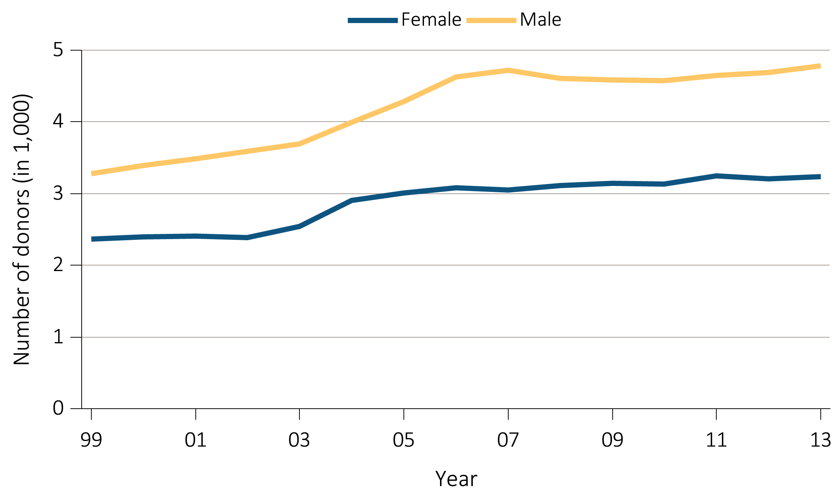
Figure 7.16 Number of deceased kidney donors and unadjusted kidney donation rates,
^{by donor sex, 1999-2013}
^{(a)} ^{Number of donors by sex}
Data Source: Data on the annual number of deaths in the US population are obtained from the Centers for Disease Control and Prevention; the deceased donor data are obtained from UNOS. Deceased donor kidney donation rates by donor sex.

Slide 28
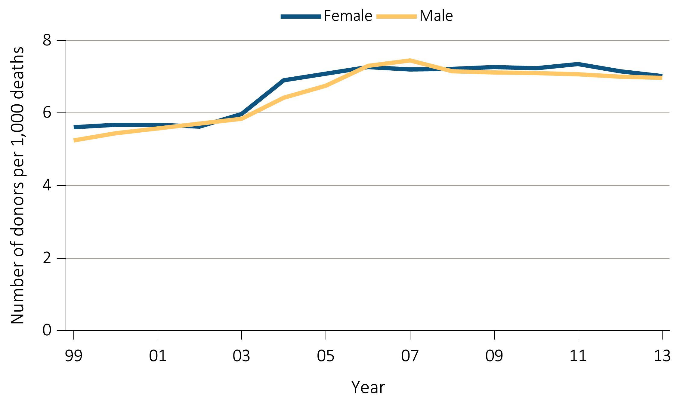
Figure 7.16 Number of deceased kidney donors and unadjusted kidney donation rates,
^{by donor sex, 1999-2013}
^{(b)} ^{Donation rates by sex}
Data Source: Data on the annual number of deaths in the US population are obtained from the Centers for Disease Control and Prevention; the deceased donor data are obtained from UNOS. Deceased donor kidney donation rates by donor sex.

Slide 29
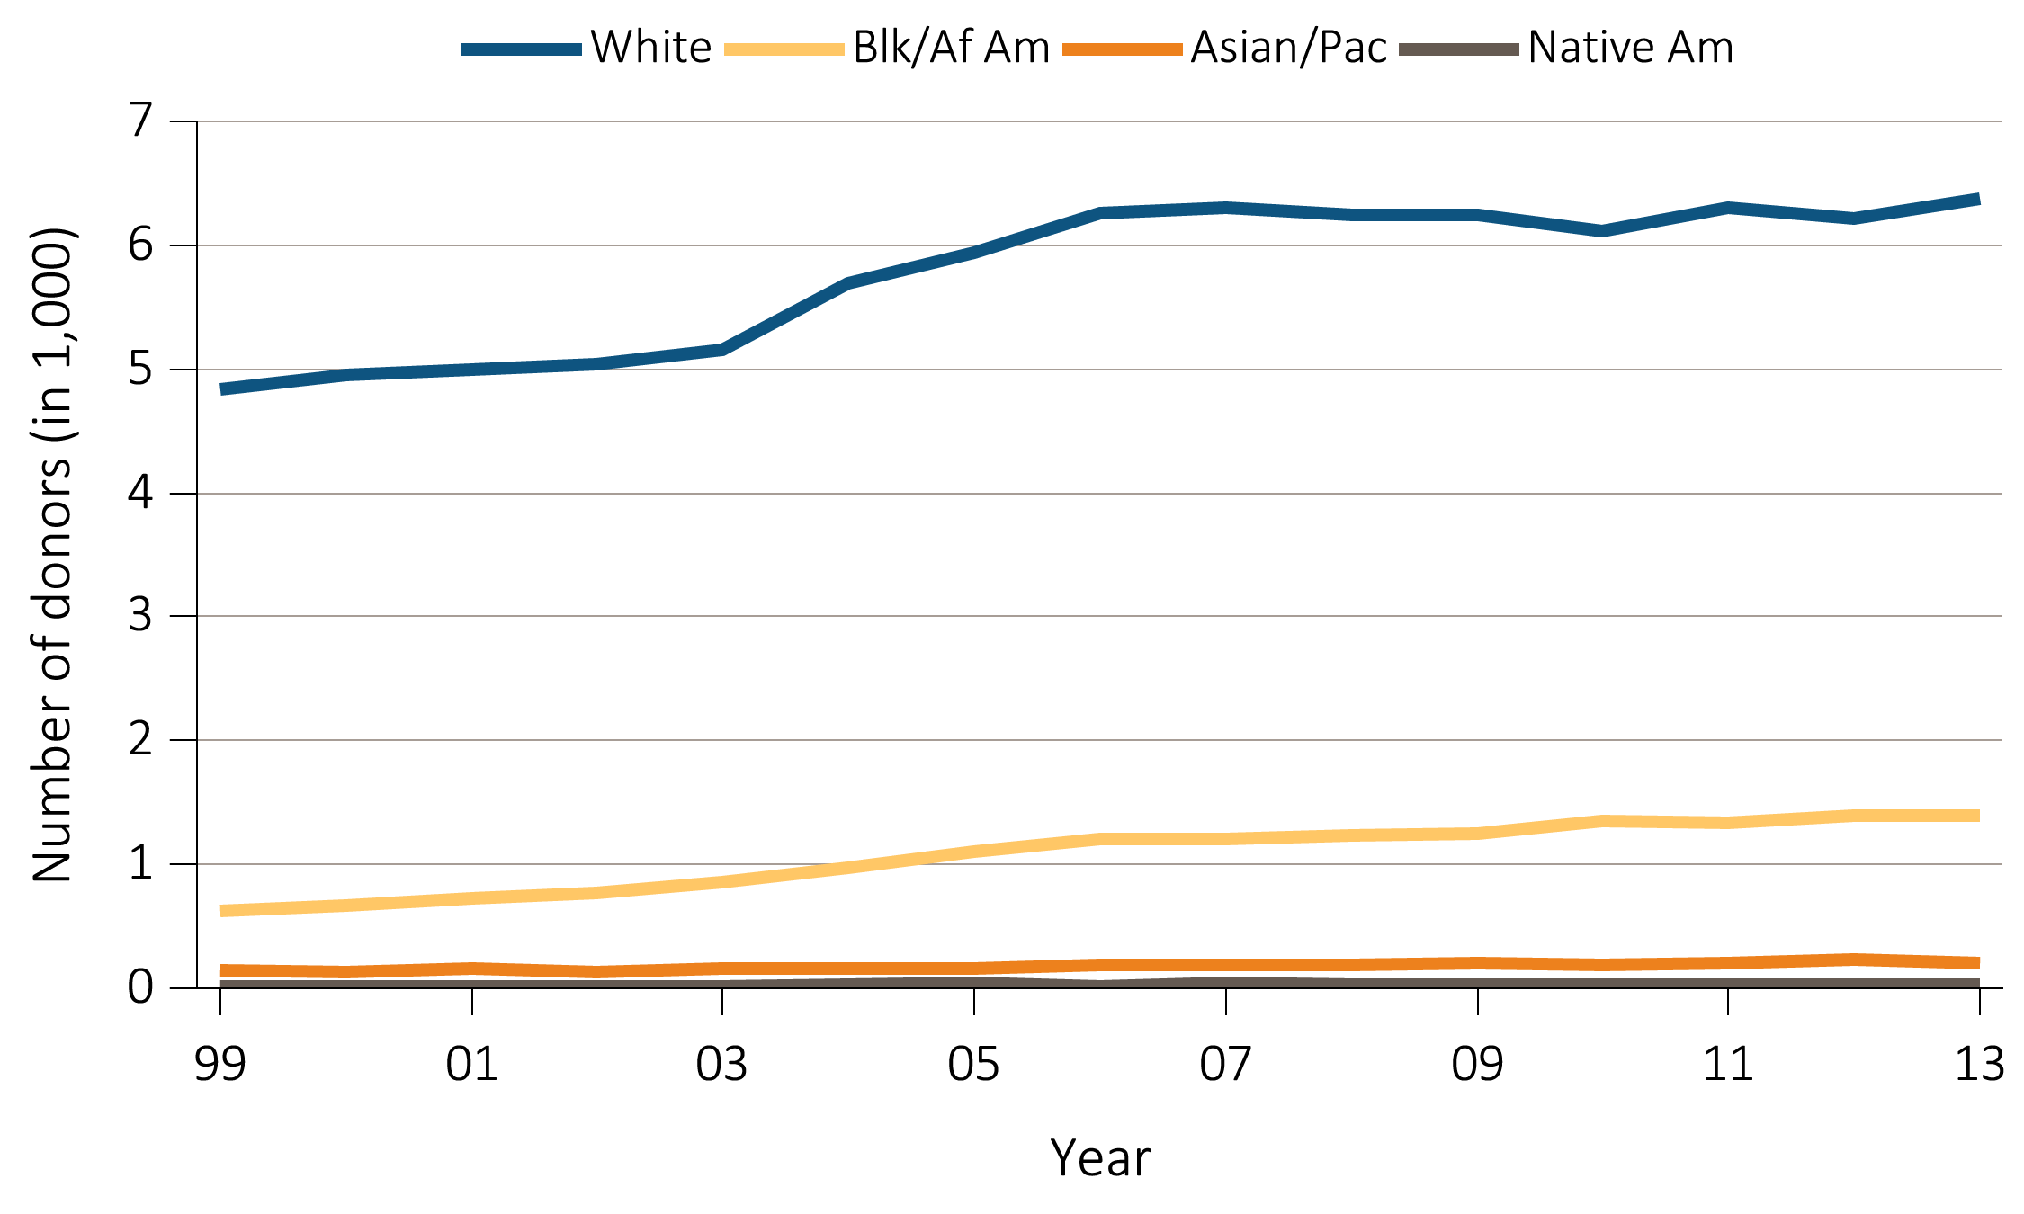
Figure 7.17 Number of deceased kidney donors and unadjusted kidney donation rates,
^{by donor race, 1999-2013}
^{(a)} ^{Number of donors by race}
Data Source: The US death population data are obtained from the Centers for Disease Control and Prevention; the deceased donor data are obtained from UNOS. Deceased donor kidney donation rates by donor race. Abbreviations: Asian/Pac, Asian/Pacific Islander; Blk/Af Am, Black/African American; Native Am, Native American.

Slide 30
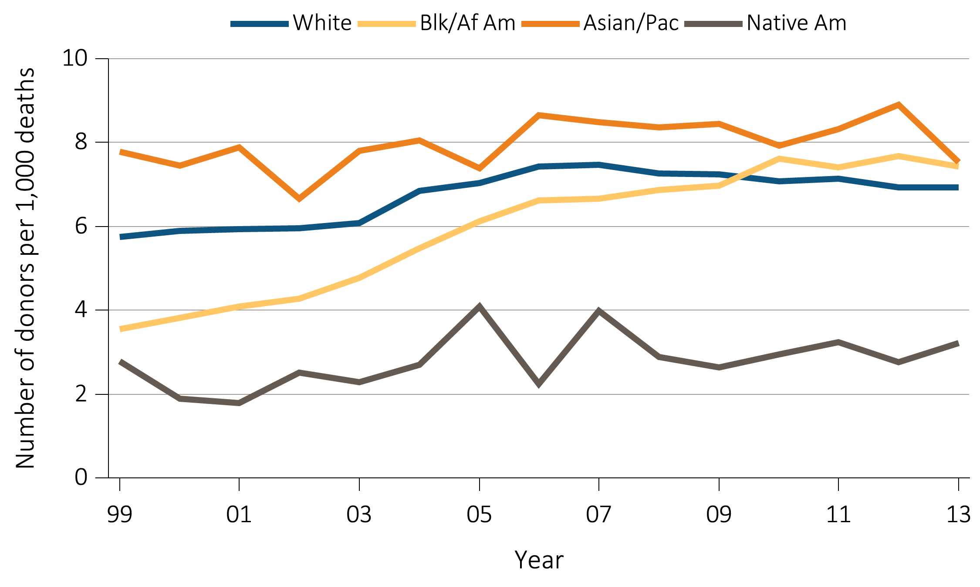
Figure 7.17 Number of deceased kidney donors and unadjusted kidney donation rates,
^{by donor race, 1999-2013}
^{(b)} ^{Donation} ^{rates by race}
Data Source: The US death population data are obtained from the Centers for Disease Control and Prevention; the deceased donor data are obtained from UNOS. Deceased donor kidney donation rates by donor race. Abbreviations: Asian/Pac, Asian/Pacific Islander; Blk/Af Am, Black/African American; Native Am, Native American.

Slide 31
^{Table 7.2} Trend in 1-, 5-, & 10-year deceased donor kidney transplant outcomes,
¹⁹⁹⁶⁻²⁰¹²
 | One year post-transplant |  |  | Five years post-transplant |  |  | Ten years post-transplant
Year | Prob. of all-cause graft failure | Prob. of return to dialysis or repeat transplant | Prob. of death | Prob. of all-cause graft failure | Prob. of return to dialysis or repeat transplant | Prob. of death | Prob. of all-cause graft failure | Prob. of return to dialysis or repeat transplant | Prob. of death
1996 | 14.3% | 10.2% | 5.8% | 36.2% | 25.7% | 19.4% | 59.1% | 42.9% | 39.3%
1997 | 12.9% | 8.5% | 6.2% | 34.7% | 23.7% | 19.2% | 58.1% | 40.8% | 39.6%
1998 | 12.8% | 9.2% | 5.5% | 33.8% | 24.0% | 18.1% | 56.8% | 40.4% | 38.1%
1999 | 13.7% | 9.2% | 5.9% | 34.0% | 23.1% | 18.9% | 56.8% | 39.4% | 38.4%
2000 | 13.2% | 8.6% | 6.4% | 34.6% | 23.1% | 19.7% | 57.3% | 39.1% | 39.3%
2001 | 12.2% | 8.0% | 5.7% | 33.3% | 21.4% | 19.9% | 55.8% | 37.0% | 38.7%
2002 | 12.3% | 8.3% | 5.8% | 33.0% | 22.2% | 18.9% | 54.1% | 36.2% | 37.4%
2003 | 12.1% | 7.6% | 5.7% | 32.1% | 20.6% | 18.6% | 54.9% | 36.1% | 37.9%
2004 | 11.5% | 7.3% | 5.5% | 31.7% | 20.8% | 18.4%
2005 | 11.4% | 7.1% | 6.0% | 30.2% | 19.3% | 18.0%
2006 | 10.8% | 7.0% | 5.2% | 29.6% | 18.9% | 17.3%
2007 | 9.7% | 6.2% | 4.7% | 28.5% | 17.9% | 16.9%
2008 | 9.5% | 6.2% | 4.4% | 26.9% | 16.2% | 16.3%
2009 | 9.5% | 5.7% | 5.0%
2010 | 9.0% | 5.6% | 4.5%
2011 | 7.6% | 4.6% | 3.9%
2012 | 7.6% | 4.6% | 3.8%
Data Source: Reference Tables F2, F14, I26; F5, F17, I29; F6, F18, I30. Outcomes among recipients of a first-time deceased donor kidney transplant; unadjusted. Abbreviations: Prob., probability.

Slide 32
^{Table 7.3} Trend in 1-, 5-, & 10-year living donor kidney transplant outcomes,
¹⁹⁹⁶⁻²⁰¹²
 | One year post-transplant |  |  | Five years post-transplant |  |  | Ten years post-transplant
Year | Prob. of all-cause graft failure | Prob. of return to dialysis or repeat transplant | Prob. of death | Prob. of all-cause graft failure | Prob. of return to dialysis or repeat transplant | Prob. of death | Prob. of all-cause graft failure | Prob. of return to dialysis or repeat transplant | Prob. of death
1996 | 6.9% | 5.2% | 2.3% | 22.9% | 16.8% | 9.6% | 43.3% | 32.4% | 22.7%
1997 | 6.7% | 4.8% | 2.7% | 22.2% | 15.8% | 10.5% | 43.2% | 31.1% | 24.4%
1998 | 6.0% | 4.4% | 2.3% | 20.9% | 14.6% | 10.0% | 42.4% | 30.6% | 23.4%
1999 | 6.1% | 4.3% | 2.2% | 20.8% | 14.7% | 9.6% | 41.2% | 29.0% | 22.7%
2000 | 6.6% | 4.6% | 2.6% | 21.9% | 14.9% | 10.6% | 42.2% | 29.1% | 24.0%
2001 | 6.2% | 4.1% | 2.5% | 21.3% | 14.3% | 10.2% | 41.2% | 27.8% | 24.0%
2002 | 5.8% | 3.9% | 2.5% | 20.5% | 13.6% | 10.3% | 40.0% | 26.2% | 24.6%
2003 | 5.4% | 3.9% | 1.9% | 20.1% | 13.8% | 9.5% | 39.6% | 26.1% | 23.3%
2004 | 5.2% | 3.5% | 2.1% | 18.8% | 12.7% | 8.8%
2005 | 5.3% | 3.7% | 2.0% | 18.7% | 12.6% | 8.8%
2006 | 4.4% | 3.0% | 1.7% | 16.8% | 11.1% | 8.1%
2007 | 3.8% | 2.4% | 1.4% | 16.6% | 10.5% | 8.0%
2008 | 4.1% | 2.7% | 1.6% | 15.3% | 9.9% | 7.5%
2009 | 3.9% | 2.6% | 1.4%
2010 | 3.5% | 2.2% | 1.4%
2011 | 3.4% | 2.2% | 1.9%
2012 | 3.2% | 1.9% | 1.5%
Data Source: Reference Tables F8, F20, I32; F11, F23, I35; F12, F24, I36. Outcomes among recipients of a first-time living donor kidney transplant; unadjusted. Abbreviations: Prob., probability.

Slide 33
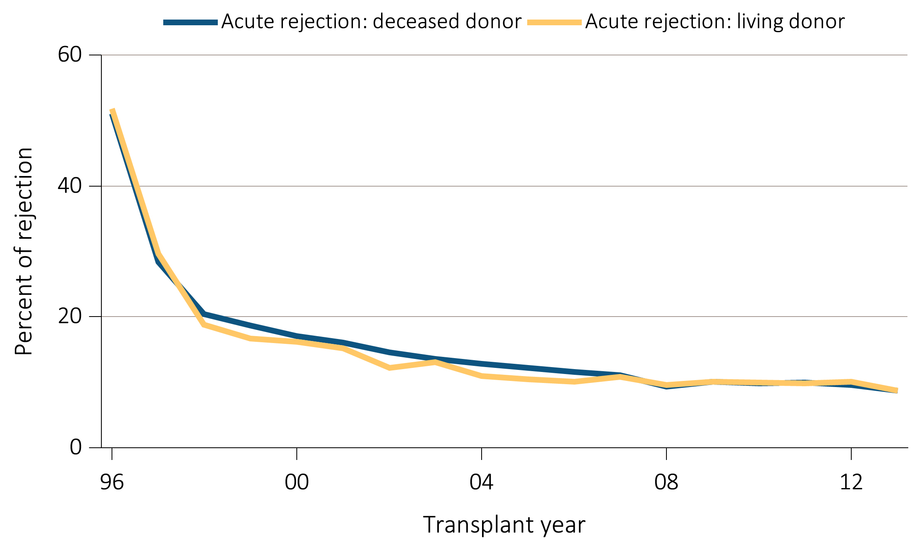
Figure 7.18 Acute rejection within the first year post-transplant for
kidney transplant recipients, 1996-2013
Data Source: Special analyses, USRDS ESRD Database. Acute rejection rates during the first year post-transplant for recipients age 18 and older with a functioning graft at discharge.

