Slide 2
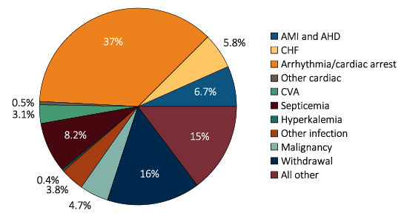
Figure 9.1.a Causes of death in ESRD patients, 2011-2013
Data Source: Reference Table H12. (a) Denominator includes other causes of death and excludes missing/unknown causes of death (23.5% of patients have unknown or missing causes of death). Abbreviations: AHD, atherosclerotic heart disease; AMI, acute myocardial infarction; CHF, congestive heart failure; CVA, cerebrovascular accident; ESRD, end-stage renal disease.

Slide 3
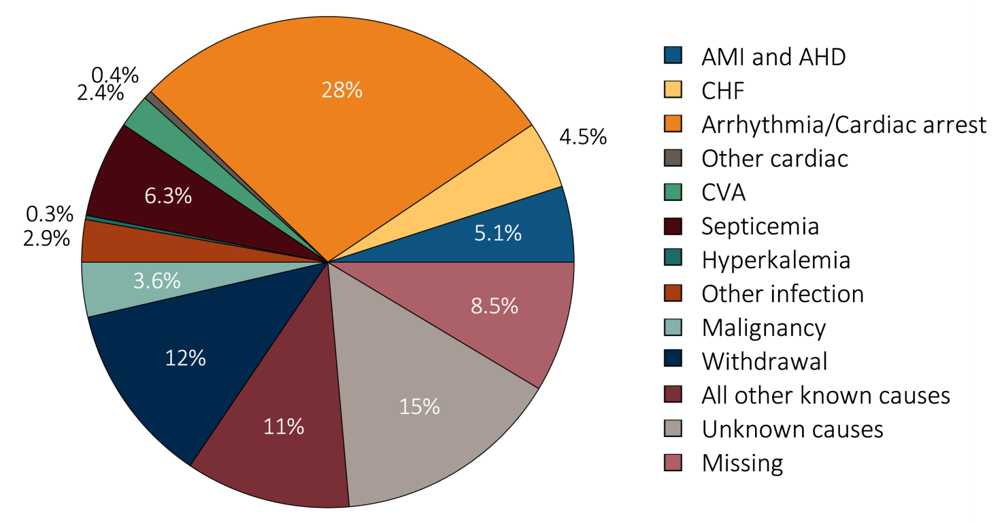
Figure 9.1.b Causes of death in ESRD patients, 2011-2013
Data Source: Reference Table H12. (b) Denominator includes all other known causes, unknown causes of death, and records that are missing the cause of death. Unknown causes include records from the CMS 2746 ESRD death notification form that specifically designate an unknown cause of death. Missing includes records in the ESRD database that are missing form 2746, or have the form but are missing or have recording errors in the primary cause of death field. Abbreviations: AHD, atherosclerotic heart disease; AMI, acute myocardial infarction; CHF, congestive heart failure; CVA, cerebrovascular accident; ESRD, end-stage renal disease.

Slide 4
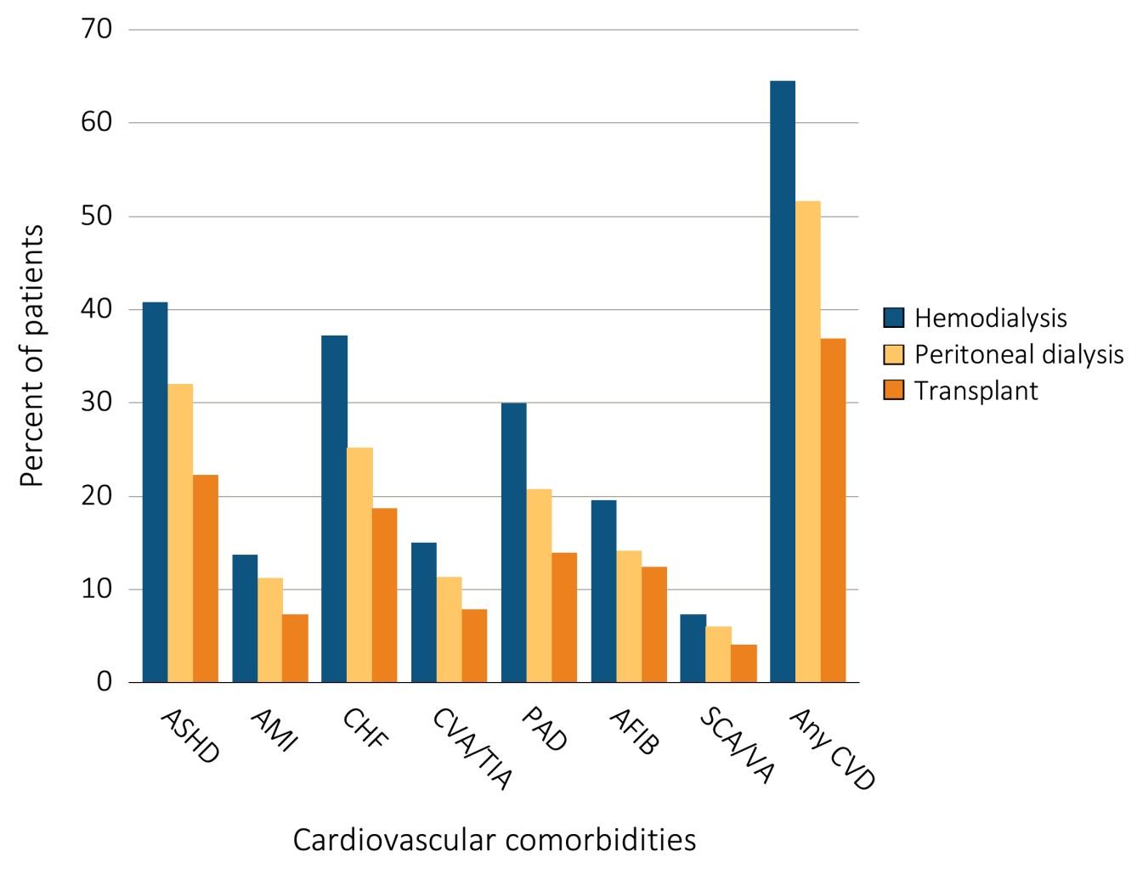
Figure 9.2 Prevalence of cardiovascular diseases in ESRD patients,
^{by treatment modality, 2013}
Data Source: Special analyses, USRDS ESRD Database. Point prevalent hemodialysis, peritoneal dialysis, and transplant patients at all ages, with Medicare as primary payer on January 1, 2011, who are continuously enrolled in Medicare Parts A and B from July, 1, 2010 to December 31, 2010, ESRD service date is at least 90 days prior to January 1, 2011, and survived past 2012. Abbreviations: AFIB, atrial fibrillation; AMI, acute myocardial infarction; ASHD, atherosclerotic heart disease; CHF, congestive heart failure; CKD, chronic kidney disease; CVA/TIA, cerebrovascular accident/transient ischemic attack; CVD, cardiovascular disease; PAD, peripheral arterial disease; SCA/VA, sudden cardiac arrest and ventricular arrhythmias.

Slide 5
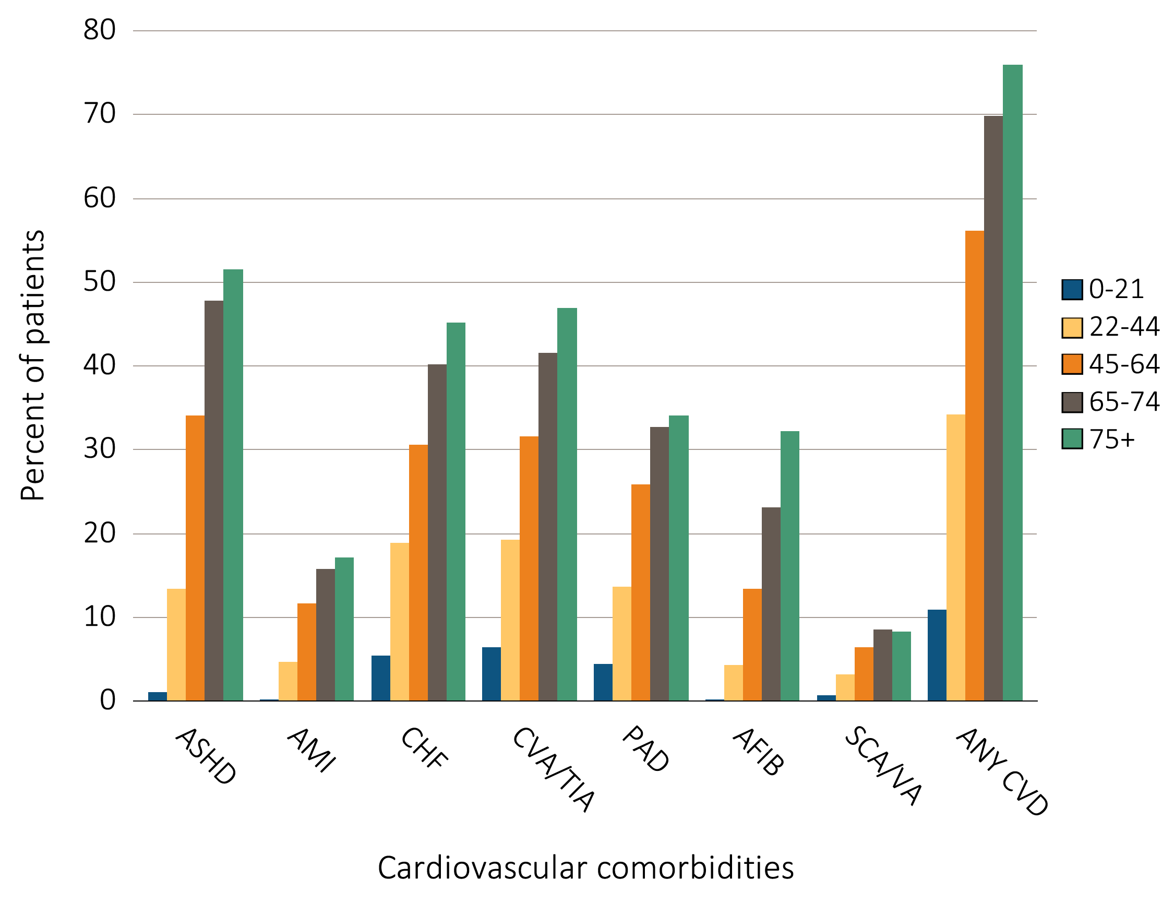
Figure 9.3 Prevalence of cardiovascular diseases in ESRD patients,
^{by age, 2013}
Data Source: Special analyses, USRDS ESRD Database. Point prevalent hemodialysis, peritoneal dialysis, and transplant patients at all ages, with Medicare as primary payer on January 1, 2011, who are continuously enrolled in Medicare Parts A and B from July, 1, 2010 to December 31, 2010, ESRD service date is at least 90 days prior to January 1, 2011, and survived past 2012.Abbreviations: AFIB, atrial fibrillation; AMI, acute myocardial infarction; ASHD, atherosclerotic heart disease; CHF, congestive heart failure; CKD, chronic kidney disease; CVA/TIA, cerebrovascular accident/transient ischemic attack; CVD, cardiovascular disease; PAD, peripheral arterial disease; SCA/VA, sudden cardiac arrest and ventricular arrhythmias.

Slide 6
Table 9.1 Prevalence of cardiovascular diseases & procedures in ESRD patients,
by treatment modality, age, race, & sex, 2013
 | # Patients | % Patients
 |  | Overall | 0-21 | 22-44 |  | 45-64 |  | 65-74 | 75+ | White | Blk/Af Am | Other | Male | Female
Cardiovascular Comorbiditiesª
Atherosclerotic heart disease (ASHD)
Hemodialysis | 147,373 | 40.8 | 2.5 | 15.6 |  | 36.8 |  | 49.7 | 52.1 | 45.1 | 36.0 | 38.4 | 40.9 | 40.7
Peritoneal dialysis | 11,180 | 32.0 | 0.9 | 11.9 |  | 31.7 |  | 44.0 | 49.1 | 35.4 | 25.7 | 27.5 | 36.5 | 27.5
Transplant | 23,465 | 22.3 | 0.4 | 6.1 |  | 19.3 |  | 36.8 | 43.2 | 24.0 | 19.0 | 18.3 | 24.0 | 19.7
Acute myocardial infarction (AMI)
Hemodialysis | 147,373 | 13.7 | 0.0 | 5.4 |  | 12.5 |  | 16.5 | 17.4 | 15.1 | 12.1 | 12.1 | 13.7 | 13.6
Peritoneal dialysis | 11,180 | 11.2 | 0.5 | 4.1 |  | 11.1 |  | 15.6 | 17.2 | 12.6 | 9.0 | 8.1 | 12.8 | 9.6
Transplant | 23,465 | 7.3 | 0.0 | 2.3 |  | 6.8 |  | 11.2 | 13.5 | 7.9 | 6.1 | 6.1 | 7.8 | 6.5
Congestive heart failure (CHF)
Hemodialysis | 147,373 | 37.2 | 10.7 | 22.4 |  | 33.7 |  | 42.2 | 45.9 | 37.8 | 37.1 | 32.0 | 35.4 | 39.4
Peritoneal dialysis | 11,180 | 25.2 | 6.5 | 16.0 |  | 23.8 |  | 32.0 | 35.5 | 25.5 | 25.6 | 21.3 | 27.2 | 23.3
Transplant | 23,465 | 18.7 | 2.2 | 6.9 |  | 15.5 |  | 29.1 | 39.5 | 19.1 | 18.8 | 13.8 | 18.9 | 18.4
Cerebrovascular accident/transient ischemic attack (CVA/TIA)
Hemodialysis | 147,373 | 15.0 | 2.8 | 5.5 |  | 12.5 |  | 19.0 | 20.3 | 15.0 | 15.4 | 13.0 | 13.5 | 16.9
Peritoneal dialysis | 11,180 | 11.3 | 1.4 | 5.5 |  | 9.9 |  | 16.6 | 17.4 | 12.0 | 10.7 | 7.6 | 11.0 | 11.6
Transplant | 23,465 | 7.8 | 0.6 | 2.4 |  | 6.2 |  | 13.0 | 17.5 | 8.2 | 7.5 | 5.2 | 7.6 | 8.1
Peripheral artery disease (PAD)
Hemodialysis | 147,373 | 30.0 | 10.3 | 16.3 |  | 28.5 |  | 34.6 | 34.9 | 31.2 | 29.3 | 23.9 | 29.9 | 30.0
Peritoneal dialysis | 11,180 | 20.7 | 5.6 | 10.7 |  | 20.7 |  | 27.7 | 26.8 | 22.3 | 18.4 | 15.2 | 22.3 | 19.0
Transplant | 23,465 | 13.9 | 0.7 | 5.0 |  | 12.7 |  | 21.3 | 25.0 | 14.6 | 13.0 | 10.2 | 15.0 | 12.3
Atrial fibrillation (AFIB)
Hemodialysis | 147,373 | 19.5 | 0.7 | 5.0 |  | 14.5 |  | 23.3 | 32.0 | 23.2 | 15.3 | 17.2 | 19.7 | 19.2
Peritoneal dialysis | 11,180 | 14.1 | 0.0 | 3.8 |  | 10.4 |  | 21.0 | 32.1 | 16.4 | 9.8 | 11.2 | 16.8 | 11.5
Transplant | 23,465 | 12.4 | 0.0 | 1.8 |  | 8.3 |  | 22.4 | 34.7 | 13.9 | 9.3 | 9.7 | 13.6 | 10.5
(Continued on next slide)

Slide 7
Table 9.1 Prevalence of cardiovascular diseases & procedures in ESRD patients,
by treatment modality, age, race, & sex, 2013 (continued)
 | # Patients | % Patients
 |  | Overall | 0-21 | 22-44 | 45-64 | 65-74 | 75+ | White | Blk/Af Am | Other | Male | Female
Cardiac arrest and ventricular arrhythmias (SCA/VA)
Hemodialysis | 147,373 | 7.3 | 0.4 | 3.8 | 6.9 | 8.8 | 8.1 | 7.2 | 7.5 | 6.0 | 7.5 | 6.9
Peritoneal dialysis | 11,180 | 6.0 | 2.3 | 3.2 | 5.7 | 7.9 | 8.6 | 6.1 | 6.3 | 3.6 | 6.7 | 5.3
Transplant | 23,465 | 4.0 | 0.2 | 1.0 | 3.2 | 7.0 | 8.8 | 4.2 | 3.8 | 3.5 | 4.5 | 3.4
Cardiovascular Procedures^{b}
Revascularization – percutaneous coronary interventions (PCI)
Hemodialysis | 60,125 | 5.3 | 0.0 | 4.8 | 6.3 | 5.4 | 4.0 | 5.6 | 4.7 | 6.3 | 5.4 | 5.2
Peritoneal dialysis | 3,578 | 6.2 | 0.0 | 5.4 | 6.1 | 7.3 | 5.3 | 6.8 | 5.3 | 3.1 | 6.0 | 6.4
Transplant | 5,228 | 5.2 | 0.0 | 5.6 | 7.0 | 4.4 | 2.6 | 5.4 | 4.5 | 5.5 | 5.4 | 4.8
Revascularization – coronary artery bypass graft (CABG)
Hemodialysis | 60,125 | 1.8 | 0.0 | 2.2 | 2.5 | 1.8 | 0.7 | 1.7 | 1.7 | 2.4 | 2.0 | 1.4
Peritoneal dialysis | 3,578 | 2.6 | 0.0 | 2.9 | 2.8 | 2.8 | 2.0 | 2.7 | 2.5 | 2.2 | 3.4 | 1.6
Transplant | 5,228 | 2.0 | 0.0 | 2.0 | 2.5 | 1.7 | 1.7 | 2.1 | 1.5 | 3.1 | 2.0 | 2.0
Implantable cardioverter defibrillators & cardiac resynchronization therapy with defibrillator (ICD/CRT-D)
Hemodialysis | 54,775 | 0.8 | 0.0 | 0.9 | 0.9 | 0.9 | 0.5 | 0.8 | 0.7 | 0.8 | 1.0 | 0.4
Peritoneal dialysis | 2,818 | 1.0 | 0.0 | 0.3 | 1.0 | 1.1 | 1.2 | 0.9 | 1.2 | 0.6 | 1.1 | 0.8
Transplant | 4,384 | 1.0 | 0.0 | 0.0 | 1.3 | 1.0 | 0.7 | 1.1 | 0.7 | 0.5 | 1.3 | 0.4
Data Source: Special analyses, USRDS ESRD Database. Point prevalent hemodialysis, peritoneal dialysis, and transplant patients at all ages, with Medicare as primary payer on January 1, 2011, who are continuously enrolled in Medicare Parts A and B from July, 1, 2010 to December 31, 2010, ESRD service date is at least 90 days prior to January 1, 2011, and survived past 2012. Abbreviations: AFIB, atrial fibrillation; AMI, acute myocardial infarction; ASHD, atherosclerotic heart disease; Af Am, African American; Blk, black; CABG, coronary artery bypass grafting; CHF, congestive heart failure; CKD, chronic kidney disease; CVA/TIA, cerebrovascular accident/transient ischemic attack; CVD, cardiovascular disease; ICD/CRT-D, implantable cardioverter defibrillators/cardiac resynchronization therapy with defibrillator devices; PAD, peripheral arterial disease; PCI, percutaneous coronary interventions; SCA/VA, sudden cardiac arrest and ventricular arrhythmias. a The denominators for all cardiovascular comorbidities are patients described above by modality. b The denominators for PCI and CABG are patients with ASHD by modality. The denominator for ICD/CRT-D is patient with CHF by modality.

Slide 8
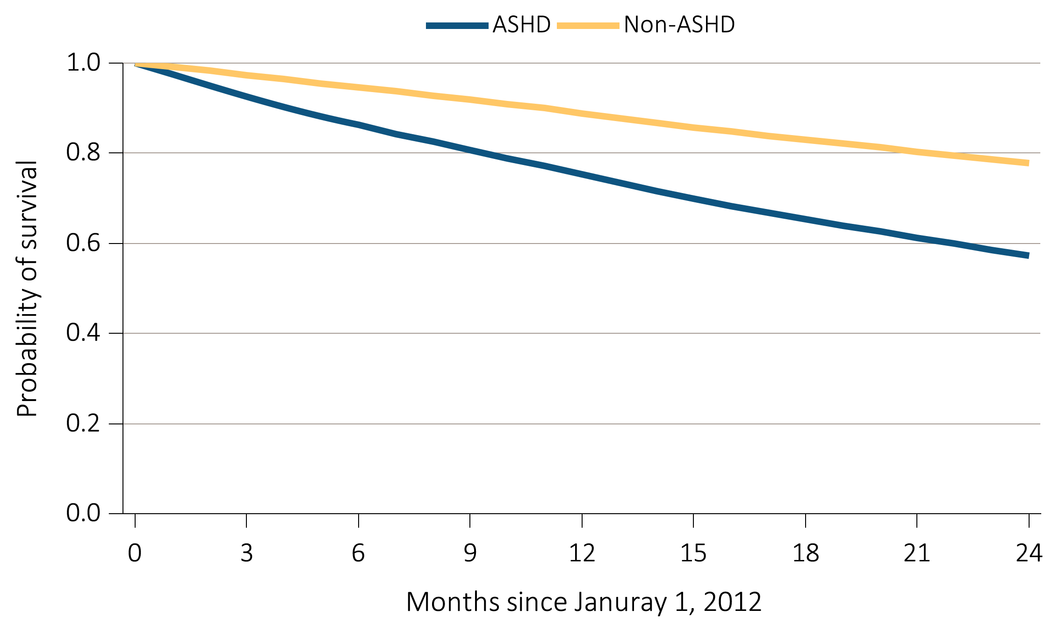
Figure 9.4 Probability of survival of ESRD patients with or without
a cardiovascular disease or undergoing a cardiovascular procedure, 2011-2013
ASHD
Data Source: Special analyses, USRDS ESRD Database. Point prevalent hemodialysis, peritoneal dialysis, and transplant patients with Medicare as primary payer on January 1, 2011, who are continuously enrolled in Medicare Parts A and B from July, 1, 2010 to December 31, 2010, and whose first ESRD service date is at least 90 days prior to January 1, 2011, and survived past 2011. Abbreviation: ASHD, atherosclerotic heart disease.

Slide 9
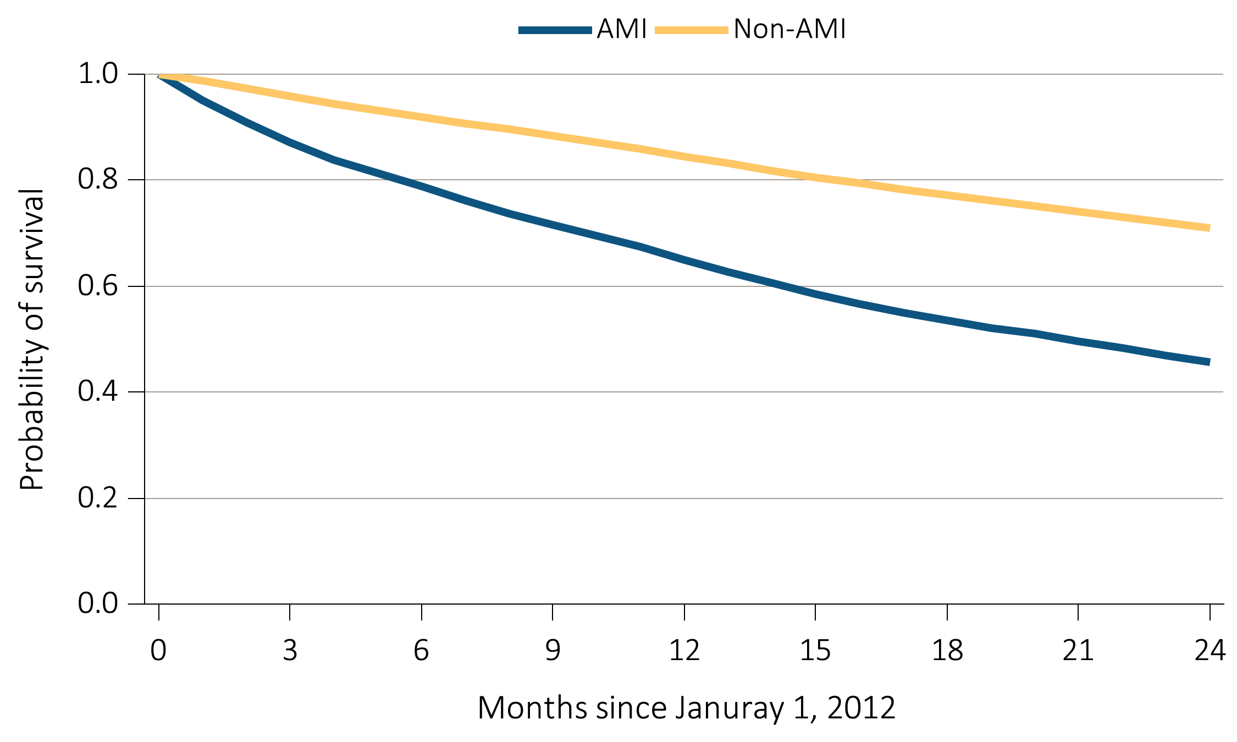
Figure 9.4 Probability of survival of ESRD patients with or without
a cardiovascular disease or undergoing a cardiovascular procedure, 2011-2013
(b) AMI
Data Source: Special analyses, USRDS ESRD Database. Point prevalent hemodialysis, peritoneal dialysis, and transplant patients with Medicare as primary payer on January 1, 2011, who are continuously enrolled in Medicare Parts A and B from July, 1, 2010 to December 31, 2010, and whose first ESRD service date is at least 90 days prior to January 1, 2011, and survived past 2011. Abbreviation: AMI, acute myocardial infarction.

Slide 10
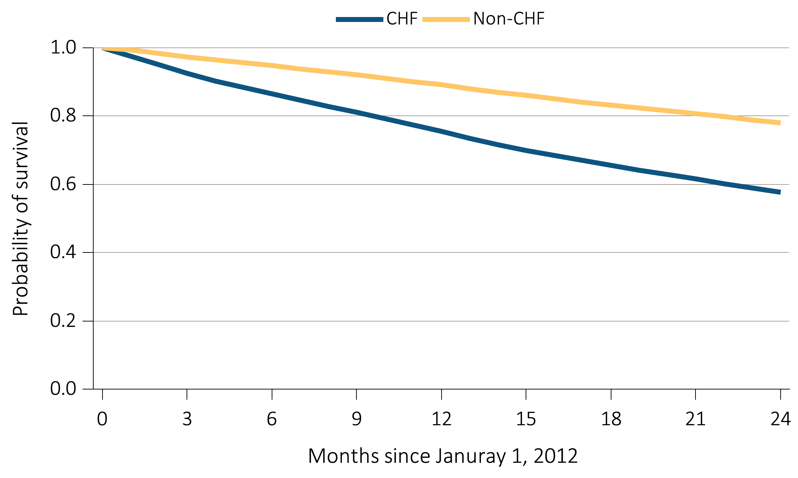
Figure 9.4 Probability of survival of ESRD patients with or without
a cardiovascular disease or undergoing a cardiovascular procedure, 2011-2013
(c) CHF
Data Source: Special analyses, USRDS ESRD Database. Point prevalent hemodialysis, peritoneal dialysis, and transplant patients with Medicare as primary payer on January 1, 2011, who are continuously enrolled in Medicare Parts A and B from July, 1, 2010 to December 31, 2010, and whose first ESRD service date is at least 90 days prior to January 1, 2011, and survived past 2011. Abbreviation: CHF, congestive heart failure.

Slide 11
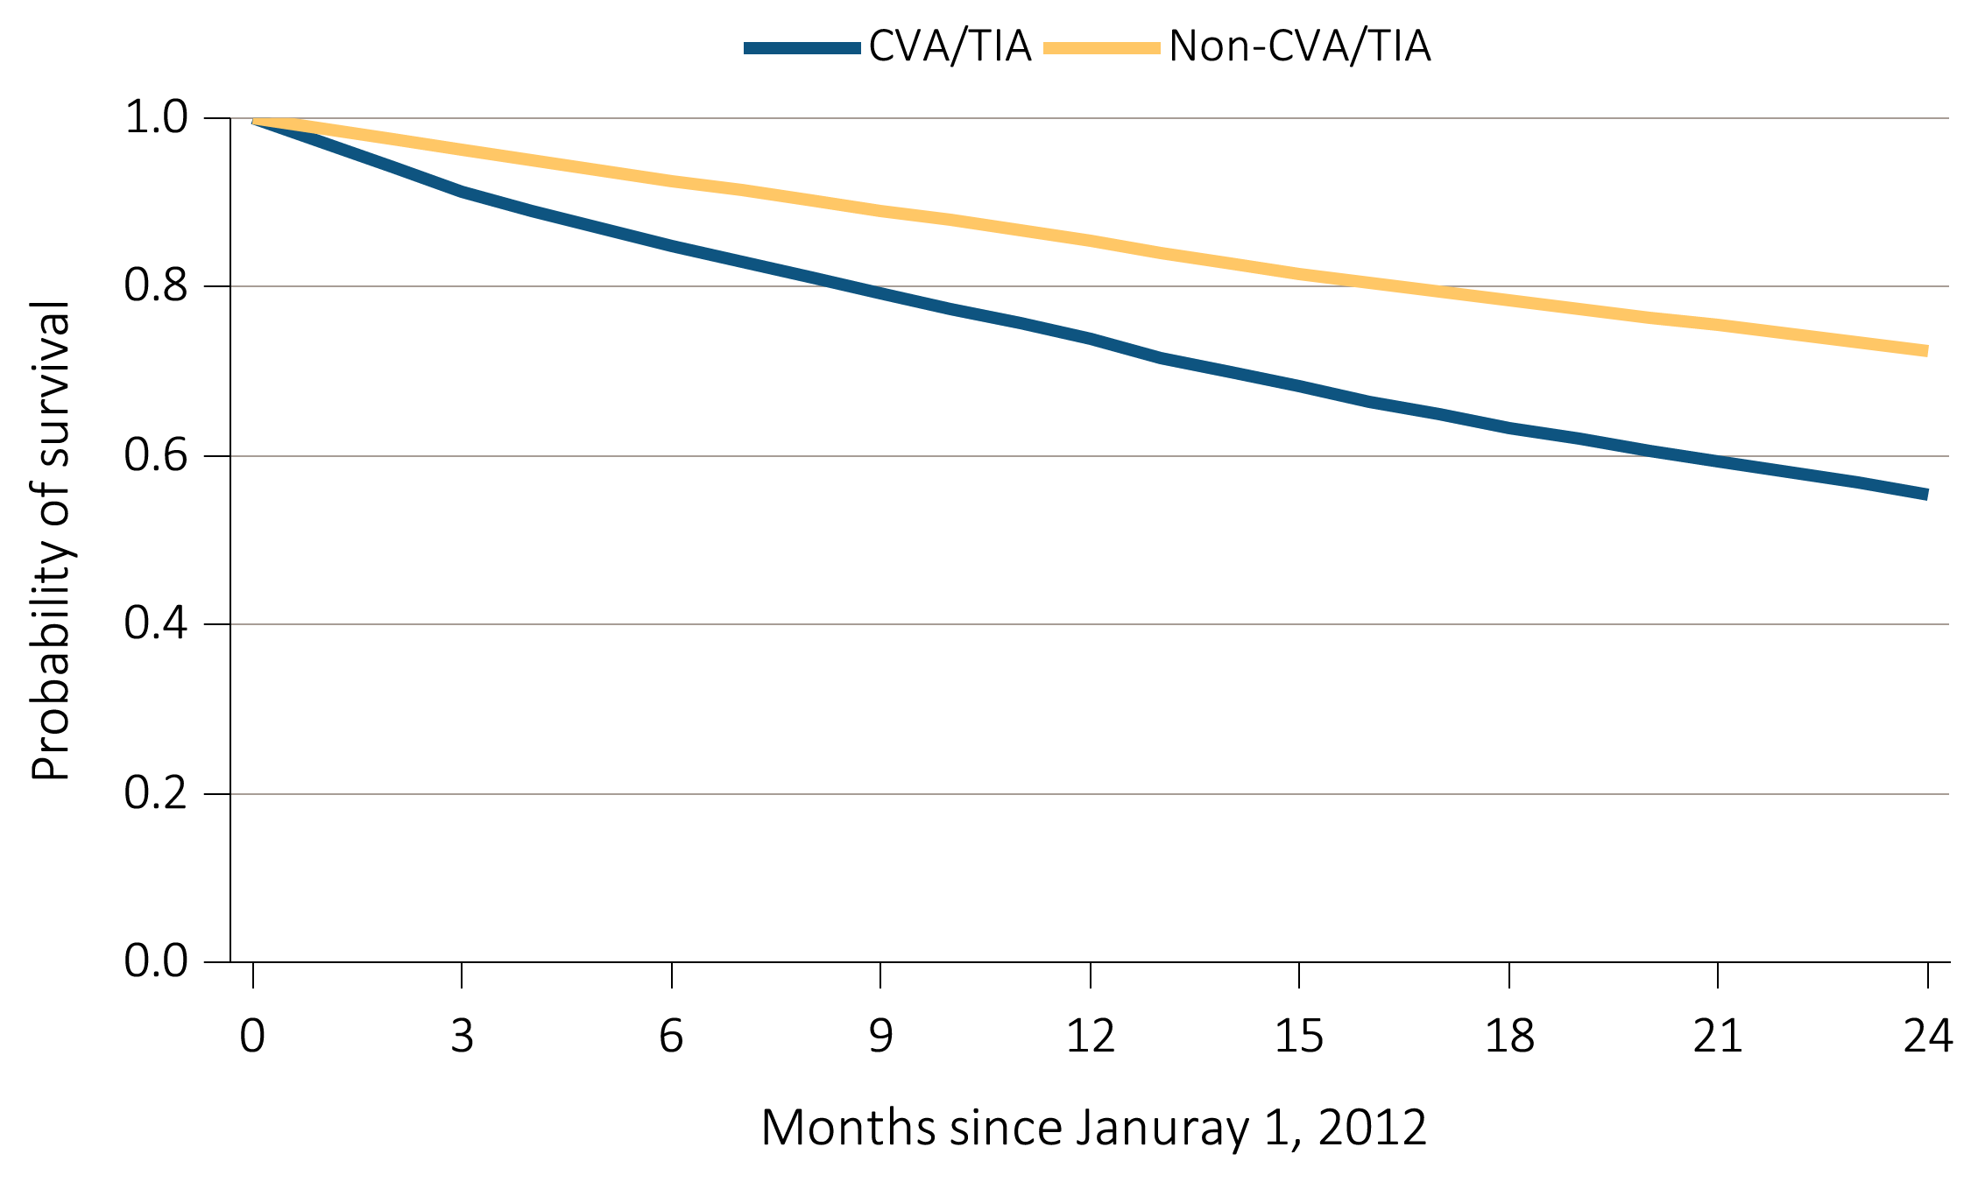
Figure 9.4 Probability of survival of ESRD patients with or without
a cardiovascular disease or undergoing a cardiovascular procedure, 2011-2013
(d) CVA / TIA
Data Source: Special analyses, USRDS ESRD Database. Point prevalent hemodialysis, peritoneal dialysis, and transplant patients with Medicare as primary payer on January 1, 2011, who are continuously enrolled in Medicare Parts A and B from July, 1, 2010 to December 31, 2010, and whose first ESRD service date is at least 90 days prior to January 1, 2011, and survived past 2011. Abbreviations: CVA/TIA, cerebrovascular accident/transient ischemic attack.

Slide 12
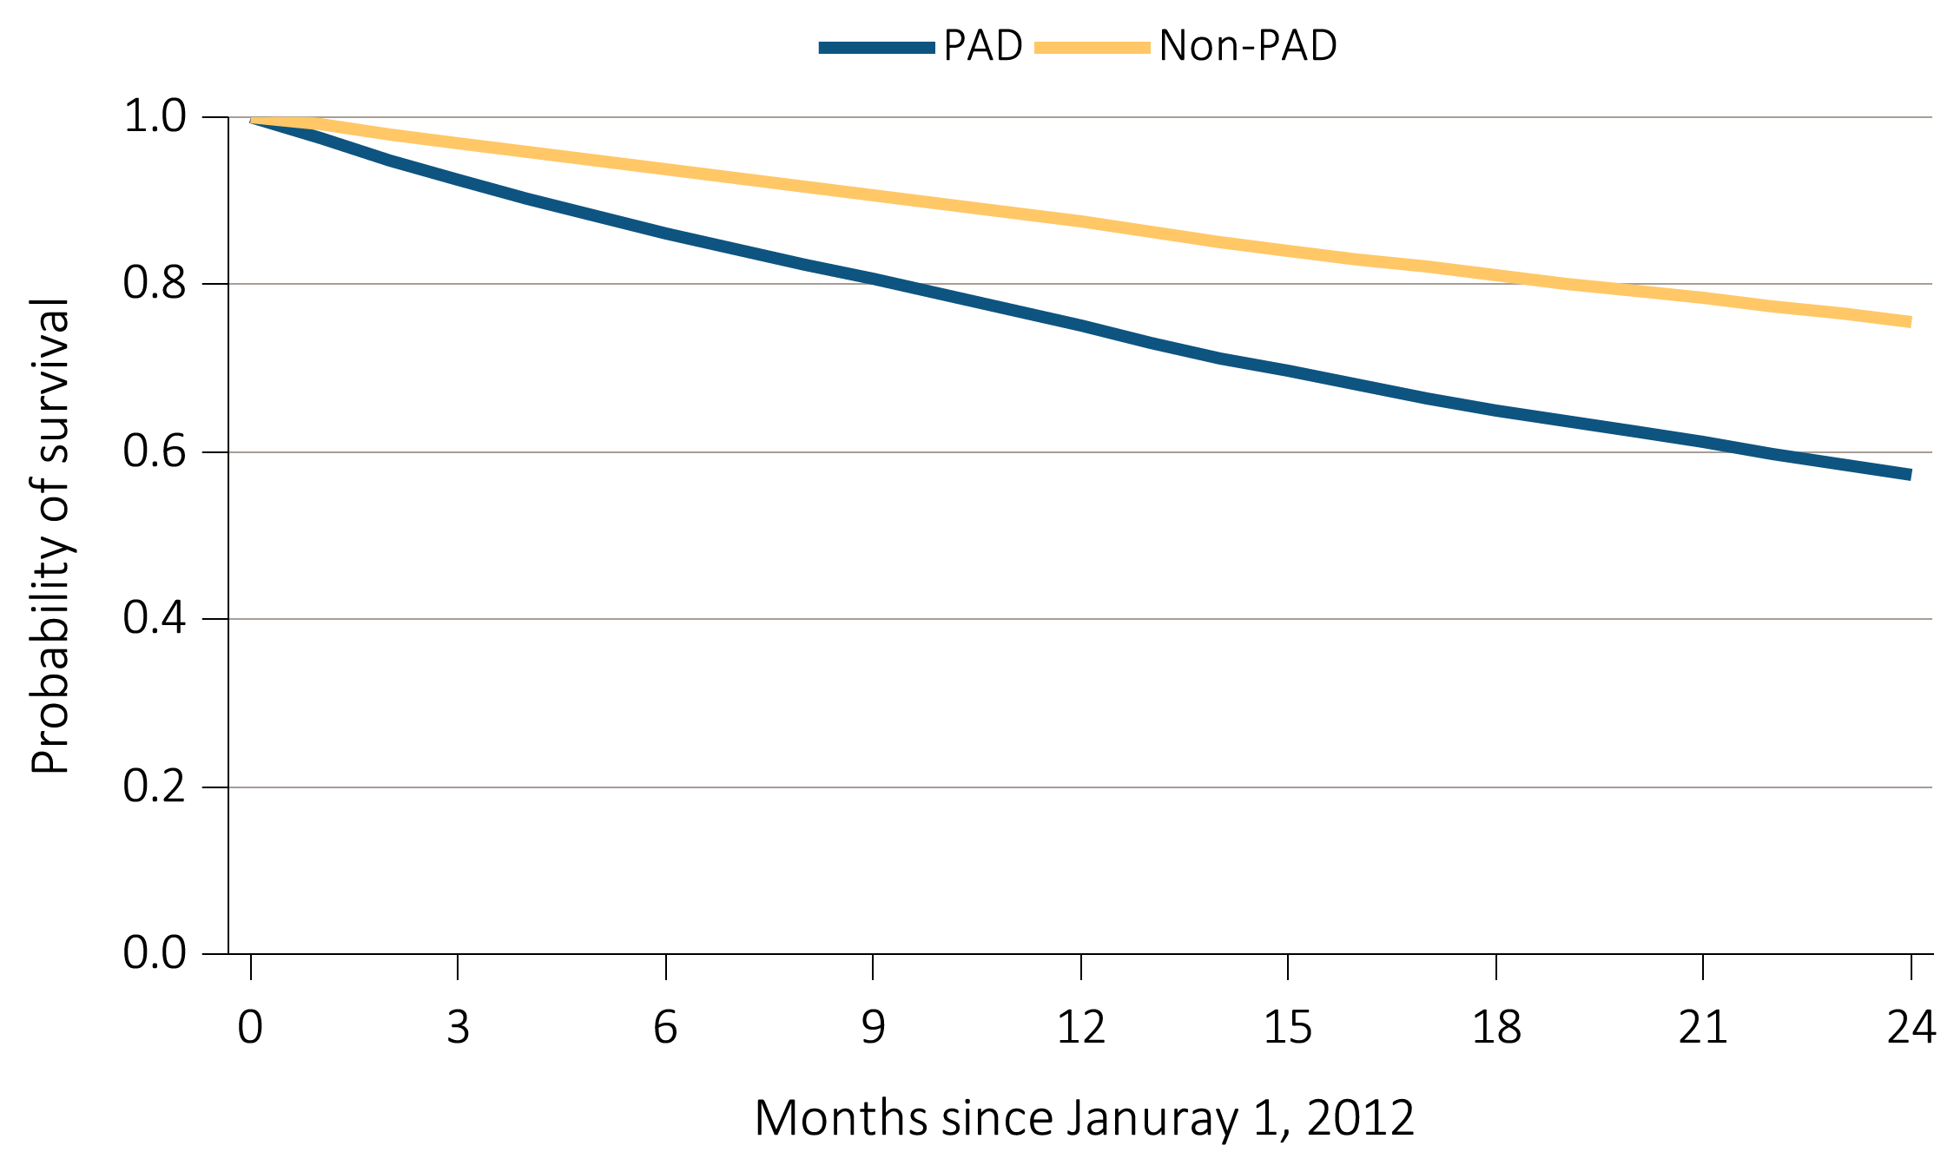
Figure 9.4 Probability of survival of ESRD patients with or without
a cardiovascular disease or undergoing a cardiovascular procedure, 2011-2013
(e) PAD
Data Source: Special analyses, USRDS ESRD Database. Point prevalent hemodialysis, peritoneal dialysis, and transplant patients with Medicare as primary payer on January 1, 2011, who are continuously enrolled in Medicare Parts A and B from July, 1, 2010 to December 31, 2010, and whose first ESRD service date is at least 90 days prior to January 1, 2011, and survived past 2011. Abbreviation: PAD, peripheral arterial disease.

Slide 13
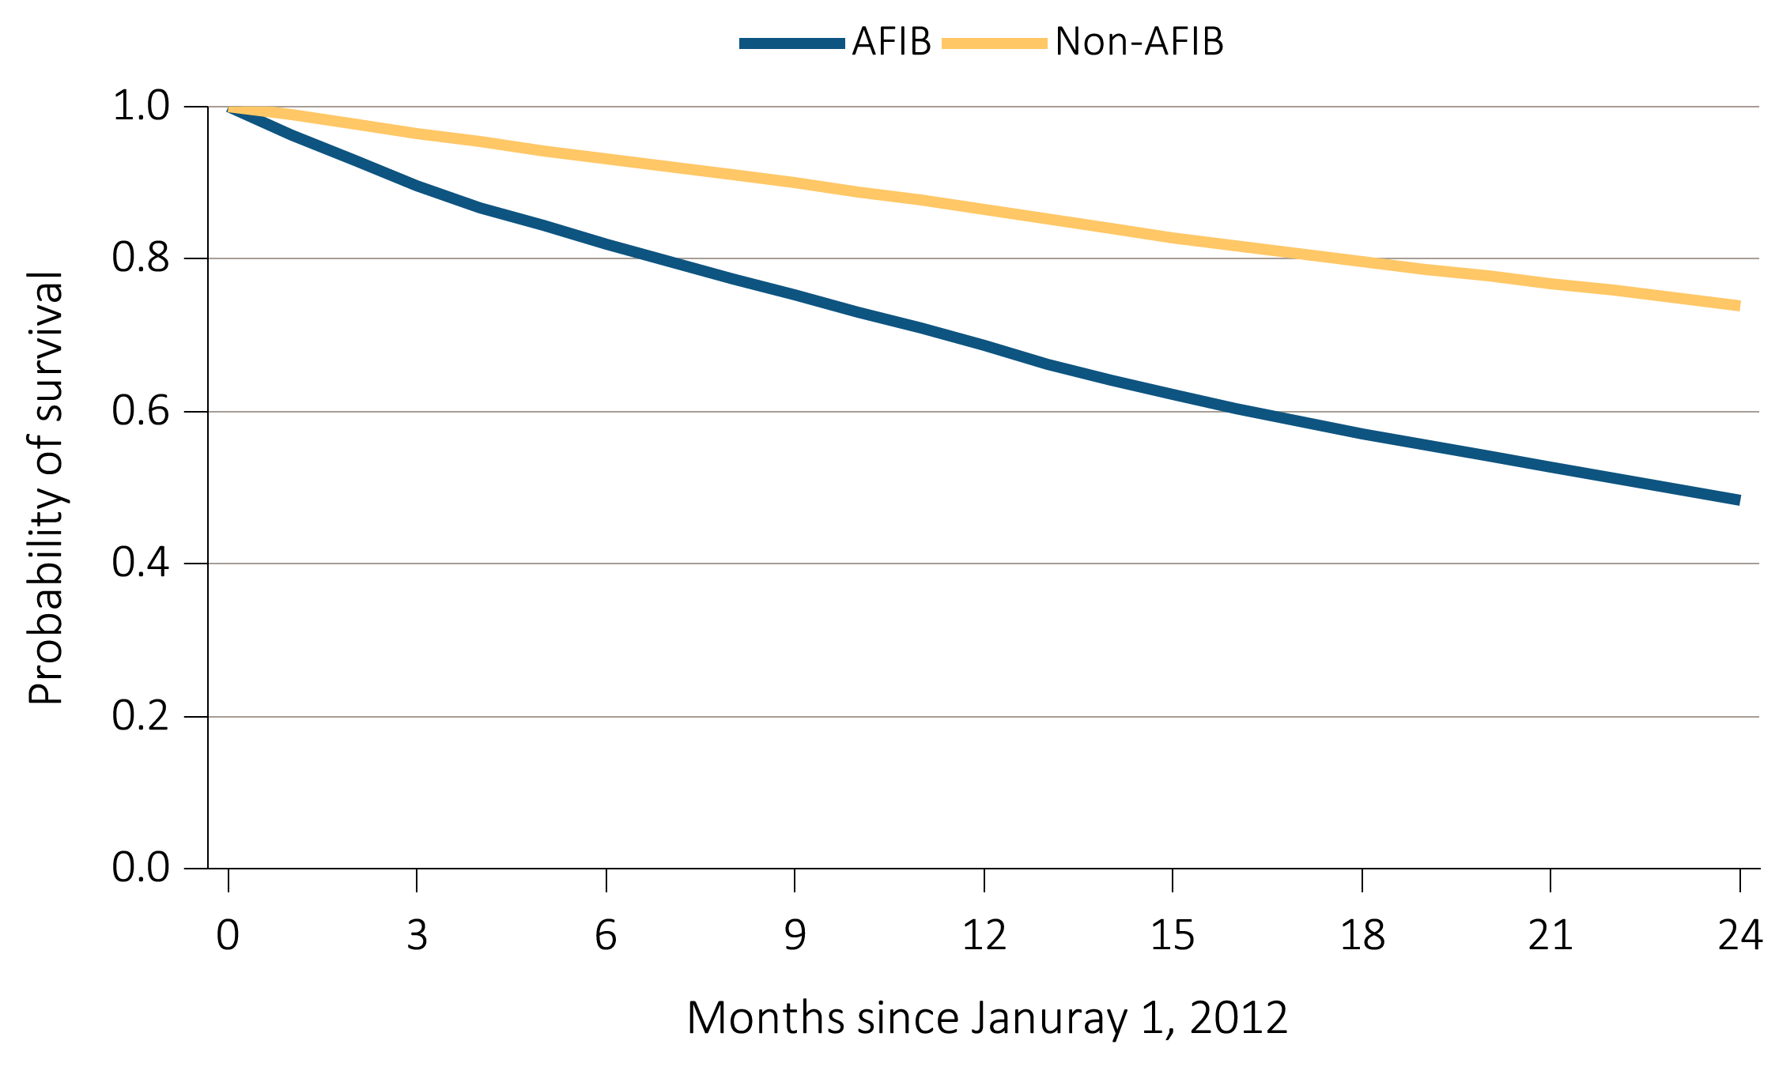
Figure 9.4 Probability of survival of ESRD patients with or without
a cardiovascular disease or undergoing a cardiovascular procedure, 2011-2013
(f) AFIB
Data Source: Special analyses, USRDS ESRD Database. Point prevalent hemodialysis, peritoneal dialysis, and transplant patients with Medicare as primary payer on January 1, 2011, who are continuously enrolled in Medicare Parts A and B from July, 1, 2010 to December 31, 2010, and whose first ESRD service date is at least 90 days prior to January 1, 2011, and survived past 2011. Abbreviation: AFIB, atrial fibrillation.

Slide 14
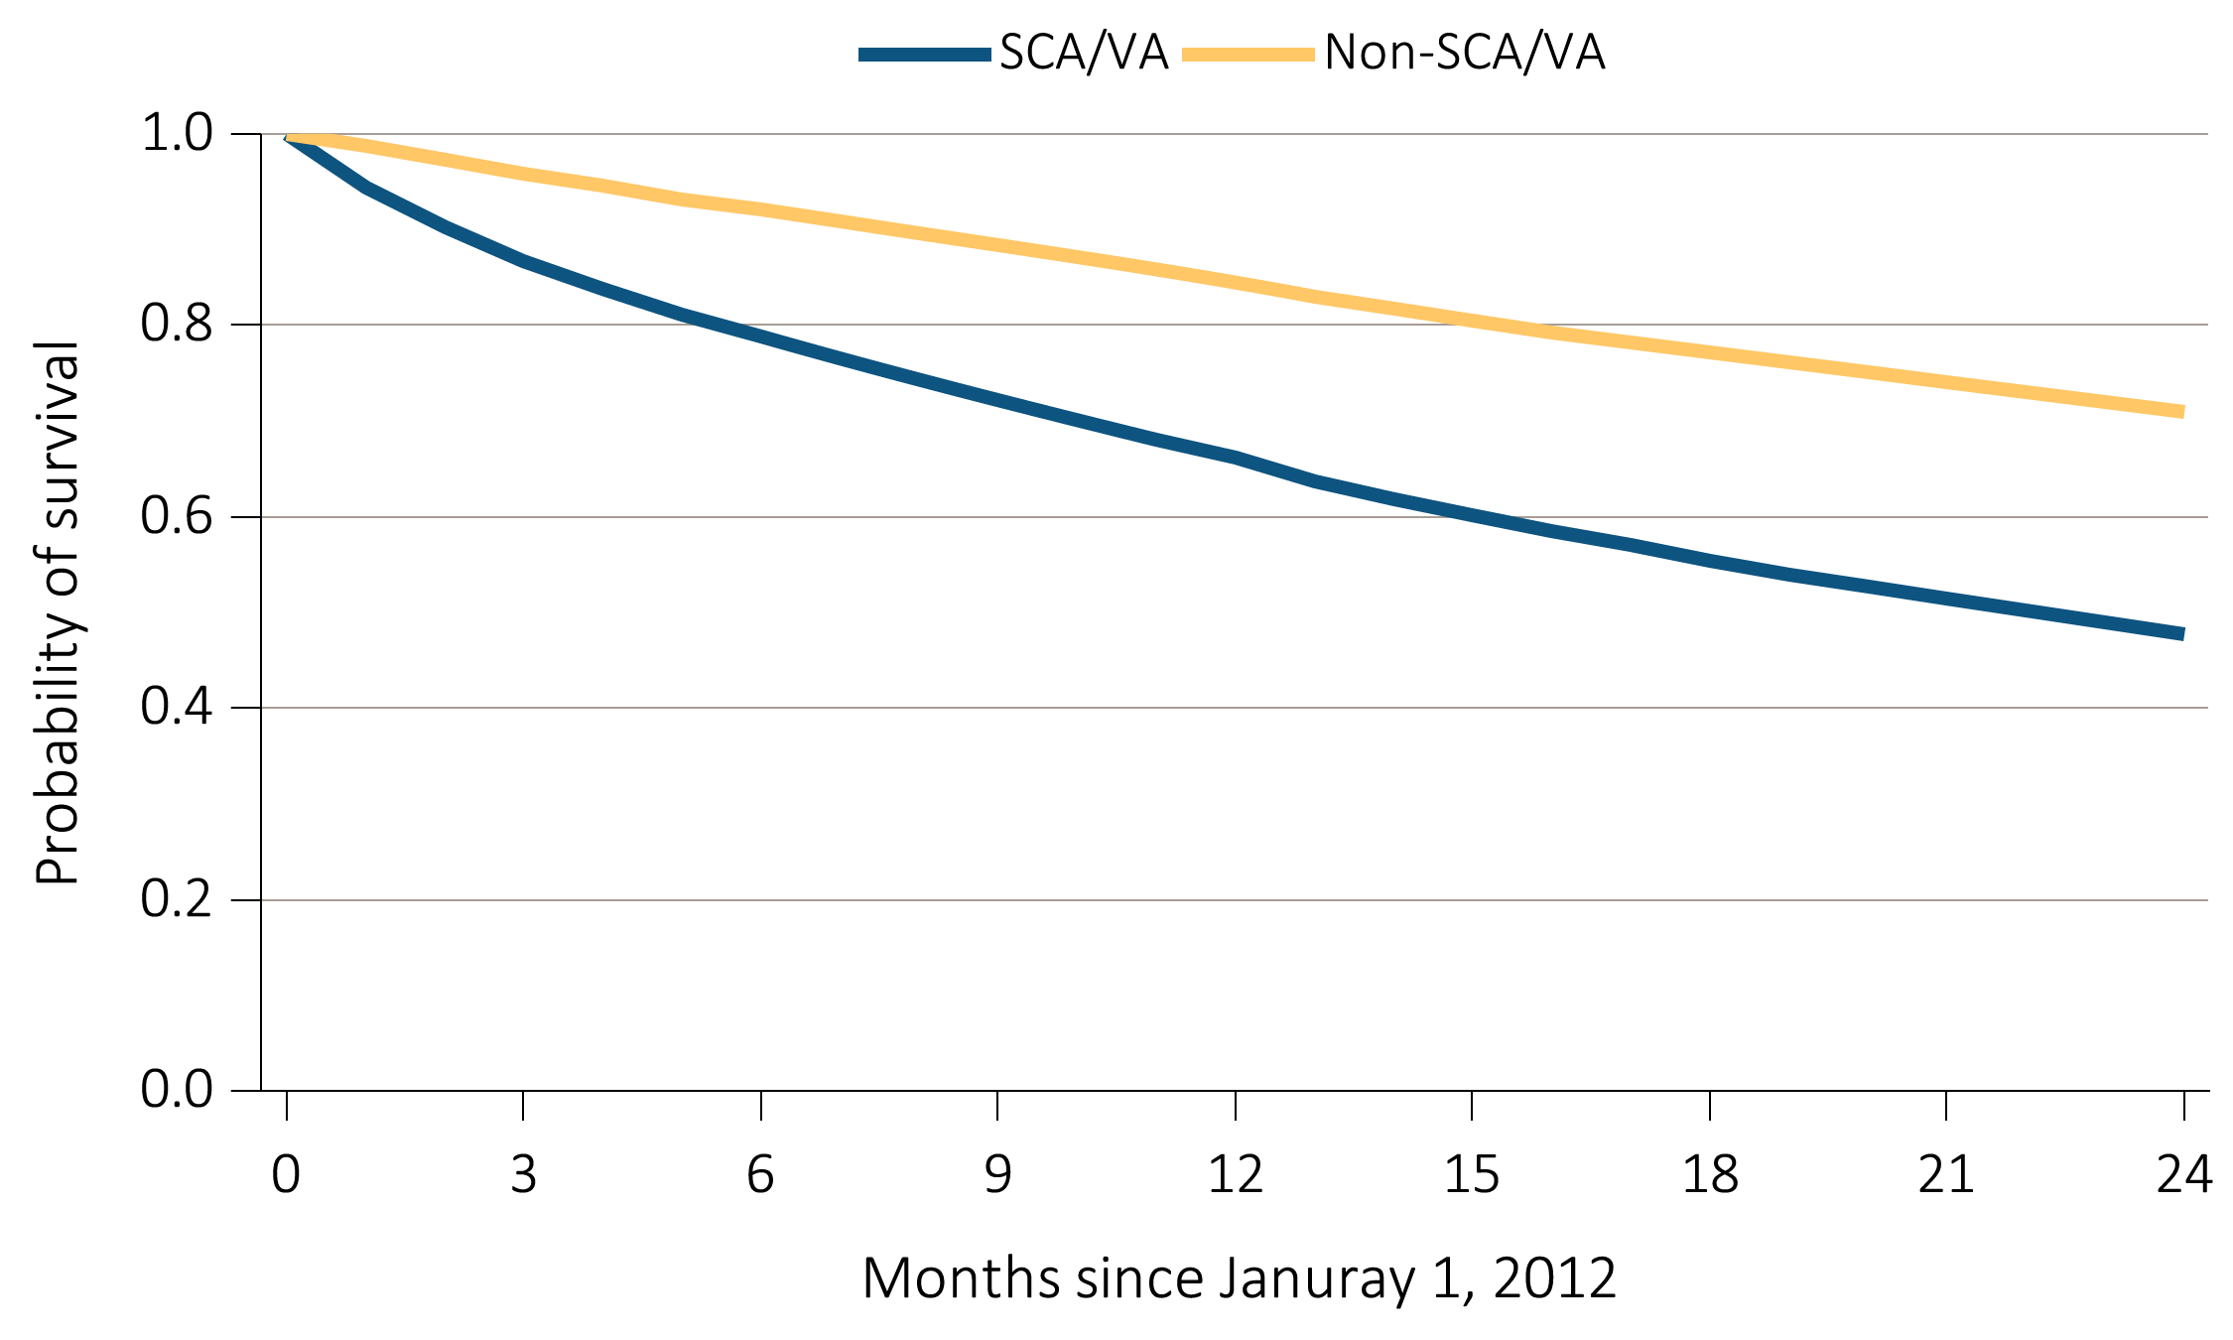
Figure 9.4 Probability of survival of ESRD patients with or without
a cardiovascular disease or undergoing a cardiovascular procedure, 2011-2013
(g) SCA / VA
Data Source: Special analyses, USRDS ESRD Database. Point prevalent hemodialysis, peritoneal dialysis, and transplant patients with Medicare as primary payer on January 1, 2011, who are continuously enrolled in Medicare Parts A and B from July, 1, 2010 to December 31, 2010, and whose first ESRD service date is at least 90 days prior to January 1, 2011, and survived past 2011. Abbreviations: SCA/VA, sudden cardiac arrest and ventricular arrhythmias.

Slide 15
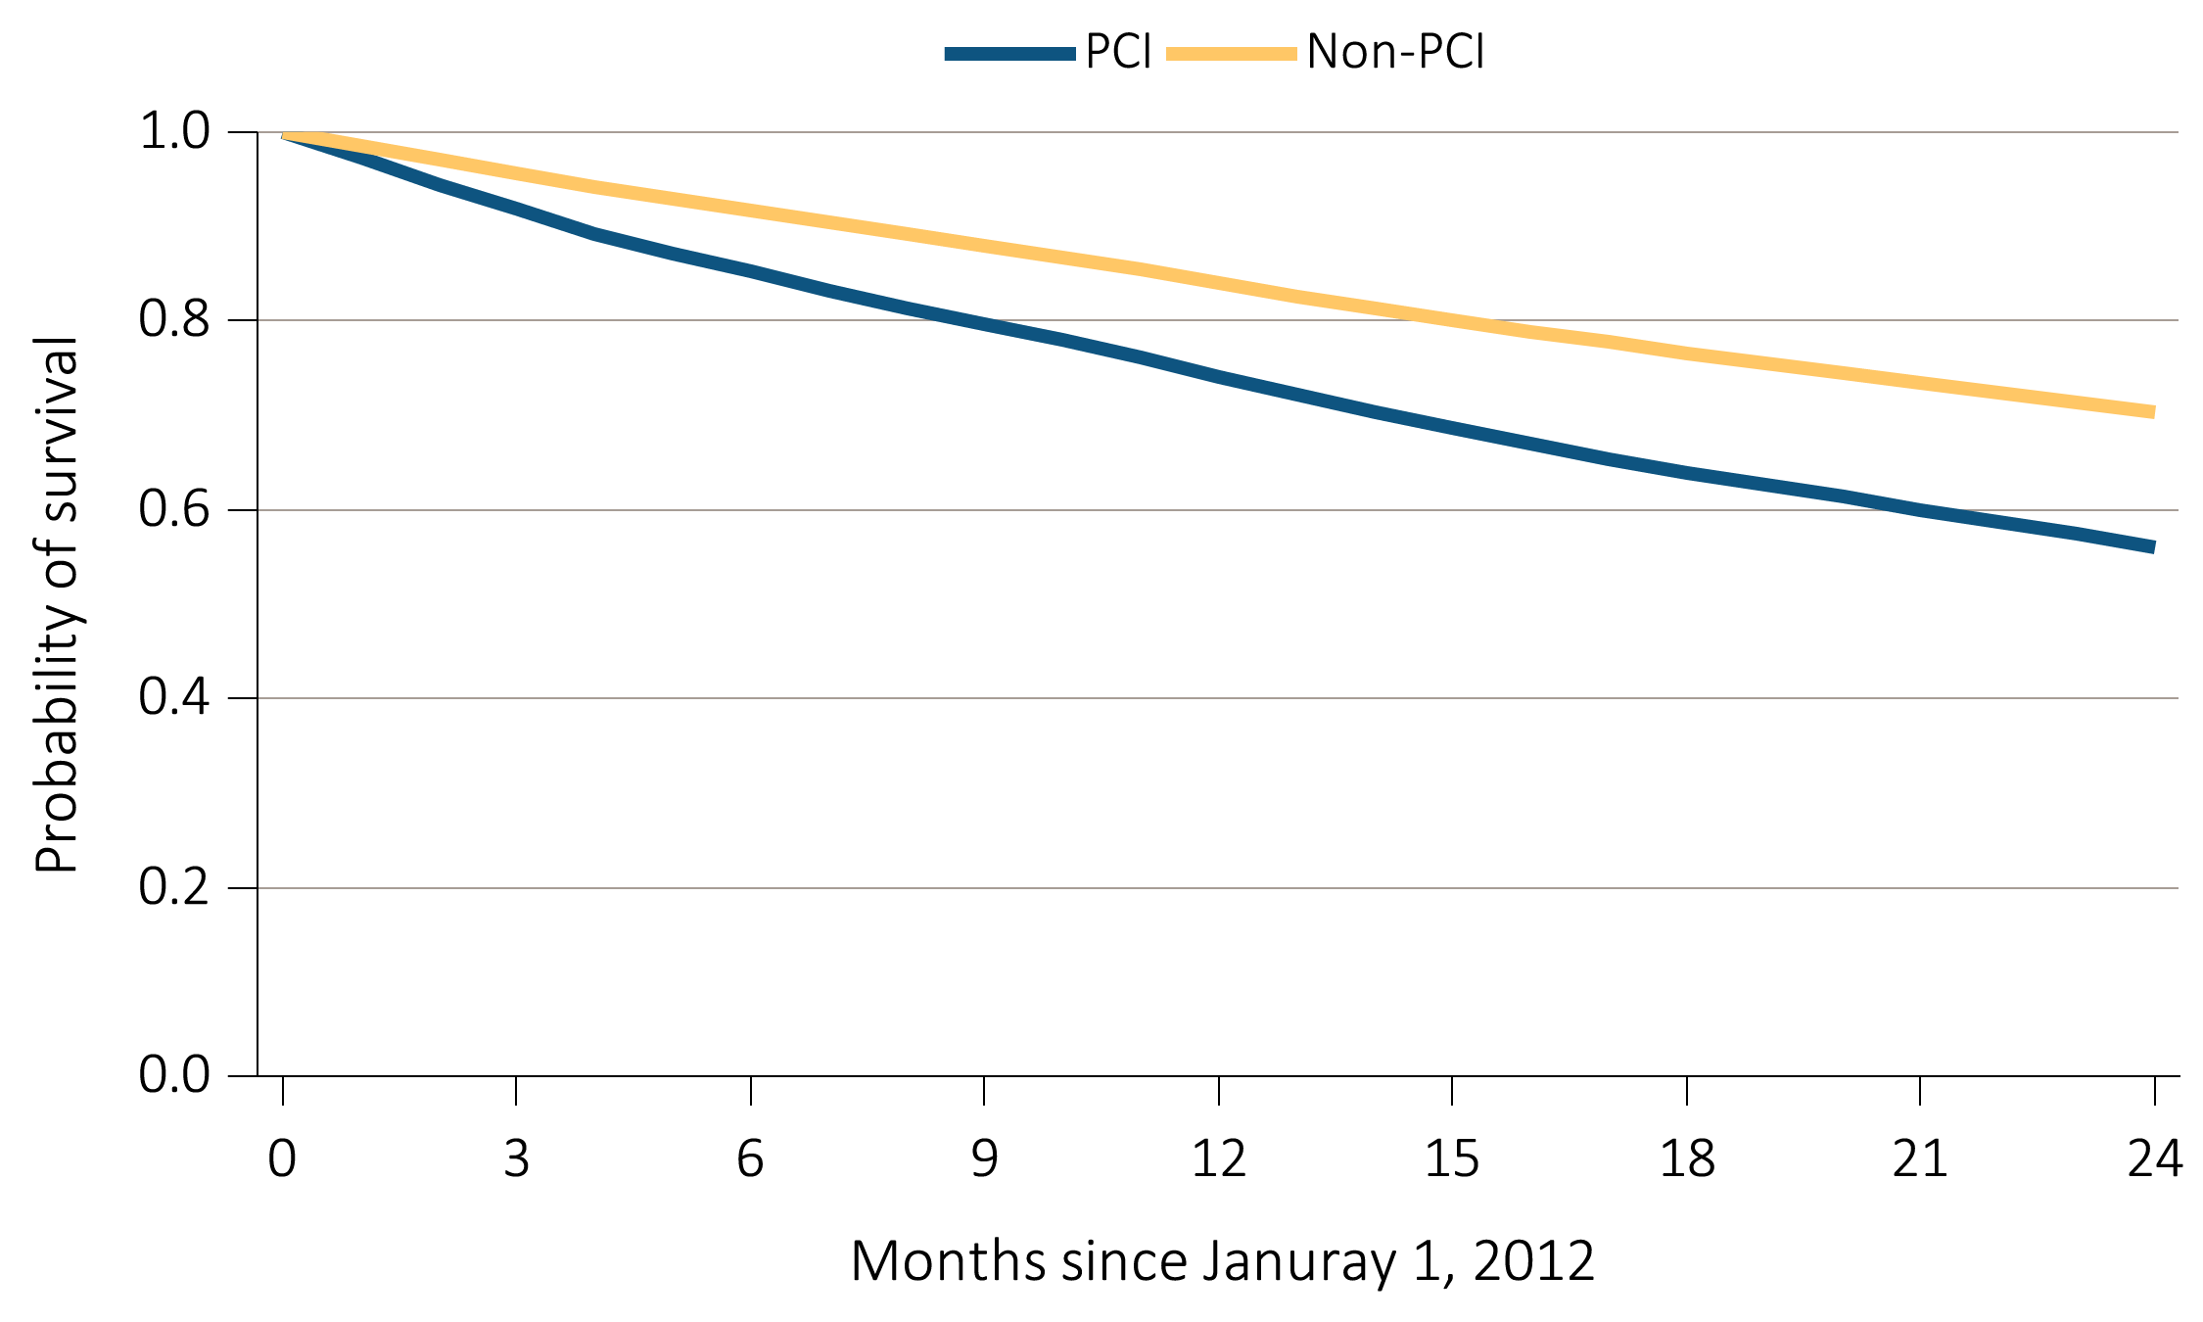
Figure 9.4 Probability of survival of ESRD patients with or without
a cardiovascular disease or undergoing a cardiovascular procedure, 2011-2013
(h) PCI
Data Source: Special analyses, USRDS ESRD Database. Point prevalent hemodialysis, peritoneal dialysis, and transplant patients with Medicare as primary payer on January 1, 2011, who are continuously enrolled in Medicare Parts A and B from July, 1, 2010 to December 31, 2010, and whose first ESRD service date is at least 90 days prior to January 1, 2011, and survived past 2011. Abbreviation: PCI, percutaneous coronary interventions.

Slide 16
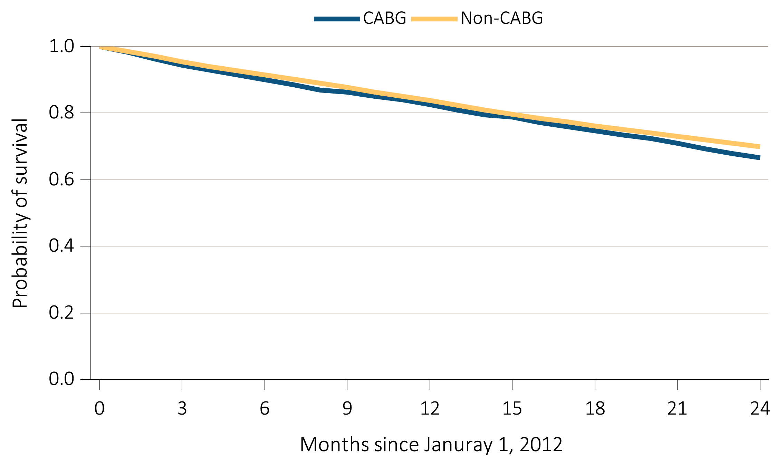
Figure 9.4 Probability of survival of ESRD patients with or without
a cardiovascular disease or undergoing a cardiovascular procedure, 2011-2013
(i) CABG
Data Source: Special analyses, USRDS ESRD Database. Point prevalent hemodialysis, peritoneal dialysis, and transplant patients with Medicare as primary payer on January 1, 2011, who are continuously enrolled in Medicare Parts A and B from July, 1, 2010 to December 31, 2010, and whose first ESRD service date is at least 90 days prior to January 1, 2011, and survived past 2011. Abbreviation: CABG, coronary artery bypass grafting.

Slide 17
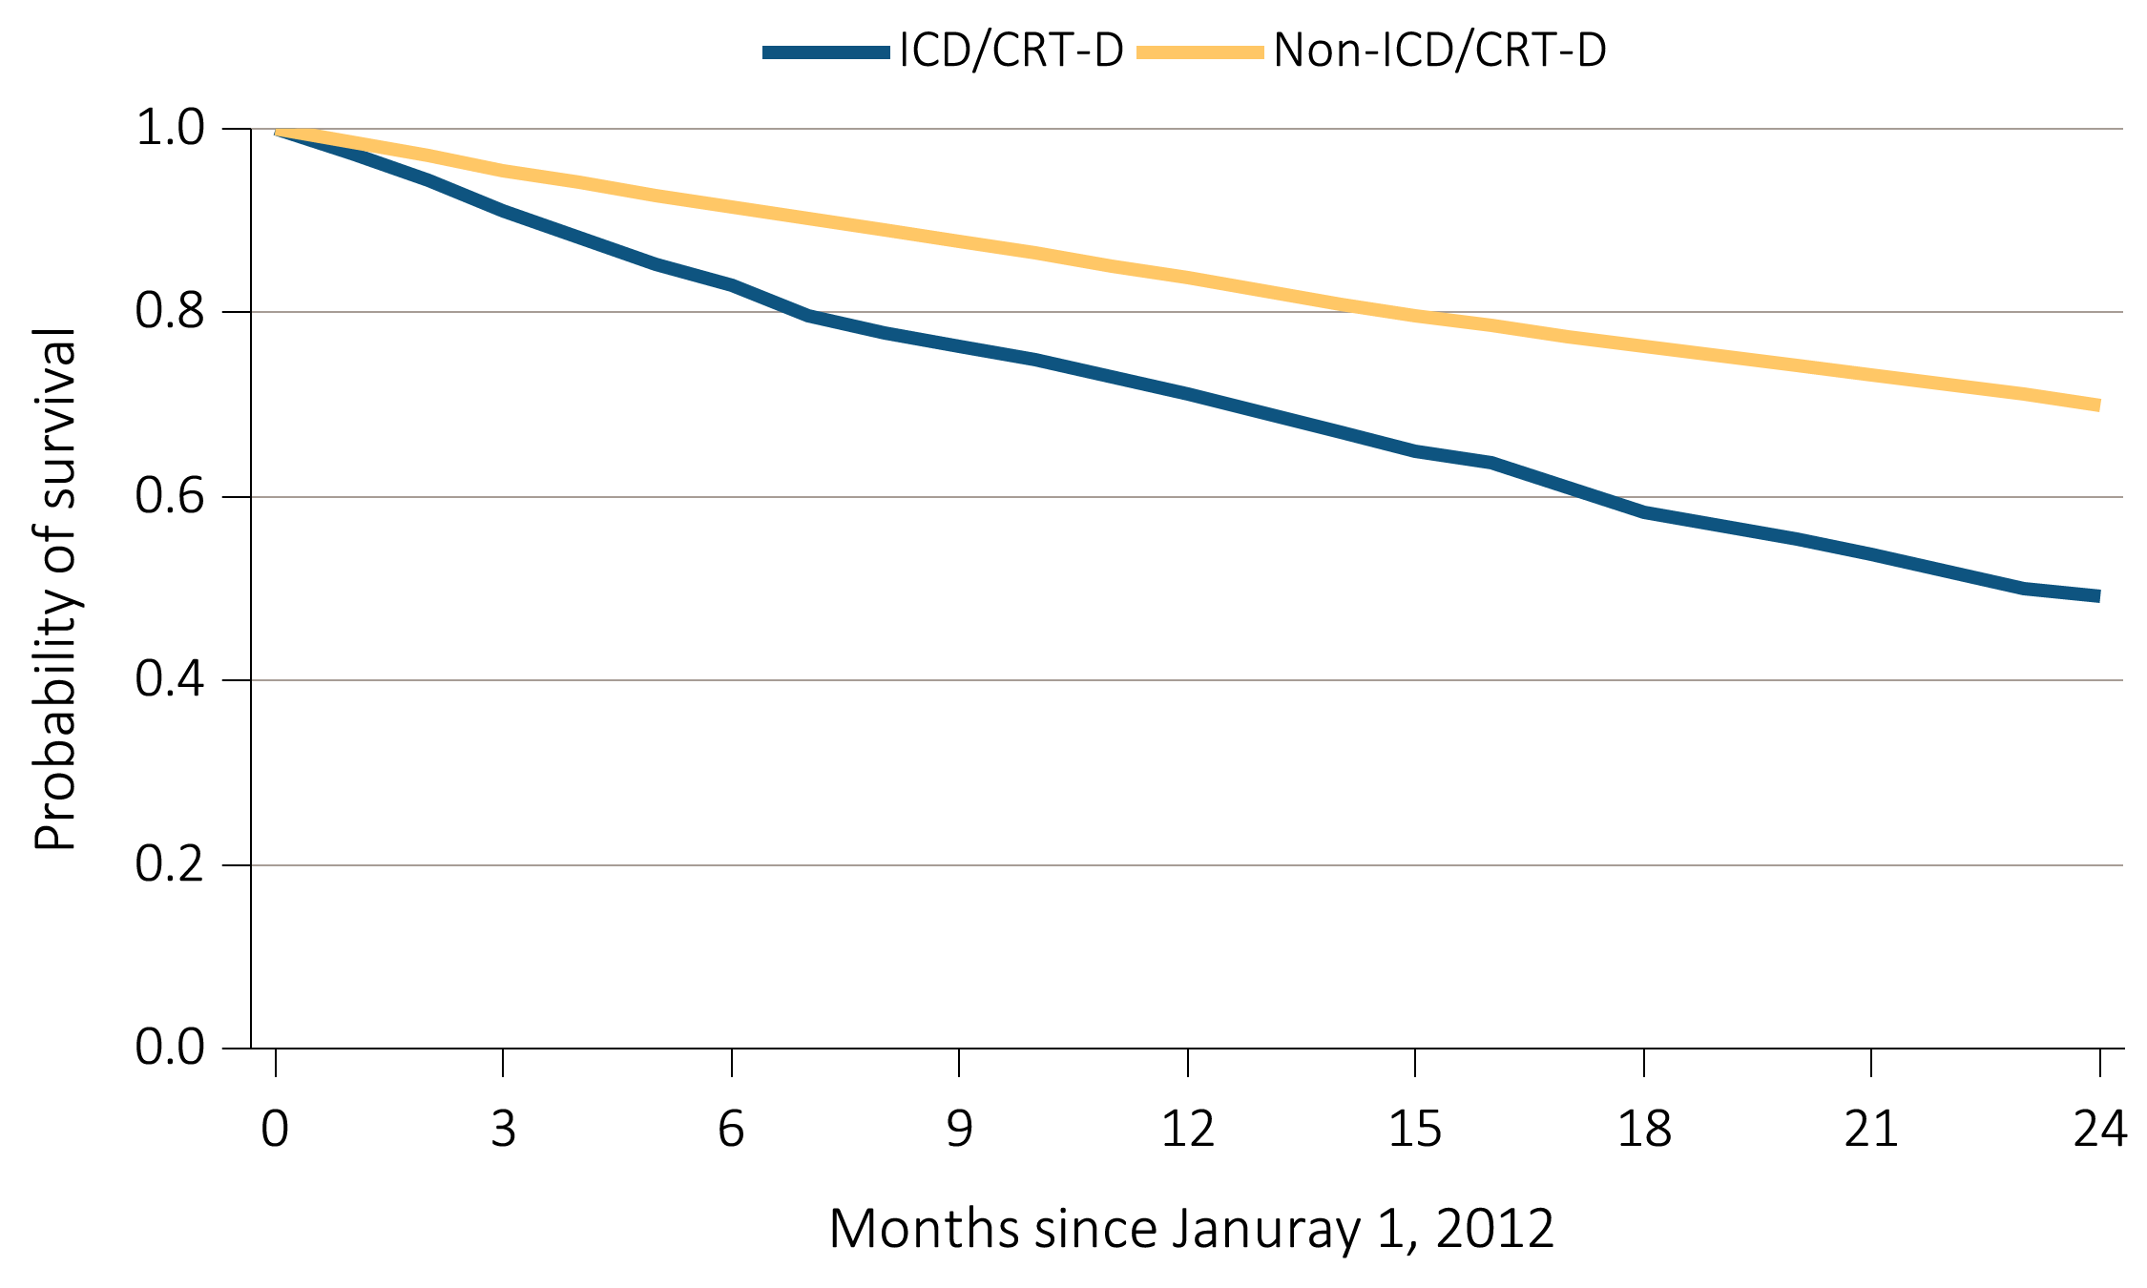
Figure 9.4 Probability of survival of ESRD patients with or without
a cardiovascular disease or undergoing a cardiovascular procedure, 2011-2013
(j) ICD / CRT / D
Data Source: Special analyses, USRDS ESRD Database. Point prevalent hemodialysis, peritoneal dialysis, and transplant patients with Medicare as primary payer on January 1, 2011, who are continuously enrolled in Medicare Parts A and B from July, 1, 2010 to December 31, 2010, and whose first ESRD service date is at least 90 days prior to January 1, 2011, and survived past 2011. Abbreviation: ICD/CRT/D, implantable cardioverter defibrillators/cardiac resynchronization therapy with defibrillator devices.

Slide 18
Table 9.2 Characteristics of patients with heart failure, by treatment modality, 2013
 | Systolic +/- Diastolic heart failure |  |  |  | Diastolic only heart failure |  |  |  | Heart failure, unspecified
 | HD |  | PD |  | HD |  | PD |  | HD |  | PD
 | N | % | N | % | N | % | N | % | N | % | N | %
Age
0-21 | 7 | 0.0 | 1 | 0.1 | 1 | 0.0 | 0 | 0.0 | 11 | 0.0 | 6 | 0.5
22-44 | 887 | 6.3 | 100 | 12.4 | 774 | 6.2 | 63 | 11.2 | 1,852 | 7.5 | 156 | 13.2
45-64 | 5,047 | 35.7 | 303 | 37.5 | 4,413 | 35.1 | 231 | 41.2 | 9,295 | 37.7 | 474 | 40.1
65-74 | 4,034 | 28.5 | 241 | 29.8 | 3,565 | 28.4 | 142 | 25.3 | 6,643 | 26.9 | 307 | 26.0
75+ | 4,170 | 29.5 | 164 | 20.3 | 3,811 | 30.3 | 125 | 22.3 | 6,858 | 27.8 | 238 | 20.2
Sex
Male | 8,431 | 59.6 | 476 | 58.8 | 5,484 | 43.6 | 264 | 47.1 | 12,573 | 51.0 | 611 | 51.7
Female | 5,714 | 40.4 | 333 | 41.2 | 7,080 | 56.4 | 297 | 52.9 | 12,086 | 49.0 | 570 | 48.3
Race
White | 7,708 | 54.5 | 555 | 68.6 | 6,547 | 52.1 | 344 | 61.3 | 12,720 | 51.6 | 755 | 63.9
Black/African American | 5,756 | 40.7 | 216 | 26.7 | 5,386 | 42.9 | 187 | 33.3 | 10,683 | 43.3 | 344 | 29.1
Other | 681 | 4.8 | 38 | 4.7 | 631 | 5.0 | 30 | 5.3 | 1,256 | 5.1 | 82 | 6.9
Diabetes
No | 4,029 | 28.5 | 323 | 39.9 | 3,505 | 27.9 | 203 | 36.2 | 7,095 | 28.8 | 439 | 37.2
Yes | 10,116 | 71.5 | 486 | 60.1 | 9,059 | 72.1 | 358 | 63.8 | 17,564 | 71.2 | 742 | 62.8
Data Source: Special analyses, USRDS ESRD Database. Point prevalent hemodialysis and peritoneal dialysis patients at all ages, with Medicare as primary payer on January 1, 2011, who are continuously enrolled in Medicare Parts A and B from July, 1, 2010 to December 31, 2010, ESRD service date is at least 90 days prior to January 1, 2011, and survived past 2012. Abbreviations: HD, hemodialysis; PD, peritoneal dialysis.

