Slide 2
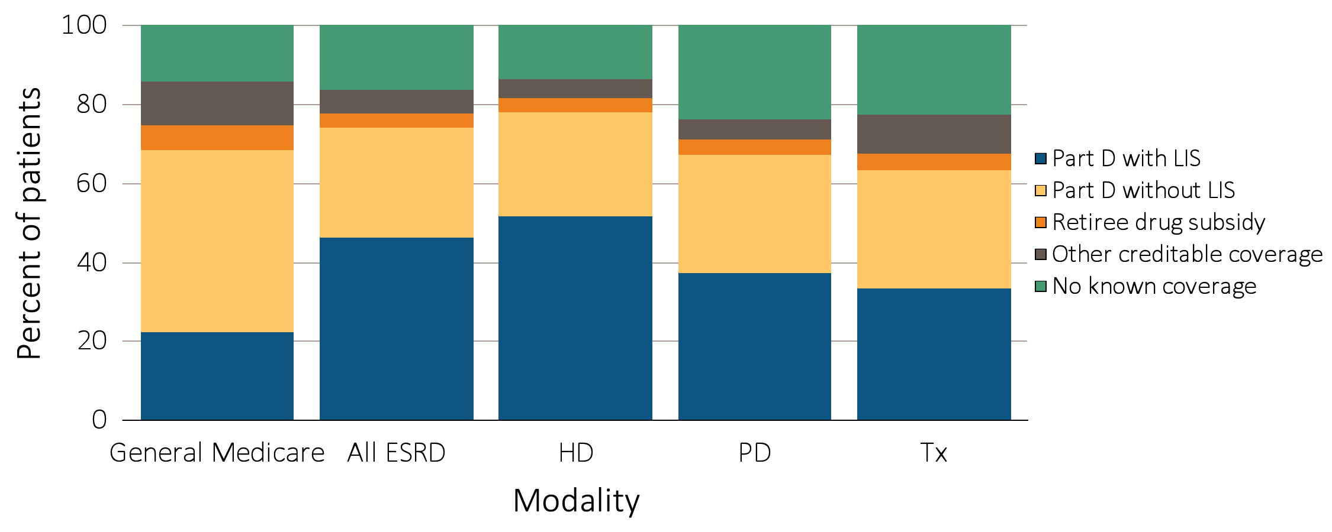
Figure 12.1 Sources of prescription drug coverage in Medicare ESRD enrollees,
^{by population, 2013}
Data source: 2013 Medicare Data, point prevalent Medicare enrollees alive on January 1, 2013. Abbreviations: ESRD, end-stage renal disease; HD, hemodialysis; LIS, Low-income Subsidy; Part D, Medicare Part D prescription drug coverage; PD, peritoneal dialysis; Tx, kidney transplant.

Slide 3
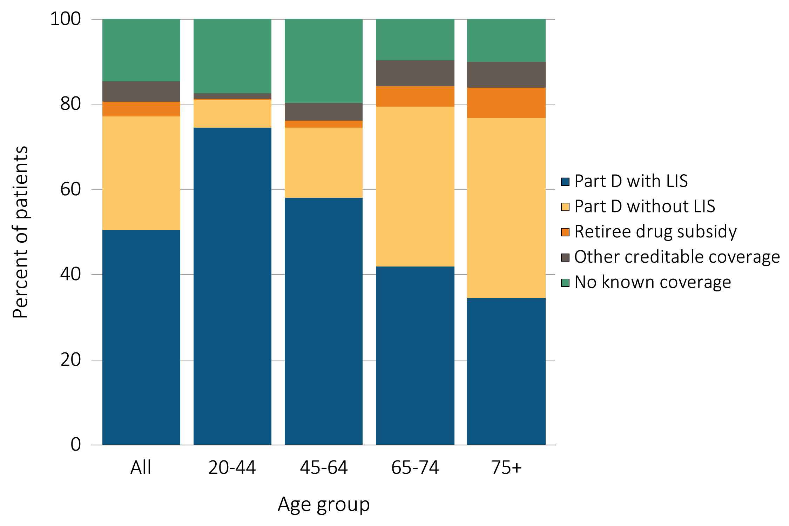
Figure 12.2 Sources of prescription drug coverage in Medicare ESRD enrollees,
^{by age & modality, 2013}
^{(a) Dialysis Patients}
Data source: 2013 Medicare Data, point prevalent Medicare enrollees alive on January 1, 2013. Abbreviations: ESRD, end-stage renal disease; LIS, Low-income Subsidy; Part D, Medicare Part D prescription drug coverage.

Slide 4
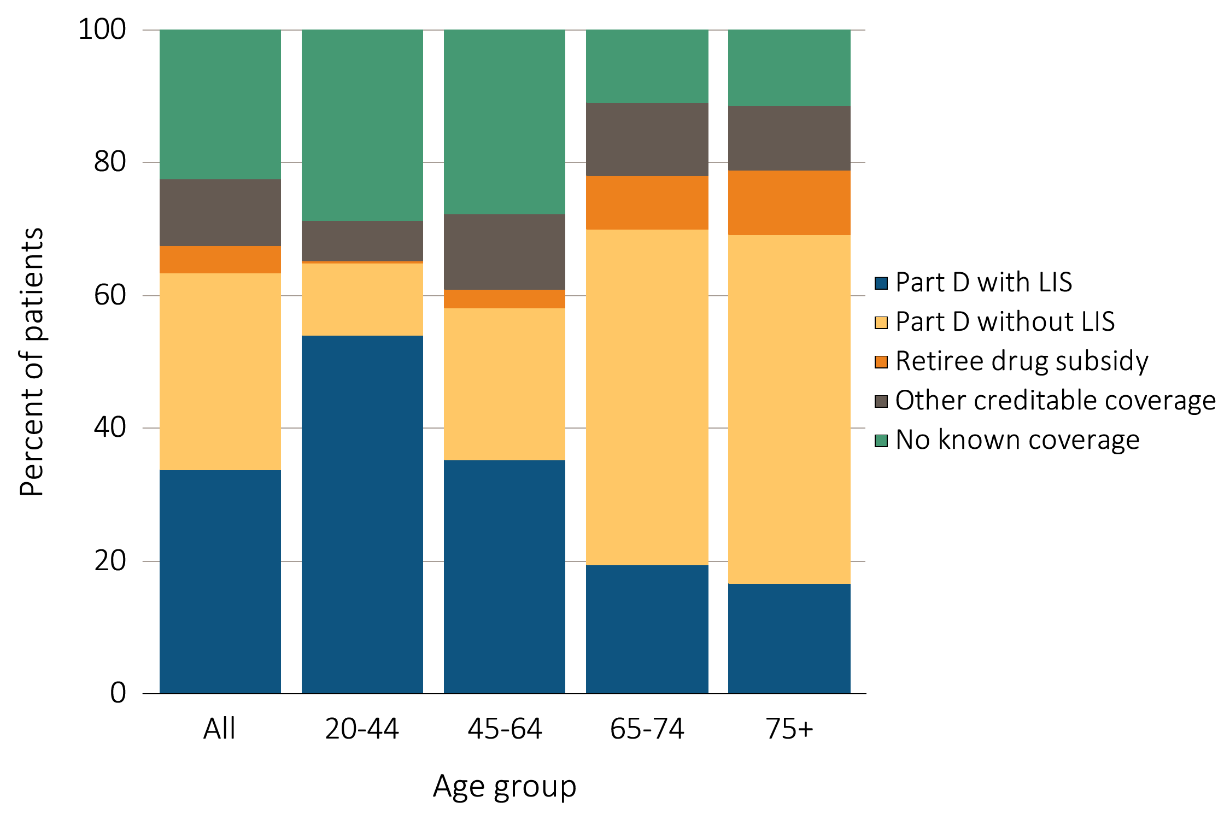
Figure 12.2 Sources of prescription drug coverage in Medicare ESRD enrollees,
^{by age & modality, 2013}
^{(b) Transplant Patients}
Data source: 2013 Medicare Data, point prevalent Medicare enrollees alive on January 1, 2013. Abbreviations: ESRD, end-stage renal disease; LIS, Low-income Subsidy; Part D, Medicare Part D prescription drug coverage.

Slide 5
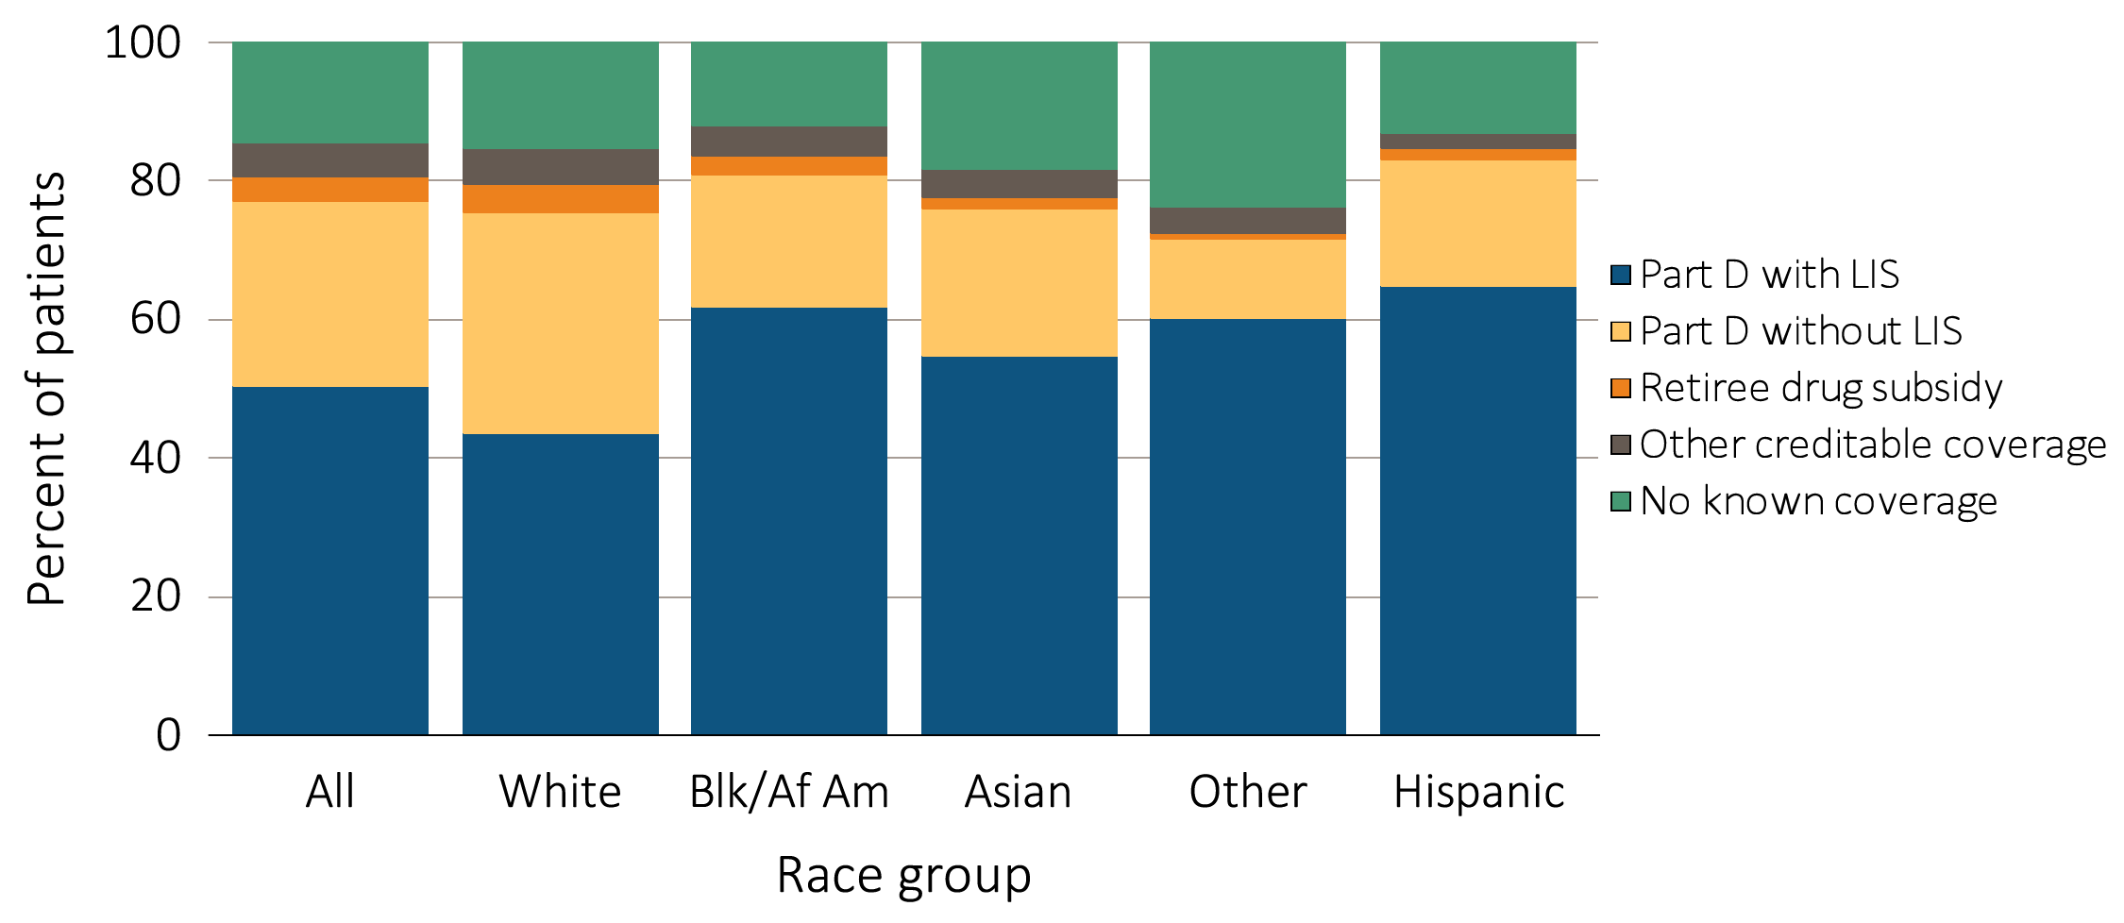
Figure 12.3 Sources of prescription drug coverage in Medicare ESRD enrollees,
by race/ethnicity & modality, 2013
^{(a) Dialysis patients}
Data source: 2013 Medicare Data, point prevalent Medicare enrollees alive on January 1, 2013. Abbreviations: Blk/Af Am, Black or African American; ESRD, end-stage renal disease; LIS, Low-income Subsidy; Part D, Medicare Part D prescription drug coverage.

Slide 6
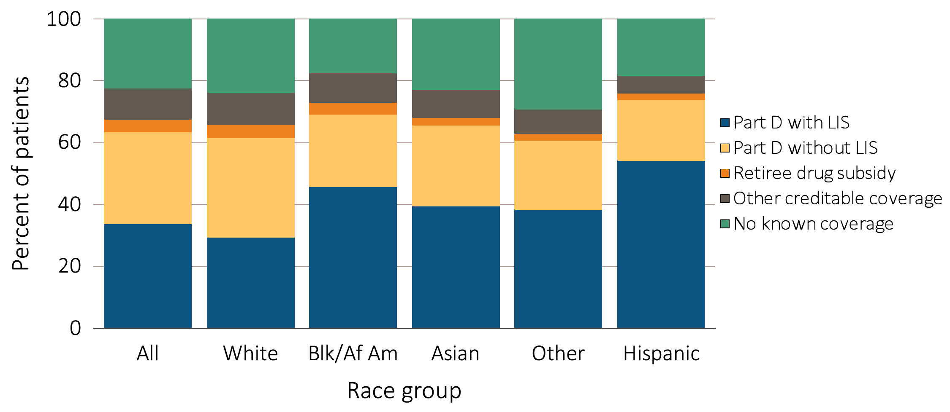
Figure 12.3 Sources of prescription drug coverage in Medicare ESRD enrollees,
by race/ethnicity & modality, 2013
^{(b) Transplant Patients}
Data source: 2013 Medicare Data, point prevalent Medicare enrollees alive on January 1, 2013. Abbreviations: Blk/Af Am, Black or African American; ESRD, end-stage renal disease; LIS, Low-income Subsidy; Part D, Medicare Part D prescription drug coverage.

Slide 7
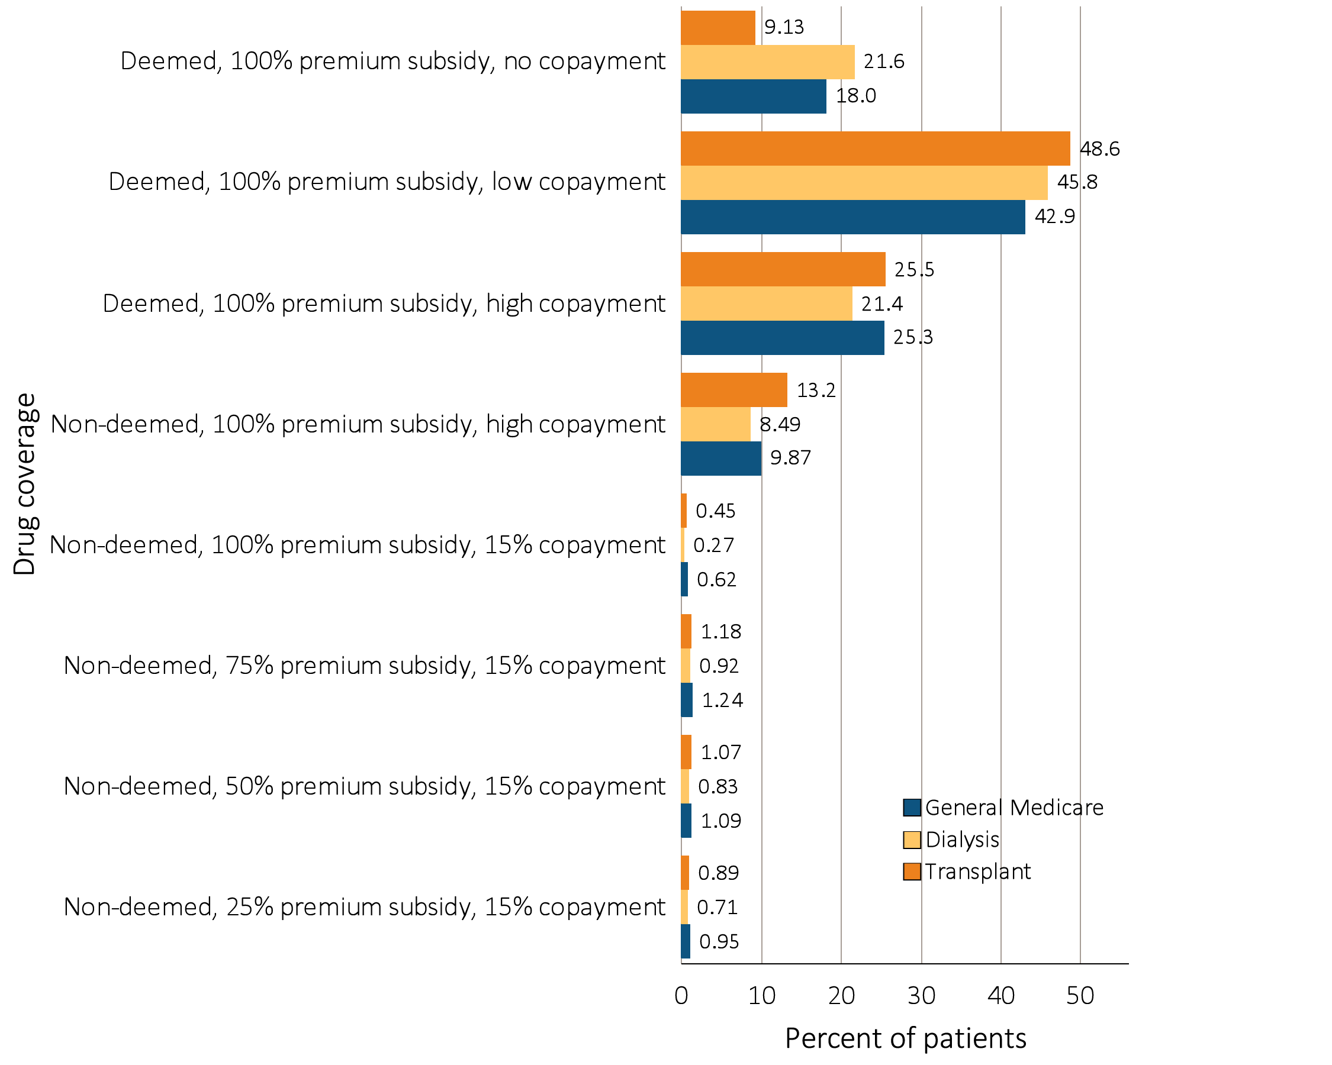
Figure 12.4 Distribution of Low-income Subsidy categories in Part D
general Medicare & ESRD patients, 2013
Data source: 2013 Medicare data, point prevalent Medicare enrollees alive on January 1, 2013. Abbreviations: ESRD, end-stage renal disease; Part D, Medicare Part D prescription drug coverage.

Slide 8
Table 12.1 Medicare Part D enrollees (%) with or without the Low-income Subsidy, by age & race, 2013
 | General Medicare |  | All ESRD |  | Hemodialysis |  | Peritoneal dialysis |  | Transplant
 | Part D with LIS | Part D without LIS | Part D with LIS | Part D without LIS | Part D with LIS | Part D without LIS | Part D with LIS | Part D without LIS | Part D with LIS | Part D without LIS
White
All ages | 26.0 | 74.0 | 55.1 | 44.9 | 58.6 | 41.4 | 49.1 | 50.9 | 47.8 | 52.2
20-44 | 88.9 | 11.1 | 87.8 | 12.2 | 91.0 | 9.0 | 88.4 | 11.6 | 82.4 | 17.6
45-64 | 52.3 | 47.7 | 70.1 | 30.0 | 75.5 | 24.5 | 63.4 | 36.6 | 56.9 | 43.1
65-74 | 15.5 | 84.6 | 40.6 | 59.4 | 48.6 | 51.4 | 25.2 | 74.8 | 22.1 | 78.0
75+ | 20.4 | 79.6 | 34.8 | 65.2 | 37.6 | 62.4 | 17.3 | 82.7 | 18.6 | 81.4
Black/Af Am
All ages | 59.8 | 40.2 | 75.0 | 25.0 | 76.7 | 23.3 | 71.9 | 28.1 | 66.0 | 34.0
20-44 | 93.6 | 6.5 | 92.0 | 8.0 | 93.7 | 6.3 | 91.4 | 8.6 | 86.0 | 14.0
45-64 | 75.3 | 24.7 | 80.2 | 19.8 | 82.6 | 17.4 | 73.8 | 26.2 | 68.8 | 31.2
65-74 | 43.7 | 56.3 | 60.4 | 39.6 | 64.1 | 35.9 | 42.7 | 57.4 | 41.6 | 58.4
75+ | 52.0 | 48.0 | 61.1 | 38.9 | 62.7 | 37.4 | 36.7 | 63.3 | 41.7 | 58.3
Other race
All ages | 59.3 | 40.7 | 71.4 | 28.6 | 75.8 | 24.2 | 60.4 | 39.6 | 60.9 | 39.1
20-44 | 87.5 | 12.5 | 87.3 | 12.7 | 90.8 | 9.2 | 84.8 | 15.2 | 80.8 | 19.3
45-64 | 62.1 | 37.9 | 75.6 | 24.4 | 80.4 | 19.6 | 62.0 | 38.0 | 66.0 | 34.0
65-74 | 49.9 | 50.1 | 61.5 | 38.5 | 68.2 | 31.8 | 42.6 | 57.4 | 47.6 | 52.5
75+ | 63.6 | 36.4 | 68.3 | 31.7 | 71.8 | 28.2 | 54.8 | 45.2 | 44.9 | 55.2
Data source: 2013 Medicare data, point prevalent Medicare enrollees alive on January 1, 2013. Abbreviations: ESRD, end-stage renal disease; LIS, Low-income Subsidy; Part D, Medicare Part D prescription drug coverage.

Slide 9
Table 12.2 Medicare Part D parameters for defined standard benefit, 2008 & 2013
 | 2008 | 2013
Deductible | $275 | $325
After the deductible is met, the beneficiary pays 25% of total prescription costs up to the initial coverage limit.
Initial coverage limit | $2,510 | $2,970
The coverage gap (“donut hole”) begins at this point.
The beneficiary pays 100% of their prescription costs up to the out-of-pocket threshold
Out-of-pocket threshold | $4,050 | $4,750
The total out-of-pocket costs including the “donut hole”
Total covered Part D prescription out-of-pocket spending: | $5,726.25 | $6,733.75
(including the coverage gap). Catastrophic coverage begins after this point.
Catastrophic coverage benefit
Generic/preferred multi-source drug | $2.25 | $2.65¹
Other drugs | $5.60 | $6.60¹
¹plus a 52.50% brand name medication discount
2013Example:
$325 (deductible) | $275 | $325
+(($$2970-$325)*25%)(initial coverage) | $558.75 | $652.50
+(($6733.75-$2970)*100%)(coverage gap) | $3,216.25 | $3,763.75
Total | $4,050.00 | $4,750.00
(maximum out-of-pocket costs prior to catastrophic coverage, excluding plan premium)
The catastrophic coverage amount is the greater of 5% of medication cost or the values shown in the chart above. In 2013, beneficiaries were charged $2.65 for those generic or preferred multisource drugs with a retail price less than $53 and 5% for those with a retail price over $53. For brand name drugs, beneficiaries paid $6.60 for those drugs with a retail price less than $132 and 5% for those with a retail price over $132.Table adapted from http://www.q1medicare.com/PartD-The-2013-Medicare-Part-D-Outlook.php.

Slide 10
Table 12.3 General Medicare & ESRD patients enrolled in Part D (%)
 | General Medicare | All ESRD | Hemodialysis | Peritoneal dialysis | Transplant
2011 | 61.01 | 68.93 | 73.17 | 61.83 | 57.15
2013 | 68.68 | 74.21 | 78.23 | 67.31 | 63.46
Data source: 2011 and 2013 Medicare data, point prevalent Medicare enrollees alive on January 1. Medicare data: general Medicare, 5% Medicare sample (ESRD, hemodialysis, peritoneal dialysis, and transplant, 100% ESRD population). Abbreviations: ESRD, end-stage renal disease; Part D, Medicare Part D prescription drug coverage.

Slide 11
Table 12.4 Total estimated Medicare Part D costs for enrollees, in billions, 2011 & 2013
 | General Medicare | All ESRD | Hemodialysis | Peritoneal dialysis | Transplant
2011 | 46.49 | 1.80 | 1.45 | 0.10 | 0.22
2013 | 52.75 | 2.30 | 1.83 | 0.14 | 0.27
Data source: 2011 and2013 Medicare data, period prevalent Medicare enrollees alive on January 1, excluding those in Medicare Advantage Part D plans and Medicare secondary payer, using as-treated model (see ESRD Methods chapter for analytical methods).

Slide 12
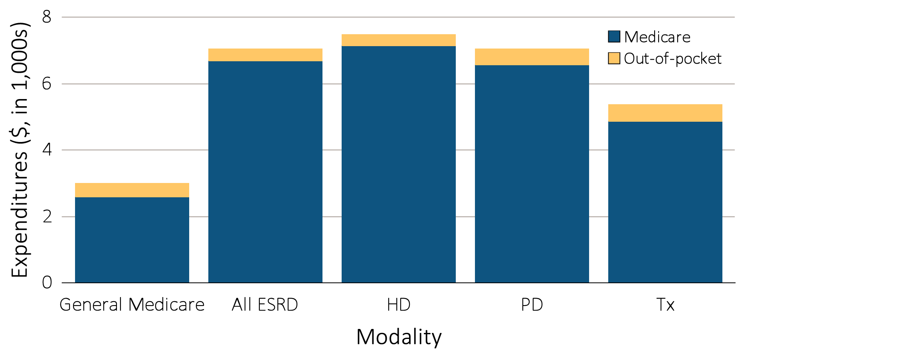
Figure 12.5 Per person per year Medicare & out-of-pocket Part D costs for enrollees, 2013
^{(a) All Part D enrollees}
Data source: 2013 Medicare data, period prevalent Medicare enrollees alive on January 1, 2013, excluding those in Medicare Advantage Part D plans and Medicare secondary payer, using as-treated model (see ESRD Methods chapter for analytical methods).

Slide 13
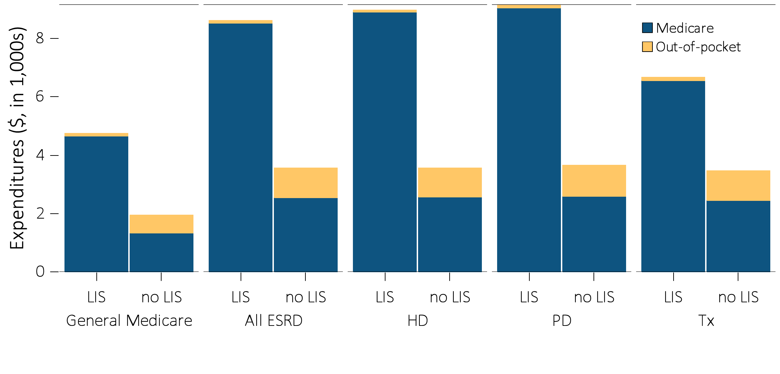
Figure 12.5 Per person per year Medicare & out-of-pocket Part D costs for enrollees, 2013
(b) Part D enrollees by Low-income Subsidy status
Data source: 2013 Medicare data, period prevalent Medicare enrollees alive on January 1, 2013, excluding those in Medicare Advantage Part D plans and Medicare secondary payer, using as-treated model (see ESRD Methods chapter for analytical methods).

Slide 14
Table 12.5 Per person per year Part D costs ($) for enrollees,
by Low-income Subsidy status, 2013
Data source: 2013 Medicare data, period prevalent Medicare enrollees alive on January 1, 2013, excluding those in Medicare Advantage Part D plans and Medicare secondary payer, using as-treated model (see ESRD Methods chapter for analytical methods).

Slide 15
Table 12.6 Common drug classes used by Part D-enrolled dialysis patients,
by percent of patients, drug class, and net cost, 2013
 | Percent of patients (%) | Net costs ($)
Calcimimetic agents | 29.1 | 407,140,771
Statins | 46.0 | 21,788,139
Calcium channel blockers | 46.2 | 15,096,030
Phosphate binder agents | 72.5 | 692,085,189
Beta blockers | 65.3 | 18,672,865
Angiotensin II receptor blockers | 43.5 | 23,391,588
Data source: 2013 Medicare data, period prevalent Medicare enrollees alive on January 1, 2013, excluding those in Medicare Advantage Part D plans and Medicare secondary payer, using as-treated model (see ESRD Methods chapter for analytical methods).

