Slide 2
Table 2.1 Demographic characteristics of all patients, among Medicare (aged 65+ years) and Clinformatics™ (all ages) patients, 2014
 | Medicare 5% |  |  | Clinformatics™
 | Sample count | (%) |  | Sample count | (%)
All | 1,276,732 | 100% |  | 6,445,818 | 100%
Age
<4 | - | - |  | 281,307 | 4.4
5-9 | - | - |  | 412,438 | 6.4
10-13 | - | - |  | 357,248 | 5.5
14-17 | - | - |  | 373,678 | 5.8
18-21 | - | - |  | 367,539 | 5.7
22-30 | - | - |  | 798,922 | 12.4
31-40 | - | - |  | 1,043,124 | 16.2
41-50 | - | - |  | 1,131,850 | 17.6
51-65 | - | - |  | 1,444,158 | 22.4
65-74 | 712,995 | 55.9 |  | 179,303 | 2.8
75-84 | 392,923 | 30.8 |  | 39,673 | 0.6
85+ | 170,814 | 13.4 |  | 16,578 | 0.3
Sex
Male | 554,559 | 43.4 |  | 3,279,378 | 50.9
Female | 722,173 | 56.6 |  | 3,165,945 | 49.1
Race/Ethnicity
White | 1,095,736 | 85.8 |  | 4,469,440 | 69.7
Black/African American | 96,565 | 7.6 |  | 556,682 | 8.7
Native American | 5,407 | 0.4
Asian | 24,606 | 1.9 |  | 334,804 | 5.2
Hispanic | - | - |  | 707,399 | 11.0
Other | 42,846 | 3.4
Unknown/Missing | 11,572 | 0.9 |  | 341,121 | 5.3
Comorbidity
DM | 302,155 | 23.7 |  | 281,945 | 4.4
HTN | 753,286 | 59.0 |  | 663,987 | 10.3
CVD | 497,773 | 39.0 |  | 286,632 | 4.5
Data Source: Special analyses, Medicare 5% sample (aged 65 and older) and Clinformatics™ (all ages) alive & eligible for all of 2014. Abbreviations: CKD, chronic kidney disease; CVD, cardiovascular disease; DM, diabetes mellitus; HTN, hypertension. CVD is defined as presence of any of the following comorbidities: cerebrovascular accident, peripheral vascular disease, atherosclerotic heart disease, congestive heart failure, dysrhythmia or other cardiac comorbidities. - No available data.

Slide 3
Table 2.2 Prevalence of coded comorbid conditions (CKD, CVD & DM), (a) total, and (b) one or more, among Medicare (aged 65+ years) and Clinformatics™ (aged 22-64 years) patients, 2014
Any diagnosis of CKD, CVD, or DM
 | Medicare 5% |  |  | Clinformatics™
 | Sample count | % |  | Sample count | %
 | 1,276,732 | 100% |  | 4,418,054 | 100%
Total CKD | 141,001 | 11.0 |  | 40,774 | 0.9
Total CVD | 497,773 | 39.0 |  | 213,093 | 4.8
Total DM | 302,155 | 23.7 |  | 234,456 | 5.3
Combinations of CKD, CVD, or DM diagnoses
 | Medicare 5% |  |  | Clinformatics™
 | Sample count | % |  | Sample count | %
 | 1,276,732 | 100% |  | 4,418,054 | 100%
Only CKD | 23,811 | 1.9 |  | 19,758 | 0.4
Only CVD | 282,930 | 22.2 |  | 169,514 | 3.8
Only DM | 117,872 | 9.2 |  | 186,038 | 4.2
CKD & DM, no CVD | 18,506 | 1.4 |  | 10,455 | 0.2
CKD & CVD, no DM | 49,066 | 3.8 |  | 5,616 | 0.1
DM & CVD, no CKD | 116,159 | 9.1 |  | 33,018 | 0.7
CKD & CVD & DM | 49,618 | 3.9 |  | 4,945 | 0.1
No CKD, no CVD, no DM | 618,770 | 48.5 |  | 3,988,710 | 90.3
Data Source: Special analyses, Medicare 5% sample (aged 65 and older) and Clinformatics™ (aged 22-64), alive & eligible for all of 2014. Abbreviations: CKD, chronic kidney disease; CVD, cardiovascular disease; DM, diabetes mellitus. CVD is defined as presence of any of the following comorbidities: cerebrovascular accident, peripheral vascular disease, atherosclerotic heart disease, congestive heart failure, dysrhythmia or other cardiac comorbidities.

Slide 4
Table 2.3 Prevalence of CKD, by demographic characteristics and comorbidities, among Medicare 5% sample (aged 65+ years) and Optum (all ages) patients, 2014
 | Prevalence of CKD
 | Medicare 5% | Clinformatics™
Overall | 11.0 | 0.9
Age
< 4 | - | 0.3
5-9 | - | 0.1
10-13 | - | 0.1
14-17 | - | 0.1
18-21 | - | 0.2
22-30 | - | 0.2
31-40 | - | 0.4
41-50 | - | 0.8
51-65 | - | 1.8
65-74 | 7.5 | 4.4
75-84 | 14.1 | 9.6
85+ | 18.9 | 13.2
Sex
Male | 12.1 | 1.0
Female | 10.2 | 0.8
Race/Ethnicity
White | 10.7 | 0.9
Black/African American | 16.0 | 1.2
Native American | 11.7 | -
Asian | 11.7 | 0.5
Hispanic | - | 0.8
Other/Unknown | 9.8 | 0.8
Comorbidity
DM – Yes | 22.5 | 7.8
DM – No | 7.5 | 0.6
HTN – Yes | 17.2 | 5.8
HTN – No | 2.1 | 0.3
CVD – Yes | 19.8 | 6.5
CVD – No | 5.4 | 0.6
Data Source: Special analyses, Medicare 5% sample (aged 65 and older) and Optum (aged 22-64), alive & eligible for all of 2014. Abbreviations: CKD, chronic kidney disease; CVD, cardiovascular disease; DM, diabetes mellitus; HTN, hypertension. CVD is defined as presence of any of the following comorbidities: cerebrovascular accident, peripheral vascular disease, atherosclerotic heart disease, congestive heart failure, dysrhythmia or other cardiac comorbidities. - No available data.

Slide 5
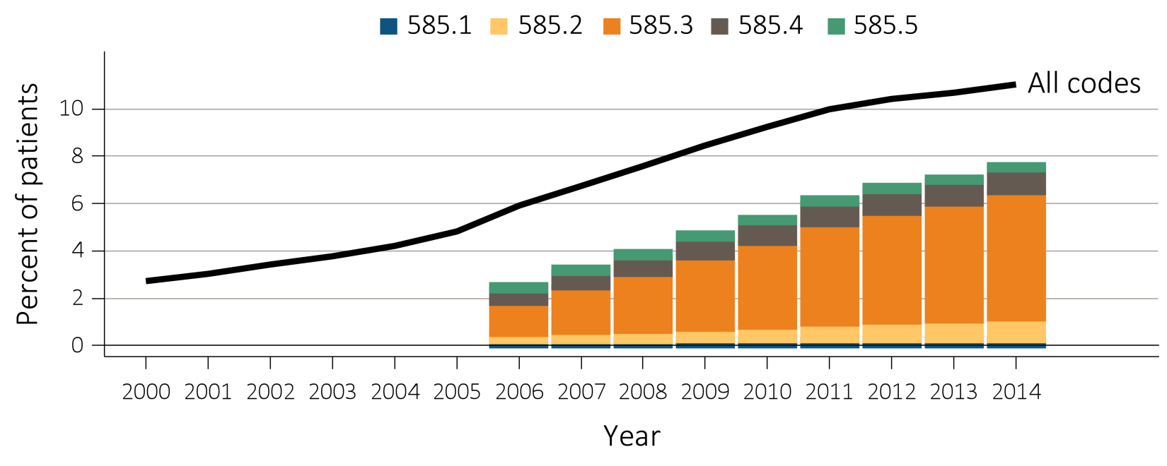
Figure 2.1 Trends in prevalence of recognized CKD, overall and by CKD stage, among Medicare patients (aged 65+ years), 2000-2014
Data Source: Special analyses, Medicare 5% sample. Known CKD stages presented as bars; curve showing “All codes” includes known CKD stages (codes 585.1-585.5) and the CKD-stage unspecified codes (585.9, and remaining non-585 CKD codes). Note: In previous years, this graph reported 585.9 codes as a component of the stacked bars. Abbreviation: CKD, chronic kidney disease.

Slide 6
Table 2.4 Percent of patients with CKD by demographic characteristics, among individuals (aged 65+ years) overall and with DM, or HTN, in NHANES (2011-2014), Medicare 5% sample (2014) and VA (2014) datasets
 | Overall |  |  |  |  | DM (with or without HTN) |  |  |  |  | HTN (No DM)
 | NHANES | Medicare | VA |  |  | NHANES | Medicare | VA |  |  | NHANES | Medicare | VA
 | CKD eGFR | CKD code | CKD code | CKD eGFR |  | CKD eGFR | CKD code | CKD code | CKD eGFR |  | CKD eGFR | CKD code | CKD code | CKD eGFR
Age
65-74 | 28.1 | 7.5 | 3.1 | 14.3 |  | 46.0 | 18.4 | 7.2 | 23.8 |  | 32.1 | 8.7 | 4.6 | 17.2
75-79 | 46.0 | 14.1 | 4.2 | 26.0 |  | 57.4 | 25.9 | 10.3 | 40.3 |  | 44.1 | 14.8 | 7.5 | 32.8
80+ | 61.8 | 18.9 | 5.2 | 35.7 |  | 80.1 | 30.8 | 13.1 | 53.3 |  | 63.6 | 20.9 | 11.9 | 49.5
Race |  |  |  |  |  |  |  |  |  |  |  | .
White | 38.6 | 10.7 | 3.6 | 22.9 |  | 55.2 | 22.0 | 8.3 | 33.1 |  | 44.1 | 12.8 | 6.7 | 29.1
Black/African American | 45.0 | 16.0 | 7.6 | 22.6 |  | 63.5 | 26.8 | 13.2 | 31.4 |  | 40.6 | 16.8 | 10.5 | 26.5
Native American | - | 11.7 | 3.4 | 17.9 |  | - | 23.1 | 7.9 | 27.9 |  | - | 12.3 | 5.5 | 21.7
Asian | - | 11.7 | 4.2 | 14.8 |  | - | 20.8 | 10.6 | 25.7 |  | - | 12.8 | 8.1 | 22.1
Other/Unknown | 37.8 | 9.7 | 2.3 | 19.1 |  | 50.5 | 21.1 | 7.8 | 33.6 |  | 39.5 | 11.2 | 6.7 | 31.1
Sex
Male | 37.3 | 12.1 | 3.9 | 22.5 |  | 49.8 | 24.3 | 9.0 | 32.8 |  | 41.4 | 15.0 | 7.2 | 28.8
Female | 40.3 | 10.2 | 2.1 | 18.9 |  | 61.1 | 21.1 | 6.8 | 34.8 |  | 44.7 | 11.8 | 5.0 | 31.0
All | 38.6 | 11.0 | 3.8 | 22.4 |  | 55.3 | 22.5 | 8.9 | 32.8 |  | 43.3 | 13.1 | 7.2 | 28.9
Data Source: Special analyses, Medicare 5% sample, aged 65 and older alive & eligible for all of 2014. NHANES 2011-2014 participants, aged 65 and older and VA aged 65 and older alive & eligible for all of 2014. The numerator for CKD by ICD-9 diagnosis codes included at least one inpatient ICD-9 diagnosis or two outpatient diagnosis in 2014; the numerator for CKD based on eGFR<60 ml/min/1.73m2 included anyone with at least one outpatient serum creatinine available in 2014; eGFR was calculated using the CKD-EPI formula; if more than one values were available, the last one in the year was used. The denominator included everyone with at least one outpatient visit in 2014. Abbreviations: CKD, chronic kidney disease; DM, diabetes mellitus; HTN, hypertension; VA, Veterans Affairs. * Values for cells with 10 or fewer patients are suppressed. - No available data.

Slide 7
Table 2.5 Change in CKD status from 2009 to 2014, among Medicare patients (aged 65+ years) alive and without ESRD in 2009
2013-2014 Status
 |  |  | No CKD diagnosis | CKD Stage 1 | CKD Stage 2 | CKD Stage 3 | CKD Stage 4 | CKD Stage 5 | CKD Stage-unspecified | ESRD alive | ESRD death | Death without ESRD | Lost to follow-up | Total N
2009 Status | No CKD diagnosis | row % | 56.8 | 0.2 | 0.8 | 4.1 | 0.5 | 0.1 | 3.6 | 0.1 | 0.1 | 21.6 | 12.1 | 1,112,300
 | CKD Stage 1 | row % | 18.5 | 5.1 | 4.0 | 15.0 | 2.6 | 0.6 | 6.4 | 1.1 | 1.4 | 36.2 | 9.2 | 2,620
 | CKD Stage 2 | row % | 15.2 | 1.0 | 9.9 | 20.5 | 2.6 | 0.5 | 6.0 | 0.8 | 0.9 | 33.9 | 8.8 | 6,150
 | CKD Stage 3 | row % | 8.3 | 0.4 | 1.8 | 27.1 | 5.8 | 0.6 | 4.1 | 1.9 | 2.1 | 40.1 | 7.9 | 36,419
 | CKD Stage 4 | row % | 2.6 | 0.2 | 0.5 | 8.1 | 11.4 | 1.5 | 2.0 | 7.5 | 9.4 | 51.1 | 5.8 | 9,657
 | CKD Stage 5 | row % | 7.1 | 0.4 | 0.7 | 6.8 | 3.0 | 1.5 | 3.8 | 8.0 | 10.7 | 52.5 | 5.6 | 2,581
 | CKD Stage-unspecified | row % | 19.6 | 0.5 | 1.5 | 10.5 | 2.4 | 0.4 | 10.9 | 0.7 | 0.9 | 45.0 | 7.8 | 45,246
 | Any CKD | row % | 13.4 | 0.6 | 2.0 | 16.8 | 4.5 | 0.6 | 7.0 | 2.0 | 2.4 | 43.1 | 7.7 | 102,673
 | Total | row % | 53.1 | 0.2 | 0.9 | 5.2 | 0.9 | 0.2 | 3.9 | 0.2 | 0.3 | 23.4 | 11.7
 |  | Total N | 645,589 | 2,809 | 10,786 | 63,087 | 10,287 | 2,001 | 46,862 | 3,385 | 3,757 | 284,435 | 141,975 | 1,214,973
Data Source: Special analyses, Medicare 5% sample. Patients alive & eligible for all of 2009. Death and ESRD status were examined yearly between 2010-2014, and carried forward if present. Among patients without death or ESRD by 2014 the last CKD diagnosis claim was used; if not available, then the last CKD diagnosis claim from 2013 was used. Lost to follow-up represents the patients who are not enrolled in Medicare Part A and Part B in 2013 or 2014. Abbreviations: CKD, chronic kidney disease; ESRD, end-stage renal disease.

Slide 8
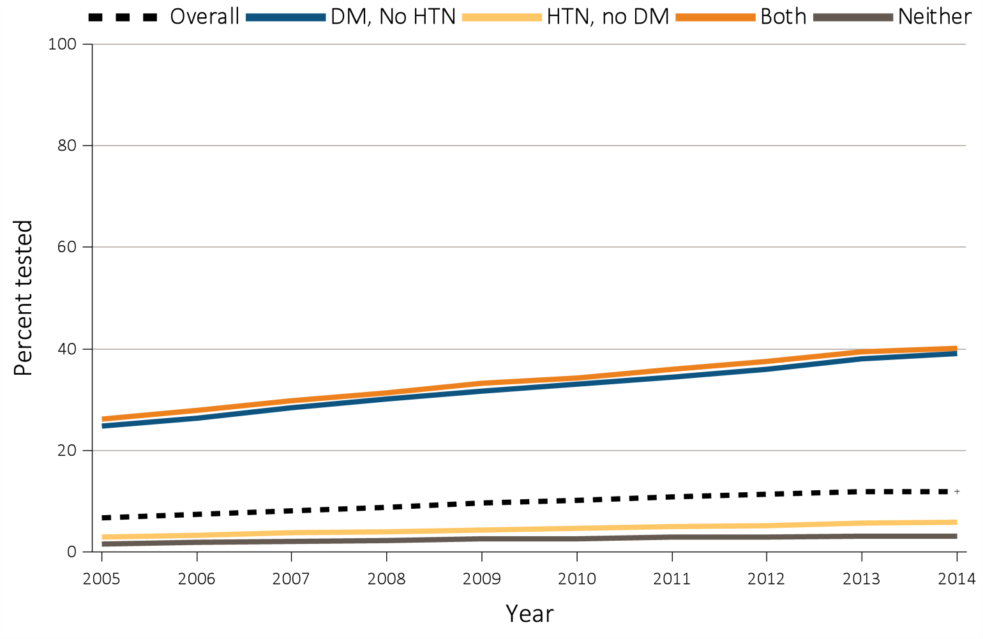
Figure 2.2 Trends in percent of patients with testing of urine albumin (a) in Medicare 5% sample (aged 65+ years) & (b) Clinformatics™ (aged 22-64 years) patients without a diagnosis of CKD by year, 2005-2014
Medicare 5%
Data Source: Special analyses, Medicare 5% sample, aged 65 and older with Part A & B coverage in the prior year and Clinformatics™ patients, aged 22-64 years. Tests tracked during each year. Abbreviations: CKD, chronic kidney disease; DM, diabetes mellitus; HTN, hypertension.

Slide 9
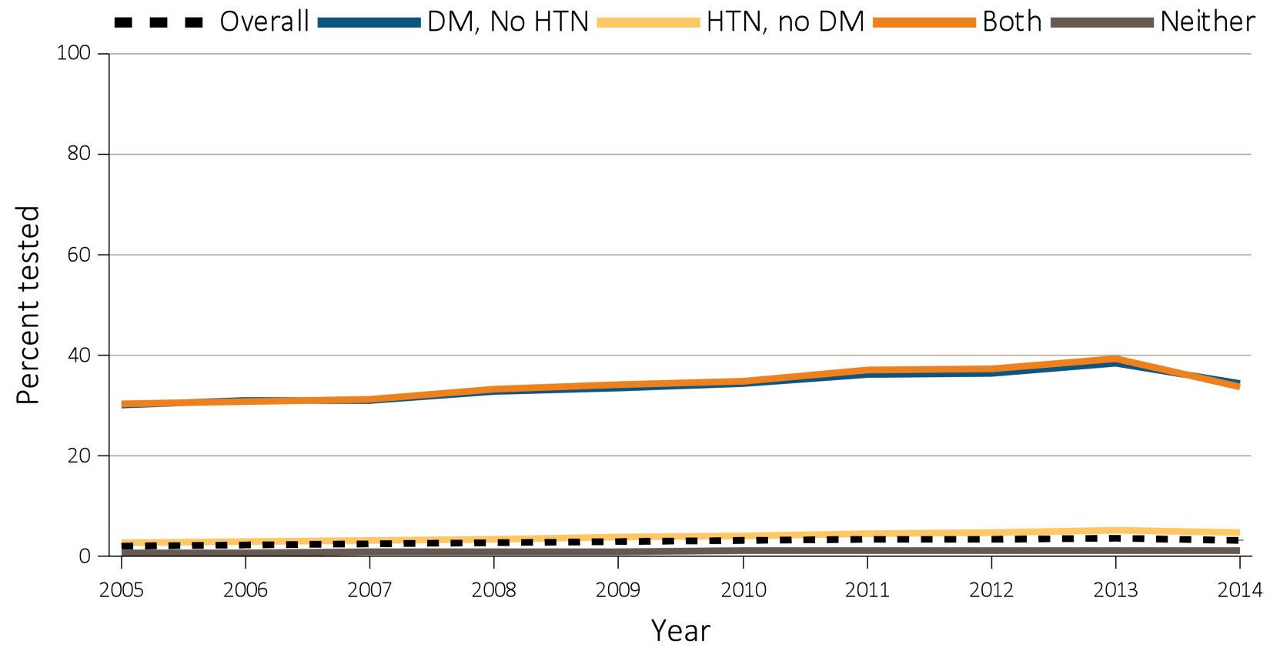
Figure 2.2 Trends in percent of patients with testing of urine albumin (a) in Medicare 5% sample (aged 65+ years) & (b) Clinformatics™ (aged 22-64 years) patients without a diagnosis of CKD by year, 2005-2014
b) Clinformatics™
Data Source: Special analyses, Medicare 5% sample, aged 65 and older with Part A & B coverage in the prior year and Clinformatics™ patients, aged 22-64 years. Tests tracked during each year. Abbreviations: CKD, chronic kidney disease; DM, diabetes mellitus; HTN, hypertension.

Slide 10
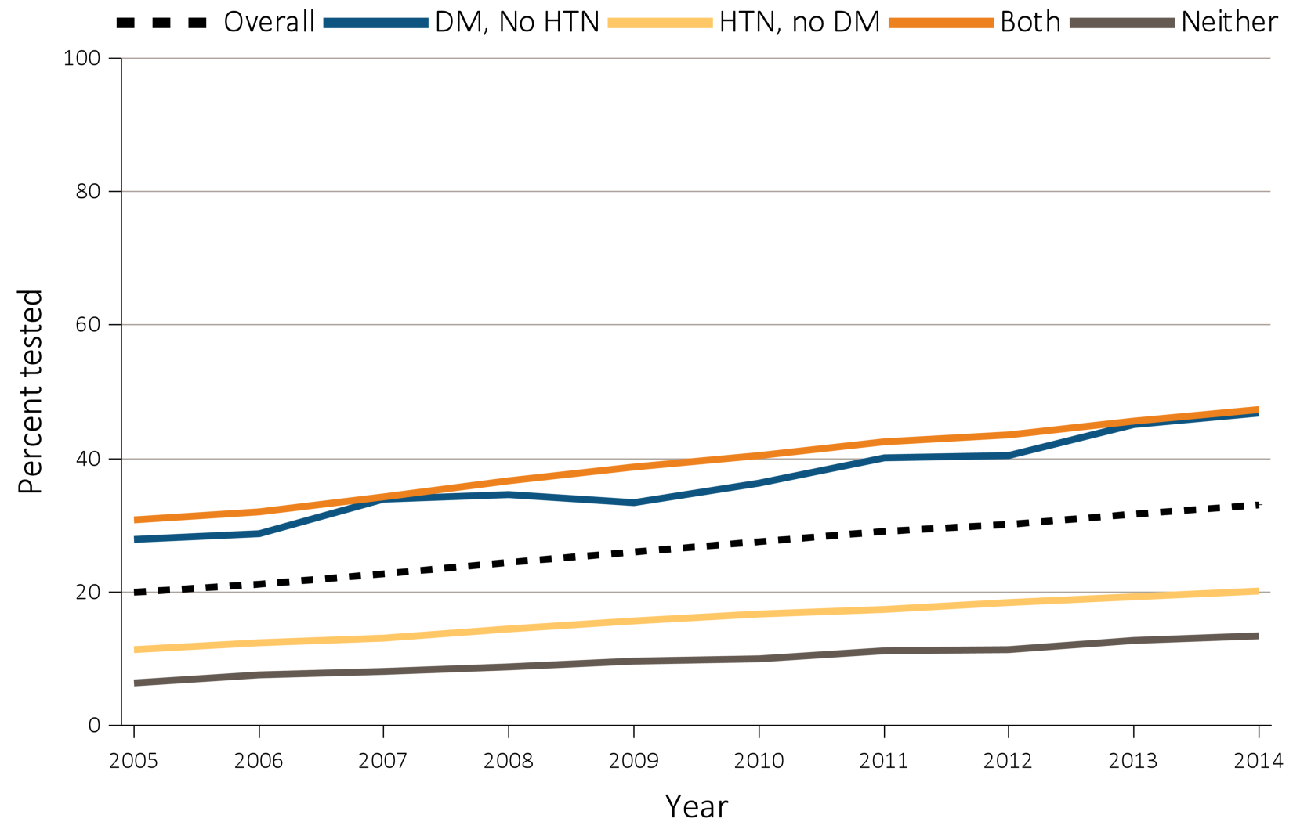
Figure 2.3 Trends in percent of patients with testing of urine albumin in (a) Medicare 5% (aged 65+ years) & (b) Clinformatics™ (aged 22-64 years) patients with a diagnosis of CKD by year, 2005-2014
Data Source: Special analyses, Medicare 5% sample, aged 65 and older with Part A & B coverage in the prior year and Clinformatics™ population aged 22-64 years old. Tests tracked during each year. Abbreviations: CKD, chronic kidney disease; DM, diabetes mellitus; HTN, hypertension.

Slide 11
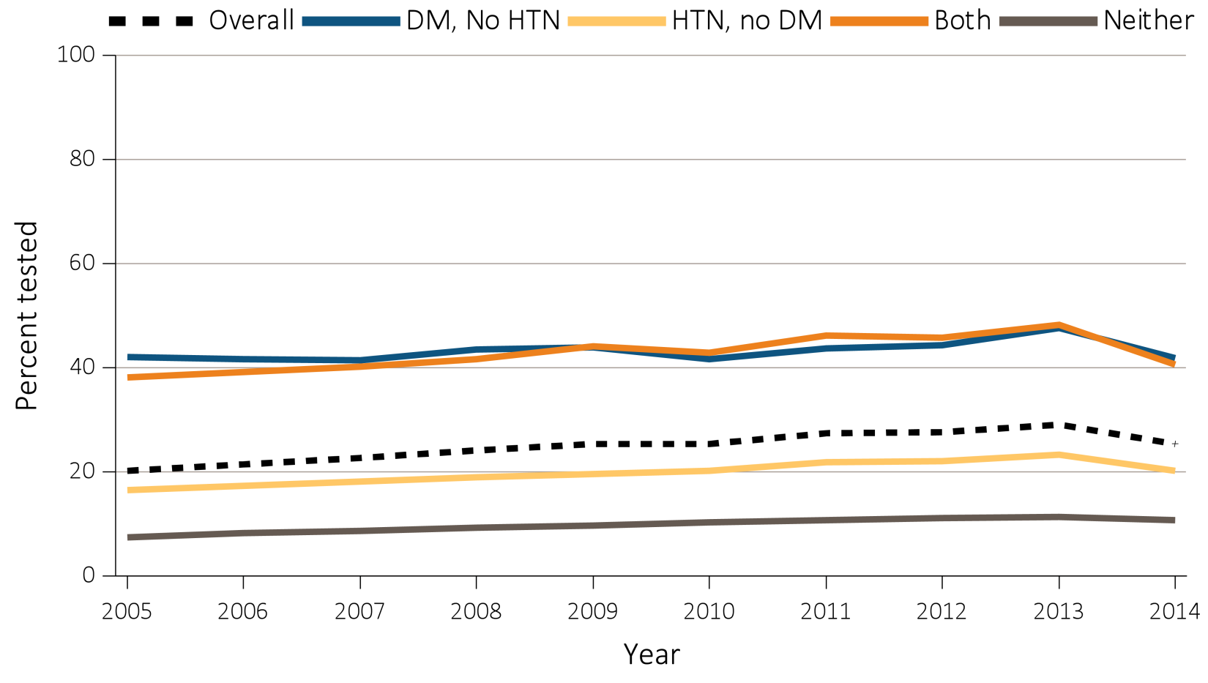
Figure 2.3 Trends in percent of patients with testing of urine albumin in (a) Medicare 5% (aged 65+ years) & (b) Clinformatics™ (aged 22-64 years) patients with a diagnosis of CKD by year, 2005-2014
b) Clinformatics™
Data Source: Special analyses, Medicare 5% sample, aged 65 and older with Part A & B coverage in the prior year and Clinformatics™ population aged 22-64 years old. Tests tracked during each year. Abbreviations: CKD, chronic kidney disease; DM, diabetes mellitus; HTN, hypertension.

Slide 12
Table 2.6 Percent of patients with a physician visit in 2014 after a CKD diagnosis in 2013, among Medicare 5% patients (aged 65+ years)
 | Any CKD diagnosis |  |  |  | CKD diagnosis code of 585.3 (Stage 3) |  |  |  | CKD diagnosis code of 585.4 (Stage 4) or higher
 | Primary care | Cardiologist | Nephrologist |  | Primary care | Cardiologist | Nephrologist |  | Primary care | Cardiologist | Nephrologist
Age
65-74 | 88.8 | 54.3 | 31.6 |  | 89.2 | 53.7 | 53.0 |  | 80.5 | 48.1 | 70.5
75-84 | 92.1 | 63.2 | 30.7 |  | 92.1 | 61.9 | 46.6 |  | 84.3 | 54.8 | 68.4
85+ | 93.6 | 64.3 | 24.0 |  | 93.3 | 62.9 | 34.1 |  | 86.7 | 53.7 | 55.0
Sex
Male | 91.1 | 59.8 | 28.9 |  | 91.5 | 59.1 | 45.7 |  | 83.7 | 52.5 | 66.1
Female | 91.1 | 59.8 | 35.5 |  | 90.9 | 59.1 | 52.5 |  | 83.2 | 50.9 | 66.8
Race
White | 89.5 | 53.0 | 28.9 |  | 88.9 | 53.2 | 45.6 |  | 82.0 | 46.6 | 66.0
Black/African American | 91.5 | 56.5 | 28.9 |  | 91.6 | 55.3 | 44.6 |  | 84.6 | 49.1 | 64.6
Asian | 91.2 | 59.7 | 30.4 |  | 91.3 | 59.1 | 48.9 |  | 83.6 | 52.6 | 67.1
Other | 90.5 | 62.4 | 30.5 |  | 91.0 | 62.6 | 48.7 |  | 82.2 | 54.9 | 68.0
Overall | 91.0 | 59.4 | 29.9 |  | 91.3 | 58.7 | 46.7 |  | 90.0 | 63.0 | 66.1
Data Source: Special analyses, Medicare 5% sample (aged 65 and older), alive & eligible for all of 2013.. CKD diagnosis is at date of first CKD claim in 2013; claims for physician visits were searched during the 12 months following that date. CKD diagnosis code of 585.4 or higher represents CKD Stages 4-5. Abbreviation: CKD, chronic kidney disease.

Slide 13
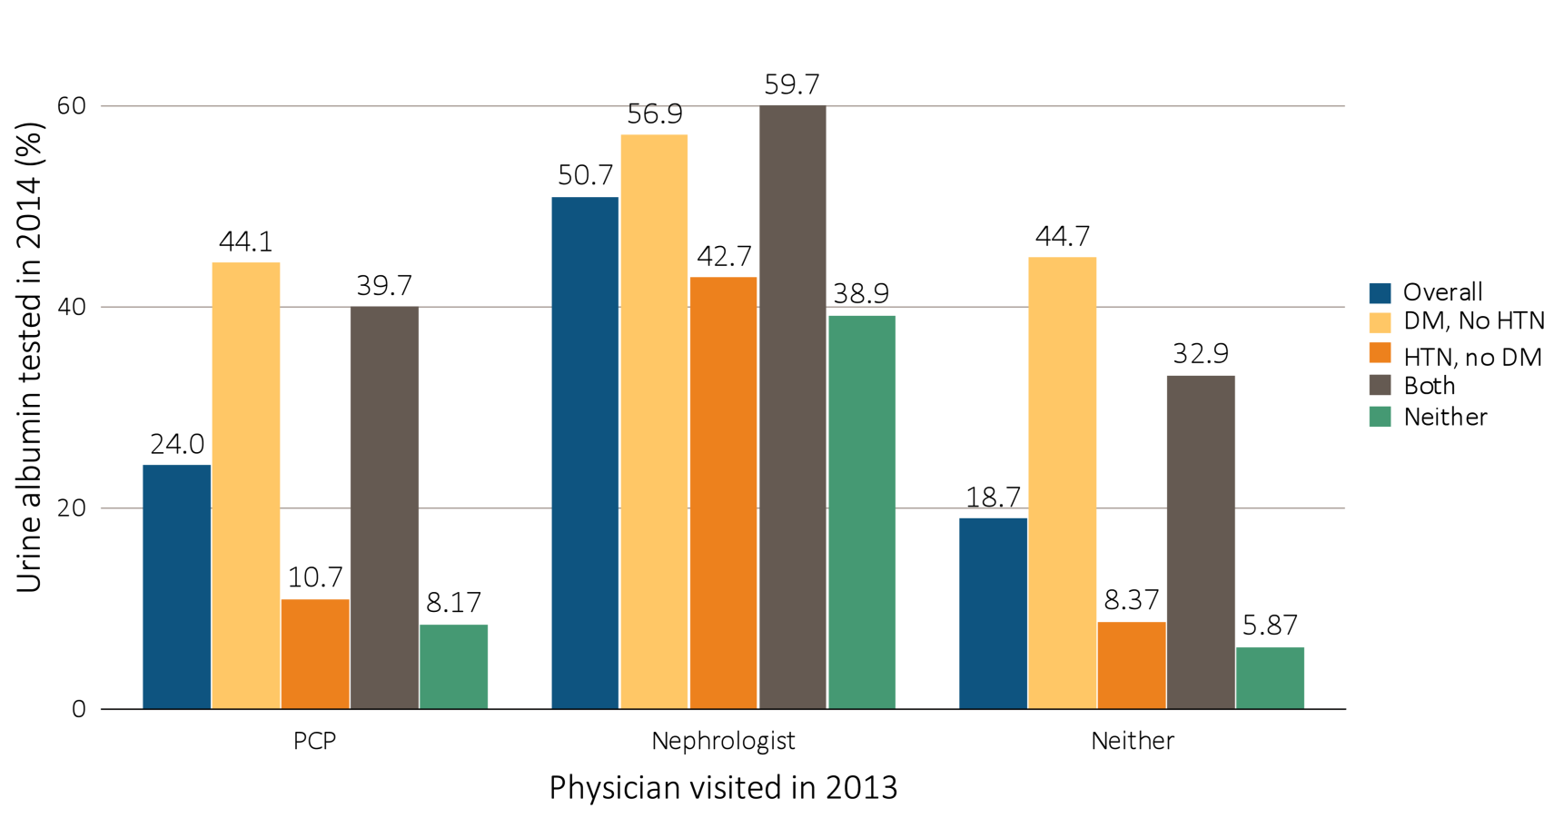
Figure 2.4 Proportion of CKD patients in 2013 with physician visit (nephrologist, PCP, both and neither), with lab testing in the following year (2014), by comorbidity
Data Source: Special analyses, Medicare 5% sample (aged 65 and older), alive & eligible for all of 2014, with a CKD diagnosis claim and a physician visit in 2013. Patients with both PCP and nephrology visits are classified as nephrologist. Abbreviations: CKD, chronic kidney disease; DM, diabetes mellitus; HTN, hypertension; PCP, primary care physician.

