Slide 2
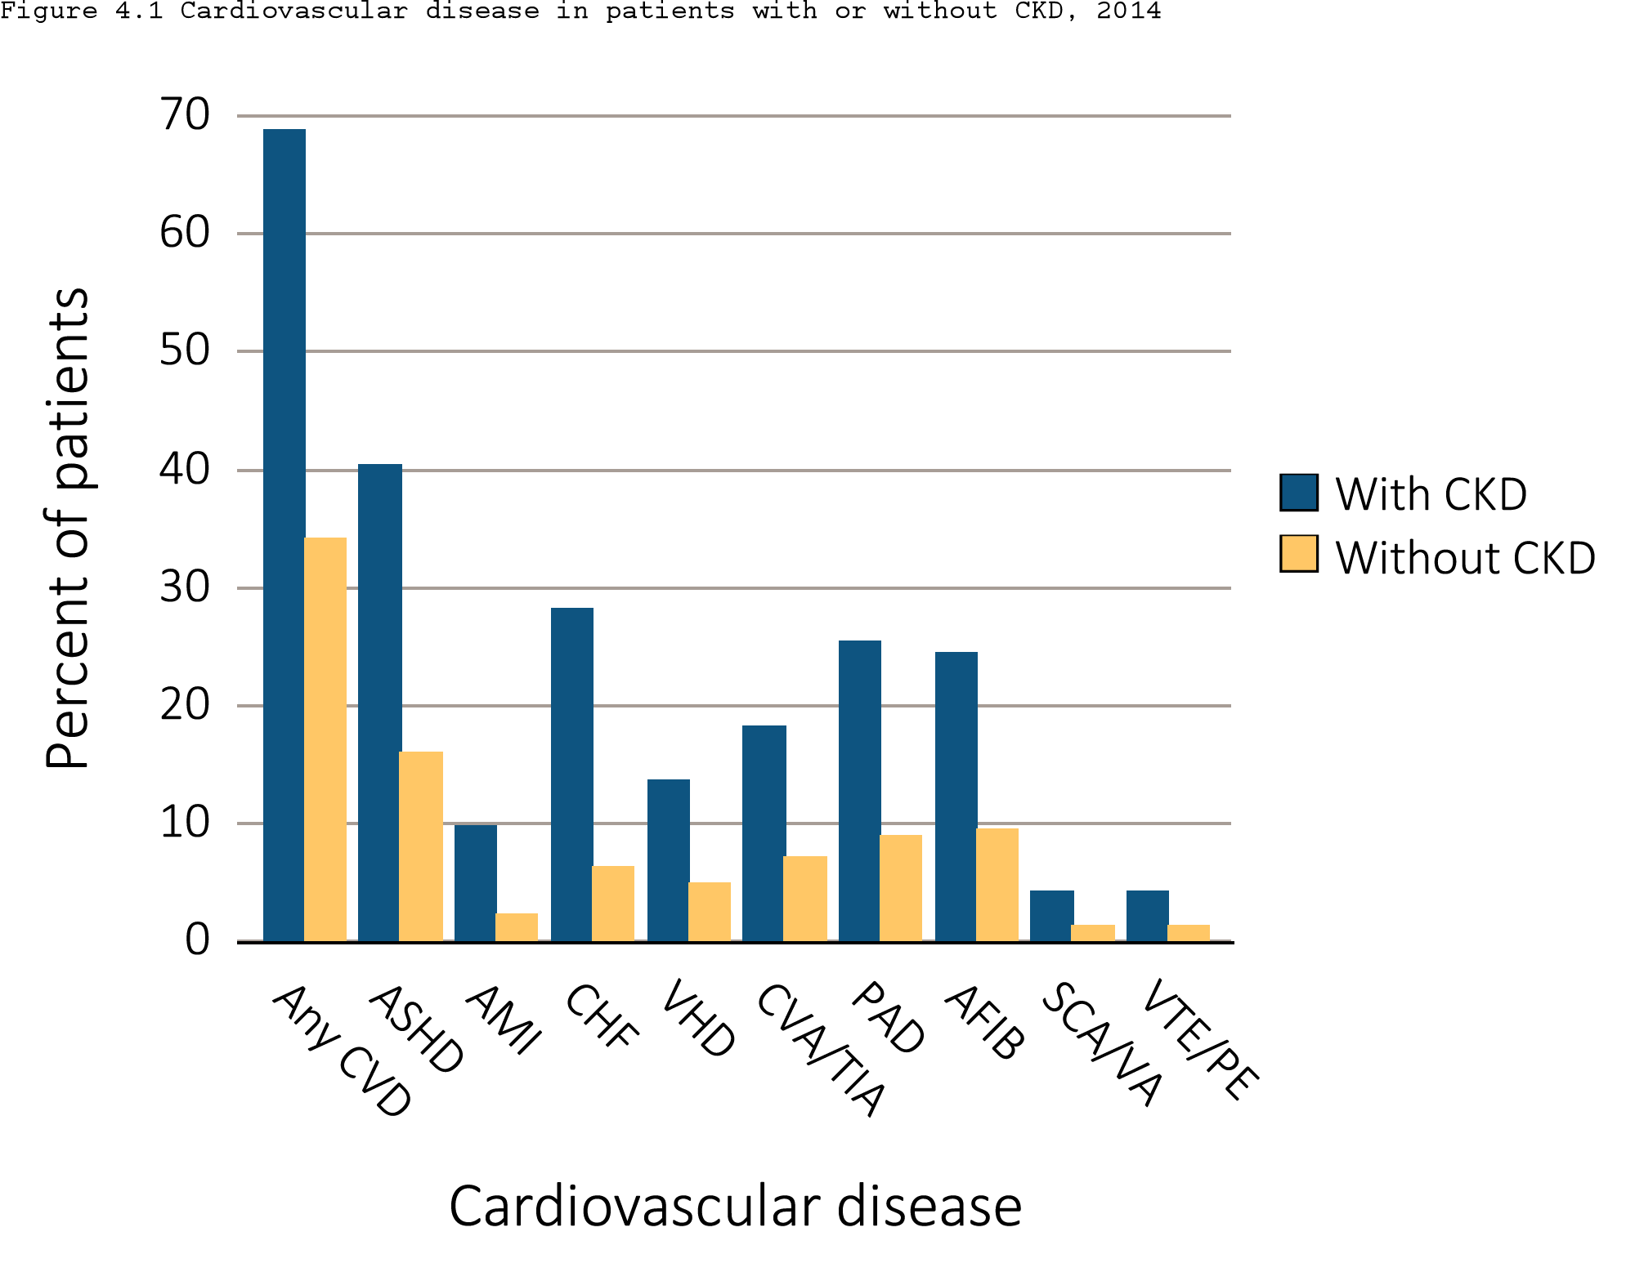
Figure 4.1 Prevalence of cardiovascular diseases in patients with or without CKD, 2014
Data Source: Special analyses, Medicare 5 percent sample. Abbreviations: AFIB, atrial fibrillation; AMI, acute myocardial infarction; ASHD, atherosclerotic heart disease; CHF, congestive heart failure; CKD, chronic kidney disease; CVA/TIA, cerebrovascular accident/transient ischemic attack; CVD, cardiovascular disease; PAD, peripheral arterial disease; SCA/VA, sudden cardiac arrest and ventricular arrhythmias; VHD, valvular heart disease; VTE/PE, venous thromboembolism and pulmonary embolism.

Slide 3
Table 4.1 Prevalence of (a) cardiovascular comorbidities & (b) cardiovascular procedures, (%) by CKD status, age, race, & sex, 2014
Cardiovascular comorbidities
 | # Patients | % Patients
 |  | Overall | 66-69 | 70-74 |  | 75-84 |  | 85+ | White | Blk/Af Am | Other | Male | Female
Any CVD
Without CKD | 1,102,843 | 34.1 | 20.3 | 28.8 | 41.2 |  | 54.4 |  | 35.0 | 30.4 | 25.3 | 37.4 | 31.6
Any CKD | 138,176 | 68.8 | 55.6 | 61.4 | 70.3 |  | 79.1 |  | 69.8 | 64.7 | 61.8 | 72.4 | 65.5
Atherosclerotic heart disease (ASHD)
Without CKD | 1,102,843 | 16.0 | 9.9 | 14.3 |  | 19.7 |  | 22.5 | 16.5 | 12.9 | 12.2 | 21.3 | 11.9
Any CKD | 138,176 | 40.3 | 32.1 | 36.7 |  | 42.6 |  | 44.0 | 41.4 | 33.9 | 36.5 | 47.9 | 33.4
Acute myocardial infarction (AMI)
Without CKD | 1,102,843 | 2.2 | 1.5 | 1.9 |  | 2.6 |  | 3.2 | 2.3 | 1.8 | 1.4 | 2.9 | 1.7
Any CKD | 138,176 | 9.8 | 8.7 | 9.0 |  | 9.9 |  | 10.7 | 10.1 | 8.3 | 7.9 | 11.7 | 8.0
Congestive heart failure (CHF)
Without CKD | 1,102,843 | 6.2 | 3.0 | 4.3 |  | 7.3 |  | 13.7 | 6.3 | 7.3 | 4.5 | 6.4 | 6.1
Any CKD | 138,176 | 28.2 | 20.7 | 22.2 |  | 27.7 |  | 37.4 | 28.3 | 30.4 | 23.0 | 28.8 | 27.7
Valvular heart disease (VHD)
Without CKD | 1,102,843 | 4.9 | 2.4 | 3.7 |  | 6.3 |  | 8.8 | 5.2 | 3.3 | 3.4 | 4.7 | 5.0
Any CKD | 138,176 | 13.6 | 8.2 | 10.0 |  | 14.1 |  | 18.1 | 14.2 | 10.3 | 10.4 | 13.6 | 13.5

Slide 4
Table 4.1 Prevalence of (a) cardiovascular comorbidities & (b) cardiovascular procedures, (%) by CKD status, age, race, & sex, 2014
Cardiovascular comorbidities
 | # Patients | % Patients
 |  | Overall | 66-69 | 70-74 |  | 75-84 |  | 85+ | White | Blk/Af Am | Other | Male | Female
Cerebrovascular accident/transient ischemic attack (CVA/TIA)
Without CKD | 1,102,843 | 7.1 | 3.8 | 5.7 |  | 9.0 |  | 11.8 | 7.1 | 7.7 | 5.4 | 7.1 | 7.1
Any CKD | 138,176 | 18.2 | 13.8 | 15.4 |  | 19.0 |  | 21.3 | 18.1 | 20.4 | 15.5 | 18.5 | 17.9
Peripheral artery disease (PAD)
Without CKD | 1,102,843 | 8.8 | 4.2 | 6.4 |  | 10.5 |  | 18.6 | 8.9 | 9.6 | 6.6 | 8.9 | 8.8
Any CKD | 138,176 | 25.3 | 18.6 | 21.6 |  | 25.6 |  | 31.2 | 25.6 | 24.7 | 22.2 | 26.7 | 24.1
Atrial fibrillation (AFIB)
Without CKD | 1,102,843 | 9.5 | 4.0 | 6.7 |  | 12.3 |  | 19.1 | 10.2 | 4.8 | 5.1 | 10.7 | 8.6
Any CKD | 138,176 | 24.5 | 14.1 | 17.8 |  | 25.6 |  | 33.1 | 26.3 | 15.0 | 16.0 | 27.0 | 22.2
Cardiac arrest and ventricular arrhythmias (SCA/VA)
Without CKD | 1,102,843 | 1.3 | 0.9 | 1.2 |  | 1.6 |  | 1.6 | 1.4 | 1.1 | 0.8 | 1.8 | 1.0
Any CKD | 138,176 | 4.2 | 3.6 | 4.1 |  | 4.6 |  | 4.1 | 4.3 | 4.4 | 3.0 | 5.8 | 2.8
Venous thromboembolism and pulmonary embolism (VTE/PE)
Without CKD | 1,102,843 | 1.2 | 0.8 | 1.0 |  | 1.5 |  | 1.9 | 1.3 | 1.5 | 0.7 | 1.2 | 1.3
Any CKD | 138,176 | 4.2 | 3.9 | 3.8 |  | 4.2 |  | 4.5 | 4.1 | 5.4 | 3.0 | 4.0 | 4.3

Slide 5
Table 4.1 Prevalence of (a) cardiovascular comorbidities & (b) cardiovascular procedures, (%) by CKD status, age, race, & sex, 2014
Cardiovascular procedures
 | # Patients | % Patients
 |  | Overall | 66-69 | 70-74 | 75-84 | 85+ | White | Blk/Af Am | Other | Male | Female
Revascularization – percutaneous coronary interventions (PCI)
Without CKD | 176,023 | 2.0 | 3.0 | 2.3 | 1.8 | 1.2 | 2.0 | 1.5 | 2.0 | 2.0 | 2.0
Any CKD | 55,737 | 3.1 | 4.6 | 4.0 | 3.1 | 1.9 | 3.1 | 2.6 | 3.2 | 3.3 | 2.9
Revascularization – coronary artery bypass graft (CABG)
Without CKD | 176,023 | 1.1 | 1.7 | 1.4 | 1.1 | 0.2 | 1.1 | 0.8 | 1.2 | 1.4 | 0.7
Any CKD | 55,737 | 1.7 | 2.9 | 2.5 | 1.9 | 0.5 | 1.8 | 1.0 | 1.8 | 2.2 | 1.1

Slide 6
Table 4.1 Prevalence of (a) cardiovascular comorbidities & (b) cardiovascular procedures, (%) by CKD status, age, race, & sex, 2014
Cardiovascular procedures
 | # Patients | % Patients
 |  | Overall | 66-69 | 70-74 | 75-84 | 85+ | White | Blk/Af Am | Other | Male | Female
Implantable cardioverter defibrillators & cardiac resynchronization therapy with defibrillator (ICD/CRT-D)
Without CKD | 68,844 | 0.5 | 0.8 | 0.8 | 0.6 | 0.2 | 0.5 | 0.4 | 0.4 | 0.8 | 0.3
Any CKD | 38,963 | 0.8 | 1.3 | 1.3 | 0.9 | 0.3 | 0.7 | 0.9 | 0.8 | 1.2 | 0.4
Carotid artery stenting and carotid artery endarterectomy (CAS/CEA)
Without CKD | 272,967 | 0.6 | 0.7 | 0.7 | 0.6 | 0.2 | 0.6 | 0.3 | 0.3 | 0.6 | 0.5
Any CKD | 76,849 | 0.8 | 1.0 | 1.2 | 0.9 | 0.4 | 0.9 | 0.4 | 0.5 | 1.0 | 0.6
Data Source: Special analyses, Medicare 5 percent sample. Patients aged 66 and older, alive, without end-stage renal disease, and residing in the United States on 12/31/2014 with fee-for-service coverage for the entire calendar year. (a) The denominators for overall prevalence of all cardiovascular comorbidities are Medicare enrollees age 66+ by CKD status. (b) The denominators for overall prevalence of PCI and CABG are Medicare enrollees age 66+ with ASHD by CKD status. The denominators for overall prevalence of ICD/CRT-D are Medicare enrollees age 66+ with CHF by CKD status. The denominators for overall prevalence of CAS/CEA are Medicare enrollees age 66+ with ASHD, CVA/TIA, or PAD by CKD status. Abbreviations: AFIB, atrial fibrillation; AMI, acute myocardial infarction; ASHD, atherosclerotic heart disease; Af Am, African American; CABG, coronary artery bypass grafting; CAS/CEA, carotid artery stenting and carotid endarterectomy; CHF, congestive heart failure; CKD, chronic kidney disease; CVA/TIA, cerebrovascular accident/transient ischemic attack; CVD, cardiovascular disease; ICD/CRT-D, implantable cardioverter defibrillators/cardiac resynchronization therapy with defibrillator devices; PAD, peripheral arterial disease; PCI, percutaneous coronary interventions; SCA/VA, sudden cardiac arrest and ventricular arrhythmias; VHD, valvular heart disease; VTE/PE, venous thromboembolism and pulmonary embolism.

Slide 7
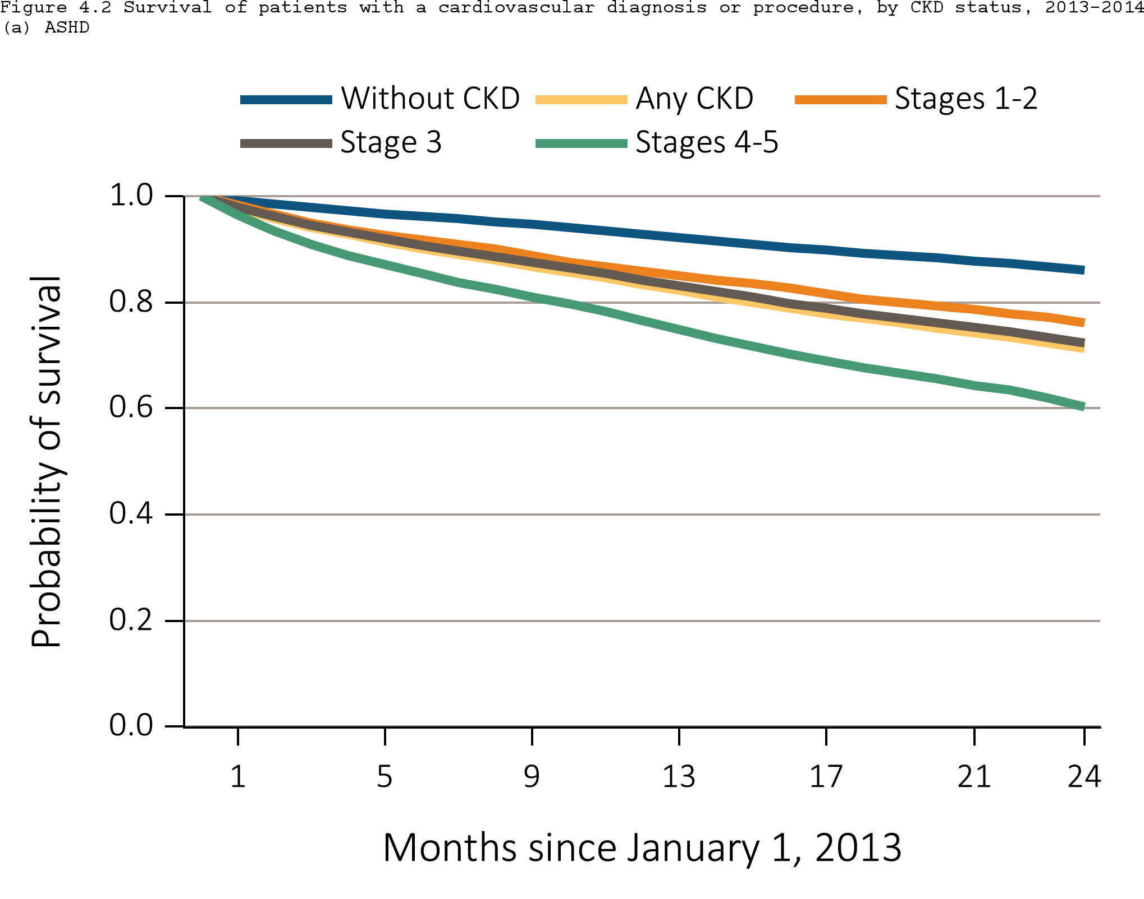
Figure 4.2 Survival of patients with a prevalent cardiovascular disease, by CKD status, 2013-2014
^{(a) ASHD}
Data Source: Special analyses, Medicare 5 percent sample. Patients aged 66 and older, alive, without end-stage renal disease, and residing in the United States on 12/31/2012, with fee-for-service coverage for the entire calendar year. Abbreviations: ASHD, atherosclerotic heart disease; CKD, chronic kidney disease.

Slide 8
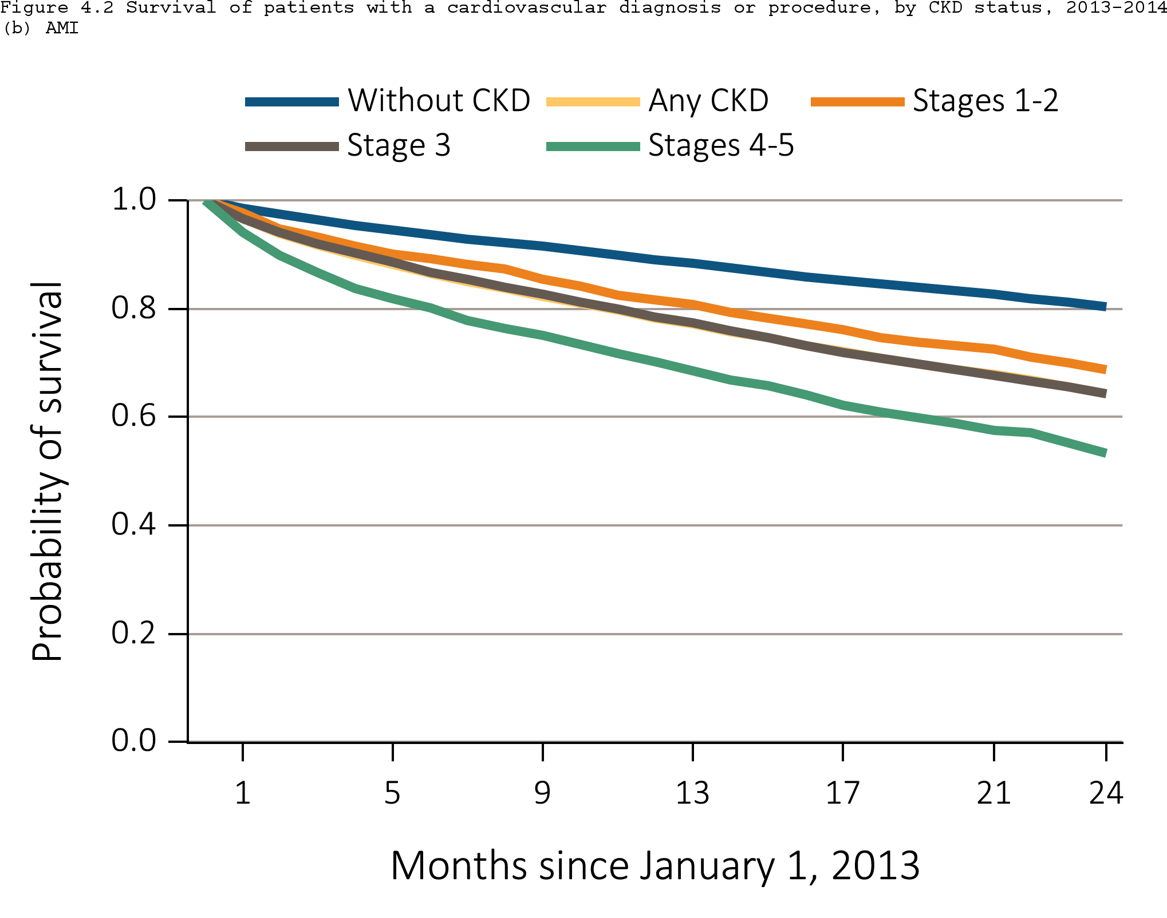
Figure 4.2 Survival of patients with a prevalent cardiovascular disease, by CKD status, 2013-2014
^{(b) AMI}
Data Source: Special analyses, Medicare 5 percent sample. Patients aged 66 and older, alive, without end-stage renal disease, and residing in the United States on 12/31/2012, with fee-for-service coverage for the entire calendar year. Abbreviations: AMI, acute myocardial infarction; CKD, chronic kidney disease.

Slide 9
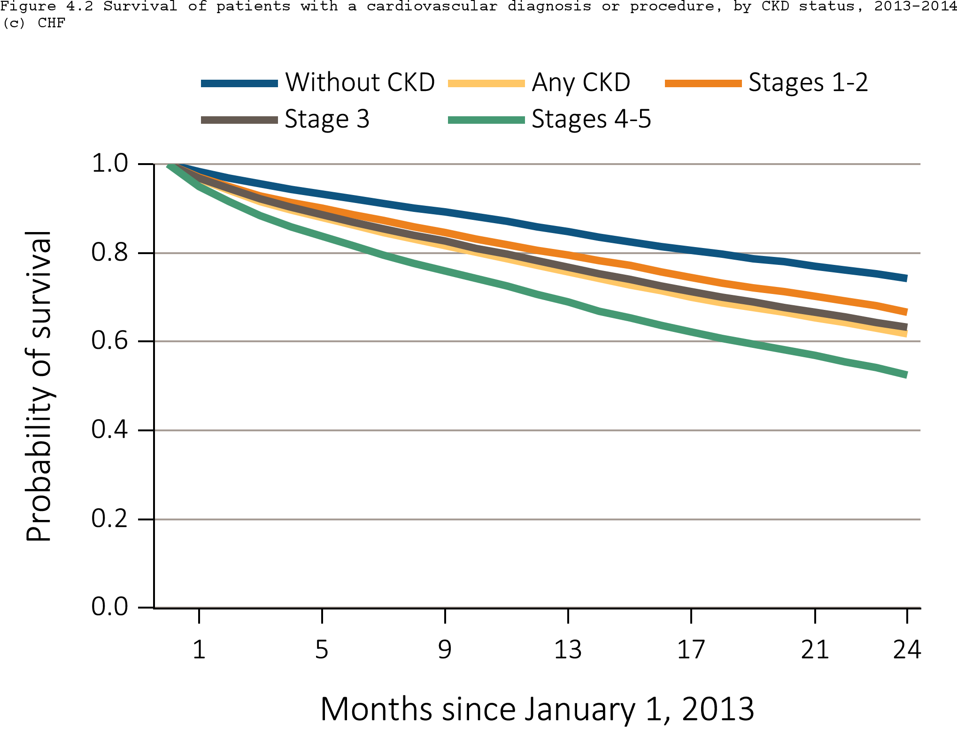
Figure 4.2 Survival of patients with a prevalent cardiovascular disease, by CKD status, 2013-2014
^{(c) CHF}
Data Source: Special analyses, Medicare 5 percent sample. Patients aged 66 and older, alive, without end-stage renal disease, and residing in the United States on 12/31/2012, with fee-for-service coverage for the entire calendar year. Abbreviations: CHF, congestive heart failure; CKD, chronic kidney disease.

Slide 10
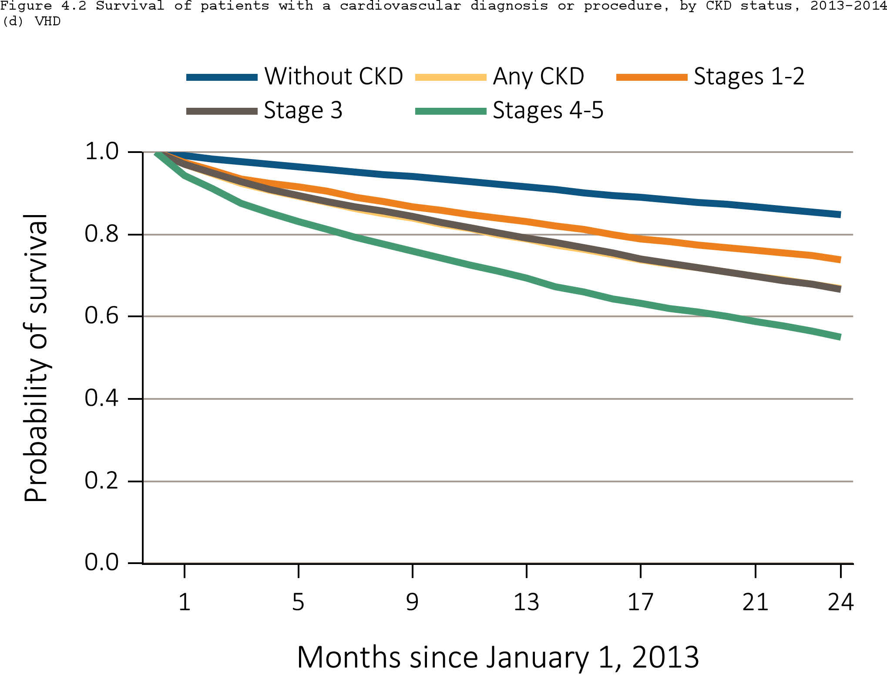
Figure 4.2 Survival of patients with a prevalent cardiovascular disease, by CKD status, 2013-2014
^{(d) VHD}
Data Source: Special analyses, Medicare 5 percent sample. Patients aged 66 and older, alive, without end-stage renal disease, and residing in the United States on 12/31/2012, with fee-for-service coverage for the entire calendar year. Abbreviations: CKD, chronic kidney disease; VHD, valvular heart disease.

Slide 11
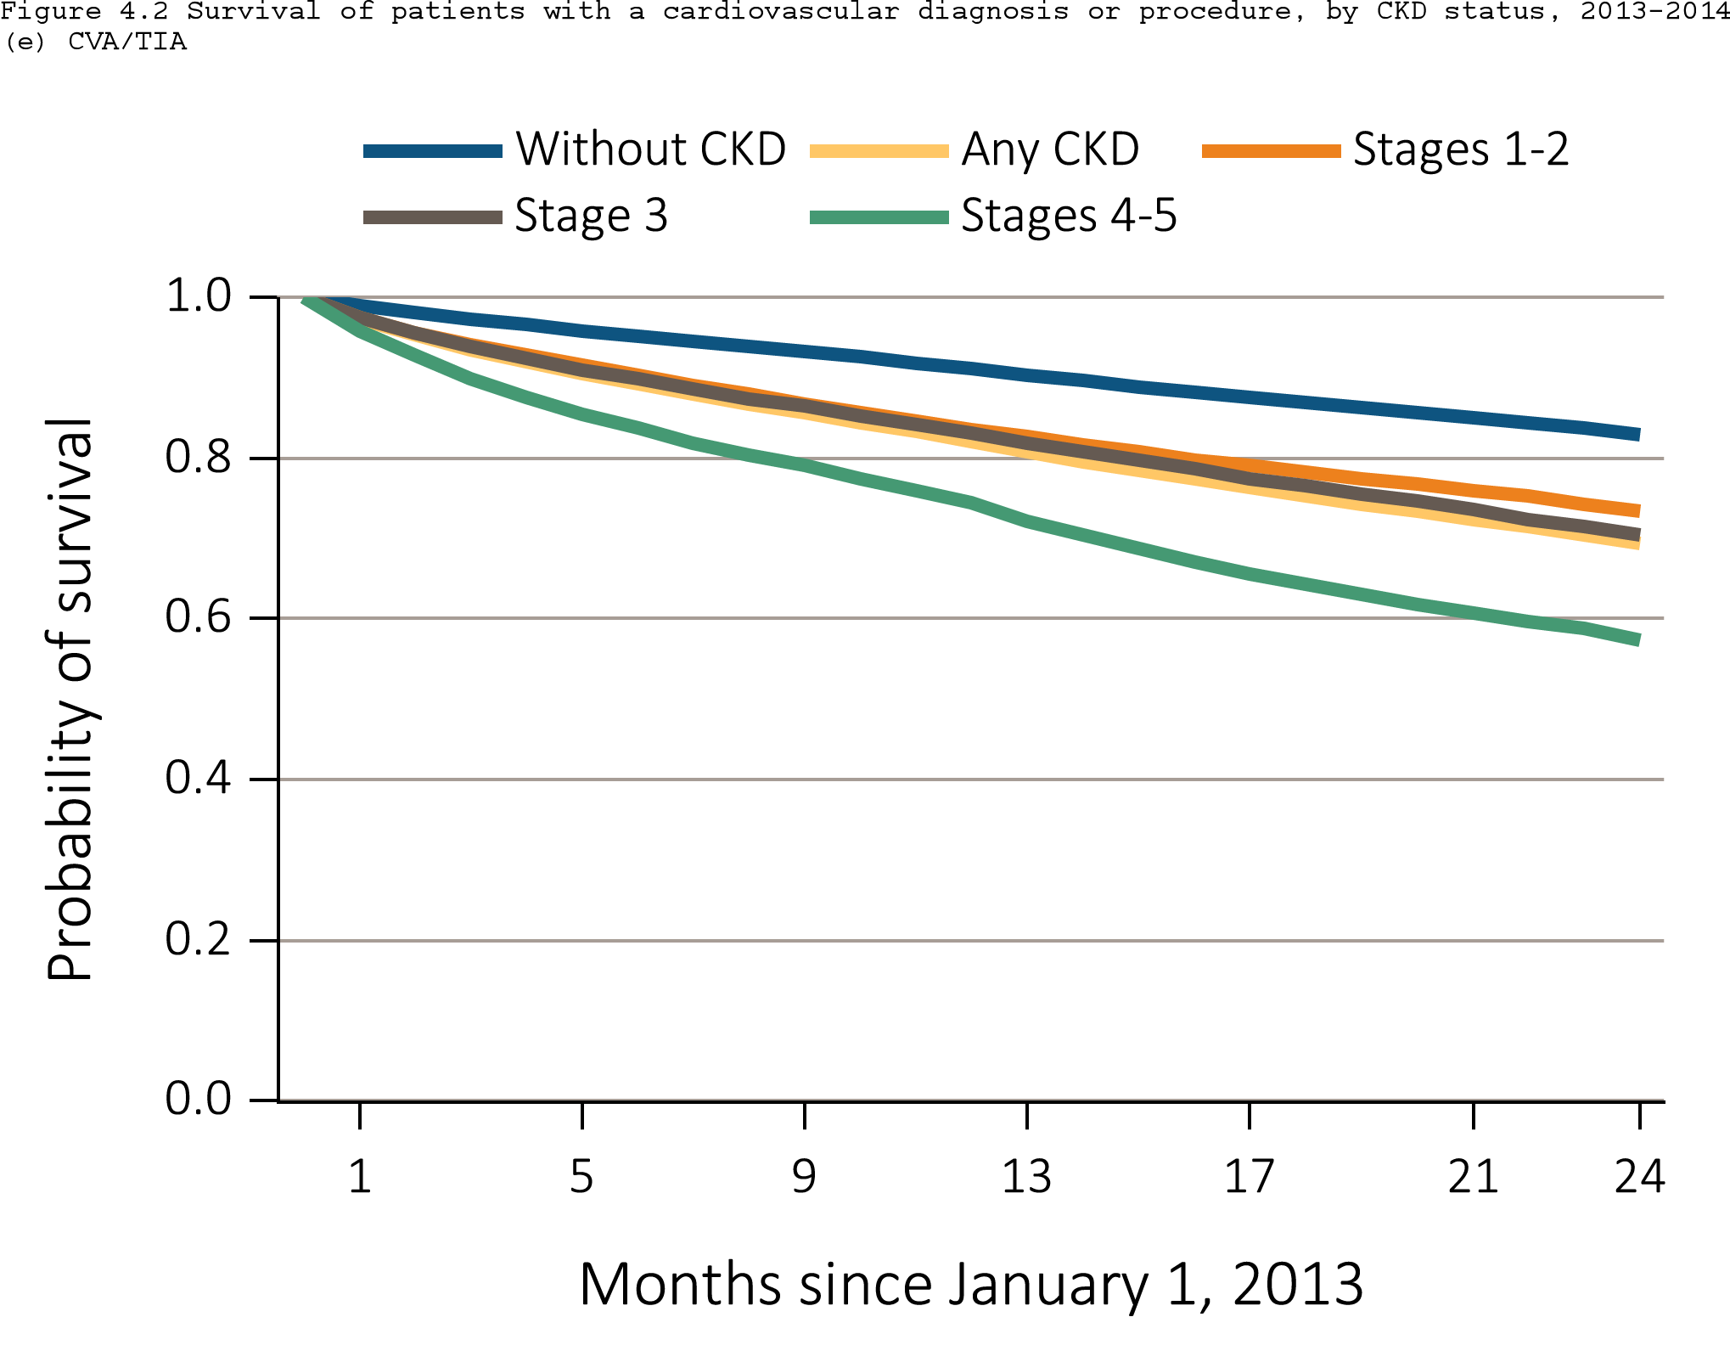
Figure 4.2 Survival of patients with a prevalent cardiovascular disease, by CKD status, 2013-2014
^{(e) CVA/TIA}
Data Source: Special analyses, Medicare 5 percent sample. Patients aged 66 and older, alive, without end-stage renal disease, and residing in the United States on 12/31/2012, with fee-for-service coverage for the entire calendar year. Abbreviations: CKD, chronic kidney disease; CVA/TIA, cerebrovascular accident/transient ischemic attack.

Slide 12

Figure 4.2 Survival of patients with a prevalent cardiovascular disease, by CKD status, 2013-2014
^{(f) PAD}
Data Source: Special analyses, Medicare 5 percent sample. Patients aged 66 and older, alive, without end-stage renal disease, and residing in the United States on 12/31/2012, with fee-for-service coverage for the entire calendar year. Abbreviations: CKD, chronic kidney disease; PAD, peripheral arterial disease; SCA/VA, sudden cardiac arrest and ventricular arrhythmias.

Slide 13
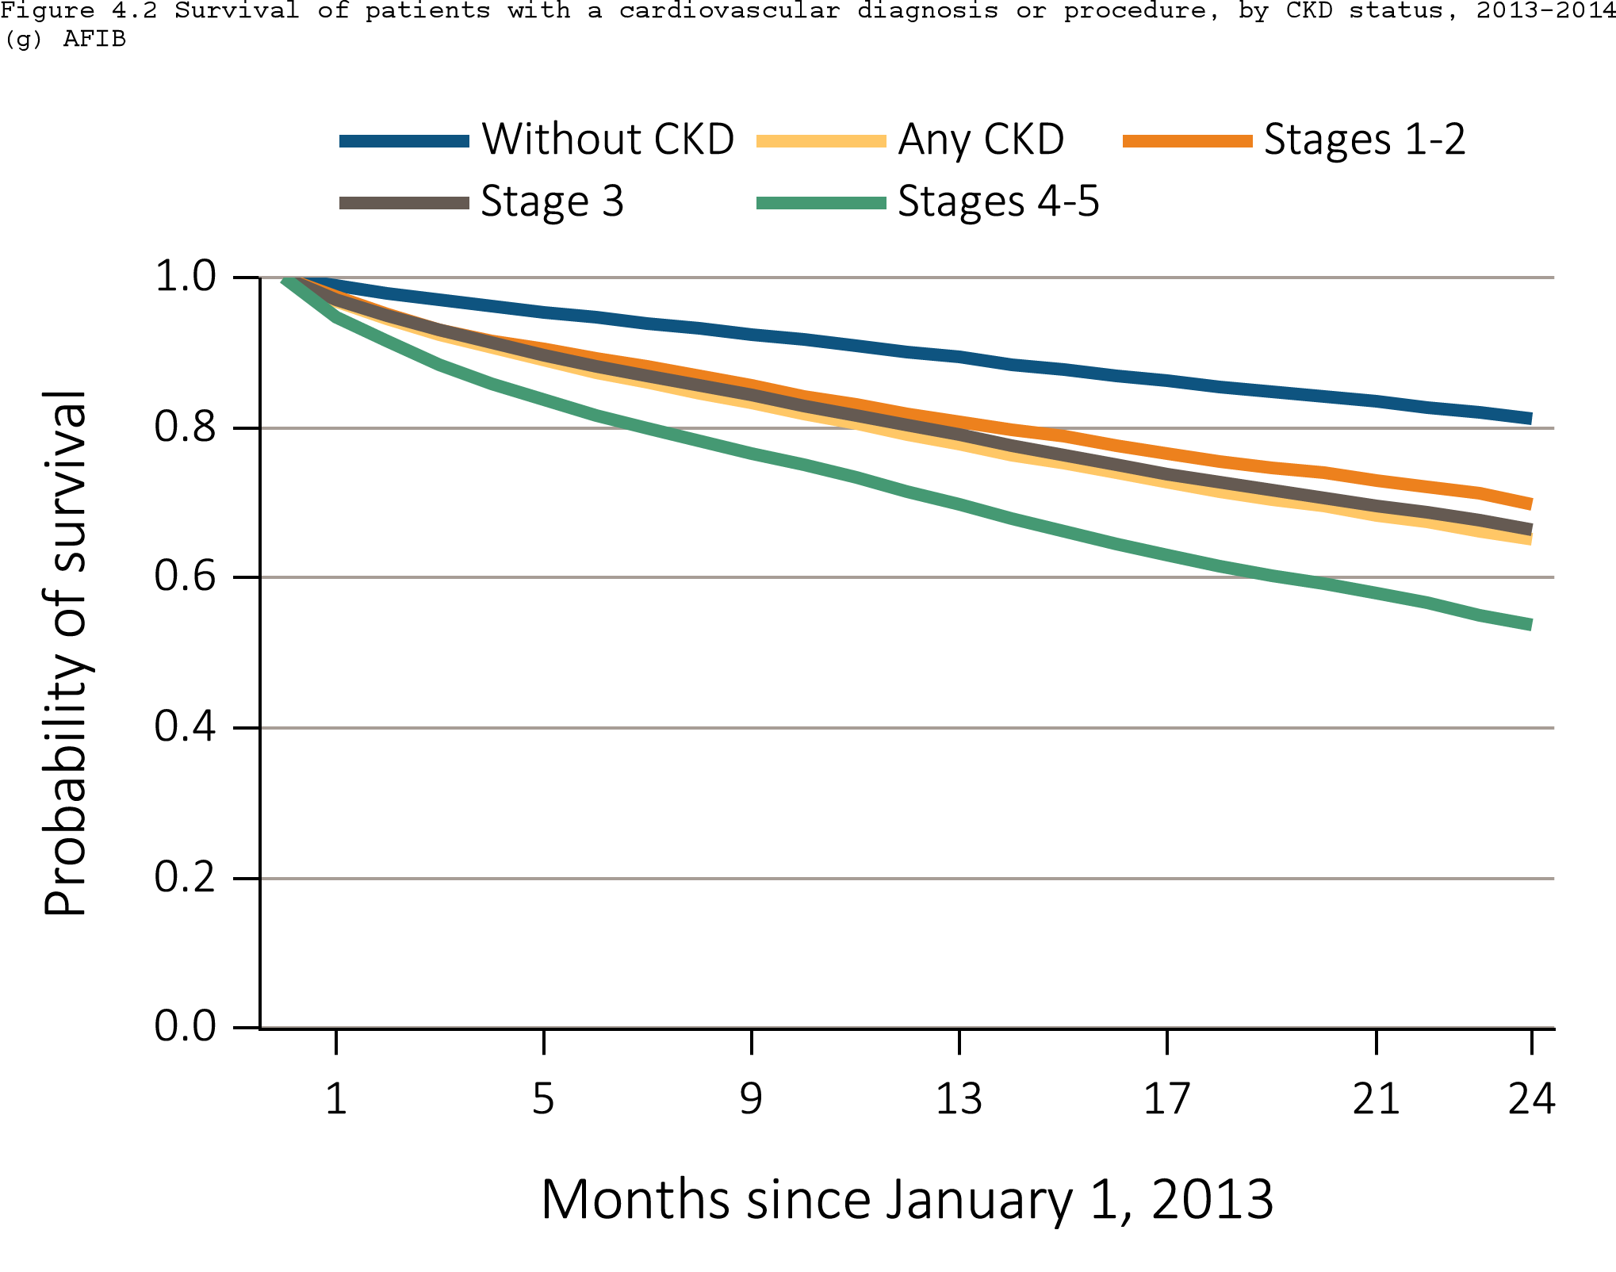
Figure 4.2 Survival of patients with a prevalent cardiovascular disease, by CKD status, 2013-2014
^{(g) AFIB}
Data Source: Special analyses, Medicare 5 percent sample. Patients aged 66 and older, alive, without end-stage renal disease, and residing in the United States on 12/31/2012, with fee-for-service coverage for the entire calendar year. Abbreviations: AFIB, atrial fibrillation; CKD, chronic kidney disease.

Slide 14
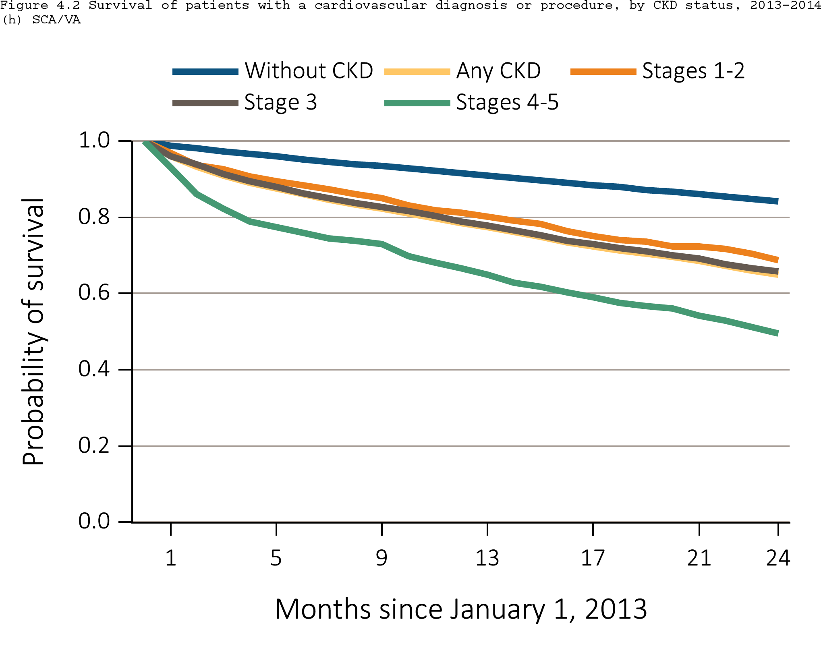
Figure 4.2 Survival of patients with a prevalent cardiovascular disease, by CKD status, 2013-2014
^{(h) SCA/VA}
Data Source: Special analyses, Medicare 5 percent sample. Patients aged 66 and older, alive, without end-stage renal disease, and residing in the United States on 12/31/2012, with fee-for-service coverage for the entire calendar year. Abbreviations: CKD, chronic kidney disease; SCA/VA, sudden cardiac arrest and ventricular arrhythmias.

Slide 15
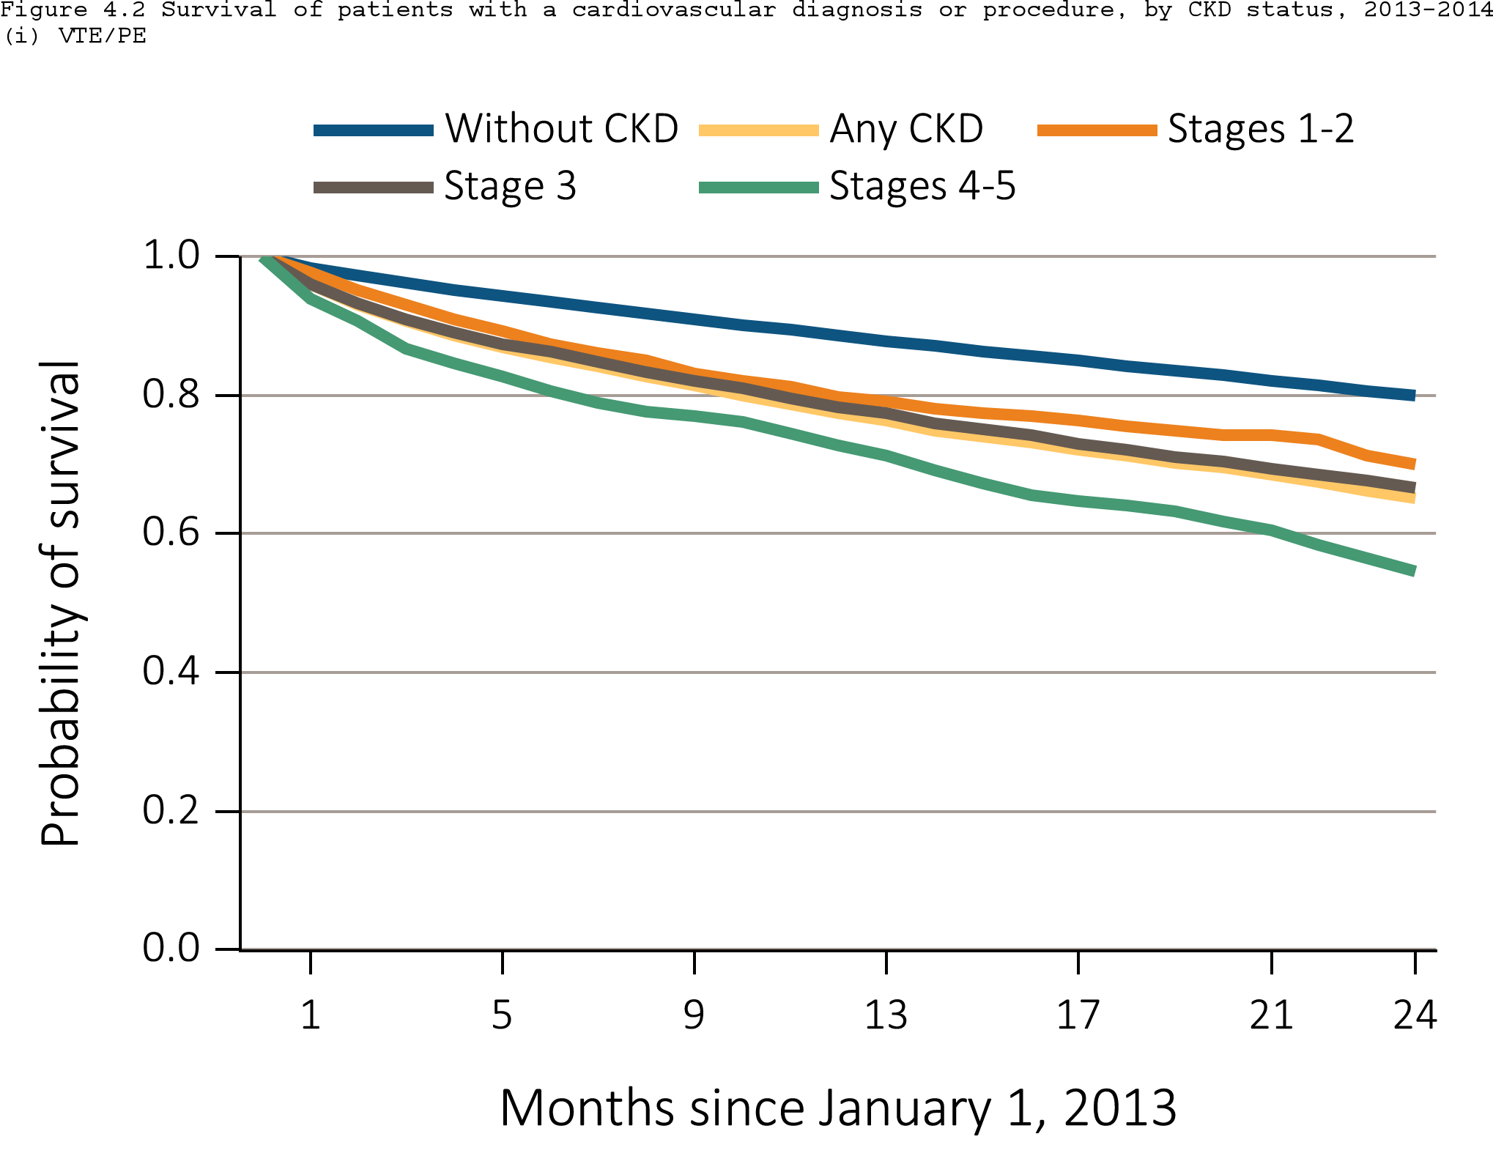
Figure 4.2 Survival of patients with a prevalent cardiovascular disease, by CKD status, 2013-2014
^{(i) VTE/PE}
Data Source: Special analyses, Medicare 5 percent sample. Patients aged 66 and older, alive, without end-stage renal disease, and residing in the United States on 12/31/2012, with fee-for-service coverage for the entire calendar year. Abbreviations: CKD, chronic kidney disease; VTE/PE venous thromboembolism and pulmonary embolism.

Slide 16
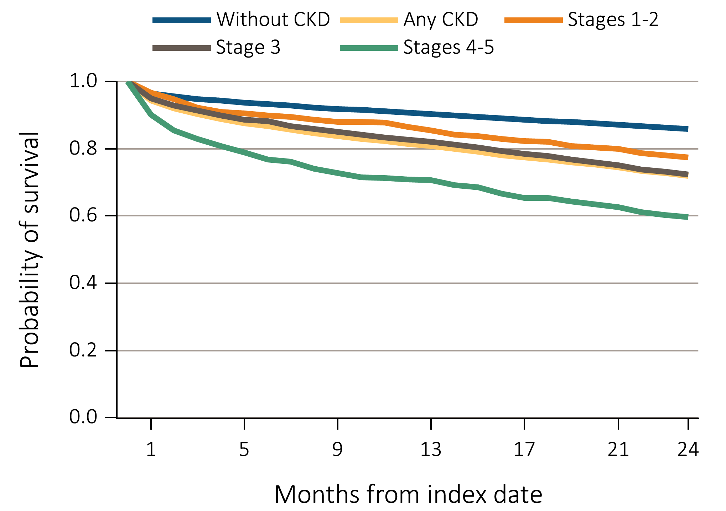
Figure 4.3 Survival of patients with a cardiovascular procedure, by CKD status, 2012-2014
^{(a) PCI}
Data Source: Special analyses, Medicare 5 percent sample. Patients aged 66 and older, alive, without end-stage renal disease, and residing in the United States on the index date, which is the date of the first condition/procedure claim, with fee-for-service coverage for the entire year prior to this date. Abbreviations: CKD, chronic kidney disease; PCI, percutaneous coronary interventions.

Slide 17
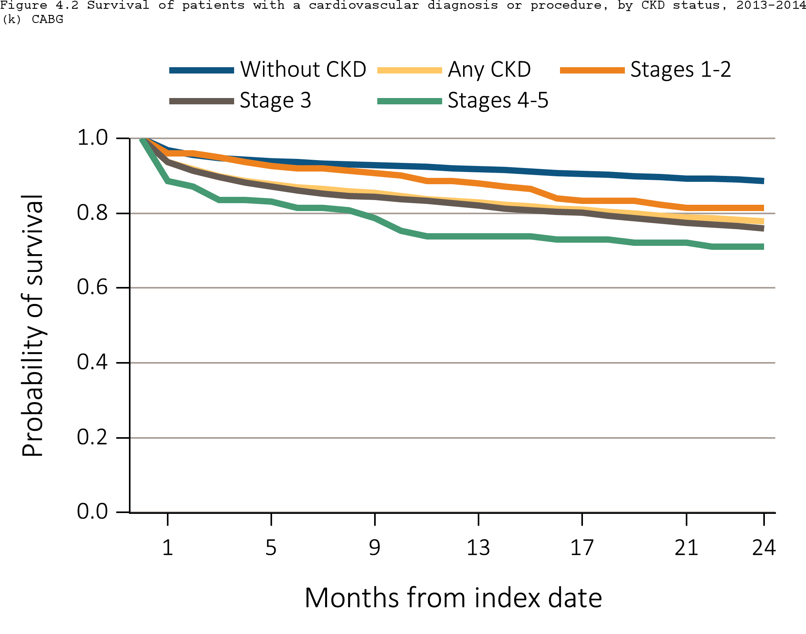
Figure 4.3 Survival of patients with a cardiovascular procedure, by CKD status, 2012-2014
^{(b) CABG}
Data Source: Special analyses, Medicare 5 percent sample. Patients aged 66 and older, alive, without end-stage renal disease, and residing in the United States on the index date, which is the date of the first condition/procedure claim, with fee-for-service coverage for the entire year prior to this date. Abbreviations: CABG, coronary artery bypass grafting; CKD, chronic kidney disease.

Slide 18
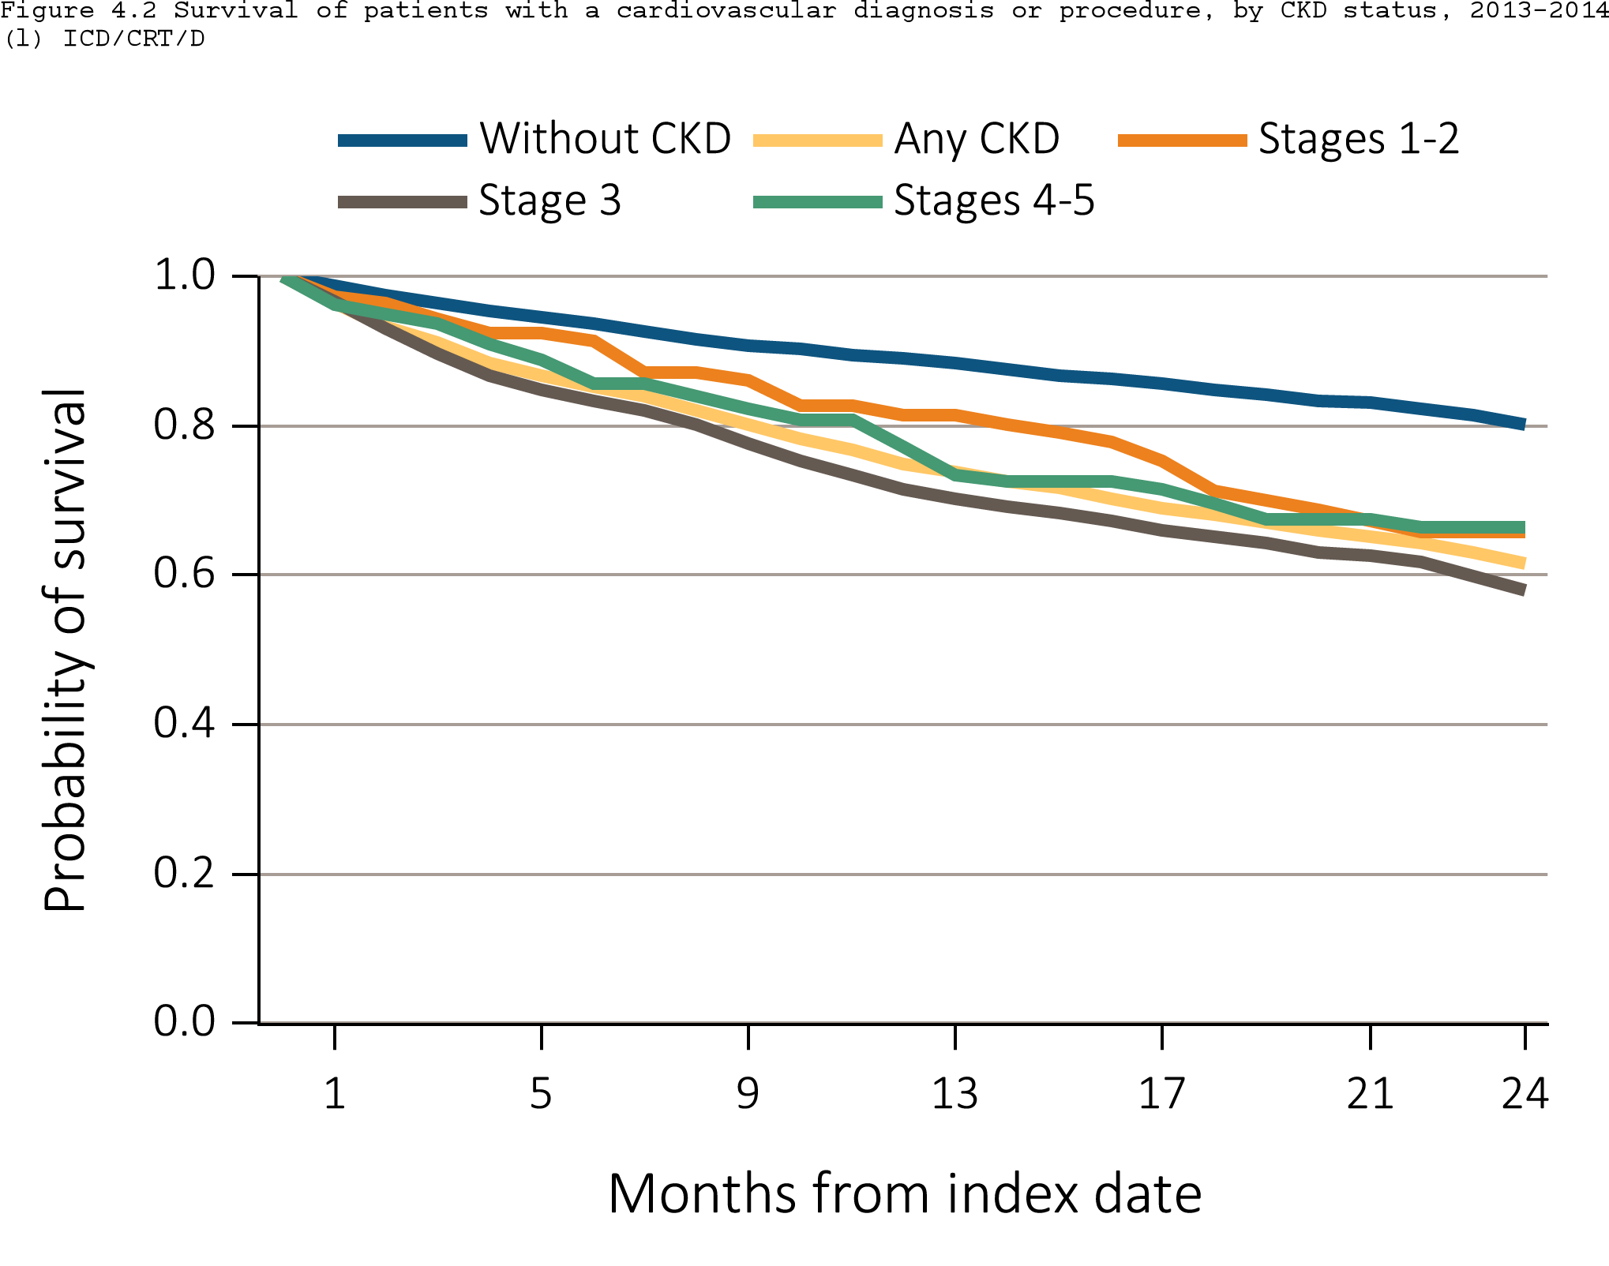
Figure 4.3 Survival of patients with a cardiovascular procedure, by CKD status, 2012-2014
^{(c) ICD/CRT/D}
Data Source: Special analyses, Medicare 5 percent sample. Patients aged 66 and older, alive, without end-stage renal disease, and residing in the United States on the index date, which is the date of the first condition/procedure claim, with fee-for-service coverage for the entire year prior to this date. Abbreviations: CKD, chronic kidney disease; ICD/CRT-D, implantable cardioverter defibrillators/cardiac resynchronization therapy with defibrillator devices.

Slide 19
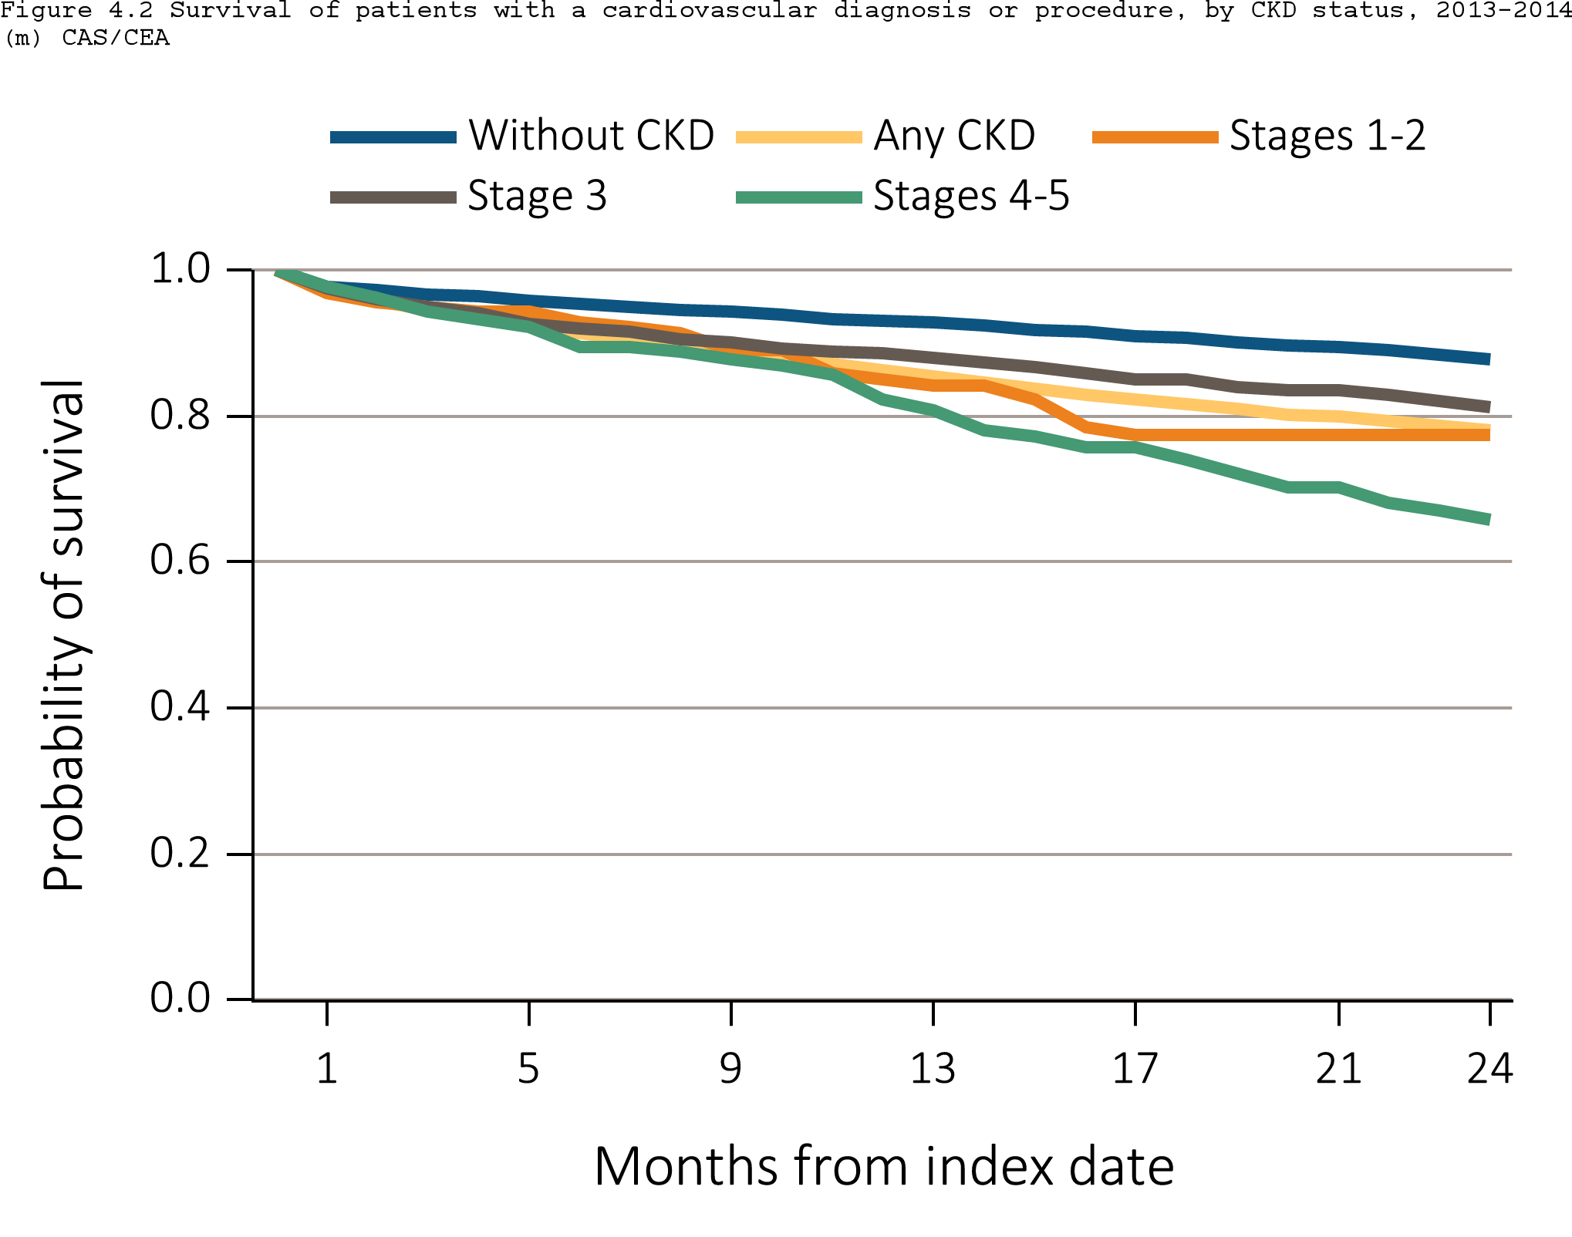
Figure 4.3 Survival of patients with a cardiovascular procedure, by CKD status, 2012-2014
^{(d) CAS/CEA}
Data Source: Special analyses, Medicare 5 percent sample. Patients aged 66 and older, alive, without end-stage renal disease, and residing in the United States on the index date, which is the date of the first condition/procedure claim, with fee-for-service coverage for the entire year prior to this date. Abbreviations: CAS/CEA, carotid artery stenting and carotid endarterectomy; CKD, chronic kidney disease.

Slide 20
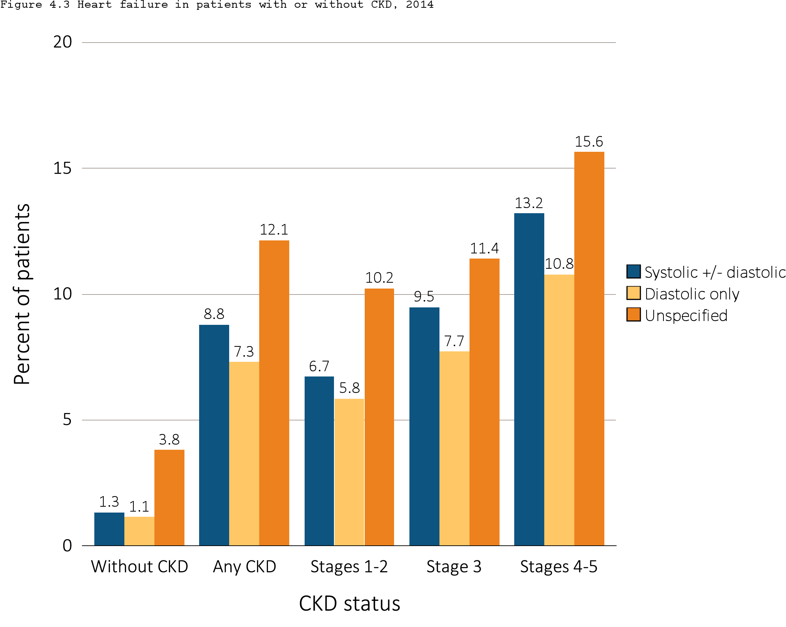
Figure 4.4 Heart failure in patients with or without CKD, 2014
Data Source: Special analyses, Medicare 5 percent sample. Patients aged 66 and older, alive, without end-stage renal disease, and residing in the United States on 12/31/2014 with fee-for-service coverage for the entire calendar year. Abbreviations: CKD, chronic kidney disease.

Slide 21
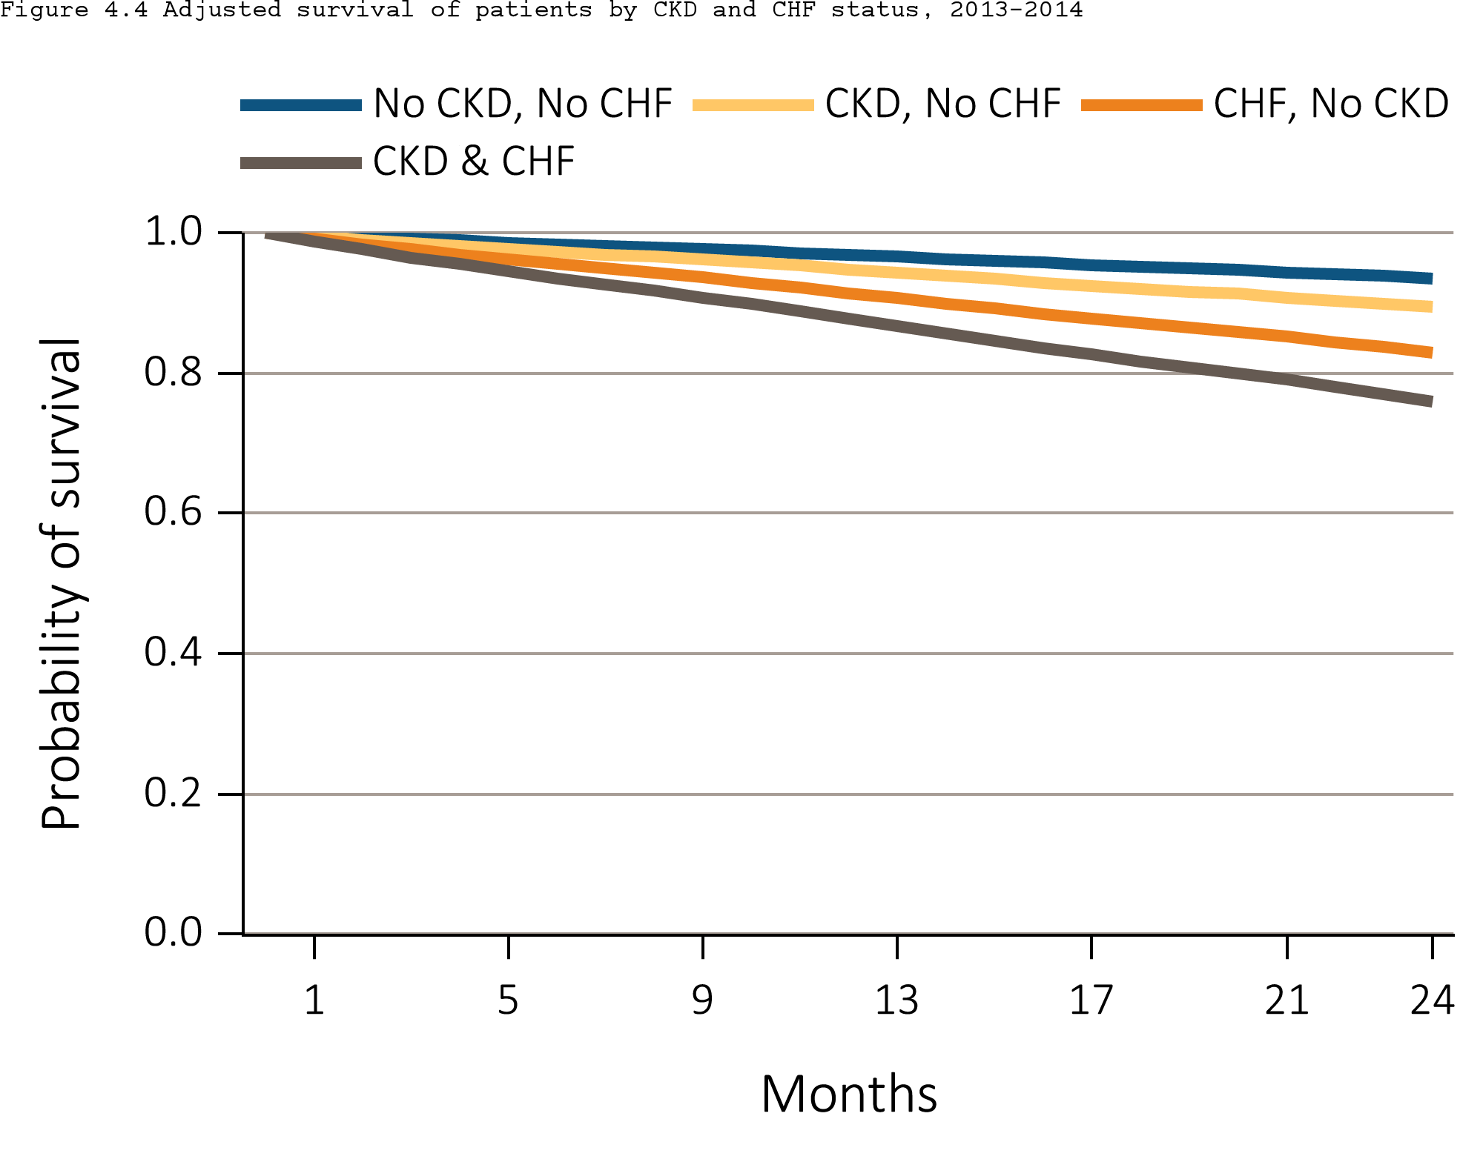
Figure 4.5 Adjusted survival of patients by CKD and CHF status, 2013-2014
Data Source: Special analyses, Medicare 5 percent sample. Patients aged 66 and older, alive, without end-stage renal disease, and residing in the United States on 12/31/2012 with fee-for-service coverage for the entire calendar year. Survival is adjusted for age, sex, race, diabetic status, and hypertension status. Abbreviations: CKD, chronic kidney disease; CHF, congestive heart failure.

Slide 22
Table 4.2 Prevalence of AFIB by stage of CKD, age, race, sex, diabetic status, hypertension status, and CHF status, 2014
 | Stage of CKD |  |  |  |  | Total
 | Stages 1-2 | Stage 3 | Stages 4-5 | Unknown stage |  | All CKD stages
N | 14,364 | 67,122 | 13,746 | 42,944 |  | 138,176
AFIB (Overall) | 20.9 | 25.0 | 27.9 | 23.7 |  | 24.5
Age
66-69 | 11.8 | 14.4 | 17.8 | 13.8 |  | 14.1
70-74 | 15.8 | 18.2 | 20.6 | 17.4 |  | 17.8
75-84 | 22.0 | 26.1 | 28.8 | 25.0 |  | 25.6
85+ | 32.2 | 33.1 | 34.2 | 32.9 |  | 33.1
Sex
Male | 23.5 | 27.9 | 30.1 | 25.9 |  | 27.0
Female | 18.4 | 22.4 | 26.1 | 21.7 |  | 22.2
Race
White | 22.7 | 26.8 | 30.4 | 25.4 |  | 26.3
Black/African American | 13.4 | 15.4 | 17.5 | 13.9 |  | 15.0
Other | 13.2 | 16.1 | 19.6 | 15.6 |  | 16.0
Comorbidity
Non-diabetes | 20.3 | 25.1 | 28.3 | 23.7 |  | 24.4
Diabetes | 21.5 | 24.9 | 27.7 | 23.7 |  | 24.5
Non-hypertension | 11.0 | 14.8 | 17.8 | 11.7 |  | 13.2
Hypertension | 21.8 | 25.7 | 28.4 | 25.3 |  | 25.5
No Heart Failure (CHF) | 12.7 | 14.7 | 14.4 | 14.9 |  | 14.5
Heart Failure (CHF) | 48.9 | 50.9 | 48.6 | 49.0 |  | 49.9
Data Source: Special analyses, Medicare 5 percent sample. Patients aged 66 and older, alive, without end-stage renal disease, and residing in the United States on 12/31/2014 with fee-for-service coverage for the entire calendar year. Abbreviations: AFIB, atrial fibrillation; CHF, congestive heart failure; CKD, chronic kidney disease.

