Slide 2
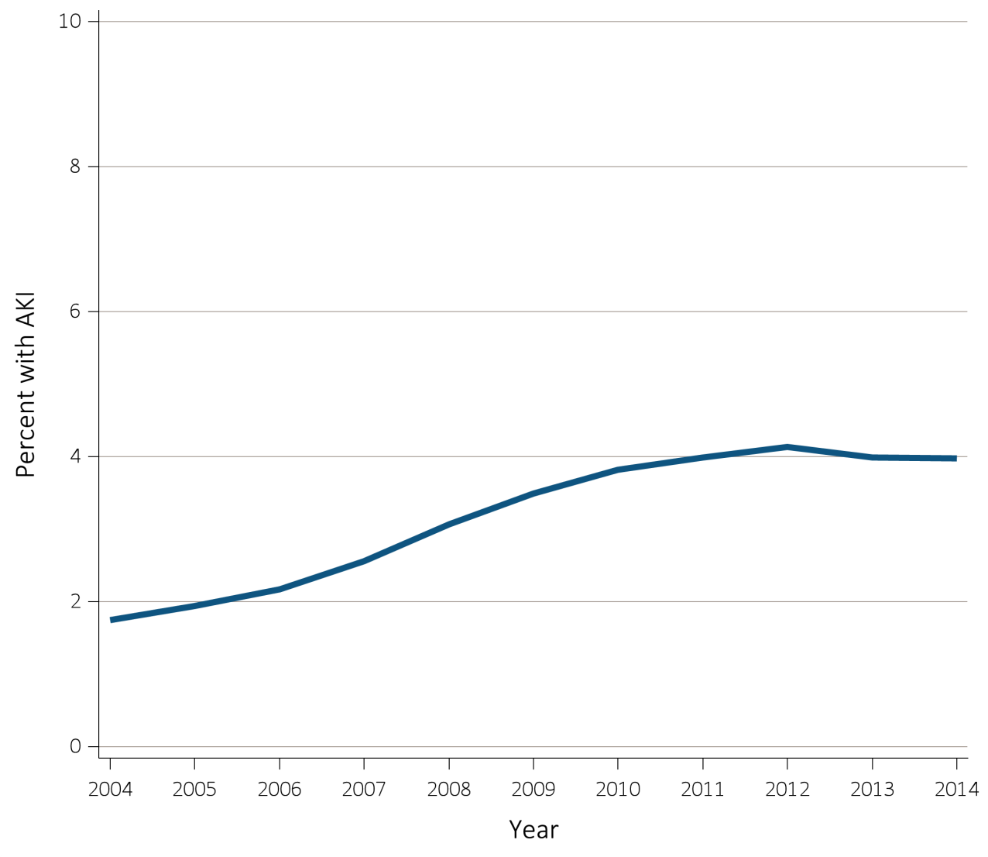
Figure 5.1 Percent of Medicare patients aged 66+ (a) with at least one AKI hospitalization, and (b) percent among those with an AKI hospitalization that required dialysis, by year, 2004-2014
(a) Percent with an AKI hospitalization
Data Source: Special analyses, Medicare 5% sample. (a) Percent with an AKI hospitalization among all Medicare patients aged 66 and older who had both Medicare Parts A & B, no Medicare Advantage plan, no ESRD by first service date from Medical Evidence form, and were alive on January 1 of year shown. (b) Percent of patients receiving dialysis during their first AKI hospitalization among patients with a first AKI hospitalization. Dialysis is identified by a diagnosis or charge for dialysis on the AKI hospitalization inpatient claim or a physician/supplier (Part B) claim for dialysis during the time period of the AKI inpatient claim. Abbreviations: AKI, acute kidney injury; ESRD, end-stage renal disease.

Slide 3
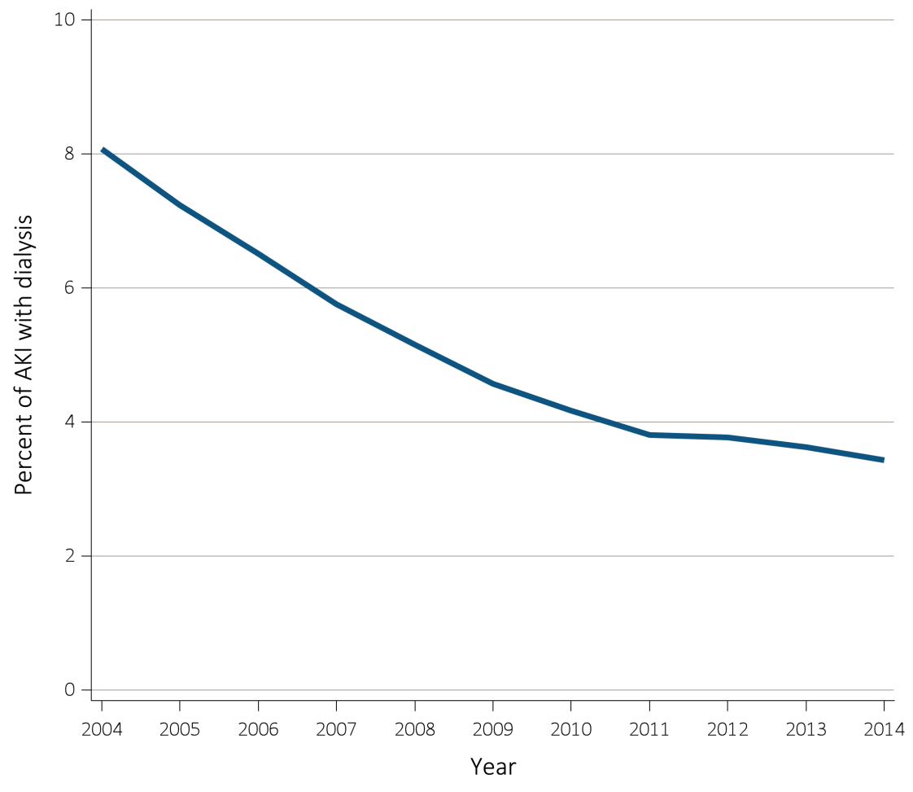
Figure 5.1 Percent of Medicare patients aged 66+ (a) with at least one AKI hospitalization, and (b) percent among those with an AKI hospitalization that required dialysis, by year, 2004-2014
(b) Percent of patients requiring dialysis among those with a first AKI hospitalization
Data Source: Special analyses, Medicare 5% sample. (a) Percent with an AKI hospitalization among all Medicare patients aged 66 and older who had both Medicare Parts A & B, no Medicare Advantage plan, no ESRD by first service date from Medical Evidence form, and were alive on January 1 of year shown. (b) Percent of patients receiving dialysis during their first AKI hospitalization among patients with a first AKI hospitalization. Dialysis is identified by a diagnosis or charge for dialysis on the AKI hospitalization inpatient claim or a physician/supplier (Part B) claim for dialysis during the time period of the AKI inpatient claim. Abbreviations: AKI, acute kidney injury; ESRD, end-stage renal disease.

Slide 4
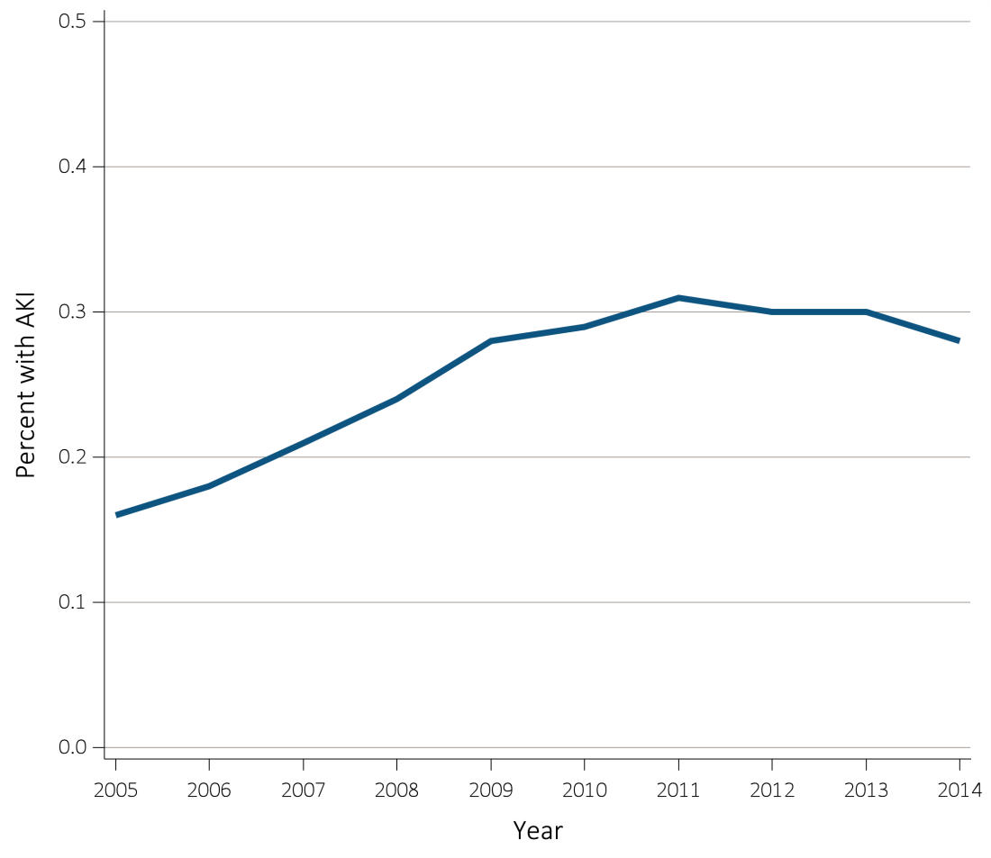
Figure 5.2 Percent of Clinformatics™ patients aged 22+ (a) with at least one AKI hospitalization, and (b) percent among those with an AKI hospitalization that required dialysis, by year, 2005-2014
(a) Percent with an AKI hospitalization
Data Source: Special analyses, Clinformatics™. (a) Percent with an AKI hospitalization among all Clinformatics™ commercial insurance patients aged 22 and older who were enrolled in the plan, did not have diagnoses of ESRD, and were alive on January 1, 2014. (b) Percent of patients receiving dialysis during their first AKI hospitalization among patients with a first AKI hospitalization. Dialysis is identified by a diagnosis or charge for dialysis on the AKI hospitalization inpatient (confinement) claim or a medical claim for dialysis during the time period of the AKI inpatient claim. Abbreviations: AKI, acute kidney injury; ESRD, end-stage renal disease.

Slide 5
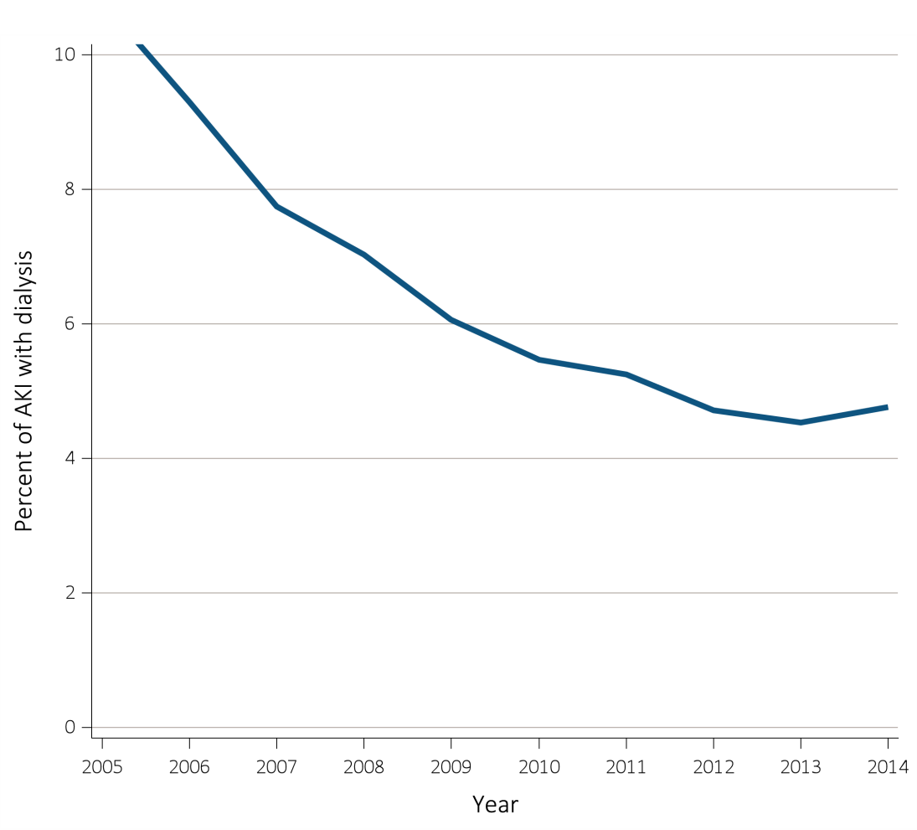
Figure 5.2 Percent of Clinformatics™ patients aged 22+ (a) with at least one AKI hospitalization, and (b) percent among those with an AKI hospitalization that required dialysis, by year, 2005-2014
(b) Percent of patients requiring dialysis among those with a first AKI hospitalization
Data Source: Special analyses, Clinformatics™. (a) Percent with an AKI hospitalization among all Clinformatics™ commercial insurance patients aged 22 and older who were enrolled in the plan, did not have diagnoses of ESRD, and were alive on January 1, 2014. (b) Percent of patients receiving dialysis during their first AKI hospitalization among patients with a first AKI hospitalization. Dialysis is identified by a diagnosis or charge for dialysis on the AKI hospitalization inpatient (confinement) claim or a medical claim for dialysis during the time period of the AKI inpatient claim. Abbreviations: AKI, acute kidney injury; ESRD, end-stage renal disease.

Slide 6
Table 5.1 Characteristics of Medicare and Clinformatics™ patients with at least one hospitalization, by age, sex, race, CKD, DM, and presence of AKI, 2014
 |  | Medicare (aged 66+) |  |  |  |  |  |  | Clinformatics™ (aged 22+)
 |  | Total |  | Without AKI |  | With AKI |  |  | Total |  | Without AKI |  | With AKI
 |  | N | % | N | % | N | % |  | N | % | N | % | N | %
Total |  | 231,894 | 100.0 | 178,747 | 100.0 | 53,147 | 100.0 |  | 307,333 | 100.0 | 287,415 | 100.0 | 19,918 | 100.0
Age
 | 22-39 | — | — | — | — | — | — |  | 132,848 | 43.2 | 130,828 | 45.5 | 2,020 | 10.1
 | 40-65 | — | — | — | — | — | — |  | 145,567 | 47.4 | 132,606 | 46.1 | 12,961 | 65.1
 | 65+ | — | — | — | — | — | — |  | 28,918 | 9.4 | 23,981 | 8.3 | 4,937 | 24.8
 | 66-69 | 36,228 | 15.6 | 29,906 | 16.7 | 6,322 | 11.9 |  | — | — | — | — | — | —
 | 70-74 | 45,009 | 19.4 | 36,484 | 20.4 | 8,525 | 16.0 |  | — | — | — | — | — | —
 | 75-79 | 43,280 | 18.7 | 33,753 | 18.9 | 9,527 | 17.9 |  | — | — | — | — | — | —
 | 80-84 | 41,067 | 17.7 | 30,863 | 17.3 | 10,204 | 19.2 |  | — | — | — | — | — | —
 | 85+ | 66,310 | 28.6 | 47,741 | 26.7 | 18,569 | 34.9 |  | — | — | — | — | — | —
Sex
 | Male | 98,054 | 42.3 | 72,345 | 40.5 | 25,709 | 48.4 |  | 105,505 | 34.3 | 92,960 | 32.3 | 12,545 | 63.0
 | Female | 133,840 | 57.7 | 106,402 | 59.5 | 27,438 | 51.6 |  | 201,828 | 65.7 | 194,455 | 67.7 | 7,373 | 37.0
Race
 | White | 201,739 | 87.0 | 157,510 | 88.1 | 44,229 | 83.2 |  | 217,342 | 70.7 | 202,931 | 70.6 | 14,411 | 72.4
 | Black/African American | 18,668 | 8.1 | 12,579 | 7.0 | 6,089 | 11.5 |  | 30,300 | 9.9 | 27,663 | 9.6 | 2,637 | 13.2
 | Native American | 1,193 | 0.5 | 930 | 0.5 | 263 | 0.5 |  | — | — | — | — | — | —
 | Hispanic | — | — | — | — | — | — |  | 30,723 | 10.0 | 29,198 | 10.2 | 1,525 | 7.7
 | Asian | 3,128 | 1.4 | 2,262 | 1.3 | 866 | 1.6 |  | 13,276 | 4.3 | 12,885 | 4.5 | 391 | 2.0
 | Other | 7,166 | 3.1 | 5,466 | 3.1 | 1,700 | 3.2 |  | 15,692 | 5.1 | 14,738 | 5.1 | 954 | 4.8
Pre-existing comorbidities
 | No DM or CKD, prior year | 137,612 | 59.3 | 115,052 | 64.4 | 22,560 | 42.5 |  | 272,983 | 88.8 | 260,248 | 90.6 | 12,735 | 63.9
 | DM no CKD, prior year | 49,165 | 21.2 | 38,030 | 21.3 | 11,135 | 21.0 |  | 24,720 | 8.0 | 20,937 | 7.3 | 3,783 | 19.0
 | CKD no DM, prior year | 21,423 | 9.2 | 13,103 | 7.3 | 8,320 | 15.7 |  | 5,194 | 1.7 | 3,650 | 1.3 | 1,544 | 7.8
 | Both CKD & DM, prior year | 23,694 | 10.2 | 12,562 | 7.0 | 11,132 | 21.0 |  | 4,436 | 1.4 | 2,580 | 0.9 | 1,856 | 9.3
Data Source: Special analyses, Medicare 5% sample and Clinformatics™. Medicare patients aged 66 and older who had both Medicare Parts A & B, no Medicare Advantage plan, no ESRD by first service date from Medical Evidence form, and were alive on January 1, 2014. Clinformatics™ commercial insurance patients aged 22 and older who were enrolled in the plan, did not have diagnoses of ESRD, and were alive on January 1, 2014. Abbreviations: AKI, acute kidney injury; CKD, chronic kidney disease; DM, diabetes mellitus; ESRD, end-stage renal disease. —This category does not apply for this dataset.

Slide 7
Table 5.2 Characteristics of Veterans Affairs patients aged 22+ with at least one hospitalization, by age, sex, race, CKD, DM, presence and stage of AKI, defined by
^{serum creatinine, FY 2014}
 |  | Total | No AKI | Any Stage AKI | Stage 1 | Stage 2 | Stage 3
Total, N |  | 319,969 | 242,834 | 77,135 | 64,566 | 2,673 | 9,896
Diagnosis of AKI, % |  | 15.6 | 5.0 | 48.8 | 45.3 | 53.9 | 70.0
Age, %
 | 22-39 | 3.9 | 4.8 | 1.3 | 1.3 | 2.0 | 1.0
 | 40-59 | 19.0 | 20.6 | 14.1 | 13.5 | 19.9 | 16.7
 | 60-65 | 17.7 | 17.6 | 18.0 | 17.6 | 22.9 | 19.5
 | 66-69 | 19.6 | 19.5 | 20.2 | 20.1 | 21.0 | 20.1
 | 70-74 | 13.2 | 12.9 | 14.4 | 14.5 | 12.1 | 13.9
 | 75-79 | 7.6 | 7.2 | 8.8 | 8.9 | 7.0 | 8.3
 | 80-84 | 7.9 | 7.3 | 9.7 | 9.9 | 6.8 | 9.3
 | 85+ | 10.9 | 10.1 | 13.5 | 14.1 | 8.2 | 11.2
Sex, %
 | Male | 94.3 | 93.5 | 96.8 | 96.8 | 95.1 | 97.1
 | Female | 5.7 | 6.5 | 3.2 | 3.2 | 4.9 | 2.9
Race, %
 | White | 69.6 | 70.4 | 66.8 | 68.1 | 69.3 | 57.4
 | Black/African American | 19.1 | 18.0 | 22.5 | 21.6 | 18.6 | 30.0
 | Native American | 0.6 | 0.7 | 0.5 | 0.5 | 0.6 | 0.5
 | Hispanic | 6.1 | 6.2 | 5.6 | 5.3 | 7.0 | 6.7
 | Asian | 0.8 | 0.8 | 0.8 | 0.8 | 0.6 | 1.2
 | Other/Not known | 3.8 | 3.8 | 3.8 | 3.7 | 4.0 | 4.3
Diabetes and CKD, %
 | No DM or CKD | 58.1 | 62.8 | 43.4 | 44.8 | 65.5 | 27.8
 | DM no CKD | 24.7 | 23.5 | 28.7 | 30.5 | 31.4 | 16.1
 | CKD no DM | 8.7 | 7.8 | 11.8 | 10.3 | 1.3 | 24.6
 | Both CKD & DM | 8.4 | 6.0 | 16.2 | 14.4 | 1.8 | 31.5
Data Source: Special analyses, Veterans Affairs data. Patients aged 22 and older with at least one hospitalization in fiscal year 2014. AKI defined by serum creatinine criteria as in KDIGO (2012), see Table A for details. Stage 3 includes those requiring dialysis. Diabetes and CKD determined by ICD-9-CM diagnosis codes. Excludes those with evidence of ESRD prior to admission by diagnosis and procedure codes. Abbreviations: AKI, acute kidney injury; CKD, chronic kidney disease; DM, diabetes mellitus; ESRD, end-stage renal disease, FY, federal fiscal year (October 1, 2013 to September 30, 2014).

Slide 8
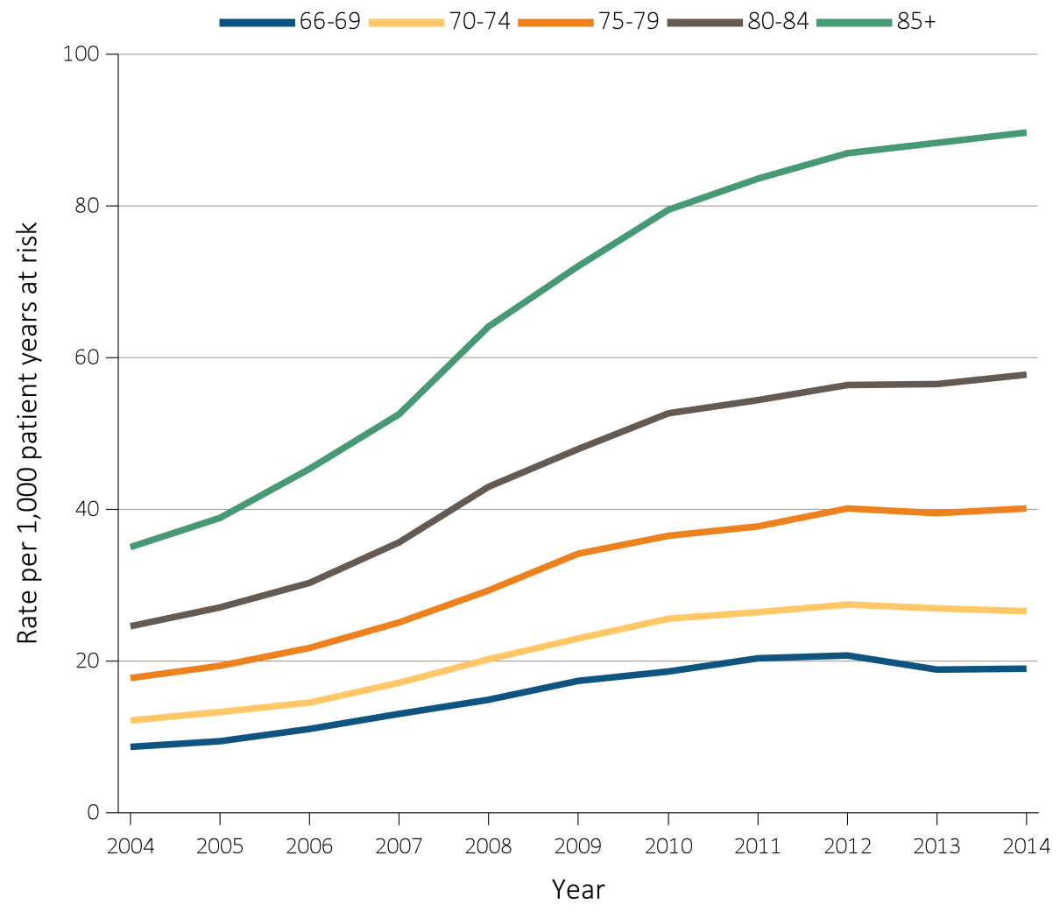
Figure 5.3 Unadjusted rates of first hospitalization with AKI, per 1,000 patient-years at risk, by age and year, 2004-2014
^{(a) Medicare (aged 66+)}
Data Source: Special analyses, Medicare 5% sample and Clinformatics™. (a) Age as of January 1 of specified year. All patient-years at risk for Medicare patients aged 66 and older who had both Medicare Parts A & B, no Medicare Advantage plan, no ESRD by first service date from Medical Evidence form, and were alive on January 1 of year shown. Censored at death, ESRD, end of Medicare Part A & B participation, or switch to Medicare Advantage program. (b) All patient-years at risk for Clinformatics™ commercial insurance patients aged 22 and older who were enrolled in the plan, did not have diagnoses of ESRD, and were alive on January of year shown. Abbreviation: AKI, acute kidney injury; ESRD, end-stage renal disease.

Slide 9
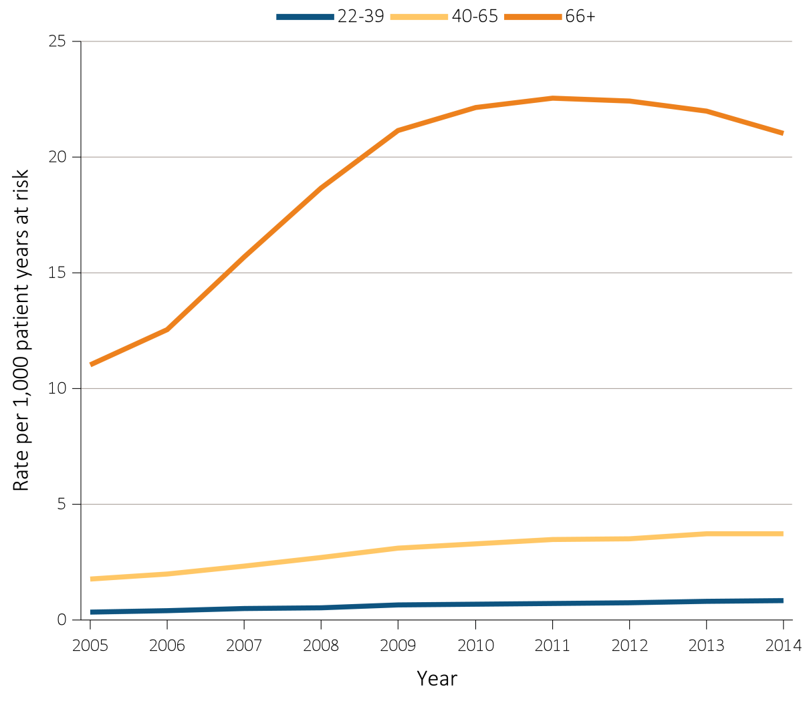
Figure 5.3 Unadjusted rates of first hospitalization with AKI, per 1,000 patient-years at risk, by age and year, 2004-2014
^{(b) Clinformatics™ (aged 22+)}
Data Source: Special analyses, Medicare 5% sample and Clinformatics™. (a) Age as of January 1 of specified year. All patient-years at risk for Medicare patients aged 66 and older who had both Medicare Parts A & B, no Medicare Advantage plan, no ESRD by first service date from Medical Evidence form, and were alive on January 1 of year shown. Censored at death, ESRD, end of Medicare Part A & B participation, or switch to Medicare Advantage program. (b) All patient-years at risk for Clinformatics™ commercial insurance patients aged 22 and older who were enrolled in the plan, did not have diagnoses of ESRD, and were alive on January of year shown. Abbreviation: AKI, acute kidney injury; ESRD, end-stage renal disease.

Slide 10
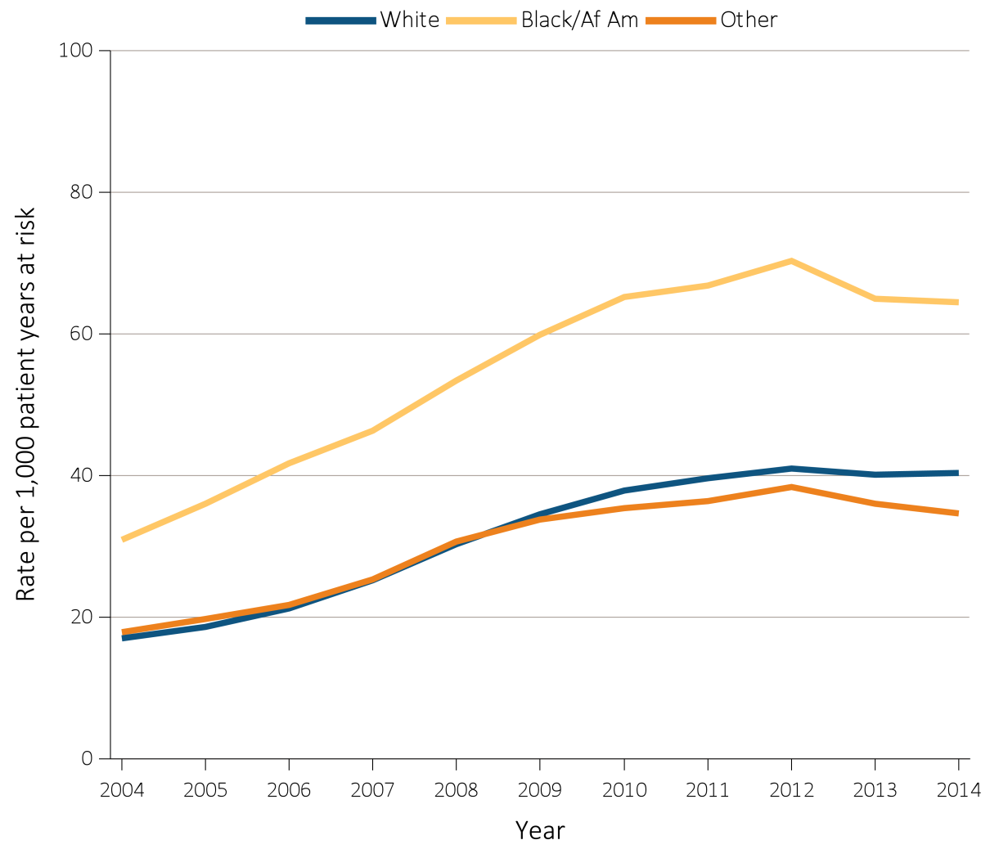
Figure 5.4 Unadjusted rates of first hospitalization with AKI, per 1,000 patient-years at risk, by race and year, 2004-2014
^{(a) Medicare (aged 66+)}
Data Source: Special analyses, Medicare 5% sample and Clinformatics™. (a) All patient-years at risk for Medicare patients aged 66 and older who had both Medicare Parts A & B, no Medicare Advantage plan, no ESRD by first service date from Medical Evidence form, and were alive on January 1 of year shown. Censored at death, ESRD, end of Medicare Part A & B participation, or switch to Medicare Advantage program. (b) All patient-years at risk for Clinformatics™ commercial insurance patients aged 22 and older who were enrolled in the plan, did not have diagnoses of ESRD, and were alive on January of year shown. Abbreviations: Af Am, African American; AKI, acute kidney injury; ESRD, end-stage renal disease.

Slide 11
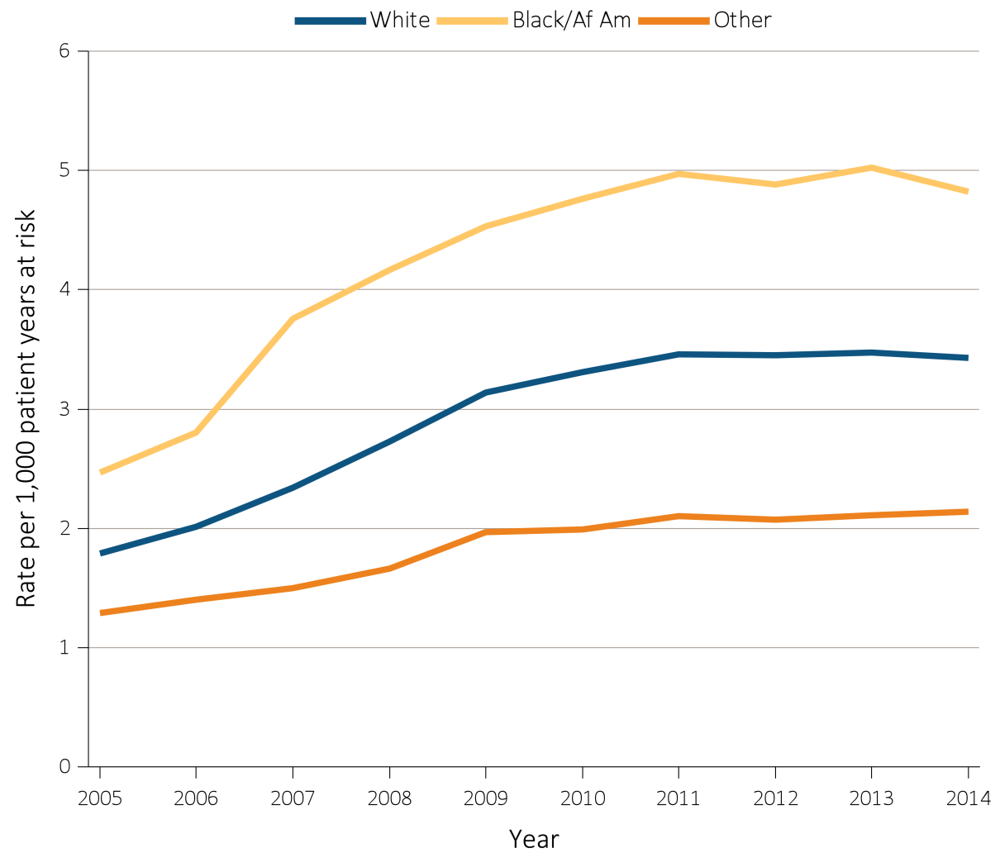
Figure 5.4 Unadjusted rates of first hospitalization with AKI, per 1,000 patient-years at risk, by race and year, 2004-2014
^{(b) Clinformatics™ (aged 22+)}
Data Source: Special analyses, Medicare 5% sample and Clinformatics™. (a) All patient-years at risk for Medicare patients aged 66 and older who had both Medicare Parts A & B, no Medicare Advantage plan, no ESRD by first service date from Medical Evidence form, and were alive on January 1 of year shown. Censored at death, ESRD, end of Medicare Part A & B participation, or switch to Medicare Advantage program. (b) All patient-years at risk for Clinformatics™ commercial insurance patients aged 22 and older who were enrolled in the plan, did not have diagnoses of ESRD, and were alive on January of year shown. Abbreviations: Af Am, African American; AKI, acute kidney injury; ESRD, end-stage renal disease.

Slide 12
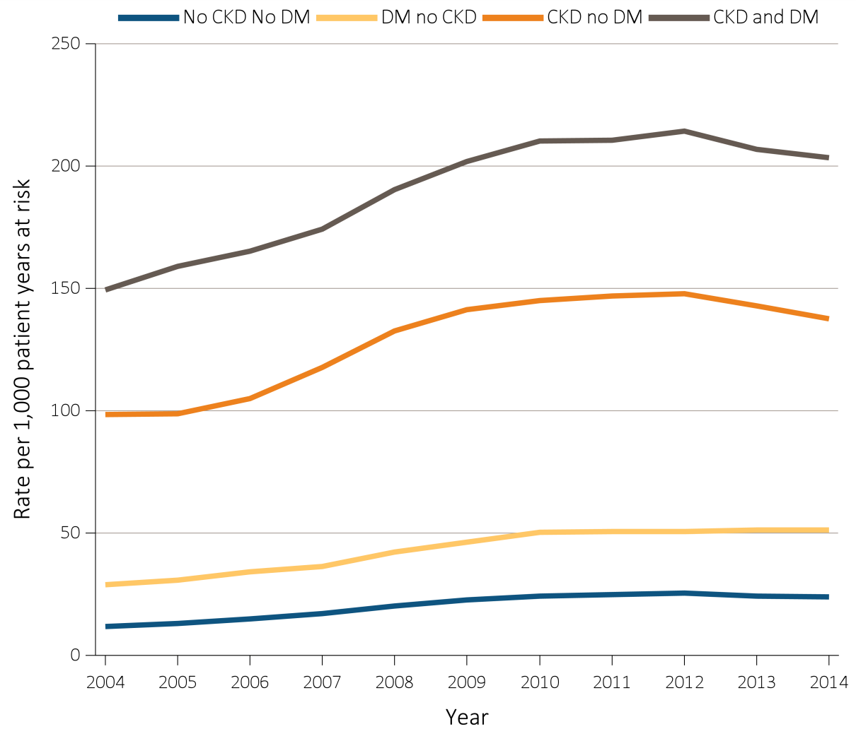
Figure 5.5 Unadjusted rates of first hospitalization with AKI, per 1,000 patient-years at risk, by CKD, DM, and year, 2004-2014
^{(a) Medicare (aged 66+)}
Data Source: Special analyses, Medicare 5% sample and Clinformatics™. (a) All patient-years at risk for Medicare patients aged 66 and older who had both Medicare Parts A & B, no Medicare Advantage plan, no ESRD by first service date from Medical Evidence form, and were alive on January 1 of year shown. Censored at death, ESRD, end of Medicare Part A & B participation, or switch to Medicare Advantage program. (b) All patient-years at risk for Clinformatics™ commercial insurance patients aged 22 and older who were enrolled in the plan, did not have diagnoses of ESRD, and were alive on January of year shown. Abbreviations: AKI, acute kidney injury; CKD, chronic kidney disease; DM, diabetes mellitus; ESRD, end-stage renal disease.

Slide 13
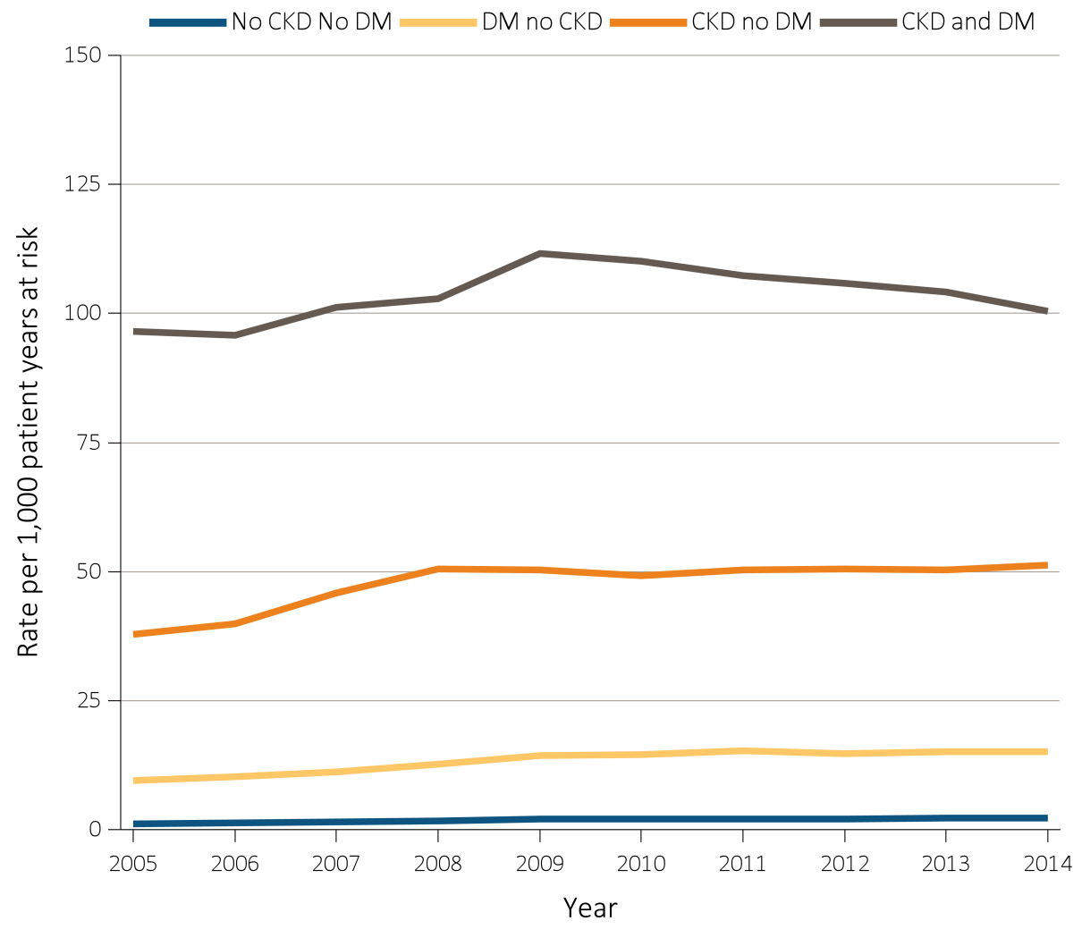
Figure 5.5 Unadjusted rates of first hospitalization with AKI, per 1,000 patient-years at risk, by CKD, DM, and year, 2004-2014
^{(b) Clinformatics™ (aged 22+)}
Data Source: Special analyses, Medicare 5% sample and Clinformatics™. (a) All patient-years at risk for Medicare patients aged 66 and older who had both Medicare Parts A & B, no Medicare Advantage plan, no ESRD by first service date from Medical Evidence form, and were alive on January 1 of year shown. Censored at death, ESRD, end of Medicare Part A & B participation, or switch to Medicare Advantage program. (b) All patient-years at risk for Clinformatics™ commercial insurance patients aged 22 and older who were enrolled in the plan, did not have diagnoses of ESRD, and were alive on January of year shown. Abbreviations: AKI, acute kidney injury; CKD, chronic kidney disease; DM, diabetes mellitus; ESRD, end-stage renal disease.

Slide 14
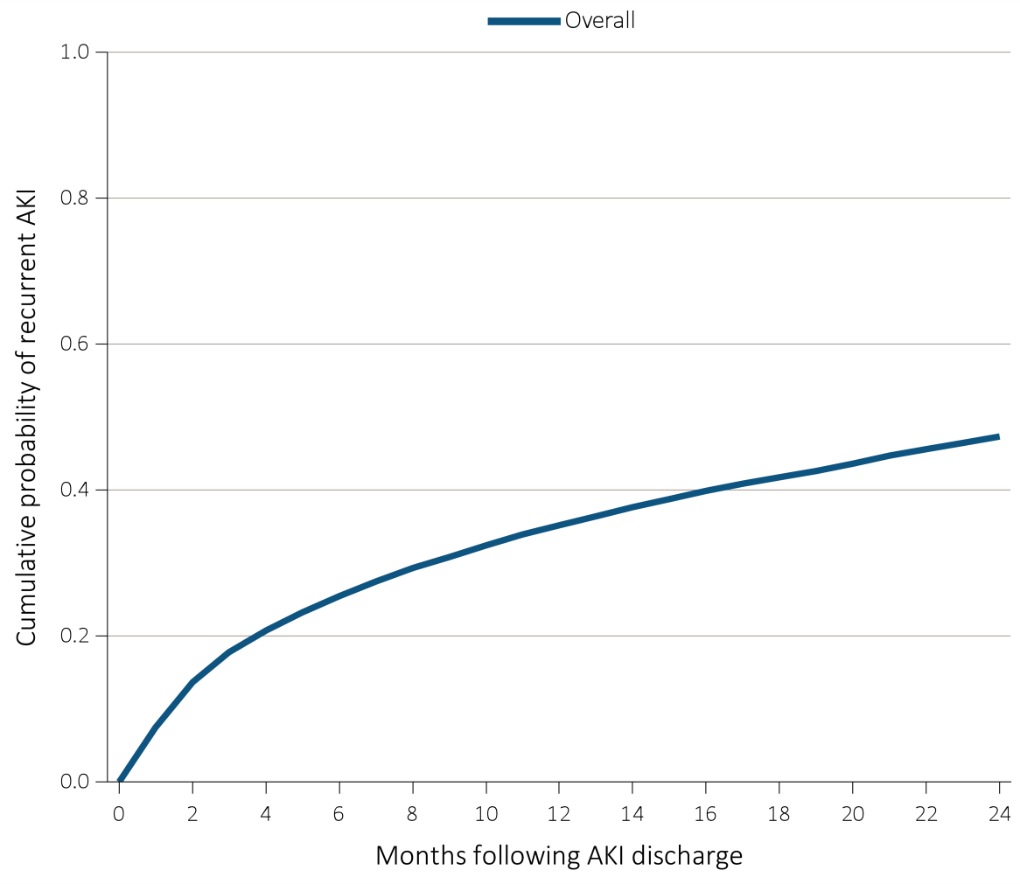
Figure 5.6 Cumulative probability of a recurrent AKI hospitalization within two years of live discharge from first AKI hospitalization in 2012 for Medicare patients aged 66+,
(a) overall, (b) by age, (c) by race, and (d) by CKD and DM
^{(a) Overall}
Data Source: Special analyses, Medicare 5% sample. Age on January 1, 2012. Medicare patients aged 66 and older who had both Medicare Parts A & B, no Medicare Advantage plan, no ESRD by first service date from Medical Evidence form on 1/1/2012, and were discharged alive from an AKI hospitalization in 2012. Censored at death, ESRD, end of Medicare Part A & B participation, or switch to Medicare Advantage program. Abbreviations: AKI, acute kidney injury; CKD, chronic kidney disease; DM, diabetes mellitus; ESRD, end-stage renal disease.

Slide 15
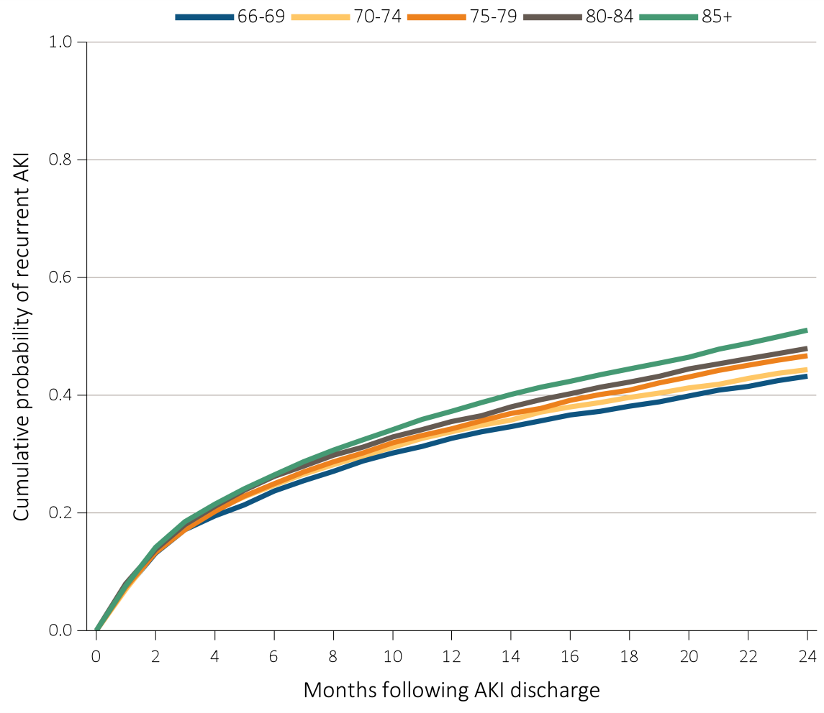
Figure 5.6 Cumulative probability of a recurrent AKI hospitalization within two years of live discharge from first AKI hospitalization in 2012 for Medicare patients aged 66+,
(a) overall, (b) by age, (c) by race, and (d) by CKD and DM
^{(b) Age}
Data Source: Special analyses, Medicare 5% sample. Age on January 1, 2012. Medicare patients aged 66 and older who had both Medicare Parts A & B, no Medicare Advantage plan, no ESRD by first service date from Medical Evidence form on 1/1/2012, and were discharged alive from an AKI hospitalization in 2012. Censored at death, ESRD, end of Medicare Part A & B participation, or switch to Medicare Advantage program. Abbreviations: AKI, acute kidney injury; CKD, chronic kidney disease; DM, diabetes mellitus; ESRD, end-stage renal disease.

Slide 16
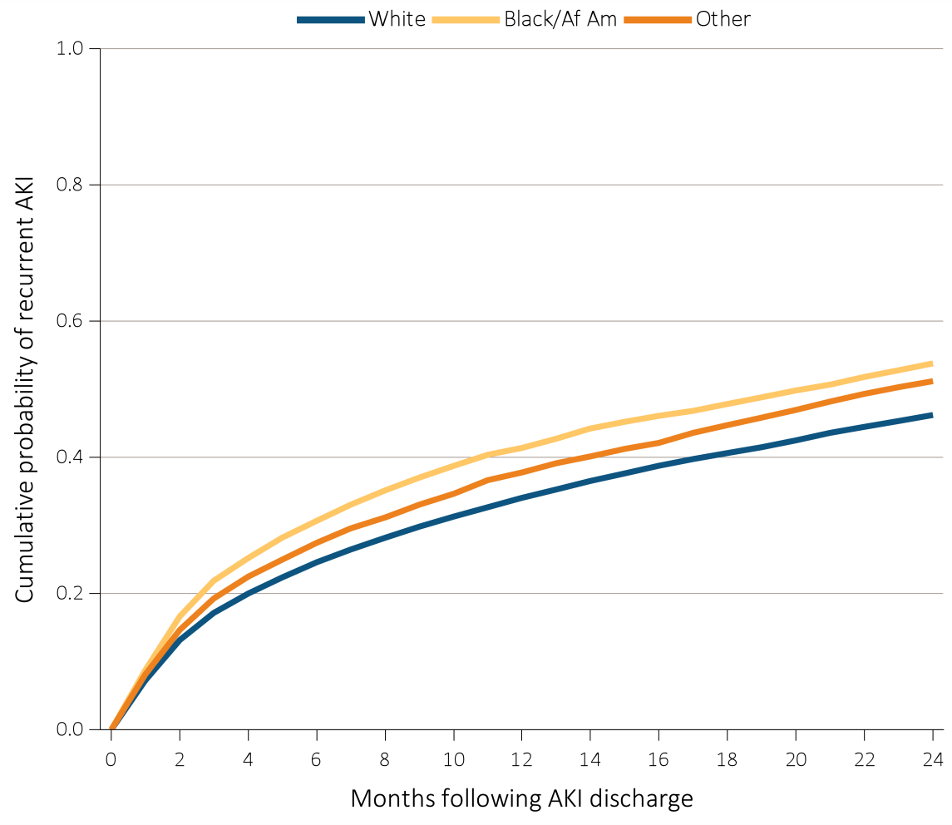
Figure 5.6 Cumulative probability of a recurrent AKI hospitalization within two years of live discharge from first AKI hospitalization in 2012 for Medicare patients aged 66+,
(a) overall, (b) by age, (c) by race, and (d) by CKD and DM
^{(c) Race}
Data Source: Special analyses, Medicare 5% sample. Age on January 1, 2012. Medicare patients aged 66 and older who had both Medicare Parts A & B, no Medicare Advantage plan, no ESRD by first service date from Medical Evidence form on 1/1/2012, and were discharged alive from an AKI hospitalization in 2012. Censored at death, ESRD, end of Medicare Part A & B participation, or switch to Medicare Advantage program. Abbreviations: AKI, acute kidney injury; CKD, chronic kidney disease; DM, diabetes mellitus; ESRD, end-stage renal disease.

Slide 17
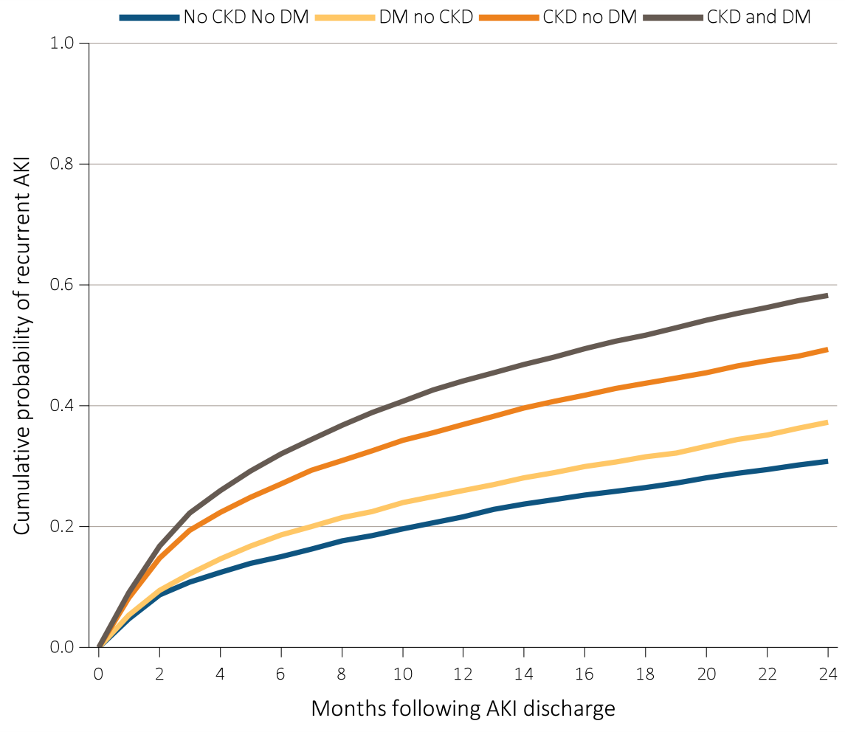
Figure 5.6 Cumulative probability of a recurrent AKI hospitalization within two years of live discharge from first AKI hospitalization in 2012 for Medicare patients aged 66+,
(a) overall, (b) by age, (c) by race, and (d) by CKD and DM
^{(d) CKD and DM}
Data Source: Special analyses, Medicare 5% sample. Age on January 1, 2012. Medicare patients aged 66 and older who had both Medicare Parts A & B, no Medicare Advantage plan, no ESRD by first service date from Medical Evidence form on 1/1/2012, and were discharged alive from an AKI hospitalization in 2012. Censored at death, ESRD, end of Medicare Part A & B participation, or switch to Medicare Advantage program. Abbreviations: AKI, acute kidney injury; CKD, chronic kidney disease; DM, diabetes mellitus; ESRD, end-stage renal disease.

Slide 18
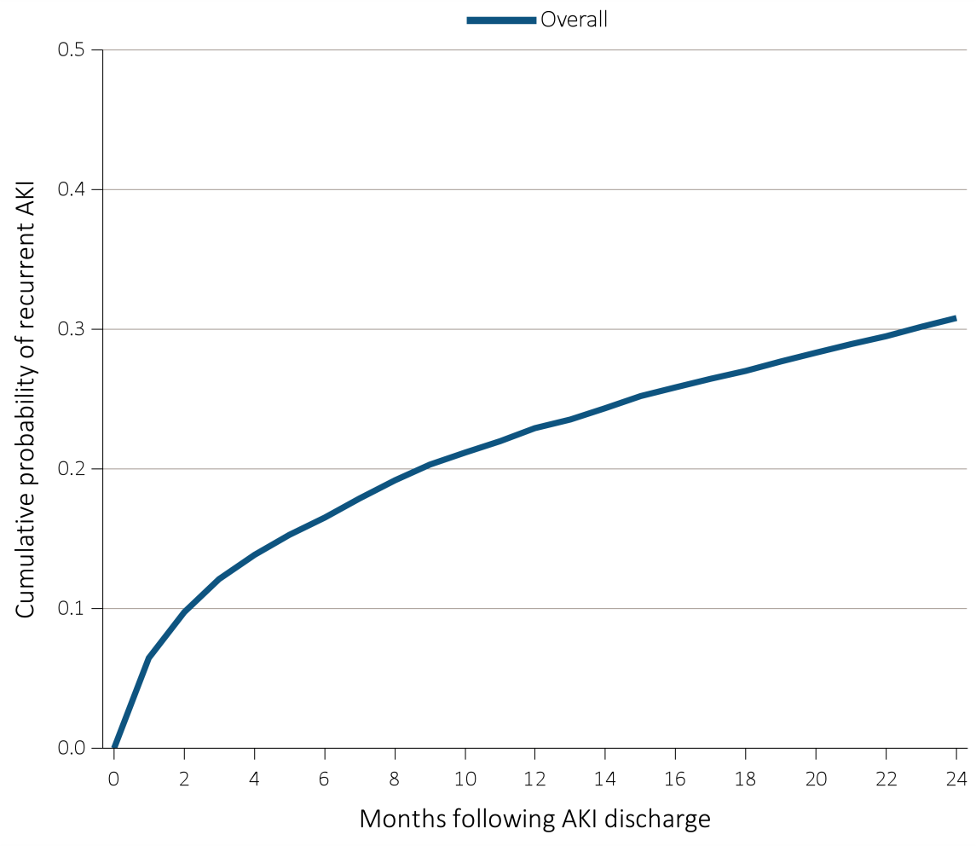
Figure 5.7 Cumulative probability of a recurrent AKI hospitalization within two years of live discharge from first AKI hospitalization in 2012 for Clinformatics™ patients aged 22+, (a) overall, (b) by age, (c) by race, and (d) by CKD and DM
^{(a) Overall}
Data Source: Special analyses, Clinformatics™. Age as of January, 2012. Clinformatics™ commercial insurance patients aged 22 and older who were enrolled in the plan, did not have diagnoses of ESRD on January 1, 2012, and were discharged alive from an AKI hospitalization in 2012. Censored at death, ESRD diagnosis, or plan disenrollment. Abbreviations: AKI, acute kidney injury; CKD, chronic kidney disease; DM, diabetes mellitus; ESRD, end-stage renal disease.

Slide 19
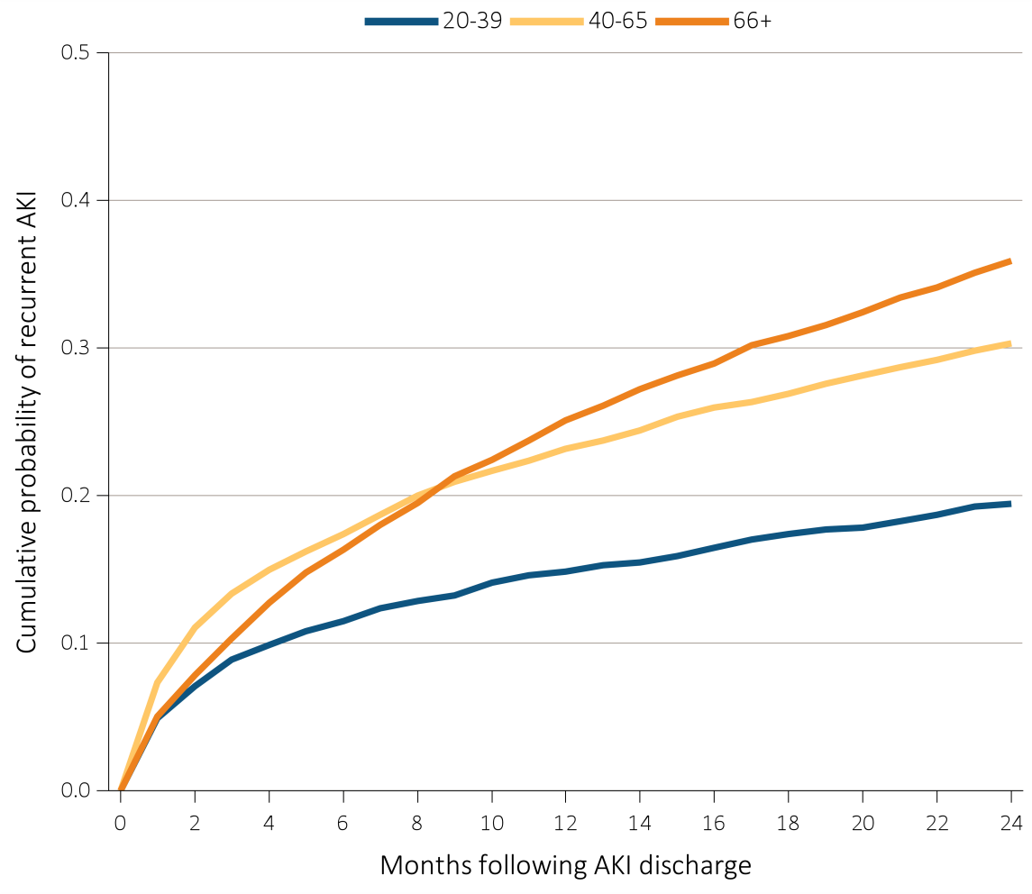
Figure 5.7 Cumulative probability of a recurrent AKI hospitalization within two years of live discharge from first AKI hospitalization in 2012 for Clinformatics™ patients aged 22+, (a) overall, (b) by age, (c) by race, and (d) by CKD and DM
^{(b) Age}
Data Source: Special analyses, Clinformatics™. Age as of January, 2012. Clinformatics™ commercial insurance patients aged 22 and older who were enrolled in the plan, did not have diagnoses of ESRD on January 1, 2012, and were discharged alive from an AKI hospitalization in 2012. Censored at death, ESRD diagnosis, or plan disenrollment. Abbreviations: AKI, acute kidney injury; CKD, chronic kidney disease; DM, diabetes mellitus; ESRD, end-stage renal disease.

Slide 20
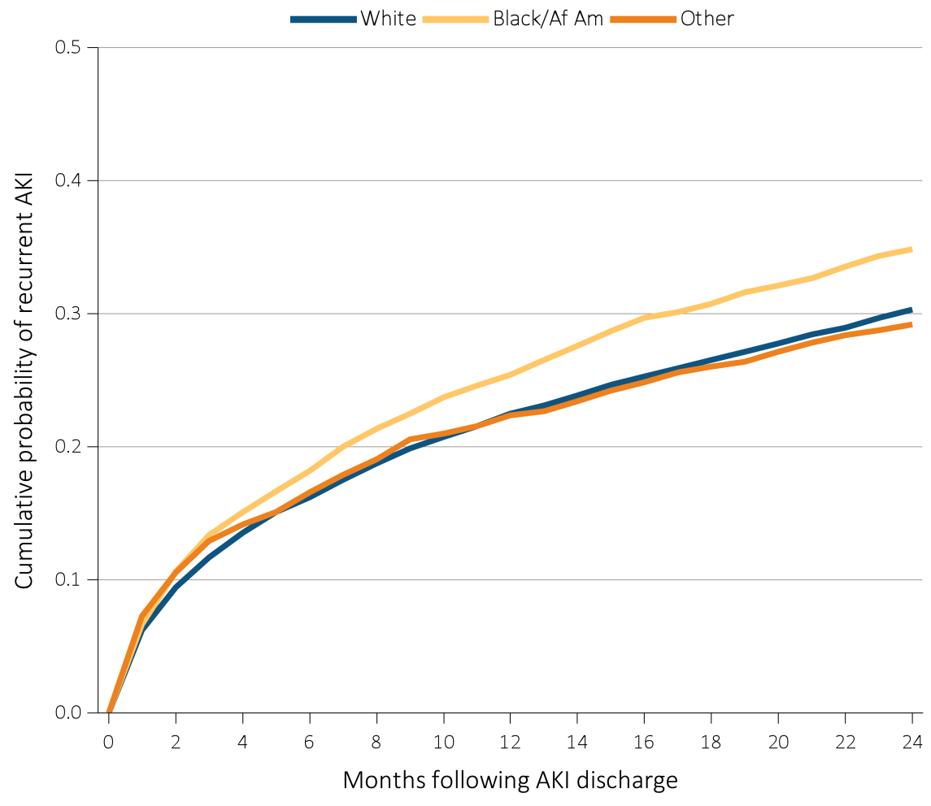
Figure 5.7 Cumulative probability of a recurrent AKI hospitalization within two years of live discharge from first AKI hospitalization in 2012 for Clinformatics™ patients aged 22+, (a) overall, (b) by age, (c) by race, and (d) by CKD and DM
^{(c) Race}
Data Source: Special analyses, Clinformatics™. Age as of January, 2012. Clinformatics™ commercial insurance patients aged 22 and older who were enrolled in the plan, did not have diagnoses of ESRD on January 1, 2012, and were discharged alive from an AKI hospitalization in 2012. Censored at death, ESRD diagnosis, or plan disenrollment. Abbreviations: AKI, acute kidney injury; CKD, chronic kidney disease; DM, diabetes mellitus; ESRD, end-stage renal disease.

Slide 21
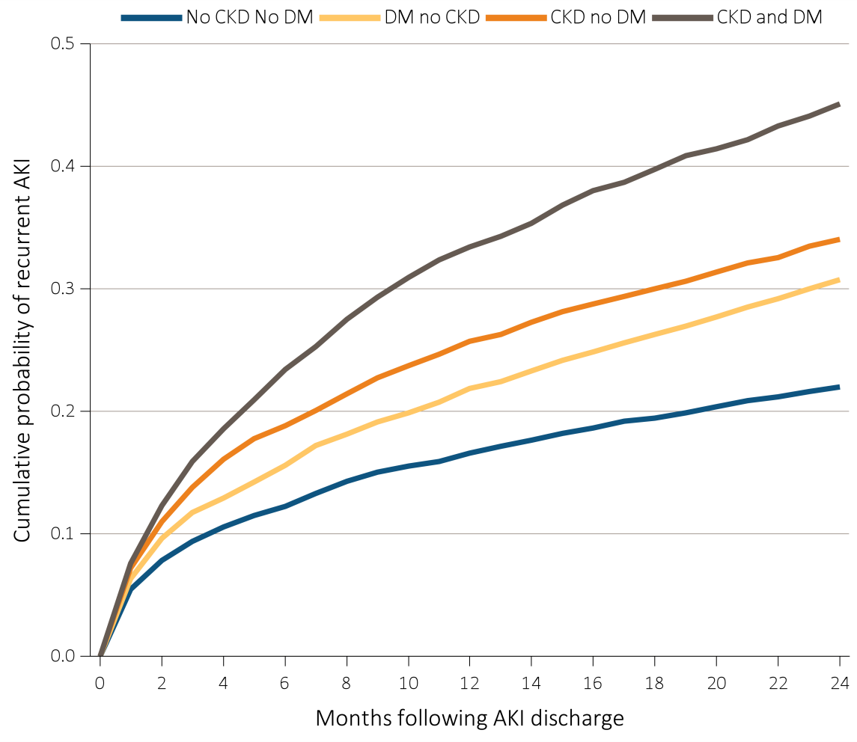
Figure 5.7 Cumulative probability of a recurrent AKI hospitalization within two years of live discharge from first AKI hospitalization in 2012 for Clinformatics™ patients aged 22+, (a) overall, (b) by age, (c) by race, and (d) by CKD and DM
^{(d) CKD and DM}
Data Source: Special analyses, Clinformatics™. Age as of January, 2012. Clinformatics™ commercial insurance patients aged 22 and older who were enrolled in the plan, did not have diagnoses of ESRD on January 1, 2012, and were discharged alive from an AKI hospitalization in 2012. Censored at death, ESRD diagnosis, or plan disenrollment. Abbreviations: AKI, acute kidney injury; CKD, chronic kidney disease; DM, diabetes mellitus; ESRD, end-stage renal disease.

Slide 22
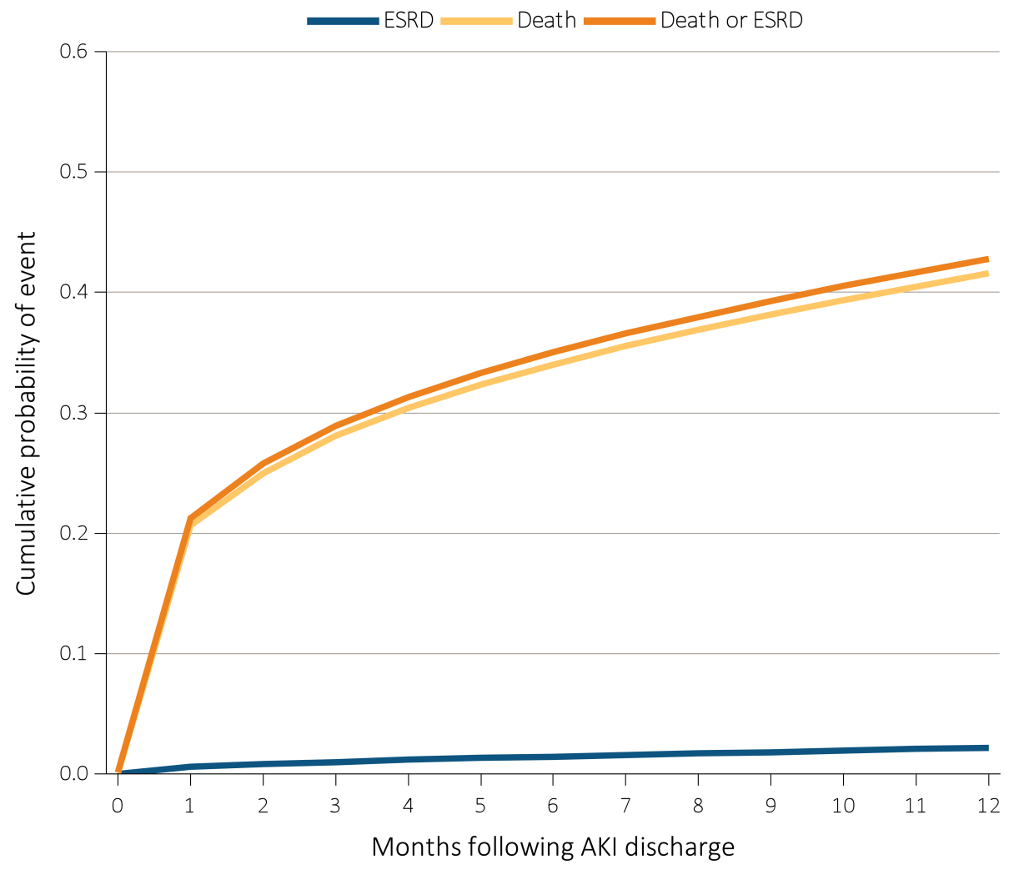
Figure 5.8 Cumulative probability of death-censored ESRD, death, and the composite of death or ESRD within one year of live discharge from first AKI hospitalization occurring in 2012-2013 for Medicare patients aged 66+
Data Source: Special analyses, Medicare 5% sample. Medicare patients aged 66 and older who had both Medicare Parts A & B, no Medicare Advantage plan, no ESRD by first service date from Medical Evidence form, and were discharged alive from a first AKI hospitalization in 2012 or 2013. All models censored at the end of Medicare Part A & B participation, switch to Medicare Advantage program, or 365 days after AKI discharge. Model for ESRD also is censored at death. Model for death is not censored at the start of ESRD. Abbreviations: AKI, acute kidney injury; ESRD, end-stage renal disease.

Slide 23
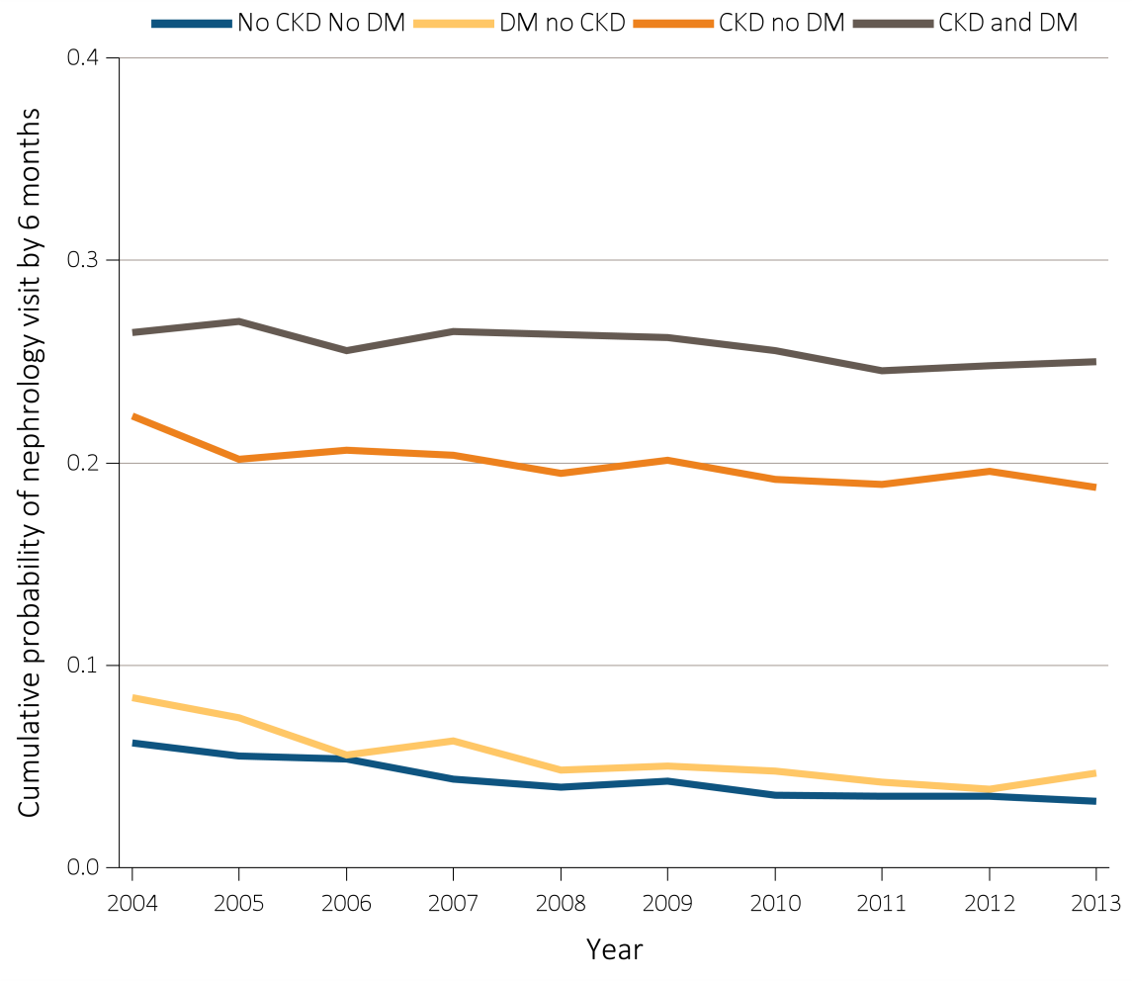
Figure 5.9 Cumulative probability of a claim for an outpatient nephrology visit within six months of live discharge from first AKI hospitalization, by CKD, DM, 2004-2013
^{(a) Medicare (aged 66+)}
Data Source: Special analyses, Medicare 5% sample and Clinformatics™. (a) Medicare patients aged 66 and older who had both Medicare Parts A & B, no Medicare Advantage plan, no ESRD by first service date from Medical Evidence form on January 1 of year shown and were discharged alive from a first AKI hospitalization during the year. Censored at death, ESRD, end of Medicare Part A & B participation, or switch to Medicare Advantage program. Physician visits are from physician/supplier claims with provider specialty codes for nephrology (39) and claim source indicating an outpatient setting. (b) Clinformatics™ commercial insurance patients aged 22 and older who were enrolled in the plan, did not have diagnoses of ESRD, and were discharged alive from an AKI hospitalization in the year shown. Censored at death, ESRD, or plan disenrollment. Provider specialty of “nephrologist” used to identify nephrology visits. Abbreviations: AKI, acute kidney injury; CKD, chronic kidney disease; DM, diabetes mellitus; ESRD, end-stage renal disease.

Slide 24
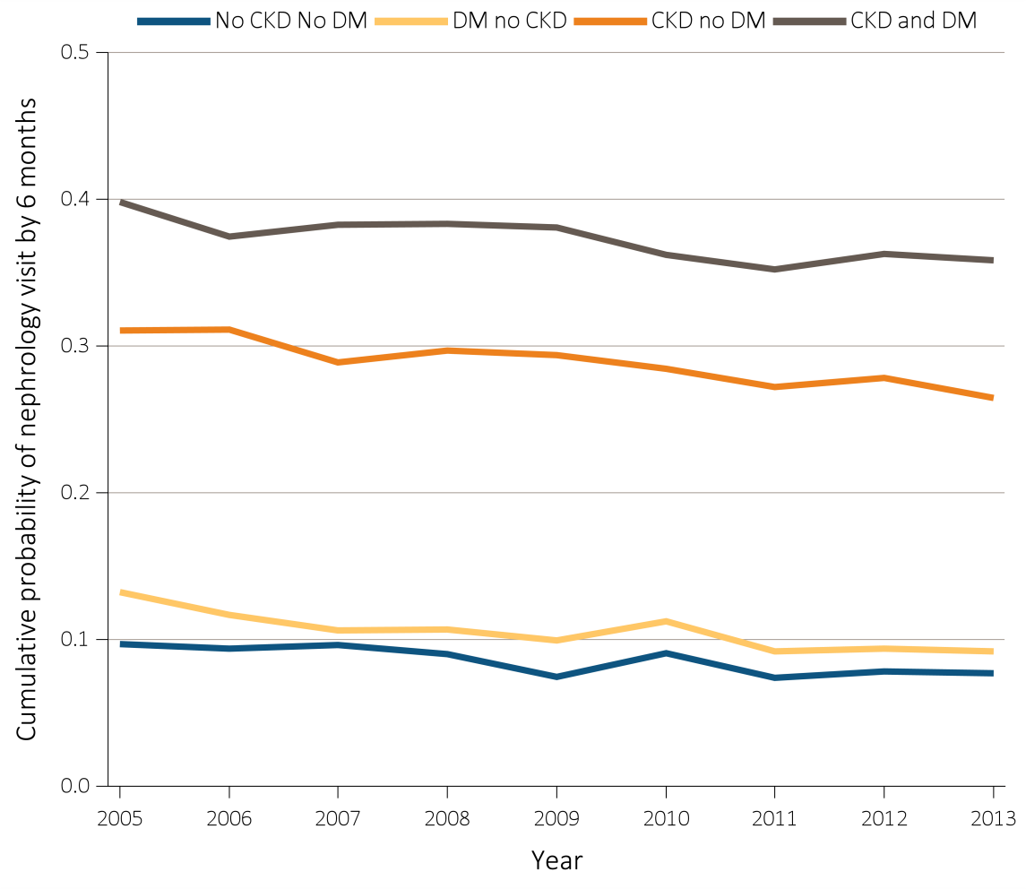
Figure 5.9 Cumulative probability of a claim for an outpatient nephrology visit within six months of live discharge from first AKI hospitalization, by CKD, DM, 2004-2013
^{(b) Clinformatics™ (aged 22+)}
Data Source: Special analyses, Medicare 5% sample and Clinformatics™. (a) Medicare patients aged 66 and older who had both Medicare Parts A & B, no Medicare Advantage plan, no ESRD by first service date from Medical Evidence form on January 1 of year shown and were discharged alive from a first AKI hospitalization during the year. Censored at death, ESRD, end of Medicare Part A & B participation, or switch to Medicare Advantage program. Physician visits are from physician/supplier claims with provider specialty codes for nephrology (39) and claim source indicating an outpatient setting. (b) Clinformatics™ commercial insurance patients aged 22 and older who were enrolled in the plan, did not have diagnoses of ESRD, and were discharged alive from an AKI hospitalization in the year shown. Censored at death, ESRD, or plan disenrollment. Provider specialty of “nephrologist” used to identify nephrology visits. Abbreviations: AKI, acute kidney injury; CKD, chronic kidney disease; DM, diabetes mellitus; ESRD, end-stage renal disease.

Slide 25
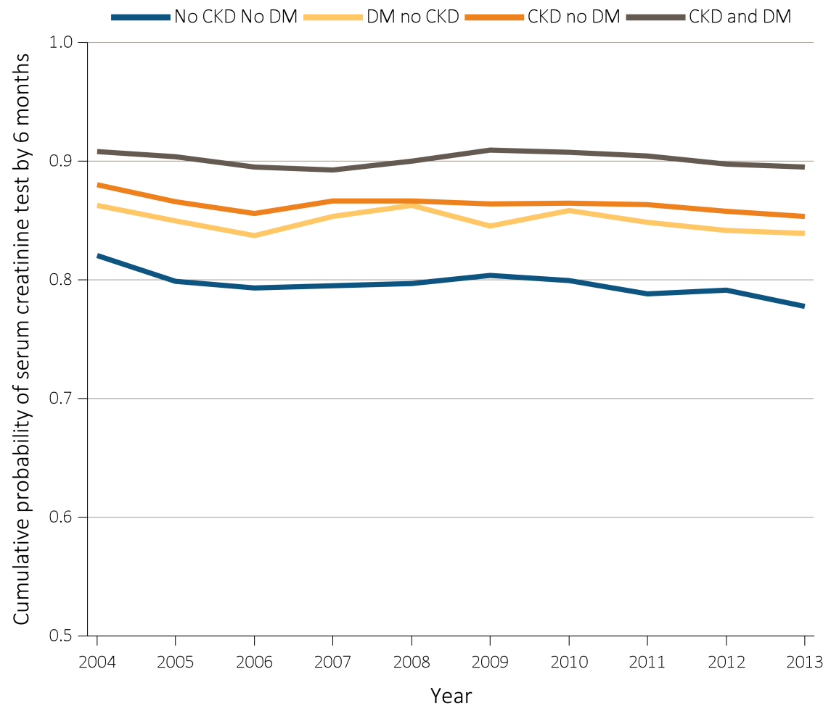
Figure 5.10 Cumulative probability of a claim for a serum creatinine test within six months of live discharge from first AKI hospitalization by CKD, DM, 2004-2014
^{(a) Medicare (aged 66+)}
Data Source: Special analyses, Medicare 5% sample and Clinformatics™. (a) Medicare patients aged 66 and older who had both Medicare Parts A & B, no Medicare Advantage plan, no ESRD by first service date from Medical Evidence form on January 1 of year shown and were discharged alive from a first AKI hospitalization in year shown. Censored at death, ESRD, end of Medicare Part A & B participation, or switch to Medicare Advantage program. (b) Clinformatics™ commercial insurance patients aged 22 and older who were enrolled in the plan, did not have diagnoses of ESRD, and were discharged alive from an AKI hospitalization in the year shown. Censored at death, ESRD diagnosis, or plan disenrollment. In both panels, date of first serum creatinine test following AKI discharge is from inpatient and outpatient claims with Healthcare Common Procedure Coding System (HCPCS) codes of 80048, 80050, 80053, 80069, or 82565. Abbreviations: AKI, acute kidney injury; CKD, chronic kidney disease; DM, diabetes mellitus; ESRD, end-stage renal disease.

Slide 26
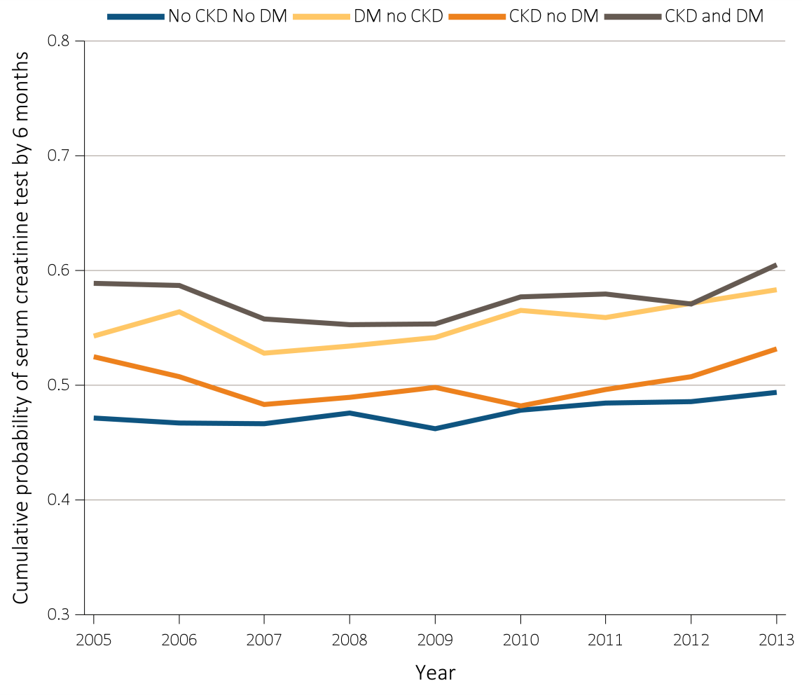
Figure 5.10 Cumulative probability of a claim for a serum creatinine test within six months of live discharge from first AKI hospitalization by CKD, DM, 2004-2014
^{(b) Clinformatics™ (aged 22+)}
Data Source: Special analyses, Medicare 5% sample and Clinformatics™. (a) Medicare patients aged 66 and older who had both Medicare Parts A & B, no Medicare Advantage plan, no ESRD by first service date from Medical Evidence form on January 1 of year shown and were discharged alive from a first AKI hospitalization in year shown. Censored at death, ESRD, end of Medicare Part A & B participation, or switch to Medicare Advantage program. (b) Clinformatics™ commercial insurance patients aged 22 and older who were enrolled in the plan, did not have diagnoses of ESRD, and were discharged alive from an AKI hospitalization in the year shown. Censored at death, ESRD diagnosis, or plan disenrollment. In both panels, date of first serum creatinine test following AKI discharge is from inpatient and outpatient claims with Healthcare Common Procedure Coding System (HCPCS) codes of 80048, 80050, 80053, 80069, or 82565. Abbreviations: AKI, acute kidney injury; CKD, chronic kidney disease; DM, diabetes mellitus; ESRD, end-stage renal disease.

Slide 27
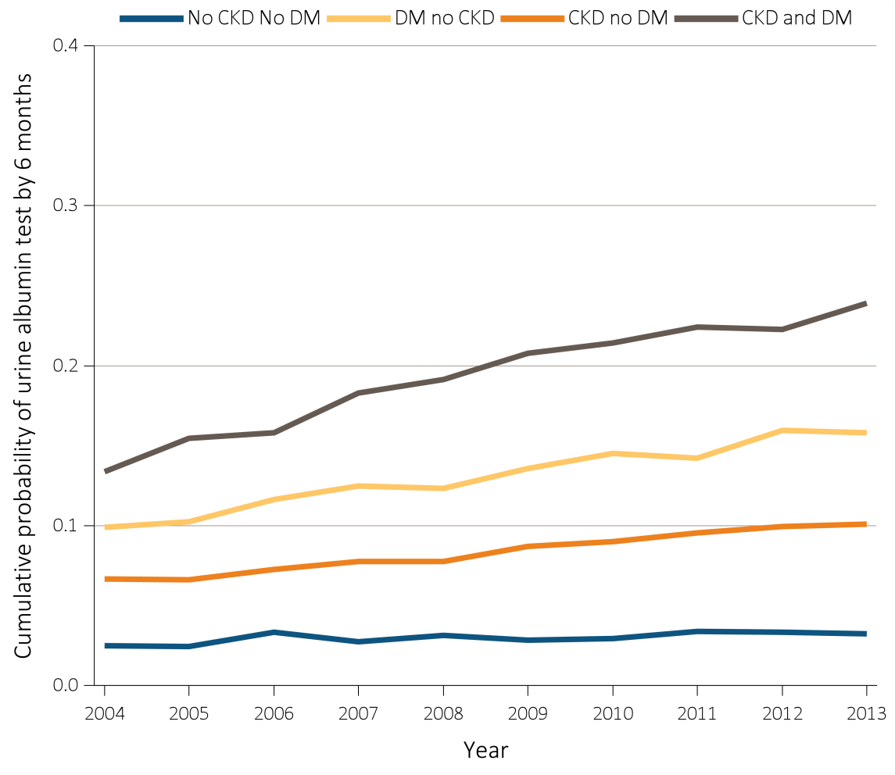
Figure 5.11 Cumulative probability of a claim for an urine albumin test within six months of live discharge from first AKI hospitalization by CKD, DM, 2004-2014
^{(a) Medicare (aged 66+)}
Data Source: Special analyses, Medicare 5% sample and Clinformatics™. (a) Medicare patients aged 66 and older who had both Medicare Parts A and B, no Medicare Advantage plan, no ESRD by first service date from Medical Evidence form on January 1 of year shown, and were discharged alive from a first AKI hospitalization in 2013. Censored at death, ESRD, end of Medicare Part A & B participation, or switch to Medicare Advantage program. (b) Clinformatics™ commercial insurance patients aged 22 and older who were enrolled in the plan, did not have diagnoses of ESRD, and were discharged alive from an AKI hospitalization in the year shown. Censored at death, ESRD diagnosis, or plan disenrollment. In both panels, date of first urine albumin test following AKI discharge is from inpatient and outpatient claims with Healthcare Common Procedure Coding System (HCPCS) codes of 82042, 82043, 82044, or 84156. Abbreviations: AKI, acute kidney injury; CKD, chronic kidney disease; DM, diabetes mellitus; ESRD, end-stage renal disease.

Slide 28
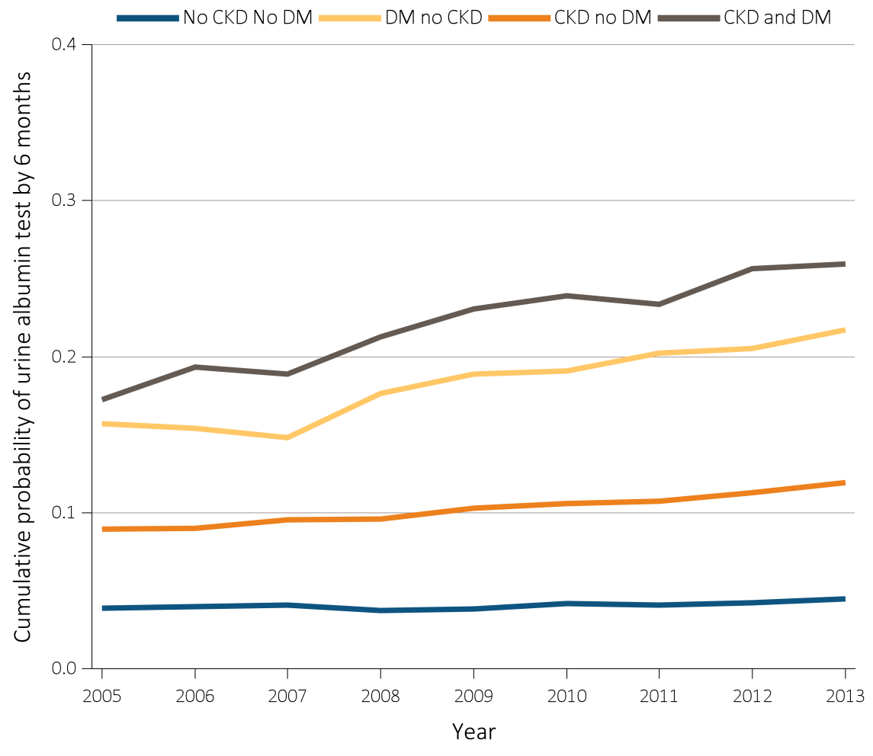
Figure 5.11 Cumulative probability of a claim for an urine albumin test within six months of live discharge from first AKI hospitalization by CKD, DM, 2004-2014
^{(b) Clinformatics™ (aged 22+)}
Data Source: Special analyses, Medicare 5% sample and Clinformatics™. (a) Medicare patients aged 66 and older who had both Medicare Parts A and B, no Medicare Advantage plan, no ESRD by first service date from Medical Evidence form on January 1 of year shown, and were discharged alive from a first AKI hospitalization in 2013. Censored at death, ESRD, end of Medicare Part A & B participation, or switch to Medicare Advantage program. (b) Clinformatics™ commercial insurance patients aged 22 and older who were enrolled in the plan, did not have diagnoses of ESRD, and were discharged alive from an AKI hospitalization in the year shown. Censored at death, ESRD diagnosis, or plan disenrollment. In both panels, date of first urine albumin test following AKI discharge is from inpatient and outpatient claims with Healthcare Common Procedure Coding System (HCPCS) codes of 82042, 82043, 82044, or 84156. Abbreviations: AKI, acute kidney injury; CKD, chronic kidney disease; DM, diabetes mellitus; ESRD, end-stage renal disease.

Slide 29
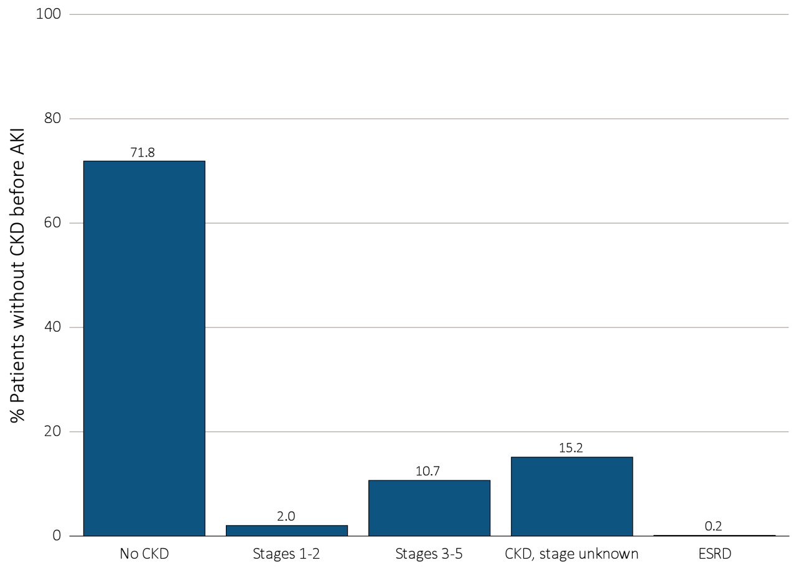
Figure 5.12 Renal status one year following discharge from AKI hospitalization in 2012-2013, among surviving Medicare patients aged 66+ without kidney disease prior to AKI hospitalization, by CKD stage and ESRD status
Data Source: Special analyses, Medicare 5% sample. Medicare patients aged 66 and older who had both Medicare Parts A & B, no Medicare Advantage plan, did not have ESRD, were discharged alive from a first AKI hospitalization in 2012 or 2013, and did not have any claims with a diagnosis of CKD in the 365 days prior to the AKI. Renal status after AKI determined from claims between discharge from AKI hospitalization and 365 days after discharge. Stage determined by 585.x claim closest to 365 days after discharge; ESRD by first service date on Medical Evidence form. Abbreviations: AKI, acute kidney injury; CKD, chronic kidney disease; ESRD, end-stage renal disease.

Slide 30
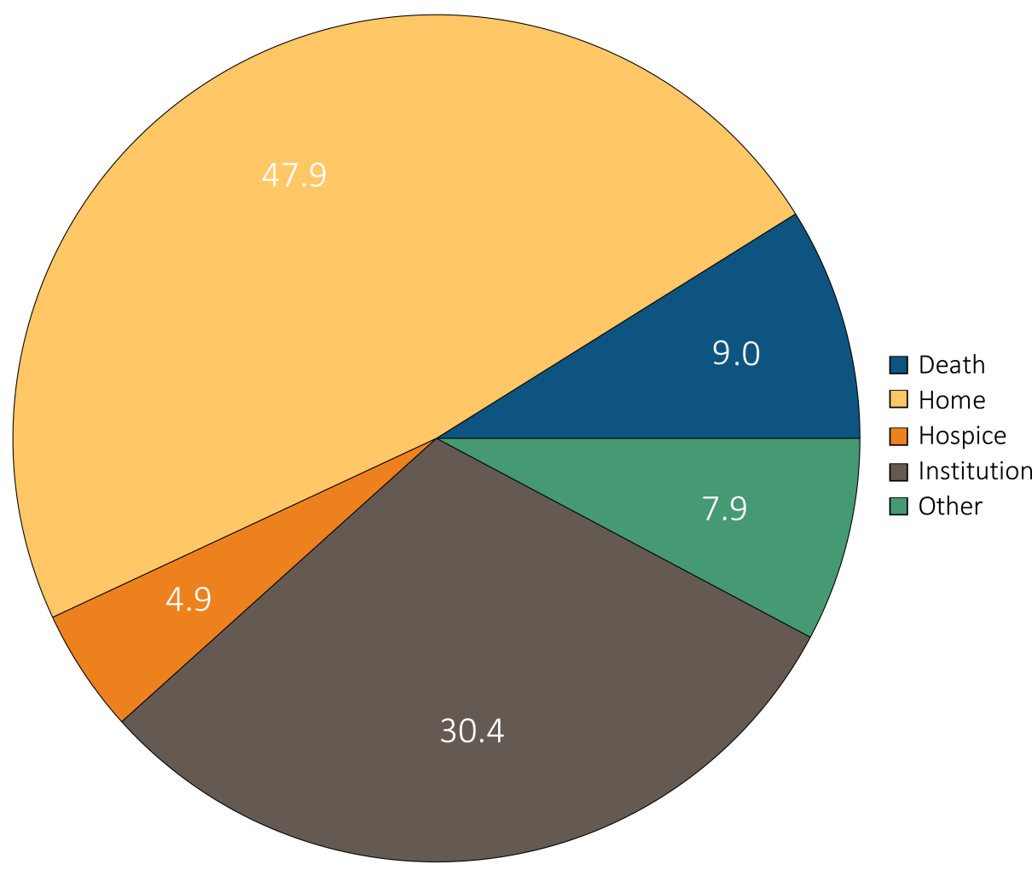
Figure 5.13 Hospital discharge status of first hospitalization for Medicare patients aged 66+ (a) with diagnosis of AKI during stay, and (b) without diagnosis of AKI during stay, 2014
(a) With diagnosis of AKI during stay
Data Source: Special analyses, Medicare 5% sample. Medicare patients aged 66 and older who had both Medicare Parts A & B, no Medicare Advantage plan, did not have ESRD on 1/1/2014, had a first hospitalization in 2014, and were not admitted to the acute care hospital from a skilled nursing facility. Institution includes short-term skilled nursing facilities, rehabilitation hospitals, and long-term care facilities. Home also includes patients receiving home health care services. Abbreviations: AKI, acute kidney injury; ESRD, end-stage renal disease.

Slide 31
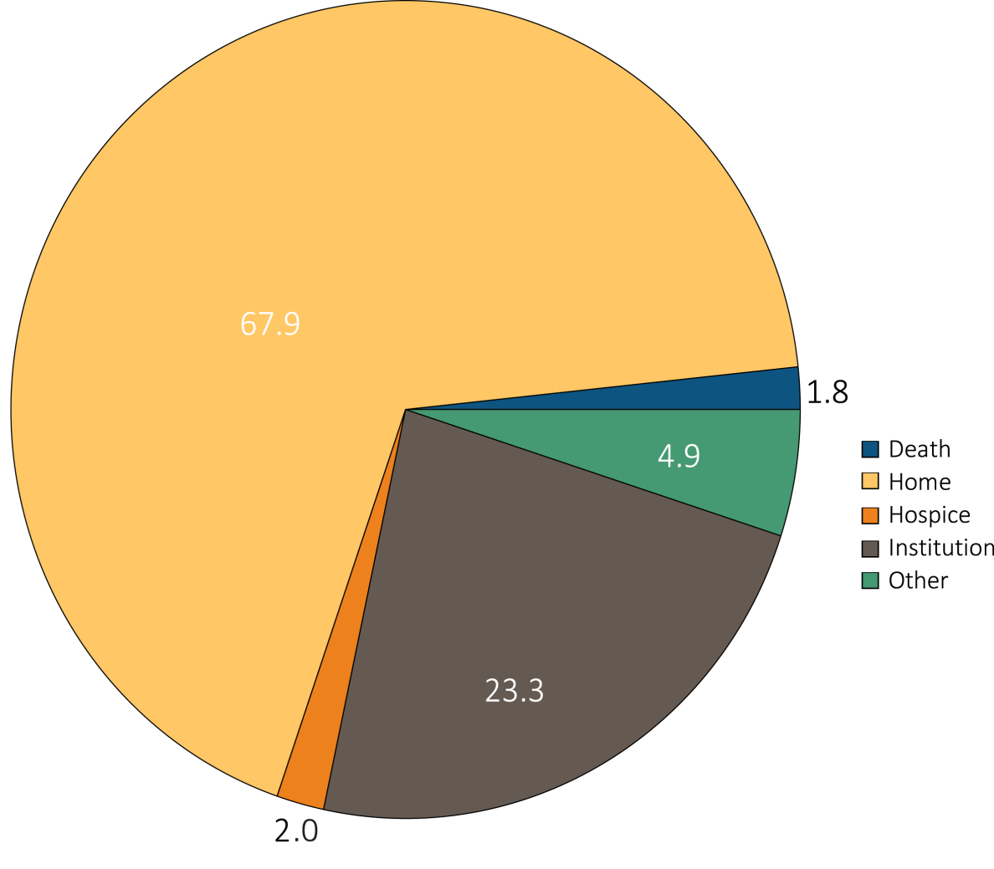
Figure 5.13 Hospital discharge status of first hospitalization for Medicare patients aged 66+ (a) with diagnosis of AKI during stay, and (b) without diagnosis of AKI during stay, 2014
(b) Without diagnosis of AKI during stay
Data Source: Special analyses, Medicare 5% sample. Medicare patients aged 66 and older who had both Medicare Parts A & B, no Medicare Advantage plan, did not have ESRD on 1/1/2014, had a first hospitalization in 2014, and were not admitted to the acute care hospital from a skilled nursing facility. Institution includes short-term skilled nursing facilities, rehabilitation hospitals, and long-term care facilities. Home also includes patients receiving home health care services. Abbreviations: AKI, acute kidney injury; ESRD, end-stage renal disease.

