Slide 2
Table 6.1 Prevalent Medicare fee-for-service patient counts and spending for beneficiaries aged 65 and older, by DM, CHF, and/or CKD, 2014
 | U.S. Medicare Population | Total Costs (millions, U.S. $) | PPPY Costs (U.S. $) | Population (%) | Costs (%)
All | 24,496,020 | $254,356 | $10,803 | 100.00 | 100.00
With CHF or CKD or DM | 8,140,540 | $130,220 | $17,013 | 33.23 | 51.20
CKD only (- DM & CHF) | 1,023,220 | $15,109 | $15,673 | 4.18 | 5.94
DM only (- CHF & CKD) | 4,093,320 | $47,846 | $12,116 | 16.71 | 18.81
CHF only (- DM & CKD) | 893,760 | $16,955 | $20,733 | 3.65 | 6.67
CKD and DM only (- CHF) | 847,220 | $14,856 | $18,610 | 3.46 | 5.84
CKD and CHF only (- DM) | 340,300 | $8,829 | $30,395 | 1.39 | 3.47
DM and CHF only (- CKD) | 515,500 | $12,599 | $26,758 | 2.10 | 4.95
CKD and CHF and DM | 427,220 | $14,025 | $38,561 | 1.74 | 5.51
No CKD or DM or CHF | 16,355,480 | $124,136 | $7,812 | 66.77 | 48.80
All CKD (+/- DM & CHF) | 2,637,960 | $52,819 | $21,857 | 10.77 | 20.77
All DM (+/- CKD & CHF) | 5,883,260 | $89,327 | $16,003 | 24.02 | 35.12
All CHF (+/- DM & CKD) | 2,176,780 | $52,409 | $26,975 | 8.89 | 20.60
CKD and DM (+/- CHF) | 1,274,440 | $28,882 | $24,854 | 5.20 | 11.36
CKD and CHF (+/- DM) | 767,520 | $22,854 | $34,935 | 3.13 | 8.99
DM and CHF (+/- CKD) | 942,720 | $26,625 | $31,902 | 3.85 | 10.47
Data Source: Medicare 5% sample. Abbreviations: CKD, chronic kidney disease; CHF, congestive heart failure; DM, diabetes mellitus; PPPY, per patient per year costs.

Slide 3
Table 6.2 Prevalent Medicare fee-for-service patient counts and spending for beneficiaries younger than age 65,
by DM, CHF, and/or CKD, 2014
 | U.S. Medicare Population | Total Costs (millions, U.S. $) | PPPY Costs (U.S. $) | Population (%) | Costs (%)
All | 5,121,280 | $61,479 | $12,524 | 100.00 | 100.00
With CHF or CKD or DM | 1,322,060 | $26,830 | $21,479 | 25.82 | 43.64
CKD only (- DM & CHF) | 101,280 | $2,199 | $23,125 | 1.98 | 3.58
DM only (- CHF & CKD) | 837,480 | $13,531 | $16,882 | 16.35 | 22.01
CHF only (- DM & CKD) | 102,740 | $2,292 | $23,678 | 2.01 | 3.73
CKD and DM only (- CHF) | 115,440 | $3,022 | $28,325 | 2.25 | 4.92
CKD and CHF only (- DM) | 22,120 | $743 | $37,972 | 0.43 | 1.21
DM and CHF only (- CKD) | 89,400 | $2,774 | $33,358 | 1.75 | 4.51
CKD and CHF and DM | 53,600 | $2,269 | $49,049 | 1.05 | 3.69
No CKD or DM or CHF | 3,799,220 | $34,649 | $9,468 | 74.19 | 56.36
All CKD (+/- DM & CHF) | 292,440 | $8,232 | $30,764 | 5.71 | 13.39
All DM (+/- CKD & CHF) | 1,095,920 | $21,596 | $20,813 | 21.40 | 35.13
All CHF (+/- DM & CKD) | 267,860 | $8,078 | $32,865 | 5.23 | 13.14
CKD and DM (+/- CHF) | 169,040 | $5,291 | $34,592 | 3.30 | 8.61
CKD and CHF (+/- DM) | 75,720 | $3,011 | $45,757 | 1.48 | 4.90
DM and CHF (+/- CKD) | 143,000 | $5,043 | $38,966 | 2.79 | 8.20
Data Source: Medicare 5% sample. Abbreviations: CKD, chronic kidney disease; CHF, congestive heart failure; DM, diabetes mellitus; PPPY, per patient per year costs.

Slide 4
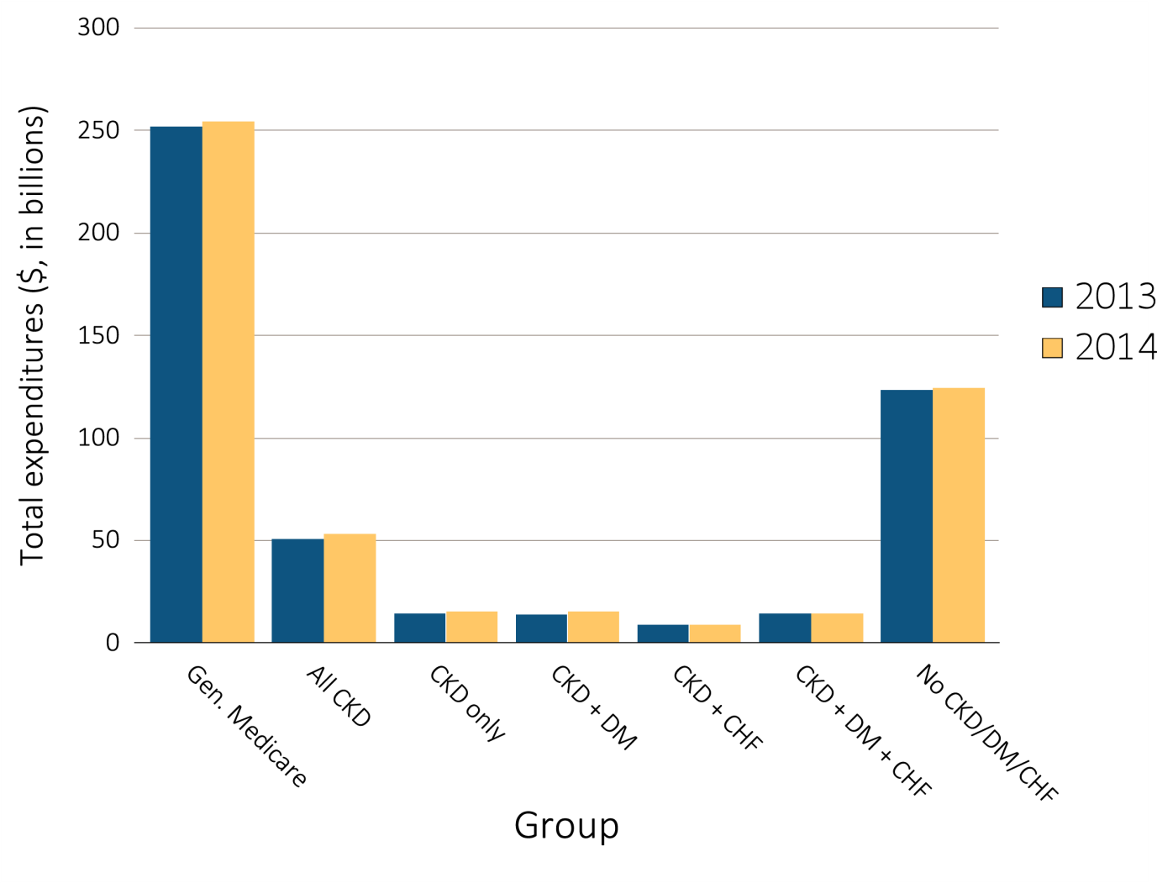
Figure 6.1 Overall Medicare Parts A, B, and D fee-for-service spending for beneficiaries aged 65 and older, by CKD, DM, CHF, and year,
2013 & 2014
Data source: Medicare 5% sample. Abbreviations: CKD, chronic kidney disease; CHF, congestive heart failure, DM, diabetes mellitus.

Slide 5
Table 6.3 Per person per year Medicare Parts A, B, and D fee-for-service spending for all CKD beneficiaries aged 65 and older,
by CKD stage, age, sex, race, and year, 2013 & 2014
 | 2013 |  |  |  |  |  | 2014
 | Any CKD | Stages 1-2 | Stage 3 | Stages 4-5 | Unk/ Unspc |  | Any CKD | Stages 1-2 | Stage 3 | Stages 4-5 | Unk/ Unspc
Patient years at risk | 2,300,185 | 227,240 | 1,023,212 | 229,794 | 819,940 |  | 2,416,542 | 248,264 | 1,125,979 | 227,522 | 814,776
All patients | $22,000 | $19,926 | $21,339 | $27,580 | $21,836 |  | $21,857 | $19,075 | $21,176 | $28,541 | $21,781
Age
65-69 | $21,054 | $17,013 | $20,891 | $31,048 | $20,387 |  | $20,672 | $17,301 | $20,399 | $30,169 | $20,085
70-74 | $20,374 | $17,545 | $19,566 | $26,823 | $20,707 |  | $20,365 | $17,440 | $19,957 | $28,312 | $20,172
75-79 | $21,537 | $20,037 | $20,904 | $26,564 | $21,431 |  | $21,432 | $17,389 | $20,857 | $28,836 | $21,647
80-84 | $22,464 | $21,296 | $21,549 | $27,563 | $22,444 |  | $22,104 | $20,458 | $21,127 | $27,564 | $22,344
85+ | $23,819 | $23,691 | $23,167 | $27,319 | $23,463 |  | $23,874 | $23,123 | $22,823 | $28,472 | $23,899
Sex
Male | $21,638 | $19,849 | $21,312 | $26,960 | $21,147 |  | $21,452 | $18,868 | $20,993 | $28,061 | $21,143
Female | $22,322 | $19,999 | $21,363 | $28,077 | $22,449 |  | $22,223 | $19,270 | $21,342 | $28,932 | $22,355
Race
White | $21,633 | $19,686 | $21,007 | $26,698 | $21,573 |  | $21,473 | $18,852 | $20,855 | $27,764 | $21,412
Black/African American | $24,413 | $20,839 | $23,358 | $32,551 | $23,901 |  | $24,604 | $21,039 | $23,593 | $32,269 | $24,415
Other | $22,811 | $21,014 | $22,578 | $28,088 | $22,154 |  | $22,370 | $18,451 | $21,525 | $30,563 | $22,734
Data source: Medicare 5% sample. Abbreviations: CKD, chronic kidney disease; Unk/unspc, CKD stage unknown or unspecified.

Slide 6
Table A. ICD-9-CM codes for Chronic Kidney Disease (CKD) stages
ICD-9-CM codeª | Stage
585.1 | CKD, Stage 1
585.2 | CKD, Stage 2 (mild)
585.3 | CKD, Stage 3 (moderate)
585.4 | CKD, Stage 4 (severe)
585.5 | CKD, Stage 5 (excludes 585.6: Stage 5, requiring chronic dialysis^{b})
CKD Stage-unspecified | For these analyses, identified by multiple codes including 585.9, 250.4x, 403.9xm & others
ª For analyses in this chapter, CKD stage estimates require at least one occurrence of a stage-specific code, and the last available CKD stage in a given year is used.
^{b} In USRDS analyses, patients with ICD-9-CM code 585.6 & with no ESRD 2728 form or other indication of end-stage renal disease (ESRD) are considered to have code 585.5.

Slide 7
Table 6.4 Per person per year Medicare Parts A, B, and D fee-for-service spending for CKD patients with DM, aged 65 and older, by CKD stage, age, sex, race, and year, 2013 & 2014
 | 2013 |  |  |  |  |  | 2014
 | Any CKD | Stages 1-2 | Stage 3 | Stages 4-5 | Unk/ Unspc |  | Any CKD | Stages 1-2 | Stage 3 | Stages 4-5 | Unk/ Unspc
Patient years at risk | 1,100,789 | 110,908 | 499,895 | 120,672 | 369,313 |  | 1,162,039 | 120,068 | 549,905 | 119,511 | 372,555
All patients | $25,034 | $22,468 | $24,557 | $31,639 | $24,291 |  | $24,854 | $21,482 | $24,369 | $32,330 | $24,260
Age
65-69 | $24,665 | $19,831 | $24,646 | $35,220 | $23,439 |  | $23,970 | $19,346 | $24,496 | $32,826 | $22,667
70-74 | $23,240 | $20,547 | $22,850 | $29,726 | $22,727 |  | $23,569 | $20,210 | $23,218 | $32,770 | $22,743
75-79 | $24,517 | $22,397 | $23,965 | $30,320 | $24,064 |  | $24,376 | $19,584 | $24,146 | $31,704 | $24,090
80-84 | $25,544 | $25,411 | $24,708 | $31,886 | $24,506 |  | $25,214 | $24,877 | $24,083 | $30,914 | $25,039
85+ | $27,560 | $25,850 | $27,130 | $32,040 | $26,846 |  | $27,346 | $25,921 | $26,190 | $33,411 | $26,959
Sex
Male | $24,105 | $21,913 | $23,976 | $30,246 | $23,131 |  | $23,899 | $21,157 | $23,721 | $31,034 | $23,008
Female | $25,928 | $23,030 | $25,133 | $32,765 | $25,413 |  | $25,790 | $21,821 | $25,020 | $33,379 | $25,490
Race
White | $24,670 | $22,102 | $24,217 | $30,861 | $24,093 |  | $24,347 | $21,196 | $23,886 | $31,216 | $23,900
Black/African American | $27,073 | $23,419 | $26,339 | $35,701 | $25,747 |  | $27,980 | $22,991 | $27,077 | $37,360 | $27,201
Other | $25,242 | $23,934 | $25,170 | $30,824 | $23,930 |  | $24,832 | $21,589 | $25,023 | $32,828 | $23,314
Data source: Medicare 5% sample. Abbreviations: CKD, chronic kidney disease; Unk/unspc, CKD stage unknown or unspecified.

Slide 8
Table 6.5 Per person per year Medicare Parts A, B, and D fee-for-service spending for CKD patients with CHF, aged 65 and older, by CKD stage, age, sex, race, and year, 2013 & 2014
 | 2013 |  |  |  |  |  | 2014
 | Any CKD | Stages 1-2 | Stage 3 | Stages 4-5 | Unk/ Unspc |  | Any CKD | Stages 1-2 | Stage 3 | Stages 4-5 | Unk/ Unspc
Patient years at risk | 650,103 | 55,549 | 289,311 | 85,624 | 219,619 |  | 654,178 | 55,376 | 307,849 | 83,484 | 207,469
All patients | $34,876 | $34,247 | $34,704 | $39,045 | $33,638 |  | $34,935 | $32,433 | $34,544 | $40,904 | $33,783
Age
65-69 | $39,632 | $35,199 | $39,416 | $50,130 | $37,742 |  | $38,821 | $35,443 | $38,226 | $48,717 | $37,075
70-74 | $36,251 | $34,125 | $36,037 | $39,043 | $36,113 |  | $35,832 | $29,128 | $35,852 | $42,876 | $35,328
75-79 | $35,995 | $35,625 | $35,685 | $39,639 | $35,082 |  | $36,241 | $31,037 | $35,947 | $43,423 | $35,355
80-84 | $34,416 | $34,794 | $33,919 | $38,352 | $33,374 |  | $34,054 | $34,510 | $33,344 | $39,060 | $32,937
85+ | $32,255 | $32,551 | $32,368 | $36,069 | $30,537 |  | $33,015 | $32,744 | $32,641 | $37,718 | $31,589
Sex
Male | $33,763 | $33,639 | $34,184 | $38,429 | $31,491 |  | $34,071 | $31,914 | $33,843 | $39,830 | $32,802
Female | $35,875 | $34,810 | $35,197 | $39,531 | $35,504 |  | $35,715 | $32,932 | $35,216 | $41,766 | $34,616
Race
White | $34,182 | $33,238 | $34,148 | $37,803 | $33,103 |  | $34,003 | $31,565 | $33,765 | $39,763 | $32,753
Black/African American | $38,725 | $37,758 | $37,761 | $45,665 | $36,847 |  | $40,381 | $36,094 | $39,766 | $46,374 | $39,611
Other | $37,325 | $40,393 | $37,004 | $40,186 | $35,604 |  | $38,027 | $35,999 | $36,121 | $44,233 | $38,915
Data source: Medicare 5% sample. Abbreviations: CKD, chronic kidney disease; Unk/unspc, CKD stage unknown or unspecified.

Slide 9
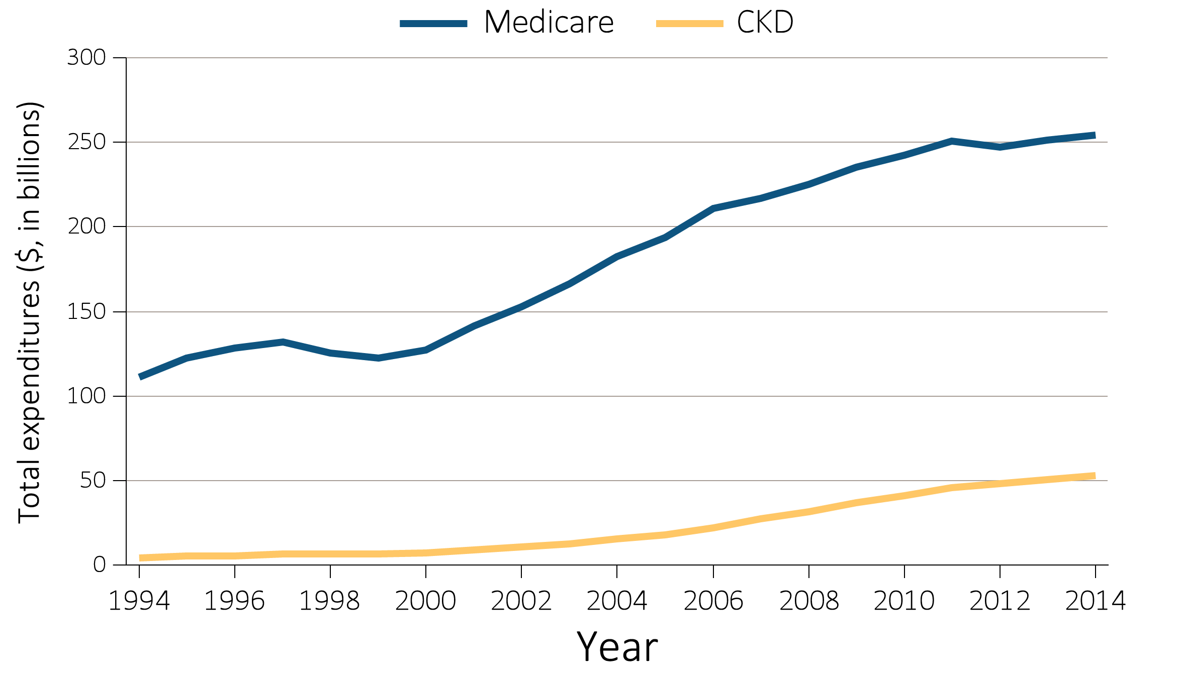
Figure 6.2 Overall Medicare Parts A, B and D fee-for-service spending for general Medicare population aged 65 and older
and for those with CKD, by year, 1994-2014
(a) All Patients
Data Source: Medicare 5% sample. Abbreviations: CKD, chronic kidney disease; CHF, congestive heart failure.

Slide 10
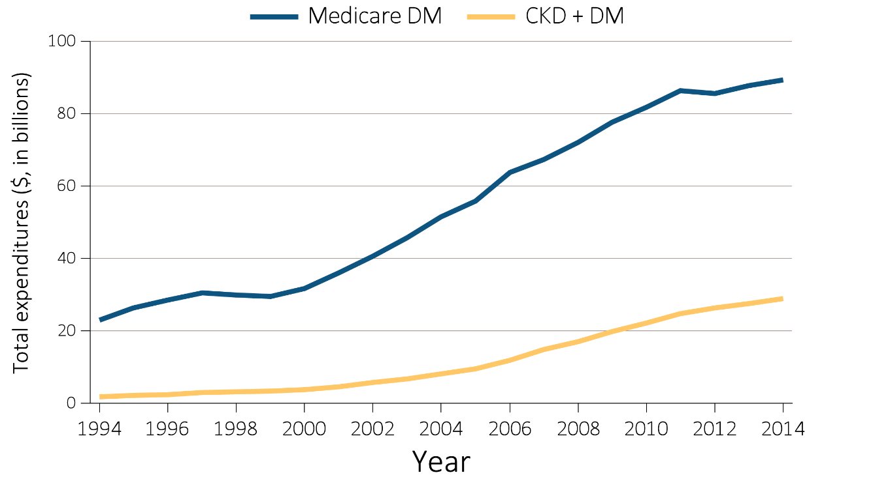
Figure 6.2 Overall Medicare Parts A, B and D fee-for-service spending for general Medicare population aged 65 and older
and for those with CKD, by year, 1994-2014
(b) Patients with DM
Data Source: Medicare 5% sample. Abbreviations: CKD, chronic kidney disease; CHF, congestive heart failure; DM, diabetes mellitus.

Slide 11
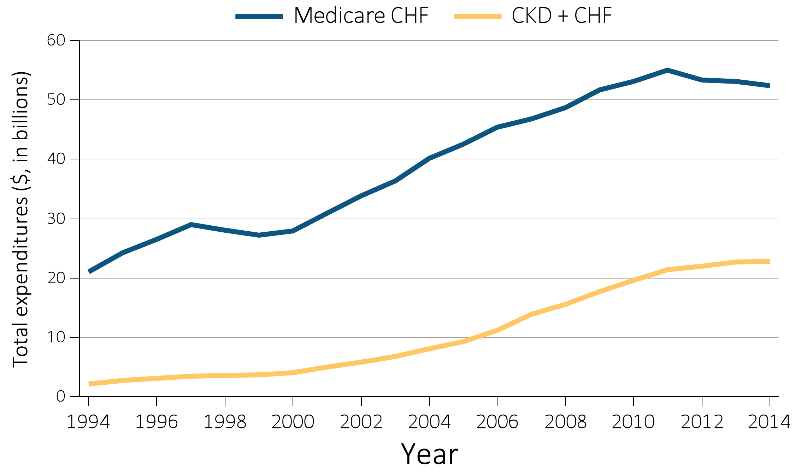
Figure 6.2 Overall Medicare Parts A, B and D fee-for-service spending for general Medicare population aged 65 and older
and for those with CKD, by year, 1994-2014
(c) Patients with CHF
Data Source: Medicare 5% sample. Abbreviations: CKD, chronic kidney disease; CHF, congestive heart failure.

Slide 12
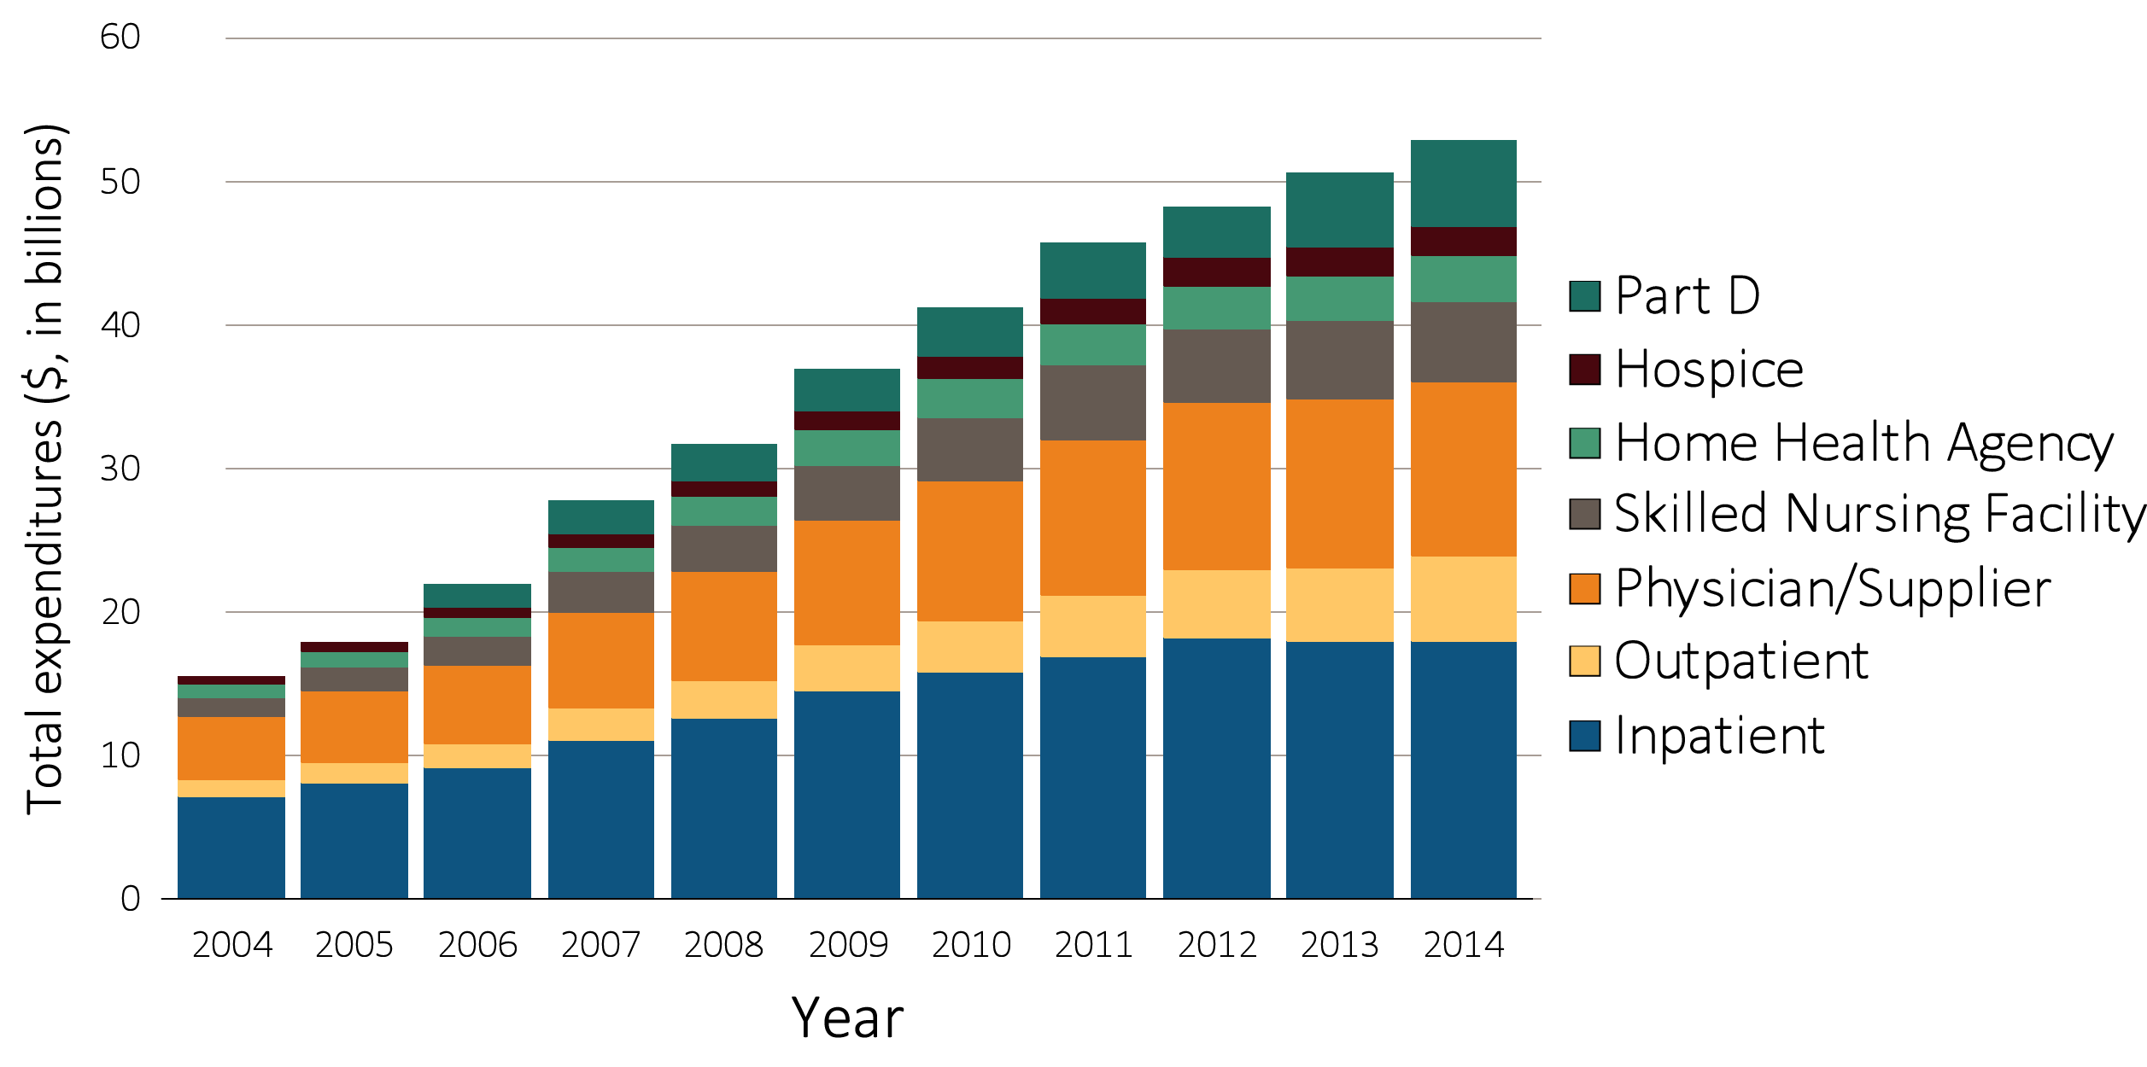
Figure 6.3 Trends in total Medicare Parts A, B, and D fee-for-service spending for CKD patients aged 65 and older, by claim type, 2004-2014
Data source: Medicare 5% sample. Part D data was initiated since 2006.

Slide 13
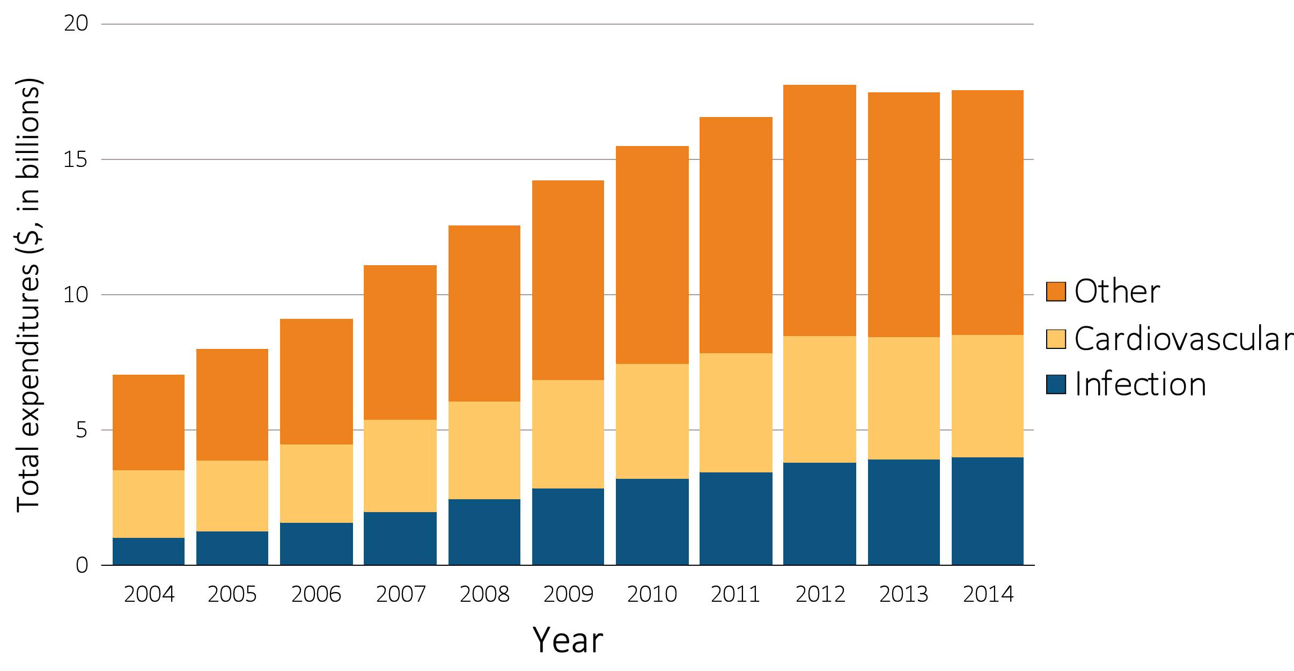
Figure 6.4 Total Medicare fee-for-service inpatient spending for CKD patients aged 65 and older, by cause of hospitalization, 2004-2014
Data source: Medicare 5% sample. Part D data was initiated since 2006.

Slide 14
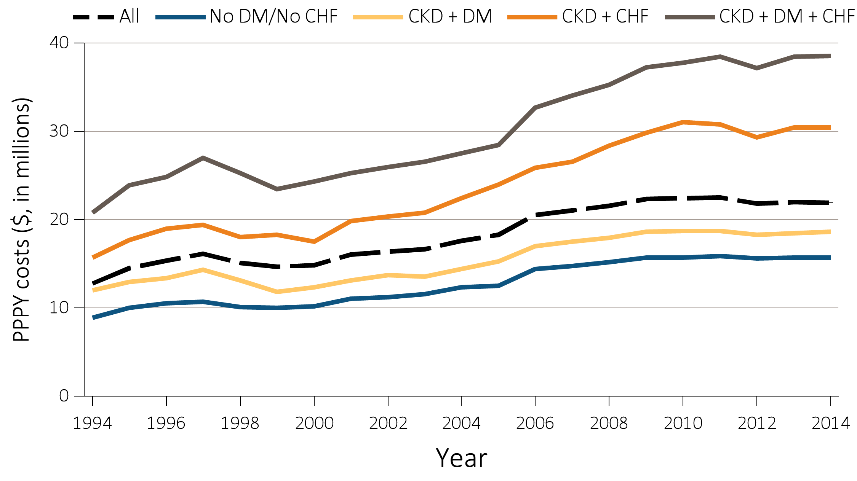
Figure 6.5 Per person per year Medicare Parts A, B, and D
fee-for-service spending for the CKD patients aged 65 and older,
by DM, CHF, and year, 1994-2014
Data Source: Medicare 5% sample. Abbreviations: CKD, chronic kidney disease; CHF, congestive heart failure, DM, diabetes mellitus; PPPY, per person per year.

