Slide 2
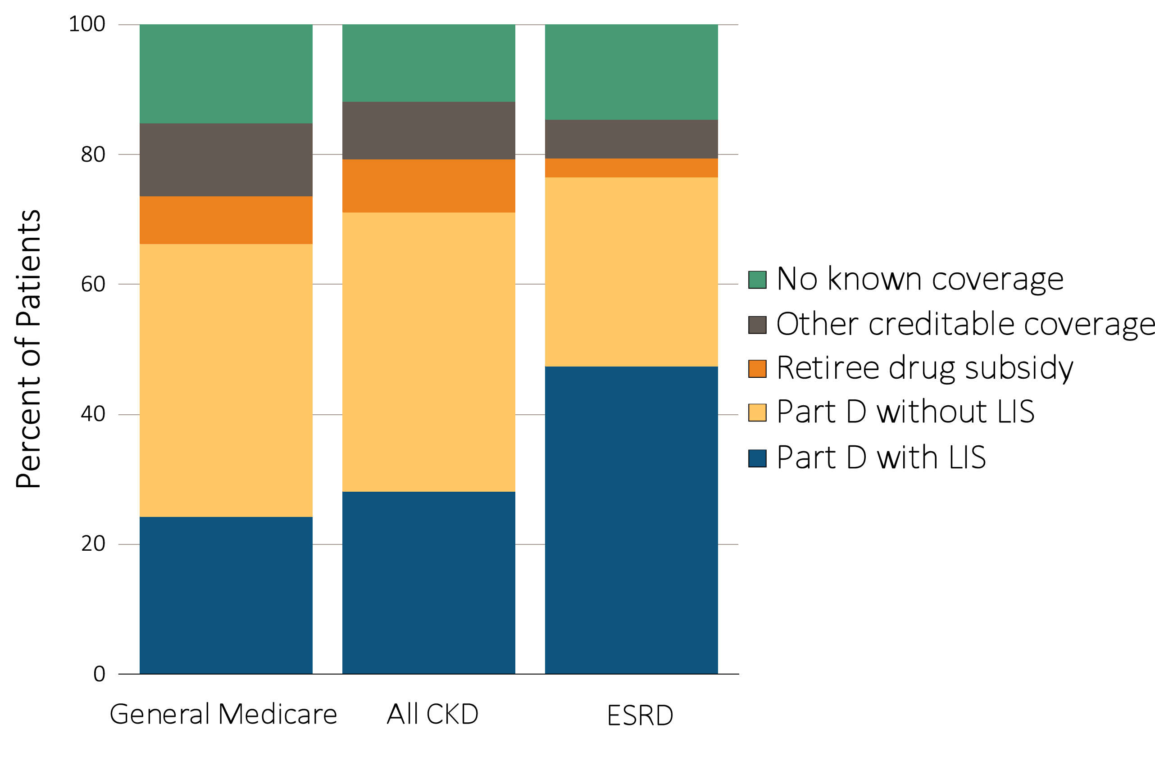
Figure 7.1 Sources of prescription drug coverage in Medicare enrollees, by population, 2014
Data Source: Data source: Medicare 5% sample. Point prevalent Medicare enrollees alive on January 1, 2014. Abbreviations: CKD, chronic kidney disease; ESRD, end-stage renal disease; LIS, Medicare Low-income Subsidy; Part D, Medicare prescription drug coverage benefit.

Slide 3
Table 7.1 Medicare Part D parameters for defined standard benefit, 2009 & 2014
 | 2009 | 2014
Deductible | $295.00 | $310.00
After the deductible is met, the beneficiary pays 25% of total prescription costs up to the initial coverage limit.
Initial coverage limit | $2,700.00 | $2,850.00
The coverage gap (“donut hole”) begins at this point.
The beneficiary pays 100% of their prescription costs up to the out-of-pocket threshold
Out-of-pocket threshold | $4,350.00 | $4,550.00
The total out-of-pocket costs including the “donut hole”
Total covered Part D prescription out-of-pocket spending | $6,153.75 | $6,455.00
(including the coverage gap). Catastrophic coverage begins after this point.
Catastrophic coverage benefit | $2.40 | ª$2.55
Generic/preferred multi-source drug | $6.00 | ª$6.35
Other drugs |  | ªplus a 52.50% brand name medication discount
2014 Example: | $295.00 | $310
$310 (deductible) | $601.25 | $635.00
+(($$2850-$310)*25%)(initial coverage) | $3,453.75 | $3,605.00
+(($6455-$2850)*100%)(coverage gap) | $4,350.00 | $4,550.00
Total | $4,350.00 | $4,550.00
(maximum out-of-pocket costs prior to catastrophic coverage, excluding plan premium)
a The catastrophic coverage amount is the greater of 5% of medication cost or the values shown in the chart above. In 2014, beneficiaries were charged $2.55 for those generic or preferred multisource drugs with a retail price less than $51 and 5% for those with a retail price over $51. For brand name drugs, beneficiaries paid $6.35 for those drugs with a retail price less than $127 and 5% for those with a retail price over $127. Table adapted from http://www.q1medicare.com/PartD-The-2014-Medicare-Part-D-Outlook.php.

Slide 4
Table 7.2 General Medicare, CKD, & ESRD patients enrolled in Part D (%)
 | General Medicare | All CKD | All ESRD
2011 | 55.7 | 59.3 | 69.9
2012 | 57.6 | 60.5 | 71.7
2013 | 65.7 | 69.3 | 75.2
2014 | 66.3 | 71.1 | 76.5
Data source: Medicare 5% sample. Point prevalent Medicare enrollees alive on January 1. Abbreviations: CKD, chronic kidney disease; ESRD, end-stage renal disease; Part D, Medicare prescription drug coverage benefit.

Slide 5
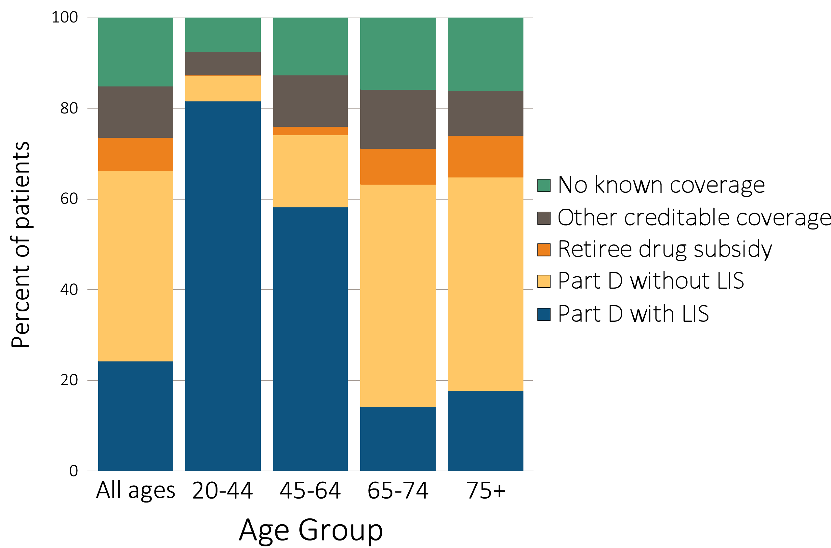
Figure 7.2 Sources of prescription drug coverage in Medicare enrollees, by age, 2014
(a) All general Medicare enrollees
Data source: Medicare 5% sample. Point prevalent Medicare enrollees alive on January 1, 2014. Abbreviations: CKD, chronic kidney disease; LIS, Medicare low income subsidy; Part D, Medicare prescription drug coverage benefit.

Slide 6
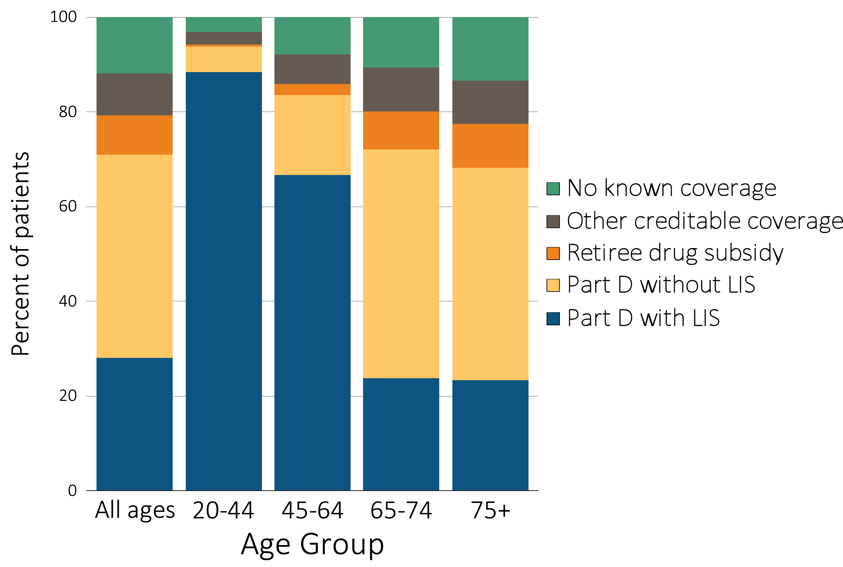
Figure 7.2 Sources of prescription drug coverage in Medicare enrollees, by age, 2014
^{(b) Enrollees with CKD}
Data source: Medicare 5% sample. Point prevalent Medicare enrollees alive on January 1, 2014. Abbreviations: CKD, chronic kidney disease; LIS, Medicare low income subsidy; Part D, Medicare prescription drug coverage benefit.

Slide 7
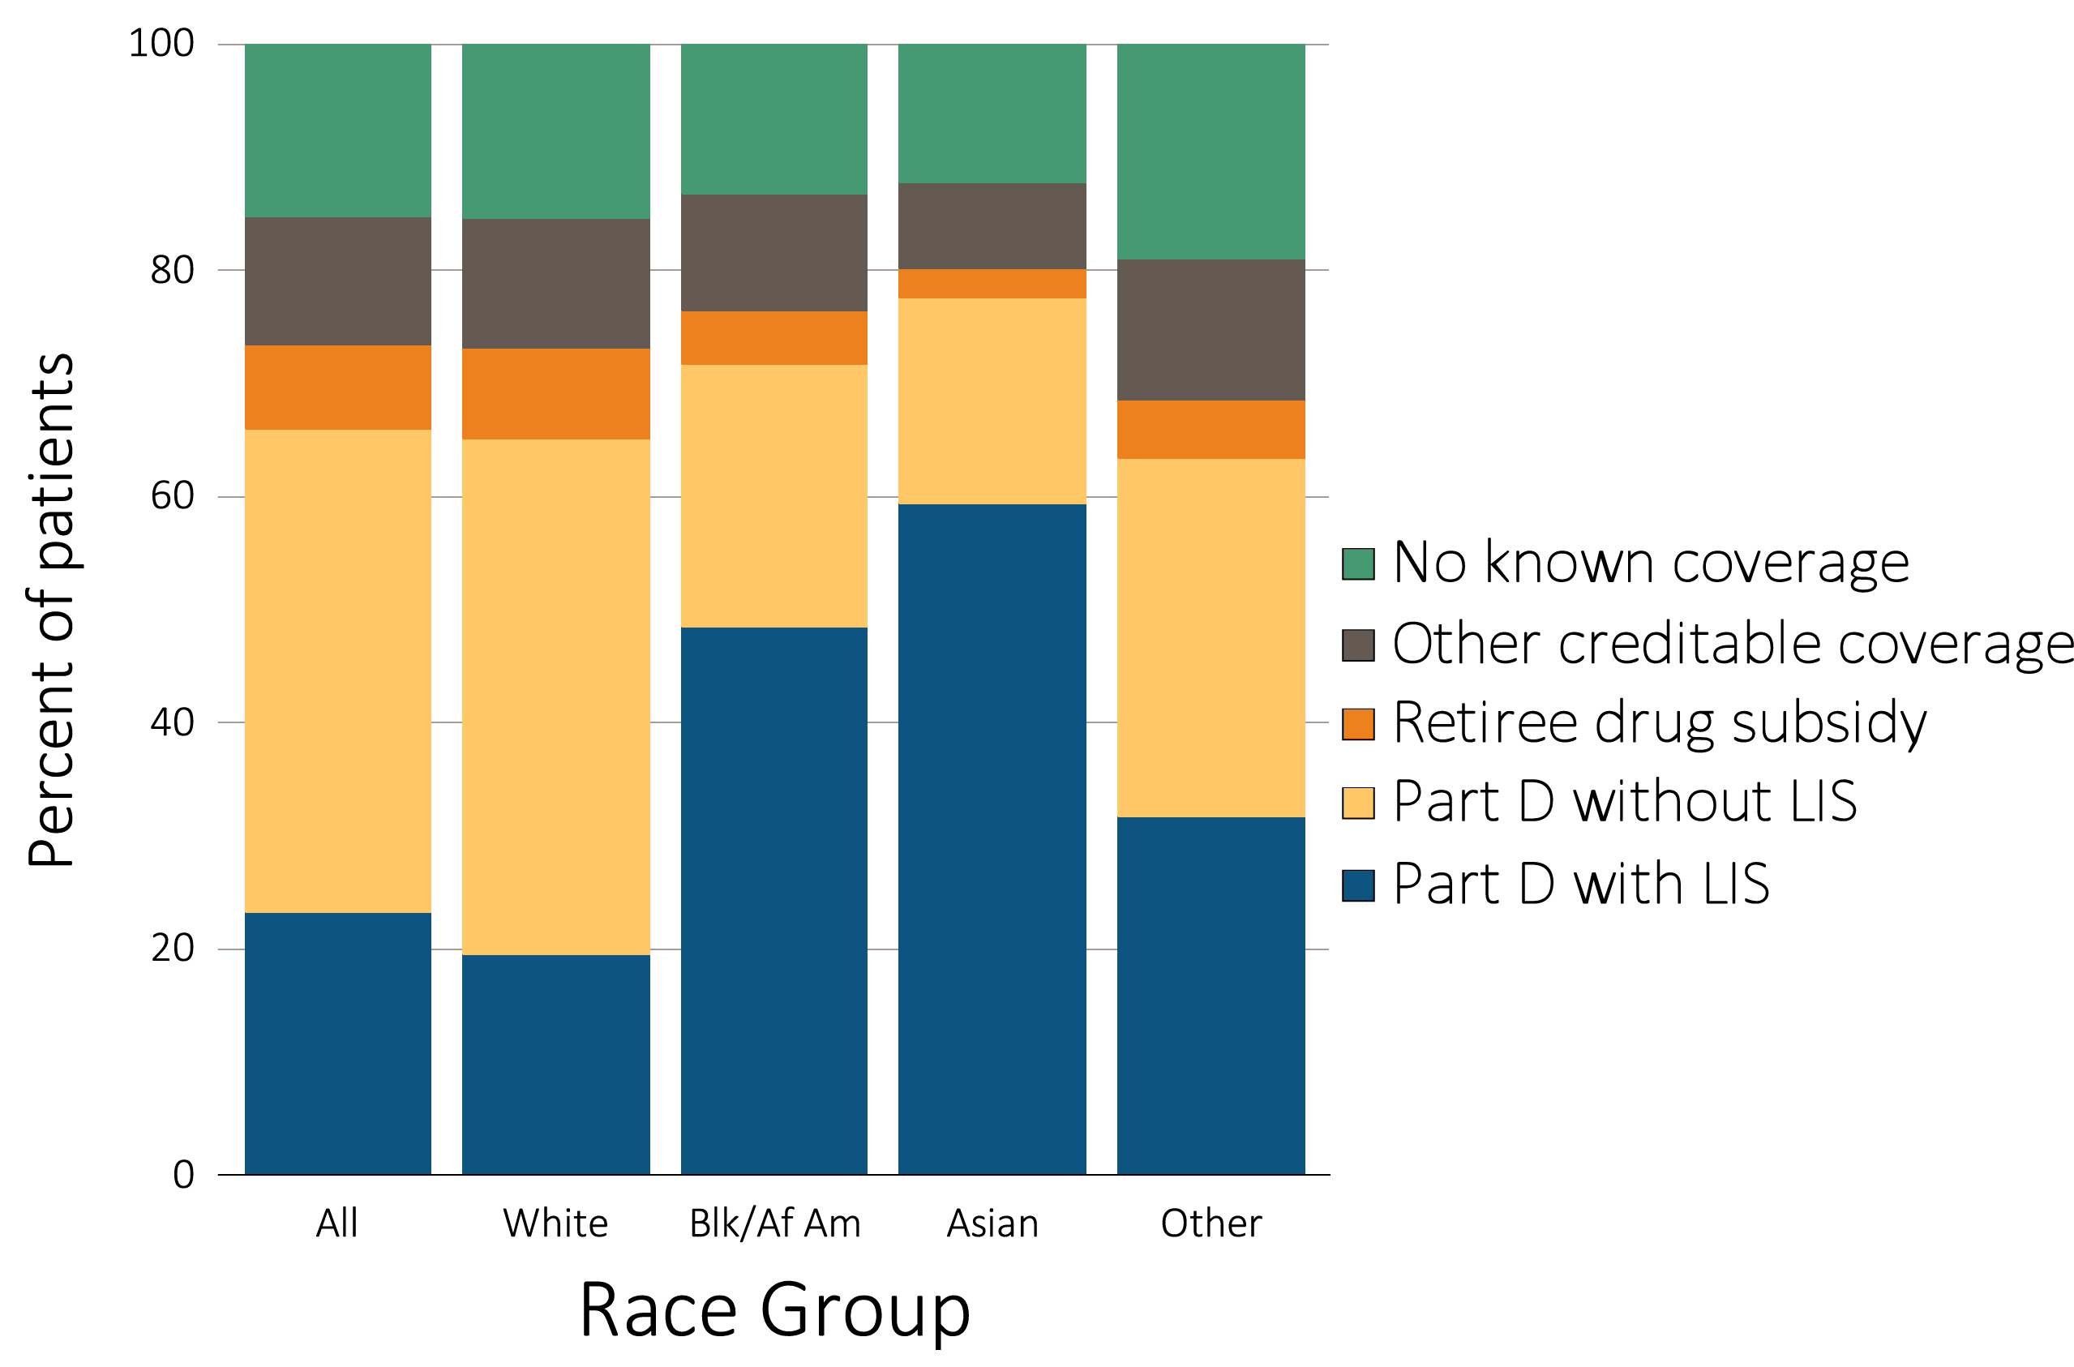
Figure 7.3 Sources of prescription drug coverage in Medicare enrollees, by race, 2014
(a) All general Medicare enrollees
Data source: Medicare 5% sample. Point prevalent Medicare enrollees alive on January 1, 2014. Abbreviations: Blk/Af Am, Black/African American; CKD, chronic kidney disease; LIS, Medicare Low-income Subsidy; Part D, Medicare prescription drug coverage benefit.

Slide 8
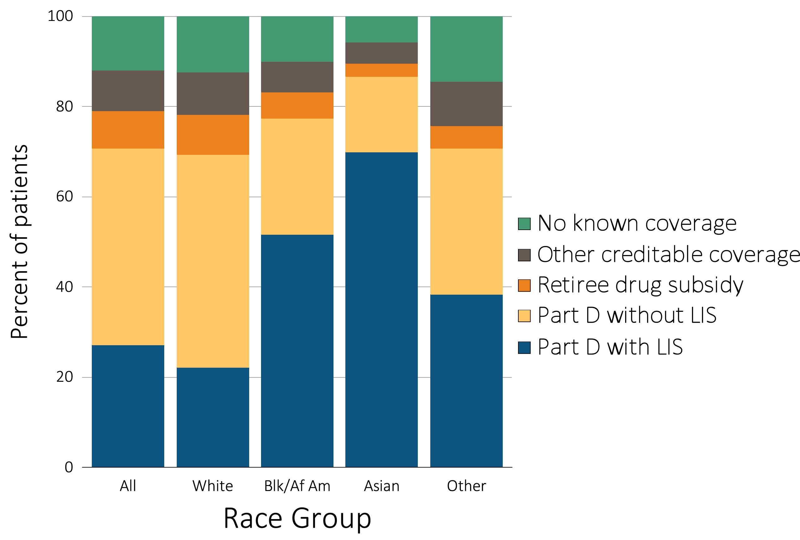
Figure 7.3 Sources of prescription drug coverage in Medicare enrollees, by race, 2014
^{(b) Enrollees with CKD}
Data source: Medicare 5% sample. Point prevalent Medicare enrollees alive on January 1, 2014. Abbreviations: Blk/Af Am, Black/African American; CKD, chronic kidney disease; LIS, Medicare Low-income Subsidy; Part D, Medicare prescription drug coverage benefit.

Slide 9
Table 7.3 Medicare Part D enrollees (%) with the Low-income Subsidy, by age & race, 2014
 | General Medicare |  | All CKD
 | Part D with Low-income Subsidy |  | Part D with Low-income Subsidy
White
All ages | 30.0 |  | 31.9
20-44 | 92.9 |  | 94.0
45-64 | 76.0 |  | 77.1
65-74 | 17.2 |  | 26.4
75+ | 21.5 |  | 27.1
Black/African American
All ages | 67.6 |  | 66.7
20-44 | 95.3 |  | 94.1
45-64 | 85.7 |  | 84.7
65-74 | 49.0 |  | 56.4
75+ | 57.9 |  | 63.6
Asian
All ages | 76.5 |  | 80.6
20-44 | 91.9 |  | 100.0
45-64 | 85.1 |  | 85.9
65-74 | 68.4 |  | 74.3
75+ | 80.1 |  | 82.3
Other races
All ages | 50.1 |  | 54.3
20-44 | 92.8 |  | 90.5
45-64 | 79.2 |  | 83.7
65-74 | 34.4 |  | 40.8
75+ | 47.5 |  | 54.7
Data source: Medicare 5% sample. Point prevalent Medicare enrollees alive on January 1, 2014. Abbreviations: CKD, chronic kidney disease; Part D, Medicare prescription drug coverage benefit.

Slide 10
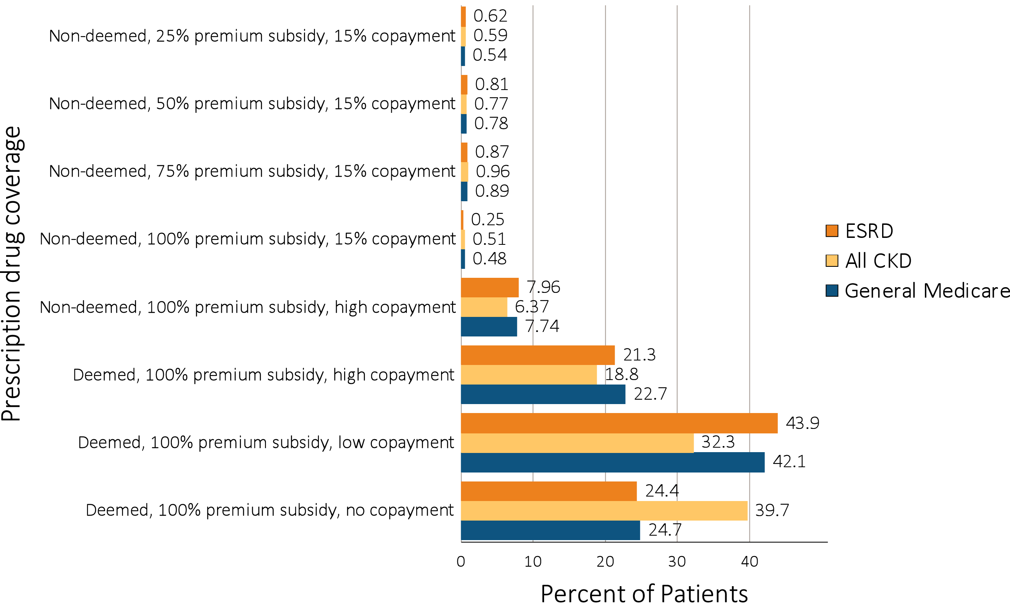
Figure 7.4 Distribution of Low-income Subsidy categories in Part D general Medicare, CKD, & ESRD patients, 2014
Data source: Medicare 5% sample. Point prevalent Medicare enrollees alive on January 1, 2014. Abbreviations: CKD, chronic kidney disease; ESRD, end-stage renal disease; Part D, Medicare prescription drug coverage benefit.

Slide 11
Table 7.4 Total estimated Medicare Part D spending for enrollees (in billions), 2011-2014
 | General Medicare | All CKD | All ESRD
2011 | 40.1 | 5.2 | 1.6
2012 | 35.7 | 4.8 | 2.0
2013 | 45.7 | 6.8 | 2.3
2014 | 50.5 | 7.7 | 2.7
Data source: Medicare Part D claims. Medicare totals include Part D claims for Part D enrollees with traditional Medicare (Parts A & B). CKD totals include Medicare CKD patients, as determined from claims. ESRD totals include all Part D claims for Medicare ESRD patients with Medicare Part D stand-alone prescription drug plans. Abbreviations: CKD, chronic kidney disease; ESRD, end-stage renal disease; Part D, Medicare prescription drug coverage benefit.

Slide 12
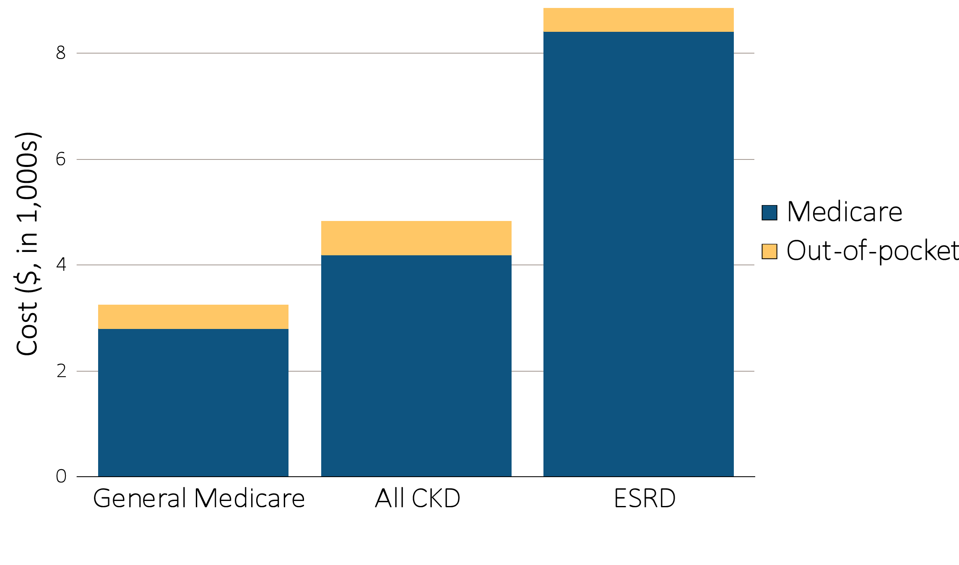
Figure 7.5 Per person per year Medicare Part D spending & out-of-pocket costs for enrollees, 2014
^{(a) All Part D enrollees}
Data source: Medicare Part D claims. Medicare totals include Part D claims for Part D enrollees with traditional Medicare (Parts A & B). CKD totals include Medicare CKD patients as determined from claims. ESRD totals include all Part D claims for Medicare ESRD patients with Medicare Part D stand-alone prescription drug plans. Costs are per person per year for calendar year 2014. Medicare Part D spending is the sum of the Medicare covered amount and the Low-income Subsidy amount. Abbreviations: CKD, chronic kidney disease; ESRD, end-stage renal disease; Part D, Medicare prescription drug coverage benefit.

Slide 13
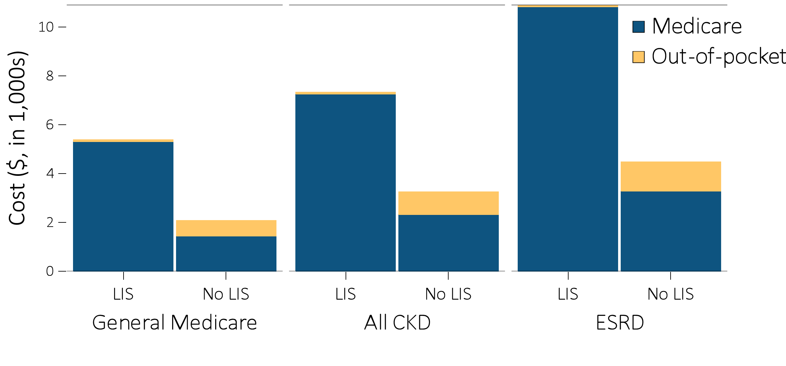
Figure 7.5 Per person per year Medicare Part D spending & out-of-pocket costs for enrollees, 2014
(b) Part D enrollees by Low-income Subsidy status
Data source: Medicare Part D claims. Medicare totals include Part D claims for Part D enrollees with traditional Medicare (Parts A & B). CKD totals include Medicare CKD patients as determined from claims. ESRD totals include all Part D claims for Medicare ESRD patients with Medicare Part D stand-alone prescription drug plans. Costs are per person per year for calendar year 2014. Medicare Part D spending is the sum of the Medicare covered amount and the Low-income Subsidy amount. Abbreviations: CKD, chronic kidney disease; ESRD, end-stage renal disease; Part D, Medicare prescription drug coverage benefit.

Slide 14
Table 7.5 Per person per year Part D spending ($) for enrollees, by Low-income Subsidy status, 2014
 | General Medicare |  |  | All CKD |  |  | All ESRD
 | Part D with Low-income Subsidy | Part D remaining enrollees |  | Part D with Low-income Subsidy | Part D remaining enrollees |  | Part D with Low-income Subsidy | Part D remaining enrollees
Age
All | 5,302 | 1,447 |  | 7,249 | 2,318 |  | 10,826 | 3,286
20-44 | 5,255 | 2,060 |  | 10,655 | 3,074 |  | 11,386 | 2,640
45-64 | 7,115 | 3,122 |  | 10,928 | 4,156 |  | 11,783 | 3,859
65-74 | 4,572 | 1,386 |  | 7,343 | 2,801 |  | 9,728 | 3,474
75+ | 4,030 | 1,329 |  | 5,426 | 1,952 |  | 7,826 | 2,643
Sex
Male | 5,310 | 1,556 |  | 7,694 | 2,476 |  | 10,925 | 3,349
Female | 5,296 | 1,367 |  | 6,978 | 2,161 |  | 10,718 | 3,190
Race
White | 5,510 | 1,446 |  | 7,506 | 2,302 |  | 10,510 | 3,318
Black | 4,881 | 1,513 |  | 6,563 | 2,344 |  | 11,325 | 3,167
Asian | 4,858 | 1,278 |  | 7,339 | 2,750 |  | 11,105 | 3,369
Other race | 4,728 | 1,396 |  | 6,708 | 2,745 |  | 7,956 | 3,319
Data source: Medicare Part D claims. All Medicare patients with Medicare Part D stand-alone prescription drug plans. CKD determined from claims. ESRD patients with Medicare Part D stand-alone prescription drug plans. Costs are per person per year for calendar year 2014. Medicare Part D PPPY is the sum of the Medicare covered amount and the Low-income Subsidy amount. LIS status is determined from the Part D enrollment. A person is classified as LIS if they are eligible for the LIS for at least one month during 2014. Abbreviations: CKD, chronic kidney disease; ESRD, end-stage renal disease; Part D, Medicare prescription drug coverage benefit.

Slide 15
Table 7.6 Top 15 drug classes received by Part D-enrolled CKD patients, by percent of patients 2014
Rank | Drug class | Percent of patients
1 | HMG-CoA Reductase Inhibitors (statins) | 59%
2 | β-Adrenergic Blocking Agents | 57%
3 | Opiate Agonists | 46%
4 | Loop Diuretics | 39%
5 | Proton-pump Inhibitors | 38%
6 | Antidepressants | 35%
7 | Angiotensin-Converting Enzyme Inhibitors | 34%
8 | Dihydropyridines | 33%
9 | Quinolones | 27%
10 | Thyroid Agents | 25%
11 | Angiotensin II Receptor Antagonists | 24%
12 | Anticonvulsants, Miscellaneous | 23%
13 | Adrenals | 21%
14 | Replacement Preparations | 20%
15 | Insulins | 20%
Data source: Medicare Part D claims. CKD patients with Medicare Part D stand-alone prescription drug plans in the Medicare 5% sample.

Slide 16
Table 7.7 Top 15 drug classes received by Part D-enrolled CKD patients, by Medicare Part D spending, 2014
Rank | Drug class | Medicare Part D spending ($ in millions) | Percent of total Medicare Part D spending
1 | Insulins | $1,017.81 | 13%
2 | Antineoplastic Agents | $758.01 | 10%
3 | Antipsychotics | $288.85 | 4%
4 | Proton-pump Inhibitors | $252.85 | 3%
5 | Dipeptidyl Peptidase IV (DDP-4) Inhibitors | $240.78 | 3%
6 | Corticosteroids | $225.37 | 3%
7 | HMG-CoA Reductase Inhibitors (statins) | $223.01 | 3%
8 | Antiretrovirals | $209.87 | 3%
9 | HCV antivirals | $206.89 | 3%
10 | Opiate Agonists | $200.95 | 3%
11 | Anticoagulants | $181.25 | 2%
12 | Anticonvulsants, Miscellaneous | $178.52 | 2%
13 | Antimuscarinics/Antispasmodics | $169.03 | 2%
14 | Antidepressants | $167.42 | 2%
15 | Angiotensin II Receptor Antagonists | $155.01 | 2%
Data source: Medicare Part D claims. CKD patients with Medicare Part D stand-alone prescription drug plans in the Medicare 5% sample. Part D spending represents the sum of the Medicare covered amount and the Low- income Subsidy amount.

