Slide 2
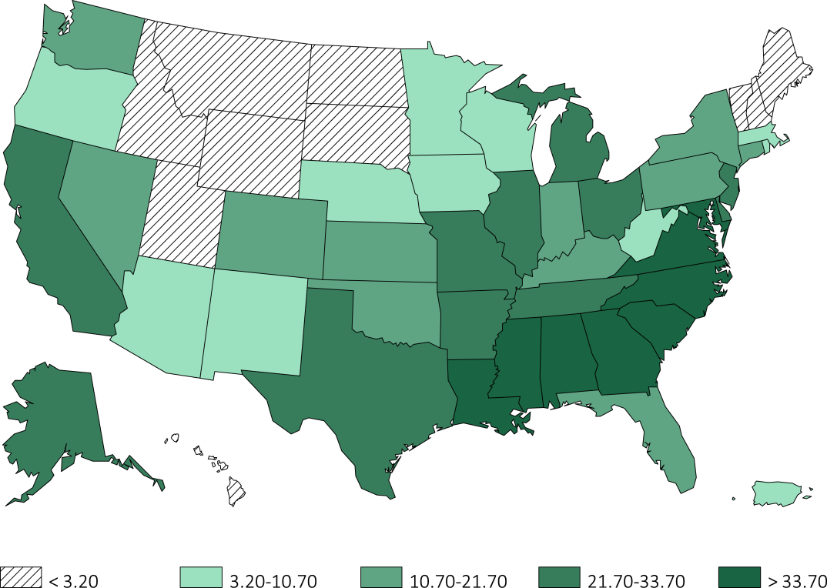
Figure 8.1 Distribution of Black incident ESRD veterans (%) among 85,505 incident ESRD veterans across states and territories of the United States, 10/1/2007-3/31/2014
Data Source: VHA Administrative data, USRDS ESRD Database, CMS Medicare Inpatient and Outpatient data. Statesand territories of the United States of America

Slide 3
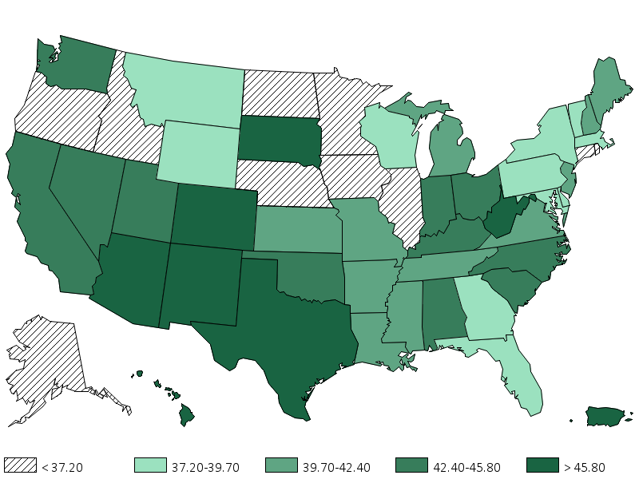
Figure 8.2 Distribution of diabetes (%) as the cause of ESRD among 85,505 incident ESRD veterans across states and territories of the United States, 10/1/2007-3/31/2014
Data Source: VHA Administrative data, USRDS ESRD Database. States and territories of the United States of America

Slide 4
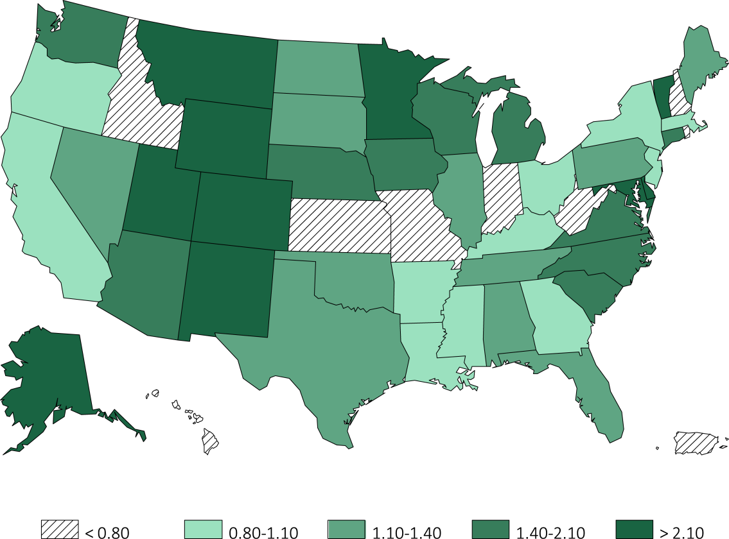
Figure 8.3 Distribution of preemptive kidney transplant rates among 85,505 incident ESRD veterans across states and territories of the United States, 10/1/2007-3/31/2014
Data Source: VHA Administrative data, USRDS ESRD Database. States and territories of the United States of America.

Slide 5
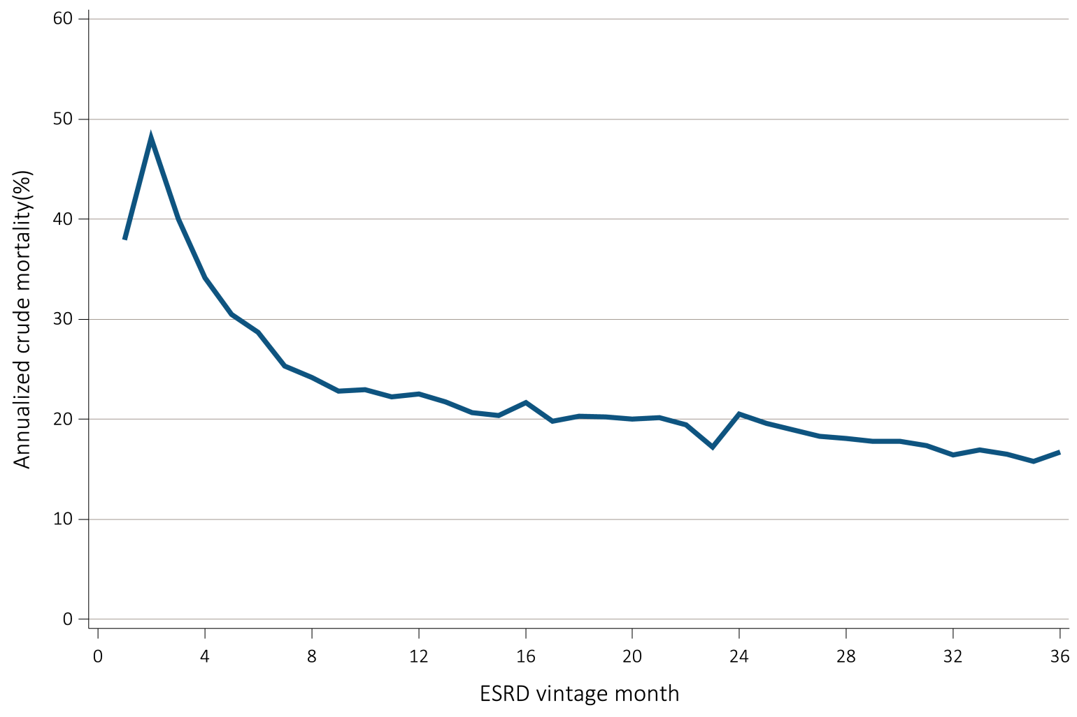
Figure 8.4 Annualized unadjusted mortality of incident ESRD veterans who transitioned to ESRD during 10/1/2007-3/31/2014 and who were followed for up to 36 months (N=85,505)
Data Source: VHA Administrative data, USRDS ESRD Database, CMS Medicare Inpatient and Outpatient data. Abbreviations: ESRD,end-stage renal disease.

Slide 6
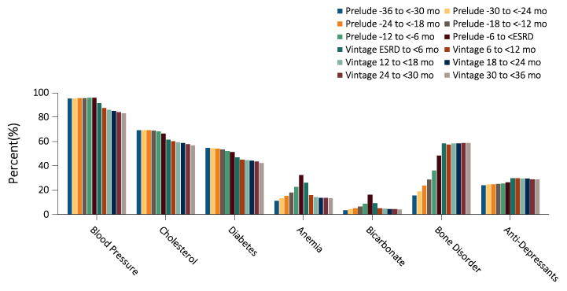
Figure 8.5 Prescribed medication to incident ESRD veterans who transitioned to ESRD during 10/1/2007-3/31/2014, with data up to -36 months prior to transition (prelude) and up to +36 months after transition (vintage) (data were abstracted from 68,435 veterans)
Data Source: VHA Administrative data, CMS Medicare Inpatient and Outpatient data. Abbreviations: ESRD, end-stage renal disease; mo, month.

Slide 7
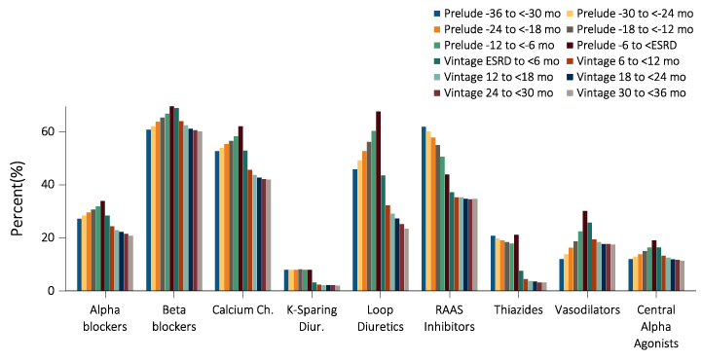
Figure 8.6a Granular Prescribed Medication Data for incident ESRD veterans who transitioned to ESRD during 10/1/2007-3/31/2014, with data up to -36 months prior to transition (prelude) and up to +36 months after transition (vintage) (data were abstracted from 68,435 veterans)
Data Source: VHA Administrative data, CMS Medicare Inpatient and Outpatient data. *Data on EPO, iron and active vitamin D medication use in the vintage period were affected by these medications being administered in commercial HD units and were therefore were probably not well-captured by either CMS or VA databases. Abbreviations: ESRD, end-stage renal disease; mo, month; Ch, channel, Hyperglyc, hyperglycemics; ESA, erythropoietin stimulating agents, Vit, vitamin.

Slide 8
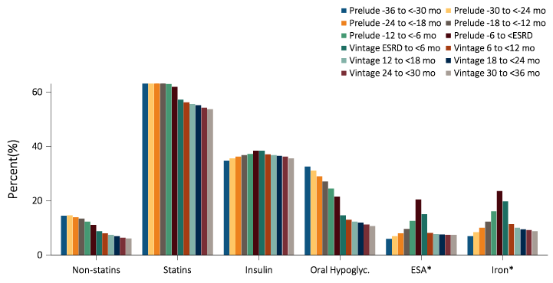
Figure 8.6b Granular Prescribed Medication Data for incident ESRD veterans who transitioned to ESRD during 10/1/2007-3/31/2014, with data up to -36 months prior to transition (prelude) and up to +36 months after transition (vintage) (data were abstracted from 68,435 veterans)
Data Source: VHA Administrative data, CMS Medicare Inpatient and Outpatient data. *Data on EPO, iron and active vitamin D medication use in the vintage period were affected by these medications being administered in commercial HD units and were therefore were probably not well-captured by either CMS or VA databases. Abbreviations: ESRD, end-stage renal disease; mo, month; Ch, channel, Hyperglyc, hyperglycemics; ESA, erythropoietin stimulating agents, Vit, vitamin.

Slide 9
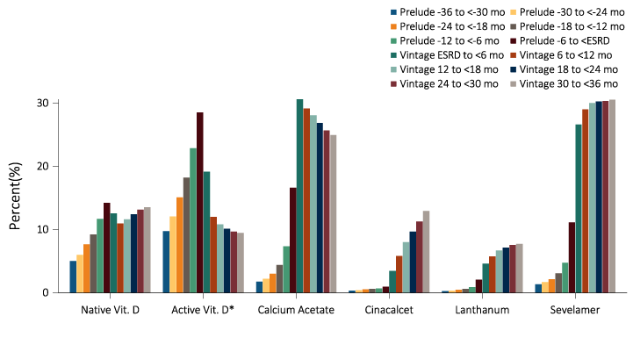
Figure 8.6c Granular Prescribed Medication Data for incident ESRD veterans who transitioned to ESRD during 10/1/2007-3/31/2014, with data up to -36 months prior to transition (prelude) and up to +36 months after transition (vintage) (data were abstracted from 68,435 veterans)
Data Source: VHA Administrative data, CMS Medicare Inpatient and Outpatient data. *Data on EPO, iron and active vitamin D medication use in the vintage period were affected by these medications being administered in commercial HD units and were therefore were probably not well-captured by either CMS or VA databases. Abbreviations: ESRD, end-stage renal disease; mo, month; Ch, channel, Hyperglyc, hyperglycemics; ESA, erythropoietin stimulating agents, Vit, vitamin.

Slide 10
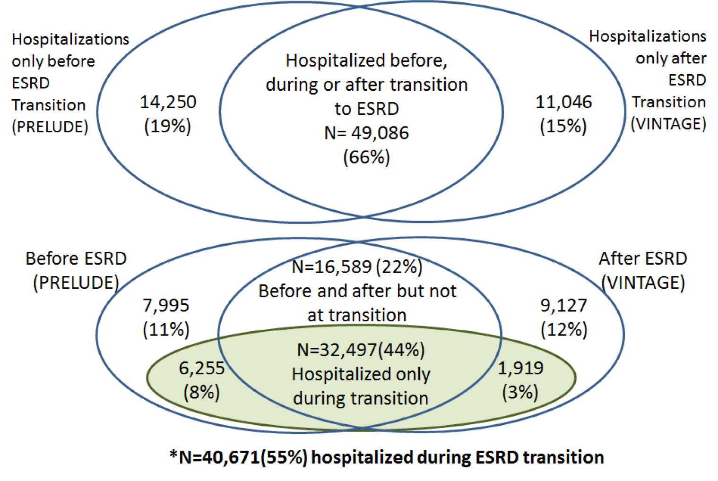
Figure 8.7 Hospitalization events in 74,382 incident ESRD veterans who transitioned to ESRD during 10/1/2007-3/31/2014
Data Source: VHA Administrative data, USRDS ESRD Database, CMS Medicare Inpatient and Outpatient data. *Unique patients with an event during transition and before or after transition to ESRD. Data ranging from -60 months prior to transition (prelude) to +24 months after transition (vintage), Upper Venn diagram: Three major hospitalization categories; Lower Venn diagram: Focus of hospital events during transition to ESRD with shaded area showing patients whose transition to ESRD occurred in the hospital (n=40,671). Abbreviations: ESRD,end-stage renal disease.

Slide 11
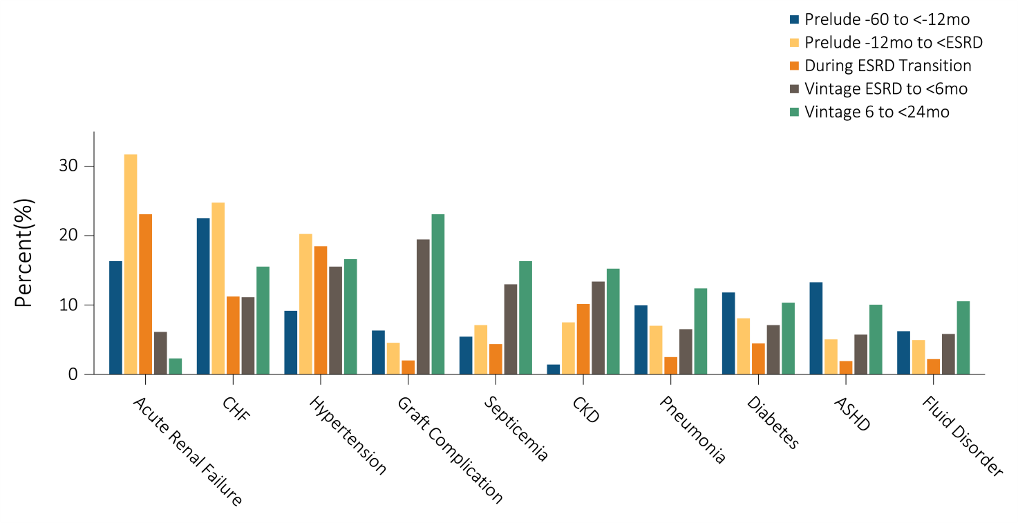
Figure 8.8a Top 20 causes of hospitalizations in 74,382 incident ESRD veterans who were hospitalized at least once during the 60 months prior to ESRD transition (prelude) up to 24 months after ESRD transition (vintage).
Data Source: XXXXXXXXXXXXXXXXXXXXXXXXXXXXXXXXXXXXXXXXXXXXXXXXXXXXXXXXXXXXXXXXXXXXXXXXXXXXXXXX

Slide 12
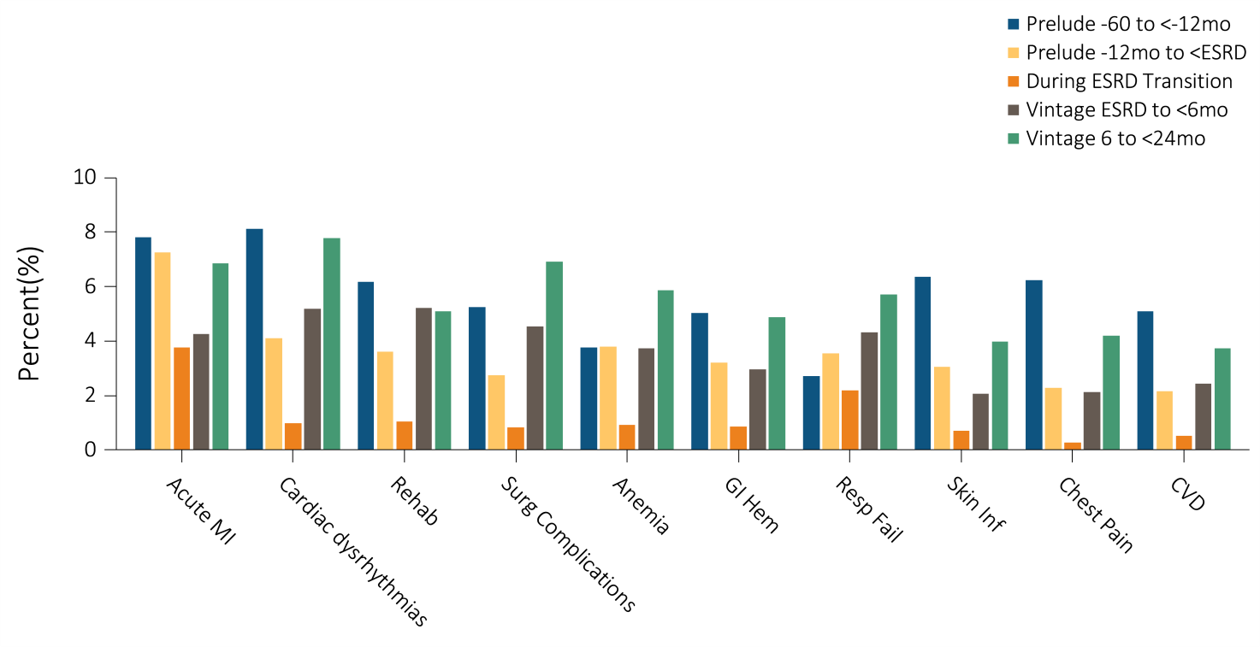
Figure 8.8b Top 20 causes of hospitalizations in 74,382 incident ESRD veterans who were hospitalized at least once during the 60 months prior to ESRD transition (prelude) up to 24 months after ESRD transition (vintage).
Data Source: VHA Administrative data, USRDS ESRD Database, CMS Medicare Inpatient and Outpatient data. Abbreviations: ASHD, astherosclerotic heart disease; CHF, congestive heart failure; CKD, chronic kidney disease; CVD, acute cerebrovascular disease; ESRD, end-stage renal disease; GI Hem, gastrointestinal hemorrhage; MI, myocardial infarction; mo, month; Resp Fail, respiratory failure; Skin Inf, skin infection; surg, surgical.

Slide 13
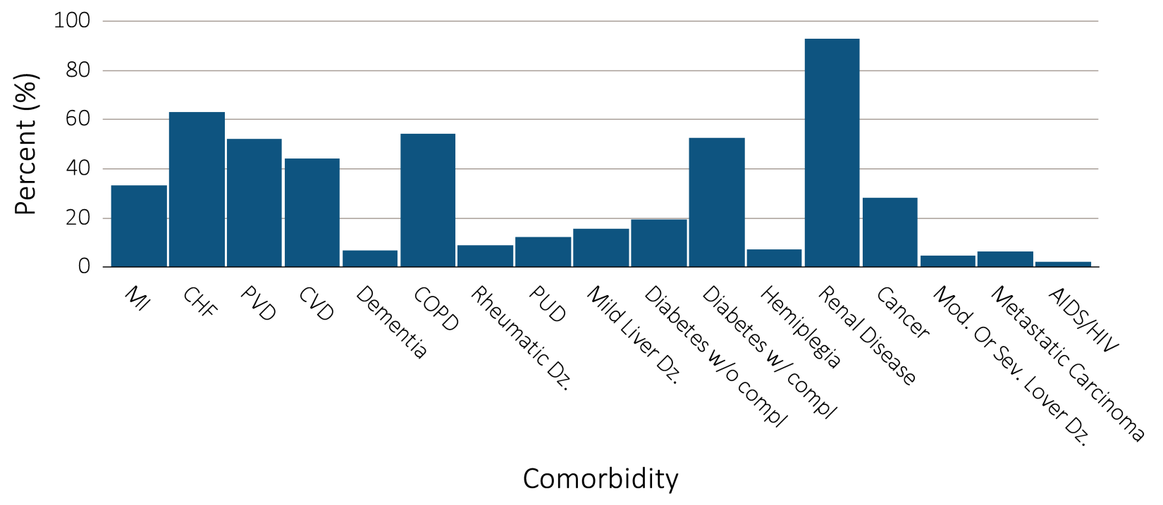
Figure 8.9a Selected comorbid conditions (a) for calculation of the Charlson Comorbidity Index (b) prior to transition to ESRD in 85,598 incident ESRD veterans
Data Source: VHA Administrative data, CMS Medicare Inpatient and Outpatient data. Abbreviations: CHF, congestive heart failure; compl, complications;COPD, chronic obstructive pulmonary disease; CVD, cerebrovascular disease; Dz, disease; ESRD, end-stage renal disease; MI, myocardial infarction; Mod, moderate; PVD, periphral vascular disease; PUD, peptic ulcer disease; Sev, Severe.

Slide 14
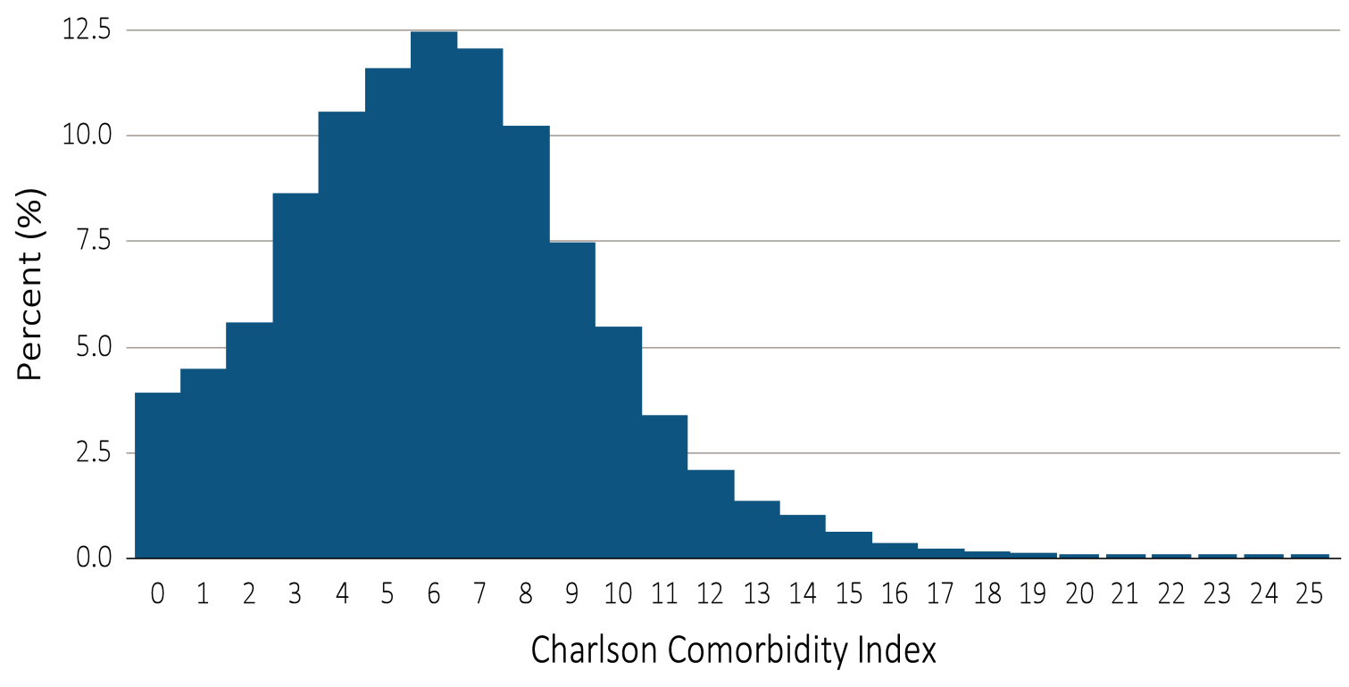
Figure 8.9b Selected comorbid conditions (a) for calculation of the Charlson Comorbidity Index (b) prior to transition to ESRD in 85,598 incident ESRD veterans
Data Source: VHA Administrative data, CMS Medicare Inpatient and Outpatient data. Abbreviations: CHF, congestive heart failure; compl, complications;COPD, chronic obstructive pulmonary disease; CVD, cerebrovascular disease; Dz, disease; ESRD, end-stage renal disease; MI, myocardial infarction; Mod, moderate; PVD, periphral vascular disease; PUD, peptic ulcer disease; Sev, Severe.

Slide 15
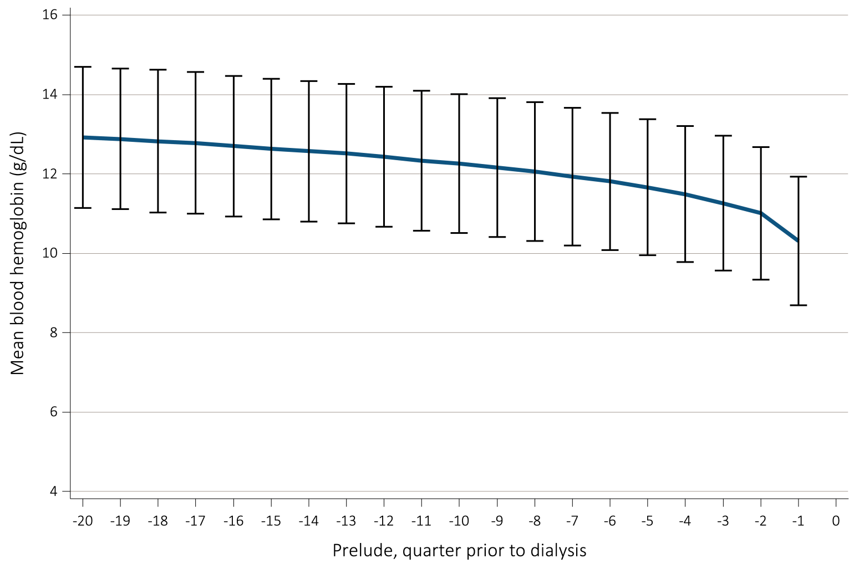
Figure 8.10 Trend in blood hemoglobin level during the prelude (pre-ESRD) time over 20 calendar quarters in 47,854 veterans who later transitioned to ESRD during 10/1/2007-3/31/2014.
Data Source: VHA Administrative data. Abbreviations: ESRD, end-stage renal disease; g/dL, grams per deciliter.

Slide 16
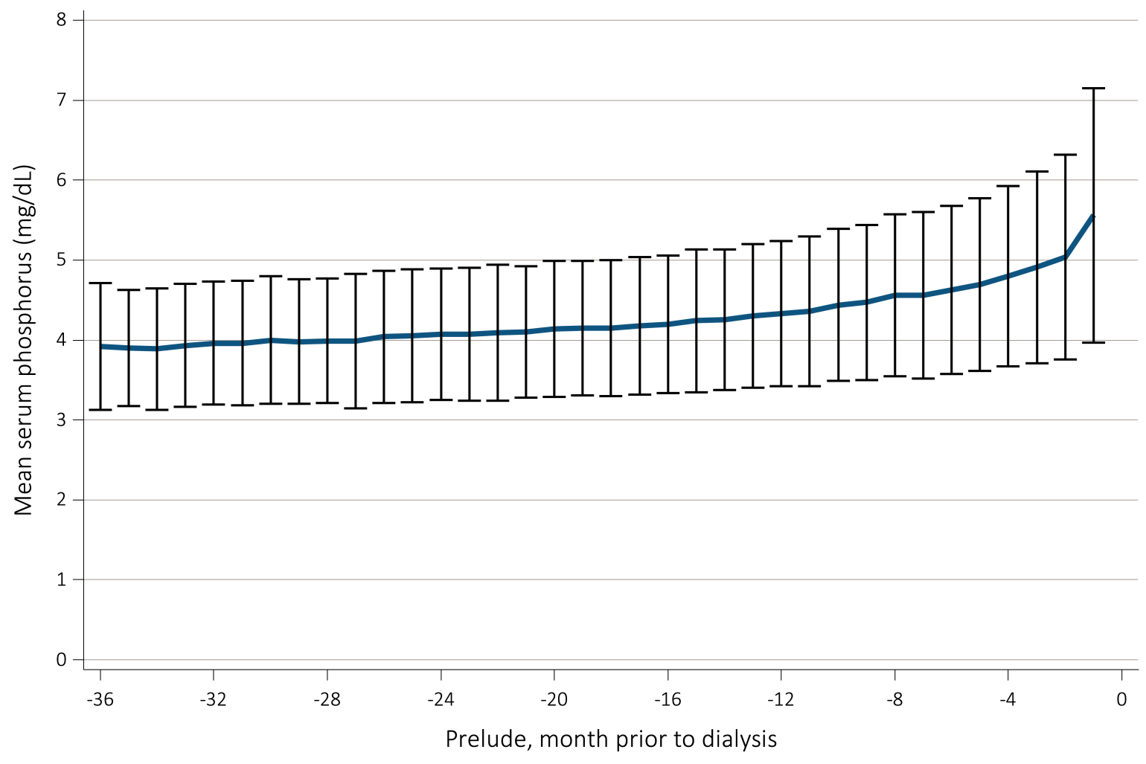
Figure 8.11 Trend in serum phosphorus level during the prelude (pre-ESRD) time over 36 months in 24,765 veterans who transitioned to ESRD during 10/1/2007-3/31/2014.
Data Source: VHA Administrative data. Abbreviations: ESRD, end-stage renal disease; mg/dL, milligrams per deciliter.

Slide 17
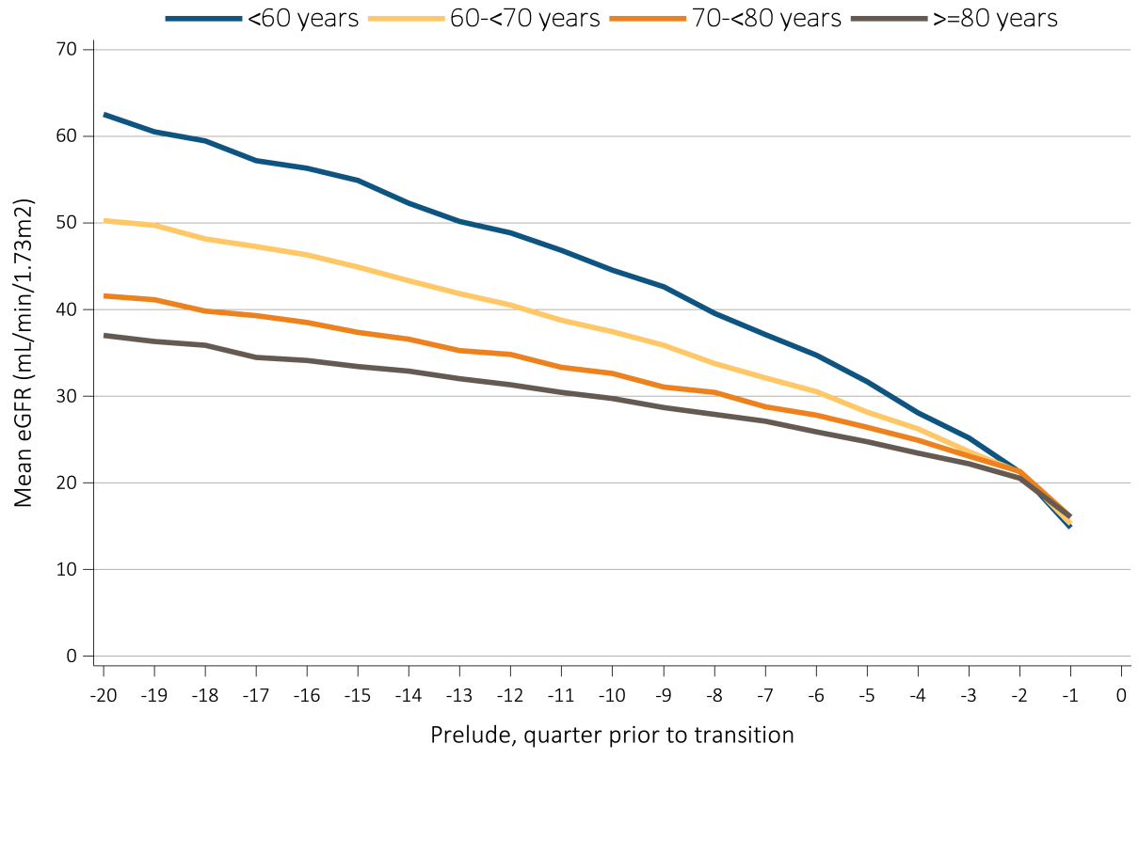
Figure 8.12a Trends in eGFR during the prelude (pre-ESRD) time over 20 calendar quarters in 49,871 veterans who transitioned to ESRD during 10/1/2007-9/31/2011. Upper Panel: Stratified by age at incidence. Lower Panel: Stratified according to ESRD etiology
Data Source: VHA Administrative data, USRDS ESRD Database. Abbreviations: eGFR; estimated glomerular filtration rate ;ESRD, end-stage renal disease; mL/min/1.73m2, milliliter per minute per 1.73 meters squared.

Slide 18
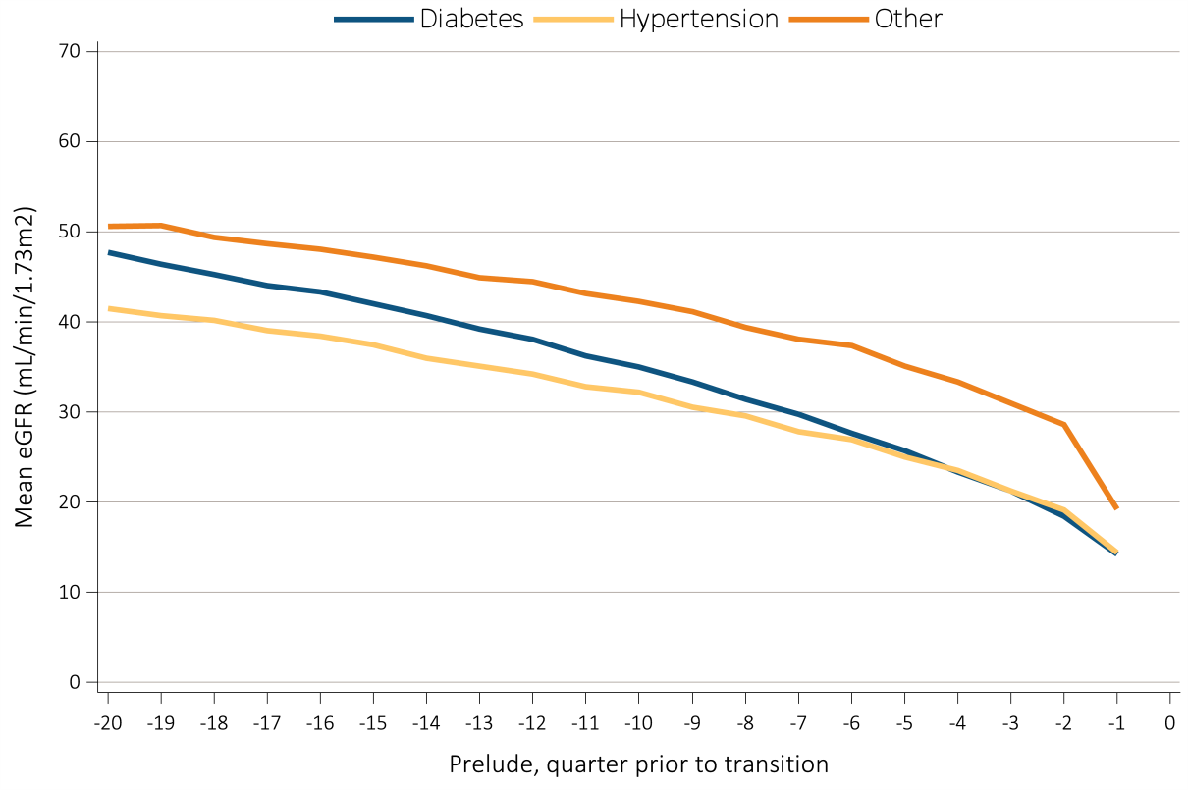
Figure 8.12b Trends in eGFR during the prelude (pre-ESRD) time over 20 calendar quarters in 49,871 veterans who transitioned to ESRD during 10/1/2007-9/31/2011. Upper Panel: Stratified by age at incidence. Lower Panel: Stratified according to ESRD etiology
Data Source: VHA Administrative data, USRDS ESRD Database. Abbreviations: eGFR; estimated glomerular filtration rate ;ESRD, end-stage renal disease; mL/min/1.73m2, milliliter per minute per 1.73 meters squared.

Slide 19
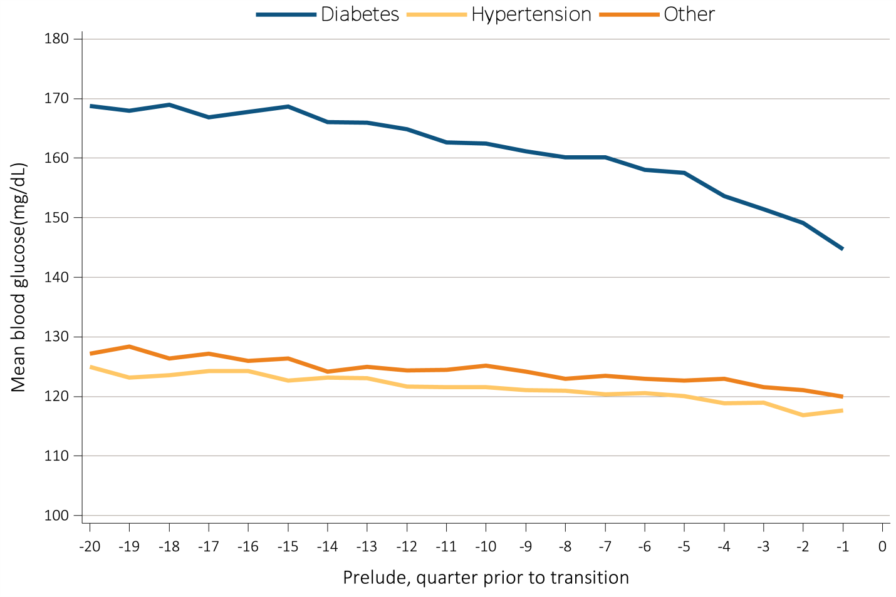
Figure 8.13 Trend in blood glucose level during the prelude (pre-ESRD) time over 20 calendar quarters in 49,608 veterans who transitioned to ESRD during 10/1/2007-3/31/2014.
Data Source: VHA Administrative data, USRDS ESRD Database. Abbreviations: ESRD, end-stage renal disease; mg/dL, milligrams per deciliter.

Slide 20
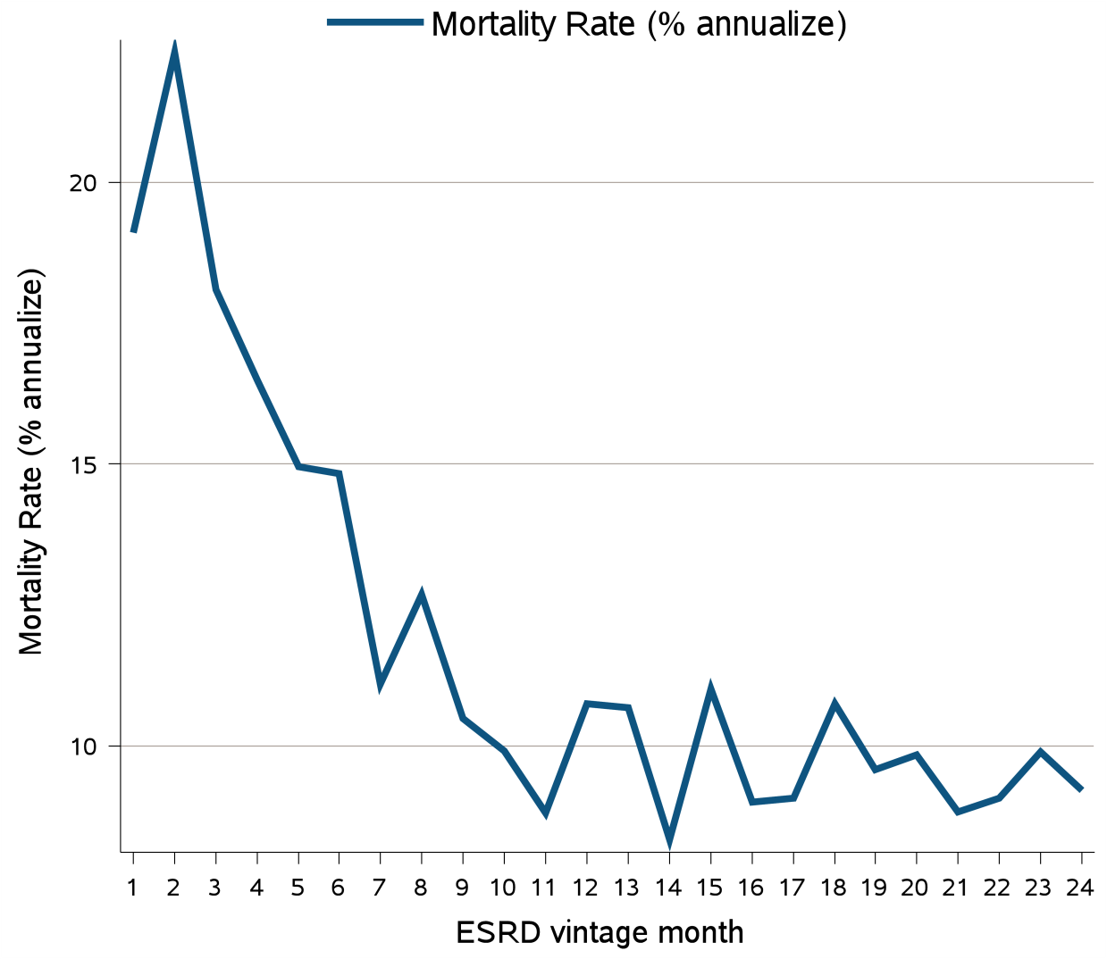
Figure 8.14 Annualized unadjusted mortality rate of the 8,038 incident ESRD patients who transitioned to ESRD during 1/1/2007-12/31/2013 who were followed for up to 24 months (N=8,038)
Data Source: Kaiser Permanente Southern California Electronic Health Records. Abbreviations: ESRD, end-stage renal disease.

Slide 21
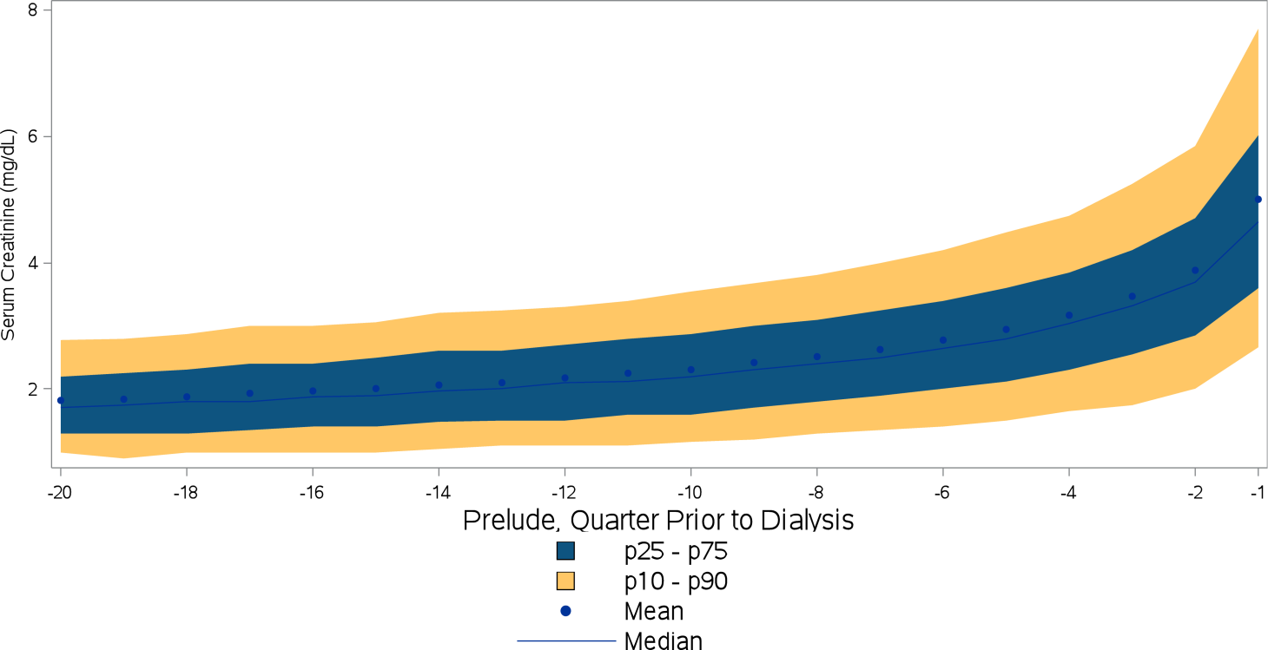
Figure 8.15 Trend in serum creatinine level during the prelude (pre-ESRD) period over 20 calendar quarters among 7,885 patients who transitioned to dialysis during 1/1/2007-12/31/2013
Data Source: Kaiser Permanente Southern California Electronic Health Records. Abbreviations: ESRD, end-stage renal disease; mg/dL, milligrams per deciliter; p, percentile.

Slide 22
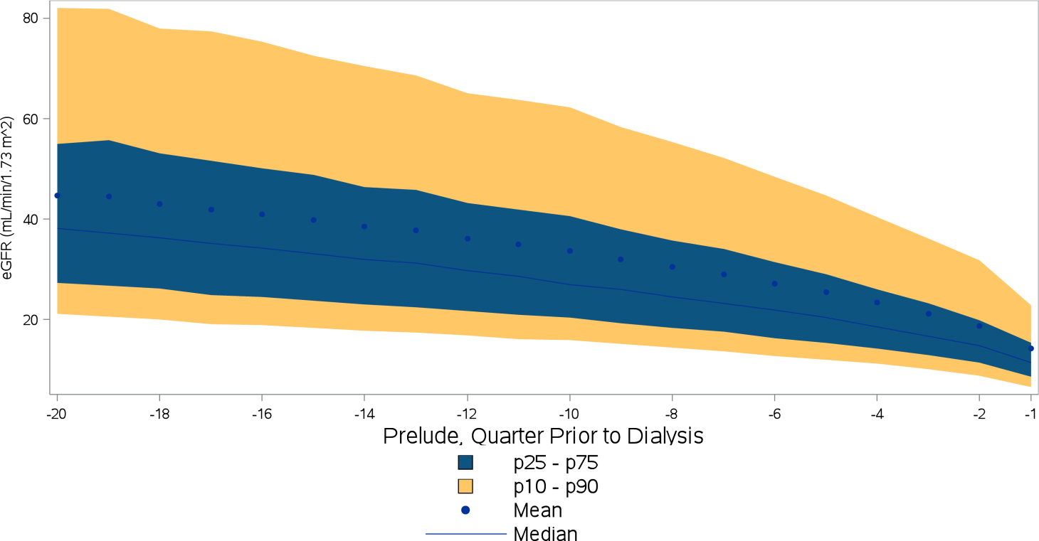
Figure 8.16 Trend in eGFR during the prelude (pre-ESRD) period over 20 calendar quarters among 7,885 patients who transitioned to dialysis during 1/1/2007-12/31/2013
Data Source: Kaiser Permanente Southern California Electronic Health Records. Abbreviations: eGFR; estimated glomerular filtration rate ;ESRD, end-stage renal disease; mL/min/1.73m2, milliliter per minute per 1.73 meters squared; p, percentile.

Slide 23
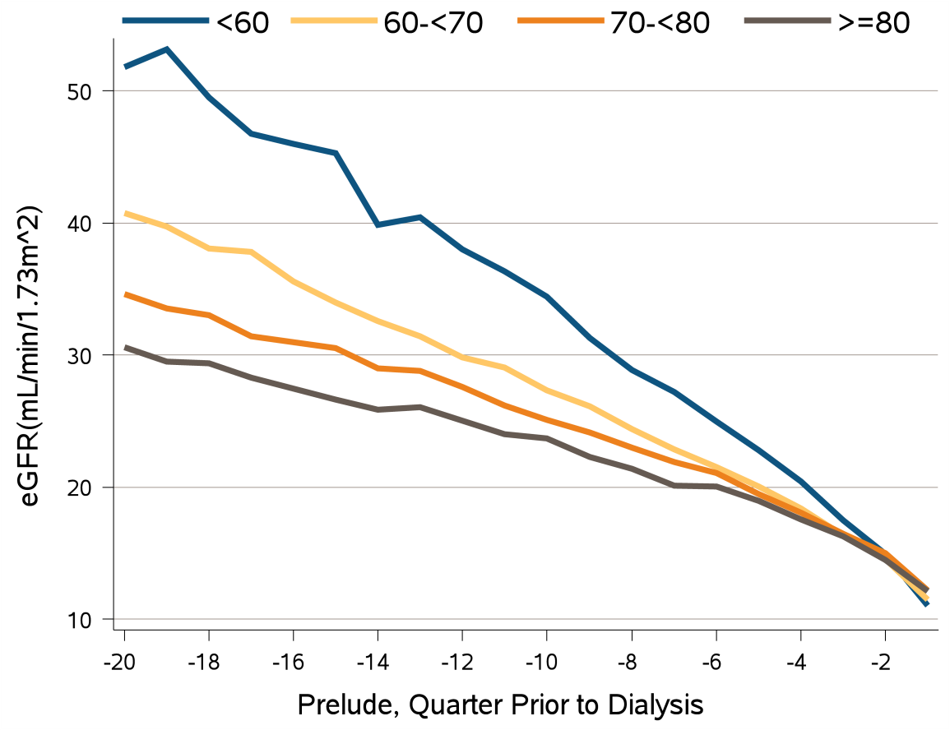
Figure 8.17 Age-at-incidence stratified trends in eGFR during the prelude (pre-ESRD) period over 20 calendar quarters among 7,885 patients who transitioned to dialysis during 1/1/2007-12/31/2013
Data Source: Kaiser Permanente Southern California Electronic Health Records. Abbreviations: eGFR; estimated glomerular filtration rate ;ESRD, end-stage renal disease; mL/min/1.73m2, milliliter per minute per 1.73 meters squared.

Slide 24
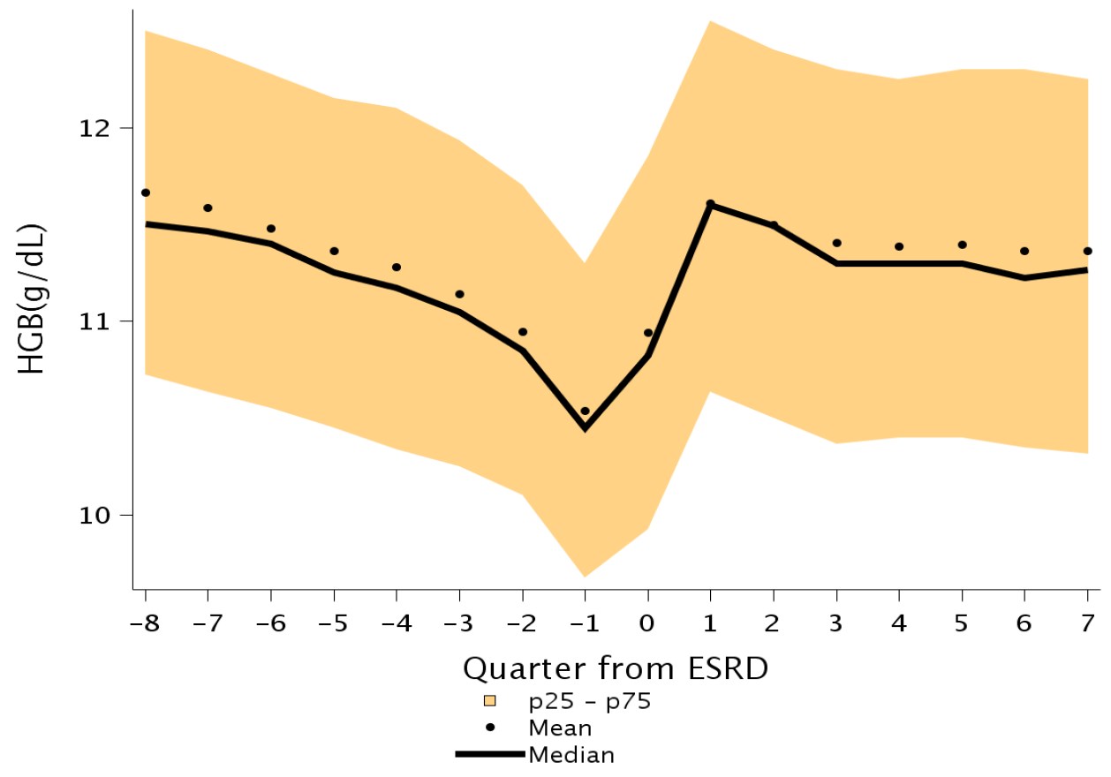
Figure 8.18 Trend in hemoglobin levels (g/dL) over 8 calendar quarters each in the prelude (pre-ESRD) and vintage (post-ESRD) periods among 8,038 patients who transitioned to ESRD during 1/1/2007-12/31/2013
Data source: Kaiser Permanente Southern California Electronic Health Records. Abbreviations: ESRD, end-stage renal disease; g/dL, grams per deciliter; p, percentile.

Slide 25
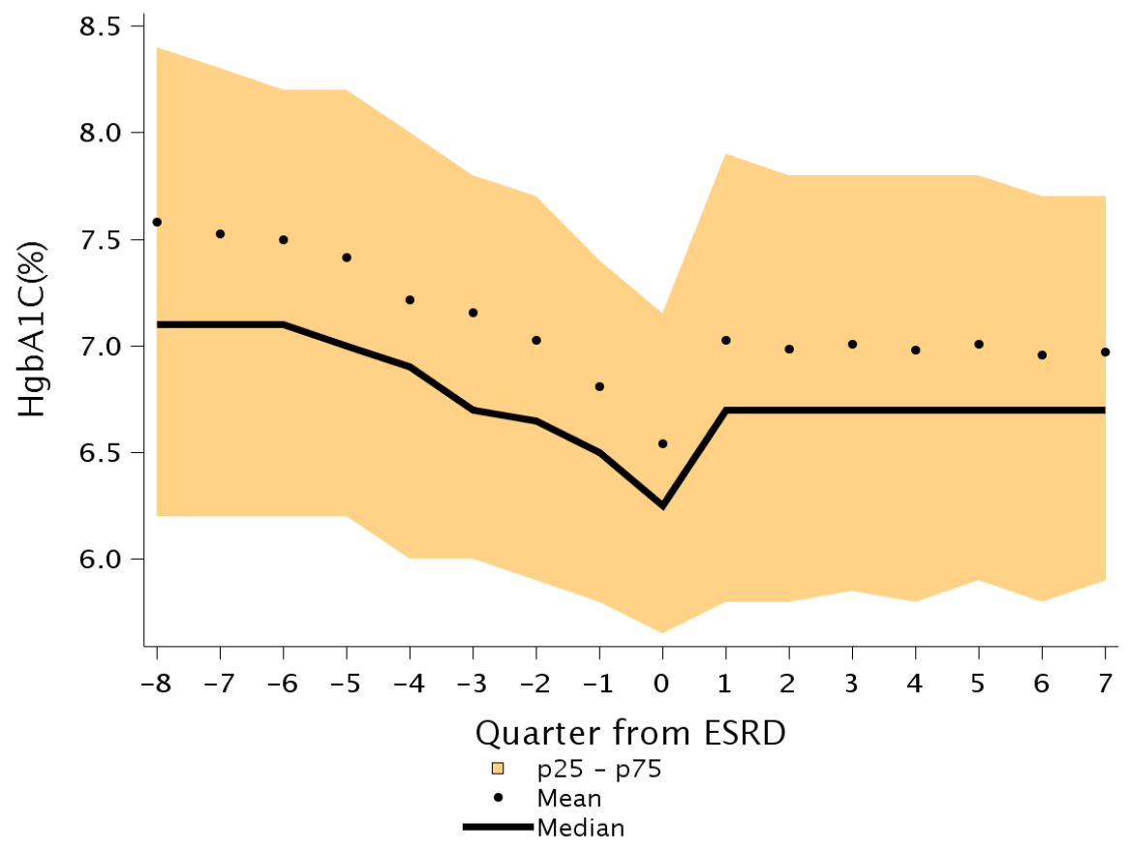
Figure 8.19 Trend in HgbA1C levels (% of total Hgb) over 8 calendar quarters each in the prelude (pre-ESRD) and vintage (post-ESRD) periods among 8,038 patients who transitioned to ESRD during 1/1/2007-12/31/2013
Data source: Kaiser Permanente Southern California Electronic Health Records. Abbreviations: HbA1C, hemoglobin A1C; Hb, hemoglobin; ESRD, end-stage renal disease ; p, percentile.

Slide 26
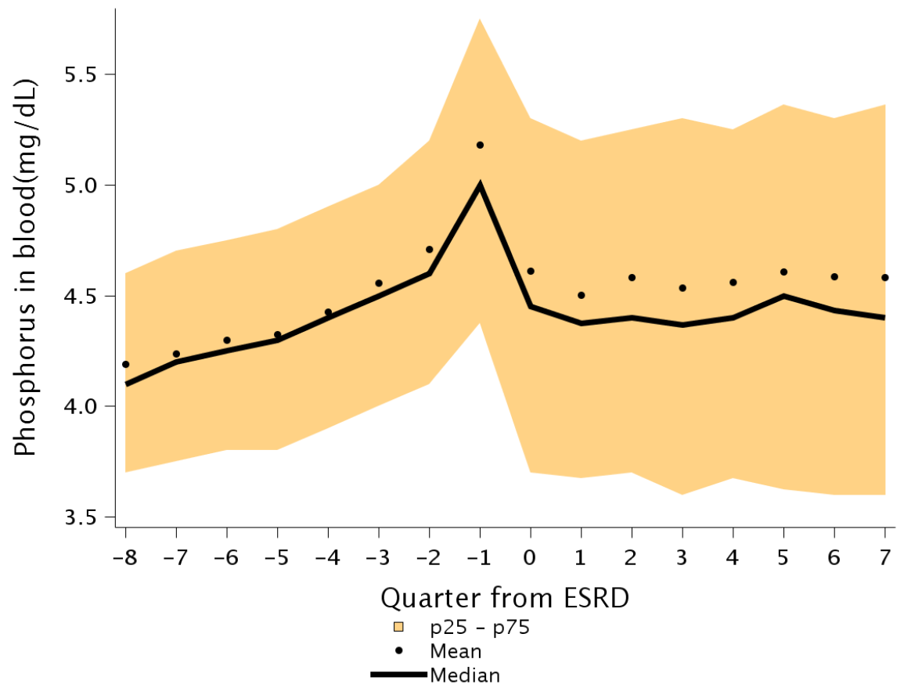
Figure 8.20 Trend in phosphorus levels (mg/dL) over 8 calendar quarters each in the prelude (pre-ESRD) and vintage (post-ESRD) periods among 8,038 patients who transitioned to ESRD during 1/1/2007-12/31/2013
Data source: Kaiser Permanente Southern California Electronic Health Records. Abbreviations: ESRD, end-stage renal disease;mg/dL, milligrams per deciliter; p, percentile.

Slide 27
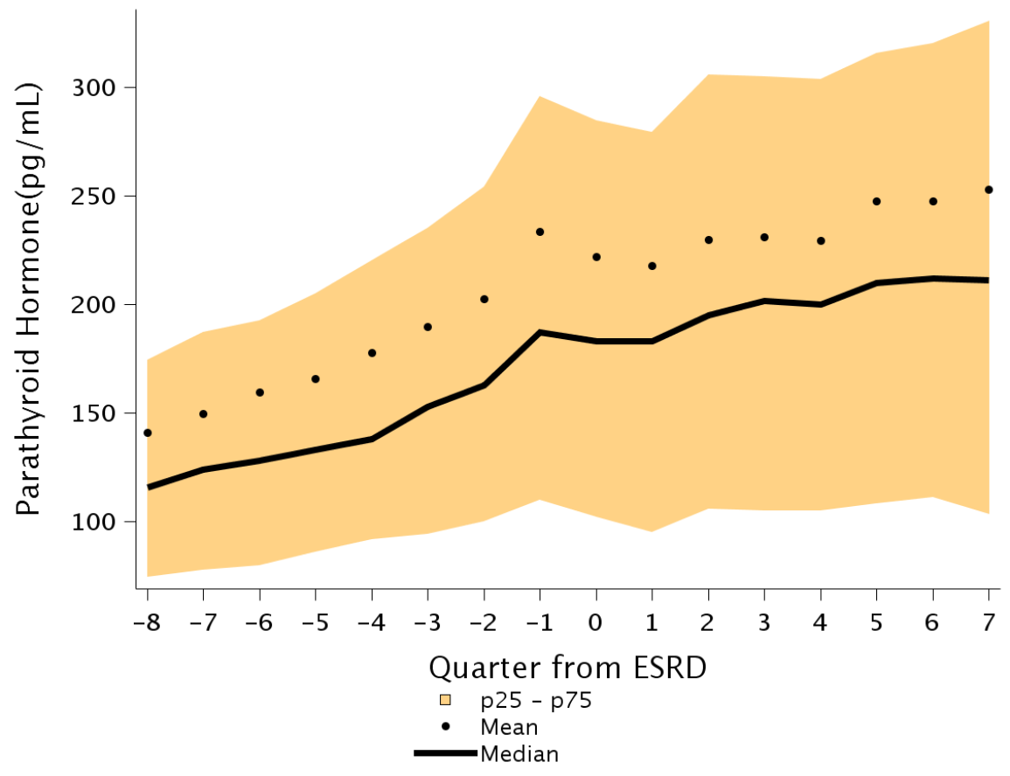
Figure 8.21 Trend in PTH levels (pg/mL) over 8 calendar quarters each in the prelude (pre-ESRD) and vintage (post-ESRD) periods among 8,038 patients who transitioned to ESRD during 1/1/2007-12/31/2013
Data source: Kaiser Permanente Southern California Electronic Health Records. Abbreviations: PTH, parathyroid hormone; ESRD, end-stage renal disease; pg/dL, picograms per deciliter; p, percentile.

Slide 28
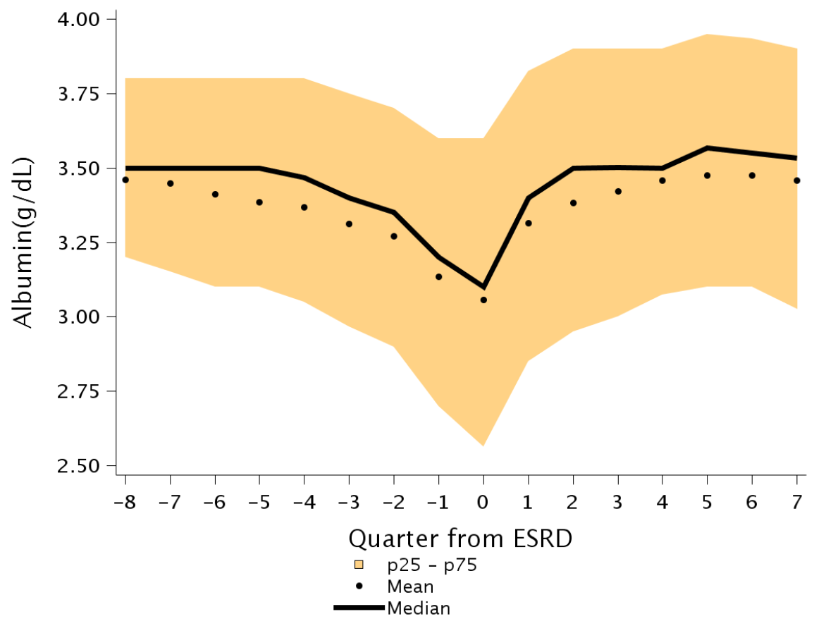
Figure 8.22 Trend in albumin levels (g/dL) over 8 calendar quarters each in the prelude (pre-ESRD) and vintage (post-ESRD) periods among 8,038 patients who transitioned to ESRD during 1/1/2007-12/31/2013
Data source: Kaiser Permanente Southern California Electronic Health Records. Abbreviations: ESRD, end-stage renal disease;g/dL, grams per deciliter; p, percentile.

Slide 29
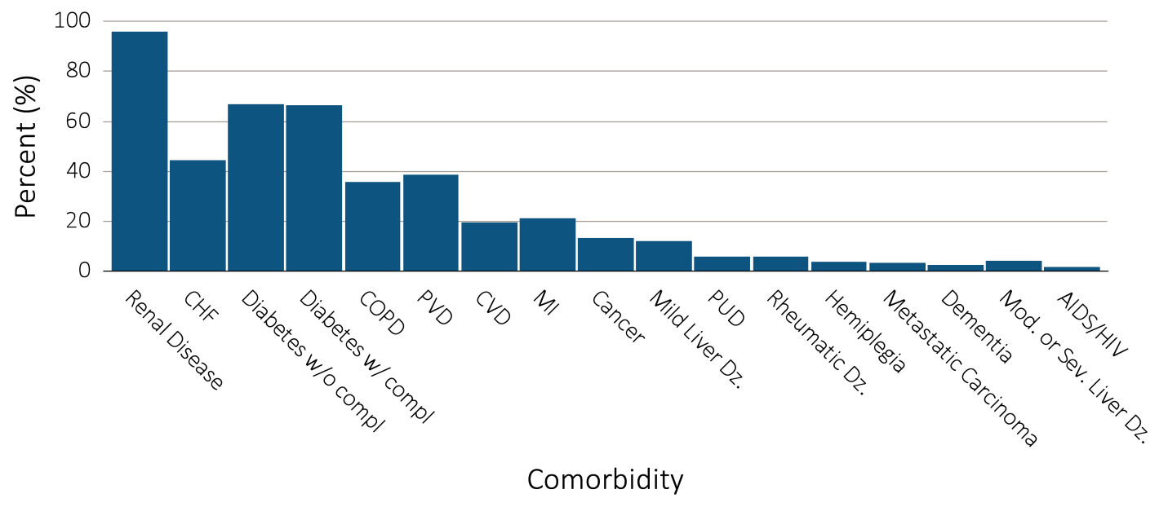
Figure 8.23a Selected comorbid conditions for calculation of the Charlson Comorbidity Index prior to transition to ESRD 8,038 incident ESRD patients
Data Source: Data source: Kaiser Permanente Southern California Electronic Health Records. Abbreviations: CHF, congestive heart failure; compl, complications; COPD, chronic obstructive pulmonary disease; CVD, cerebrovascular disease; Dz, disease; ESRD, end-stage renal disease; MI, myocardial infarction; Mod, moderate; PVD, periphral vascular disease; PUD, peptic ulcer disease; Sev, Severe.

Slide 30
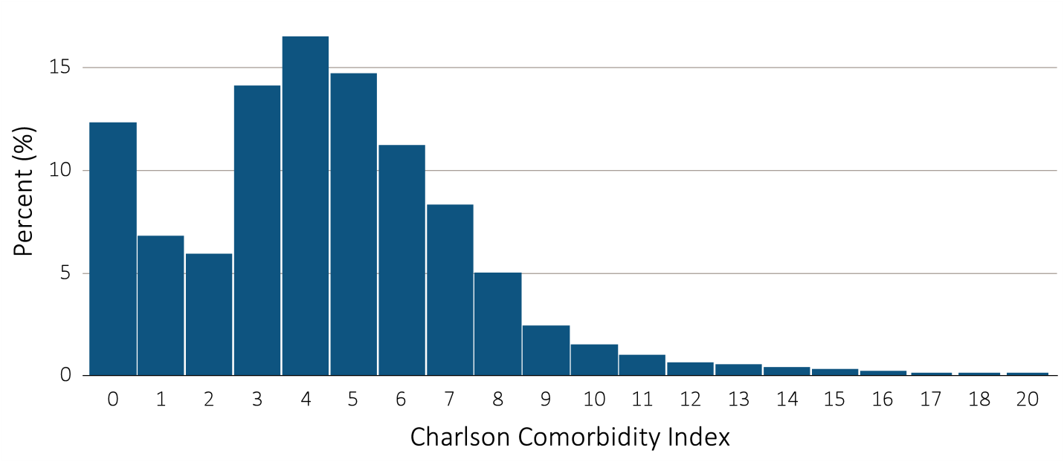
Figure 8.23b Selected comorbid conditions for calculation of the Charlson Comorbidity Index prior to transition to ESRD 8,038 incident ESRD patients
Data Source: Kaiser Permanente Southern California Electronic Health Records. Abbreviations: CHF, congestive heart failure; compl, complications; COPD, chronic obstructive pulmonary disease; CVD, cerebrovascular disease; Dz, disease; ESRD, end-stage renal disease; MI, myocardial infarction; Mod, moderate; PVD, periphral vascular disease; PUD, peptic ulcer disease; Sev, Severe.

