Slide 2
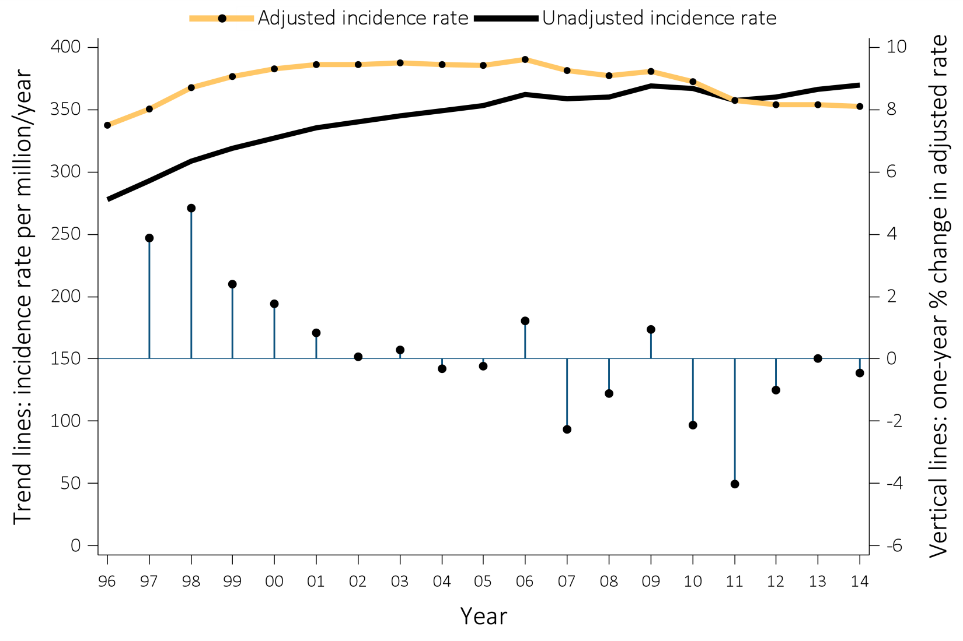
Figure i.1 Trends in the unadjusted and adjusted* incidence rates (per million/year) of ESRD (trend lines; scale on right), and annual percent (%) change in the adjusted* incidence rate of ESRD (vertical lines; scale on left) in the U.S. population, 1996-2014
Data Source: Reference Table A.2.2 and special analyses, USRDS ESRD Database. *Adjusted for age, sex, race, and ethnicity. The standard population was the U.S. population in 2011. Abbreviation: ESRD, end-stage renal disease. This graphic is adapted from Figure 1.1.
^{.t}

Slide 3
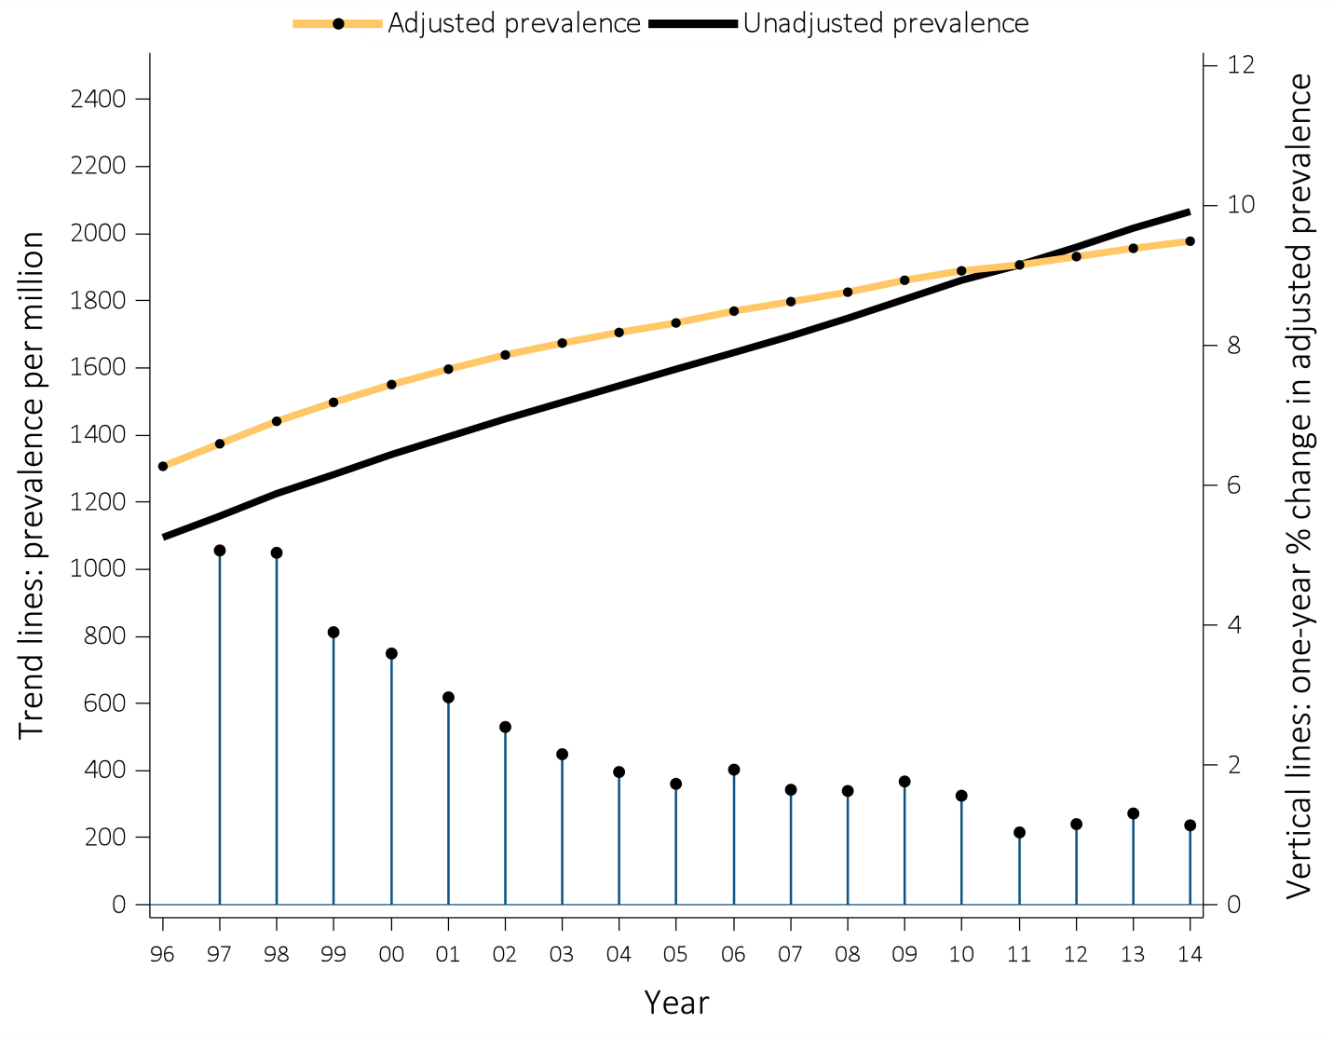
Figure i.2 Trends in the unadjusted and adjusted* ESRD prevalence (per million) (trend lines; scale on left), and annual percent (%) change in adjusted* prevalence of ESRD (vertical lines; scale on right), in the U.S. population, 1996-2014
Data Source: Reference Table B.2.2 and special analyses, USRDS ESRD Database. *Adjusted for age, sex, race, and ethnicity. The standard population was the U.S. population in 2011. Abbreviation: ESRD, end-stage renal disease. This graphic is adapted from Figure 1.10.

Slide 4
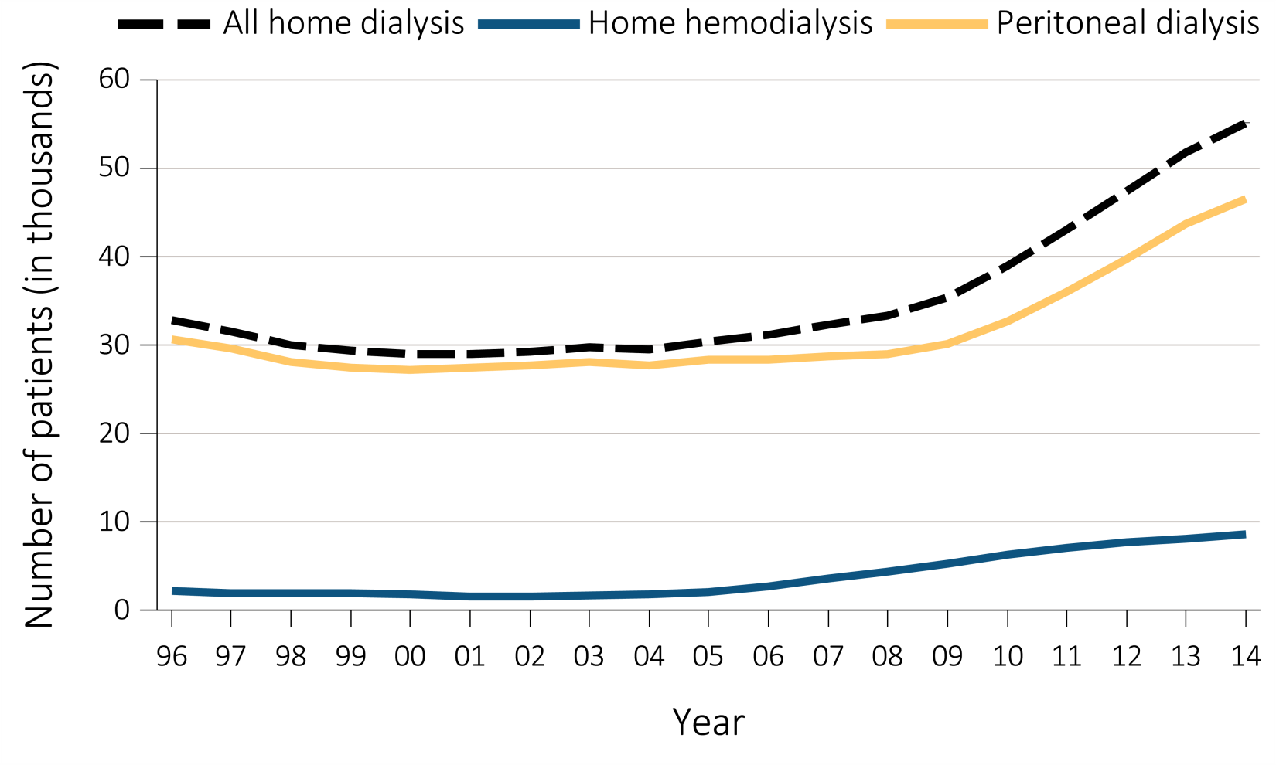
Figure i.3 Trends in number of prevalent ESRD cases (in thousands) using home dialysis, by type of therapy, in the United States, 1996-2014
Data Source: Reference Table D.1. December 31 prevalent ESRD patients; Peritoneal dialysis consists of CAPD and CCPD only. Abbreviations: CAPD, continuous ambulatory peritoneal dialysis; CCPD, continuous cycler peritoneal dialysis; ESRD, end-stage renal disease. This graphic is adapted from Figure 1.19.

Slide 5
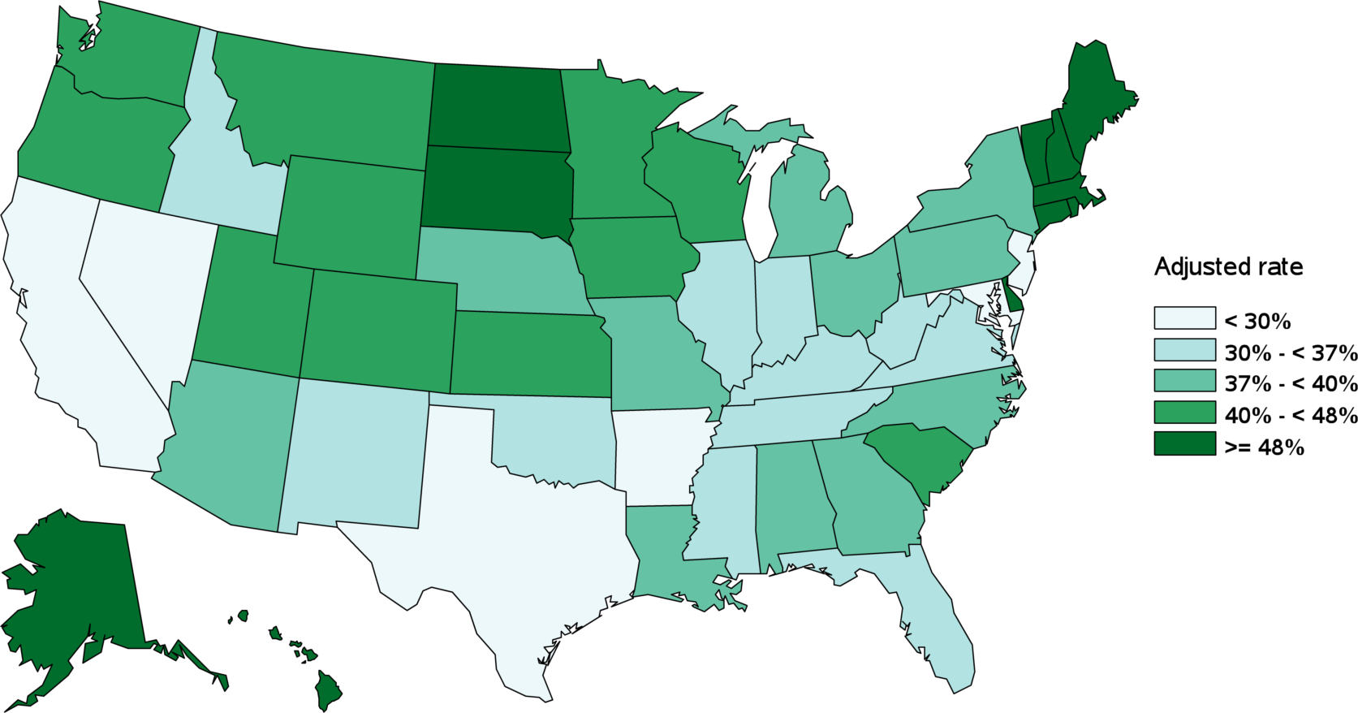
Figure i.4 HP2020 CKD-10 Geographic distribution of the adjusted proportion of chronic kidney disease patients receiving care from a nephrologist at least 12 months before the start of renal replacement therapy, by state, in the U.S. population, 2014: Target 29.8%
Data Source: Special analyses, USRDS ESRD Database. Incident hemodialysis patients with a valid ESRD Medical Evidence CMS 2728 form; nephrologist care determined from Medical Evidence form. Adjusted for age, sex, and race. Abbreviations: CDC, Centers for Disease Control and Prevention; CKD, chronic kidney disease; ESRD, end-stage renal disease. This graphic is adapted from Figure 2.1.

Slide 6
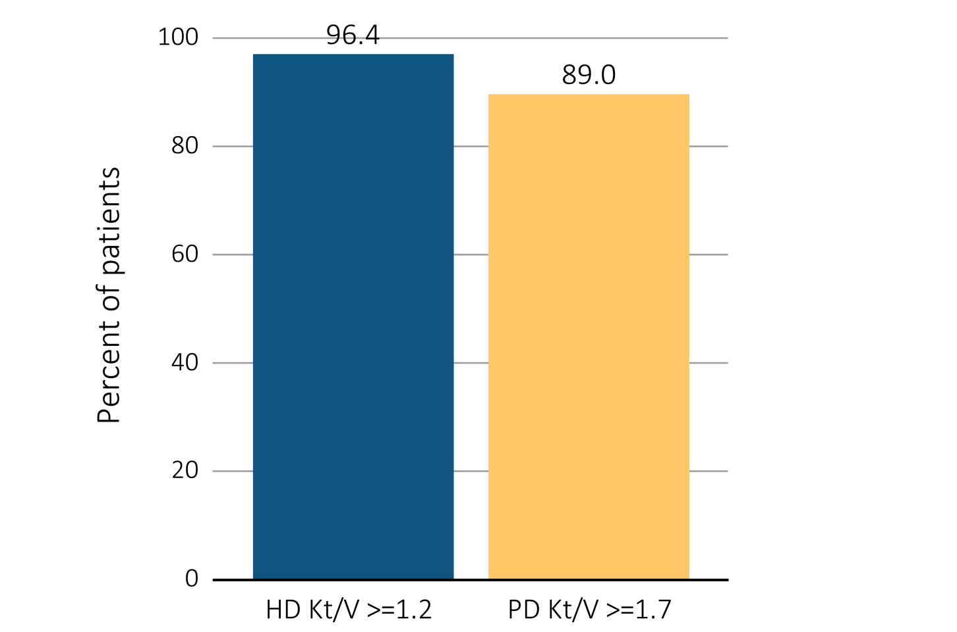
Figure i.5 ESRD clinical indicators, CROWNWeb data, December 2015
(a) Percentage of prevalent hemodialysis and peritoneal dialysis patients meeting clinical care guidelines for dialysis adequacy by modality
Data Source: Special analyses, USRDS ESRD Database. Results shown are for laboratory values reported to CROWNWeb for December 2015, restricted to patients as follows: (a) dialysis patients initiating treatment for ESRD at least 1 year prior to December 1, 2015, and who were alive through December 31, 2015; (b) dialysis patients initiating treatment for ESRD at least 90 days prior to December 1, 2015, who were ≥18 years old as of December 1, 2015, and who were alive through December 31, 2015; and (c) hemodialysis and peritoneal dialysis patients initiating treatment for ESRD at least 90 days prior to December 1, 2015, who were ≥18 years old as of December 1, 2015, and who were alive through December 31, 2015. Abbreviations: CROWNWeb, Consolidated Renal Operations in a Web-Enabled Network; ESRD, end-stage renal disease; HD, hemodialysis; Hgb, hemoglobin; Kt/V, see Glossary; PD, peritoneal dialysis. This graphic is adapted from Figure 3.1.

Slide 7
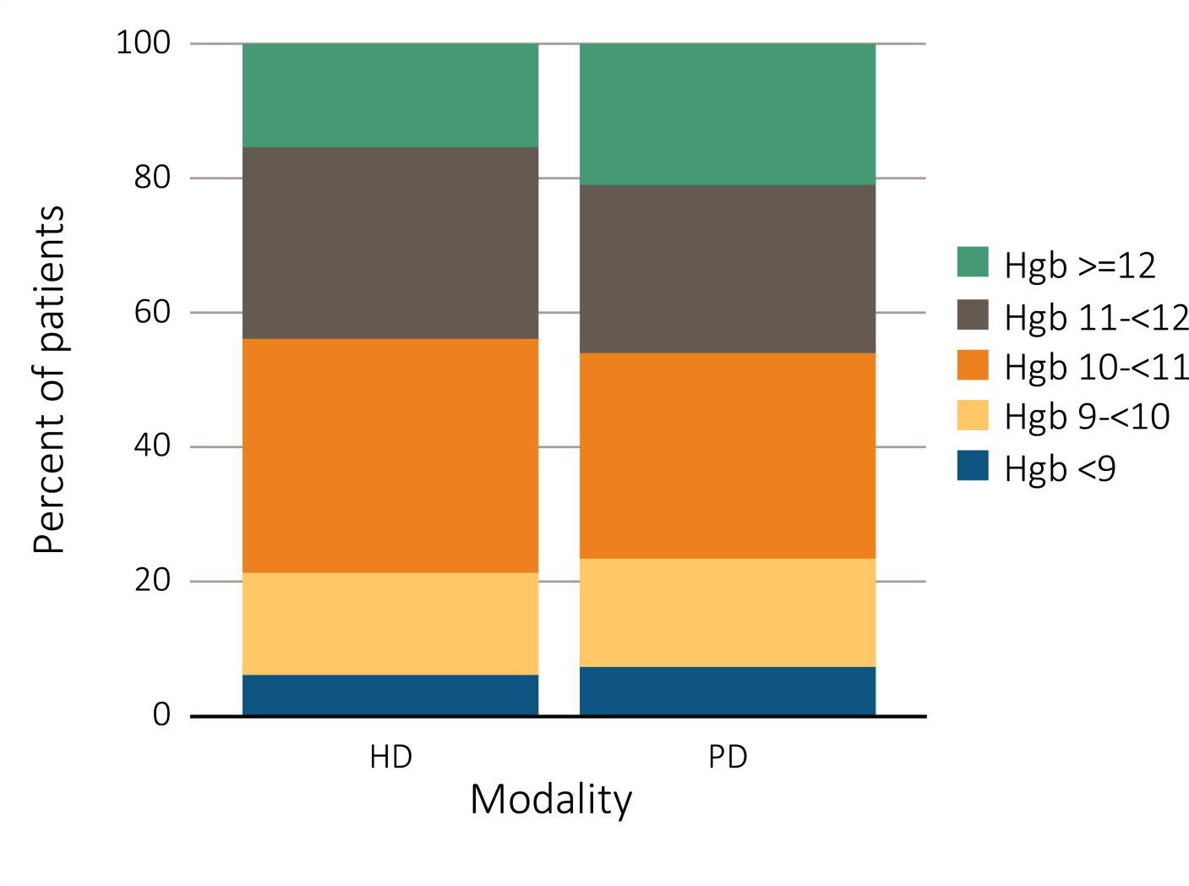
Figure i.5 ESRD clinical indicators, CROWNWeb data, December 2015 (b) Percentage distribution of achieved mean Hgb among prevalent hemodialysis and peritoneal dialysis patients
Data Source: Special analyses, USRDS ESRD Database. Results shown are for laboratory values reported to CROWNWeb for December 2015, restricted to patients as follows: (a) dialysis patients initiating treatment for ESRD at least 1 year prior to December 1, 2015, and who were alive through December 31, 2015; (b) dialysis patients initiating treatment for ESRD at least 90 days prior to December 1, 2015, who were ≥18 years old as of December 1, 2015, and who were alive through December 31, 2015; and (c) hemodialysis and peritoneal dialysis patients initiating treatment for ESRD at least 90 days prior to December 1, 2015, who were ≥18 years old as of December 1, 2015, and who were alive through December 31, 2015. Abbreviations: CROWNWeb, Consolidated Renal Operations in a Web-Enabled Network; ESRD, end-stage renal disease; HD, hemodialysis; Hgb, hemoglobin; Kt/V, see Glossary; PD, peritoneal dialysis. This graphic is adapted from Figure 3.1.

Slide 8
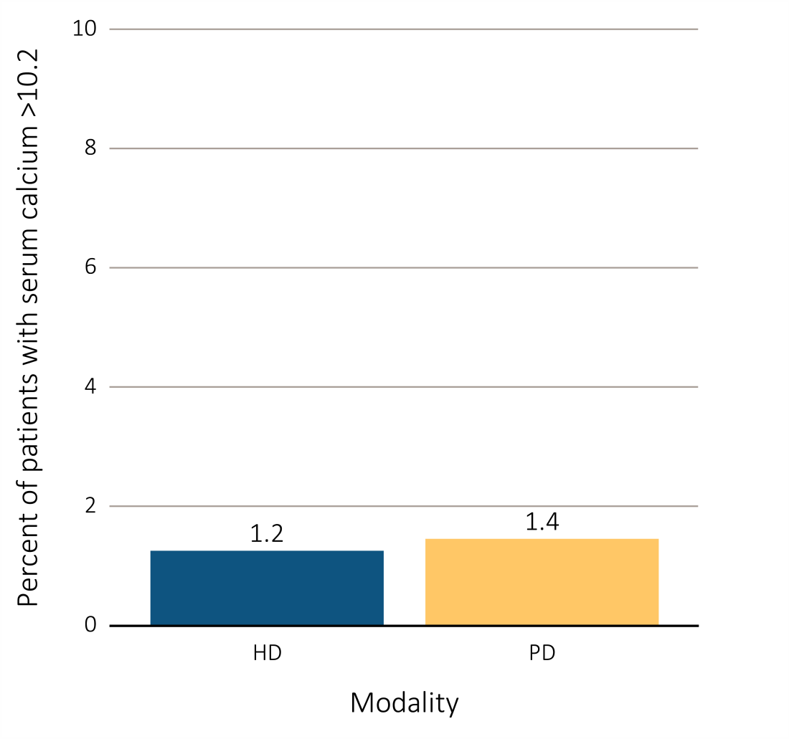
Figure i.5 ESRD clinical indicators, CROWNWeb data, December 2015 (c) Percentage of dialysis patients with serum calcium >10.2 mg/dL by modality
Data Source: Special analyses, USRDS ESRD Database. Results shown are for laboratory values reported to CROWNWeb for December 2015, restricted to patients as follows: (a) dialysis patients initiating treatment for ESRD at least 1 year prior to December 1, 2015, and who were alive through December 31, 2015; (b) dialysis patients initiating treatment for ESRD at least 90 days prior to December 1, 2015, who were ≥18 years old as of December 1, 2015, and who were alive through December 31, 2015; and (c) hemodialysis and peritoneal dialysis patients initiating treatment for ESRD at least 90 days prior to December 1, 2015, who were ≥18 years old as of December 1, 2015, and who were alive through December 31, 2015. Abbreviations: CROWNWeb, Consolidated Renal Operations in a Web-Enabled Network; ESRD, end-stage renal disease; HD, hemodialysis; Hgb, hemoglobin; Kt/V, see Glossary; PD, peritoneal dialysis. This graphic is adapted from Figure 3.1.

Slide 9
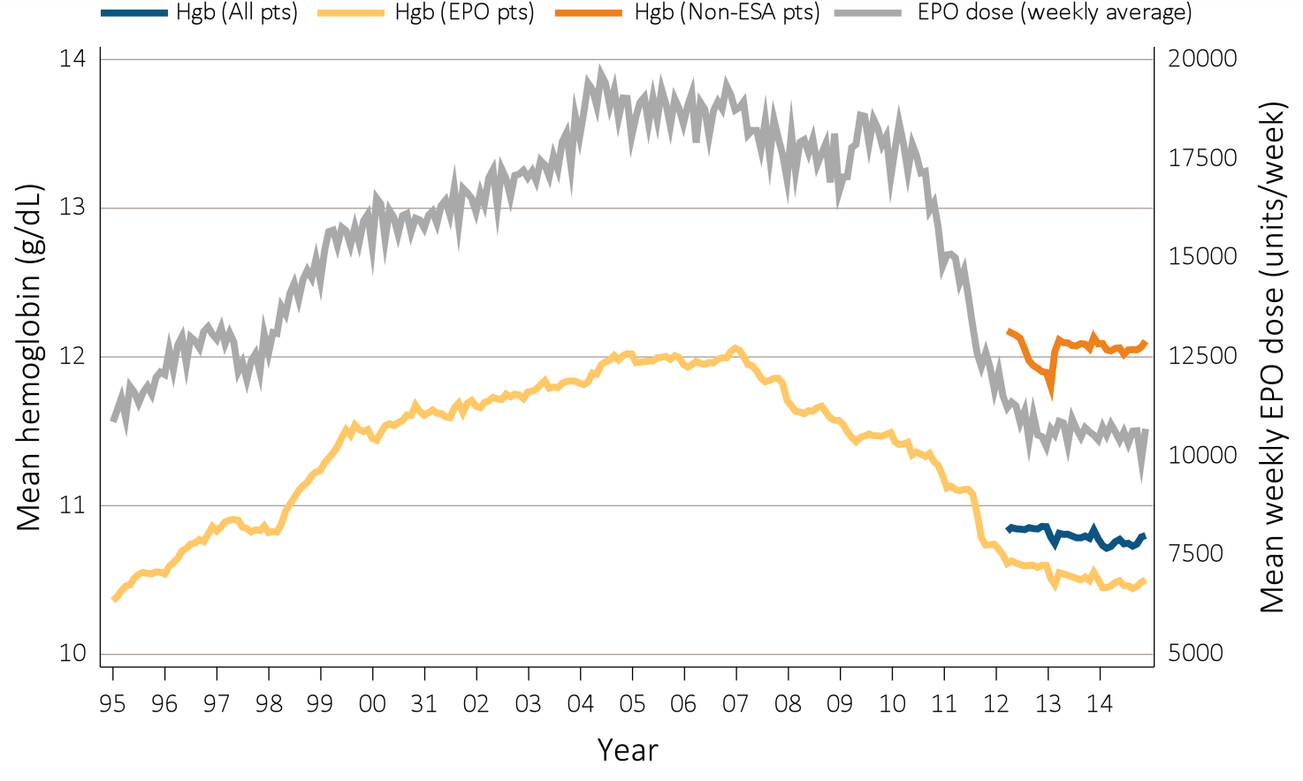
Figure i.6 Anemia measures among adult hemodialysis patients on dialysis ≥90 days: mean monthly Hgb level and mean weekly EPO dose (averaged over a month), Medicare claims, 1995-2014
Data Source: Special analyses, USRDS ESRD Database. Mean monthly Hgb level among ESA-treated adult hemodialysis patients on dialysis ≥90 days (1995 through 2014) or mean monthly Hgb level among all adult hemodialysis patients (April 2012 to December 2014 only) who, within the given month had a Hgb claim (only the first reported Hgb value in a month was used) and were on dialysis ≥90 days; analyses were restricted to patients ≥18 years old at the start of the month. Mean weekly EPO (epoetin alfa) dose is shown for hemodialysis patients within a given month who had an EPO claim, were on dialysis ≥90 days, and were ≥18 years old at the start of the month. EPO dose is expressed as mean EPO units per week averaged over all EPO claims within a given month. Abbreviations: EPO, erythropoietin; ESA, erythropoiesis-stimulating agents; Hgb, hemoglobin. This graphic is adapted from Figure 3.2.

Slide 10
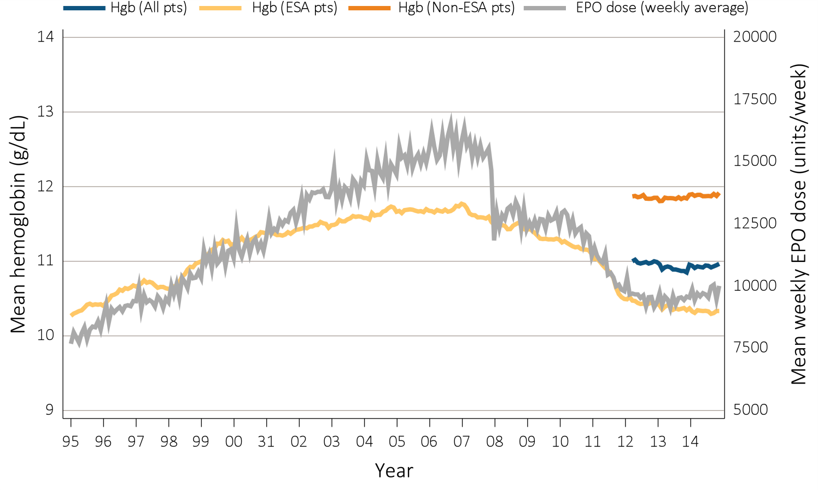
Figure i.7 Anemia measures among adult peritoneal dialysis patients on dialysis ≥90 days, mean monthly Hgb level and mean weekly EPO dose (averaged over a month), Medicare claims, 1995-2014
Data Source: Special analyses, USRDS ESRD Database. Mean monthly Hgb level among ESA-treated adult peritoneal dialysis patients on dialysis ≥90 days (1995 through 2014) or mean monthly Hgb level among all adult peritoneal patients (April 2012 to December 2014 only) who, within the given month had a Hgb claim (only the first reported Hgb value in a month was used) and were on dialysis ≥90 days; analyses were restricted to patients ≥18 years old at the start of the month. Mean weekly EPO (epoetin alfa) dose is shown for peritoneal patients within a given month who had an EPO claim, were on dialysis ≥90 days, and were ≥18 years old at the start of the month. EPO dose is expressed as mean EPO units per week averaged over all EPO claims within a given month. Abbreviations: EPO, erythropoietin; ESA, erythropoiesis-stimulating agents; Hgb, hemoglobin. This graphic is adapted from Figure 3.8.

Slide 11
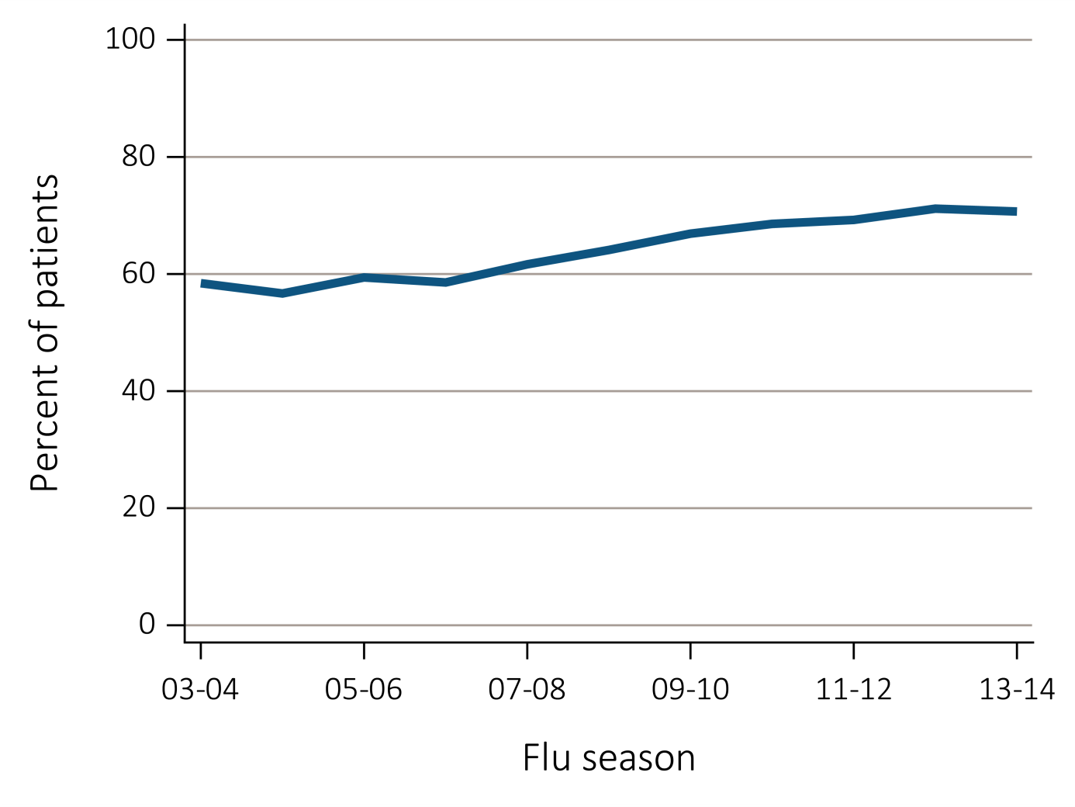
Figure i.8 Percentage of ESRD patients with a claim for seasonal influenza vaccination (August 1-April 30 of subsequent year), overall, Medicare data, ²⁰⁰³⁻²⁰¹⁴
Data Source: Special analyses, USRDS ESRD Database. ESRD patients initiating treatment for ESRD at least 90 days before seasonal period: August 1-April 30 for influenza. Abbreviation: ESRD, end-stage renal disease. This graphic is adapted from Figure 3.19.

Slide 12
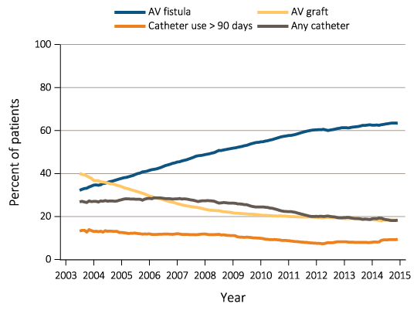
Figure i.9 Trends in vascular access type use among ESRD prevalent patients, ²⁰⁰³⁻²⁰¹⁴
Data Source: Special analyses, USRDS ESRD Database and Fistula First data. Fistula First data reported from July 2003 through April 2012, CROWNWeb data are reported from June 2012 through December 2014. Abbreviations: AV, arteriovenous; CROWNWeb, Consolidated Renal Operations in a Web-enabled Network; ESRD, end-stage renal disease. This graphic is adapted from Figure 4.6.

Slide 13
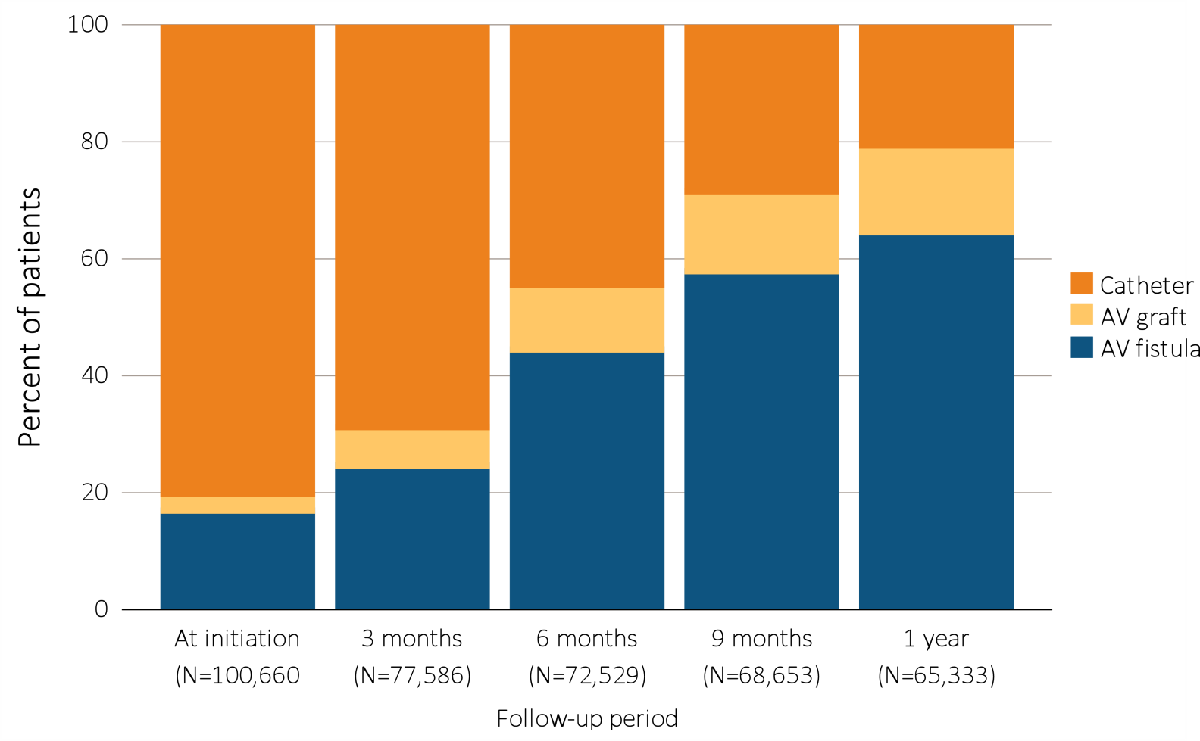
Figure i.10 Change in type of vascular access during the first year of dialysis among patients starting ESRD via hemodialysis in 2014 quarterly: type of vascular access in use (cross-sectional), ESRD Medical Evidence form (CMS 2728) and CROWNWeb, 2014-2015
Data Source: Special analyses, USRDS ESRD Database. Data from January 1, 2014 to December 31, 2014: (a) Medical Evidence form (CMS 2728) at initiation and CROWNWeb for subsequent time periods. (b) ESRD patients initiating hemodialysis (N =102,367). Patients with a maturing AV fistula / AV graft with a catheter in place were classified as having a catheter. The apparent decrease in AV fistula and AV graft use at 1 month is related to missing data due to the different data sources used for incident and prevalent patients. Abbreviations: AV, arteriovenous; CMS, Centers for Medicare & Medicaid; CROWNWeb, Consolidated Renal Operations in a Web-enabled Network; ESRD, end-stage renal disease; HD, hemodialysis; PD, peritoneal dialysis. This graphic is adapted from Figure 4.7.

Slide 14
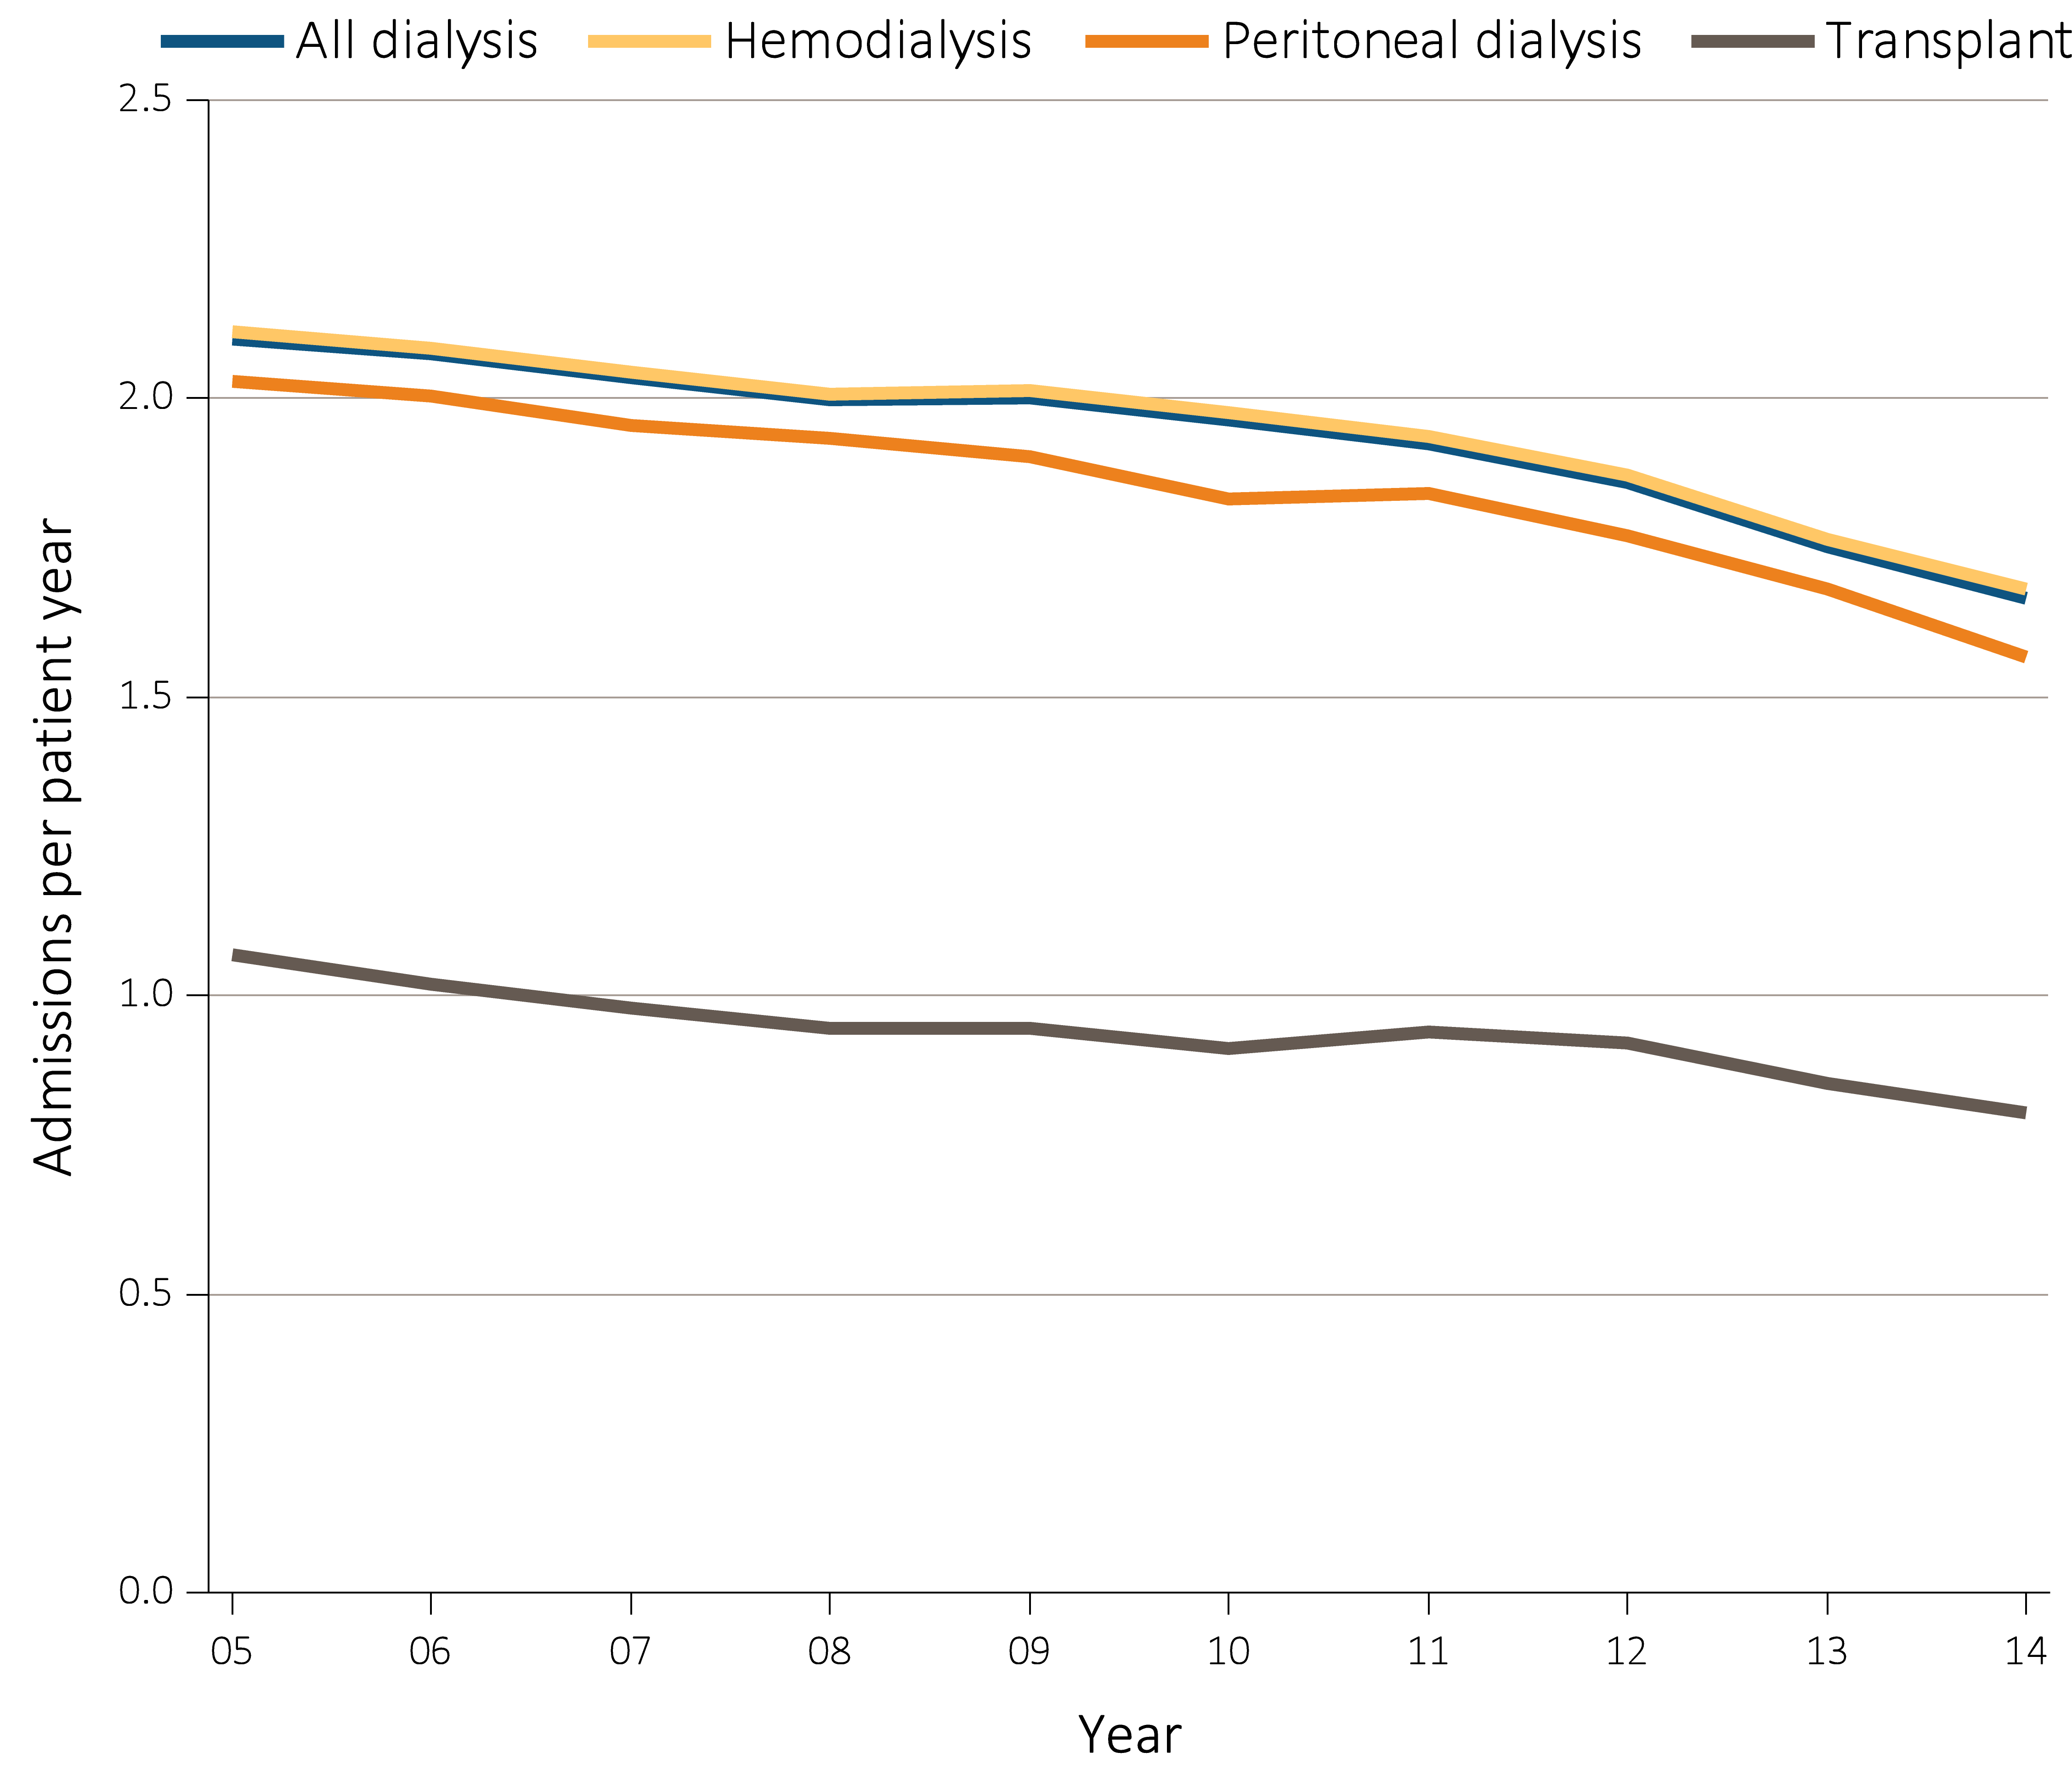
Figure i.11 Adjusted hospitalization rates for ESRD patients, by treatment modality, ²⁰⁰⁵⁻²⁰¹⁴
Data Source: Reference Tables G.1, G.3, G.4, G.5, G.6, G.8, G.9, G.10, and special analyses, USRDS ESRD Database. Period prevalent ESRD patients; adjusted for age, sex, race, primary cause of kidney failure & their two-way interactions; reference population, ESRD patients, 2011. Abbreviation: ESRD, end-stage renal disease. This graphic is adapted from Figure 5.1.

Slide 15
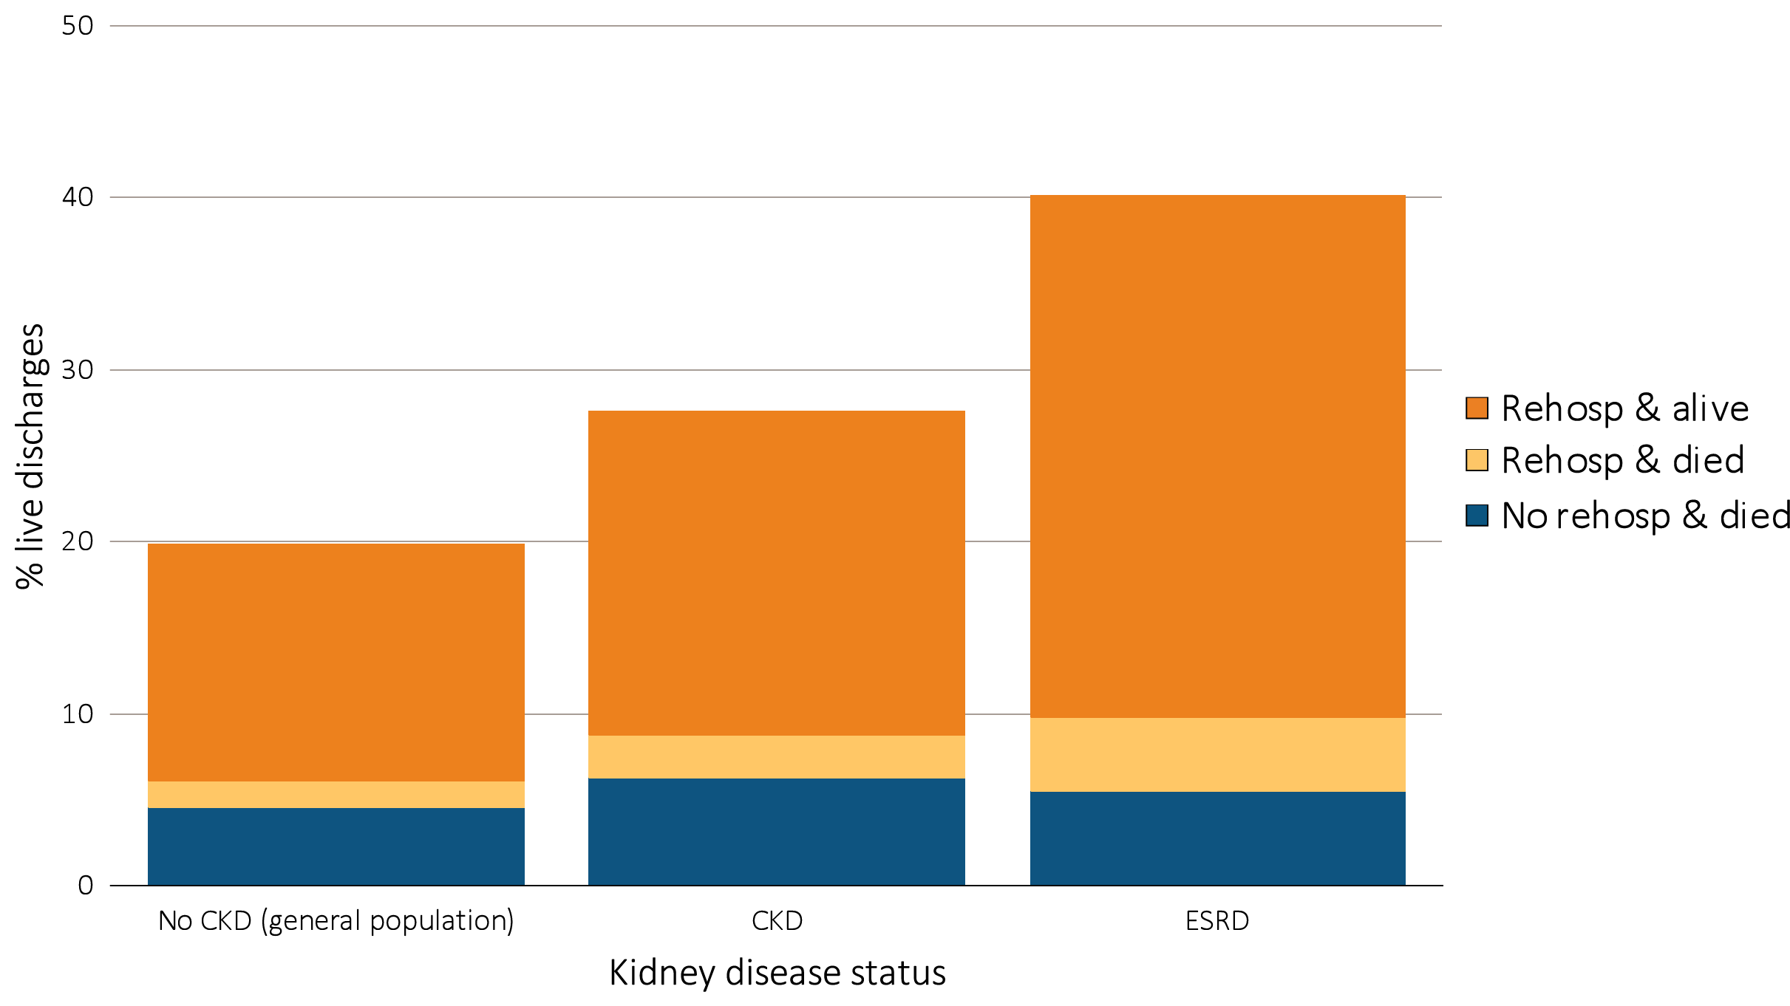
Figure i.12 Proportion of patients aged 66 & older discharged alive from the hospital who were either rehospitalized or died within 30 days of discharge, by kidney disease status, 2014
Data Source: Special analyses, USRDS ESRD Database and Medicare 5% sample. January 1, 2014 point prevalent Medicare patients aged 66 & older on December 31, 2013. For general Medicare: January 1, 2014 point prevalent, Medicare patients aged 66 & older, discharged alive from an all-cause index hospitalization between January 1, 2014, and December 1, 2014, unadjusted. CKD determined using claims for 2013. Abbreviations: CKD, chronic kidney disease; ESRD, end-stage renal disease; rehosp, rehospitalization. This graphic is adapted from Figure 5.6.

Slide 16
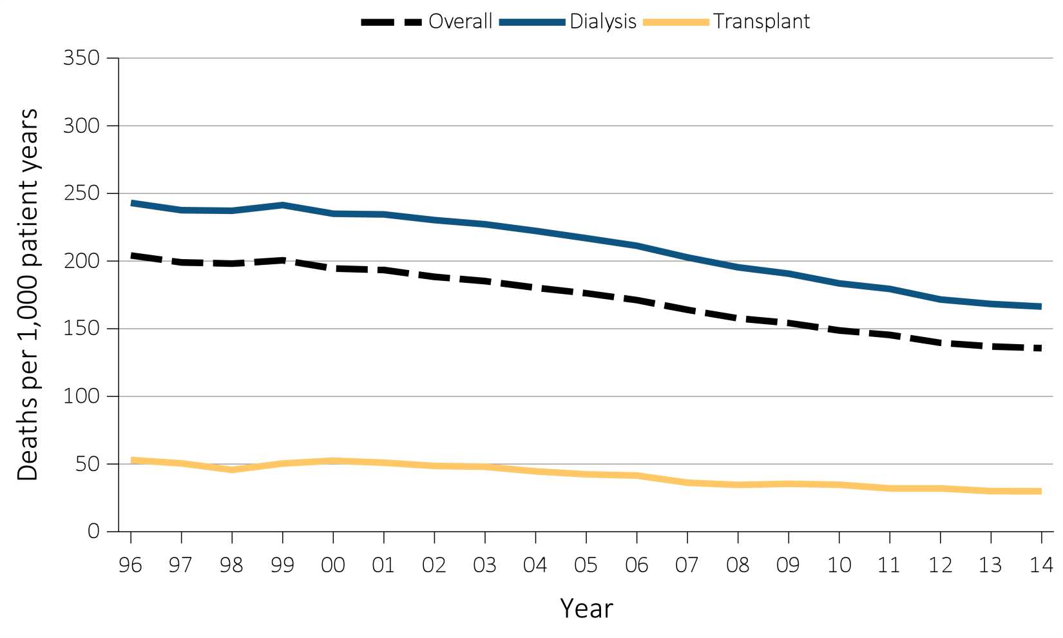
Figure i.13 Adjusted all-cause mortality (deaths per 1,000 patient-years)
by treatment modality for period-prevalent patients, 1996-2014
(a) Overall, dialysis, and transplant
Data Source: Reference Tables H.2_adj, H4_adj, H.8_adj, H.9_adj, and H.10_adj; and special analyses, USRDS ESRD Database. Adjusted for age, sex, race, ethnicity, primary diagnosis and vintage. Reference population: period prevalent ESRD patients, 2011. Abbreviations: HD, hemodialysis; PD, peritoneal dialysis. This graphic is adapted from Figure 6.1.

Slide 17
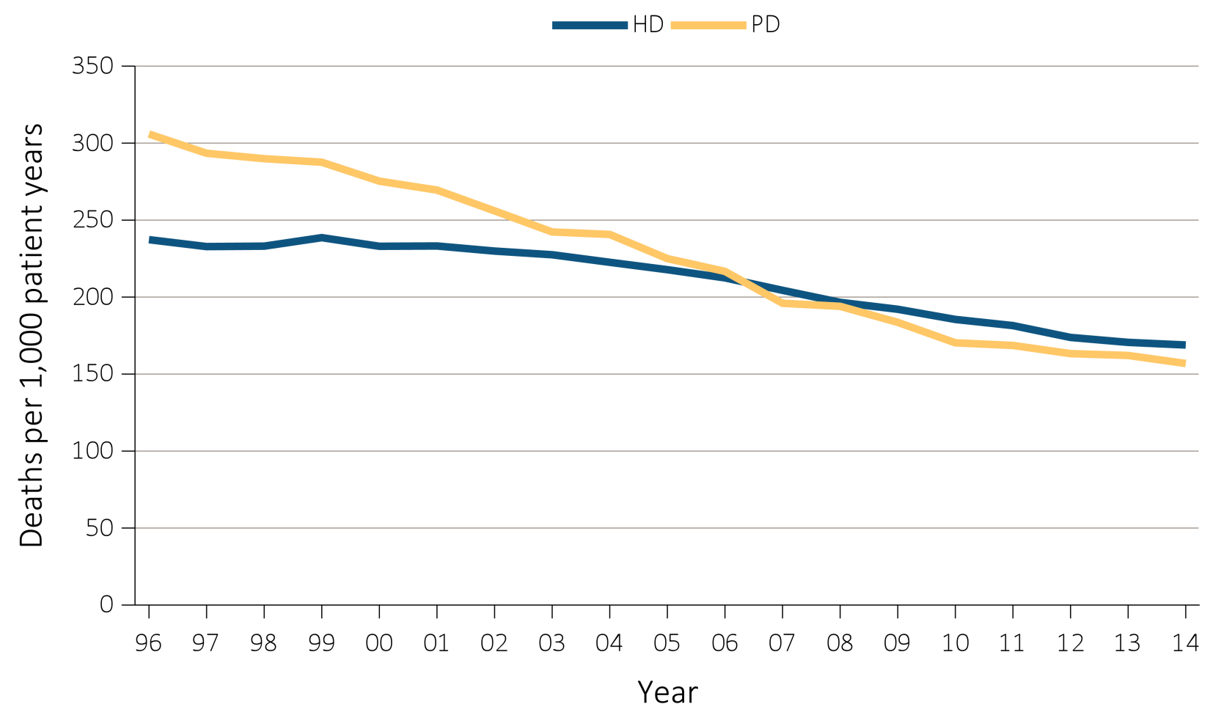
Figure i.13 Adjusted all-cause mortality (deaths per 1,000 patient-years)
by treatment modality for period-prevalent patients, 1996-2014
(b) Hemodialysis and peritoneal dialysis
Data Source: Reference Tables H.2_adj, H4_adj, H.8_adj, H.9_adj, and H.10_adj; and special analyses, USRDS ESRD Database. Adjusted for age, sex, race, ethnicity, primary diagnosis and vintage. Reference population: period prevalent ESRD patients, 2011. Abbreviations: HD, hemodialysis; PD, peritoneal dialysis. This graphic is adapted from Figure 6.1.

Slide 18
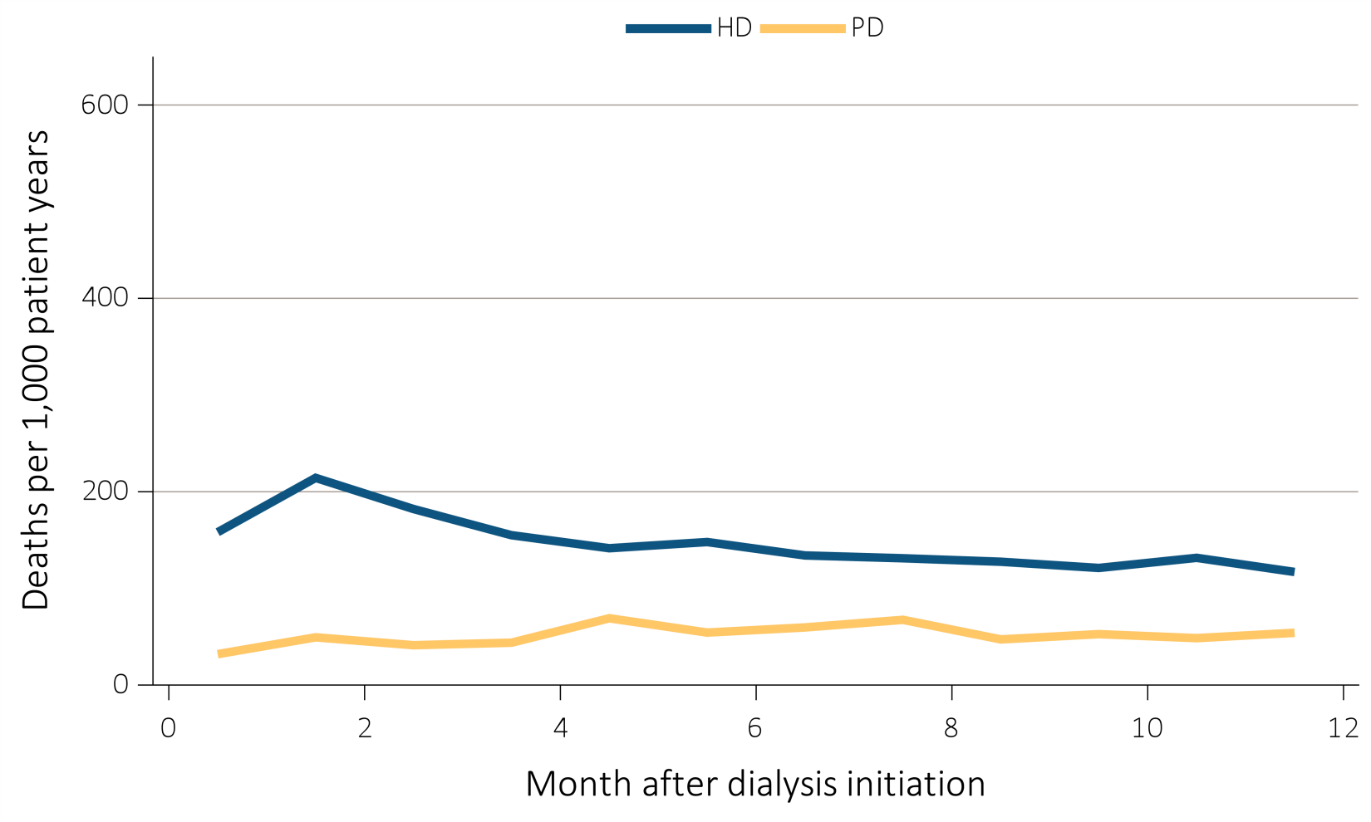
Figure i.14 Adjusted mortality (deaths per 1,000 patient-years) by treatment modality and number of months after treatment initiation among ESRD patients, 2013 ^{(a) Under age 65}
Data Source: Special analyses, USRDS ESRD Database. Adjusted (age, race, sex, ethnicity, and primary diagnosis) mortality among 2013 incident ESRD patients during the first year of therapy. Reference population: incident ESRD patients, 2011. Abbreviations: ESRD, end-stage renal disease; HD, hemodialysis; PD, peritoneal dialysis. This graphic is adapted from Figure 6.3.

Slide 19
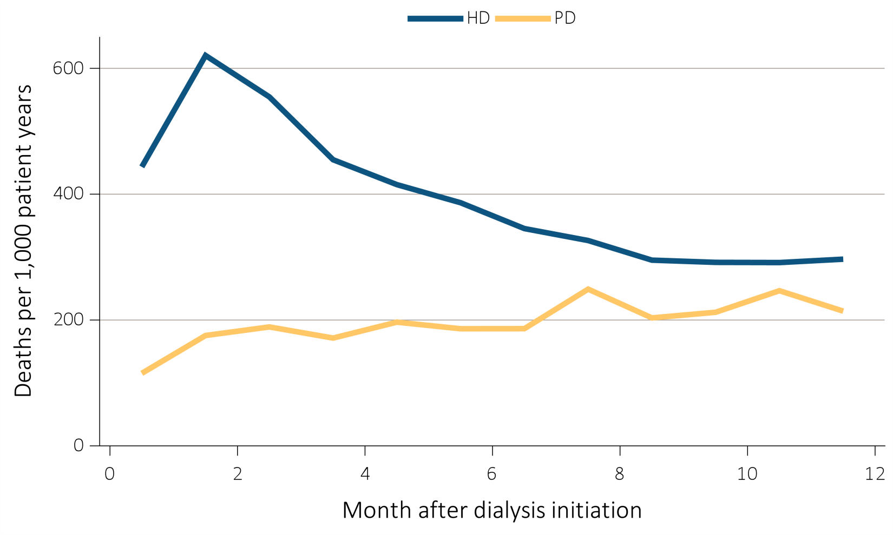
Figure i.14 Adjusted mortality (deaths per 1,000 patient-years) by treatment modality and number of months after treatment initiation among ESRD patients, 2013 ^{(b) Aged 65 and over}
Data Source: Special analyses, USRDS ESRD Database. Adjusted (age, race, sex, ethnicity, and primary diagnosis) mortality among 2013 incident ESRD patients during the first year of therapy. Reference population: incident ESRD patients, 2011. Abbreviations: ESRD, end-stage renal disease; HD, hemodialysis; PD, peritoneal dialysis. This graphic is adapted from Figure 6.3.

Slide 20
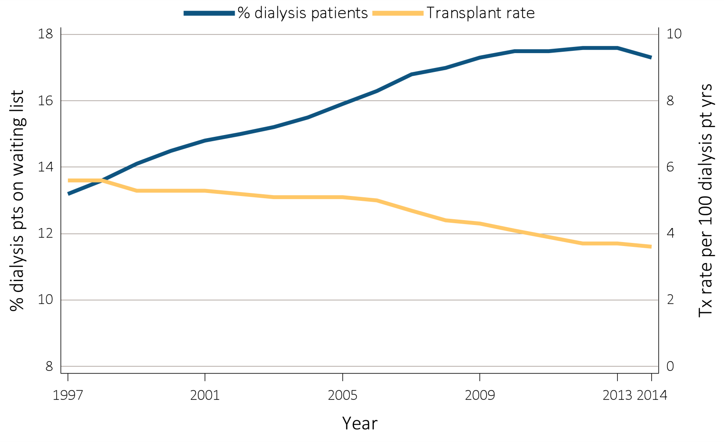
Figure i.15 Percentage of dialysis patients wait-listed and
unadjusted kidney transplant rates, 1997-2014
Data Source: Reference Tables E.4 and E.9. Percentage of dialysis patients on the kidney waiting list is for all dialysis patients. Unadjusted transplant rates are for all dialysis patients. Abbreviations: Tx, transplant; pt yrs, patient years. This graphic is adapted from Figure 7.1.

Slide 21
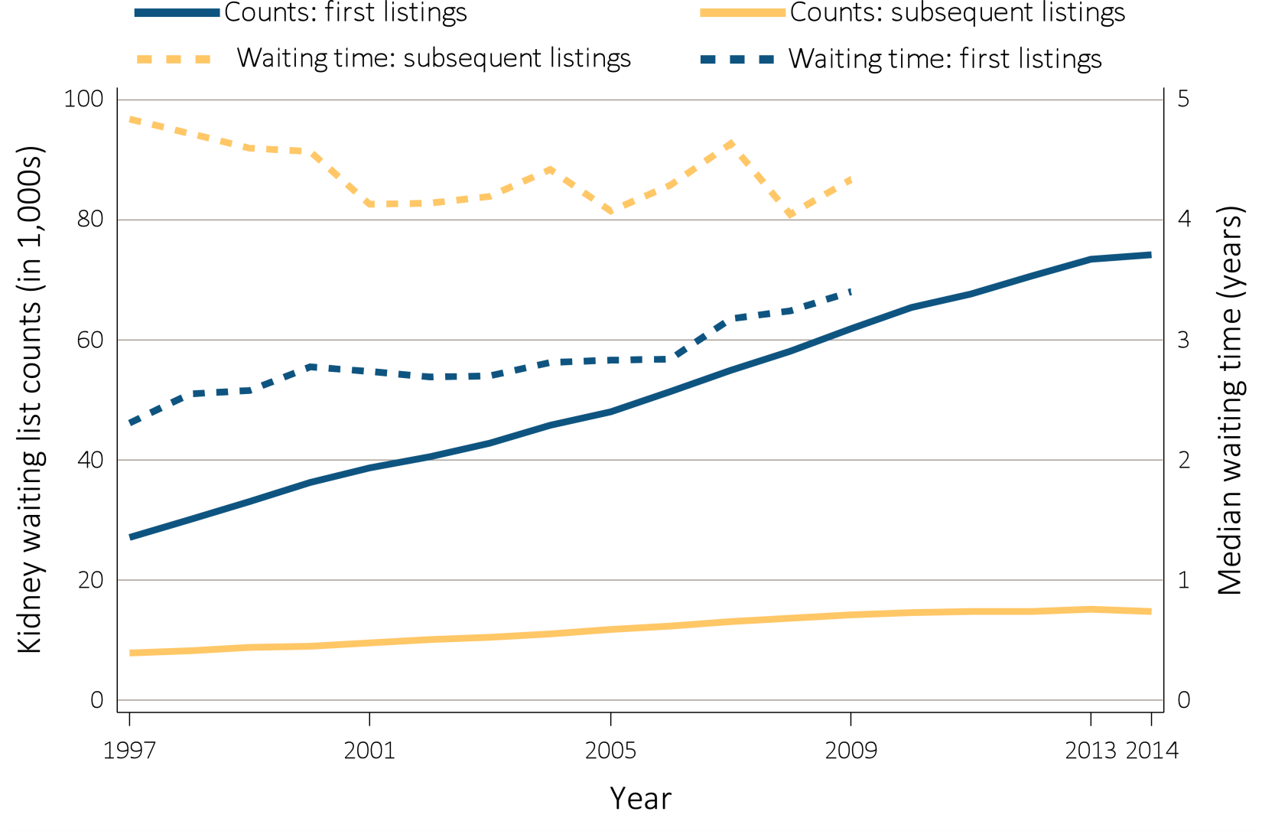
Figure i.16 Number of patients wait-listed for kidney transplant, 1997-2014,
and median waiting time, 1997-2009
Data Source: Reference Tables E.2 and E.3. Waiting list counts include all candidates listed for a kidney transplant on December 31 of each year. Median waiting time is calculated for all candidates enrolled on the waiting list in a given year. This graphic is adapted from Figure 7.2.

Slide 22
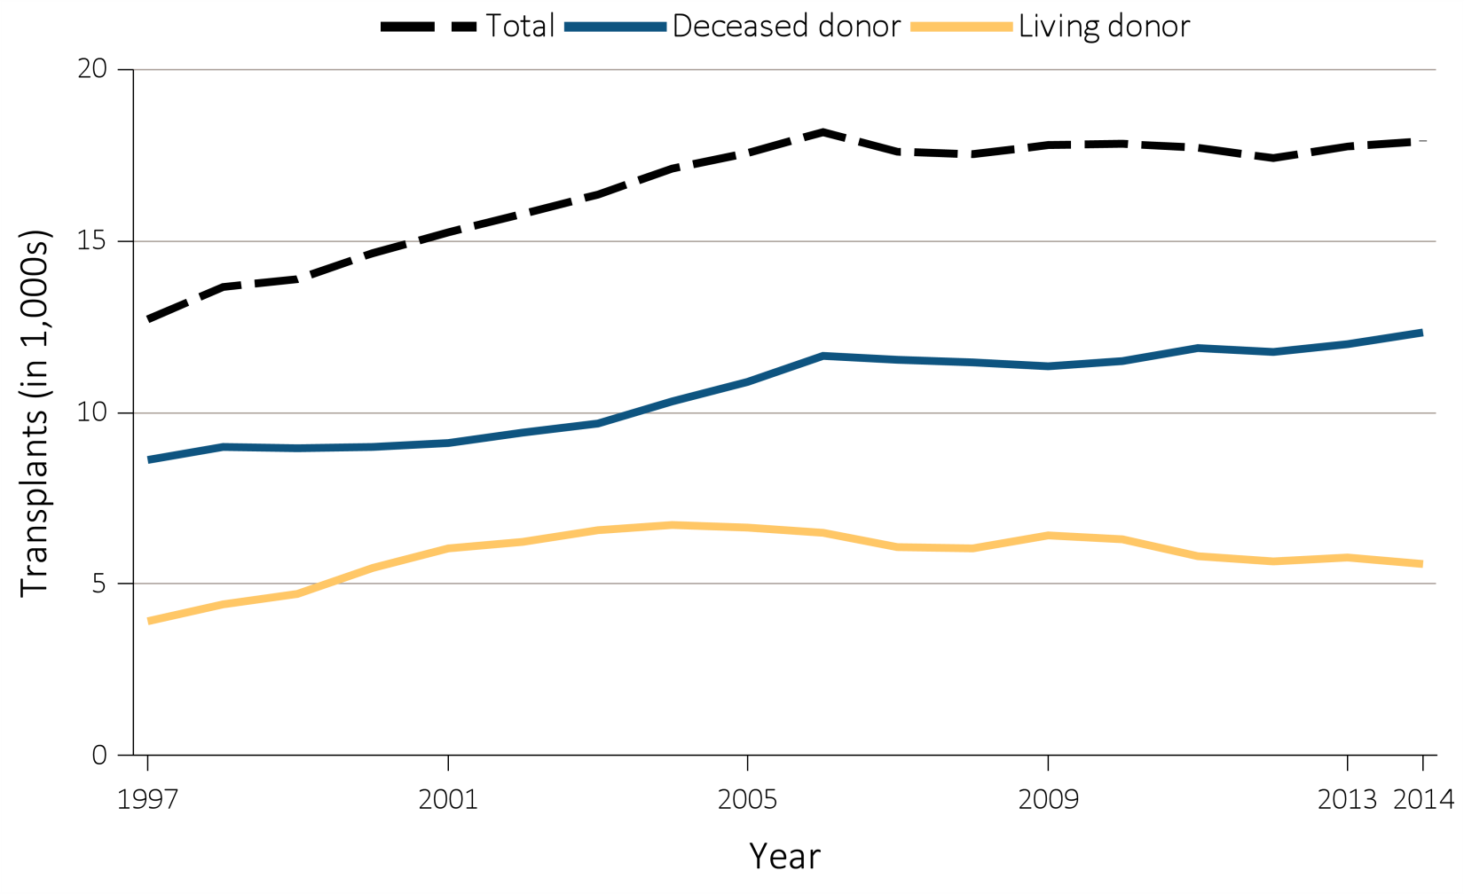
Figure i.17 Number of kidney transplants by donor type, 1997-2014
Data Source: Reference Tables E.8, E.8.2, and E.8.3. Counts of all transplants by year. This graphic is adapted from Figure 7.3.

Slide 23
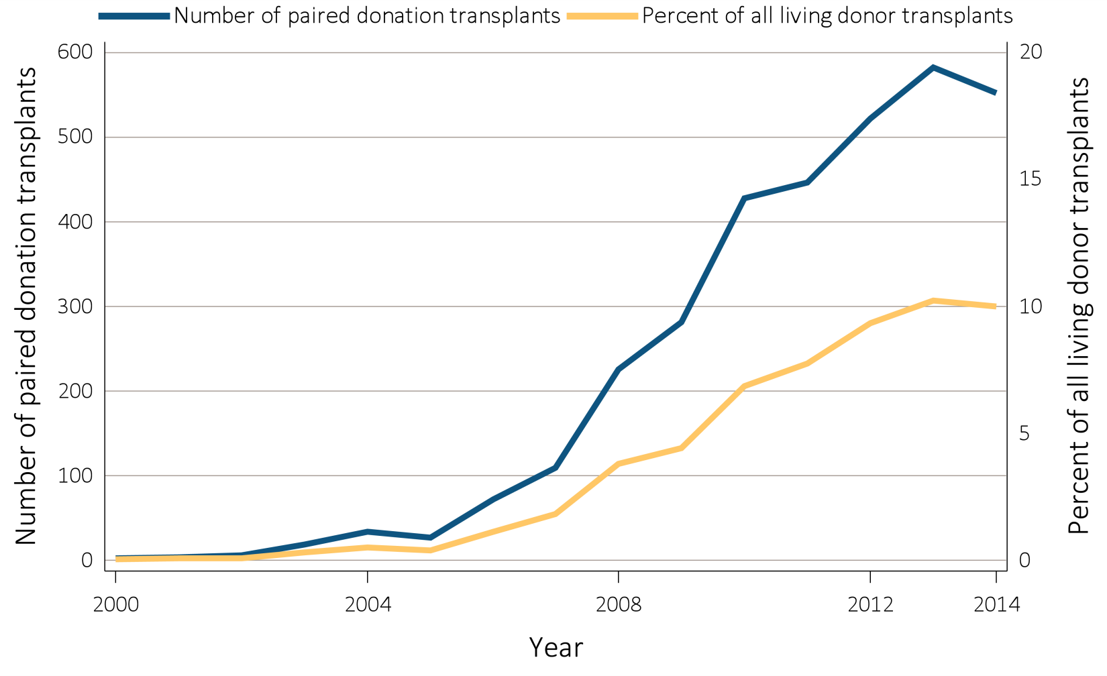
Figure i.18 Number of paired donation transplants and percent of
all living donor transplants, 2000-2014
Data Source: Data are obtained from the Organ Procurement and Transplantation Network (OPTN). Paired donation transplant counts and percent of all living donor transplants. This graphic is adapted from Figure 7.15.

Slide 24
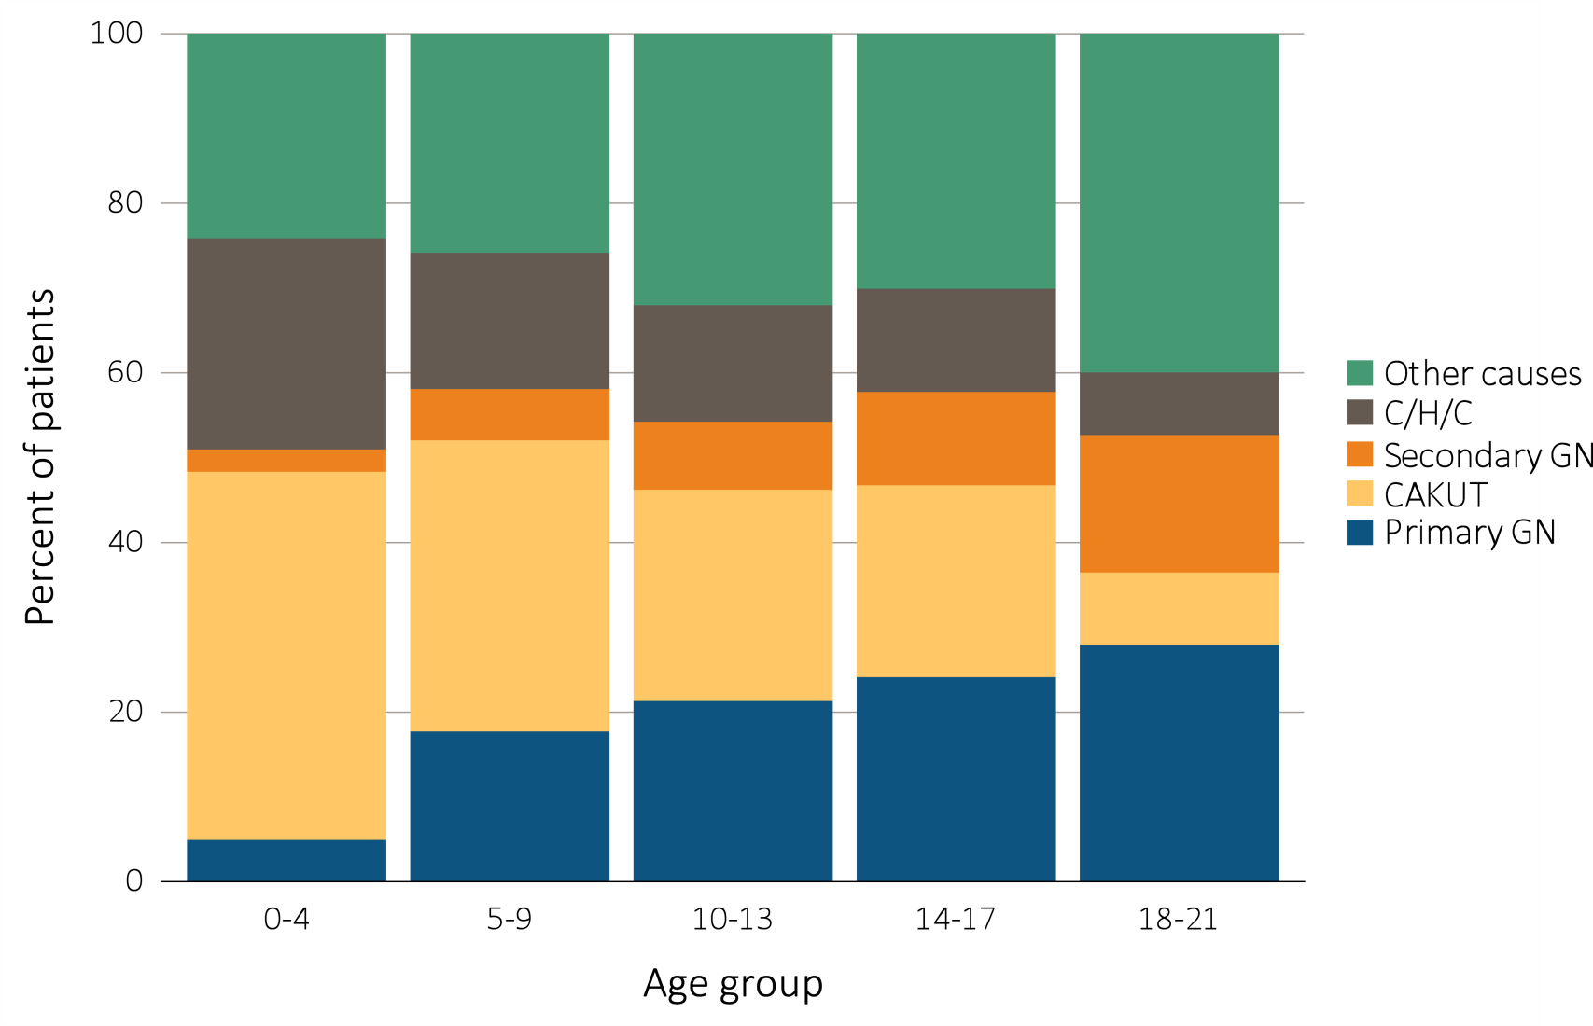
Figure i.19 Distribution of reported incident pediatric ESRD patients
by primary cause of ESRD, by age, 2000-2014
Data Source: Special analyses, USRDS ESRD Database. Abbreviations: CAKUT, congenital anomalies of the kidney and urinary tract; C/H/C, cystic/hereditary/congenital diseases; GN, glomerulonephritis. This graphic is adapted from Figure 8.3.

Slide 25
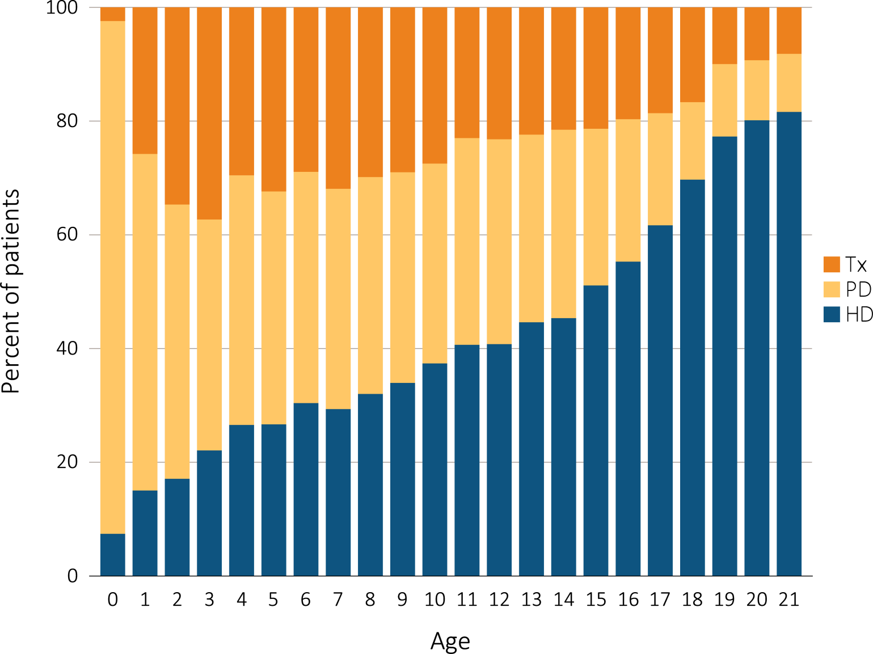
Figure i.20 Cross-sectional trends in pediatric ESRD modality at initiation, 1996-2014
^{(a) By patient age}
Data Source: Special analyses, USRDS ESRD Database. Includes incident ESRD patients in the years 1996-2014. Abbreviations: ESRD, end-stage renal disease; HD, hemodialysis; PD, peritoneal dialysis; Tx, transplant. This graphic is adapted from Figure 8.2.

Slide 26
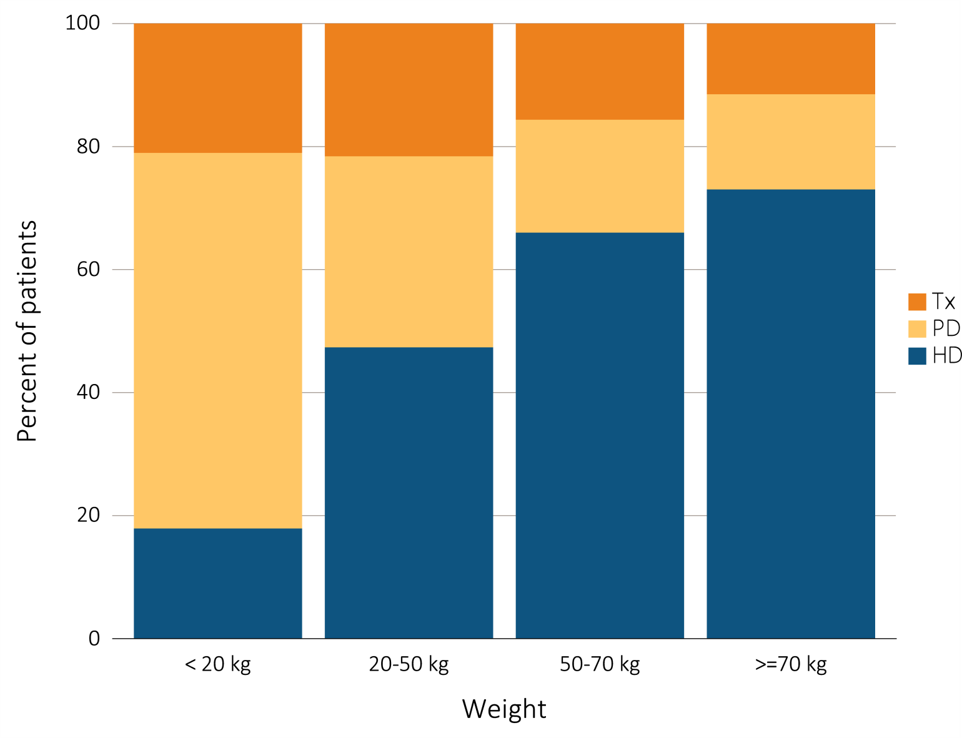
Figure i.20 Cross-sectional trends in pediatric ESRD modality at initiation, 1996-2014
^{(b) By patient weight}
Data Source: Special analyses, USRDS ESRD Database. Includes incident ESRD patients in the years 1996-2014. Abbreviations: ESRD, end-stage renal disease; HD, hemodialysis; PD, peritoneal dialysis; Tx, transplant. This graphic is adapted from Figure 8.2.

Slide 27
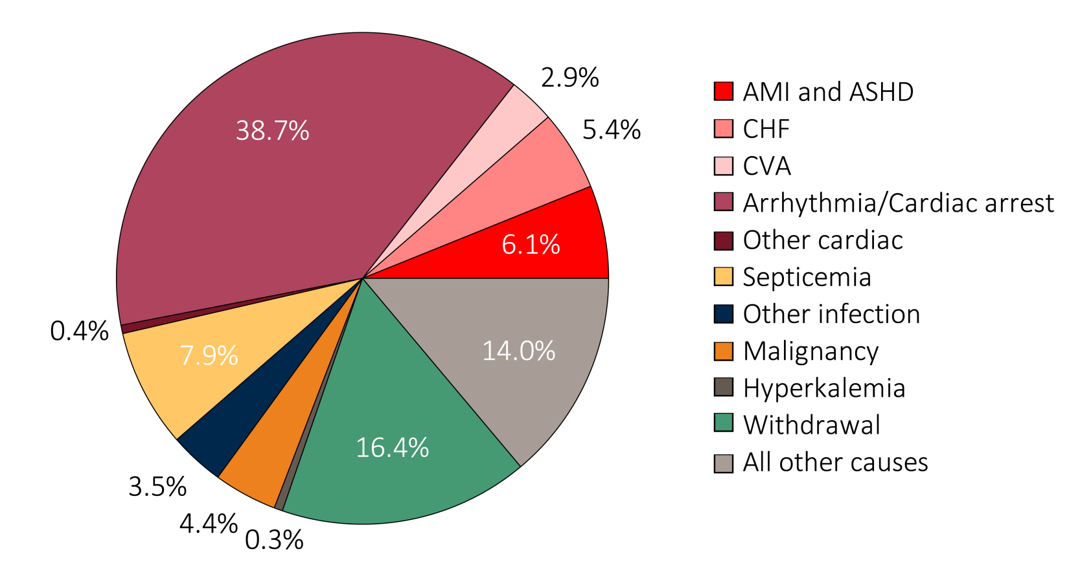
Figure i.21 Causes of death in ESRD patients, 2012-2014
(a) Denominator excludes missing/unknown causes of death
Data Source: Special analysis using Reference Table H.12. (a) Denominator includes other causes of death and excludes missing/unknown causes of death (24.7% of patients have unknown or missing causes of death). (b) Denominator includes other known causes, unknown causes of death, and records that are missing the cause of death. Unknown causes include records from the CMS 2746 ESRD death notification form that specifically designate an unknown cause of death. Missing includes records in the ESRD database that are missing the CMS 2746, or have the form but are missing or have recording errors in the primary cause of death field. Abbreviations: ASHD, atherosclerotic heart disease; AMI, acute myocardial infarction; CHF, congestive heart failure; CVA, cerebrovascular accident. This graphic is adapted from Figure 9.1.

Slide 28
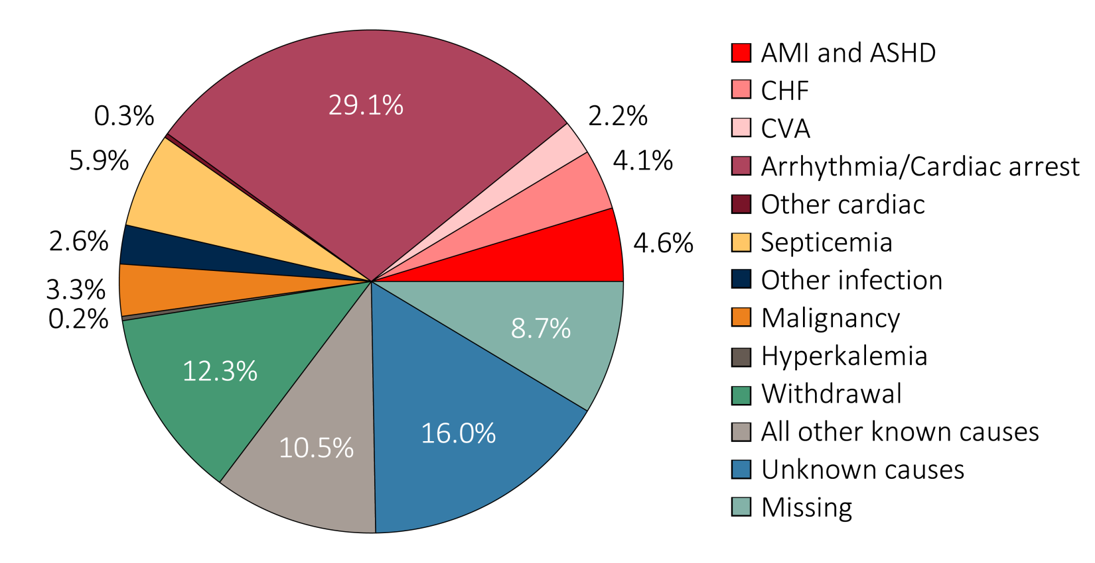
Figure i.21 Causes of death in ESRD patients, 2012-2014
(b) Denominator includes missing/unknown causes of death
Data Source: Special analysis using Reference Table H.12. (a) Denominator includes other causes of death and excludes missing/unknown causes of death (24.7% of patients have unknown or missing causes of death). (b) Denominator includes other known causes, unknown causes of death, and records that are missing the cause of death. Unknown causes include records from the CMS 2746 ESRD death notification form that specifically designate an unknown cause of death. Missing includes records in the ESRD database that are missing the CMS 2746, or have the form but are missing or have recording errors in the primary cause of death field. Abbreviations: ASHD, atherosclerotic heart disease; AMI, acute myocardial infarction; CHF, congestive heart failure; CVA, cerebrovascular accident. This graphic is adapted from Figure 9.1.

Slide 29
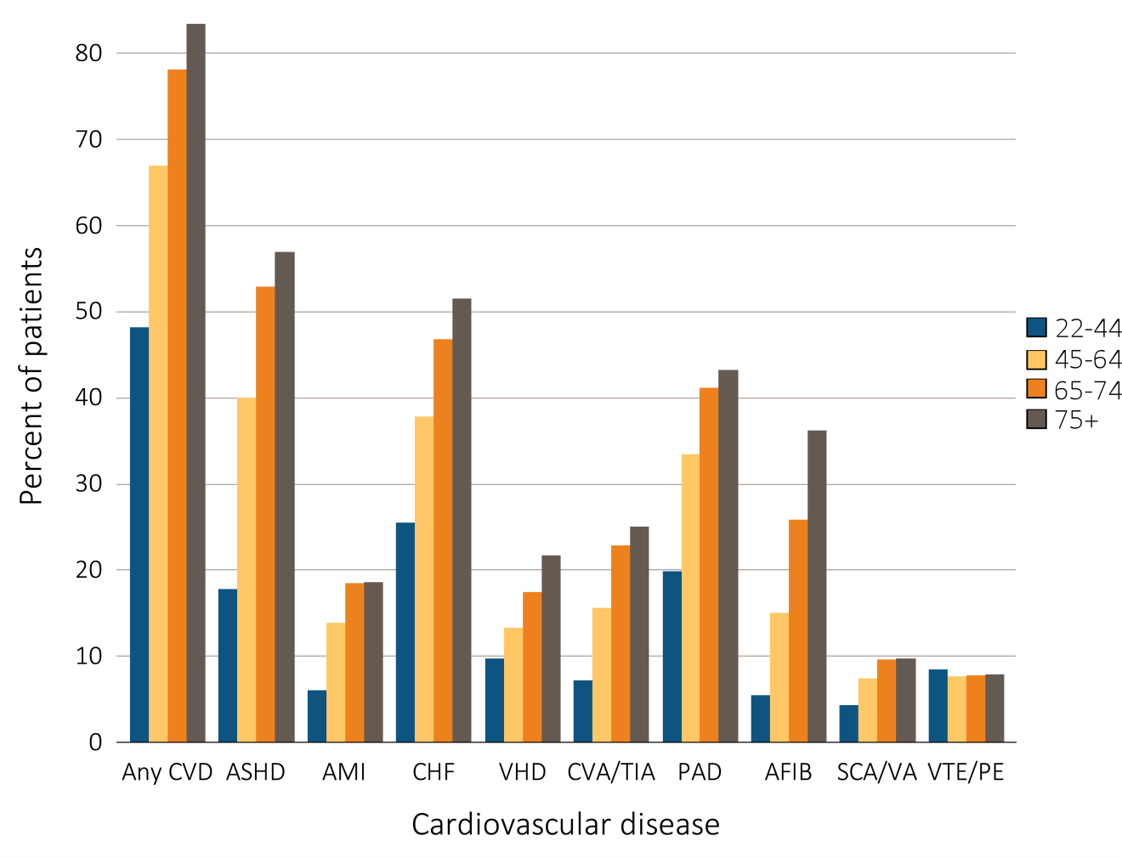
Figure i.22 Prevalence of cardiovascular diseases in adult ESRD patients, by age, 2014
Data Source: Special analyses, USRDS ESRD Database. Point prevalent hemodialysis, peritoneal dialysis, and transplant patients aged 22 and older, with Medicare as primary payer on January 1, 2014, who are continuously enrolled in Medicare Parts A and B from January, 1, 2013 to December 31, 2013,and ESRD service date is at least 90 days prior to January 1, 2014. Abbreviations: AFIB, atrial fibrillation; AMI, acute myocardial infarction; ASHD, atherosclerotic heart disease; CHF, congestive heart failure; CVA/TIA, cerebrovascular accident/transient ischemic attack; CVD, cardiovascular disease; PAD, peripheral arterial disease; SCA/VA, sudden cardiac arrest and ventricular arrhythmias; VHD, valvular heart disease; VTE/PE, venous thromboembolism and pulmonary embolism. This graphic is adapted from Figure 9.3.

Slide 30
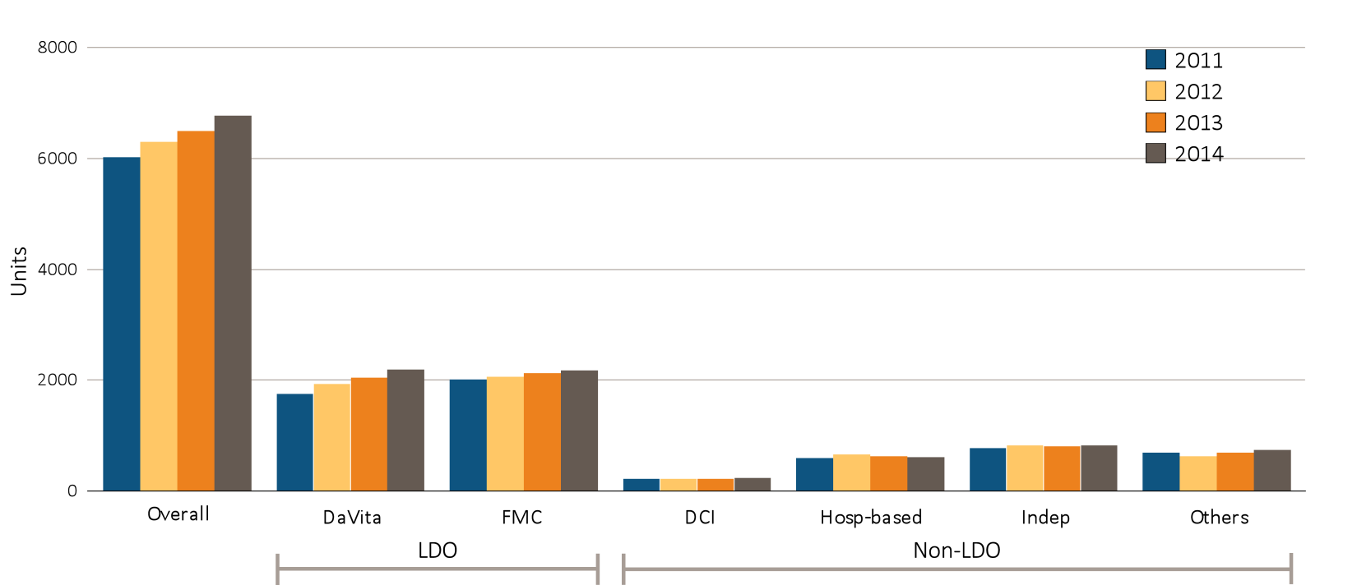
Figure i.23 Figure 10.2 Dialysis unit counts, by unit affiliation, 2011–2014
Data Source: Special analyses, USRDS ESRD Database. Abbreviations: DCI, Dialysis Clinic, Inc.; FMC, Fresenius; Hosp-based, hospital-based dialysis centers; Indep, independent dialysis providers; Others, other dialysis organizations. This graphic is adapted from Figure 10.1.

Slide 31
Table i.1 All-cause Standardized Mortality Ratio, by unit affiliation, 2014
Affiliation | All (National average) | White | Black/African American | Asian | Native American | Hispanic
Overall | 1.00 (0.99-1.01) | 1.12 (1.11-1.13) | 0.85 (0.84-0.86) | 0.70 (0.68-0.72) | 0.86 (0.81-0.91) | 0.79 (0.77-0.80)
LDOs
DaVita | 1.02 (1.01-1.03) | 1.14 (1.13-1.16) | 0.85 (0.83-0.86) | 0.71 (0.67-0.75) | 0.82 (0.74-0.90) | 0.79 (0.77-0.81)
Fresenius | 0.98 (0.97-0.99) | 1.10 (1.09-1.12) | 0.81 (0.79-0.82) | 0.77 (0.73-0.82) | 0.88 (0.76-1.00) | 0.79 (0.77-0.81)
DCI | 0.92 (0.89-0.95) | 1.06 (1.01-1.10) | 0.78 (0.73-0.82) | 0.66 (0.51-0.84) | 0.70 (0.54-0.90) | 0.77 (0.66-0.89)
Hospital-based | 0.94 (0.91-0.97) | 1.04 (1.00-1.08) | 0.86 (0.80-0.91) | 0.69 (0.58-0.81) | 0.72 (0.58-0.89) | 0.71 (0.63-0.79)
Independent | 1.03 (1.01-1.04) | 1.14 (1.11-1.16) | 0.90 (0.87-0.93) | 0.70 (0.65-0.75) | 0.92 (0.81-1.03) | 0.82 (0.78-0.85)
Others | 1.02 (1.00-1.04) | 1.12 (1.09-1.14) | 0.87 (0.84-0.90) | 0.75 (0.70-0.80) | 1.27 (1.05-1.54) | 0.81 (0.78-0.85)
Data source: Special analyses, USRDS ESRD Database. Period prevalent dialysis patients; 95% confidence intervals are shown in parentheses. The overall measure is adjusted for patient age, race, ethnicity, sex, diabetes, duration of ESRD, nursing home status, patient comorbidities at incidence, body mass index (BMI) at incidence, and population death rates. The race-specific measures are adjusted for all the above characteristics except patient race. The Hispanic-specific measure is adjusted for all the above characteristics except patient ethnicity. Abbreviations: DCI, Dialysis Clinic, Inc.; LDO, large dialysis organizations; Others, other dialysis organizations. This table is adapted from Table 10.2.

Slide 32
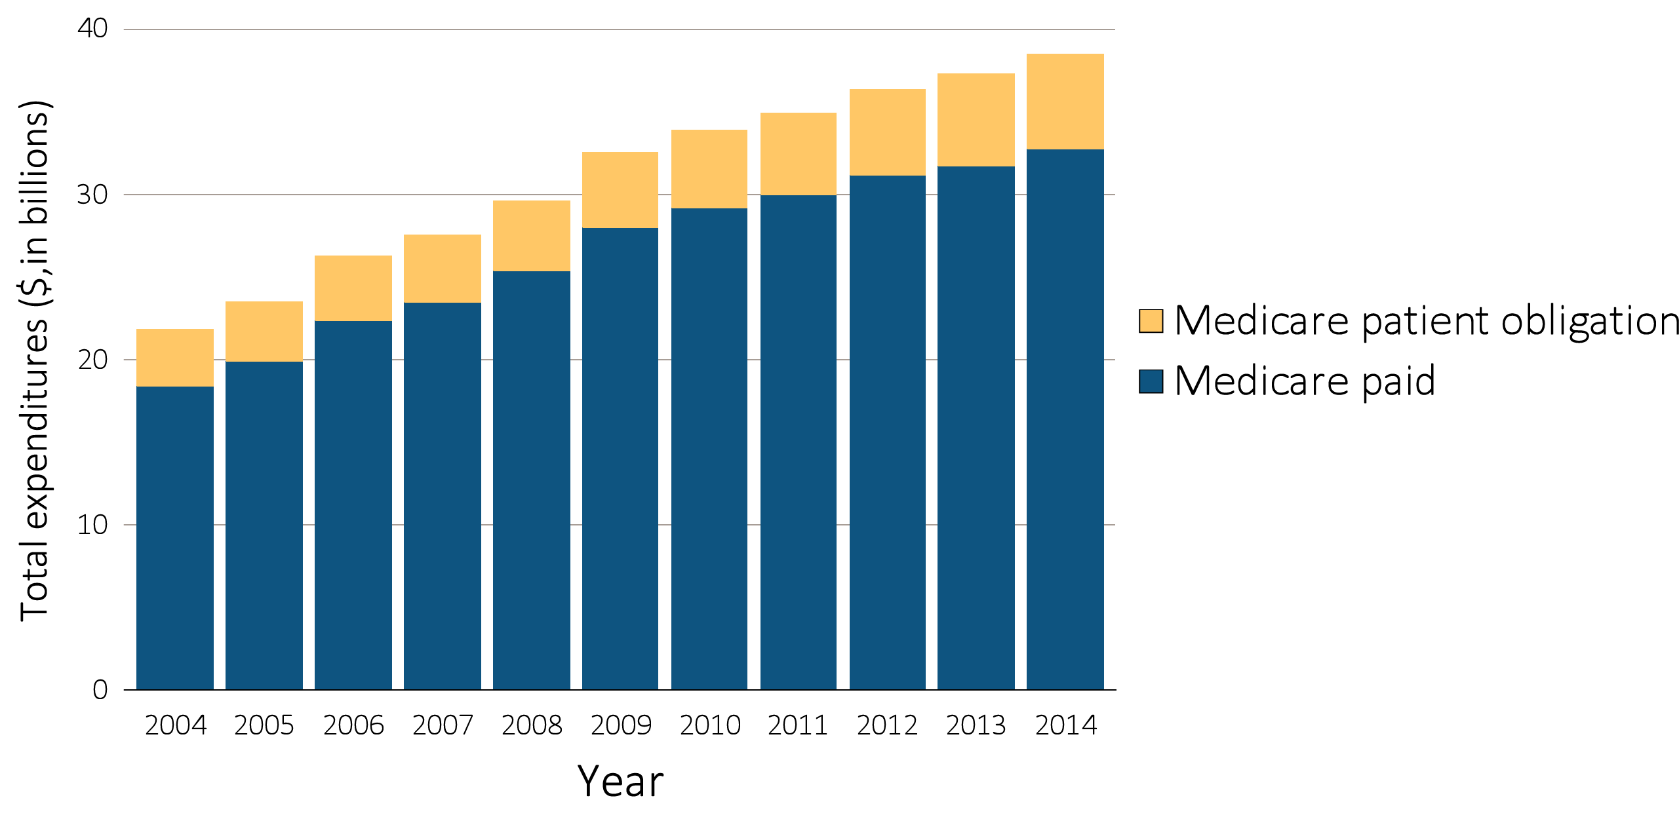
Figure i.24 Trends in ESRD expenditures, 2004-2014
Data Source: Special analyses, USRDS ESRD Database; Reference Table K.1. Abbreviations: ESRD, end-stage renal disease. This graphic is adapted from Figure 11.1.

Slide 33
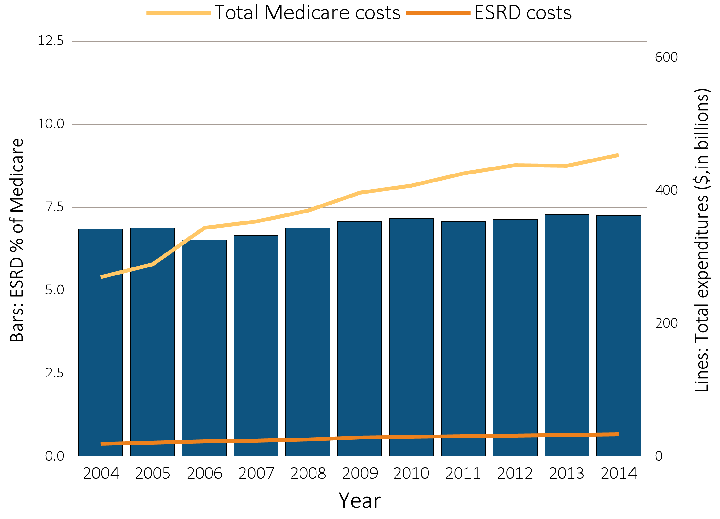
Figure i.25 Trends in costs of the Medicare & ESRD programs, 2004-2014
Data Source: Special analyses, Total ESRD costs obtained from USRDS ESRD Database; Reference Table K.1. Total Medicare expenditures obtained from Trustees Report, Table II.B1 https://www.cms.gov/Research-Statistics-Data-and-Systems/Statistics-Trends-and-Reports/ReportsTrustFunds/TrusteesReports.html. Abbreviations: ESRD, end-stage renal disease. This graphic is adapted from Figure 11.2.

Slide 34
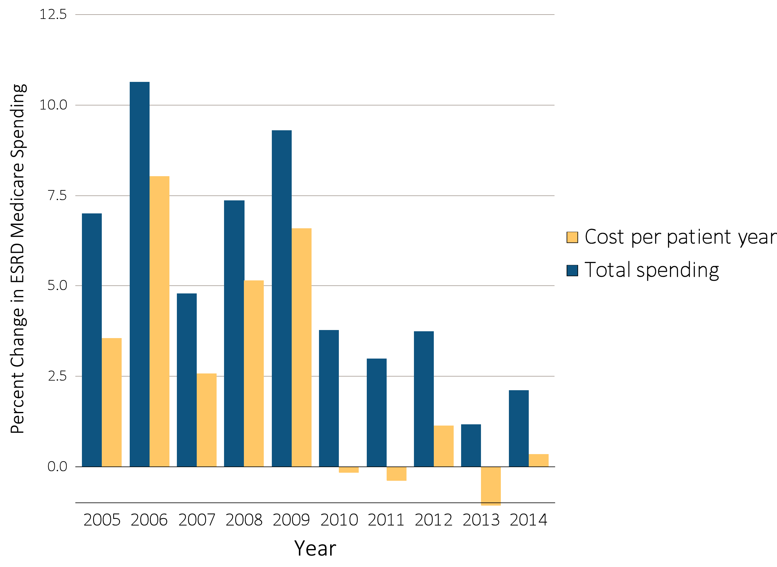
Figure i.26 Annual percent change in Medicare ESRD spending, 2004-2014
Data Source: Special analyses, USRDS ESRD Database; Reference Table K.4. Total Medicare ESRD costs from claims data; includes all claims with Medicare as primary payer only. Abbreviations: ESRD, end-stage renal disease. This graphic is adapted from Figure 11.4.

Slide 35
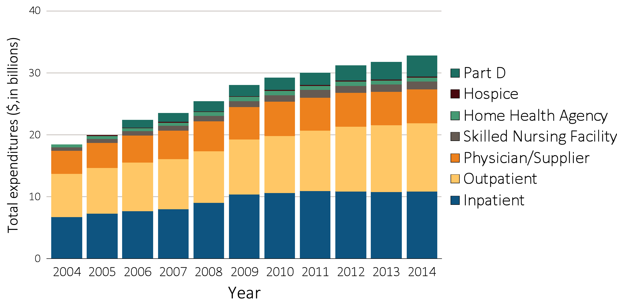
Figure i.27 Trends in total Medicare fee-for-service spending for ESRD, by type of service, 2004-2014
Data Source: Special analyses, USRDS ESRD Database; Reference Table K.1. Total Medicare costs from claims data. Abbreviations: ESRD, end-stage renal disease. This graphic is adapted from Figure 11.5.

Slide 36
Table i.2 General Medicare & ESRD patients enrolled in Part D (%)
 | General Medicare | All ESRD | Hemodialysis | Peritoneal dialysis | Transplant
2011 | 60 | 70 | 74 | 62 | 59
2012 | 62 | 72 | 76 | 64 | 62
2013 | 67 | 75 | 79 | 67 | 66
2014 | 69 | 77 | 80 | 69 | 68
Data source: Special analyses, 2011-2014 Medicare data, point prevalent Medicare enrollees alive on January 1. Medicare data: general Medicare, Medicare 5% sample (ESRD, hemodialysis, peritoneal dialysis, and transplant, 100% ESRD population). Abbreviations: ESRD, end-stage renal disease; Part D, Medicare Part D prescription drug coverage. This table is adapted from Table 12.2.

Slide 37
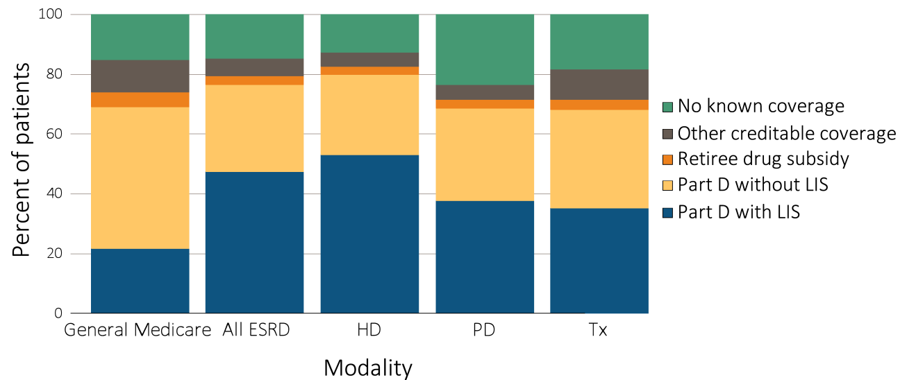
Figure i.28 Sources of prescription drug coverage in Medicare ESRD enrollees, by population, 2014
Data source: Special analyses, 2014 Medicare Data, point prevalent Medicare enrollees alive on January 1, 2014. Abbreviations: ESRD, end-stage renal disease; HD, hemodialysis; LIS, Low-income Subsidy; Part D, Medicare Part D prescription drug coverage; PD, peritoneal dialysis; Tx, kidney transplant. This graphic is adapted from Figure 12.1.

Slide 38
Table i.3 Total estimated Medicare Part D spending for enrollees, in billions, 2011-2014
 | General Medicare | All ESRD | Hemodialysis | Peritoneal dialysis | Transplant
2011 | 45.96 | 1.64 | 1.29 | 0.09 | 0.21
2012 | 40.08 | 2.00 | 1.59 | 0.12 | 0.23
2013 | 52.08 | 2.27 | 1.79 | 0.14 | 0.27
2014 | 58.07 | 2.71 | 2.10 | 0.17 | 0.35
Data source: Special analyses, 2011-2014 Medicare data, period prevalent Medicare enrollees alive on January 1, excluding those in Medicare Advantage Part D plans and Medicare secondary payer, using as-treated model (see ESRD Methods chapter for analytical methods). Part D spending represents the sum of the Medicare covered amount and the Low- income Subsidy amount. This table is adapted from Table 12.4.

Slide 39
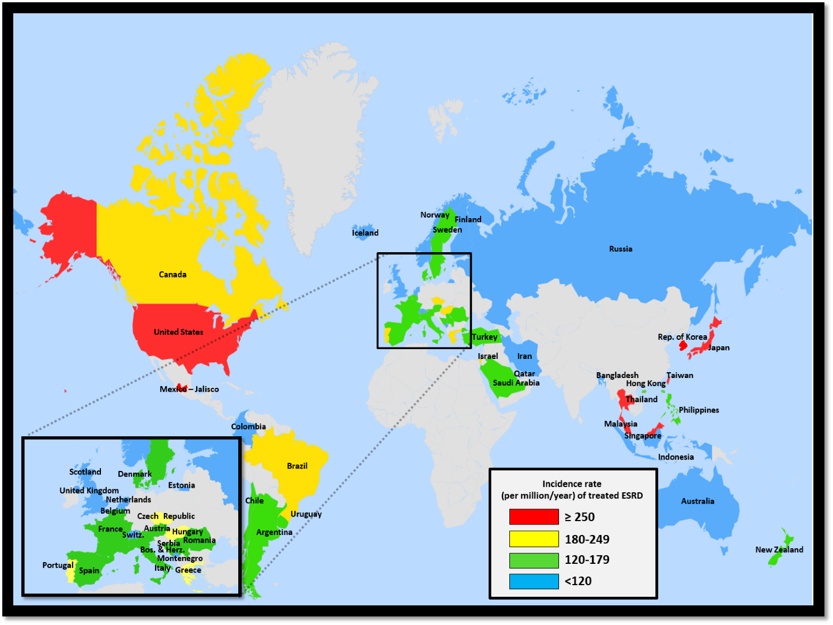
Figure i.29 Geographic variations in the incidence rate of treated ESRD (per million population/year), by country, 2014
Data Source: Special analyses, USRDS ESRD Database. Data presented only for countries from which relevant information was available. All rates are unadjusted. ^United Kingdom: England, Wales, Northern Ireland (Scotland data reported separately). Data for Italy include 6 regions. Data for Indonesia represent the West Java region. Data for France include 22 regions. Data for Spain include 18 of 19 regions. Data for Canada excludes Quebec. Japan includes dialysis patients only. Abbreviations: ESRD, end-stage renal disease. This graphic is adapted from Figure 13.1.

Slide 40
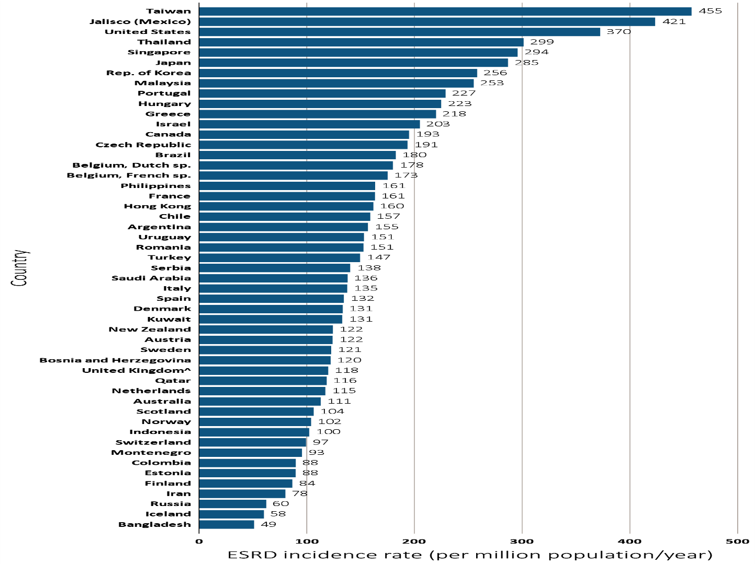
^{Figure i.30 Incidence} rate of treated ESRD (per million population/year), by country, 2014
^{Data Source:} Special analyses, USRDS ESRD Database. Data presented only for countries from which relevant information was available. All rates are unadjusted. ^United Kingdom: England, Wales, Northern Ireland (Scotland data reported separately). Data for Italy include 6 regions. Data for Indonesia represent the West Java region. Data for France include 22 regions. Data for Spain include 18 of 19 regions. Data for Canada excludes Quebec. Japan includes dialysis patients only. Abbreviations: ESRD, end-stage renal disease; sp., speaking. This graphic is adapted from Figure 13.2.

Slide 41
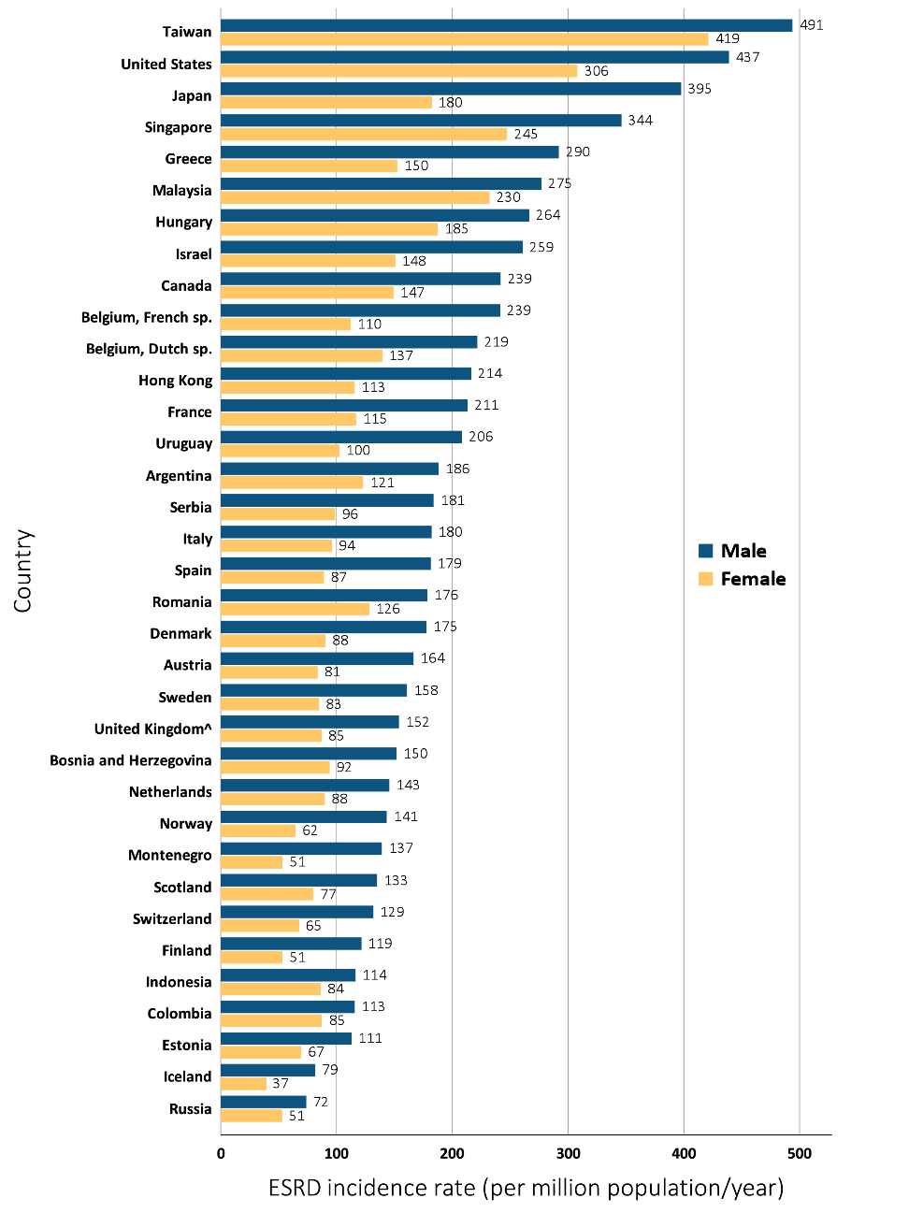
Figure i.31 Incidence rate of treated ESRD (per million population/year), by sex and country, 2014
Data Source: Special analyses, USRDS ESRD Database. Data presented only for countries from which relevant information was available. ^United Kingdom: England, Wales, Northern Ireland (Scotland data reported separately). Data for Spain include 18 of 19 regions. Data for France include 22 regions. Data for Indonesia represent the West Java region. Data for Italy represent 6 regions. Data for Canada excludes Quebec. Japan includes dialysis patients only. Abbreviations: ESRD, end-stage renal disease; sp., speaking. This graphic is adapted from Figure 13.8.

Slide 42
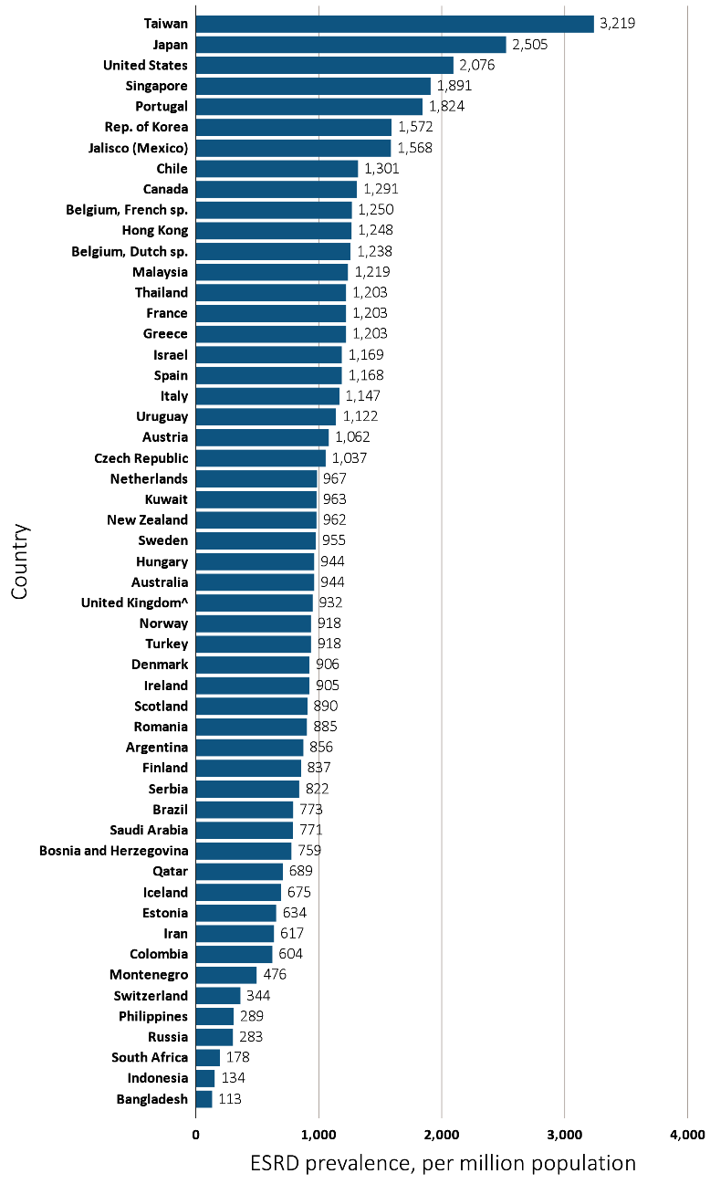
Figure i.32 Prevalence of treated ESRD per million population, by country, 2014
Data Source: Special analyses, USRDS ESRD Database. Data presented only for countries from which relevant information was available. ^United Kingdom: England, Wales, Northern Ireland (Scotland data reported separately). The prevalence is unadjusted and reflects prevalence at the end of 2014. Switzerland includes dialysis patients only. Data for Indonesia represent the West Java region. Data for Spain include 18 of 19 regions. Data for France include 22 regions. Data for Italy includes 6 regions. Data for Canada excludes Quebec. Abbreviations: ESRD, end-stage renal disease; sp., speaking. This graphic is adapted from Figure 13.9.

Slide 43
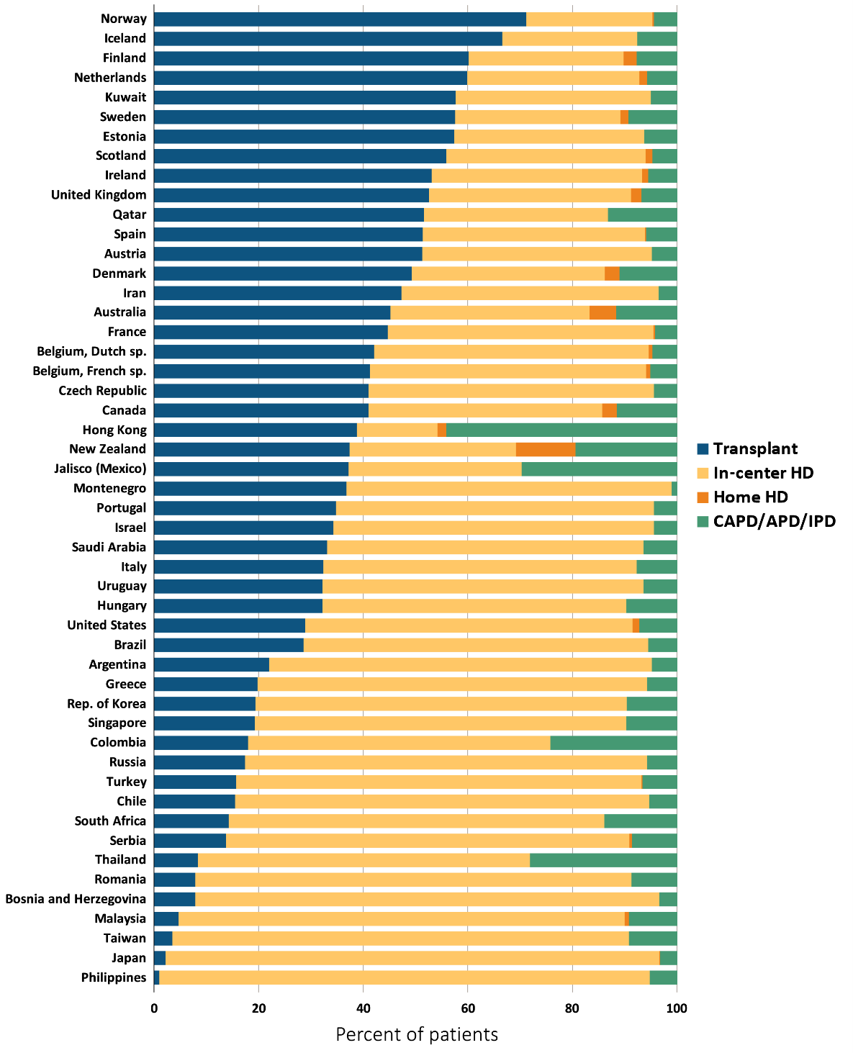
Figure i.33 Percent distribution of type of renal replacement therapy modality used by ESRD patients, by country, 2014
^{Data Source:} Special analyses, USRDS ESRD Database. Denominator is calculated as the sum of patients receiving HD, PD, Home HD, or treated with a functioning transplant; does not include patients with other/unknown modality. Data for Spain include 18 of 19 regions. Data for France include 22 regions. Data for Italy include 6 regions. Data for Canada excludes Quebec. Abbreviations: CAPD, continuous ambulatory peritoneal dialysis; APD, automated peritoneal dialysis; IPD, intermittent peritoneal dialysis; ESRD, end-stage renal disease; HD, hemodialysis; PD, peritoneal dialysis; sp., speaking. This graphic is adapted from Figure 13.12.

Slide 44
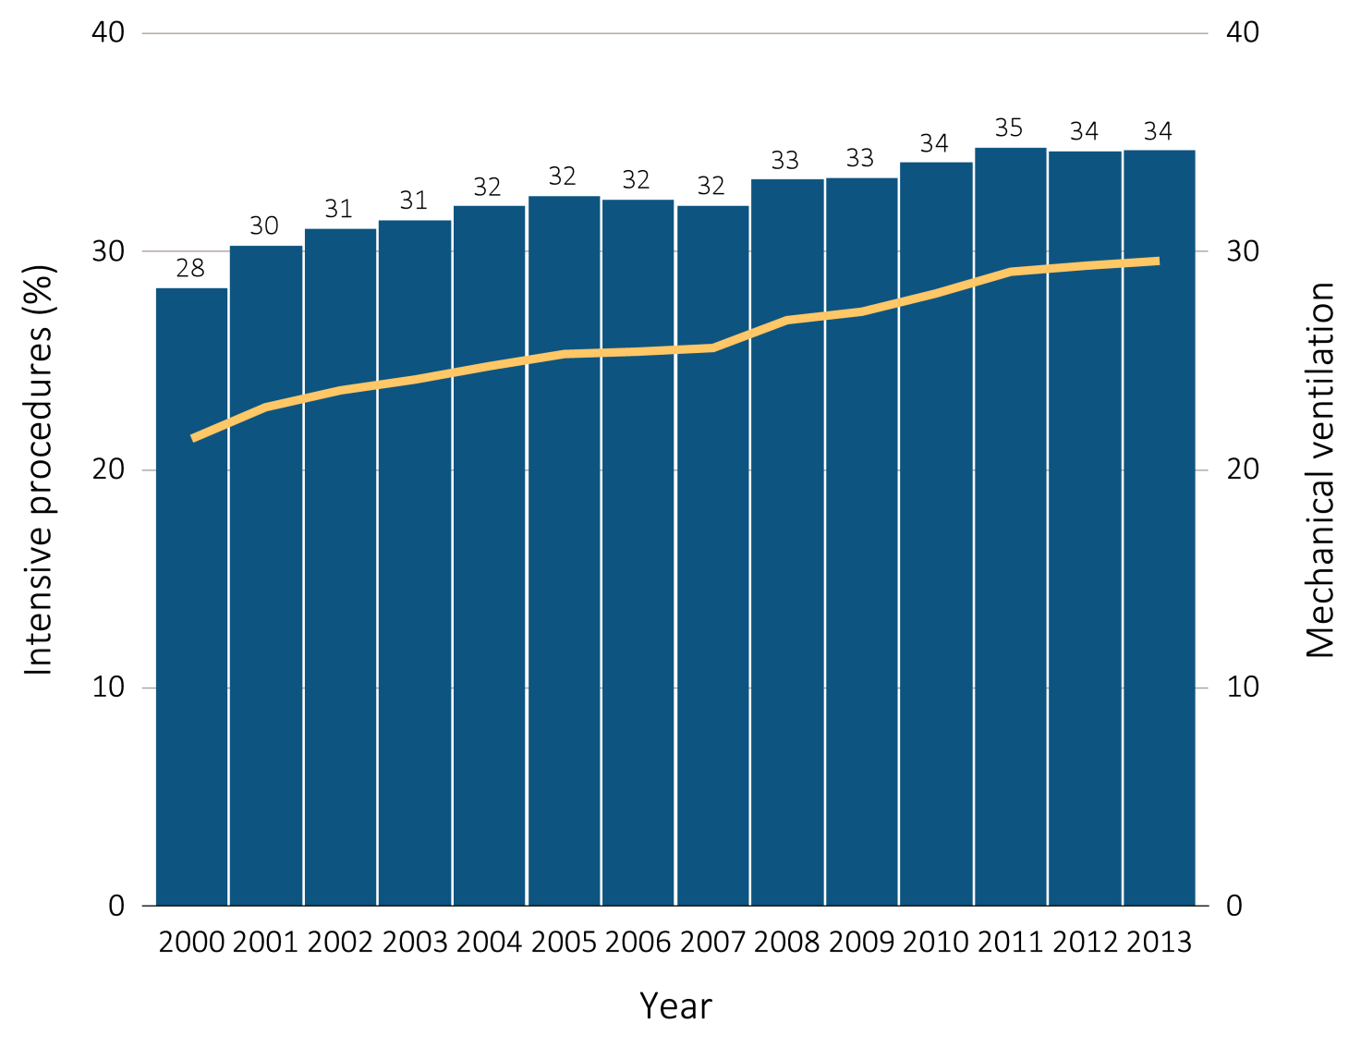
Figure i.34 Intensive procedures during the last 90 days of life among Medicare beneficiaries with ESRD overall, and by age, race, ethnicity, sex, and modality, 2000-2013
(a) Intensive procedures and mechanical ventilation by year, overall
Data Source: Special analyses, USRDS ESRD Database. Denominator population is all decedents with Medicare Parts A and B throughout the last 90 days of life. Intensive procedures were identified by ICD-9 procedure code search of Medicare Institutional claims from short- and long-stay hospitals. The yellow line in panel (a) denotes the percentage of patients who were intubated or received mechanical ventilation. This graphic is adapted from Figure 14.4.

Slide 45
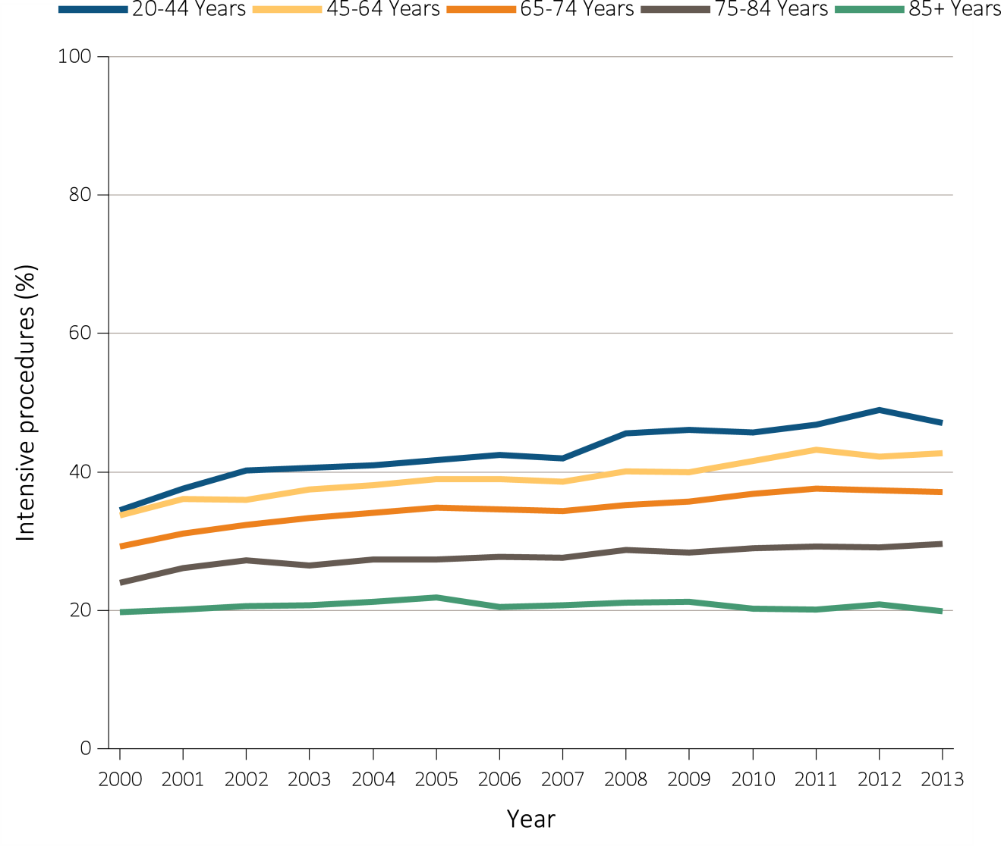
Figure i.34 Intensive procedures during the last 90 days of life among Medicare beneficiaries with ESRD overall, and by age, race, ethnicity, sex, and modality, 2000-2013
(b) Intensive procedures by age
Data Source: Special analyses, USRDS ESRD Database. Denominator population is all decedents with Medicare Parts A and B throughout the last 90 days of life. Intensive procedures were identified by ICD-9 procedure code search of Medicare Institutional claims from short- and long-stay hospitals. The yellow line in panel (a) denotes the percentage of patients who were intubated or received mechanical ventilation. This graphic is adapted from Figure 14.4.

Slide 46
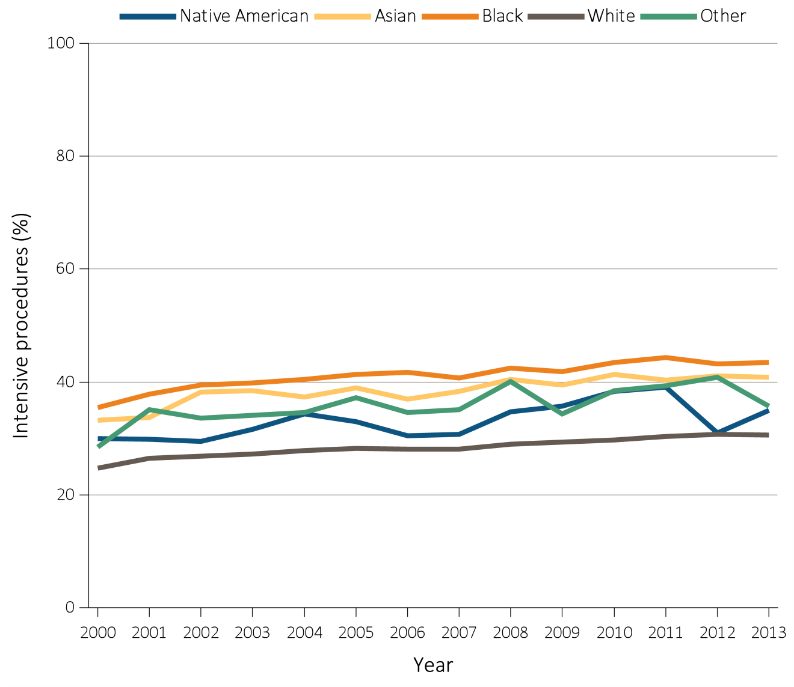
Figure i.34 Intensive procedures during the last 90 days of life among Medicare beneficiaries with ESRD overall, and by age, race, ethnicity, sex, and modality, 2000-2013
(c) Intensive procedures by race
Data Source: Special analyses, USRDS ESRD Database. Denominator population is all decedents with Medicare Parts A and B throughout the last 90 days of life. Intensive procedures were identified by ICD-9 procedure code search of Medicare Institutional claims from short- and long-stay hospitals. The yellow line in panel (a) denotes the percentage of patients who were intubated or received mechanical ventilation. This graphic is adapted from Figure 14.4.

Slide 47
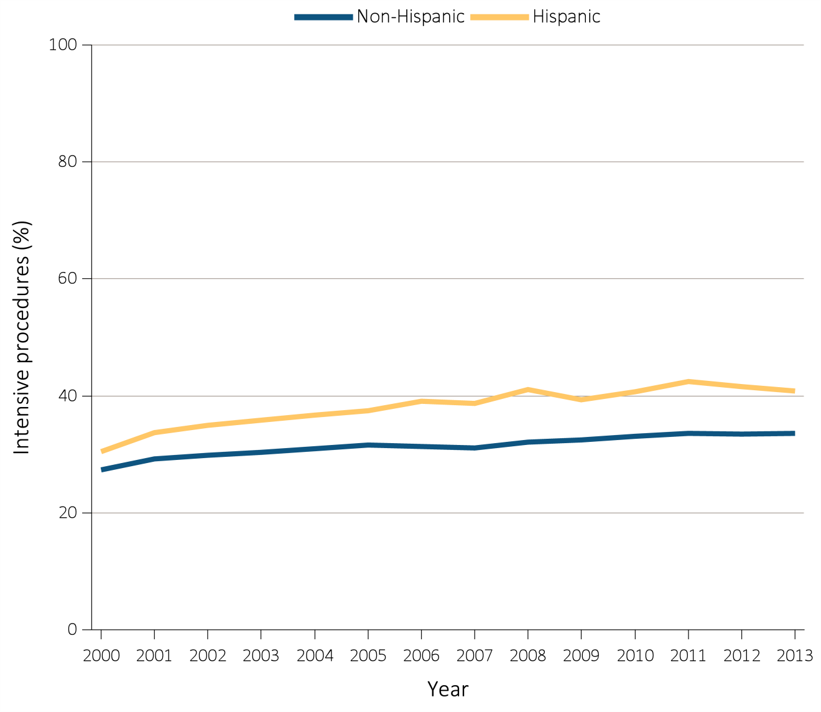
Figure i.34 Intensive procedures during the last 90 days of life among Medicare beneficiaries with ESRD overall, and by age, race, ethnicity, sex, and modality, 2000-2013
(d) Intensive procedures by ethnicity
Data Source: Special analyses, USRDS ESRD Database. Denominator population is all decedents with Medicare Parts A and B throughout the last 90 days of life. Intensive procedures were identified by ICD-9 procedure code search of Medicare Institutional claims from short- and long-stay hospitals. The yellow line in panel (a) denotes the percentage of patients who were intubated or received mechanical ventilation. This graphic is adapted from Figure 14.4.

Slide 48
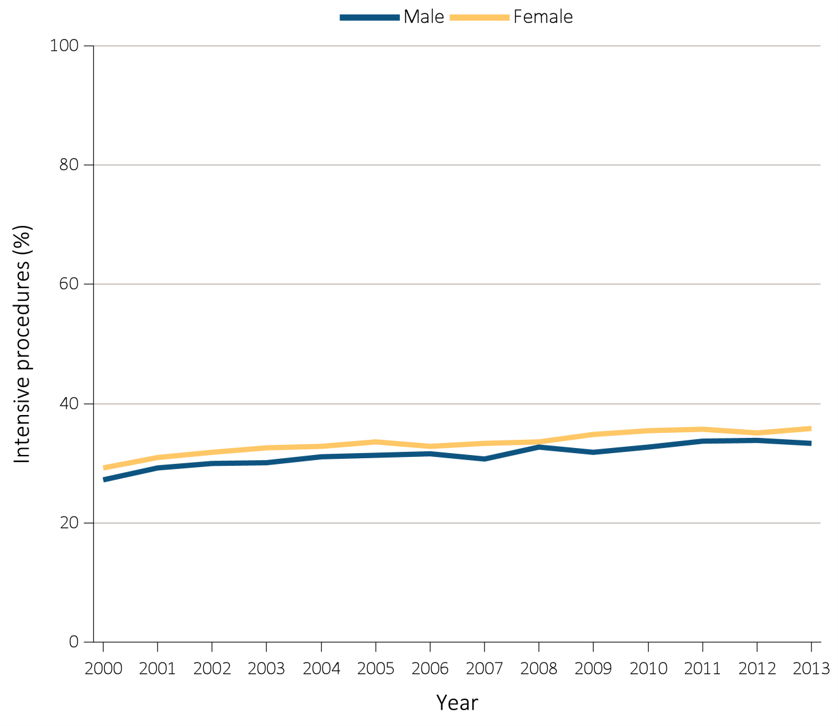
Figure i.34 Intensive procedures during the last 90 days of life among Medicare beneficiaries with ESRD overall, and by age, race, ethnicity, sex, and modality, 2000-2013
(e) Intensive procedures by sex
Data Source: Special analyses, USRDS ESRD Database. Denominator population is all decedents with Medicare Parts A and B throughout the last 90 days of life. Intensive procedures were identified by ICD-9 procedure code search of Medicare Institutional claims from short- and long-stay hospitals. The yellow line in panel (a) denotes the percentage of patients who were intubated or received mechanical ventilation. This graphic is adapted from Figure 14.4.

Slide 49
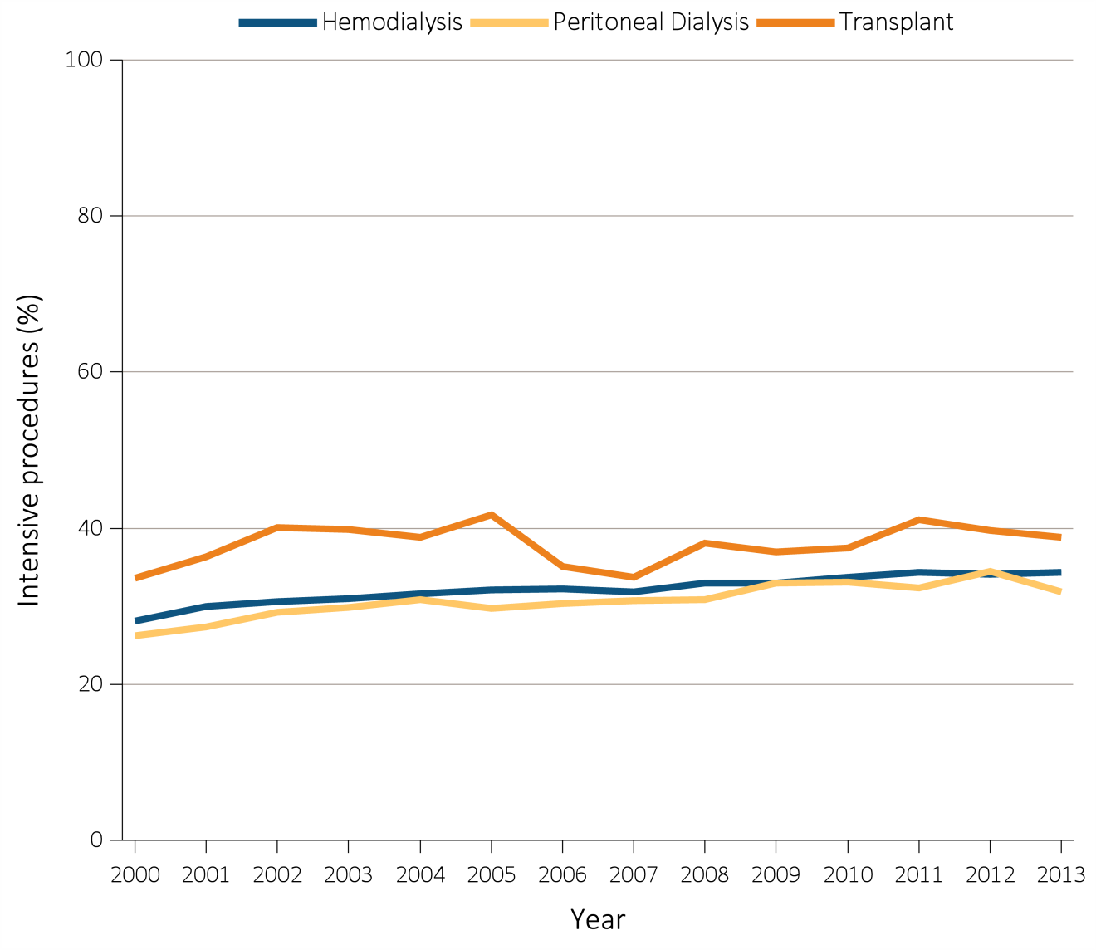
Figure i.34 Intensive procedures during the last 90 days of life among Medicare beneficiaries with ESRD overall, and by age, race, ethnicity, sex, and modality, 2000-2013
(f) Intensive procedures by modality
Data Source: Special analyses, USRDS ESRD Database. Denominator population is all decedents with Medicare Parts A and B throughout the last 90 days of life. Intensive procedures were identified by ICD-9 procedure code search of Medicare Institutional claims from short- and long-stay hospitals. The yellow line in panel (a) denotes the percentage of patients who were intubated or received mechanical ventilation. This graphic is adapted from Figure 14.4.

Slide 50
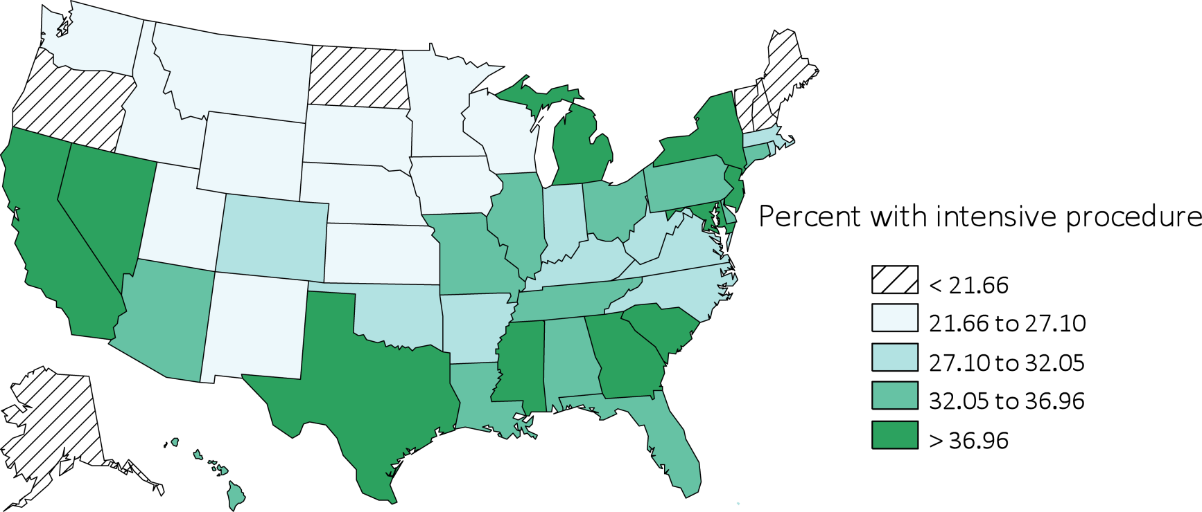
Figure i.34 Intensive procedures during the last 90 days of life among Medicare beneficiaries with ESRD overall, and by age, race, ethnicity, sex, and modality, 2000-2013
(g) Intensive procedures by state
Data Source: Special analyses, USRDS ESRD Database. Denominator population is all decedents with Medicare Parts A and B throughout the last 90 days of life. Intensive procedures were identified by ICD-9 procedure code search of Medicare Institutional claims from short- and long-stay hospitals. The yellow line in panel (a) denotes the percentage of patients who were intubated or received mechanical ventilation. This graphic is adapted from Figure 14.4.

Slide 51
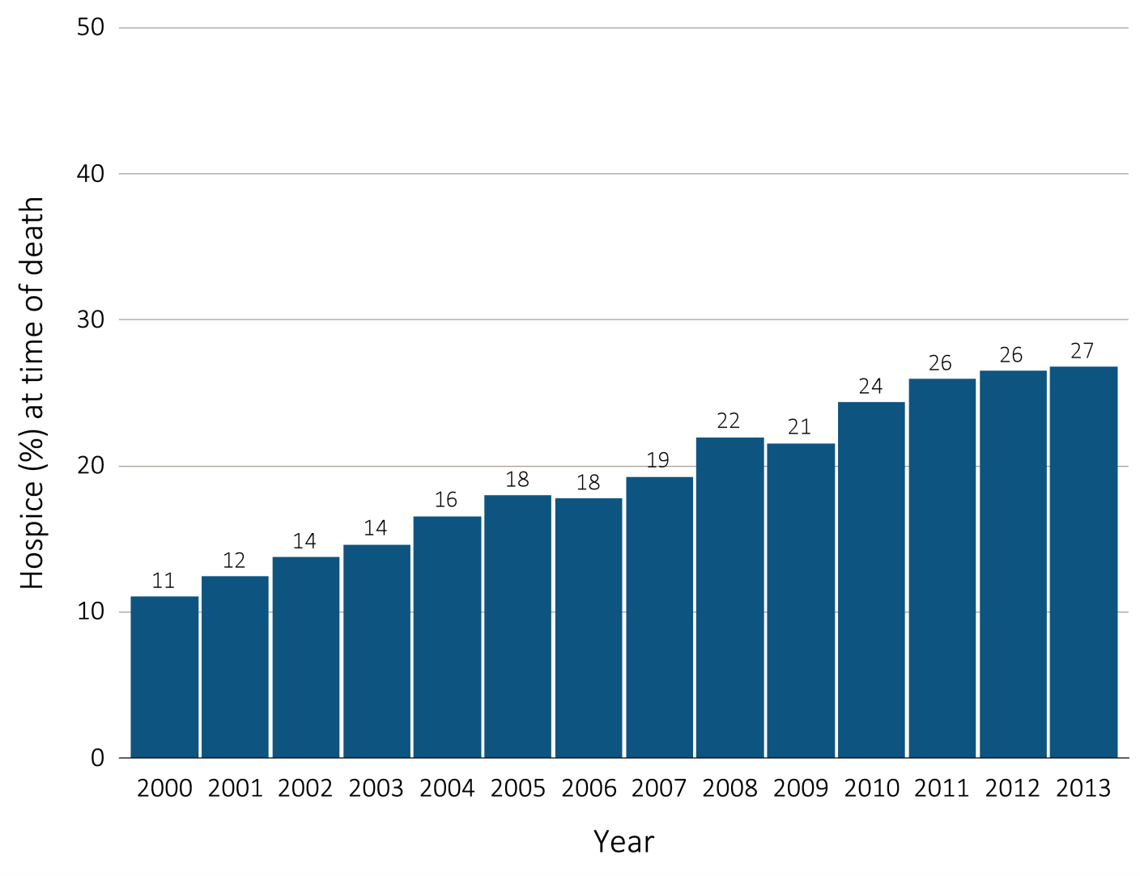
Figure i.35 Hospice utilization at the time of death among Medicare beneficiaries with ESRD overall, and by age, race, ethnicity, sex, modality, and whether dialysis was discontinued, 2000-2013
(a) Hospice utilization by year, overall
Data Source: Special Analyses, USRDS ESRD Database. Denominator population is all decedents with Medicare Parts A and B throughout the last 90 days of life. Receipt of hospice care at the time of death was defined as having a claim in the Hospice SAF on or after the date of death or Discharge Status from hospice=40, 41, or 42. This graphic is adapted from Figure 14.8.

Slide 52
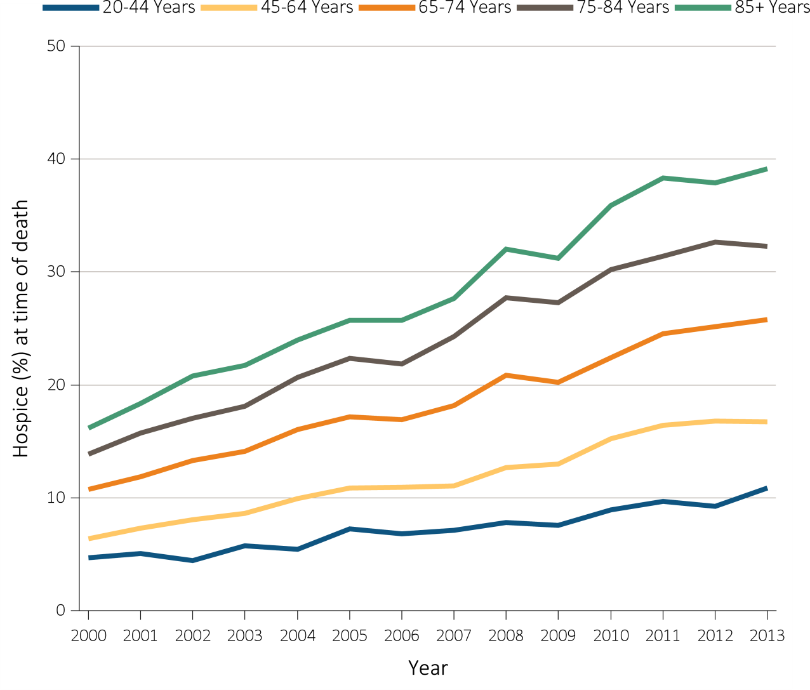
Figure i.35 Hospice utilization at the time of death among Medicare beneficiaries with ESRD overall, and by age, race, ethnicity, sex, modality, and whether dialysis was discontinued, 2000-2013
(b) Hospice utilization by age
Data Source: Special Analyses, USRDS ESRD Database. Denominator population is all decedents with Medicare Parts A and B throughout the last 90 days of life. Receipt of hospice care at the time of death was defined as having a claim in the Hospice SAF on or after the date of death or Discharge Status from hospice=40, 41, or 42. This graphic is adapted from Figure 14.8.

Slide 53
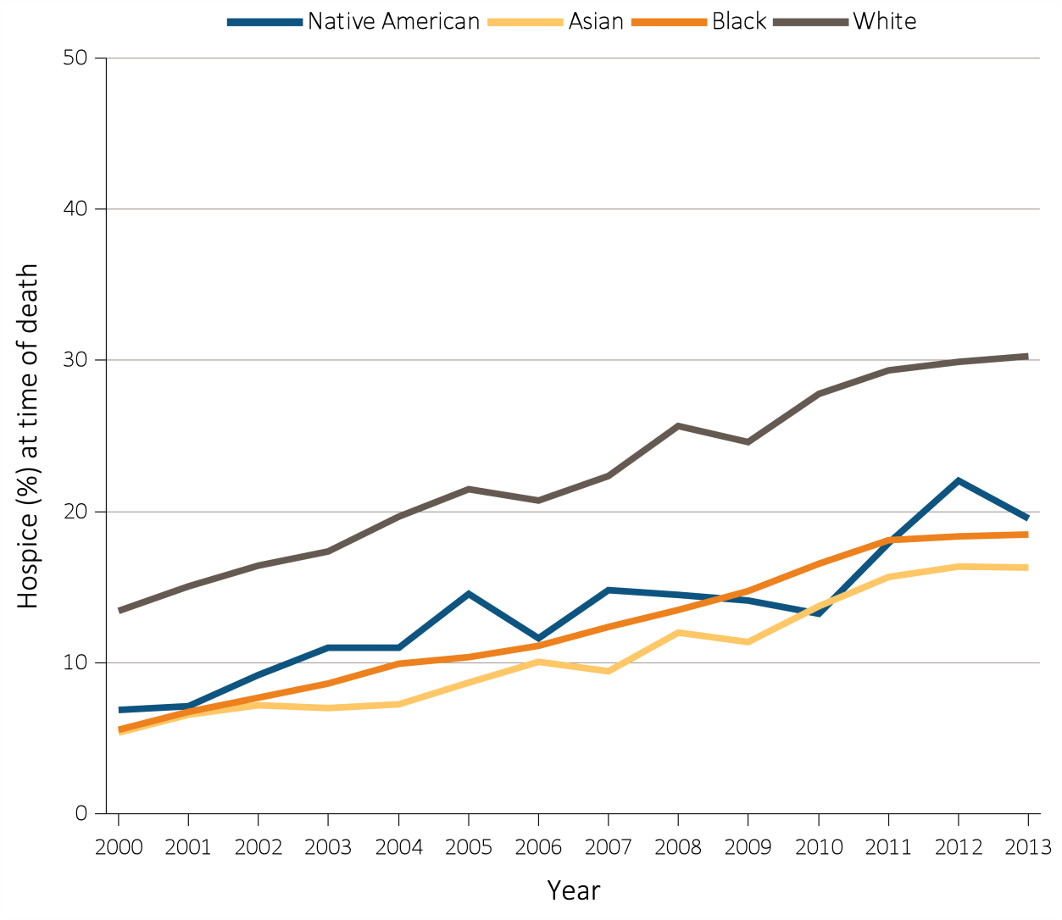
Figure i.35 Hospice utilization at the time of death among Medicare beneficiaries with ESRD overall, and by age, race, ethnicity, sex, modality, and whether dialysis was discontinued, 2000-2013
(c) Hospice utilization by race
Data Source: Special Analyses, USRDS ESRD Database. Denominator population is all decedents with Medicare Parts A and B throughout the last 90 days of life. Receipt of hospice care at the time of death was defined as having a claim in the Hospice SAF on or after the date of death or Discharge Status from hospice=40, 41, or 42. This graphic is adapted from Figure 14.8.

Slide 54
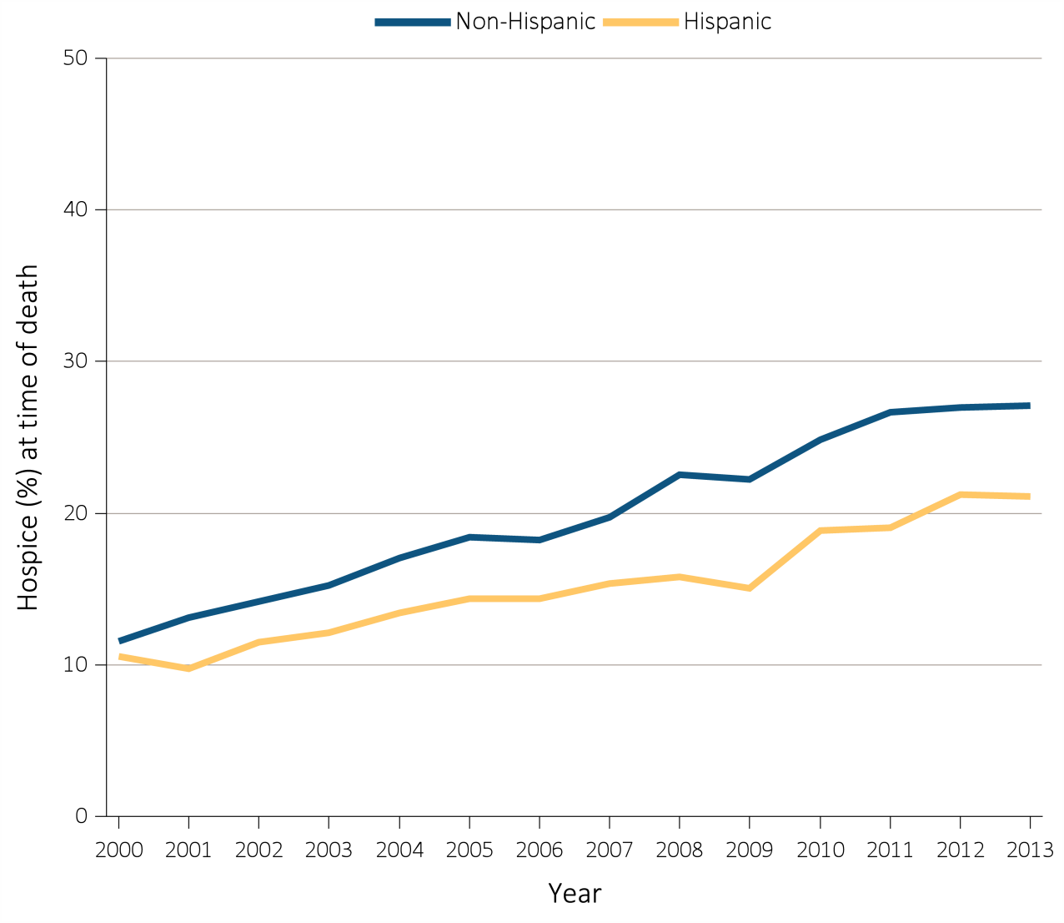
Figure i.35 Hospice utilization at the time of death among Medicare beneficiaries with ESRD overall, and by age, race, ethnicity, sex, modality, and whether dialysis was discontinued, 2000-2013
(d) Hospice utilization by ethnicity
Data Source: Special Analyses, USRDS ESRD Database. Denominator population is all decedents with Medicare Parts A and B throughout the last 90 days of life. Receipt of hospice care at the time of death was defined as having a claim in the Hospice SAF on or after the date of death or Discharge Status from hospice=40, 41, or 42. This graphic is adapted from Figure 14.8.

Slide 55
Figure i.35 Hospice utilization at the time of death among Medicare beneficiaries with ESRD overall, and by age, race, ethnicity, sex, modality, and whether dialysis was discontinued, 2000-2013
(e) Hospice utilization by sex
Data Source: Special Analyses, USRDS ESRD Database. Denominator population is all decedents with Medicare Parts A and B throughout the last 90 days of life. Receipt of hospice care at the time of death was defined as having a claim in the Hospice SAF on or after the date of death or Discharge Status from hospice=40, 41, or 42. This graphic is adapted from Figure 14.8.

Slide 56
Figure i.35 Hospice utilization at the time of death among Medicare beneficiaries with ESRD overall, and by age, race, ethnicity, sex, modality, and whether dialysis was discontinued, 2000-2013
(f) Hospice utilization by modality
Data Source: Special Analyses, USRDS ESRD Database. Denominator population is all decedents with Medicare Parts A and B throughout the last 90 days of life. Receipt of hospice care at the time of death was defined as having a claim in the Hospice SAF on or after the date of death or Discharge Status from hospice=40, 41, or 42. This graphic is adapted from Figure 14.8.

Slide 57
Figure i.35 Hospice utilization at the time of death among Medicare beneficiaries with ESRD overall, and by age, race, ethnicity, sex, modality, and whether dialysis was discontinued, 2000-2013
(g) Hospice utilization by whether patients discontinued dialysis before death
Data Source: Special Analyses, USRDS ESRD Database. Denominator population is all decedents with Medicare Parts A and B throughout the last 90 days of life. Receipt of hospice care at the time of death was defined as having a claim in the Hospice SAF on or after the date of death or Discharge Status from hospice=40, 41, or 42. This graphic is adapted from Figure 14.8.

Slide 58
Figure i.35 Hospice utilization at the time of death among Medicare beneficiaries with ESRD overall, and by age, race, ethnicity, sex, modality, and whether dialysis was discontinued, 2000-2013
(h) Hospice utilization by state
Data Source: Special Analyses, USRDS ESRD Database. Denominator population is all decedents with Medicare Parts A and B throughout the last 90 days of life. Receipt of hospice care at the time of death was defined as having a claim in the Hospice SAF on or after the date of death or Discharge Status from hospice=40, 41, or 42. This graphic is adapted from Figure 14.8.

