Slide 2
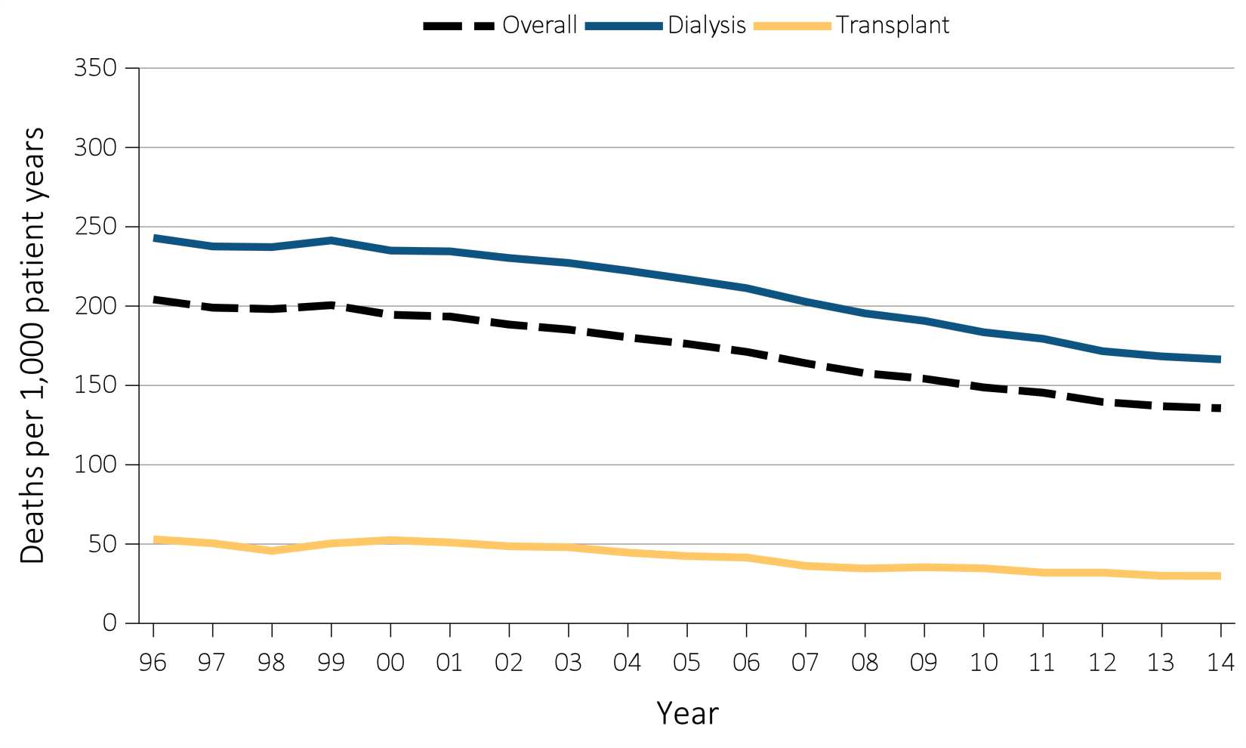
Figure 6.1.a Adjusted all-cause mortality (deaths per 1,000 patient-years) by treatment modality: overall, dialysis, and transplant for period-prevalent patients, 1996-2014
Data Source: Reference Tables H.2_adj, H4_adj, H.8_adj, H.9_adj, and H.10_adj; and special analyses, USRDS ESRD Database. Adjusted for age, sex, race, ethnicity, primary diagnosis, and vintage. Reference population: period prevalent ESRD patients, 2011. Abbreviations: HD, hemodialysis; PD, peritoneal dialysis.

Slide 3
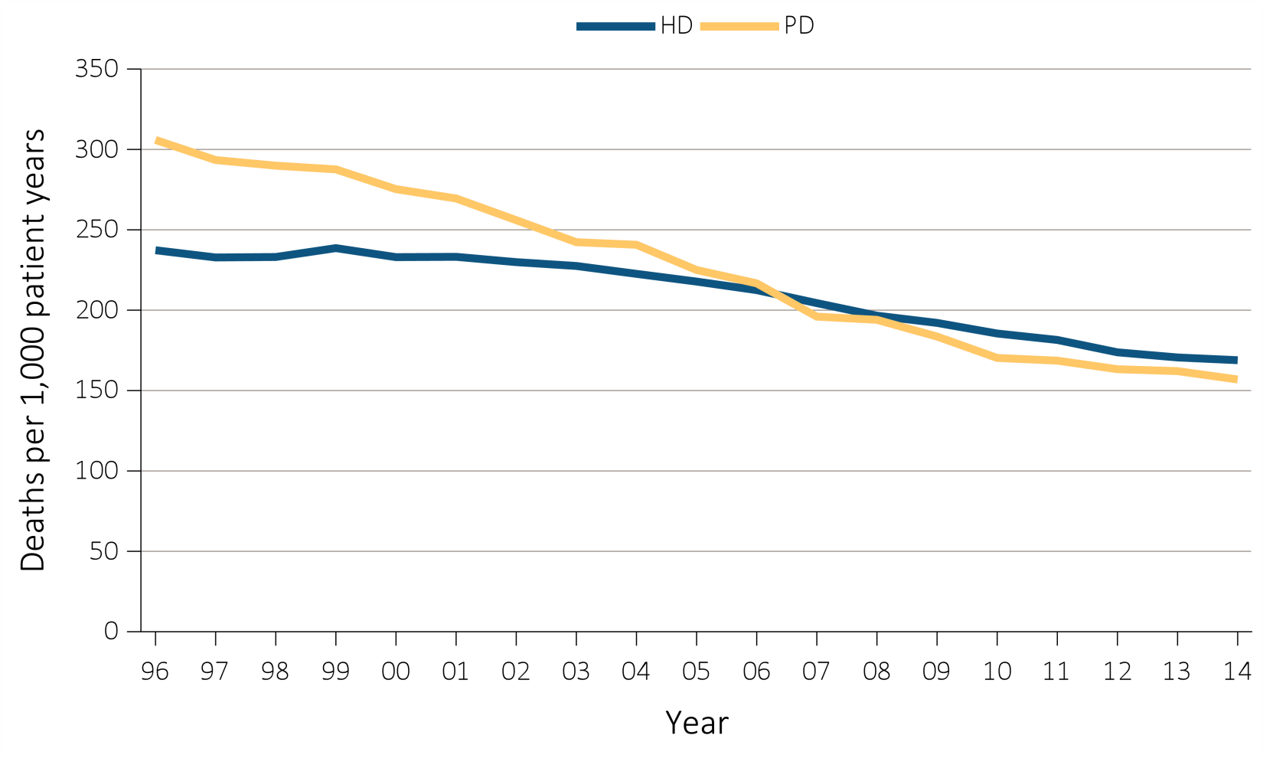
Figure 6.1.b Adjusted all-cause mortality (deaths per 1,000 patient-years) by treatment modality: hemodialysis and peritoneal dialysis, for period-prevalent patients, 1996-2014
Data Source: Reference Tables H.2_adj, H4_adj, H.8_adj, H.9_adj, and H.10_adj; and special analyses, USRDS ESRD Database. Adjusted for age, sex, race, ethnicity, primary diagnosis, and vintage. Reference population: period prevalent ESRD patients, 2011. Abbreviations: HD, hemodialysis; PD, peritoneal dialysis.

Slide 4
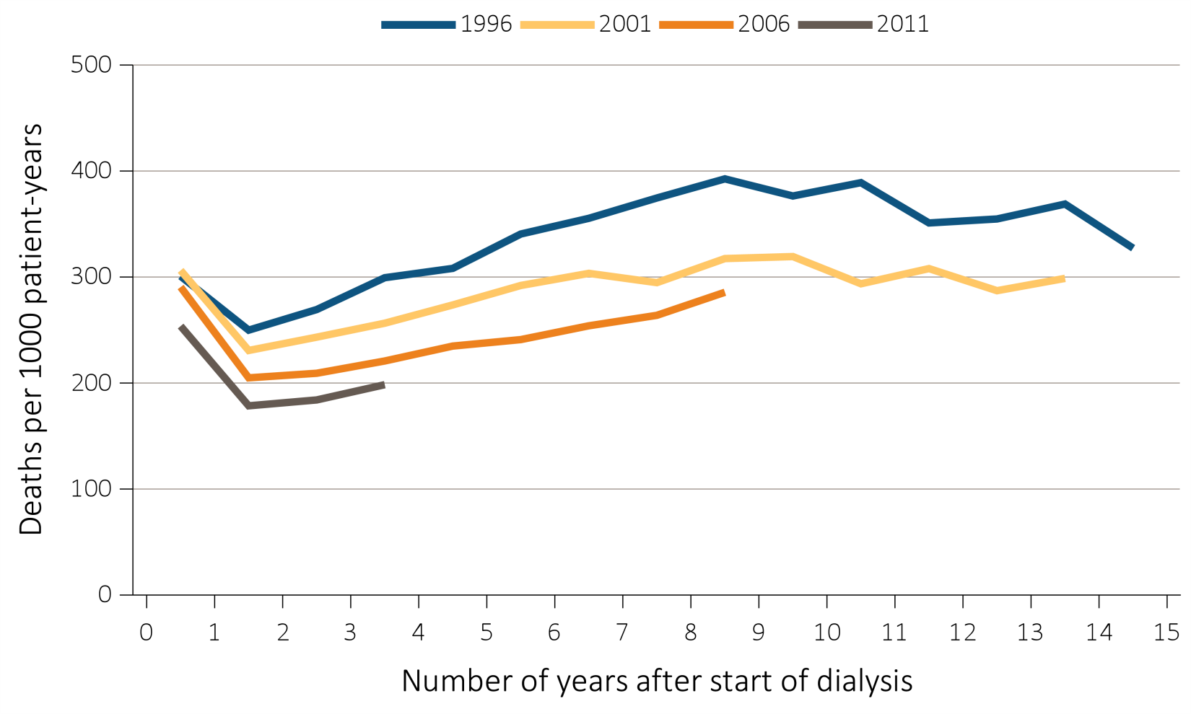
Figure 6.2.a Adjusted all-cause mortality (deaths per 1,000 patient-years) by treatment modality, cohort (year of ESRD onset), and number of years after start of dialysis among incident hemodialysis patients, 1996, 2001, 2006, and 2011
Data Source: Special analyses, USRDS ESRD Database. Adjusted for age, sex, race, and primary diagnosis. Reference population: period prevalent ESRD patients, 2011. Abbreviation: ESRD, end-stage renal disease.

Slide 5
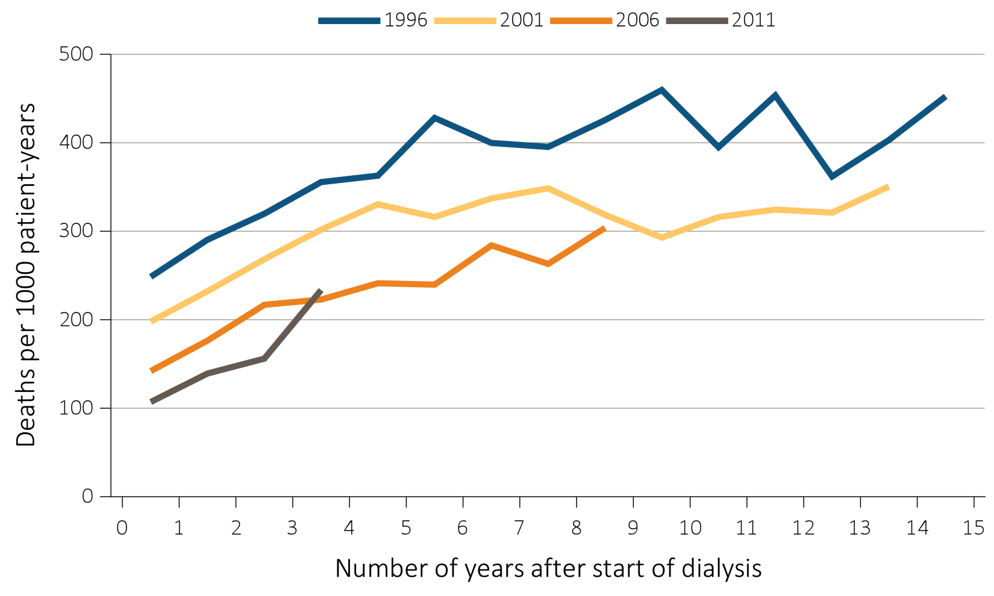
Figure 6.2.b Adjusted all-cause mortality (deaths per 1,000 patient-years) by treatment modality, cohort (year of ESRD onset), and number of years after start of dialysis among incident peritoneal dialysis patients, 1996, 2001, 2006, and 2011
Data Source: Special analyses, USRDS ESRD Database. Adjusted for age, sex, race, and primary diagnosis. Reference population: period prevalent ESRD patients, 2011. Abbreviation: ESRD, end-stage renal disease.

Slide 6
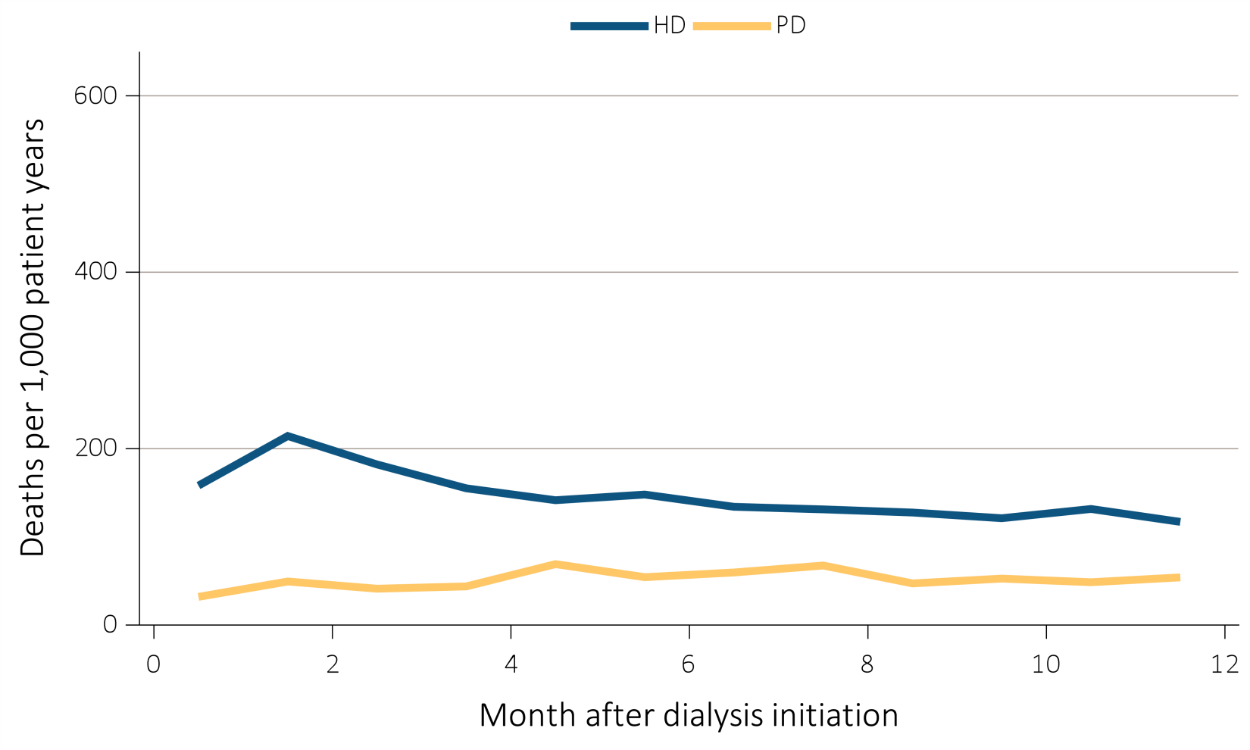
Figure 6.3.a Adjusted mortality (deaths per 1000 patient-years) by treatment modality and number of months after treatment initiation among ESRD patients, under age 65, 2013
Data Source: Special analyses, USRDS ESRD Database. Adjusted (age, race, sex, ethnicity, and primary diagnosis) mortality among 2013 incident ESRD patients during the first year of therapy. Reference population: incident ESRD patients, 2011. Abbreviations: ESRD, end-stage renal disease; HD, hemodialysis; PD, peritoneal dialysis.

Slide 7
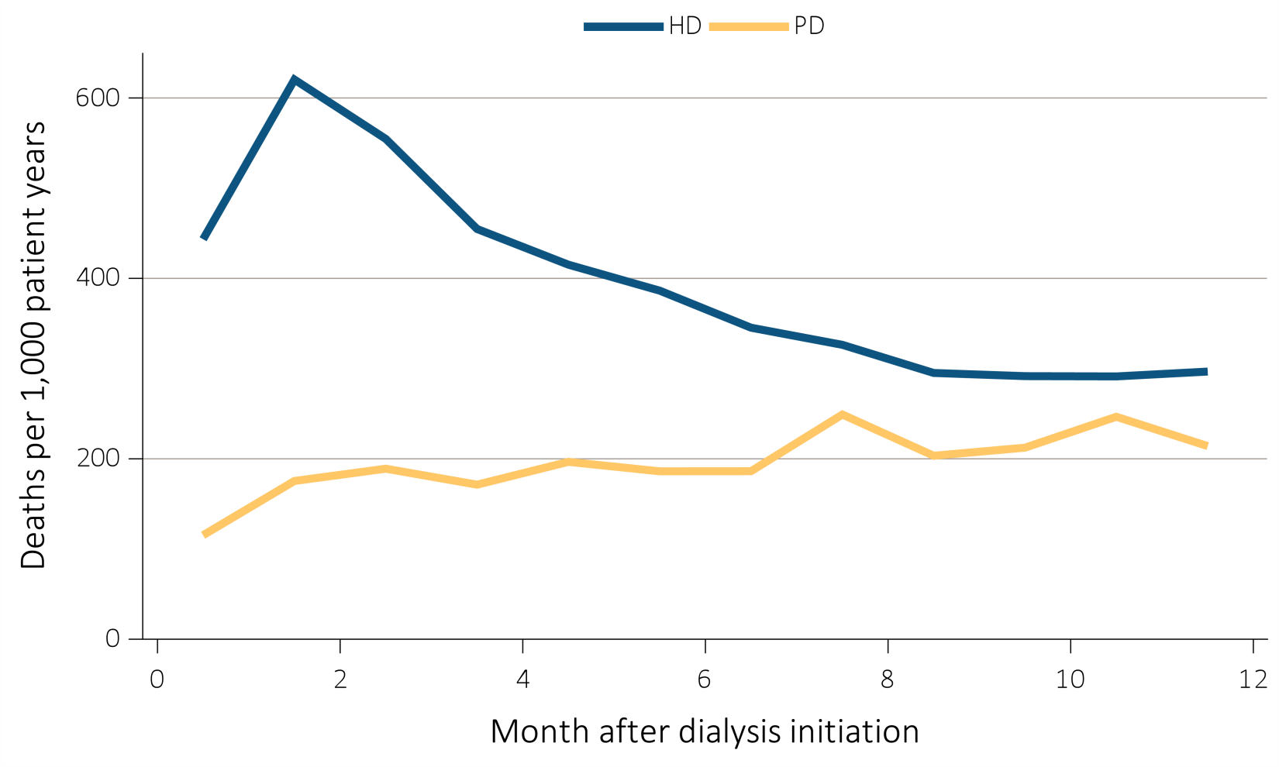
Figure 6.3.b Adjusted mortality (deaths per 1000 patient-years) by treatment modality and number of months after treatment initiation among ESRD patients, aged 65 and over, 2013
Data Source: Special analyses, USRDS ESRD Database. Adjusted (age, race, sex, ethnicity, and primary diagnosis) mortality among 2013 incident ESRD patients during the first year of therapy. Reference population: incident ESRD patients, 2011. Abbreviations: ESRD, end-stage renal disease; HD, hemodialysis; PD, peritoneal dialysis.

Slide 8
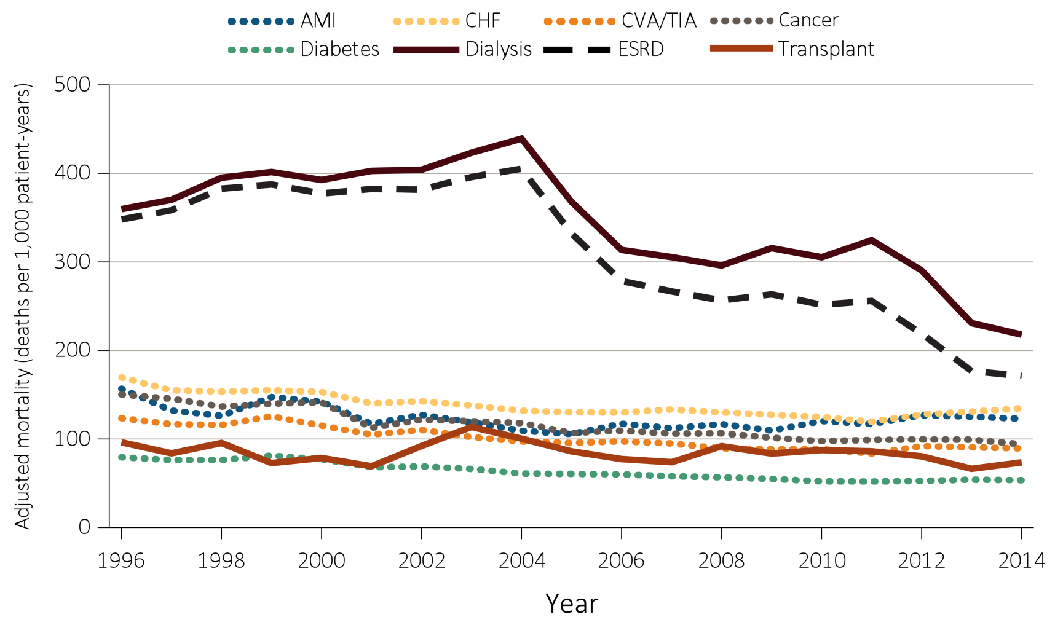
Figure 6.4 Adjusted mortality (deaths per 1,000 patient-years) by calendar year, treatment modality, and Medicare comorbidity among ESRD patients and comorbidity-specific Medicare populations aged 65 & older, 1996-2014
Data Source: Special analyses, USRDS ESRD Database, and Medicare 5% sample. Unadjusted and adjusted (sex and race) mortality rates starting with the January 1 point prevalent sample in the ESRD and general populations, aged 65 and older (per 1,000 patient-years at risk). Reference population: period prevalent ESRD patients, 2012. Abbreviations: AMI, acute myocardial infarction; CHF, congestive heart failure; CVA/TIA, cerebrovascular accident/transient ischemic attack; ESRD, end-stage renal disease.

Slide 9
Table 6.1.a Adjusted all-cause mortality (deaths per 1,000 patient-years) by age and race, among ESRD patients, 2014
Age | Race | ESRD | Dialysis | Transplant
0-21 | White | 10 | 33 | 4
 | Black/African American | 18 | 35 | 6
 | Other | 8 | 26 | 4
22-44 | White | 33 | 64 | 9
 | Black/African American | 43 | 54 | 11
 | Other | 20 | 37 | 4
45-64 | White | 108 | 155 | 35
 | Black/African American | 98 | 112 | 34
 | Other | 77 | 102 | 20
65-74 | White | 209 | 249 | 80
 | Black/African American | 171 | 185 | 79
 | Other | 139 | 161 | 59
75+ | White | 357 | 377 | 136
 | Black/African American | 270 | 276 | 143
 | Other | 233 | 240 | 111
Data Source: Special analyses, USRDS ESRD Database. Adjusted (race and primary diagnosis) all-cause mortality among 2014 period prevalent patients. Reference population: period prevalent ESRD patients, 2011. Abbreviation: ESRD, end-stage renal disease.

Slide 10
Table 6.1.b Adjusted all-cause mortality (deaths per 1,000 patient-years) by age and sex, among ESRD patients, 2014 (continued)
Age | Sex | ESRD | Dialysis | Transplant
0-21 | Male | 9 | 31 | 3
 | Female | 12 | 36 | 4
22-44 | Male | 34 | 56 | 9
 | Female | 39 | 66 | 10
45-64 | Male | 105 | 141 | 36
 | Female | 107 | 144 | 31
65-74 | Male | 205 | 245 | 83
 | Female | 196 | 224 | 74
75+ | Male | 357 | 379 | 140
 | Female | 330 | 342 | 129
Data Source: Special analyses, USRDS ESRD Database. Adjusted (sex and primary diagnosis) all-cause mortality among 2014 period prevalent patients. Reference population: period prevalent ESRD patients, 2011. Abbreviation: ESRD, end-stage renal disease.

Slide 11
Table 6.2 Unadjusted percentages of deaths due to cardiovascular disease (CVD), infection, other specified causes, and with missing data, by modality among ESRD patients, 2013
 | Cause-specific mortality
 | CVD | Infection | Other cause | Missing cause
Modality
ESRD | 39% | 8% | 25% | 28%
Dialysis | 41% | 8% | 26% | 24%
Transplant | 9% | 5% | 13% | 73%
Data Source: Special analyses, USRDS ESRD Database. All-cause mortality among 2012 prevalent patients. Reference population: period prevalent ESRD patients, 2011. Abbreviations: CVD, cardiovascular disease; ESRD, end-stage renal disease.

Slide 12
Table 6.3 Adjusted survival (%) by treatment modality and incident cohort year (year of ESRD onset): Dialysis
 | 3 months | 12 months | 24 months | 36 months | 60 months
Hemodialysis
2001 | 91.0 | 74.8 | 61.4 | 50.8 | 35.6
2003 | 91.0 | 74.8 | 61.8 | 51.4 | 36.5
2005 | 91.2 | 75.4 | 62.7 | 52.9 | 38.5
2007 | 91.5 | 76.3 | 64.1 | 54.6 | 39.9
2009 | 91.7 | 77.4 | 65.6 | 56.1 | 41.5
Peritoneal dialysis
2001 | 95.5 | 82.1 | 67.3 | 55.4 | 39.4
2003 | 96.3 | 83.9 | 69.0 | 57.7 | 42.9
2005 | 96.4 | 85.6 | 72.3 | 61.6 | 45.7
2007 | 96.9 | 87.5 | 74.8 | 64.6 | 49.0
2009 | 97.3 | 87.8 | 76.5 | 66.5 | 51.4
Data Source: Reference Tables I.1_adj-I.36_adj. Adjusted survival probabilities, from day one, in the ESRD population. Reference population: incident ESRD patients, 2011. Adjusted for age, sex, race, Hispanic ethnicity, and primary diagnosis. Abbreviation: ESRD, end-stage renal disease.

Slide 13
Table 6.3 Adjusted survival (%) by treatment modality and incident cohort year (year of ESRD onset): Transplant (continued)
 | 3 months | 12 months | 24 months | 36 months | 60 months
Deceased-donor transplant
2001 | 94.9 | 89.4 | 83.2 | 77.8 | 66.1
2003 | 95.7 | 90 | 84.6 | 79.5 | 69.2
2005 | 95.6 | 89.9 | 85.1 | 80.5 | 71.3
2007 | 96.7 | 92.3 | 88.1 | 83.7 | 73.3
2009 | 96.8 | 92.3 | 88.5 | 84.3 | 75.7
Living donor transplant
2001 | 97.3 | 93.6 | 89.6 | 85.5 | 76.0
2003 | 98.1 | 95.6 | 91.9 | 87.8 | 79.3
2005 | 98.2 | 95.3 | 92.0 | 88.7 | 81.0
2007 | 99.1 | 97.2 | 94.8 | 91.9 | 85.1
2009 | 98.9 | 97.1 | 94.5 | 91.4 | 84.6
Data Source: Reference Tables I.1_adj-I.36_adj. Adjusted survival probabilities, from day one, in the ESRD population. Reference population: incident ESRD patients, 2011. Adjusted for age, sex, race, Hispanic ethnicity, and primary diagnosis. Abbreviation: ESRD, end-stage renal disease.

Slide 14
Table 6.4 Expected remaining lifetime (years) by age, sex, and treatment modality of prevalent dialysis patients, prevalent transplant patients, and the general U.S. population (2013), based on USRDS data and the National Vital Statistics Report (2016)
 |  | Age | 0-14 | 15-19 | 20-24 | 25-29 | 30-34 | 35-39 | 40-44 | 45-49 | 50-54 | 55-59 | 60-64 | 65-69 | 70-74 | 75-79 | 80-84 | 85+
ESRD patients, 2013 | Dialysis | Male | 22.6 | 21.6 | 18.5 | 16.2 | 14.3 | 12.6 | 11.0 | 9.2 | 7.9 | 6.6 | 5.5 | 4.5 | 3.8 | 3.2 | 2.6 | 2.2
 |  | Female | 23.3 | 19.0 | 16.4 | 14.3 | 13.0 | 11.6 | 10.4 | 8.9 | 7.8 | 6.6 | 5.7 | 4.8 | 4.0 | 3.5 | 2.9 | 2.4
 | Transplant | Male | 60.1 | 47.9 | 43.4 | 39.2 | 35.1 | 31 | 27.2 | 23.4 | 19.9 | 16.7 | 13.8 | 11.4 | 9.5 | 7.7ª
 |  | Female | 59.8 | 48.5 | 44.2 | 40.2 | 36.4 | 32.8 | 28.9 | 25.2 | 21.7 | 18.3 | 15.3 | 12.6 | 10.4 | 8.7ª
General U.S. population, 2013 |  | Male | 70.7 | 59.7 | 55.0 | 50.3 | 45.7 | 41.0 | 36.4 | 31.9 | 27.7 | 23.7 | 19.8 | 16.2 | 12.8 | 9.8 | 7.1 | 3.7
 |  | Female | 75.4 | 64.4 | 59.5 | 54.6 | 49.7 | 45.0 | 40.3 | 35.6 | 31.1 | 26.8 | 22.6 | 18.5 | 14.7 | 11.3 | 8.4 | 4.4
Data Source: Reference Table H.13; special analyses, USRDS ESRD Database; and National Vital Statistics Report. “Table 7. Life expectancy at selected ages, by race, Hispanic origin, race for non-Hispanic population, and sex: United States, 2013 (2016).” Expected remaining lifetimes (years) of the general U.S. population and of period prevalent dialysis and transplant patients. ªCell values combine ages 75+. Abbreviation: ESRD, end-stage renal disease.

Slide 15
Table 6.5 Adjusted mortality (deaths per 1,000 patient-years) by age, sex, treatment modality, and Medicare comorbidity among ESRD patients and people covered by Medicare in 2013, based on USRDS and CMS data, 2014
Age | Sex | Dialysis | Transplant | All Medicare | Cancer | Diabetes | CHF | CVA/ TIA | AMI
65-74 | Male | 228 | 64 | 26 | 75 | 41 | 106 | 71 | 92
 | Female | 215 | 53 | 18 | 67 | 31 | 102 | 59 | 97
75+ | Male | 345 | 119 | 91 | 139 | 110 | 236 | 168 | 206
 | Female | 324 | 119 | 82 | 134 | 101 | 220 | 150 | 205
Data Source: Special analyses, USRDS ESRD Database and Medicare 5%sample. Adjusted for race. Medicare data limited to patients with at least one month of Medicare eligibility in 2013. Reference population: Medicare patients, 2014. Abbreviations: AMI, acute myocardial infarction; CHF, congestive heart failure; CMS, Centers for Medicare & Medicaid; CVA/TIA, cerebrovascular accident/transient ischemic attack; ESRD, end-stage renal disease.

