Slide 2
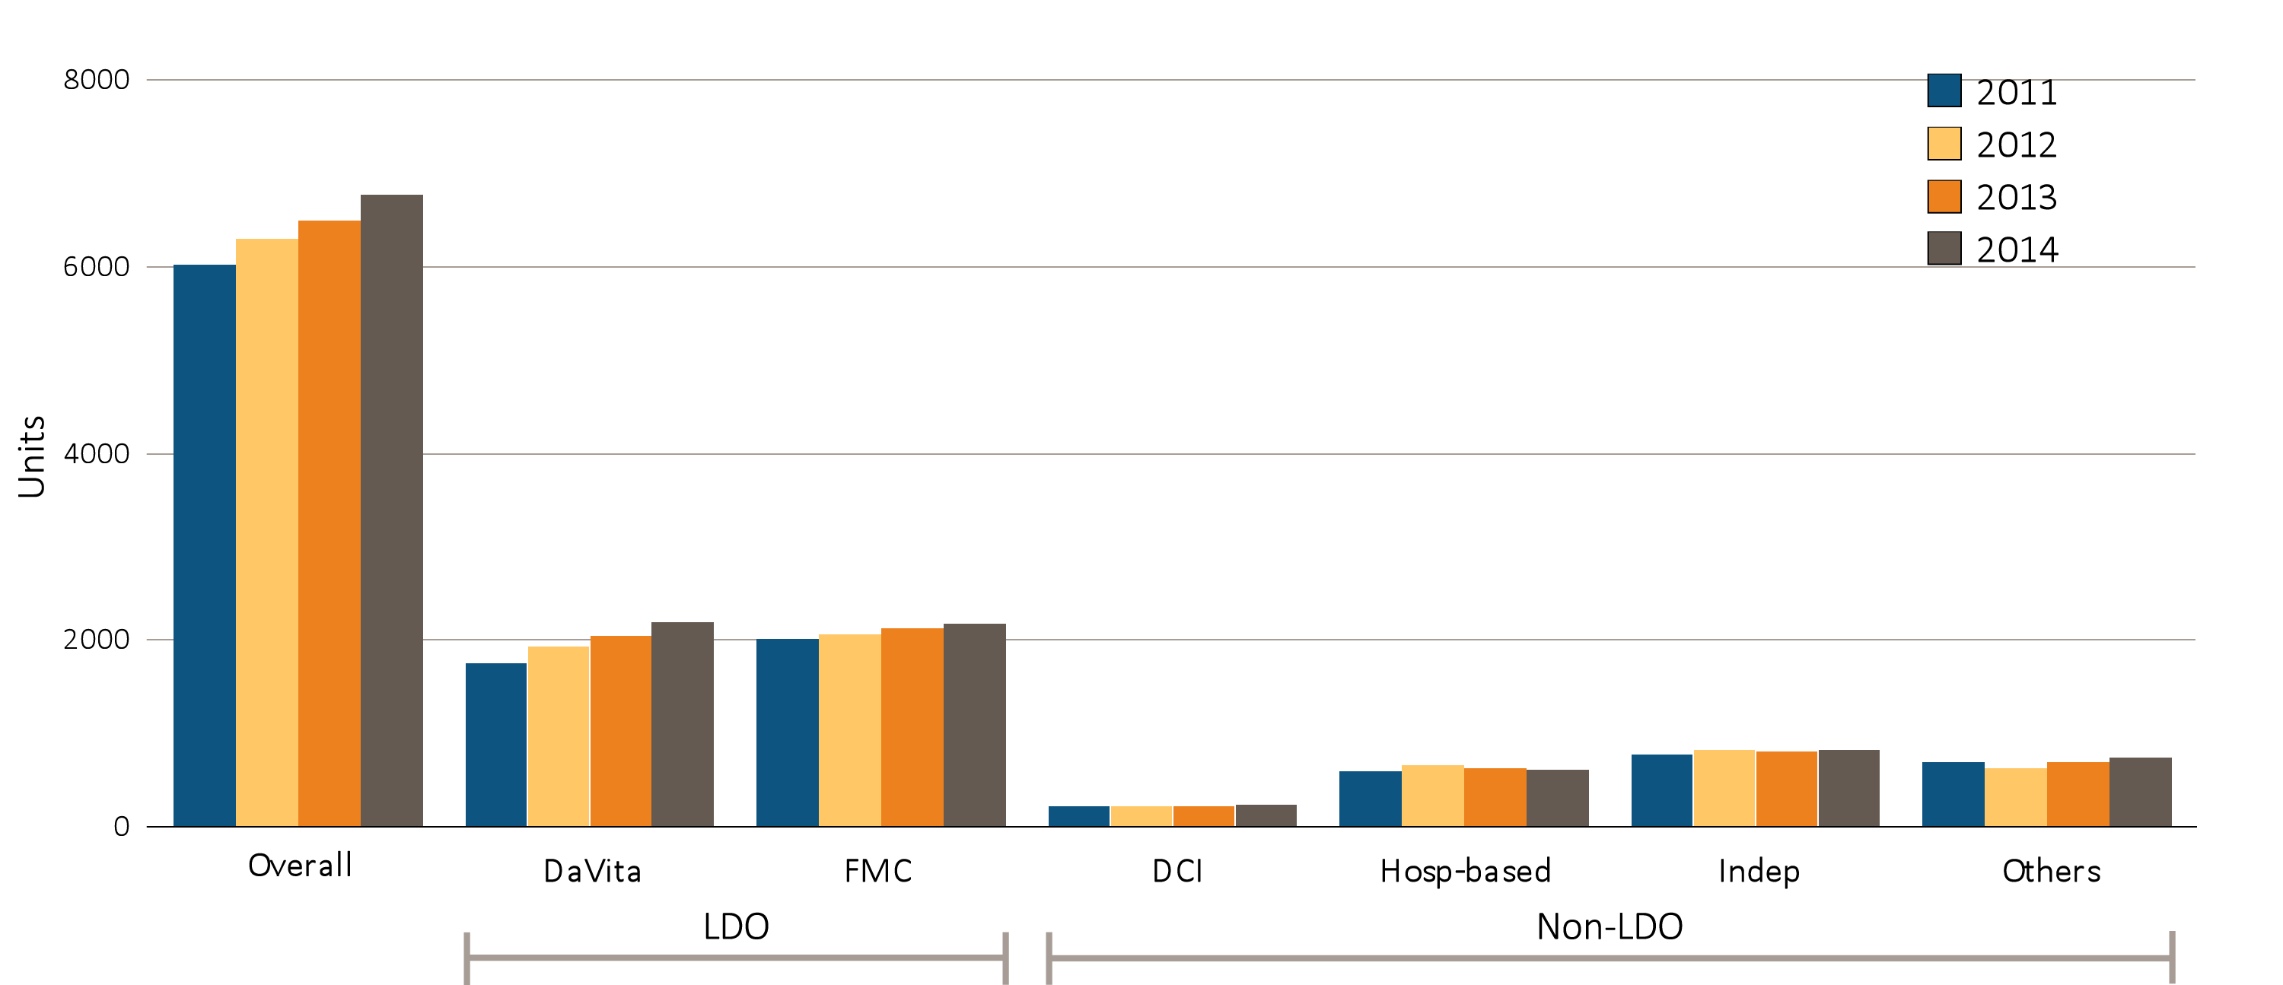
Figure 10.1 Dialysis unit counts, by unit affiliation, 2011–2014
Data Source: Special analyses, USRDS ESRD Database. Abbreviations: DCI, Dialysis Clinic, Inc.; FMC, Fresenius; Hosp-based, hospital-based dialysis centers; Indep, independent dialysis providers; Others, other dialysis organizations. Note: the number of dialysis units in 2011 has been updated for DaVita from 1681 as reported in the 2015 ADR to 1745; and from 750 in 2015 to 686 currently for Others.

Slide 3
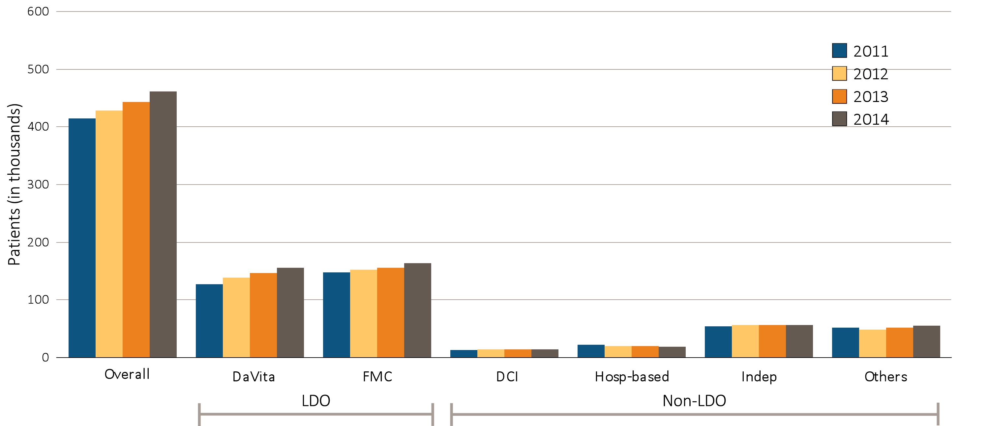
Figure 10.2 Dialysis patient counts, by unit affiliation, 2011–2014
Data Source: Special analyses, USRDS ESRD Database. Abbreviations: DCI, Dialysis Clinic, Inc.; FMC, Fresenius; Hosp-based, hospital-based dialysis centers; Indep, independent dialysis providers; Others, other dialysis organizations.

Slide 4
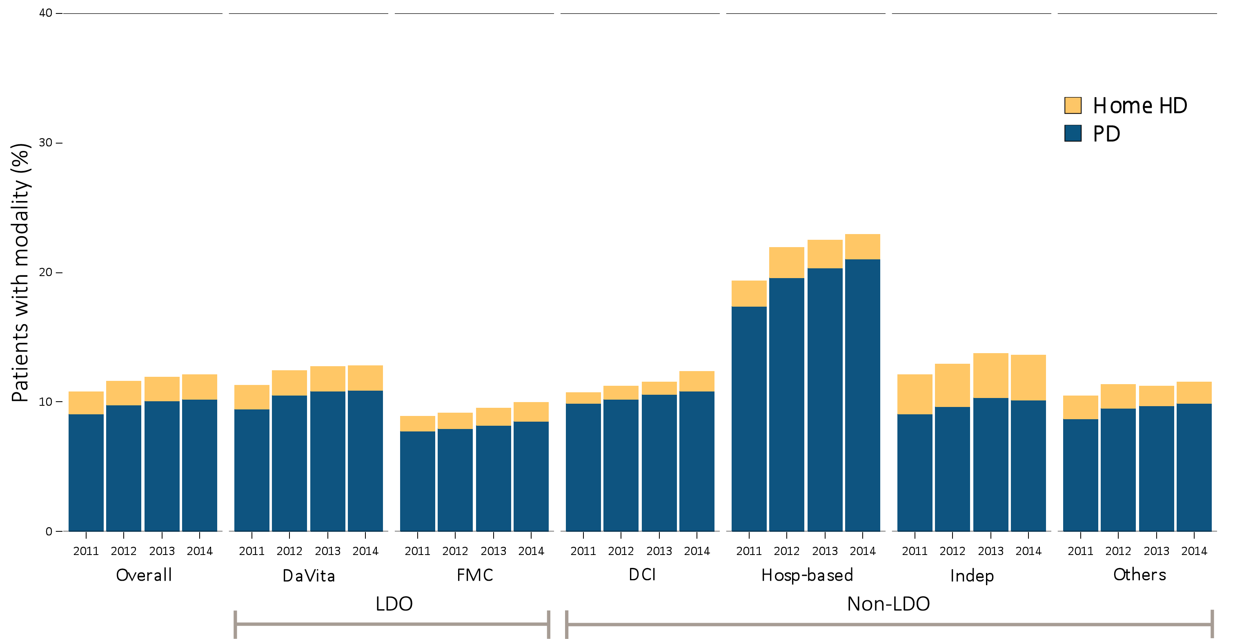
Figure 10.3 Prevalence of home-based dialysis modality, by unit affiliation, 2011–2014
^{(a) All patients}
Data source: Special analyses, USRDS ESRD Database. Abbreviations: HD, hemodialysis; Hosp-based, hospital-based dialysis centers; Indep, independent dialysis providers; LDO, large dialysis organizations; PD, peritoneal dialysis; Others, other dialysis organizations.

Slide 5
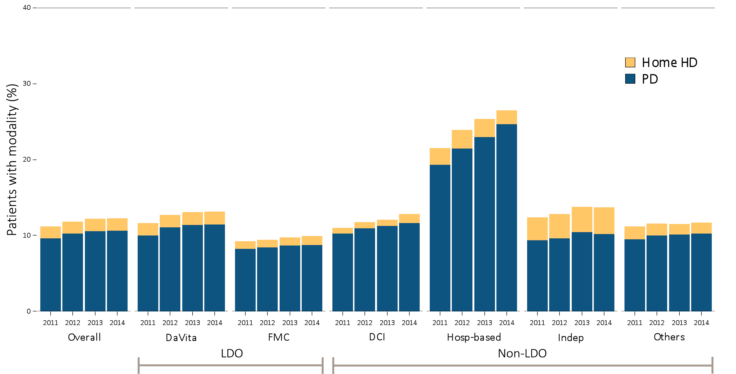
Figure 10.3 Prevalence of home-based dialysis modality, by unit affiliation, 2011–2014
^{(b) Female patients}
Data source: Special analyses, USRDS ESRD Database. Abbreviations: HD, hemodialysis; Hosp-based, hospital-based dialysis centers; Indep, independent dialysis providers; LDO, large dialysis organizations; PD, peritoneal dialysis; Others, other dialysis organizations.

Slide 6
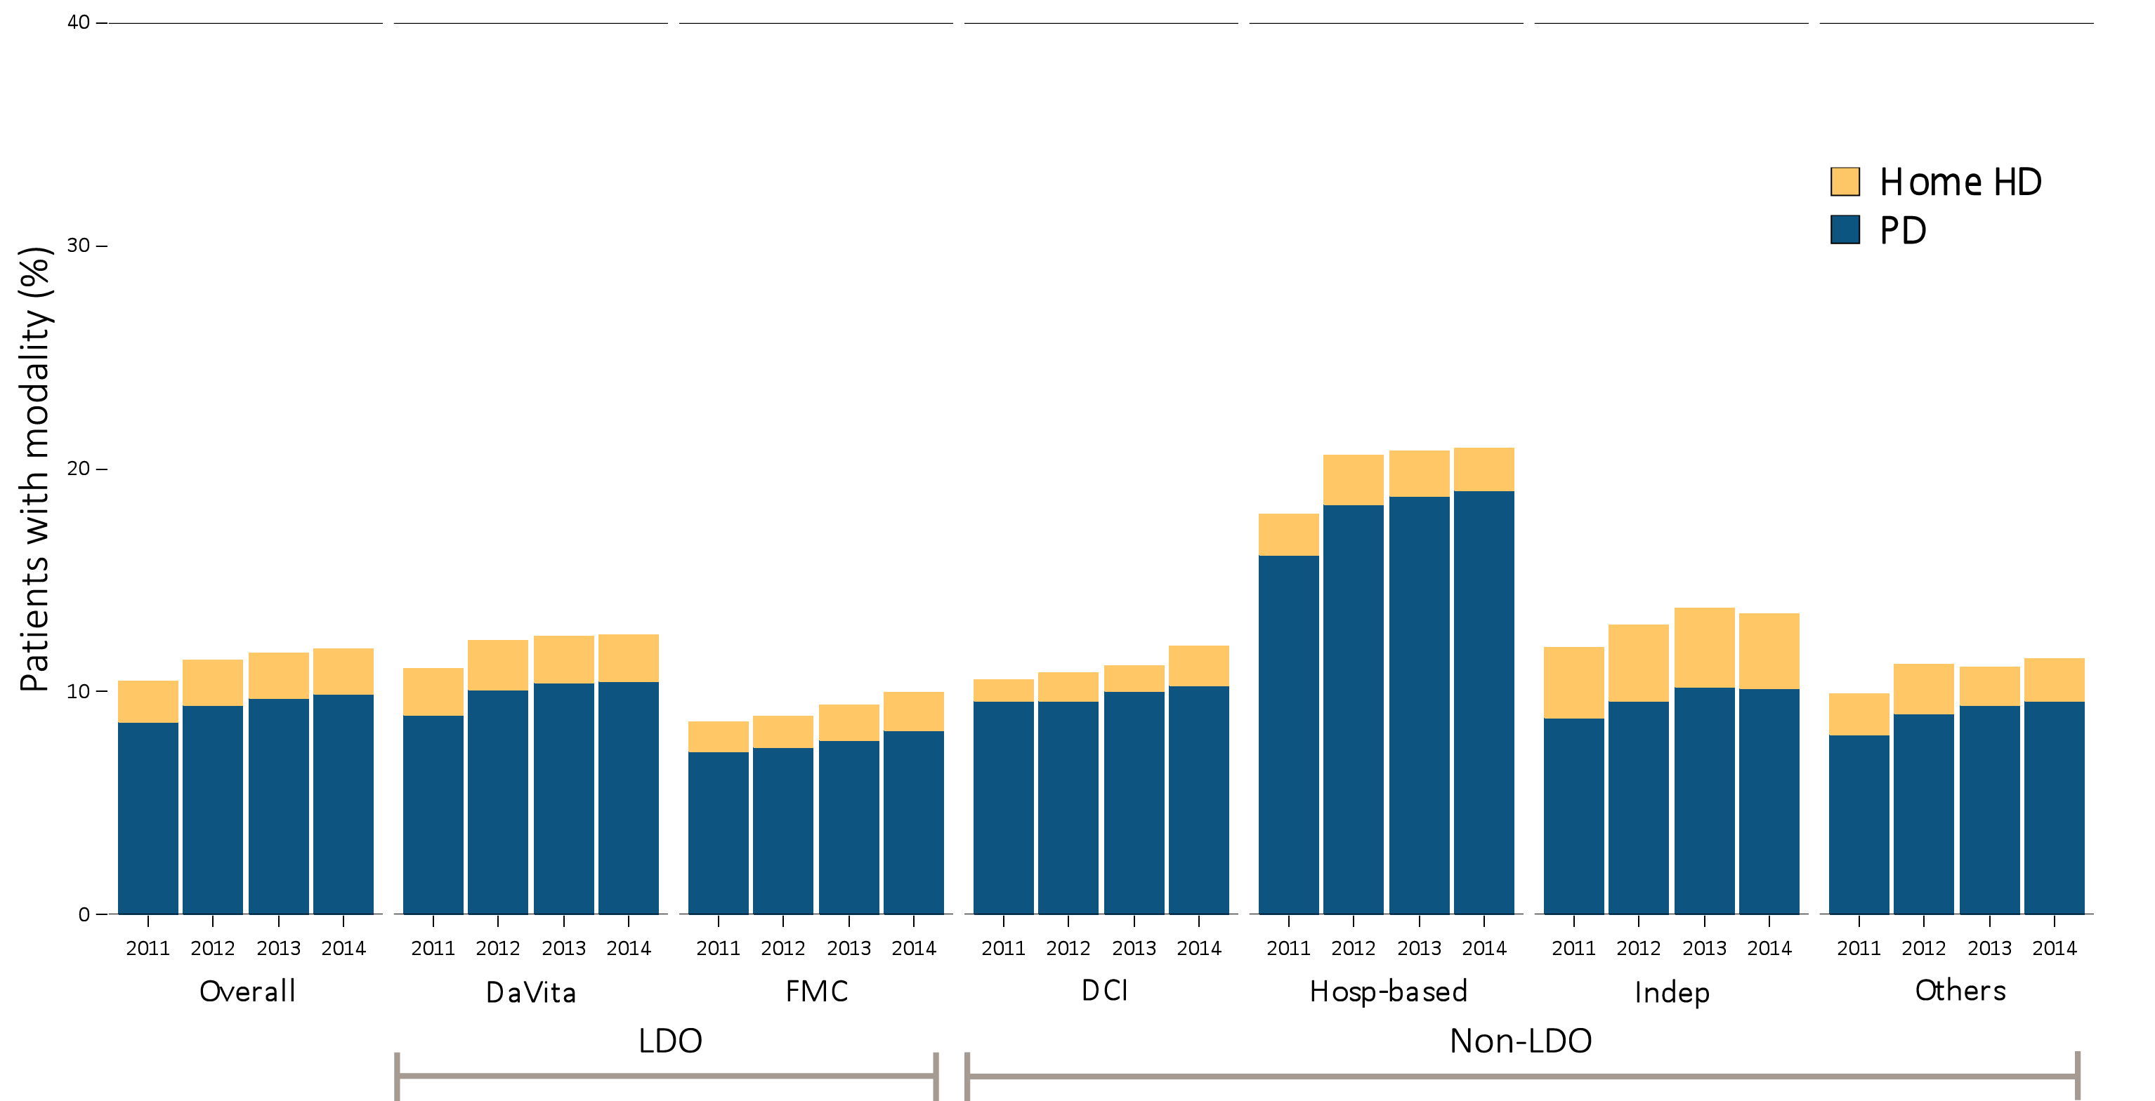
Figure 10.3 Prevalence of home-based dialysis modality, by unit affiliation, 2011–2014
^{(c) Male patients}
Data source: Special analyses, USRDS ESRD Database. Abbreviations: HD, hemodialysis; Hosp-based, hospital-based dialysis centers; Indep, independent dialysis providers; LDO, large dialysis organizations; PD, peritoneal dialysis; Others, other dialysis organizations.

Slide 7
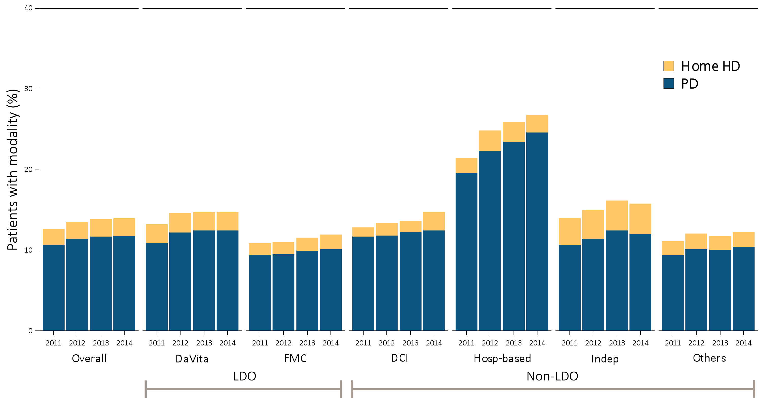
Figure 10.3 Prevalence of home-based dialysis modality, by unit affiliation, 2011–2014
^{(d) White patients}
Data source: Special analyses, USRDS ESRD Database. Abbreviations: HD, hemodialysis; Hosp-based, hospital-based dialysis centers; Indep, independent dialysis providers; LDO, large dialysis organizations; PD, peritoneal dialysis; Others, other dialysis organizations.

Slide 8
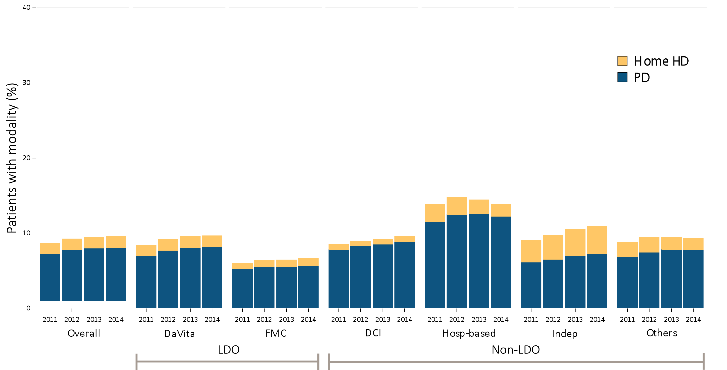
Figure 10.3 Prevalence of home-based dialysis modality, by unit affiliation, 2011–2014
^{(e) African American patients}
Data source: Special analyses, USRDS ESRD Database. Abbreviations: HD, hemodialysis; Hosp-based, hospital-based dialysis centers; Indep, independent dialysis providers; LDO, large dialysis organizations; PD, peritoneal dialysis; Others, other dialysis organizations.

Slide 9
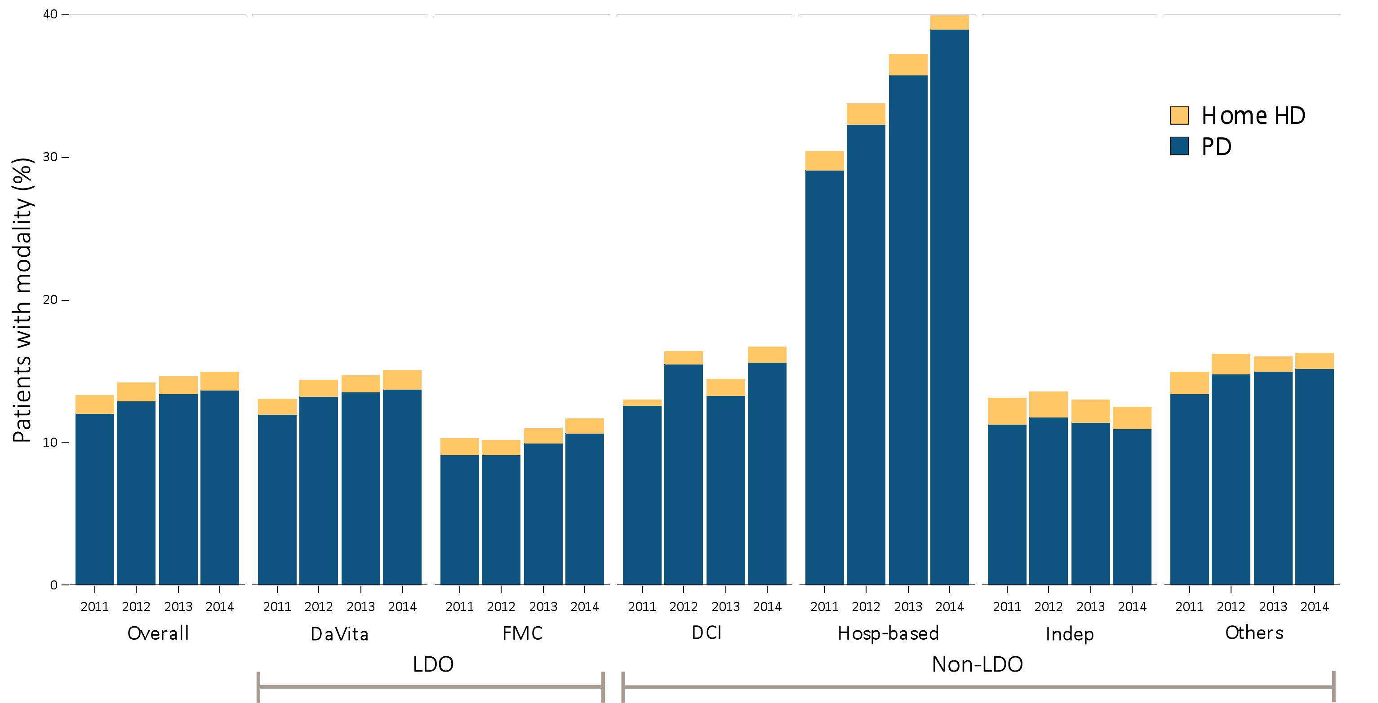
Figure 10.3 Prevalence of home-based dialysis modality, by unit affiliation, 2011–2014
^{(f) Asian patients}
Data source: Special analyses, USRDS ESRD Database. Abbreviations: HD, hemodialysis; Hosp-based, hospital-based dialysis centers; Indep, independent dialysis providers; LDO, large dialysis organizations; PD, peritoneal dialysis; Others, other dialysis organizations.

Slide 10
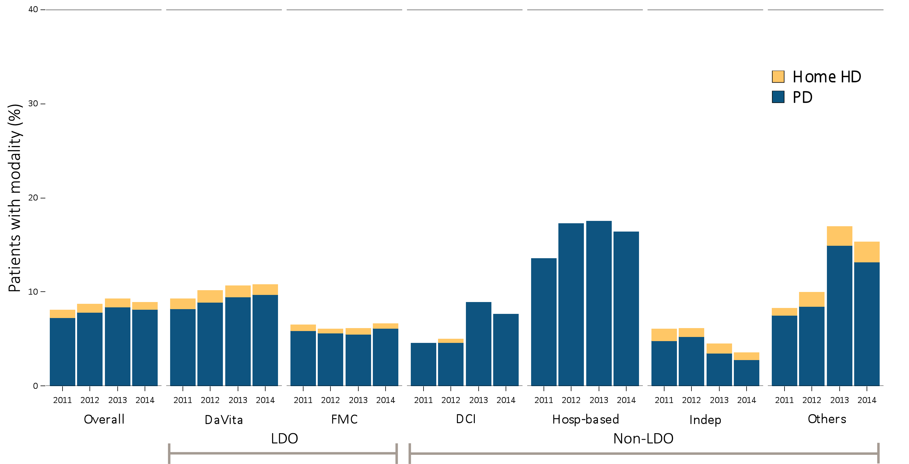
Figure 10.3 Prevalence of home-based dialysis modality, by unit affiliation, 2011–2014
^{(g) Native American patients}
Data source: Special analyses, USRDS ESRD Database. Abbreviations: HD, hemodialysis; Hosp-based, hospital-based dialysis centers; Indep, independent dialysis providers; LDO, large dialysis organizations; PD, peritoneal dialysis; Others, other dialysis organizations.

Slide 11
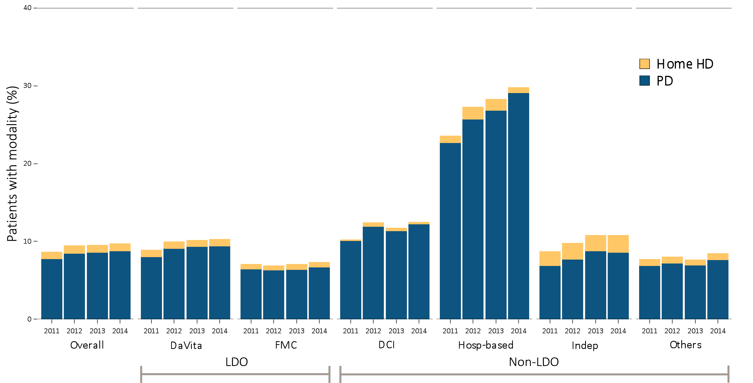
Figure 10.3 Prevalence of home-based dialysis modality, by unit affiliation, 2011–2014
^{(h) Hispanic patients}
Data source: Special analyses, USRDS ESRD Database. Abbreviations: HD, hemodialysis; Hosp-based, hospital-based dialysis centers; Indep, independent dialysis providers; LDO, large dialysis organizations; PD, peritoneal dialysis; Others, other dialysis organizations.

Slide 12
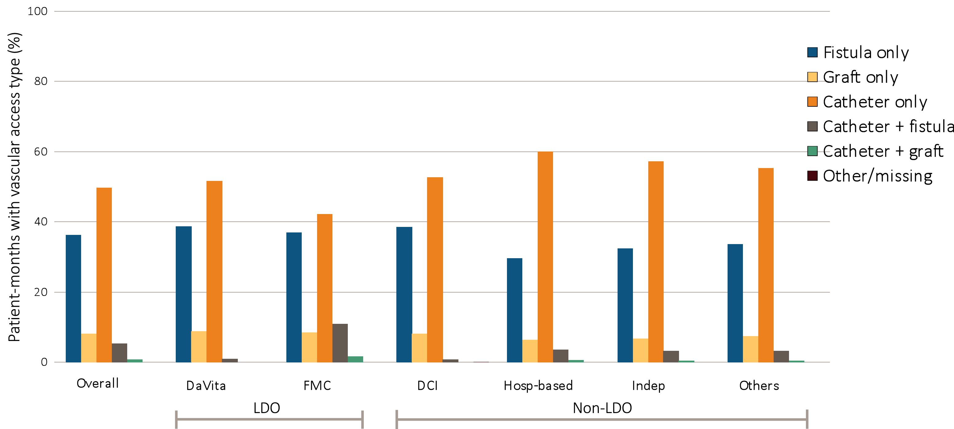
Figure 10.4 Prevalence of vascular access types among incident hemodialysis patients, by unit affiliation, 2014
^{(a) All patients}
Data source: Special analyses, USRDS ESRD Database. Abbreviations: Hosp-based, hospital-based dialysis centers; Indep, independent dialysis providers; LDO, large dialysis organizations; Others, other dialysis organizations.

Slide 13
Figure 10.4 Prevalence of vascular access types among incident hemodialysis patients, by unit affiliation, 2014
^{(b) Female patients}
Data source: Special analyses, USRDS ESRD Database. Abbreviations: Hosp-based, hospital-based dialysis centers; Indep, independent dialysis providers; LDO, large dialysis organizations; Others, other dialysis organizations.

Slide 14
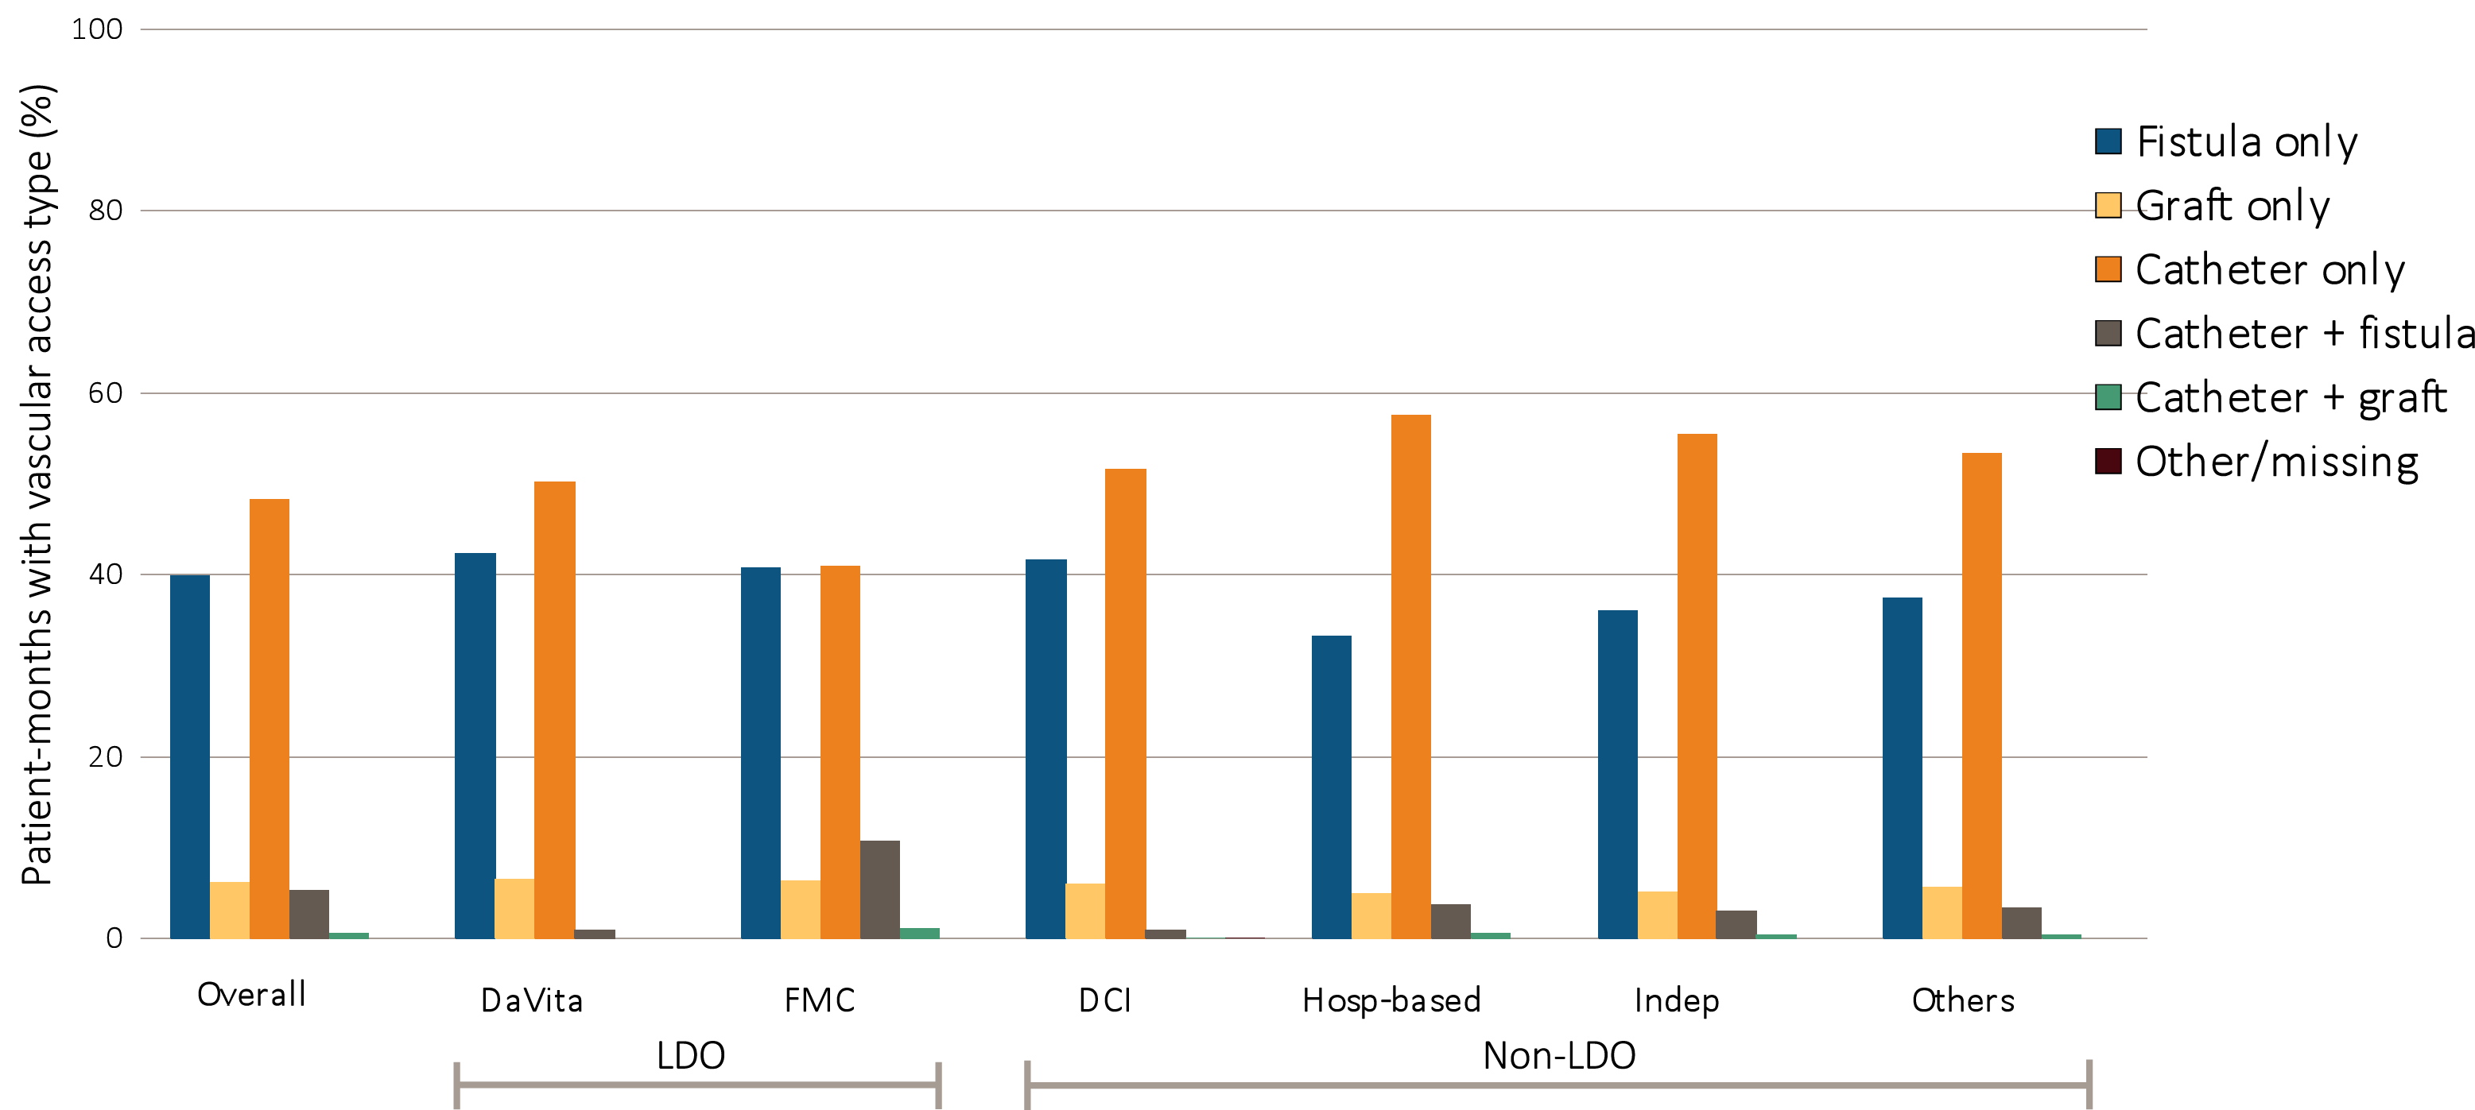
Figure 10.4 Prevalence of vascular access types among incident hemodialysis patients, by unit affiliation, 2014
^{(c) Male patients}
Data source: Special analyses, USRDS ESRD Database. Abbreviations: Hosp-based, hospital-based dialysis centers; Indep, independent dialysis providers; LDO, large dialysis organizations; Others, other dialysis organizations.

Slide 15
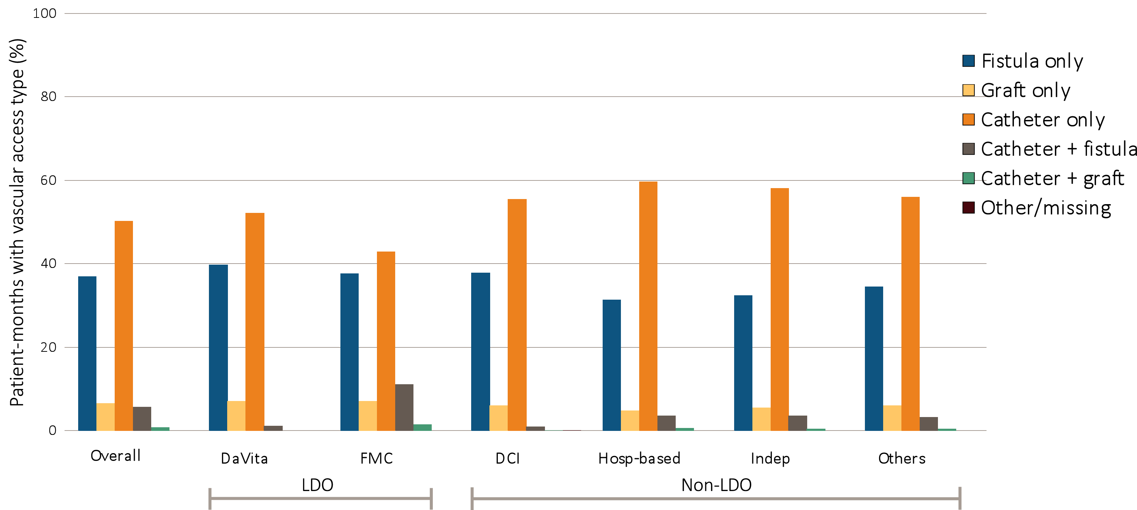
Figure 10.4 Prevalence of vascular access types among incident hemodialysis patients, by unit affiliation, 2014
^{(d) White patients}
Data source: Special analyses, USRDS ESRD Database. Abbreviations: Hosp-based, hospital-based dialysis centers; Indep, independent dialysis providers; LDO, large dialysis organizations; Others, other dialysis organizations.

Slide 16
Figure 10.4 Prevalence of vascular access types among incident hemodialysis patients, by unit affiliation, 2014
^{(e) African American patients}
Data source: Special analyses, USRDS ESRD Database. Abbreviations: Hosp-based, hospital-based dialysis centers; Indep, independent dialysis providers; LDO, large dialysis organizations; Others, other dialysis organizations.

Slide 17
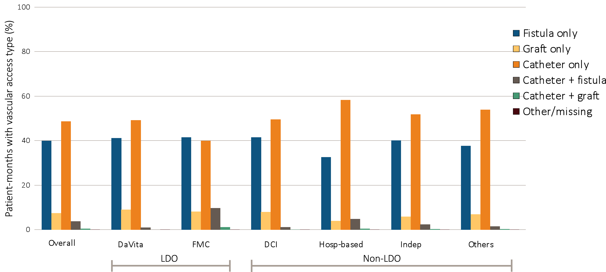
Figure 10.4 Prevalence of vascular access types among incident hemodialysis patients, by unit affiliation, 2014
^{(f) Asian patients}
Data source: Special analyses, USRDS ESRD Database. Abbreviations: Hosp-based, hospital-based dialysis centers; Indep, independent dialysis providers; LDO, large dialysis organizations; Others, other dialysis organizations.

Slide 18
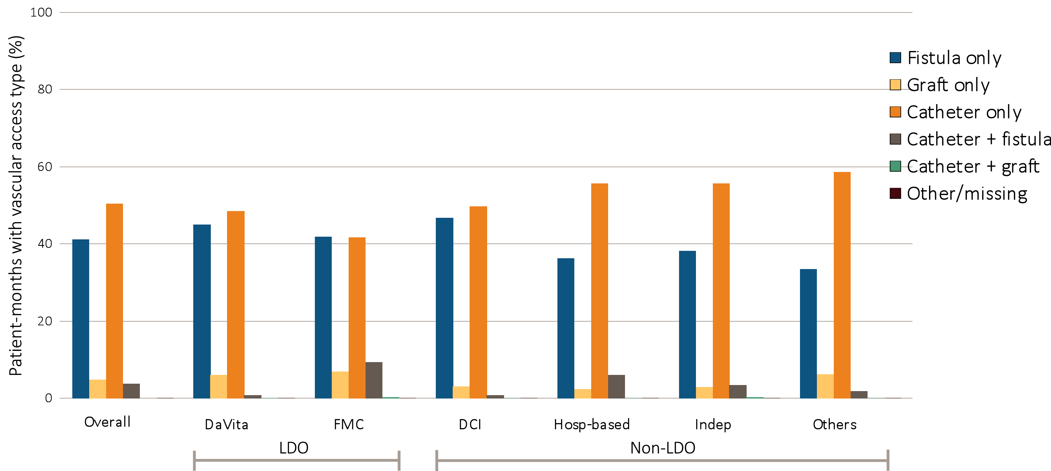
Figure 10.4 Prevalence of vascular access types among incident hemodialysis patients, by unit affiliation, 2014
^{(g) Native American patients}
Data source: Special analyses, USRDS ESRD Database. Abbreviations: Hosp-based, hospital-based dialysis centers; Indep, independent dialysis providers; LDO, large dialysis organizations; Others, other dialysis organizations.

Slide 19
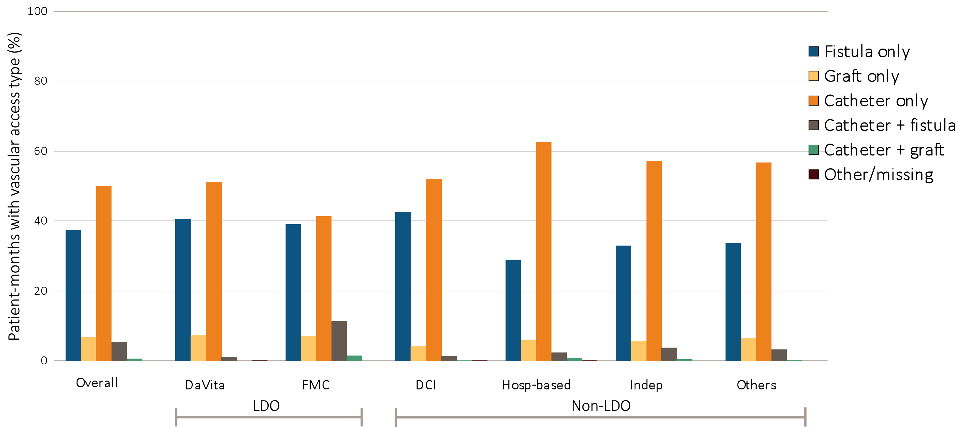
Figure 10.4 Prevalence of vascular access types among incident hemodialysis patients, by unit affiliation, 2014
^{(h) Hispanic patients}
Data source: Special analyses, USRDS ESRD Database. Abbreviations: Hosp-based, hospital-based dialysis centers; Indep, independent dialysis providers; LDO, large dialysis organizations; Others, other dialysis organizations.

Slide 20
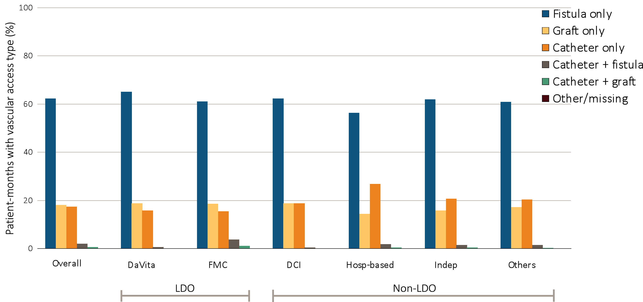
Figure 10.5 Prevalence of vascular access types among prevalent hemodialysis patients, by unit affiliation, 2014
^{(a) All patients}
Data source: Special analyses, USRDS ESRD Database. Period prevalent hemodialysis patients. Abbreviations: Hosp-based, hospital-based dialysis centers; Indep, independent dialysis providers; LDO, large dialysis organizations; Others, other dialysis organizations.

Slide 21
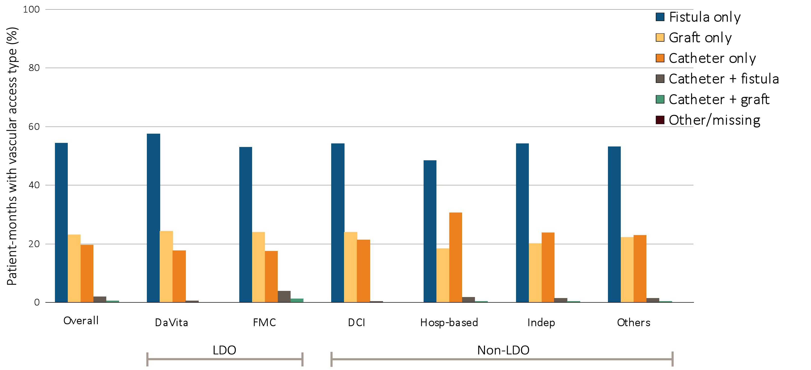
Figure 10.5 Prevalence of vascular access types among prevalent hemodialysis patients, by unit affiliation, 2014
^{(b) Female patients}
Data source: Special analyses, USRDS ESRD Database. Period prevalent hemodialysis patients. Abbreviations: Hosp-based, hospital-based dialysis centers; Indep, independent dialysis providers; LDO, large dialysis organizations; Others, other dialysis organizations.

Slide 22
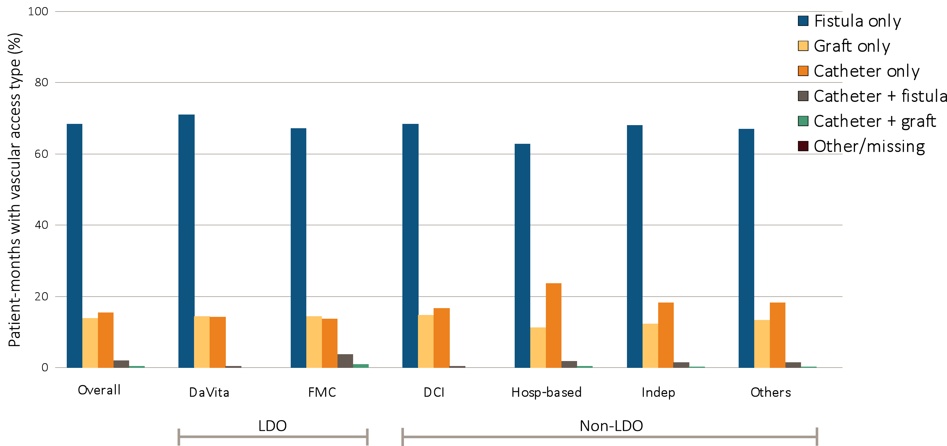
Figure 10.5 Prevalence of vascular access types among prevalent hemodialysis patients, by unit affiliation, 2014
^{(c) Male patients}
Data source: Special analyses, USRDS ESRD Database. Period prevalent hemodialysis patients. Abbreviations: Hosp-based, hospital-based dialysis centers; Indep, independent dialysis providers; LDO, large dialysis organizations; Others, other dialysis organizations.

Slide 23
Figure 10.5 Prevalence of vascular access types among prevalent hemodialysis patients, by unit affiliation, 2014
^{(d) White patients}
Data source: Special analyses, USRDS ESRD Database. Period prevalent hemodialysis patients. Abbreviations: Hosp-based, hospital-based dialysis centers; Indep, independent dialysis providers; LDO, large dialysis organizations; Others, other dialysis organizations.

Slide 24
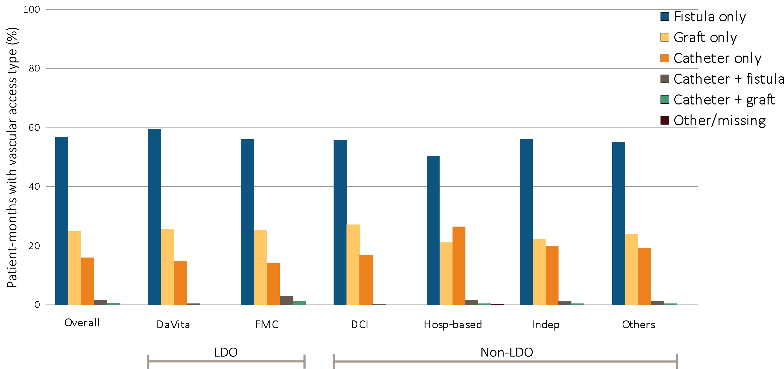
Figure 10.5 Prevalence of vascular access types among prevalent hemodialysis patients, by unit affiliation, 2014
^{(e) African American patients}
Data source: Special analyses, USRDS ESRD Database. Period prevalent hemodialysis patients. Abbreviations: Hosp-based, hospital-based dialysis centers; Indep, independent dialysis providers; LDO, large dialysis organizations; Others, other dialysis organizations.

Slide 25
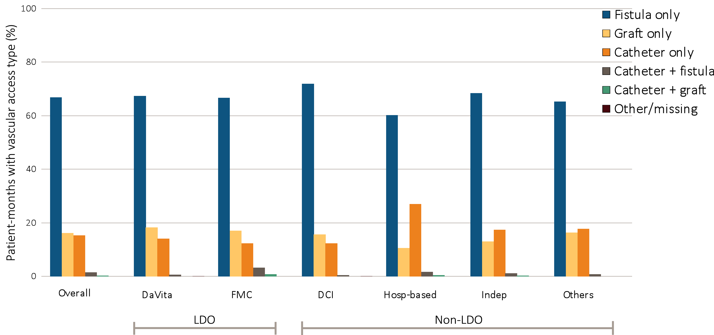
Figure 10.5 Prevalence of vascular access types among prevalent hemodialysis patients, by unit affiliation, 2014
^{(f) Asian patients}
Data source: Special analyses, USRDS ESRD Database. Period prevalent hemodialysis patients. Abbreviations: Hosp-based, hospital-based dialysis centers; Indep, independent dialysis providers; LDO, large dialysis organizations; Others, other dialysis organizations.

Slide 26
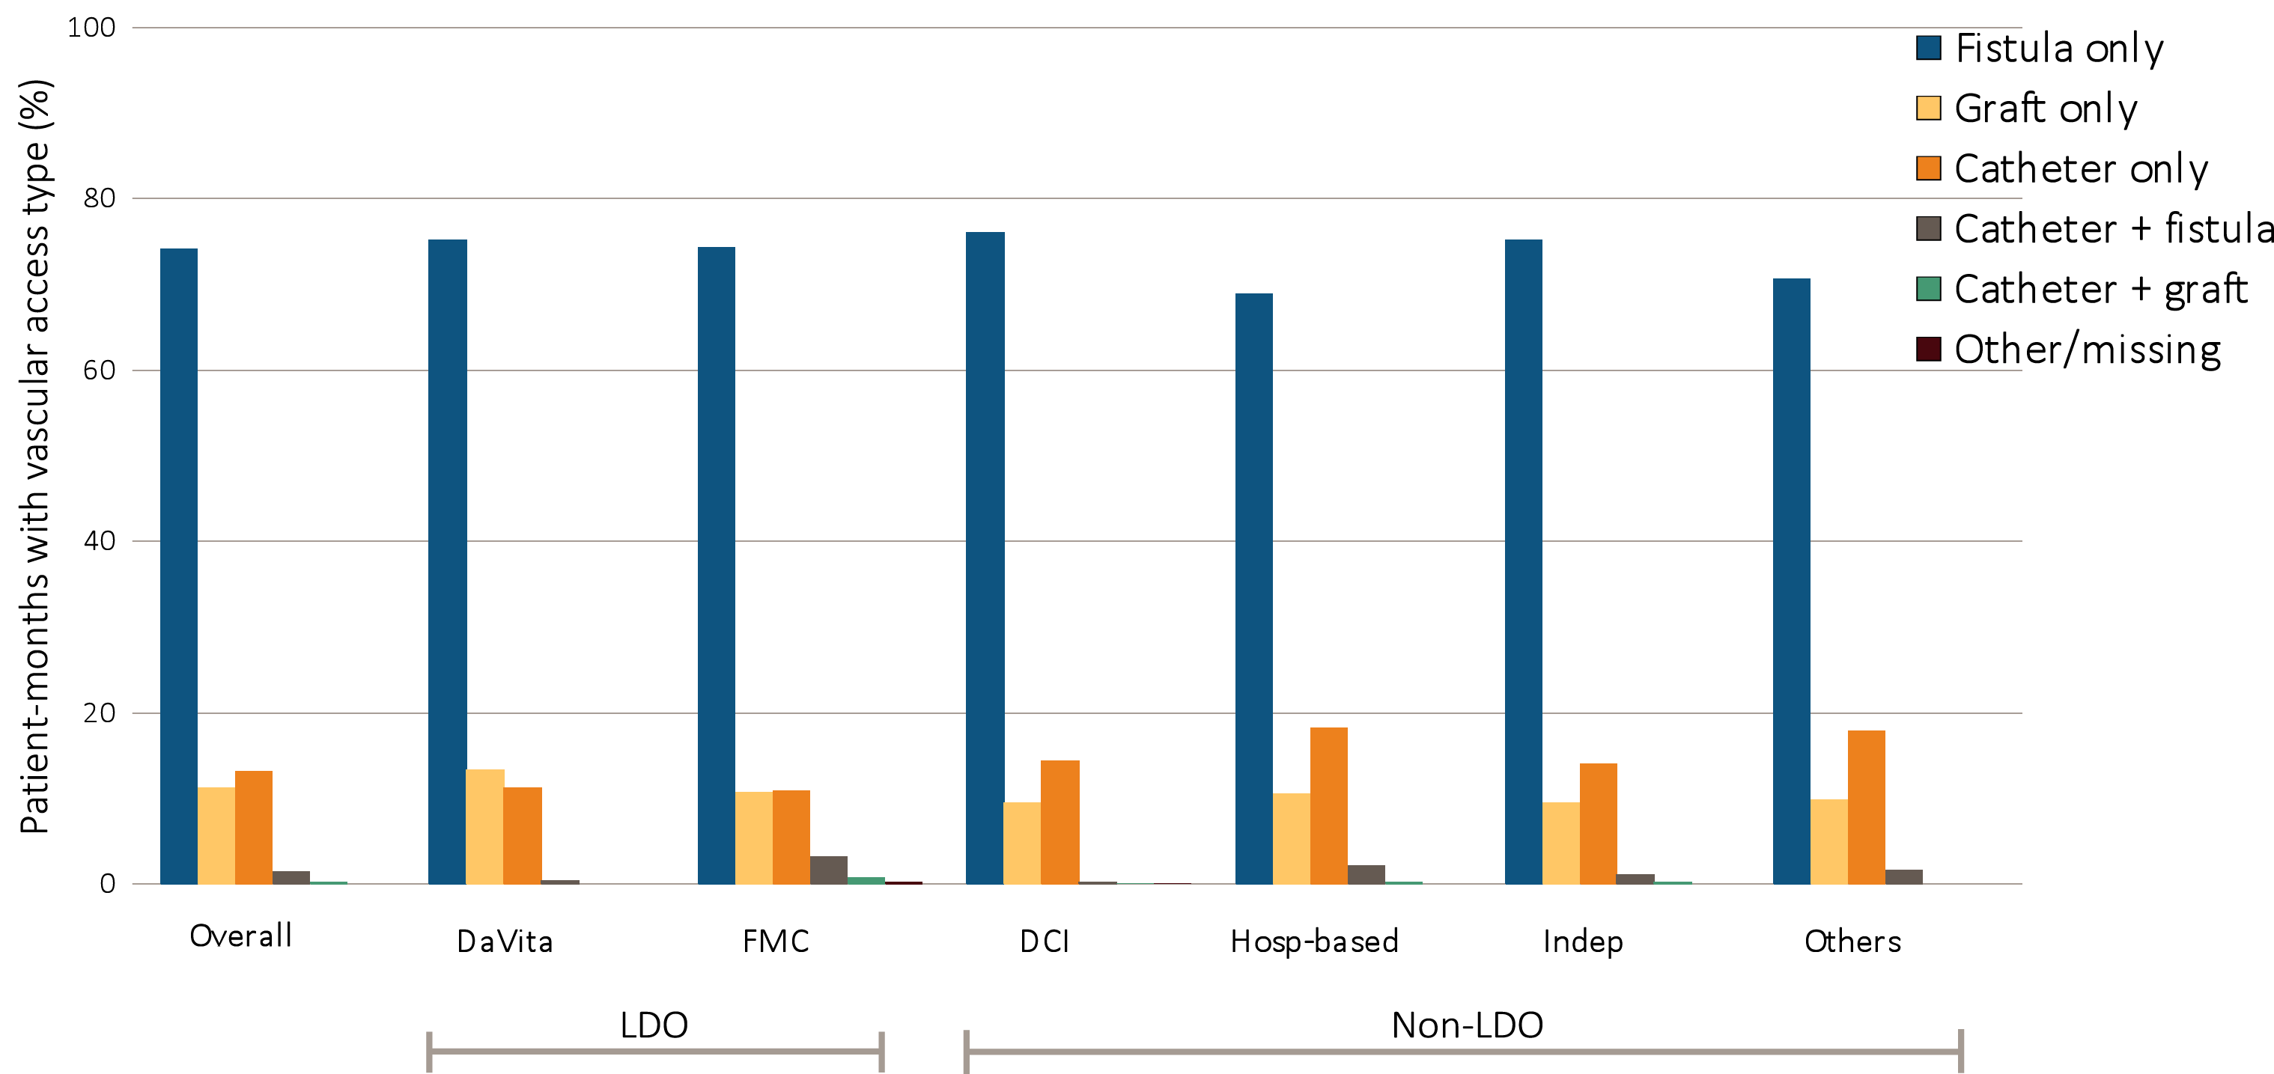
Figure 10.5 Prevalence of vascular access types among prevalent hemodialysis patients, by unit affiliation, 2014
^{(g) Native American patients}
Data source: Special analyses, USRDS ESRD Database. Period prevalent hemodialysis patients. Abbreviations: Hosp-based, hospital-based dialysis centers; Indep, independent dialysis providers; LDO, large dialysis organizations; Others, other dialysis organizations.

Slide 27
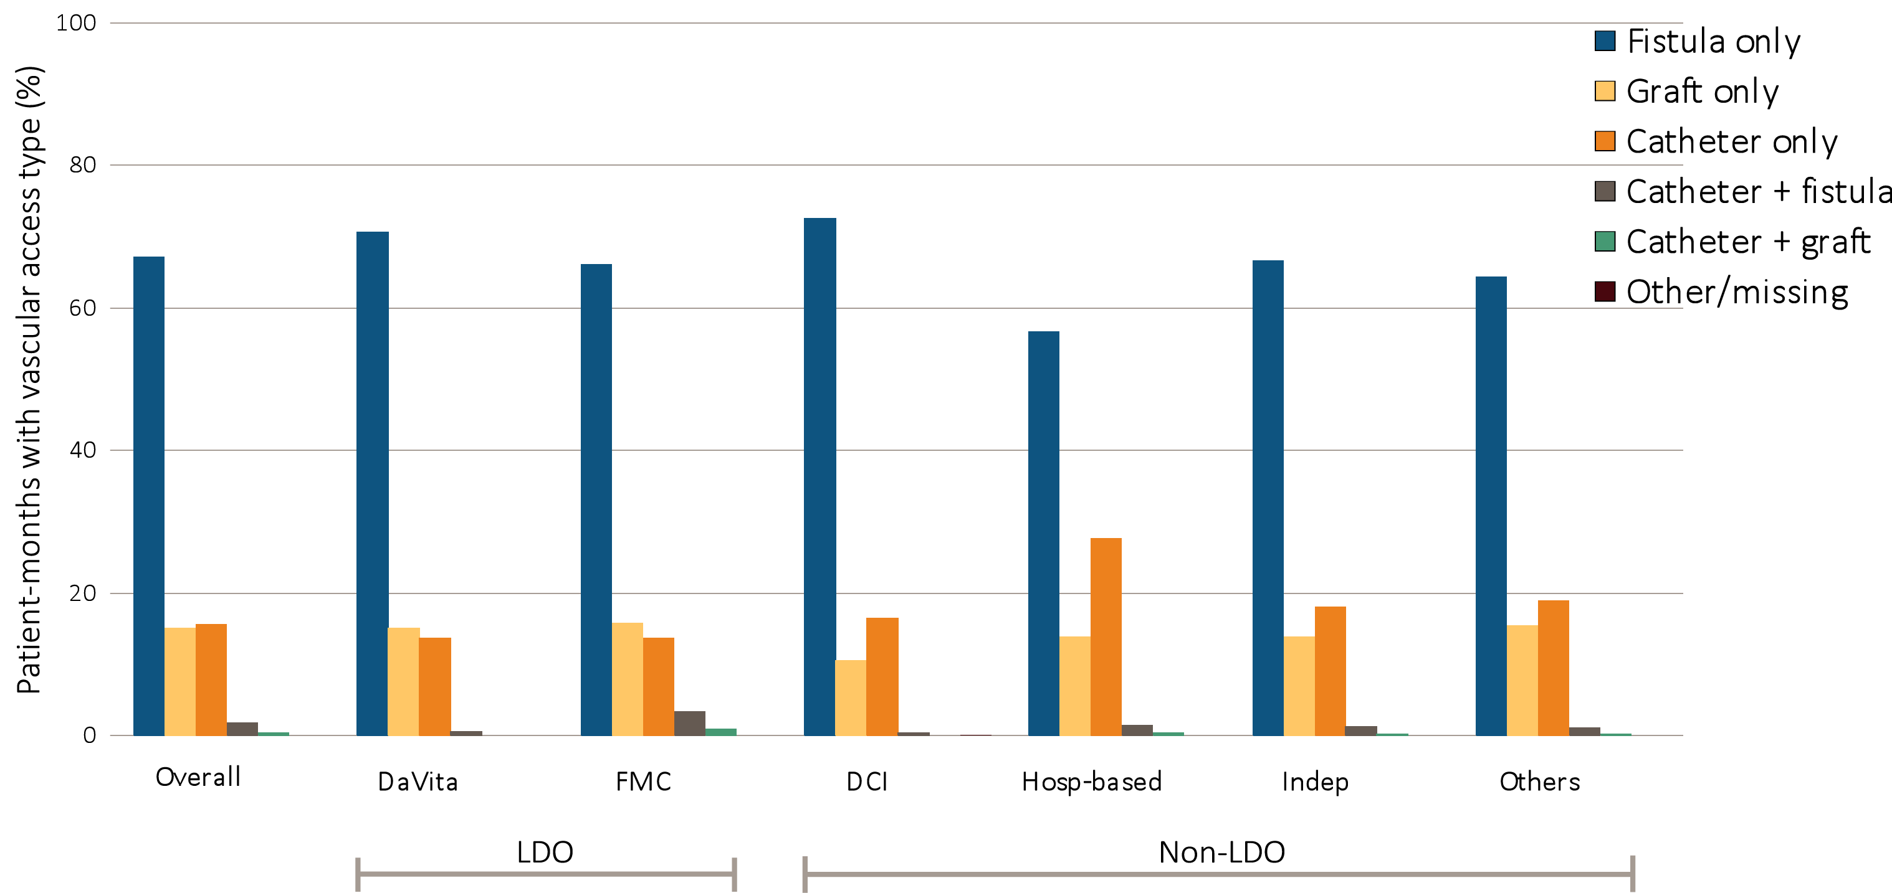
Figure 10.5 Prevalence of vascular access types among prevalent hemodialysis patients, by unit affiliation, 2014
^{(h) Hispanic patients}
Data source: Special analyses, USRDS ESRD Database. Period prevalent hemodialysis patients. Abbreviations: Hosp-based, hospital-based dialysis centers; Indep, independent dialysis providers; LDO, large dialysis organizations; Others, other dialysis organizations.

Slide 28
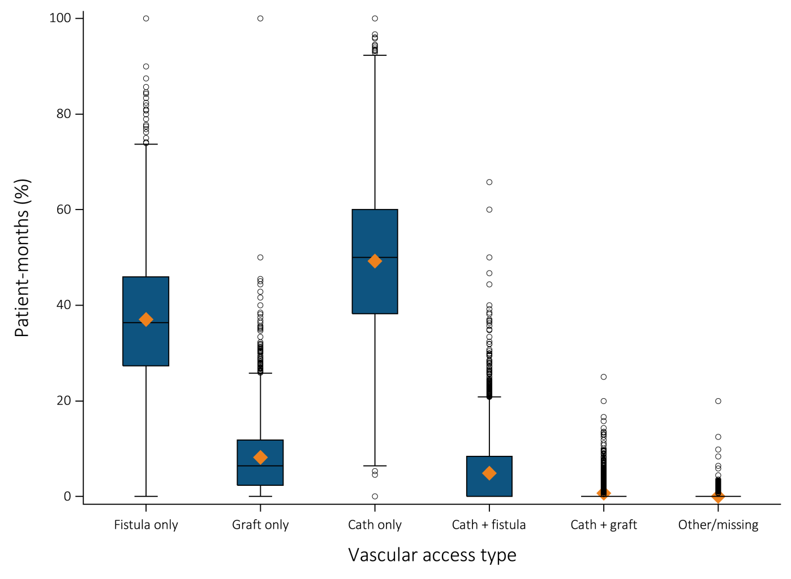
Figure 10.6 Facility-level distribution of vascular access type among HD patients during the first 30 days of dialysis, 2014
(a) Incident hemodialysis patients
Data source: Special analyses, USRDS ESRD Database. The orange diamonds represent the average facility-level rate of each type of vascular access. The bars within each box represent the median. The boxes represent the interquartile range. The vertical lines are capped at the 5th and 95th percentile of these facility-level rates. Abbreviation: Cath, catheter.

Slide 29
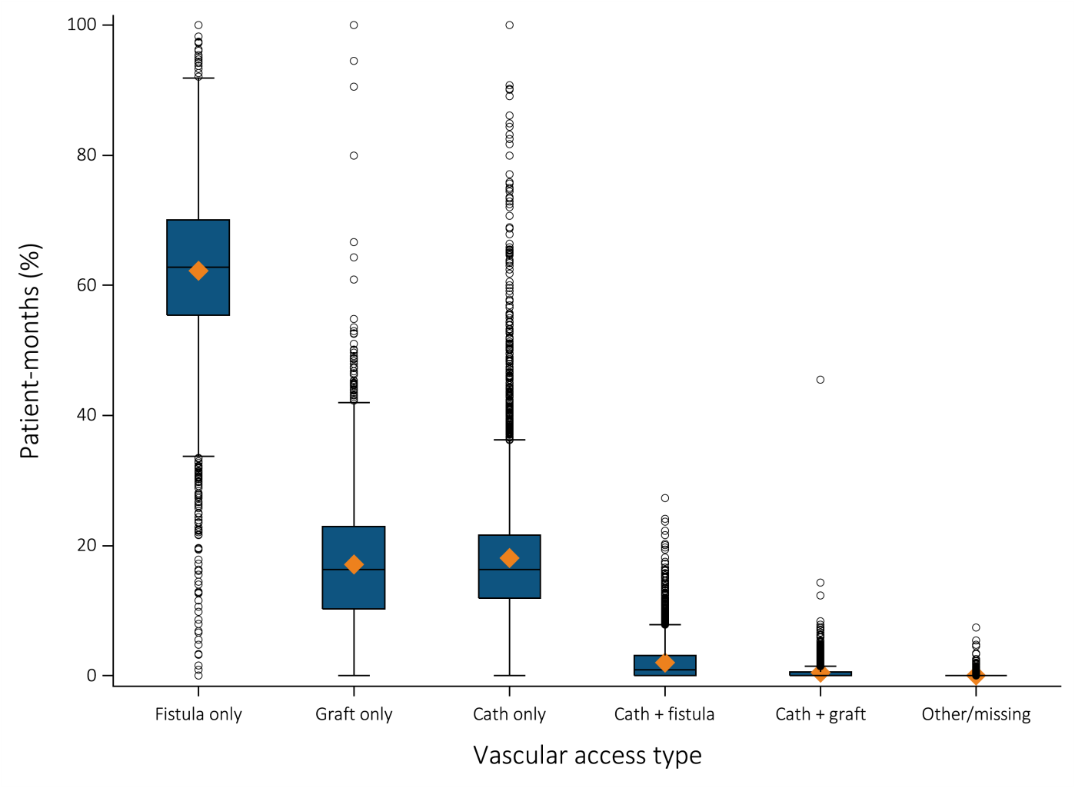
Figure 10.6 Facility-level distribution of vascular access type among HD patients during the first 30 days of dialysis, 2014
(b) Prevalent hemodialysis patients
Data source: Special analyses, USRDS ESRD Database. The orange diamonds represent the average facility-level rate of each type of vascular access. The bars within each box represent the median. The boxes represent the interquartile range. The vertical lines are capped at the 5th and 95th percentile of these facility-level rates. Abbreviation: Cath, catheter.

Slide 30
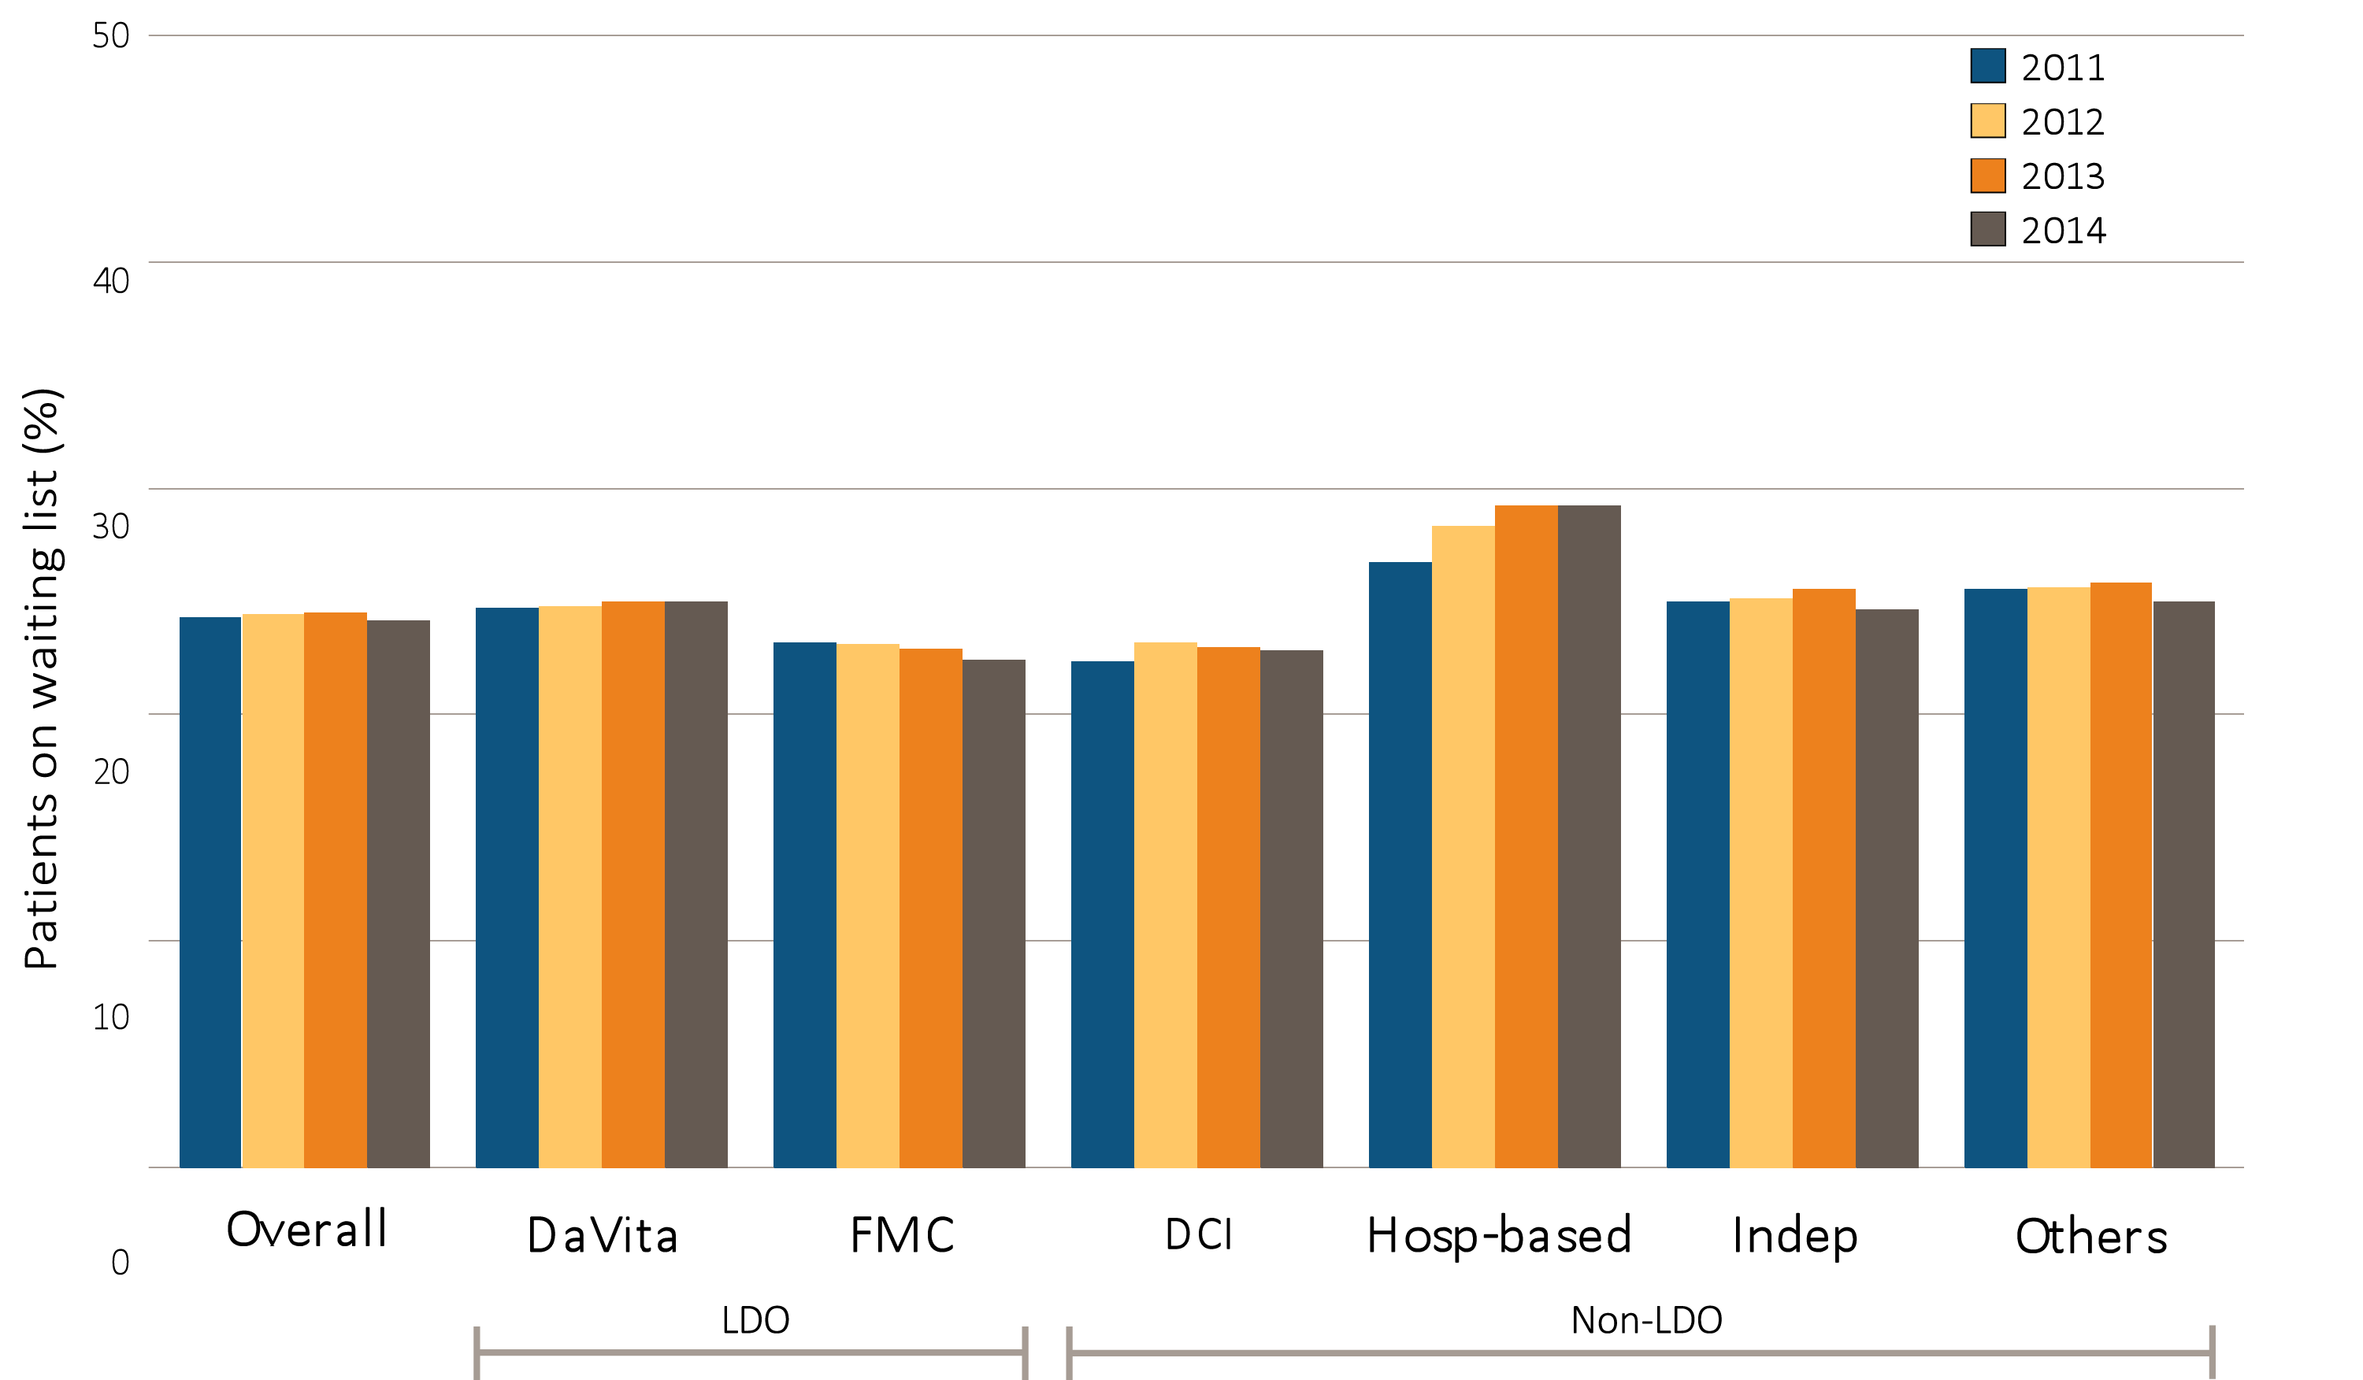
Figure 10.7 Percentage of patients younger than 70 on a kidney transplant waiting list, by unit affiliation, 2011–2014
^{(a) All patients}
Data source: Special analyses, USRDS ESRD Database. Dialysis patients younger than 70 years on December 31. Abbreviations: Hosp-based, hospital-based dialysis centers; Indep, independent dialysis providers; LDO, large dialysis organizations; Others, other dialysis organizations.

Slide 31
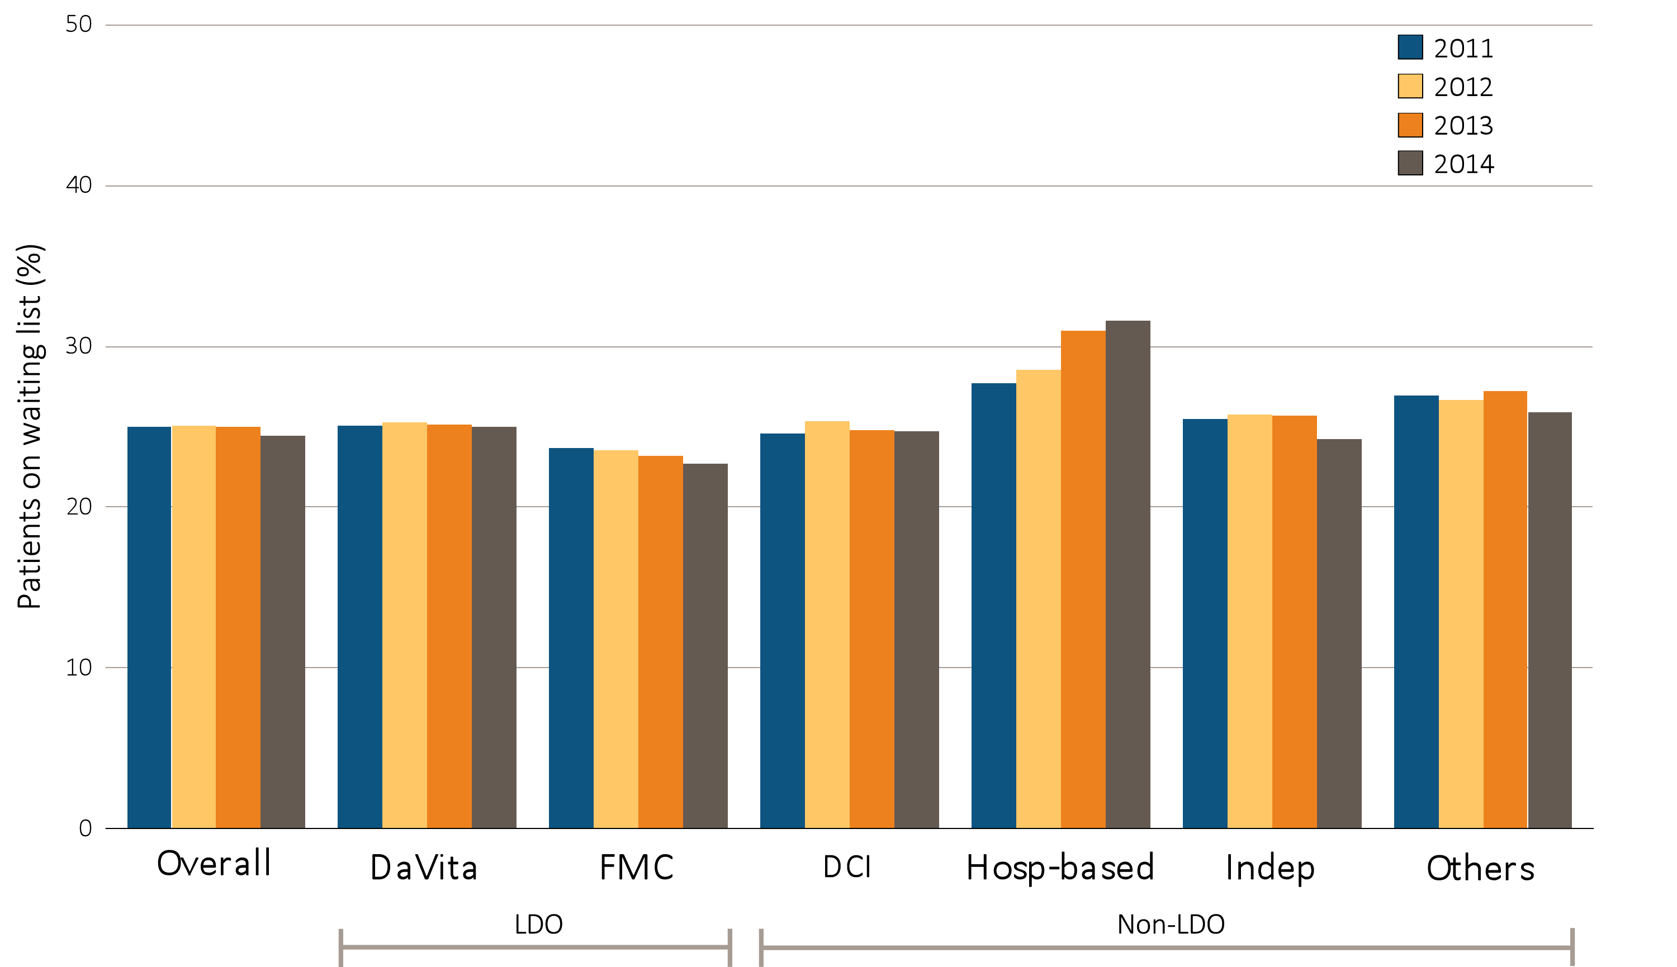
Figure 10.7 Percentage of patients younger than 70 on a kidney transplant waiting list, by unit affiliation, 2011–2014
^{(b) White patients}
Data source: Special analyses, USRDS ESRD Database. Dialysis patients younger than 70 years on December 31. Abbreviations: Hosp-based, hospital-based dialysis centers; Indep, independent dialysis providers; LDO, large dialysis organizations; Others, other dialysis organizations.

Slide 32
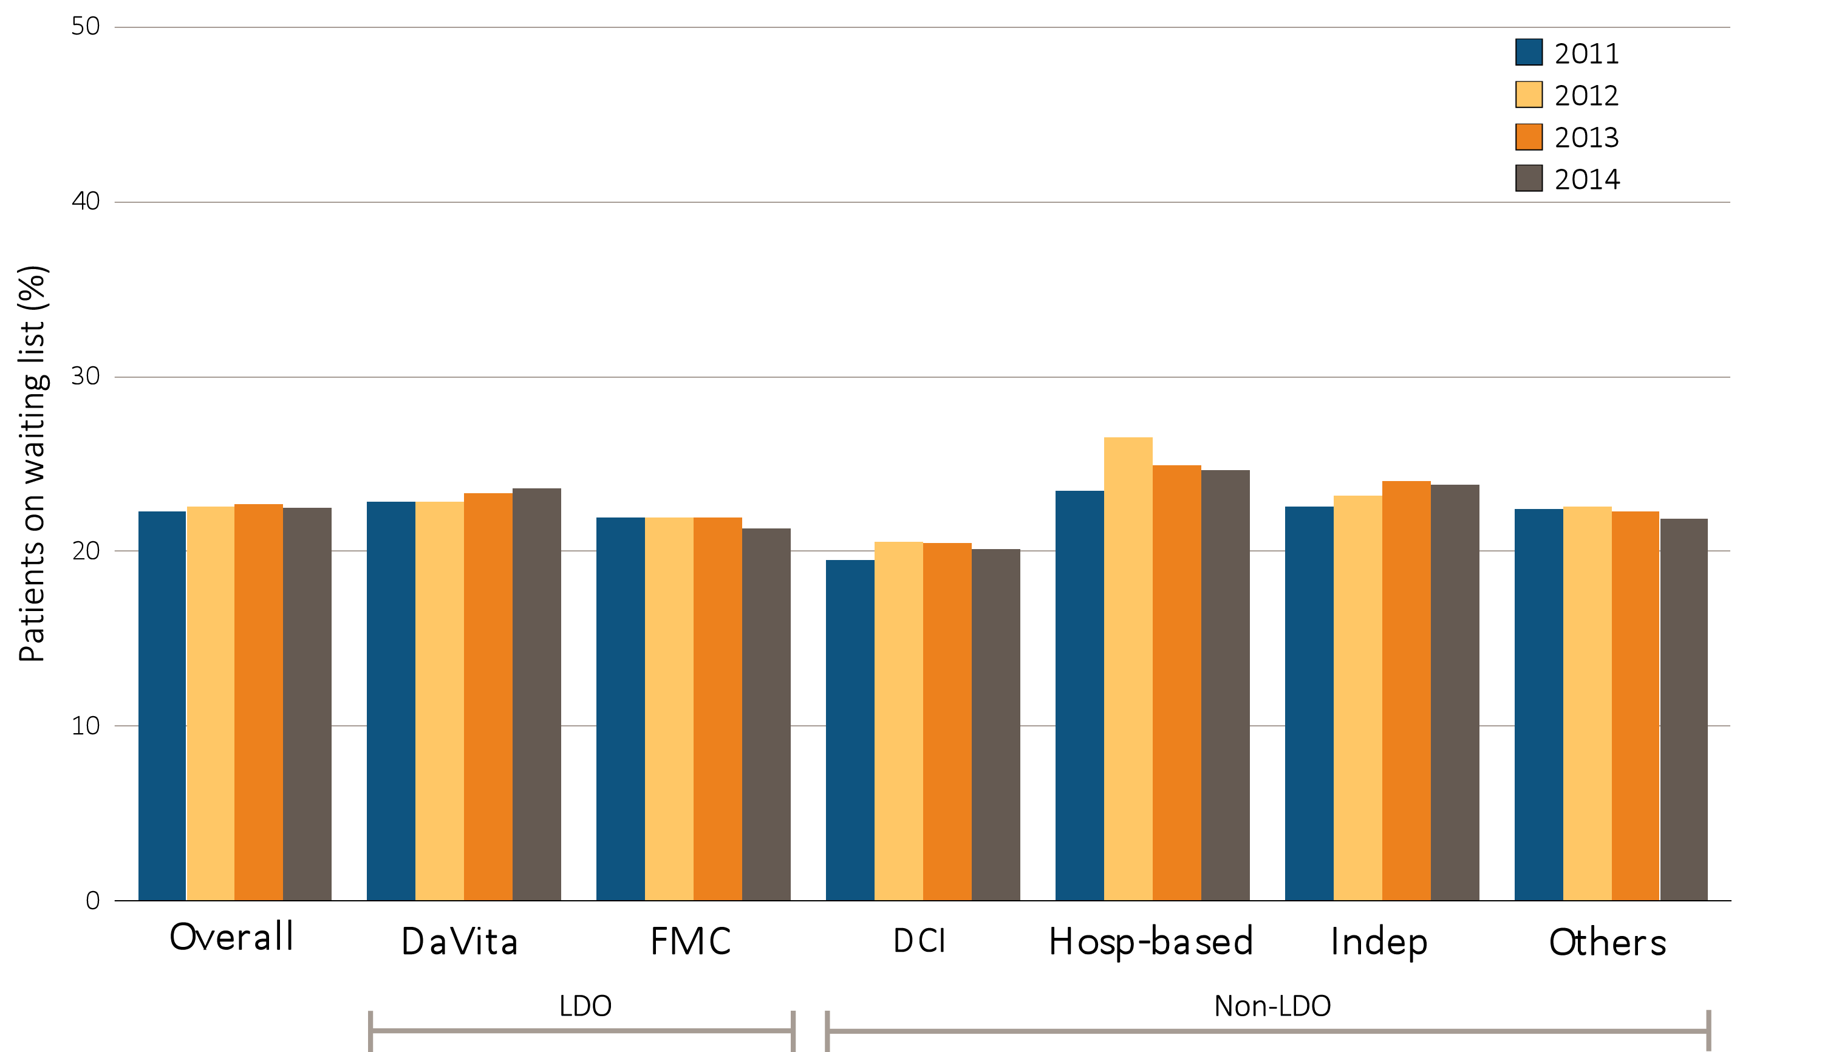
Figure 10.7 Percentage of patients younger than 70 on a kidney transplant waiting list, by unit affiliation, 2011–2014
^{(c) African American patients}
Data source: Special analyses, USRDS ESRD Database. Dialysis patients younger than 70 years on December 31. Abbreviations: Hosp-based, hospital-based dialysis centers; Indep, independent dialysis providers; LDO, large dialysis organizations; Others, other dialysis organizations.

Slide 33
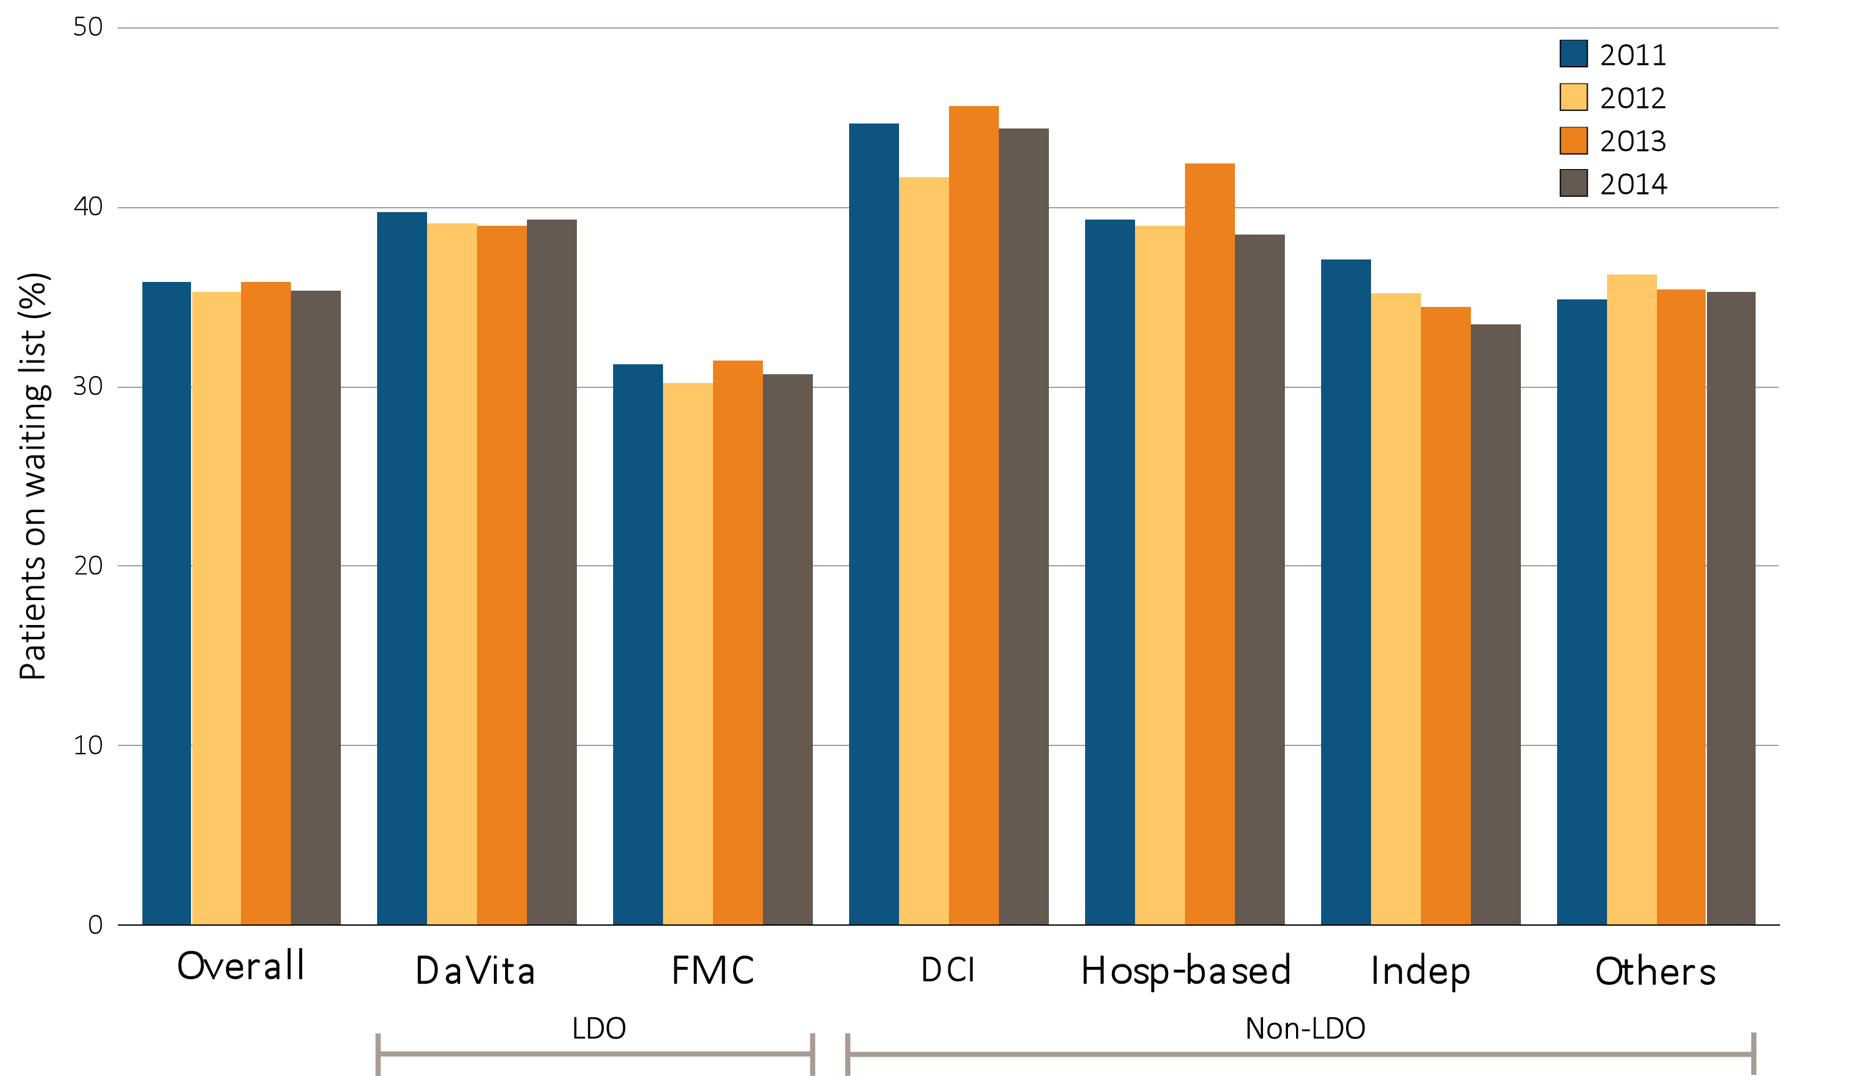
Figure 10.7 Percentage of patients younger than 70 on a kidney transplant waiting list, by unit affiliation, 2011–2014
^{(d) Asian patients}
Data source: Special analyses, USRDS ESRD Database. Dialysis patients younger than 70 years on December 31. Abbreviations: Hosp-based, hospital-based dialysis centers; Indep, independent dialysis providers; LDO, large dialysis organizations; Others, other dialysis organizations.

Slide 34
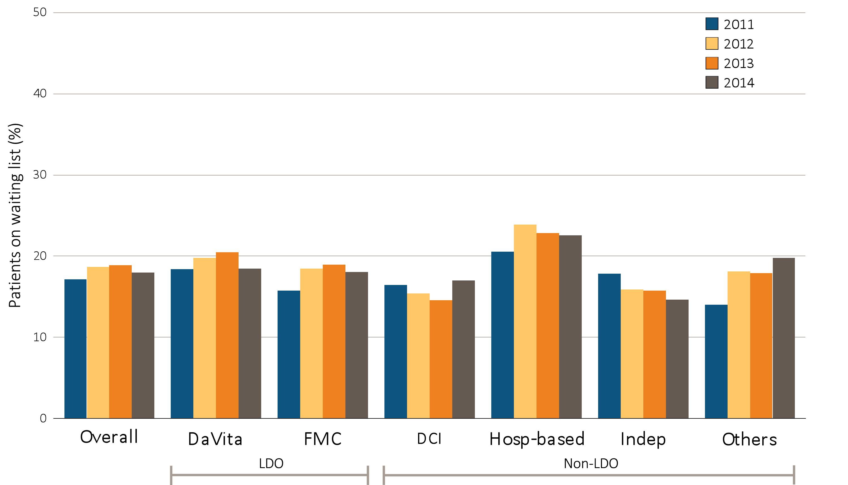
Figure 10.7 Percentage of patients younger than 70 on a kidney transplant waiting list, by unit affiliation, 2011–2014
^{(e) Native American patients}
Data source: Special analyses, USRDS ESRD Database. Dialysis patients younger than 70 years on December 31. Abbreviations: Hosp-based, hospital-based dialysis centers; Indep, independent dialysis providers; LDO, large dialysis organizations; Others, other dialysis organizations.

Slide 35
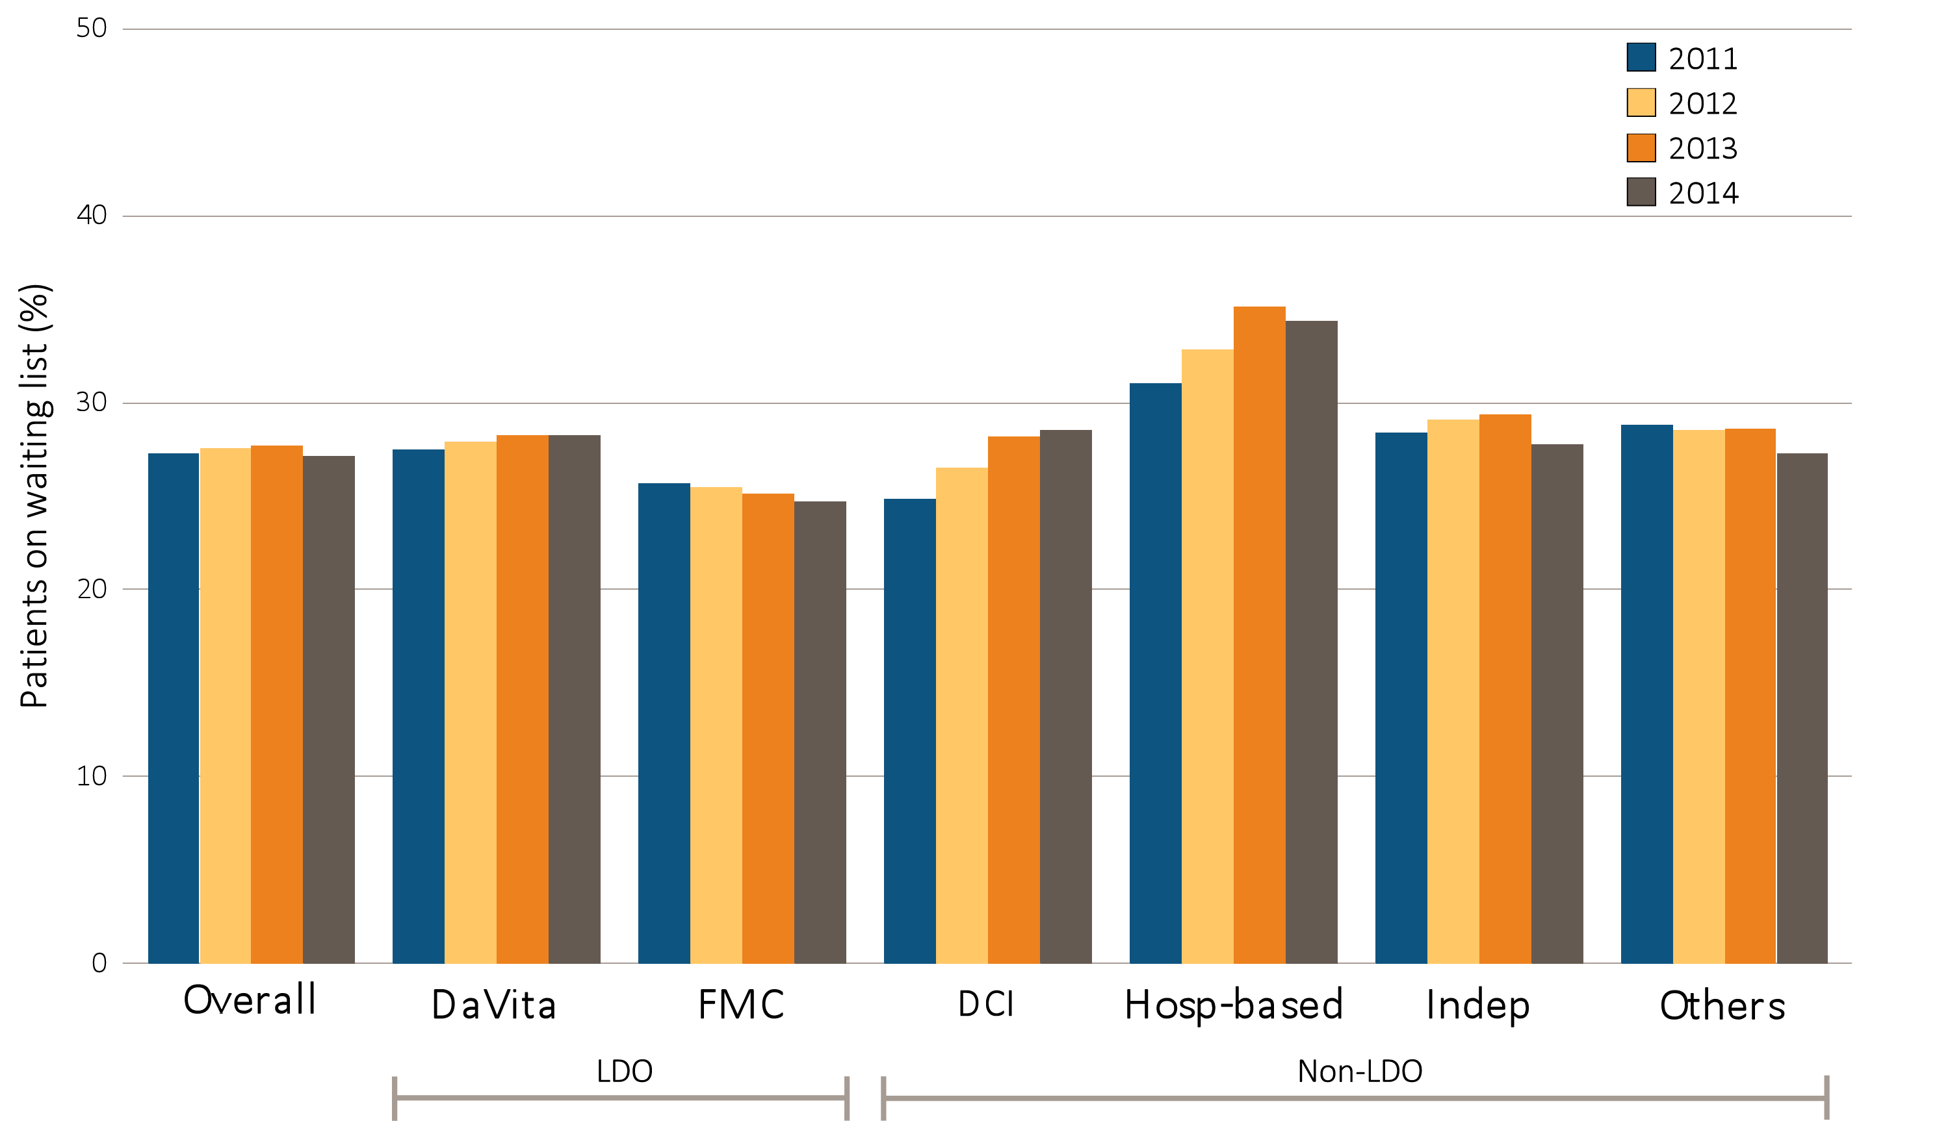
Figure 10.7 Percentage of patients younger than 70 on a kidney transplant waiting list, by unit affiliation, 2011–2014
^{(f) Hispanic patients}
Data source: Special analyses, USRDS ESRD Database. Dialysis patients younger than 70 years on December 31. Abbreviations: Hosp-based, hospital-based dialysis centers; Indep, independent dialysis providers; LDO, large dialysis organizations; Others, other dialysis organizations.

Slide 36
Table 10.1 All-cause Standardized Mortality Ratio, by unit affiliation, 2011–2014

Slide 37
Table 10.1 All-cause Standardized Mortality Ratio, by unit affiliation, 2011–2014
Data source: Special analyses, USRDS ESRD Database. Period prevalent dialysis patients; 95% confidence intervals are shown in parentheses. The overall measure is adjusted for patient age, race, ethnicity, sex, diabetes, duration of ESRD, nursing home status, patient comorbidities at incidence, body mass index (BMI) at incidence, and population death rates. The race-specific measures are adjusted for all the above characteristics except patient race. The Hispanic-specific measure is adjusted for all the above characteristics except patient ethnicity. Abbreviations: DCI, Dialysis Clinic, Inc.; LDO, large dialysis organizations; Others, other dialysis organizations.

Slide 38
Table 10.2 All-cause Standardized Mortality Ratio, by unit affiliation, 2014
Data source: Special analyses, USRDS ESRD Database. Period prevalent dialysis patients; 95% confidence intervals are shown in parentheses. The overall measure is adjusted for patient age, race, ethnicity, sex, diabetes, duration of ESRD, nursing home status, patient comorbidities at incidence, body mass index (BMI) at incidence, and population death rates. The race-specific measures are adjusted for all the above characteristics except patient race. The Hispanic-specific measure is adjusted for all the above characteristics except patient ethnicity. Abbreviations: DCI, Dialysis Clinic, Inc.; LDO, large dialysis organizations; Others, other dialysis organizations.

Slide 39
Table 10.3 All-cause Standardized Hospitalization Ratio, by unit affiliation, 2011–2014

Slide 40
Table 10.3 All-cause Standardized Hospitalization Ratio, by unit affiliation, 2011–2014
Data source: Special analyses, USRDS ESRD Database. Period prevalent dialysis patients; 95% confidence intervals are shown in parentheses. The overall measure is adjusted for patient age, race, ethnicity, sex, diabetes, duration of ESRD, nursing home status, patient comorbidities at incidence, body mass index (BMI) at incidence, and population death rates. The race-specific measures are adjusted for all the above characteristics except patient race. The Hispanic-specific measure is adjusted for all the above characteristics except patient ethnicity. Abbreviations: DCI, Dialysis Clinic, Inc.; LDO, large dialysis organizations; Others, other dialysis organizations.

Slide 41
Table 10.4 All-cause standardized hospitalization ratio, by unit affiliation, 2014
Data source: Special analyses, USRDS ESRD Database. Period prevalent dialysis patients; 95% confidence intervals are shown in parentheses. The overall measure is adjusted for patient age, race, ethnicity, sex, diabetes, duration of ESRD, nursing home status, patient comorbidities at incidence, body mass index (BMI) at incidence, and population death rates. The race-specific measures are adjusted for all the above characteristics except patient race. The Hispanic-specific measure is adjusted for all the above characteristics except patient ethnicity. Abbreviations: DCI, Dialysis Clinic, Inc.; LDO, large dialysis organizations; Others, other dialysis organizations.

