Slide 2
Table 12.1 Medicare Part D parameters for defined standard benefit, 2009 & 2014
 | 2009 | 2014
Deductible | $295.00 | $310.00
After the deductible is met, the beneficiary pays 25% of total prescription costs up to the initial coverage limit.
Initial coverage limit | $2,700.00 | $2,850.00
The coverage gap (“donut hole”) begins at this point.
The beneficiary pays 100% of their prescription costs up to the out-of-pocket threshold
Out-of-pocket threshold | $4,350.00 | $4,550.00
The total out-of-pocket costs including the “donut hole”
Total covered Part D prescription out-of-pocket spending | $6,153.75 | $6,455.00
(including the coverage gap). Catastrophic coverage begins after this point.
Catastrophic coverage benefit | $2.40 | ª$2.55
Generic/preferred multi-source drug | $6.00 | ª$6.35
Other drugs |  | ªplus a 52.50% brand name medication discount
2014 Example: | $295.00 | $310
$310 (deductible) | $601.25 | $635.00
+(($$2850-$310)*25%)(initial coverage) | $3,453.75 | $3,605.00
+(($6455-$2850)*100%)(coverage gap) | $4,350.00 | $4,550.00
Total | $4,350.00 | $4,550.00
(maximum out-of-pocket costs prior to catastrophic coverage, excluding plan premium)
a The catastrophic coverage amount is the greater of 5% of medication cost or the values shown in the chart above. In 2014, beneficiaries were charged $2.55 for those generic or preferred multisource drugs with a retail price less than $51 and 5% for those with a retail price over $51. For brand name drugs, beneficiaries paid $6.35 for those drugs with a retail price less than $127 and 5% for those with a retail price over $127. Table adapted from http://www.q1medicare.com/PartD-The-2014-Medicare-Part-D-Outlook.php.

Slide 3
Table 12.2 General Medicare & ESRD patients enrolled in Part D (%)
 | General Medicare | All ESRD | Hemodialysis | Peritoneal dialysis | Transplant
2011 | 60 | 70 | 74 | 62 | 59
2012 | 62 | 72 | 76 | 64 | 62
2013 | 67 | 75 | 79 | 67 | 66
2014 | 69 | 77 | 80 | 69 | 68
Data source: 2011-2014 Medicare data, point prevalent Medicare enrollees alive on January 1. Medicare data: general Medicare, 5% Medicare sample (ESRD, hemodialysis, peritoneal dialysis, and transplant, 100% ESRD population). Abbreviations: ESRD, end-stage renal disease; Part D, Medicare Part D prescription drug coverage.

Slide 4
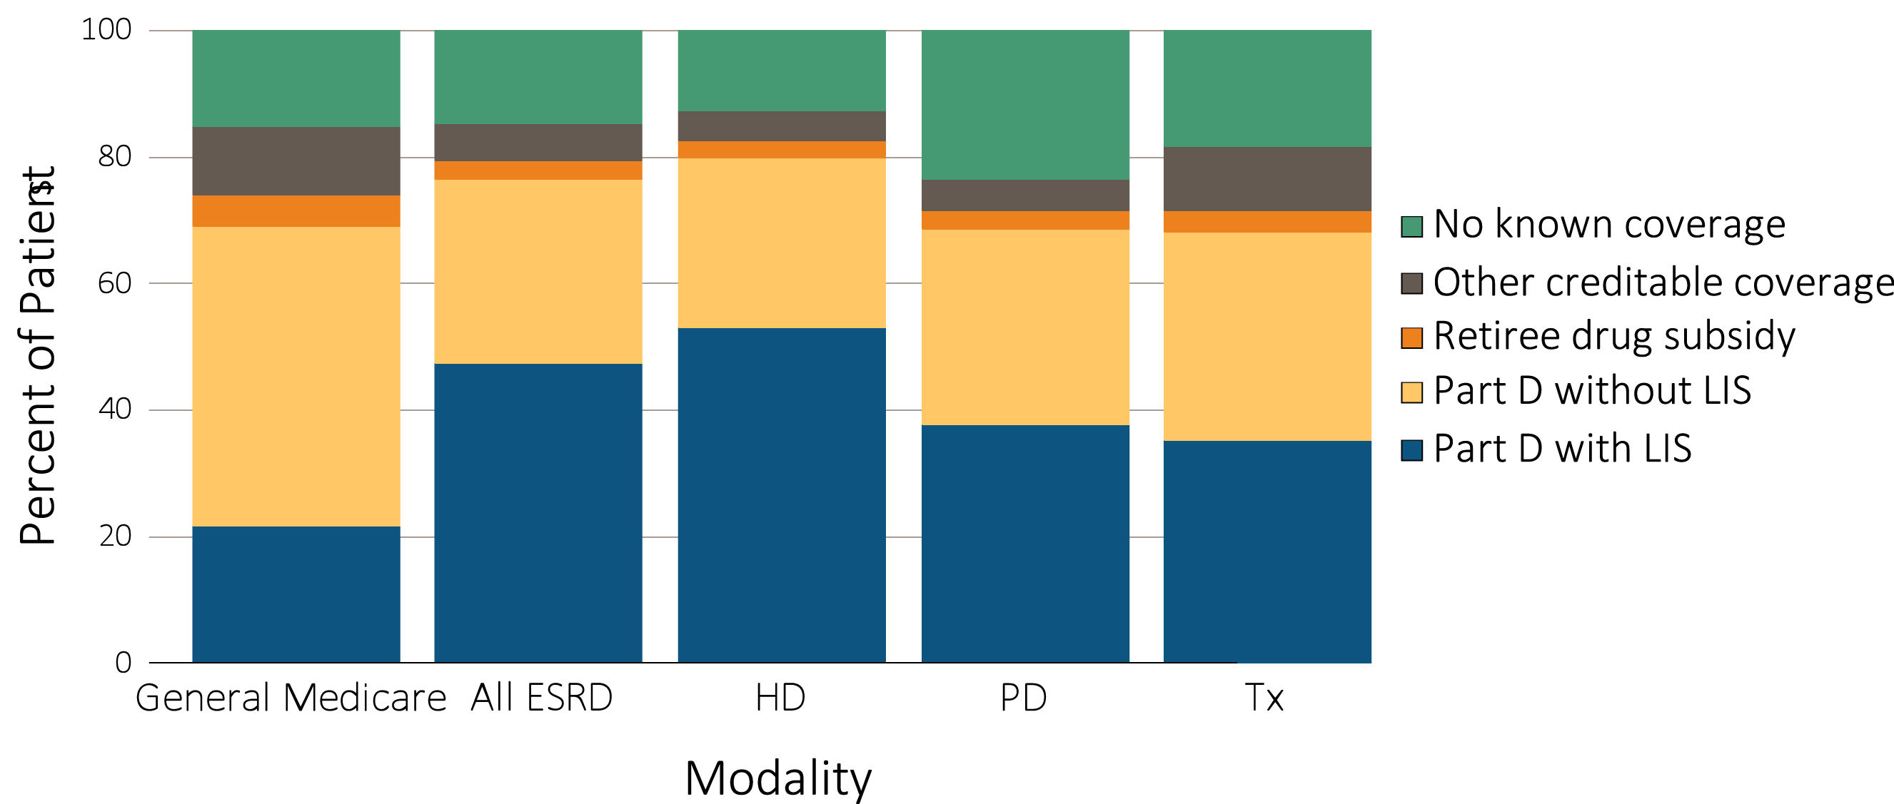
Figure 12.1 Sources of prescription drug coverage in Medicare ESRD enrollees, by population, 2014
Data source: 2014 Medicare Data, point prevalent Medicare enrollees alive on January 1, 2014. Abbreviations: ESRD, end-stage renal disease; HD, hemodialysis; LIS, Low-income Subsidy; Part D, Medicare Part D prescription drug coverage; PD, peritoneal dialysis; Tx, kidney transplant..

Slide 5
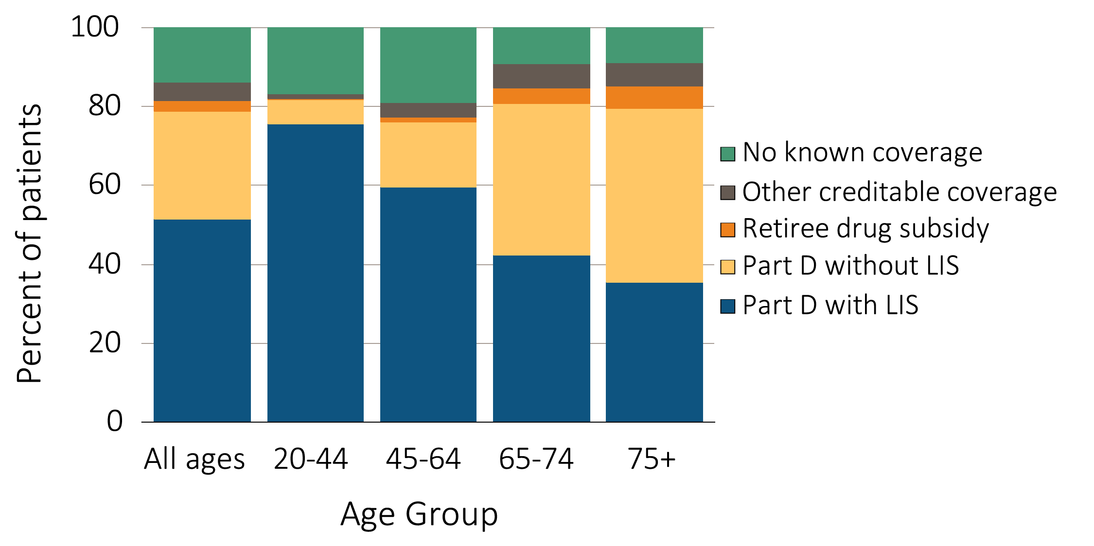
Figure 12.2 Sources of prescription drug coverage in Medicare ESRD enrollees, by age & modality, 2014
^{(a) Dialysis patients}
Data source: 2014 Medicare Data, point prevalent Medicare enrollees alive on January 1, 2014. Abbreviations: ESRD, end-stage renal disease; LIS, Low-income Subsidy; Part D, Medicare Part D prescription drug coverage.

Slide 6
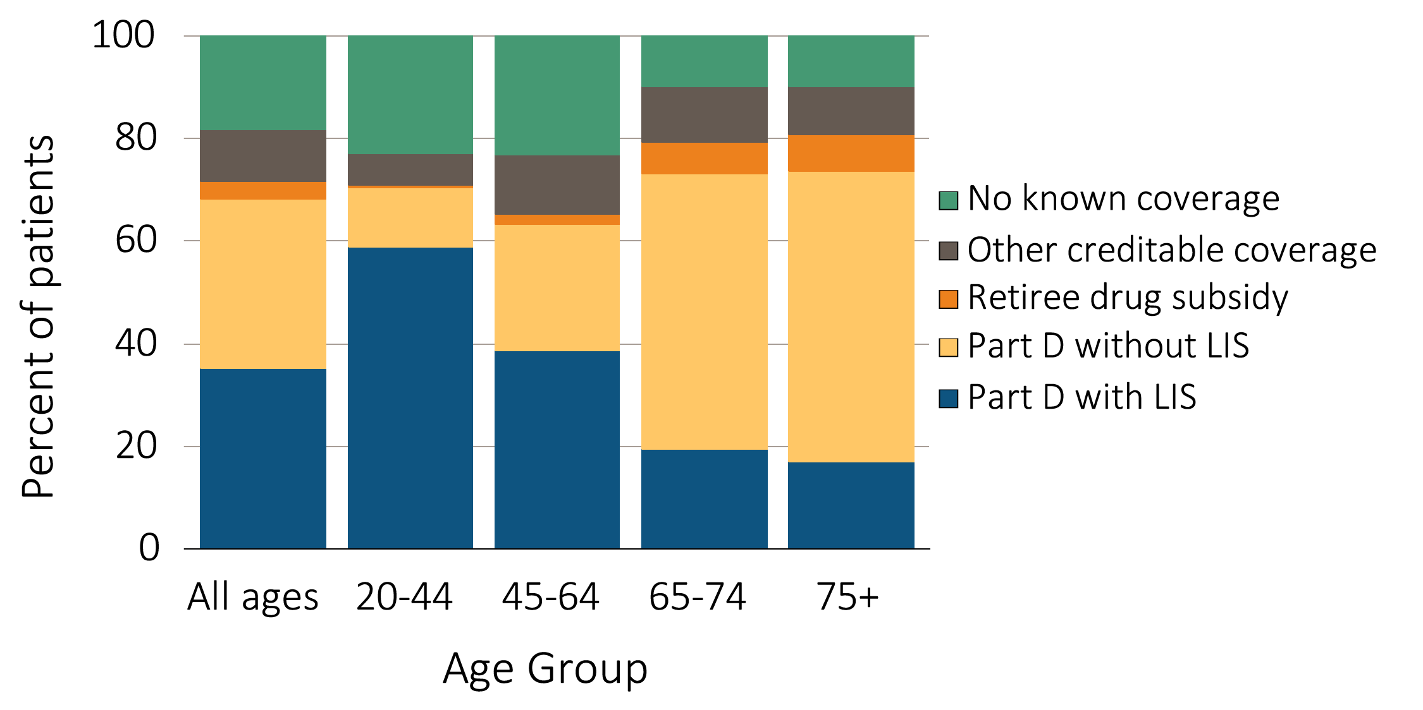
Figure 12.2 Sources of prescription drug coverage in Medicare ESRD enrollees, by age & modality, 2014
^{(b) Transplant patients}
Data source: 2014 Medicare Data, point prevalent Medicare enrollees alive on January 1, 2014. Abbreviations: ESRD, end-stage renal disease; LIS, Low-income Subsidy; Part D, Medicare Part D prescription drug coverage..

Slide 7
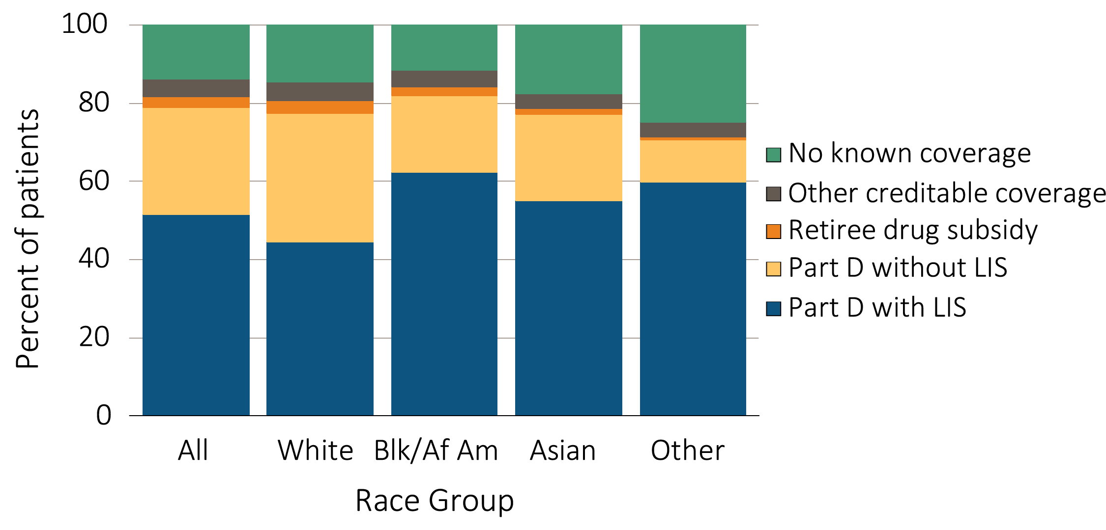
Figure 12.3 Sources of prescription drug coverage in Medicare ESRD enrollees, by race/ethnicity & modality, 2014
^{(a) Dialysis patients}
Data source: 2014 Medicare Data, point prevalent Medicare enrollees alive on January 1, 2014. Abbreviations: Blk/Af Am, Black or African American; ESRD, end-stage renal disease; LIS, Low-income Subsidy; Part D, Medicare Part D prescription drug coverage.

Slide 8
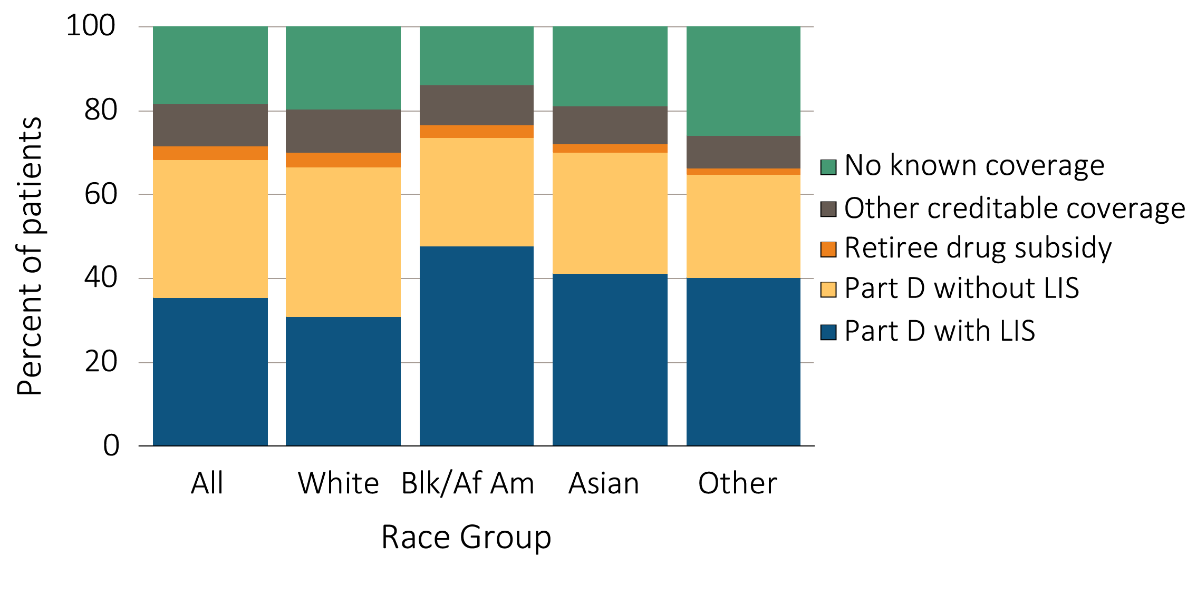
Figure 12.3 Sources of prescription drug coverage in Medicare ESRD enrollees, by race/ethnicity & modality, 2014
^{(b) Transplant patients}
Data source: 2014 Medicare Data, point prevalent Medicare enrollees alive on January 1, 2014. Abbreviations: Blk/Af Am, Black or African American; ESRD, end-stage renal disease; LIS, Low-income Subsidy; Part D, Medicare Part D prescription drug coverage.

Slide 9
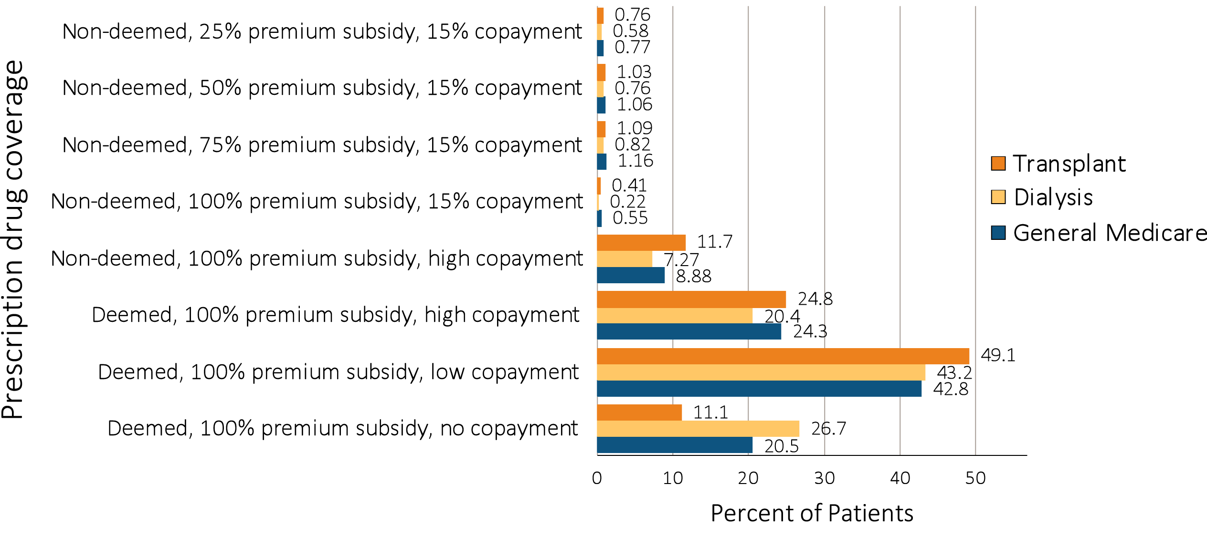
Figure 12.4 Distribution of Low-income Subsidy categories in Part D general Medicare & ESRD patients, 2014
Data source: 2014 Medicare data, point prevalent Medicare enrollees alive on January 1, 2014. Abbreviations: ESRD, end-stage renal disease; Part D, Medicare Part D prescription drug coverage..

Slide 10
Table 12.3 Medicare Part D enrollees (%) with the Low-income Subsidy, by age & race, 2014
 | General Medicare |  | All ESRD |  | Hemodialysis |  | Peritoneal dialysis |  | Transplant
White
All ages | 24.7 |  | 54.4 |  | 58.8 |  | 48.1 |  | 46.4
20-44 | 88.2 |  | 88.1 |  | 91.6 |  | 88.3 |  | 82.3
45-64 | 51.7 |  | 70.3 |  | 76.1 |  | 64.4 |  | 57.1
65-74 | 14.7 |  | 39.7 |  | 48.6 |  | 24.7 |  | 21.3
75+ | 19.0 |  | 34.1 |  | 37.5 |  | 17.5 |  | 18.0
Black/African American
All ages | 57.9 |  | 74.4 |  | 76.3 |  | 71.2 |  | 64.9
20-44 | 92.8 |  | 92.3 |  | 94.3 |  | 90.3 |  | 85.9
45-64 | 74.5 |  | 80.4 |  | 82.8 |  | 74.6 |  | 69.2
65-74 | 42.2 |  | 59.5 |  | 63.7 |  | 40.6 |  | 40.3
75+ | 49.7 |  | 59.5 |  | 61.2 |  | 36.1 |  | 39.1
Asian
All ages | 64.1 |  | 68.7 |  | 73.2 |  | 57.1 |  | 58.8
20-44 | 89.8 |  | 87.0 |  | 89.5 |  | 83.7 |  | 83.1
45-64 | 65.4 |  | 73.5 |  | 78.3 |  | 58.9 |  | 66.0
65-74 | 55.5 |  | 58.3 |  | 65.2 |  | 40.6 |  | 45.3
75+ | 71.3 |  | 66.9 |  | 70.7 |  | 54.0 |  | 41.2
Other race
All ages | 37.8 |  | 78.6 |  | 85.3 |  | 78.8 |  | 62.2
20-44 | 88.5 |  | 91.2 |  | 95.9 |  | 96.5 |  | 76.4
45-64 | 56.3 |  | 83.2 |  | 89.0 |  | 82.8 |  | 67.9
65-74 | 25.9 |  | 67.9 |  | 77.2 |  | 54.0 |  | 48.8
75+ | 38.1 |  | 66.5 |  | 75.0 |  | 37.5 |  | 40.4
Data source: 2014 Medicare data, point prevalent Medicare enrollees alive on January 1, 2014. Abbreviations: ESRD, end-stage renal disease; LIS, Low-income Subsidy; Part D, Medicare Part D prescription drug coverage.

Slide 11
Table 12.4 Total estimated Medicare Part D spending for enrollees, in billions, 2011-2014
 | General Medicare | All ESRD | Hemodialysis | Peritoneal dialysis | Transplant
2011 | 45.96 | 1.64 | 1.29 | 0.09 | 0.21
2012 | 40.08 | 2.00 | 1.59 | 0.12 | 0.23
2013 | 52.08 | 2.27 | 1.79 | 0.14 | 0.27
2014 | 58.07 | 2.71 | 2.10 | 0.17 | 0.35
Data source: 2011-2014 Medicare data, period prevalent Medicare enrollees alive on January 1, excluding those in Medicare Advantage Part D plans and Medicare secondary payer, using as-treated model (see ESRD Methods chapter for analytical methods). Part D spending represents the sum of the Medicare covered amount and the Low- income Subsidy amount.

Slide 12
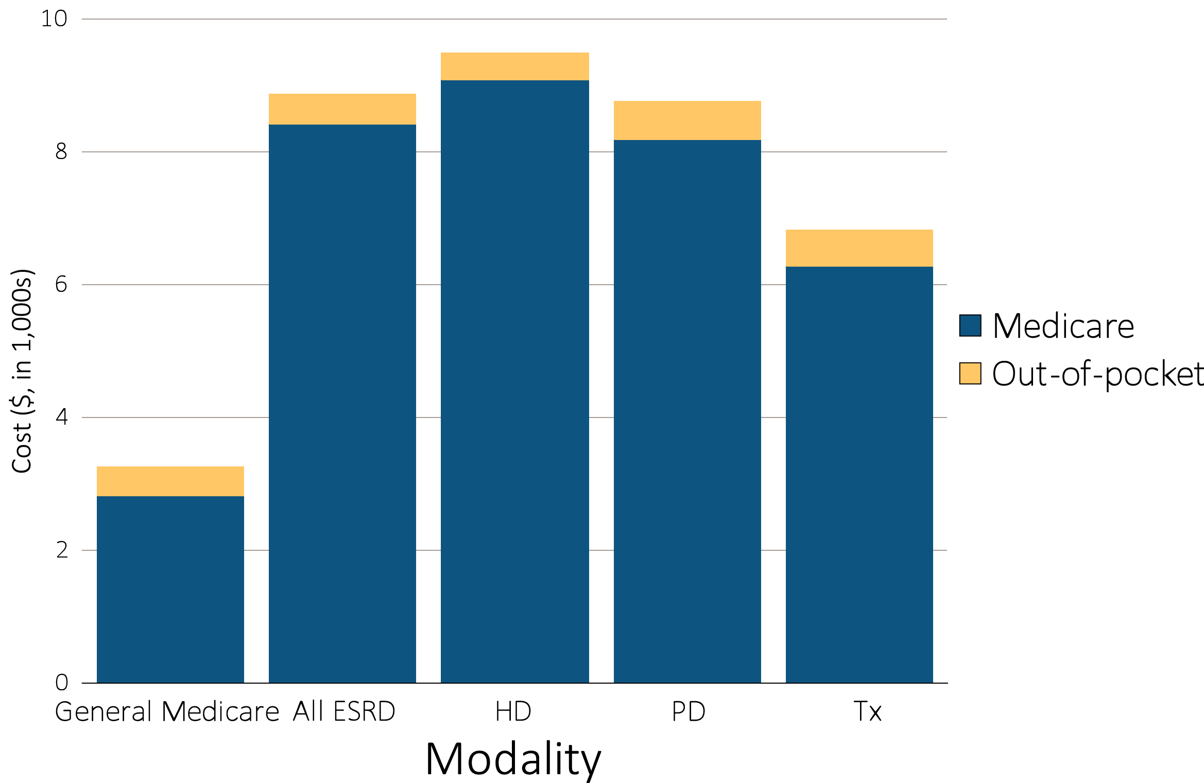
Figure 12.5 Per person per year Medicare Part D spending & out-of-pocket costs for enrollees, 2014
^{(a) All Part D enrollees}
Data source: 2014 Medicare data, period prevalent Medicare enrollees alive on January 1, 2014, excluding those in Medicare Advantage Part D plans and Medicare secondary payer, using as-treated model (see ESRD Methods chapter for analytical methods). Part D spending represents the sum of the Medicare covered amount and the Low- income Subsidy amount.

Slide 13
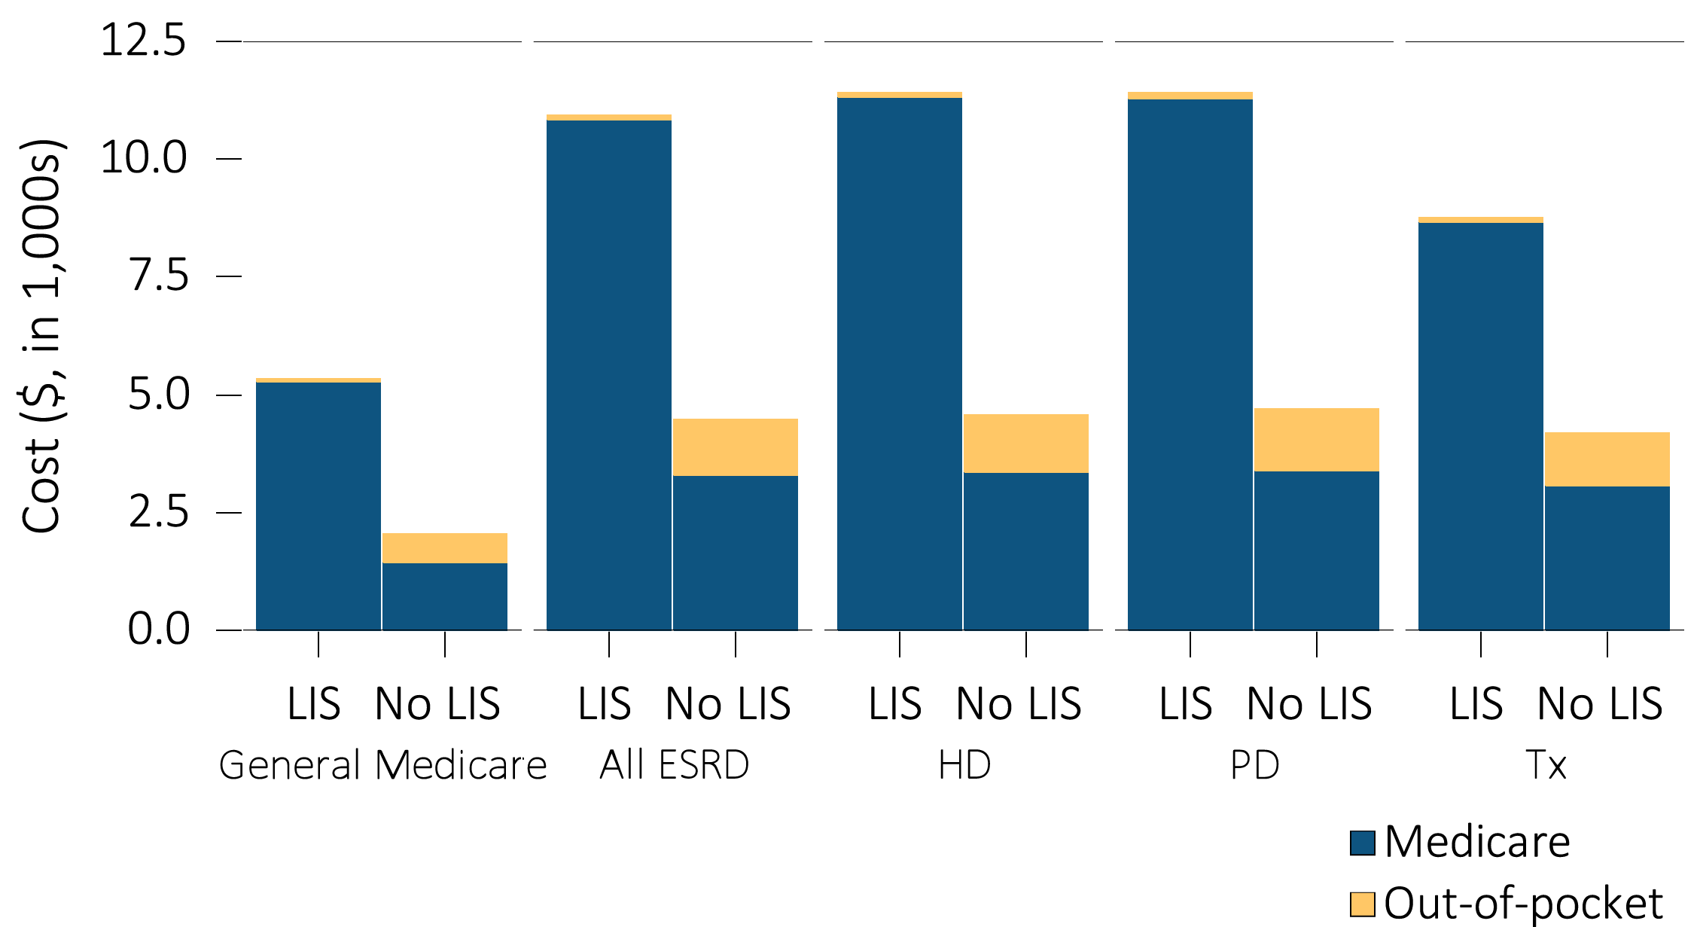
Figure 12.5 Per person per year Medicare Part D spending & out-of-pocket costs for enrollees, 2014
(b) Part D enrollees by Low-income Subsidy status
Data source: 2014 Medicare data, period prevalent Medicare enrollees alive on January 1, 2014, excluding those in Medicare Advantage Part D plans and Medicare secondary payer, using as-treated model (see ESRD Methods chapter for analytical methods). Part D spending represents the sum of the Medicare covered amount and the Low- income Subsidy amount.

Slide 14
Table 12.5 Per person per year Part D spending ($) for enrollees, by Low-income Subsidy status, 2014
 | General Medicare |  |  | All ESRD |  |  | Hemodialysis |  |  | Peritoneal dialysis |  |  | Transplant
 | Part D with LIS | Part D without LIS |  | Part D with LIS | Part D without LIS |  | Part D with LIS | Part D without LIS |  | Part D with LIS | Part D without LIS |  | Part D with LIS | Part D without LIS
Age
All | 5,265 | 1,437 |  | 10,826 | 3,286 |  | 11,323 | 3,358 |  | 11,287 | 3,402 |  | 8,655 | 3,080
20-44 | 5,341 | 2,104 |  | 11,386 | 2,640 |  | 12,908 | 3,464 |  | 11,564 | 2,780 |  | 6,902 | 1,551
45-64 | 6,861 | 2,163 |  | 11,783 | 3,859 |  | 12,310 | 4,075 |  | 11,595 | 3,727 |  | 9,529 | 3,272
65-74 | 4,457 | 1,371 |  | 9,728 | 3,474 |  | 9,957 | 3,560 |  | 9,434 | 3,577 |  | 9,016 | 3,274
75+ | 4,026 | 1,331 |  | 7,826 | 2,643 |  | 8,075 | 2,653 |  | 7,021 | 2,877 |  | 6,905 | 2,632
Sex
Male | 5,283 | 1,542 |  | 10,925 | 3,349 |  | 11,411 | 3,361 |  | 11,608 | 3,420 |  | 8,853 | 3,291
Female | 5,253 | 1,358 |  | 10,718 | 3,190 |  | 11,228 | 3,354 |  | 10,987 | 3,373 |  | 8,394 | 2,753
Race
White | 5,461 | 1,436 |  | 10,510 | 3,318 |  | 11,056 | 3,405 |  | 11,416 | 3,487 |  | 8,499 | 3,084
Black/African American | 5,133 | 1,512 |  | 11,325 | 3,167 |  | 11,745 | 3,204 |  | 10,875 | 2,914 |  | 8,884 | 3,105
Asian | 4,523 | 1,220 |  | 11,105 | 3,369 |  | 11,523 | 3,537 |  | 12,539 | 3,523 |  | 9,086 | 2,996
Other race | 4,617 | 1,365 |  | 7,956 | 3,319 |  | 7,713 | 3,764 |  | 10,034 | 3,699 |  | 8,381 | 2,765
Data source: 2014 Medicare data, period prevalent Medicare enrollees alive on January 1, 2014, excluding those in Medicare Advantage Part D plans and Medicare secondary payer, using as-treated model (see ESRD Methods chapter for analytical methods). Part D spending represents the sum of the Medicare covered amount and the Low- income Subsidy amount.

Slide 15
Table 12.6 Top 15 drug classes received by Part D-enrolled dialysis patients, by percent of patients, 2014
Rank | Drug class | Percent of patients
1 | Phosphate-binding Agents | 72%
2 | β-Adrenergic Blocking Agents | 66%
3 | Opiate Agonists | 54%
4 | HMG-CoA Reductase Inhibitors | 47%
5 | Dihydropyridines | 46%
6 | Proton-pump Inhibitors | 42%
7 | Insulins | 32%
8 | Cinacalcet | 30%
9 | Antidepressants | 30%
10 | Anticonvulsants | 27%
11 | Angiotensin-Converting Enzyme Inhibitors | 27%
12 | Direct Vasodilators | 24%
13 | Quinolones | 22%
14 | Central α-Agonists | 19%
15 | Platelet-aggregation Inhibitors | 18%
Data source: Medicare Part D claims. Dialysis patients with Medicare Part D stand-alone prescription drug plans in the Medicare 5% sample.

Slide 16
Table 12.7 Top 15 drug classes received by Part D-enrolled dialysis patients, by spending, 2014
Rank | Drug class | Medicare Part D spending ($ in millions) | Percent of total Medicare Part D spending
1 | Phosphate-binding Agents | $840.53 | 37.0%
2 | Cinacalcet | $479.86 | 21.1%
3 | Insulins | $160.58 | 7.1%
4 | HIV Antiretrovirals | $72.73 | 3.2%
5 | Nucleosides and Nucleotides | $60.02 | 2.6%
6 | Antineoplastic Agents | $52.79 | 2.3%
7 | Proton-pump Inhibitors | $41.02 | 1.8%
8 | HCV antivirals | $37.50 | 1.7%
9 | Opiate Agonists | $30.54 | 1.3%
10 | Vasodilating Agents | $24.95 | 1.1%
11 | Vasodilating Agents | $22.57 | 1.0%
12 | Anticonvulsants | $21.25 | 0.9%
13 | HMG-CoA Reductase Inhibitors | $21.10 | 0.9%
14 | Antipsychotics | $20.14 | 0.9%
15 | Corticosteroids | $20.09 | 0.9%
Data source: Medicare Part D claims. Dialysis patients with Medicare Part D stand-alone prescription drug plans in the Medicare 5% sample. Part D spending represents the sum of the Medicare covered amount and the Low- income Subsidy amount.

