Slide 2
Table 14.1 Characteristics of decedents with ESRD by death year, 2000-2013
 | 2000 | 2001 | 2002 | 2003 | 2004 | 2005 | 2006 | 2007 | 2008 | 2009 | 2010 | 2011 | 2012 | 2013 | Total
n | 72,814 | 76,865 | 79,489 | 82,382 | 84,057 | 85,792 | 87,500 | 87,526 | 88,329 | 89,855 | 90,563 | 91,775 | 91,781 | 92,687 | 1,201,415
% | 6.1 | 6.4 | 6.6 | 6.9 | 7.0 | 7.1 | 7.3 | 7.3 | 7.4 | 7.5 | 7.5 | 7.6 | 7.6 | 7.7 | 100
Age (mean) | 67.5 (13.7) | 67.6 (13.8) | 67.8 (13.8) | 67.9 (13.8) | 68.1 (13.7) | 68.3 (13.8) | 68.5 (13.8) | 68.6 (13.8) | 68.8 (13.6) | 68.7 (13.7) | 69.0 (13.5) | 69.1 (13.4) | 69.2 (13.4) | 69.2 (13.2) | 68.5 (13.7)
Age Category
0-19 | 0.2 | 0.2 | 0.2 | 0.2 | 0.2 | 0.2 | 0.1 | 0.1 | 0.1 | 0.1 | 0.1 | 0.1 | 0.1 | 0.1 | 0.1
20-44 | 6.4 | 6.3 | 6.1 | 5.7 | 5.6 | 5.4 | 5.1 | 5.1 | 4.8 | 4.8 | 4.4 | 4.3 | 4.2 | 4.0 | 5.1
45-64 | 27.9 | 28.3 | 28.1 | 28.7 | 28.8 | 28.6 | 29.1 | 28.7 | 28.7 | 29.0 | 28.9 | 28.8 | 28.3 | 28.0 | 28.6
65-74 | 28.6 | 27.9 | 27.5 | 27.0 | 26.7 | 26.2 | 25.7 | 25.9 | 26.3 | 26.5 | 26.6 | 26.9 | 27.7 | 28.5 | 27.0
75-84 | 28.5 | 28.7 | 28.8 | 28.8 | 28.9 | 29.0 | 28.6 | 28.5 | 27.9 | 27.4 | 27.3 | 27.0 | 26.7 | 26.6 | 28.0
≥85 | 8.4 | 8.7 | 9.4 | 9.7 | 10.0 | 10.7 | 11.3 | 11.8 | 12.1 | 12.2 | 12.7 | 13.0 | 13.1 | 12.9 | 11.2
Race
Native American | 1.2 | 1.1 | 1.1 | 1.1 | 1.1 | 1.2 | 1.1 | 1.1 | 1.1 | 1.1 | 1.1 | 1.0 | 1.0 | 0.9 | 1.1
Asian | 2.8 | 2.8 | 2.9 | 3.0 | 3.0 | 3.2 | 3.2 | 3.4 | 3.3 | 3.5 | 3.5 | 3.7 | 3.7 | 3.7 | 3.3
Black/African American | 28.1 | 28.3 | 28.0 | 28.1 | 28.4 | 28.0 | 27.7 | 27.4 | 27.3 | 27.1 | 26.7 | 26.4 | 26.1 | 26.0 | 27.4
White | 66.0 | 65.9 | 66.2 | 65.8 | 65.5 | 66.3 | 67.1 | 67.2 | 67.4 | 67.5 | 68.0 | 68.2 | 68.7 | 69.1 | 67.1
Unknown | 0.2 | 0.1 | 0.2 | 0.1 | 0.1 | 0.1 | 0.1 | 0.1 | 0.1 | 0.1 | 0.1 | 0.1 | 0.2 | 0.1 | 0.1
Other | 1.7 | 1.7 | 1.7 | 1.8 | 1.8 | 1.2 | 0.9 | 0.8 | 0.8 | 0.7 | 0.6 | 0.6 | 0.4 | 0.2 | 1.0
Hispanic
No | 72.9 | 76.4 | 79.1 | 80.6 | 81.9 | 82.9 | 83.8 | 84.6 | 84.8 | 84.8 | 85.0 | 84.9 | 84.5 | 84.6 | 82.4
Yes | 8.6 | 9.2 | 9.5 | 10.0 | 10.2 | 10.5 | 10.6 | 10.6 | 10.9 | 11.3 | 11.4 | 11.9 | 11.9 | 11.7 | 10.7
Unknown | 15.4 | 11.8 | 9.2 | 7.2 | 5.8 | 4.7 | 3.8 | 3.2 | 2.6 | 2.3 | 2.0 | 1.7 | 1.6 | 1.4 | 4.9
Missing | 3.2 | 2.6 | 2.2 | 2.2 | 2.1 | 1.9 | 1.8 | 1.6 | 1.6 | 1.6 | 1.6 | 1.6 | 2.1 | 2.2 | 2.0
Sex
Male | 47.8 | 47.6 | 47.5 | 46.9 | 46.3 | 46.0 | 45.8 | 45.3 | 44.9 | 44.3 | 44.2 | 43.8 | 43.6 | 45.4 | 45.6
Female | 52.2 | 52.4 | 52.5 | 53.2 | 53.7 | 54.0 | 54.2 | 54.7 | 55.1 | 55.7 | 55.8 | 56.2 | 56.4 | 54.5 | 54.4
Last Treatment Modality
Hemodialysis | 86.7 | 87.4 | 88.2 | 88.5 | 88.7 | 88.8 | 89.0 | 89.3 | 89.1 | 89.1 | 89.0 | 88.4 | 87.9 | 88.1 | 88.5
Peritoneal Dialysis | 7.7 | 7.1 | 6.5 | 6.0 | 5.8 | 5.3 | 5.1 | 4.7 | 4.7 | 4.5 | 4.5 | 4.8 | 5.2 | 5.7 | 5.5
Transplant | 4.7 | 4.7 | 4.5 | 4.7 | 4.7 | 5.0 | 5.0 | 5.2 | 5.2 | 5.5 | 5.6 | 5.8 | 6.1 | 6.1 | 5.2
Missing | 1.0 | 0.9 | 0.8 | 0.8 | 0.8 | 0.9 | 0.9 | 0.9 | 1.0 | 1.0 | 0.9 | 0.9 | 0.8 | 0.1 | 0.8
Medicare Parts A&B as primary payer during last 90 days of life
Yes | 73.4 | 73.4 | 74.4 | 75.0 | 74.9 | 74.3 | 73.2 | 71.5 | 69.6 | 68.8 | 68.1 | 67.7 | 67.5 | 66.6 | 71.2
Data Source: Special analyses, USRDS ESRD Database. Denominator is all decedents. Abbreviation: ESRD, end-stage renal disease.

Slide 3
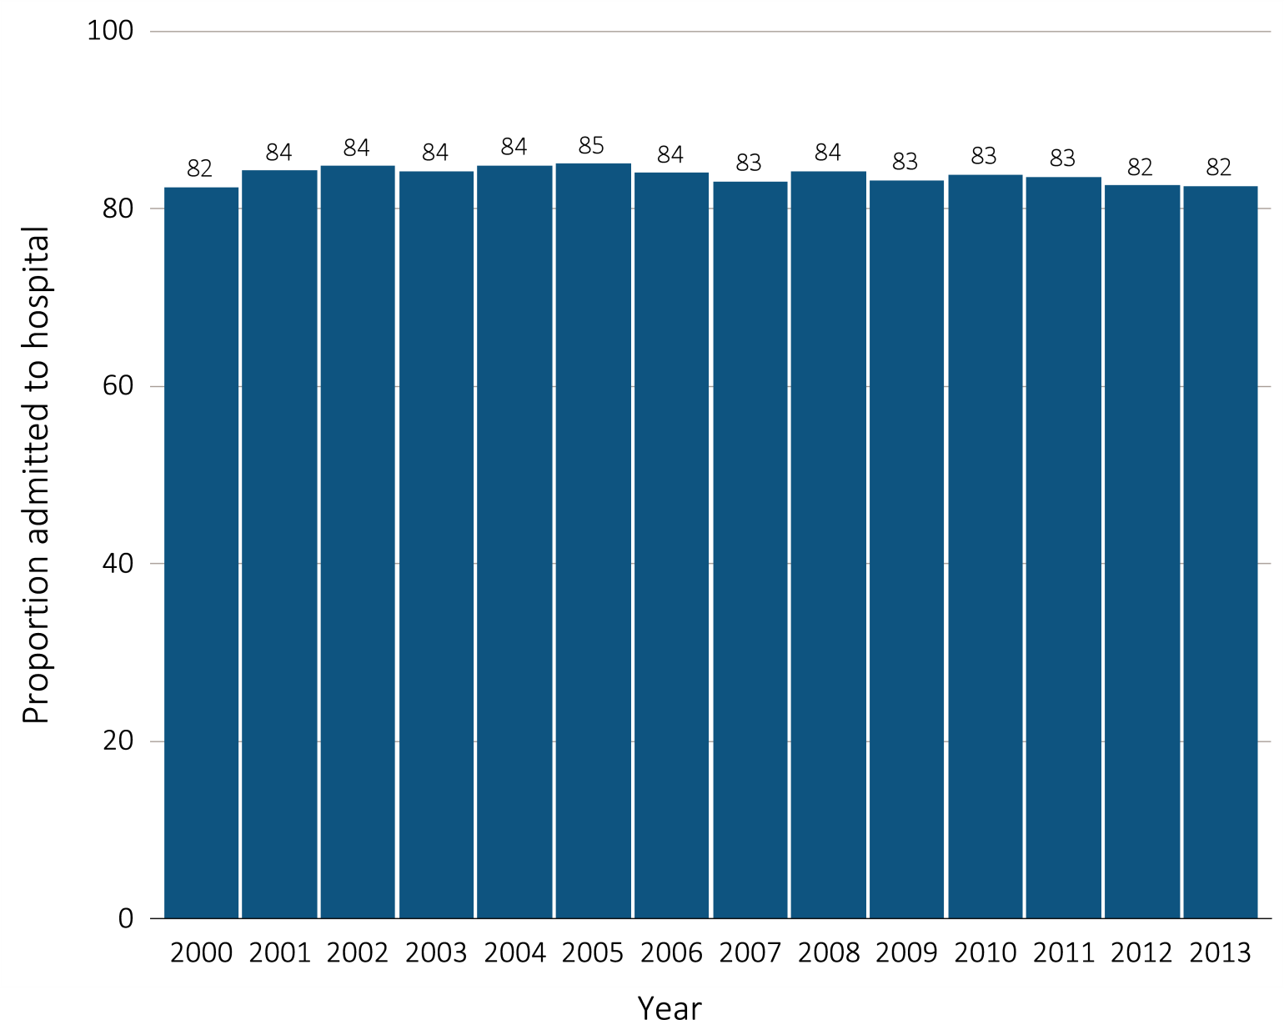
Figure 14.1 Hospital admission during the last 90 days of life among Medicare beneficiaries with ESRD, 2000-2013
Data Source: Special analyses, USRDS ESRD Database. Denominator is all decedents with Medicare Parts A and B throughout the last 90 days of life. Includes hospital stays in both short- and long-stay hospitals. Abbreviation: ESRD, end-stage renal disease.

Slide 4
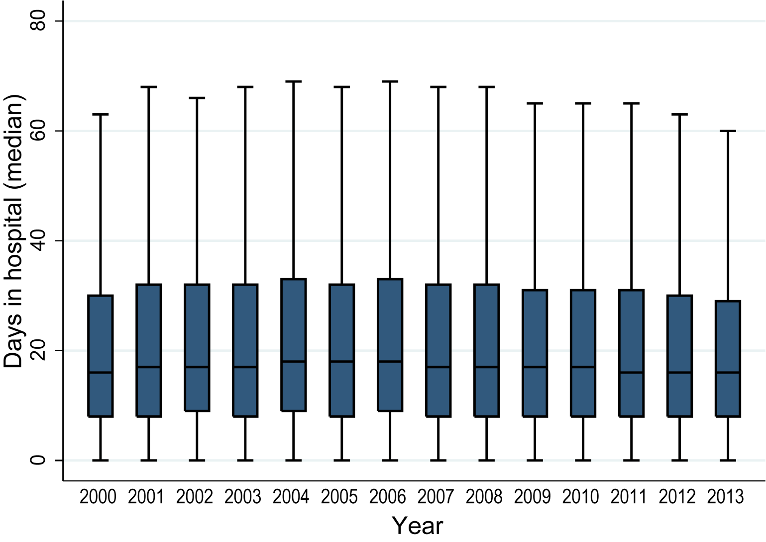
Figure 14.2 Days spent in the hospital during the last 90 days of life among Medicare beneficiaries with ESRD, 2000-2013
Data Source: Special analyses, USRDS ESRD Database. Denominator is all decedents with Medicare Parts A and B throughout the last 90 days of life who were admitted to the hospital at least once. Includes hospital stays in both short- and long-stay hospitals. Explanation of box plot: The lower border of the box is the first quartile and the upper border is the third quartile of the distribution, the length of the box is the interquartile range and the line in the middle of the box is the median value. The whiskers (vertical lines above and below each box) extend from the lowest value of the distribution that is ≥ the first quartile minus 1.5 times the interquartile range at the bottom to the highest value of the distribution that is ≤ the third quartile plus 1.5 times the interquartile range at the top. Values outside this range (outliers) are not plotted. Abbreviation: ESRD, end-stage renal disease.

Slide 5
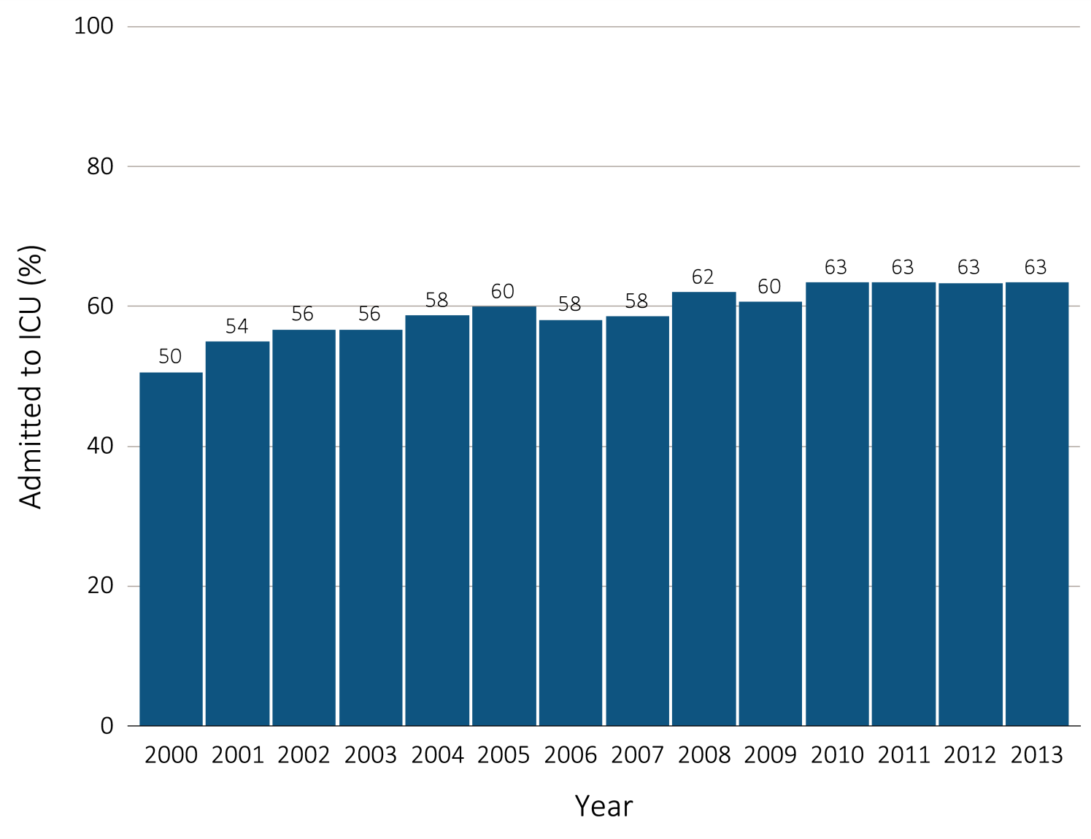
Figure 14.3 ICU admission during the last 90 days of life among Medicare beneficiaries with ESRD overall, and by age, race, ethnicity, sex, and modality, 2000-2013
(a) ICU admission by year, overall
Data Source: Special analyses, USRDS ESRD Database. Denominator is all decedents with Medicare Parts A and B throughout the last 90 days of life. ICU admission was identified using ICU revenue center codes in Medicare Institutional claims. Abbreviations: ESRD, end-stage renal disease; ICU, Intensive care unit.

Slide 6
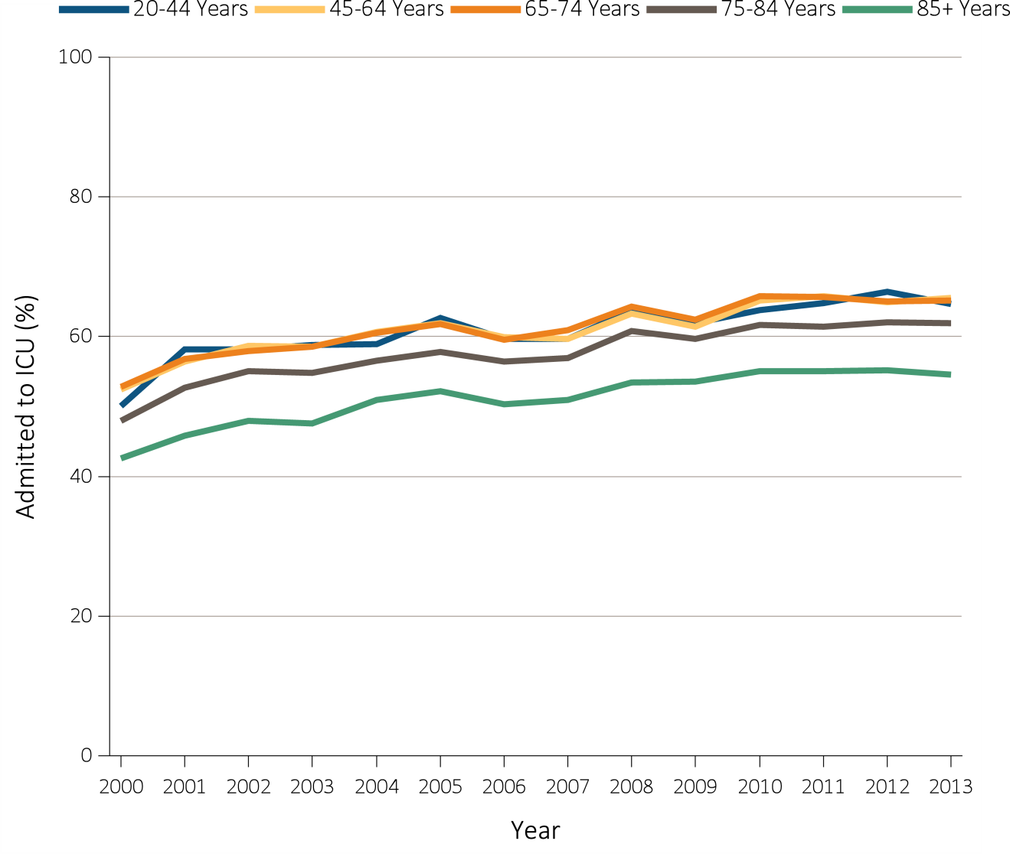
Figure 14.3 ICU admission during the last 90 days of life among Medicare beneficiaries with ESRD overall, and by age, race, ethnicity, sex, and modality, 2000-2013
(b) ICU admission by age
Data Source: Special analyses, USRDS ESRD Database. Denominator is all decedents with Medicare Parts A and B throughout the last 90 days of life. ICU admission was identified using ICU revenue center codes in Medicare Institutional claims. Abbreviations: ESRD, end-stage renal disease; ICU, Intensive care unit.

Slide 7
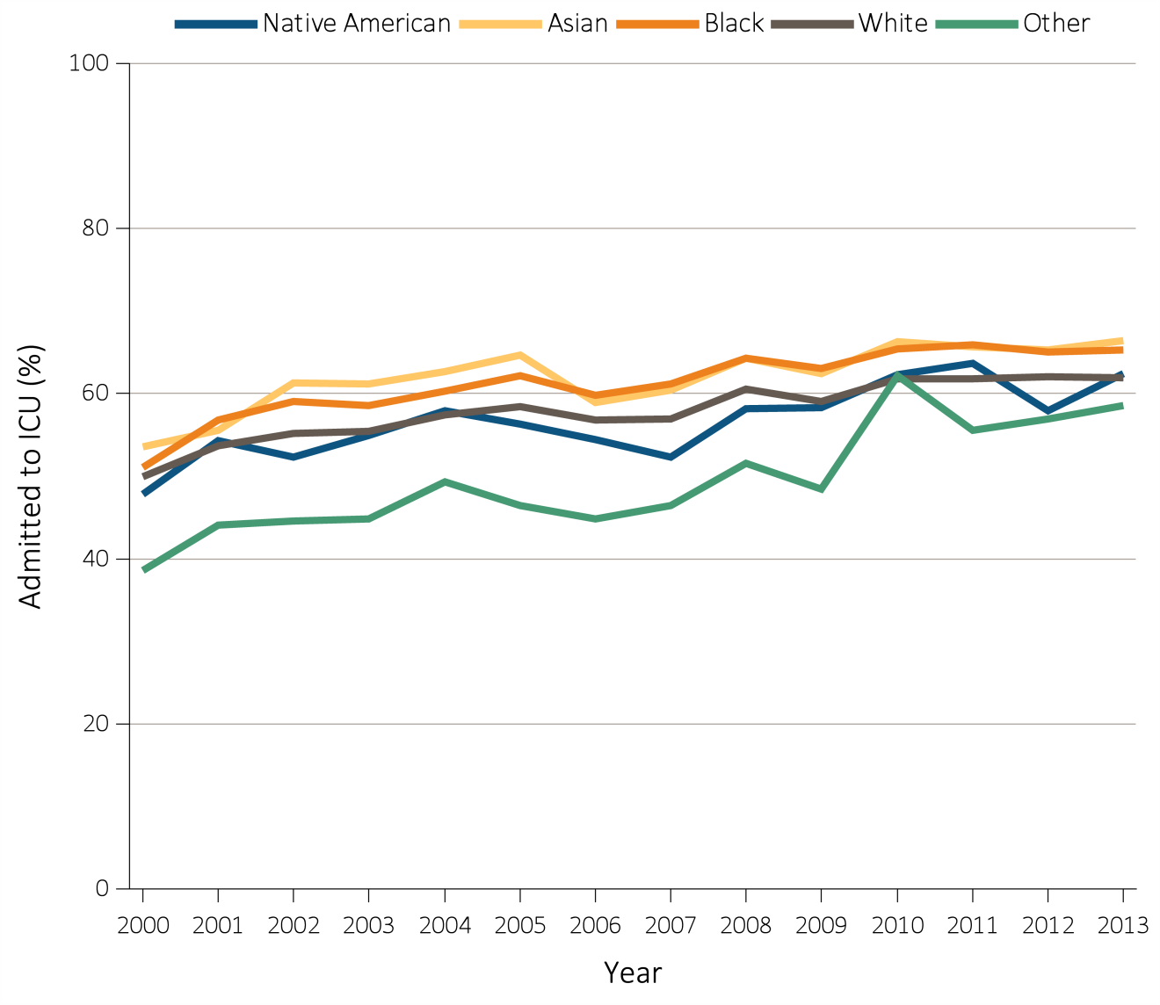
Figure 14.3 ICU admission during the last 90 days of life among Medicare beneficiaries with ESRD overall, and by age, race, ethnicity, sex, and modality, 2000-2013
(c) ICU admission by race
Data Source: Special analyses, USRDS ESRD Database. Denominator is all decedents with Medicare Parts A and B throughout the last 90 days of life. ICU admission was identified using ICU revenue center codes in Medicare Institutional claims. Abbreviations: ESRD, end-stage renal disease; ICU, Intensive care unit.

Slide 8
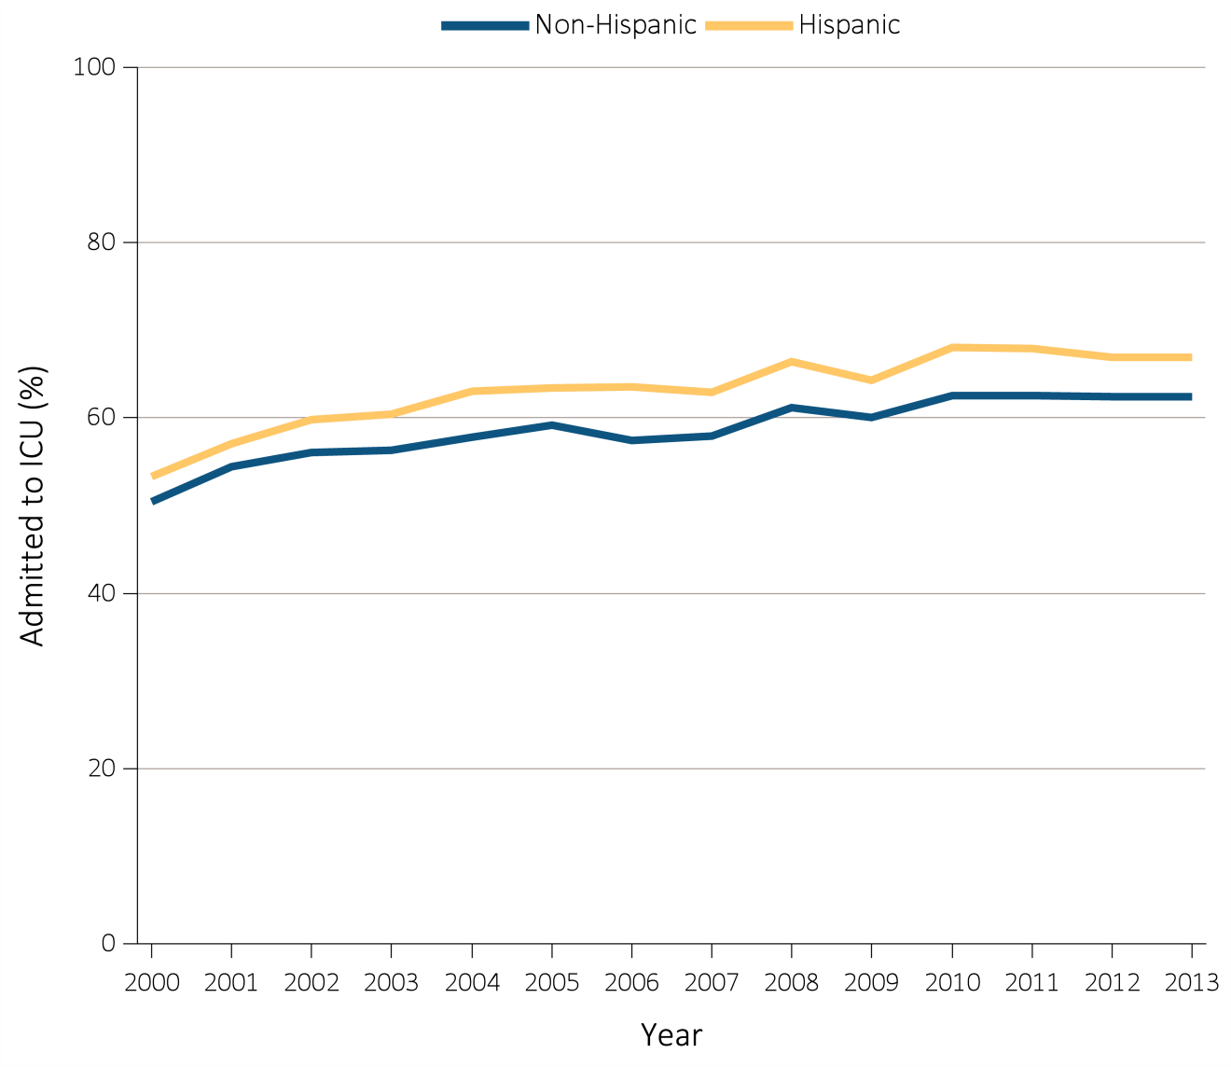
Figure 14.3 ICU admission during the last 90 days of life among Medicare beneficiaries with ESRD overall, and by age, race, ethnicity, sex, and modality, 2000-2013
(d) ICU admission by ethnicity
Data Source: Special analyses, USRDS ESRD Database. Denominator is all decedents with Medicare Parts A and B throughout the last 90 days of life. ICU admission was identified using ICU revenue center codes in Medicare Institutional claims. Abbreviations: ESRD, end-stage renal disease; ICU, Intensive care unit.

Slide 9
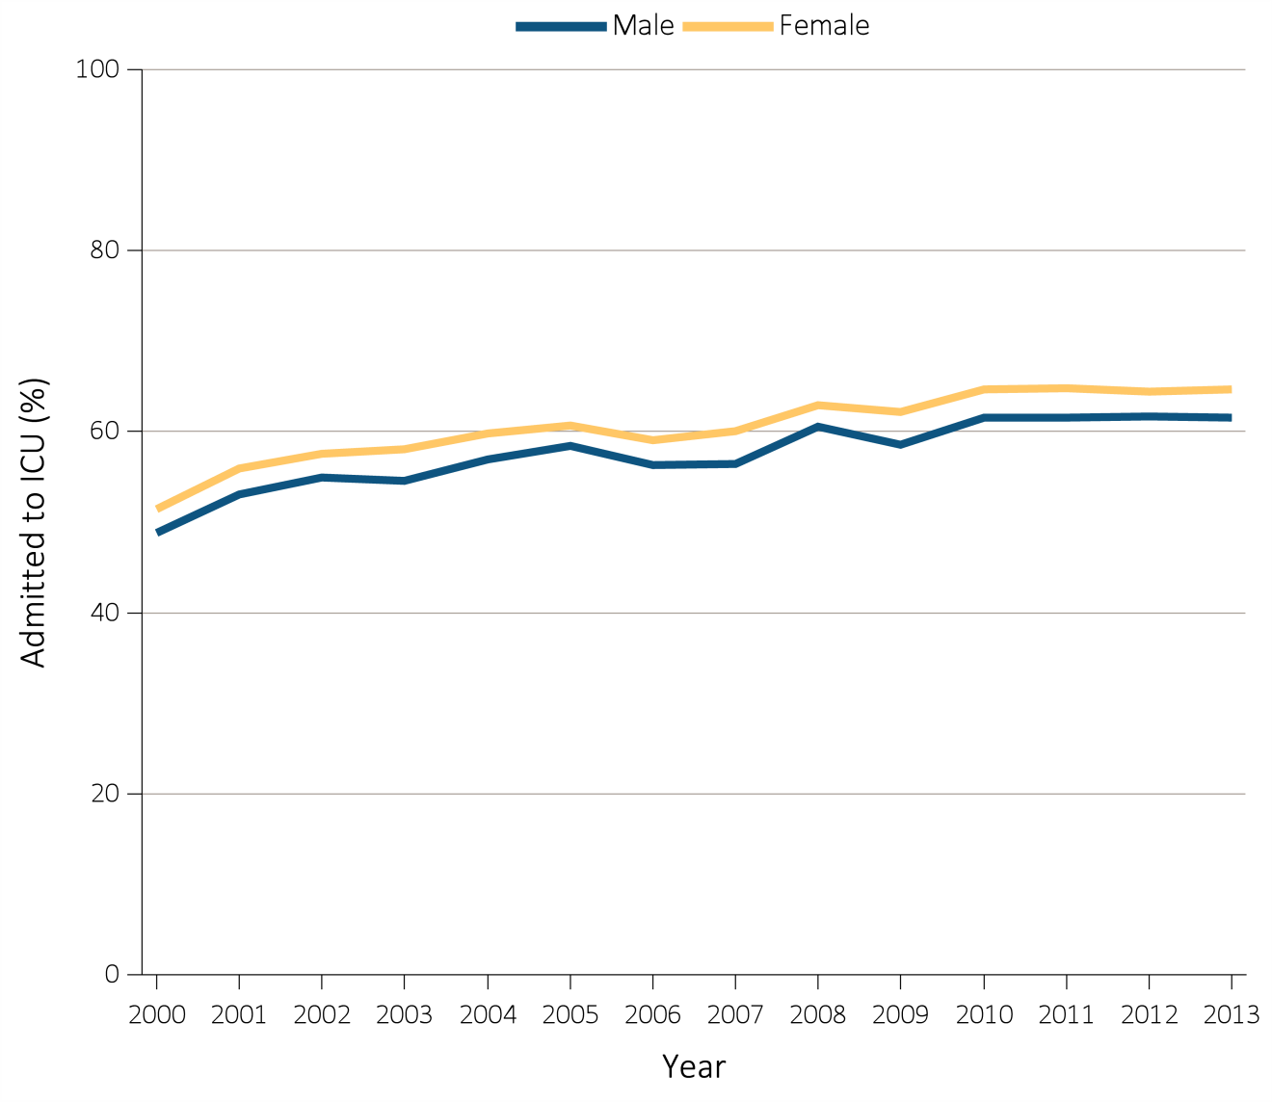
Figure 14.3 ICU admission during the last 90 days of life among Medicare beneficiaries with ESRD overall, and by age, race, ethnicity, sex, and modality, 2000-2013
(e) ICU admission by sex
Data Source: Special analyses, USRDS ESRD Database. Denominator is all decedents with Medicare Parts A and B throughout the last 90 days of life. ICU admission was identified using ICU revenue center codes in Medicare Institutional claims. Abbreviations: ESRD, end-stage renal disease; ICU, Intensive care unit.

Slide 10
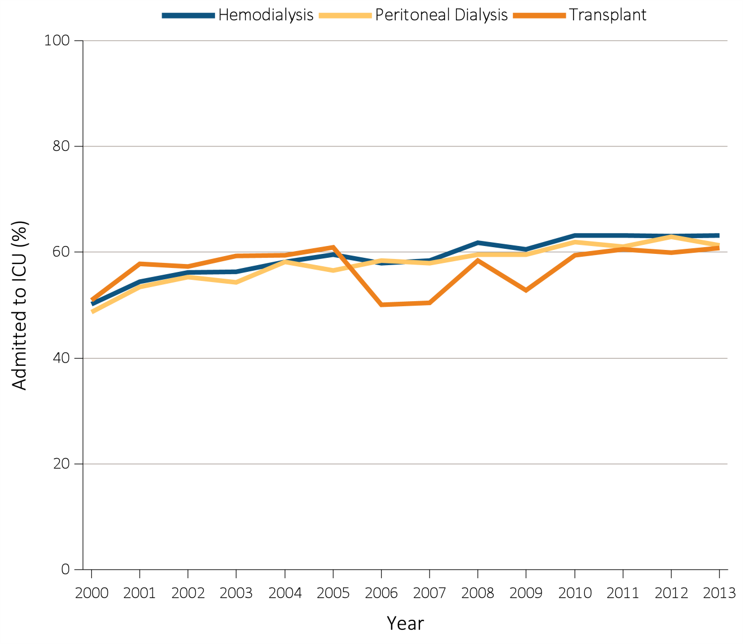
Figure 14.3 ICU admission during the last 90 days of life among Medicare beneficiaries with ESRD overall, and by age, race, ethnicity, sex, and modality, 2000-2013
(f) ICU admission by modality
Data Source: Special analyses, USRDS ESRD Database. Denominator is all decedents with Medicare Parts A and B throughout the last 90 days of life. ICU admission was identified using ICU revenue center codes in Medicare Institutional claims. Abbreviations: ESRD, end-stage renal disease; ICU, Intensive care unit.

Slide 11
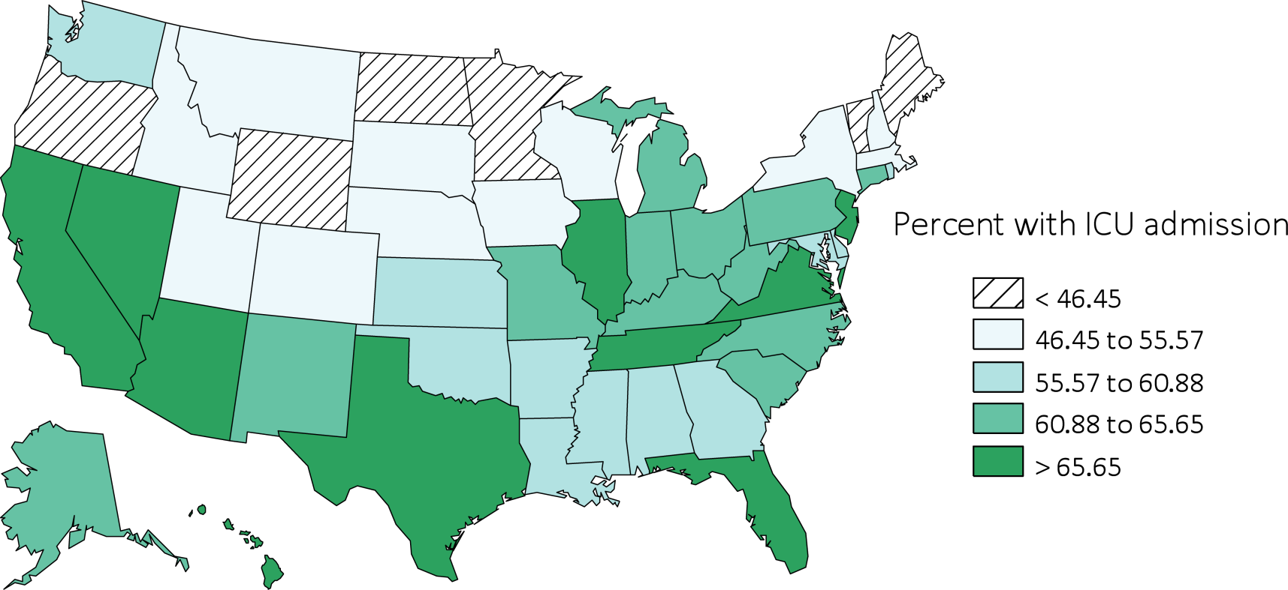
Figure 14.3 ICU admission during the last 90 days of life among Medicare beneficiaries with ESRD overall, and by age, race, ethnicity, sex, and modality, 2000-2013
(g) ICU admission by state
Data Source: Special analyses, USRDS ESRD Database. Denominator is all decedents with Medicare Parts A and B throughout the last 90 days of life. ICU admission was identified using ICU revenue center codes in Medicare Institutional claims. Abbreviations: ESRD, end-stage renal disease; ICU, Intensive care unit.

Slide 12
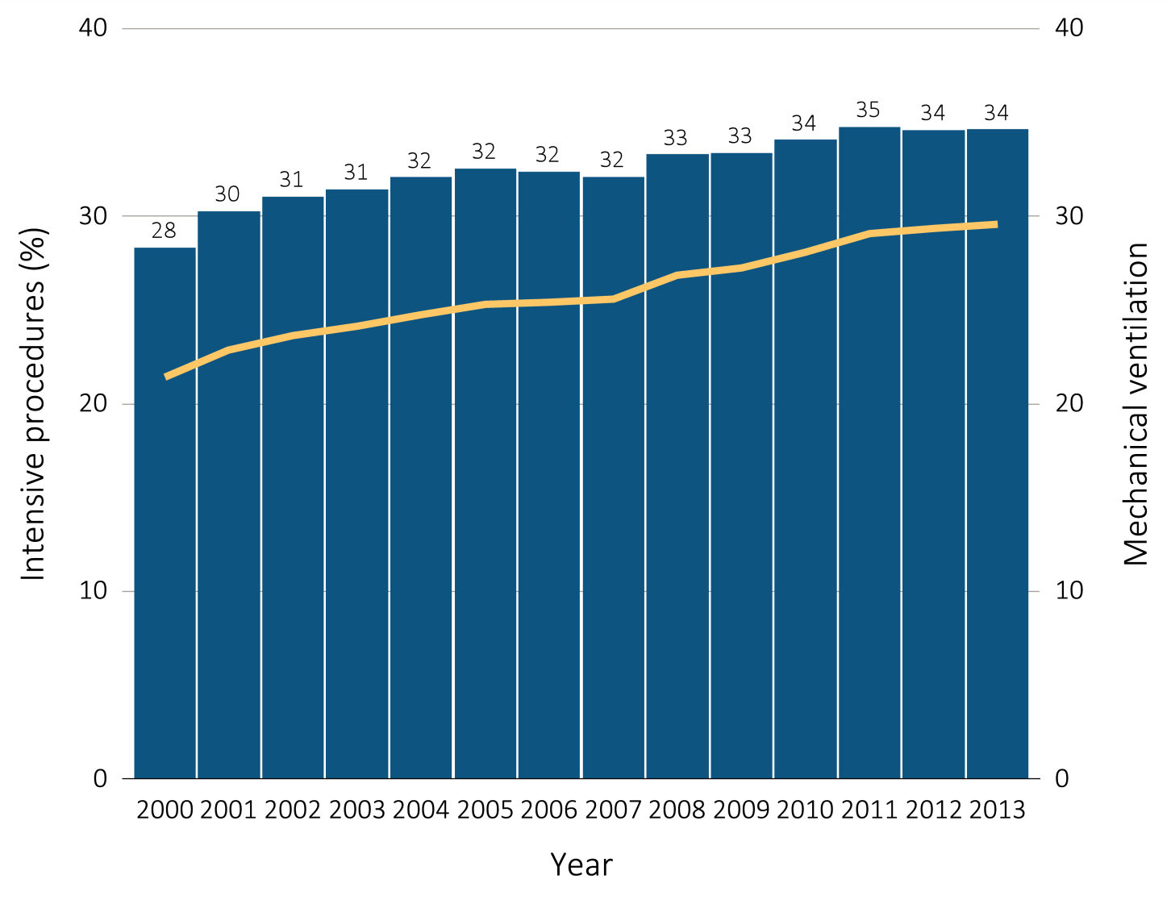
Figure 14.4 Intensive procedures during the last 90 days of life among Medicare beneficiaries with ESRD overall, and by age, race, ethnicity, sex, and modality, 2000-2013
(a) Intensive procedures and mechanical ventilation by year, overall
Data Source: Special analyses, USRDS ESRD Database. Denominator population is all decedents with Medicare Parts A and B throughout the last 90 days of life. Intensive procedures were identified by ICD-9 procedure code search of Medicare Institutional claims from short- and long-stay hospitals. The yellow line denotes the percentage of patients who were intubated or received mechanical ventilation. Abbreviation: ESRD, end-stage renal disease.

Slide 13
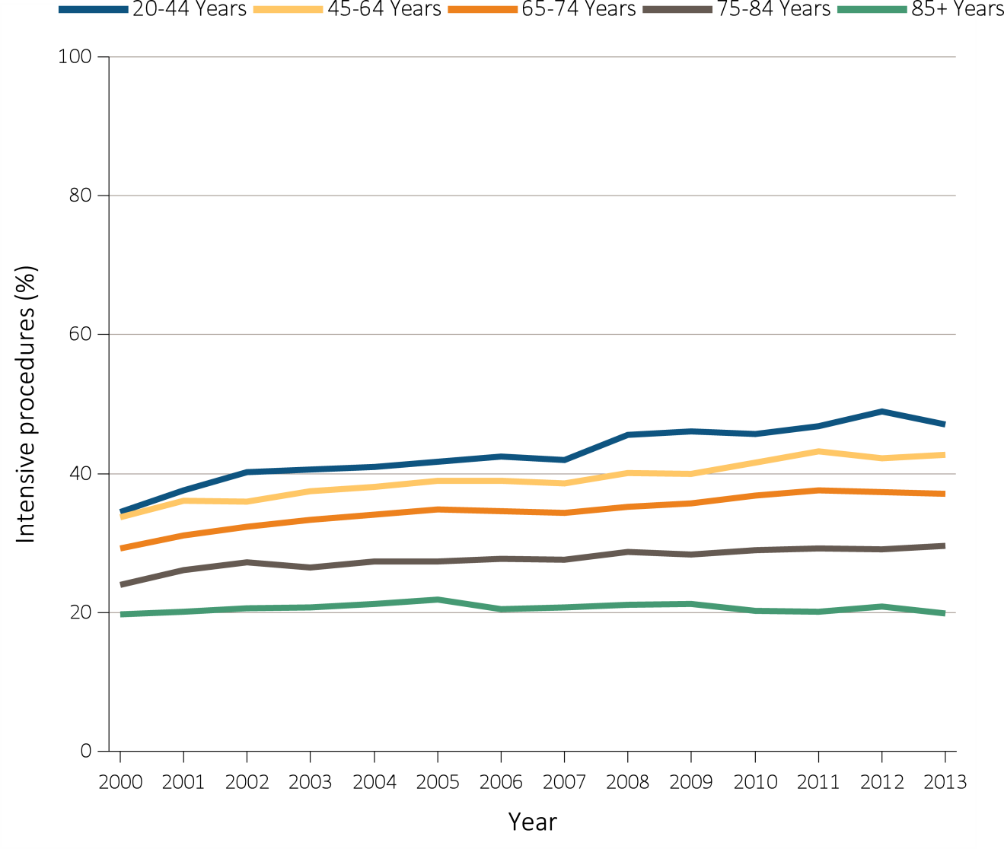
Figure 14.4 Intensive procedures during the last 90 days of life among Medicare beneficiaries with ESRD overall, and by age, race, ethnicity, sex, and modality, 2000-2013
(b) Intensive procedures by age
Data Source: Special analyses, USRDS ESRD Database. Denominator population is all decedents with Medicare Parts A and B throughout the last 90 days of life. Intensive procedures were identified by ICD-9 procedure code search of Medicare Institutional claims from short- and long-stay hospitals. Abbreviation: ESRD, end-stage renal disease.

Slide 14
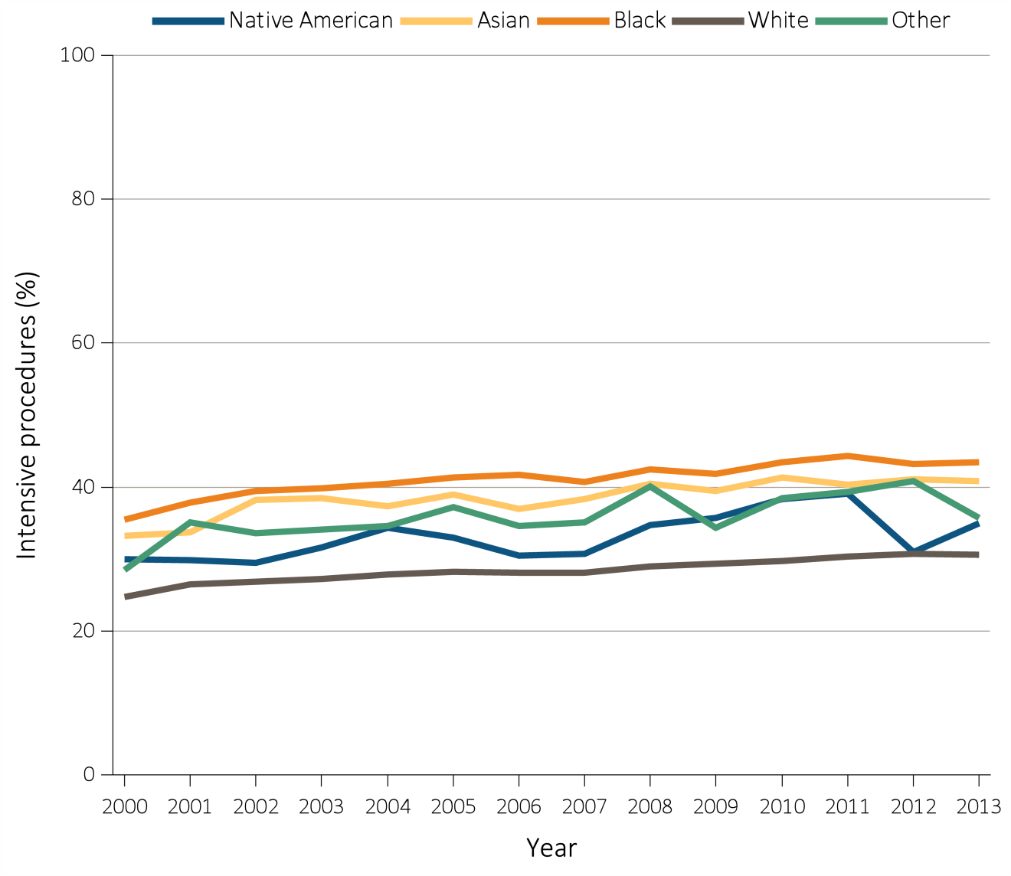
Figure 14.4 Intensive procedures during the last 90 days of life among Medicare beneficiaries with ESRD overall, and by age, race, ethnicity, sex, and modality, 2000-2013
(c) Intensive procedures by race
Data Source: Special analyses, USRDS ESRD Database. Denominator population is all decedents with Medicare Parts A and B throughout the last 90 days of life. Intensive procedures were identified by ICD-9 procedure code search of Medicare Institutional claims from short- and long-stay hospitals. Abbreviation: ESRD, end-stage renal disease.

Slide 15
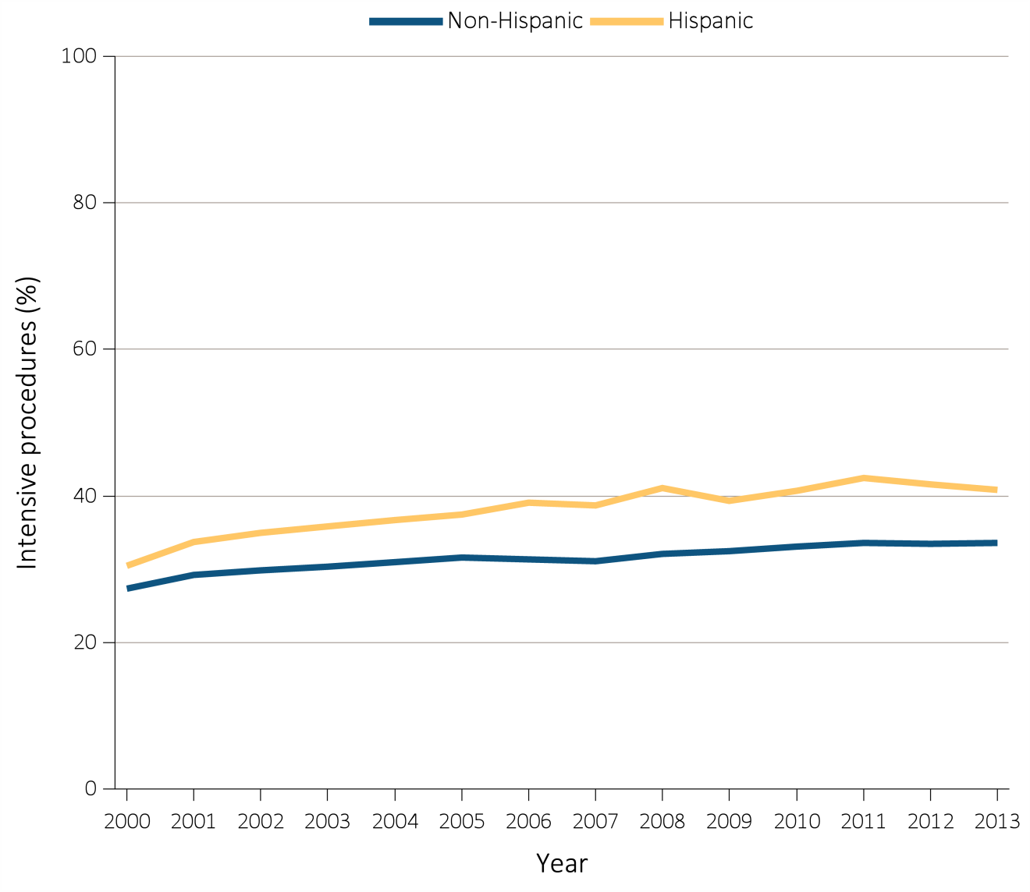
Figure 14.4 Intensive procedures during the last 90 days of life among Medicare beneficiaries with ESRD overall, and by age, race, ethnicity, sex, and modality, 2000-2013
(d) Intensive procedures by ethnicity
Data Source: Special analyses, USRDS ESRD Database. Denominator population is all decedents with Medicare Parts A and B throughout the last 90 days of life. Intensive procedures were identified by ICD-9 procedure code search of Medicare Institutional claims from short- and long-stay hospitals. Abbreviation: ESRD, end-stage renal disease.

Slide 16
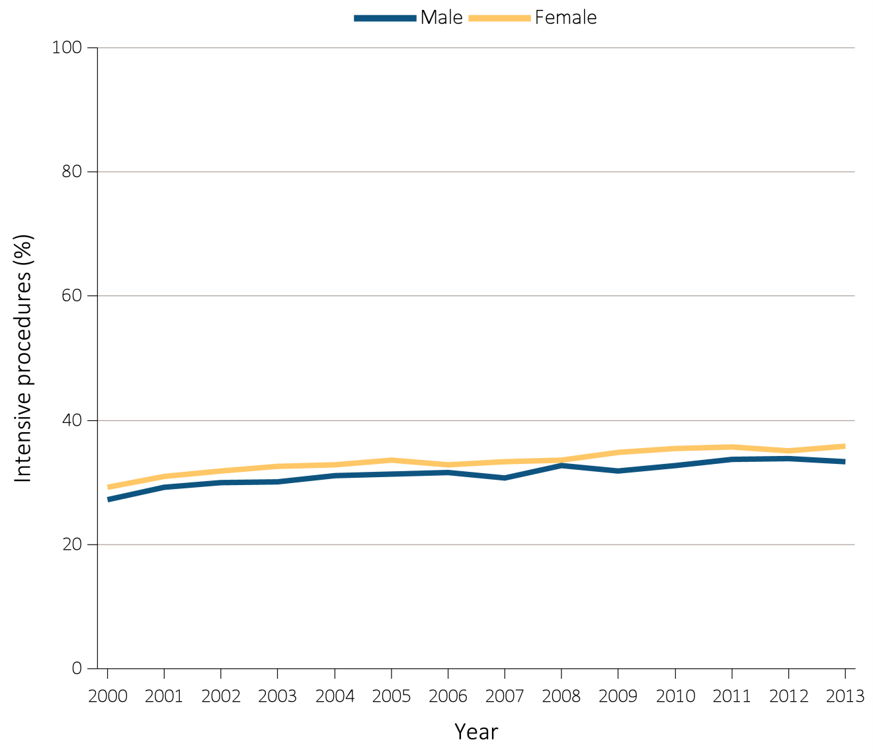
Figure 14.4 Intensive procedures during the last 90 days of life among Medicare beneficiaries with ESRD overall, and by age, race, ethnicity, sex, and modality, 2000-2013
(e) Intensive procedures by sex
Data Source: Special analyses, USRDS ESRD Database. Denominator population is all decedents with Medicare Parts A and B throughout the last 90 days of life. Intensive procedures were identified by ICD-9 procedure code search of Medicare Institutional claims from short- and long-stay hospitals. Abbreviation: ESRD, end-stage renal disease.

Slide 17
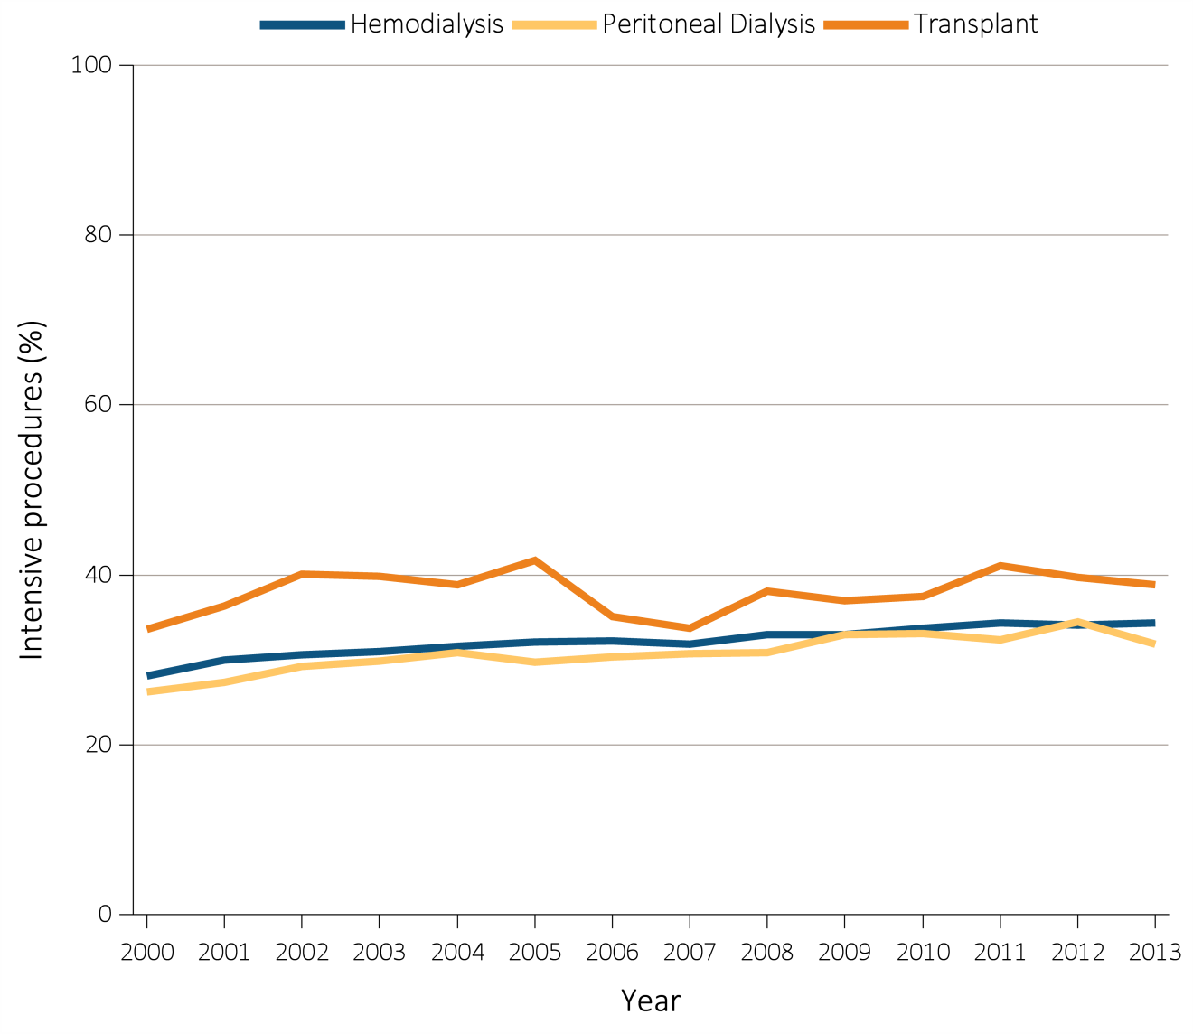
Figure 14.4 Intensive procedures during the last 90 days of life among Medicare beneficiaries with ESRD overall, and by age, race, ethnicity, sex, and modality, 2000-2013
(f) Intensive procedures by modality
Data Source: Special analyses, USRDS ESRD Database. Denominator population is all decedents with Medicare Parts A and B throughout the last 90 days of life. Intensive procedures were identified by ICD-9 procedure code search of Medicare Institutional claims from short- and long-stay hospitals. Abbreviation: ESRD, end-stage renal disease.

Slide 18
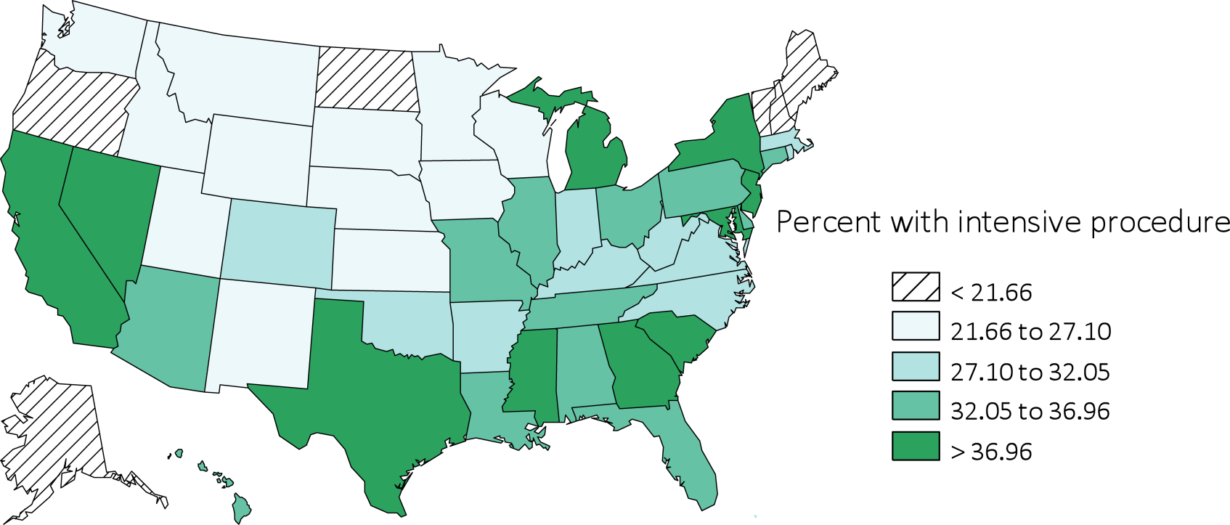
Figure 14.4 Intensive procedures during the last 90 days of life among Medicare beneficiaries with ESRD overall, and by age, race, ethnicity, sex, and modality, 2000-2013
(g) Intensive procedures by state
Data Source: Special analyses, USRDS ESRD Database. Denominator population is all decedents with Medicare Parts A and B throughout the last 90 days of life. Intensive procedures were identified by ICD-9 procedure code search of Medicare Institutional claims from short- and long-stay hospitals. Abbreviation: ESRD, end-stage renal disease.

Slide 19
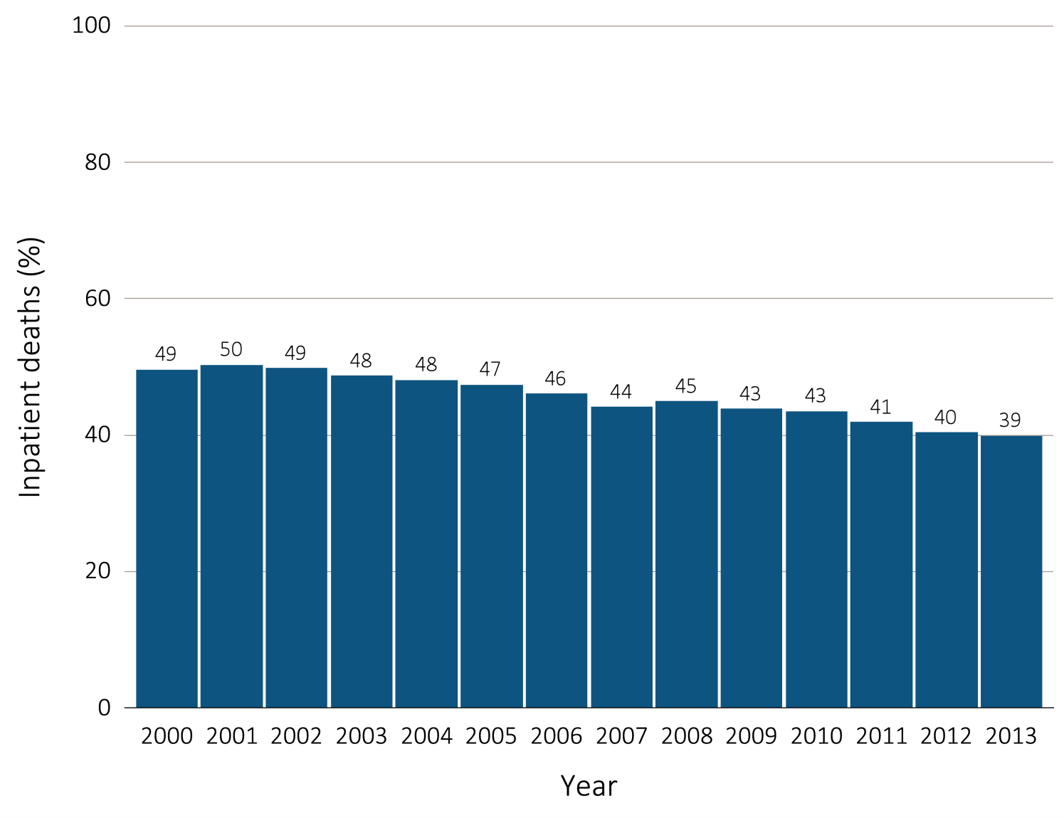
Figure 14.5 Inpatient deaths among Medicare beneficiaries with ESRD overall, and by age, race, ethnicity, sex, and modality, 2000-2013
(a) Inpatient deaths by year, overall
Data Source: Special analyses, USRDS ESRD Database. Denominator population is all decedents with Medicare Parts A and B throughout the last 90 days of life. Includes deaths occurring in short- and long-stay hospitals. Abbreviation: ESRD, end-stage renal disease.

Slide 20
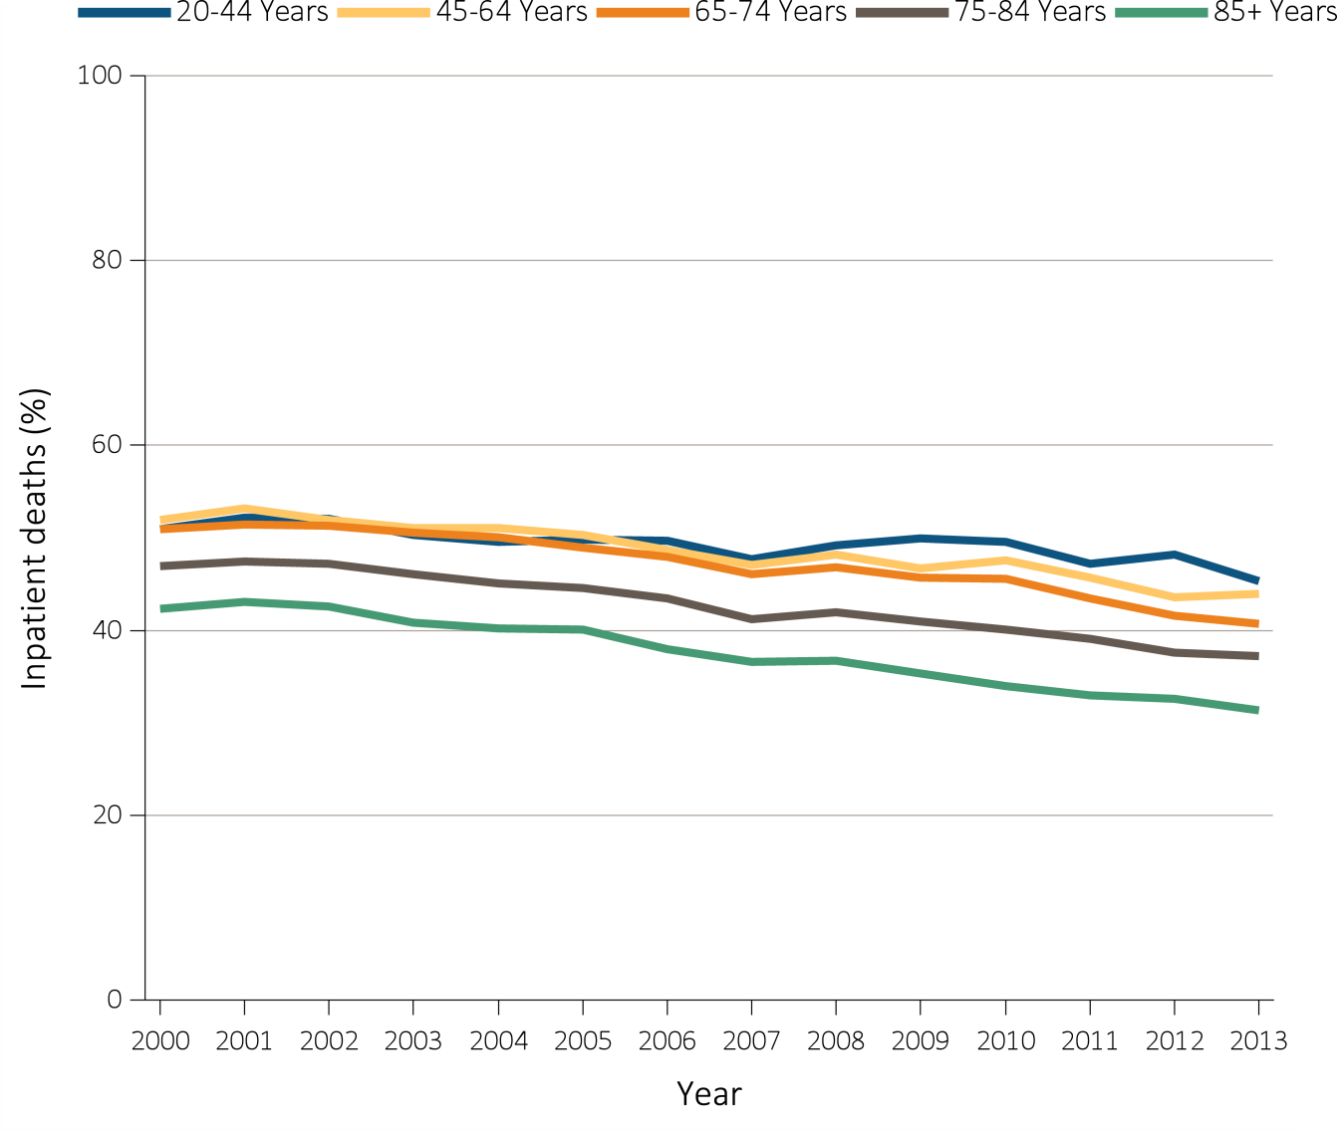
Figure 14.5 Inpatient deaths among Medicare beneficiaries with ESRD overall, and by age, race, ethnicity, sex, and modality, 2000-2013
(b) Inpatient deaths by age
Data Source: Special analyses, USRDS ESRD Database. Denominator population is all decedents with Medicare Parts A and B throughout the last 90 days of life. Includes deaths occurring in short- and long-stay hospitals. Abbreviation: ESRD, end-stage renal disease.

Slide 21
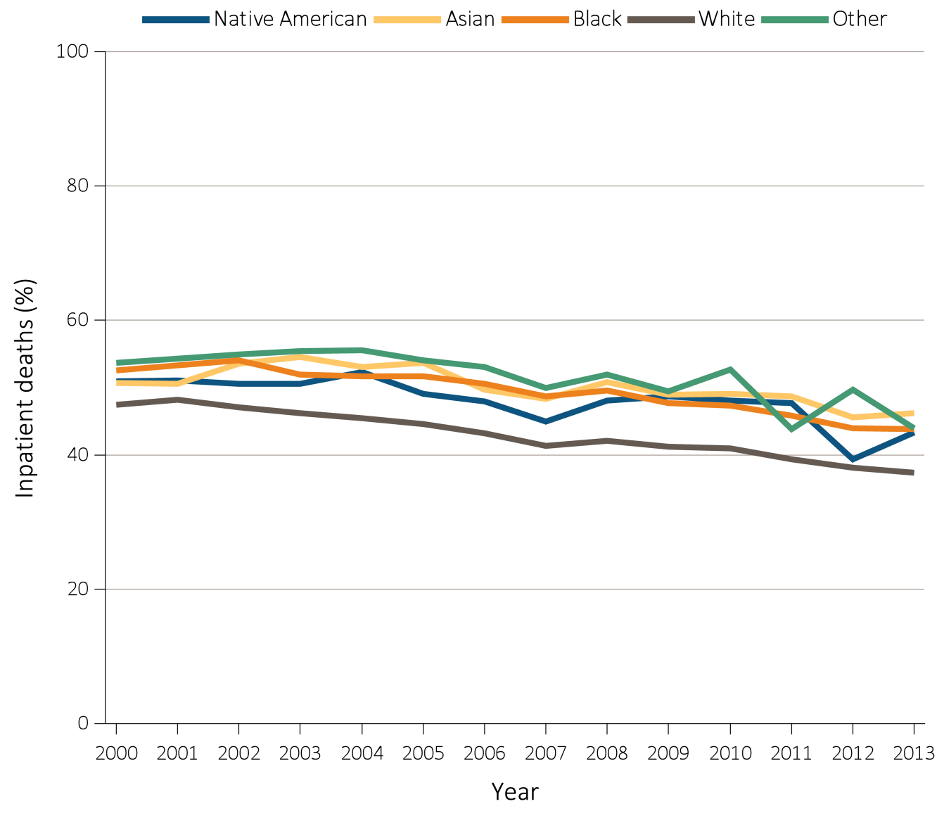
Figure 14.5 Inpatient deaths among Medicare beneficiaries with ESRD overall, and by age, race, ethnicity, sex, and modality, 2000-2013
(c) Inpatient deaths by race
Data Source: Special analyses, USRDS ESRD Database. Denominator population is all decedents with Medicare Parts A and B throughout the last 90 days of life. Includes deaths occurring in short- and long-stay hospitals. Abbreviation: ESRD, end-stage renal disease.

Slide 22
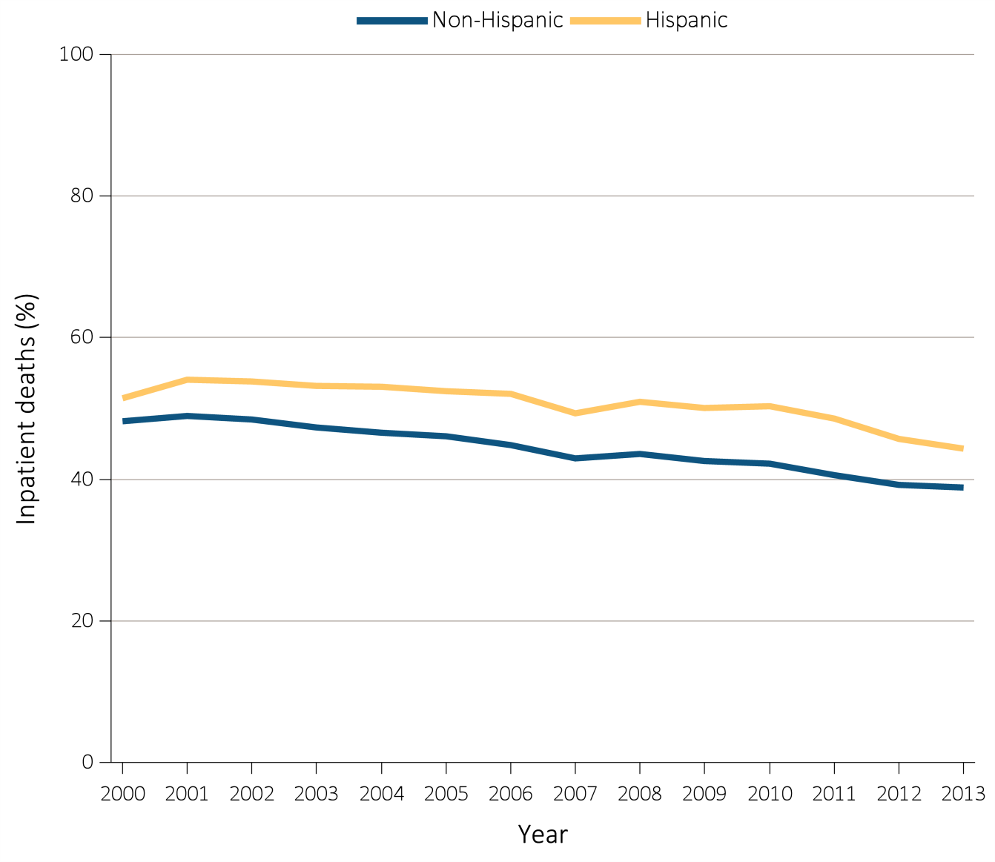
Figure 14.5 Inpatient deaths among Medicare beneficiaries with ESRD overall, and by age, race, ethnicity, sex, and modality, 2000-2013
(d) Inpatient deaths by ethnicity
Data Source: Special analyses, USRDS ESRD Database. Denominator population is all decedents with Medicare Parts A and B throughout the last 90 days of life. Includes deaths occurring in short- and long-stay hospitals. Abbreviation: ESRD, end-stage renal disease.

Slide 23
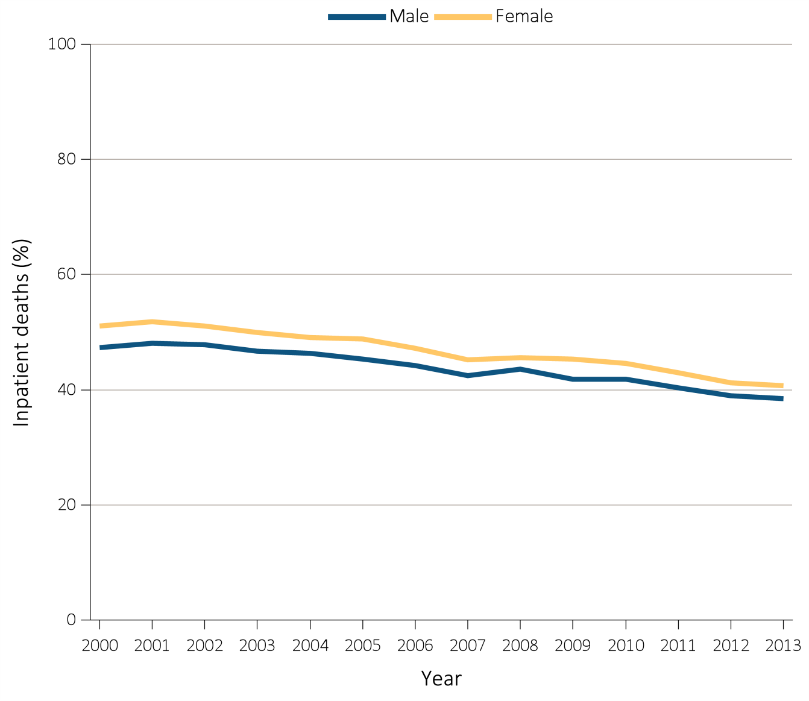
Figure 14.5 Inpatient deaths among Medicare beneficiaries with ESRD overall, and by age, race, ethnicity, sex, and modality, 2000-2013
(e) Inpatient deaths by sex
Data Source: Special analyses, USRDS ESRD Database. Denominator population is all decedents with Medicare Parts A and B throughout the last 90 days of life. Includes deaths occurring in short- and long-stay hospitals. Abbreviation: ESRD, end-stage renal disease.

Slide 24
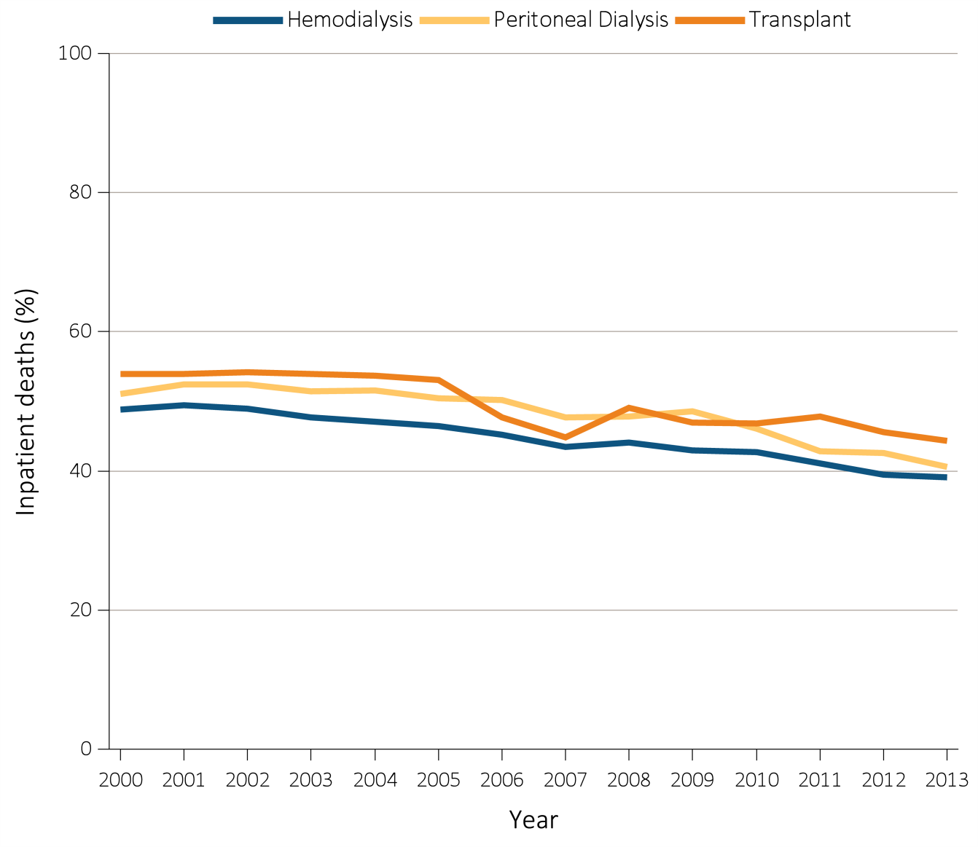
Figure 14.5 Inpatient deaths among Medicare beneficiaries with ESRD overall, and by age, race, ethnicity, sex, and modality, 2000-2013
(f) Inpatient deaths by modality
Data Source: Special analyses, USRDS ESRD Database. Denominator population is all decedents with Medicare Parts A and B throughout the last 90 days of life. Includes deaths occurring in short- and long-stay hospitals. Abbreviation: ESRD, end-stage renal disease.

Slide 25
Table 14.2 Characteristics of ESRD patients receiving care in a nursing facility during the last year of life: 2000-2013
 | 2000 | 2001 | 2002 | 2003 | 2004 | 2005 | 2006 | 2007 | 2008 | 2009 | 2010 | 2011 | 2012 | 2013 | Total
N | 13,818 | 14,780 | 16,026 | 16,999 | 18,223 | 18,683 | 18,722 | 18,313 | 18,996 | 19,122 | 19,704 | 20,918 | 21,026 | 21,692 | 257,022
Age, mean (std) | 70.5(11.9) | 70.5(12.1) | 70.8(12.0) | 71.0(12.0) | 70.9(12.0) | 71.3(12.0) | 71.3(12.1) | 71.4(12.1) | 71.7(12.0) | 71.5(12.1) | 71.5(12.0) | 71.6(11.9) | 71.5(12.1) | 71.4(12.0) | 71.3(12.0)
Vintage of ESRD, year, mean (std) | 4(4) | 5(4) | 5(4) | 5(4) | 5(4) | 5(4) | 5(4) | 5(4) | 5(4) | 5(4) | 5(5) | 6(5) | 6(5) | 6(5) | 5(4)
Vintage of ESRD, year, median (q1,q3) | 3(2,6) | 3(2,6) | 4(2,6) | 4(2,6) | 4(2,6) | 4(2,6) | 4(2,6) | 4(2,6) | 4(2,6) | 4(2,7) | 4(2,7) | 4(2,7) | 4(2,7) | 4(3,8) | 4(2,6)
Age Category
20-44 | 3.5 | 3.6 | 3.3 | 3.0 | 3.1 | 2.8 | 2.8 | 2.7 | 2.5 | 2.3 | 2.3 | 2.1 | 2.3 | 2.2 | 2.7
45-64 | 22.3 | 22.7 | 22.1 | 23.0 | 22.9 | 22.6 | 23.5 | 22.9 | 22.6 | 23.8 | 24.3 | 24.0 | 24.9 | 24.3 | 23.4
65-74 | 32.4 | 31.4 | 30.9 | 29.6 | 29.8 | 29.0 | 28.3 | 28.9 | 28.9 | 28.9 | 28.9 | 29.4 | 28.6 | 30.1 | 29.5
75-84 | 32.7 | 33.0 | 33.7 | 34.1 | 34.0 | 34.4 | 33.2 | 33.0 | 32.7 | 31.4 | 31.0 | 30.6 | 30.4 | 29.6 | 32.3
>=85 | 9.1 | 9.4 | 10.1 | 10.3 | 10.2 | 11.1 | 12.2 | 12.5 | 13.2 | 13.5 | 13.5 | 13.9 | 13.9 | 13.8 | 12.1
Race
Native American | 1.4 | 1.0 | 1.3 | 1.1 | 1.1 | 1.1 | 1.1 | 1.1 | 1.1 | 1.0 | 1.0 | 1.1 | 1.0 | 1.0 | 1.1
Asian | 1.9 | 1.9 | 1.9 | 2.2 | 2.0 | 2.1 | 2.3 | 2.3 | 2.4 | 2.5 | 2.5 | 2.6 | 2.8 | 2.9 | 2.3
Black/African American | 29.6 | 29.9 | 29.3 | 29.1 | 30.0 | 29.1 | 29.6 | 29.5 | 28.3 | 28.9 | 28.3 | 28.3 | 28.4 | 27.7 | 28.9
White | 66.5 | 66.3 | 66.5 | 66.7 | 66.0 | 67.1 | 66.7 | 66.8 | 67.7 | 67.2 | 67.8 | 67.5 | 67.5 | 68.2 | 67.1
Unknown | 0.1 | 0.1 | 0.1 | 0.1 | 0.0 | 0.0 | 0.0 | 0.0 | 0.0 | 0.0 | 0.0 | 0.0 | 0.0 | 0.1 | 0.0
Other | 0.6 | 0.8 | 0.9 | 0.9 | 0.8 | 0.5 | 0.3 | 0.3 | 0.4 | 0.4 | 0.3 | 0.4 | 0.3 | 0.2 | 0.5
Hispanic
Missing on Hispanic | 0.4 | 0.5 | 0.4 | 0.3 | 0.3 | 0.4 | 0.3 | 0.2 | 0.4 | 0.4 | 0.4 | 0.4 | 0.5 | 0.5 | 0.4
Hispanic | 8.0 | 8.5 | 8.5 | 8.9 | 8.6 | 9.2 | 8.9 | 9.0 | 8.9 | 9.6 | 9.3 | 9.9 | 10.7 | 10.8 | 9.3
Non-Hispanic | 81.0 | 84.7 | 87.1 | 88.4 | 89.2 | 89.0 | 89.8 | 90.1 | 90.0 | 89.4 | 89.7 | 89.1 | 88.4 | 88.4 | 88.4
Unknown | 10.7 | 6.3 | 4.0 | 2.4 | 1.8 | 1.5 | 0.9 | 0.7 | 0.8 | 0.7 | 0.6 | 0.6 | 0.4 | 0.3 | 2.0
^{(Continued on next slide)}

Slide 26
Table 14.2 Characteristics of ESRD patients receiving care in a nursing facility during the last year of life: 2000-2013 (continued)
 | 2000 | 2001 | 2002 | 2003 | 2004 | 2005 | 2006 | 2007 | 2008 | 2009 | 2010 | 2011 | 2012 | 2013 | Total
N | 13,818 | 14,780 | 16,026 | 16,999 | 18,223 | 18,683 | 18,722 | 18,313 | 18,996 | 19,122 | 19,704 | 20,918 | 21,026 | 21,692 | 257,022
Sex*
Male | 46.0 | 46.7 | 46.6 | 47.0 | 48.7 | 48.9 | 49.3 | 50.0 | 50.3 | 51.4 | 51.5 | 51.7 | 51.7 | 51.6 | 49.6
Female | 54.0 | 53.3 | 53.4 | 53.0 | 51.3 | 51.1 | 50.6 | 50.0 | 49.7 | 48.6 | 48.5 | 48.3 | 48.3 | 48.4 | 50.4
Last Treatment Modality
Missing on modality | 9.7 | 10.7 | 11.6 | 11.1 | 11.8 | 12.3 | 13.1 | 12.4 | 16.2 | 14.5 | 15.2 | 15.5 | 16.0 | 16.6 | 13.6
Hemodialysis | 82.0 | 82.0 | 82.0 | 82.4 | 81.8 | 81.8 | 81.1 | 82.1 | 78.1 | 79.7 | 78.8 | 77.9 | 76.9 | 76.1 | 80.0
Peritoneal dialysis | 5.4 | 4.1 | 3.6 | 3.4 | 3.2 | 2.7 | 2.8 | 2.5 | 2.3 | 2.0 | 2.1 | 2.4 | 2.5 | 2.6 | 2.9
Transplant | 2.9 | 3.2 | 2.9 | 3.1 | 3.2 | 3.1 | 3.1 | 3.1 | 3.4 | 3.7 | 3.9 | 4.1 | 4.6 | 4.7 | 3.6
Dual eligibility
Missing on dual eligibility | 10.1 | 10.2 | 10.7 | 10.1 | 9.8 | 9.5 | 9.1 | 9.0 | 9.4 | 9.4 | 9.8 | 9.3 | 9.8 | 4.7 | 9.3
Dual eligibility | 53.6 | 54.0 | 53.5 | 54.5 | 53.5 | 53.0 | 53.8 | 54.1 | 54.0 | 53.6 | 54.0 | 53.6 | 53.0 | 56.0 | 53.9
Non-dual eligibility | 36.3 | 35.7 | 35.8 | 35.4 | 36.7 | 37.6 | 37.1 | 36.9 | 36.6 | 37.0 | 36.2 | 37.1 | 37.2 | 39.3 | 36.9
Medicare Parts A&B as primary payer during last 365 days of life
Yes | 100.0 | 100.0 | 100.0 | 100.0 | 100.0 | 100.0 | 100.0 | 100.0 | 100.0 | 100.0 | 100.0 | 100.0 | 100.0 | 100.0 | 100.0
Data Source: Special analyses, USRDS ESRD Database. The denominator population is all ESRD patients who were at least 20 years of age at the time of death, received treatment for ESRD for at least one year, and had continuous Medicare Parts A&B coverage during the last year of life. Nursing facility use was ascertained using Medicare claims.
Abbreviation: ESRD, end-stage renal disease.

Slide 27
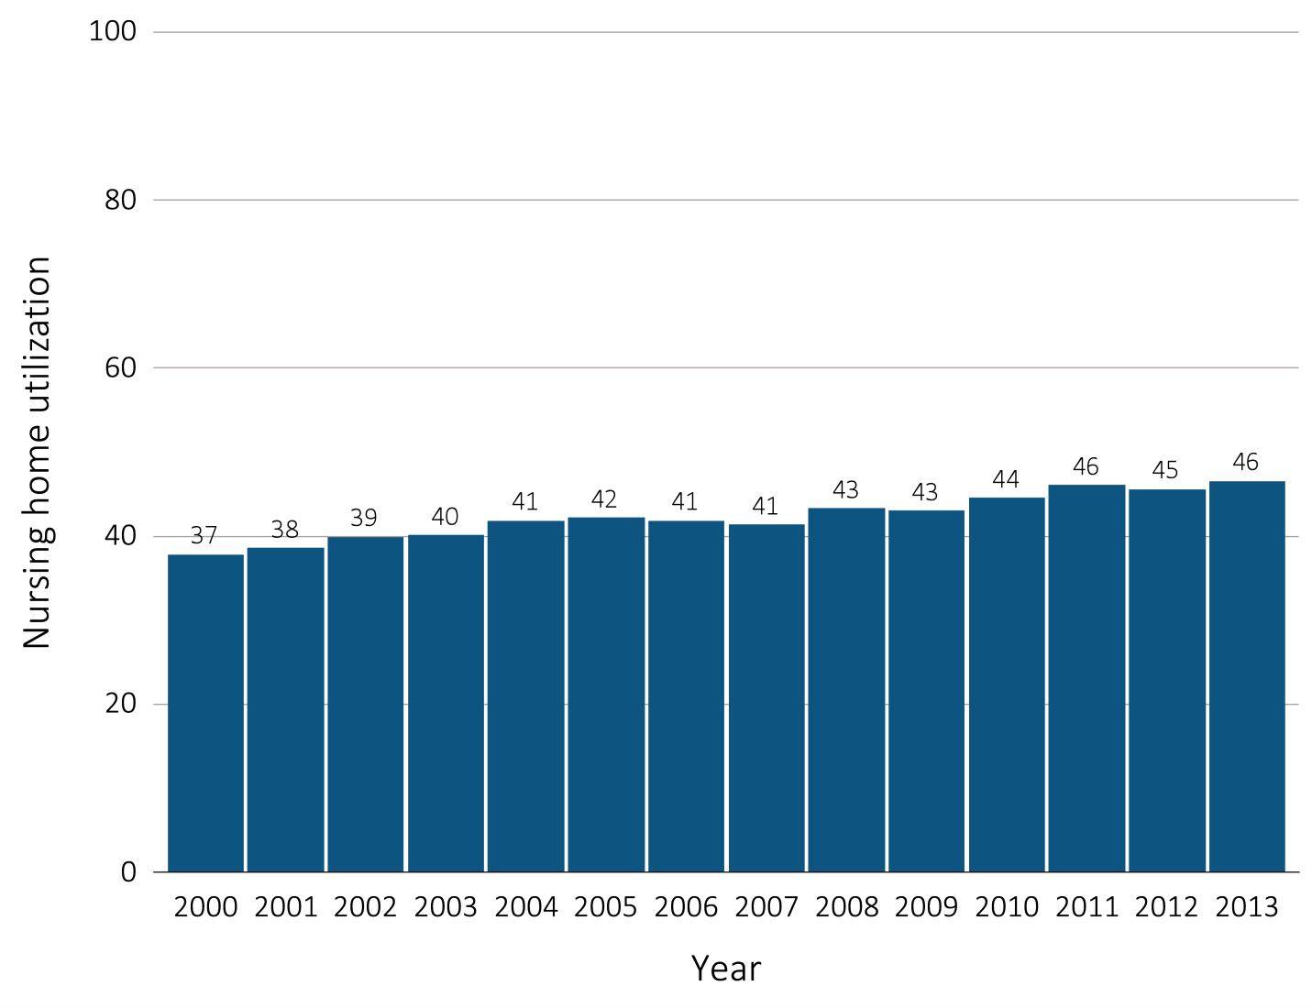
Figure 14.6 Nursing facility utilization in the last year of life among decedents overall, and by age, race, ethnicity, sex, and modality, 2000-2013
(a) Nursing facility utilization by year, overall
Data Source: Special analyses, USRDS ESRD Database. Denominator population is all decedents admitted to a nursing home during the last year of life. Abbreviation: ESRD, end-stage renal disease.

Slide 28
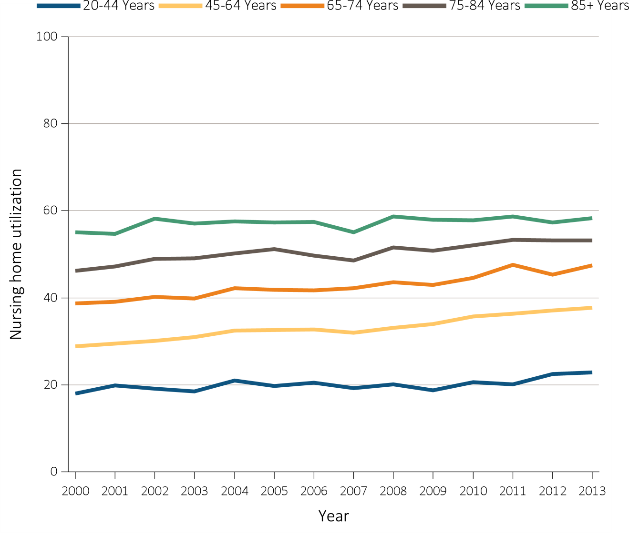
Figure 14.6 Nursing facility utilization in the last year of life among decedents overall, and by age, race, ethnicity, sex, and modality, 2000-2013
(b) Nursing facility utilization by age
Data Source: Special analyses, USRDS ESRD Database. Denominator population is all decedents admitted to a nursing home during the last year of life. Abbreviation: ESRD, end-stage renal disease.

Slide 29
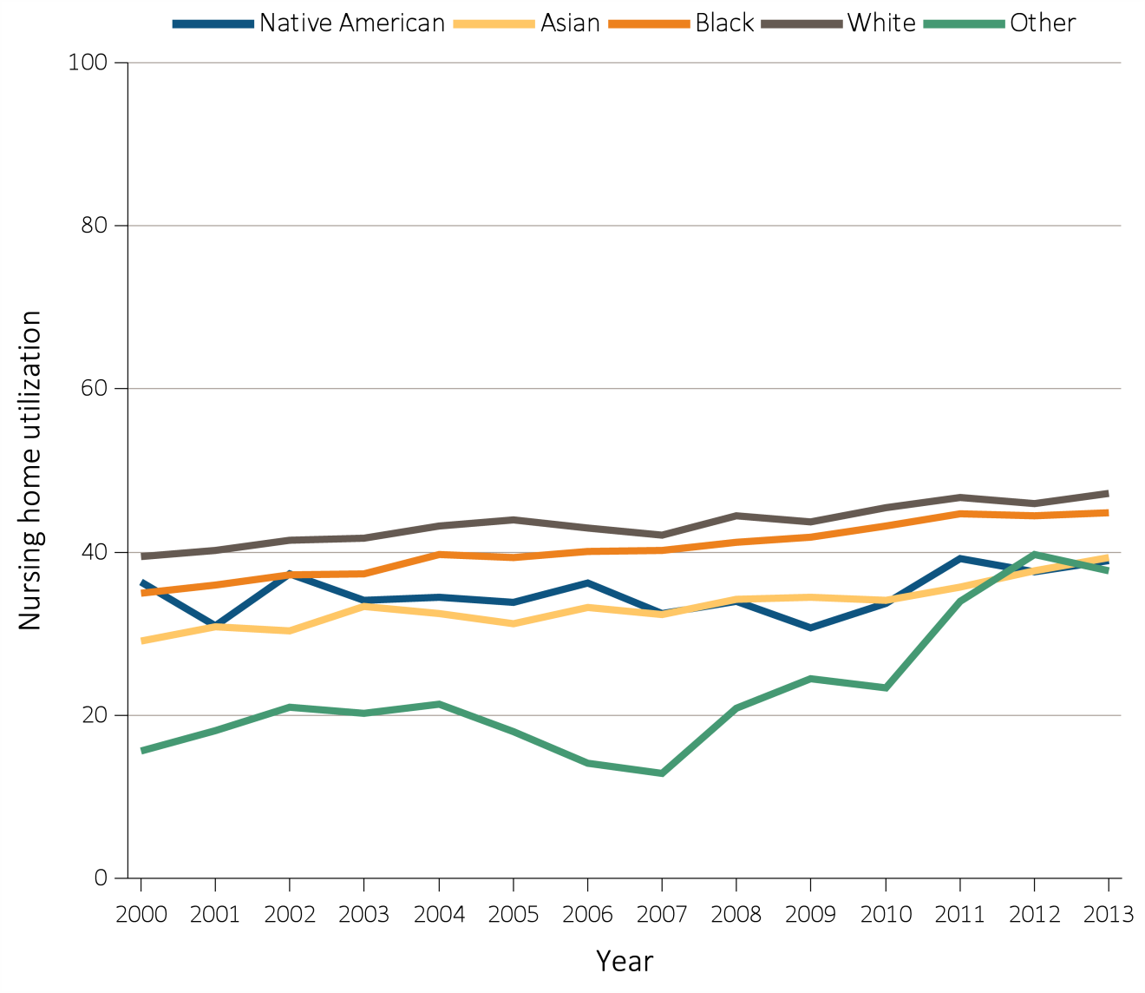
Figure 14.6 Nursing facility utilization in the last year of life among decedents overall, and by age, race, ethnicity, sex, and modality, 2000-2013
(c) Nursing facility utilization by race
Data Source: Special analyses, USRDS ESRD Database. Denominator population is all decedents admitted to a nursing home during the last year of life. Abbreviation: ESRD, end-stage renal disease.

Slide 30
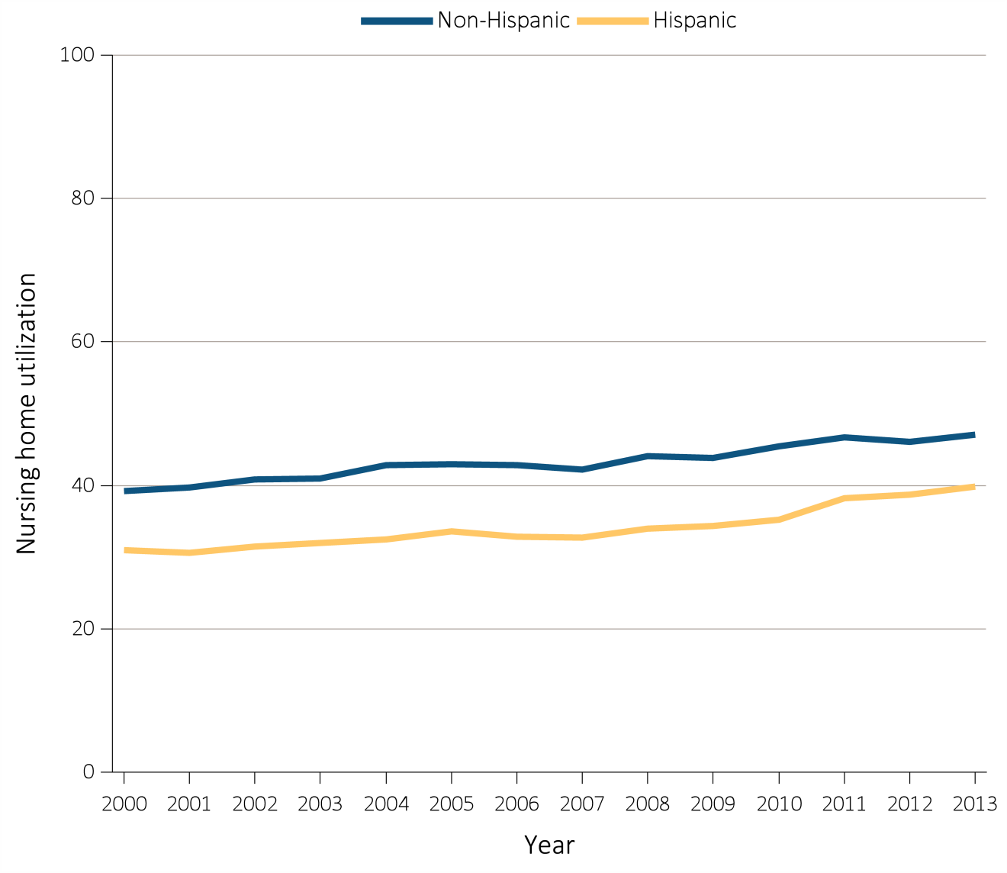
Figure 14.6 Nursing facility utilization in the last year of life among decedents overall, and by age, race, ethnicity, sex, and modality, 2000-2013
(d) Nursing facility utilization by ethnicity
Data Source: Special analyses, USRDS ESRD Database. Denominator population is all decedents admitted to a nursing home during the last year of life. Abbreviation: ESRD, end-stage renal disease.

Slide 31
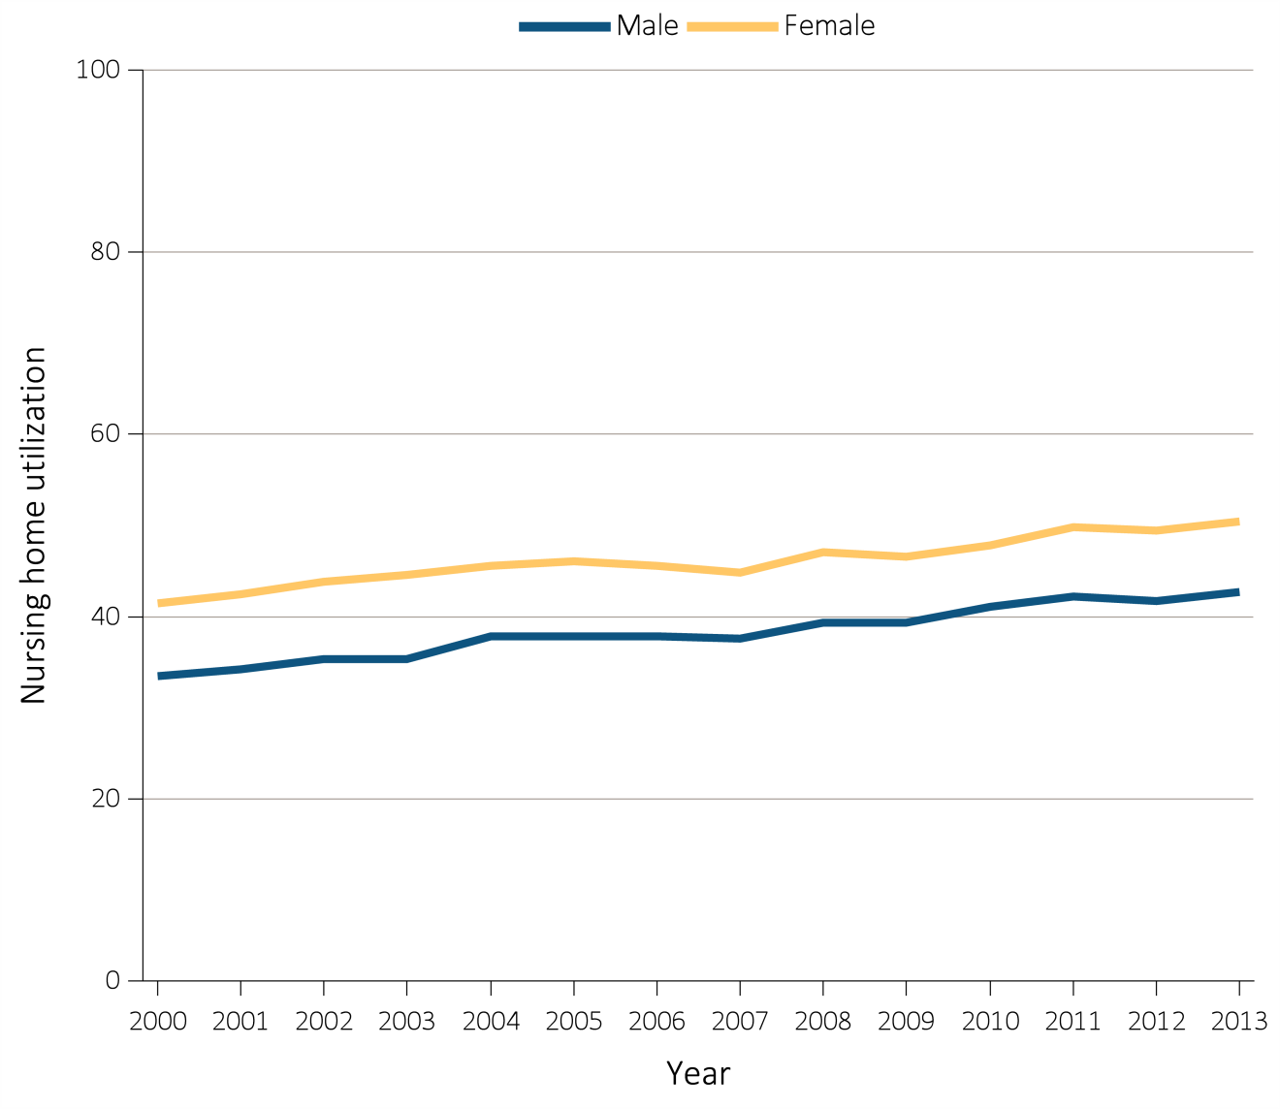
Figure 14.6 Nursing facility utilization in the last year of life among decedents overall, and by age, race, ethnicity, sex, and modality, 2000-2013
(e) Nursing facility utilization by sex
Data Source: Special analyses, USRDS ESRD Database. Denominator population is all decedents admitted to a nursing home during the last year of life. Abbreviation: ESRD, end-stage renal disease.

Slide 32
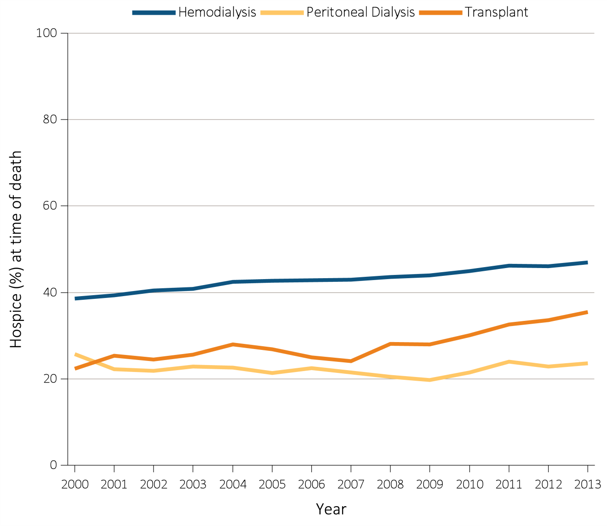
Figure 14.6 Nursing facility utilization in the last year of life among decedents overall, and by age, race, ethnicity, sex, and modality, 2000-2013
(f) Nursing facility utilization by modality
Data Source: Special analyses, USRDS ESRD Database. Denominator population is all decedents admitted to a nursing home during the last year of life. Abbreviation: ESRD, end-stage renal disease.

Slide 33
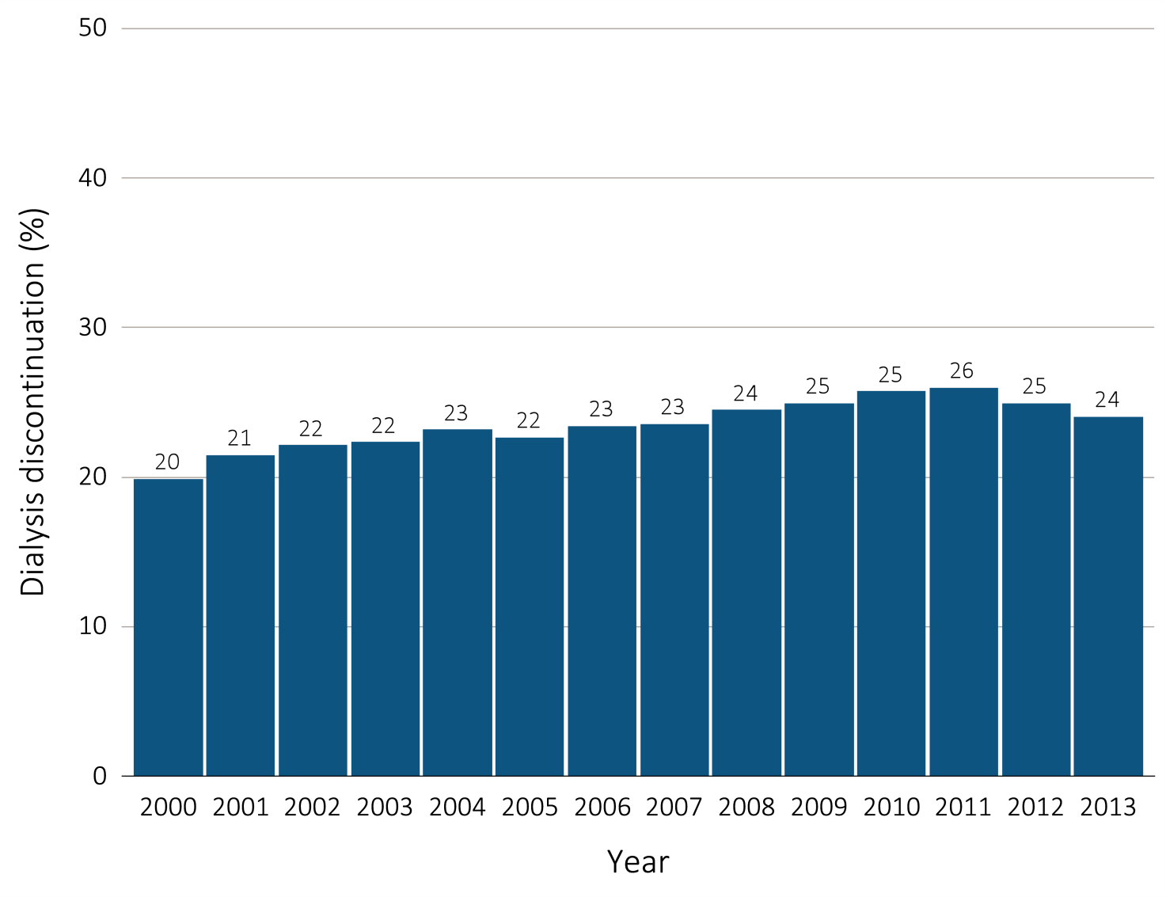
Figure 14.7 Dialysis discontinuation before death among decedents overall, and by age, race, ethnicity, sex, and modality, 2000-2013
(a) Dialysis discontinuation by year, overall
Data Source: Special analyses, USRDS ESRD Database. Denominator population is all patients with complete data on dialysis discontinuation from the CMS ESRD Death Notification form (CMS 2746). Abbreviation: ESRD, end-stage renal disease.

Slide 34
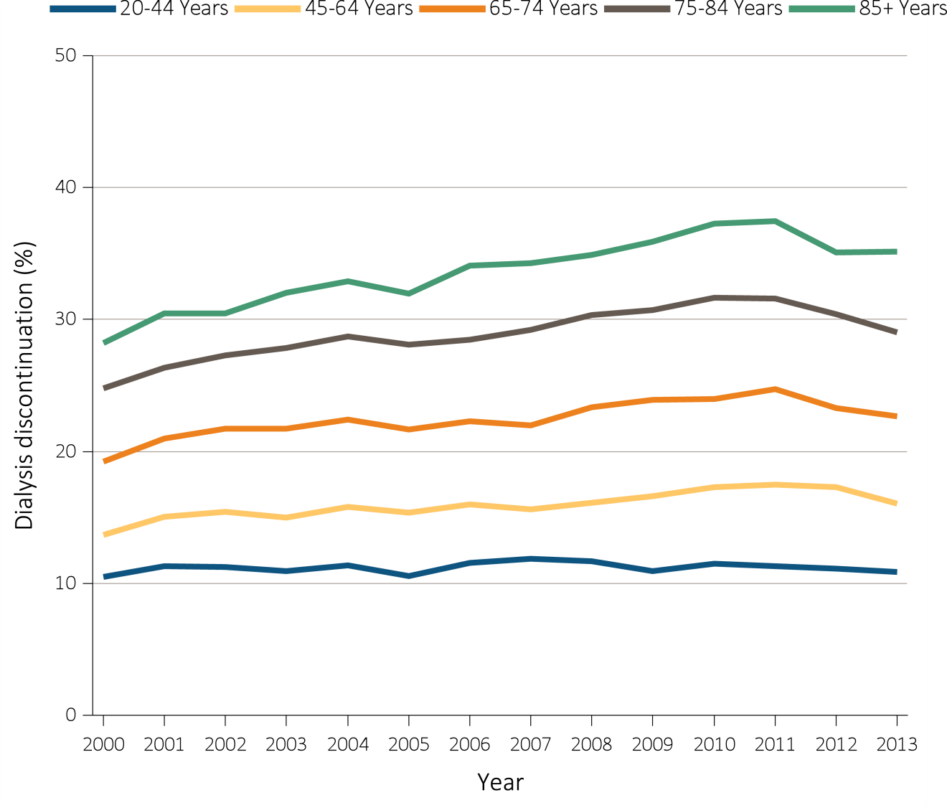
Figure 14.7 Dialysis discontinuation before death among decedents overall, and by age, race, ethnicity, sex, and modality, 2000-2013
(b) Dialysis discontinuation by age
Data Source: Special analyses, USRDS ESRD Database. Denominator population is all patients with complete data on dialysis discontinuation from the CMS ESRD Death Notification form (CMS 2746). Abbreviation: ESRD, end-stage renal disease.

Slide 35
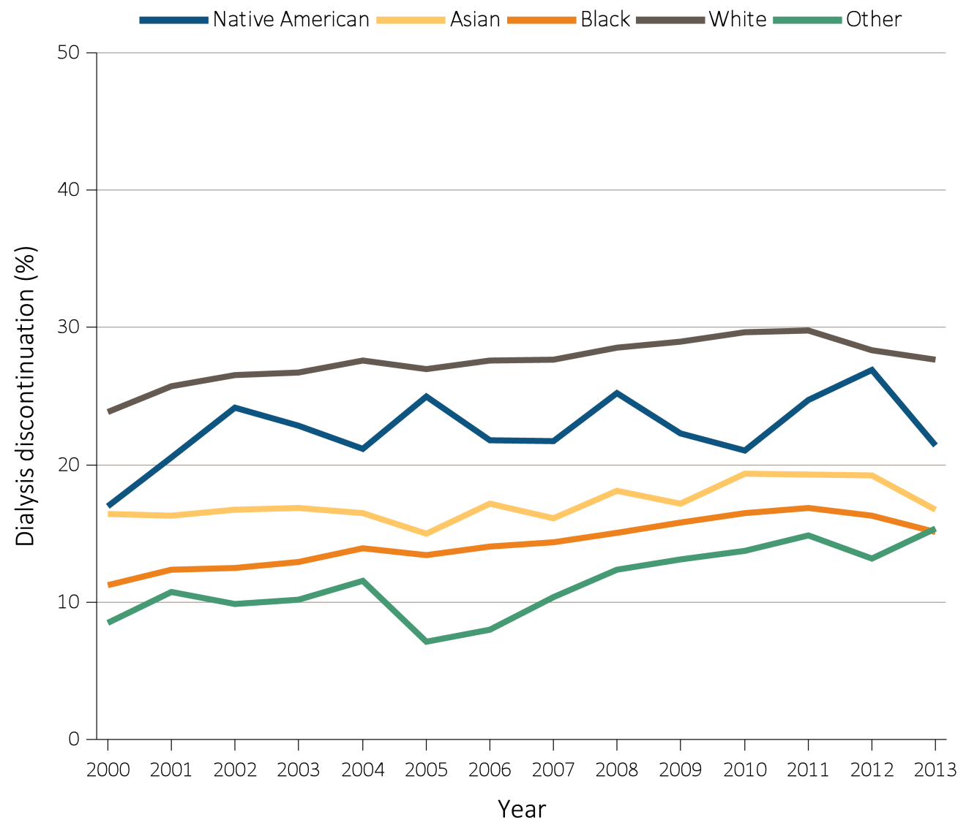
Figure 14.7 Dialysis discontinuation before death among decedents overall, and by age, race, ethnicity, sex, and modality, 2000-2013
(c) Dialysis discontinuation by race
Data Source: Special analyses, USRDS ESRD Database. Denominator population is all patients with complete data on dialysis discontinuation from the CMS ESRD Death Notification form (CMS 2746). Abbreviation: ESRD, end-stage renal disease.

Slide 36
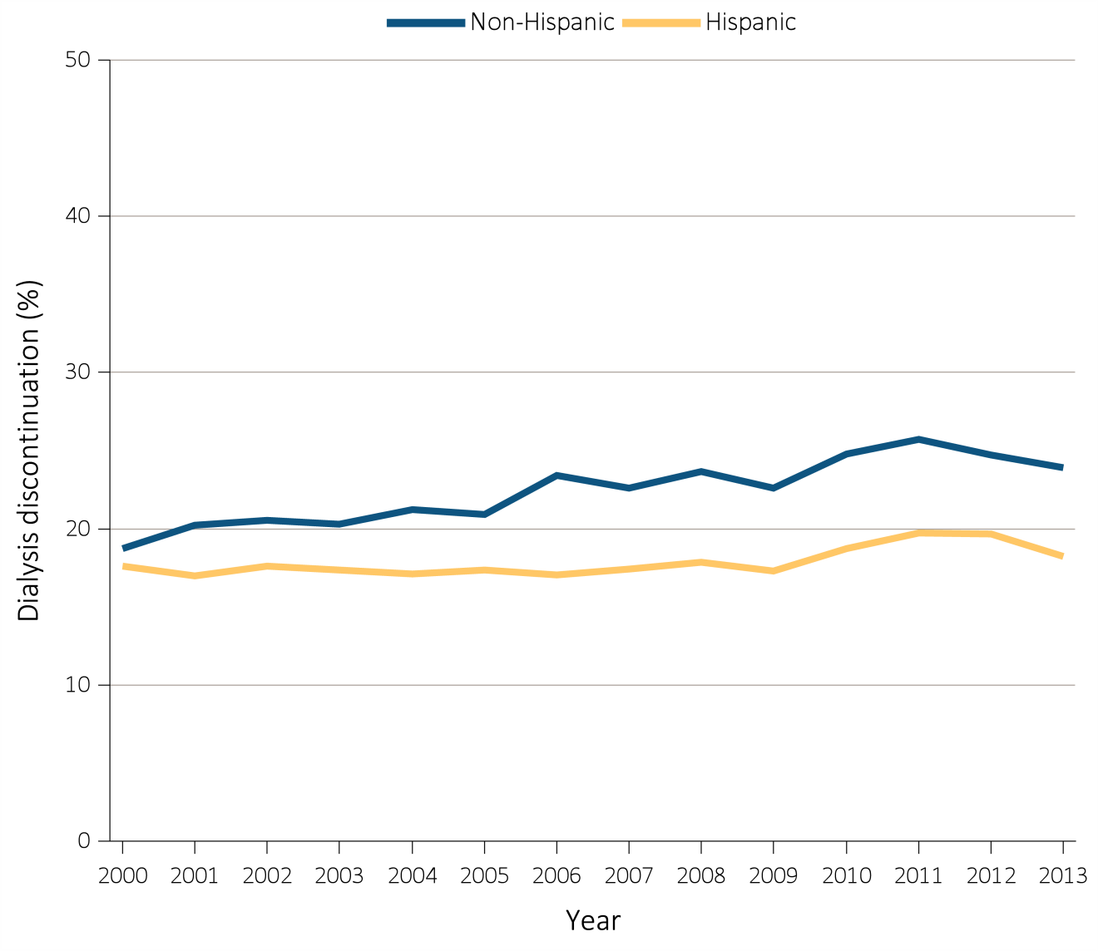
Figure 14.7 Dialysis discontinuation before death among decedents overall, and by age, race, ethnicity, sex, and modality, 2000-2013
(d) Dialysis discontinuation by ethnicity
Data Source: Special analyses, USRDS ESRD Database. Denominator population is all patients with complete data on dialysis discontinuation from the CMS ESRD Death Notification form (CMS 2746). Abbreviation: ESRD, end-stage renal disease.

Slide 37
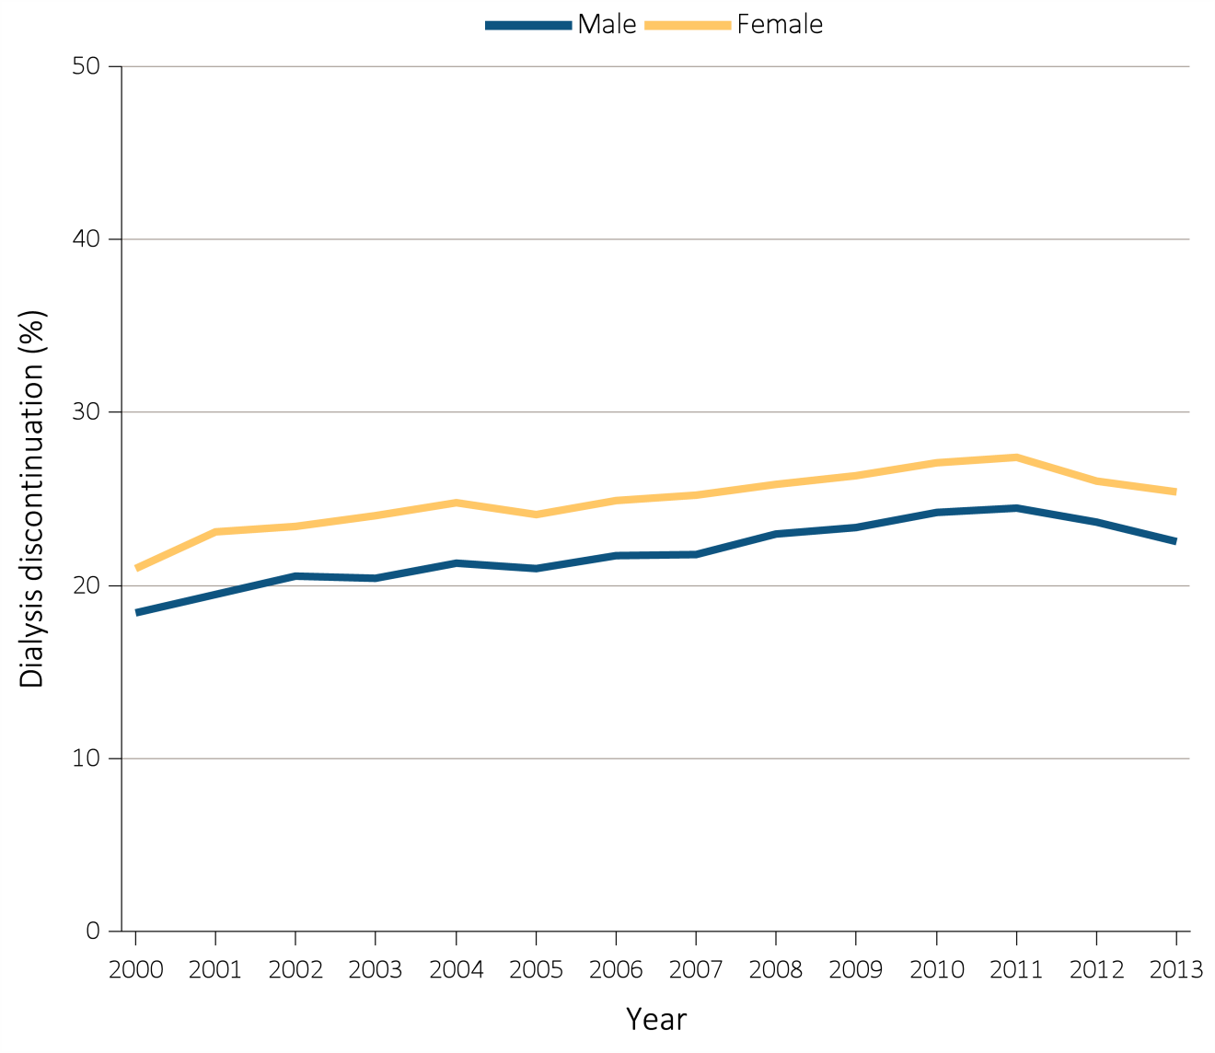
Figure 14.7 Dialysis discontinuation before death among decedents overall, and by age, race, ethnicity, sex, and modality, 2000-2013
(e) Dialysis discontinuation by sex
Data Source: Special analyses, USRDS ESRD Database. Denominator population is all patients with complete data on dialysis discontinuation from the CMS ESRD Death Notification form (CMS 2746). Abbreviation: ESRD, end-stage renal disease.

Slide 38
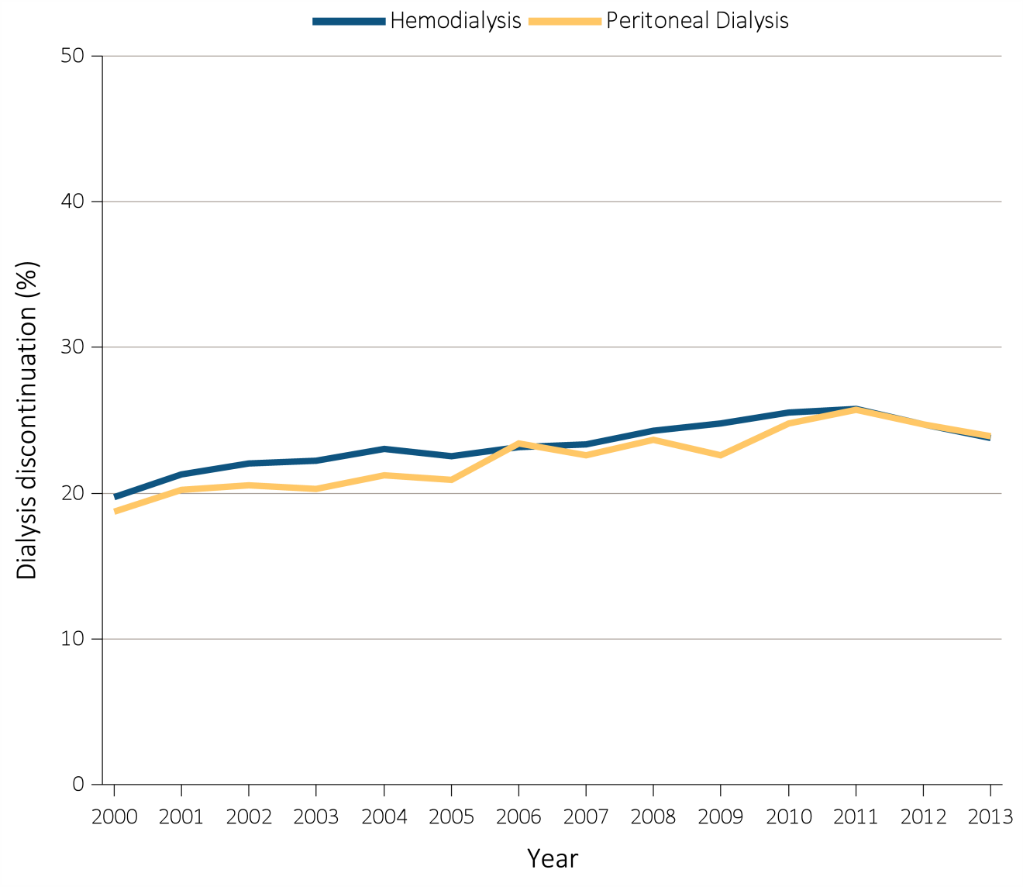
Figure 14.7 Dialysis discontinuation before death among decedents overall, and by age, race, ethnicity, sex, and modality, 2000-2013
(f) Dialysis discontinuation by modality
Data Source: Special analyses, USRDS ESRD Database. Denominator population is all patients with complete data on dialysis discontinuation from the CMS ESRD Death Notification form (CMS 2746). Abbreviation: ESRD, end-stage renal disease.

Slide 39
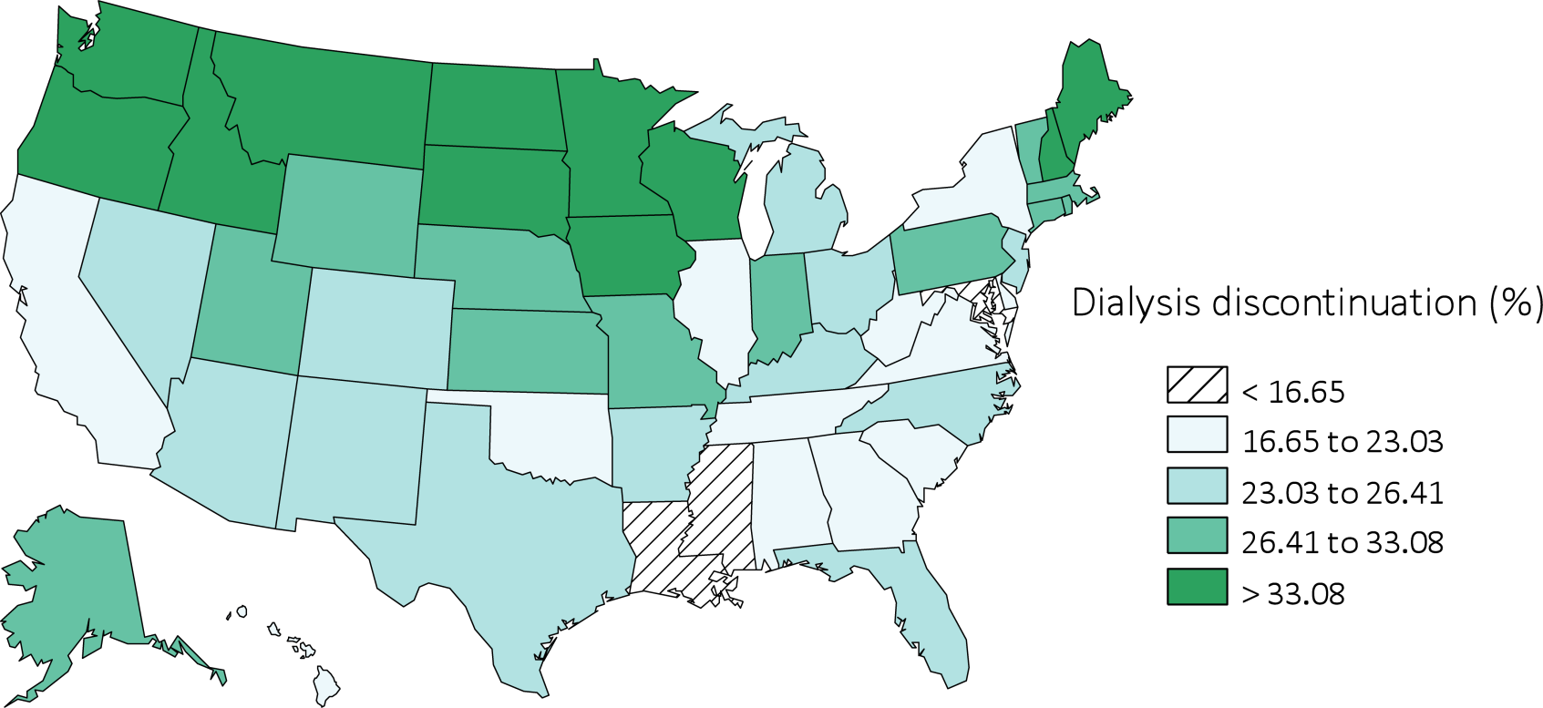
Figure 14.7 Dialysis discontinuation before death among decedents overall, and by age, race, ethnicity, sex, and modality, 2000-2013
(g) Dialysis discontinuation by state
Data Source: Special analyses, USRDS ESRD Database. Denominator population is all patients with complete data on dialysis discontinuation from the CMS ESRD Death Notification form (CMS 2746). Abbreviation: ESRD, end-stage renal disease.

Slide 40
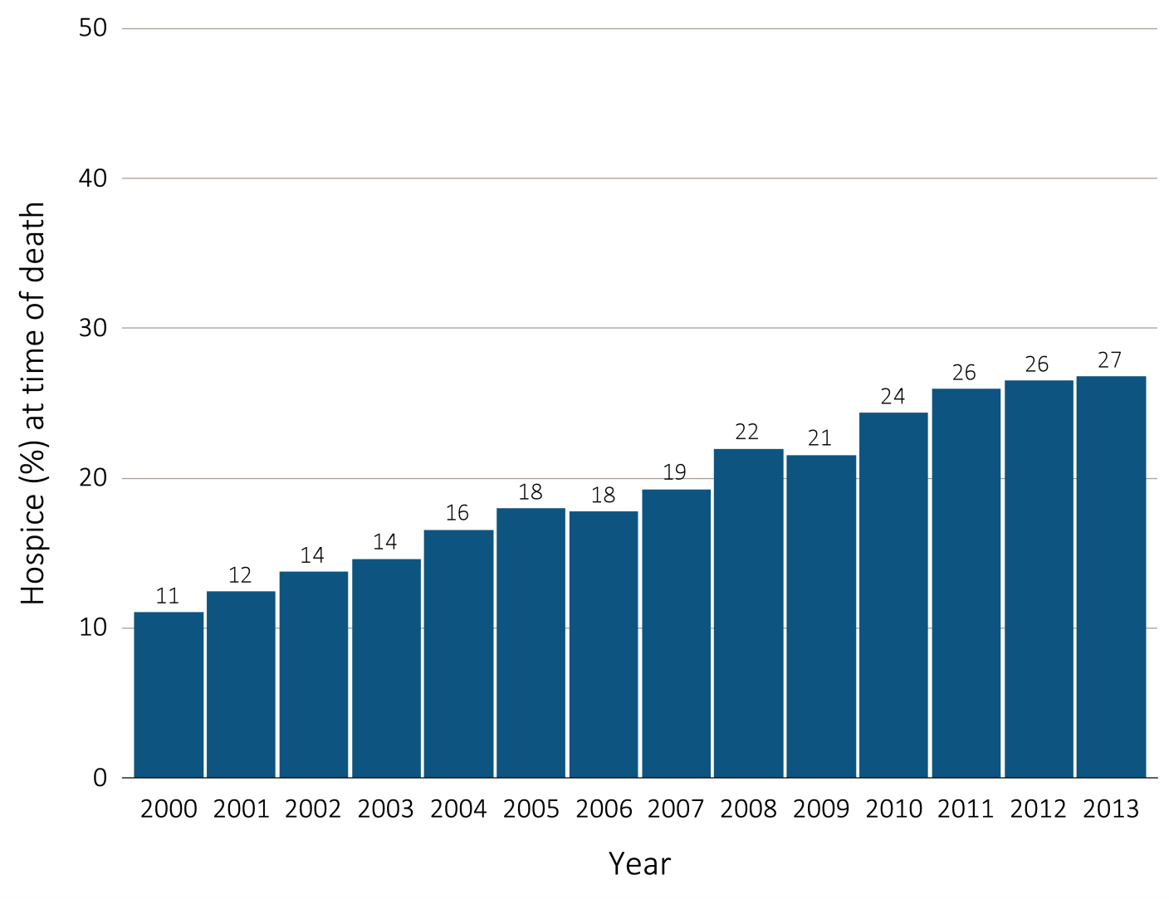
Figure 14.8 Hospice utilization at the time of death among Medicare beneficiaries with ESRD overall, and by age, race, ethnicity, sex, modality, and whether dialysis was discontinued, 2000-2013
(a) Hospice utilization by year, overall
Data Source: Special analyses, USRDS ESRD Database. Denominator population is all decedents with Medicare Parts A and B throughout the last 90 days of life. Receipt of hospice care at the time of death was defined as having a claim in the Hospice SAF on or after the date of death or Discharge Status from hospice=40, 41, or 42. Abbreviation: ESRD, end-stage renal disease.

Slide 41
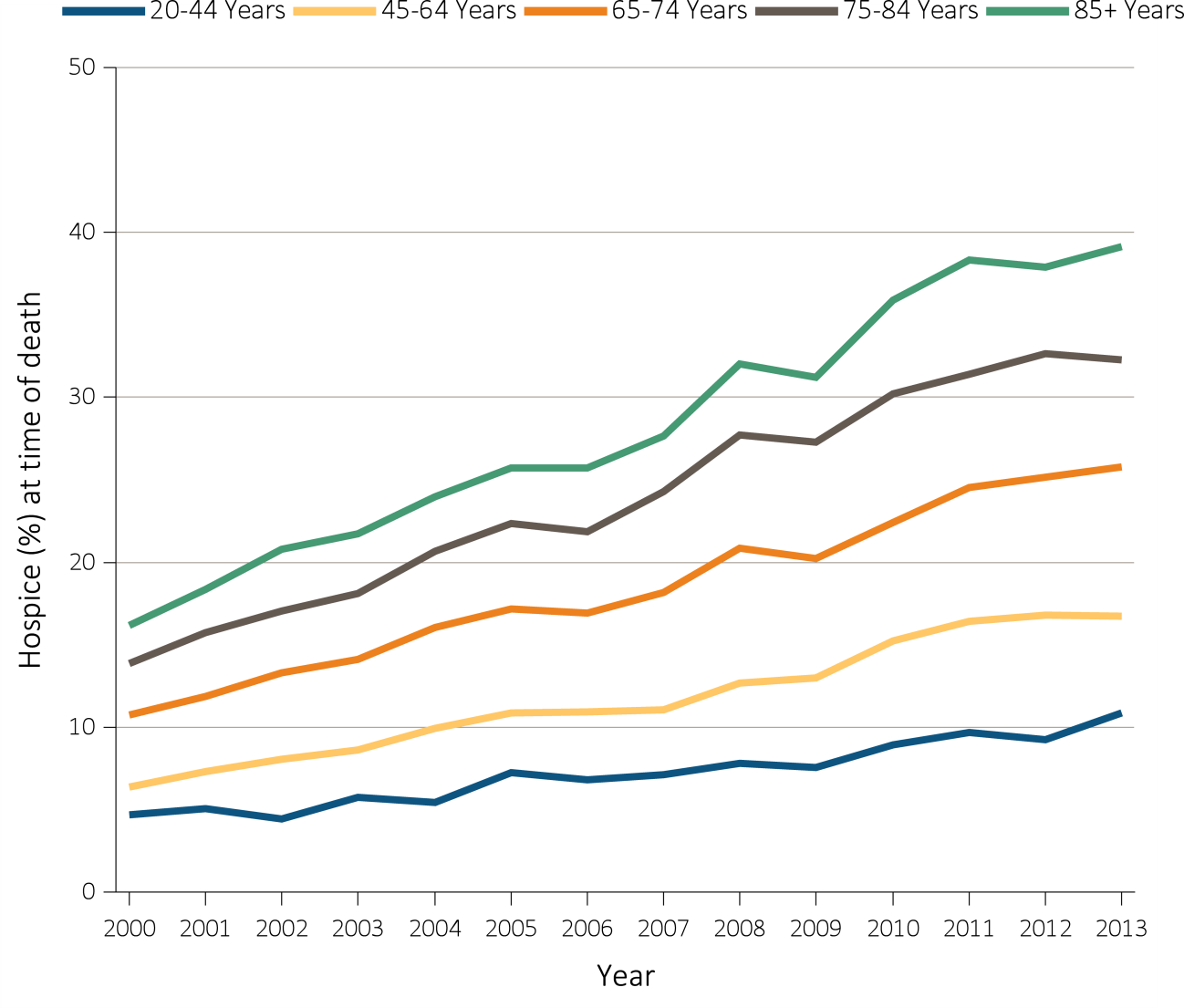
Figure 14.8 Hospice utilization at the time of death among Medicare beneficiaries with ESRD overall, and by age, race, ethnicity, sex, modality, and whether dialysis was discontinued, 2000-2013
(b) Hospice utilization by age
Data Source: Special analyses, USRDS ESRD Database. Denominator population is all decedents with Medicare Parts A and B throughout the last 90 days of life. Receipt of hospice care at the time of death was defined as having a claim in the Hospice SAF on or after the date of death or Discharge Status from hospice=40, 41, or 42. Abbreviation: ESRD, end-stage renal disease.

Slide 42
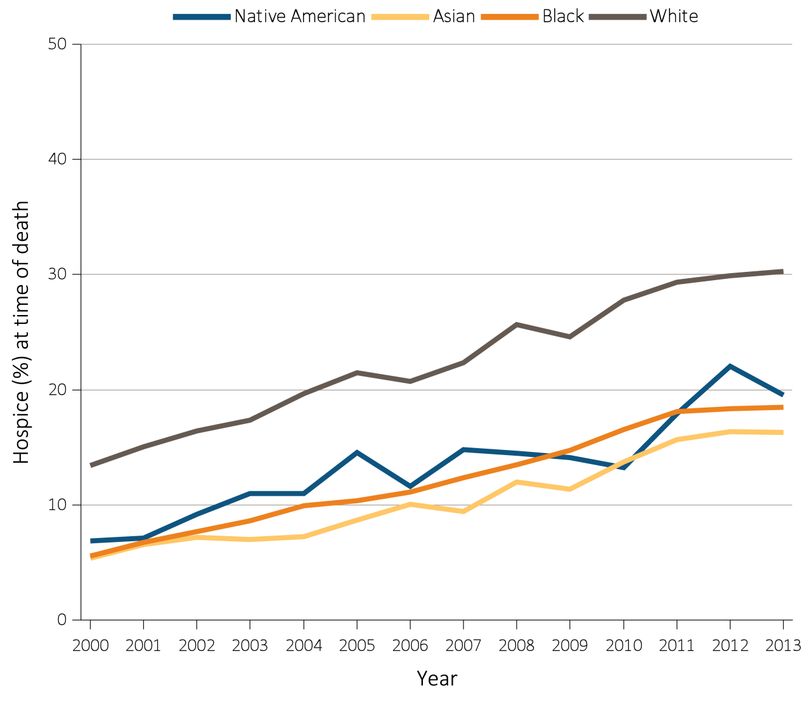
Figure 14.8 Hospice utilization at the time of death among Medicare beneficiaries with ESRD overall, and by age, race, ethnicity, sex, modality, and whether dialysis was discontinued, 2000-2013
(c) Hospice utilization by race
Data Source: Special analyses, USRDS ESRD Database. Denominator population is all decedents with Medicare Parts A and B throughout the last 90 days of life. Receipt of hospice care at the time of death was defined as having a claim in the Hospice SAF on or after the date of death or Discharge Status from hospice=40, 41, or 42. Abbreviation: ESRD, end-stage renal disease.

Slide 43
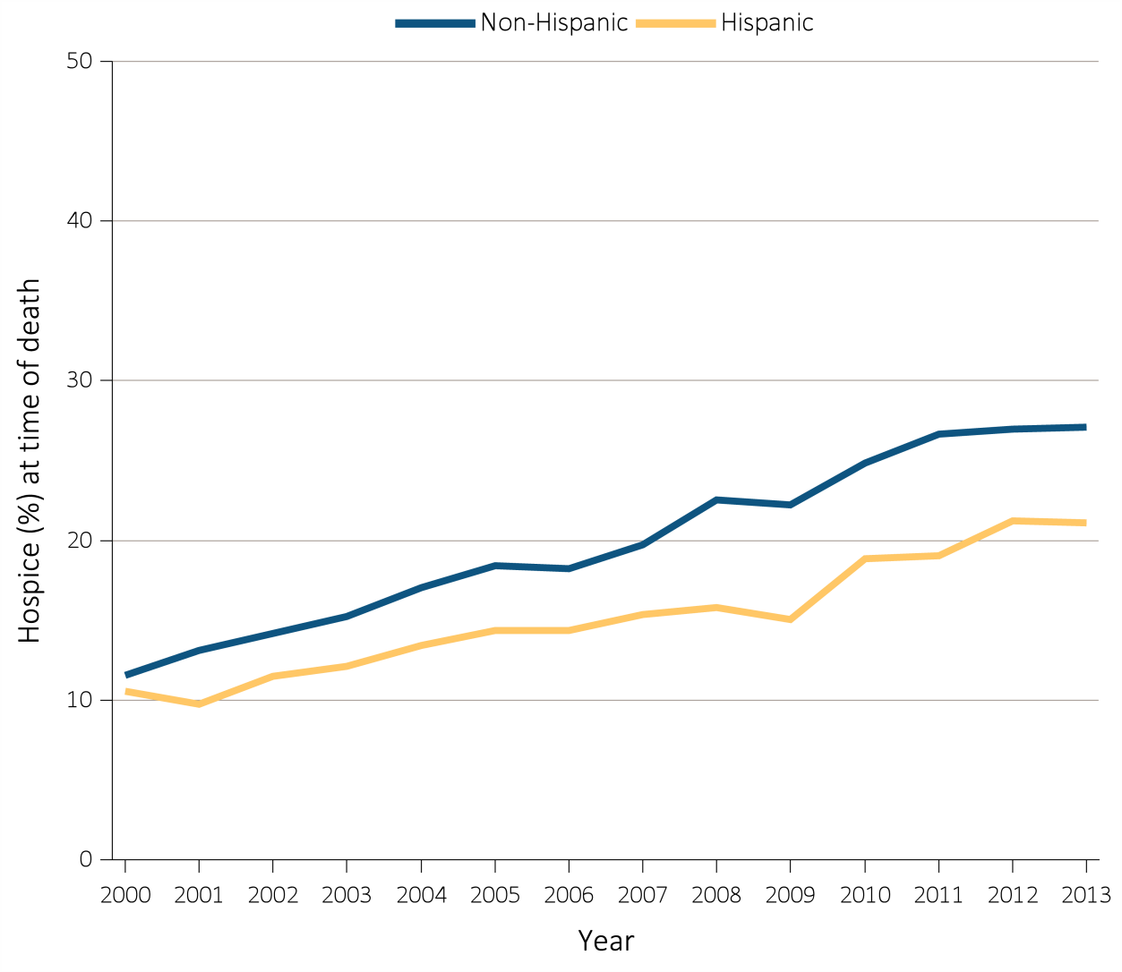
Figure 14.8 Hospice utilization at the time of death among Medicare beneficiaries with ESRD overall, and by age, race, ethnicity, sex, modality, and whether dialysis was discontinued, 2000-2013
(d) Hospice utilization by ethnicity
Data Source: Special analyses, USRDS ESRD Database. Denominator population is all decedents with Medicare Parts A and B throughout the last 90 days of life. Receipt of hospice care at the time of death was defined as having a claim in the Hospice SAF on or after the date of death or Discharge Status from hospice=40, 41, or 42. Abbreviation: ESRD, end-stage renal disease.

Slide 44
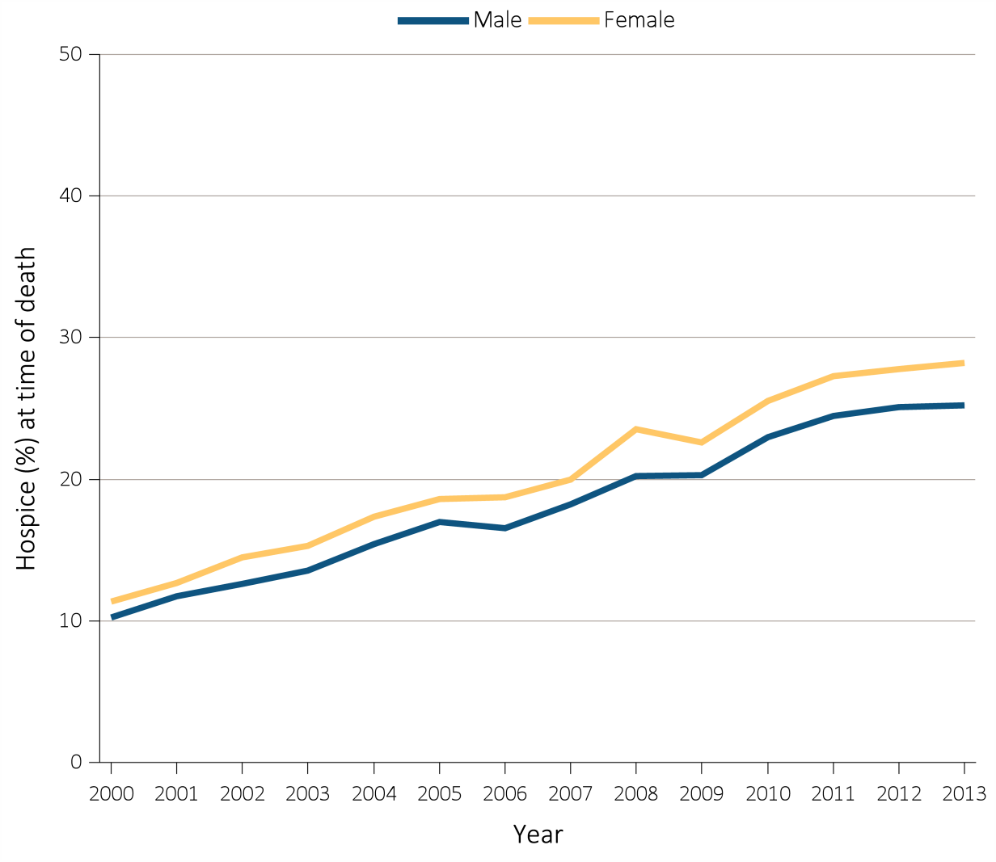
Figure 14.8 Hospice utilization at the time of death among Medicare beneficiaries with ESRD overall, and by age, race, ethnicity, sex, modality, and whether dialysis was discontinued, 2000-2013
(e) Hospice utilization by sex
Data Source: Special analyses, USRDS ESRD Database. Denominator population is all decedents with Medicare Parts A and B throughout the last 90 days of life. Receipt of hospice care at the time of death was defined as having a claim in the Hospice SAF on or after the date of death or Discharge Status from hospice=40, 41, or 42. Abbreviation: ESRD, end-stage renal disease.

Slide 45
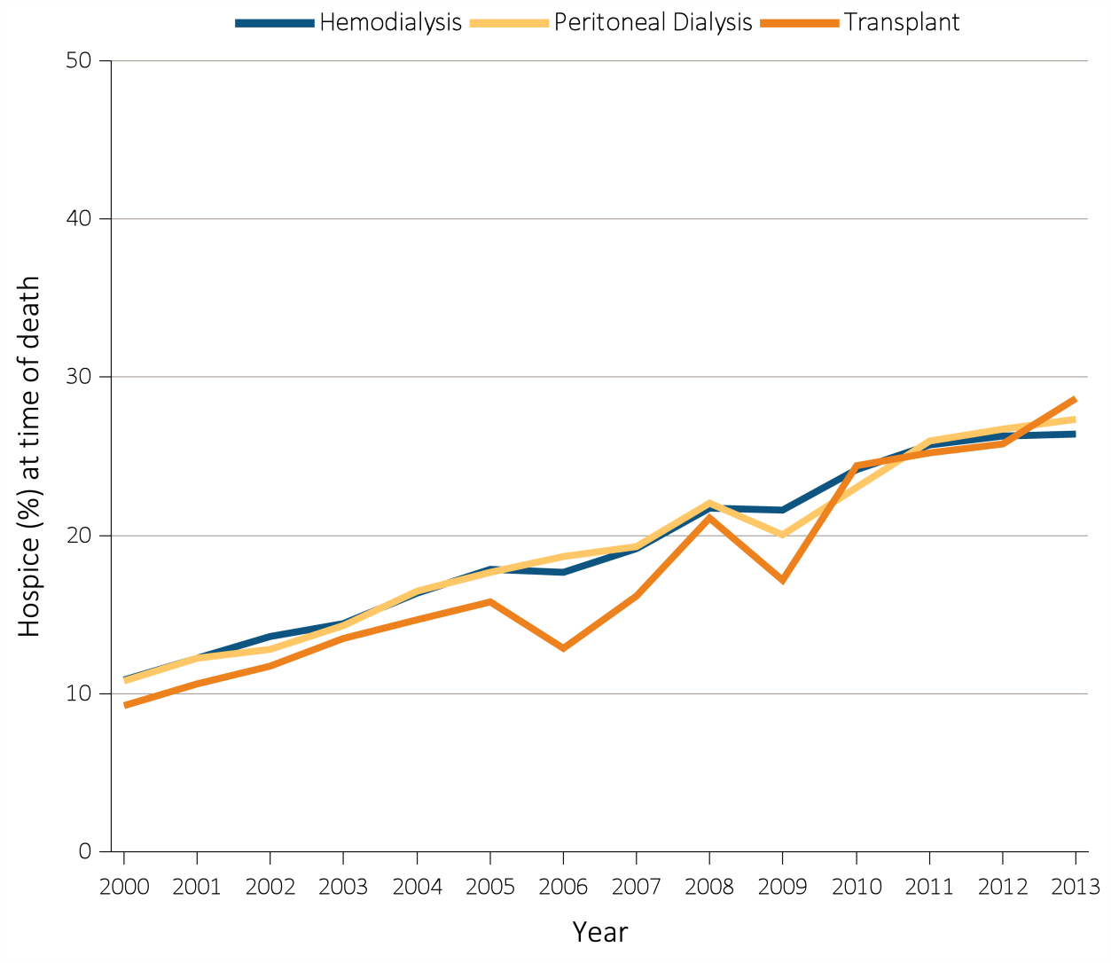
Figure 14.8 Hospice utilization at the time of death among Medicare beneficiaries with ESRD overall, and by age, race, ethnicity, sex, modality, and whether dialysis was discontinued, 2000-2013
(f) Hospice utilization by modality
Data Source: Special analyses, USRDS ESRD Database. Denominator population is all decedents with Medicare Parts A and B throughout the last 90 days of life. Receipt of hospice care at the time of death was defined as having a claim in the Hospice SAF on or after the date of death or Discharge Status from hospice=40, 41, or 42. Abbreviation: ESRD, end-stage renal disease.

Slide 46
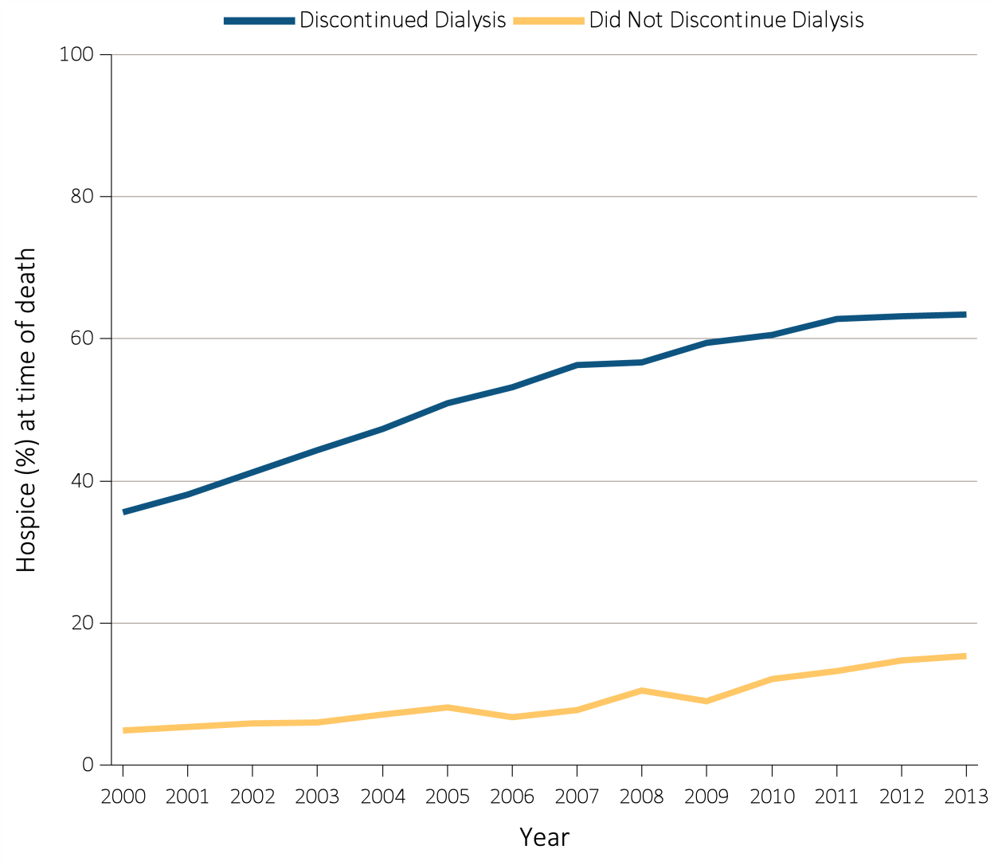
Figure 14.8 Hospice utilization at the time of death among Medicare beneficiaries with ESRD overall, and by age, race, ethnicity, sex, modality, and whether dialysis was discontinued, 2000-2013
(g) Hospice utilization by whether patients discontinued dialysis before death
Data Source: Special analyses, USRDS ESRD Database. Denominator population is all decedents with Medicare Parts A and B throughout the last 90 days of life. Receipt of hospice care at the time of death was defined as having a claim in the Hospice SAF on or after the date of death or Discharge Status from hospice=40, 41, or 42. Abbreviation: ESRD, end-stage renal disease.

Slide 47
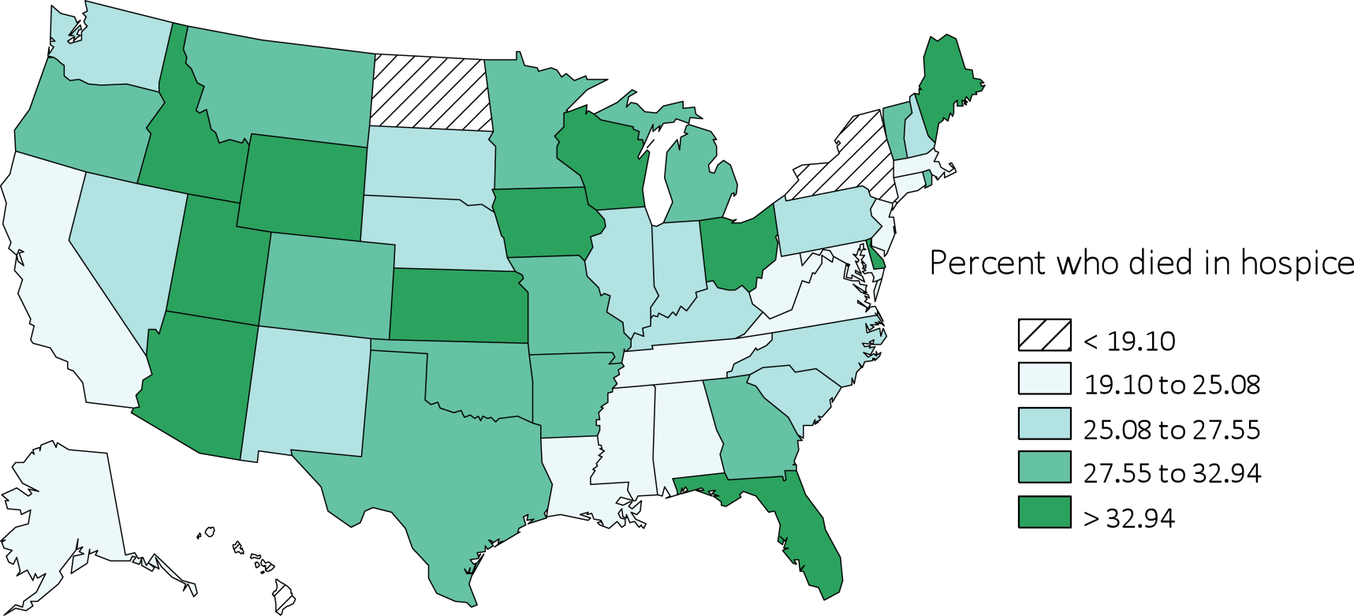
Figure 14.8 Hospice utilization at the time of death among Medicare beneficiaries with ESRD overall, and by age, race, ethnicity, sex, modality, and whether dialysis was discontinued, 2000-2013
(h) Hospice utilization by state
Data Source: Special analyses, USRDS ESRD Database. Denominator population is all decedents with Medicare Parts A and B throughout the last 90 days of life. Receipt of hospice care at the time of death was defined as having a claim in the Hospice SAF on or after the date of death or Discharge Status from hospice=40, 41, or 42. Abbreviation: ESRD, end-stage renal disease.

Slide 48
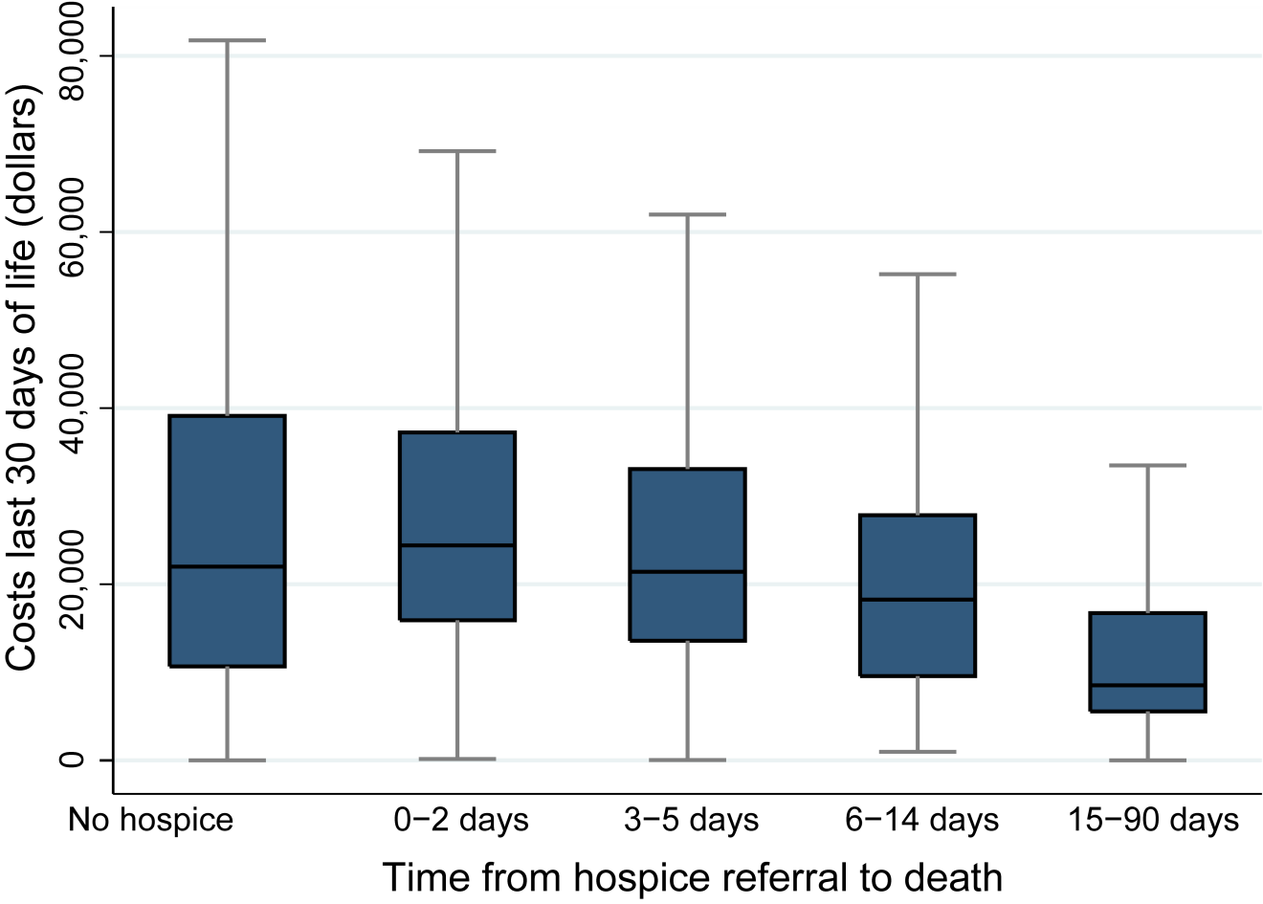
Figure 14.9 Costs in the (a) last 30 days of life, and (b) last 7 days of life in relation to timing of hospice care, 2013
(a) Last 30 days of life
Data Source: Special analyses, USRDS ESRD Database. Denominator population is all decedents with Medicare Parts A and B throughout the last 90 days of life exclusive of those patients without any costs during the last 30 days of life and those with negative costs. Date of the first claim in the Hospice SAF (HCFASAF=H) within the last 90 days of life is taken as the date of first receipt of hospice services. Timing of hospice referral in relation to death was categorized as 0-2 days, 3-5 days 6-14 days, and 15-90 days). Explanation of box plot: the lower border of the box is the first quartile and the upper border is the third quartile of the distribution, the length of the box is the interquartile range, and the line in the middle of the box is the median value. The whiskers extend from the lowest value of the distribution that is ≥ the first quartile minus 1.5 times the interquartile range at the bottom to the highest value of the distribution that is ≤ the third quartile plus 1.5 times the interquartile range at the top. Values outside this range (outliers) are not plotted.

Slide 49
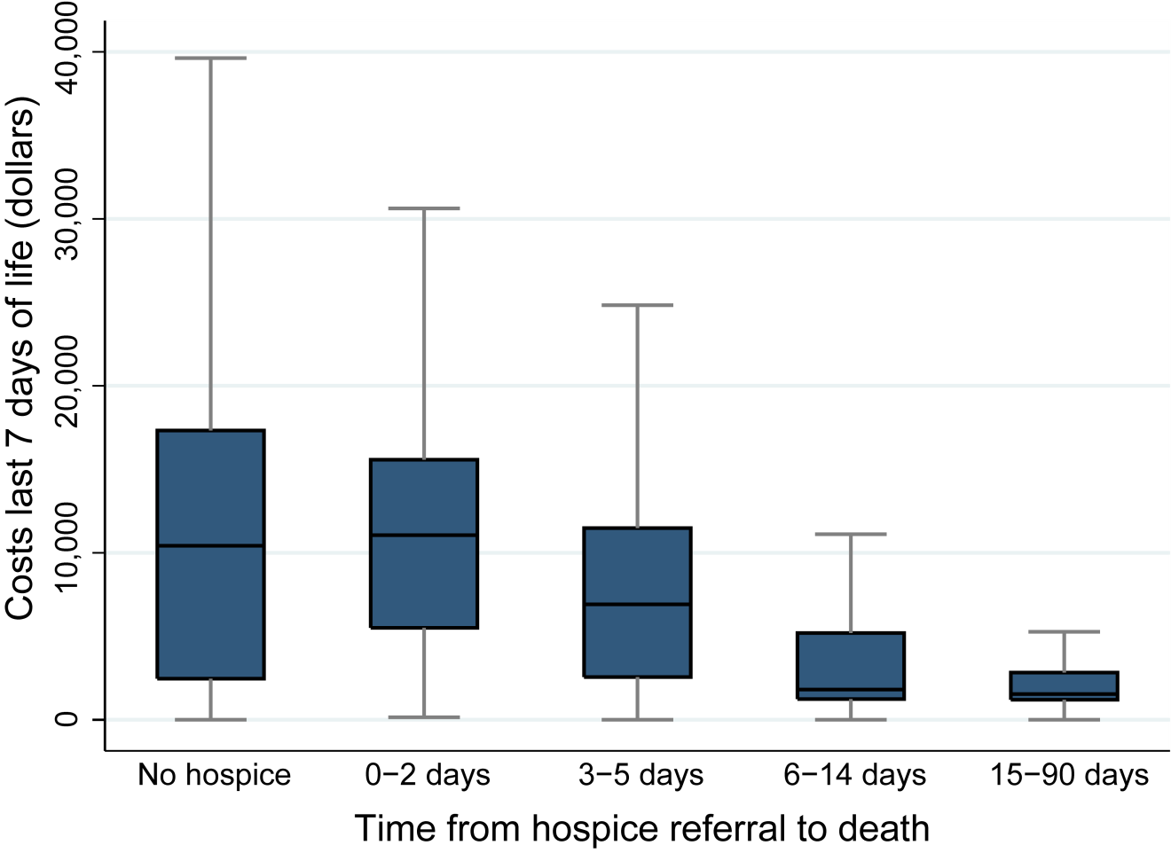
Figure 14.9 Costs in the (a) last 30 days of life, and (b) last 7 days of life in relation to timing of hospice care, 2013
(b) Last 7 days of life
Data Source: Special analyses, USRDS ESRD Database. Denominator population is all decedents with Medicare Parts A and B throughout the last 90 days of life exclusive of those patients without any costs during the last 30 days of life and those with negative costs. Date of the first claim in the Hospice SAF (HCFASAF=H) within the last 90 days of life is taken as the date of first receipt of hospice services. Timing of hospice referral in relation to death was categorized as 0-2 days, 3-5 days 6-14 days, and 15-90 days). Explanation of box plot: the lower border of the box is the first quartile and the upper border is the third quartile of the distribution, the length of the box is the interquartile range, and the line in the middle of the box is the median value. The whiskers extend from the lowest value of the distribution that is ≥ the first quartile minus 1.5 times the interquartile range at the bottom to the highest value of the distribution that is ≤ the third quartile plus 1.5 times the interquartile range at the top. Values outside this range (outliers) are not plotted.

