Slide 1
2017 Annual Data Report
Volume 1: Chronic Kidney Disease
Chapter 4:
Cardiovascular Disease in Patients with Chronic Kidney Disease

Slide 2
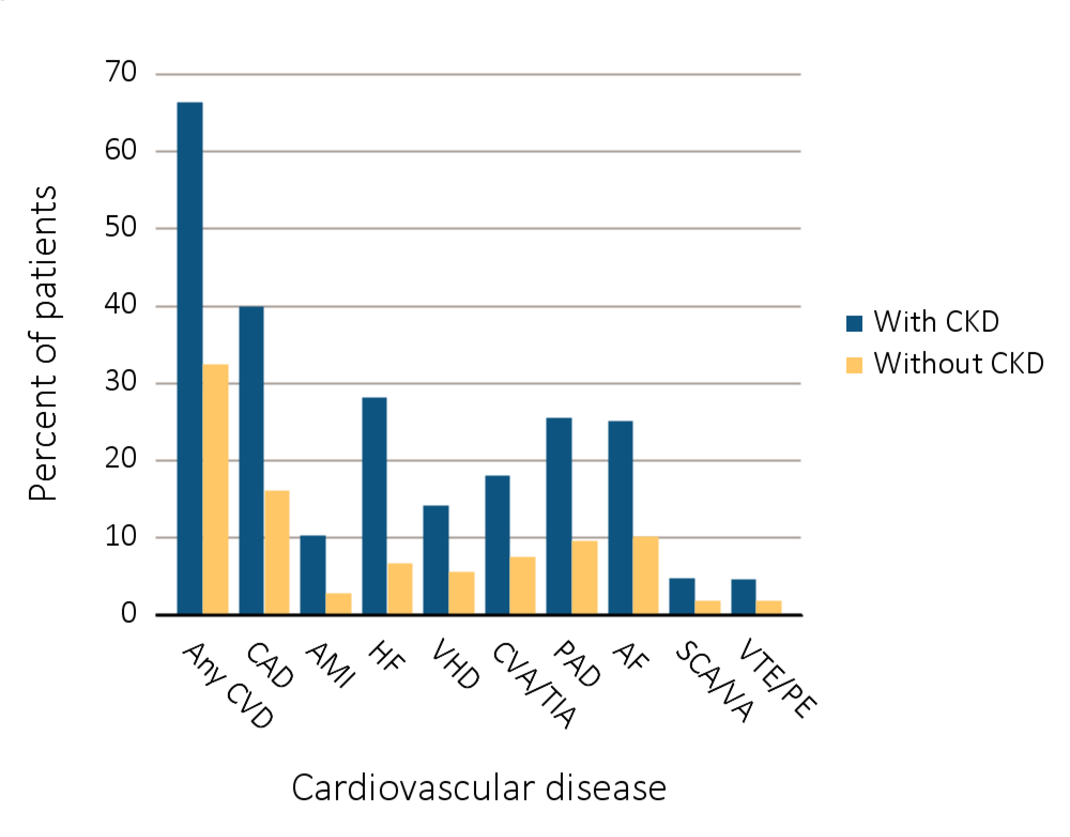
vol 1 Figure 4.1 Prevalence of common cardiovascular diseases in patients with or without CKD, 2015
Data Source: Special analyses, Medicare 5% sample. Abbreviations: AF, atrial fibrillation; AMI, acute myocardial infarction; CAD, coronary artery disease; CKD, chronic kidney disease; CVA/TIA, cerebrovascular accident/transient ischemic attack; CVD, cardiovascular disease; HF, heart failure; PAD, peripheral arterial disease; SCA/VA, sudden cardiac arrest and ventricular arrhythmias; VHD, valvular heart disease; VTE/PE, venous thromboembolism and pulmonary embolism.

Slide 3
vol 1 Table 4.1 Prevalence of (a) cardiovascular comorbidities & (b) annual incidence of cardiovascular procedures, by CKD status, age, race, & sex, 2015
Cardiovascular comorbidities
 | # Patients | % Patients
 |  | Overall | 66-69 | 70-74 |  | 75-84 |  | 85+ | White | Blk/Af Am | Other | Male | Female
Any CVD
Without CKD | 1,102,413 | 31.9 | 18.9 | 27.0 | 39.0 |  | 52.1 |  | 32.8 | 28.0 | 23.3 | 35.3 | 29.3
Any CKD | 146,663 | 65.8 | 52.0 | 58.5 | 67.6 |  | 76.4 |  | 66.9 | 61.7 | 57.7 | 69.8 | 62.1
Coronary artery disease (CAD)
Without CKD | 1,102,413 | 15.6 | 9.6 | 13.9 |  | 19.4 |  | 22.4 | 16.1 | 12.3 | 11.7 | 20.8 | 11.6
Any CKD | 146,663 | 39.4 | 30.9 | 35.8 |  | 41.6 |  | 43.6 | 40.5 | 33.3 | 34.8 | 47.0 | 32.3
Acute myocardial infarction (AMI)
Without CKD | 1,102,413 | 2.2 | 1.5 | 2.0 |  | 2.7 |  | 3.4 | 2.3 | 1.9 | 1.4 | 2.9 | 1.7
Any CKD | 146,663 | 9.7 | 8.3 | 9.1 |  | 9.7 |  | 10.9 | 10.0 | 8.2 | 7.3 | 11.5 | 8.0
Heart failure (HF)
Without CKD | 1,102,413 | 6.1 | 3.0 | 4.3 |  | 7.2 |  | 13.6 | 6.2 | 6.9 | 4.2 | 6.4 | 5.9
Any CKD | 146,663 | 27.6 | 20.0 | 21.7 |  | 27.2 |  | 37.1 | 27.9 | 29.3 | 21.8 | 28.2 | 27.2
Valvular heart disease (VHD)
Without CKD | 1,102,413 | 5.0 | 2.4 | 3.8 |  | 6.6 |  | 9.2 | 5.3 | 3.3 | 3.3 | 4.9 | 5.1
Any CKD | 146,663 | 13.6 | 8.1 | 10.0 |  | 14.2 |  | 18.5 | 14.2 | 10.3 | 10.7 | 13.6 | 13.6
Cerebrovascular accident/transient ischemic attack (CVA/TIA)
Without CKD | 1,102,413 | 6.9 | 3.7 | 5.6 |  | 8.9 |  | 11.7 | 7.0 | 7.5 | 5.2 | 6.9 | 6.9
Any CKD | 146,663 | 17.5 | 12.7 | 15.0 |  | 18.6 |  | 20.5 | 17.5 | 18.6 | 15.4 | 17.7 | 17.3
Peripheral artery disease (PAD)
Without CKD | 1,102,413 | 9.1 | 4.3 | 6.7 |  | 11.0 |  | 19.1 | 9.2 | 9.7 | 6.5 | 9.3 | 8.9
Any CKD | 146,663 | 24.9 | 17.5 | 20.6 |  | 25.5 |  | 31.6 | 25.3 | 24.4 | 20.9 | 26.5 | 23.5
Atrial fibrillation (AF)
Without CKD | 1,102,413 | 9.6 | 4.1 | 6.9 |  | 12.5 |  | 19.6 | 10.3 | 4.8 | 5.1 | 10.8 | 8.7
Any CKD | 146,663 | 24.6 | 14.2 | 17.9 |  | 25.9 |  | 33.7 | 26.4 | 14.7 | 16.0 | 27.3 | 22.1
Cardiac arrest and ventricular arrhythmias (SCA/VA)
Without CKD | 1,102,413 | 1.3 | 0.9 | 1.3 |  | 1.7 |  | 1.7 | 1.4 | 1.1 | 0.8 | 1.9 | 1.0
Any CKD | 146,663 | 4.2 | 3.5 | 4.0 |  | 4.6 |  | 4.2 | 4.3 | 4.4 | 2.8 | 5.7 | 2.8
Venous thromboembolism and pulmonary embolism (VTE/PE)
Without CKD | 1,102,413 | 1.3 | 0.8 | 1.1 |  | 1.5 |  | 1.9 | 1.3 | 1.5 | 0.6 | 1.2 | 1.3
Any CKD | 146,663 | 4.1 | 3.8 | 3.6 |  | 4.1 |  | 4.6 | 4.1 | 5.1 | 2.4 | 4.0 | 4.2

Slide 4
vol 1 Table 4.1 Prevalence of (a) cardiovascular comorbidities & (b) annual incidence of cardiovascular procedures, by CKD status, age, race, & sex, 2015 (continued)
(b) Cardiovascular procedures
 | # Patients | % Patients
 |  | Overall |  | 66-69 | 70-74 | 75-84 | 85+ | White | Blk/Af Am | Other | Male | Female
Revascularization – percutaneous coronary interventions (PCI)
Without CKD | 171,640 |  | 1.6 | 2.3 | 1.8 | 1.4 | 1.0 | 1.6 | 1.4 | 1.5 | 1.6 | 1.6
Any CKD | 57,788 |  | 2.4 | 3.0 | 2.9 | 2.5 | 1.7 | 2.4 | 2.2 | 2.2 | 2.5 | 2.1
Revascularization – coronary artery bypass graft (CABG)
Without CKD | 171,640 |  | 1.1 | 1.6 | 1.4 | 1.1 | 0.3 | 1.1 | 0.5 | 1.1 | 1.3 | 0.7
Any CKD | 57,788 |  | 1.6 | 2.9 | 2.4 | 1.8 | 0.4 | 1.7 | 1.2 | 1.8 | 2.1 | 1.0
Implantable cardioverter defibrillators & cardiac resynchronization therapy with defibrillator (ICD/CRT-D)
Without CKD | 67,366 |  | 0.5 | 0.8 | 0.8 | 0.7 | 0.2 | 0.5 | 0.6 | 0.5 | 0.8 | 0.4
Any CKD | 40,545 |  | 0.9 | 1.3 | 1.4 | 1.0 | 0.5 | 0.9 | 1.0 | 0.9 | 1.3 | 0.6
Carotid artery stenting and carotid artery endarterectomy (CAS/CEA)
Without CKD | 269,224 |  | 0.6 | 0.7 | 0.7 | 0.7 | 0.3 | 0.6 | 0.4 | 0.5 | 0.6 | 0.5
Any CKD | 79,790 |  | 0.7 | 0.9 | 1.1 | 0.8 | 0.4 | 0.8 | 0.4 | 0.5 | 0.9 | 0.6
Data Source: Special analyses, Medicare 5% sample. Patients aged 66 and older, alive, without end-stage renal disease, and residing in the United States on 12/31/2015 with fee-for-service coverage for the entire calendar year. Abbreviations: AF, atrial fibrillation; AMI, acute myocardial infarction; Blk/Af Am, Black African American; CABG, coronary artery bypass grafting; CAD, coronary artery disease; CAS/CEA, carotid artery stenting and carotid endarterectomy; CKD, chronic kidney disease; CVA/TIA, cerebrovascular accident/transient ischemic attack; CVD, cardiovascular disease; HF, heart failure; ICD/CRT-D, implantable cardioverter defibrillators/cardiac resynchronization therapy with defibrillator devices; PAD, peripheral arterial disease; PCI, percutaneous coronary interventions; SCA/VA, sudden cardiac arrest and ventricular arrhythmias; VHD, valvular heart disease; VTE/PE, venous thromboembolism and pulmonary embolism. (a) The denominators for overall prevalence of all cardiovascular comorbidities were Medicare enrollees aged 66+ by CKD status. (b) The denominators for overall prevalence of PCI and CABG were Medicare enrollees aged 66+ with CAD by CKD status. The denominators for overall prevalence of ICD/CRT-D were Medicare enrollees aged 66+ with HF by CKD status. The denominators for overall prevalence of CAS/CEA were Medicare enrollees aged 66+ with CAD, CVA/TIA, or PAD by CKD status.

Slide 5
Table A. ICD-9-CM and ICD-10-CM codes for Chronic Kidney Disease (CKD) stages
ICD-9-CM codeª | ICD-10-CM codeª | Stage
585.1 | N18.1 | CKD, Stage 1
585.2 | N18.2 | CKD, Stage 2 (mild)
585.3 | N18.3 | CKD, Stage 3 (moderate)
585.4 | N18.4 | CKD, Stage 4 (severe)
585.5 | N18.5 | CKD, Stage 5 (excludes 585.6: Stage 5, requiring chronic dialysis^{b})
CKD Stage-unspecified | CKD Stage-unspecified | For these analyses, identified by multiple codes including 585.9, 250.4x, 403.9x & others for ICD-9-CM and A18.xx, E08.xx, E11.xx and other for ICD-10-CM.
ª For analyses in this chapter, CKD stage estimates require at least one occurrence of a stage-specific code, and the last available CKD stage in a given year is used. ^{b} In USRDS analyses, patients with ICD-9-CM code 585.6 or ICD-10-CM code N18.6 & with no ESRD 2728 form or other indication of end-stage renal disease (ESRD) are considered to have code 585.5 or N18.5

Slide 6
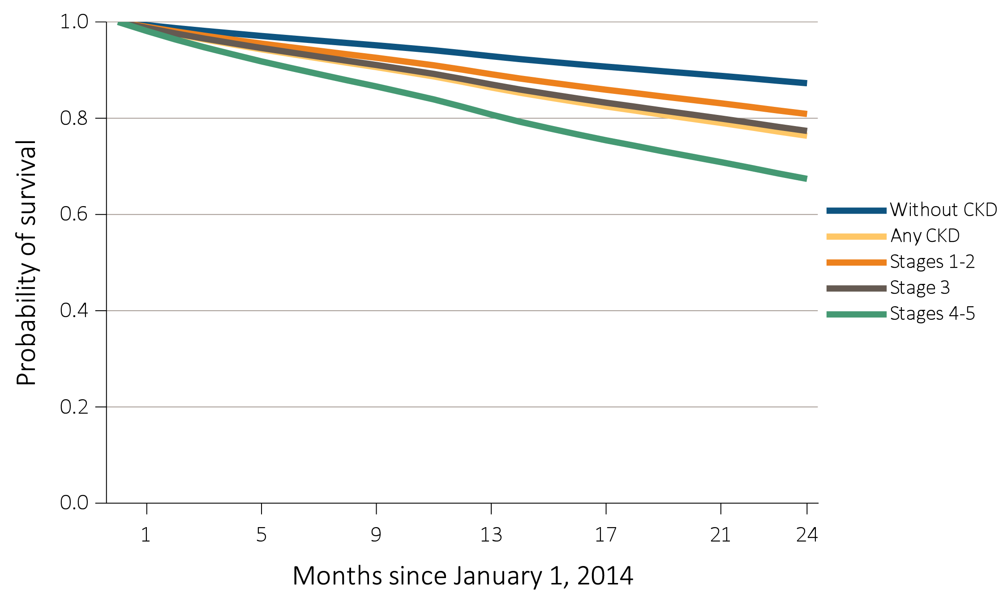
vol 1 Figure 4.2 Probability of survival of patients with a prevalent cardiovascular disease, by CKD status, adjusted for age and sex, 2014-2015
(a) Coronary artery disease (CAD)
Data Source: Special analyses, Medicare 5% sample. Patients aged 66 and older, alive, without end-stage renal disease, and residing in the United States on 12/31/2013, with fee-for-service coverage for the entire calendar year. Abbreviations: CKD, chronic kidney disease.

Slide 7
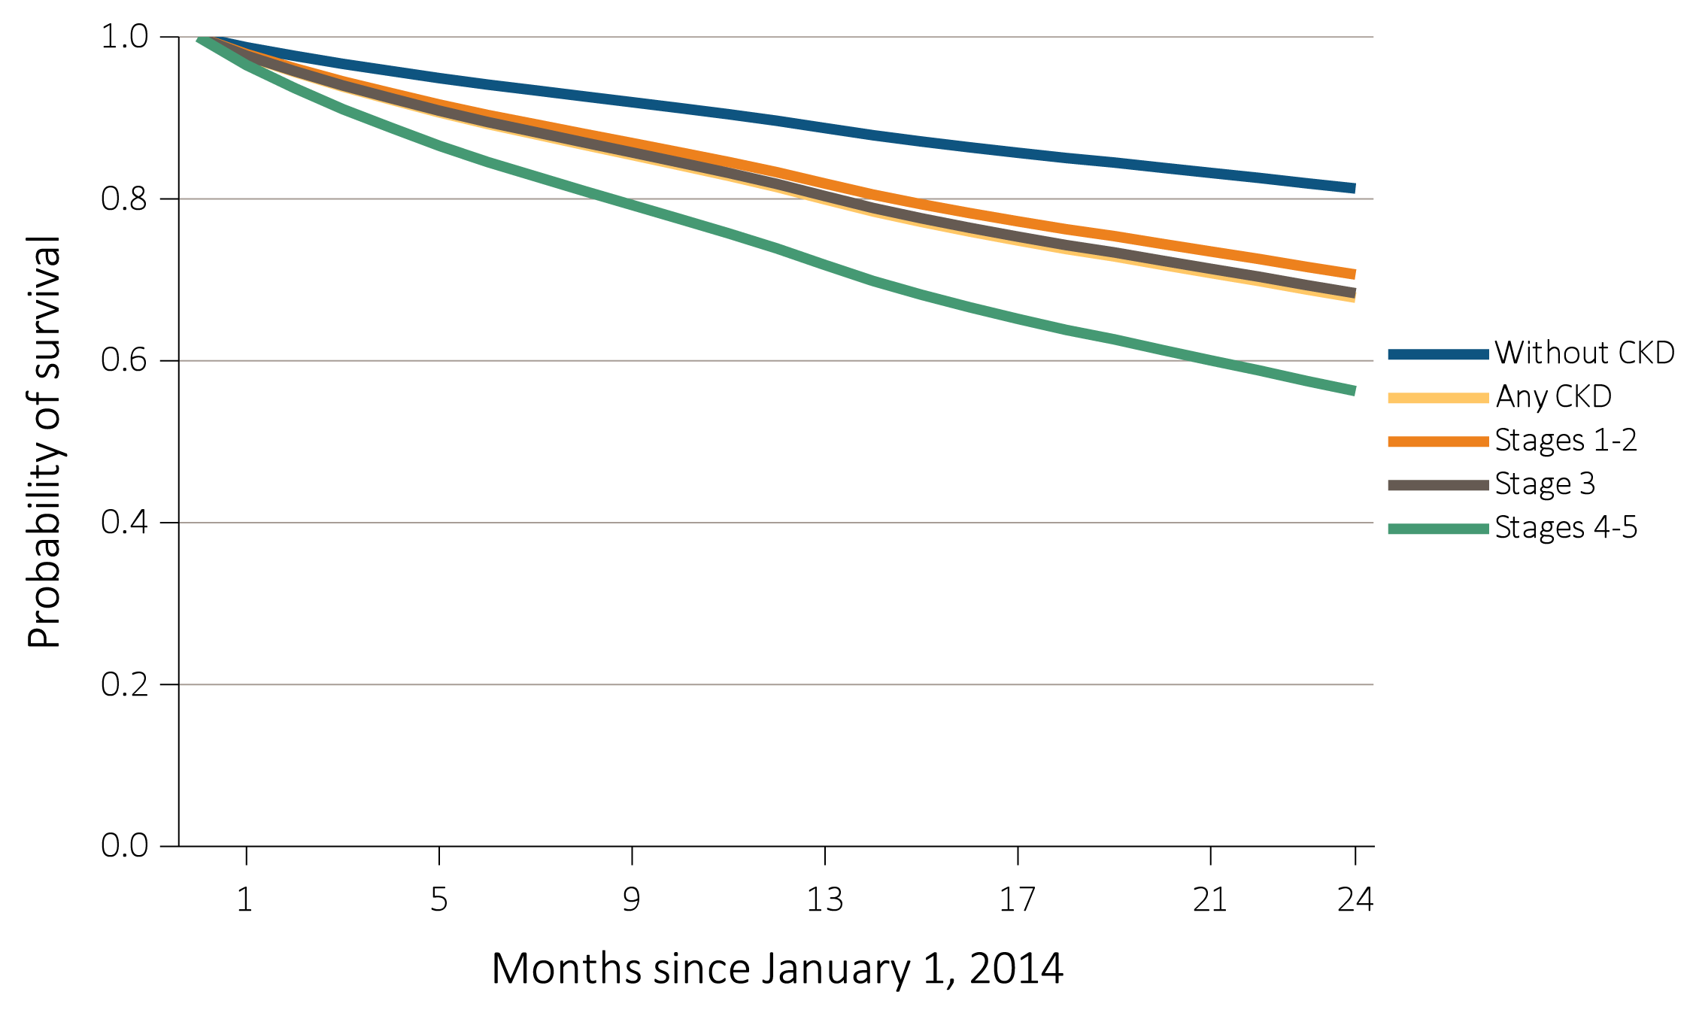
vol 1 Figure 4.2 Probability of survival of patients with a prevalent cardiovascular disease, by CKD status, adjusted for age and sex, 2014-2015
(b) Acute myocardial infarction (AMI)
Data Source: Special analyses, Medicare 5% sample. Patients aged 66 and older, alive, without end-stage renal disease, and residing in the United States on 12/31/2013, with fee-for-service coverage for the entire calendar year. Abbreviations: CKD, chronic kidney disease.

Slide 8
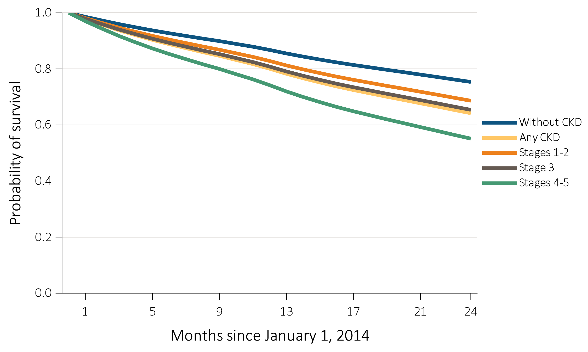
vol 1 Figure 4.2 Probability of survival of patients with a prevalent cardiovascular disease, by CKD status, adjusted for age and sex, 2014-2015
(c) Heart failure (HF)
Data Source: Special analyses, Medicare 5% sample. Patients aged 66 and older, alive, without end-stage renal disease, and residing in the United States on 12/31/2013, with fee-for-service coverage for the entire calendar year. Abbreviations: CKD, chronic kidney disease.

Slide 9
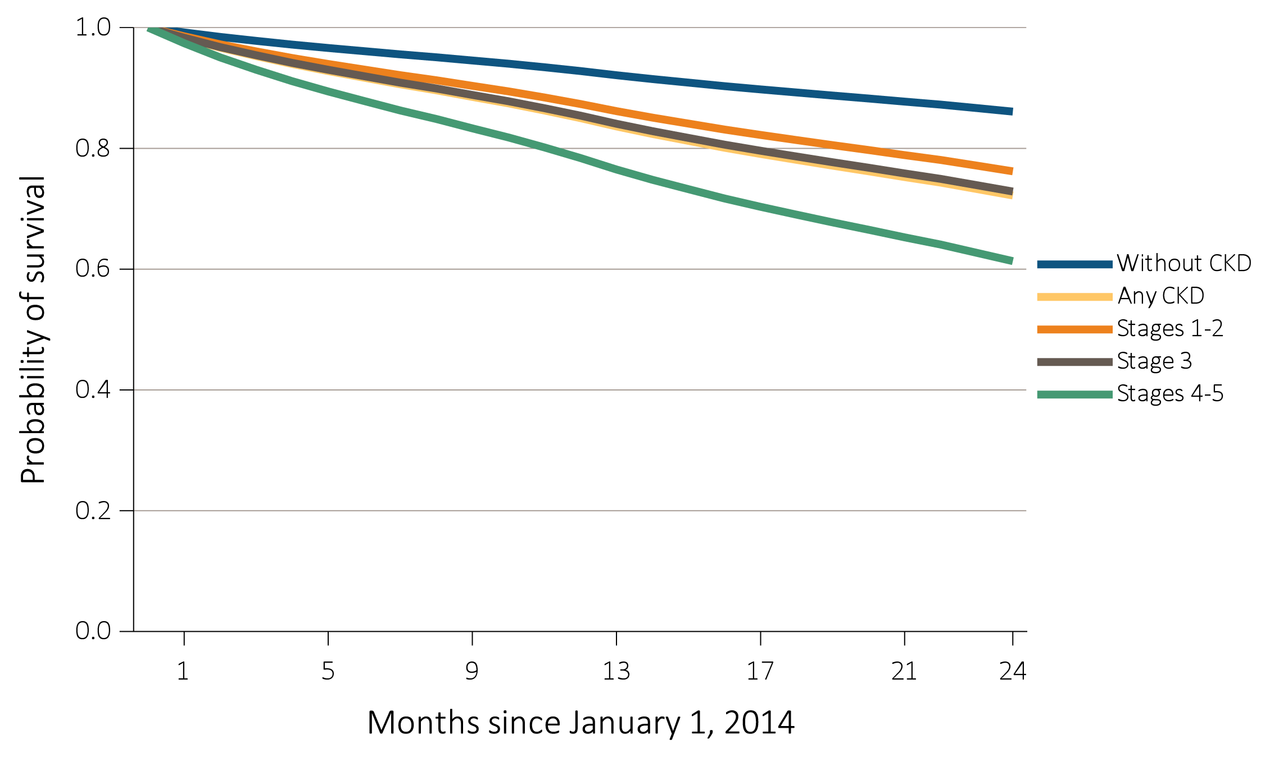
vol 1 Figure 4.2 Probability of survival of patients with a prevalent cardiovascular disease, by CKD status, adjusted for age and sex, 2014-2015
(d) Valvular heart disease (VHD)
Data Source: Special analyses, Medicare 5% sample. Patients aged 66 and older, alive, without end-stage renal disease, and residing in the United States on 12/31/2013, with fee-for-service coverage for the entire calendar year. Abbreviations: CKD, chronic kidney disease.

Slide 10
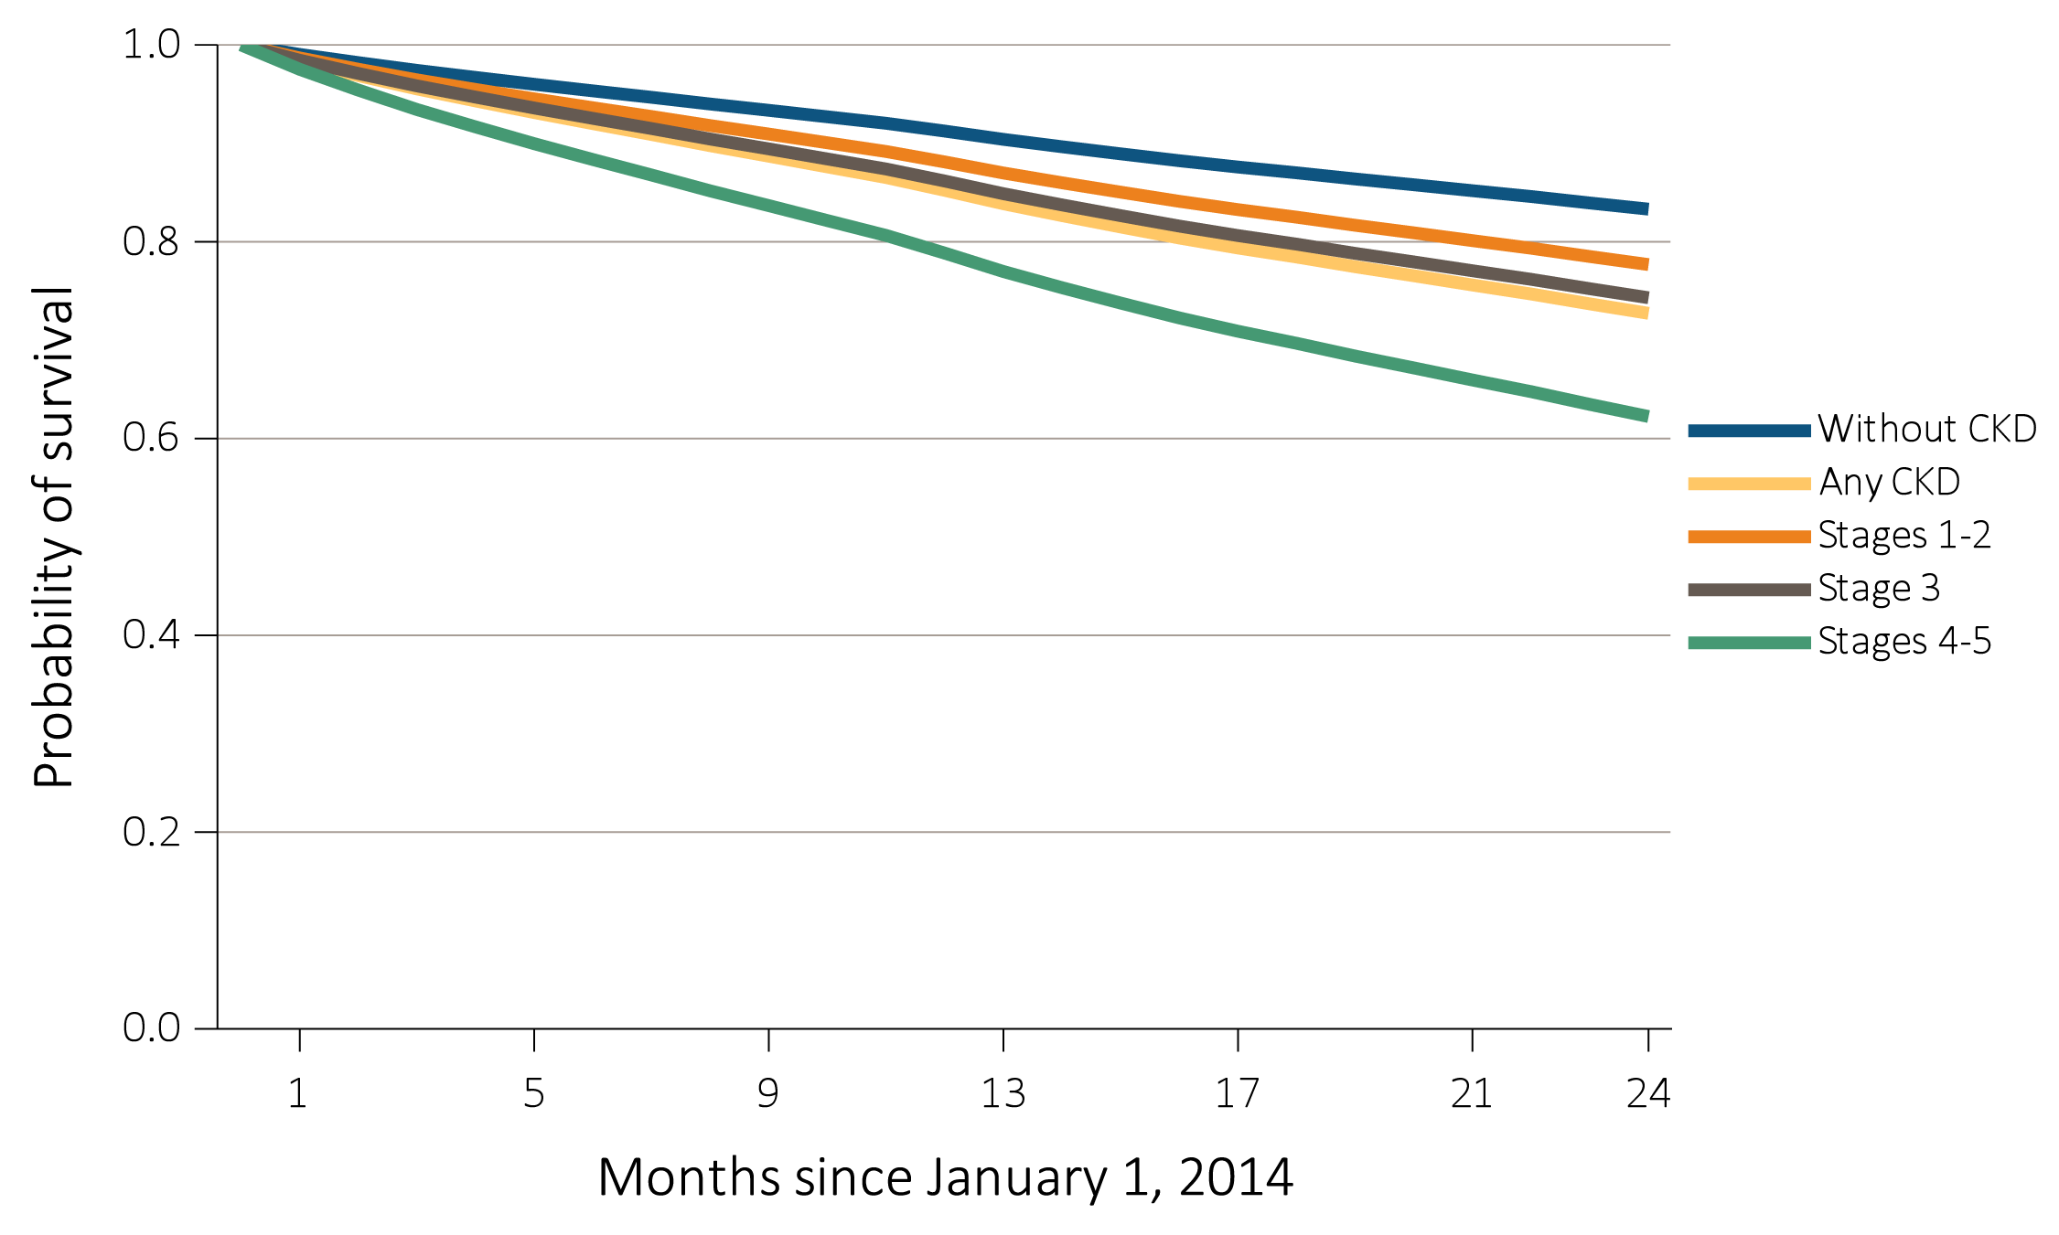
vol 1 Figure 4.2 Probability of survival of patients with a prevalent cardiovascular disease, by CKD status, adjusted for age and sex, 2014-2015
(e) Cerebrovascular accident/transient ischemic attack (CVA/TIA)
Data Source: Special analyses, Medicare 5% sample. Patients aged 66 and older, alive, without end-stage renal disease, and residing in the United States on 12/31/2013, with fee-for-service coverage for the entire calendar year. Abbreviations: CKD, chronic kidney disease.

Slide 11
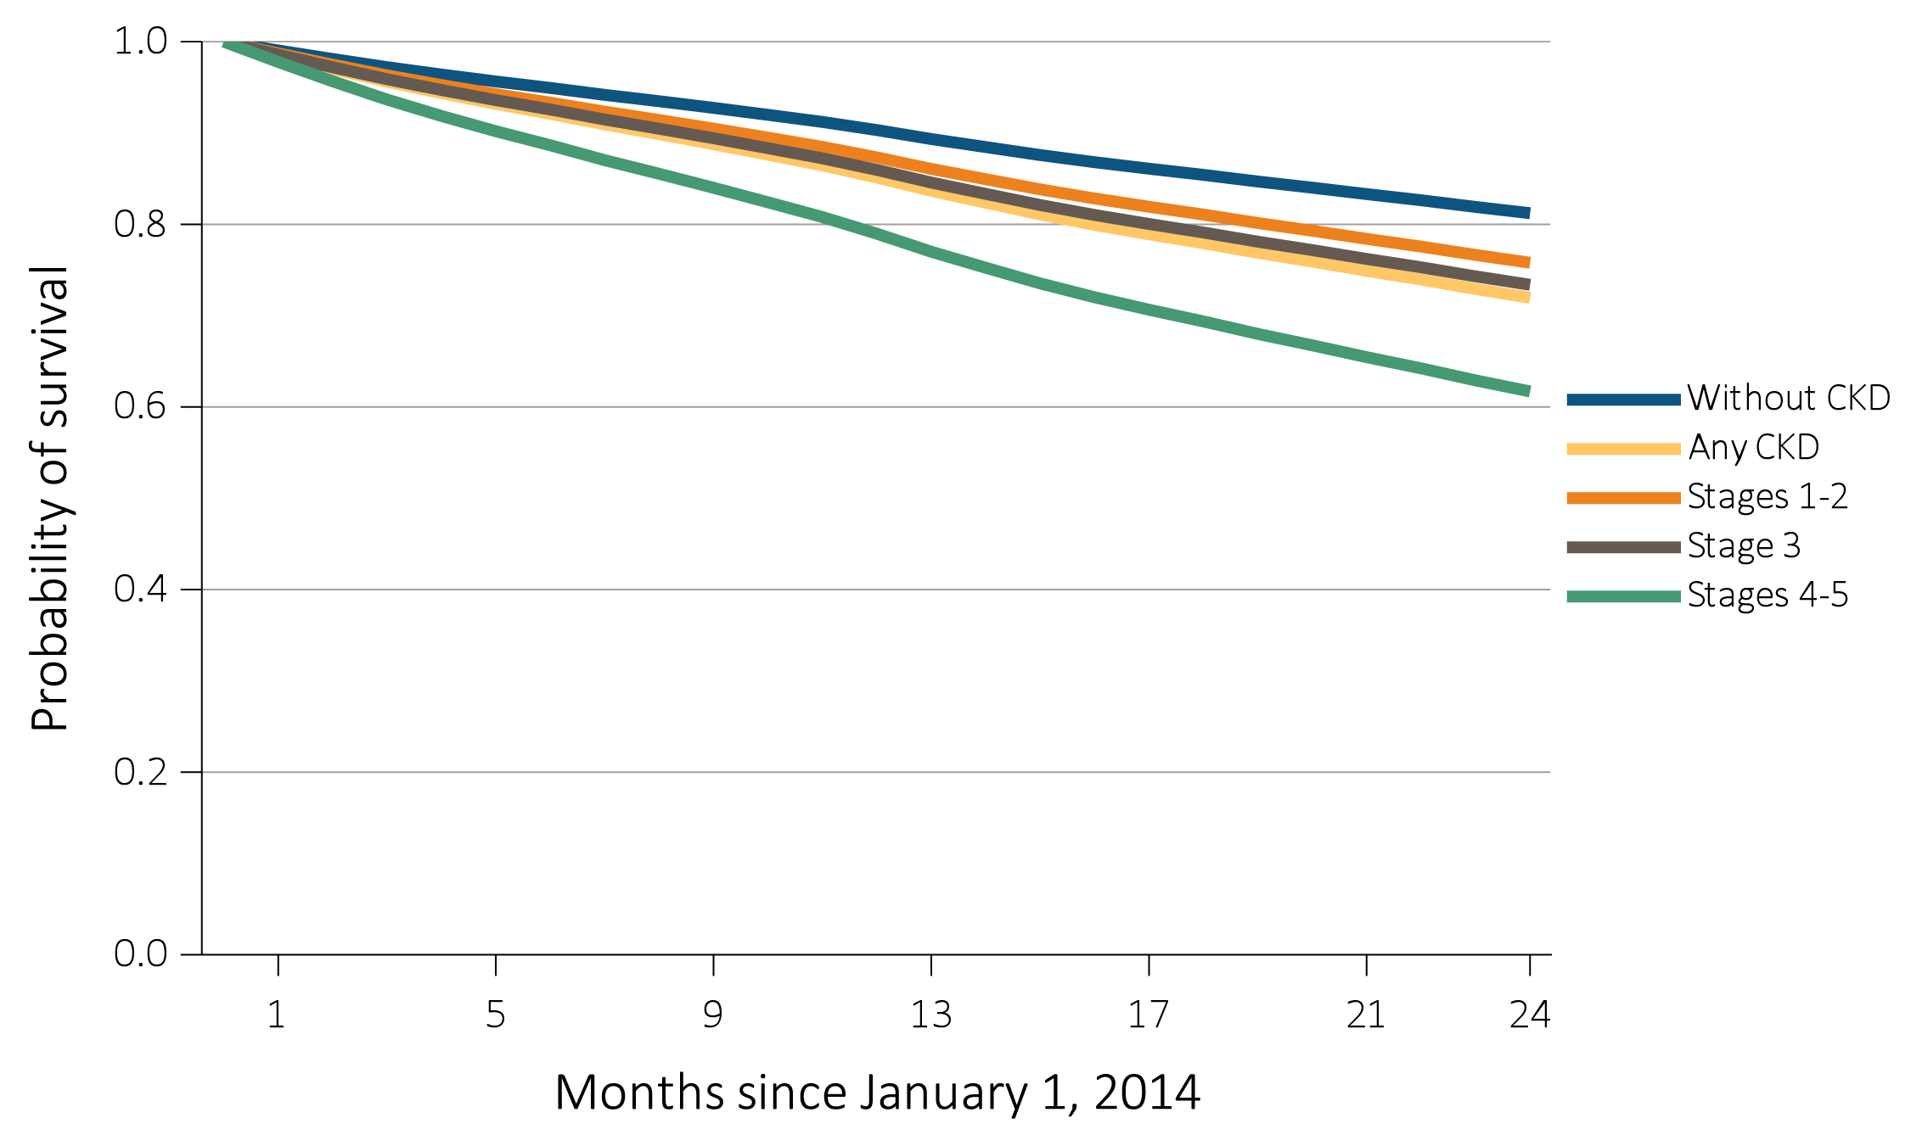
vol 1 Figure 4.2 Probability of survival of patients with a prevalent cardiovascular disease, by CKD status, adjusted for age and sex, 2014-2015
(f) Peripheral arterial disease (PAD)
Data Source: Special analyses, Medicare 5% sample. Patients aged 66 and older, alive, without end-stage renal disease, and residing in the United States on 12/31/2013, with fee-for-service coverage for the entire calendar year. Abbreviations: CKD, chronic kidney disease.

Slide 12
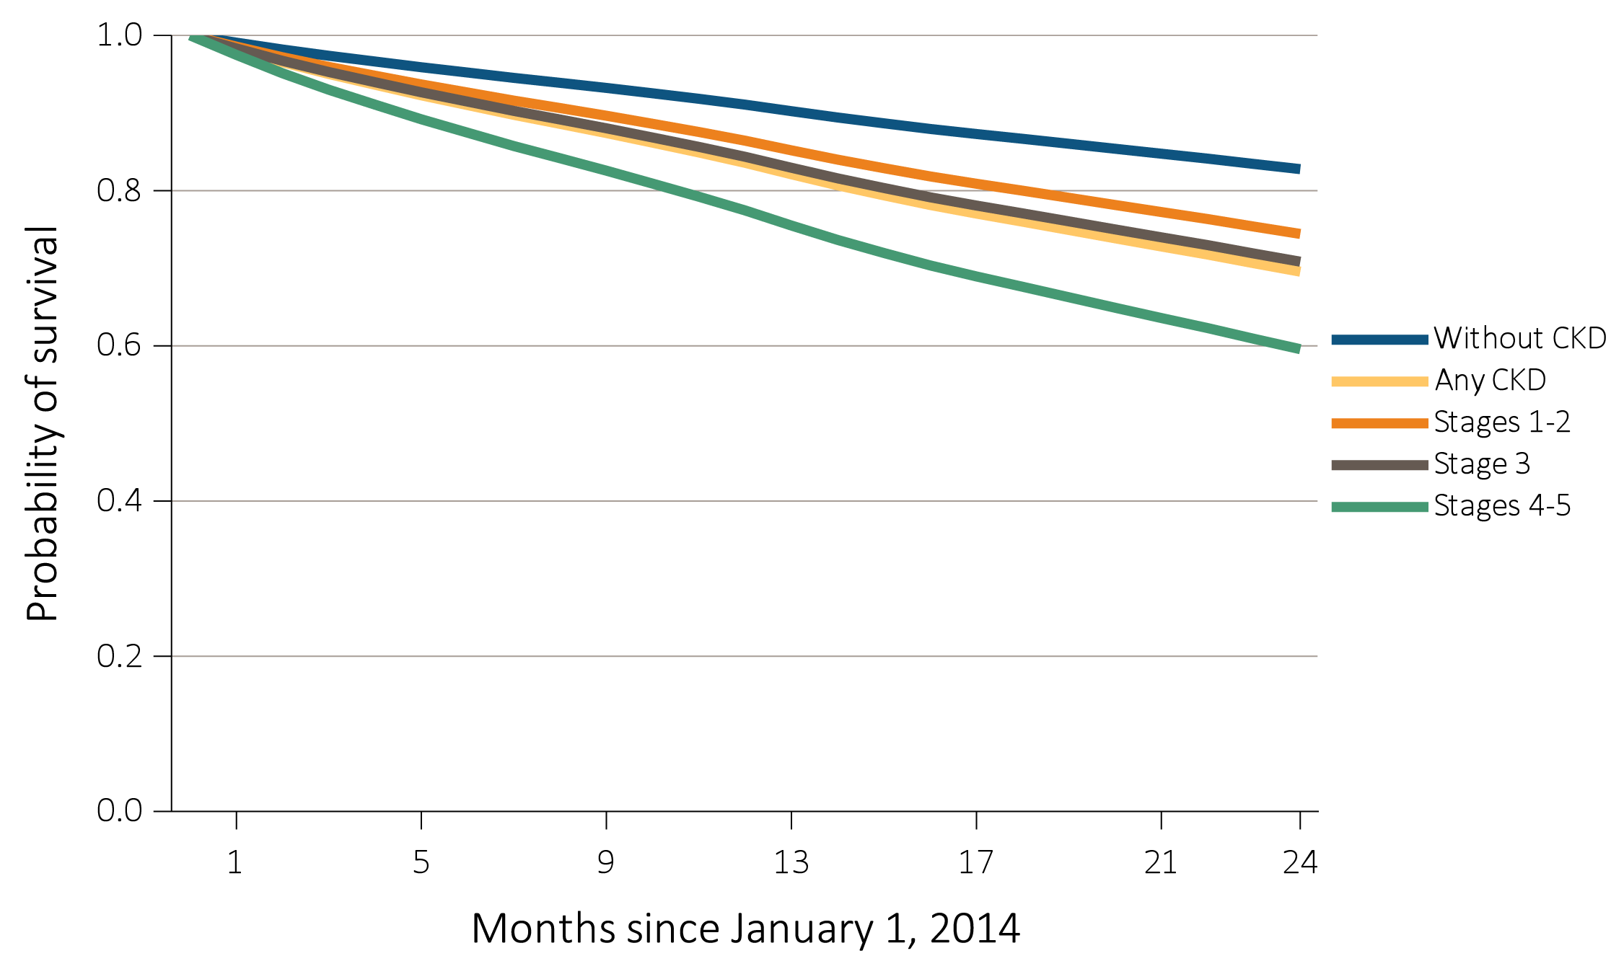
vol 1 Figure 4.2 Probability of survival of patients with a prevalent cardiovascular disease, by CKD status, adjusted for age and sex, 2014-2015
(g) Atrial fibrillation (AF)
Data Source: Special analyses, Medicare 5% sample. Patients aged 66 and older, alive, without end-stage renal disease, and residing in the United States on 12/31/2013, with fee-for-service coverage for the entire calendar year. Abbreviations: CKD, chronic kidney disease.

Slide 13
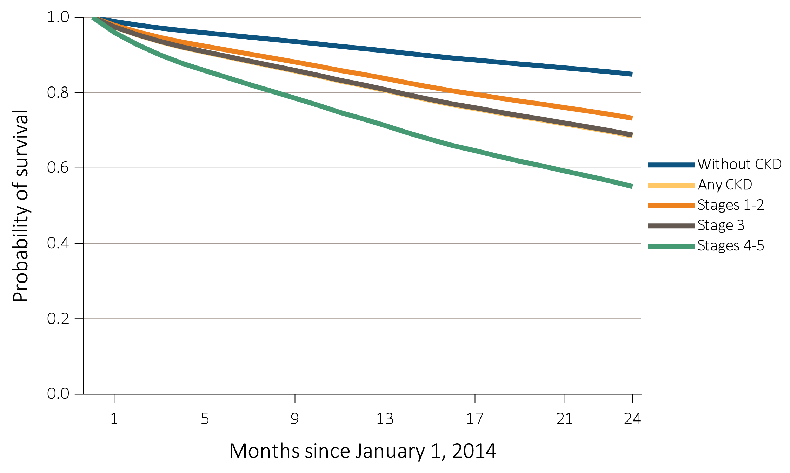
vol 1 Figure 4.2 Probability of survival of patients with a prevalent cardiovascular disease, by CKD status, adjusted for age and sex, 2014-2015
(h) Sudden cardiac arrest and ventricular arrhythmias (SCA/VA)
Data Source: Special analyses, Medicare 5% sample. Patients aged 66 and older, alive, without end-stage renal disease, and residing in the United States on 12/31/2013, with fee-for-service coverage for the entire calendar year. Abbreviations: CKD, chronic kidney disease.

Slide 14
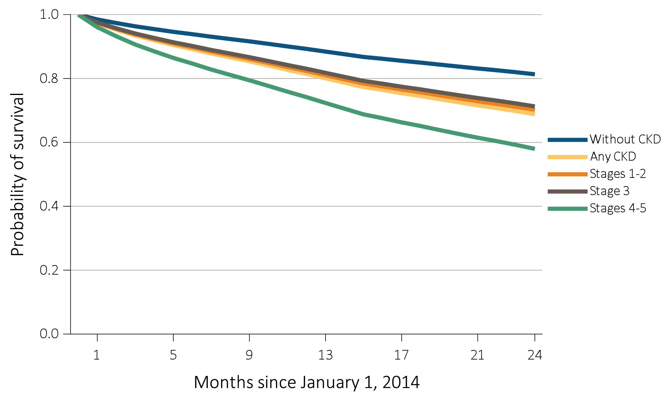
vol 1 Figure 4.2 Probability of survival of patients with a prevalent cardiovascular disease, by CKD status, adjusted for age and sex, 2014-2015
(i) Venous thromboembolism and pulmonary embolism (VTE/PE)
Data Source: Special analyses, Medicare 5% sample. Patients aged 66 and older, alive, without end-stage renal disease, and residing in the United States on 12/31/2013, with fee-for-service coverage for the entire calendar year. Abbreviations: CKD, chronic kidney disease.

Slide 15
vol 1 Table 4.2 Two-year survival of patients with a prevalent cardiovascular disease, by CKD status, adjusted for age and sex, 2014-2015
 | CKD Status
Cardiovascular Disease | No CKD (%) | CKD (%) | Stages 1 to 2 (%) | Stage 3 (%) | Stages 4 to 5 (%)
CAD | 87.3 | 76.4 | 80.9 | 77.4 | 67.4
AMI | 81.3 | 67.8 | 70.7 | 68.3 | 56.3
HF | 75.3 | 64.2 | 68.6 | 65.4 | 55.1
VHD | 86.1 | 72.2 | 76.2 | 72.9 | 61.3
CVA/TIA | 83.3 | 72.7 | 77.7 | 74.3 | 62.2
PAD | 81.2 | 72.0 | 75.8 | 73.4 | 61.7
AF | 82.8 | 69.6 | 74.4 | 70.8 | 59.6
SCA/VA | 84.9 | 68.5 | 73.2 | 68.7 | 55.1
VTE/PE | 81.3 | 68.8 | 70.2 | 71.3 | 58.0
Data Source: Special analyses, Medicare 5% sample. Patients aged 66 and older, alive, without end-stage renal disease, and residing in the United States on 12/31/2013, with fee-for-service coverage for the entire calendar year. Abbreviations: AF, atrial fibrillation; AMI, acute myocardial infarction; CAD, coronary artery disease; CKD, chronic kidney disease; CVA/TIA, cerebrovascular accident/transient ischemic attack; HF, heart failure; PAD, peripheral arterial disease; SCA/VA, sudden cardiac arrest and ventricular arrhythmias; VHD, valvular heart disease; VTE/PE, venous thromboembolism and pulmonary embolism.

Slide 16
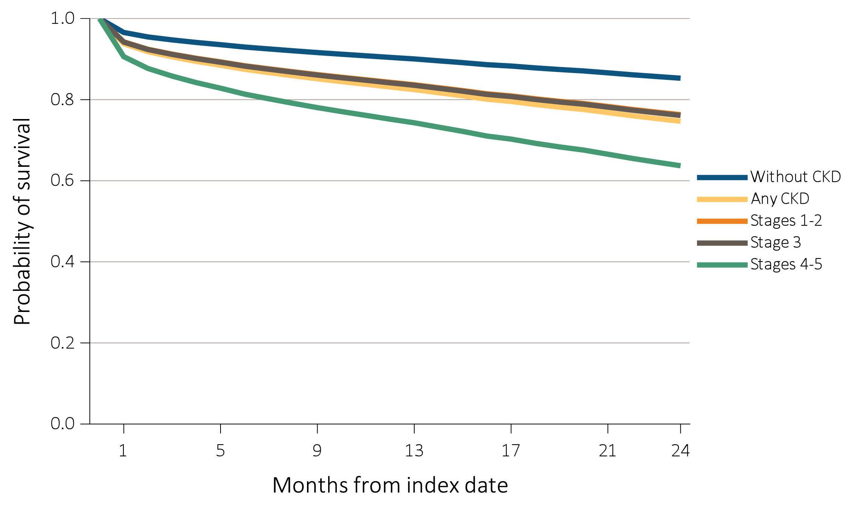
vol 1 Figure 4.3 Probability of survival of patients with a cardiovascular procedure, by CKD status, adjusted for age and sex, 2013-2015
(a) Percutaneous coronary interventions (PCI)
Data Source: Special analyses, Medicare 5% sample. Patients aged 66 and older, alive, without end-stage renal disease, and residing in the United States on the index date, which was the date of the first procedure claim, with fee-for-service coverage for the entire year prior to this date. Abbreviations: CKD, chronic kidney disease.

Slide 17
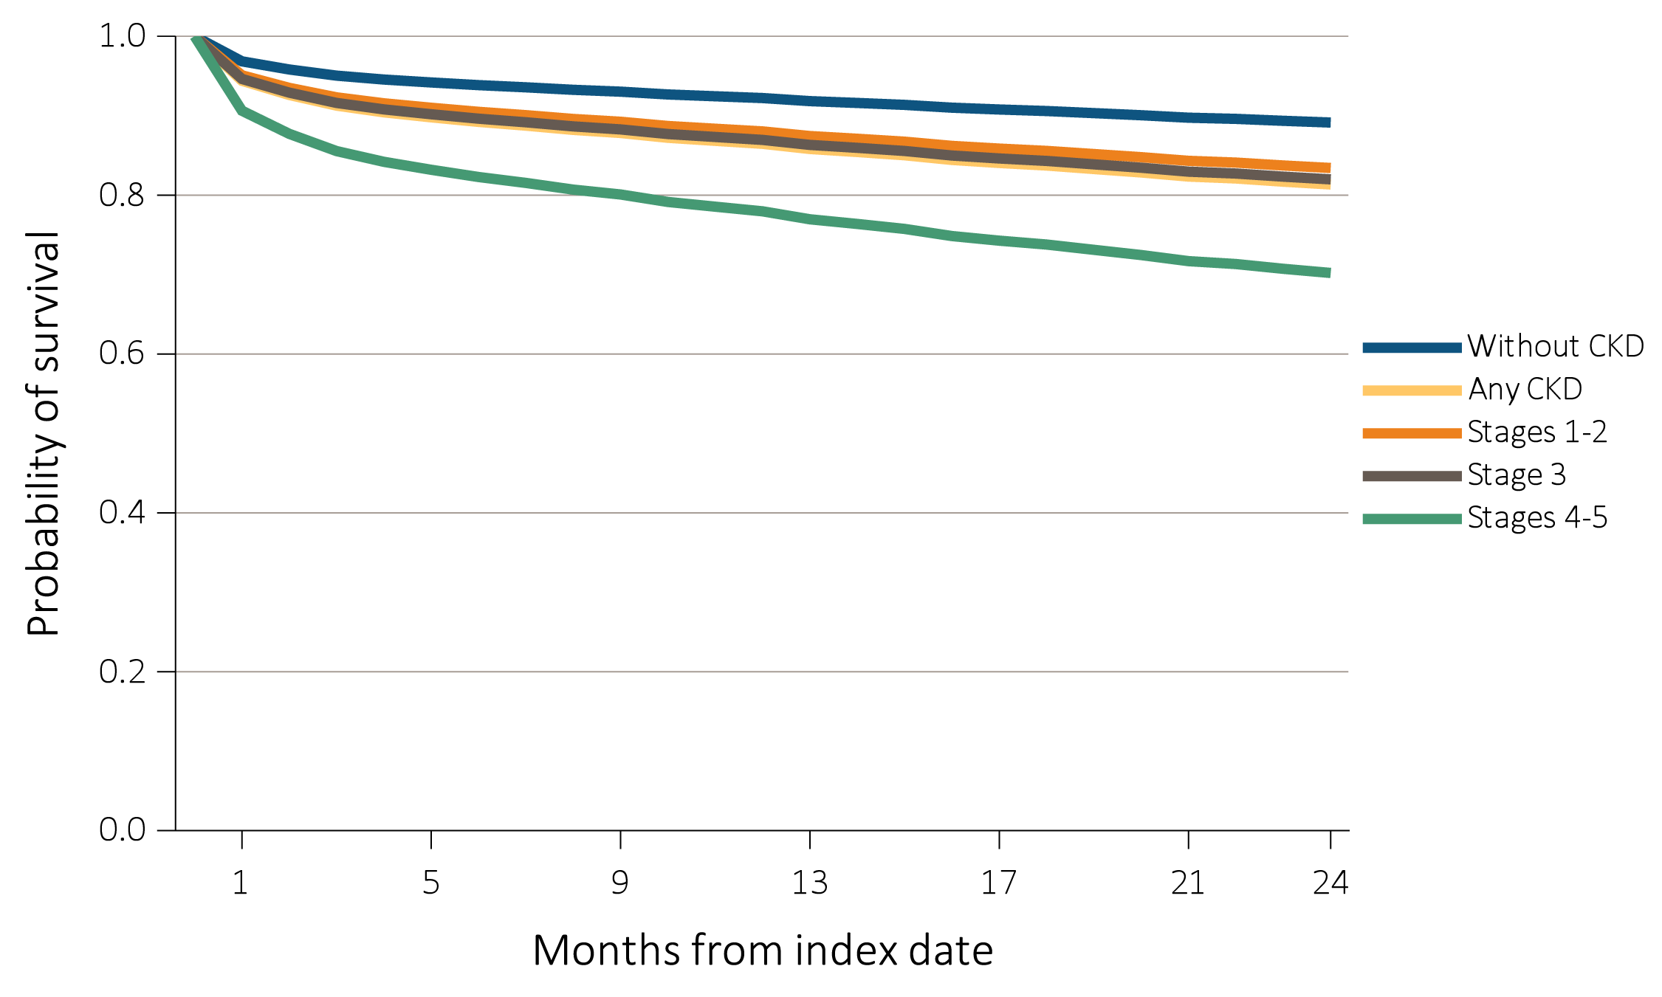
vol 1 Figure 4.3 Probability of survival of patients with a cardiovascular procedure, by CKD status, adjusted for age and sex, 2013-2015
(b) Coronary artery bypass grafting (CABG)
Data Source: Special analyses, Medicare 5% sample. Patients aged 66 and older, alive, without end-stage renal disease, and residing in the United States on the index date, which was the date of the first procedure claim, with fee-for-service coverage for the entire year prior to this date. Abbreviations: CKD, chronic kidney disease.

Slide 18
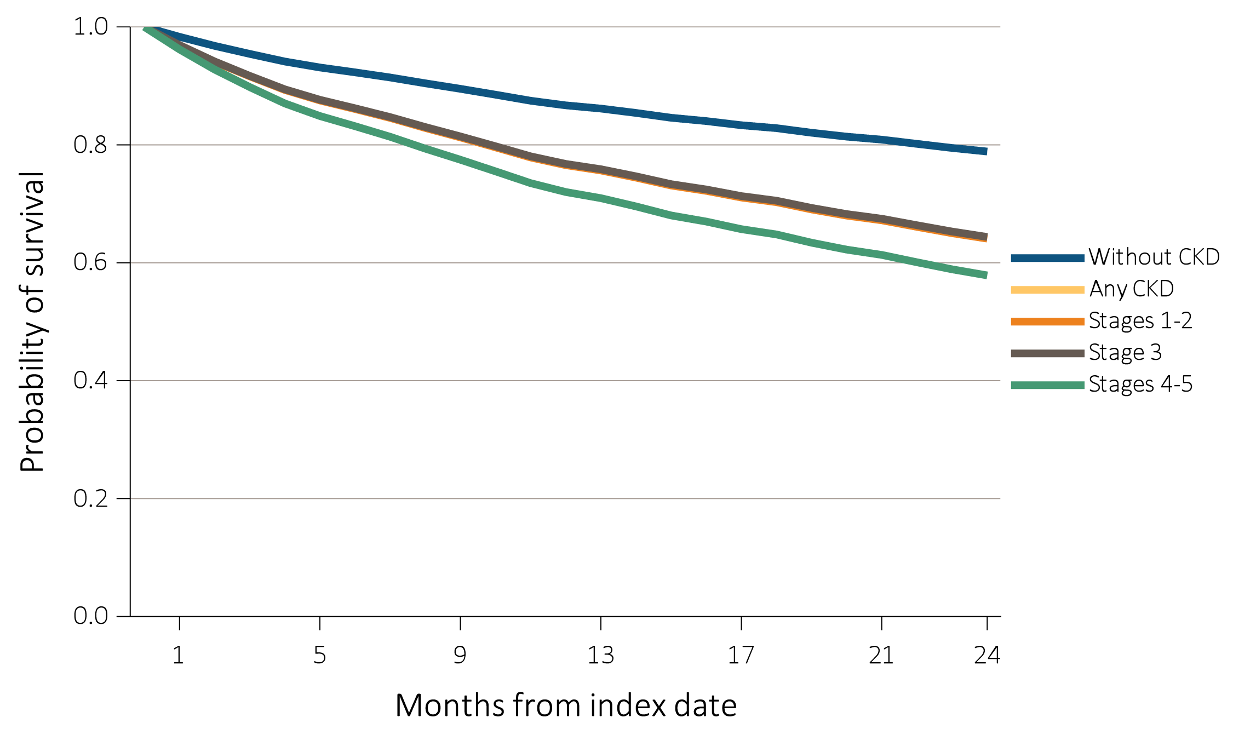
vol 1 Figure 4.3 Probability of survival of patients with a cardiovascular procedure, by CKD status, adjusted for age and sex, 2013-2015
(c) Implantable cardioverter defibrillators/cardiac resynchronization therapy with defibrillator devices
(ICD/CRT-D)
Data Source: Special analyses, Medicare 5% sample. Patients aged 66 and older, alive, without end-stage renal disease, and residing in the United States on the index date, which was the date of the first procedure claim, with fee-for-service coverage for the entire year prior to this date. Abbreviations: CKD, chronic kidney disease.

Slide 19
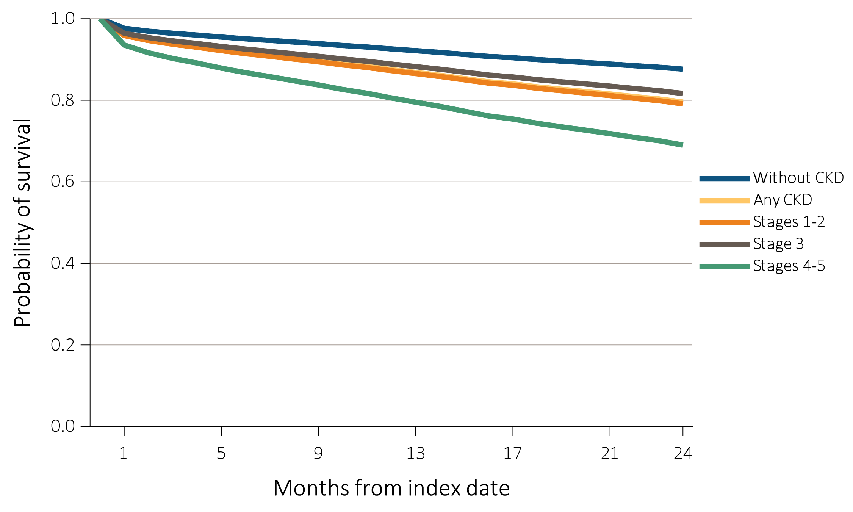
vol 1 Figure 4.3 Probability of survival of patients with a cardiovascular procedure, by CKD status, adjusted for age and sex, 2013-2015
(d) Carotid artery stenting and carotid endarterectomy (CAS/CEA)
Data Source: Special analyses, Medicare 5% sample. Patients aged 66 and older, alive, without end-stage renal disease, and residing in the United States on the index date, which was the date of the first procedure claim, with fee-for-service coverage for the entire year prior to this date. Abbreviations: CKD, chronic kidney disease.

Slide 20
vol 1 Table 4.3 Two-year survival of patients with a cardiovascular procedure, by CKD status, adjusted for age and sex, 2013-2015
 | CKD Status
Cardiovascular Procedure | No CKD (%) | CKD (%) | Stages 1 to 2 (%) | Stage 3 (%) | Stages 4 to 5 (%)
PCI | 85.3 | 74.7 | 76.3 | 76.1 | 63.7
CABG | 89.1 | 81.3 | 83.4 | 82.0 | 70.2
ICD/CRT-D | 78.9 | 64.4 | 64.1 | 64.4 | 57.9
CAS/CEA | 87.6 | 79.5 | 79.1 | 81.6 | 69.0
Data Source: Special analyses, Medicare 5% sample. Patients aged 66 and older, alive, without end-stage renal disease, and residing in the United States on the index date, which was the date of the first procedure claim, with fee-for-service coverage for the entire year prior to this date. Abbreviations: CABG, coronary artery bypass grafting; CAS/CEA, carotid artery stenting and carotid endarterectomy; CKD, chronic kidney disease; ICD/CRT-D, implantable cardioverter defibrillators/cardiac resynchronization therapy with defibrillator devices; PCI, percutaneous coronary interventions.

Slide 21
vol 1 Table 4.4 Cardiovascular pharmacological treatments by (a) comorbidities and (b) procedures, by CKD status, 2015
(a) Cardiovascular comorbidities
 |  | % Patients
 | # Patients | Beta- blockers | Statins | P2Y₁₂ inhibitors | Warfarin | Direct Oral Anticoagulants | ACEIs/ ARBs
Any CVD
Without CKD | 239,800 | 57.1 | 63.0 | 16.6 | 15.2 | 9.8 | 55.1
Any CKD | 66,354 | 68.0 | 68.0 | 20.7 | 18.3 | 10.9 | 61.5
Coronary artery disease (CAD)
Without CKD | 116,846 | 68.1 | 75.7 | 26.3 | 11.7 | 7.9 | 60.5
Any CKD | 39,684 | 76.1 | 75.8 | 28.8 | 17.5 | 10.7 | 63.8
Acute myocardial infarction (AMI)
Without CKD | 16,545 | 77.6 | 78.2 | 39.8 | 14.1 | 9.9 | 65.2
Any CKD | 9,666 | 83.5 | 79.0 | 39.7 | 19.1 | 12.3 | 65.4
Heart failure (HF)
Without CKD | 46,509 | 72.5 | 60.6 | 16.9 | 22.1 | 13.4 | 63.4
Any CKD | 28,204 | 77.8 | 67.4 | 21.8 | 23.8 | 14.0 | 61.7
Valvular heart disease (VHD)
Without CKD | 37,493 | 60.5 | 61.9 | 13.7 | 18.6 | 11.1 | 56.0
Any CKD | 13,585 | 74.9 | 69.8 | 21.5 | 24.6 | 14.1 | 62.6
Cerebrovascular accident/transient ischemic attack (CVA/TIA)
Without CKD | 52,488 | 51.3 | 68.1 | 25.0 | 12.8 | 8.0 | 55.6
Any CKD | 17,830 | 67.4 | 73.1 | 30.0 | 16.8 | 10.9 | 62.1
Peripheral artery disease (PAD)
Without CKD | 69,923 | 50.2 | 58.7 | 18.2 | 11.5 | 6.8 | 53.3
Any CKD | 25,460 | 67.0 | 68.0 | 25.7 | 16.3 | 9.8 | 60.8
Atrial fibrillation (AF)
Without CKD | 71,368 | 69.4 | 57.8 | 8.9 | 40.8 | 27.8 | 53.2
Any CKD | 24,507 | 76.4 | 65.4 | 14.9 | 40.7 | 25.0 | 58.9
Cardiac arrest and ventricular arrhythmias (SCA/VA)
Without CKD | 9,951 | 73.6 | 64.2 | 17.0 | 16.7 | 12.5 | 60.9
Any CKD | 4,205 | 82.0 | 70.9 | 25.4 | 26.0 | 15.2 | 65.1
Venous thromboembolism and pulmonary embolism (VTE/PE)
Without CKD | 9,580 | 44.4 | 49.2 | 6.9 | 57.7 | 23.9 | 46.0
Any CKD | 4,137 | 60.9 | 58.6 | 11.9 | 54.5 | 23.4 | 55.5

Slide 22
vol 1 Table 4.4 Cardiovascular pharmacological treatments by (a) comorbidities and (b) procedures, by CKD status, 2015 (continued)
(b) Cardiovascular Procedures
 |  |  |  |  | % Patients
 |  | # Patients |  |  | Beta- blockers | Statins | P2Y₁₂ inhibitors | Warfarin | Direct Oral Anticoagulants | ACEIs/ ARBs
Revascularization – percutaneous coronary interventions (PCI)
Without CKD |  |  | 1,738 |  | 90.0 | 91.3 | 95.4 | 10.1 | 7.5 | 75.5
Any CKD |  |  | 899 |  | 93.2 | 89.2 | 96.6 | 13.3 | 11.6 | 73.6
Revascularization – coronary artery bypass graft (CABG)
Without CKD |  |  | 1,167 |  | 93.8 | 92.9 | 38.6 | 20.0 | 9.3 | 68.2
Any CKD |  |  | 607 |  | 92.9 | 92.1 | 41.7 | 22.7 | 12.0 | 68.5
Implantable cardioverter defibrillators & cardiac resynchronization therapy with defibrillator (ICD/CRT-D)
Without CKD |  |  | 263 |  | 88.6 | 75.7 | 22.4 | 31.9 | 24.7 | 78.7
Any CKD |  |  | 284 |  | 91.2 | 73.9 | 34.5 | 35.9 | 21.5 | 75.7
Carotid artery stenting and carotid artery endarterectomy (CAS/CEA)
Without CKD |  |  | 1,034 |  | 58.3 | 80.8 | 52.9 | 8.8 | 9.4 | 62.2
Any CKD |  |  | 408 |  | 71.6 | 85.3 | 50.5 | 15.0 | 10.8 | 72.1
Data Source: Special analyses, Medicare 5% sample. Patients aged 66 and older, alive, without end-stage renal disease, and residing in the United States on 12/31/2015 with fee-for-service and Part D coverage for the entire calendar year. Abbreviations: ACEIs/ARBs, Angiotensin converting enzyme inhibitors and angiotensin receptor blockers; AF, atrial fibrillation; AMI, acute myocardial infarction; CAD, coronary artery disease; CABG, coronary artery bypass grafting; CAS/CEA, carotid artery stenting and carotid endarterectomy; CKD, chronic kidney disease; CVA/TIA, cerebrovascular accident/transient ischemic attack; CVD, cardiovascular disease; HF, heart failure; ICD/CRT-D, implantable cardioverter defibrillators/cardiac resynchronization therapy with defibrillator devices; PAD, peripheral arterial disease; PCI, percutaneous coronary interventions; SCA/VA, sudden cardiac arrest and ventricular arrhythmias; VHD, valvular heart disease; VTE/PE, venous thromboembolism and pulmonary embolism.

Slide 23
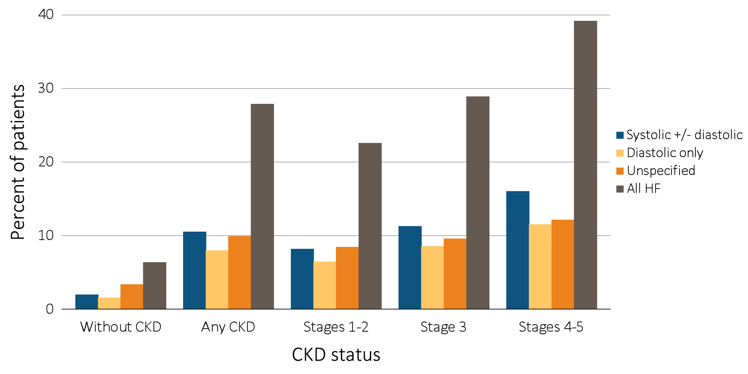
vol 1 Figure 4.4 Heart failure in patients with or without CKD, 2015
Data Source: Special analyses, Medicare 5% sample. Patients aged 66 and older, alive, without end-stage renal disease, and residing in the United States on 12/31/2015 with fee-for-service coverage for the entire calendar year. Abbreviation: CKD, chronic kidney disease.

Slide 24
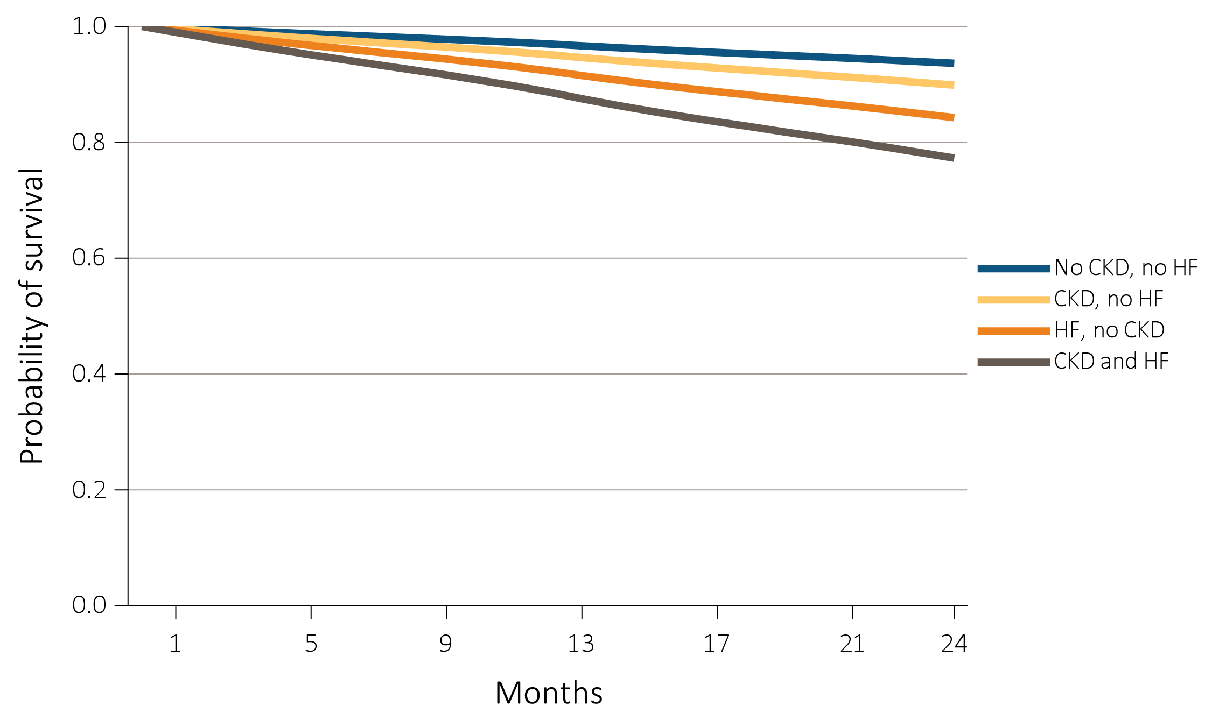
vol 1 Figure 4.5 Adjusted survival of patients by CKD and heart failure status, 2014-2015
Data Source: Special analyses, Medicare 5% sample. Patients aged 66 and older, alive, without end-stage renal disease, and residing in the United States on 12/31/2013 with fee-for-service coverage for the entire calendar year. Survival was adjusted for age, sex, race, diabetic status, and hypertension status. Abbreviations: CKD, chronic kidney disease.

Slide 25
vol 1 Table 4.5 Prevalence of atrial fibrillation by stage of CKD, age, race, sex, and diabetic, hypertension, and heart failure status, 2015
 |  | Stage of CKD |  |  |  |  | Total
 | No CKD | Stages 1-2 | Stage 3 | Stages 4-5 | Unknown stage |  | All CKD stages
# Patients | 1,102,413 | 16,008 | 75,595 | 13,951 | 41,109 |  | 146,663
Atrial fibrillation (Overall) | 9.6 | 21.5 | 25.5 | 27.7 | 23.1 |  | 24.6
Age
66-69 | 4.1 | 11.5 | 15.5 | 16.9 | 13.0 |  | 14.2
70-74 | 6.9 | 16.9 | 18.5 | 21.6 | 16.4 |  | 17.9
75-84 | 12.5 | 22.8 | 26.4 | 28.4 | 25.1 |  | 25.9
85+ | 19.6 | 32.5 | 34.0 | 33.6 | 33.6 |  | 33.7
Sex
Male | 10.8 | 24.3 | 28.6 | 30.6 | 25.1 |  | 27.3
Female | 8.7 | 18.7 | 22.7 | 25.2 | 21.2 |  | 22.1
Race
White | 10.3 | 23.4 | 27.4 | 30.2 | 24.7 |  | 26.4
Black/African American | 4.8 | 12.7 | 14.9 | 17.2 | 14.0 |  | 14.7
Other | 5.1 | 13.6 | 16.8 | 17.6 | 15.2 |  | 16.0
Comorbidity
No diabetes | 8.8 | 20.7 | 25.0 | 27.8 | 22.9 |  | 24.2
Diabetes | 12.9 | 22.2 | 26.1 | 27.5 | 23.5 |  | 25.1
No hypertension | 3.9 | 11.9 | 15.5 | 16.3 | 11.1 |  | 13.3
Hypertension | 14.2 | 22.5 | 26.4 | 28.3 | 25.0 |  | 25.8
No heart failure | 7.3 | 13.4 | 14.9 | 14.5 | 14.4 |  | 14.5
Heart failure | 44.6 | 49.5 | 52.1 | 48.2 | 50.8 |  | 51.0
Data Source: Special analyses, Medicare 5% sample. Patients aged 66 and older, alive, without end-stage renal disease, and residing in the United States on 12/31/2015 with fee-for-service coverage for the entire calendar year. Abbreviations: CKD, chronic kidney disease.

