Slide 1
2017 Annual Data Report
Volume 1: Chronic Kidney Disease
Chapter 7: Prescription Drug Coverage in Patients with CKD

Slide 2
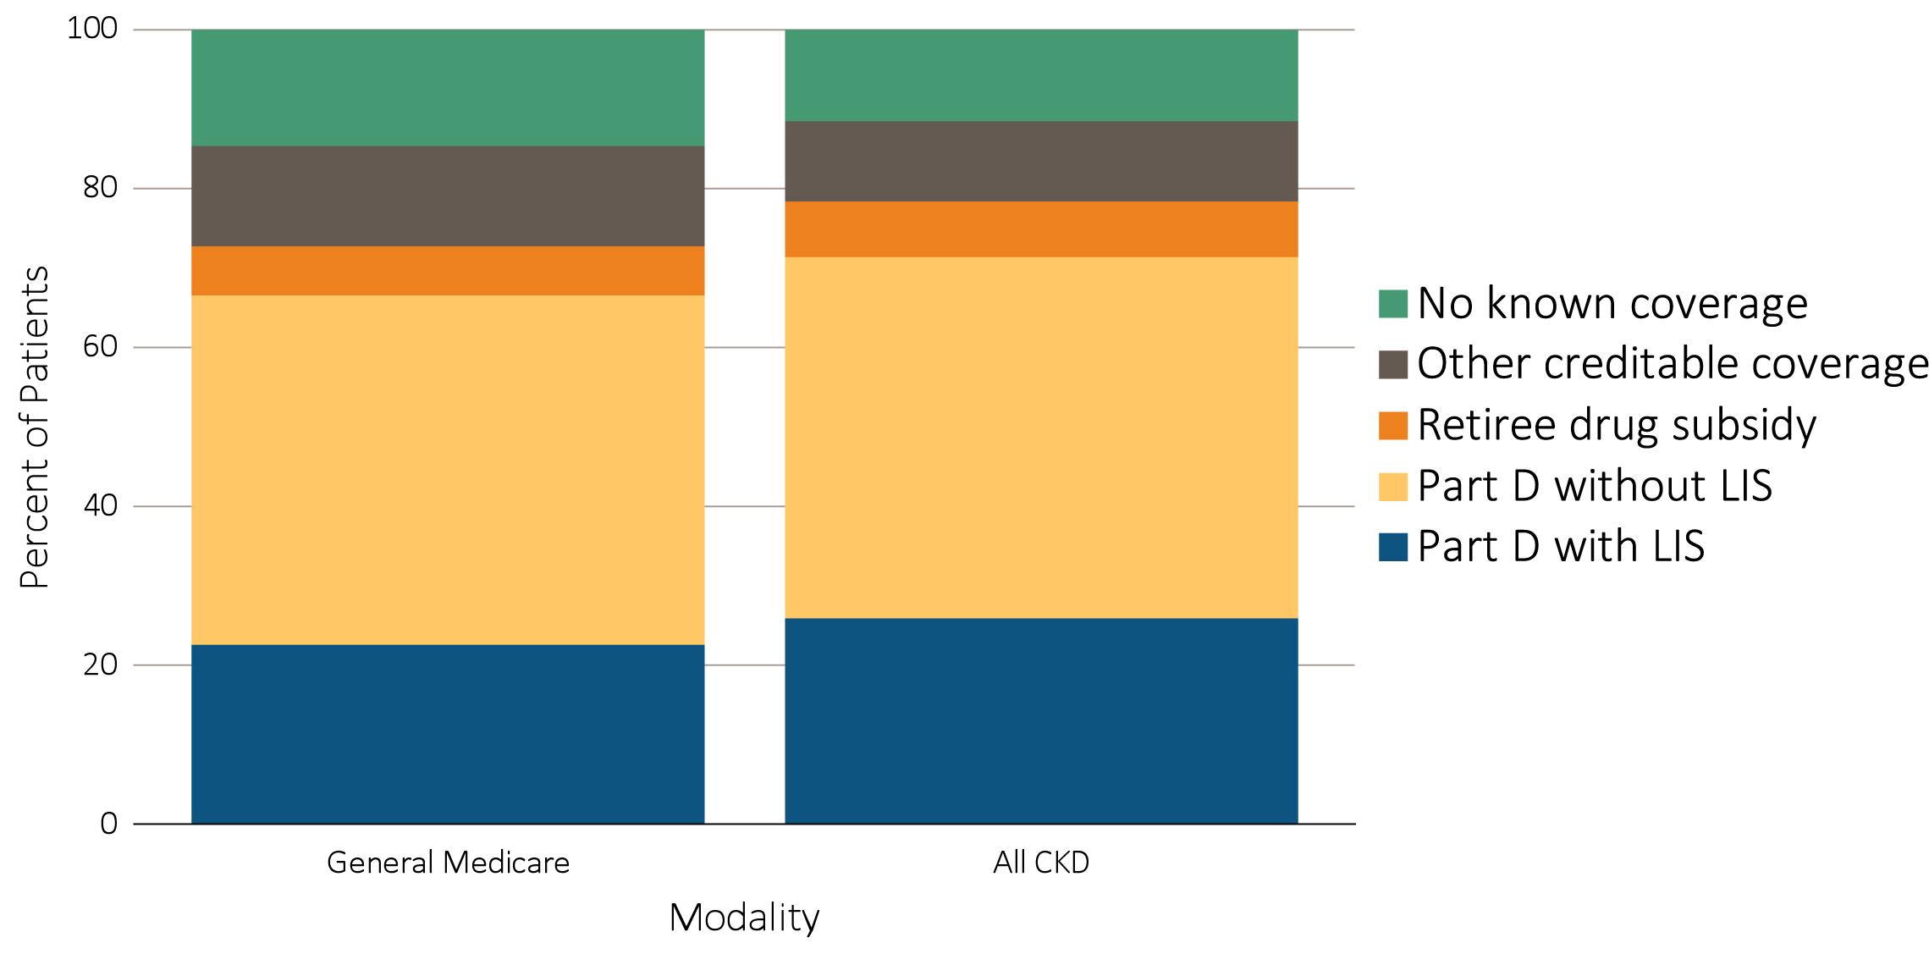
vol 1 Figure 7.1 Sources of prescription drug coverage in Medicare enrollees, by population, 2015
Data source: Medicare 5% sample. Point prevalent Medicare enrollees alive on January 1, 2015. Abbreviations: CKD, chronic kidney disease; LIS, Medicare Low-income Subsidy; Part D, Medicare prescription drug coverage benefit.

Slide 3
vol 1 Table 7.1 General Medicare and CKD patients enrolled in Part D
 | General Medicare (%) | All CKD (%)
2011 | 55.7 | 59.3
2012 | 57.6 | 60.5
2013 | 65.7 | 69.3
2014 | 66.3 | 71.1
2015 | 67.1 | 71.9
Data source: Medicare 5% sample. Point prevalent Medicare enrollees alive on January 1. Abbreviations: CKD, chronic kidney disease; Part D, Medicare prescription drug coverage benefit.

Slide 4
vol 1 Table 7.2 Medicare Part D parameters for defined standard benefit, 2010 & 2015
 | 2010 | 2015
Deductible | $310 | $320
After the deductible is met, the beneficiary pays 25% of total prescription costs up to the initial coverage limit.
Initial coverage limit | $2,830 | $2,960
The coverage gap (“donut hole”) begins at this point.
The beneficiary pays 100% of their prescription costs up to the out-of-pocket threshold
Out-of-pocket threshold | $4,550 | $4,700
The total out-of-pocket costs including the “donut hole”
Total covered Part D prescription out-of-pocket spending | $6,440.00 | $6,680.00
Catastrophic coverage begins after this point (including the coverage gap).
Catastrophic coverage benefit | $2.50 | *$2.65
Generic/preferred multi-source drug | $6.30 | *$6.60
Other drugs |  | plus a 55% brand-name medication discount
2015 Example:
$320 (deductible) | $310.00 | $320
+(($2960-$320)*25%) (initial coverage) | $630.00 | $660.00
+(($6680-$2960)*100%) (coverage gap) | $3,610.00 | $3,720.00
Total | $4,550.00 | $4,700.00
(maximum out-of-pocket costs prior to catastrophic coverage, excluding plan premium)
*The catastrophic coverage amount is the greater of 5% of medication cost or the values shown in the chart above. In 2015, beneficiaries were charged $2.65 for those generic or preferred multisource drugs with a retail price less than $53 and 5% for those with a retail price over $53. For brand name drugs, beneficiaries paid $6.6 for those drugs with a retail price less than $132 and 5% for those with a retail price over $132. Table adapted from http://www.q1medicare.com/PartD-The-2015-Medicare-Part-D-Outlook.php.

Slide 5
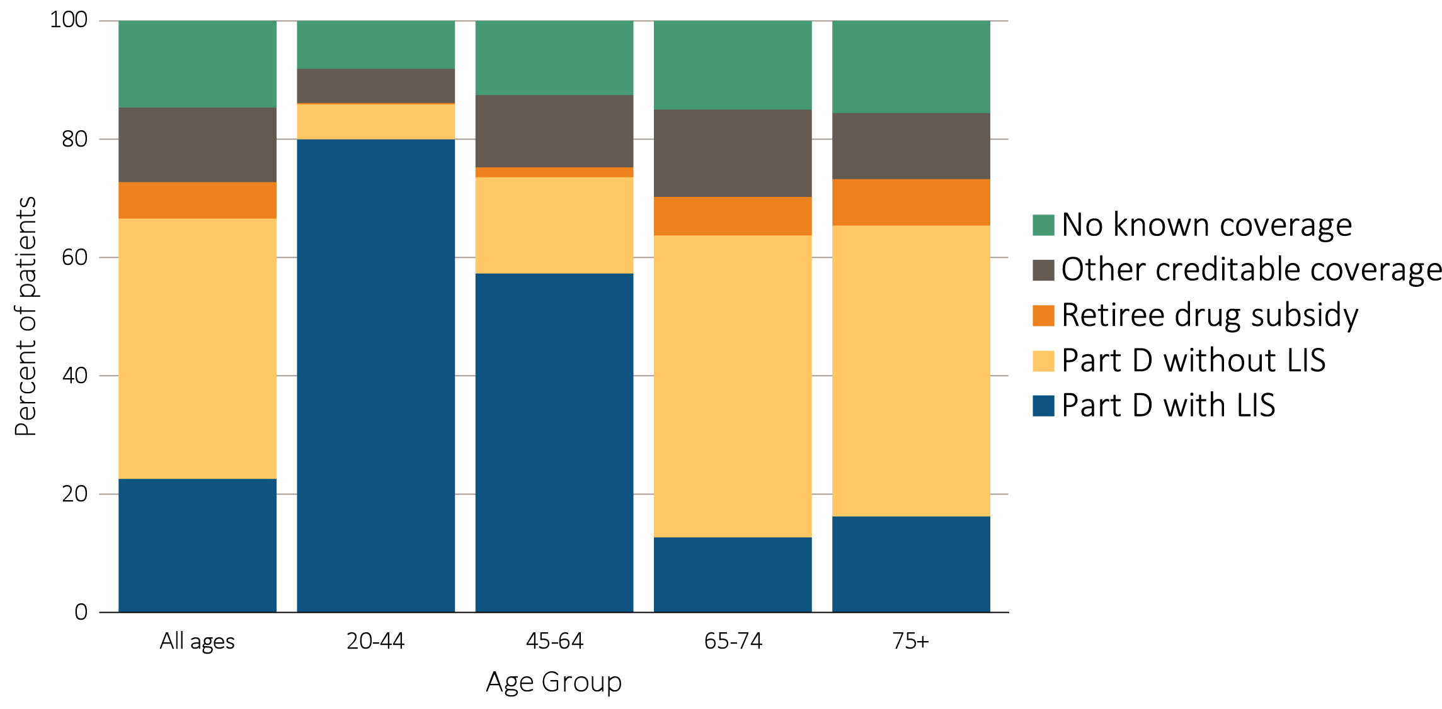
vol 1 Figure 7.2 Sources of prescription drug coverage in Medicare enrollees, by age, 2015
(a) All general Medicare enrollees
Data source: Medicare 5% sample. Point prevalent Medicare enrollees alive on January 1, 2015. Abbreviations: CKD, chronic kidney disease; LIS, Medicare Low-income Subsidy; Part D, Medicare prescription drug coverage benefit.

Slide 6
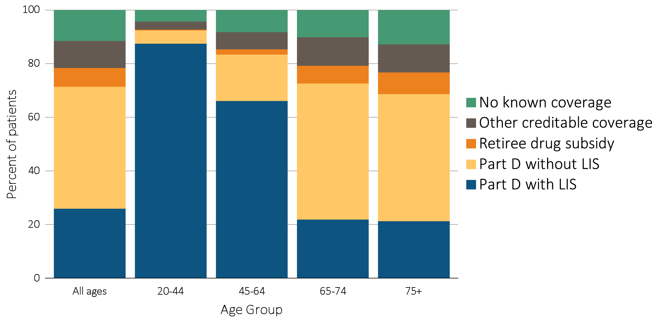
vol 1 Figure 7.2 Sources of prescription drug coverage in Medicare enrollees, by age, 2015
(b) Enrollees with CKD
Data source: Medicare 5% sample. Point prevalent Medicare enrollees alive on January 1, 2015. Abbreviations: CKD, chronic kidney disease; LIS, Medicare Low-income Subsidy; Part D, Medicare prescription drug coverage benefit.

Slide 7
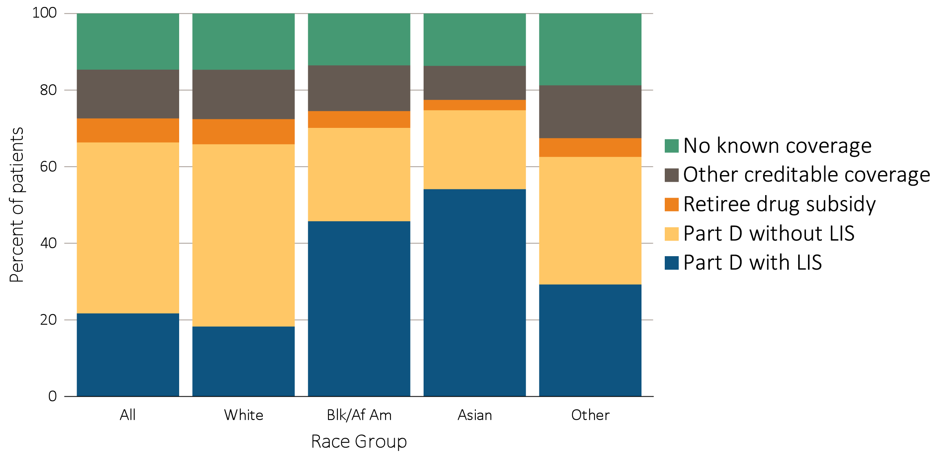
vol 1 Figure 7.3 Sources of prescription drug coverage in Medicare enrollees, by race, 2015
(a) All general Medicare enrollees
Data source: Medicare 5% sample. Point prevalent Medicare enrollees alive on January 1, 2015. Abbreviations: Blk/Af Am, Black/African American; CKD, chronic kidney disease; LIS, Medicare Low-income Subsidy; Part D, Medicare prescription drug coverage benefit.

Slide 8
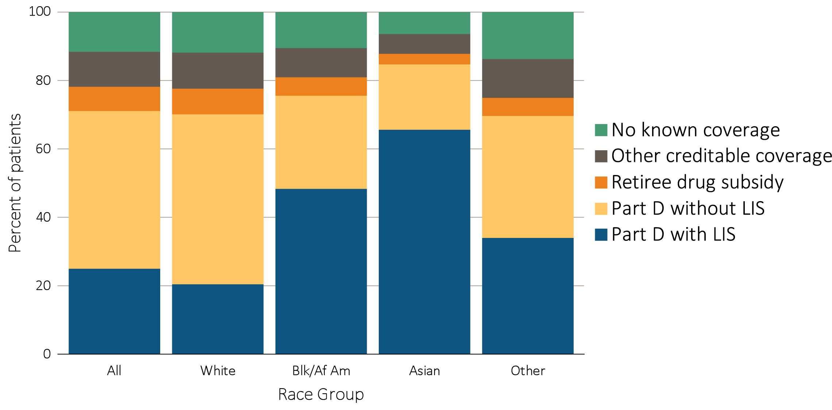
vol 1 Figure 7.3 Sources of prescription drug coverage in Medicare enrollees, by race, 2015
(b) Enrollees with CKD
Data source: Medicare 5% sample. Point prevalent Medicare enrollees alive on January 1, 2015. Abbreviations: Blk/Af Am, Black/African American; CKD, chronic kidney disease; LIS, Medicare Low-income Subsidy; Part D, Medicare prescription drug coverage benefit.

Slide 9
vol 1 Table 7.3 Medicare Part D enrollees with the Low-income Subsidy, by age & race, 2015
 | General Medicare (%) | All CKD (%)
 | Part D with Low-income Subsidy | Part D with Low-income Subsidy
White
All ages | 28.3 | 29.7
20-44 | 92.5 | 94.4
45-64 | 75.5 | 76.6
65-74 | 15.9 | 24.4
75+ | 20.0 | 24.8
Black/African American
All ages | 65.5 | 64.2
20-44 | 95.0 | 95.6
45-64 | 85.3 | 85.0
65-74 | 46.5 | 54.4
75+ | 55.5 | 60.1
Asian
All ages | 72.6 | 77.6
20-44 | 92.7 | 100.0
45-64 | 84.2 | 84.3
65-74 | 63.6 | 71.7
75+ | 76.2 | 79.0
Other races
All ages | 47.2 | 49.2
20-44 | 93.4 | 88.2
45-64 | 79.5 | 79.3
65-74 | 31.4 | 38.9
75+ | 43.6 | 48.5
Data source: Medicare 5% sample. Point prevalent Medicare enrollees alive on January 1, 2015. Abbreviations: CKD, chronic kidney disease; Part D, Medicare prescription drug coverage benefit.

Slide 10
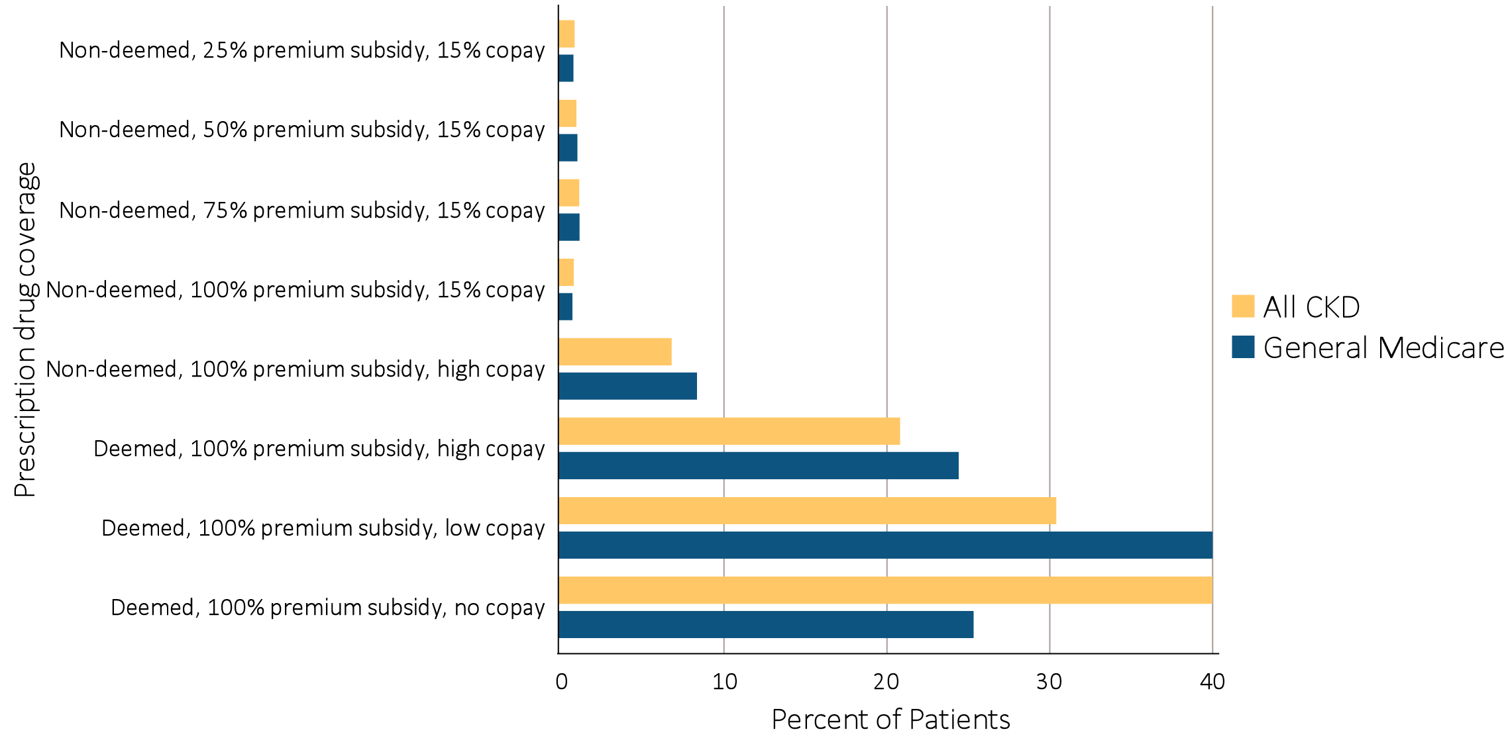
vol 1 Figure 7.4 Distribution of Low-income Subsidy categories in Part D general Medicare and CKD patients, 2015
Data source: Medicare 5% sample. Point prevalent Medicare enrollees alive on January 1, 2015. Abbreviations: CKD, chronic kidney disease; Part D, Medicare prescription drug coverage benefit.

Slide 11
vol 1 Table 7.4 Total estimated Medicare Part D spending for fee-for-service beneficiaries (in billions),2011-2015
 | General Medicare | All CKD
2011 | 40.1 | 5.2
2012 | 35.7 | 4.8
2013 | 45.7 | 6.8
2014 | 50.5 | 7.7
2015 | 54.2 | 8.7
Data source: Medicare Part D claims. Medicare totals include Part D claims for Part D enrollees with traditional Medicare (Parts A & B). CKD totals include Medicare CKD patients, as determined from claims. Abbreviations: CKD, chronic kidney disease; Part D, Medicare prescription drug coverage benefit.

Slide 12
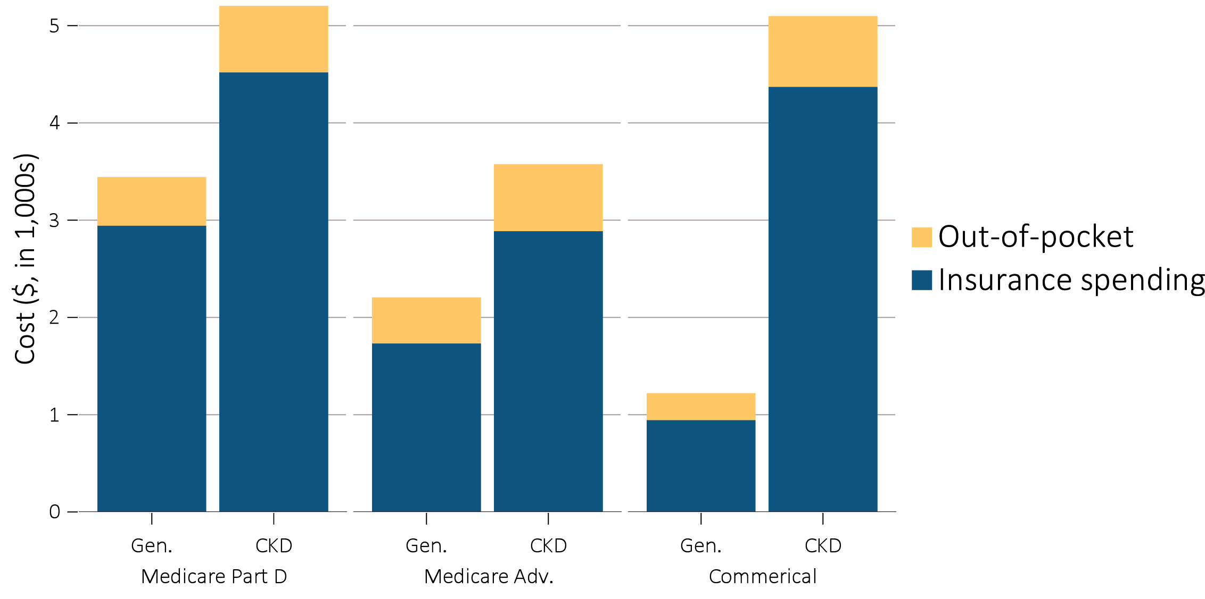
vol 1 Figure 7.5 Per person per year & out-of-pocket costs (in $1,000s) for enrollees, 2015
(a) All enrollees by type of insurance and modality
Data source: Medicare Part D claims and Optum Clinformatics™ claims. Medicare totals include Part D claims for Part D enrollees with traditional Medicare (Parts A & B). CKD totals include Medicare CKD patients as determined from claims. Costs are per person per year for calendar year 2015. Medicare total is the sum of Medicare net payment plus Low-income Supplement amount. Abbreviations: Gen., general enrollees; CKD, chronic kidney disease; Medicare adv., Medicare Advantage plans.

Slide 13
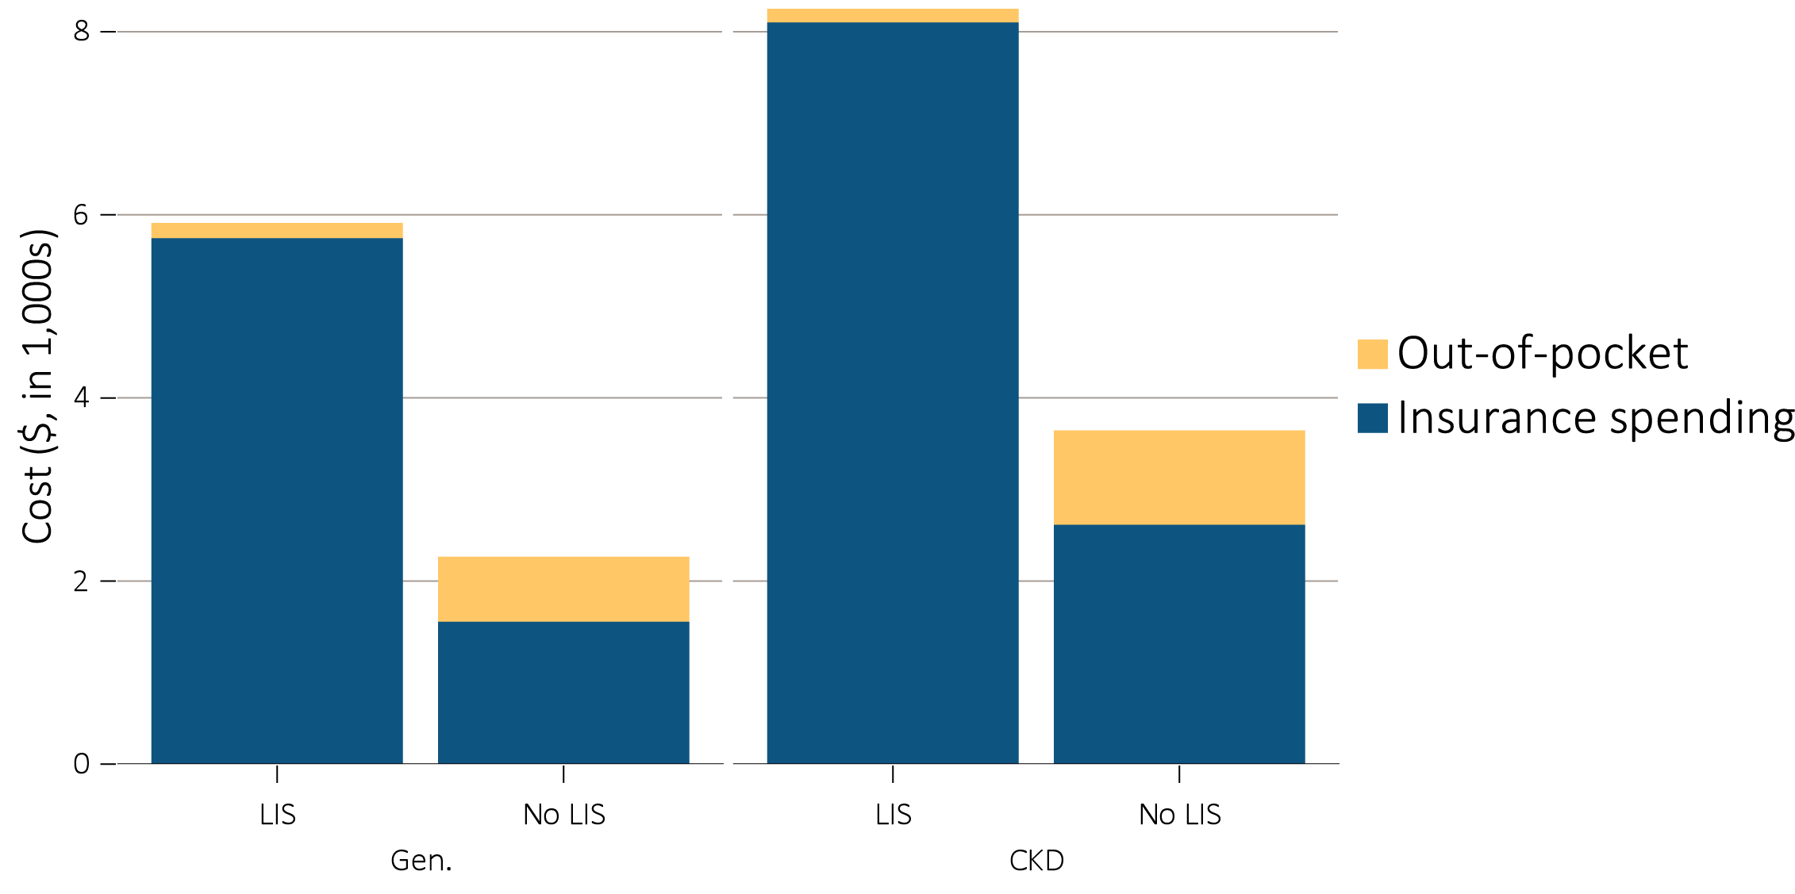
vol 1 Figure 7.5 Per person per year & out-of-pocket costs (in $1,000s) for enrollees, 2015
(b) Medicare Part D enrollees by Low-income Subsidy status
Data source: Medicare Part D claims and Optum Clinformatics™ claims. Medicare totals include Part D claims for Part D enrollees with traditional Medicare (Parts A & B). CKD totals include Medicare CKD patients as determined from claims. Costs are per person per year for calendar year 2015. Medicare total is the sum of Medicare net payment plus Low-income Supplement amount. Abbreviations: Gen., general enrollees; CKD, chronic kidney disease; Medicare adv., Medicare Advantage plans.

Slide 14
vol 1 Table 7.5 Per person per year spending ($) for enrollees, 2015
 | Medicare Part D with LIS, General | Medicare Part D with LIS, CKD | Medicare Part D without LIS, General | Medicare Part D without LIS, CKD | Medicare Advantage, General | Medicare Advantage, CKD | Managed care, General | Managed care, CKD
Age
All | 5,788 | 8,145 | 1,598 | 2,658 | 1,760 | 2,914 | 971 | 4,398
20-44 | 5,613 | 10,613 | 2,636 | 3,020 | 4,847 | 9,465 | 538 | 2,639
45-64 | 7,872 | 12,647 | 3,790 | 5,959 | 4,887 | 7,564 | 1,289 | 4,726
65-74 | 4,966 | 8,217 | 1,527 | 3,138 | 1,490 | 3,367 | 2,048 | 5,379
75+ | 4,146 | 5,802 | 1,450 | 2,212 | 1,348 | 2,206 | 2,725 | 3,824
Sex
Male | 5,877 | 8,816 | 1,749 | 2,891 | 1,740 | 2,828 | 945 | 4,651
Female | 5,727 | 7,733 | 1,488 | 2,427 | 1,774 | 2,989 | 997 | 4,056
Race
White | 5,988 | 8,237 | 1,587 | 2,586 | 1,794 | 2,840 | 1,004 | 4,484
Black/African American | 5,590 | 7,947 | 1,811 | 3,054 | 2,567 | 3,864 | 916 | 4,189
Asian | 4,710 | 7,467 | 1,360 | 2,380 | 1,855 | 3,713 | 554 | 3,188
Other race | 4,861 | 7,081 | 1,723 | 4,525 | NA | NA | NA | NA
Data source: Medicare Part D claims and Optum Clinformatics™ claims. CKD determined from claims. Costs are per person per year for calendar year 2015. Medicare PPPY is the sum of Medicare net payment and the Low-income Supplement amount. LIS status is determined from the Part D enrollment. A person is classified as LIS if they are eligible for the LIS for at least one month during 2015. Abbreviations: CKD, chronic kidney disease; Part D, Medicare prescription drug coverage benefit.

Slide 15
vol 1 Table 7.6 Top 15 drug classes received by CKD cohorts in different health plans, by percent of patients, 2015
 | Medicare Part D |  | Medicare Advantage |  | Managed Care
Rank | Drug class | % | Drug class | % | Drug class | %
1 | Lipid-lowering agents | 63.6 | Lipid-lowering agents | 53.4 | Renin-angiotensin-aldosterone system inhibitors | 51.4
2 | Antibacterials | 60.5 | Renin-angiotensin-aldosterone system inhibitors | 51.1 | Antibacterials | 49.5
3 | Renin-angiotensin-aldosterone system inhibitors | 58.1 | Antibacterials | 44.8 | Lipid-lowering agents | 48.0
4 | β-adrenergic blocking agents | 56.0 | β-adrenergic blocking agents | 42.9 | Analgesics and antipyretics | 41.7
5 | Analgesics and antipyretics | 49.4 | Analgesics and antipyretics | 37.9 | β-adrenergic blocking agents | 33.4
6 | Diuretics | 48.5 | Diuretics | 36.2 | Antidiabetic agents | 32.8
7 | Antiulcer agents and acid suppressants | 42.4 | Calcium-channel blocking agents | 32.5 | Calcium-channel blocking agents | 26.8
8 | Calcium-channel blocking agents | 39.1 | Antidiabetic agents | 31.6 | Diuretics | 25.8
9 | Antidiabetic agents | 36.9 | Antiulcer agents and acid Suppressants | 30.3 | Psychotherapeutic agents | 23.1
10 | Psychotherapeutic agents | 36.8 | Psychotherapeutic agents | 26.4 | Diabetic consumables* | 21.8
11 | Antithrombotic agents | 31.4 | Diabetic consumables* | 22.7 | Antiulcer agents and acid suppressants | 21.2
12 | Anticonvulsants | 26.0 | Antithrombotic agents | 21.8 | Adrenals | 18.8
13 | Thyroid and antithyroid agents | 25.8 | Thyroid and antithyroid agents | 19.8 | Anxiolytics, sedatives, and hypnotics | 18.2
14 | Anxiolytics, sedatives, and hypnotics | 24.2 | Anticonvulsants | 18.3 | Anticonvulsants | 15.1
15 | Adrenals | 21.9 | Vaccines | 17.4 | Thyroid and antithyroid agents | 14.8
Data source: Medicare Part D claims and Optum Clinformatics™ claims. CKD patients with Medicare Part D stand-alone prescription drug plans in the Medicare 5% sample. Diabetic Consumables refers blood glucose test strips, blood glucose meters/sensors, lancets, needles, pen needles etc.

Slide 16
vol 1 Table 7.7 Top 15 drug classes received by different CKD cohorts (Medicare Part D/Medicare Advantage programs/managed care health plans), by spending, 2015
Medicare Part D
Rank | Drug class | Spending ($ in millions) | Percent of total spending (%)
1 | Antidiabetic agents | 1,685.4 | 19.4
2 | Antineoplastic agents | 994.6 | 11.4
3 | Antivirals | 643.5 | 7.4
4 | Lipid-lowering agents | 437.5 | 5.0
5 | Psychotherapeutic agents | 386.7 | 4.4
6 | Antithrombotic agents | 283.2 | 3.3
7 | Analgesics and antipyretics | 262.3 | 3.0
8 | Anti-inflammatory agents | 255.0 | 2.9
9 | Antiulcer agents and acid | 246.8 | 2.8
10 | Anticonvulsants | 231.1 | 2.7
11 | Disease-modifying antirheumatic agents | 177.8 | 2.0
12 | Anticholinergic agents | 174.5 | 2.0
13 | Antibacterials | 154.0 | 1.8
14 | Vasodilating agents (respiratory tract) | 150.9 | 1.7
15 | Central nervous system agents, miscellaneous | 148.4 | 1.7
Data source: Medicare Part D claims and Optum Clinformatics™ claims. CKD patients with Medicare Part D stand-alone prescription drug plans in the Medicare 5% sample. Medicare Part D spending represents the sum of the Medicare covered amount and the Low- income Subsidy amount. Diabetic Consumables refers blood glucose test strips, blood glucose meters/sensors, lancets, needles, pen needles etc.

Slide 17
vol 1 Table 7.7 Top 15 drug classes received by different CKD cohorts (Medicare Part D/ Medicare Advantage programs/managed care health plans), by spending, 2015
(b) Medicare Advantage
Rank | Drug class | Spending ($ in millions) | Percent of total spending
1 | Antidiabetic agents | 109.2 | 17.7
2 | Antineoplastic agents | 63.3 | 10.3
3 | Lipid-lowering agents | 46.7 | 7.6
4 | Antivirals | 32.9 | 5.3
5 | Diabetes consumables* | 30.1 | 4.9
6 | Psychotherapeutic agents | 23.8 | 3.9
7 | Antithrombotic agents | 23.0 | 3.7
8 | Analgesics and antipyretics | 18.8 | 3.0
9 | Anti-inflammatory agents | 18.7 | 3.0
10 | Renin-angiotensin-aldosterone system inhibitors | 15.9 | 2.6
11 | Antiulcer agents and acid | 15.3 | 2.5
12 | Anticonvulsants | 14.8 | 2.4
13 | Anticholinergic agents | 11.9 | 1.9
14 | Calcium-channel blocking agents | 10.0 | 1.6
15 | β-adrenergic blocking agents | 9.4 | 1.5
Data source: Medicare Part D claims and Optum Clinformatics™ claims. CKD patients with Medicare Part D stand-alone prescription drug plans in the Medicare 5% sample. Medicare Part D spending represents the sum of the Medicare covered amount and the Low- income Subsidy amount. Diabetic Consumables refers blood glucose test strips, blood glucose meters/sensors, lancets, needles, pen needles etc.

Slide 18
vol 1 Table 7.7 Top 15 drug classes received by different CKD cohorts (Medicare Part D/ Medicare Advantage programs/managed care health plans), by spending, 2015
(c) Managed Care
Rank | Drug class | Spending ($ in millions) | Percent of total spending
1 | Antidiabetic agents | 49.1 | 21.9
2 | Antineoplastic agents | 32.5 | 14.5
3 | Antivirals | 18.4 | 8.2
4 | Lipid-lowering agents | 13.4 | 6.0
5 | Disease-modifying antirheumatic agents | 8.7 | 3.9
6 | Analgesics and antipyretics | 7.9 | 3.5
7 | Antithrombotic agents | 6.8 | 3.1
8 | Psychotherapeutic agents | 6.5 | 2.9
9 | Diabetic consumables* | 6.2 | 2.8
10 | Renin-angiotensin-aldosterone system inhibitors | 4.3 | 1.9
11 | Anti-inflammatory agents | 3.7 | 1.6
12 | Anticonvulsants | 3.6 | 1.6
13 | Antibacterials | 3.3 | 1.5
14 | Immunosuppressive agents | 3.1 | 1.4
15 | Immunomodulatory agents | 2.8 | 1.3
Data source: Medicare Part D claims and Optum Clinformatics™ claims. CKD patients with Medicare Part D stand-alone prescription drug plans in the Medicare 5% sample. Medicare Part D spending represents the sum of the Medicare covered amount and the Low- income Subsidy amount. Diabetic Consumables refers blood glucose test strips, blood glucose meters/sensors, lancets, needles, pen needles etc.

Slide 19
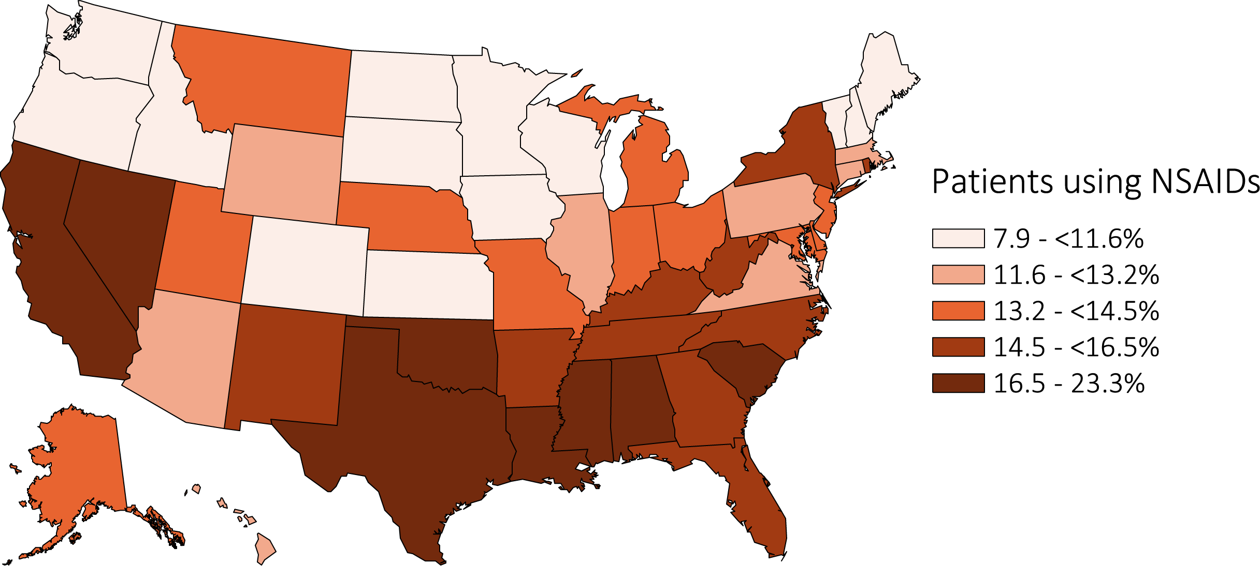
vol 1 Figure 7.6 Estimated utilization rate of prescription NSAIDs, by state, Medicare CKD Patients, 2015
Data source: Medicare Part D claims. CKD patients with Medicare Part D stand-alone prescription drug plans in the Medicare 5% sample. Abbreviations: NSAIDs, nonsteroidal anti-inflammatory agents. NSAID filled under Medicare Part D represent a fraction of actual NSAID use.

Slide 20
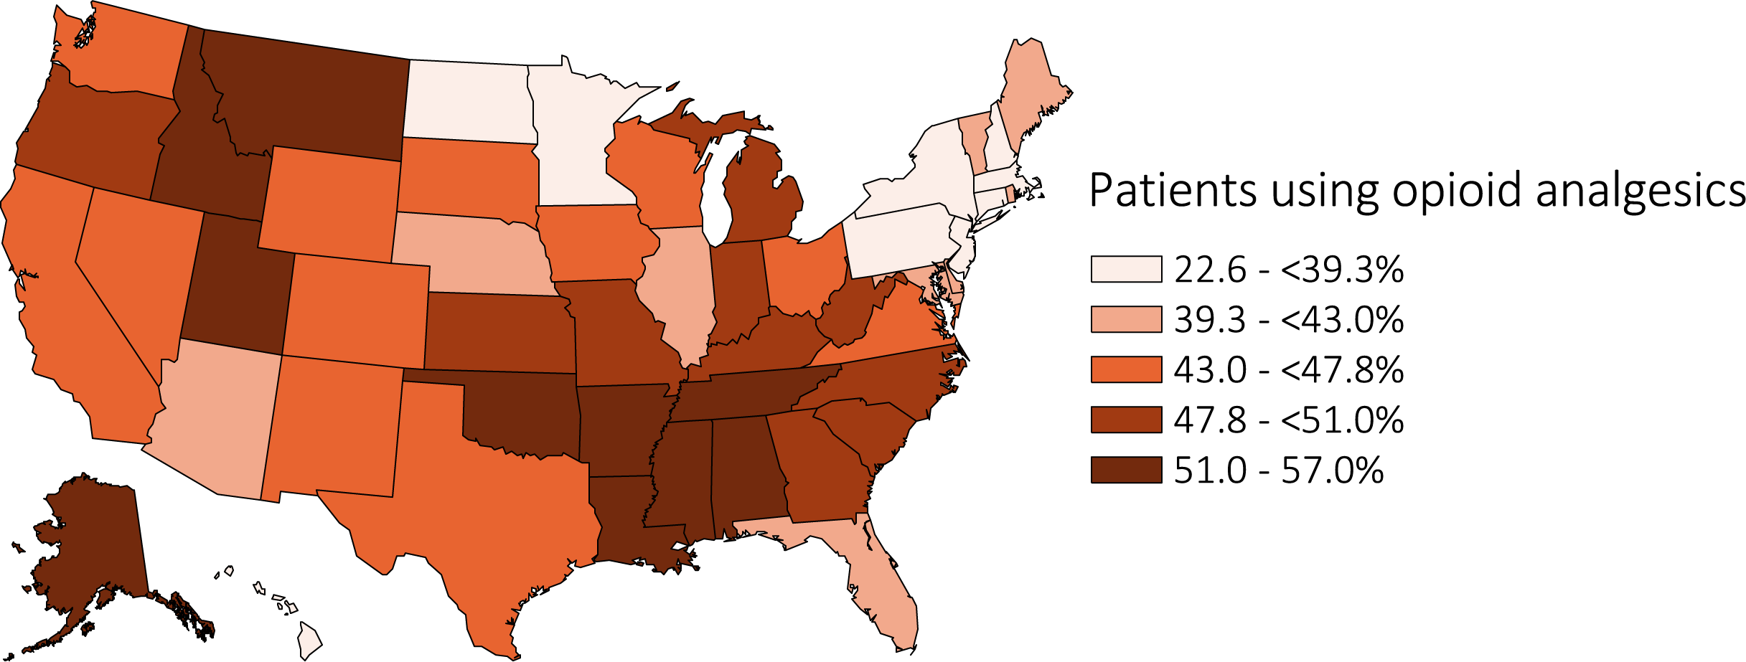
vol 1 Figure 7.7 Estimated utilization rate of opioid analgesics, by state, Medicare CKD Patients, 2015
Data source: Medicare Part D claims. CKD patients with Medicare Part D stand-alone prescription drug plans in the Medicare 5% sample.

