Slide 1
2017 Annual Data Report
Volume 2: End-Stage Renal Disease
Chapter 1:
Incidence, Prevalence, Patient Characteristics, and Treatment Modalities

Slide 2
vol 2 Table 1.1 Trends in annual number of ESRD incident cases, unadjusted and adjusted incidence rates of ESRD, and annual percentage change in the U.S. population, 1980-2015
 | Incident count |  | Unadjusted rate |  | Adjusted rate
Year | No. cases | % Change from previous year | Unadjusted rate (per million/year) | % Change from previous year | Adjusted rate (per million/year) | % Change from previous year
1980 | 17,903 | n/a | 72 | n/a | 87 | n/a
1981 | 20,039 | 11.9 | 81 | 12.3 | 99 | 13.4
1982 | 22,567 | 12.6 | 92 | 13.5 | 114 | 14.5
1983 | 25,774 | 14.2 | 104 | 13.1 | 129 | 13.7
1984 | 27,325 | 6.0 | 110 | 5.6 | 136 | 5.7
1985 | 30,214 | 10.6 | 121 | 9.9 | 149 | 9.5
1986 | 33,109 | 9.6 | 132 | 8.9 | 161 | 7.9
1987 | 36,604 | 10.6 | 145 | 10.1 | 178 | 10.2
1988 | 40,994 | 12.0 | 161 | 10.6 | 196 | 10.4
1989 | 46,304 | 13.0 | 181 | 12.6 | 219 | 11.5
1990 | 50,826 | 9.8 | 198 | 9.2 | 238 | 9.0
1991 | 55,388 | 9.0 | 213 | 7.7 | 256 | 7.5
1992 | 60,891 | 9.9 | 231 | 8.6 | 277 | 8.2
1993 | 64,488 | 5.9 | 242 | 4.7 | 290 | 4.5
1994 | 69,958 | 8.5 | 259 | 7.1 | 310 | 7.0
1995 | 72,199 | 3.2 | 264 | 1.8 | 315 | 1.6
1996 | 77,000 | 6.6 | 278 | 5.3 | 329 | 4.5
1997 | 82,120 | 6.6 | 293 | 5.3 | 343 | 4.4
1998 | 87,330 | 6.3 | 309 | 5.3 | 360 | 4.8
1999 | 91,409 | 4.7 | 319 | 3.4 | 368 | 2.4
2000 | 94,702 | 3.6 | 327 | 2.5 | 374 | 1.5
2001 | 97,966 | 3.4 | 336 | 2.6 | 380 | 1.7
2002 | 100,177 | 2.3 | 340 | 1.3 | 381 | 0.1
2003 | 102,599 | 2.4 | 345 | 1.5 | 382 | 0.3
2004 | 104,465 | 1.8 | 349 | 1.2 | 382 | -0.1
2005 | 106,623 | 2.1 | 354 | 1.3 | 382 | 0.1
2006 | 110,327 | 3.5 | 362 | 2.5 | 387 | 1.4
2007 | 110,316 | 0.0 | 359 | -0.9 | 379 | -2.1
2008 | 111,843 | 1.4 | 360 | 0.4 | 375 | -1.0
2009 | 115,497 | 3.3 | 369 | 2.5 | 380 | 1.2
2010 | 115,829 | 0.3 | 367 | -0.6 | 372 | -2.0
2011 | 113,735 | -1.8 | 358 | -2.5 | 358 | -3.8
2012 | 115,437 | 1.5 | 360 | 0.7 | 355 | -0.9
2013 | 118,160 | 2.4 | 367 | 1.8 | 356 | 0.3
2014 | 121,033 | 2.4 | 372 | 1.4 | 356 | 0.0
2015 | 124,114 | 2.5 | 378 | 1.8 | 357 | 0.4
Data Source: Reference Tables A.1 and special analyses. The special analyses exclude U.S. Territories, unknown/other races. USRDS ESRD Database. Standardized for age, sex, and race. Abbreviations: ESRD, end-stage renal disease; n/a, not applicable.

Slide 3
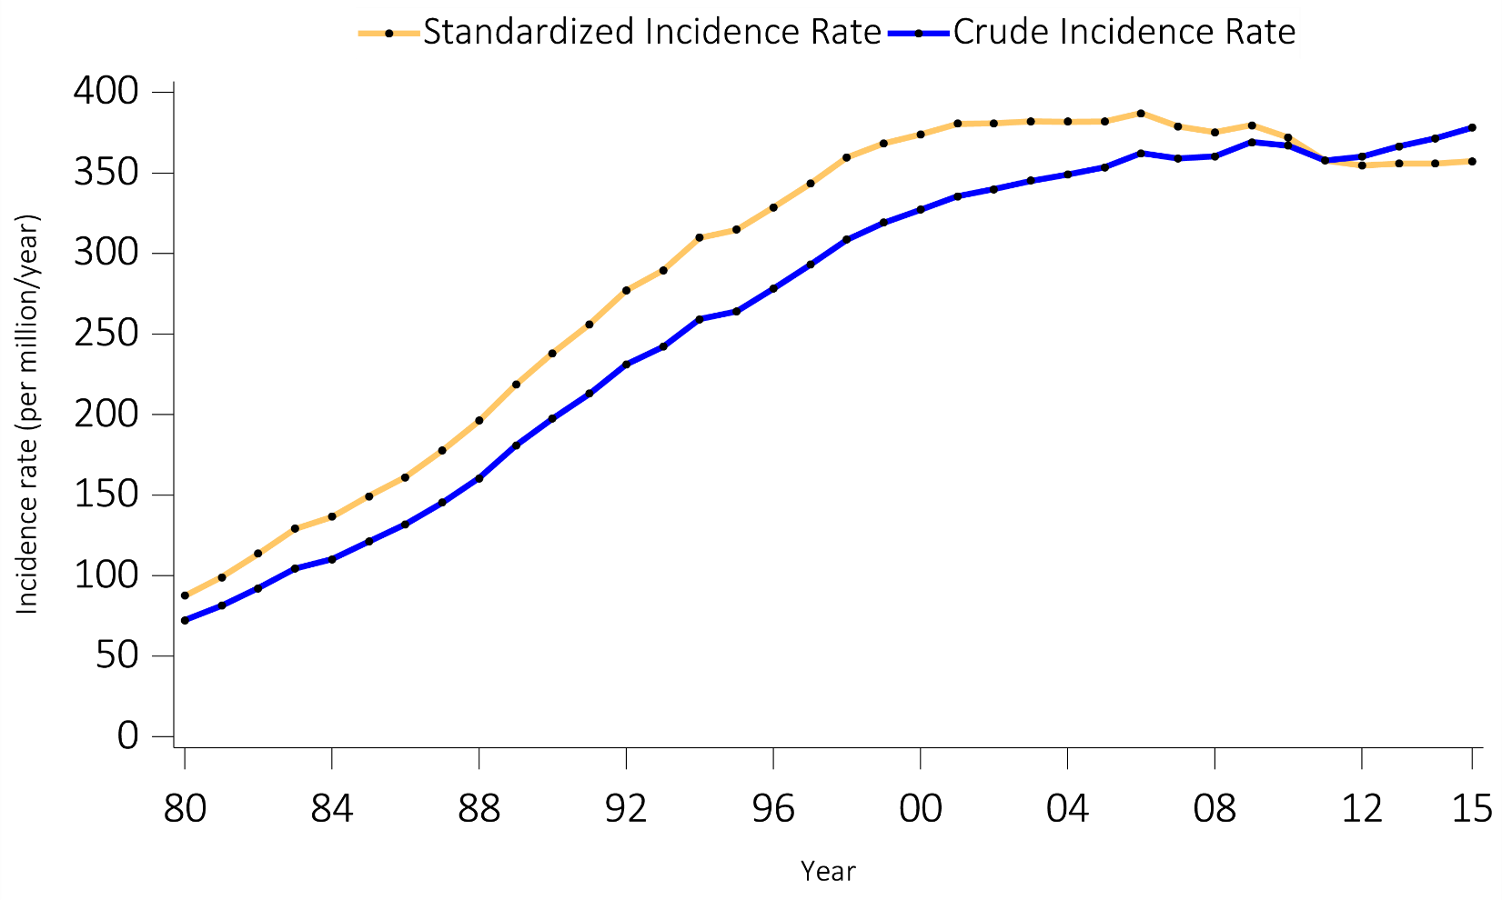
vol 2 Figure 1.1 Trends in the (a) unadjusted and standardized incidence rates of ESRD, and (b) the annual percentage change in the standardized incidence rate of ESRD in the U.S. population, 1980-2015
(a) Incidence rate per million/year
Data Source: Reference Table A.2(2) and special analyses, USRDS ESRD Database. Standardized for age, sex, and race. The standard population was the U.S. population in 2011. Abbreviation: ESRD, end-stage renal disease.

Slide 4
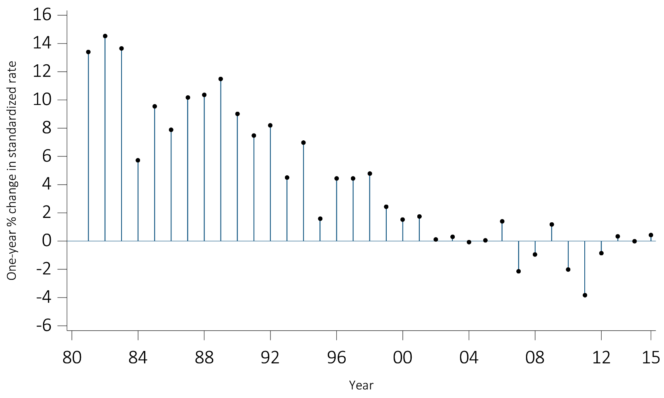
vol 2 Figure 1.1 Trends in the (a) unadjusted and standardized incidence rates of ESRD, and (b) the annual percentage change in the standardized incidence rate of ESRD in the U.S. population, 1980-2015
(b) One-year percentage change in standardized incidence rate
Data Source: Reference Table A.2(2) and special analyses, USRDS ESRD Database. Standardized for age, sex, and race. The standard population was the U.S. population in 2011. Abbreviation: ESRD, end-stage renal disease.

Slide 5
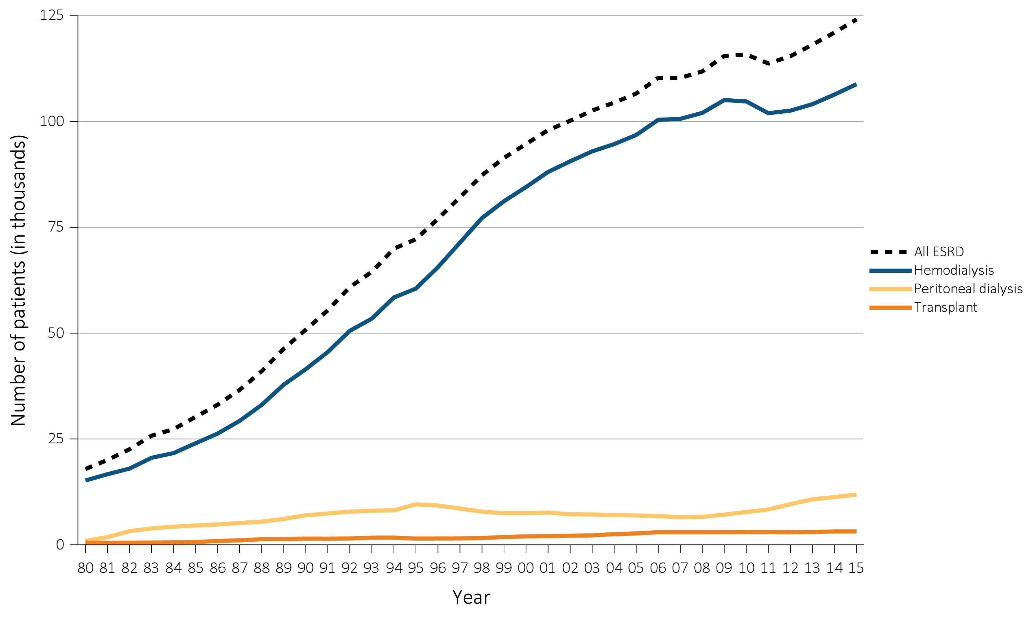
vol 2 Figure 1.2 Trends in the annual number of ESRD incident cases, by modality, in the U.S. population, 1980-2015
Data Source: Reference Table D1. Abbreviation: ESRD, end-stage renal disease.

Slide 6
vol 2 Table 1.2 Unadjusted and adjusted incidence rates of ESRD and annual number of ESRD incident cases, overall and by modality and ESRD Network, in the U.S. population, 2015
 |  | Total ESRD |  |  |  | Hemodialysis |  |  | Peritoneal dialysis |  |  | Transplant
Network | States in Network* | No. of cases | Adjusted incidence rate (per million/year) | Unadjusted incidence rate (per million/year) |  | No. of cases | % of network |  | No. of cases | % of network |  | No. of cases | % of network
14 | TX | 11,472 | 455 | 415 |  | 10,318 | 89.9 |  | 896 | 7.8 |  | 237 | 2.1
18 | Southern CA | 9,480 | 419 | 384 |  | 8,365 | 88.2 |  | 925 | 9.8 |  | 182 | 1.9
13 | AR, LA, OK | 5,200 | 396 | 446 |  | 4,509 | 86.7 |  | 612 | 11.8 |  | 78 | 1.5
3 | NJ, PR, VI | 5,376 | 395 | 431 |  | 3,517 | 90.0 |  | 270 | 6.9 |  | 115 | 2.9
10 | IL | 5,387 | 391 | 414 |  | 4,647 | 86.3 |  | 585 | 10.9 |  | 130 | 2.4
9 | IN, KY, OH | 9,301 | 388 | 407 |  | 8,278 | 89.0 |  | 807 | 8.7 |  | 181 | 1.9
8 | AL, MS, TN | 6,688 | 368 | 461 |  | 5,809 | 86.9 |  | 782 | 11.7 |  | 88 | 1.3
12 | IA, KS, MO, NE | 4,640 | 349 | 329 |  | 3,919 | 84.5 |  | 587 | 12.7 |  | 127 | 2.7
17 | Northern CA, HI, GU, AS, MP | 6,144 | 347 | 356 |  | 4,914 | 83.5 |  | 842 | 14.3 |  | 124 | 2.1
4 | DE, PA | 5,326 | 342 | 386 |  | 4,737 | 88.9 |  | 439 | 8.2 |  | 128 | 2.4
11 | MI, MN, ND, SD, WI | 7,576 | 336 | 330 |  | 6,597 | 87.1 |  | 645 | 8.5 |  | 297 | 3.9
2 | NY | 7,548 | 336 | 377 |  | 6,953 | 92.1 |  | 359 | 4.8 |  | 229 | 3.0
6 | NC, SC, GA | 10,858 | 336 | 428 |  | 9,416 | 86.7 |  | 1,209 | 11.1 |  | 216 | 2.0
5 | MD, DC, VA, WV | 6,938 | 334 | 406 |  | 6,189 | 89.2 |  | 574 | 8.3 |  | 156 | 2.2
7 | FL | 8,310 | 327 | 405 |  | 7,379 | 88.8 |  | 758 | 9.1 |  | 150 | 1.8
15 | AZ, CO, NV, NM, UT, WY | 6,084 | 309 | 288 |  | 5,241 | 86.1 |  | 647 | 10.6 |  | 186 | 3.1
1 | CT, MA, ME, NH, RI, VT | 3,995 | 262 | 268 |  | 3,467 | 86.8 |  | 361 | 9.0 |  | 162 | 4.1
16 | AK, ID, MT, OR, WA | 3,500 | 254 | 237 |  | 2,943 | 84.1 |  | 446 | 12.7 |  | 108 | 3.1
All networks |  | 124,114 | 354 | 376 |  | 107,198 | 87.8 |  | 11,744 | 9.6 |  | 2,894 | 2.4
Data Source: Reference Table A.10, and special analyses, USRDS ESRD Database. The special analyses exclude U.S. Territories, unknown/other races. Standardized for age, sex, and race. The standard population was the U.S. population in 2011. Listed from highest to lowest adjusted rate per million/year. * Includes 50 states, Washington, D.C. (DC), Puerto Rico (PR), Guam (GU), American Samoa (AS), U.S. Virgin Islands, and Northern Mariana Islands. Northern and Southern California (CA) split into Networks 17 and 18. Abbreviations: Af Am, African American; ESRD, end-stage renal disease; Hisp, Hispanic; N Am, Native American.

Slide 7
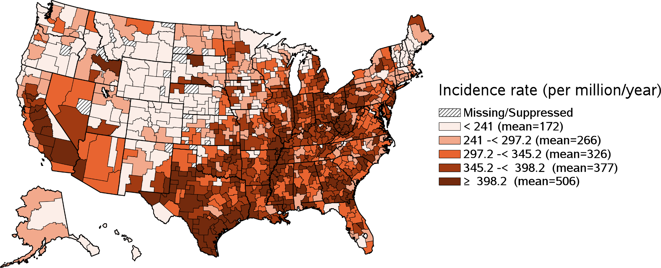
vol 2 Figure 1.3 Map of the adjusted incidence rate of ESRD, by Health Service Area, in the U.S. population, 2011-2015
Data Source: Special analyses, USRDS ESRD Database. Standardized for age, sex, and race. The standard population was the U.S. population in 2011. Values for cells with 10 or fewer patients are suppressed. Abbreviation: ESRD, end-stage renal disease.

Slide 8
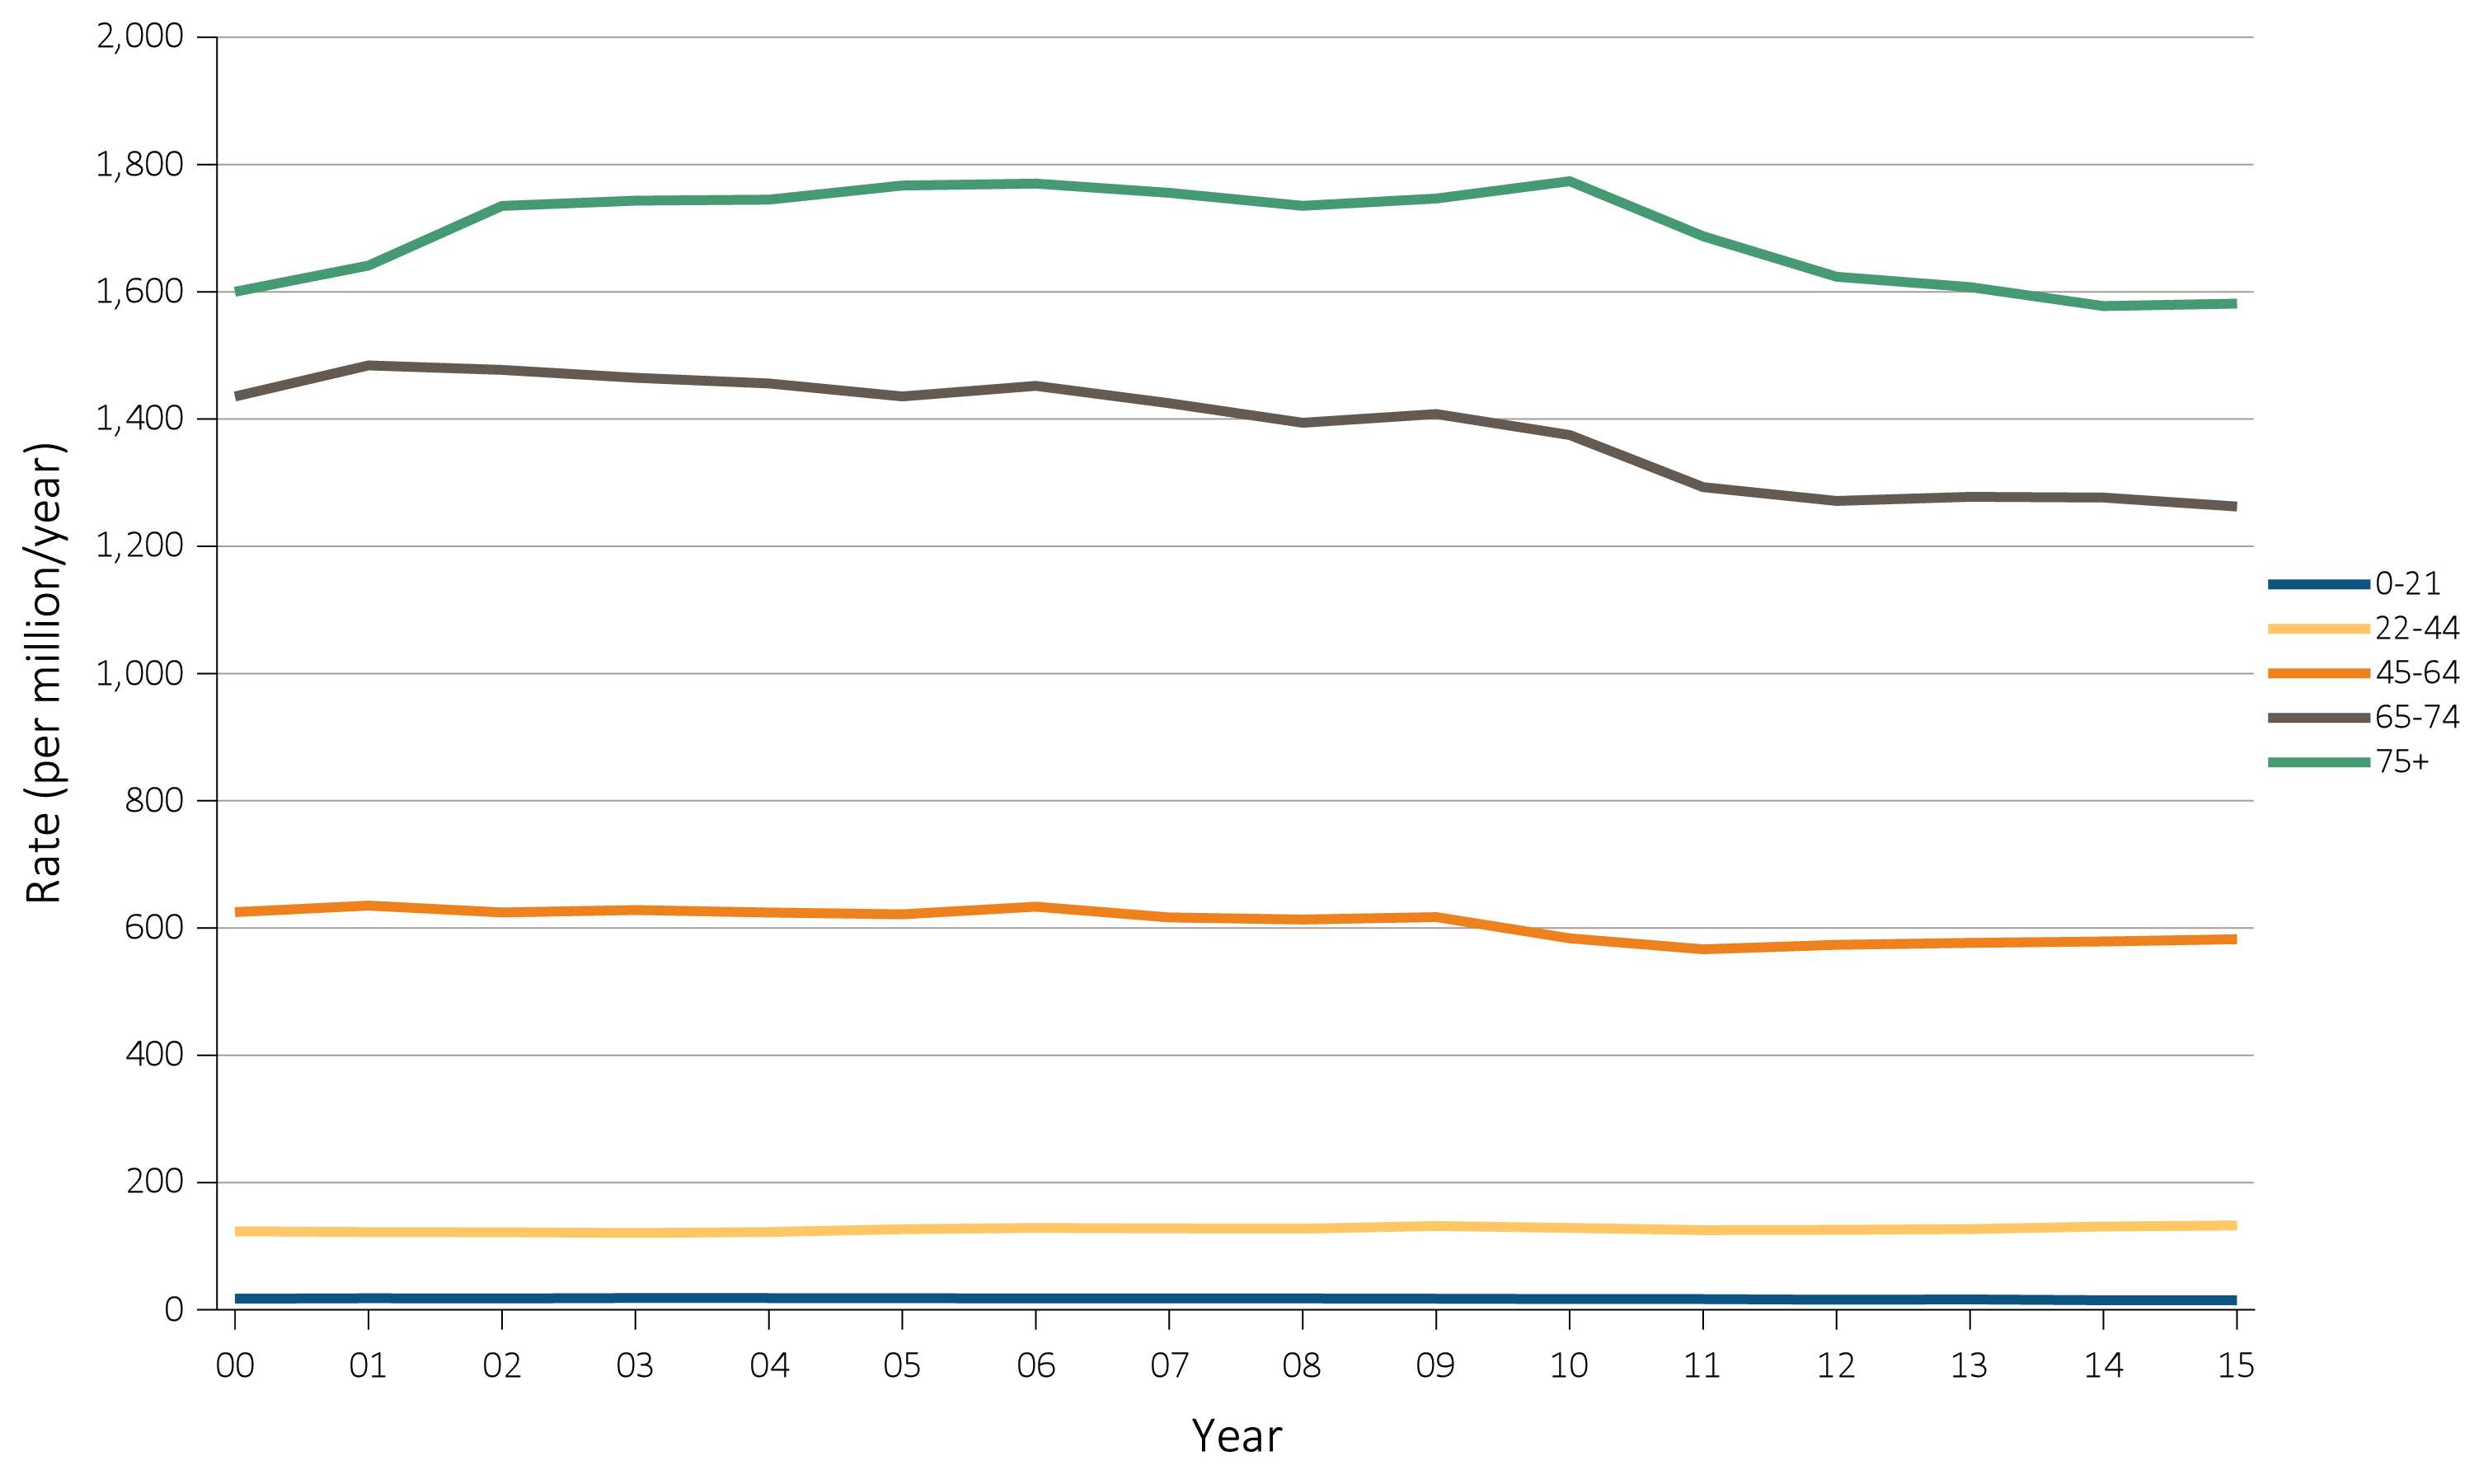
vol 2 Figure 1.4 Trends in adjusted ESRD incidence rate, by age group, in the U.S. population, 2000-2015
Data Source: Reference Table A.2(2) and special analyses, USRDS ESRD Database. Standardized for sex and race. The standard population was the U.S. population in 2011. Abbreviation: ESRD, end-stage renal disease.

Slide 9
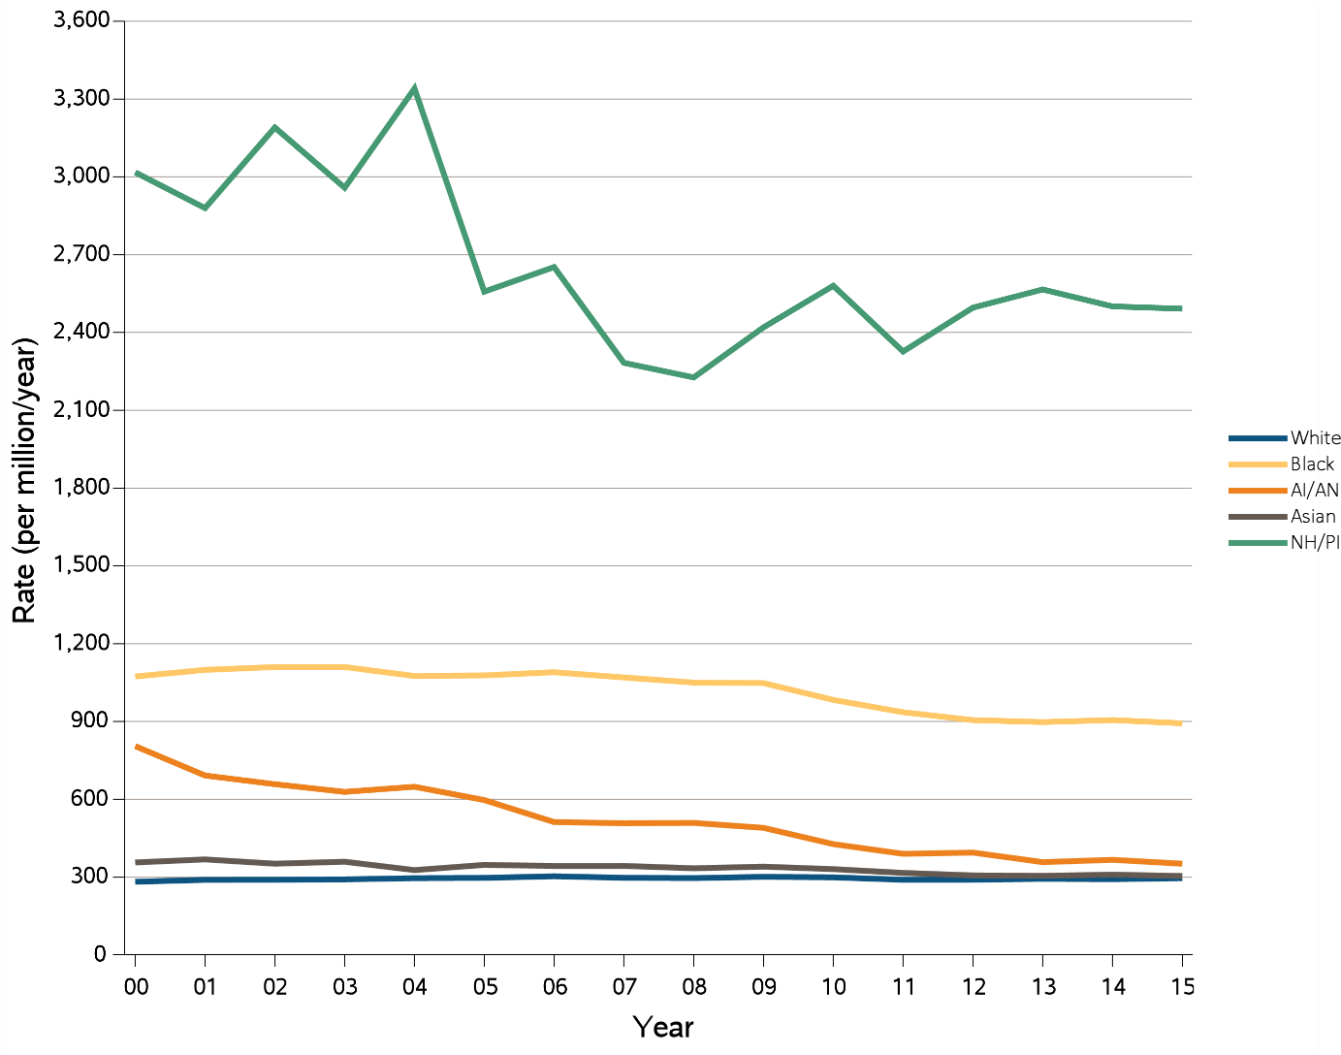
vol 2 Figure 1.5 Trends in adjusted ESRD incidence rate, by race, in the U.S. population, 2000-2015
Data Source: Reference Table A.2(2) and special analyses, USRDS ESRD Database. Standardized for age and sex. The standard population was the U.S. population in 2011. Abbreviations; AI/AN: Americans Indian/Alaska Native; NA/PI: Native Hawaiian/Pacific Islander; ESRD, end-stage renal disease.

Slide 10
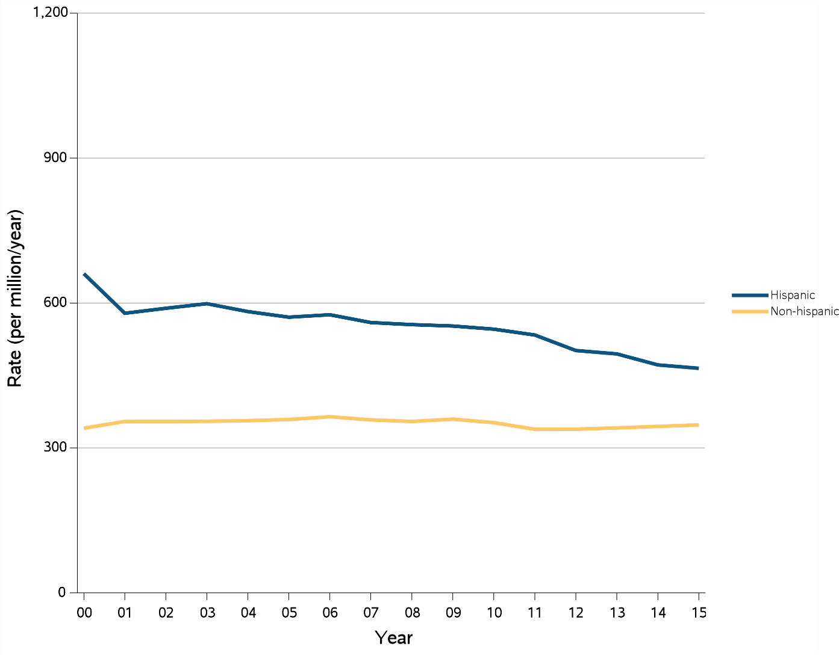
vol 2 Figure 1.6 Trends in adjusted ESRD incidence rate, by Hispanic ethnicity, in the U.S. population,2000-2015
Data Source: Reference Tables A.2(2). Standardized for age, sex, and race. The standard population was the U.S. population in 2011. Abbreviation: ESRD, end-stage renal disease.

Slide 11
vol 2 Table 1.3 Trends in annual number of ESRD prevalent cases, unadjusted and adjusted of ESRD, and annual percentage change, in the U.S. population, 1980-2015
 | Prevalent count |  | Unadjusted prevalence |  | Age-sex-race Standardized
Year | No. of cases | % change from previous year | Prevalence (per million year) | % change from previous year | Prevalence (per million year) | % change from previous year
1980 | 56,434 | n/a | 229.3 | n/a | 273.7 | n/a
1981 | 64,252 | 13.9 | 260.3 | 13.5 | 311.6 | 13.8
1982 | 72,491 | 12.8 | 293.5 | 12.8 | 352.0 | 13.0
1983 | 85,570 | 18.0 | 344.8 | 17.5 | 414.7 | 17.8
1984 | 95,887 | 12.1 | 384.8 | 11.6 | 463.1 | 11.7
1985 | 105,423 | 9.9 | 421.1 | 9.4 | 505.9 | 9.2
1986 | 116,109 | 10.1 | 461.5 | 9.6 | 552.2 | 9.2
1987 | 127,468 | 9.8 | 503.9 | 9.2 | 601.9 | 9.0
1988 | 143,523 | 12.6 | 564.1 | 11.9 | 674.7 | 12.1
1989 | 162,662 | 13.3 | 636.2 | 12.8 | 760.9 | 12.8
1990 | 180,474 | 11.0 | 698.0 | 9.7 | 834.5 | 9.7
1991 | 199,548 | 10.6 | 762.8 | 9.3 | 909.6 | 9.0
1992 | 220,348 | 10.4 | 832.5 | 9.1 | 990.0 | 8.8
1993 | 240,557 | 9.2 | 898.6 | 7.9 | 1,065.8 | 7.7
1994 | 262,626 | 9.2 | 969.5 | 7.9 | 1,146.0 | 7.5
1995 | 281,557 | 7.2 | 1,027.1 | 5.9 | 1,209.0 | 5.5
1996 | 304,413 | 8.1 | 1,096.5 | 6.8 | 1,283.9 | 6.2
1997 | 326,185 | 7.2 | 1.160.2 | 5.8 | 1,349.0 | 5.1
1998 | 348,762 | 6.9 | 1.226.1 | 5.7 | 1,417.0 | 5.0
1999 | 369,623 | 6.0 | 1,284.9 | 4.8 | 1,473.2 | 4.0
2000 | 390,561 | 5.7 | 1,343.5 | 4.6 | 1,526.5 | 3.6
2001 | 410,502 | 5.1 | 1,399.1 | 4.1 | 1,575.2 | 3.2
2002 | 429,876 | 4.7 | 1,452.8 | 3.8 | 1,617.8 | 2.7
2003 | 448,514 | 4.3 | 1,503.2 | 3.5 | 1,655.6 | 2.3
2004 | 467,038 | 4.1 | 1,552.4 | 3.3 | 1,690.2 | 2.1
2005 | 485,905 | 4.0 | 1,600.2 | 3.1 | 1,722.5 | 1.9
2006 | 506,633 | 4.3 | 1,652.1 | 3.2 | 1,758.4 | 2.1
2007 | 526,709 | 4.0 | 1,701.3 | 3.0 | 1,789.5 | 1.8
2008 | 547,750 | 4.0 | 1,753.0 | 3.0 | 1,821.6 | 1.8
2009 | 570,416 | 4.1 | 1,810.2 | 3.3 | 1,857.3 | 2.0
2010 | 592,656 | 3.9 | 1,865.8 | 3.1 | 1,890.0 | 1.8
2011 | 612,417 | 3.3 | 1,914.1 | 2.6 | 1,913.9 | 1.3
2012 | 633,912 | 3.5 | 1,966.4 | 2.7 | 1,940.8 | 1.4
2013 | 656,856 | 3.6 | 2,022.1 | 2.8 | 1,971.5 | 1.6
2014 | 680,320 | 3.6 | 2,077.1 | 2.7 | 2,000.4 | 1.5
2015 | 703,243 | 3.4 | 2,127.6 | 2.4 | 2,023.6 | 1.2
Data Source: Reference Tables B.1, B.2, B2(2) and special analyses, USRDS ESRD Database. The special analyses exclude U.S. Territories, unknown/other races. Standardized for age, sex, and race. Abbreviations: ESRD, end-stage renal disease; n/a, not applicable.

Slide 12
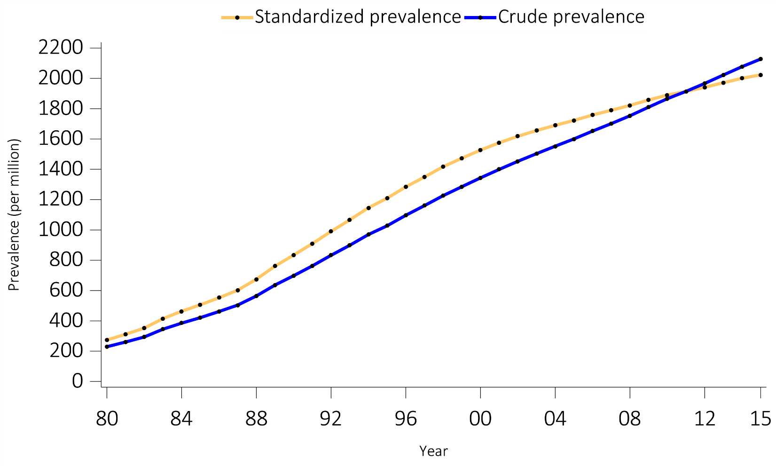
vol 2 Figure 1.7 Trends in the (a) unadjusted and standardized prevalence of ESRD, and (b) annual percentage change in the standardized prevalence of ESRD, in the U.S. population, 1980-2015
(a) Prevalence per million
Data Source: Reference Table B.2(2) and special analyses, USRDS ESRD Database. Standardized for age, sex, and race. The standard population was the U.S. population in 2011. Abbreviation: ESRD, end-stage renal disease.

Slide 13
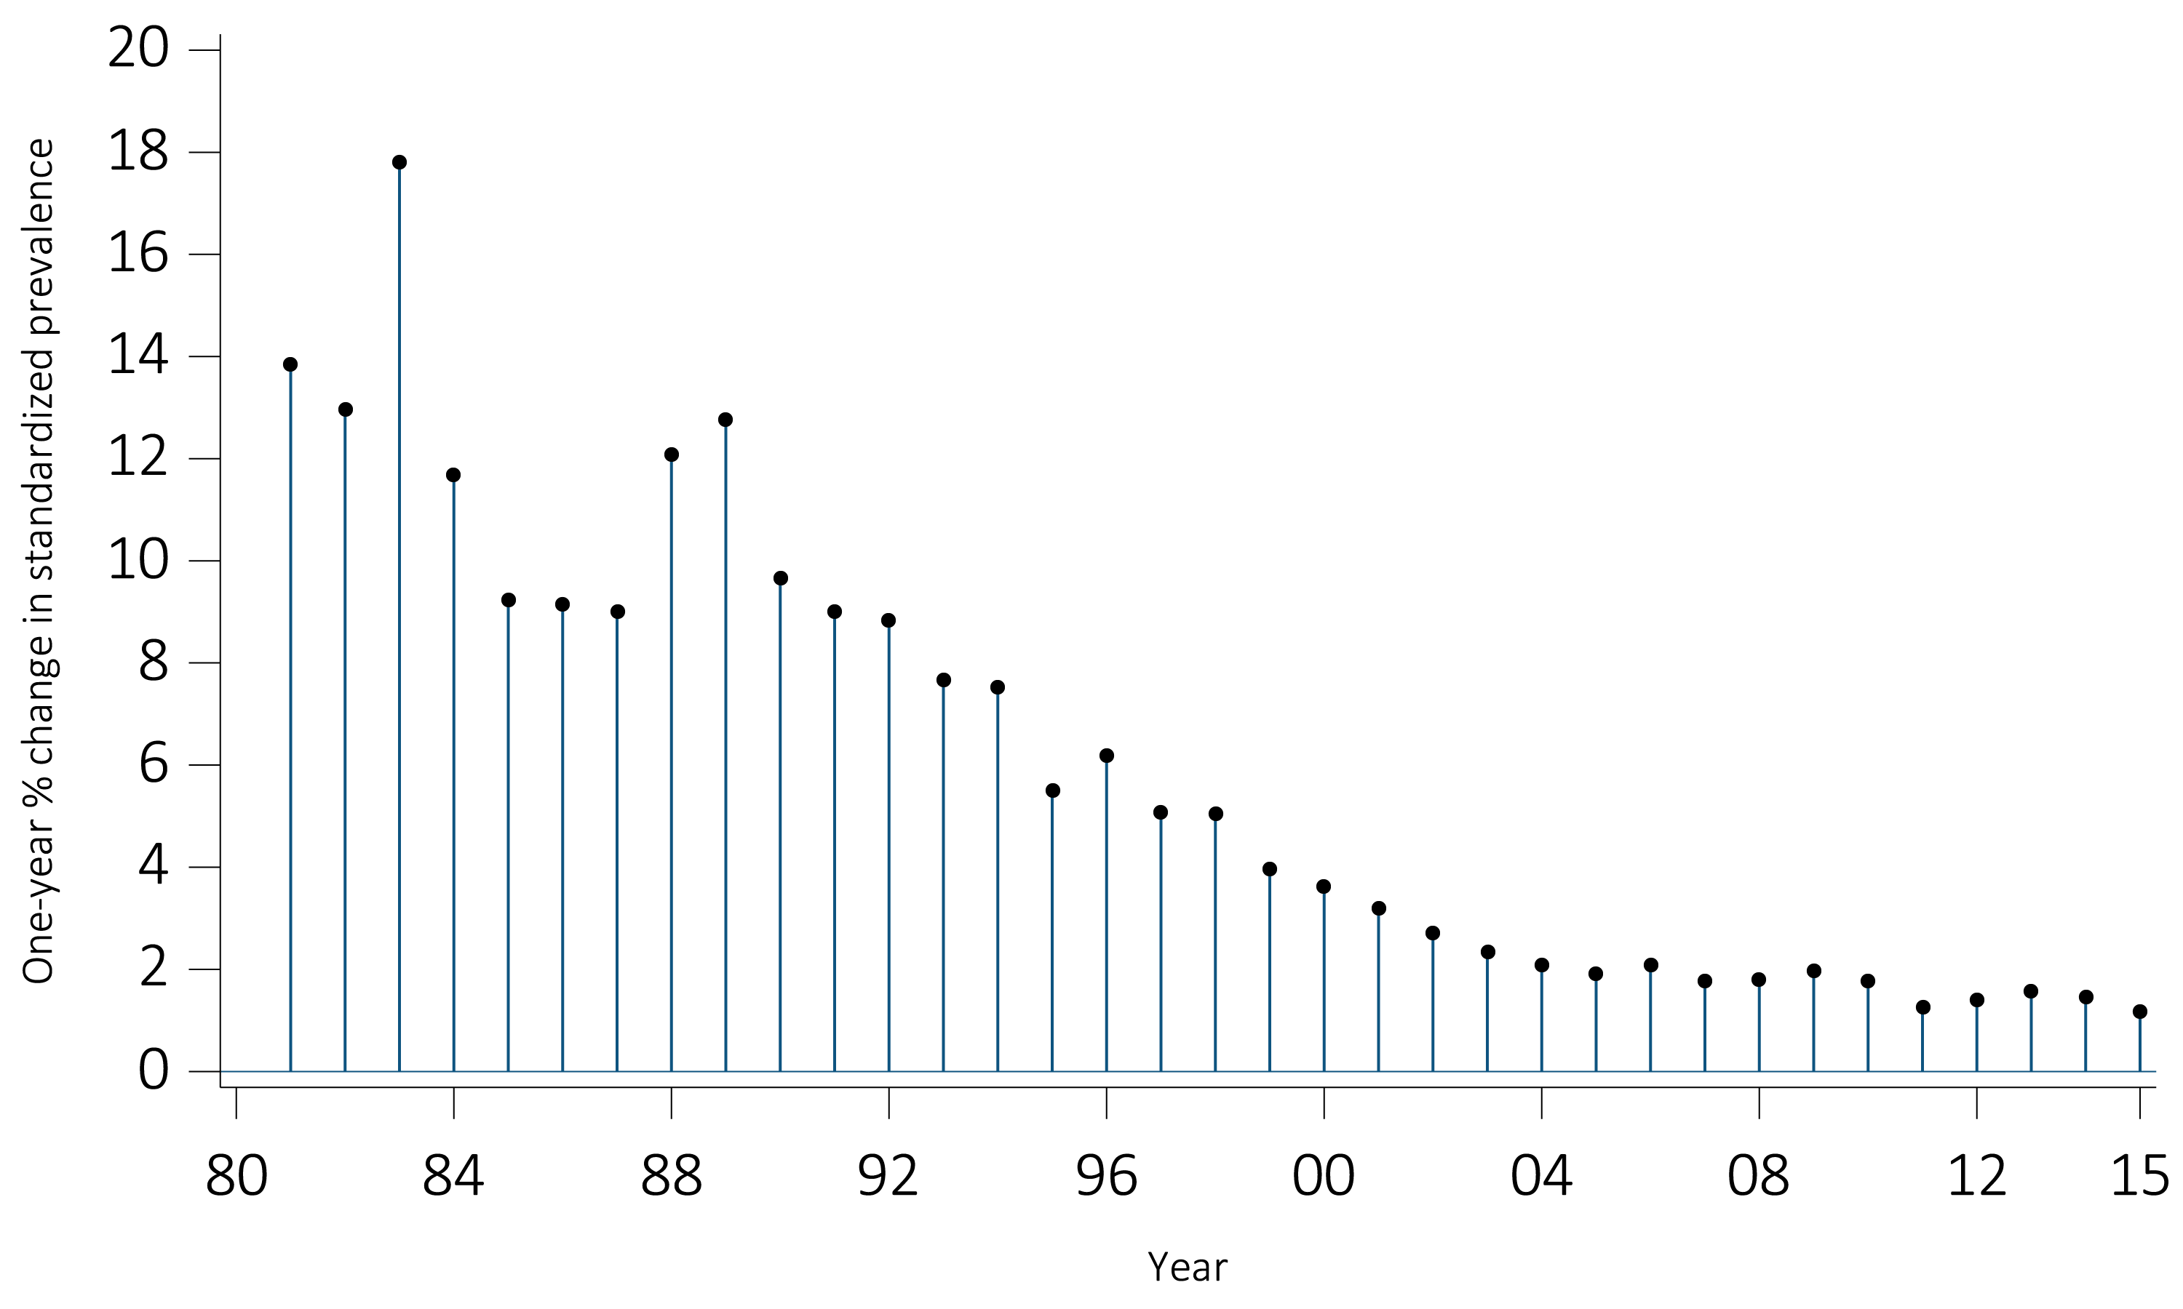
vol 2 Figure 1.7 Trends in the (a) unadjusted and standardized prevalence of ESRD, and (b) annual percentage change in the standardized prevalence of ESRD, in the U.S. population, 1980-2015
(b) One-year percentage change in standardized prevalence
Data Source: Reference Table B.2(2) and special analyses, USRDS ESRD Database. Standardized for age, sex, and race. The standard population was the U.S. population in 2011. Abbreviation: ESRD, end-stage renal disease.

Slide 14
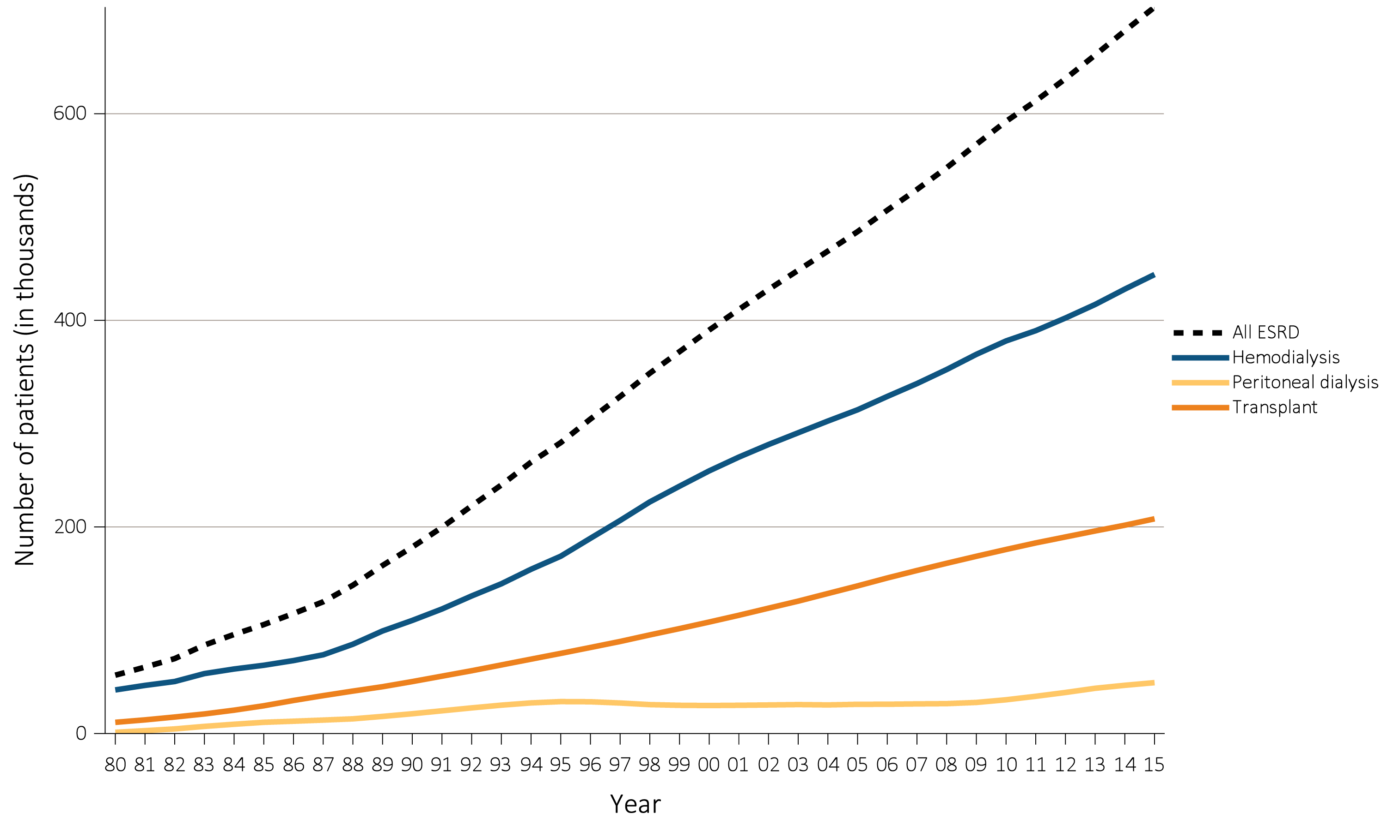
vol 2 Figure 1.8 Trends in the number of ESRD prevalent cases, by modality, in the U.S. population,1980-2015
Data Source: Reference Table D.1. Abbreviation: ESRD, end-stage renal disease.

Slide 15
vol 2 Table 1.4 Unadjusted and adjusted* prevalence of ESRD and annual number of ESRD prevalent cases, by modality and ESRD Network, in the U.S. population, 2015
 |  | Total ESRD |  |  |  | Hemodialysis |  |  | Peritoneal dialysis |  |  | Transplant
Network | States in network* | No. of cases | Adjusted prevalence (per million) | Unadjusted prevalence (per million) |  | No. of cases | % of network |  | No. of cases | % of network |  | No. of cases | % of network
8 | AL, MS, TN | 36,231 | 2,375 | 2,493 |  | 24,557 | 67.8 |  | 2,954 | 8.2 |  | 8,639 | 23.8
6 | NC, SC, GA | 61,901 | 2,295 | 2,437 |  | 42,206 | 68.2 |  | 5,161 | 8.3 |  | 14,379 | 23.2
10 | IL | 31,186 | 2,284 | 2,405 |  | 19,036 | 61.0 |  | 2,112 | 6.8 |  | 9,960 | 31.9
5 | MD, DC, VA, WV | 40,283 | 2,244 | 2,366 |  | 25,508 | 63.3 |  | 2,540 | 6.3 |  | 12,118 | 30.1
18 | Southern CA | 58,464 | 2,233 | 2,370 |  | 39,367 | 67.3 |  | 4,583 | 7.8 |  | 14,433 | 24.7
14 | TX | 62,691 | 2,162 | 2,254 |  | 43,515 | 69.4 |  | 4,106 | 6.5 |  | 14,910 | 23.8
3 | NJ, PR, VI | 28,142 | 2,154 | 2,266 |  | 13,130 | 64.0 |  | 970 | 4.7 |  | 6,387 | 31.1
13 | AR, LA, OK | 25,861 | 2,146 | 2,261 |  | 17,373 | 67.2 |  | 2,236 | 8.6 |  | 6,174 | 23.9
2 | NY | 44,189 | 2,133 | 2,221 |  | 29,035 | 65.7 |  | 1,619 | 3.7 |  | 13,460 | 30.5
4 | DE, PA | 29,800 | 2,090 | 2,192 |  | 18,180 | 61.0 |  | 1,855 | 6.2 |  | 9,662 | 32.4
17 | Northern CA, HI, GU, AS, MP | 38,296 | 2,055 | 2,156 |  | 22,885 | 61.4 |  | 3,254 | 8.7 |  | 11,019 | 29.6
9 | IN, KY, OH | 47,341 | 1,986 | 2,077 |  | 29,914 | 63.2 |  | 3,557 | 7.5 |  | 13,710 | 29.0
7 | FL | 42,167 | 1,956 | 2,050 |  | 27,134 | 64.3 |  | 3,091 | 7.3 |  | 11,795 | 28.0
11 | MI, MN, ND, SD, WI | 45,422 | 1,883 | 1,980 |  | 25,329 | 55.8 |  | 2,608 | 5.7 |  | 17,384 | 38.3
12 | IA, KS, MO, NE | 25,378 | 1,726 | 1,799 |  | 14,057 | 55.4 |  | 2,138 | 8.4 |  | 9,119 | 35.9
15 | AZ, CO, NV, NM, UT, WY | 35,998 | 1,611 | 1,705 |  | 21,161 | 58.8 |  | 2,650 | 7.4 |  | 12,049 | 33.5
1 | CT, MA, ME, NH, RI, VT | 23,875 | 1,521 | 1,606 |  | 13,080 | 54.8 |  | 1,401 | 5.9 |  | 9,325 | 39.1
16 | AK, ID, MT, OR, WA | 22,340 | 1,437 | 1,508 |  | 12,060 | 54.0 |  | 1,935 | 8.7 |  | 8,287 | 37.1
All networks |  | 703,243 | 2,026 | 2,129 |  | 437,527 | 63.3 |  | 48,770 | 7.1 |  | 202,810 | 29.4
Data Source: Reference Table B.10 and special analyses, USRDS ESRD Database. The special analyses exclude U.S. Territories, unknown/other races. Standardized for age, sex, and race. The standard population was the U.S. population in 2011. Listed from lowest to highest prevalence per million. *Includes 50 states, Washington, D.C. (DC), Puerto Rico (PR), Guam (GU), American Samoa (AS), U.S. Virgin Islands, and Northern Mariana Islands. Northern and Southern California (CA) split into Networks 17 and 18. Unknown counties in California are grouped to Network

Slide 16
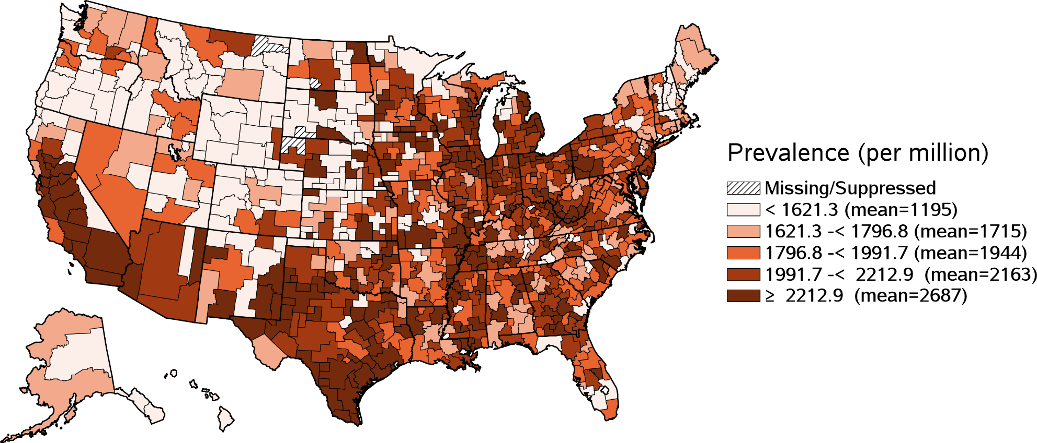
vol 2 Figure 1.9 Map of the adjusted prevalence of ESRD, by Health Service Area, in the U.S. population, 2011-2015*
Data Source: Special analyses, USRDS ESRD Database. Standardized for age, sex, and race. The standard population was the U.S. population in 2011. *Three Health Service Areas were suppressed because the ratio of unadjusted rate to adjusted rate or adjusted rate to unadjusted rate was greater than 3. Values for cells with 10 or fewer patients are suppressed. Abbreviation: ESRD, end-stage renal disease.

Slide 17
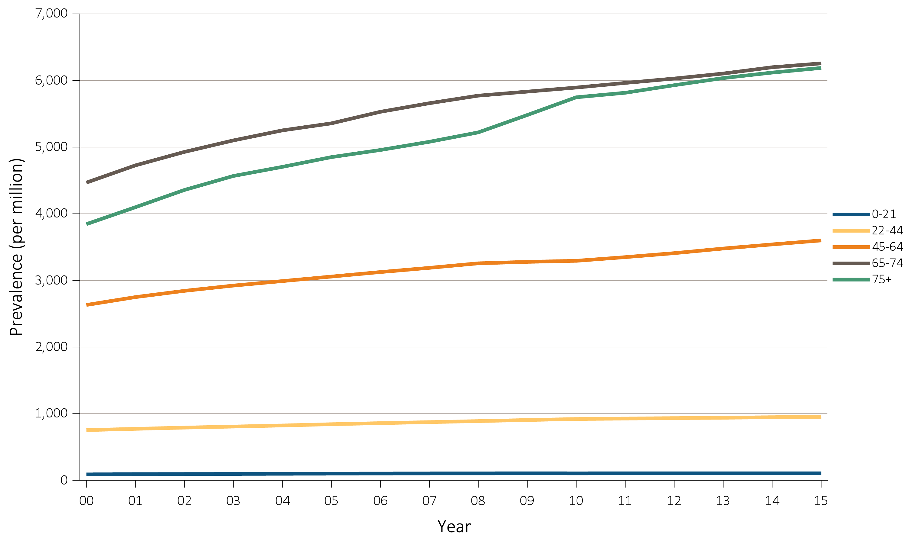
vol 2 Figure 1.10 Trends in the adjusted prevalence of ESRD, by age group, in the U.S. population, 2000-2015
Data Source: Reference Table B.2(2) and special analyses, USRDS ESRD Database. Point prevalence on December 31 of each year. Standardized for sex and race. The standard population was the U.S. population in 2011. Abbreviations: ESRD, end-stage renal disease.

Slide 18
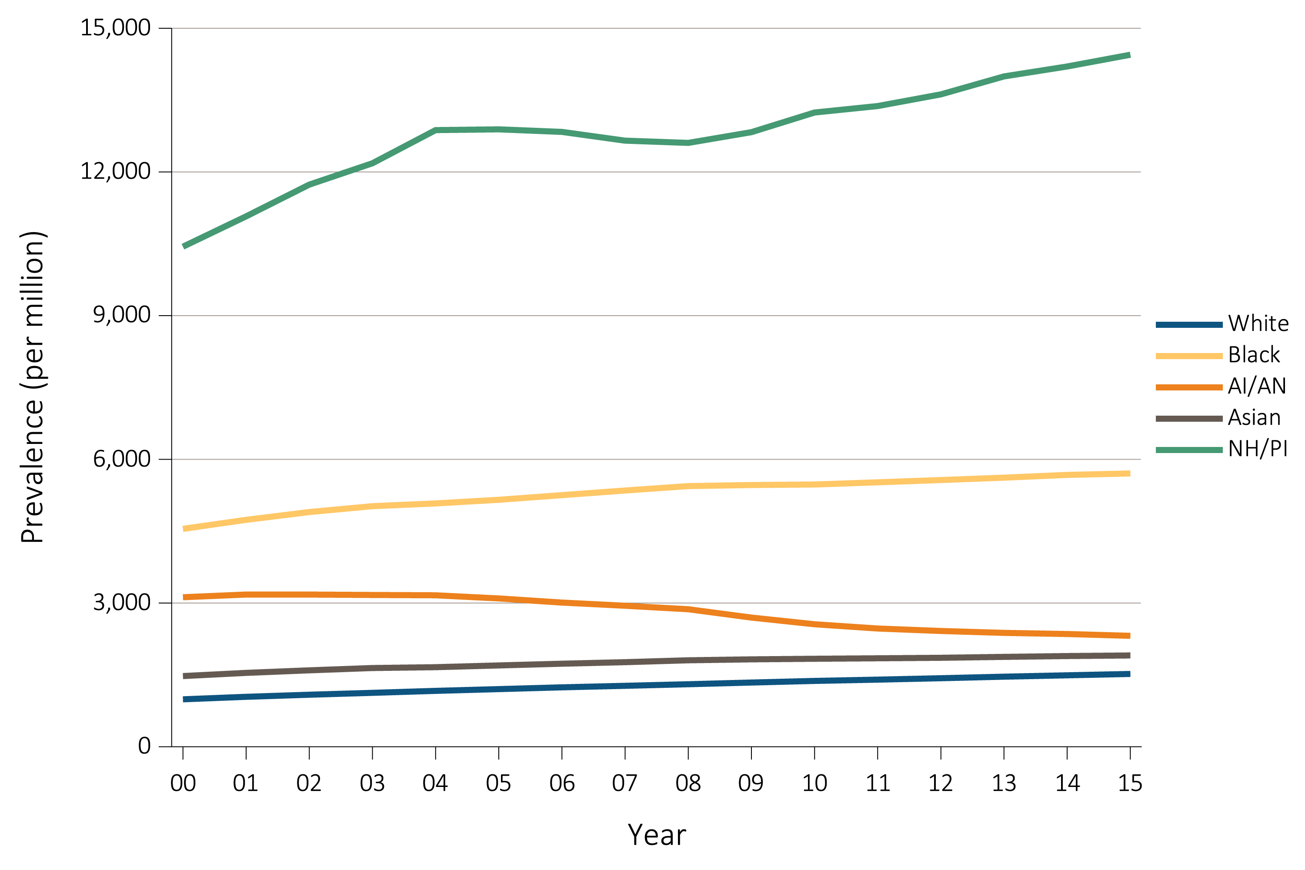
vol 2 Figure 1.11 Trends in adjusted prevalence of ESRD, by race, in the U.S. population, 2000-2015
Data Source: Reference Table B.2(2) and special analyses, USRDS ESRD Database. Point prevalence on December 31 of each year. Standardized for age and sex. The standard population was the U.S. population in 2011. Abbreviations NH/PI: Native Hawaiian/Pacific Islander; AI/AN: Americans Indian/Alaska Natives; ESRD, end-stage renal disease.

Slide 19
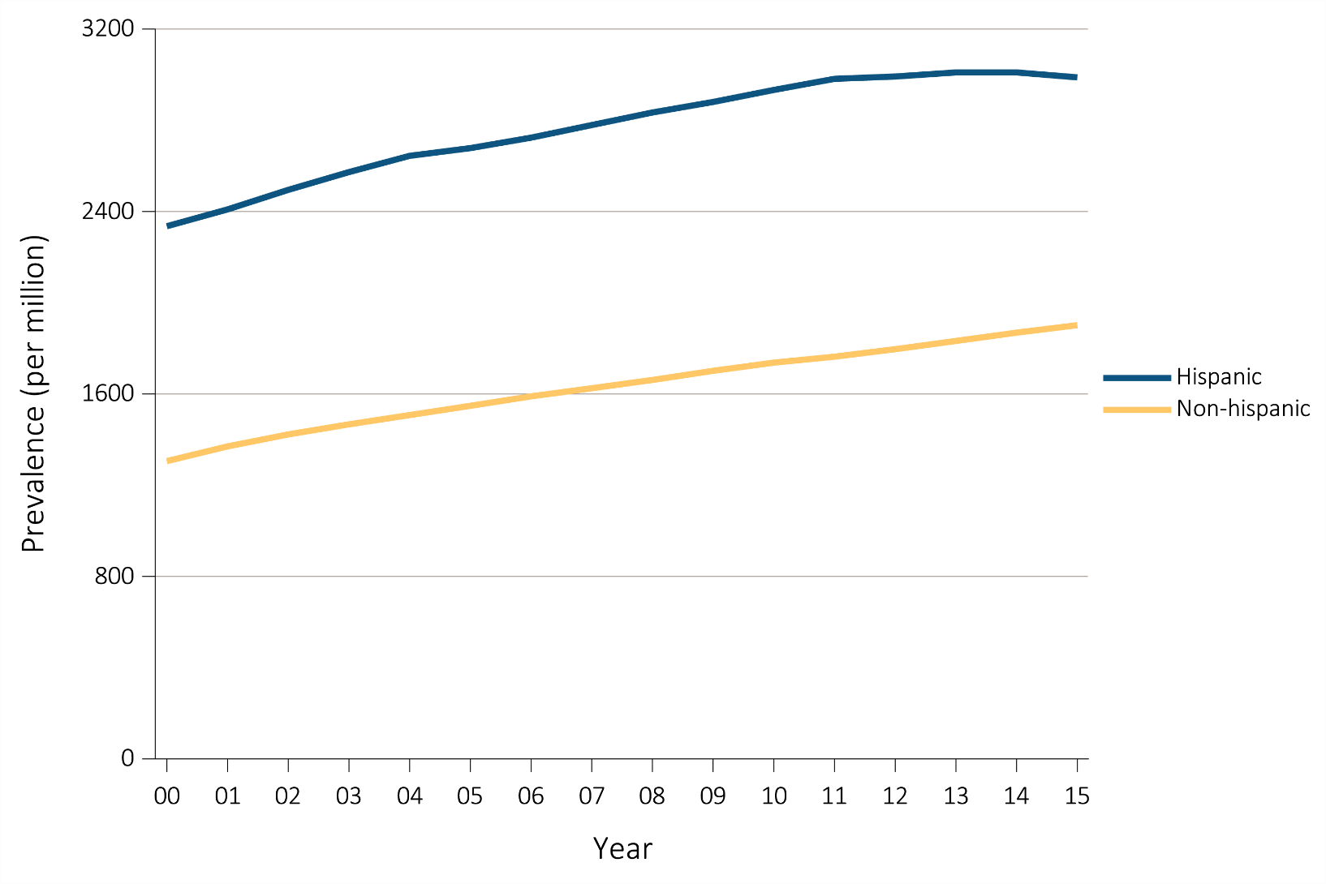
vol 2 Figure 1.12 Trends in the adjusted prevalence of ESRD, by Hispanic ethnicity, in the U.S. population, 2000-2015
Data Source: Reference Tables B.1, B.2(2). Point prevalence on December 31 of each year. Standardized for age, sex, and race. The standard population was the U.S. population in 2011. Abbreviation: ESRD, end-stage renal disease.

Slide 20
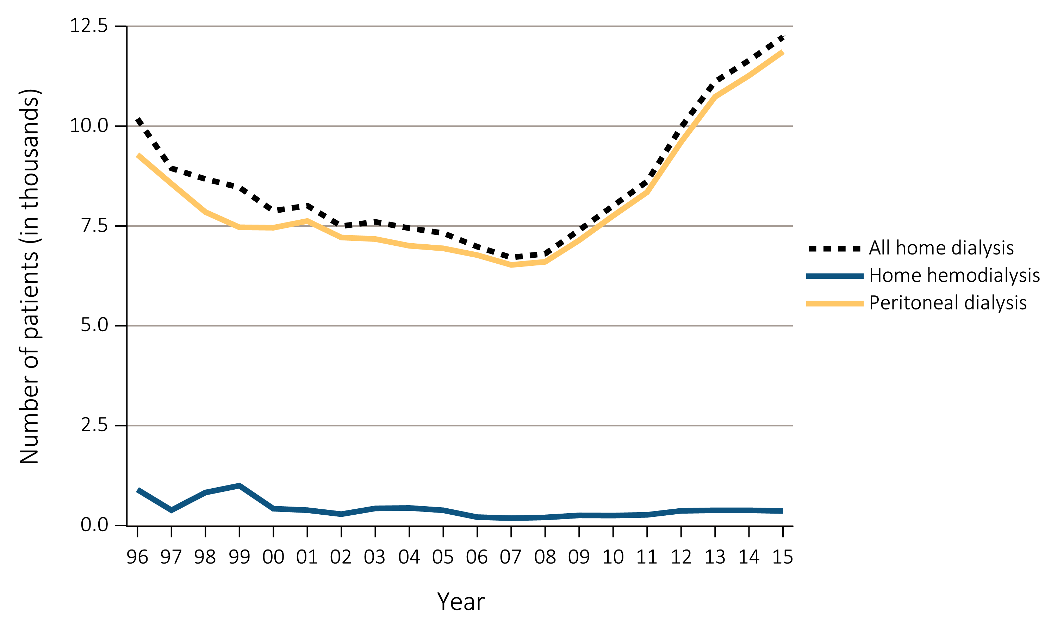
vol 2 Figure 1.13 Trends in the number of incident ESRD cases using home dialysis, by type of therapy, in the U.S. population, 1996-2015
Data Source: Reference Table D.1. Abbreviations: ESRD, end-stage renal disease.

Slide 21
vol 2 Table 1.5 Number and percentage of incident cases of hemodialysis, peritoneal dialysis, and transplantation by age, sex, race, ethnicity, and primary cause of ESRD, in the U.S. population, 2015
 | Total | HD |  | PD |  | Transplant
 |  | N | % | N | % | N | %
Age
0-21 | 1,399 | 739 | 52.8 | 367 | 26.2 | 293 | 20.9
22-44 | 13,855 | 11,035 | 79.6 | 2,052 | 14.8 | 768 | 5.5
45-64 | 47,809 | 41,235 | 86.2 | 5,057 | 10.6 | 1,517 | 3.2
65-74 | 32,125 | 28,898 | 90.0 | 2,705 | 8.4 | 522 | 1.6
75+ | 28,644 | 26,919 | 94.0 | 1,683 | 5.9 | 42 | 0.1
Sex
Male | 71,984 | 63,256 | 87.9 | 6,839 | 9.5 | 1,889 | 2.6
Female | 51,848 | 45,570 | 87.9 | 5,025 | 9.7 | 1,253 | 2.4
Race
White | 83,059 | 72,504 | 87.3 | 8,225 | 9.9 | 2,330 | 2.8
Black/African American | 32,429 | 29,532 | 91.1 | 2,635 | 8.1 | 262 | 0.8
American Indian or Alaska Native | 1,124 | 988 | 87.9 | 87 | 7.7 | 49 | 4.4
Asian | 5,029 | 4,028 | 80.1 | 699 | 13.9 | 302 | 6.0
Native Hawaiian or Pacific Islander | 1,466 | 1,298 | 88.5 | 158 | 10.8 | 10 | 0.7
Other or Multiracial | 390 | 324 | 83.1 | 44 | 11.3 | 22 | 5.6
Unknown | 335 | 152 | 45.4 | 16 | 4.8 | 167 | 49.9
Ethnicity
Hispanic | 18,151 | 16,201 | 89.3 | 1,649 | 9.1 | 301 | 1.7
Non-Hispanic | 104,627 | 92,113 | 88.0 | 10,167 | 9.7 | 2,347 | 2.2
Unknown | 1,054 | 512 | 48.6 | 48 | 4.6 | 494 | 46.9
Primary Cause of ESRD
Diabetes | 56,218 | 50,748 | 90.3 | 5,062 | 9.0 | 408 | 0.7
Hypertension | 34,727 | 31,220 | 89.9 | 3,243 | 9.3 | 264 | 0.8
Glomerulonephritis | 9,198 | 7,063 | 76.8 | 1,633 | 17.8 | 502 | 5.5
Cystic Kidney | 2,833 | 1,764 | 62.3 | 596 | 21.0 | 473 | 16.7
Other/Unknown | 20,856 | 18,031 | 86.5 | 1,330 | 6.4 | 1,495 | 7.2
Total | 123,832 | 108,826 | 87.9 | 11,864 | 9.6 | 3,142 | 2.5
Data Source: Special analyses, USRDS ESRD Database. The numbers in this table exclude “Other PD” and “Uncertain Dialysis.” Abbreviations: ESRD, end-stage renal disease; HD, hemodialysis, including home hemodialysis and in center hemodialysis; PD, peritoneal dialysis.

Slide 22
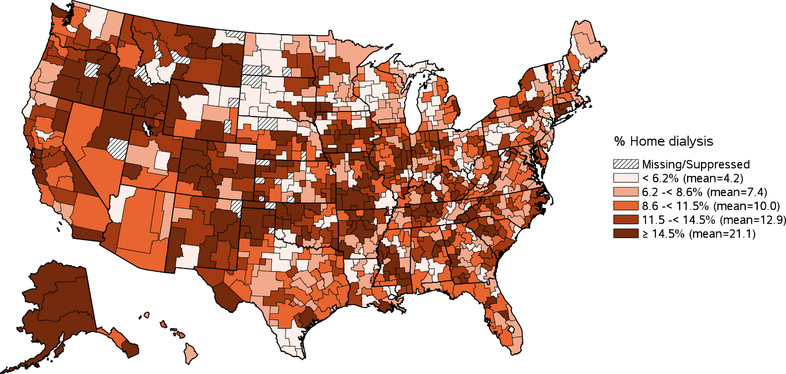
vol 2 Figure 1.14 Map of the percentage of incident dialysis cases using home dialysis (peritoneal dialysis or home hemodialysis), by Health Service Area, 2011-2015
Data Source: Special analyses, USRDS ESRD Database. Values for cells with 10 or fewer patients are suppressed.

Slide 23
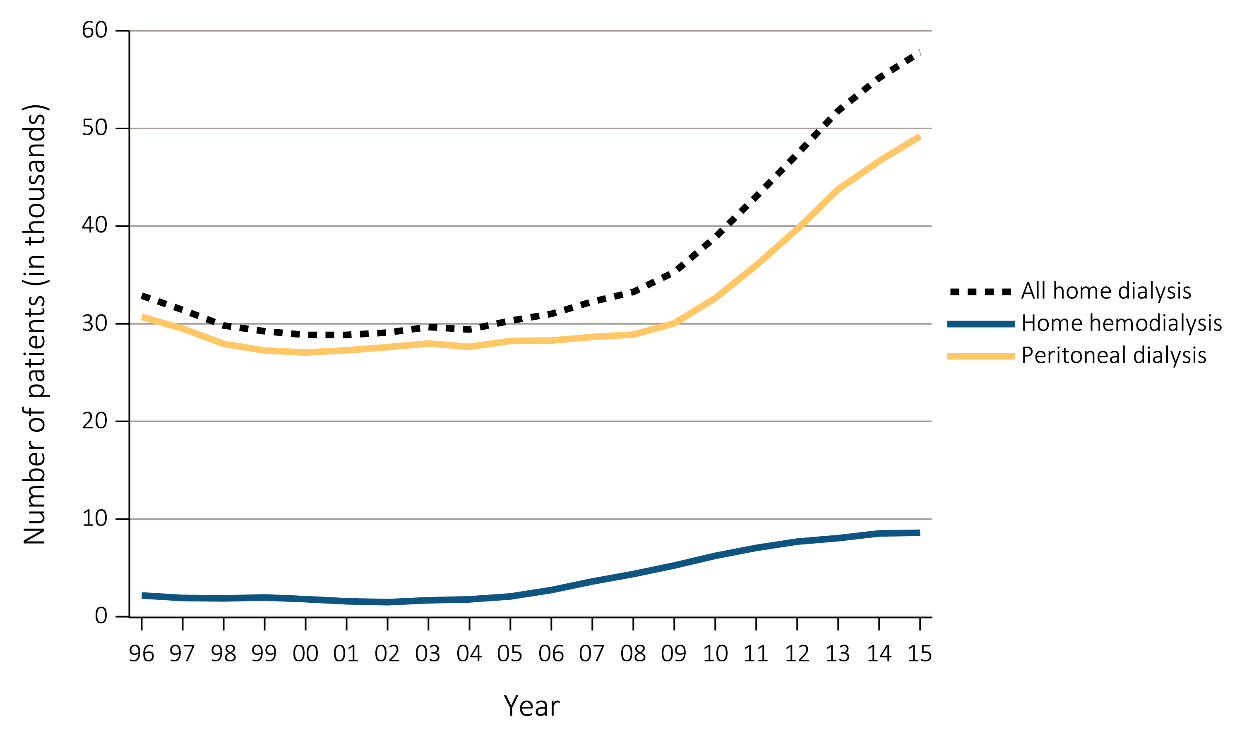
vol 2 Figure 1.15 Trends in number of prevalent ESRD cases using home dialysis, by type of therapy, in the United States, 1996-2015
Data Source: Reference Table D.1. December 31 prevalent ESRD patients. Peritoneal dialysis consists of CAPD and CCPD only. Abbreviations: CAPD, continuous ambulatory peritoneal dialysis; CCPD, continuous cycler peritoneal dialysis; ESRD, end-stage renal disease.

Slide 24
vol 2 Table 1.6 Percentage of prevalent cases of hemodialysis, peritoneal dialysis, and transplant by age, sex, race, ethnicity, and primary ESRD diagnosis, in the United States, 2015
 | Total | Hemodialysis |  | Peritoneal dialysis |  | Transplant
 |  | N | % | N | % | N | %
Age
0-21 | 9,738 | 1,775 | 18.2 | 1,008 | 10.4 | 6,955 | 71.4
22-44 | 102,744 | 51,188 | 49.8 | 9,072 | 8.8 | 42,484 | 41.3
45-64 | 308,616 | 184,098 | 59.7 | 21,791 | 7.1 | 102,727 | 33.3
65-74 | 166,679 | 112,875 | 67.7 | 10,899 | 6.5 | 42,905 | 25.7
75+ | 113,575 | 94,401 | 83.1 | 6,435 | 5.7 | 12,739 | 11.2
Sex
Male | 405,248 | 254,066 | 62.7 | 27,262 | 6.7 | 123,920 | 30.6
Female | 296,046 | 190,240 | 64.3 | 21,941 | 7.4 | 83,865 | 28.3
Race
White | 430,569 | 251,259 | 58.4 | 32,543 | 7.6 | 146,767 | 34.1
Black/African American | 215,299 | 160,990 | 74.8 | 12,304 | 5.7 | 42,005 | 19.5
American Indian or Alaska Native | 7,497 | 5,228 | 69.7 | 421 | 5.6 | 1,848 | 24.6
Asian | 32,968 | 18,927 | 57.4 | 3,104 | 9.4 | 10,937 | 33.2
Native Hawaiian or Pacific Islander | 8,453 | 6,208 | 73.4 | 640 | 7.6 | 1,605 | 19.0
Other or Multiracial | 3,333 | 1,176 | 35.3 | 142 | 4.3 | 2,015 | 60.5
Unknown | 3,233 | 549 | 17.0 | 51 | 1.6 | 2,633 | 81.4
Ethnicity
Hispanic | 122,272 | 82,510 | 67.5 | 7,733 | 6.3 | 32,029 | 26.2
Non-Hispanic | 561,794 | 359,578 | 64.0 | 41,248 | 7.3 | 160,968 | 28.7
Unknown | 17,286 | 2,249 | 13.0 | 224 | 1.3 | 14,813 | 85.7
Primary Cause of ESRD
Diabetes | 267,956 | 203,295 | 75.9 | 18,294 | 6.8 | 46,367 | 17.3
Hypertension | 178,875 | 130,537 | 73.0 | 13,459 | 7.5 | 34,879 | 19.5
Glomerulonephritis | 112,235 | 44,897 | 40.0 | 8,785 | 7.8 | 58,553 | 52.2
Cystic Kidney | 33,194 | 10,357 | 31.2 | 2,268 | 6.8 | 20,569 | 62.0
Other/Unknown | 109,092 | 55,251 | 50.6 | 6,399 | 5.9 | 47,442 | 43.5
Total | 701,352 | 444,337 | 63.4 | 49,205 | 7.0 | 207,810 | 29.6
Data Source: Special analyses, USRDS ESRD Database. The numbers in this table exclude “Other PD” and “Uncertain Dialysis.” Abbreviation: ESRD, end-stage renal disease; HD, hemodialysis; PD, peritoneal dialysis.

Slide 25
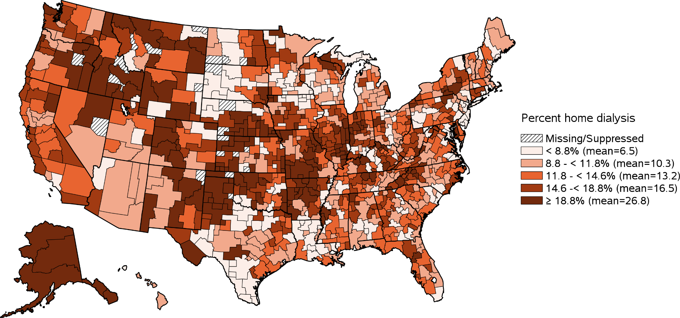
vol 2 Figure 1.16 Map of the percentage of prevalent dialysis cases using home dialysis, by Health Service Area, 2011-2015
Data Source: Special analyses, USRDS ESRD Database. Values for cells with 10 or fewer patients are suppressed.

Slide 26
vol 2 Table 1.7 Distribution of the reported duration of pre-ESRD nephrology care, by (a) demographic and (b) clinical characteristics, among incident ESRD cases in the U.S. population, 2015
 |  | Duration of pre-ESRD nephrology care
 | No. of cases | >12 months | 6-12 months | 0-6 months | None | Unknown
Total | 119,580 | 30.9 | 19.3 | 13.4 | 22.4 | 14.0
Age
0-21 | 1,449 | 44.1 | 14.7 | 14.1 | 20.5 | 6.5
22-44 | 13,573 | 27.4 | 18.3 | 13.9 | 28.3 | 12.2
45-64 | 45,701 | 28.9 | 19.4 | 13.6 | 23.9 | 14.1
65-74 | 31,082 | 32.6 | 19.9 | 13.0 | 20.1 | 14.3
75+ | 27,775 | 33.4 | 19.2 | 13.1 | 19.6 | 14.9
Sex
Female | 50,327 | 31.1 | 19.7 | 13.5 | 21.6 | 14.2
Male | 69,253 | 30.8 | 19.0 | 13.3 | 22.9 | 13.9
Race
American Indian/Alaska Native | 1,123 | 31.3 | 20.6 | 13.5 | 23.8 | 10.8
Asian | 4,850 | 33.1 | 20.2 | 14.8 | 18.6 | 13.3
Black/African American | 31,580 | 27.1 | 19.0 | 13.4 | 24.5 | 16.0
White | 80,581 | 32.4 | 19.4 | 13.2 | 21.7 | 13.4
Native Hawaiian/ Pacific Islander | 1,440 | 28.1 | 19.2 | 14.4 | 27.2 | 11.1
Other/Unknown | * | 50 | 17 | * | * | 33.4
Ethnicity
Hispanic | 17,158 | 24.0 | 19.0 | 14.4 | 27.0 | 15.7
Non-Hispanic | 102,422 | 32.1 | 19.4 | 13.2 | 21.6 | 13.8
Primary Diagnosis
Diabetes | 56,369 | 31.6 | 21.4 | 13.6 | 19.5 | 13.8
Hypertension | 34,821 | 28.0 | 18.6 | 13.7 | 23.3 | 16.4
Glomerulonephritis | 9,336 | 40.0 | 18.1 | 12.0 | 21.6 | 8.3
Cystic kidney | 2,873 | 57.2 | 18.1 | 9.1 | 9.2 | 6.5
Other/Unknown | 16,181 | 24.9 | 14.7 | 13.2 | 33.1 | 14.1
(a) Demographic characteristics (% within row)
Data Source: Special analyses, USRDS ESRD Database. Population only includes incident cases with CMS form 2728. *Count ≤10. eGFR calculated using the CKD-EPI equation (CKD-EPI eGFR (ml/min/1.73 m²) for those aged ≥18 years and the Schwartz equation for those aged <18 years. Abbreviations: AV, arteriovenous; CKD-EPI, chronic kidney disease epidemiology calculation; CV, central venous; eGFR, estimated glomerular filtration rate; ESA, erythropoiesis-stimulating agents; ESRD, end-stage renal disease; RRT, renal replacement therapy.

Slide 27
vol 2 Table 1.7 Distribution of the reported duration of pre-ESRD nephrology care, by (a) demographic and (b) clinical characteristics, among incident ESRD cases in the U.S. population, 2015
 |  | Duration of pre-ESRD nephrology care
 | No. of cases | >12 mo. | 6-12 mo. | 0-6 mo. | None | Unknown
Dietary care
No | 110,306 | 29.1 | 18.9 | 12.7 | 24.2 | 15.2
Yes | 9,274 | 53.2 | 24.6 | 20.9 | 0.7 | 0.7
ESA use
No | 103,238 | 27.4 | 18.4 | 12.7 | 25.4 | 16.1
Yes | 16,342 | 53.6 | 24.8 | 17.3 | 3.3 | 0.9
eGFR at RRT start
<5 | 16,846 | 26.2 | 16.4 | 11.6 | 32.1 | 13.7
5-<10 | 56,028 | 33.2 | 20.1 | 13.4 | 20.3 | 13.0
10-<15 | 32,624 | 32.0 | 20.2 | 14.0 | 19.8 | 14.0
>=15 | 14,008 | 25.4 | 17.7 | 14.1 | 24.8 | 17.9
Vascular Access
AV fistula | 17,897 | 54.3 | 24.8 | 9.8 | 3.6 | 7.4
AV graft | 3,147 | 42.5 | 26.3 | 13.6 | 8.5 | 9.0
CV catheter with maturing fistula/graft | 19,078 | 32.8 | 21.7 | 14.4 | 18.2 | 12.8
CV catheter only | 65,153 | 19.5 | 15.7 | 14.1 | 32.7 | 18.1
Other/Unknown | 14,305 | 49.0 | 24.3 | 12.8 | 7.6 | 6.3
(b) Clinical characteristics (% within row)
Data Source: Special analyses, USRDS ESRD Database. Population only includes incident cases with CMS form 2728. *Count ≤10. eGFR calculated using the CKD-EPI equation (CKD-EPI eGFR (ml/min/1.73 m²) for those aged ≥18 years and the Schwartz equation for those aged <18 years. Abbreviations: AV, arteriovenous; CKD-EPI, chronic kidney disease epidemiology calculation; CV, central venous; eGFR, estimated glomerular filtration rate; ESA, erythropoiesis-stimulating agents; ESRD, end-stage renal disease; RRT, renal replacement therapy.

Slide 28
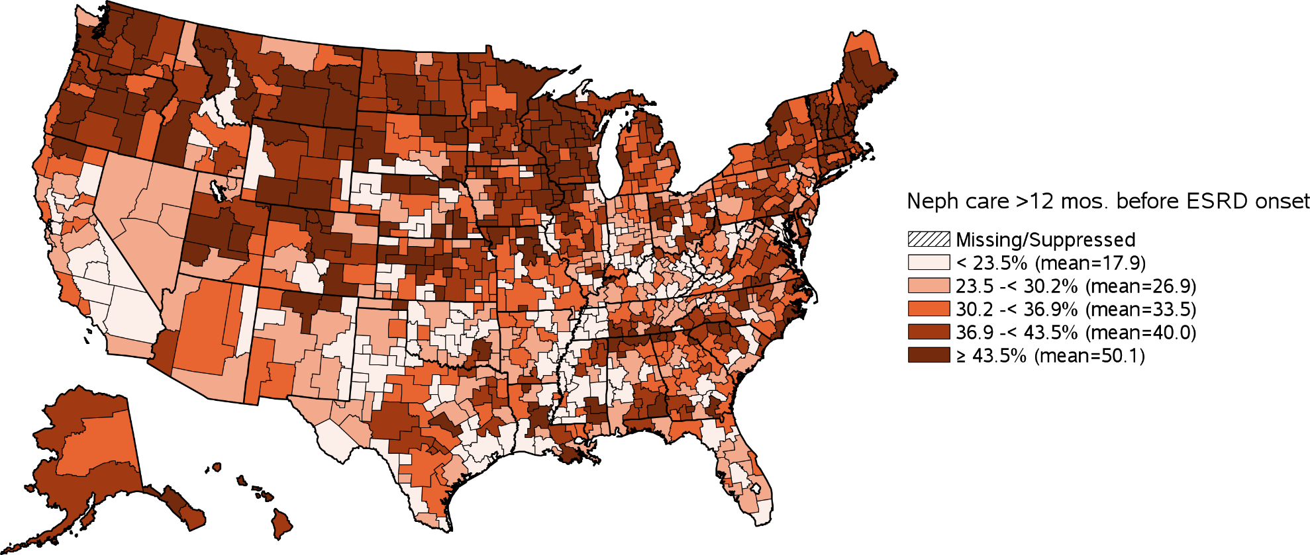
vol 2 Figure 1.17 Percentage of incident cases who had received >12 months of pre-ESRD nephrology care, by Health Service Area, 2011-2015
Data Source: Special analyses, USRDS ESRD Database. Population only includes incident cases with CMS form 2728. Values for cells with 10 or fewer patients are suppressed. Abbreviations: ESRD, end-stage renal disease; Neph., nephrology.

Slide 29
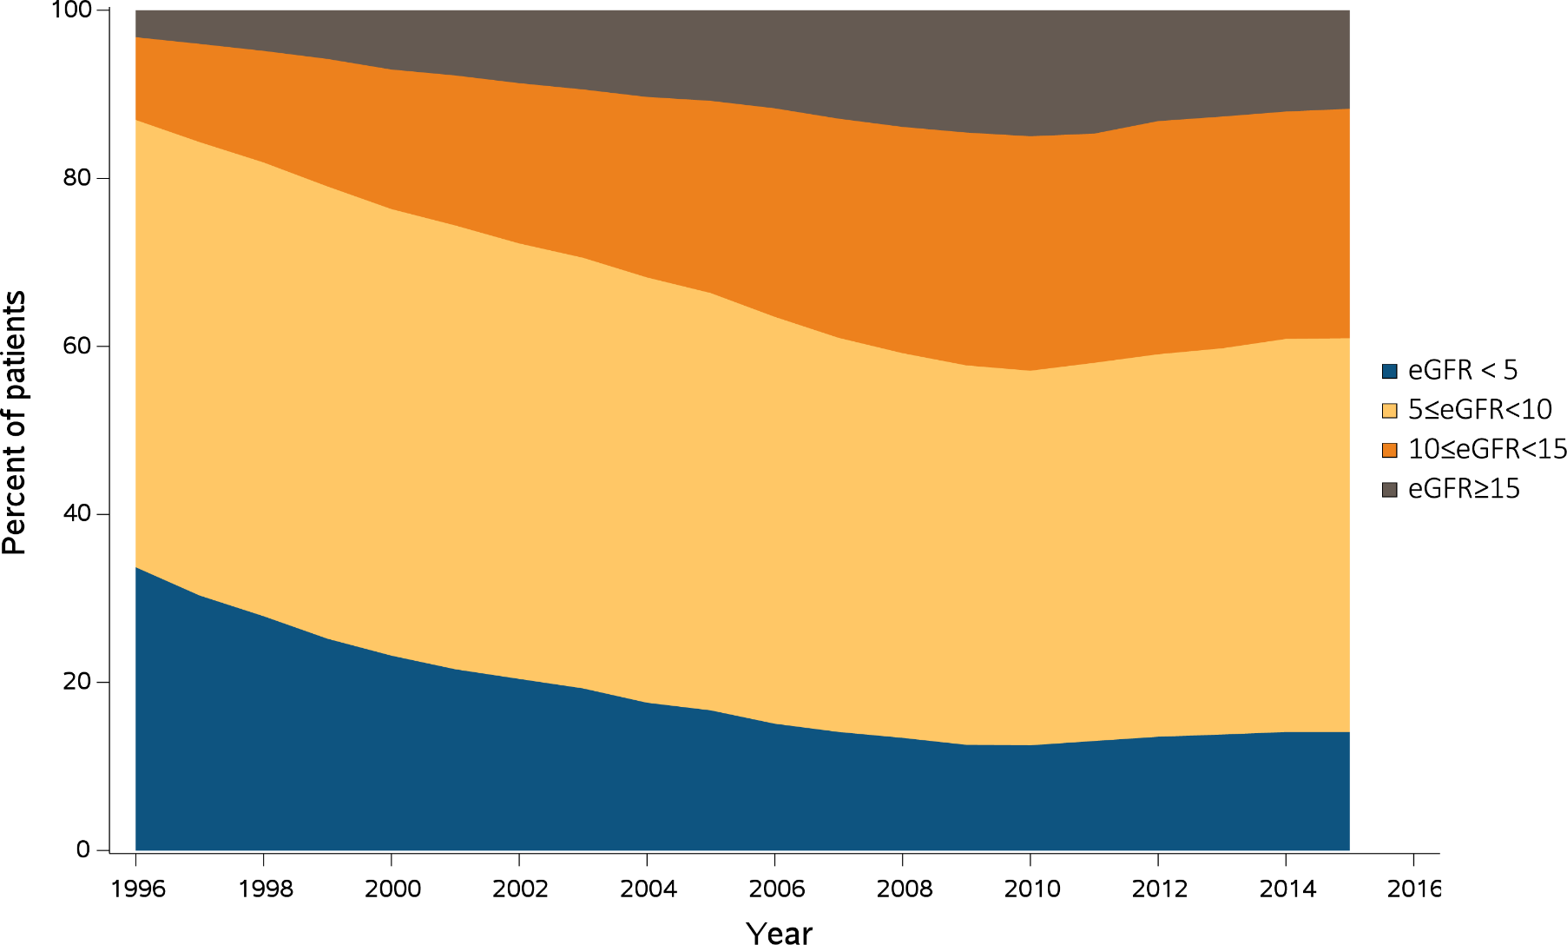
vol 2 Figure 1.18 Trends in the distribution of eGFR (ml/min/1.73 m²) among incident ESRD patients, 1996-2015
Data Source: Special analyses, USRDS ESRD Database. Population only includes incident cases with CMS form 2728. eGFR calculated using the CKD-EPI equation (CKD-EPI eGFR (ml/min/1.73 m²) for those aged ≥18 and the Schwartz equation for those aged <18. Abbreviations: CKD-EPI; chronic kidney disease epidemiology calculation; eGFR, estimated glomerular filtration rate; ESRD, end-stage renal disease.

Slide 30
vol 2 Table 1.8 Distributions of laboratory values (mean) and treatment characteristics (%), by age, sex, race, ethnicity, and primary cause of ESRD, among incident ESRD cases, 2015
 |  | Nutrition |  |  | Anemia |  |  | Lipids |  |  | Diabetes
 | eGF (mL/min/1.73 m²) | Serum albumin (g/dL) | Dietary care (%) |  | Hemoglobin (g/dL) | ESA use (%) |  | Total cholesterol (mg/dL) | LDL (mg/dL) |  | HbA1c (%)
Age
0-21 | 13.8 | 3.4 | 38.4 |  | 9.6 | 26.2 |  | 184.0 | 109.0 |  | 5.0
22-44 | 9.5 | 3.2 | 7.3 |  | 9.2 | 10.0 |  | 171.3 | 102.2 |  | 7.0
45-64 | 10.0 | 3.2 | 7.4 |  | 9.4 | 11.2 |  | 159.8 | 94.1 |  | 6.8
65-74 | 10.2 | 3.2 | 7.7 |  | 9.4 | 13.8 |  | 150.7 | 84.7 |  | 6.6
75+ | 10.4 | 3.2 | 6.6 |  | 9.5 | 15.4 |  | 141.2 | 77.3 |  | 6.4
Sex |  |  | 0.0 |  |  | 0.0
Male | 10.4 | 3.2 | 7.8 |  | 9.5 | 11.7 |  | 149.3 | 86.3 |  | 6.7
Female | 9.7 | 3.1 | 7.4 |  | 9.2 | 14.5 |  | 165.3 | 94.3 |  | 6.7
Race |  |  | 0.0 |  |  | 0.0
White | 8.8 | 3.3 | 11.6 |  | 9.3 | 19.0 |  | 160.8 | 90.2 |  | 6.6
Black/African American | 9.2 | 2.9 | 8.0 |  | 9.2 | 14.0 |  | 147.3 | 82.0 |  | 6.7
American Indian/Alaska Native | 10.4 | 3.2 | 7.7 |  | 9.5 | 13.0 |  | 152.7 | 86.9 |  | 6.7
Asian | 9.8 | 3.2 | 6.6 |  | 9.1 | 11.8 |  | 161.4 | 95.8 |  | 6.6
Native Hawaiian/Pacific Islander | 8.3 | 3.2 | 9.9 |  | 9.3 | 16.0 |  | 155.6 | 87.6 |  | 6.8
Ethnicity |  |  | 0.0 |  |  | 0.0
Yes | 9.6 | 3.1 | 7.5 |  | 9.2 | 11.3 |  | 156.1 | 88.5 |  | 6.8
No | 10.2 | 3.2 | 7.6 |  | 9.4 | 13.3 |  | 155.4 | 89.6 |  | 6.7
Primary Cause of ESRD |  |  | 0.0 |  |  | 0.0
Diabetes | 10.3 | 3.1 | 7.2 |  | 9.3 | 14.3 |  | 153.0 | 87.8 |  | 7.0
Hypertension | 9.7 | 3.3 | 6.0 |  | 9.4 | 11.5 |  | 154.6 | 89.4 |  | 6.1
Glomerulonephritis | 9.2 | 3.3 | 11.5 |  | 9.4 | 17.0 |  | 174.8 | 100.8 |  | 5.8
Cystic kidney | 9.5 | 3.8 | 15.2 |  | 10.2 | 15.8 |  | 164.6 | 94.9 |  | 5.5
Total | 10.1 | 3.2 | 7.6 |  | 9.4 | 12.9 |  | 155.5 | 89.5 |  | 6.7
Data Source: Special analyses, USRDS ESRD Database. Abbreviations: eGFR, estimated glomerular filtration rate; ESA, erythropoiesis-stimulating agents; ESRD, end-stage renal disease; HbA1c, glycosylated hemoglobin; LDL, low-density lipoprotein.

Slide 31
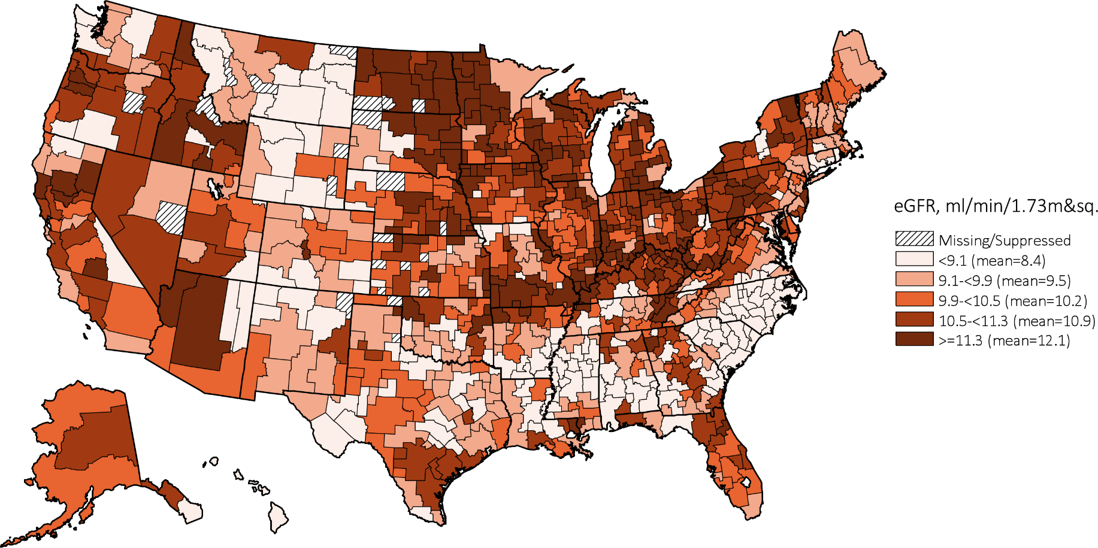
vol 2 Figure 1.19 Map of mean eGFR at initiation of renal replacement therapy, by Health Service Area, 2011-2015
Data Source: Special analyses, USRDS ESRD Database. Population only includes incident cases with CMS form 2728. eGFR calculated using the CKD-EPI equation (CKD-EPI eGFR (ml/min/1.73 m²) for those aged ≥18 and the Schwartz equation for those aged <18. Values for cells with 10 or fewer patients are suppressed. Abbreviations: eGFR, estimated glomerular filtration rate; CKD-EPI, chronic kidney disease epidemiology calculation.

Slide 32
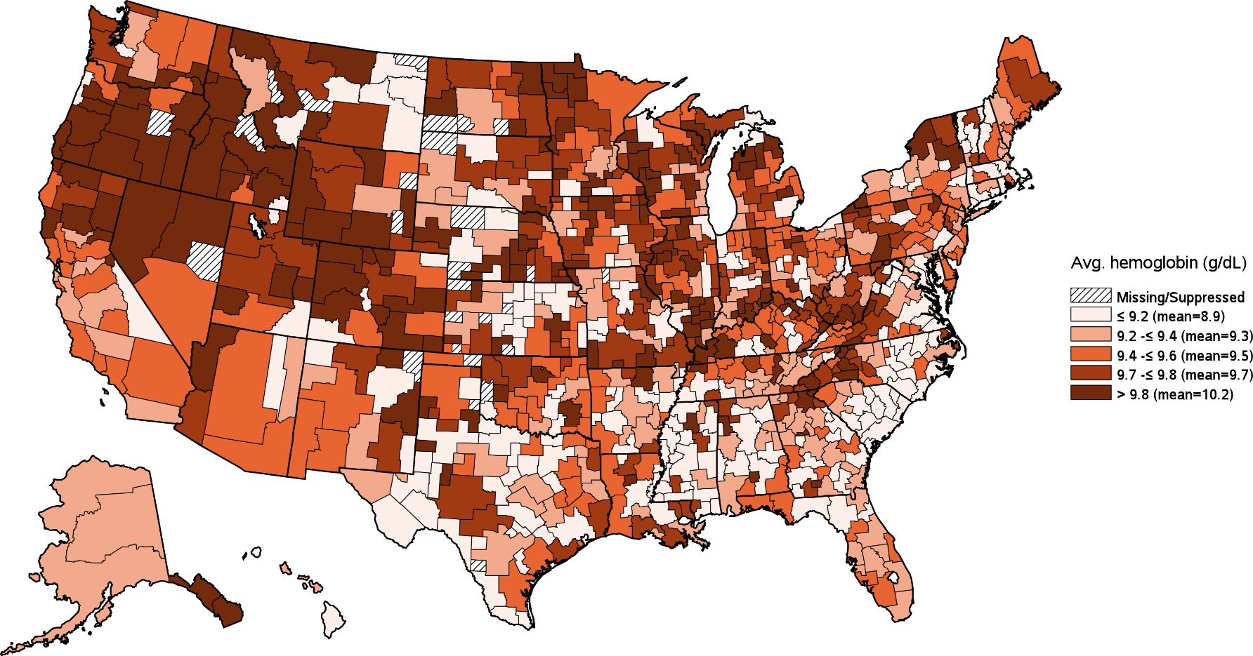
vol 2 Figure 1.20 Map of average hemoglobin level at initiation of renal replacement therapy, by Health Service Area, 2011-2015
Data Source: Special analyses, USRDS ESRD Database. Population only includes incident cases with CMS form 2728. Values for cells with 10 or fewer patients are suppressed. Abbreviation: ESRD, end-stage renal disease.

Slide 33
vol 2 Table 1.9 Distribution of duration of pre-ESRD nephrology care, hemoglobin level, and eGFR, by ESRD Network, among incident
ESRD cases, 2015
Network | States in network* |  | Duration of pre-ESRD nephrology care |  |  |  |  | Mean eGFR (ml/min/1.73 m²) | Mean Hgb (g/dL)
 |  |  | (% in row)
 |  |  | >12 months | 6-12 months | 0-6 months | None | Unknown
18 | Southern CA |  | 21.1 | 17.5 | 17.5 | 22.3 | 21.5 | 10.3 | 9.5
14 | TX |  | 24.3 | 18.8 | 14.0 | 28.7 | 14.2 | 9.6 | 9.3
10 | IL |  | 25.7 | 17.9 | 15.5 | 19.0 | 22.0 | 10.2 | 9.3
5 | FL |  | 27.0 | 19.2 | 12.1 | 24.3 | 17.5 | 10.1 | 9.3
7 | MD, DC, VA, WV |  | 28.4 | 20.4 | 14.0 | 20.6 | 16.7 | 9.5 | 9.3
3 | NJ, PR, VI |  | 28.6 | 19.4 | 11.7 | 31.9 | 8.4 | 9.6 | 9.5
13 | AR, LA, OK |  | 28.8 | 19.3 | 10.8 | 25.8 | 15.2 | 9.3 | 9.5
9 | AL, MS, TN |  | 29.7 | 18.9 | 12.2 | 26.0 | 13.2 | 9.1 | 9.2
8 | IN, KY, OH |  | 30.1 | 21.7 | 12.3 | 17.9 | 18.1 | 10.7 | 9.4
17 | Northern CA, HI, GU, AS, MP |  | 31.9 | 22.6 | 14.8 | 19.4 | 11.3 | 9.8 | 9.4
15 | AZ, CO, NV, NM, UT, WY |  | 32.5 | 19.2 | 16.1 | 20.9 | 11.3 | 10.3 | 9.7
2 | NY |  | 32.7 | 17.5 | 11.4 | 22.2 | 16.2 | 9.3 | 9.2
6 | NC, SC, GA |  | 34.0 | 19.7 | 13.6 | 21.2 | 11.5 | 8.9 | 9.3
12 | IA, KS, MO, NE |  | 34.1 | 20.8 | 12.8 | 23.8 | 8.5 | 10.5 | 9.4
4 | DE, PA |  | 36.9 | 18.2 | 13.1 | 20.3 | 11.5 | 9.9 | 9.4
11 | MI, MN, ND, SD, WI |  | 40.6 | 17.8 | 12.5 | 20.0 | 9.1 | 10.5 | 9.5
16 | AK, ID, MT, OR, WA |  | 43.7 | 19.7 | 13.9 | 18.3 | 4.4 | 9.9 | 9.6
1 | CT, MA, ME, NH, RI, VT |  | 47.4 | 20.7 | 9.5 | 14.4 | 8.1 | 9.2 | 9.3
All networks |  |  | 31.0 | 19.3 | 13.4 | 22.4 | 14.0 | 9.8 | 9.4
Data Source: Special analyses, USRDS ESRD Database. Population only includes incident cases with CMS form 2728. eGFR calculated using the CKD-EPI equation (CKD-EPI eGFR (ml/min/1.73 m2) for those aged ≥18 years and the Schwartz equation for those aged <18 years. Listed from lowest to highest by >12 months duration of pre-ESRD nephrology care. * Includes 50 states, Washington, D.C. (DC), Puerto Rico (PR), Guam (GU), American Samoa (AS), U.S. Virgin Islands, and Northern Mariana Islands. Northern and Southern California (CA) split into Networks 17 and 18. Abbreviations: ESRD, end-stage renal disease; eGFR, estimated glomerular filtration rate; CKD-EPI, chronic kidney disease epidemiology calculation; Hgb, hemoglobin.

