Slide 1
2017 Annual Data Report
Volume 2: End-Stage Renal Disease
Chapter 8: Cardiovascular Disease in Patients with ESRD

Slide 2
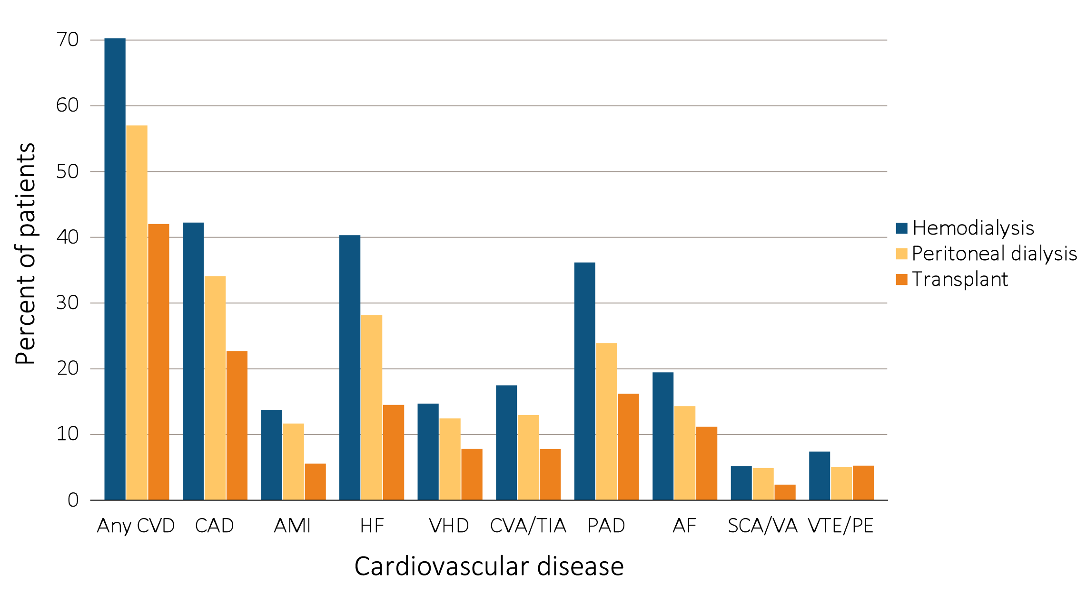
vol 2 Figure 8.1 Prevalence of cardiovascular diseases in adult ESRD patients, by treatment modality, 2015
Data Source: Special analyses, USRDS ESRD Database. Point prevalent hemodialysis, peritoneal dialysis, and transplant patients aged 22 and older, who are continuously enrolled in Medicare Parts A and B, and with Medicare as primary payer from January 1, 2015 to December 31, 2015, and ESRD service date is at least 90 days prior to January 1, 2015. Abbreviations: AF, atrial fibrillation; AMI, acute myocardial infarction; CAD, coronary artery disease; CVA/TIA, cerebrovascular accident/transient ischemic attack; CVD, cardiovascular disease; HF, heart failure; PAD, peripheral arterial disease; SCA/VA, sudden cardiac arrest and ventricular arrhythmias; VHD, valvular heart disease; VTE/PE, venous thromboembolism and pulmonary embolism.

Slide 3
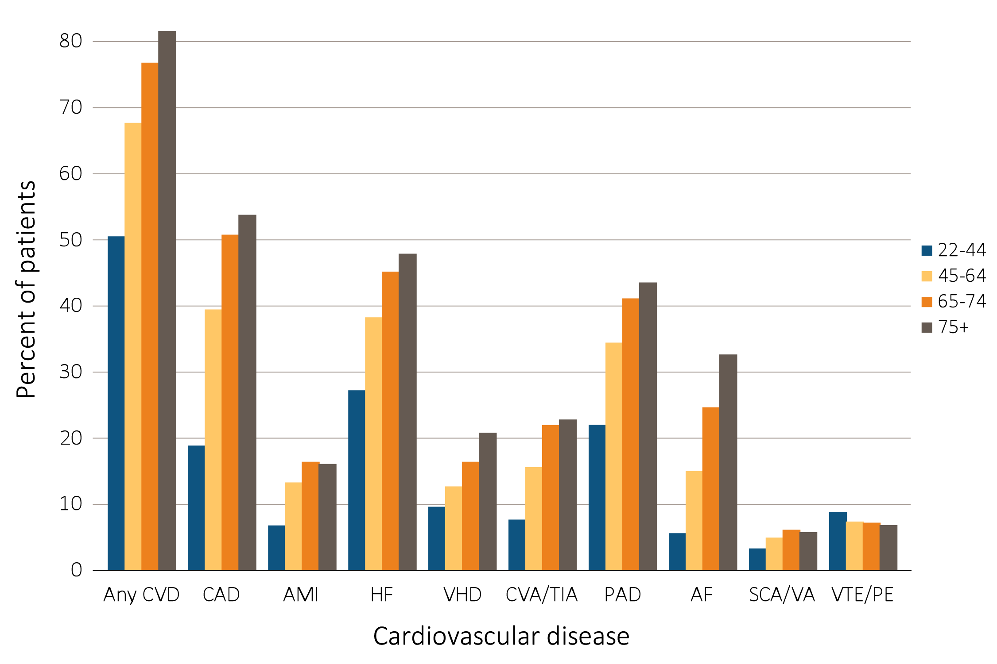
vol 2 Figure 8.2 Prevalence of cardiovascular diseases in adult ESRD patients, by age, 2015
(a) Hemodialysis patients
Data Source: Special analyses, USRDS ESRD Database. Point prevalent hemodialysis and peritoneal dialysis patients aged 22 and older, who are continuously enrolled in Medicare Parts A and B, and with Medicare as primary payer from January 1, 2015 to December 31, 2015, and ESRD service date is at least 90 days prior to January 1, 2015. Abbreviations: AF, atrial fibrillation; AMI, acute myocardial infarction; CAD, coronary artery disease; CVA/TIA, cerebrovascular accident/transient ischemic attack; CVD, cardiovascular disease; HD, hemodialysis; HF, heart failure; PAD, peripheral arterial disease; PD, peritoneal dialysis; SCA/VA, sudden cardiac arrest and ventricular arrhythmias; VHD, valvular heart disease; VTE/PE, venous thromboembolism and pulmonary embolism.

Slide 4
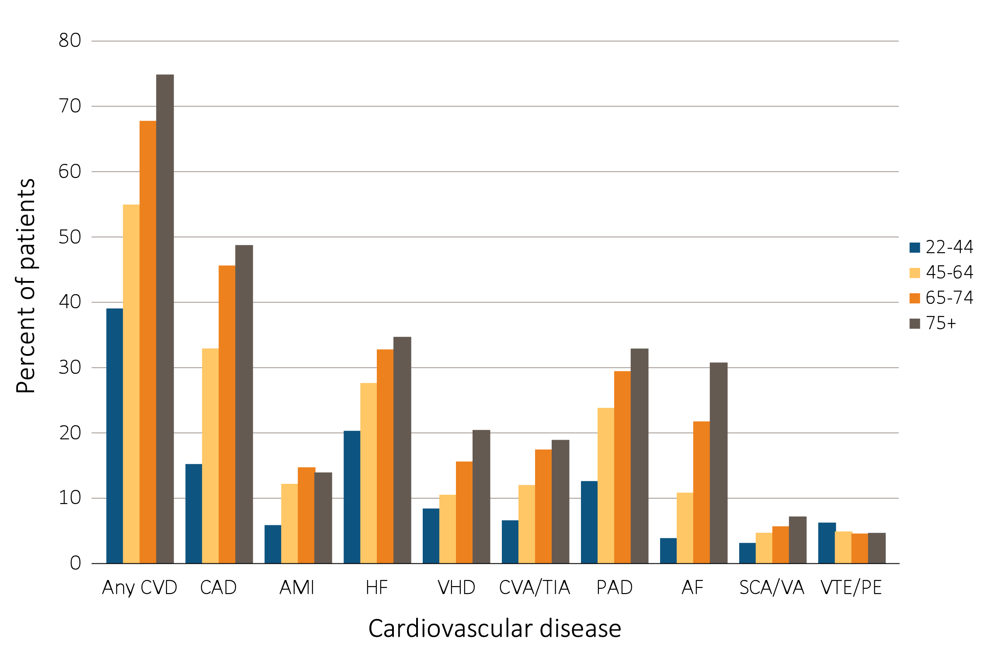
vol 2 Figure 8.2 Prevalence of cardiovascular diseases in adult ESRD patients, by age, 2015
(b) Peritoneal dialysis patients
Data Source: Special analyses, USRDS ESRD Database. Point prevalent hemodialysis and peritoneal dialysis patients aged 22 and older, who are continuously enrolled in Medicare Parts A and B, and with Medicare as primary payer from January 1, 2015 to December 31, 2015, and ESRD service date is at least 90 days prior to January 1, 2015. Abbreviations: AF, atrial fibrillation; AMI, acute myocardial infarction; CAD, coronary artery disease; CVA/TIA, cerebrovascular accident/transient ischemic attack; CVD, cardiovascular disease; HD, hemodialysis; HF, heart failure; PAD, peripheral arterial disease; PD, peritoneal dialysis; SCA/VA, sudden cardiac arrest and ventricular arrhythmias; VHD, valvular heart disease; VTE/PE, venous thromboembolism and pulmonary embolism.

Slide 5
vol 2 Table 8.1 Prevalence of (a) cardiovascular comorbidities & (b) cardiovascular procedures in adult ESRD patients, by treatment modality, age, race, & sex, 2015 (cont.)
Table 8.1 continued on next page.
Cardiovascular comorbidities
 | # Patients | Percentage of patients (%)
 |  | Overall | 22-44 | 45-64 | 65-74 | 75+ | White | Black | AI/AN | Asian | NH/PI | Other | Male | Female
Any CVD
Hemodialysis | 216,384 | 69.8 | 50.1 | 67.2 | 76.3 | 81.1 | 72.2 | 67.6 | 61.2 | 66.4 | 61.8 | 65.4 | 68.2 | 72.0
Peritoneal dialysis | 21,462 | 56.6 | 38.6 | 54.5 | 67.3 | 74.4 | 58.7 | 53.4 | 51.3 | 48.4 | 57.5 | 44.7 | 60.0 | 52.7
Transplant | 72,535 | 41.6 | 18.4 | 37.5 | 54.8 | 65.8 | 42.8 | 39.4 | 40.9 | 34.5 | 36.7 | 36.7 | 43.6 | 38.6
Coronary artery disease (CAD)
Hemodialysis | 216,384 | 41.8 | 18.4 | 39.0 | 50.3 | 53.3 | 46.0 | 36.6 | 35.6 | 41.8 | 38.8 | 39.6 | 42.1 | 41.4
Peritoneal dialysis | 21,462 | 33.7 | 14.8 | 32.5 | 45.2 | 48.3 | 36.8 | 27.6 | 29.0 | 29.7 | 30.7 | 26.3 | 38.7 | 27.8
Transplant | 72,535 | 22.3 | 5.9 | 19.7 | 31.5 | 38.1 | 23.7 | 18.7 | 24.3 | 19.2 | 20.6 | 18.4 | 25.2 | 17.9
Acute myocardial infarction (AMI)
Hemodialysis | 216,384 | 13.3 | 6.3 | 12.8 | 16.0 | 15.6 | 14.9 | 11.4 | 11.5 | 11.9 | 13.4 | 10.5 | 13.4 | 13.2
Peritoneal dialysis | 21,462 | 11.2 | 5.4 | 11.7 | 14.3 | 13.5 | 12.3 | 9.4 | 8.0 | 8.0 | 12.7 | 7.9 | 12.9 | 9.3
Transplant | 72,535 | 5.1 | 1.9 | 4.8 | 6.8 | 7.9 | 5.5 | 4.2 | 6.1 | 3.3 | 5.6 | 3.6 | 5.8 | 4.2
Heart failure (HF)
Hemodialysis | 216,384 | 39.9 | 26.8 | 37.8 | 44.7 | 47.4 | 40.5 | 39.9 | 31.0 | 35.6 | 34.7 | 34.1 | 37.8 | 42.7
Peritoneal dialysis | 21,462 | 27.7 | 19.9 | 27.2 | 32.3 | 34.2 | 27.6 | 29.1 | 26.9 | 21.8 | 28.5 | 23.7 | 29.5 | 25.7
Transplant | 72,535 | 14.1 | 5.9 | 12.3 | 18.7 | 24.5 | 13.8 | 15.8 | 13.3 | 11.4 | 14.0 | 8.6 | 14.4 | 13.6
Valvular heart disease (VHD)
Hemodialysis | 216,384 | 14.3 | 9.2 | 12.2 | 16.0 | 20.4 | 15.5 | 13.0 | 9.9 | 14.0 | 11.1 | 14.4 | 13.1 | 15.8
Peritoneal dialysis | 21,462 | 12.0 | 8.0 | 10.1 | 15.2 | 20.0 | 12.9 | 10.3 | 11.3 | 10.8 | 11.0 | 2.6 | 12.2 | 11.8
Transplant | 72,535 | 7.4 | 2.5 | 5.5 | 10.7 | 16.1 | 7.9 | 6.4 | 3.8 | 6.2 | 5.6 | 6.0 | 7.1 | 7.8
Cerebrovascular accident/transient ischemic attack (CVA/TIA)
Hemodialysis | 216,384 | 17.1 | 7.2 | 15.2 | 21.5 | 22.4 | 17.4 | 17.1 | 10.8 | 15.4 | 14.5 | 13.1 | 15.4 | 19.2
Peritoneal dialysis | 21,462 | 12.5 | 6.1 | 11.6 | 17.0 | 18.5 | 13.5 | 11.1 | 8.8 | 9.7 | 11.0 | 13.2 | 12.5 | 12.6
Transplant | 72,535 | 7.3 | 2.2 | 5.8 | 10.8 | 14.1 | 7.6 | 7.0 | 6.1 | 5.5 | 5.4 | 5.6 | 7.2 | 7.5
Peripheral artery disease (PAD)
Hemodialysis | 216,384 | 35.7 | 21.6 | 34.0 | 40.7 | 43.1 | 37.7 | 34.1 | 30.9 | 29.0 | 27.3 | 31.8 | 35.4 | 36.1
Peritoneal dialysis | 21,462 | 23.5 | 12.2 | 23.4 | 29.0 | 32.4 | 25.4 | 20.5 | 21.4 | 16.2 | 23.2 | 13.2 | 26.0 | 20.5
Transplant | 72,535 | 15.8 | 6.3 | 14.5 | 20.7 | 25.3 | 16.1 | 15.5 | 18.4 | 11.5 | 13.0 | 17.3 | 17.1 | 13.8
Atrial fibrillation (AF)
Hemodialysis | 216,384 | 19.0 | 5.2 | 14.6 | 24.2 | 32.2 | 22.7 | 14.5 | 10.4 | 18.9 | 16.7 | 17.3 | 19.5 | 18.4
Peritoneal dialysis | 21,462 | 13.9 | 3.4 | 10.4 | 21.3 | 30.3 | 16.1 | 9.0 | 9.2 | 12.9 | 15.8 | 5.3 | 16.5 | 10.8
Transplant | 72,535 | 10.7 | 1.5 | 7.2 | 17.1 | 26.6 | 11.9 | 7.9 | 8.2 | 8.1 | 8.9 | 4.9 | 11.9 | 9.0
Cardiac arrest and ventricular arrhythmias (SCA/VA)
Hemodialysis | 216,384 | 4.7 | 2.9 | 4.5 | 5.7 | 5.3 | 4.8 | 4.9 | 3.3 | 3.3 | 3.2 | 3.4 | 5.2 | 4.2
Peritoneal dialysis | 21,462 | 4.5 | 2.7 | 4.2 | 5.2 | 6.7 | 4.6 | 4.5 | 2.5 | 2.9 | 4.8 | 0.0 | 5.4 | 3.4
Transplant | 72,535 | 1.9 | 0.7 | 1.6 | 2.7 | 3.7 | 1.9 | 2.1 | 1.7 | 1.3 | 1.2 | 1.7 | 2.1 | 1.6
Venous thromboembolism and pulmonary embolism (VTE/PE)
Hemodialysis | 216,384 | 7.0 | 8.3 | 6.9 | 6.8 | 6.4 | 6.3 | 8.2 | 4.2 | 4.5 | 4.3 | 6.3 | 6.3 | 7.9
Peritoneal dialysis | 21,462 | 4.6 | 5.8 | 4.4 | 4.1 | 4.2 | 4.4 | 5.7 | 1.3 | 1.9 | 5.7 | 2.6 | 4.4 | 4.9
Transplant | 72,535 | 4.8 | 3.4 | 4.5 | 5.8 | 6.5 | 4.7 | 5.8 | 3.8 | 2.0 | 3.3 | 3.8 | 4.9 | 4.8

Slide 6
vol 2 Table 8.1 Prevalence of (a) cardiovascular comorbidities & (b) cardiovascular procedures in adult ESRD patients, by treatment modality, age, race, & sex, 2015
(b) Cardiovascular procedures
 |  | Percentage of patients (%)
 | # Patients | Overall | 22-44 | 45-64 | 65-74 | 75+ | White | Blk/Af Am | AI/AN | Asian | NH/PI | Other | Male | Female
Revascularization – percutaneous coronary interventions (PCI)
Hemodialysis | 90,475 | 3.7 | 3.5 | 4.1 | 3.9 | 2.8 | 3.9 | 3.4 | 3.4 | 4.0 | 4.4 | 4.6 | 3.7 | 3.6
Peritoneal dialysis | 7,224 | 5.5 | 5.1 | 6.8 | 4.5 | 4.1 | 5.9 | 4.1 | 4.3 | 6.4 | 2.9 | * | 5.3 | 5.7
Transplant | 16,152 | 2.4 | 4.1 | 2.6 | 2.0 | 2.1 | 2.5 | 1.7 | 3.2 | 1.8 | 6.0 | 3.1 | 2.4 | 2.3
Revascularization – coronary artery bypass graft (CABG)
Hemodialysis | 90,475 | 1.8 | 2.0 | 2.4 | 1.8 | 0.7 | 1.9 | 1.5 | 2.6 | 1.9 | 2.5 | 2.0 | 2.1 | 1.4
Peritoneal dialysis | 7,224 | 3.4 | 3.7 | 4.3 | 3.3 | 1.5 | 3.6 | 2.7 | 4.3 | 3.5 | 11.4 | * | 3.9 | 2.7
Transplant | 16,152 | 1.3 | 0.8 | 1.6 | 1.3 | 0.8 | 1.4 | 1.3 | 1.6 | 1.1 | 0.0 | 3.1 | 1.5 | 1.1
Implantable cardioverter defibrillators & cardiac resynchronization therapy with defibrillator devices (ICD/CRT-D)
Hemodialysis | 86,319 | 0.8 | 0.7 | 0.9 | 0.9 | 0.6 | 0.8 | 0.7 | 0.7 | 1.0 | 0.6 | 0.8 | 1.0 | 0.6
Peritoneal dialysis | 5,947 | 0.8 | 0.9 | 1.0 | 0.6 | 0.6 | 0.8 | 0.9 | 0.0 | 0.0 | 1.5 | * | 0.7 | 0.9
Transplant | 10,206 | 0.6 | 0.3 | 0.8 | 0.6 | 0.5 | 0.6 | 0.7 | 1.0 | 0.3 | 1.5 | 0.0 | 0.7 | 0.4
Carotid artery stenting and carotid artery endarterectomy (CAS/CEA)
Hemodialysis | 127,063 | 0.4 | 0.1 | 0.3 | 0.5 | 0.5 | 0.5 | 0.2 | 0.2 | 0.1 | 0.4 | 0.5 | 0.4 | 0.4
Peritoneal dialysis | 9,893 | 0.5 | 0.0 | 0.4 | 0.8 | 0.5 | 0.6 | 0.3 | 0.0 | 0.2 | 0.0 | 0.0 | 0.5 | 0.5
Transplant | 23,416 | 0.3 | 0.0 | 0.2 | 0.5 | 0.3 | 0.4 | 0.2 | 0.4 | 0.6 | 0.7 | 0.0 | 0.3 | 0.3
Data Source: Special analyses, USRDS ESRD Database. Point prevalent hemodialysis, peritoneal dialysis, and transplant patients aged 22 and older, who are continuously enrolled in Medicare Parts A and B, and with Medicare as primary payer from January 1, 2015 to December 31, 2015, and ESRD service date is at least 90 days prior to January 1, 2015. (a) The denominators for all cardiovascular comorbidities are patients described above by modality. (b) The denominators for PCI and CABG are patients with CAD by modality. The denominator for ICD/CRT-D is patients with HF by modality. The denominator for CAS/CEA is patients with CAD, CVA/TIA, or PAD by modality. *Values for cells with 10 or fewer patients are suppressed. Abbreviations: AF, atrial fibrillation; AI/AN, American Indian or Alaska Native; AMI, acute myocardial infarction; Blk/Af Am, Black African American; CABG, coronary artery bypass grafting; CAD, coronary artery disease; CAS/CEA, carotid artery stenting and carotid artery endarterectomy; CVA/TIA, cerebrovascular accident/transient ischemic attack; CVD, cardiovascular disease; HF, heart failure; ICD/CRT-D, implantable cardioverter defibrillators/cardiac resynchronization therapy with defibrillator devices; NH/PI, Native Hawaiian or Pacific Islander; PAD, peripheral arterial disease; PCI, percutaneous coronary interventions; SCA/VA, sudden cardiac arrest and ventricular arrhythmias; VHD, valvular heart disease; VTE/PE, venous thromboembolism and pulmonary embolism.

Slide 7
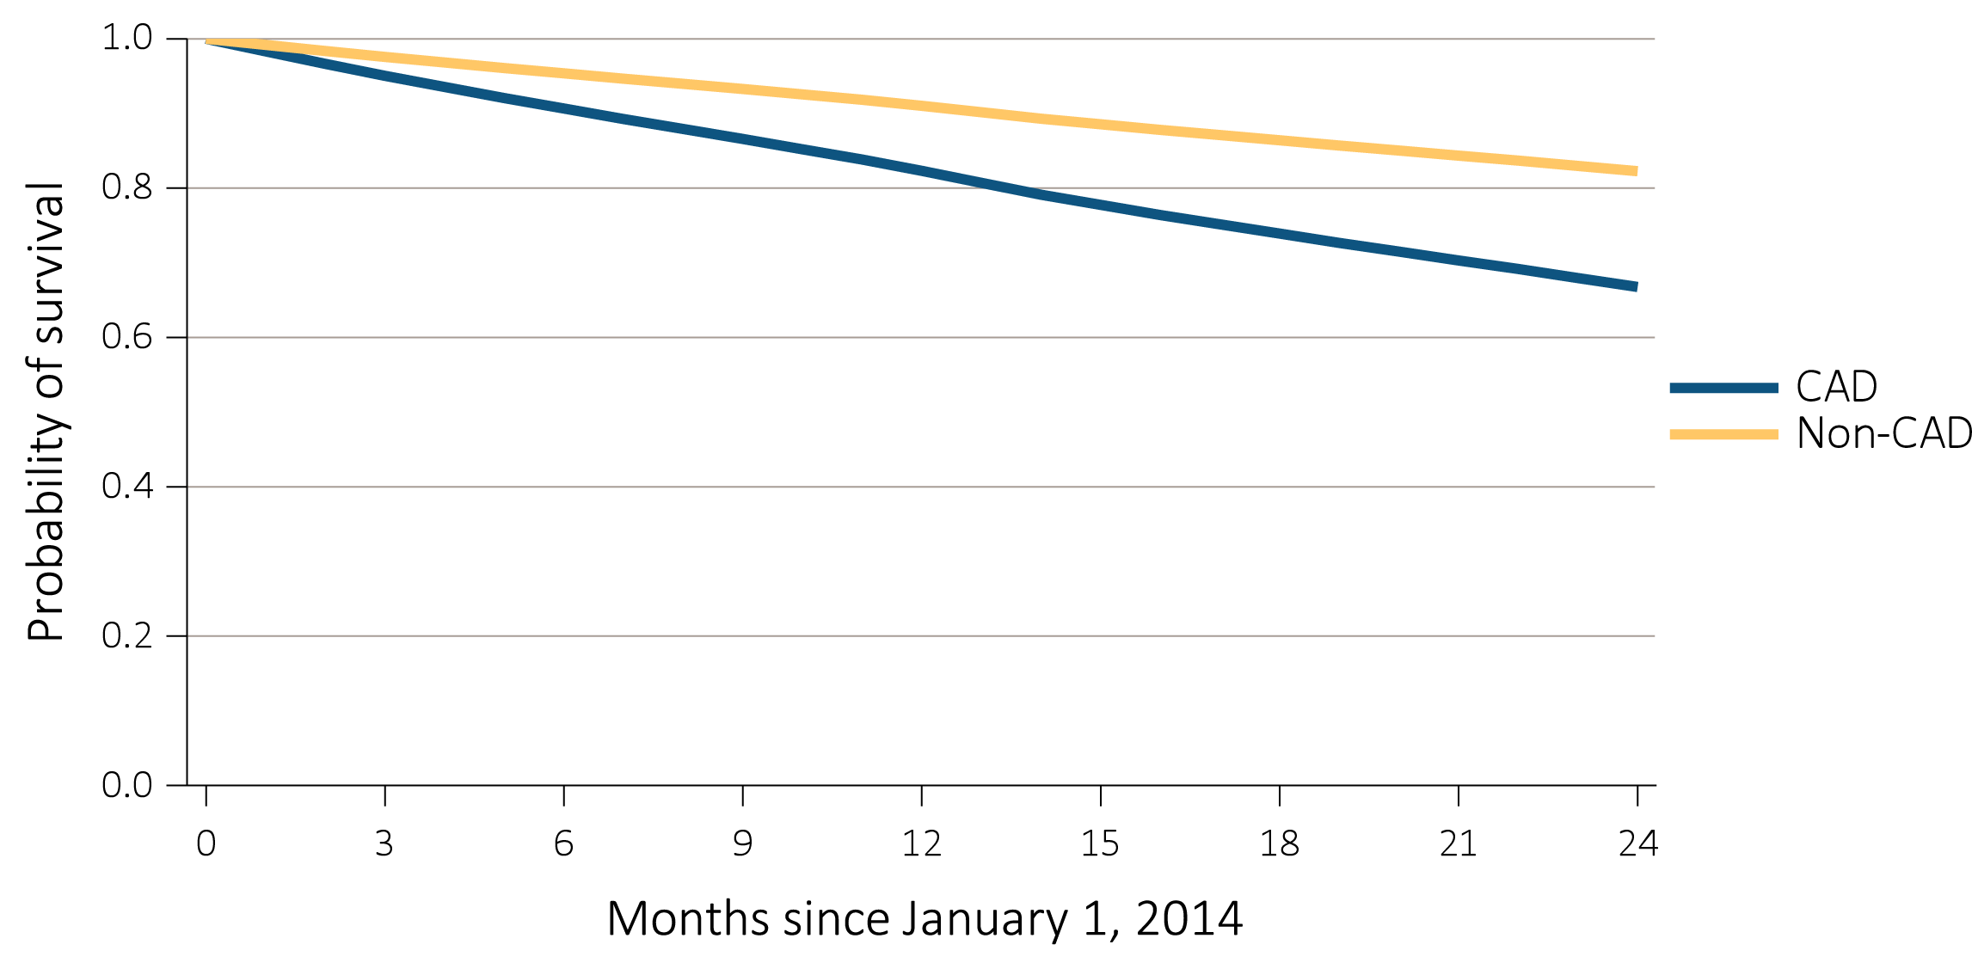
vol 2 Figure 8.3 Probability of survival of adult ESRD patients with or without a cardiovascular disease, adjusted for age and sex, 2014-2015
(a) Coronary artery disease (CAD)
Data Source: Special analyses, USRDS ESRD Database. Point prevalent hemodialysis, peritoneal dialysis, and transplant patients aged 22 and older, who are continuously enrolled in Medicare Parts A and B, and with Medicare as primary payer from January 1, 2013 to December 31, 2013, and whose first ESRD service date is at least 90 days prior to January 1, 2013, and survived past 2013.

Slide 8
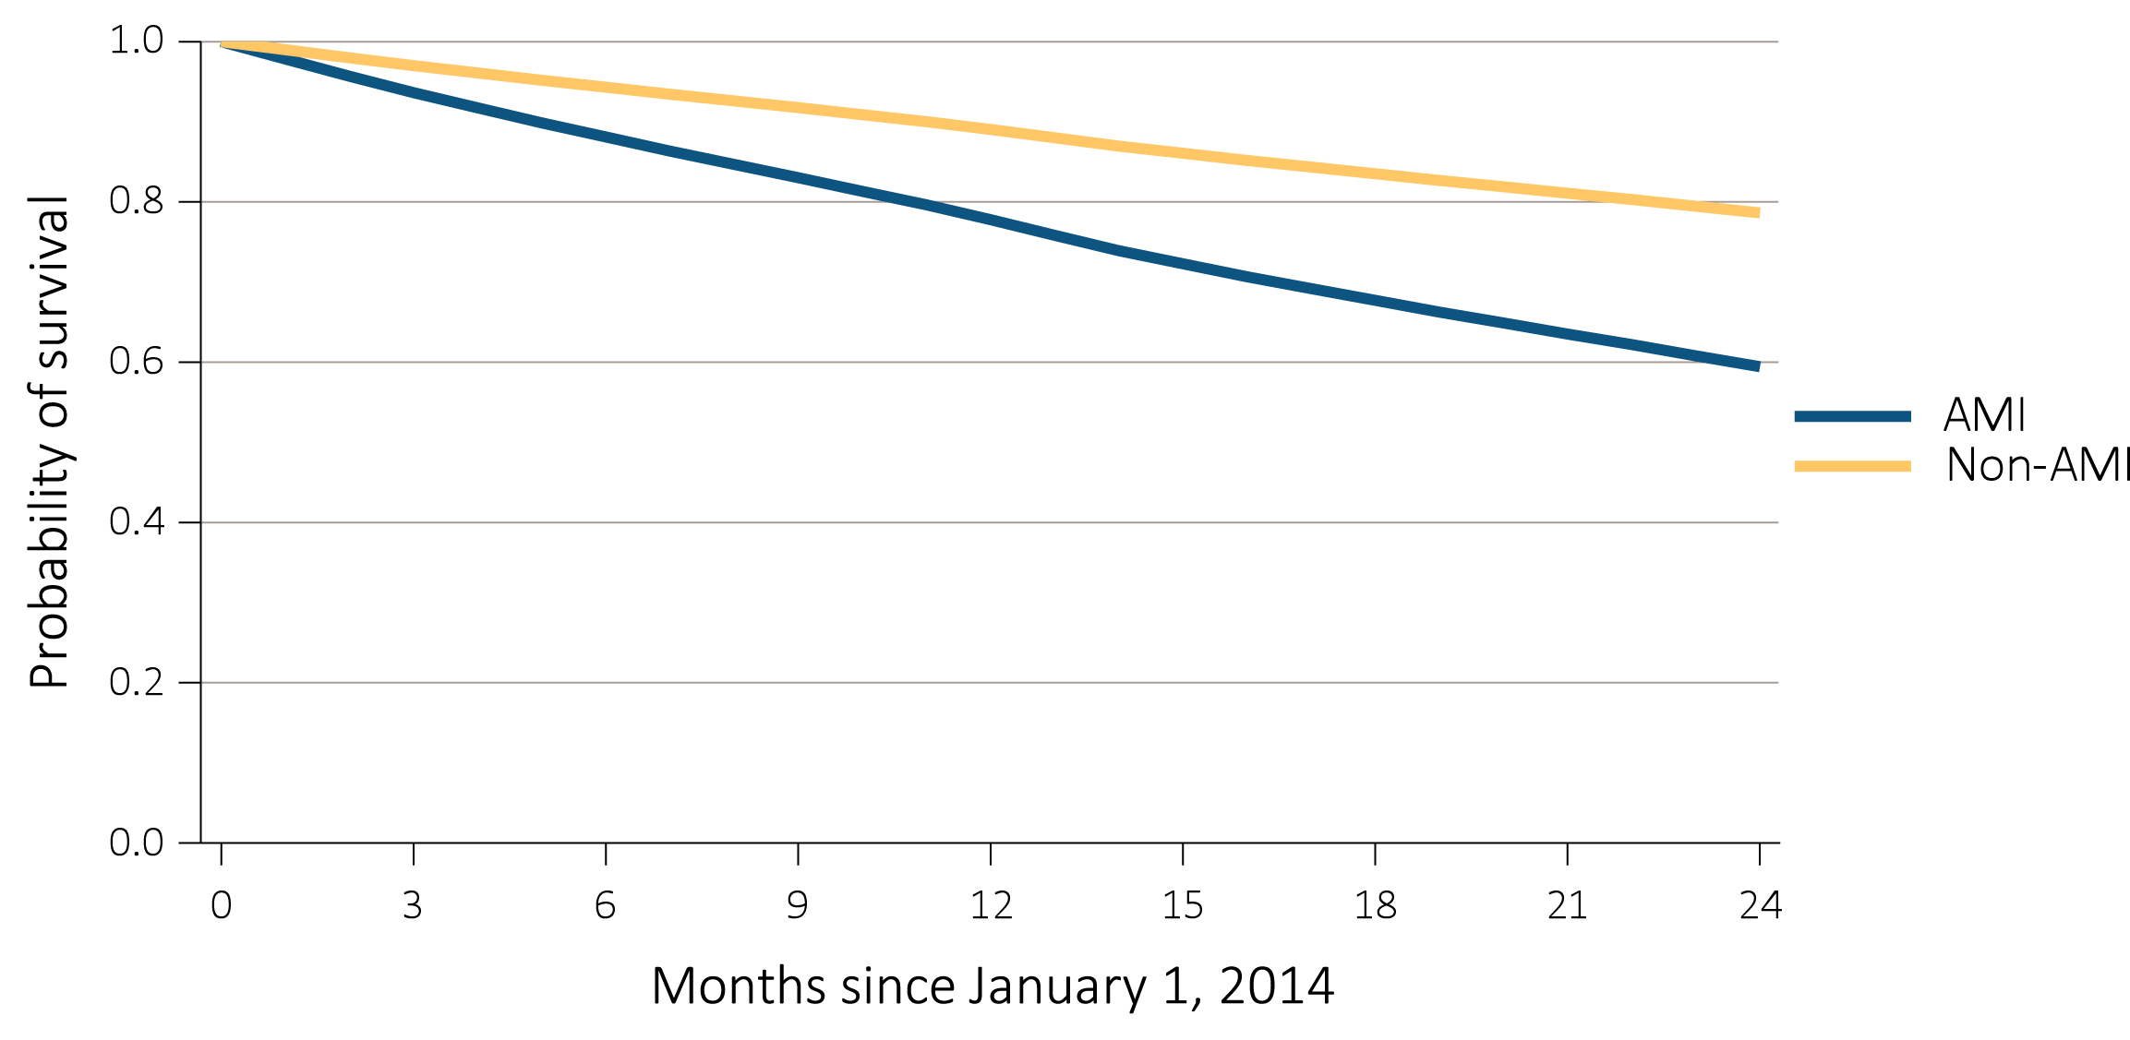
vol 2 Figure 8.3 Probability of survival of adult ESRD patients with or without a cardiovascular disease, adjusted for age and sex, 2014-2015
(b) Acute myocardial infarction (AMI)
Data Source: Special analyses, USRDS ESRD Database. Point prevalent hemodialysis, peritoneal dialysis, and transplant patients aged 22 and older, who are continuously enrolled in Medicare Parts A and B, and with Medicare as primary payer from January 1, 2013 to December 31, 2013, and whose first ESRD service date is at least 90 days prior to January 1, 2013, and survived past 2013.

Slide 9
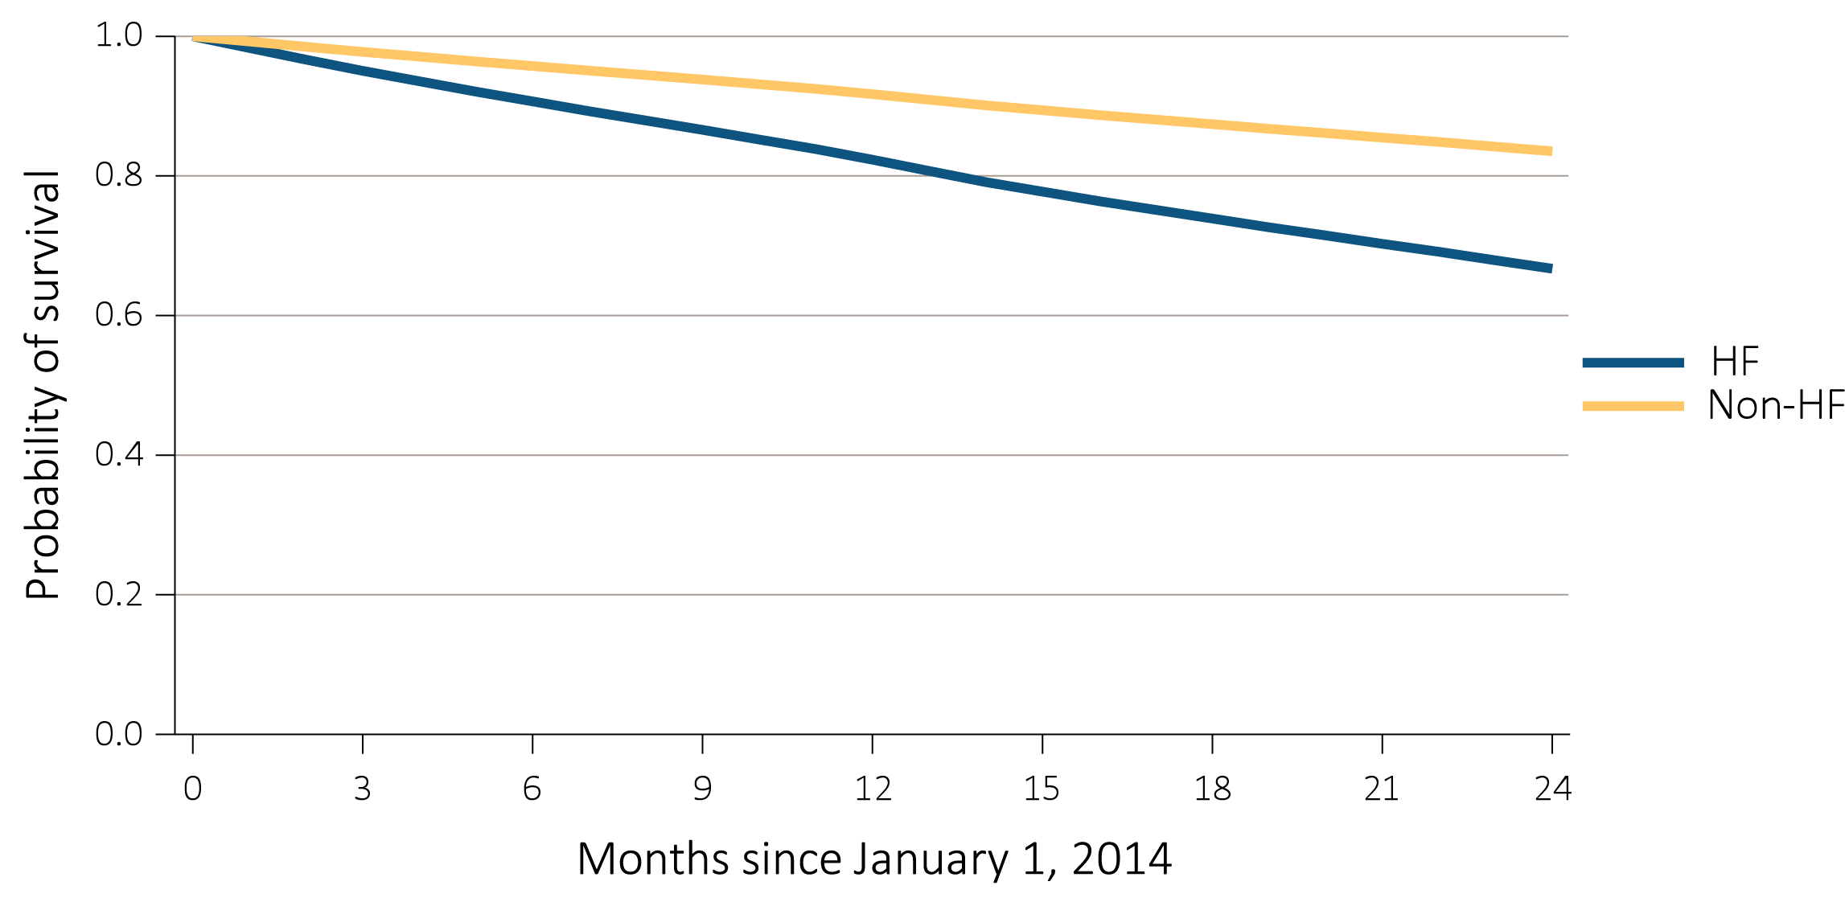
vol 2 Figure 8.3 Probability of survival of adult ESRD patients with or without a cardiovascular disease, adjusted for age and sex, 2014-2015
(c) Heart failure (HF)
Data Source: Special analyses, USRDS ESRD Database. Point prevalent hemodialysis, peritoneal dialysis, and transplant patients aged 22 and older, who are continuously enrolled in Medicare Parts A and B, and with Medicare as primary payer from January 1, 2013 to December 31, 2013, and whose first ESRD service date is at least 90 days prior to January 1, 2013, and survived past 2013.

Slide 10
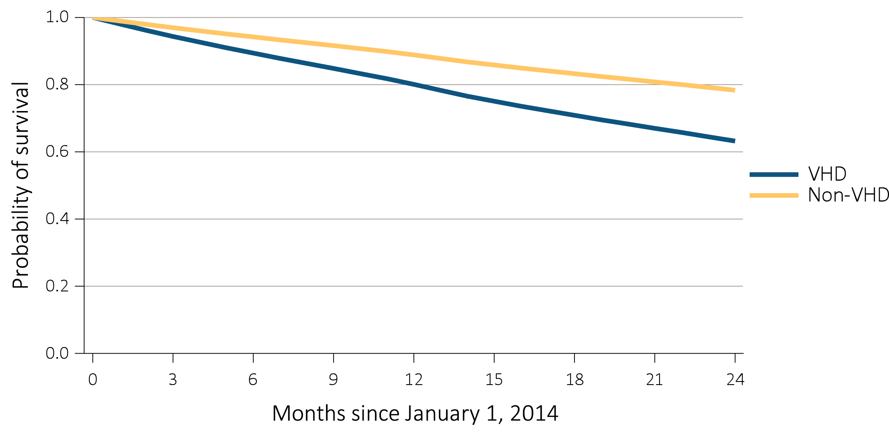
vol 2 Figure 8.3 Probability of survival of adult ESRD patients with or without a cardiovascular disease, adjusted for age and sex, 2014-2015
(d) Valvular heart disease (VHD)
Data Source: Special analyses, USRDS ESRD Database. Point prevalent hemodialysis, peritoneal dialysis, and transplant patients aged 22 and older, who are continuously enrolled in Medicare Parts A and B, and with Medicare as primary payer from January 1, 2013 to December 31, 2013, and whose first ESRD service date is at least 90 days prior to January 1, 2013, and survived past 2013.

Slide 11
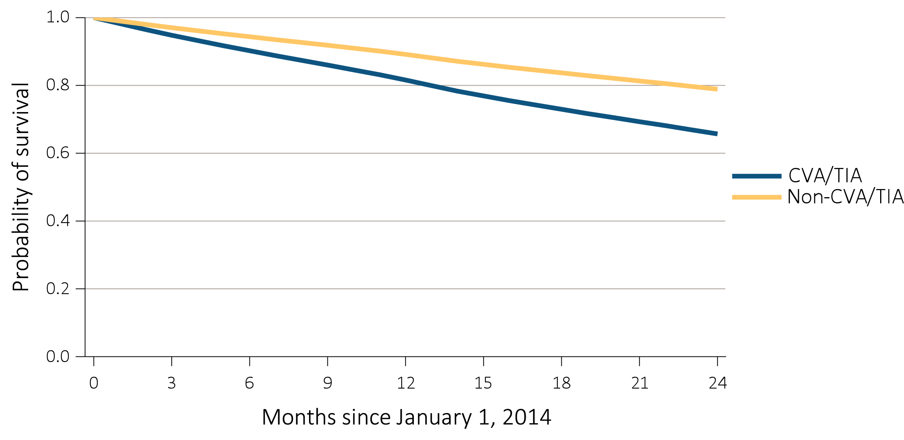
vol 2 Figure 8.3 Probability of survival of adult ESRD patients with or without a cardiovascular disease, adjusted for age and sex, 2014-2015
(e) Cerebrovascular accident/transient ischemic attack (CVA/TIA)
Data Source: Special analyses, USRDS ESRD Database. Point prevalent hemodialysis, peritoneal dialysis, and transplant patients aged 22 and older, who are continuously enrolled in Medicare Parts A and B, and with Medicare as primary payer from January 1, 2013 to December 31, 2013, and whose first ESRD service date is at least 90 days prior to January 1, 2013, and survived past 2013.

Slide 12
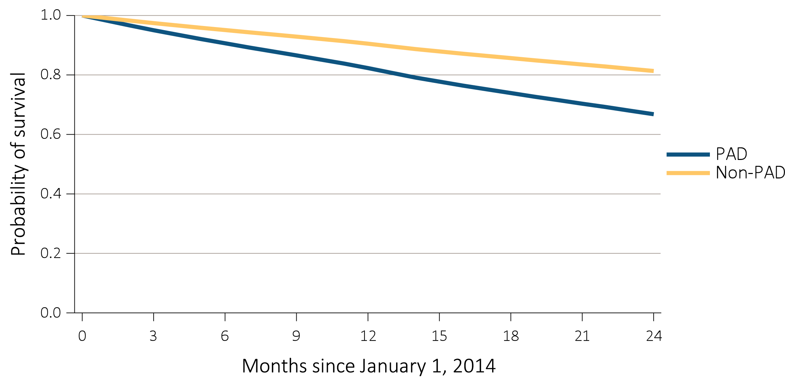
vol 2 Figure 8.3 Probability of survival of adult ESRD patients with or without a cardiovascular disease, adjusted for age and sex, 2014-2015
(f) Peripheral arterial disease (PAD)
Data Source: Special analyses, USRDS ESRD Database. Point prevalent hemodialysis, peritoneal dialysis, and transplant patients aged 22 and older, who are continuously enrolled in Medicare Parts A and B, and with Medicare as primary payer from January 1, 2013 to December 31, 2013, and whose first ESRD service date is at least 90 days prior to January 1, 2013, and survived past 2013.

Slide 13
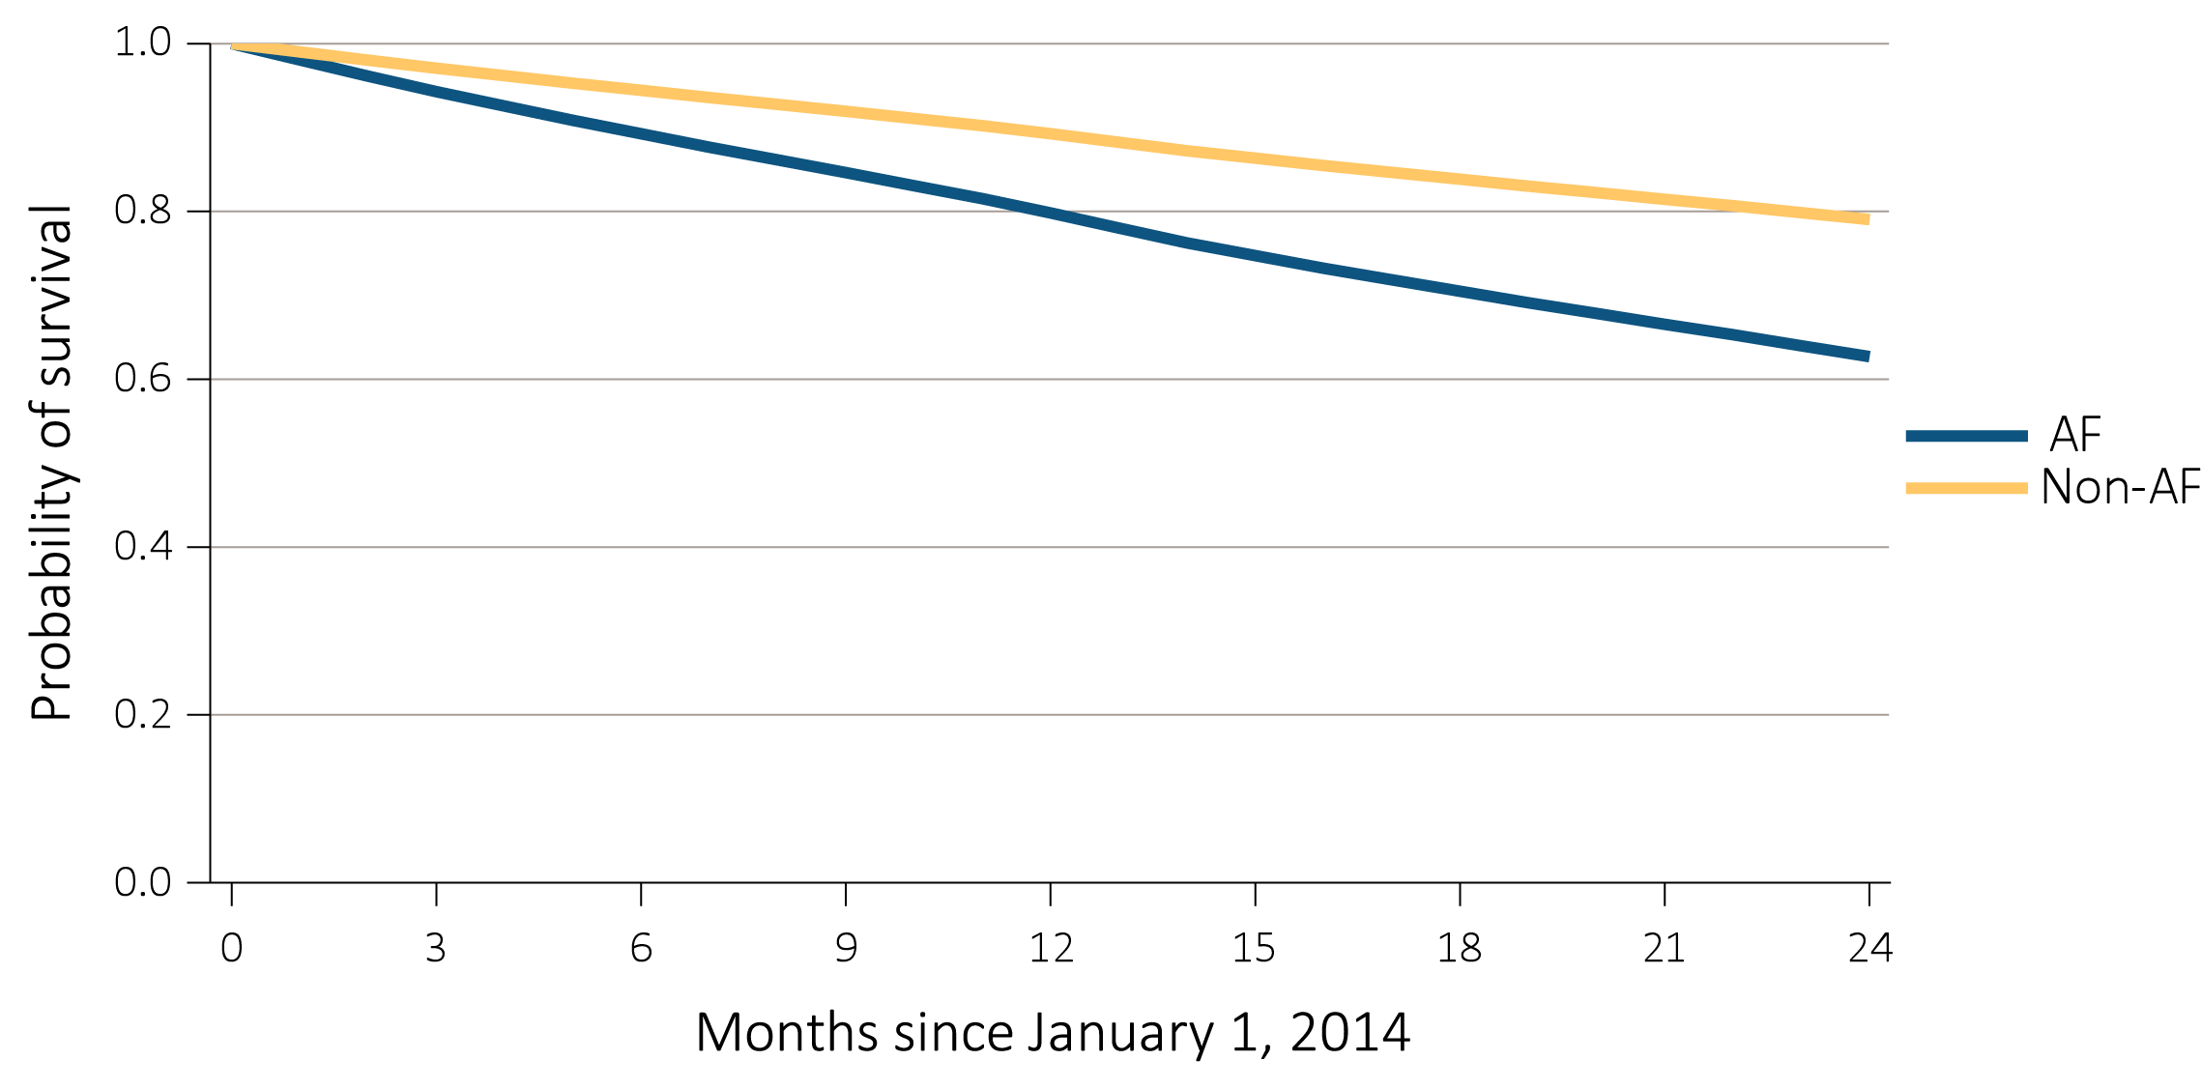
vol 2 Figure 8.3 Probability of survival of adult ESRD patients with or without a cardiovascular disease, adjusted for age and sex, 2014-2015
(g) Atrial fibrillation (AF)
Data Source: Special analyses, USRDS ESRD Database. Point prevalent hemodialysis, peritoneal dialysis, and transplant patients aged 22 and older, who are continuously enrolled in Medicare Parts A and B, and with Medicare as primary payer from January 1, 2013 to December 31, 2013, and whose first ESRD service date is at least 90 days prior to January 1, 2013, and survived past 2013.

Slide 14
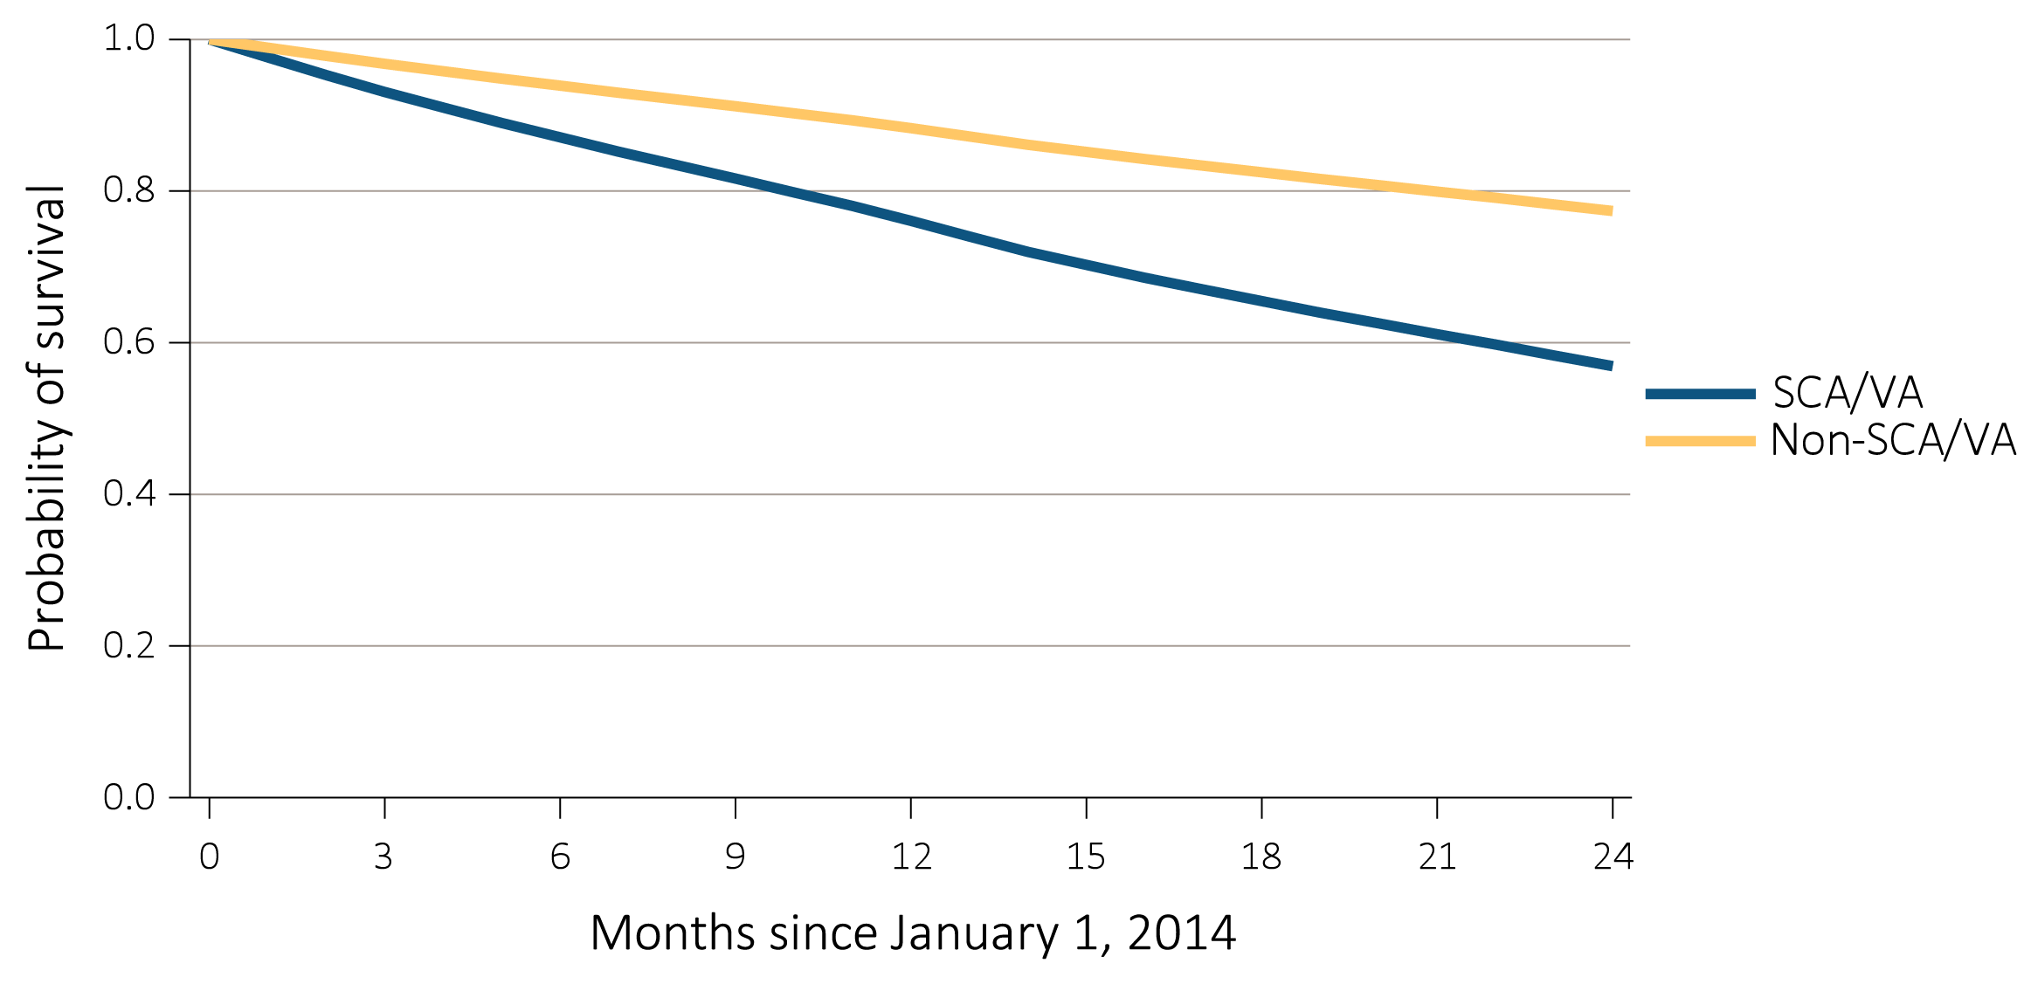
vol 2 Figure 8.3 Probability of survival of adult ESRD patients with or without a cardiovascular disease, adjusted for age and sex, 2014-2015
(h) Sudden cardiac arrest and ventricular arrhythmias (SCA/VA)
Data Source: Special analyses, USRDS ESRD Database. Point prevalent hemodialysis, peritoneal dialysis, and transplant patients aged 22 and older, who are continuously enrolled in Medicare Parts A and B, and with Medicare as primary payer from January 1, 2013 to December 31, 2013, and whose first ESRD service date is at least 90 days prior to January 1, 2013, and survived past 2013.

Slide 15
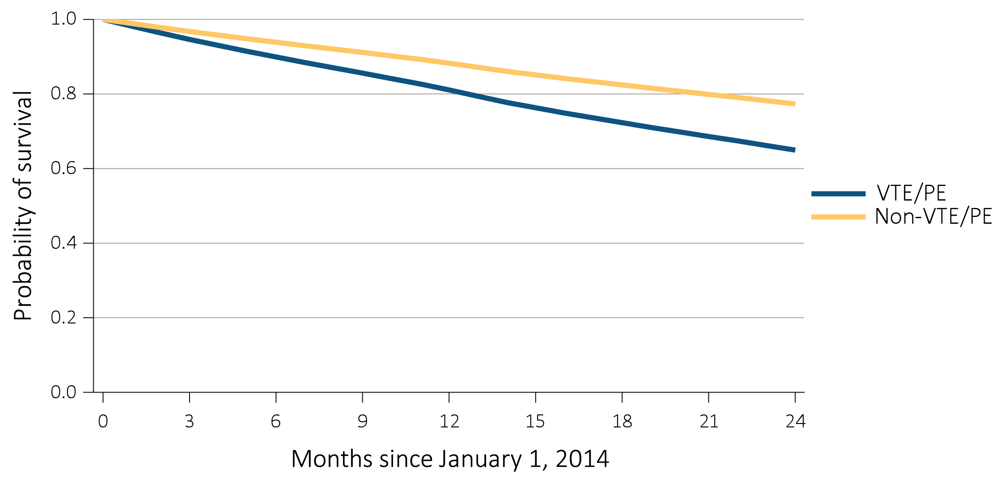
vol 2 Figure 8.3 Probability of survival of adult ESRD patients with or without a cardiovascular disease, adjusted for age and sex, 2014-2015
(i) Venous thromboembolism and pulmonary embolism (VTE/PE)
Data Source: Special analyses, USRDS ESRD Database. Point prevalent hemodialysis, peritoneal dialysis, and transplant patients aged 22 and older, who are continuously enrolled in Medicare Parts A and B, and with Medicare as primary payer from January 1, 2013 to December 31, 2013, and whose first ESRD service date is at least 90 days prior to January 1, 2013, and survived past 2013.

Slide 16
vol 2 Table 8.2 Two-year survival of adult ESRD patients with or without a cardiovascular disease, adjusted for age and sex, 2014-2015
 | Presence of cardiovascular disease
Cardiovascular disease | Survival when present (%) | Survival when not present (%)
CAD | 66.8 | 82.3
AMI | 59.4 | 78.6
HF | 66.7 | 83.5
VHD | 63.2 | 78.3
CVA/TIA | 65.7 | 78.9
PAD | 66.8 | 81.3
AF | 62.7 | 79.0
SCA/VA | 56.9 | 77.4
VTE/PE | 65.0 | 77.3
Data Source: Special analyses, USRDS ESRD Database. Point prevalent hemodialysis, peritoneal dialysis, and transplant patients aged 22 and older, who are continuously enrolled in Medicare Parts A and B, and with Medicare as primary payer from January 1, 2013 to December 31, 2013, and whose first ESRD service date is at least 90 days prior to January 1, 2013, and survived past 2013. Abbreviations: AF, atrial fibrillation; AMI, acute myocardial infarction; CAD, coronary artery disease; CVA/TIA, cerebrovascular accident/transient ischemic attack; HF, heart failure; PAD, peripheral arterial disease; SCA/VA, sudden cardiac arrest and ventricular arrhythmias; VHD, valvular heart disease; VTE/PE, venous thromboembolism and pulmonary embolism.

Slide 17
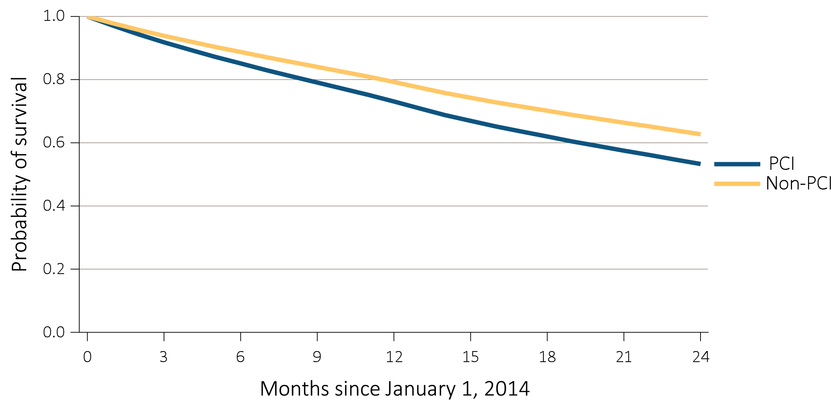
vol 2 Figure 8.4 Probability of survival of adult ESRD patients with or without a completed cardiovascular procedure, adjusted for age and sex, 2014-2015
(a) Percutaneous coronary interventions (PCI)
Data Source: Special analyses, USRDS ESRD Database. Point prevalent hemodialysis, peritoneal dialysis, and transplant patients aged 22 and older, who are continuously enrolled in Medicare Parts A and B, and with Medicare as primary payer from January 1, 2013 to December 31, 2013, and whose first ESRD service date is at least 90 days prior to January 1, 2013, and survived past 2013.

Slide 18
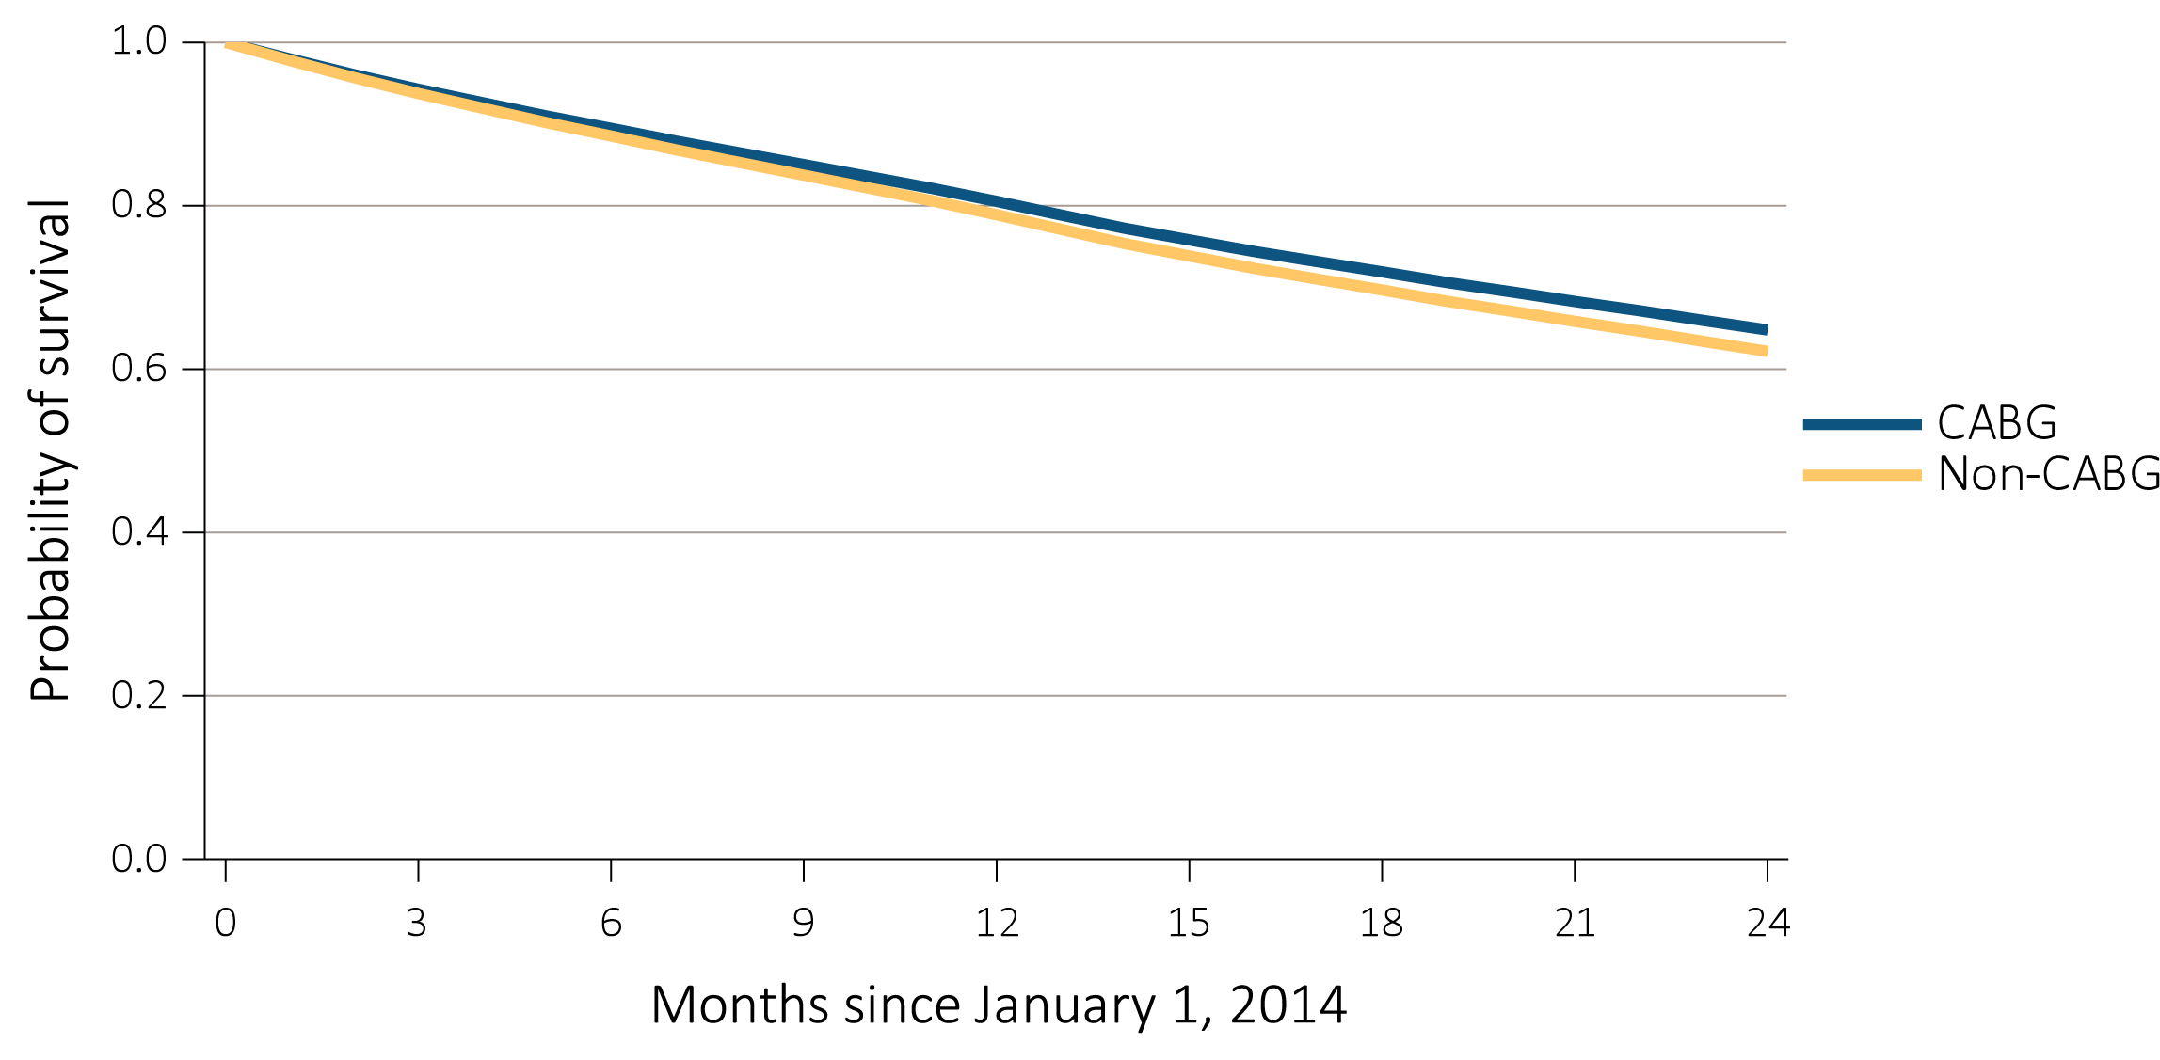
vol 2 Figure 8.4 Probability of survival of adult ESRD patients with or without a completed cardiovascular procedure, adjusted for age and sex, 2014-2015
(b) Coronary artery bypass grafting (CABG)
Data Source: Special analyses, USRDS ESRD Database. Point prevalent hemodialysis, peritoneal dialysis, and transplant patients aged 22 and older, who are continuously enrolled in Medicare Parts A and B, and with Medicare as primary payer from January 1, 2013 to December 31, 2013, and whose first ESRD service date is at least 90 days prior to January 1, 2013, and survived past 2013.

Slide 19
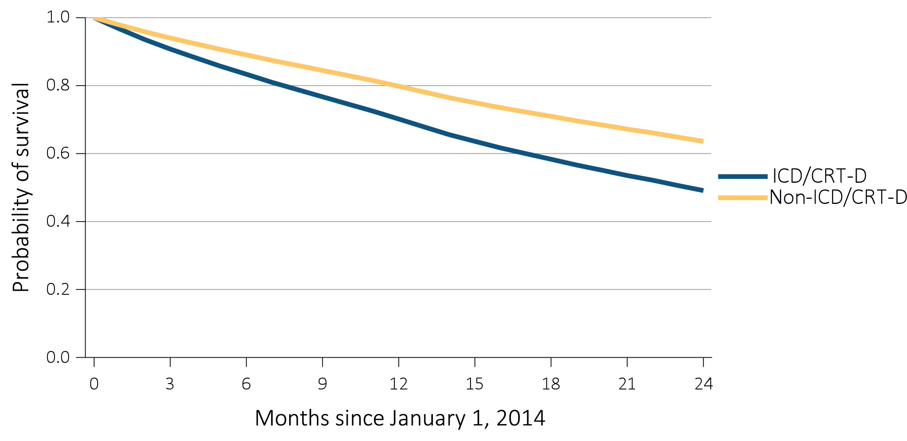
vol 2 Figure 8.4 Probability of survival of adult ESRD patients with or without a completed cardiovascular procedure, adjusted for age and sex, 2014-2015
(c) Implantable cardioverter defibrillators/cardiac resynchronization therapy with defibrillator devices (ICD/CRT-D)
Data Source: Special analyses, USRDS ESRD Database. Point prevalent hemodialysis, peritoneal dialysis, and transplant patients aged 22 and older, who are continuously enrolled in Medicare Parts A and B, and with Medicare as primary payer from January 1, 2013 to December 31, 2013, and whose first ESRD service date is at least 90 days prior to January 1, 2013, and survived past 2013.

Slide 20
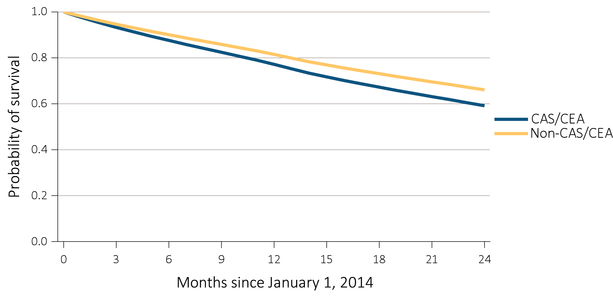
vol 2 Figure 8.4 Probability of survival of adult ESRD patients with or without a completed cardiovascular procedure, adjusted for age and sex, 2014-2015
(d) Carotid artery stenting and carotid endarterectomy (CAS/CEA)
Data Source: Special analyses, USRDS ESRD Database. Point prevalent hemodialysis, peritoneal dialysis, and transplant patients aged 22 and older, who are continuously enrolled in Medicare Parts A and B, and with Medicare as primary payer from January 1, 2013 to December 31, 2013, and whose first ESRD service date is at least 90 days prior to January 1, 2013, and survived past 2013.

Slide 21
vol 2 Table 8.3 Two-year survival of adult ESRD patients with or without a completed cardiovascular procedure, adjusted for age and sex, 2014-2015
 | Presence of cardiovascular procedure
Cardiovascular procedure | Survival when present (%) | Survival when not present (%)
PCI | 53.3 | 62.7
CABG | 64.8 | 62.2
ICD/CRT-D | 49.1 | 63.6
CAS/CEA | 59.2 | 66.1
Data Source: Special analyses, USRDS ESRD Database. Point prevalent hemodialysis, peritoneal dialysis, and transplant patients aged 22 and older, who are continuously enrolled in Medicare Parts A and B, and with Medicare as primary payer from January 1, 2013 to December 31, 2013, and whose first ESRD service date is at least 90 days prior to January 1, 2013, and survived past 2013. Abbreviations: CABG, coronary artery bypass grafting; CAS/CEA, carotid artery stunting and carotid artery endarterectomy; ICD/CRT-D, implantable cardioverter defibrillators/cardiac resynchronization therapy with defibrillator devices; PCI, percutaneous coronary interventions.

Slide 22
vol 2 Table 8.4 Cardiovascular pharmacological treatments by (a) comorbidities and (b) procedures in adult ESRD patients, by modality, 2015 (cont.)
(a) Cardiovascular comorbidities
 | # Patients | Percentage of patients (%)
 |  | Beta- blockers | Statins | P2Y₁₂ inhibitors | Warfarin | Direct Oral Anticoagulants | ACEIs/ ARBs
Any CVD
Hemodialysis | 151,130 | 60.2 | 46.6 | 19.7 | 13.6 | 2.0 | 36.4
Peritoneal dialysis | 12,144 | 60.1 | 47.5 | 19.1 | 11.9 | 1.9 | 40.3
Transplant | 30,158 | 58.2 | 52.5 | 13.5 | 15.0 | 4.8 | 33.0
Coronary artery disease (CAD)
Hemodialysis | 90,475 | 64.0 | 54.6 | 27.3 | 13.9 | 2.3 | 38.1
Peritoneal dialysis | 7,224 | 62.7 | 54.8 | 27.4 | 11.6 | 1.9 | 40.8
Transplant | 16,152 | 62.5 | 59.2 | 20.6 | 13.1 | 4.6 | 34.4
Acute myocardial infarction (AMI)
Hemodialysis | 28,770 | 68.5 | 60.0 | 36.4 | 15.5 | 2.6 | 42.0
Peritoneal dialysis | 2,411 | 67.2 | 59.7 | 38.8 | 13.3 | 2.0 | 44.3
Transplant | 3,723 | 67.7 | 63.2 | 30.6 | 16.4 | 5.9 | 37.5
Heart failure (HF)
Hemodialysis | 86,319 | 65.7 | 48.8 | 21.5 | 15.0 | 2.5 | 40.0
Peritoneal dialysis | 5,947 | 65.7 | 49.0 | 21.1 | 13.1 | 2.3 | 43.6
Transplant | 10,206 | 64.1 | 54.2 | 14.4 | 17.9 | 6.2 | 34.4
Valvular heart disease (VHD)
Hemodialysis | 30,888 | 63.3 | 47.7 | 21.5 | 18.8 | 2.8 | 38.7
Peritoneal dialysis | 2,577 | 63.4 | 48.2 | 22.1 | 18.2 | 2.9 | 40.8
Transplant | 5,365 | 60.2 | 52.4 | 13.0 | 19.8 | 6.3 | 33.3
Cerebrovascular accident/transient ischemic attack (CVA/TIA)
Hemodialysis | 36,896 | 63.4 | 55.7 | 27.3 | 14.7 | 2.4 | 39.2
Peritoneal dialysis | 2,690 | 61.3 | 55.0 | 27.0 | 13.3 | 2.0 | 42.5
Transplant | 5,328 | 58.9 | 58.0 | 21.1 | 15.3 | 5.2 | 34.5
Peripheral artery disease (PAD)
Hemodialysis | 77,324 | 59.8 | 49.3 | 24.3 | 14.2 | 2.1 | 36.0
Peritoneal dialysis | 5,034 | 58.7 | 50.2 | 25.4 | 11.7 | 2.1 | 39.9
Transplant | 11,431 | 58.9 | 53.9 | 17.9 | 13.9 | 4.4 | 34.5
Atrial fibrillation (AF)
Hemodialysis | 41,141 | 60.3 | 47.3 | 17.9 | 33.9 | 5.7 | 30.8
Peritoneal dialysis | 2,979 | 59.2 | 46.5 | 16.9 | 30.6 | 5.4 | 34.4
Transplant | 7,796 | 62.1 | 50.4 | 9.7 | 35.9 | 13.0 | 32.6
Cardiac arrest and ventricular arrhythmias (SCA/VA)
Hemodialysis | 10,245 | 67.1 | 50.1 | 24.6 | 20.9 | 3.5 | 38.0
Peritoneal dialysis | 957 | 63.8 | 48.4 | 24.6 | 17.5 | 3.4 | 39.6
Transplant | 1,400 | 66.2 | 55.0 | 17.3 | 22.3 | 7.8 | 35.2
Venous thromboembolism and pulmonary embolism (VTE/PE)
Hemodialysis | 15,078 | 58.5 | 42.8 | 18.2 | 39.9 | 5.2 | 33.5
Peritoneal dialysis | 993 | 58.7 | 40.9 | 16.4 | 42.9 | 5.6 | 37.9
Transplant | 3,497 | 56.0 | 48.0 | 8.3 | 48.2 | 11.1 | 30.9

Slide 23
vol 2 Table 8.4 Cardiovascular pharmacological treatments by (a) comorbidities and (b) procedures in adult ESRD patients, by modality, 2015
(b) Cardiovascular procedures
 | # Patients | Percentage of patients (%)
 |  | Beta- blockers | Statins | P2Y₁₂ inhibitors | Warfarin | Direct Oral Anticoagulants | ACEIs/ ARBs
Revascularization – percutaneous coronary interventions (PCI)
Hemodialysis | 3,353 | 75.1 | 72.4 | 78.0 | 12.0 | 2.0 | 50.3
Peritoneal dialysis | 395 | 71.4 | 66.8 | 73.4 | 12.4 | 3.3 | 50.9
Transplant | 384 | 75.0 | 74.5 | 75.5 | 11.7 | 7.0 | 41.9
Revascularization – coronary artery bypass graft (CABG)
Hemodialysis | 1,625 | 74.0 | 72.3 | 38.6 | 16.8 | 2.3 | 46.6
Peritoneal dialysis | 248 | 72.2 | 73.0 | 35.9 | 16.1 | 3.6 | 46.8
Transplant | 218 | 71.6 | 72.0 | 31.2 | 18.8 | 3.2 | 39.4
Implantable cardioverter defibrillators & cardiac resynchronization therapy with defibrillator (ICD/CRT-D)
Hemodialysis | 717 | 76.4 | 56.3 | 31.2 | 23.6 | 4.7 | 50.6
Peritoneal dialysis | 49 | 77.6 | 53.1 | 36.7 | 16.3 | 4.1 | 59.2
Transplant | 65 | 78.5 | 69.2 | 18.5 | 30.8 | 10.8 | 43.1
Carotid artery stenting and carotid artery endarterectomy (CAS/CEA)
Hemodialysis | 471 | 62.4 | 59.7 | 43.7 | 11.0 | 2.8 | 41.8
Peritoneal dialysis | 51 | 66.7 | 66.7 | 41.2 | 13.7 | 2.0 | 43.1
Transplant | 75 | 57.3 | 62.7 | 36.0 | 16.0 | 5.3 | 48.0
Data Source: Special analyses, USRDS ESRD Database. Point prevalent hemodialysis, peritoneal dialysis, and transplant patients aged 22 and older, who are continuously enrolled in Medicare Parts A, B, and D, and with Medicare as primary payer from January 1, 2015 to December 31, 2015, and ESRD service date is at least 90 days prior to January 1, 2015. Abbreviations: ACEIs/ARBs, Angiotensin converting enzyme inhibitors and angiotensin receptor blockers; AF, atrial fibrillation; AMI, acute myocardial infarction; CAD, coronary artery disease; CABG, coronary artery bypass grafting; CAS/CEA, carotid artery stenting and carotid endarterectomy; CVA/TIA, cerebrovascular accident/transient ischemic attack; CVD, cardiovascular disease; HF, heart failure; ICD/CRT-D, implantable cardioverter defibrillators/cardiac resynchronization therapy with defibrillator devices; PAD, peripheral arterial disease; PCI, percutaneous coronary interventions; SCA/VA, sudden cardiac arrest and ventricular arrhythmias; VHD, valvular heart disease; VTE/PE, venous thromboembolism and pulmonary embolism.

Slide 24
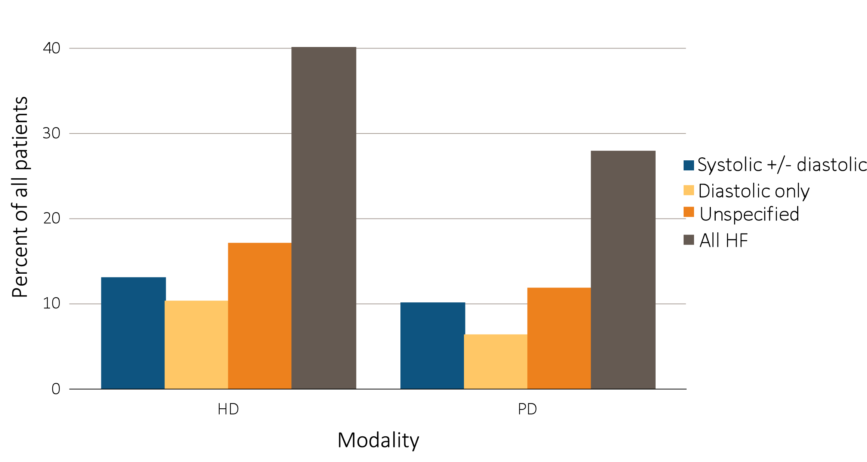
vol 2 Figure 8.5 Heart failure in adult ESRD patients by modality, 2015
Data Source: Special analyses, USRDS ESRD Database. Point prevalent hemodialysis and peritoneal dialysis patients aged 22 and older, who are continuously enrolled in Medicare Parts A and B, and with Medicare as primary payer from January 1, 2015 to December 31, 2015, and ESRD service date is at least 90 days prior to January 1, 2015. Abbreviations: HD, hemodialysis; PD, peritoneal dialysis.

