Slide 1
2018 Annual Data Report
Volume 1: Chronic Kidney Disease
Chapter 1:
CKD in the General Population
2018 Annual Data Report
Volume 1 CKD, Chapter 1

Slide 2

Table A. Kidney Disease Outcomes and Quality Improvement (KDOQI) CKD Staging Guidelines
CKD Stage | Description | GFR (ml/min/1.73 m²)
1 | Kidney damage with normal or ↑ GFR | >90
2 | Kidney damage with mild ↓ in GFR | 60-89
3 | Moderate ↓ in GFR | 30-59
4 | Severe ↓ in GFR | 15-29
5 | Kidney failure | <15 (or dialysis)
Data Source: National Health and Nutrition Examination Survey (NHANES), 2001-2004, 2005-2008, 2009-2012 & 2013–2016participants aged 20 & older. Whisker lines indicate 95% confidence intervals. Abbreviation: CKD, chronic kidney disease.

Slide 3
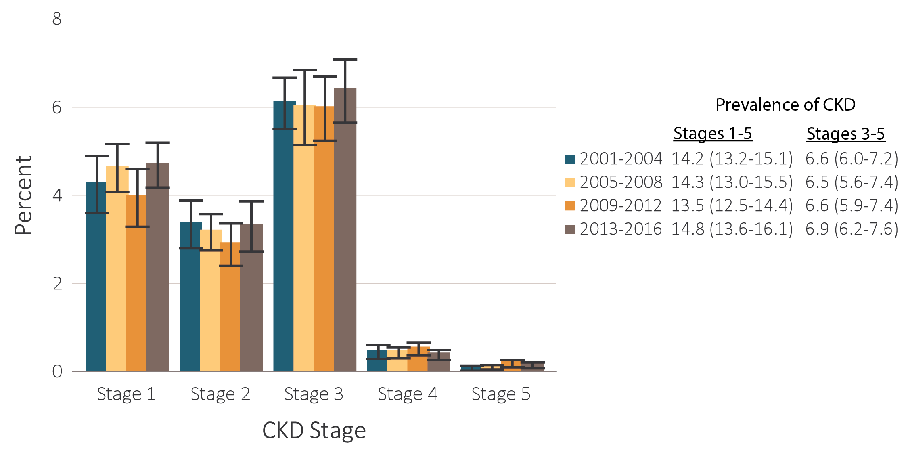
vol 1 Figure 1.1 Prevalence of CKD by stage among NHANES participants, 2001-2016
Data Source: National Health and Nutrition Examination Survey (NHANES), 2001-2004, 2005-2008, 2009-2012 & 2013–2016participants aged 20 & older. Whisker lines indicate 95% confidence intervals. Abbreviation: CKD, chronic kidney disease.

Slide 4
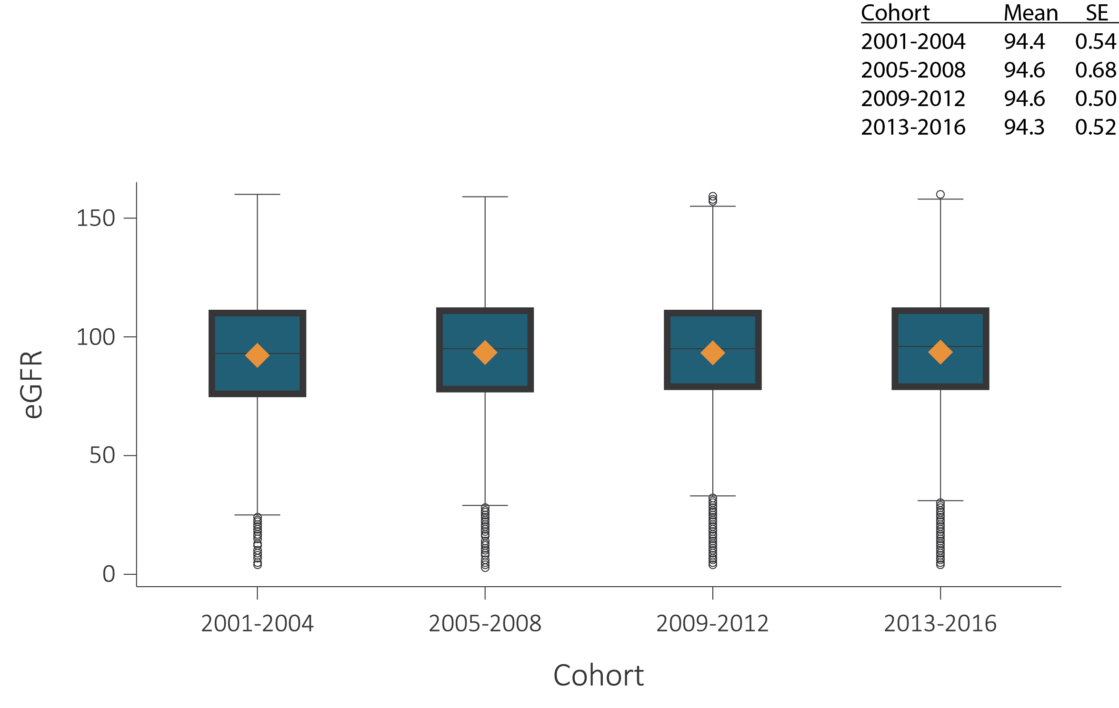
vol 1 Figure 1.2 eGFR distribution among NHANES participants, 2001-2016 - All
(a) All individuals
Data Source: National Health and Nutrition Examination Survey (NHANES), 2001-2016 participants aged 20 & older. Single-sample estimates of eGFR; eGFR calculated using the CKD-EPI equation. Abbreviations: eGFR, estimated glomerular filtration rate; SE, standard error. Accounts for change in serum creatinine assays.

Slide 5
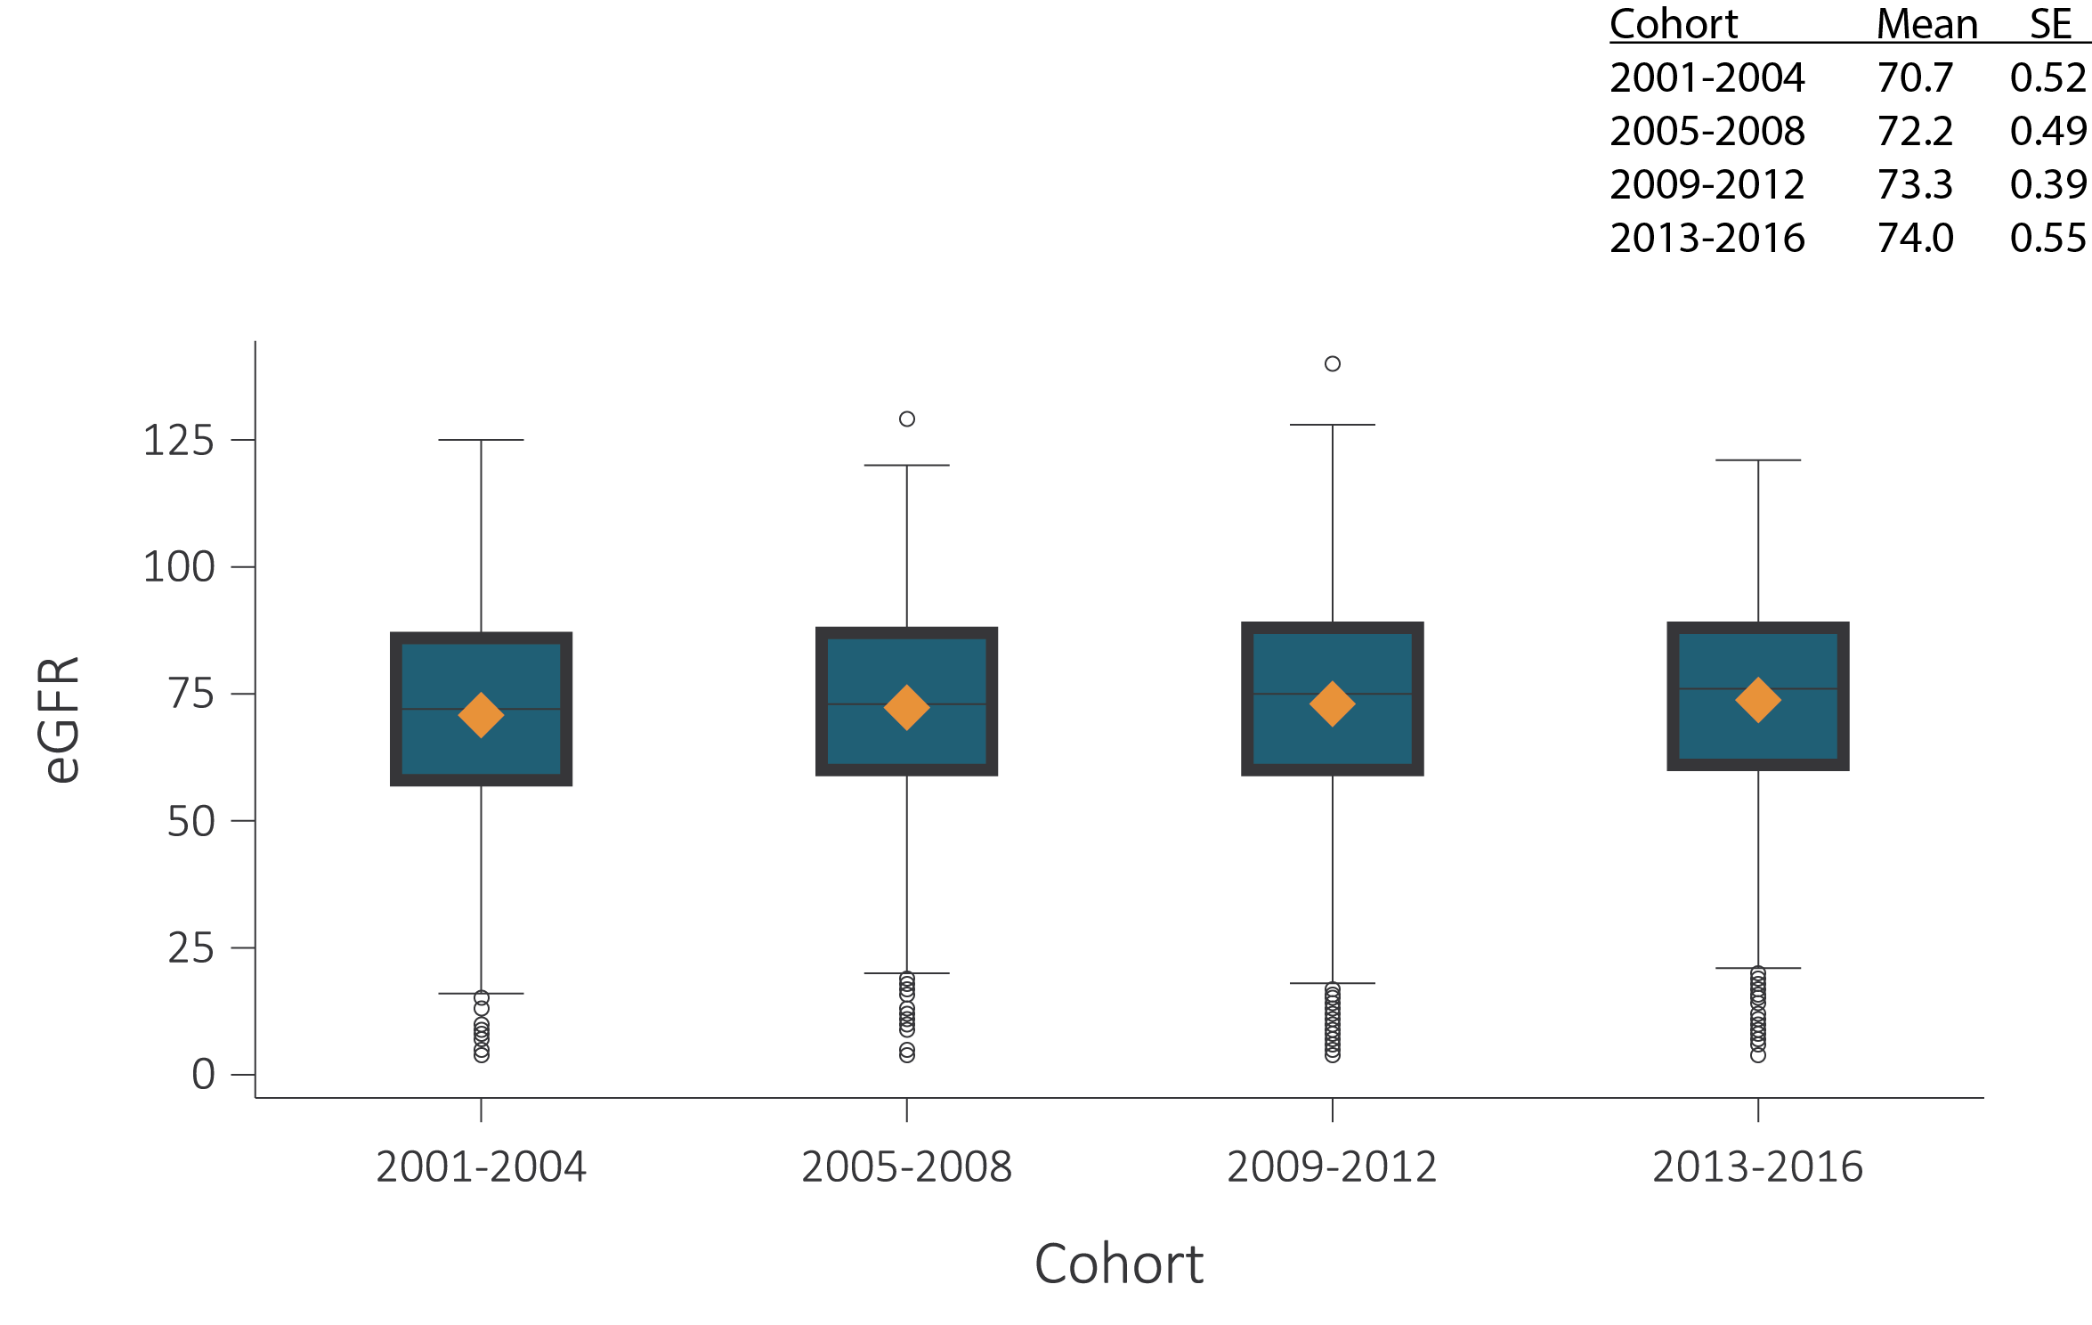
vol 1 Figure 1.2 eGFR distribution among NHANES participants, 2001-2016 - All
(b) Individuals 60+ years
Data Source: National Health and Nutrition Examination Survey (NHANES), 2001-2016 participants aged 20 & older. Single-sample estimates of eGFR; eGFR calculated using the CKD-EPI equation. Abbreviations: eGFR, estimated glomerular filtration rate; SE, standard error. Accounts for change in serum creatinine assays.

Slide 6
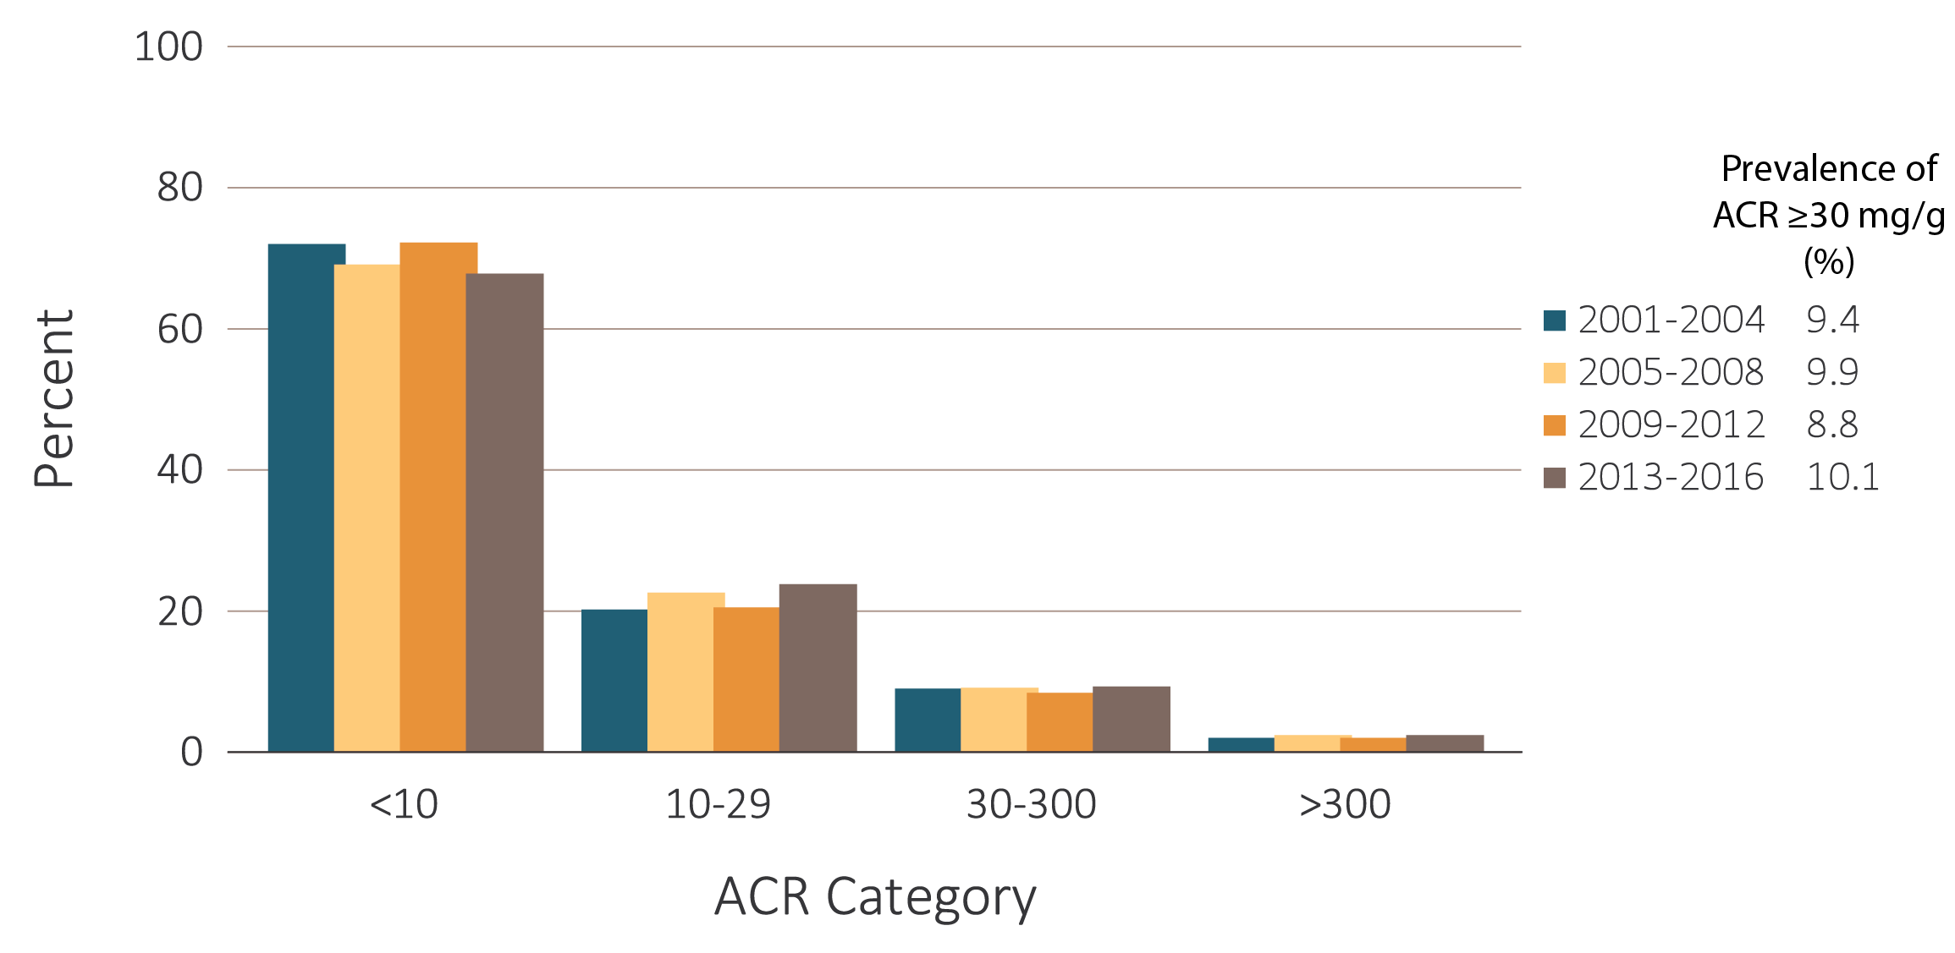
vol 1 Figure 1.3 Urine albumin/creatinine ratio (ACR) distribution among NHANES participants, 2001-2016
Data Source: National Health and Nutrition Examination Survey (NHANES), 2001-2016 participants aged 20 & older. Single-sample estimates of ACR. Abbreviation: ACR, urine albumin (mg)/creatinine (g) ratio.

Slide 7
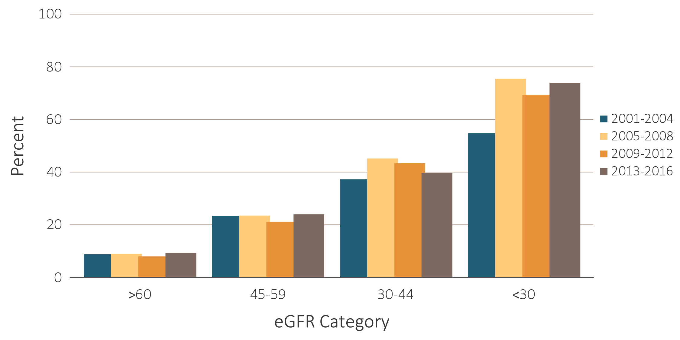
vol 1 Figure 1.4 Percentage of NHANES (2001-2016) participants with ACR >30 mg/g, by eGFR category
Data Source: National Health and Nutrition Examination Survey (NHANES), 2001-2016 participants aged 20 & older. Single-sample estimates of eGFR. Abbreviations: ACR, urine albumin (mg)/creatinine (g) ratio; eGFR, estimated glomerular filtration rate.

Slide 8
vol 1 Table 1.1 Percentage of NHANES 2013-2016 participants, in the various CKD (eGFR and albuminuria) risk categories (KDIGO 2012)
Percentage in each category (2013-2016)
 |  |  |  | Albuminuria categories |  |  | Total
 |  |  |  | A1 | A2 | A3
 |  |  |  | Normal to mildly increased | Moderately increased | Severely increased
 |  |  |  | <30 mg/g <3 mg/mmol | 30-300 mg/g 3-30 mg/mmol | >300 mg/g >30 mg/mmol
GFR categories (ml/min/1.73 m²) | G1 | Normal to high | ≥90 | 54.9 | 4.2 | 0.5 | 59.6
 | G2 | Mildly decreased | 60-89 | 30.2 | 2.9 | 0.3 | 33.5
 | G3a | Mildly to moderately decreased | 45-59 | 3.6 | 0.8 | 0.3 | 4.7
 | G3b | Moderately to severely decreased | 30-44 | 1.0 | 0.4 | 0.2 | 1.7
 | G4 | Severely decreased | 15-29 | 0.13 | 0.10 | 0.15 | 0.37
 | G5 | Kidney failure | <15 | 0.01 | 0.04 | 0.09 | 0.13
Total |  |  |  | 89.9 | 8.5 | 1.6 | 100
Data source: National Health and Nutrition Examination Survey (NHANES), 2001-2004, 2005-2008, 2009-2012 & 2013-2016 participants aged 20 and older. Single-sample estimates of eGFR and ACR; eGFR calculated using the CKD-EPI equation. Low risk: eGFR ≥60 ml/min/1.73 m² and ACR <30 mg/g; moderately high risk: eGFR 45-59 ml/min/1.73 m² or eGFR ≥60 ml/min/1.73 m² and ACR 30-300 mg/g; high risk: eGFR 30-44 ml/min/1.73 m² or eGFR 45-59 ml/min/1.73 m² and ACR 30-300 mg/g or eGFR ≥60 ml/min/1.73 m² and ACR >300 mg/g; very high risk: eGFR <30 ml/min/1.73 m² or eGFR 30-44 ml/min/1.73 m² and ACR 30-300 mg/g or eGFR ≥60 ml/min/1.73 m² and ACR >300 mg/g. Abbreviations: ACR, urine albumin/creatinine ratio; CKD, chronic kidney disease; eGFR, estimated glomerular filtration rate; GFR, glomerular filtration rate; KDIGO, Kidney Disease: Improving Global Outcomes CKD Work Group.

Slide 9
vol 1 Table 1.1 Percentage of NHANES 2013-2016 participants, in the various CKD (eGFR and albuminuria) risk categories (KDIGO 2012)
(b) Summary of prevalence in each risk category, by cohort (2001-2016)
Data source: National Health and Nutrition Examination Survey (NHANES), 2001-2004, 2005-2008, 2009-2012 & 2013-2016 participants aged 20 and older. Single-sample estimates of eGFR and ACR; eGFR calculated using the CKD-EPI equation. Low risk: eGFR ≥60 ml/min/1.73 m² and ACR <30 mg/g; moderately high risk: eGFR 45-59 ml/min/1.73 m² or eGFR ≥60 ml/min/1.73 m² and ACR 30-300 mg/g; high risk: eGFR 30-44 ml/min/1.73 m² or eGFR 45-59 ml/min/1.73 m² and ACR 30-300 mg/g or eGFR ≥60 ml/min/1.73 m² and ACR >300 mg/g; very high risk: eGFR <30 ml/min/1.73 m² or eGFR 30-44 ml/min/1.73 m² and ACR 30-300 mg/g or eGFR ≥60 ml/min/1.73 m² and ACR >300 mg/g. Abbreviations: ACR, urine albumin/creatinine ratio; CKD, chronic kidney disease; eGFR, estimated glomerular filtration rate; GFR, glomerular filtration rate; KDIGO, Kidney Disease: Improving Global Outcomes CKD Work Group.

Slide 10
vol 1 Table 1.2 Prevalence (%) of CKD in NHANES population within age, sex, race/ethnicity, & risk factor categories, 2001-2016
 | All CKD |  |  |  |  | eGFR <60 ml/min/1.73 m² |  |  |  |  | ACR ≥30 mg/g
 | 2001-2004 | 2005-2008 | 2009-2012 | 2013-2016 |  | 2001-2004 | 2005-2008 | 2009-2012 | 2013-2016 |  | 2001-2004 | 2005-2008 | 2009-2012 | 2013-2016
Age
20-39 | 5.4 | 6.1 | 5.5 | 6.3 |  | 0.2 | 0.2 | 0.2 | 0.4 |  | 5.3 | 6.0 | 5.4 | 6.1
40-59 | 9.7 | 10.1 | 8.3 | 10.4 |  | 2.1 | 2.5 | 2.2 | 2.8 |  | 8.2 | 8.2 | 6.8 | 8.6
60+ | 38.8 | 34.5 | 33.1 | 32.2 |  | 26.7 | 23.5 | 23.0 | 21.1 |  | 19.4 | 19.1 | 17.0 | 17.3
Sex
Male | 12.7 | 12.1 | 12.3 | 12.9 |  | 5.4 | 5.4 | 5.7 | 6.1 |  | 9.1 | 8.5 | 8.5 | 8.9
Female | 15.5 | 16.3 | 14.6 | 16.7 |  | 7.7 | 7.5 | 7.5 | 7.6 |  | 9.7 | 9.1 | 9.1 | 11.2
Race/Ethnicity
Non-Hispanic White | 14.3 | 14.4 | 13.6 | 15.6 |  | 7.7 | 7.7 | 7.7 | 8.2 |  | 8.5 | 9.0 | 7.9 | 9.6
Non-Hispanic Black/African American | 14.7 | 16.3 | 16.1 | 15.9 |  | 4.7 | 5.7 | 6.5 | 5.8 |  | 12.4 | 13.3 | 12.2 | 12.6
Mexican American | 11.4 | 11.8 | 11.9 | 12.6 |  | 1.5 | 1.9 | 2.1 | 3.3 |  | 10.5 | 10.9 | 10.9 | 11.2
Other Hispanic | 13.0 | 14.9 | 11.5 | 11.4 |  | 3.9 | 2.7 | 4.3 | 3.0 |  | 11.4 | 13.1 | 9.3 | 9.1
Other Non-Hispanic | 15.9 | 11.4 | 11.7 | 12.6 |  | 5.2 | 2.1 | 4.1 | 4.7 |  | 12.8 | 10.2 | 9.8 | 9.8
Risk Factor
Diabetes | 43.6 | 40.1 | 38.6 | 36.0 |  | 18.2 | 17.4 | 21.0 | 18.7 |  | 33.2 | 31.6 | 26.9 | 25.8
Self-reported diabetes | 43.8 | 41.8 | 39.5 | 37.1 |  | 19.2 | 18.7 | 22.4 | 19.3 |  | 32.4 | 33.1 | 27.1 | 27.3
Hypertension | 32.7 | 31.6 | 30.9 | 31.2 |  | 17.7 | 16.8 | 17.4 | 16.1 |  | 20.4 | 20.8 | 19.3 | 20.7
Self-reported hypertension | 27.2 | 26.6 | 26.1 | 26.6 |  | 15.8 | 14.8 | 15.7 | 14.7 |  | 16.4 | 17.3 | 15.8 | 16.9
Self-reported cardiovascular disease | 42.2 | 40.6 | 40.8 | 40.3 |  | 29.4 | 27.3 | 28.2 | 26.3 |  | 22.8 | 25.6 | 23.2 | 24.8
Obesity (BMI ≥30) | 16.5 | 17.2 | 16.5 | 16.8 |  | 6.6 | 7.0 | 7.8 | 7.2 |  | 11.9 | 12.6 | 10.8 | 12.1
All | 14.2 | 14.3 | 13.5 | 14.8 |  | 6.6 | 6.5 | 6.6 | 6.9 |  | 9.4 | 9.9 | 8.8 | 10.1
Data source: National Health and Nutrition Examination Survey (NHANES), 2001-2004, 2005-2008, 2009-2012 & 2013-2016 participants age 20 & older. Single-sample estimates of eGFR & ACR; eGFR calculated using the CKD-EPI equation. Diabetes defined as HbA1c >7%, self-reported (SR), or currently taking glucose-lowering medications. Hypertension defined as BP ≥130/≥80 for those with diabetes or CKD, otherwise BP ≥140/≥90, or taking medication for hypertension. Values in Figure 1.12 cannot be directly compared to those in Table 1.3 due to different survey cohorts. The table represents NHANES participants who are classified as hypertensive (measured/treated) but some of those are at target blood pressure. Abbreviations: ACR, urine albumin/creatinine ratio; BMI, body mass index; BP, blood pressure, CKD, chronic kidney disease; eGFR, estimated glomerular filtration rate.

Slide 11
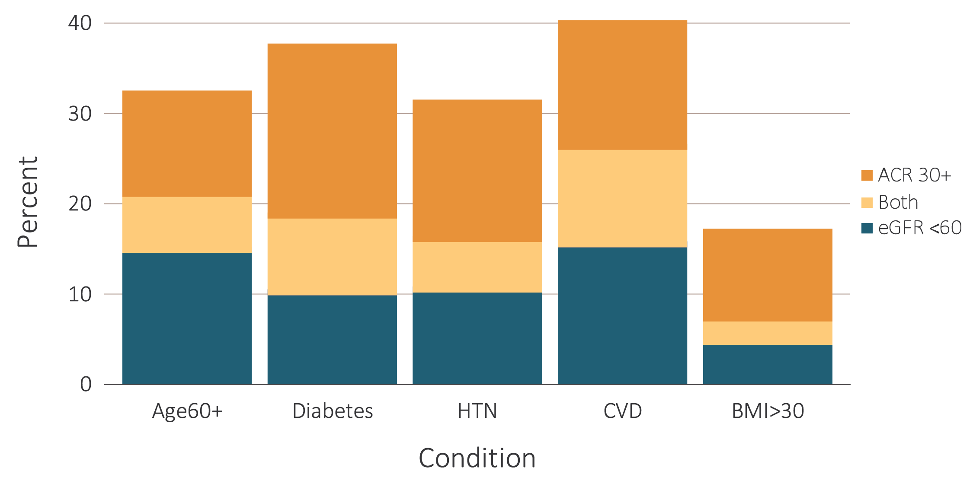
vol 1 Figure 1.5 Distribution of markers of CKD in NHANES participants with diabetes, hypertension, self-reported cardiovascular disease, & obesity, 2013–2016
Data Source: National Health and Nutrition Examination Survey (NHANES), 2013-2016 participants age 20 & older. Single-sample estimates of eGFR & ACR; eGFR calculated using the CKD-EPI equation. Abbreviations: ACR, urine albumin/creatinine ratio; BMI, body mass index; CKD, chronic kidney disease; SR CVD, self-reported cardiovascular disease; eGFR, estimated glomerular filtration rate; HTN, hypertension.

Slide 12
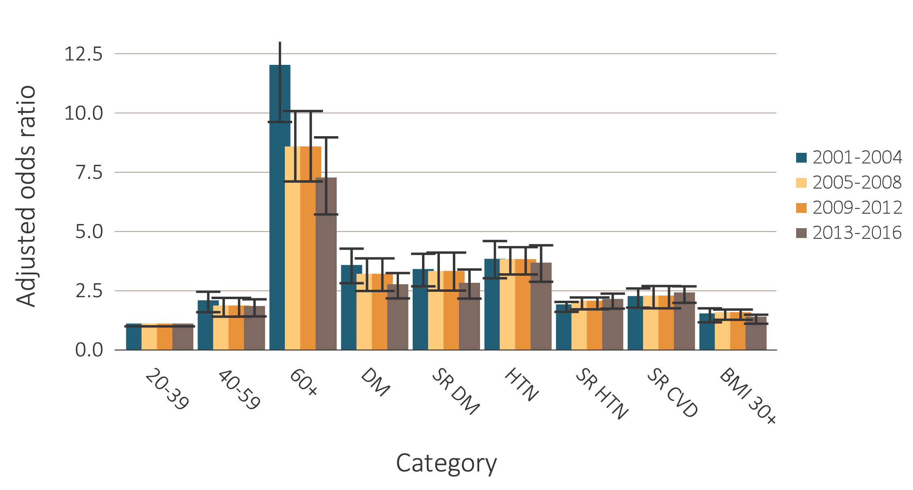
vol 1 Figure 1.6 Adjusted odds ratios of CKD in NHANES participants, by risk factor, 2001-2016
Data Source: National Health and Nutrition Examination Survey (NHANES), 2001-2004, 2005-2008, 2009-2012 & 2013-2016 participants age 20 & older; single-sample estimates of eGFR & ACR. Adjusted for age, sex, & race; eGFR calculated using the CKD-EPI equation. Whisker lines indicate 95% confidence intervals. Abbreviations: ACR, urine albumin/creatinine ratio; BMI, body mass index; CKD, chronic kidney disease; CVD, cardiovascular disease; DM, diabetes mellitus; eGFR, estimated glomerular filtration rate; HTN, hypertension; SR, self-reported.

Slide 13
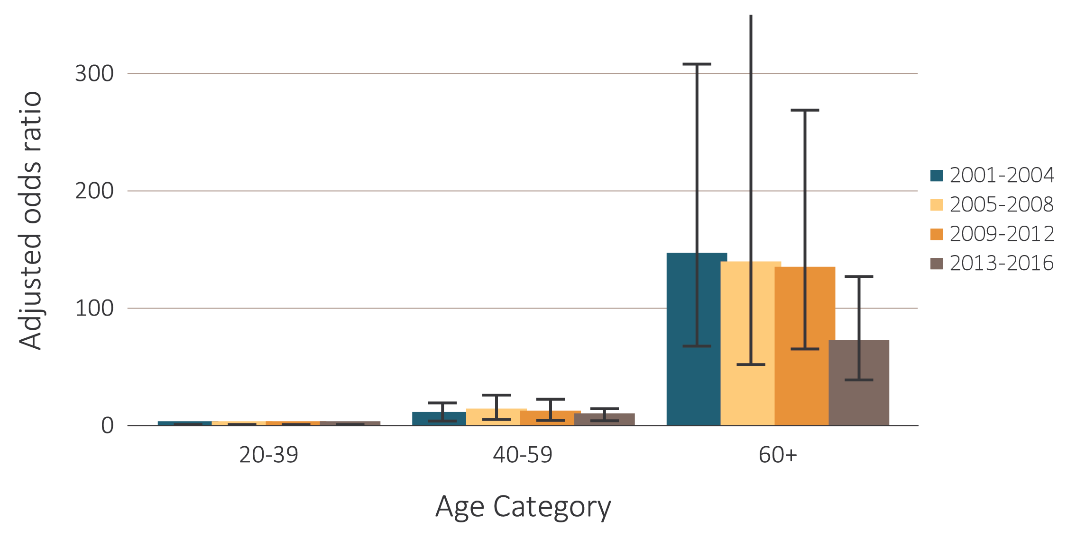
vol 1 Figure 1.7 Adjusted odds ratios of eGFR <60 ml/min/1.73 m² in NHANES participants, by age & risk factor, 2001-2016
Age category
Data Source: National Health and Nutrition Examination Survey (NHANES), 2001-2004, 2005-2008, 2009-2012 & 2013-2016 participants age 20 & older; single-sample estimates of eGFR & ACR. Adjusted for age, sex, & race; eGFR calculated using the CKD-EPI equation. Whisker lines indicate 95% confidence intervals. Abbreviations: ACR, urine albumin/creatinine ratio; BMI, body mass index; CKD, chronic kidney disease; CVD, cardiovascular disease; DM, diabetes mellitus; eGFR, estimated glomerular filtration rate; HTN, hypertension; SR, self-reported.

Slide 14
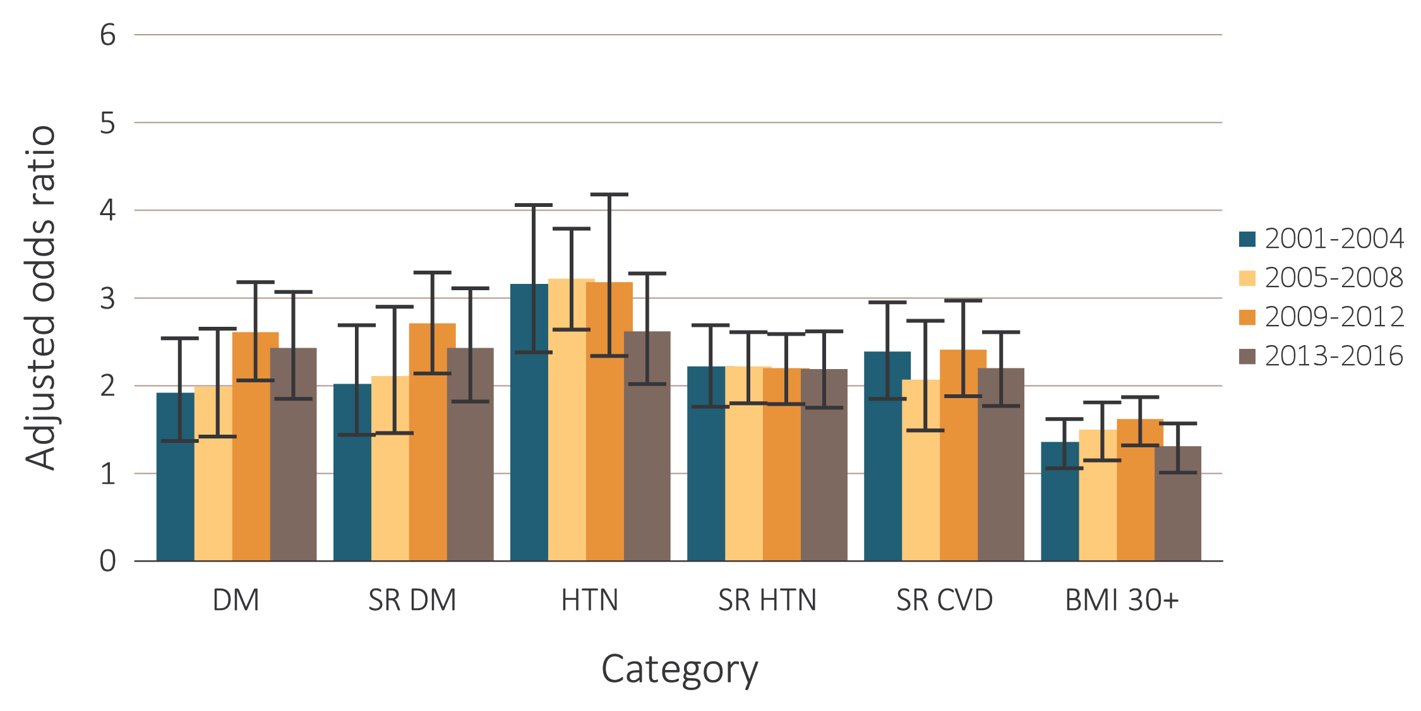
vol 1 Figure 1.7 Adjusted odds ratios of eGFR <60 ml/min/1.73 m² in NHANES participants, by age & risk factor, 2001-2016
(b) CKD risk factor
Data Source: National Health and Nutrition Examination Survey (NHANES), 2001-2004, 2005-2008, 2009-2012 & 2013-2016 participants age 20 & older; single-sample estimates of eGFR & ACR. Adjusted for age, sex, & race; eGFR calculated using the CKD-EPI equation. Whisker lines indicate 95% confidence intervals. Abbreviations: ACR, urine albumin/creatinine ratio; BMI, body mass index; CKD, chronic kidney disease; CVD, cardiovascular disease; DM, diabetes mellitus; eGFR, estimated glomerular filtration rate; HTN, hypertension; SR, self-reported.

Slide 15
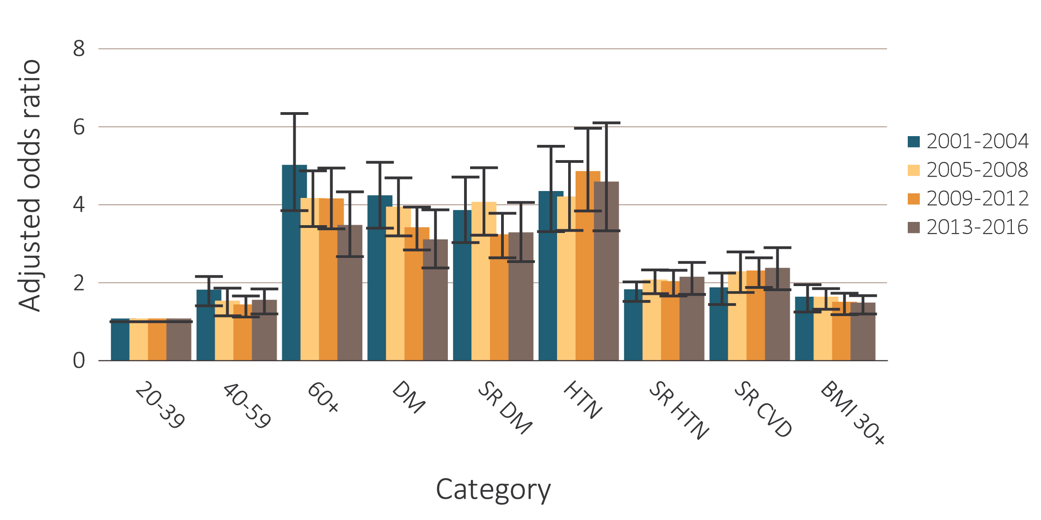
vol 1 Figure 1.8 Adjusted odds ratios of urine albumin/creatinine ratio ≥30 mg/g in NHANES participants, by age & risk factor, 2001-2016
Data Source: National Health and Nutrition Examination Survey (NHANES), 2001-2004, 2005-2008, 2009-2012 & 2013-2016 participants age 20 & older; single-sample estimates of eGFR & ACR. Adjusted for age, sex, & race; eGFR calculated using the CKD-EPI equation. Whisker lines indicate 95% confidence intervals. Abbreviations: ACR, urine albumin/creatinine ratio; BMI, body mass index; CKD, chronic kidney disease; CVD, cardiovascular disease; DM, diabetes mellitus; eGFR, estimated glomerular filtration rate; HTN, hypertension; SR, self-reported.

Slide 16
vol 1 Table 1.3 Time trends in socioeconomic factors among individuals with and without CKD, percent of NHANES participants, 2001-2016
 | No CKD |  |  |  |  | All CKD |  |  |  |  | eGFR <60 ml/min/1.73 m² |  |  |  |  |  | ACR ≥30 mg/g
 | 2001-2004 | 2005-2008 | 2009-2012 | 2013-2016 |  | 2001-2004 | 2005-2008 | 2009-2012 | 2013-2016 |  | 2001-2004 | 2005-2008 | 2009-2012 | 2013-2016 |  |  | 2001-2004 | 2005-2008 | 2009-2012 | 2013-2016
Health insurance status
Not insured | 18.8 | 20.0 | 21.5 | 16.4 |  | 9.4 | 12.1 | 13.5 | 11.6 |  | 2.8 | 4.8 | 3.2 | 4.7 |  |  | 12.7 | 15.1 | 18.9 | 14.9
Insured | 81.2 | 80.0 | 78.5 | 83.6 |  | 90.6 | 87.9 | 86.5 | 88.4 |  | 97.2 | 95.2 | 96.8 | 95.3 |  |  | 87.3 | 84.9 | 81.1 | 85.1
Private only | 61.1 | 59.5 | 56.0 | 54.9 |  | 32.7 | 31.2 | 28.0 | 29.9 |  | 19.8 | 18.1 | 19.7 | 19.4 |  |  | 39.0 | 36.1 | 31.3 | 33.6
Medicare only | 4.6 | 3.8 | 3.8 | 4.7 |  | 19.7 | 14.1 | 16.6 | 14.4 |  | 28.1 | 18.5 | 23.5 | 20.9 |  |  | 16.6 | 12.6 | 13.6 | 11.6
Other government only | 6.7 | 5.0 | 6.0 | 7.6 |  | 5.8 | 5.1 | 5.8 | 8.1 |  | 2.0 | 2.7 | 3.9 | 5.3 |  |  | 8.0 | 6.0 | 7.2 | 10.8
Private and any government | 6.0 | 6.7 | 7.1 | 8.0 |  | 23.8 | 27.8 | 26.1 | 24.2 |  | 36.1 | 44.6 | 39.2 | 36.3 |  |  | 16.1 | 21.3 | 18.6 | 17.0
Other/Unknown | 2.8 | 5.0 | 5.6 | 8.4 |  | 8.6 | 9.7 | 10 | 11.8 |  | 11.2 | 11.3 | 10.5 | 13.4 |  |  | 7.6 | 8.9 | 10.4 | 12.1
Income
Less than $10,000 | 7.4 | 4.9 | 6.0 | 5.0 |  | 10.6 | 6.6 | 7.8 | 7.6 |  | 10.2 | 5.2 | 5.3 | 6.6 |  |  | 12.7 | 7.0 | 9.6 | 8.7
$10,000 – $24,999 | 20.5 | 16.8 | 16.1 | 14.3 |  | 29.2 | 25.7 | 23.8 | 22.4 |  | 30.7 | 29.2 | 24.5 | 24.0 |  |  | 29.1 | 26.4 | 25.0 | 22.2
$25,000 – $44,999 | 20.4 | 19.9 | 19.1 | 17.5 |  | 20.9 | 23.7 | 21.6 | 20.3 |  | 23.6 | 24.2 | 25.2 | 18.6 |  |  | 18.1 | 22.9 | 19.1 | 21.7
$45,000 – $74,999 | 22.0 | 22.3 | 19.5 | 20.4 |  | 18.9 | 19.5 | 18.5 | 17.9 |  | 17.5 | 19.0 | 20.0 | 18.5 |  |  | 19.1 | 19.0 | 16.6 | 17.3
$75,000 or more | 24.2 | 31.2 | 32.7 | 35.8 |  | 12.6 | 17.7 | 19.8 | 24.6 |  | 10.7 | 13.9 | 17.0 | 24.8 |  |  | 12.7 | 18.4 | 20.7 | 22.6
Missing | 5.5 | 4.9 | 6.6 | 7.1 |  | 7.8 | 6.8 | 8.4 | 7.3 |  | 7.3 | 8.4 | 8.0 | 7.6 |  |  | 8.3 | 6.3 | 9.0 | 7.4
Education
<High School | 16.8 | 17.3 | 16.2 | 13.9 |  | 28.8 | 27.0 | 25.8 | 19.2 |  | 31.5 | 27.3 | 26.1 | 17.4 |  |  | 29.2 | 28.1 | 27.2 | 21.2
High School Graduate/GED | 25.9 | 24.2 | 21.1 | 20.5 |  | 26.3 | 28.0 | 23.1 | 24.5 |  | 26.2 | 31.6 | 23.7 | 25.3 |  |  | 25.9 | 26.6 | 23.1 | 24.3
At least some College | 57.3 | 58.5 | 62.7 | 65.6 |  | 44.9 | 45.0 | 51.1 | 56.3 |  | 42.4 | 41.1 | 50.2 | 57.3 |  |  | 44.9 | 45.3 | 49.7 | 54.5
Data Source: National Health and Nutrition Examination Survey (NHANES), 2001-2004, 2005-2008, 2009-2012 & 2013-2016 participants age 20 & older. Single-sample estimates of eGFR & ACR; eGFR calculated using the CKD-EPI equation. Abbreviations: ACR, urine albumin/creatinine ratio; CKD, chronic kidney disease; eGFR, estimated glomerular filtration rate.

Slide 17
vol 1 Table 1.4 Time Trends in Health Risk Behaviors among individuals with and without CKD, percent of NHANES participants, 2001-2016
 | No CKD |  |  |  |  | All CKD |  |  |  |  |  | eGFR <60 ml/min/1.73 m² |  |  |  |  |  |  |  |  |  | ACR ≥30 mg/g
 | 2001-2004 | 2005-2008 | 2009-2012 | 2013-2016 |  | 2001-2004 | 2005-2008 | 2009-2012 |  | 2013-2016 |  | 2001-2004 | 2005-2008 |  |  | 2009-2012 |  | 2013-2016 |  |  |  | 2001-2004 |  | 2005-2008 | 2009-2012 | 2013-2016
Physical Activity (%)
Vigorous | 37.4 | 40.9 | 41.0 | 44.2 |  | 18.6 | 23.3 | 20.9 |  | 26.7 |  | 13.8 | 16.0 |  | 13.6 |  | 19.4 |  |  |  | 20.0 |  | 25.1 |  | 23.9 |  | 28.5
Moderate | 30.9 | 31.8 | 32.6 | 31.1 |  | 36.6 | 33.3 | 32.6 |  | 35.1 |  | 38.2 | 35.0 |  | 33.8 |  | 35.8 |  |  |  | 35.2 |  | 31.1 |  | 30.0 |  | 34.6
Sedentary | 31.7 | 27.3 | 26.4 | 24.7 |  | 44.9 | 43.4 | 46.5 |  | 38.2 |  | 48.0 | 49.0 |  | 52.6 |  | 44.8 |  |  |  | 44.8 |  | 43.8 |  | 46.1 |  | 36.9
Smoking (%)
Current | 21.5 | 20.3 | 17.2 | 15.0 |  | 20.0 | 17.8 | 16.1 |  | 16.8 |  | 9.0 | 9.7 |  | 9.7 |  | 10.1 |  |  |  | 25.9 |  | 21.4 |  | 19.2 |  | 21.0
Former | 23.5 | 23.9 | 23.1 | 23.0 |  | 32.4 | 28.7 | 31.4 |  | 30.3 |  | 39.6 | 36.6 |  | 38.8 |  | 36.3 |  |  |  | 28.1 |  | 26.4 |  | 28.1 |  | 27.9
Never | 55.0 | 55.8 | 59.6 | 62.0 |  | 47.6 | 53.4 | 52.5 |  | 52.8 |  | 51.4 | 53.7 |  | 51.4 |  | 53.6 |  |  |  | 46.0 |  | 52.2 |  | 52.7 |  | 51.1
Amount of Sleep (%)
Less than 6 hours | - | 13.9 | 13.1 | 12.3 |  | - | 14.7 | 14.8 |  | 14.0 |  | - | 9.2 |  | 12.9 |  | 14.1 |  |  |  | - |  | 18.0 |  | 16.5 |  | 14.1
6 hours | - | 23.4 | 24.2 | 22.5 |  | - | 22.2 | 19.7 |  | 21.8 |  | - | 22.1 |  | 15.6 |  | 20.5 |  |  |  | - |  | 22.9 |  | 22.6 |  | 22.8
7-8 hours | - | 57.2 | 57.1 | 58.3 |  | - | 53.9 | 55.5 |  | 53.2 |  | - | 57.5 |  | 57.3 |  | 48.6 |  |  |  | - |  | 51.2 |  | 53.2 |  | 54.9
9 hours or more | - | 5.5 | 5.6 | 6.9 |  | - | 9.2 | 10.0 |  | 11.0 |  | - | 11.1 |  | 14.2 |  | 16.8 |  |  |  | - |  | 7.9 |  | 7.8 |  | 8.2
Macronutrient Intake*
Energy (kcal) | 2,307 | 2,254 | 2,238 | 2,212 |  | 1,862 | 1,885 | 1,883 |  | 1,916 |  | 1,637 | 1,712 |  | 1,712 |  | 1,800 |  |  |  | 1,973 |  | 1,943 |  | 1,958 |  | 1,963
Fat (grams) | 87 | 86 | 84 | 86 |  | 70 | 73 | 72 |  | 73 |  | 62 | 67 |  | 66 |  | 71 |  |  |  | 74 |  | 75 |  | 74 |  | 74
Carbohydrates (grams) | 282 | 269 | 271 | 260 |  | 230 | 226 | 229 |  | 228 |  | 205 | 208 |  | 209 |  | 216 |  |  |  | 241 |  | 232 |  | 238 |  | 232
Protein (grams) | 86 | 86 | 85 | 86 |  | 70 | 75 | 73 |  | 74 |  | 63 | 69 |  | 66 |  | 70 |  |  |  | 74 |  | 76 |  | 76 |  | 76
Total Sugars (grams) | 135 | 123 | 121 | 114 |  | 107 | 102 | 102 |  | 101 |  | 95 | 95 |  | 93 |  | 99 |  |  |  | 112 |  | 103 |  | 105 |  | 100
Sodium (mg) | 3,576 | 3,622 | 3,685 | 3,632 |  | 2,965 | 3,082 | 3,175 |  | 3,192 |  | 2,617 | 2,825 |  | 2,913 |  | 2,950 |  |  |  | 3,142 |  | 3,162 |  | 3,297 |  | 3,303
Potassium (mg) | 2,806 | 2,743 | 2,829 | 2,721 |  | 2,468 | 2,510 | 2,529 |  | 2,450 |  | 2,376 | 2,434 |  | 2,376 |  | 2,466 |  |  |  | 2,488 |  | 2,505 |  | 2,572 |  | 2,407
Data Source: National Health and Nutrition Examination Survey (NHANES), 2001-2004, 2005-2008, 2009-2012 & 2013-2016 participants age 20 & older. Single-sample estimates of eGFR & ACR; eGFR calculated using the CKD-EPI equation. – Data not available. Abbreviations: ACR, urine albumin/creatinine ratio; CKD, chronic kidney disease; eGFR, estimated glomerular filtration rate. *Dietary intake data not yet available for 2015/2016.

Slide 18
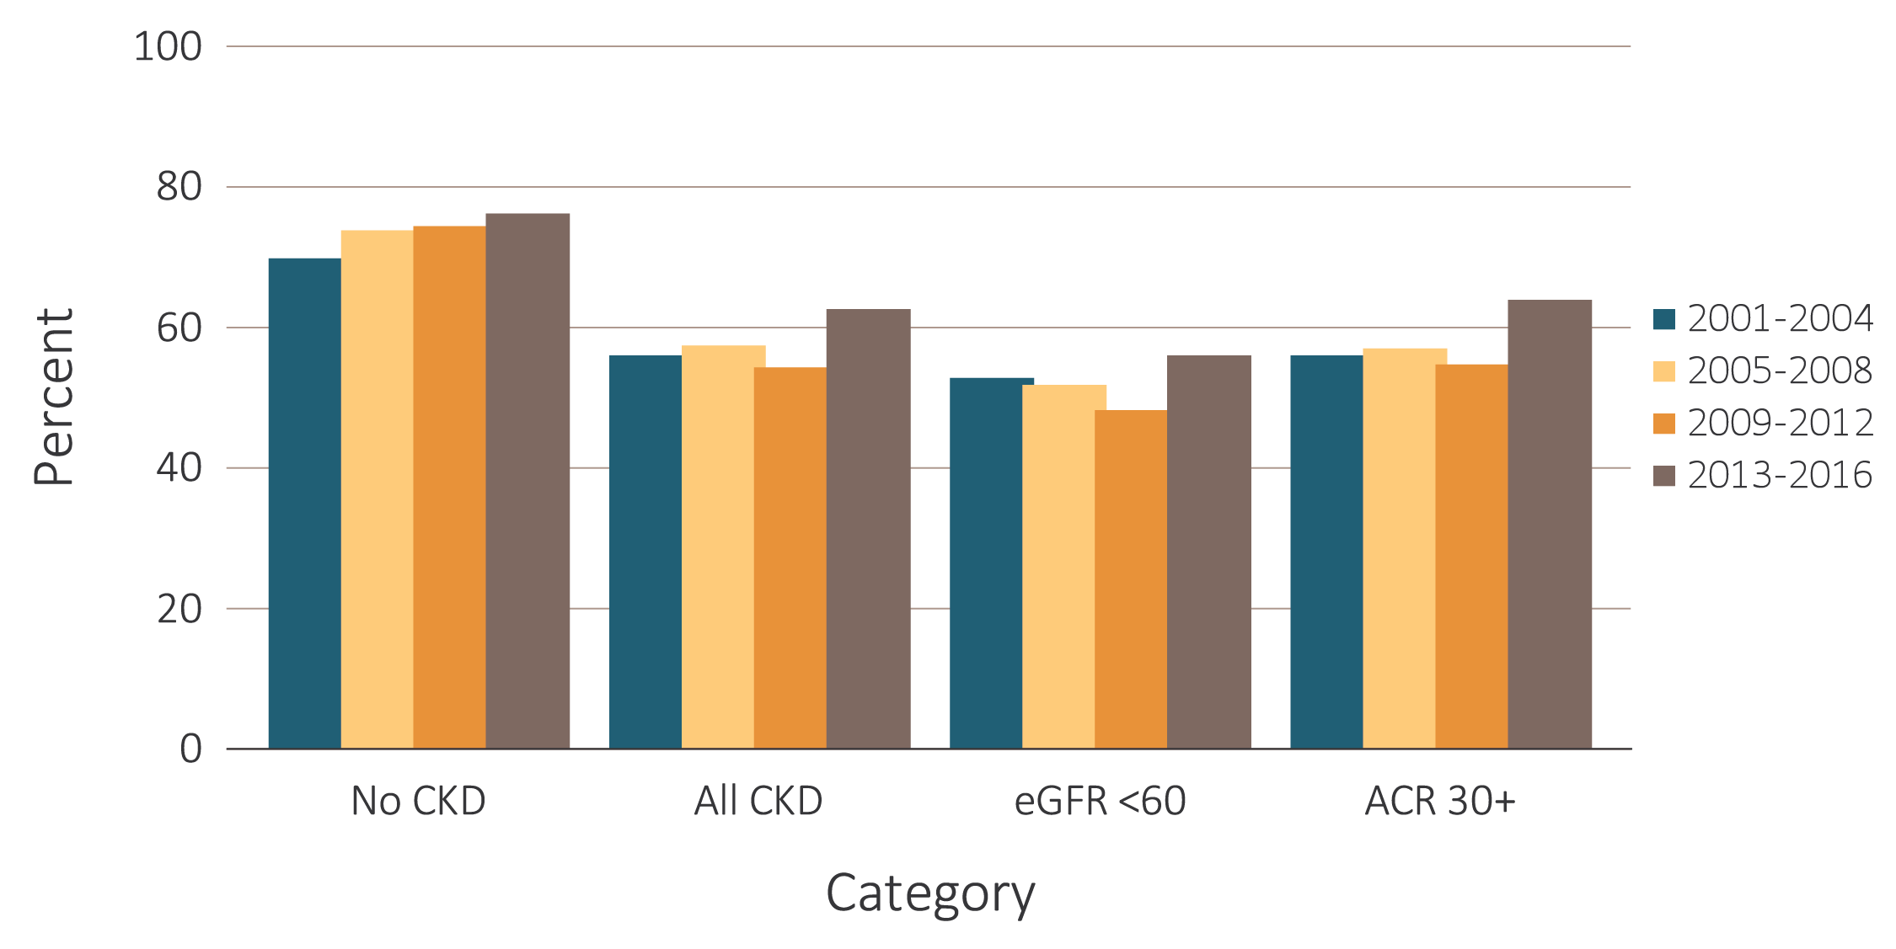
vol 1 Figure 1.9 NHANES participants physically active, 2001-2016
Data Source: National Health and Nutrition Examination Survey (NHANES), 2001-2004, 2005-2008, 2009-2012 & 2013-2016 participants aged 20 & older. Single-sample estimates of eGFR & ACR; eGFR calculated using the CKD-EPI equation. Abbreviations: ACR, urine albumin/creatinine ratio; CKD, chronic kidney disease; eGFR, estimated glomerular filtration rate.

Slide 19
vol 1 Table 1.5 Treatment, and measures of control of CKD risk factors, among NHANES participants with CKD, 2001-2016
 | All CKD |  |  |  |  |  | eGFR <60 ml/min/1.73 m² |  |  |  |  |  | ACR ≥30 mg/g
 | 2001-2004 | 2005-2008 | 2009-2012 | 2013-2016 | Trend p-value |  | 2001-2004 | 2005-2008 | 2009-2012 | 2013-2016 | Trend p-value |  | 2001-2004 | 2005-2008 | 2009-2012 | 2013-2016 | Trend p-value
Hypertension, by current hypertensive status ª
Non-hypertensive status | 25.6 | 26.9 | 25.0 | 27.7 | 0.50 |  | 15.4 | 16.1 | 15.7 | 19.7 | 0.05 |  | 29.4 | 30.1 | 27.9 | 29.4 | 0.82
Hypertensive (measured/treated) | 74.4 | 73.1 | 75.0 | 72.3 |  |  | 84.6 | 83.9 | 84.3 | 80.3 |  |  | 70.6 | 69.9 | 72.1 | 70.6
Control of hypertension among hypertensive patients ^{b}
Unaware | 28.5 | 24.5 | 21.9 | 20.0 | <0.01 |  | 21.9 | 19.0 | 16.0 | 13.3 | <0.01 |  | 31.3 | 26.3 | 24.9 | 23.5 | <0.01
Aware, not treated | 9.2 | 8.0 | 6.2 | 12.1 |  |  | 5.8 | 4.1 | 2.4 | 5.1 |  |  | 10.7 | 10.6 | 8.4 | 15.9
Aware, treated, uncontrolled | 45.6 | 44.6 | 43.4 | 40.5 |  |  | 51.0 | 48.8 | 46.3 | 44.1 |  |  | 45.8 | 44.9 | 43.9 | 42.0
Aware, treated, controlled | 16.7 | 22.8 | 28.4 | 27.4 |  |  | 21.3 | 28.0 | 35.3 | 37.3 |  |  | 12.2 | 18.2 | 22.8 | 18.6
Total cholesterol ^{c}
<200 (desirable) | 48.7 | 54.6 | 60.2 | 62.2 | <0.01 |  | 49.0 | 58.2 | 64.5 | 66.6 | <0.01 |  | 49.0 | 54.8 | 58.9 | 60.7 | <0.01
200–239 (borderline high) | 31.0 | 27.2 | 26.0 | 23.3 |  |  | 31.7 | 24.2 | 22.7 | 20.7 |  |  | 30.8 | 27.6 | 27.3 | 23.9
240+ (high) | 20.3 | 18.2 | 13.9 | 14.5 |  |  | 19.2 | 17.7 | 12.7 | 12.6 |  |  | 20.3 | 17.6 | 13.7 | 15.4
Control of diabetes among patients with diabetes ^{d}
HbA1c <7% (controlled) | 43.8 | 47.8 | 46.3 | 41.7 | 0.42 |  | 54.8 | 59.6 | 56.3 | 48.0 | 0.11 |  | 37.0 | 43.4 | 37.1 | 36.3 | 0.45
HbA1c 7% - 7.9% (borderline) | 21.1 | 25.3 | 25.3 | 22.7 |  |  | 24.4 | 24.1 | 26.4 | 27.0 |  |  | 22.3 | 25.6 | 26.8 | 21.9
HbA1c 8% + (uncontrolled) | 35.1 | 27.0 | 28.4 | 35.6 |  |  | 20.8 | 16.3 | 17.3 | 25.0 |  |  | 40.7 | 31.0 | 36.1 | 41.8
Data Source: National Health and Nutrition Examination Survey (NHANES), 2001-2004, 2005-2008, 2009-2012 & 2013-2016 participants age 20 & older. Single-sample estimates of eGFR & ACR; eGFR calculated using the CKD-EPI equation. ª Hypertension defined as blood pressure ≥130/≥80 for those with CKD and diabetes; otherwise, ≥140/≥90, or self- reported treatment for hypertension.
^{b} Awareness and treatment are self-reported. Control defined as <130/<80 for those with CKD and diabetes; otherwise <140/<90. ^{c} Total cholesterol classified according to Adult Treatment Panel III blood cholesterol guidelines (ATP III). ^{d} Glycosylated hemoglobin (HbA1c) classified according to American Diabetes Association guidelines. Abbreviations: ACR, urine albumin/creatinine ratio; CKD, chronic kidney disease; eGFR, estimated glomerular filtration rate; HbA1c, glycosylated hemoglobin.

Slide 20
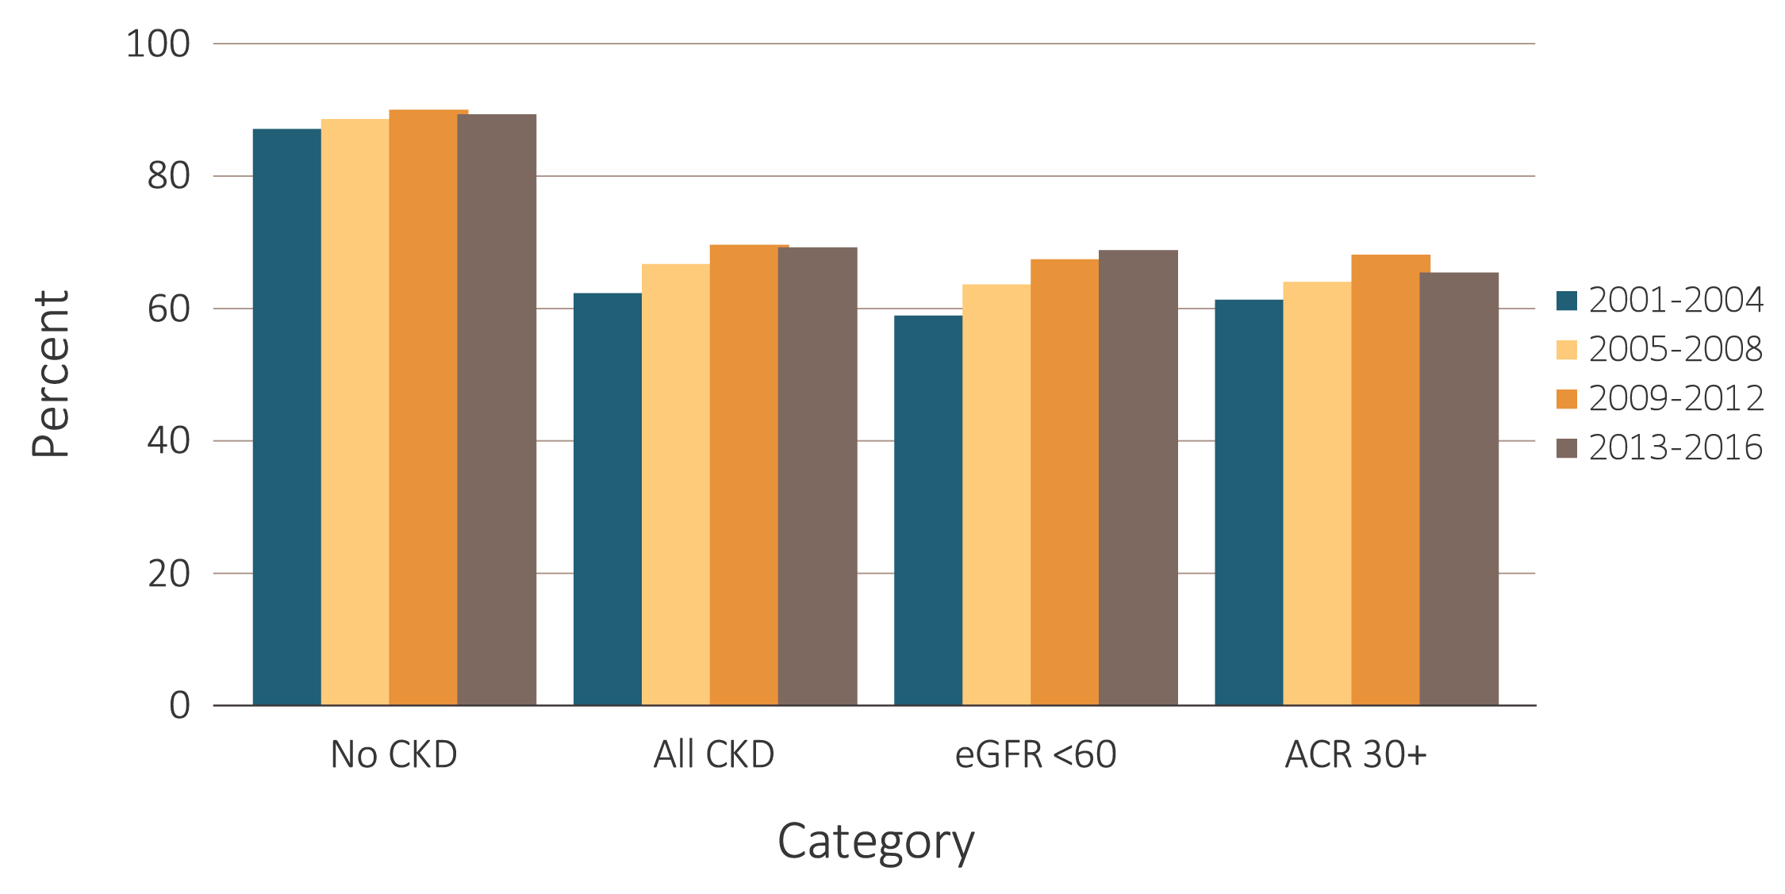
vol 1 Figure 1.10 Time Trends of NHANES participants with and without CKD at target blood pressure, 2001-2016
(a) Blood pressure target <140/90 mm Hg
Data Source: National Health and Nutrition Examination Survey (NHANES), 2001-2004, 2005-2008, 2009-2012 & 2013-2016 participants aged 20 & older. Single-sample estimates of eGFR & ACR; eGFR calculated using the CKD-EPI equation. Figure represents all hypertensive participants including those who were at target blood pressure, probably due to medication. Abbreviations: ACR, urine albumin/creatinine ratio; CKD, chronic kidney disease; eGFR, estimated glomerular filtration rate.

Slide 21
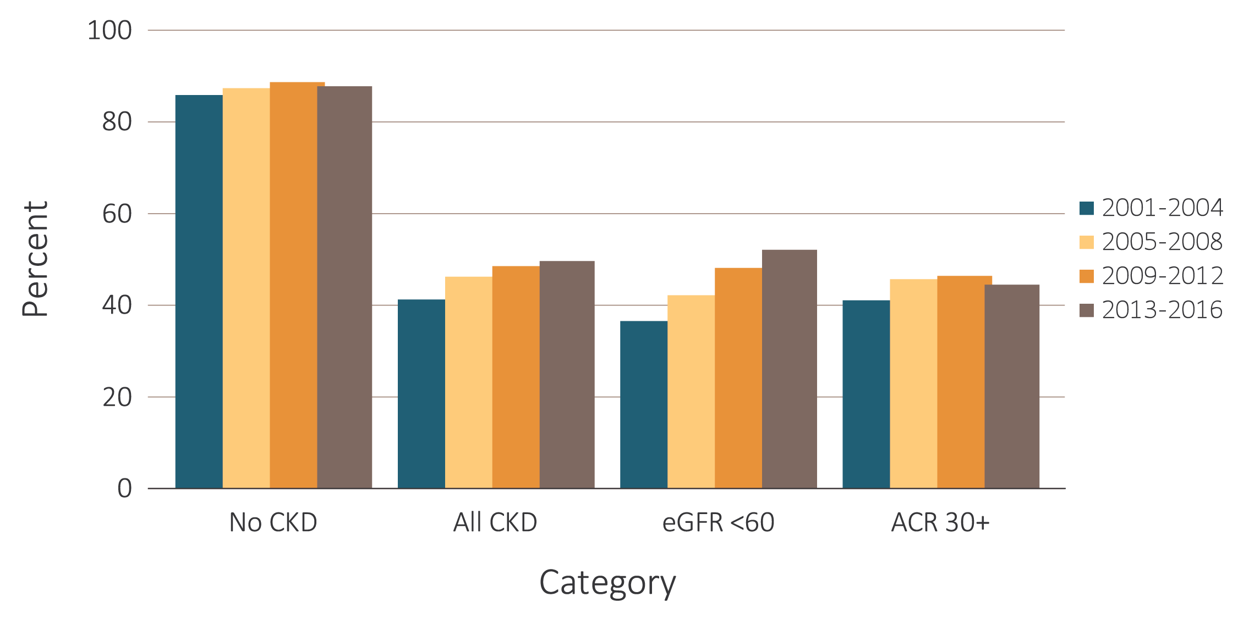
vol 1 Figure 1.10 Time Trends of NHANES participants with and without CKD at target blood pressure, 2001-2016
(b) Blood Pressure target <130/80 mm Hg
Data Source: National Health and Nutrition Examination Survey (NHANES), 2001-2004, 2005-2008, 2009-2012 & 2013-2016 participants aged 20 & older. Single-sample estimates of eGFR & ACR; eGFR calculated using the CKD-EPI equation. Figure represents all hypertensive participants including those who were at target blood pressure, probably due to medication. Abbreviations: ACR, urine albumin/creatinine ratio; CKD, chronic kidney disease; eGFR, estimated glomerular filtration rate.

Slide 22
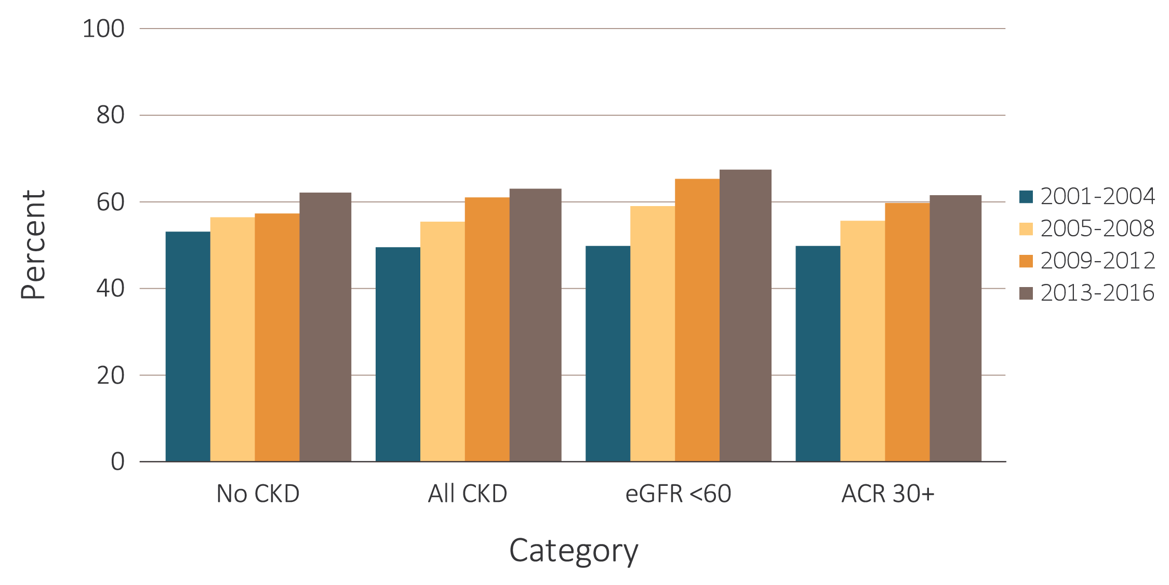
vol 1 Figure 1.11 Time Trends of NHANES participants with and without CKD with respect to cholesterol in the normal range, 2001-2016
Data Source: National Health and Nutrition Examination Survey (NHANES), 2001-2004, 2005-2008, 2009-2012 & 2013-2016 participants aged 20 & older. Single-sample estimates of eGFR & ACR; eGFR calculated using the CKD-EPI equation. Abbreviations: ACR, urine albumin/creatinine ratio; CKD, chronic kidney disease; eGFR, estimated glomerular filtration rate.

Slide 23
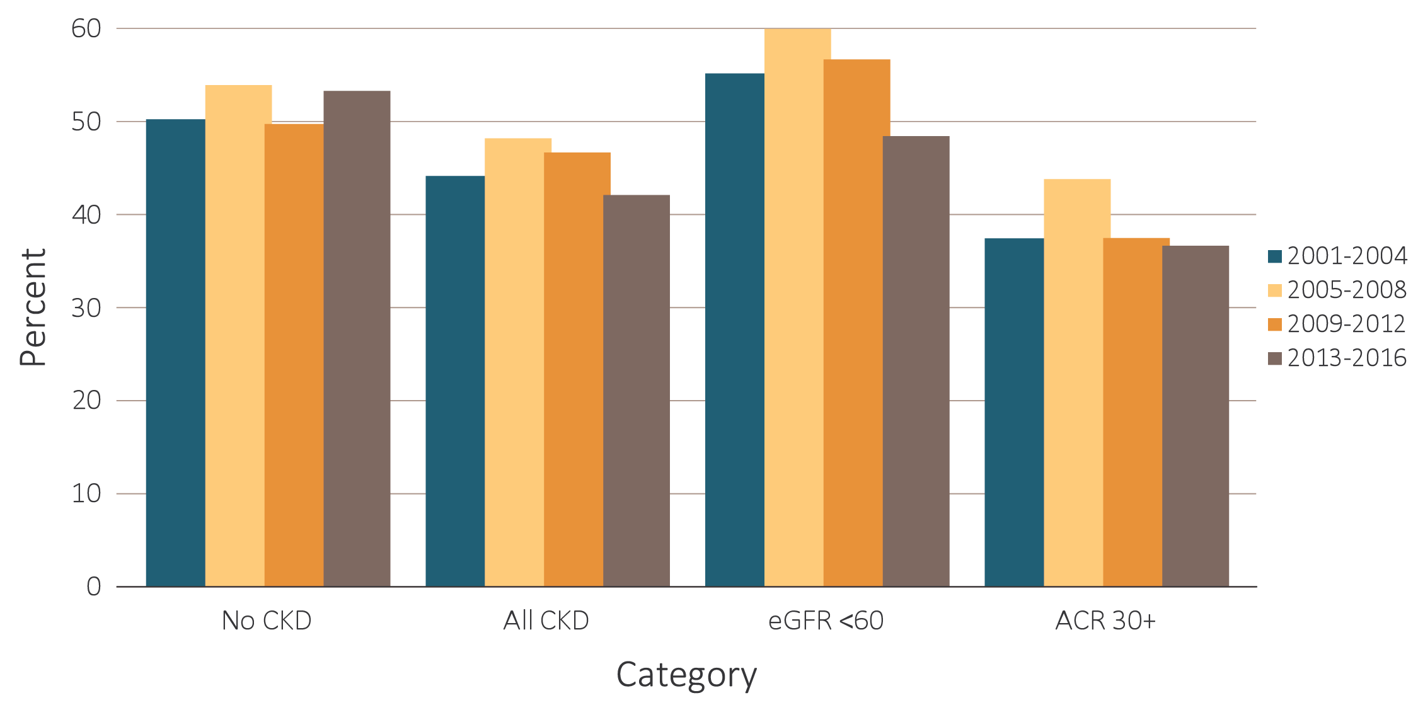
vol 1 Figure 1.12 Time trends of diabetic NHANES participants with and without CKD with respect to glycemic control, 2001-2016
Glycosylated hemoglobin <7%
Data Source: National Health and Nutrition Examination Survey (NHANES), 2001-2004, 2005-2008, 2009-2012 & 2013-2016 participants aged 20 & older. Single-sample estimates of eGFR & ACR; eGFR calculated using the CKD-EPI equation. Abbreviations: ACR, urine albumin/creatinine ratio; CKD, chronic kidney disease; eGFR, estimated glomerular filtration rate.

Slide 24
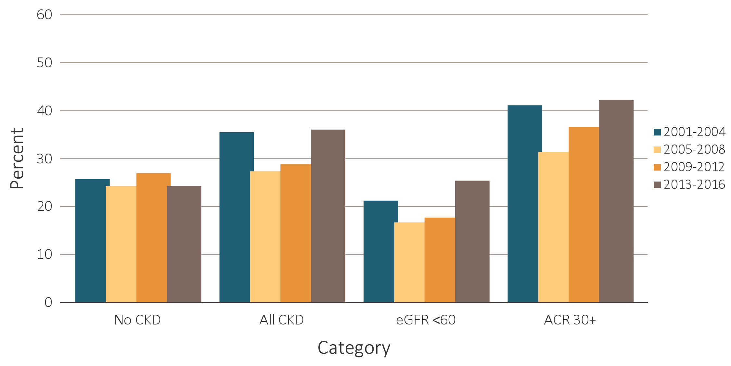
vol 1 Figure 1.12 Time trends of diabetic NHANES participants with and without CKD with respect to glycemic control, 2001-2016
(b) Glycosylated hemoglobin >8%
Data Source: National Health and Nutrition Examination Survey (NHANES), 2001-2004, 2005-2008, 2009-2012 & 2013-2016 participants aged 20 & older. Single-sample estimates of eGFR & ACR; eGFR calculated using the CKD-EPI equation. Abbreviations: ACR, urine albumin/creatinine ratio; CKD, chronic kidney disease; eGFR, estimated glomerular filtration rate.

Slide 25
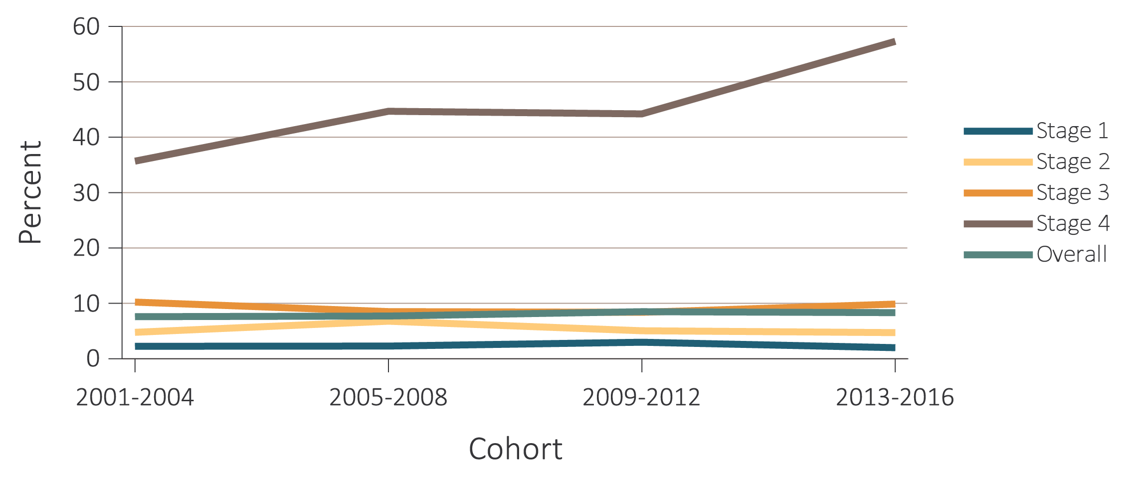
vol 1 Figure 1.13 Time trends of individuals with CKD aware of their kidney disease, NHANES 2001-2016
(a) By CKD stage
Data Source: National Health and Nutrition Examination Survey (NHANES), 2001-2016 participants aged 20 & older. Abbreviations: ACR, urine albumin/creatinine ratio; CKD, chronic kidney disease; DM, diabetes mellitus; eGFR, estimated glomerular filtration rate; HTN, hypertension.

Slide 26
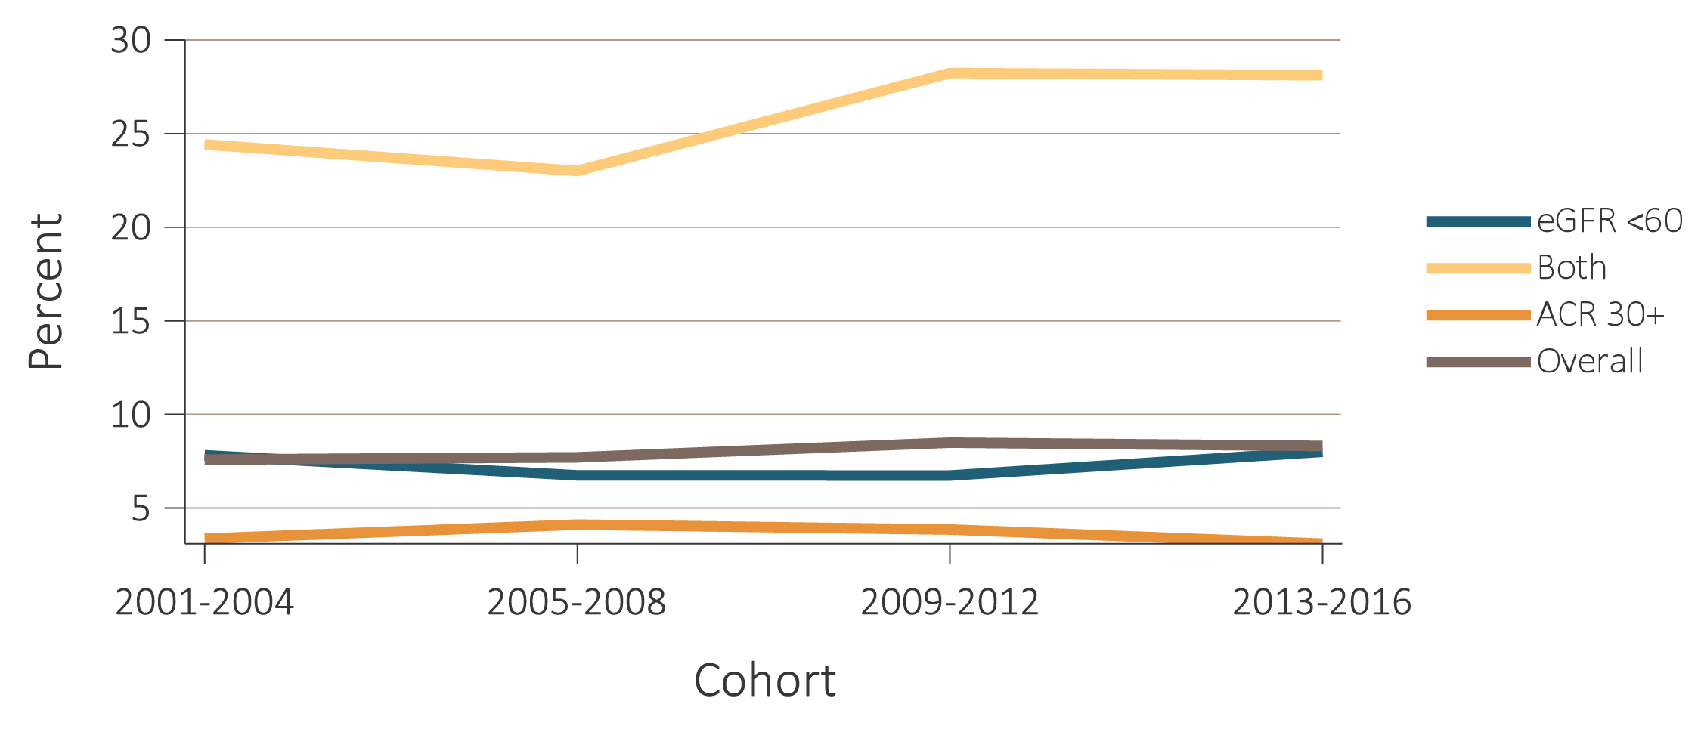
vol 1 Figure 1.13 Time trends of individuals with CKD aware of their kidney disease, NHANES 2001-2016
(b) By low eGFR and by albuminuria status
Data Source: National Health and Nutrition Examination Survey (NHANES), 2001-2016 participants aged 20 & older. Abbreviations: ACR, urine albumin/creatinine ratio; CKD, chronic kidney disease; DM, diabetes mellitus; eGFR, estimated glomerular filtration rate; HTN, hypertension.

Slide 27
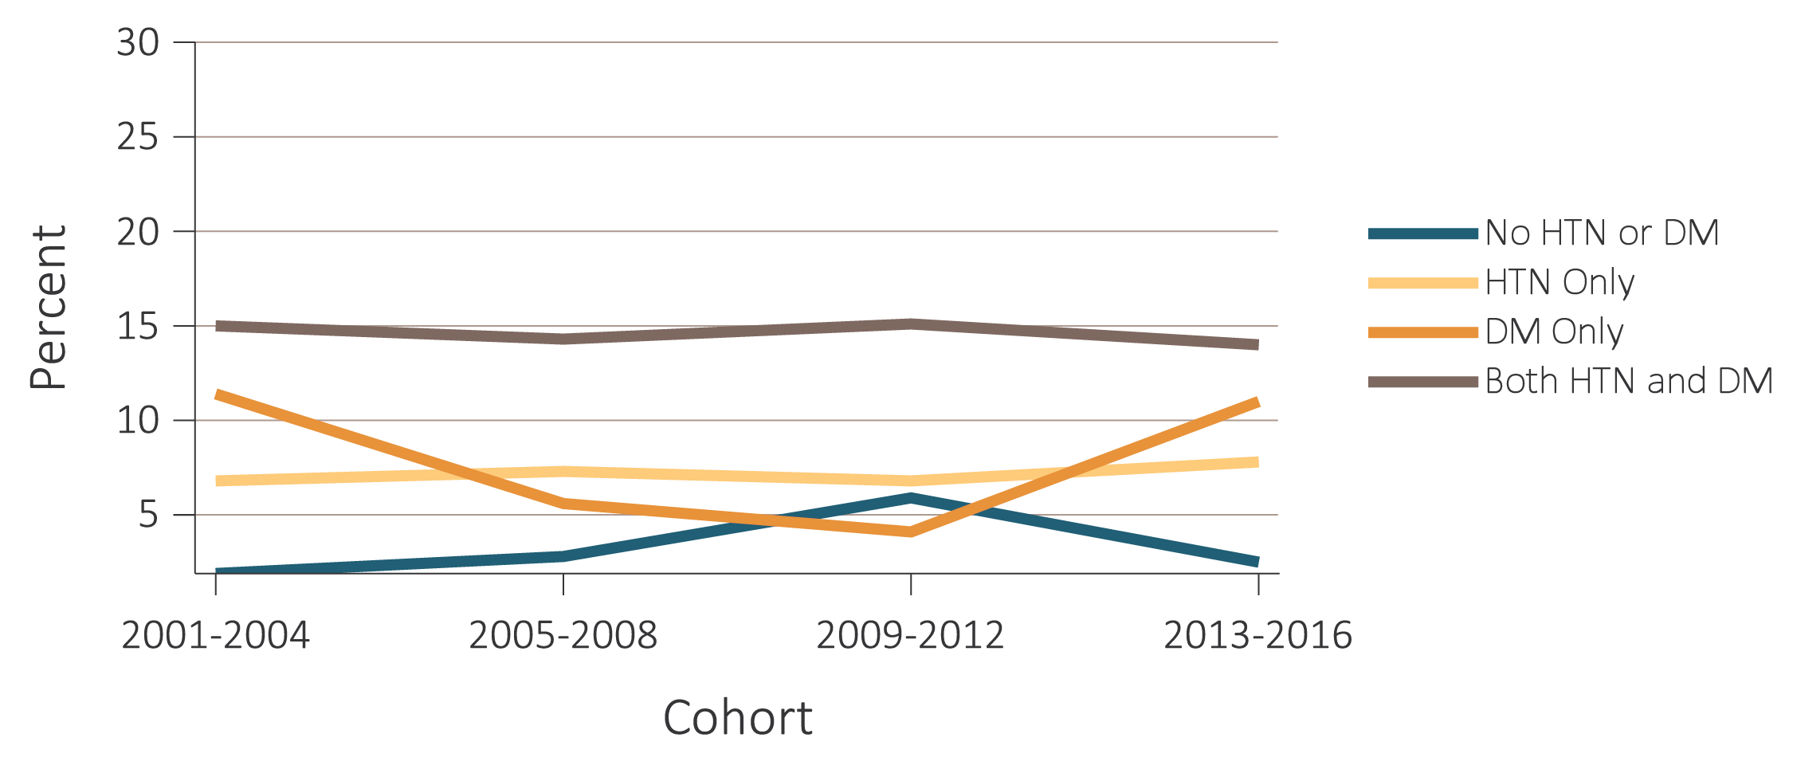
vol 1 Figure 1.13 Time trends of individuals with CKD aware of their kidney disease, NHANES 2001-2016
(c) By diabetes and hypertension status
Data Source: National Health and Nutrition Examination Survey (NHANES), 2001-2016 participants aged 20 & older. Abbreviations: ACR, urine albumin/creatinine ratio; CKD, chronic kidney disease; DM, diabetes mellitus; eGFR, estimated glomerular filtration rate; HTN, hypertension.

Slide 28
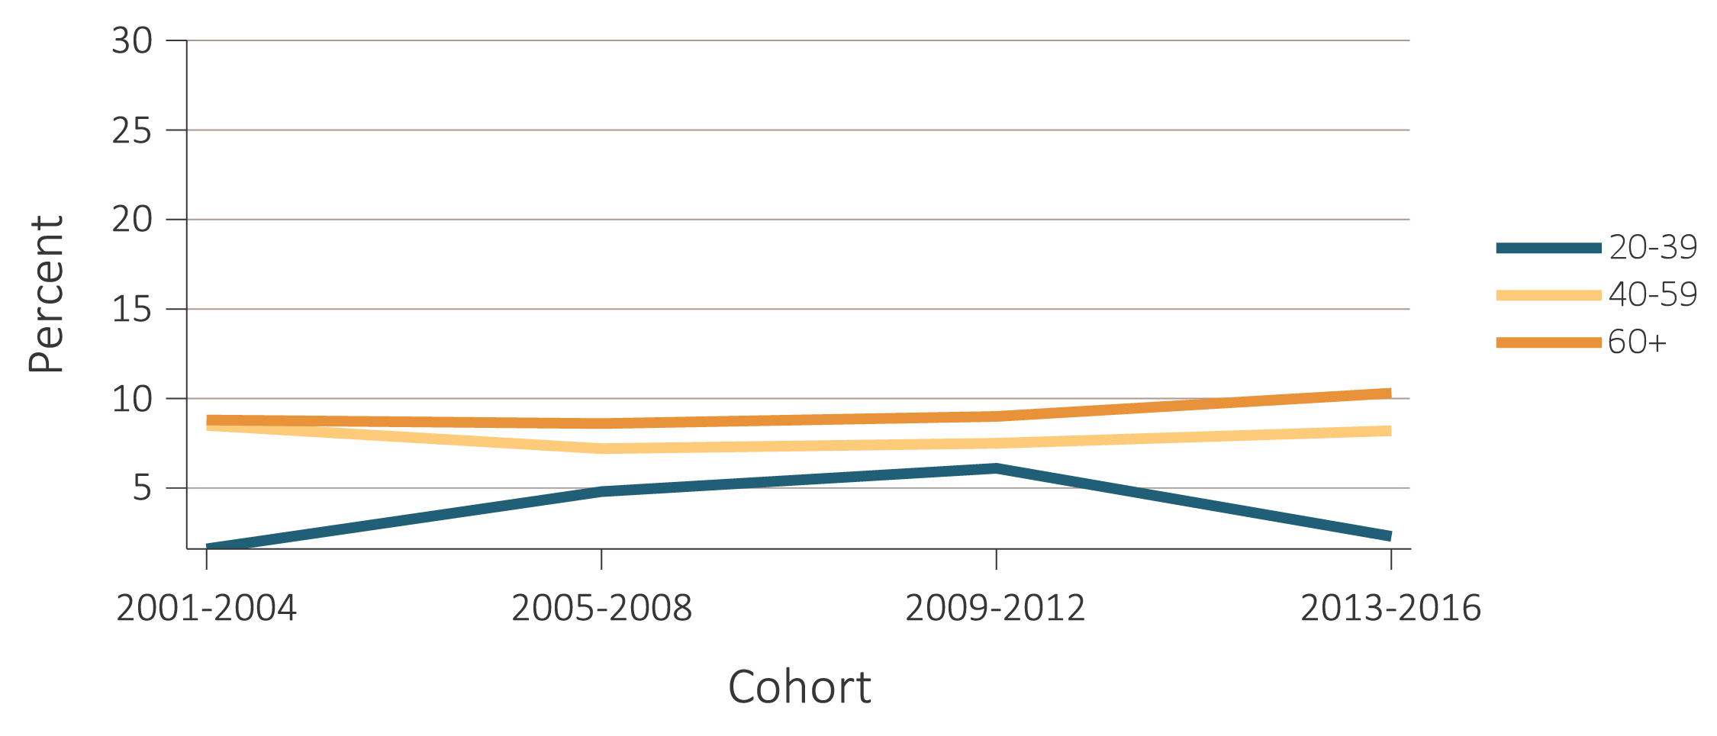
vol 1 Figure 1.13 Time trends of individuals with CKD aware of their kidney disease, NHANES 2001-2016
(d) By age categories
Data Source: National Health and Nutrition Examination Survey (NHANES), 2001-2016 participants aged 20 & older. Abbreviations: ACR, urine albumin/creatinine ratio; CKD, chronic kidney disease; DM, diabetes mellitus; eGFR, estimated glomerular filtration rate; HTN, hypertension.

Slide 29
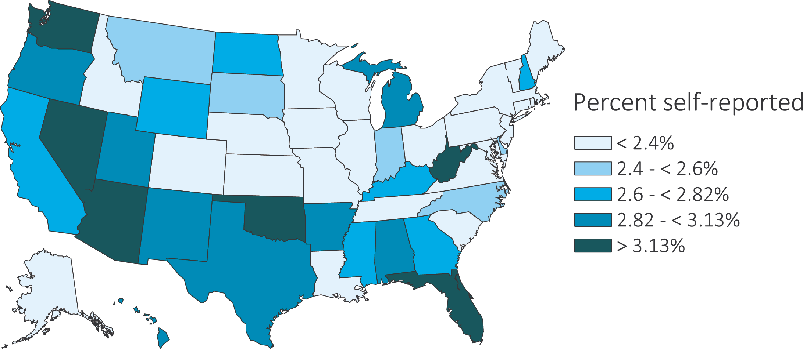
vol 1 Figure 1.14 Estimated prevalence of self-reported kidney disease by state, BRFSS participants ages 18 and older
(a) 2013
Data source: Behavioral Risk Factors Surveillance System (BRFSS), participants aged 18 & older. 2013 (N=491,777), 2014 (N=464,617), 2015 (N=441,460), and 2016 (N=486,303).

Slide 30
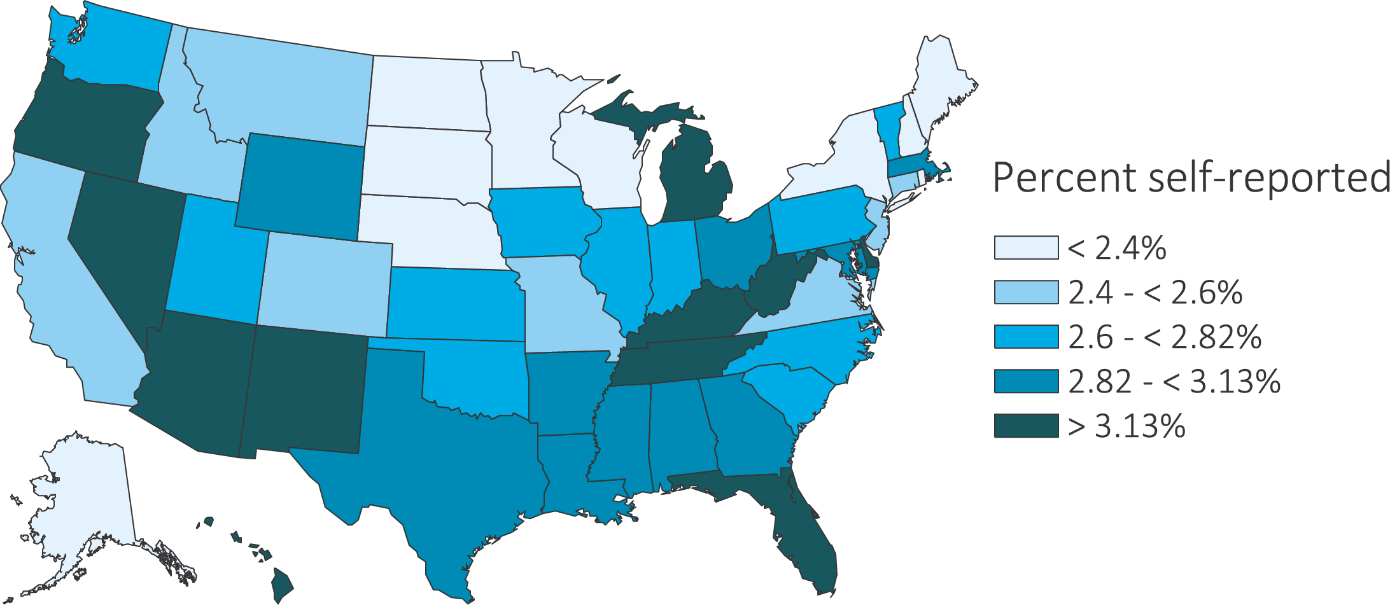
vol 1 Figure 1.14 Estimated prevalence of self-reported kidney disease by state, BRFSS participants ages 18 and older
(b) 2014
Data source: Behavioral Risk Factors Surveillance System (BRFSS), participants aged 18 & older. 2013 (N=491,777), 2014 (N=464,617), 2015 (N=441,460), and 2016 (N=486,303).

Slide 31
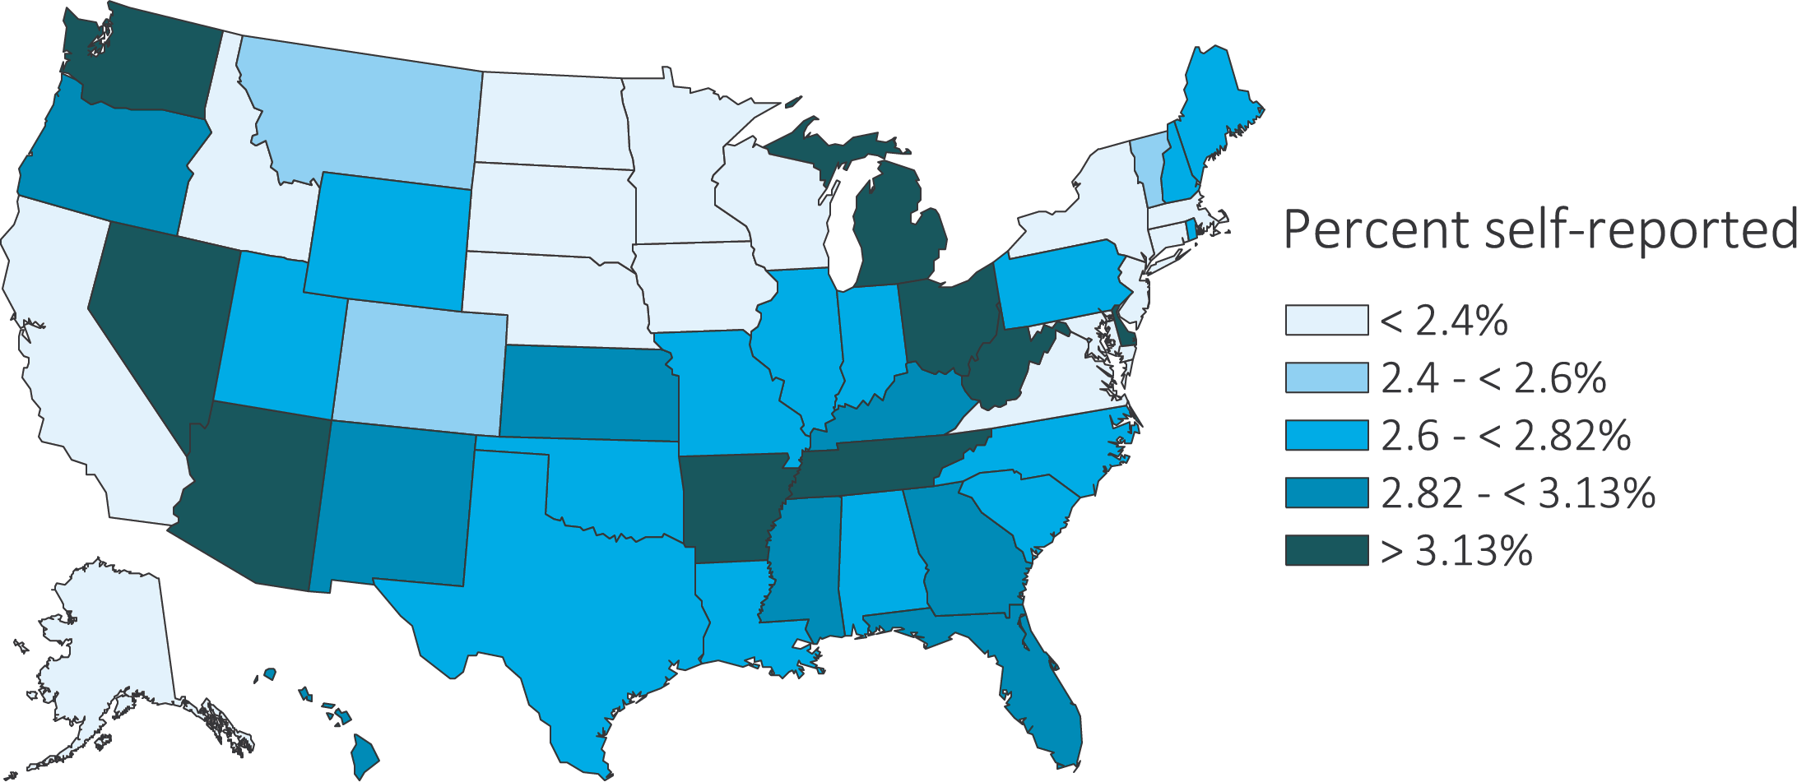
vol 1 Figure 1.14 Estimated prevalence of self-reported kidney disease by state, BRFSS participants ages 18 and older
(c) 2015
Data source: Behavioral Risk Factors Surveillance System (BRFSS), participants aged 18 & older. 2013 (N=491,777), 2014 (N=464,617), 2015 (N=441,460), and 2016 (N=486,303).

Slide 32
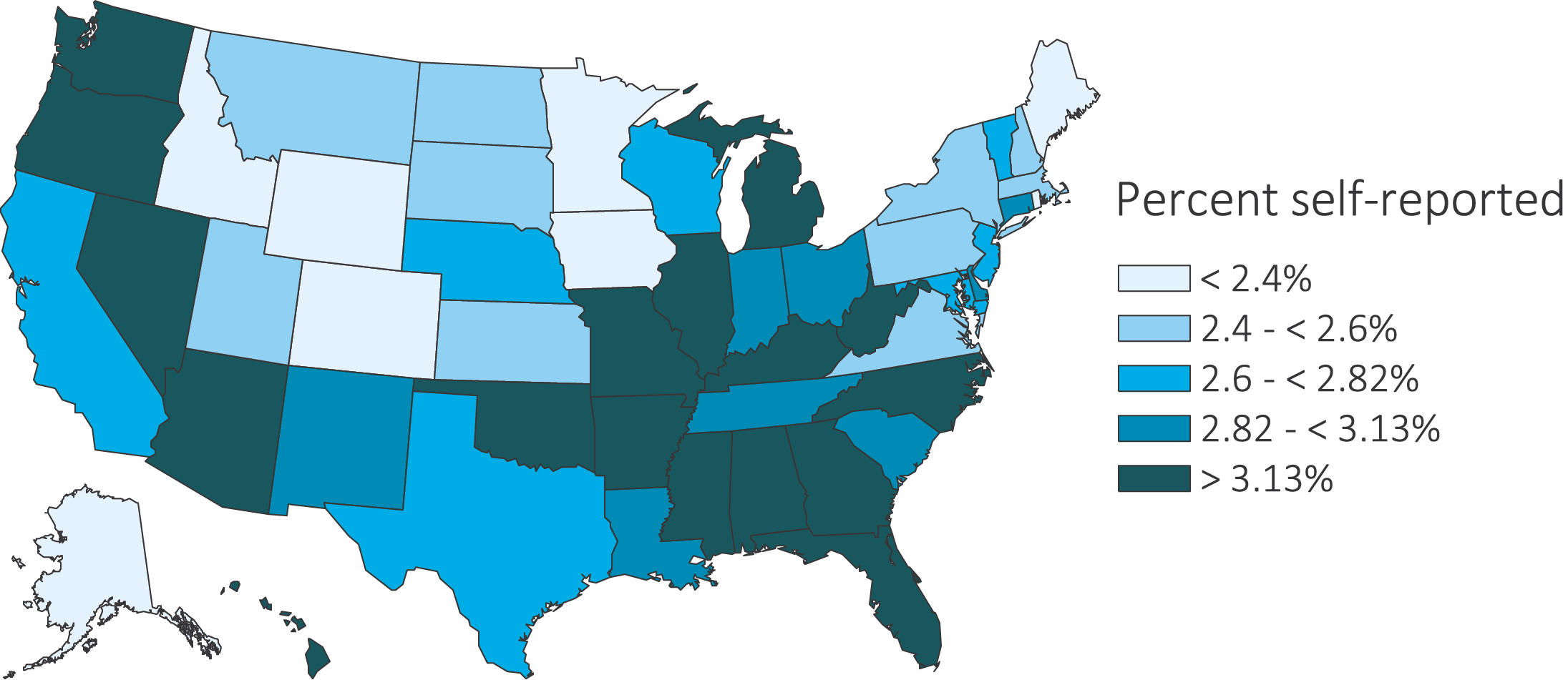
vol 1 Figure 1.14 Estimated prevalence of self-reported kidney disease by state, BRFSS participants ages 18 and older
(d) 2016
Data source: Behavioral Risk Factors Surveillance System (BRFSS), participants aged 18 & older. 2013 (N=491,777), 2014 (N=464,617), 2015 (N=441,460), and 2016 (N=486,303).

