Slide 1
2018 Annual Data Report
Volume 1: Chronic Kidney Disease
Chapter 2: Identification and Care of Patients with CKD

Slide 2
Table A. ICD-9-CM and ICD-10-CM codes for Chronic Kidney Disease (CKD) stages
ICD-9-CM codeª | ICD-10-CM codeª | Stage
585.1 | N18.1 | CKD, Stage 1
585.2 | N18.2 | CKD, Stage 2 (mild)
585.3 | N18.3 | CKD, Stage 3 (moderate)
585.4 | N18.4 | CKD, Stage 4 (severe)
585.5 | N18.5 | CKD, Stage 5 (excludes 585.6: Stage 5, requiring chronic dialysis^{b})
CKD Stage-unspecified | CKD Stage-unspecified | For these analyses, identified by multiple codes including 585.9, 250.4x, 403.9x & others for ICD-9-CM and A18.xx, E08.xx, E11.xx and other for ICD-10-CM.
ªFor analyses in this chapter, CKD stage estimates require at least one occurrence of a stage-specific code, and the last available CKD stage in a given year is used. ^{b}In USRDS analyses, patients with ICD-9-CM code 585.6 or ICD-10-CM code N 18.6 & with no ESRD 2728 form or other indication of end-stage renal disease (ESRD) are considered to have code 585.5 or N 18.5.
2018 Annual Data Report
Volume 1 CKD, Chapter 2

Slide 3
vol 1 Table 2.1 Demographic characteristics of all patients, among Medicare (aged 65+ years), Optum Clinformatics™ (ages 22 or older) and Veterans Affairs (ages 22 or older) patients, 2016
 | Medicare 5% |  |  | Optum Clinformatics™ |  |  | Veterans Affairs
 | Sample count | Percent (%) |  | Sample count | Percent (%) |  | Sample count | Percent (%)
All | 1,286,211 | 100 |  | 5,354,131 | 100 |  | 6,673,889 | 100
Age
22-30 | - | - |  | 934,959 | 17.5 |  | 311,807 | 4.7
31-40 | - | - |  | 1,223,069 | 22.8 |  | 647,353 | 9.7
41-50 | - | - |  | 1,258,509 | 23.5 |  | 640,908 | 9.6
51-64 | - | - |  | 1,674,668 | 31.3 |  | 1,485,870 | 22.3
65-74 | 729,462 | 56.7 |  | 206,188 | 3.9 |  | 2,010,195 | 30.1
75-84 | 388,900 | 30.2 |  | 39,653 | 0.7 |  | 918,428 | 13.9
85+ | 167,849 | 13.1 |  | 17,085 | 0.3 |  | 659,328 | 9.9
Sex
Male | 559,118 | 43.5 |  | 2,725,981 | 50.9 |  | 692,611 | 10.4
Female | 727,093 | 56.5 |  | 2,627,281 | 49.1 |  | 5,981,174 | 89.6
Race/Ethnicity
White | 1,098,136 | 85.4 |  | 3,458,337 | 67.8 |  | 4,626,512 | 69.3
Black/African American | 96,120 | 7.5 |  | 463,015 | 9.1 |  | 1,040,546 | 15.6
Native American | 5,681 | 0.4 |  | - | - |  | 53,816 | 0.8
Asian | 24,921 | 1.9 |  | 285,804 | 5.6 |  | 67,768 | 1.0
Hispanic | - | - |  | 646,123 | 12.7 |  | - | -
Other/Unknown/Missing | 61,353 | 4.7 |  | 245,002 | 4.8 |  | 885,247 | 13.3
Comorbidity
Diabetes mellitus | 309,241 | 24.0 |  | 328,822 | 6.1 |  | 1,110,214 | 16.6
Hypertension | 777,832 | 60.5 |  | 778,159 | 14.5 |  | 1,604,804 | 24.0
Cardiovascular disease | 513,794 | 40.0 |  | 327,865 | 6.1 |  | 766,053 | 11.5
Data Source: Special analyses, Medicare 5% sample (aged 65 and older), Optum Clinformatics™ (ages 22 or older) and Veterans Affairs (ages 22 or older) alive & eligible for all of 2016. Abbreviation: CKD, chronic kidney disease. CVD is defined as presence of any of the following comorbidities: cerebrovascular accident, peripheral vascular disease, atherosclerotic heart disease, heart failure, dysrhythmia or other cardiac comorbidities. - No available data.
2018 Annual Data Report
Volume 1 CKD, Chapter 2

Slide 4
vol 1 Table 2.2 Prevalence of comorbid conditions by diagnosis codes (CKD, CVD, & DM), (a) total & (b) one or more, among Medicare (aged 65+ years) , Optum Clinformatics™ (aged 22-64 years) and Veterans Affairs (aged 22-64 years) patients, 2016
(a) Any diagnosis of CKD, CVD, or DM
 | Medicare 5% |  |  | Clinformatics™ |  |  | Veterans Affairs
 | Sample count | % |  | Sample count | % |  | Sample count | %
All | 1,286,211 | 100 |  | 5,091,205 | 100 |  | 3,085,938 | 100
Total CKD | 178,025 | 13.8 |  | 85,789 | 1.7 |  | 82,755 | 2.7
Total CVD | 513,794 | 39.9 |  | 261,580 | 5.1 |  | 152,029 | 4.9
Total DM | 309,241 | 24.0 |  | 282,139 | 5.5 |  | 302,803 | 9.8
Data Source: Special analyses, Medicare 5% sample (aged 65 and older), Optum Clinformatics™ (ages 22-64 years) and Veterans Affairs (ages 22-64 years) alive & eligible for all of 2016. Abbreviations: CKD, chronic kidney disease; CVD, cardiovascular disease; DM, diabetes mellitus. CVD is defined as presence of any of the following comorbidities: cerebrovascular accident, peripheral vascular disease, atherosclerotic heart disease, congestive heart failure, dysrhythmia or other cardiac comorbidities. CKD in the VA is defined as anyone with at least one inpatient ICD-9 or ICD-10 diagnosis or two outpatient diagnosis codes in 2016 or eGFR<60 ml/min/1.73m2 based on at least one outpatient serum creatinine available in 2016; eGFR was calculated using the CKD-EPI formula; if more than one value was available, the last one in the year was used. The denominator included everyone with at least one outpatient visit in 2016.
2018 Annual Data Report
Volume 1 CKD, Chapter 2

Slide 5
vol 1 Table 2.2 Prevalence of comorbid conditions by diagnosis codes (CKD, CVD, & DM), (a) total & (b) one or more, among Medicare (aged 65+ years) , Optum Clinformatics™ (aged 22-64 years) and Veterans Affairs (aged 22-64 years) patients, 2016 (continued)
(b) Combinations of CKD, CVD, or DM diagnoses
 | Medicare 5% |  |  | Clinformatics™ |  | Veterans Affairs
 | Sample count | % |  | Sample count | % |  | Sample count | %
All | 1,286,211 | 100 |  | 5,091,205 | 100 |  | 3,085,938 | 100
Only CKD | 33,386 | 2.6 |  | 48,807 | 1.0 |  | 41,469 | 1.3
Only CVD | 281,665 | 21.9 |  | 195,910 | 3.8 |  | 94,794 | 3.1
Only DM | 112,358 | 8.7 |  | 217,275 | 4.3 |  | 238,002 | 7.7
CKD & DM, no CVD | 23,971 | 1.9 |  | 13,293 | 0.3 |  | 18,637 | 0.6
CKD & CVD, no DM | 59,217 | 4.6 |  | 14,099 | 0.3 |  | 11,071 | 0.4
DM & CVD, no CKD | 111,461 | 8.7 |  | 41,981 | 0.8 |  | 34,586 | 1.1
CKD & CVD & DM | 61,451 | 4.8 |  | 9,590 | 0.2 |  | 10,529 | 0.3
At least one comorbidity | 683,509 | 53.1 |  | 540,955 | 10.6 |  | 438,559 | 14
At least two comorbidities | 256,100 | 19.9 |  | 78,963 | 1.6 |  | 74,823 | 2.4
No CKD, no CVD, no DM | 602,702 | 46.9 |  | 4,550,250 | 89.4 |  | 2,635,801 | 85.4
Data Source: Special analyses, Medicare 5% sample (aged 65 and older), Optum Clinformatics™ (aged 22-64), and Veterans Affairs (ages 22-64 years) alive & eligible for all of 2016. Abbreviations: CKD, chronic kidney disease; CVD, cardiovascular disease; DM, diabetes mellitus. CVD is defined as presence of any of the following comorbidities: cerebrovascular accident, peripheral vascular disease, atherosclerotic heart disease, congestive heart failure, dysrhythmia or other cardiac comorbidities. CKD in the VA is defined as anyone with at least one inpatient ICD-9 or ICD-10 diagnosis or two outpatient diagnosis codes in 2016 or eGFR<60 ml/min/1.73m² based on at least one outpatient serum creatinine available in 2016; eGFR was calculated using the CKD-EPI formula; if more than one value was available, the last one in the year was used. The denominator included everyone with at least one outpatient visit in 2016.
2018 Annual Data Report
Volume 1 CKD, Chapter 2

Slide 6
vol 1 Table 2.3 Percent of patients with CKD by demographic characteristics, among individuals aged 65+ years in NHANES (2011-2016), Optum ClinformaticsTM (2016), Medicare 5% sample (2016), and Veterans Affairs (2016) datasets
 | Survey-based | Claim-based |  | Claim and lab-based
 | NHANES | Optum ClinformaticsTM | Medicare | VA
 | CKD (eGFR) | CKD (Code) | CKD (Code) | CKD (Code or eGFR)
All | 38.1 | 8.1 | 13.8 | 23.9
Age
65-74 | 28.7 | 6.2 | 10.1 | 17.1
75-79 | 42.6 | 13.5 | 17.2 | 29.3
80+ | 58.5 | 18.9 | 22.6 | 37.4
Race
White | 38.1 | 8.4 | 13.5 | 24.4
Black/African American | 39.7 | 9.5 | 18.7 | 25.7
Native American | - | - | 14.1 | 21.1
Asian | - | 5.73 | 14.3 | 17.3
Other/Unknown | 33.8 | 7.86 | 11.6 | 19.6
Sex
Male | 36.0 | 9.2 | 15.6 | 24.1
Female | 38.9 | 6.8 | 12.5 | 19.3
Data Source: Special analyses, Medicare 5% sample aged 65 and older alive & eligible for all of 2016. NHANES 2013-2016 participants aged 65 and older, Clinformatics patients aged 65 and older, and VA aged 65 and older alive & eligible for all of 2016. CKD in the Veterans Affairs data is defined as anyone with at least one inpatient ICD-9 or ICD-10 diagnosis or two outpatient diagnosis codes in 2016 or eGFR<60 ml/min/1.73m² based on at least one outpatient serum creatinine available in 2016; eGFR was calculated using the CKD-EPI formula; if more than one value was available, the last one in the year was used. The denominator included everyone with at least one outpatient visit in 2016. Abbreviations: CKD, chronic kidney disease; VA, Veterans Affairs. - No available data.
2018 Annual Data Report
Volume 1 CKD, Chapter 2

Slide 7
vol 1 Table 2.4 Prevalence of CKD, by demographic characteristics and comorbidities, among Medicare 5% sample (aged 65+ years), Optum Clinformatics™ (ages 22 or older), and Veterans Affairs (ages 22 or older) patients overall, and with diabetes mellitus or hypertension, 2016
 | All |  |  |  | Diabetes mellitus (with or without hypertension) |  |  |  | Hypertension (without diabetes mellitus)
 | Medicare 5% | Optum ClinformaticsTM | Veterans Affairs |  | Medicare 5% | Optum ClinformaticsTM | Veterans Affairs |  | Medicare 5% | Optum ClinformaticsTM | Veterans Affairs
Overall | 13.8 | 2.0 | 14.9 |  | 27.6 | 9.7 | 31.3 |  | 15.6 | 6.6 | 23.8
Age
22-30 | - | 0.6 | 0.4 |  | - | 5.0 | 3.2 |  | - | 6.2 | 3.6
31-40 | - | 0.9 | 1.0 |  | - | 4.8 | 3.7 |  | - | 5.0 | 4.4
41-50 | - | 1.5 | 2.5 |  | - | 6.1 | 6.9 |  | - | 4.9 | 6.3
51-64 | - | 3.0 | 7.2 |  | - | 9.4 | 16.2 |  | - | 6.1 | 11.6
65-74 | 10.1 | 6.2 | 17.1 |  | 23.1 | 15.9 | 29.5 |  | 11.1 | 9.6 | 21.3
75-84 | 17.2 | 13.5 | 29.3 |  | 31.4 | 27.4 | 47.8 |  | 17.4 | 17.6 | 38.2
85+ | 22.6 | 18.9 | 37.4 |  | 37.1 | 33.9 | 61.4 |  | 24.3 | 26.1 | 55.2
Sex | . | . |  |  | . | . |  |  | . | .
Male | 15.6 | 2.2 | 16 |  | 29.9 | 10.5 | 31.8 |  | 18.0 | 7.3 | 24.3
Female | 12.5 | 1.8 | 5.3 |  | 25.6 | 8.5 | 20.5 |  | 13.9 | 5.8 | 15.7
Race/Ethnicity | . | . |  |  | . | . |  |  | . | .
White | 13.5 | 2.1 | 16.3 |  | 27.4 | 10.1 | 32.5 |  | 15.4 | 6.8 | 25
Black/African American | 18.7 | 2.3 | 12.8 |  | 31.1 | 10.5 | 27.6 |  | 18.8 | 6.7 | 19.5
Native American | 14.1 | - | 11.5 |  | 25.4 | 6.5 | 26.1 |  | 13.7 | 5.7 | 19.8
Asian | 14.3 | 1.2 | 7.4 |  | 26.8 |  | 22.8 |  | 14.9 |  | 19.8
Hispanic | 13.2 | 1.7 | - |  | 25.5 | 8.4 | - |  | 14.5 | 5.9 | -
Other/Unknown | 7.8 | 2.0 | 9.9 |  | 19.7 | 9.0 | 31.2 |  | 9.9 | 6.8 | 25.6
Data Source: Special analyses, Medicare 5% sample (aged 65 and older), Optum Clinformatics™ data (ages 22 or older) and the Veterans Affairs data (ages 22 or older) alive & eligible for all of 2016. Abbreviation: CKD, chronic kidney disease. CKD in the VA is defined as anyone with at least one inpatient ICD-9 or ICD-10 diagnosis or two outpatient diagnosis codes in 2016 or eGFR<60 ml/min/1.73m² based on at least one outpatient serum creatinine available in 2016; eGFR was calculated using the CKD-EPI formula; if more than one value was available, the last one in the year was used. The denominator included everyone with at least one outpatient visit in 2016. - No available data.-- data suppressed
2018 Annual Data Report
Volume 1 CKD, Chapter 2

Slide 8
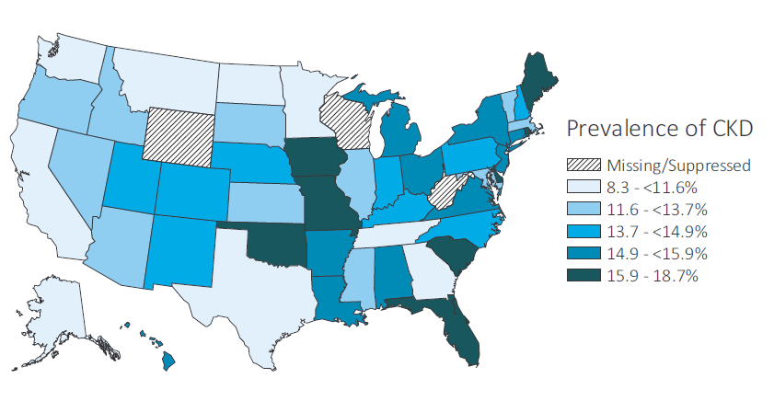
vol 1 Figure 2.1 Prevalence of CKD by state among Medicare 5% sample (aged 65+ years) and Optum Clinformatics™ (ages 22 or older) patients, 2016
(a) Medicare 5%
Data Source: Special analyses, Medicare 5% sample (aged 65 and older) and Optum Clinformatics™ data (ages 22 or older) alive & eligible for all of 2016. Abbreviation: CKD, chronic kidney disease.
2018 Annual Data Report
Volume 1 CKD, Chapter 2

Slide 9
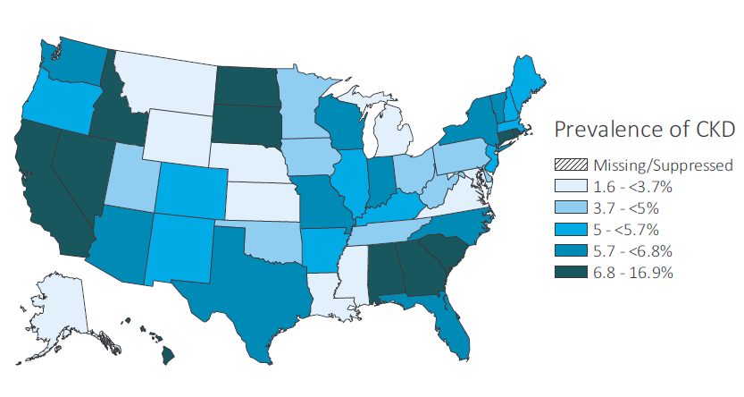
vol 1 Figure 2.1 Prevalence of CKD by state among Medicare 5% sample (aged 65+ years) and Optum Clinformatics™ (ages 22 or older) patients, 2016
(b) Optum Clinformatics™
Data Source: Special analyses, Medicare 5% sample (aged 65 and older) and Optum Clinformatics™ data (ages 22 or older) alive & eligible for all of 2016. Abbreviation: CKD, chronic kidney disease
2018 Annual Data Report
Volume 1 CKD, Chapter 2

Slide 10
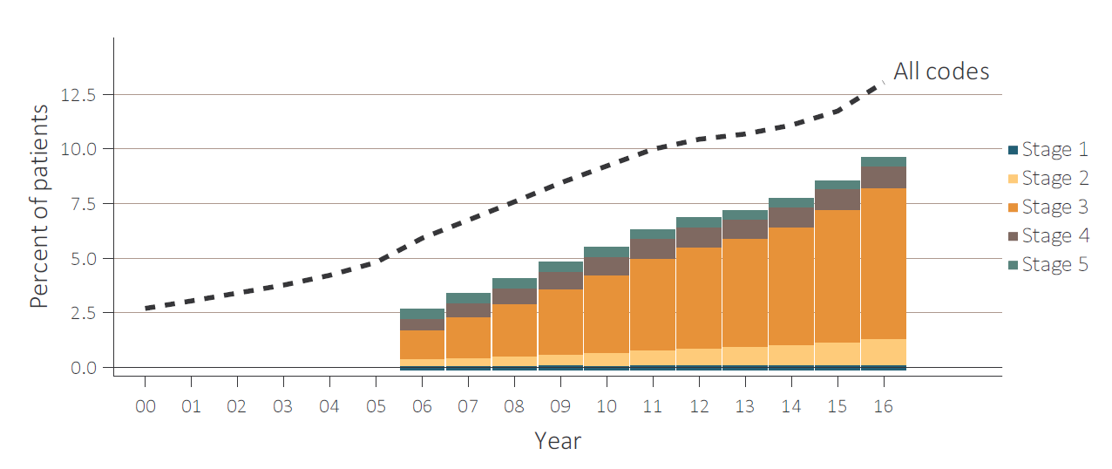
vol 1 Figure 2.2 Trends in prevalence of recognized CKD, overall and by CKD stage, among Medicare patients (aged 65+ years), 2000-2016
Data Source: Special analyses, Medicare 5% sample. Known CKD stages presented as bars; curve showing “All codes” includes known CKD stages (ICD-9 codes 585.1-585.5 or ICD-10 codes N18.1-N18.5) and the CKD-stage unspecified codes (ICD-9 code 585.9, ICD-10 code N18.9 and remaining non-stage specific CKD codes). For years 2000-2016, ICD-9 codes are used to identify CKD; additionally, starting October 1, 2015, ICD-10 codes are used to identify CKD. Note: In previous years, this graph reported 585.9 codes as a component of the stacked bars. Abbreviation: CKD, chronic kidney disease.
2018 Annual Data Report
Volume 1 CKD, Chapter 2

Slide 11
vol 1 Table 2.5 Change in CKD status from 2011 to 2016, among Medicare patients (aged 65+ years) alive and without ESRD in 2011
 |  | 2015-2016 Status (row %)
 |  | No CKD Diagnosis | CKD Stage 1 | CKD Stage 2 | CKD Stage 3 | CKD Stage 4 | CKD Stage 5 | CKD Stage-unspecified | ESRD alive | ESRD death | Death without ESRD | Lost to follow-up | Total N
 | No CKD Diagnosis | 54.6 | 0.2 | 1.0 | 5.2 | 0.5 | 0.1 | 4.5 | 0.1 | 0.1 | 20.9 | 12.8 | 1,101,461
 | Any CKD | 11.6 | 0.5 | 2.4 | 19.1 | 4.2 | 0.6 | 6.2 | 1.7 | 2.0 | 42.9 | 8.9 | 122,233
 | CKD Stage 1 | 14.7 | 5.5 | 4.6 | 17.7 | 2.2 | 0.5 | 6.1 | 1.0 | 0.8 | 36.2 | 10.7 | 2,761
2011 | CKD Stage 2 | 13.7 | 0.8 | 10.6 | 20.2 | 2.5 | 0.3 | 4.9 | 0.5 | 0.6 | 35.4 | 10.4 | 8,571
Status | CKD Stage 3 | 7.6 | 0.3 | 1.8 | 28.1 | 5.1 | 0.5 | 3.5 | 1.6 | 1.6 | 40.9 | 9.0 | 51,237
 | CKD Stage 4 | 2.3 | 0.2 | 0.5 | 8.1 | 11.6 | 1.7 | 1.5 | 7.0 | 8.4 | 52.2 | 6.5 | 10,942
 | CKD Stage 5 | 6.0 | 0.2 | 0.7 | 6.8 | 2.9 | 1.9 | 3.1 | 8.2 | 10.8 | 52.6 | 6.9 | 2,455
 | CKD Stage-unspecified | 17.8 | 0.4 | 1.8 | 12.4 | 2.1 | 0.4 | 10.6 | 0.6 | 0.7 | 44.1 | 9.0 | 46,267
 | Total | 50.3 | 0.2 | 1.1 | 6.6 | 0.9 | 0.2 | 4.6 | 0.3 | 0.3 | 23.1 | 12.4
 | Total N | 615,594 | 2,894 | 13,904 | 80,181 | 11,059 | 1,940 | 56,545 | 3,294 | 3,584 | 283,057 | 151,642 | 1,223,694
Data Source: Special analyses, Medicare 5% sample. Patients alive & eligible for all of 2011. Death and ESRD status were examined yearly between 2011-2016, and were carried forward if present. Among patients without death or ESRD by 2016, the last CKD diagnosis claim was used; if not available, then the last CKD diagnosis claim from 2015 was used. Lost to follow-up represents the patients who were not in Medicare Part A and Part B fee for service in 2015 or 2016. These persons moved to a Medicare Advantage Plan and thus did not generate billing data from which CKD status could be determined. Abbreviations: CKD, chronic kidney disease; ESRD, end-stage renal disease.
2018 Annual Data Report
Volume 1 CKD, Chapter 2

Slide 12
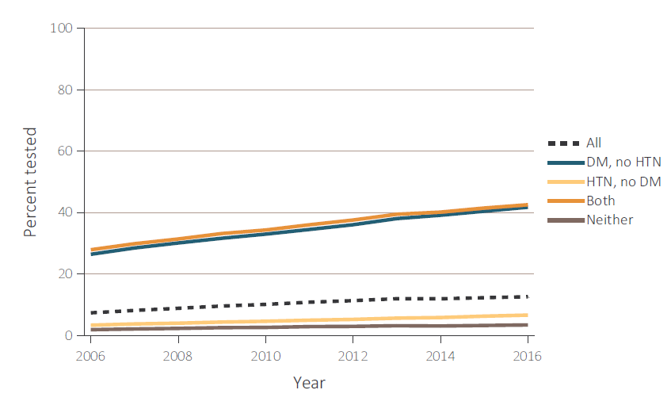
vol 1 Figure 2.3 Trends in percent of patients with testing of urine albumin (a) in Medicare 5% sample (aged 65+ years), & (b) Optum Clinformatics™ (aged 22-64 years) patients without a diagnosis of CKD, by year from 2006 to 2016
(a) Medicare 5%
Data Source: Special analyses, Medicare 5% sample aged 65 and older with Part A & B coverage in the prior year and Optum Clinformatics™ patients aged 22-64 years. Tests tracked during each year. Abbreviations: CKD, chronic kidney disease; DM, diabetes mellitus; HTN, hypertension.
2018 Annual Data Report
Volume 1 CKD, Chapter 2

Slide 13
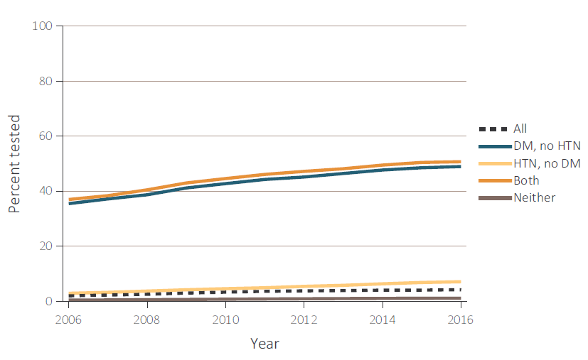
vol 1 Figure 2.3 Trends in percent of patients with testing of urine albumin (a) in Medicare 5% sample (aged 65+ years), & (b) Optum Clinformatics™ (aged 22-64 years) patients without a diagnosis of CKD, by year from 2006 to 2016
(b) Optum Clinformatics™
Data Source: Special analyses, Medicare 5% sample aged 65 and older with Part A & B coverage in the prior year and Optum Clinformatics™ patients aged 22-64 years. Tests tracked during each year. Abbreviations: CKD, chronic kidney disease; DM, diabetes mellitus; HTN, hypertension.
2018 Annual Data Report
Volume 1 CKD, Chapter 2

Slide 14
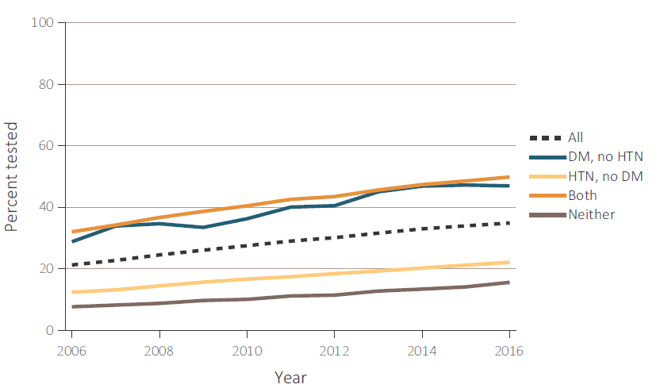
vol 1 Figure 2.4 Trends in percent of patients with testing of urine albumin in (a) Medicare 5% (aged 65+ years), & (b) Optum Clinformatics™ (aged 22-64 years) patients with a diagnosis of CKD, by year from 2006-2016
(a) Medicare 5%
Data Source: Special analyses, Medicare 5% sample (aged 65 and older) with Part A & B coverage in the prior year and Optum Clinformatics™ population (aged 22-64 years). Tests tracked during each year. Abbreviations: CKD, chronic kidney disease; DM, diabetes mellitus; HTN, hypertension.
2018 Annual Data Report
Volume 1 CKD, Chapter 2

Slide 15
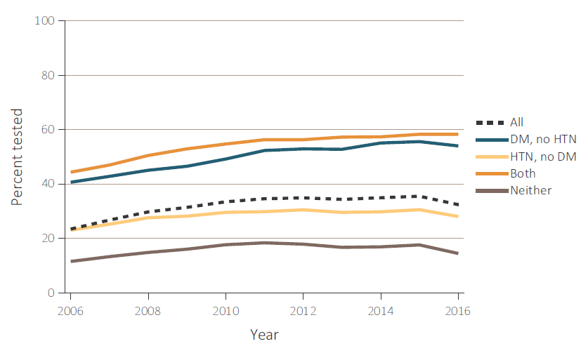
vol 1 Figure 2.4 Trends in percent of patients with testing of urine albumin in (a) Medicare 5% (aged 65+ years), & (b) Optum Clinformatics™ (aged 22-64 years) patients with a diagnosis of CKD, by year from 2006-2016
(b) Optum Clinformatics™
Data Source: Special analyses, Medicare 5% sample (aged 65 and older) with Part A & B coverage in the prior year and Optum Clinformatics™ population (aged 22-64 years). Tests tracked during each year. Abbreviations: CKD, chronic kidney disease; DM, diabetes mellitus; HTN, hypertension.
2018 Annual Data Report
Volume 1 CKD, Chapter 2

Slide 16
vol 1 Table 2.6 Percent of patients with a physician visit in 2016 after a CKD diagnosis in 2015, among Medicare 5% patients (aged 65+ years)
 | Any CKD diagnosis |  |  |  | CKD diagnosis code of 585.3 (Stage 3) |  |  |  | CKD diagnosis code of 585.4/N18.4 (Stage 4) or 585.5/N18.5 (Stage 5)
 | Primary care | Cardiologist | Nephrologist |  | Primary care | Cardiologist | Nephrologist |  | Primary care | Cardiologist | Nephrologist
Overall | 89.6 | 54.4 | 25.7 |  | 90.8 | 55.6 | 41.1 |  | 89.9 | 60.9 | 64.2
Age
65-74 | 87.6 | 49.0 | 26.1 |  | 89.1 | 51.2 | 47.1 |  | 80.9 | 46.4 | 69.7
75-84 | 91.3 | 58.9 | 27.3 |  | 91.7 | 58.2 | 41.0 |  | 84.3 | 51.8 | 66.6
85+ | 92.9 | 61.5 | 21.9 |  | 92.7 | 59.9 | 29.2 |  | 86.6 | 51.8 | 52.0
Sex
Male | 89.9 | 54.7 | 24.8 |  | 91.0 | 55.9 | 39.8 |  | 83.7 | 49.8 | 63.8
Female | 90.8 | 56.6 | 32.8 |  | 90.9 | 56.6 | 48.0 |  | 84.0 | 50.3 | 67.7
Race
White | 89.4 | 49.9 | 25.7 |  | 89.7 | 50.6 | 41.2 |  | 82.6 | 46.0 | 64.8
Black/African American | 90.4 | 51.8 | 25.2 |  | 91.0 | 52.0 | 38.6 |  | 84.0 | 46.9 | 62.3
Other | 89.5 | 57.5 | 26.2 |  | 90.8 | 59.6 | 43.3 |  | 83.2 | 52.9 | 67.1
Data Source: Special analyses, Medicare 5% sample aged 65 and older alive & eligible for all of 2015. CKD diagnosis is at date of first CKD claim in 2015; claims for physician visits were searched during the 12 months following that date. ICD-9 CKD diagnosis code of 585.4 or higher or ICD-10 CKD diagnosis code of N18.3 or higher represents CKD Stages 4-5. Abbreviation: CKD, chronic kidney disease.
2018 Annual Data Report
Volume 1 CKD, Chapter 2

Slide 17
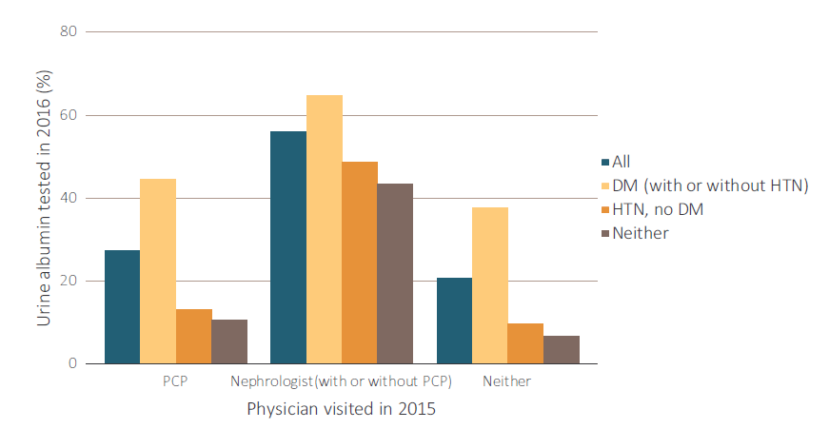
vol 1 Figure 2.5 Percent of CKD patients in 2015 with physician visit (nephrologist, primary care provider, both, and neither), with laboratory testing in the following year (2016), by comorbidity
Data Source: Special analyses, Medicare 5% sample aged 65 and older alive & eligible for all of 2016, with a CKD diagnosis claim based on ICD-9 diagnostic codes and a physician visit in 2015. Patient visits with both PCP and nephrologists are classified as nephrologist. Abbreviations: CKD, chronic kidney disease; DM, diabetes mellitus; HTN, hypertension; PCP, primary care physician.
2018 Annual Data Report
Volume 1 CKD, Chapter 2

