Slide 1
2018 Annual Data Report
Volume 1: Chronic Kidney Disease
Chapter 3:
Morbidity and Mortality
2018 Annual Data Report
Volume 1 CKD, Chapter 3

Slide 2

vol 1 Table 3.1 Unadjusted and adjusted all-cause mortality rates per 1,000 patient-years at risk for Medicare patients aged 66 and older, by CKD status, 2016
 | Unadjusted |  |  | Adjusted
 | No CKD | All CKD |  | No CKD | All CKD
All | 41.3 | 122.6 |  | 43.1 | 103.0
Age
66–69 | 15.3 | 61.0 |  | 15.0 | 59.4
70–74 | 20.1 | 70.4 |  | 19.8 | 68.5
75–84 | 40.7 | 106.3 |  | 40.7 | 104.1
85+ | 135.7 | 237.4 |  | 136.3 | 236.0
Sex
Male | 42.0 | 127.6 |  | 48.2 | 114.4
Female | 40.7 | 118.1 |  | 39.2 | 94.9
Race
White | 42.2 | 126.2 |  | 43.4 | 104.2
Black/African American | 41.6 | 113.7 |  | 46.9 | 106.6
Other | 27.9 | 88.9 |  | 33.2 | 78.3
Data source: Medicare 5% sample. January 1, 2016 point prevalent patients aged 66 and older. Adjusted for age/sex/race. Standard population: all patients, 2016. Abbreviation: CKD, chronic kidney disease.

Slide 3
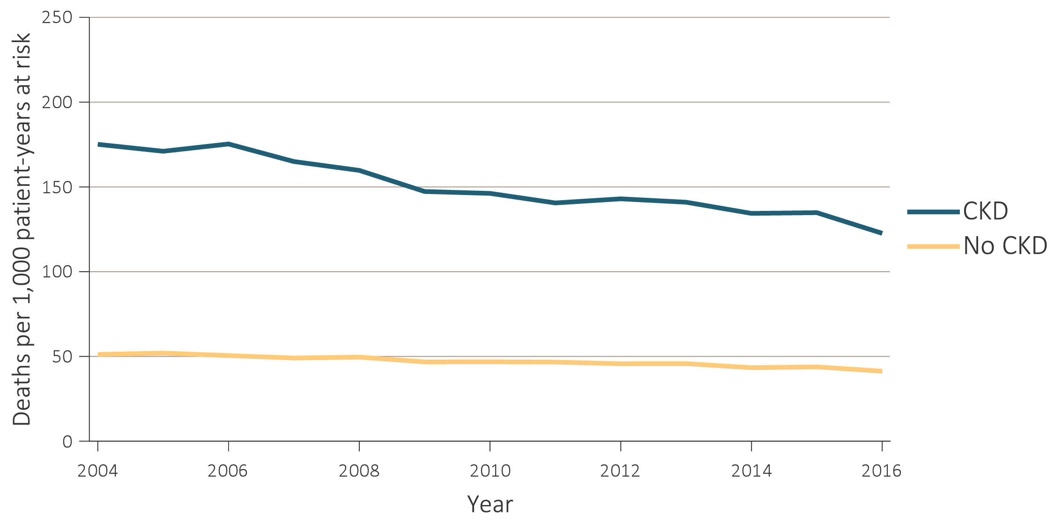
vol 1 Figure 3.1 Unadjusted and adjusted all-cause mortality rates per 1,000 patient-years at risk for Medicare patients aged 66 and older, by CKD status and year, 2004-2016
Unadjusted
Data source: Special analyses, Medicare 5% sample. January 1 of each reported year, point prevalent Medicare patients aged 66 and older. 1.b adjusted for age/sex/race and 1.c adjusted for age/sex/race/comorbidities. 1.e adjusted for age/sex and 1.f adjusted for age/sex/comorbidities. Standard population: Medicare 2011 patients. Abbreviation: CKD, chronic kidney disease.

Slide 4
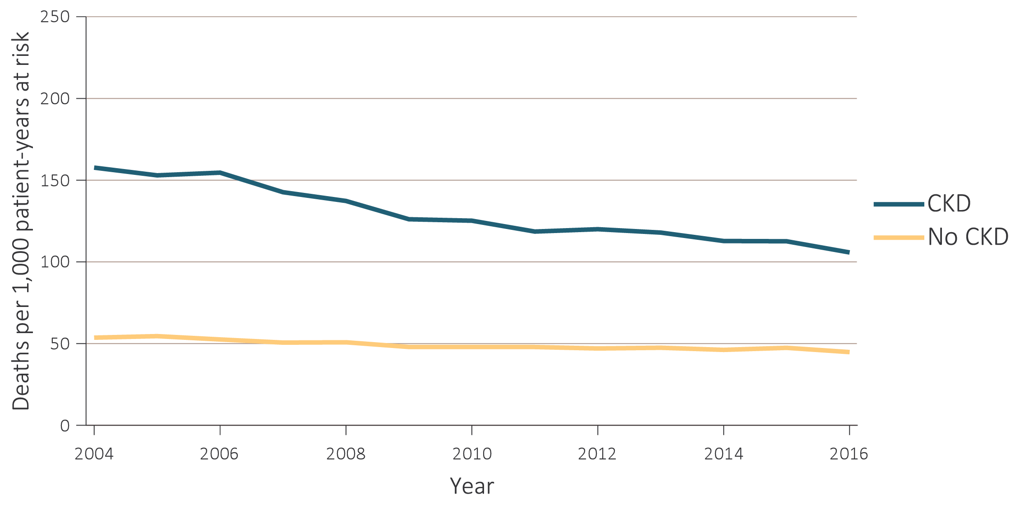
vol 1 Figure 3.1 Unadjusted and adjusted all-cause mortality rates per 1,000 patient-years at risk for Medicare patients aged 66 and older, by CKD status and year, 2004-2016
(b) Adjusted
Data source: Special analyses, Medicare 5% sample. January 1 of each reported year, point prevalent Medicare patients aged 66 and older. 1.b adjusted for age/sex/race and 1.c adjusted for age/sex/race/comorbidities. 1.e adjusted for age/sex and 1.f adjusted for age/sex/comorbidities. Standard population: Medicare 2011 patients. Abbreviation: CKD, chronic kidney disease.

Slide 5
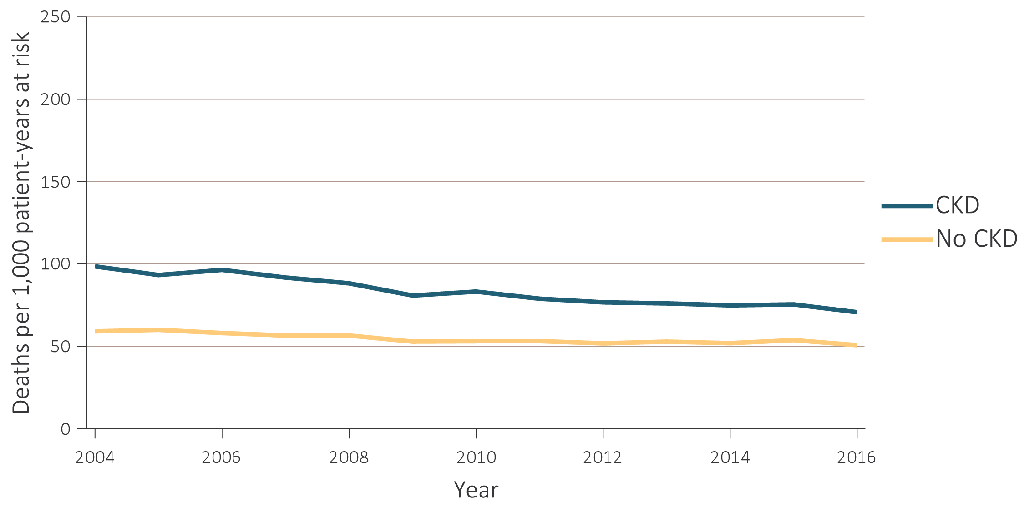
vol 1 Figure 3.1 Unadjusted and adjusted all-cause mortality rates per 1,000 patient-years at risk for Medicare patients aged 66 and older, by CKD status and year, 2004-2016
(c) Adjusted for comorbidities
Data source: Special analyses, Medicare 5% sample. January 1 of each reported year, point prevalent Medicare patients aged 66 and older. 1.b adjusted for age/sex/race and 1.c adjusted for age/sex/race/comorbidities. 1.e adjusted for age/sex and 1.f adjusted for age/sex/comorbidities. Standard population: Medicare 2011 patients. Abbreviation: CKD, chronic kidney disease.

Slide 6
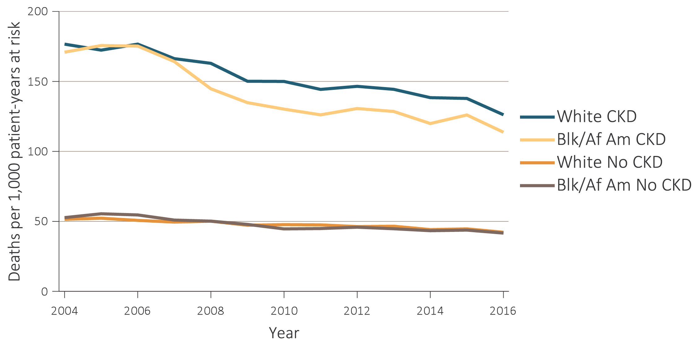
vol 1 Figure 3.1 Unadjusted and adjusted all-cause mortality rates per 1,000 patient-years at risk for Medicare patients aged 66 and older, by CKD status and year, 2004-2016
(d) Unadjusted
Data source: Special analyses, Medicare 5% sample. January 1 of each reported year, point prevalent Medicare patients aged 66 and older. 1.b adjusted for age/sex/race and 1.c adjusted for age/sex/race/comorbidities. 1.e adjusted for age/sex and 1.f adjusted for age/sex/comorbidities. Standard population: Medicare 2011 patients. Abbreviation: CKD, chronic kidney disease.

Slide 7
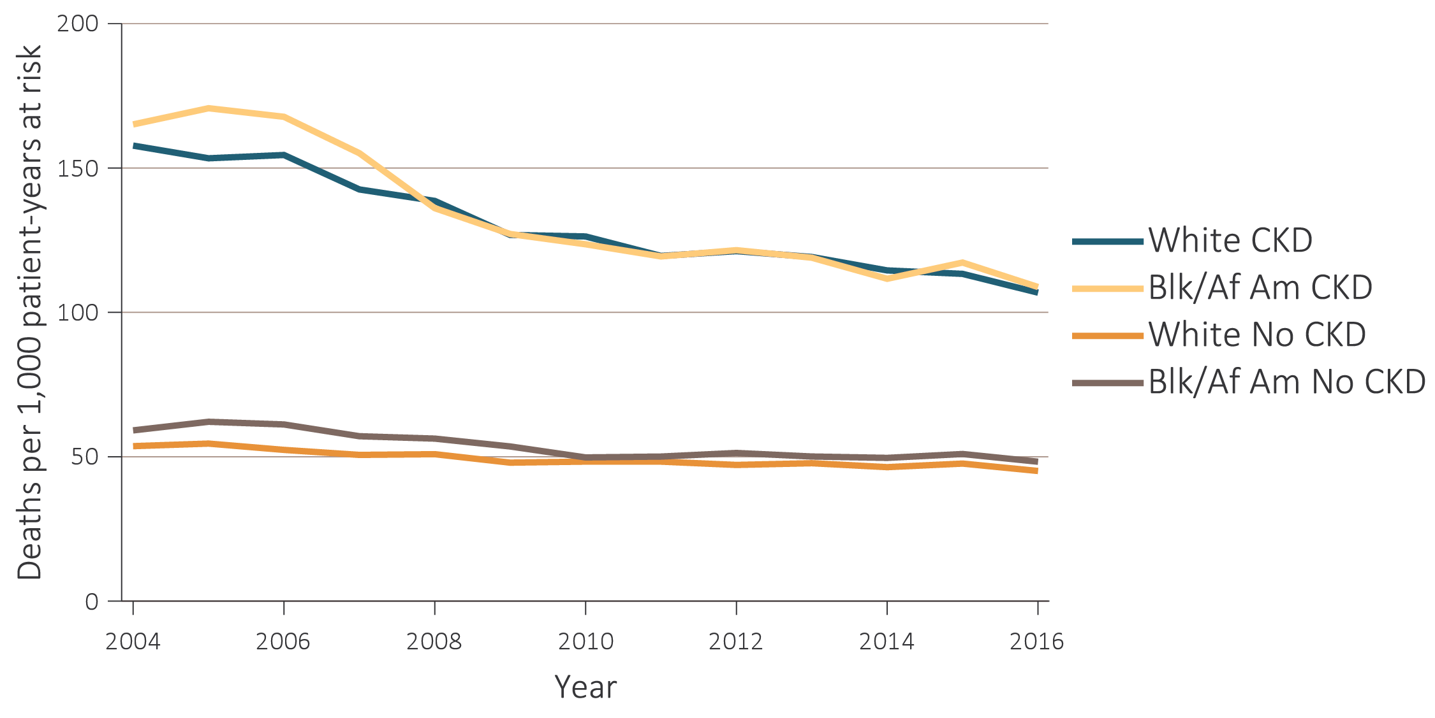
vol 1 Figure 3.1 Unadjusted and adjusted all-cause mortality rates per 1,000 patient-years at risk for Medicare patients aged 66 and older, by CKD status and year, 2004-2016
(e) Adjusted
Data source: Special analyses, Medicare 5% sample. January 1 of each reported year, point prevalent Medicare patients aged 66 and older. 1.b adjusted for age/sex/race and 1.c adjusted for age/sex/race/comorbidities. 1.e adjusted for age/sex and 1.f adjusted for age/sex/comorbidities. Standard population: Medicare 2011 patients. Abbreviation: CKD, chronic kidney disease.

Slide 8
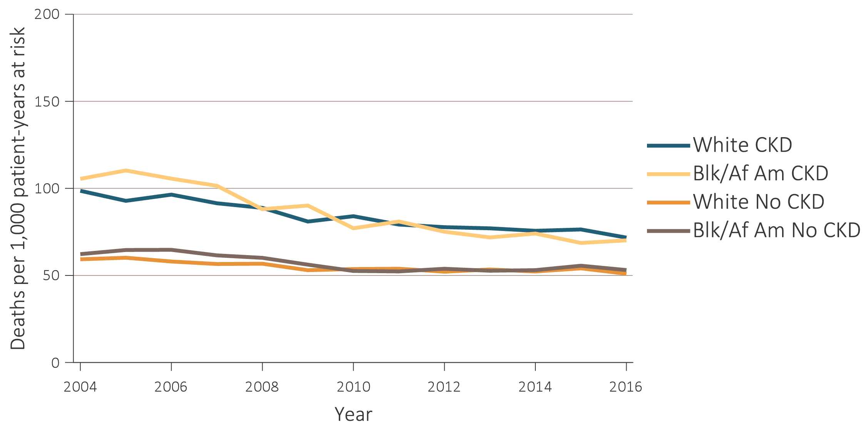
vol 1 Figure 3.1 Unadjusted and adjusted all-cause mortality rates per 1,000 patient-years at risk for Medicare patients aged 66 and older, by CKD status and year, 2004-2016
(f) Adjusted for comorbidities
Data source: Special analyses, Medicare 5% sample. January 1 of each reported year, point prevalent Medicare patients aged 66 and older. 1.b adjusted for age/sex/race and 1.c adjusted for age/sex/race/comorbidities. 1.e adjusted for age/sex and 1.f adjusted for age/sex/comorbidities. Standard population: Medicare 2011 patients. Abbreviation: CKD, chronic kidney disease.

Slide 9
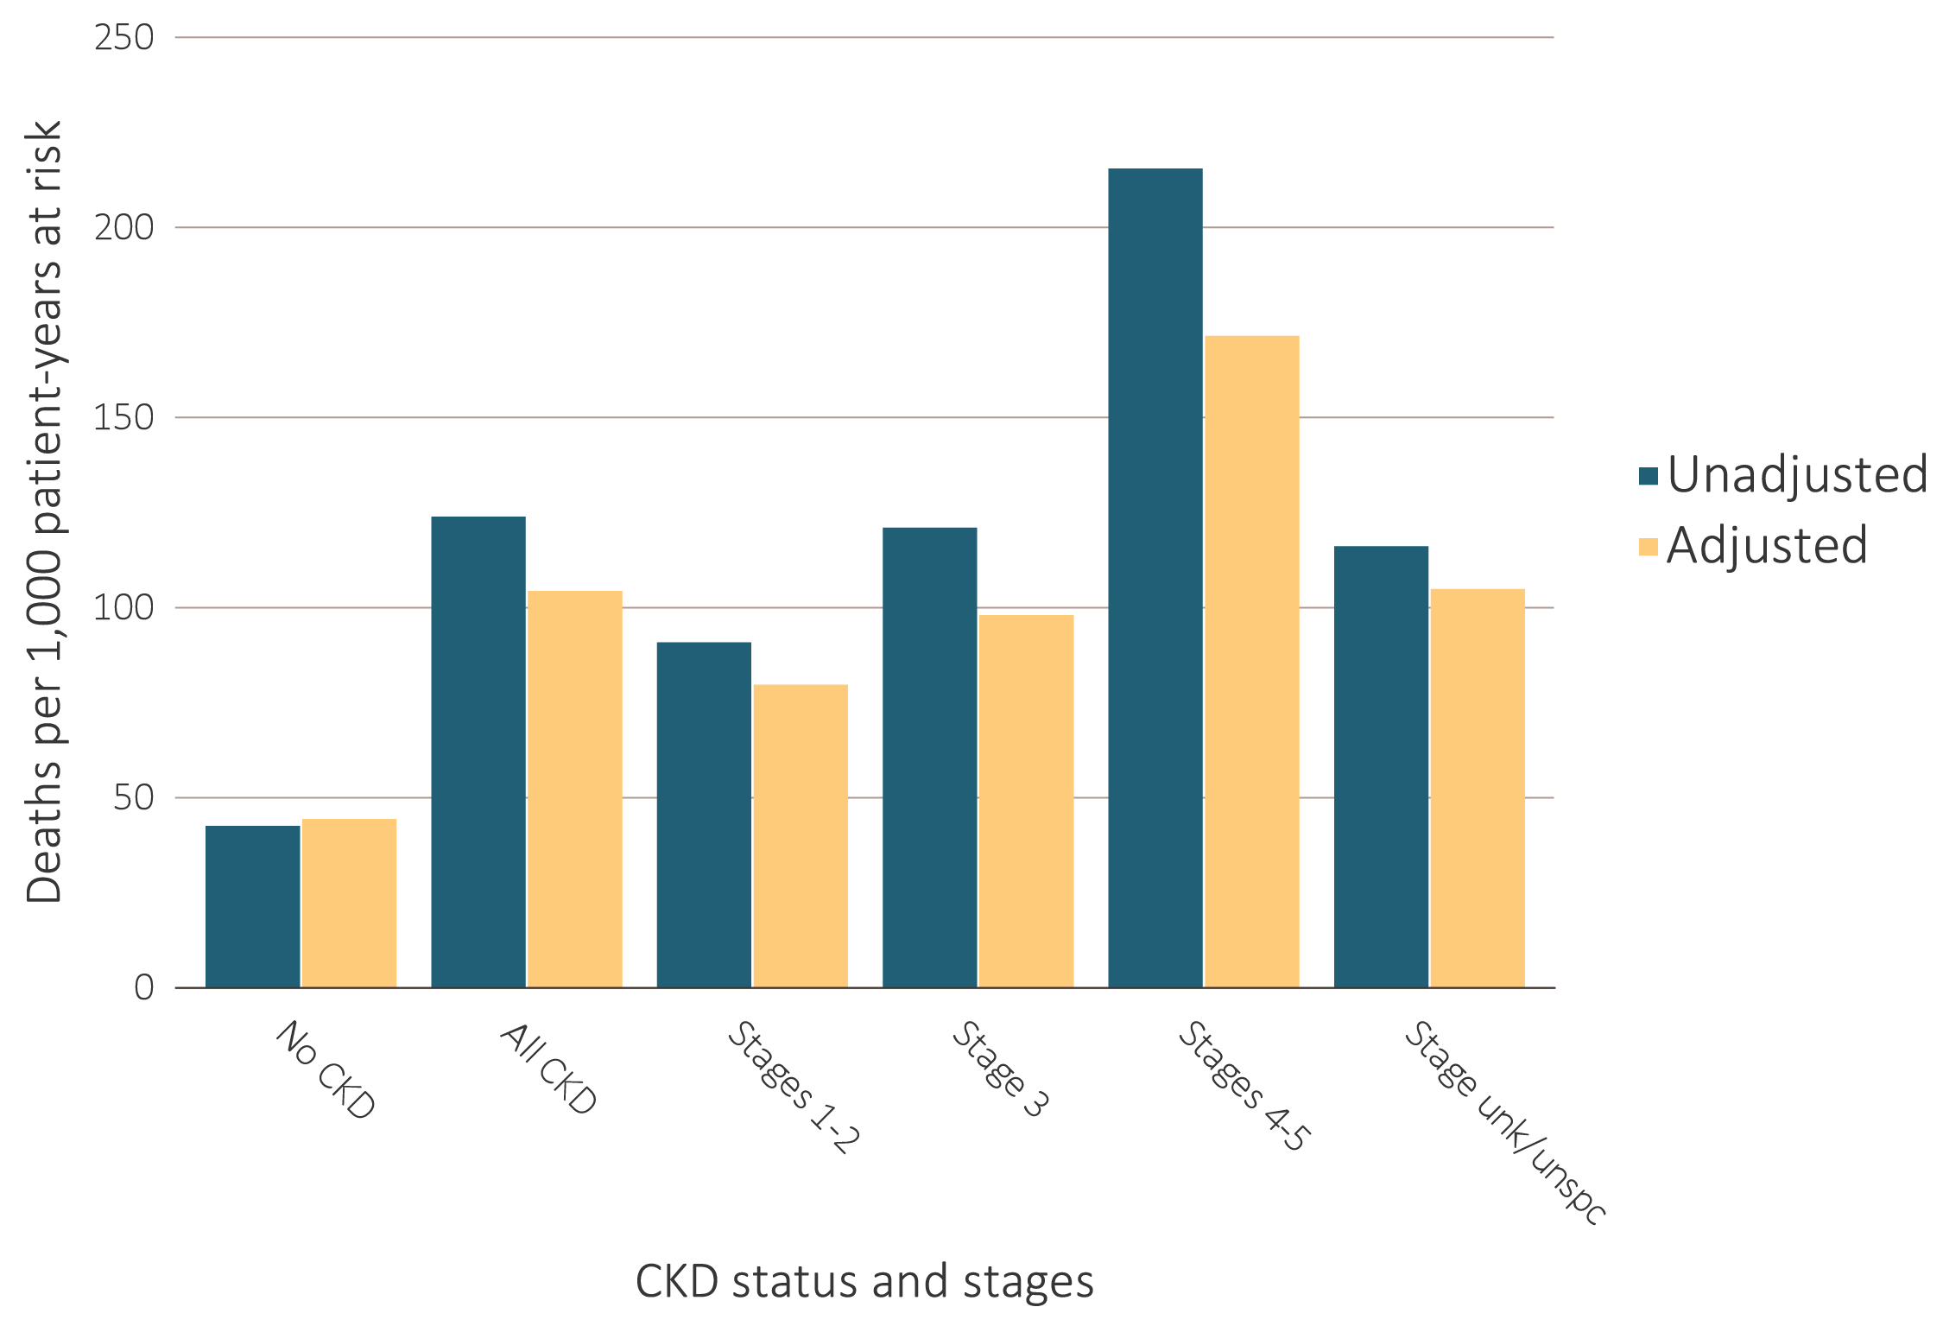
vol 1 Figure 3.2 Unadjusted and adjusted all-cause mortality rates per 1,000 patient-years at risk for Medicare patients aged 66 and older, by CKD status and stage, 2016
Data source: Special analyses, Medicare 5% sample. January 1 of each reported year, point prevalent Medicare patients aged 66 and older. Adjusted for age/sex/race. Standard population: Medicare 2016 patients. Abbreviations: CKD, chronic kidney disease; unk/unspc, CKD stage unidentified.

Slide 10
Table A. ICD-9-CM and ICD-10-CM codes for Chronic Kidney Disease (CKD) stages
ICD-9-CM codeª | ICD-10-CM codeª | Stage
585.1 | N18.1 | CKD, Stage 1
585.2 | N18.2 | CKD, Stage 2 (mild)
585.3 | N18.3 | CKD, Stage 3 (moderate)
585.4 | N18.4 | CKD, Stage 4 (severe)
585.5 | N18.5 | CKD, Stage 5 (excludes 585.6: Stage 5, requiring chronic dialysis^{b})
CKD Stage-unspecified | CKD Stage-unspecified | For these analyses, identified by multiple codes including 585.9, 250.4x, 403.9x & others for ICD-9-CM and A18.xx, E08.xx, E11.xx, and others for ICD10-CM.
ª For analyses in this chapter, CKD stage estimates require at least one occurrence of a stage-specific code, and the last available CKD stage in a given year is used. ^{b} In USRDS analyses, patients with ICD-9-CM code 585.6 or ICD-10-CM code N18.6 & with no ESRD 2728 form or other indication of end-stage renal disease (ESRD) are considered to have code 585.5 or N18.5.

Slide 11
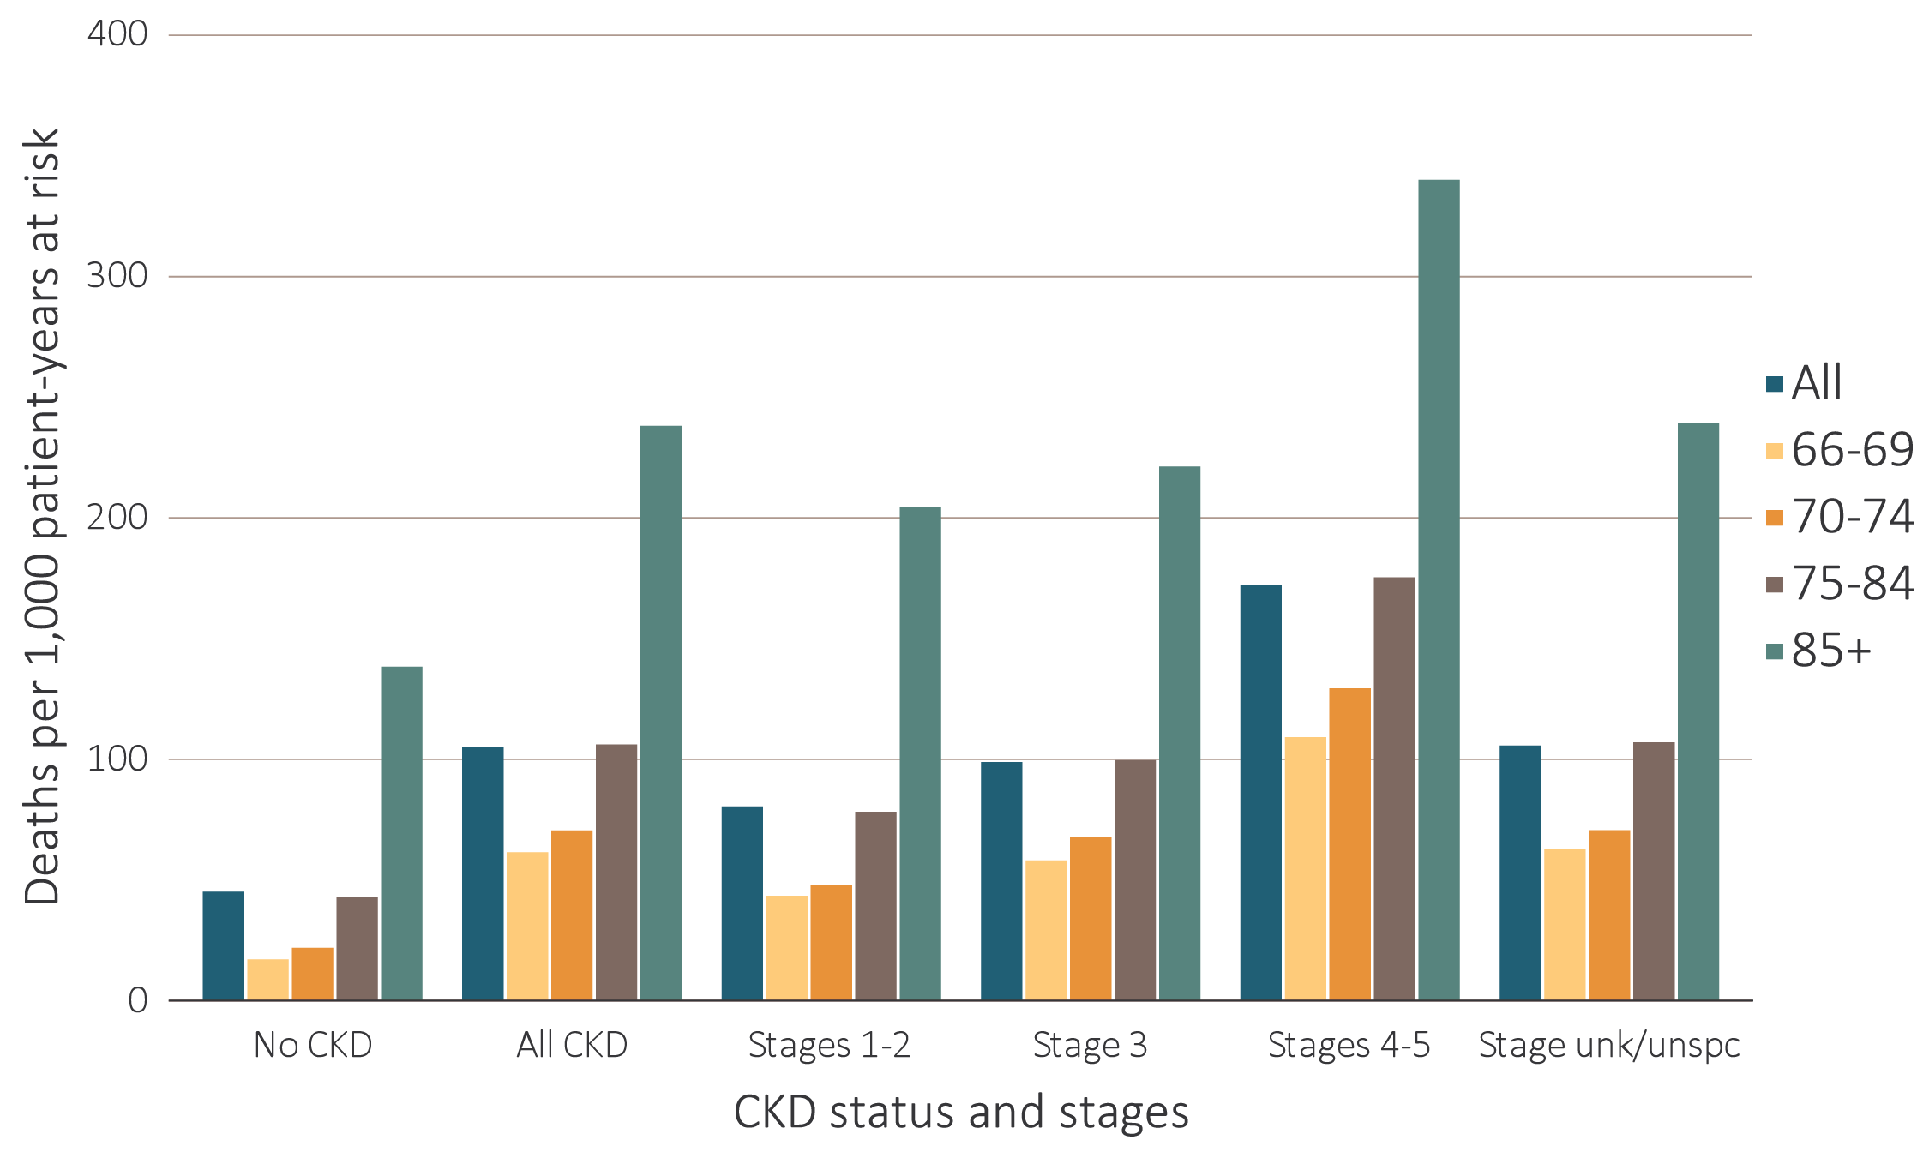
vol 1 Figure 3.3 Adjusted all-cause mortality rates per 1,000 patient-years at risk for Medicare patients aged 66 and older, by age, CKD status, and stage, 2016
Data source: Special analyses, Medicare 5% sample. January 1 of each reported year, point prevalent Medicare patients aged 66 and older. Adjusted for age/sex/race. Standard population: Medicare 2016 patients. Abbreviations: CKD, chronic kidney disease; unk/unspc, CKD stage unidentified.

Slide 12
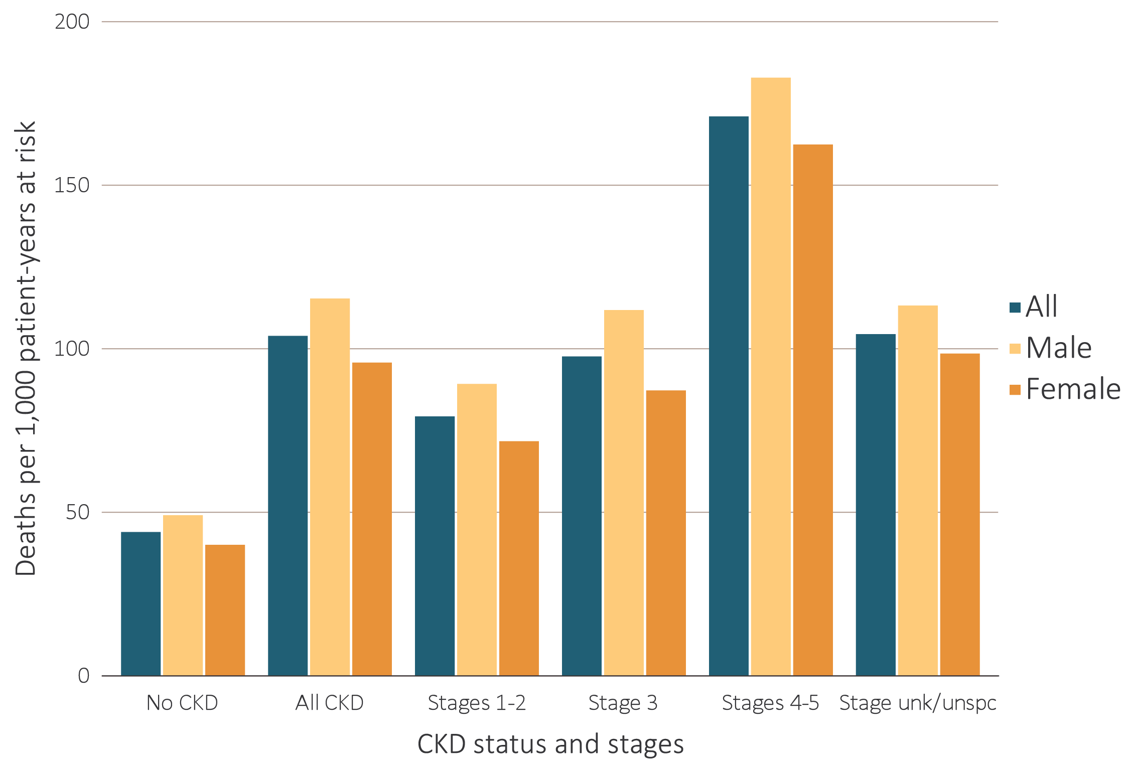
vol 1 Figure 3.4 Adjusted all-cause mortality rates per 1,000 patient-years at risk for Medicare patients aged 66 and older, by sex, CKD status, and stage, 2016
Data source: Special analyses, Medicare 5% sample. January 1 of each reported year, point prevalent Medicare patients aged 66 and older. Adjusted for age/sex/race. Standard population: Medicare 2016 patients. Abbreviations: CKD, chronic kidney disease; unk/unspc, CKD stage unidentified.

Slide 13
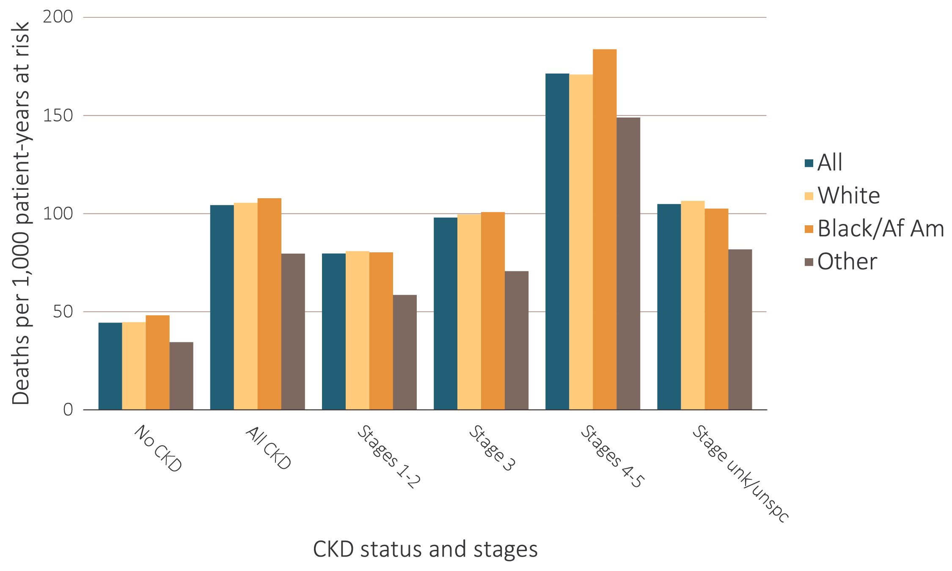
vol 1 Figure 3.5 Adjusted all-cause mortality rates per 1,000 patient-years at risk for Medicare patients aged 66 and older, by race, CKD status, and stage, 2016
Data source: Special analyses, Medicare 5% sample. January 1 of each reported year, point prevalent Medicare patients aged 66 and older. Adjusted for age/sex/race. Standard population: Medicare 2016 patients. Abbreviations: Af Am, African American; CKD, chronic kidney disease; unk/unspc, CKD stage unidentified.

Slide 14
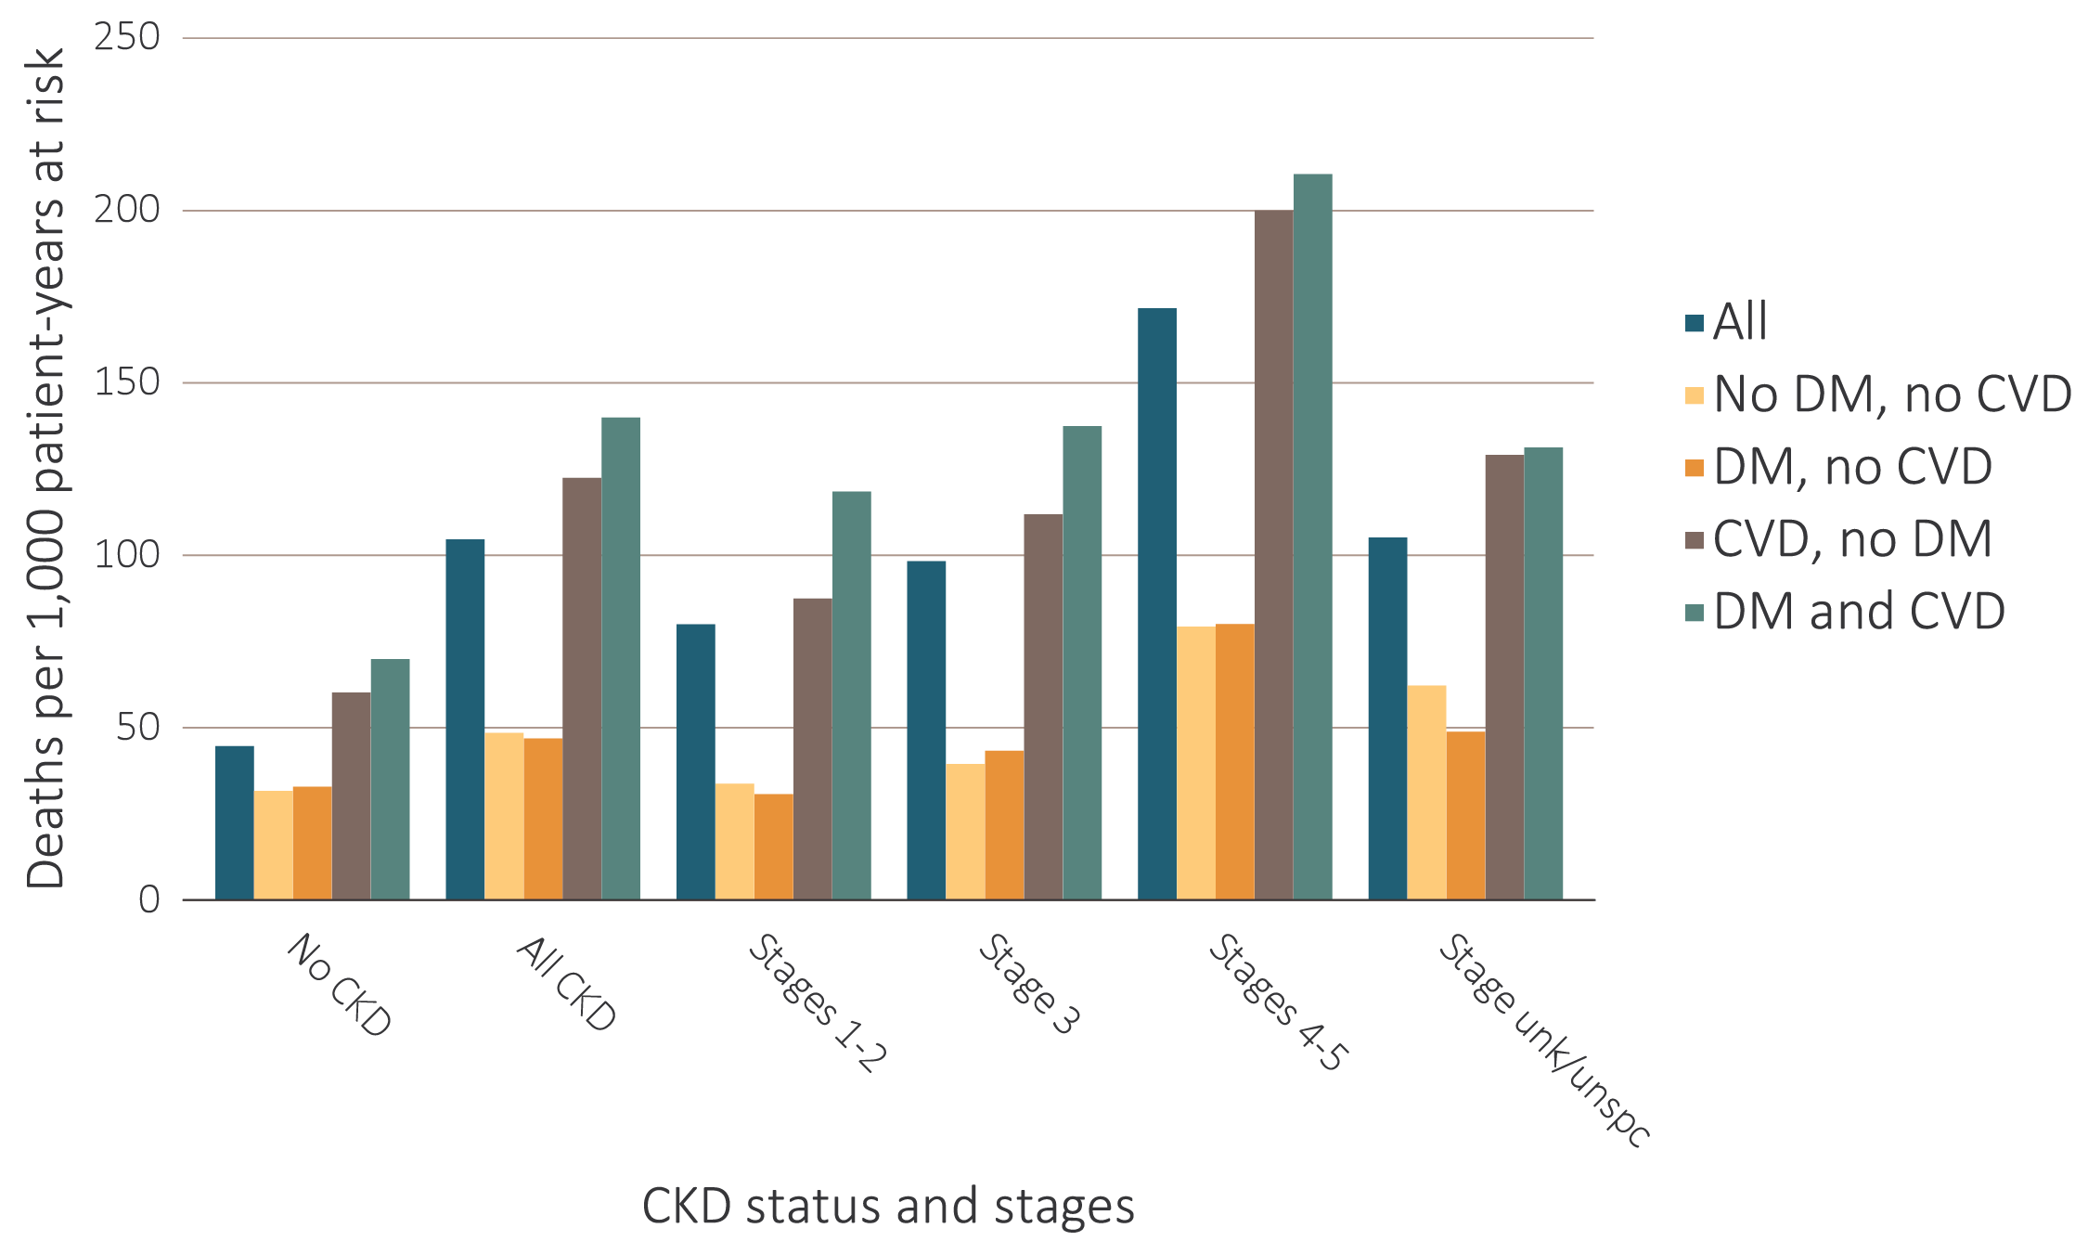
vol 1 Figure 3.6 Adjusted all-cause mortality rates per 1,000 patient-years at risk for Medicare patients aged 66 and older, by cardiovascular disease and diabetes mellitus, CKD status, and stage, 2016
Data source: Special analyses, Medicare 5% sample. January 1 of each reported year, point prevalent Medicare patients aged 66 and older. Adjusted for age/sex/race. Standard population: Medicare 2016 patients. Abbreviations: CKD, chronic kidney disease; CVD, cardiovascular disease; DM, diabetes mellitus; unk/unspc, CKD stage unidentified.

Slide 15
vol 1 Table 3.2 Unadjusted and adjusted all-cause hospitalization rates per 1,000 patient-years at risk for Medicare and Optum ClinformaticsTM patients, by CKD status, 2016
Data source: Medicare 5% sample and Optum ClinformaticsTM. January 1, 2016 point prevalent Medicare patients, aged 66 and older. Standard population: all Medicare patients, 2016. Optum Clinformatics™ commercial insurance patients aged 22 and older who were enrolled in the plan, did not have diagnoses of ESRD, and were alive on January 1, 2016. Adjusted for age/sex/race; rates by one factor are adjusted for the others. A dot (.) represents a zero value. Standard population: all Optum ClinformaticsTM patients, 2016. Abbreviations: CKD, chronic kidney disease; ESRD, end-stage kidney disease.

Slide 16
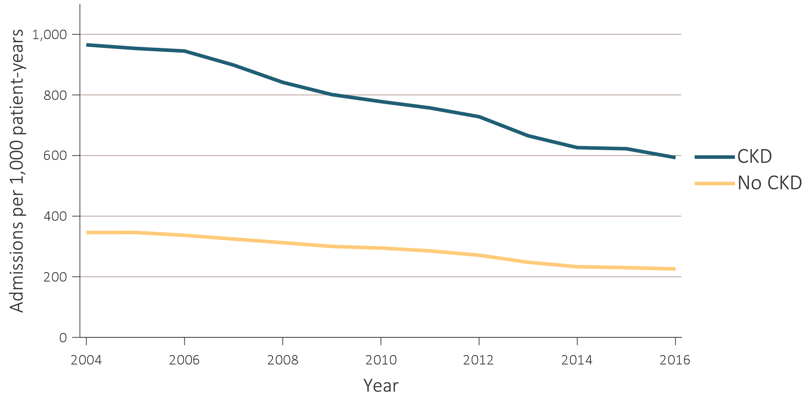
vol 1 Figure 3.7 Unadjusted and adjusted all-cause hospitalization rates per 1,000 patient-years at risk for Medicare and Optum ClinformaticsTM patients, by CKD status and year, 2004-2016
(a) Medicare - unadjusted
Data source: Medicare 5% sample and Optum ClinformaticsTM. January 1 of each reported year, point prevalent Medicare patients, aged 66 and older. Standard Medicare population: all patients, 2011. Optum Clinformatics™ commercial insurance patients aged 22 and older who were enrolled in the plan, did not have diagnoses of ESRD, and were alive on January 1 of each reported year. Adjusted for age/sex/race; rates by one factor are adjusted for the others. Standard Optum ClinformaticsTM population: all patients, 2011. Abbreviation: CKD, chronic kidney disease.

Slide 17
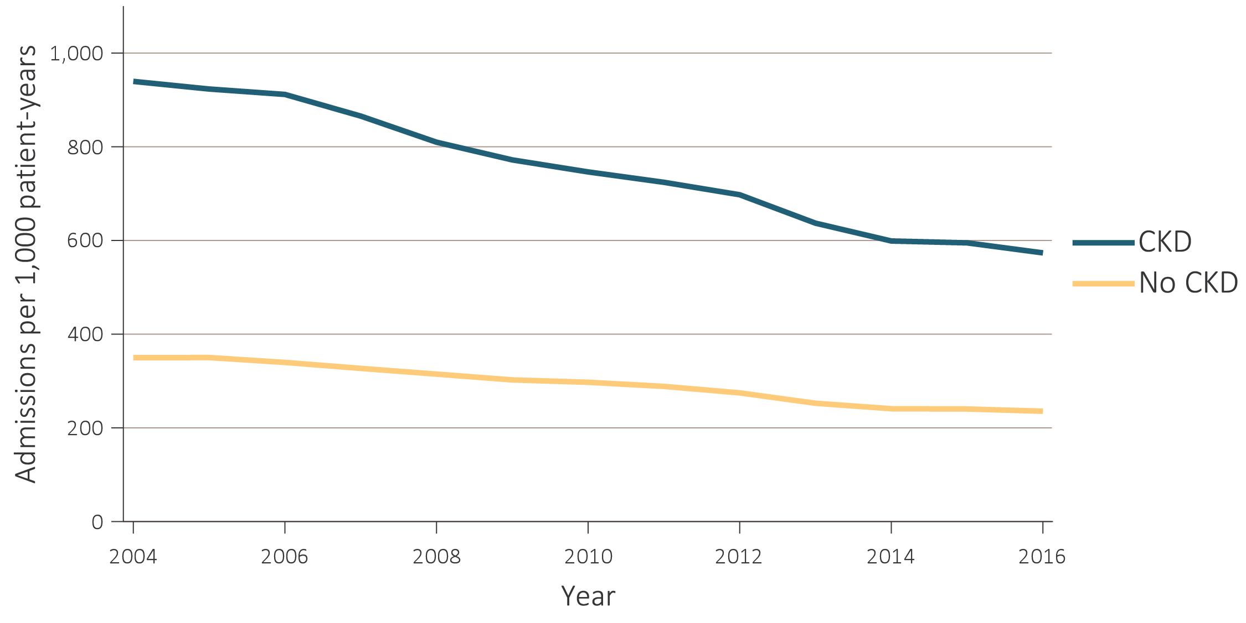
vol 1 Figure 3.7 Unadjusted and adjusted all-cause hospitalization rates per 1,000 patient-years at risk for Medicare and Optum ClinformaticsTM patients, by CKD status and year, 2004-2016
(b) Medicare - adjusted
Data source: Medicare 5% sample and Optum ClinformaticsTM. January 1 of each reported year, point prevalent Medicare patients, aged 66 and older. Standard Medicare population: all patients, 2011. Optum Clinformatics™ commercial insurance patients aged 22 and older who were enrolled in the plan, did not have diagnoses of ESRD, and were alive on January 1 of each reported year. Adjusted for age/sex/race; rates by one factor are adjusted for the others. Standard Optum ClinformaticsTM population: all patients, 2011. Abbreviation: CKD, chronic kidney disease.

Slide 18
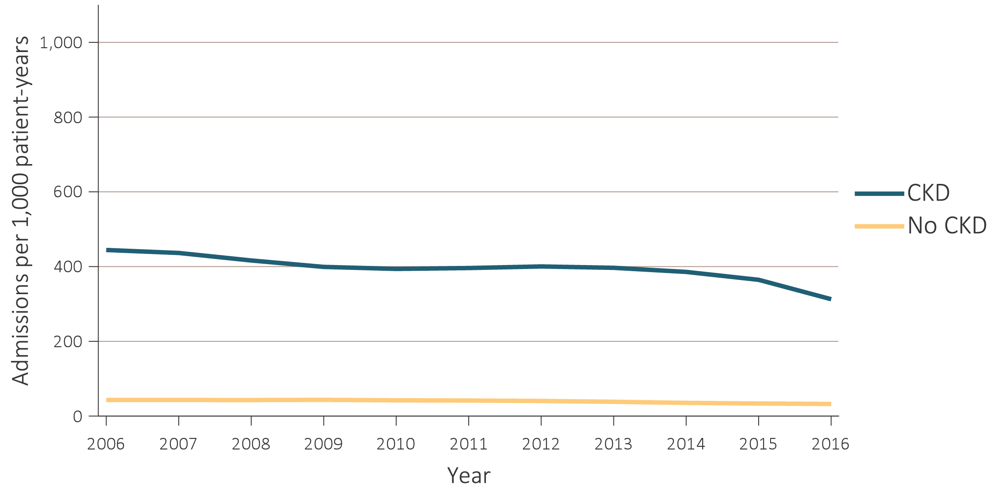
vol 1 Figure 3.7 Unadjusted and adjusted all-cause hospitalization rates per 1,000 patient-years at risk for Medicare and Optum ClinformaticsTM patients, by CKD status and year, 2004-2016
(c) Optum ClinformaticsTM - unadjusted
Data source: Medicare 5% sample and Optum ClinformaticsTM. January 1 of each reported year, point prevalent Medicare patients, aged 66 and older. Standard Medicare population: all patients, 2011. Optum Clinformatics™ commercial insurance patients aged 22 and older who were enrolled in the plan, did not have diagnoses of ESRD, and were alive on January 1 of each reported year. Adjusted for age/sex/race; rates by one factor are adjusted for the others. Standard Optum ClinformaticsTM population: all patients, 2011. Abbreviation: CKD, chronic kidney disease.

Slide 19
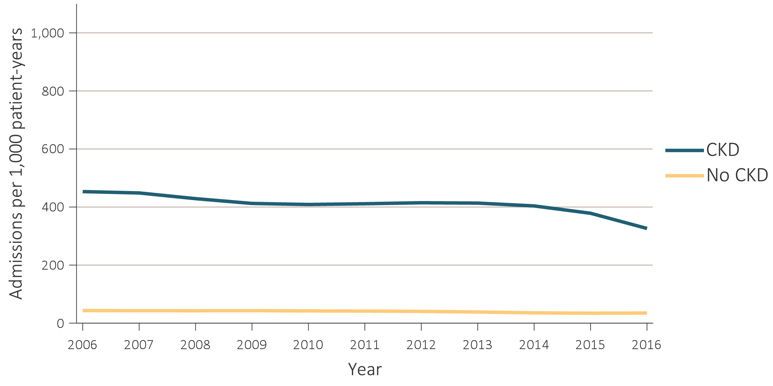
vol 1 Figure 3.7 Unadjusted and adjusted all-cause hospitalization rates per 1,000 patient-years at risk for Medicare and Optum ClinformaticsTM patients, by CKD status and year, 2004-2016
(d) Optum ClinformaticsTM - adjusted
Data source: Medicare 5% sample and Optum ClinformaticsTM. January 1 of each reported year, point prevalent Medicare patients, aged 66 and older. Standard Medicare population: all patients, 2011. Optum Clinformatics™ commercial insurance patients aged 22 and older who were enrolled in the plan, did not have diagnoses of ESRD, and were alive on January 1 of each reported year. Adjusted for age/sex/race; rates by one factor are adjusted for the others. Standard Optum ClinformaticsTM population: all patients, 2011. Abbreviation: CKD, chronic kidney disease.

Slide 20
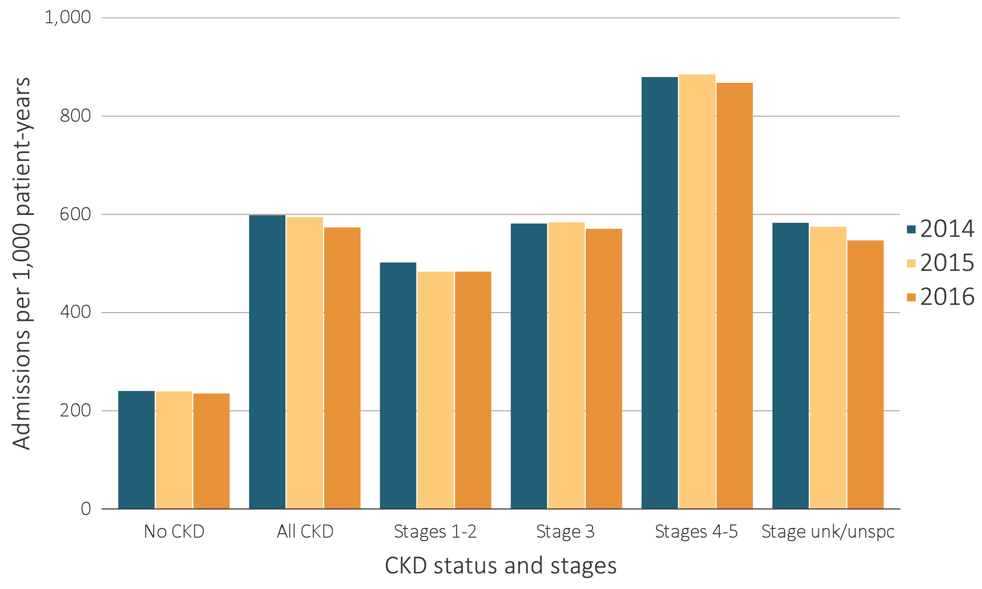
vol 1 Figure 3.8 Adjusted all-cause hospitalization rates per 1,000 patient-years at risk for Medicare patients aged 66 and older and Optum ClinformaticsTM patients aged 22 and older, by CKD status and stage, 2014-2016
(a) Medicare
Data source: Medicare 5% sample and Optum ClinformaticsTM. January 1, 2016 point prevalent Medicare patients, aged 66 and older. Standard Medicare population: all patients, 2016. Optum Clinformatics™ commercial insurance patients aged 22 and older who were enrolled in the plan, did not have diagnoses of ESRD, and were alive on January 1, 2016. Adjusted for age/sex/race; rates by one factor are adjusted for the others. Standard population: all Optum ClinformaticsTM patients, 2016. Abbreviations: CKD, chronic kidney disease unk/unspc, CKD stage unidentified.

Slide 21
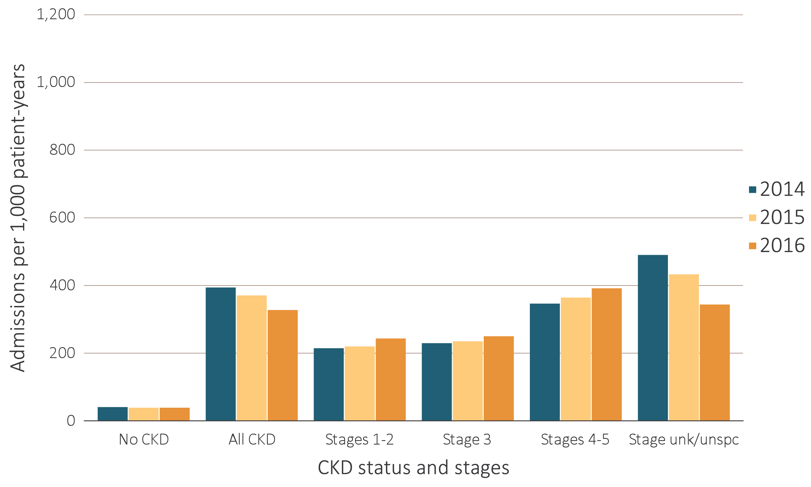
vol 1 Figure 3.8 Adjusted all-cause hospitalization rates per 1,000 patient-years at risk for Medicare patients aged 66 and older and Optum ClinformaticsTM patients aged 22 and older, by CKD status and stage, 2014-2016
(b) Optum ClinformaticsTM
Data source: Medicare 5% sample and Optum ClinformaticsTM. January 1, 2016 point prevalent Medicare patients, aged 66 and older. Standard Medicare population: all patients, 2016. Optum Clinformatics™ commercial insurance patients aged 22 and older who were enrolled in the plan, did not have diagnoses of ESRD, and were alive on January 1, 2016. Adjusted for age/sex/race; rates by one factor are adjusted for the others. Standard population: all Optum ClinformaticsTM patients, 2016. Abbreviations: CKD, chronic kidney disease unk/unspc, CKD stage unidentified.

Slide 22

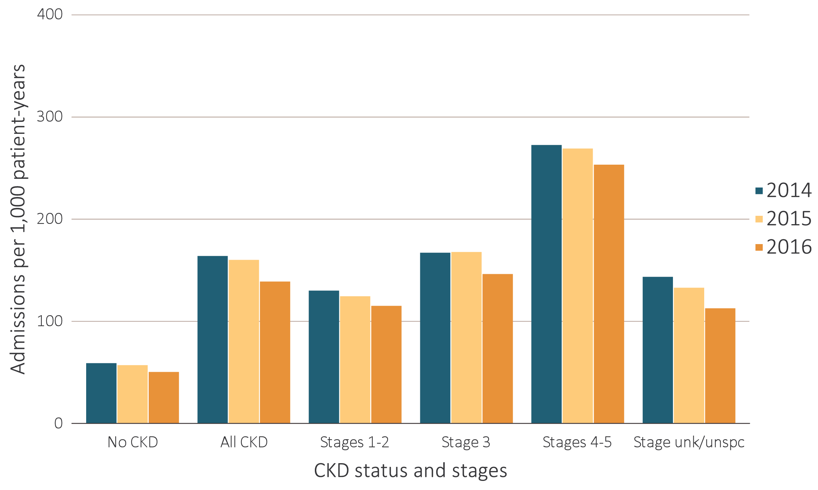
vol 1 Figure 3.9 Adjusted rates of hospitalization for cardiovascular disease per 1,000 patient-years at risk for Medicare patients aged 66 and older and Optum ClinformaticsTM patients aged 22 and older, by CKD status and stage, 2014-2016
Data source: Medicare 5% sample and Optum ClinformaticsTM. January 1, 2016 point prevalent Medicare patients, aged 66 and older. Standard Medicare population: all patients, 2016. Optum Clinformatics™ commercial insurance patients aged 22 and older who were enrolled in the plan, did not have diagnoses of ESRD, and were alive on January 1, 2016. Adjusted for age/sex/race; rates by one factor are adjusted for the others. Standard Optum ClinformaticsTM population: all patients, 2016. Abbreviations: CKD, chronic kidney disease unk/unspc, CKD stage unidentified.

Slide 23

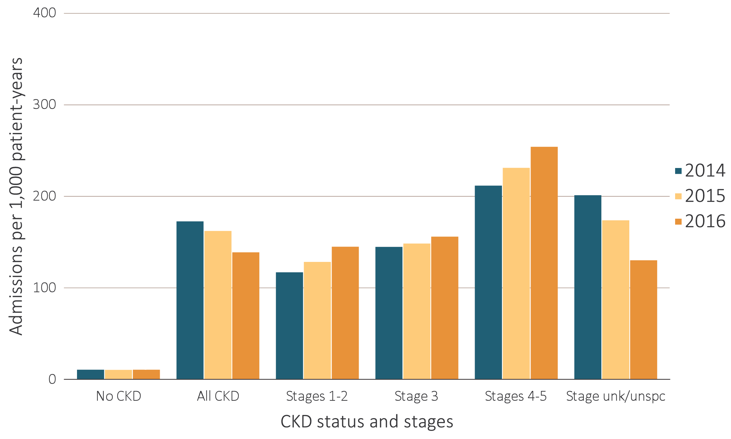
vol 1 Figure 3.9 Adjusted rates of hospitalization for cardiovascular disease per 1,000 patient-years at risk for Medicare patients aged 66 and older and Optum ClinformaticsTM patients aged 22 and older, by CKD status and stage, 2014-2016
Data source: Medicare 5% sample and Optum ClinformaticsTM. January 1, 2016 point prevalent Medicare patients, aged 66 and older. Standard Medicare population: all patients, 2016. Optum Clinformatics™ commercial insurance patients aged 22 and older who were enrolled in the plan, did not have diagnoses of ESRD, and were alive on January 1, 2016. Adjusted for age/sex/race; rates by one factor are adjusted for the others. Standard Optum ClinformaticsTM population: all patients, 2016. Abbreviations: CKD, chronic kidney disease unk/unspc, CKD stage unidentified.

Slide 24
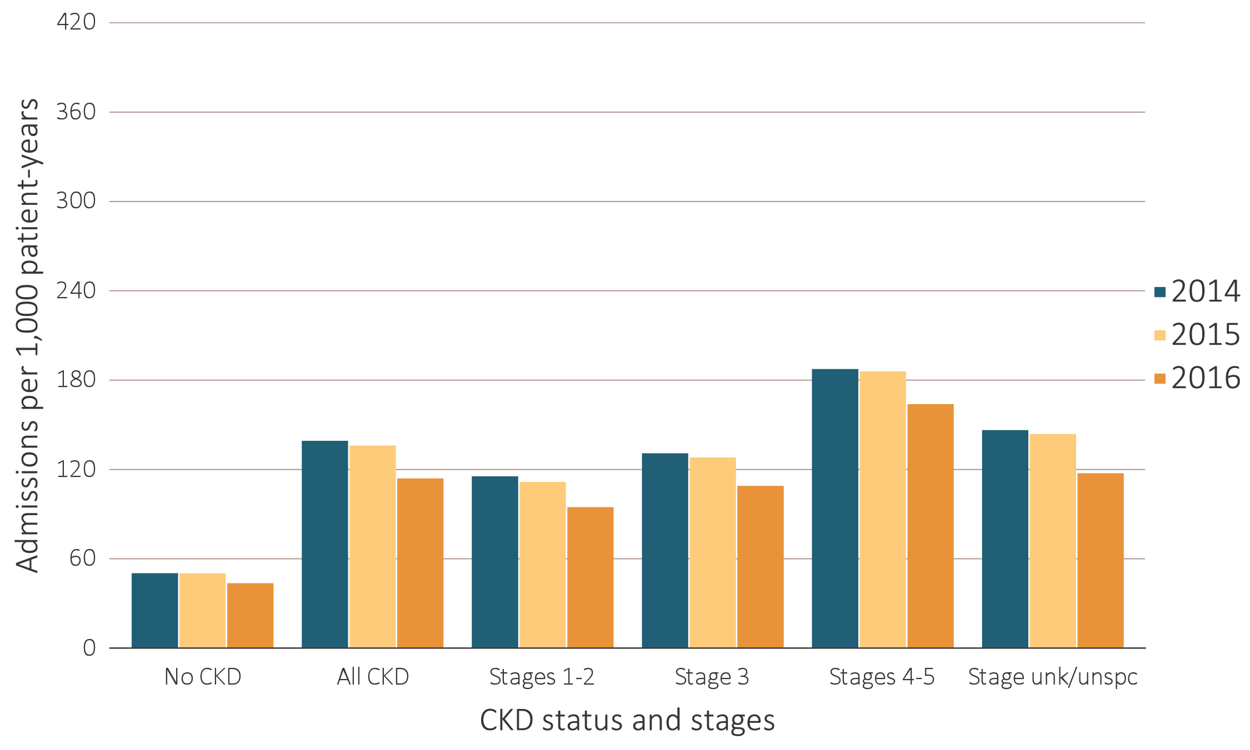
vol 1 Figure 3.10 Adjusted rates of hospitalization for infection per 1,000 patient-years at risk for Medicare aged 66 and older and Optum ClinformaticsTM patients aged 22 and older, by CKD status and stage, 2014-2016
Data source: Medicare 5% sample and Optum ClinformaticsTM. January 1, 2016 point prevalent Medicare patients, aged 66 and older. Standard Medicare population: all patients, 2016. Optum Clinformatics™ commercial insurance patients aged 22 and older who were enrolled in the plan, did not have diagnoses of ESRD, and were alive on January 1, 2016. Adjusted for age/sex/race; rates by one factor are adjusted for the others. Standard population: all Optum ClinformaticsTM patients, 2016. Abbreviations: CKD, chronic kidney disease unk/unspc, CKD stage unidentified.

Slide 25
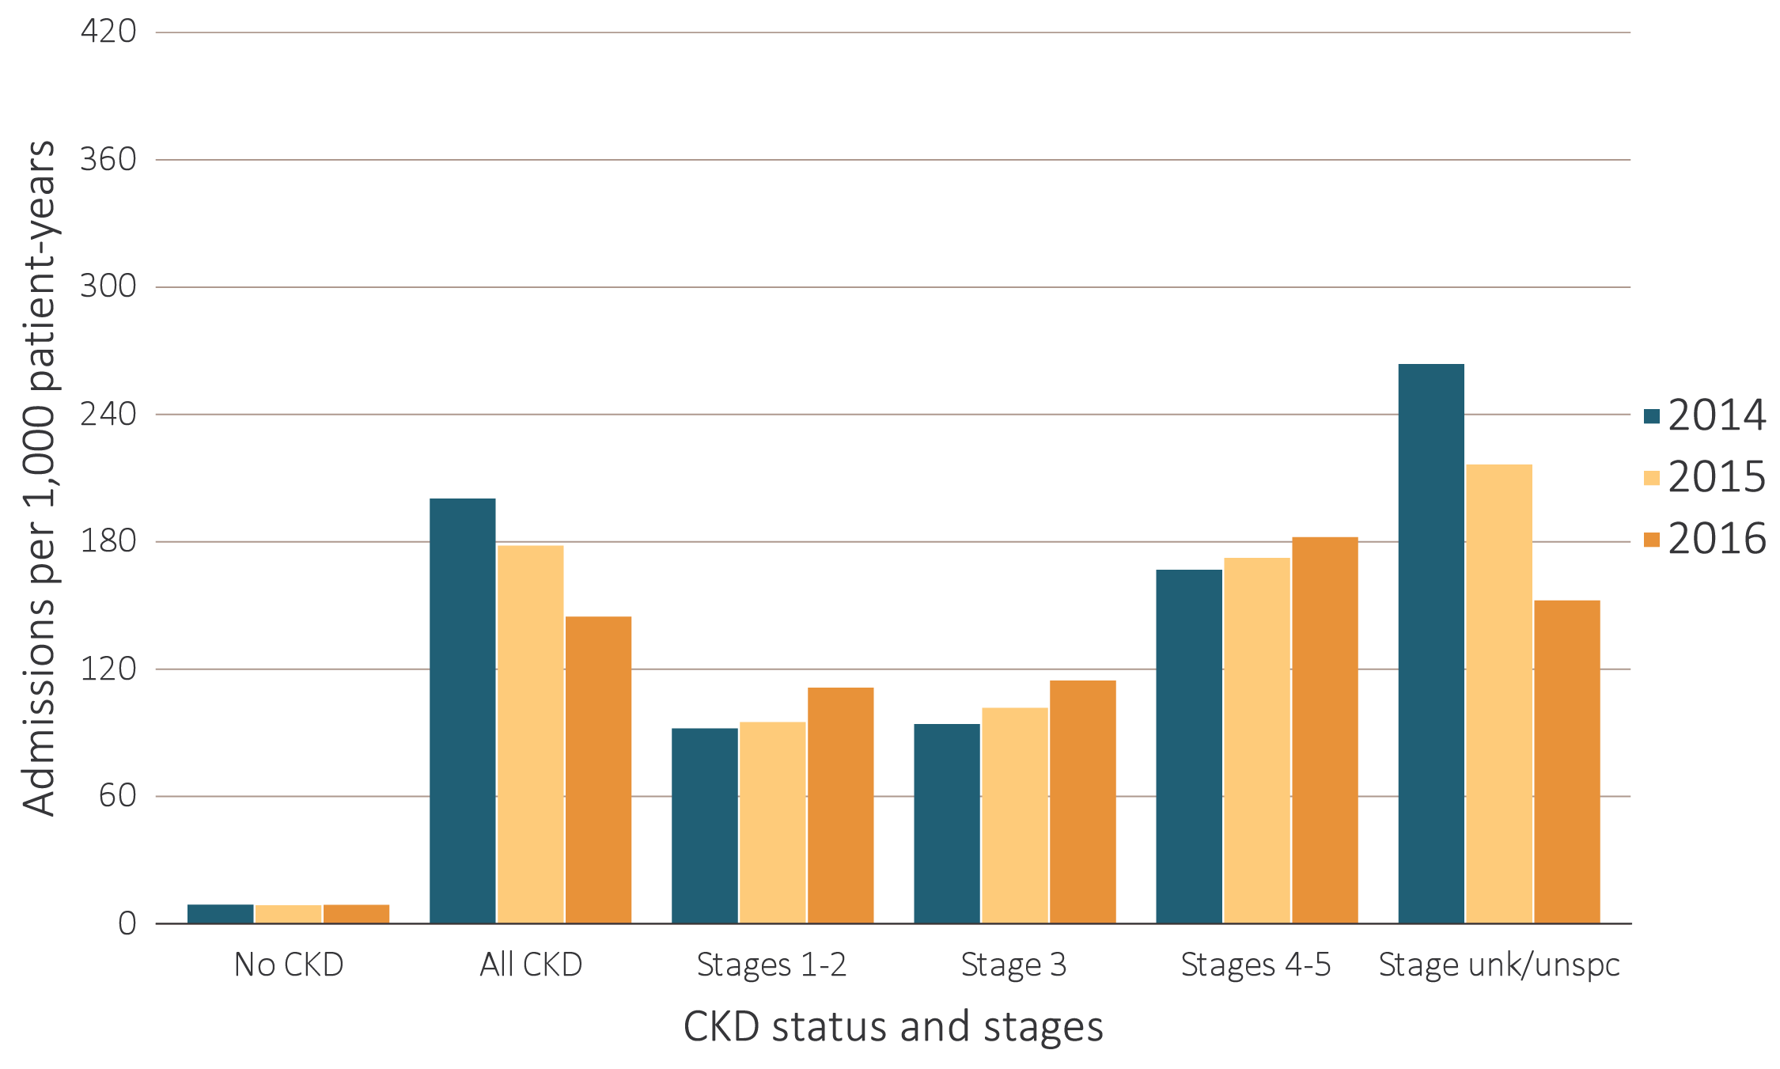
vol 1 Figure 3.10 Adjusted rates of hospitalization for infection per 1,000 patient-years at risk for Medicare aged 66 and older and Optum ClinformaticsTM patients aged 22 and older, by CKD status and stage, 2014-2016
Data source: Medicare 5% sample and Optum ClinformaticsTM. January 1, 2016 point prevalent Medicare patients, aged 66 and older. Standard Medicare population: all patients, 2016. Optum Clinformatics™ commercial insurance patients aged 22 and older who were enrolled in the plan, did not have diagnoses of ESRD, and were alive on January 1, 2016. Adjusted for age/sex/race; rates by one factor are adjusted for the others. Standard population: all Optum ClinformaticsTM patients, 2016. Abbreviations: CKD, chronic kidney disease unk/unspc, CKD stage unidentified.

Slide 26
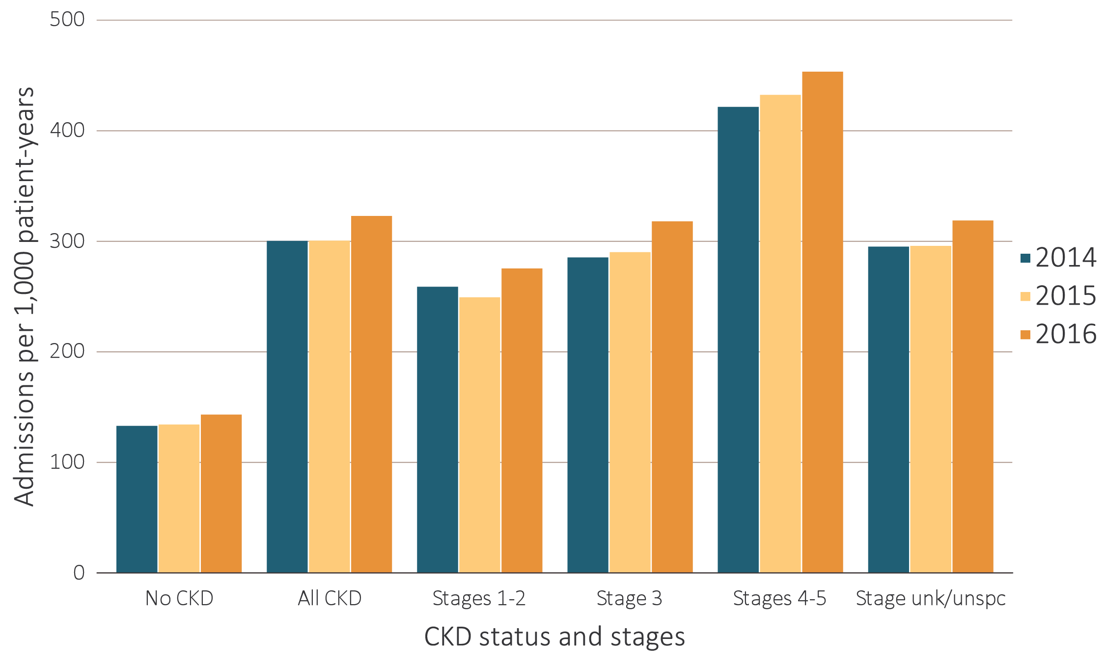
vol 1 Figure 3.11 Adjusted rates of hospitalization for causes other than cardiovascular disease and infection per 1,000 patient-years at risk for Medicare aged 66 and older and Optum ClinformaticsTM patients aged 22 and older, by CKD status and stage, 2014-2016
Data source: Medicare 5% sample and Optum ClinformaticsTM. January 1, 2016 point prevalent Medicare patients, aged 66 and older. Standard Medicare population: all patients, 2016. Optum Clinformatics™ commercial insurance patients aged 22 and older who were enrolled in the plan, did not have diagnoses of ESRD, and were alive on January 1, 2016. Adjusted for age/sex/race; rates by one factor are adjusted for the others. Standard Optum ClinformaticsTM population: all patients, 2016. Abbreviations: CKD, chronic kidney disease unk/unspc, CKD stage unidentified.

Slide 27
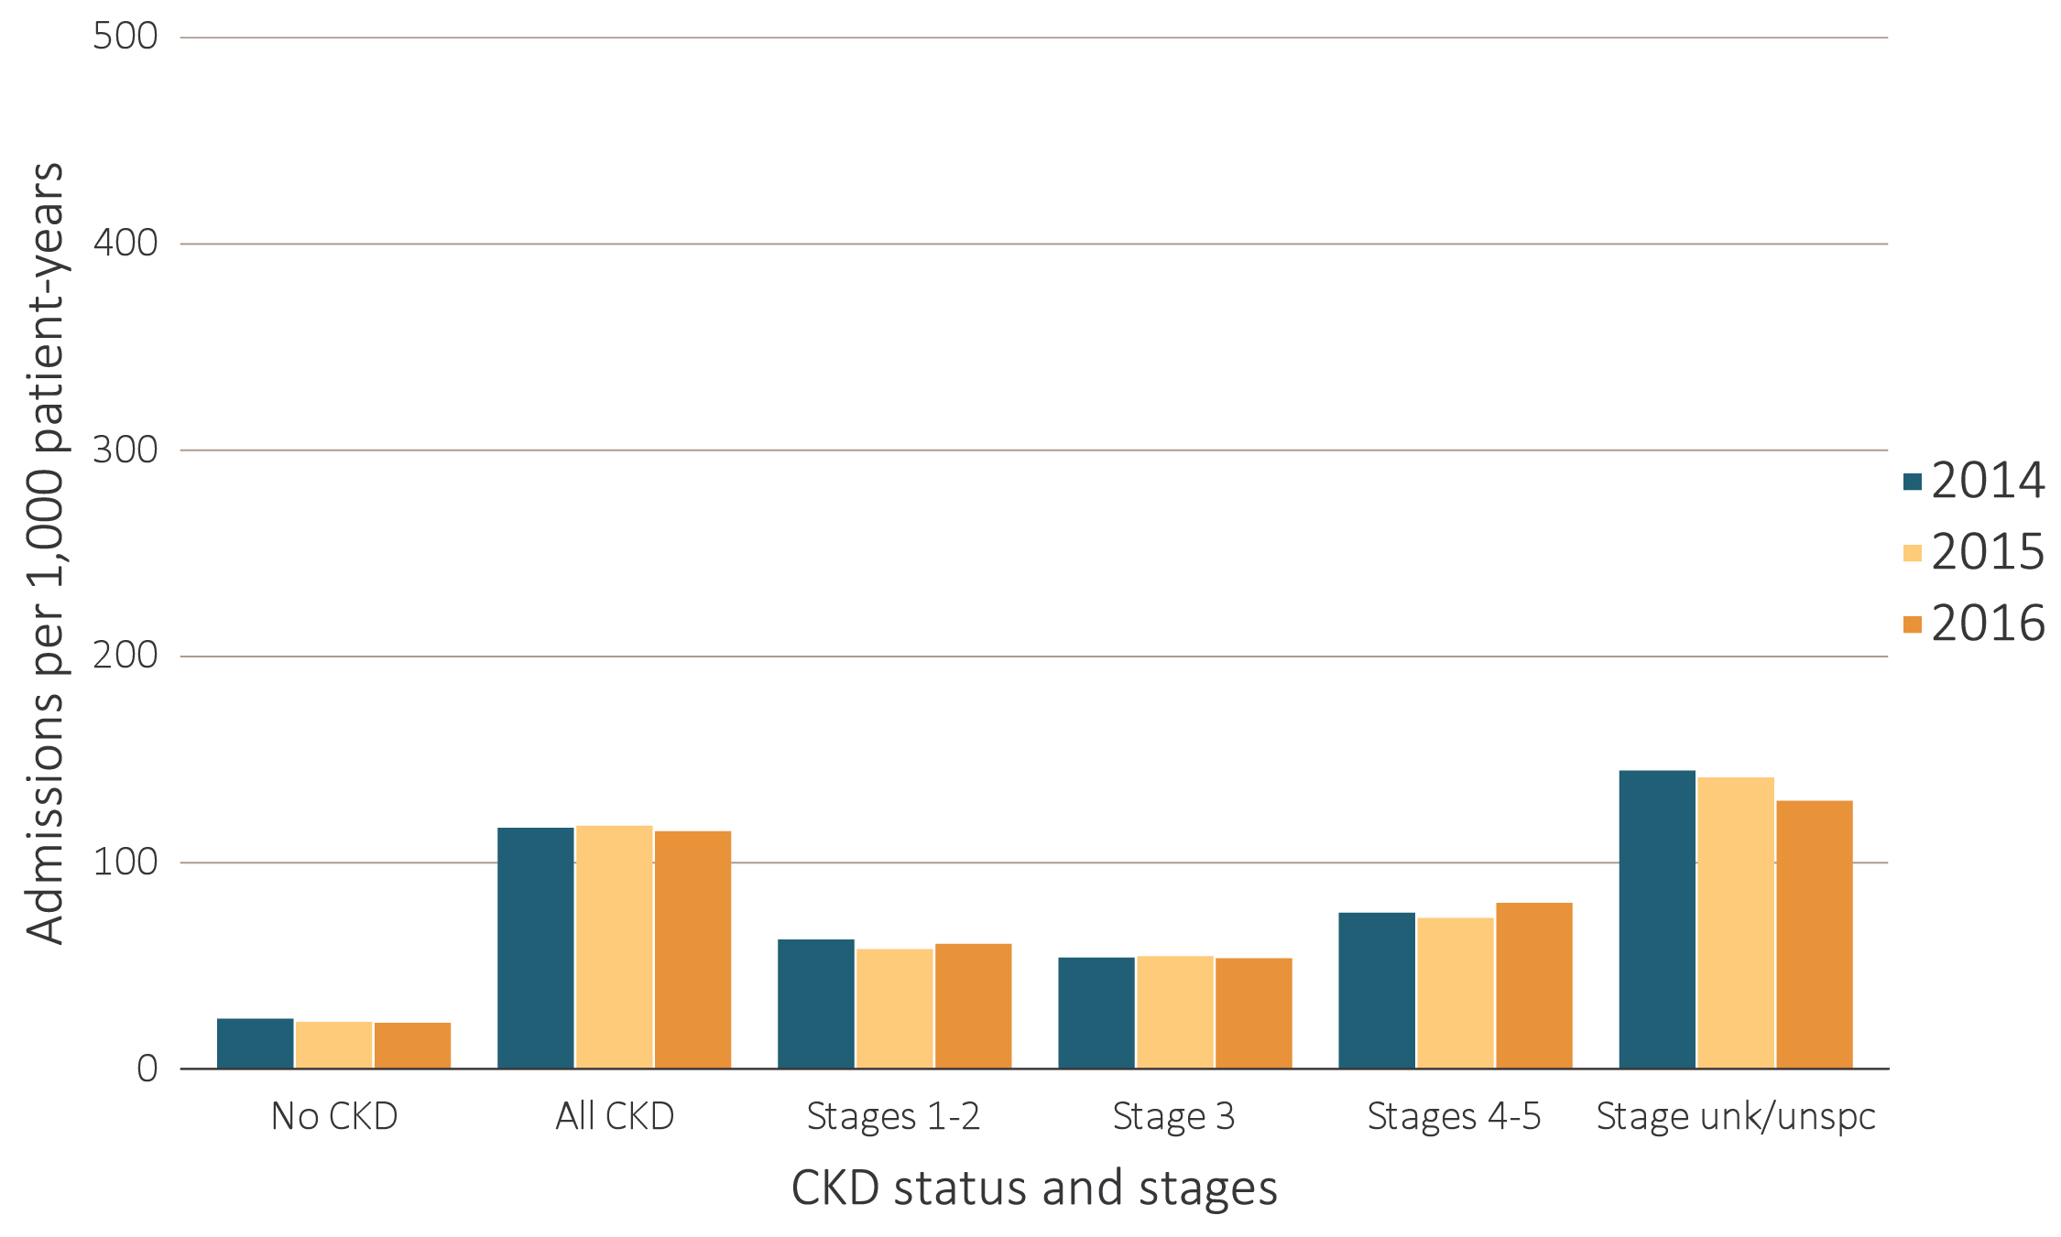
vol 1 Figure 3.11 Adjusted rates of hospitalization for causes other than cardiovascular disease and infection per 1,000 patient-years at risk for Medicare aged 66 and older and Optum ClinformaticsTM patients aged 22 and older, by CKD status and stage, 2014-2016
Data source: Medicare 5% sample and Optum ClinformaticsTM. January 1, 2016 point prevalent Medicare patients, aged 66 and older. Standard Medicare population: all patients, 2016. Optum Clinformatics™ commercial insurance patients aged 22 and older who were enrolled in the plan, did not have diagnoses of ESRD, and were alive on January 1, 2016. Adjusted for age/sex/race; rates by one factor are adjusted for the others. Standard Optum ClinformaticsTM population: all patients, 2016. Abbreviations: CKD, chronic kidney disease unk/unspc, CKD stage unidentified.

Slide 28
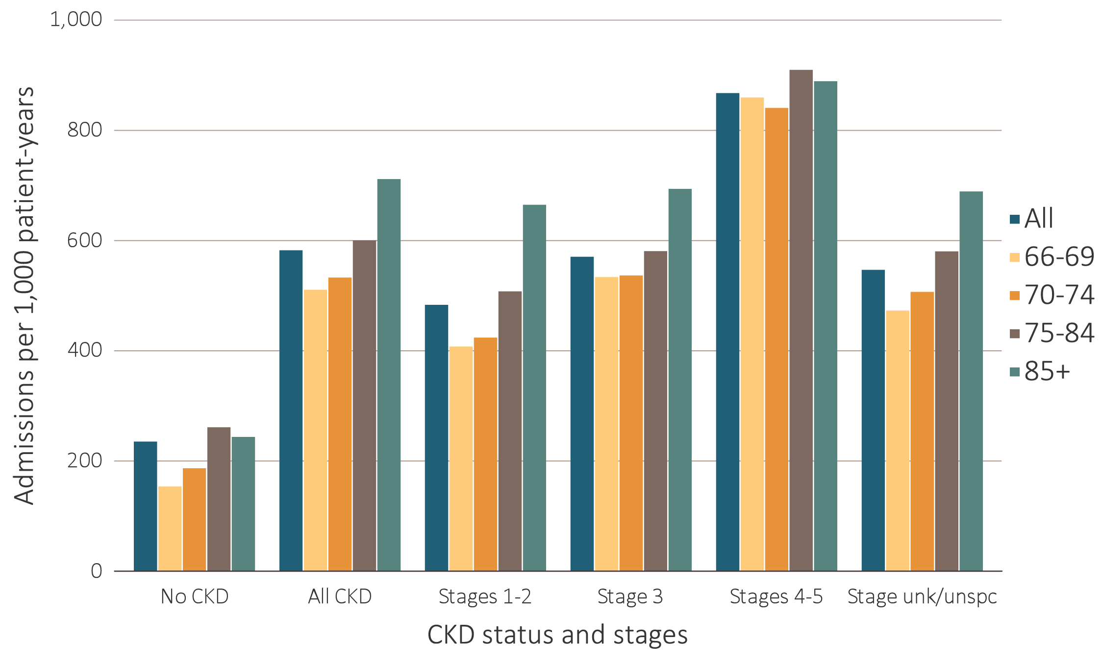
vol 1 Figure 3.12 Adjusted all-cause hospitalization rates per 1,000 patient-years at risk for Medicare patients aged 66 and older, by age, CKD status, and stage, 2016
Data source: Medicare 5% sample. January 1, 2016 point prevalent Medicare patients aged 66 and older. Adjusted for age/sex/race; rates by one factor are adjusted for the others. Standard population: all patients, 2016. Abbreviations: CKD, chronic kidney disease; unk/unspc, CKD stage unidentified.

Slide 29
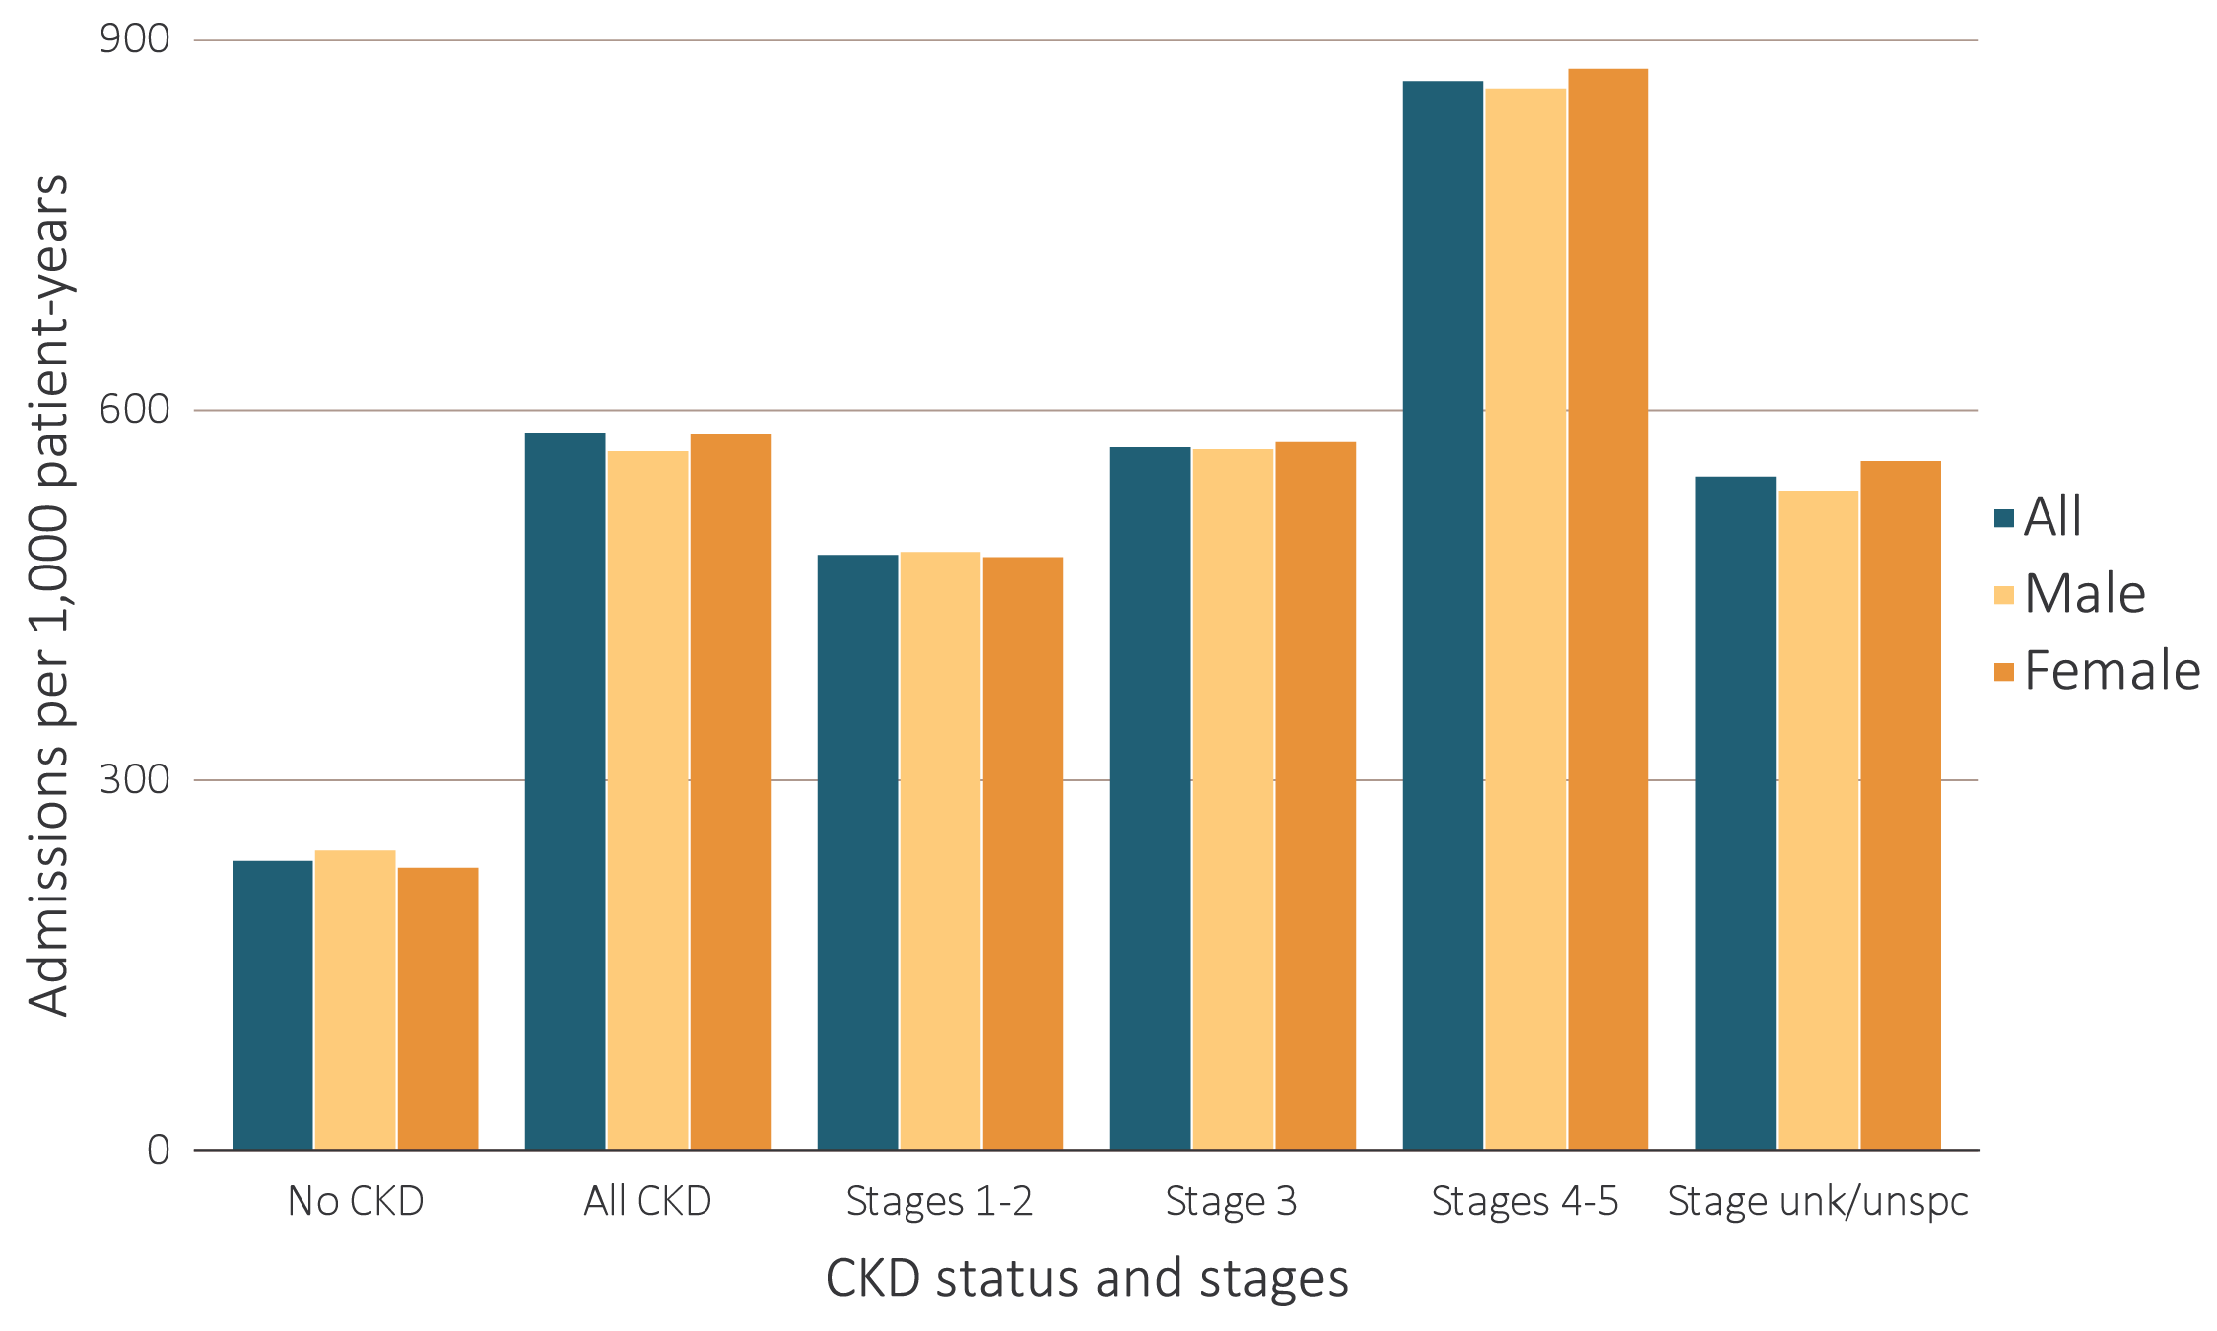
vol 1 Figure 3.13 Adjusted all-cause hospitalization rates per 1,000 patient-years at risk for Medicare patients aged 66 and older, by sex, CKD status, and stage, 2016
Data source: Medicare 5% sample. January 1, 2016 point prevalent Medicare patients aged 66 and older. Adjusted for age/sex/race; rates by one factor are adjusted for the others. Standard population: all patients, 2016. Abbreviations: CKD, chronic kidney disease; unk/unspc, CKD stage unidentified.

Slide 30
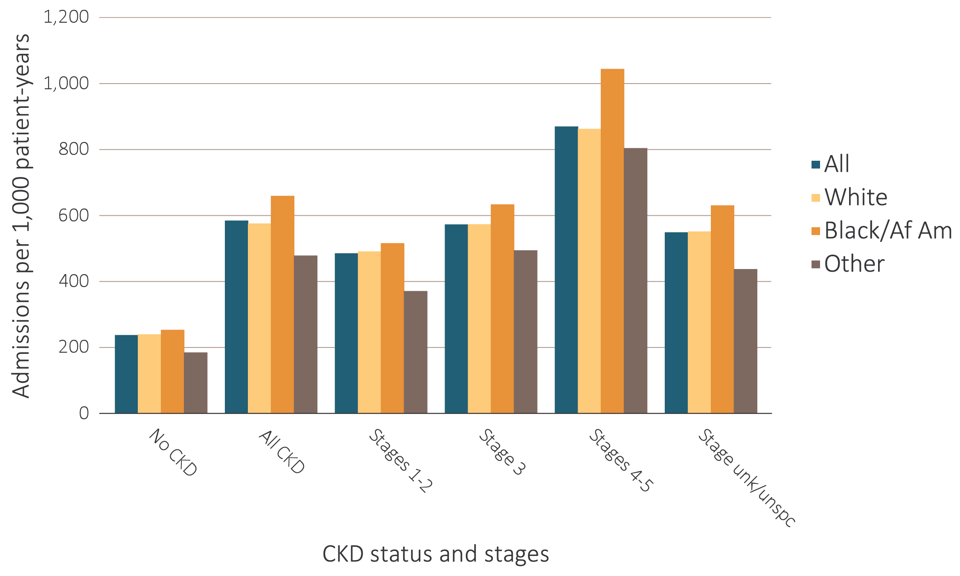
vol 1 Figure 3.14 Adjusted all-cause hospitalization rates per 1,000 patient-years at risk for Medicare patients aged 66 and older, by race, CKD status, and stage, 2016
Data source: Medicare 5% sample. January 1, 2016 point prevalent Medicare patients aged 66 and older. Adjusted for age/sex/race; rates by one factor are adjusted for the others. Standard population: all patients, 2016. Abbreviations: Af Am, African American; CKD, chronic kidney disease; unk/unspc, CKD stage unidentified.

Slide 31
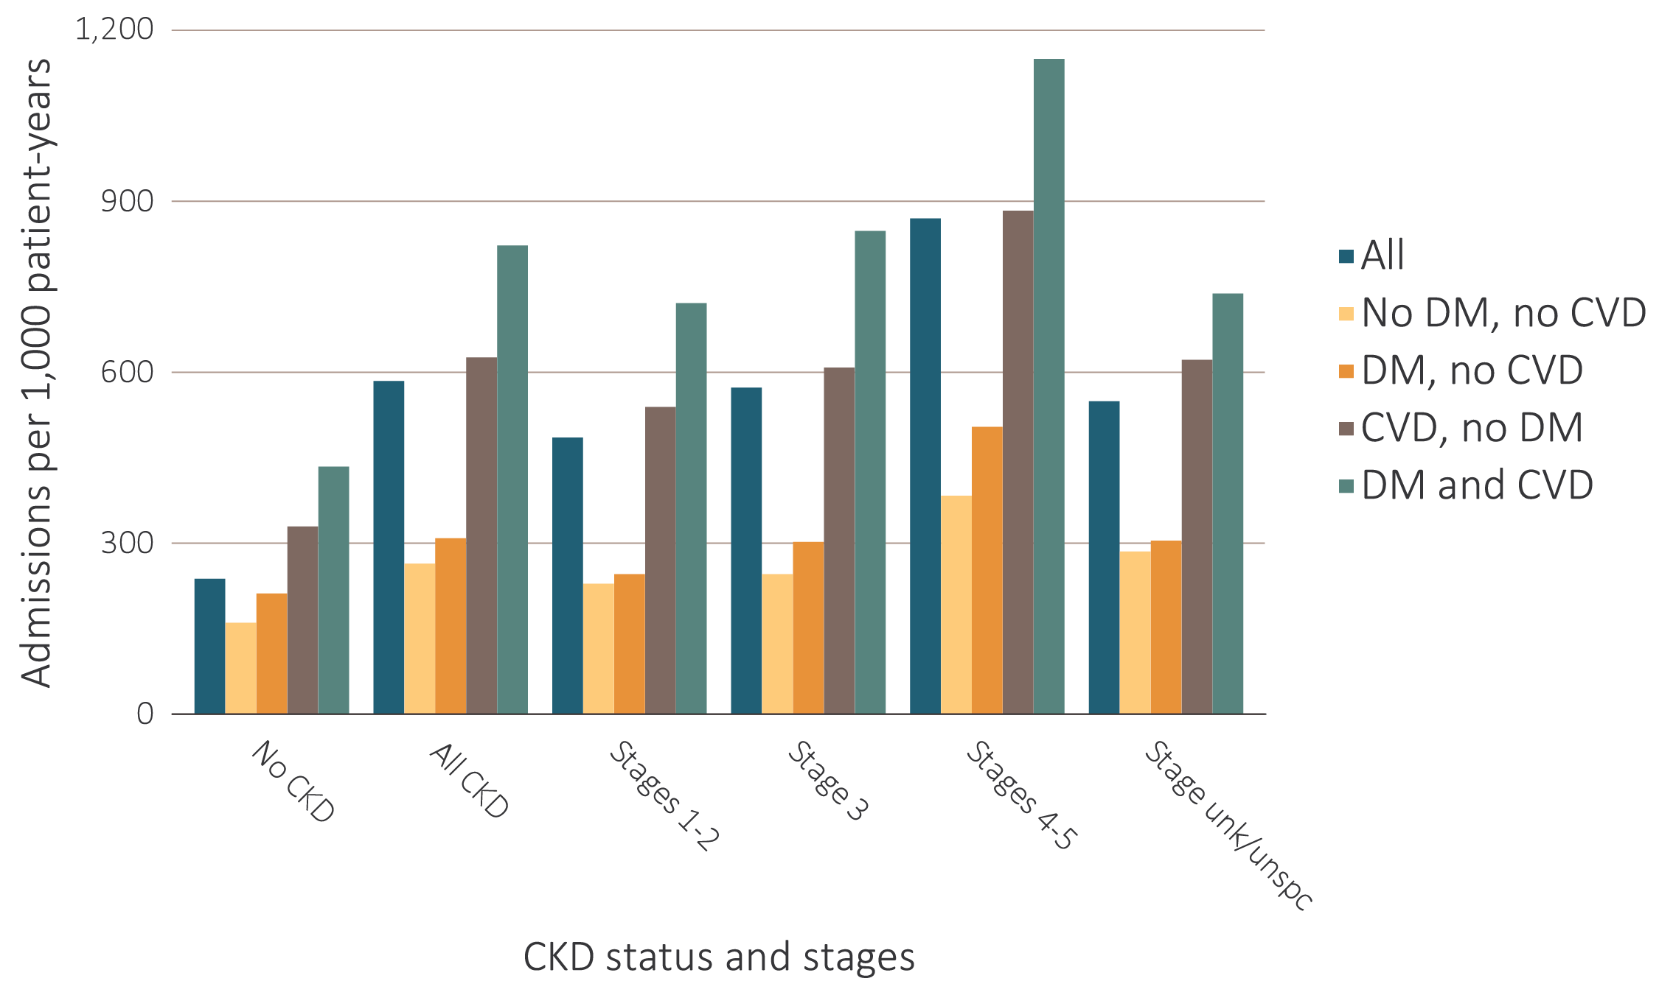
vol 1 Figure 3.15 Adjusted all-cause hospitalization rates per 1,000 patient-years at risk for Medicare patients aged 66 and older, by cardiovascular disease and diabetes mellitus, CKD status, and stage, 2016
Data source: Medicare 5% sample. January 1, 2016 point prevalent Medicare patients aged 66 and older. Adjusted for age/sex/race; rates by one factor are adjusted for the others. Standard population: all patients, 2016. Abbreviations: CKD, chronic kidney disease; CVD, cardiovascular disease; DM, diabetes mellitus; unk/unspc, CKD stage unidentified.

Slide 32
vol 1 Table 3.3 Unadjusted percentage of patients readmitted to the hospital within 30 days of discharge, among Medicare patients aged 66 and older who were discharged alive from an all-cause index hospitalization between January 1 and December 1, by CKD status and stage, 2016
 | No CKD (%) | All CKD (%) | Stages 1 or 2 (%) | Stage 3 (%) | Stages 4 or 5 (%) | Stage Unknown (%)
All | 15.3 | 21.6 | 21.6 | 21.7 | 23.6 | 20.9
Age
66-69 | 14.9 | 23.2 | 22.4 | 23.6 | 25.5 | 22.5
70-74 | 15.2 | 22.9 | 23.8 | 23.1 | 24.7 | 22.1
75-84 | 15.6 | 21.7 | 19.9 | 21.9 | 24.5 | 20.9
85+ | 15.2 | 19.8 | 22.0 | 19.6 | 21.4 | 18.9
Sex
Male | 16.2 | 22.0 | 21.3 | 22.2 | 23.9 | 21.2
Female | 14.6 | 21.3 | 21.8 | 21.1 | 23.4 | 20.7
Race
White | 15.1 | 21.4 | 21.4 | 21.4 | 23.2 | 20.8
Black/African American | 17.7 | 23.1 | 23.2 | 23.0 | 25.1 | 22.2
Other | 16.0 | 21.7 | 20.2 | 21.7 | 25.3 | 20.9
Hospital readmission
No readmission & died | 4.5 | 6.0 | 4.9 | 6.0 | 7.6 | 5.7
Readmission & died | 1.7 | 2.6 | 2.2 | 2.7 | 3.0 | 2.4
Readmission & lived | 13.6 | 19.0 | 19.3 | 18.9 | 20.6 | 18.5
Data source: Medicare 5% sample. January 1, 2016 point prevalent Medicare patients aged 66 and older, discharged alive from an all-cause index hospitalization between January 1, 2016, and December 1, 2016; unadjusted. Abbreviation: CKD, chronic kidney disease.

Slide 33
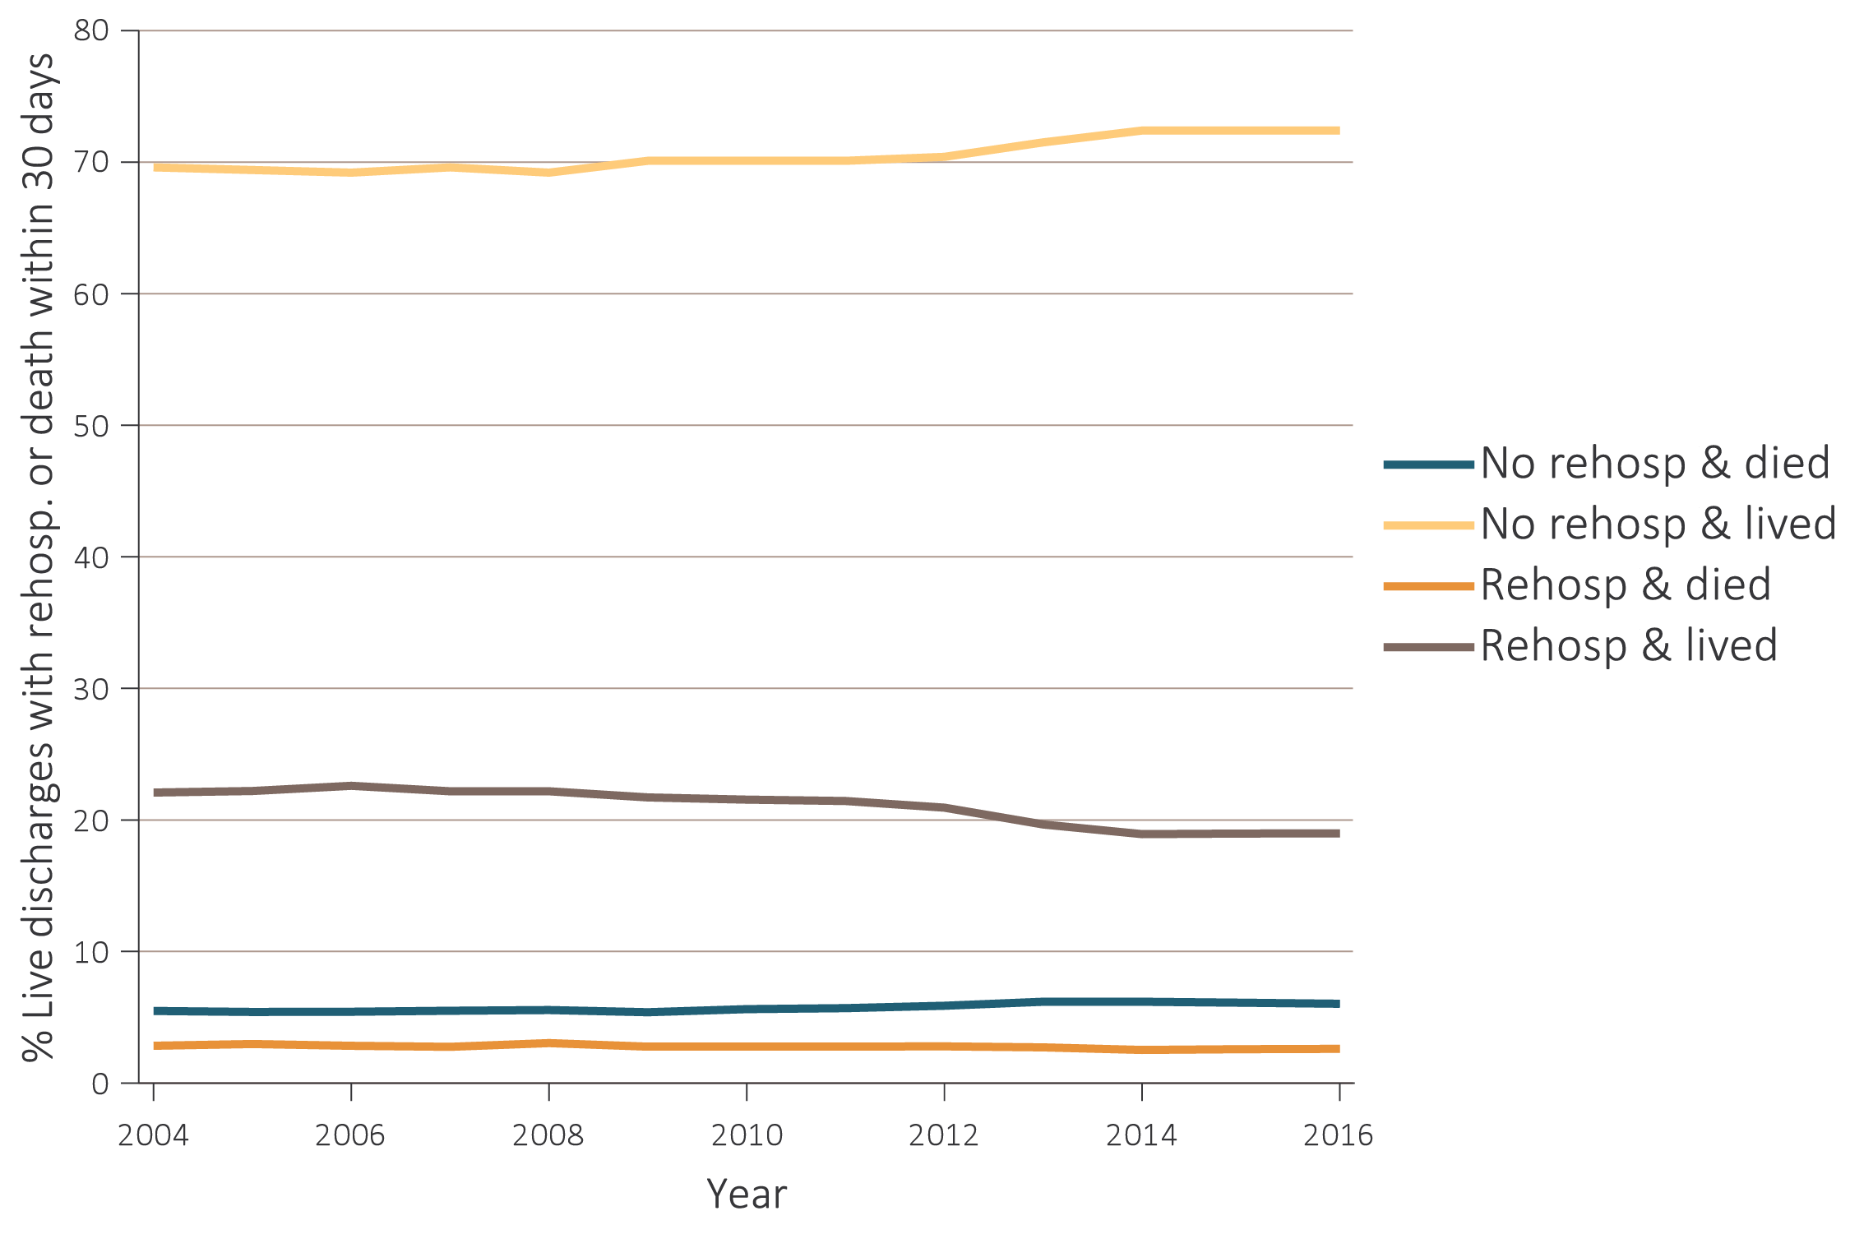
vol 1 Figure 3.16 Adjusted percentage of patients readmitted to the hospital within 30 days of discharge, among Medicare CKD patients aged 66 and older who were discharged alive from an all-cause index hospitalization between January 1 and December 1, by year, 2004-2016
Data source: Medicare 5% sample. January 1 of each reported year, point prevalent Medicare patients aged 66 and older with CKD (defined during the prior year), discharged alive from an all-cause index hospitalization between January 1 and December 1 of the reported year. Adjusted for age/sex/race. Standard population: 2011. Abbreviations: CKD, chronic kidney disease; Rehosp, rehospitalized.

Slide 34
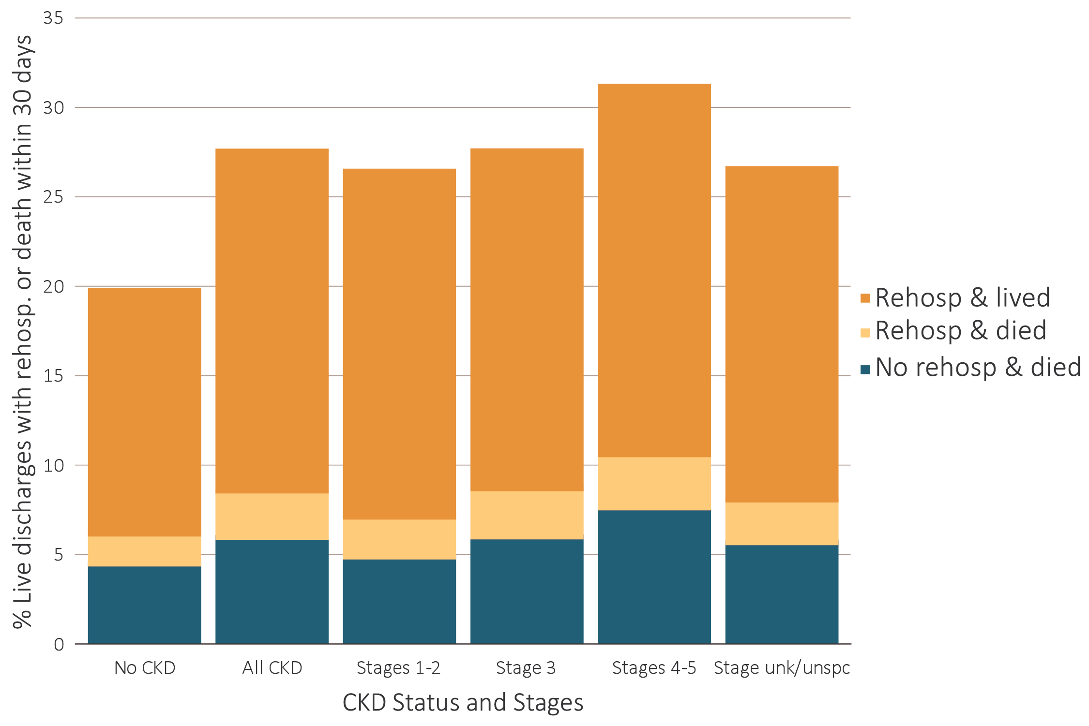
vol 1 Figure 3.17 Unadjusted percentage of patients readmitted to the hospital within 30 days of discharge, among Medicare patients aged 66 and older who were discharged alive from an all-cause index hospitalization between January 1 and December 1, by CKD status and stage, 2016
Data source: Medicare 5% sample. January 1, 2016 point prevalent Medicare patients aged 66 and older, discharged alive from an all-cause index hospitalization between January 1, 2016, and December 1, 2016, unadjusted. Abbreviations: CKD, chronic kidney disease; Rehosp, rehospitalized; unk/unspc, CKD stage unidentified.

Slide 35
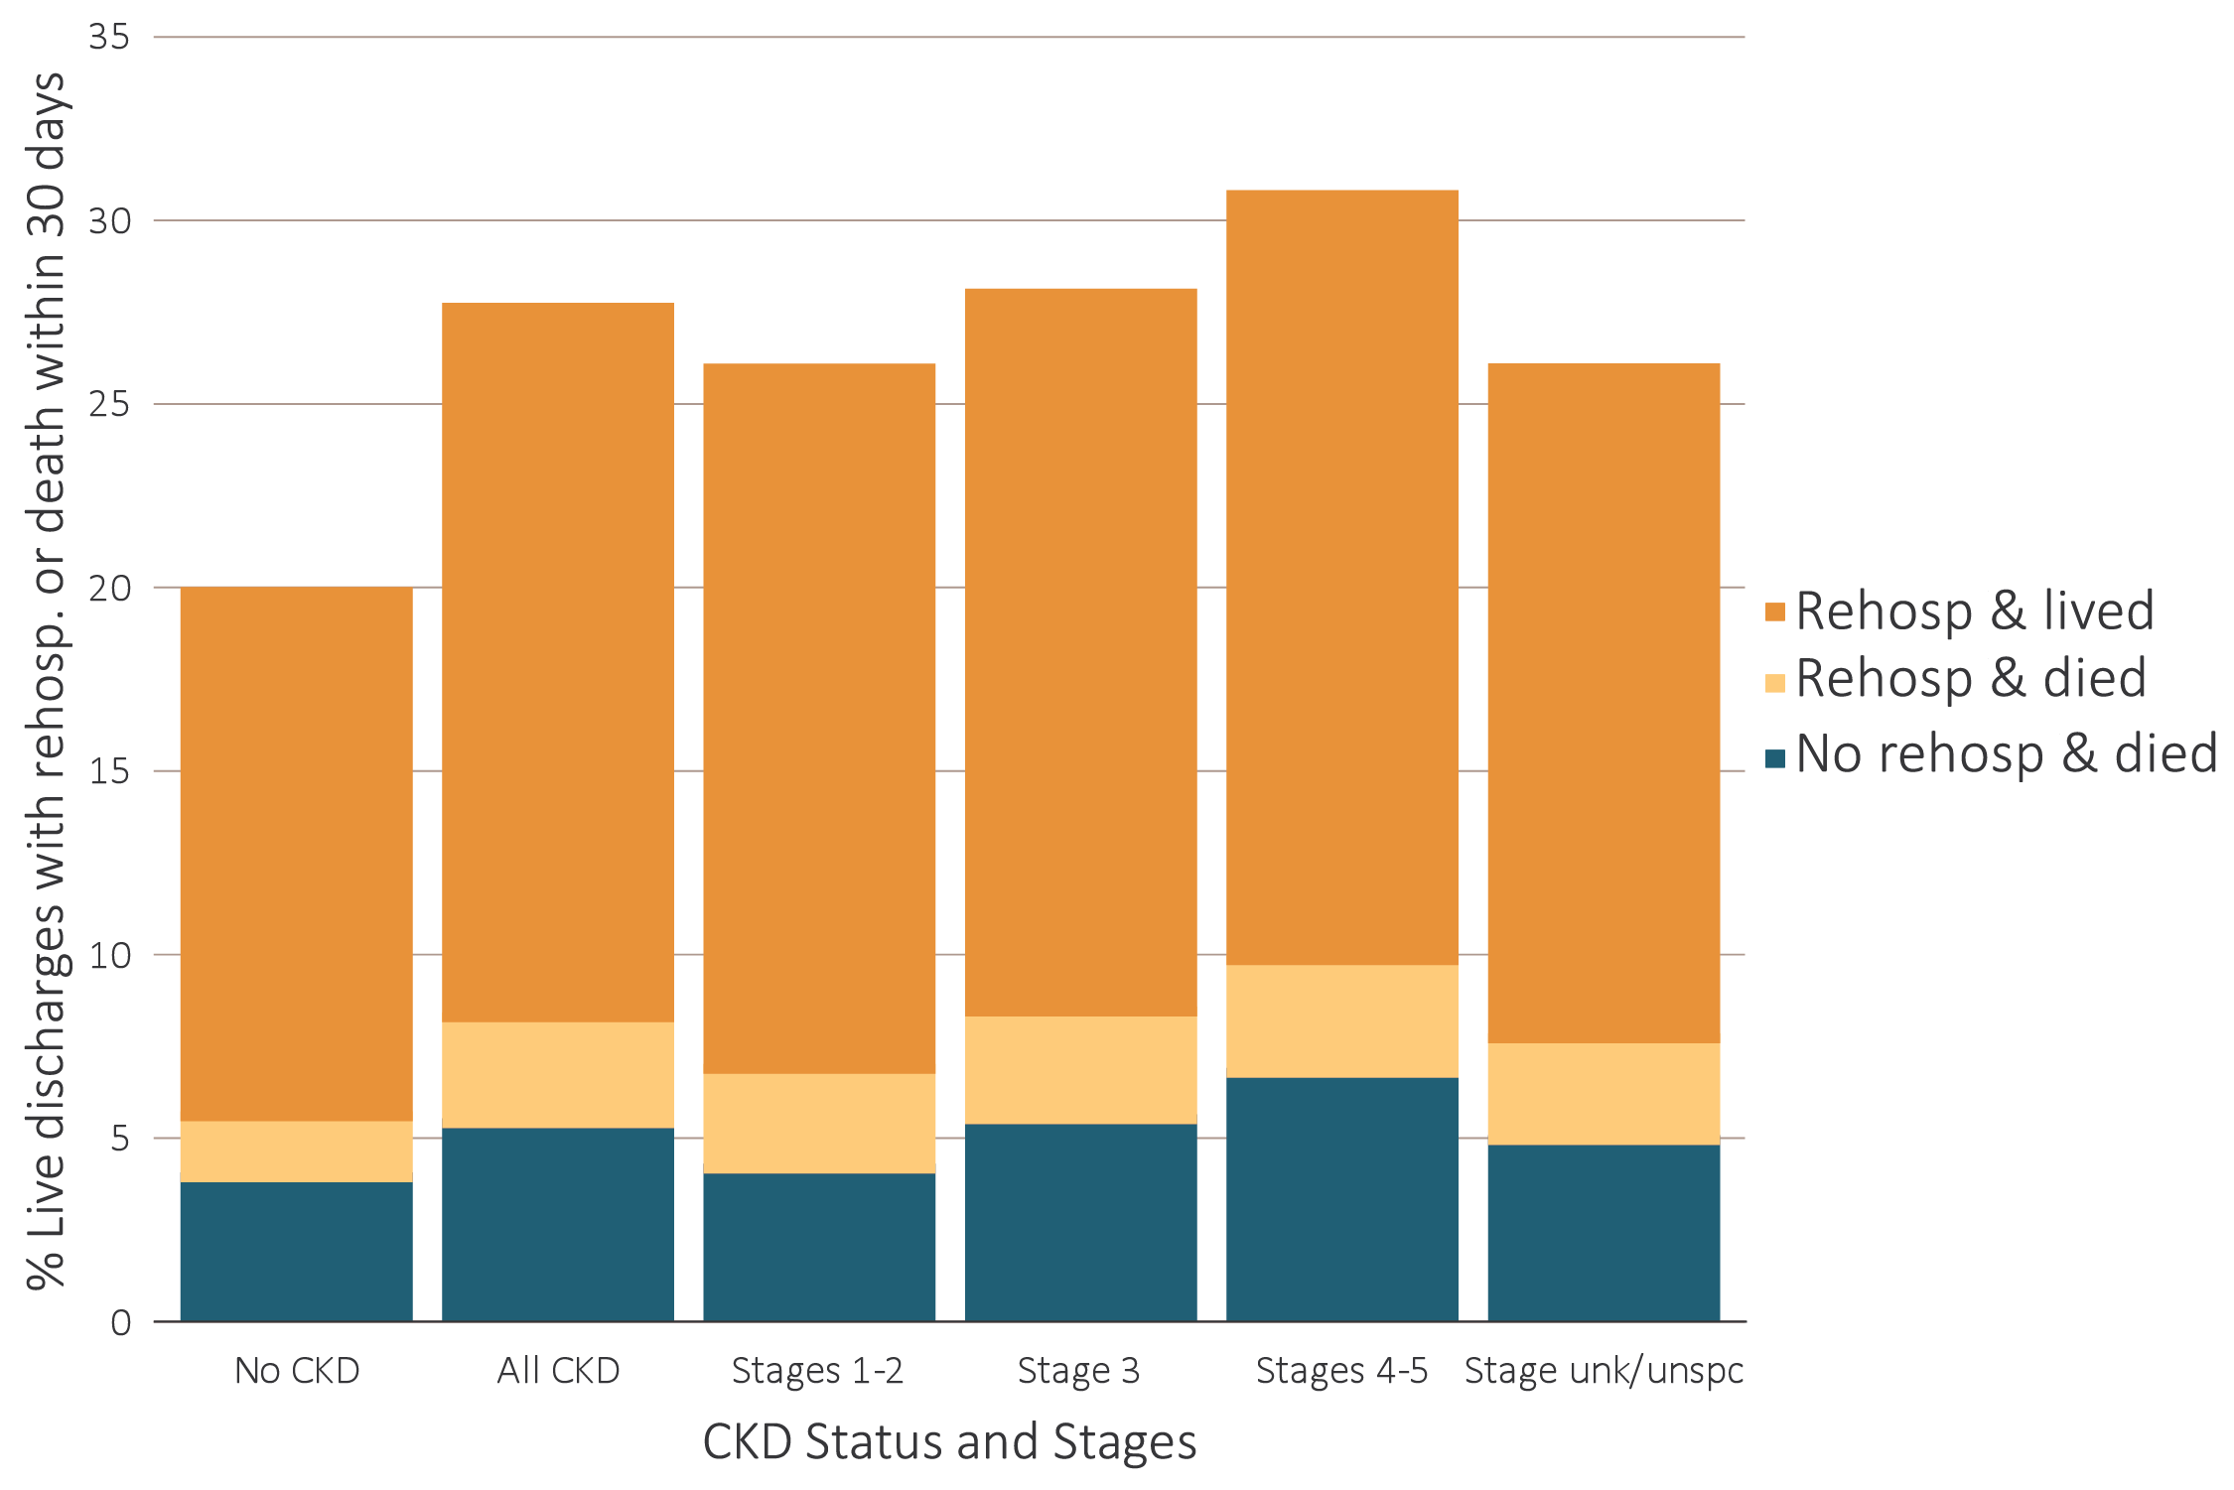
vol 1 Figure 3.18 Unadjusted percentage of patients readmitted to the hospital within 30 days of discharge, among Medicare patients aged 66 and older who were discharged alive from a cardiovascular-related index hospitalization between January 1 and December 1, by CKD status and stage, 2016
Data source: Medicare 5% sample. January 1, 2016 point prevalent Medicare patients aged 66 and older, discharged alive from a CVD index hospitalization between January 1, 2016, and December 1, 2016; unadjusted. Abbreviations: CKD, chronic kidney disease; Rehosp, rehospitalized; unk/unspc, CKD stage unidentified.

Slide 36
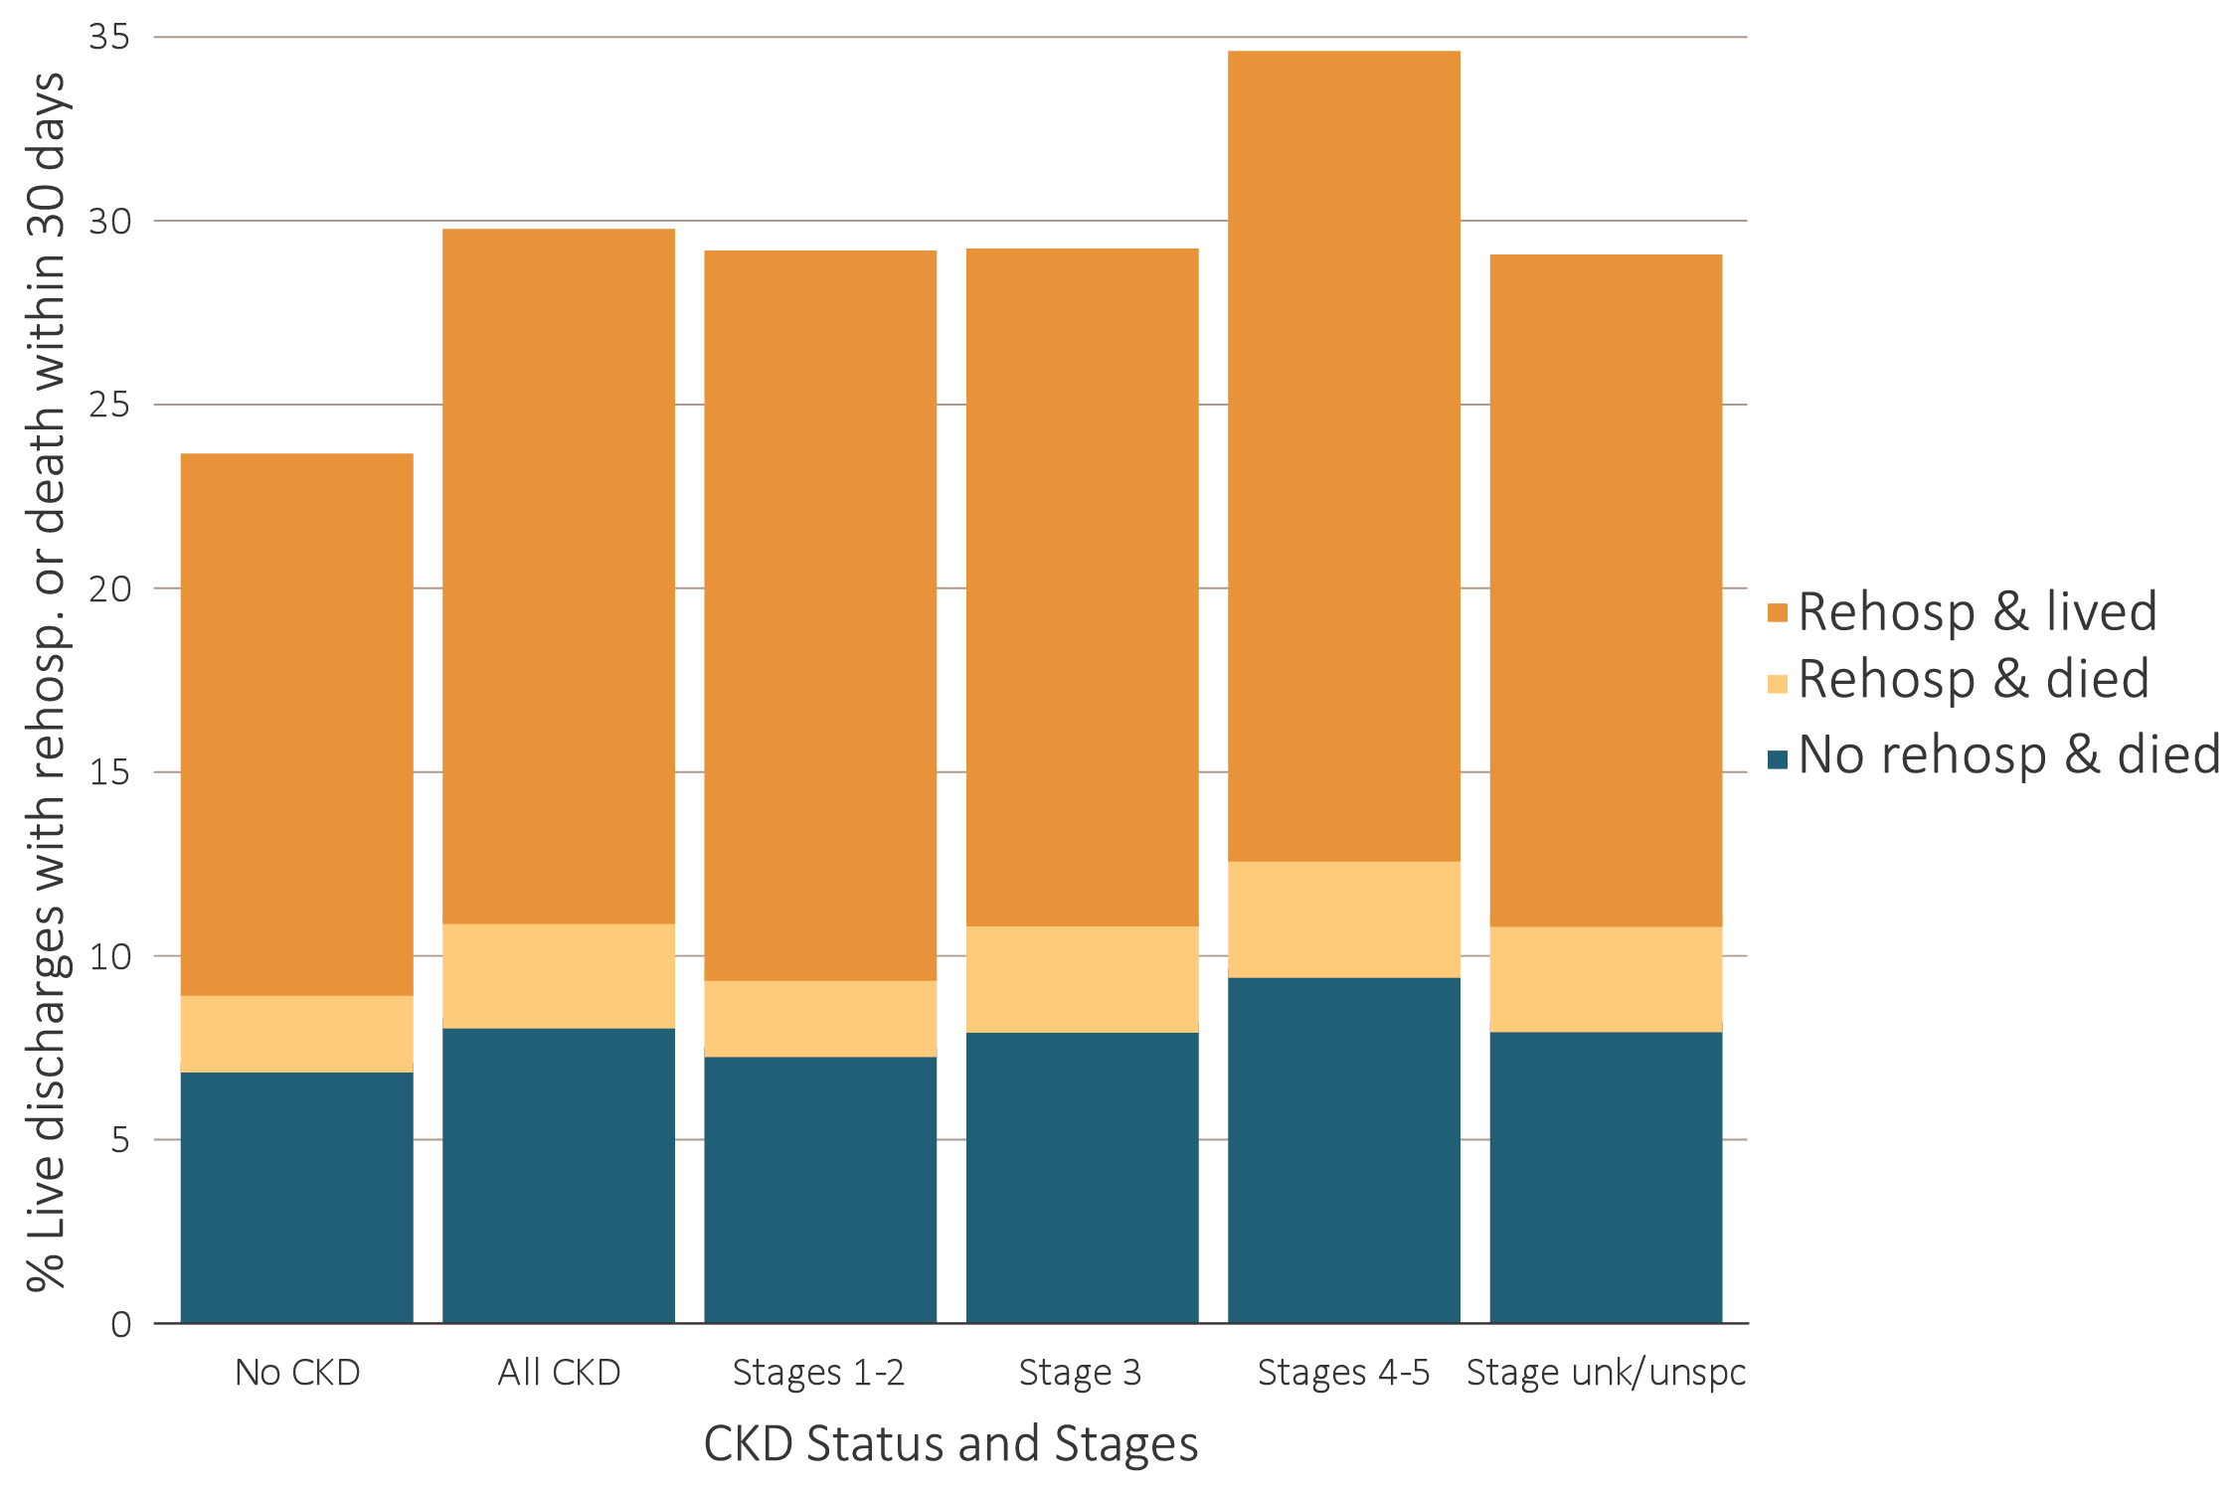
vol 1 Figure 3.19 Unadjusted percentage of patients readmitted to the hospital within 30 days of discharge, among Medicare patients aged 66 and older who were discharged alive from an infection-related index hospitalization between January 1 and December 1, by CKD status and stage, 2016
Data source: Medicare 5% sample. January 1, 2016 point prevalent Medicare patients aged 66 and older, discharged alive from an infection index hospitalization between January 1, 2016, and December 1, 2016, unadjusted. Abbreviations: CKD, chronic kidney disease; Rehosp, rehospitalized; unk/unspc, CKD stage unidentified.

Slide 37
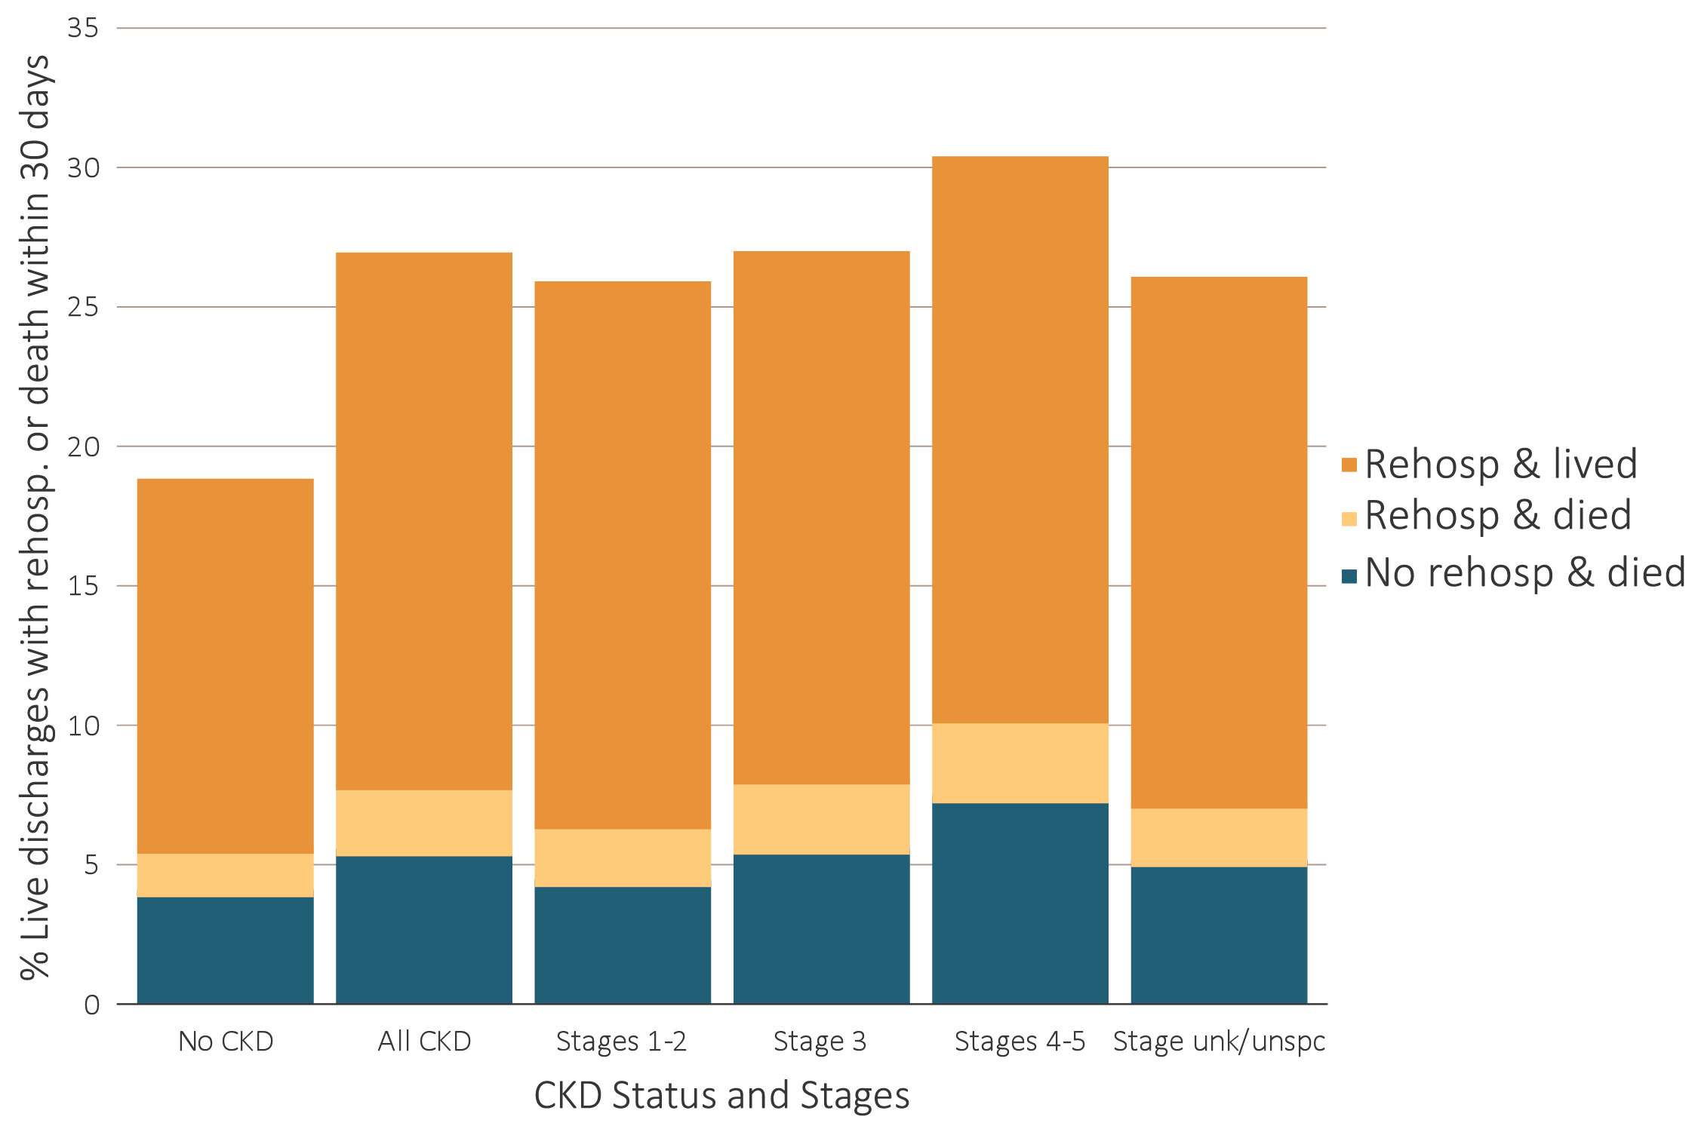
vol 1 Figure 3.20 Unadjusted percentage of patients readmitted to the hospital within 30 days of discharge, among Medicare patients aged 66 and older who were discharged alive from a no-cardiovascular and no-infection-related index hospitalization between January 1 and December 1, by CKD status and stage, 2016
Data Source: Medicare 5% sample. January 1, 2016 point prevalent Medicare patients aged 66 and older, discharged alive from a no-cardiovascular and no-infection index hospitalization between January 1, 2016, and December 1, 2016; unadjusted. Abbreviations: CKD, chronic kidney disease; Rehosp, rehospitalized; unk/unspc, CKD stage unidentified.

Slide 38
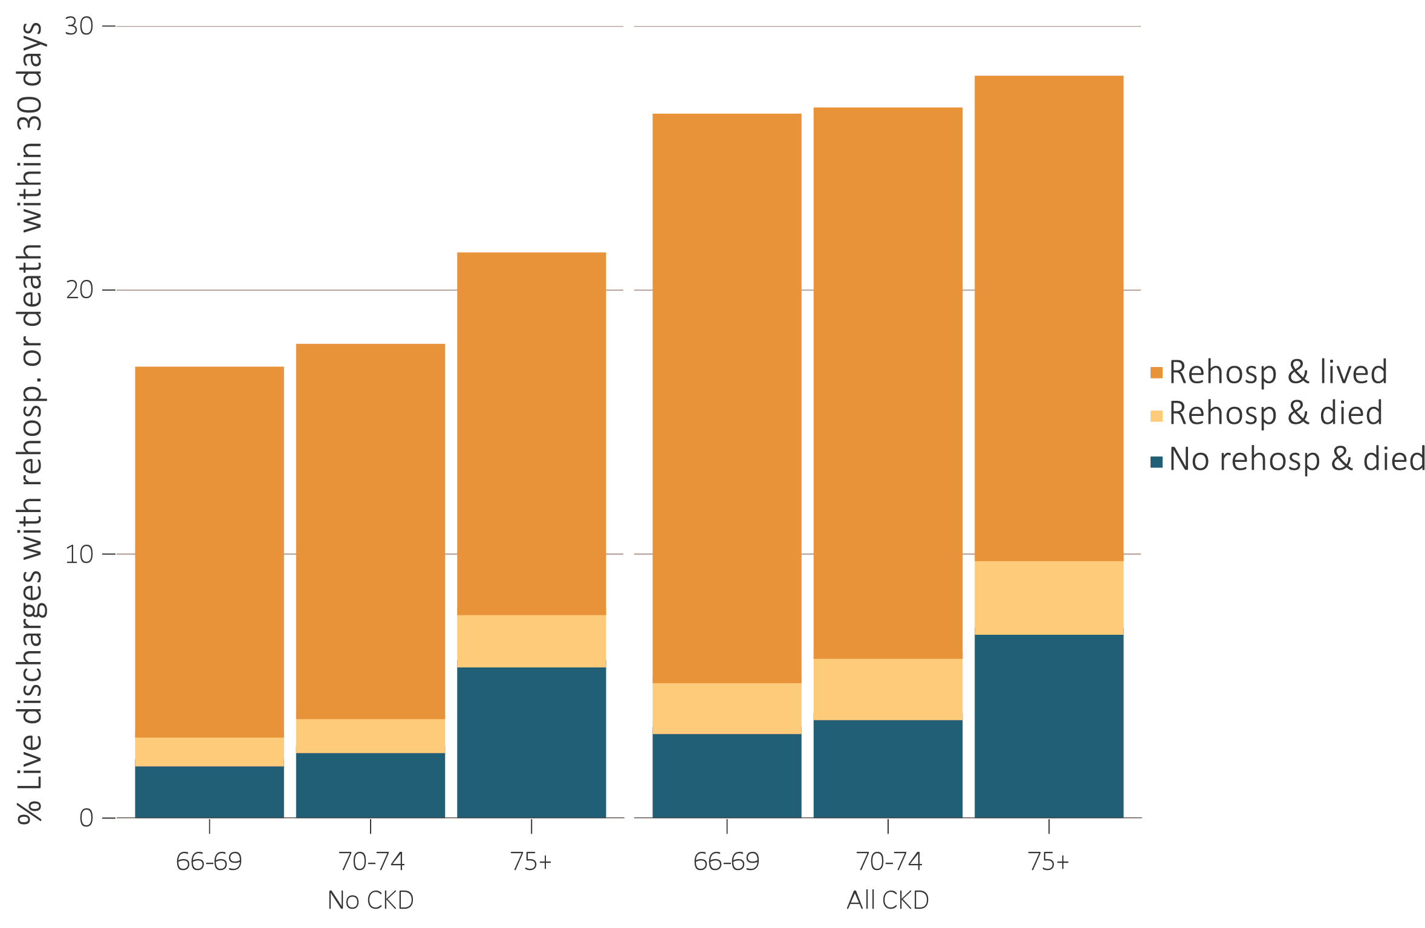
vol 1 Figure 3.21 Unadjusted percentage of patients readmitted to the hospital within 30 days of discharge, among Medicare patients aged 66 and older who were discharged alive from an all-cause index hospitalization between January 1 and December 1, by age and CKD status, 2016
Data source: Medicare 5% sample. January 1, 2016 point prevalent Medicare patients aged 66 and older, discharged alive from an all-cause index hospitalization between January 1, 2016, and December 1, 2016; unadjusted. Abbreviations: CKD, chronic kidney disease; Rehosp, rehospitalized.

Slide 39
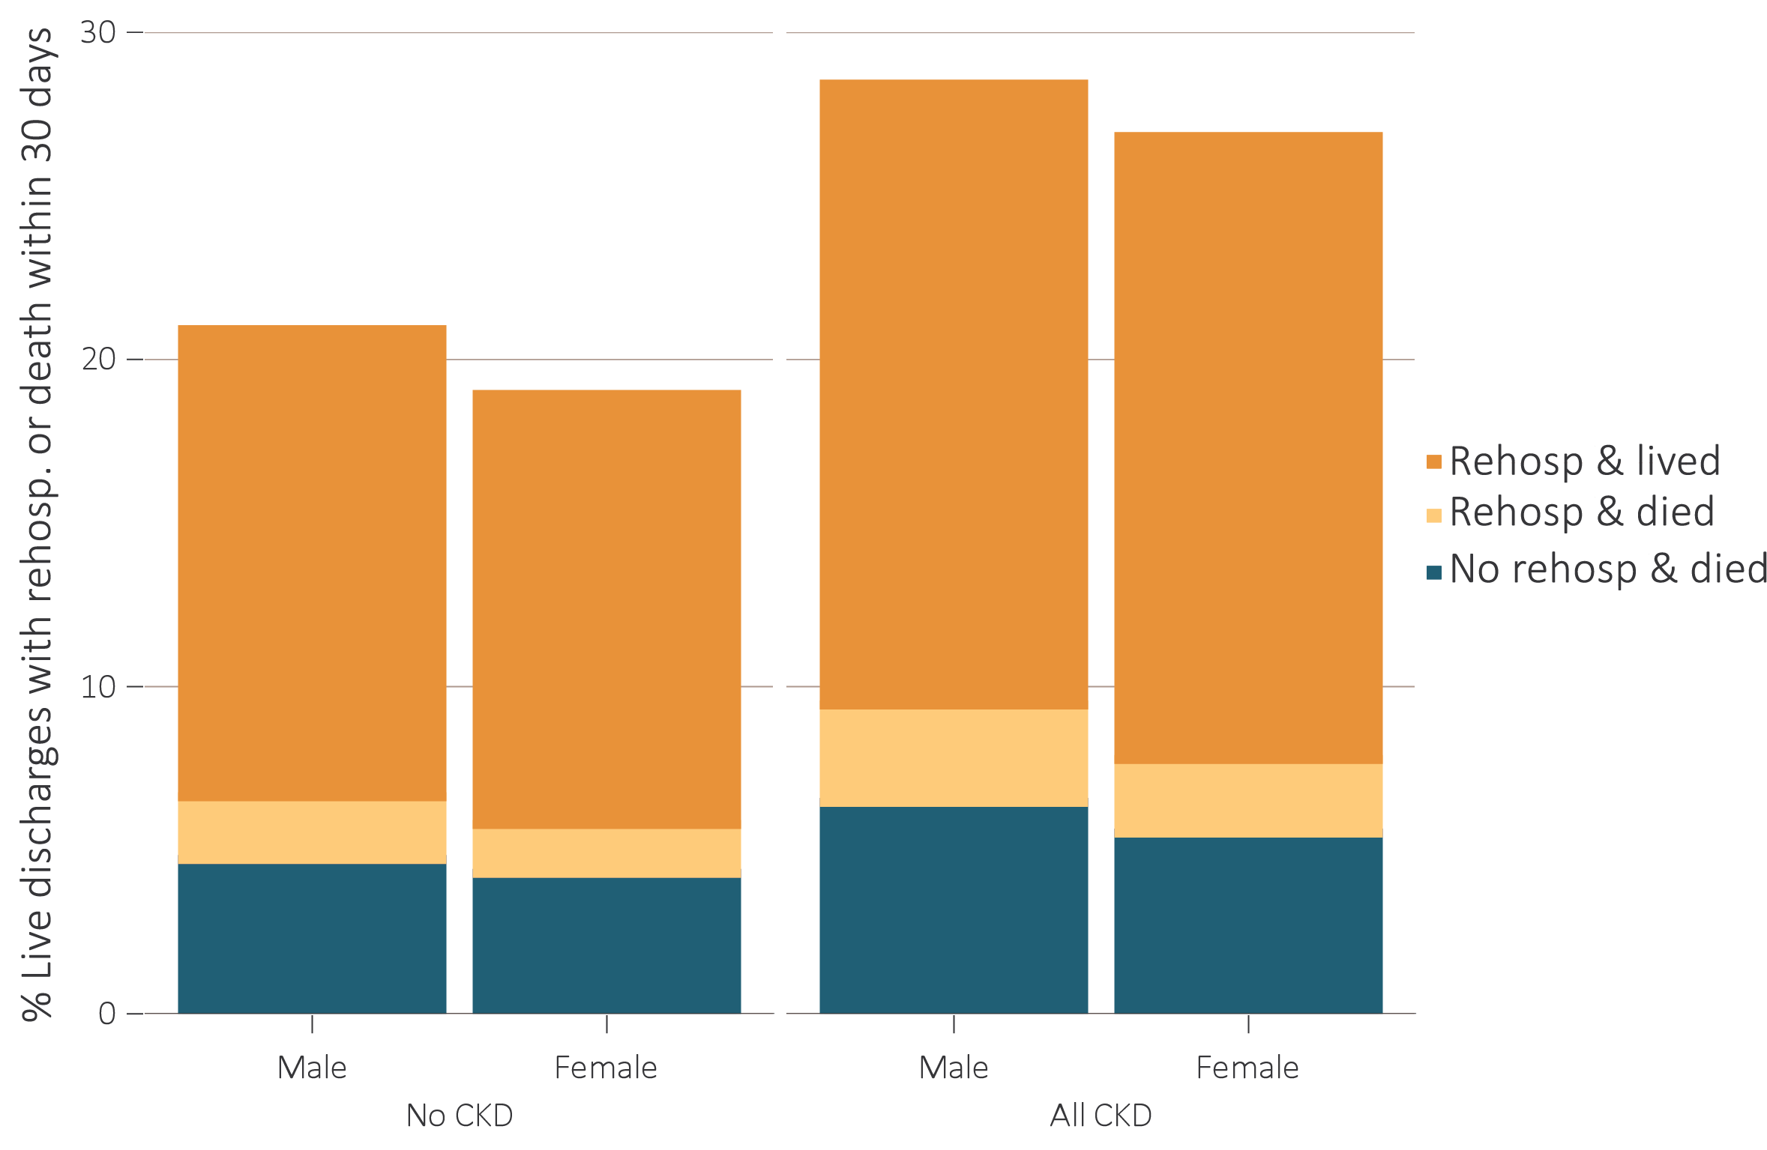
vol 1 Figure 3.22 Unadjusted percentage of patients readmitted to the hospital within 30 days of discharge, among Medicare patients aged 66 and older who were discharged alive from an all-cause index hospitalization between January 1 and December 1, by sex and CKD status, 2016
Data source: Medicare 5% sample. January 1, 2016 point prevalent Medicare patients aged 66 and older, discharged alive from an all-cause index hospitalization between January 1, 2016, and December 1, 2016; unadjusted. Abbreviations: CKD, chronic kidney disease; Rehosp, rehospitalized.

Slide 40
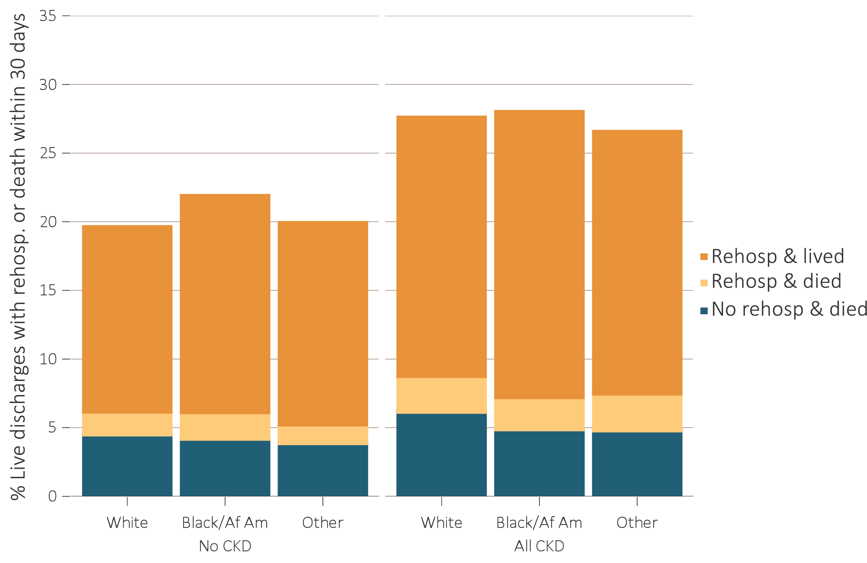
vol 1 Figure 3.23 Unadjusted percentage of patients readmitted to the hospital within 30 days of discharge, among Medicare patients aged 66 and older who were discharged alive from an all-cause index hospitalization between January 1 and December 1, by race and CKD status, 2016
Data Source: Medicare 5% sample. January 1, 2016 point prevalent Medicare patients aged 66 and older, discharged alive from an all-cause index hospitalization between January 1, 2016, and December 1, 2016; unadjusted. Abbreviations: Af Am, African American; CKD, chronic kidney disease; Rehosp, rehospitalized.

