Slide 1
2017 Annual Data Report
Volume 1: Chronic Kidney Disease
Chapter 4: Cardiovascular Disease in Patients with CKD

Slide 2
vol 1 Figure 4.1 Prevalence of common cardiovascular diseases in patients with or without CKD, 2016
Data Source: Special analyses, Medicare 5% sample. Abbreviations: AF, atrial fibrillation; AMI, acute myocardial infarction; CAD, coronary artery disease; CKD, chronic kidney disease; CVA/TIA, cerebrovascular accident/transient ischemic attack; CVD, cardiovascular disease; HF, heart failure; PAD, peripheral arterial disease; SCA/VA, sudden cardiac arrest and ventricular arrhythmias; VHD, valvular heart disease; VTE/PE, venous thromboembolism and pulmonary embolism
2018 Annual Data Report
Volume 1 CKD, Chapter 4

Slide 3
vol 1 Table 4.1 Prevalence of (a) cardiovascular comorbidities & (b) annual incidence of cardiovascular procedures, by CKD status, age, race, & sex, 2016
 | (a) Cardiovascular comorbidities
 | # Patients | % Patients
 |  | Overall | 66-69 | 70-74 | 75-84 | 85+ | White | Blk/Af Am | Other | Male | Female
Any CVD
Without CKD | 1,086,232 | 32.4 | 19.8 | 27.3 | 39.2 | 52.1 | 33.4 | 28.7 | 23.8 | 36.3 | 29.5
Any CKD | 175,840 | 64.5 | 50.0 | 56.9 | 66.9 | 76.5 | 65.3 | 62.1 | 57.3 | 68.1 | 61.0
Coronary artery disease (CAD)
Without CKD | 1,086,232 | 15.6 | 10.0 | 13.9 | 19.4 | 22.1 | 16.2 | 12.3 | 11.9 | 21.2 | 11.5
Any CKD | 175,840 | 37.9 | 29.3 | 34.4 | 40.2 | 42.8 | 38.8 | 33.2 | 33.3 | 45.0 | 31.1
Acute myocardial infarction (AMI)
Without CKD | 1,086,232 | 2.3 | 1.6 | 2.1 | 2.7 | 3.4 | 2.4 | 1.9 | 1.6 | 3.1 | 1.7
Any CKD | 175,840 | 9.3 | 8.1 | 8.5 | 9.5 | 10.4 | 9.5 | 8.2 | 7.6 | 11.0 | 7.6
Heart failure (HF)
Without CKD | 1,086,232 | 6.1 | 3.1 | 4.3 | 7.2 | 13.3 | 6.2 | 7.1 | 4.2 | 6.5 | 5.9
Any CKD | 175,840 | 25.9 | 18.3 | 20.1 | 25.7 | 36.1 | 25.9 | 28.4 | 21.5 | 25.9 | 25.9
Valvular heart disease (VHD)
Without CKD | 1,086,232 | 5.1 | 2.6 | 3.9 | 6.6 | 9.3 | 5.4 | 3.4 | 3.5 | 5.0 | 5.2
Any CKD | 175,840 | 12.8 | 7.5 | 9.3 | 13.6 | 18.1 | 13.4 | 10.1 | 10.2 | 12.8 | 12.9
Cerebrovascular accident/transient ischemic attack (CVA/TIA)
Without CKD | 1,086,232 | 6.7 | 3.7 | 5.5 | 8.6 | 11.0 | 6.8 | 7.2 | 4.9 | 6.9 | 6.6
Any CKD | 175,840 | 16.1 | 11.4 | 13.8 | 17.5 | 18.9 | 15.9 | 18.6 | 14.7 | 16.4 | 15.8
Peripheral artery disease (PAD)
Without CKD | 1,086,232 | 9.7 | 4.8 | 7.1 | 11.6 | 20.1 | 9.8 | 10.6 | 7.1 | 10.0 | 9.4
Any CKD | 175,840 | 25.2 | 17.4 | 20.9 | 26.0 | 32.8 | 25.3 | 26.3 | 22.2 | 26.6 | 24.0
Atrial fibrillation (AF)
Without CKD | 1,086,232 | 9.8 | 4.4 | 7.0 | 12.5 | 19.8 | 10.5 | 4.8 | 5.3 | 11.2 | 8.7
Any CKD | 175,840 | 23.8 | 13.5 | 17.3 | 25.3 | 33.7 | 25.5 | 15.0 | 15.6 | 26.1 | 21.6
Cardiac arrest and ventricular arrhythmias (SCA/VA)
Without CKD | 1,086,232 | 1.4 | 1.0 | 1.4 | 1.8 | 1.8 | 1.5 | 1.1 | 0.9 | 2.0 | 1.0
Any CKD | 175,840 | 4.1 | 3.4 | 3.9 | 4.4 | 4.3 | 4.1 | 4.5 | 3.0 | 5.5 | 2.8
Venous thromboembolism and pulmonary embolism (VTE/PE)
Without CKD | 1,086,232 | 1.2 | 0.8 | 1.0 | 1.3 | 1.8 | 1.2 | 1.3 | 0.6 | 1.2 | 1.1
Any CKD | 175,840 | 3.7 | 3.3 | 3.4 | 3.8 | 4.2 | 3.7 | 5.1 | 2.2 | 3.7 | 3.8
Data Source: Special analyses, Medicare 5% sample. Patients aged 66 and older, alive, without end-stage renal disease, and residing in the United States on 12/31/2016 with fee-for-service coverage for the entire calendar year. Abbreviations: AF, atrial fibrillation; AMI, acute myocardial infarction; Blk/Af Am, Black African American; CABG, coronary artery bypass grafting; CAD, coronary artery disease; CAS/CEA, carotid artery stenting and carotid endarterectomy; CKD, chronic kidney disease; CVA/TIA, cerebrovascular accident/transient ischemic attack; CVD, cardiovascular disease; HF, heart failure; ICD/CRT-D, implantable cardioverter defibrillators/cardiac resynchronization therapy with defibrillator devices; PAD, peripheral arterial disease; PCI, percutaneous coronary interventions; SCA/VA, sudden cardiac arrest and ventricular arrhythmias; VHD, valvular heart disease; VTE/PE, venous thromboembolism and pulmonary embolism. (a) The denominators for overall prevalence of all cardiovascular comorbidities were Medicare enrollees aged 66+ by CKD status. (b) The denominators for overall prevalence of PCI and CABG were Medicare enrollees aged 66+ with CAD by CKD status. The denominators for overall prevalence of ICD/CRT-D were Medicare enrollees aged 66+ with HF by CKD status. The denominators for overall prevalence of CAS/CEA were Medicare enrollees aged 66+ with CAD, CVA/TIA, or PAD by CKD status
2018 Annual Data Report
Volume 1 CKD, Chapter 4

Slide 4
vol 1 Table 4.1 Prevalence of (a) cardiovascular comorbidities & (b) annual incidence of cardiovascular procedures, by CKD status, age, race, & sex, 2016 (continued)
 | (b) Cardiovascular procedures
 | # Patients | % Patients
 |  | Overall | 66-69 | 70-74 | 75-84 | 85+ | White | Blk/Af Am | Other | Male | Female
Revascularization – percutaneous coronary interventions (PCI)
Without CKD | 169,959 | 2.1 | 3.0 | 2.5 | 1.9 | 1.3 | 2.1 | 1.5 | 2.2 | 2.2 | 2.0
Any CKD | 66,659 | 3.1 | 4.1 | 3.5 | 3.4 | 2.0 | 3.1 | 2.9 | 3.3 | 3.2 | 2.9
Revascularization – coronary artery bypass graft (CABG)
Without CKD | 169,959 | 1.1 | 1.8 | 1.5 | 1.0 | 0.2 | 1.1 | 0.6 | 1.3 | 1.3 | 0.7
Any CKD | 66,659 | 1.5 | 2.7 | 2.4 | 1.6 | 0.3 | 1.6 | 1.0 | 1.0 | 2.0 | 0.9
Implantable cardioverter defibrillators & cardiac resynchronization therapy with defibrillator (ICD/CRT-D)
Without CKD | 66,426 | 0.6 | 0.6 | 0.8 | 0.6 | 0.3 | 0.6 | 0.4 | 0.6 | 0.8 | 0.4
Any CKD | 45,552 | 1.0 | 1.5 | 1.4 | 1.1 | 0.6 | 1.0 | 1.4 | 1.0 | 1.4 | 0.7
Carotid artery stenting and carotid artery endarterectomy (CAS/CEA)
Without CKD | 268,808 | 0.5 | 0.6 | 0.7 | 0.6 | 0.2 | 0.6 | 0.3 | 0.4 | 0.6 | 0.4
Any CKD | 93,656 | 0.7 | 0.8 | 0.8 | 0.8 | 0.4 | 0.7 | 0.4 | 0.6 | 0.8 | 0.6
Data Source: Special analyses, Medicare 5% sample. Patients aged 66 and older, alive, without end-stage renal disease, and residing in the United States on 12/31/2016 with fee-for-service coverage for the entire calendar year. Abbreviations: AF, atrial fibrillation; AMI, acute myocardial infarction; Blk/Af Am, Black African American; CABG, coronary artery bypass grafting; CAD, coronary artery disease; CAS/CEA, carotid artery stenting and carotid endarterectomy; CKD, chronic kidney disease; CVA/TIA, cerebrovascular accident/transient ischemic attack; CVD, cardiovascular disease; HF, heart failure; ICD/CRT-D, implantable cardioverter defibrillators/cardiac resynchronization therapy with defibrillator devices; PAD, peripheral arterial disease; PCI, percutaneous coronary interventions; SCA/VA, sudden cardiac arrest and ventricular arrhythmias; VHD, valvular heart disease; VTE/PE, venous thromboembolism and pulmonary embolism. (a) The denominators for overall prevalence of all cardiovascular comorbidities were Medicare enrollees aged 66+ by CKD status. (b) The denominators for overall prevalence of PCI and CABG were Medicare enrollees aged 66+ with CAD by CKD status. The denominators for overall prevalence of ICD/CRT-D were Medicare enrollees aged 66+ with HF by CKD status. The denominators for overall prevalence of CAS/CEA were Medicare enrollees aged 66+ with CAD, CVA/TIA, or PAD by CKD status.
2018 Annual Data Report
Volume 1 CKD, Chapter 4

Slide 5
Table A. ICD-9-CM and ICD-10-CM codes for Chronic Kidney Disease (CKD) stages
ICD-9-CM codeª | ICD-10-CM code | Stage
585.1 | N18.1 | CKD, Stage 1
585.2 | N18.2 | CKD, Stage 2 (mild)
585.3 | N18.3 | CKD, Stage 3 (moderate)
585.4 | N18.4 | CKD, Stage 4 (severe)
585.5 | N18.5 | CKD, Stage 5 (excludes 585.6: Stage 5, requiring chronic dialysis^{b})
CKD Stage-unspecified | CKD Stage-unspecified | For these analyses, identified by multiple codes including 585.9, 250.4x, 403.9x & others for ICD-9-CM and A18.xx, E08.xx, E11.xx and others for ICD-10-CM.
ª For analyses in this chapter, CKD stage estimates require at least one occurrence of a stage-specific code, and the last available CKD stage in a given year is used. ^{b} In USRDS analyses, patients with ICD-9-CM code 585.6 or ICD-10-CM code N18.6 & with no ESRD 2728 form or other indication of end-stage renal disease (ESRD) are considered to have code 585.5 or N18.5
2018 Annual Data Report
Volume 1 CKD, Chapter 4

Slide 6
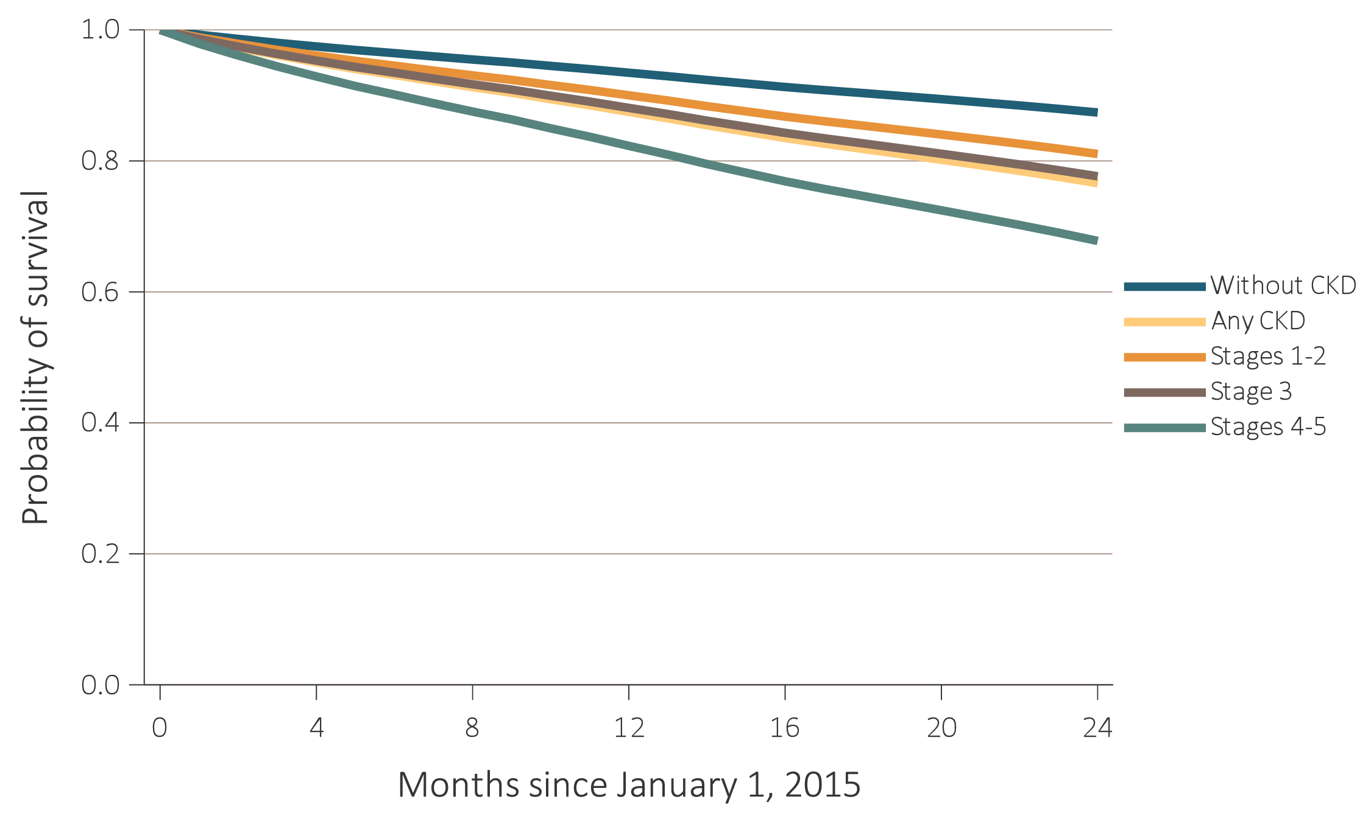
vol 1 Figure 4.2 Probability of survival of patients with a prevalent cardiovascular disease, by CKD status, adjusted for age and sex, 2015-2016 (a) Coronary artery disease (CAD)
Data Source: Special analyses, Medicare 5% sample. Patients aged 66 and older, alive, without end-stage renal disease, and residing in the United States on 12/31/2014, with fee-for-service coverage for the entire calendar year. Abbreviation: CKD, chronic kidney disease.
2018 Annual Data Report
Volume 1 CKD, Chapter 4

Slide 7
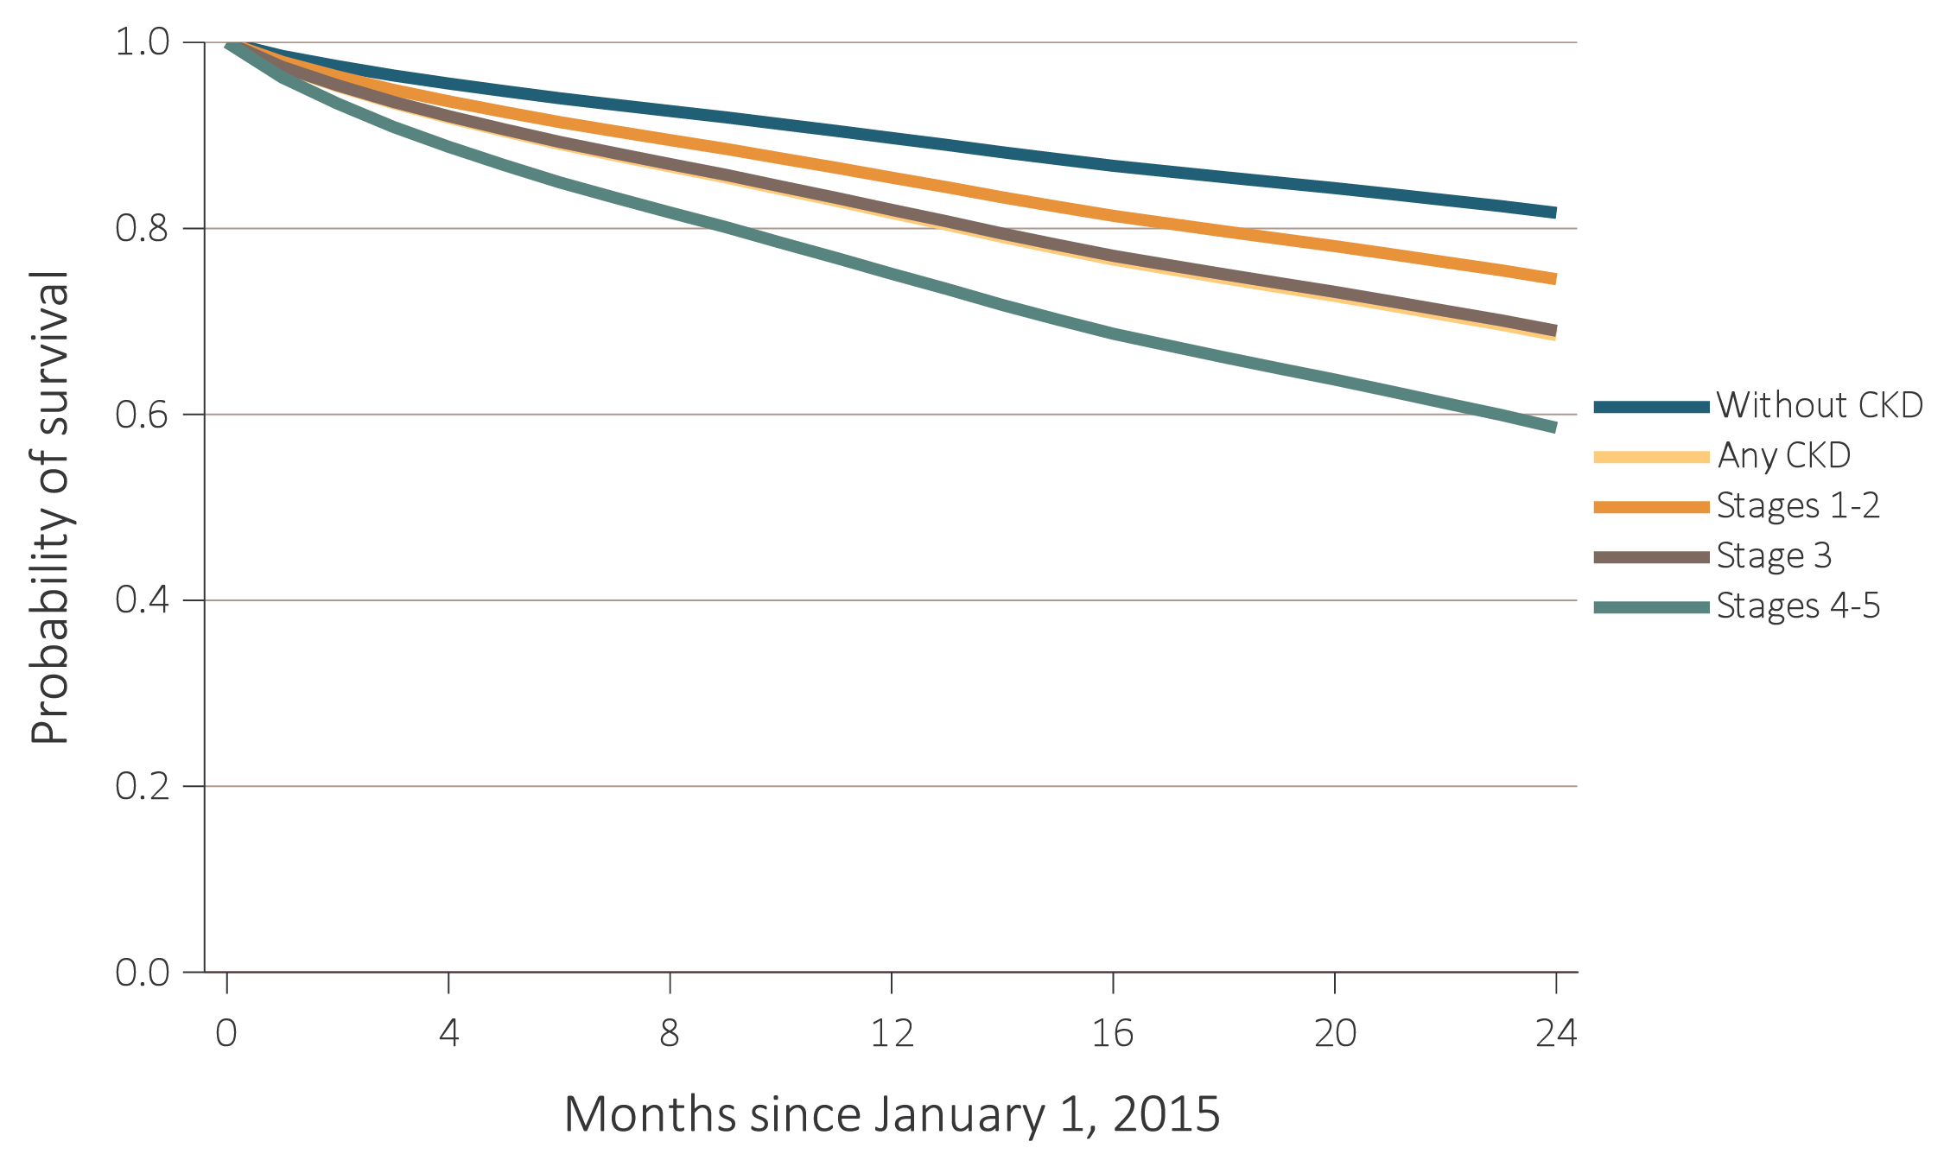
vol 1 Figure 4.2 Probability of survival of patients with a prevalent cardiovascular disease, by CKD status, adjusted for age and sex, 2015-2016 (b) Acute myocardial infarction (AMI)
Data Source: Special analyses, Medicare 5% sample. Patients aged 66 and older, alive, without end-stage renal disease, and residing in the United States on 12/31/2014, with fee-for-service coverage for the entire calendar year. Abbreviation: CKD, chronic kidney disease.
2018 Annual Data Report
Volume 1 CKD, Chapter 4

Slide 8
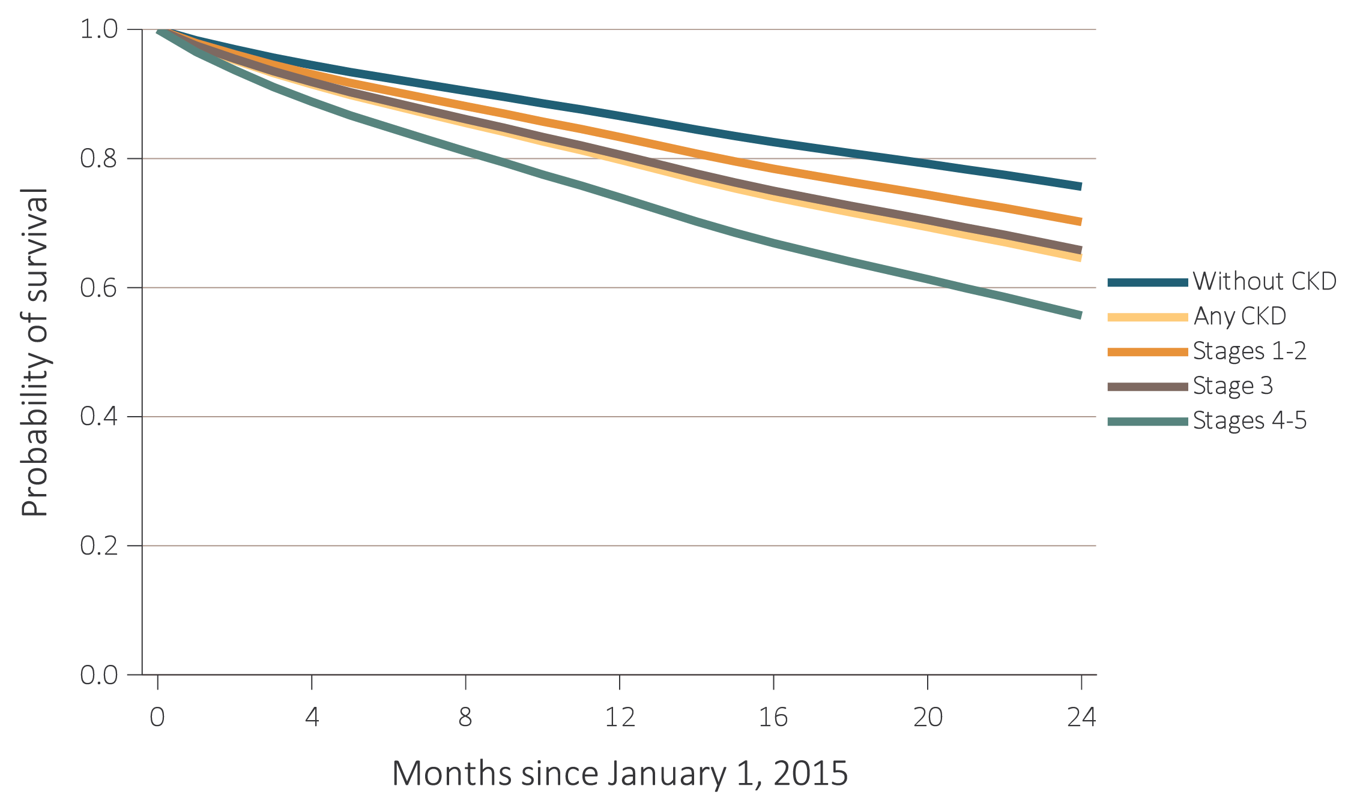
vol 1 Figure 4.2 Probability of survival of patients with a prevalent cardiovascular disease, by CKD status, adjusted for age and sex, 2015-2016 (c) Heart failure (HF)
Data Source: Special analyses, Medicare 5% sample. Patients aged 66 and older, alive, without end-stage renal disease, and residing in the United States on 12/31/2014, with fee-for-service coverage for the entire calendar year. Abbreviation: CKD, chronic kidney disease.
2018 Annual Data Report
Volume 1 CKD, Chapter 4

Slide 9
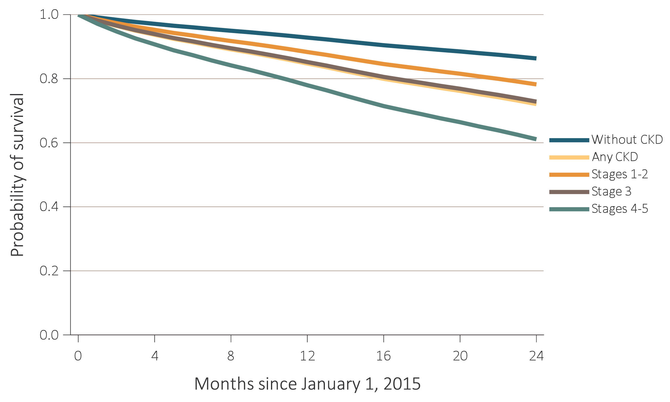
vol 1 Figure 4.2 Probability of survival of patients with a prevalent cardiovascular disease, by CKD status, adjusted for age and sex, 2015-2016 (d) Valvular heart disease (VHD)
Data Source: Special analyses, Medicare 5% sample. Patients aged 66 and older, alive, without end-stage renal disease, and residing in the United States on 12/31/2014, with fee-for-service coverage for the entire calendar year. Abbreviation: CKD, chronic kidney disease.
2018 Annual Data Report
Volume 1 CKD, Chapter 4

Slide 10
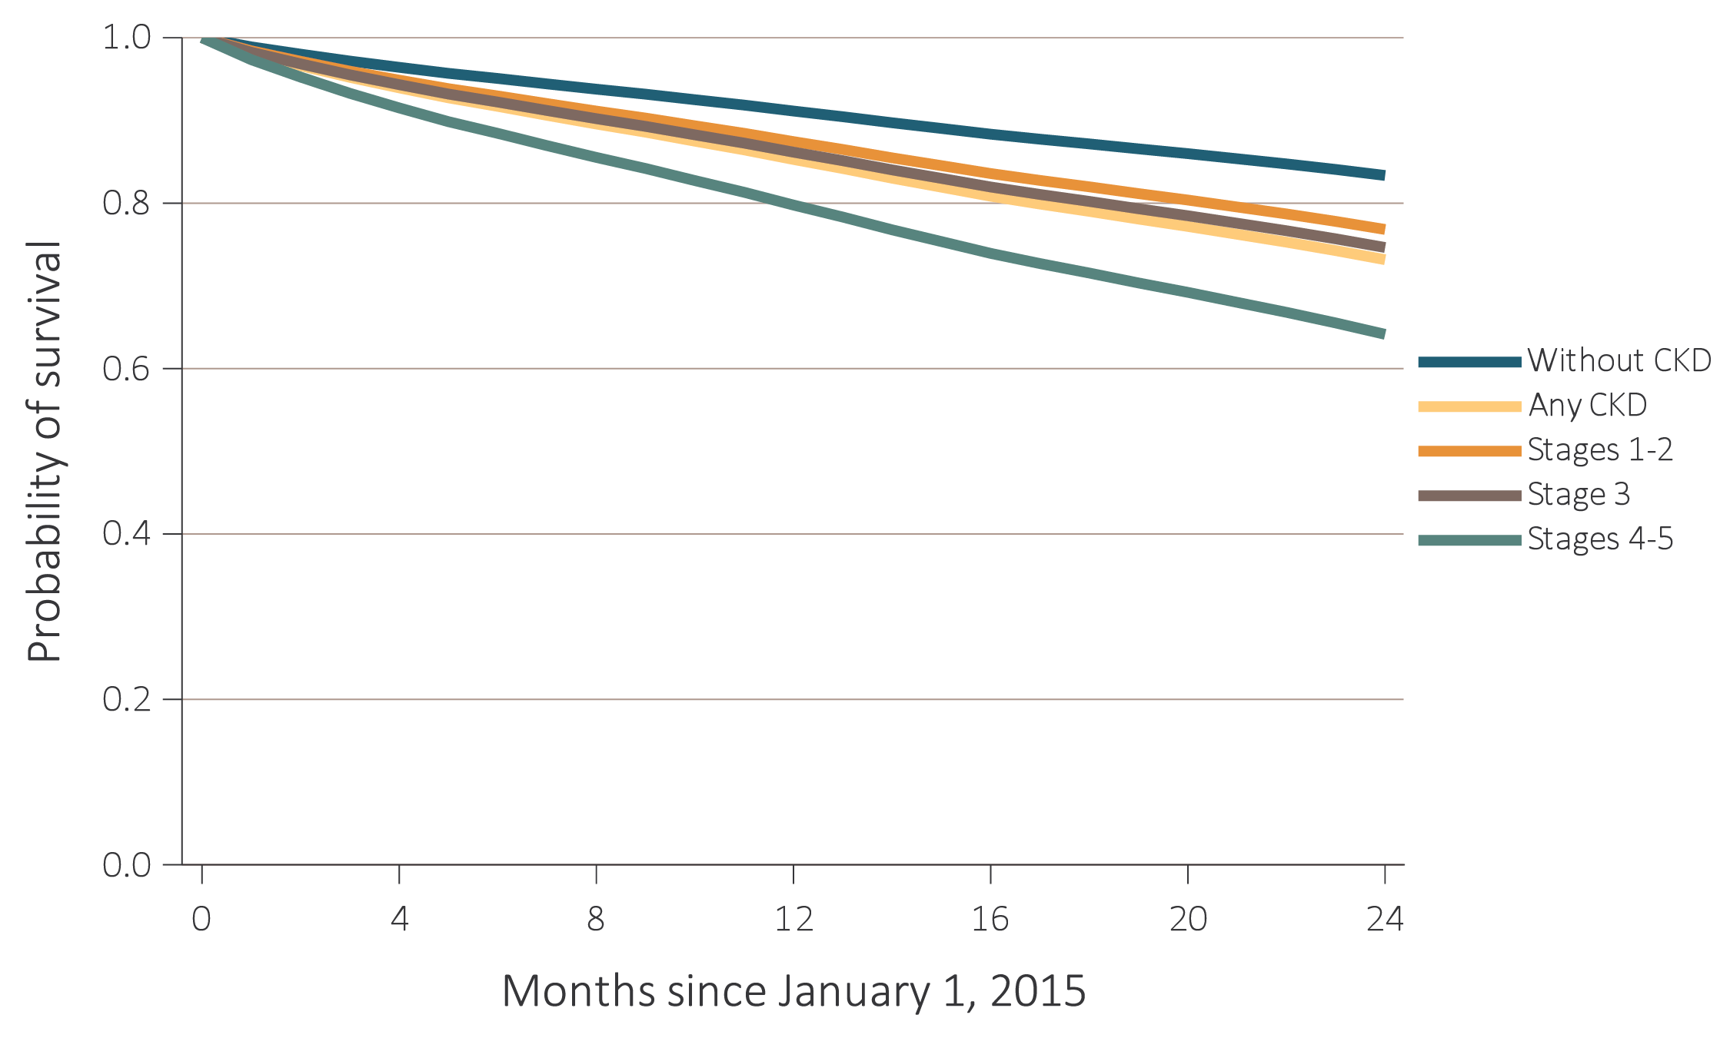
vol 1 Figure 4.2 Probability of survival of patients with a prevalent cardiovascular disease, by CKD status, adjusted for age and sex, 2015-2016 (e) Cerebrovascular accident/transient ischemic attack (CVA/TIA)
Data Source: Special analyses, Medicare 5% sample. Patients aged 66 and older, alive, without end-stage renal disease, and residing in the United States on 12/31/2014, with fee-for-service coverage for the entire calendar year. Abbreviation: CKD, chronic kidney disease.
2018 Annual Data Report
Volume 1 CKD, Chapter 4

Slide 11
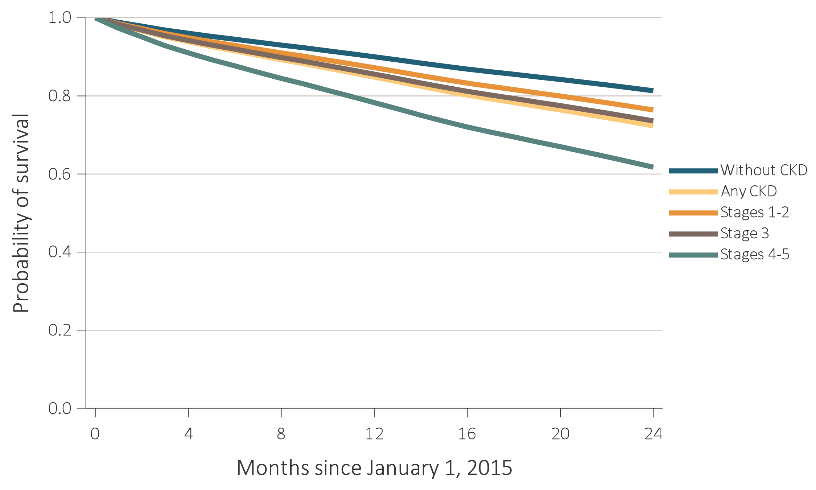
vol 1 Figure 4.2 Probability of survival of patients with a prevalent cardiovascular disease, by CKD status, adjusted for age and sex, 2015-2016 (f) Peripheral arterial disease (PAD)
Data Source: Special analyses, Medicare 5% sample. Patients aged 66 and older, alive, without end-stage renal disease, and residing in the United States on 12/31/2014, with fee-for-service coverage for the entire calendar year. Abbreviation: CKD, chronic kidney disease.
2018 Annual Data Report
Volume 1 CKD, Chapter 4

Slide 12
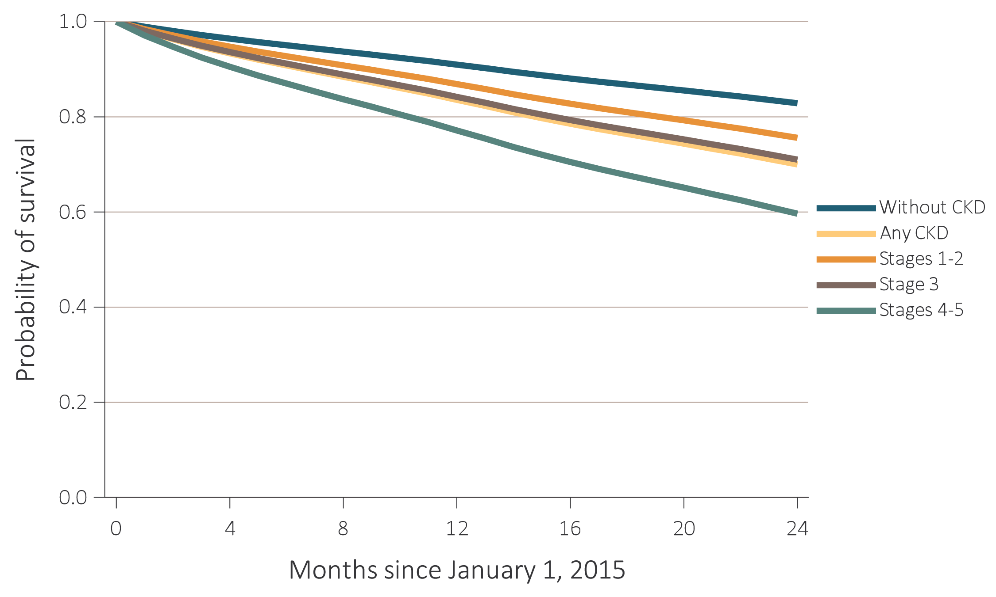
vol 1 Figure 4.2 Probability of survival of patients with a prevalent cardiovascular disease, by CKD status, adjusted for age and sex, 2015-2016 (g) Atrial fibrillation (AF)
Data Source: Special analyses, Medicare 5% sample. Patients aged 66 and older, alive, without end-stage renal disease, and residing in the United States on 12/31/2014, with fee-for-service coverage for the entire calendar year. Abbreviation: CKD, chronic kidney disease.
2018 Annual Data Report
Volume 1 CKD, Chapter 4

Slide 13
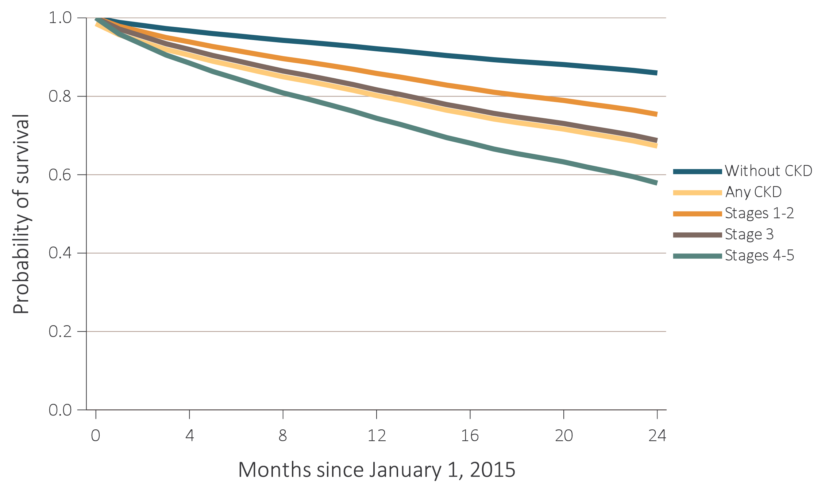
vol 1 Figure 4.2 Probability of survival of patients with a prevalent cardiovascular disease, by CKD status, adjusted for age and sex, 2015-2016 (h) Sudden cardiac arrest and ventricular arrhythmias (SCA/VA)
Data Source: Special analyses, Medicare 5% sample. Patients aged 66 and older, alive, without end-stage renal disease, and residing in the United States on 12/31/2014, with fee-for-service coverage for the entire calendar year. Abbreviation: CKD, chronic kidney disease.
2018 Annual Data Report
Volume 1 CKD, Chapter 4

Slide 14
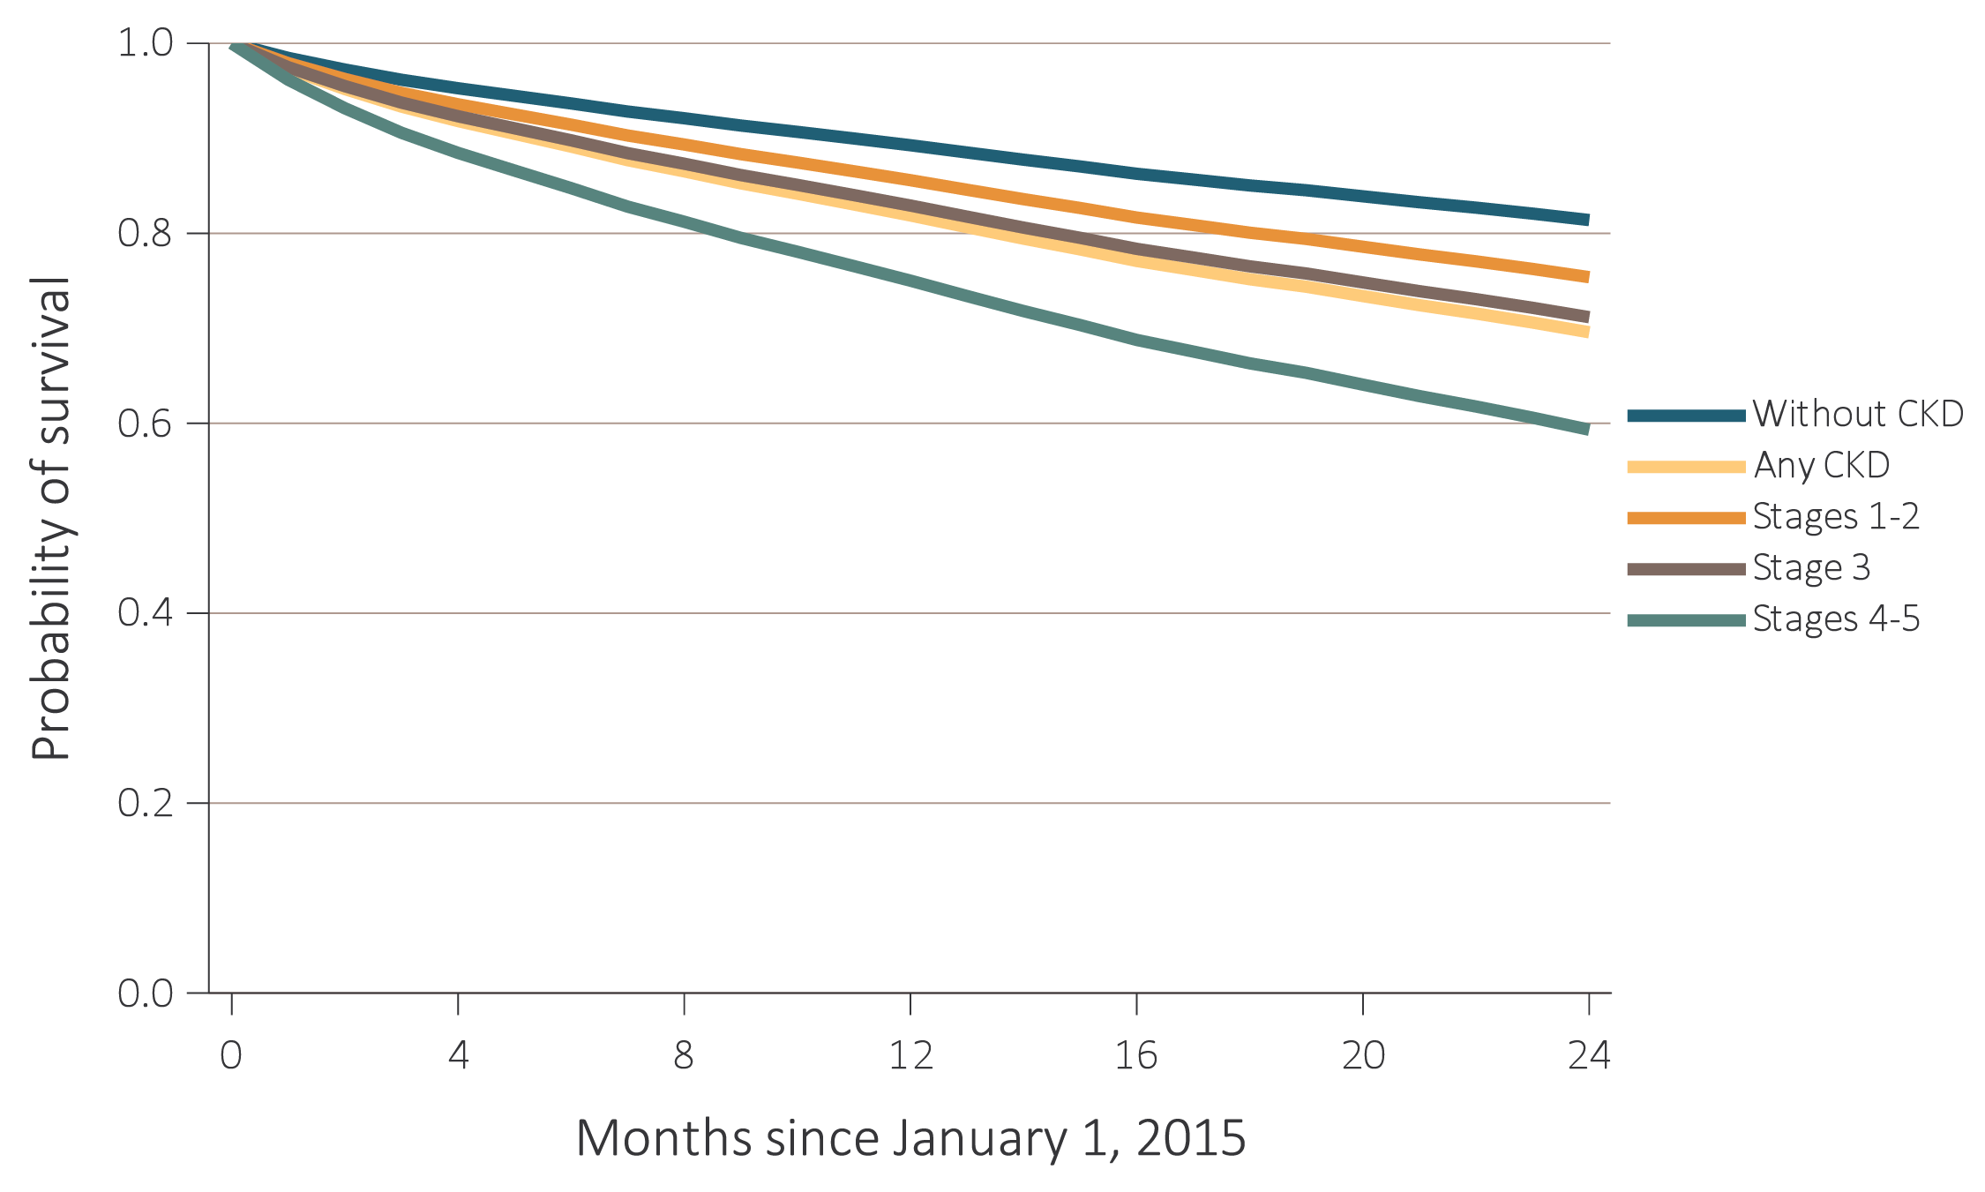
vol 1 Figure 4.2 Probability of survival of patients with a prevalent cardiovascular disease, by CKD status, adjusted for age and sex, 2015-2016 (i) Venous thromboembolism and pulmonary embolism (VTE/PE)
Data Source: Special analyses, Medicare 5% sample. Patients aged 66 and older, alive, without end-stage renal disease, and residing in the United States on 12/31/2014, with fee-for-service coverage for the entire calendar year. Abbreviation: CKD, chronic kidney disease.
2018 Annual Data Report
Volume 1 CKD, Chapter 4

Slide 15
vol 1 Table 4.2 Two-year survival of patients with a prevalent cardiovascular disease, by CKD status, adjusted for age and sex, 2015-2016
 | CKD status
Cardiovascular disease | No CKD (%) | CKD (%) | Stages 1 to 2 (%) | Stage 3 (%) | Stages 4 to 5 (%)
CAD | 87.4 | 76.6 | 81.1 | 77.6 | 67.4
AMI | 81.7 | 68.5 | 74.5 | 69.0 | 58.6
HF | 75.6 | 64.6 | 70.2 | 65.8 | 55.7
VHD | 86.3 | 72.1 | 78.2 | 72.8 | 61.1
CVA/TIA | 83.3 | 73.2 | 76.8 | 74.6 | 64.1
PAD | 81.3 | 72.3 | 76.4 | 73.6 | 61.7
AF | 82.9 | 70.0 | 75.6 | 71.0 | 59.6
SCA/VA | 86.0 | 68.8 | 75.4 | 68.7 | 57.9
VTE/PE | 81.4 | 69.6 | 75.4 | 71.2 | 59.3
Data Source: Special analyses, Medicare 5% sample. Patients aged 66 and older, alive, without end-stage renal disease, and residing in the United States on 12/31/2014, with fee-for-service coverage for the entire calendar year. Abbreviations: AF, atrial fibrillation; AMI, acute myocardial infarction; CAD, coronary artery disease; CKD, chronic kidney disease; CVA/TIA, cerebrovascular accident/transient ischemic attack; HF, heart failure; PAD, peripheral arterial disease; SCA/VA, sudden cardiac arrest and ventricular arrhythmias; VHD, valvular heart disease; VTE/PE, venous thromboembolism and pulmonary embolism.
2018 Annual Data Report
Volume 1 CKD, Chapter 4

Slide 16
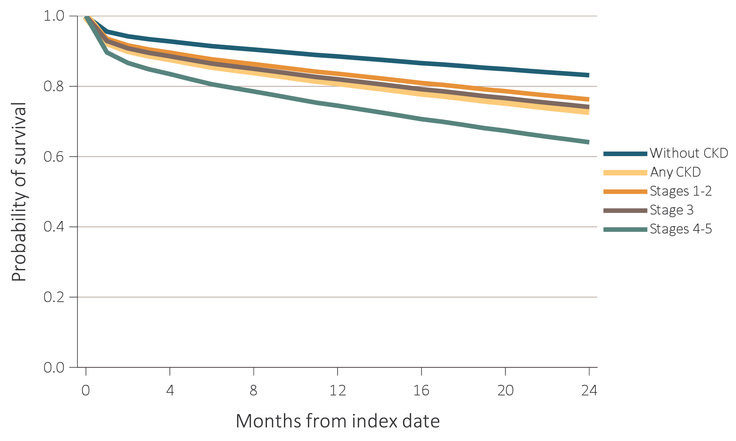
vol 1 Figure 4.3 Probability of survival of patients with a cardiovascular procedure, by CKD status, adjusted for age and sex, 2014-2016 (a) Percutaneous coronary interventions (PCI)
Data Source: Special analyses, Medicare 5% sample. Patients aged 66 and older, alive, without end-stage renal disease, and residing in the United States on the index date, which was the date of the first procedure claim, with fee-for-service coverage for the entire year prior to this date. Abbreviation: CKD, chronic kidney disease.
2018 Annual Data Report
Volume 1 CKD, Chapter 4

Slide 17
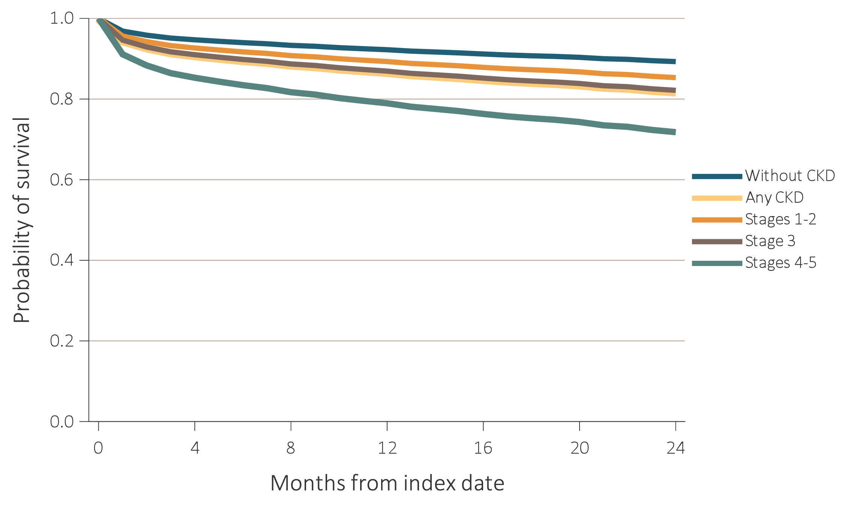
vol 1 Figure 4.3 Probability of survival of patients with a cardiovascular procedure, by CKD status, adjusted for age and sex, 2014-2016 (b) Coronary artery bypass grafting (CABG)
Data Source: Special analyses, Medicare 5% sample. Patients aged 66 and older, alive, without end-stage renal disease, and residing in the United States on the index date, which was the date of the first procedure claim, with fee-for-service coverage for the entire year prior to this date. Abbreviation: CKD, chronic kidney disease.
2018 Annual Data Report
Volume 1 CKD, Chapter 4

Slide 18
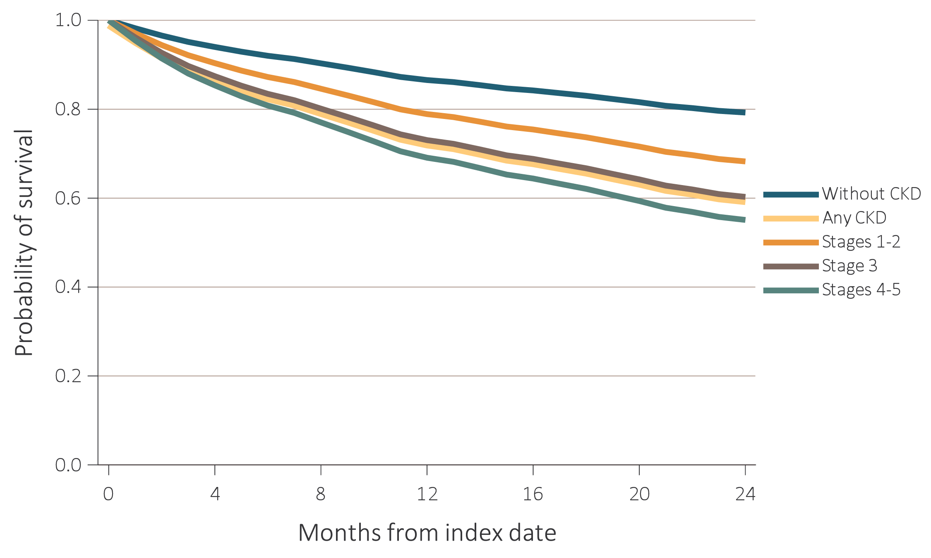
vol 1 Figure 4.3 Probability of survival of patients with a cardiovascular procedure, by CKD status, adjusted for age and sex, 2014-2016
(c) Implantable cardioverter defibrillators/cardiac resynchronization therapy with defibrillator devices (ICD/CRT-D)
Data Source: Special analyses, Medicare 5% sample. Patients aged 66 and older, alive, without end-stage renal disease, and residing in the United States on the index date, which was the date of the first procedure claim, with fee-for-service coverage for the entire year prior to this date. Abbreviation: CKD, chronic kidney disease.
2018 Annual Data Report
Volume 1 CKD, Chapter 4

Slide 19
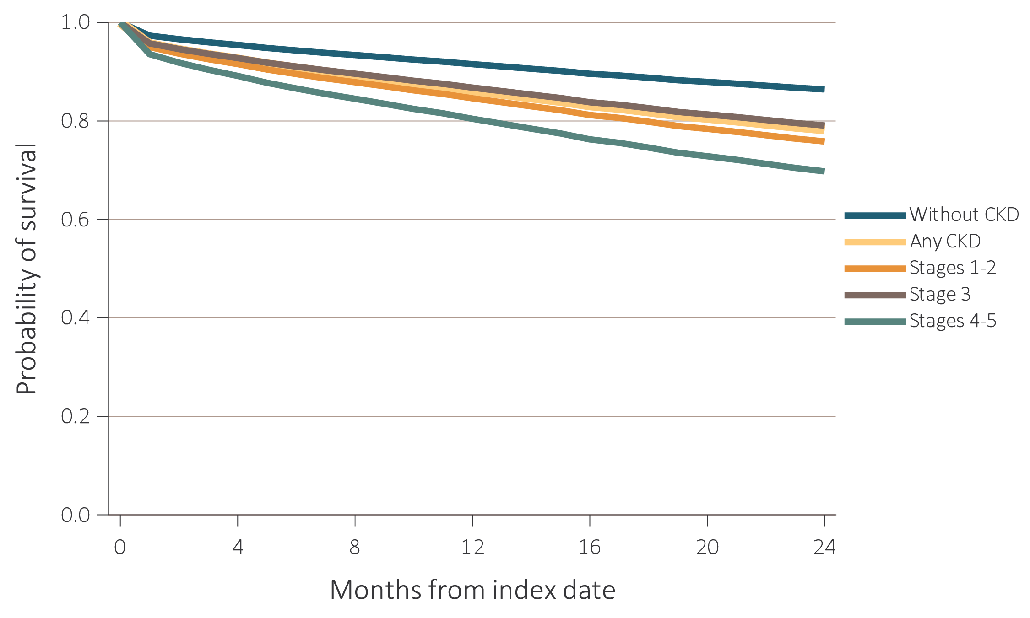
vol 1 Figure 4.3 Probability of survival of patients with a cardiovascular procedure, by CKD status, adjusted for age and sex, 2014-2016 (d) Carotid artery stenting and carotid endarterectomy (CAS/CEA)
Data Source: Special analyses, Medicare 5% sample. Patients aged 66 and older, alive, without end-stage renal disease, and residing in the United States on the index date, which was the date of the first procedure claim, with fee-for-service coverage for the entire year prior to this date. Abbreviation: CKD, chronic kidney disease.
2018 Annual Data Report
Volume 1 CKD, Chapter 4

Slide 20
vol 1 Table 4.3 Two-year survival of patients with a cardiovascular procedure, by CKD status, adjusted for age and sex, 2014-2016
 | CKD status
Cardiovascular procedure | No CKD (%) | CKD (%) | Stages 1 to 2 (%) | Stage 3 (%) | Stages 4 to 5 (%)
PCI | 83.2 | 73.0 | 76.3 | 74.1 | 64.3
CABG | 89.3 | 81.8 | 85.3 | 82.2 | 71.8
ICD/CRT-D | 79.2 | 60.3 | 68.3 | 60.3 | 55.1
CAS/CEA | 86.4 | 78.2 | 78.5 | 79.0 | 70.1
Data Source: Special analyses, Medicare 5% sample. Patients aged 66 and older, alive, without end-stage renal disease, and residing in the United States on the index date, which was the date of the first procedure claim, with fee-for-service coverage for the entire year prior to this date. Abbreviations: CABG, coronary artery bypass grafting; CAS/CEA, carotid artery stenting and carotid endarterectomy; CKD, chronic kidney disease; ICD/CRT-D, implantable cardioverter defibrillators/cardiac resynchronization therapy with defibrillator devices; PCI, percutaneous coronary interventions.
2018 Annual Data Report
Volume 1 CKD, Chapter 4

Slide 21
vol 1 Table 4.4 Cardiovascular pharmacological treatments by (a) comorbidities and (b) procedures, by CKD status, 2016
 |  | (a) Cardiovascular comorbidities
 |  | % Patients
 | # Patients | Beta- blockers | Statins | P2Y12 inhibitors | Warfarin | Direct Oral Anticoagulants | ACEs/ ARBs
Any CVD
Without CKD | 247,266 | 54.6 | 63.0 | 16.2 | 12.8 | 11.8 | 53.8
Any CKD | 80,331 | 65.1 | 68.2 | 20.4 | 15.3 | 13.4 | 59.7
Coronary artery disease (CAD)
Without CKD | 119,066 | 65.2 | 75.7 | 26.1 | 9.8 | 9.5 | 59.2
Any CKD | 47,197 | 73.0 | 75.7 | 28.7 | 14.8 | 13.0 | 61.8
Acute myocardial infarction (AMI)
Without CKD | 17,202 | 74.8 | 78.4 | 40.4 | 11.5 | 11.5 | 63.6
Any CKD | 11,514 | 79.9 | 78.8 | 39.8 | 16.6 | 14.8 | 63.4
Heart failure (HF)
Without CKD | 47,170 | 70.5 | 60.6 | 16.6 | 18.9 | 16.6 | 61.2
Any CKD | 32,658 | 75.6 | 67.3 | 21.7 | 20.5 | 17.1 | 59.9
Valvular heart disease (VHD)
Without CKD | 38,681 | 57.6 | 61.7 | 13.9 | 15.4 | 13.1 | 55.0
Any CKD | 15,804 | 71.3 | 69.0 | 21.5 | 20.2 | 16.9 | 61.0
Cerebrovascular accident/transient ischemic attack (CVA/TIA)
Without CKD | 51,550 | 49.1 | 69.3 | 24.7 | 10.5 | 9.9 | 54.4
Any CKD | 20,225 | 64.7 | 73.5 | 30.6 | 14.2 | 13.0 | 60.8
Peripheral artery disease (PAD)
Without CKD | 75,554 | 48.3 | 59.5 | 17.8 | 9.4 | 8.3 | 52.3
Any CKD | 31,982 | 63.6 | 68.2 | 24.3 | 14.0 | 12.1 | 59.5
Atrial fibrillation (AF)
Without CKD | 73,778 | 67.2 | 57.9 | 8.7 | 34.6 | 33.2 | 51.3
Any CKD | 29,174 | 74.0 | 65.7 | 14.2 | 34.8 | 30.9 | 56.8
Cardiac arrest and ventricular arrhythmias (SCA/VA)
Without CKD | 10,866 | 69.9 | 63.9 | 17.4 | 13.2 | 14.4 | 58.4
Any CKD | 5,014 | 79.4 | 70.6 | 25.2 | 22.0 | 19.4 | 64.0
Venous thromboembolism and pulmonary embolism (VTE/PE)
Without CKD | 8,895 | 41.7 | 49.4 | 7.8 | 47.8 | 31.8 | 45.3
Any CKD | 4,695 | 59.3 | 57.2 | 12.0 | 45.2 | 32.5 | 54.2
Data Source: Special analyses, Medicare 5% sample. Patients aged 66 and older, alive, without end-stage renal disease, and residing in the United States on 12/31/2016 with fee-for-service and Part D coverage for the entire calendar year. Abbreviations: ACEs/ARBs, Angiotensin converting enzyme inhibitors and angiotensin receptor blockers; AF, atrial fibrillation; AMI, acute myocardial infarction; CAD, coronary artery disease; CABG, coronary artery bypass grafting; CAS/CEA, carotid artery stenting and carotid endarterectomy; CKD, chronic kidney disease; CVA/TIA, cerebrovascular accident/transient ischemic attack; CVD, cardiovascular disease; HF, heart failure; ICD/CRT-D, implantable cardioverter defibrillators/cardiac resynchronization therapy with defibrillator devices; PAD, peripheral arterial disease; PCI, percutaneous coronary interventions; SCA/VA, sudden cardiac arrest and ventricular arrhythmias; VHD, valvular heart disease; VTE/PE, venous thromboembolism and pulmonary embolism.
2018 Annual Data Report
Volume 1 CKD, Chapter 4

Slide 22
vol 1 Table 4.4 Cardiovascular pharmacological treatments by (a) comorbidities and (b) procedures, by CKD status, 2016 (continued)
 |  | (b) Cardiovascular procedures
 |  | % Patients
 | # Patients | Beta- blockers | Statins | P2Y12 inhibitors | Warfarin | Direct Oral Anticoagulants | ACEs/ ARBs
Revascularization – percutaneous coronary interventions (PCI)
Without CKD | 2,390 | 84.8 | 88.2 | 94.5 | 7.7 | 8.6 | 73.9
Any CKD | 1,418 | 88.5 | 87.0 | 92.5 | 13.6 | 12.6 | 70.0
Revascularization – coronary artery bypass graft (CABG)
Without CKD | 1,210 | 92.1 | 90.0 | 39.1 | 17.4 | 12.0 | 68.3
Any CKD | 681 | 92.7 | 90.7 | 38.6 | 21.4 | 16.0 | 70.5
Implantable cardioverter defibrillators & cardiac resynchronization therapy with defibrillator (ICD/CRT-D)
Without CKD | 337 | 85.2 | 72.1 | 25.2 | 24.9 | 23.7 | 72.7
Any CKD | 345 | 88.4 | 74.5 | 29.3 | 30.1 | 28.7 | 72.5
Carotid artery stenting and carotid artery endarterectomy (CAS/CEA)
Without CKD | 1,018 | 56.2 | 82.8 | 50.3 | 7.5 | 11.1 | 63.2
Any CKD | 437 | 71.4 | 87.6 | 54.5 | 12.1 | 11.4 | 65.7
Data Source: Special analyses, Medicare 5% sample. Patients aged 66 and older, alive, without end-stage renal disease, and residing in the United States on 12/31/2016 with fee-for-service and Part D coverage for the entire calendar year. Abbreviations: ACEs/ARBs, Angiotensin converting enzyme inhibitors and angiotensin receptor blockers; AF, atrial fibrillation; AMI, acute myocardial infarction; CAD, coronary artery disease; CABG, coronary artery bypass grafting; CAS/CEA, carotid artery stenting and carotid endarterectomy; CKD, chronic kidney disease; CVA/TIA, cerebrovascular accident/transient ischemic attack; CVD, cardiovascular disease; HF, heart failure; ICD/CRT-D, implantable cardioverter defibrillators/cardiac resynchronization therapy with defibrillator devices; PAD, peripheral arterial disease; PCI, percutaneous coronary interventions; SCA/VA, sudden cardiac arrest and ventricular arrhythmias; VHD, valvular heart disease; VTE/PE, venous thromboembolism and pulmonary embolism.
2018 Annual Data Report
Volume 1 CKD, Chapter 4

Slide 23
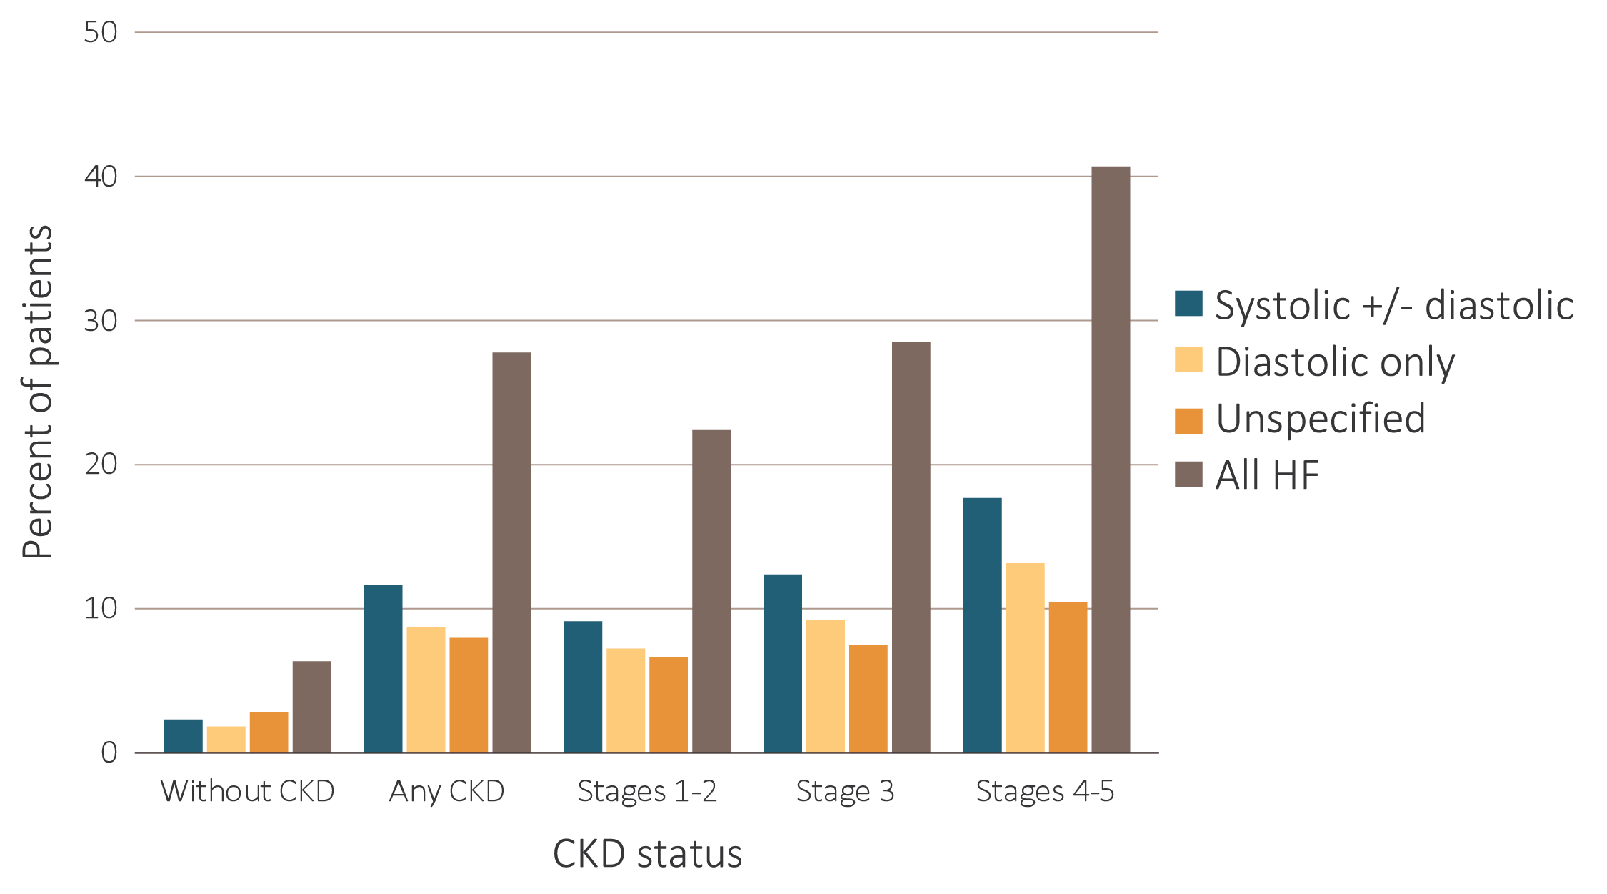
vol 1 Figure 4.4 Heart failure in patients with or without CKD, 2016
Data Source: Special analyses, Medicare 5% sample. Patients aged 66 and older, alive, without end-stage renal disease, and residing in the United States on 12/31/2016 with fee-for-service coverage for the entire calendar year. Abbreviation: CKD, chronic kidney disease.
2018 Annual Data Report
Volume 1 CKD, Chapter 4

Slide 24
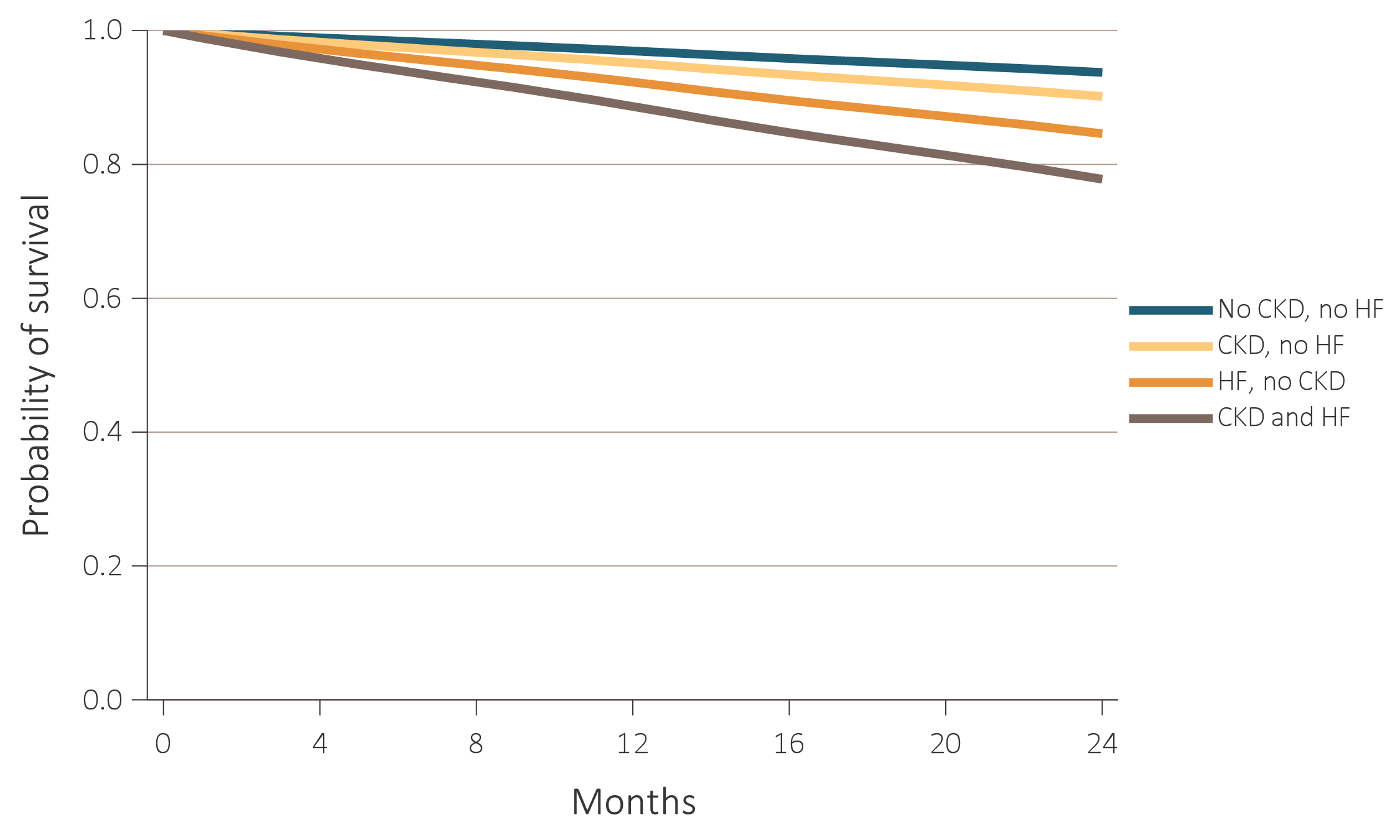
vol 1 Figure 4.5 Adjusted survival of patients by CKD and heart failure status, 2015-2016
Data Source: Special analyses, Medicare 5% sample. Patients aged 66 and older, alive, without end-stage renal disease, and residing in the United States on 12/31/2014 with fee-for-service coverage for the entire calendar year. Survival was adjusted for age, sex, race, diabetic status, and hypertension status. Abbreviation: CKD, chronic kidney disease.
2018 Annual Data Report
Volume 1 CKD, Chapter 4

Slide 25
vol 1 Table 4.5 Prevalence of atrial fibrillation by stage of CKD, age, race, sex, and diabetic, hypertension, and heart failure status, 2016
 | No CKD | CKD stage
 |  | Stages 1-2 | Stage 3 | Stages 4-5 | Unknown stage | All CKD stages
# Patients | 1,086,232 | 18,750 | 88,322 | 14,833 | 53,935 | 175,840
Atrial fibrillation (Overall) | 9.8 | 21.3 | 25.4 | 28.3 | 20.9 | 23.8
Age
66-69 | 4.4 | 11.9 | 15.5 | 17.8 | 11.3 | 13.5
70-74 | 7.0 | 15.9 | 18.4 | 22.0 | 15.4 | 17.3
75-84 | 12.5 | 23.2 | 26.1 | 28.3 | 23.7 | 25.3
85+ | 19.8 | 32.4 | 34.0 | 35.6 | 32.7 | 33.7
Sex
Male | 11.2 | 24.1 | 28.2 | 30.8 | 22.4 | 26.1
Female | 8.7 | 18.5 | 22.8 | 26.3 | 19.2 | 21.6
Race
White | 10.5 | 23.1 | 27.1 | 30.8 | 22.2 | 25.5
Black/African American | 4.8 | 13.9 | 15.7 | 18.3 | 12.7 | 15.0
Other | 5.3 | 13.9 | 16.9 | 19.1 | 13.3 | 15.6
Comorbidity
No diabetes | 9.0 | 21.0 | 25.2 | 28.1 | 20.2 | 23.4
Diabetes | 12.9 | 21.7 | 25.6 | 28.5 | 21.6 | 24.3
No hypertension | 4.0 | 9.8 | 14.3 | 15.5 | 8.6 | 11.0
Hypertension | 14.3 | 22.5 | 26.2 | 28.9 | 23.3 | 25.2
No heart failure | 7.5 | 13.4 | 15.1 | 15.0 | 13.7 | 14.4
Heart failure | 44.6 | 50.0 | 51.8 | 48.2 | 49.4 | 50.6
Data Source: Special analyses, Medicare 5% sample. Patients aged 66 and older, alive, without end-stage renal disease, and residing in the United States on 12/31/2016 with fee-for-service coverage for the entire calendar year. Abbreviation: CKD, chronic kidney disease.
2018 Annual Data Report
Volume 1 CKD, Chapter 4

