Slide 1
2018 Annual Data Report
Volume 1: Chronic Kidney Disease
2018 Annual Data Report Volume 1 CKD, Chapter 5

Slide 2
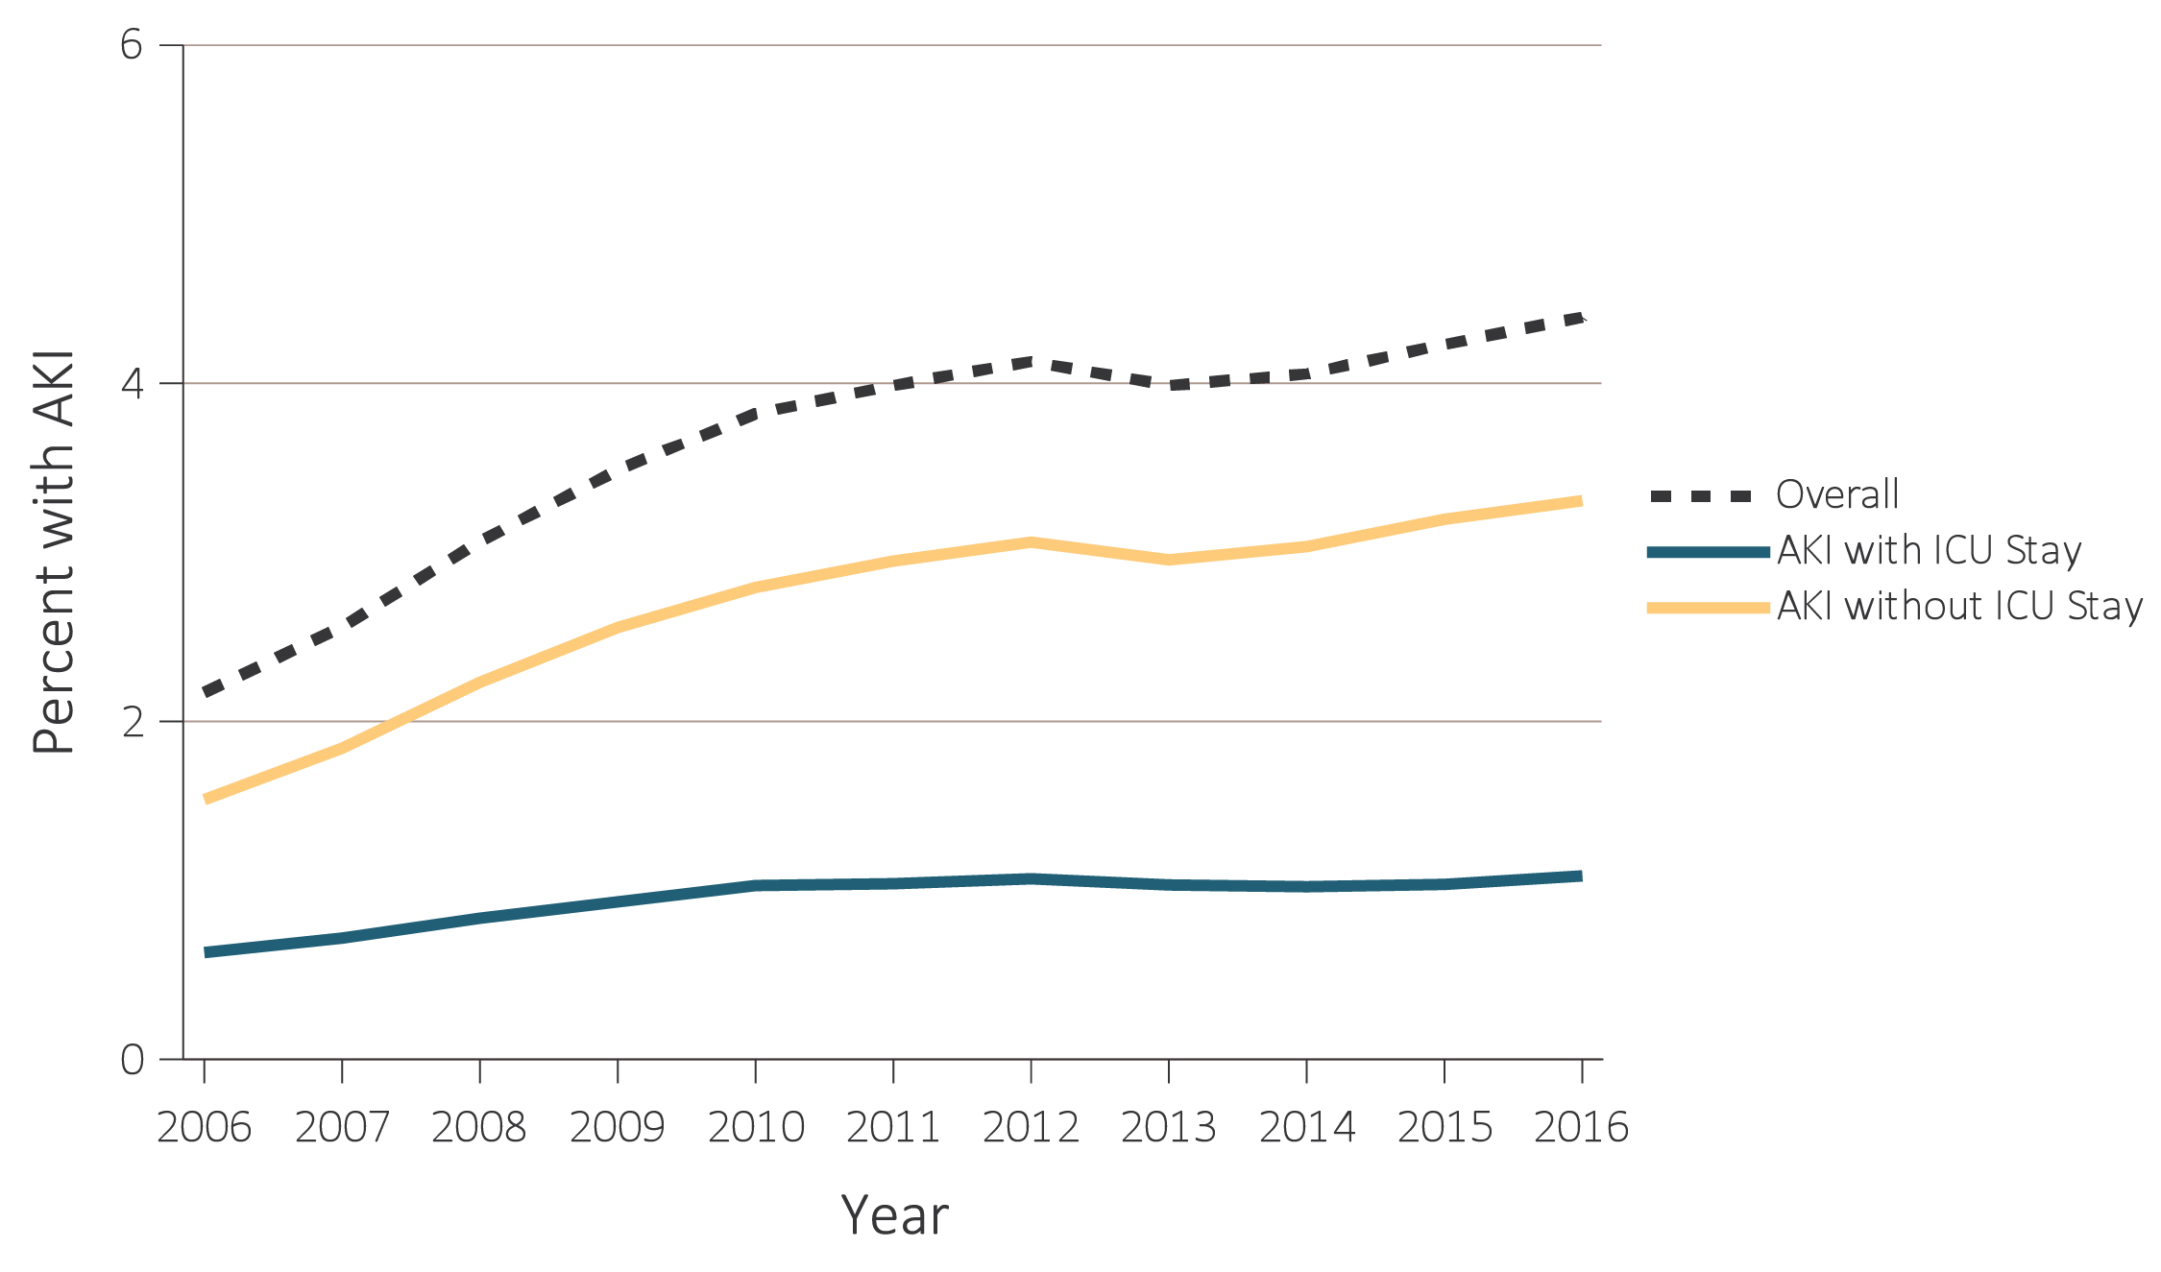
vol 1 Figure 5.1 Percent of Medicare patients aged 66+ (a) with at least one AKI hospitalization, and (b) percent among those with an AKI hospitalization who required dialysis, and (c) percent of patients with nephrology consultation, among those with a first AKI hospitalization, by whether an intensive care unit (ICU) stay was required, 2006-2016
(a) Percent of patients with an AKI hospitalization
Data Source: Special analyses, Medicare 5% sample. (a) Percent with an AKI hospitalization among all Medicare patients aged 66 and older who had both Medicare Parts A & B, no Medicare Advantage plan, no ESRD by first service date from Medical Evidence form, and were alive on January 1 of year shown. (b) Percent of patients receiving dialysis during their first AKI hospitalization among patients with a first AKI hospitalization. Dialysis is identified by a diagnosis or charge for dialysis on the AKI hospitalization inpatient claim or a physician/supplier (Part B) claim for dialysis during the time of the AKI inpatient claim. Abbreviations: AKI, acute kidney injury; ESRD, end-stage renal disease; ICU, intensive care unit.

Slide 3
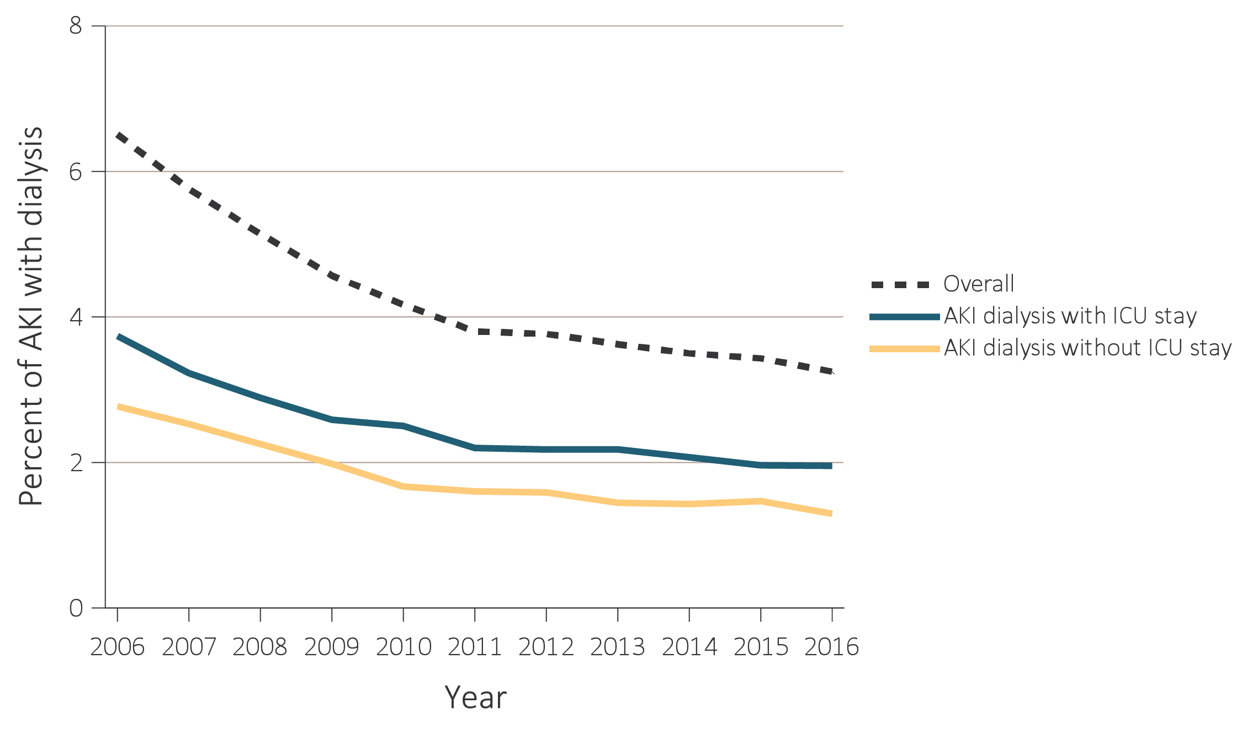
vol 1 Figure 5.1 Percent of Medicare patients aged 66+ (a) with at least one AKI hospitalization, and (b) percent among those with an AKI hospitalization who required dialysis, and (c) percent of patients with nephrology consultation, among those with a first AKI hospitalization, by whether an intensive care unit (ICU) stay was required, 2006-2016
(b) Percent of patients requiring inpatient dialysis, among those with a first AKI hospitalization
Data Source: Special analyses, Medicare 5% sample. (a) Percent with an AKI hospitalization among all Medicare patients aged 66 and older who had both Medicare Parts A & B, no Medicare Advantage plan, no ESRD by first service date from Medical Evidence form, and were alive on January 1 of year shown. (b) Percent of patients receiving dialysis during their first AKI hospitalization among patients with a first AKI hospitalization. Dialysis is identified by a diagnosis or charge for dialysis on the AKI hospitalization inpatient claim or a physician/supplier (Part B) claim for dialysis during the time of the AKI inpatient claim. Abbreviations: AKI, acute kidney injury; ESRD, end-stage renal disease; ICU, intensive care unit.

Slide 4
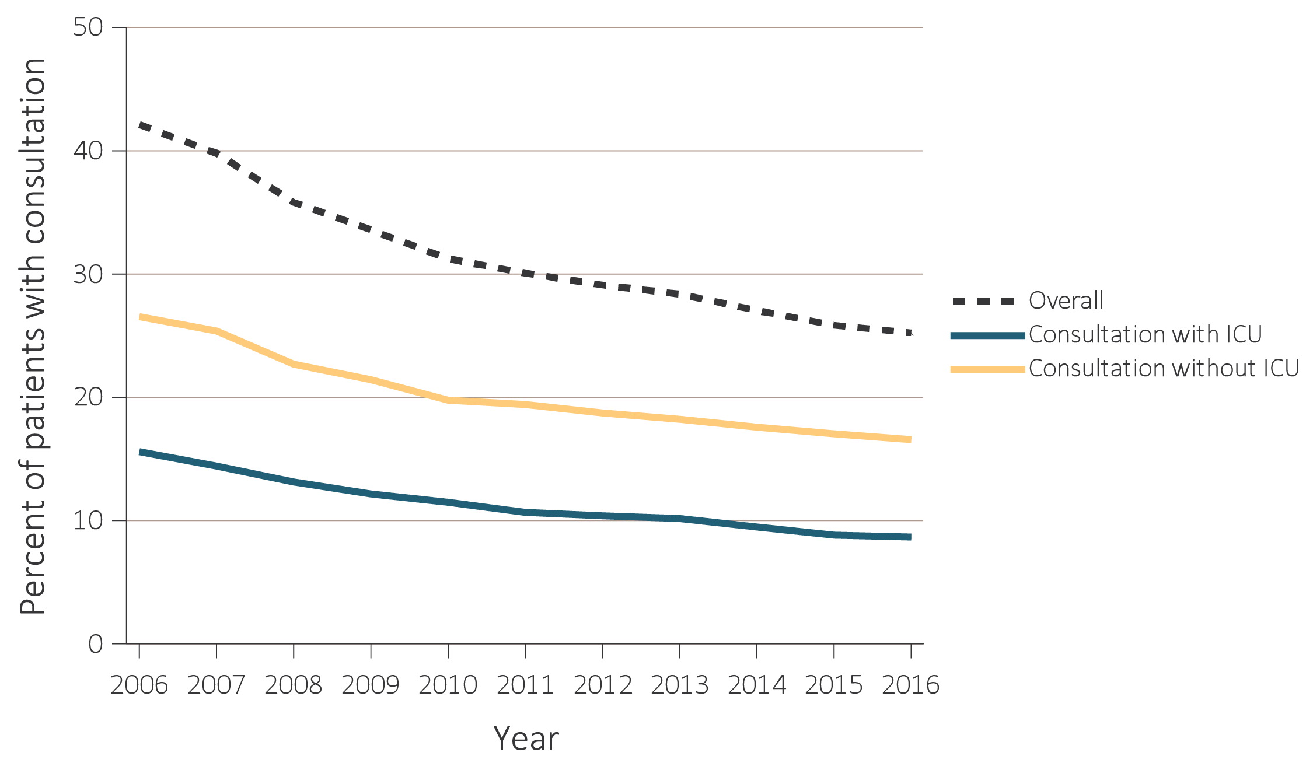
vol 1 Figure 5.1 Percent of Medicare patients aged 66+ (a) with at least one AKI hospitalization, and (b) percent among those with an AKI hospitalization who required dialysis, and (c) percent of patients with nephrology consultation, among those with a first AKI hospitalization, by whether an intensive care unit (ICU) stay was required, 2006-2016
(c) Percent of patients with nephrology consultation, among those with a first AKI hospitalization
Data Source: Special analyses, Medicare 5% sample. (a) Percent with an AKI hospitalization among all Medicare patients aged 66 and older who had both Medicare Parts A & B, no Medicare Advantage plan, no ESRD by first service date from Medical Evidence form, and were alive on January 1 of year shown. (b) Percent of patients receiving dialysis during their first AKI hospitalization among patients with a first AKI hospitalization. Dialysis is identified by a diagnosis or charge for dialysis on the AKI hospitalization inpatient claim or a physician/supplier (Part B) claim for dialysis during the time of the AKI inpatient claim. Abbreviations: AKI, acute kidney injury; ESRD, end-stage renal disease; ICU, intensive care unit.

Slide 5
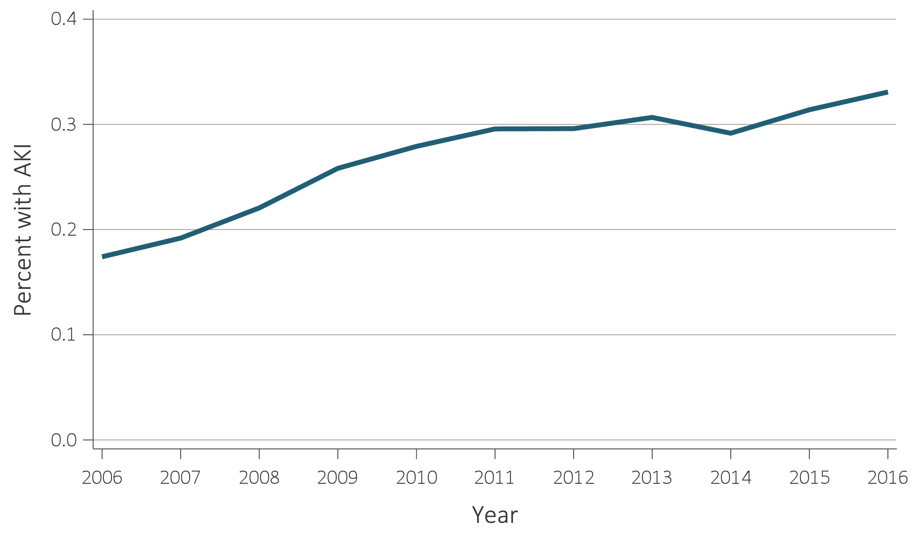
vol 1 Figure 5.2 Percent of Optum Clinformatics™ patients aged 22+ with at least one AKI hospitalization, by year, 2006-2016
Data Source: Special analyses, Optum Clinformatics™. Percent with an AKI hospitalization among all Optum Clinformatics™ commercial insurance patients aged 22 and older who were enrolled in the plan, did not have diagnoses of ESRD, and were alive on January 1 of year shown. Abbreviations: AKI, acute kidney injury; ESRD, end-stage renal disease.

Slide 6
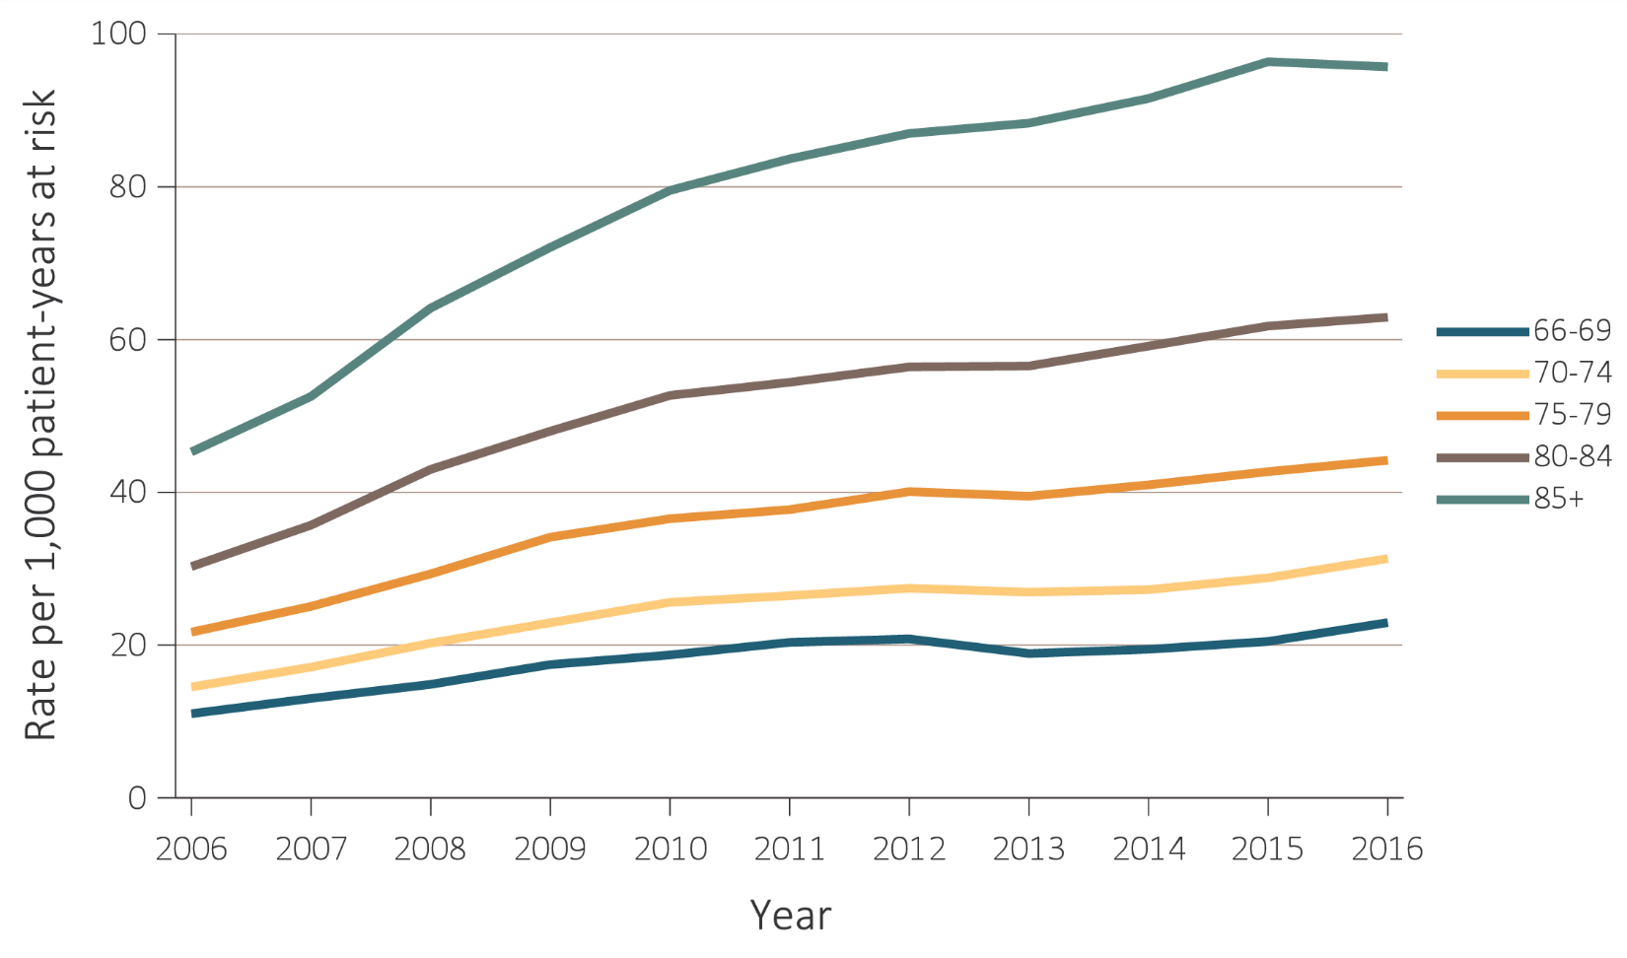
vol 1 Figure 5.3 Unadjusted rates of hospitalization with AKI and AKI requiring dialysis, per 1,000 patient-years at risk, by age, 2006-2016
(a) Medicare (aged 66+) – rate of AKI
Data Source: Special analyses, Medicare 5% sample and Optum Clinformatics™. (a) and (b) Age as of January 1 of specified year. All patient-years at risk for Medicare patients aged 66 and older who had both Medicare Parts A & B, no Medicare Advantage plan, no ESRD by first service date from Medical Evidence form, and were alive on January 1 of year shown. Censored at death, ESRD, end of Medicare Parts A & B participation, or switch to Medicare Advantage program. (c) All patient-years at risk for Optum Clinformatics™ commercial insurance patients aged 22 and older who were enrolled in the plan, did not have diagnoses of ESRD, and were alive on January 1 of year shown. Abbreviation: AKI, acute kidney injury; ESRD, end-stage renal disease.

Slide 7
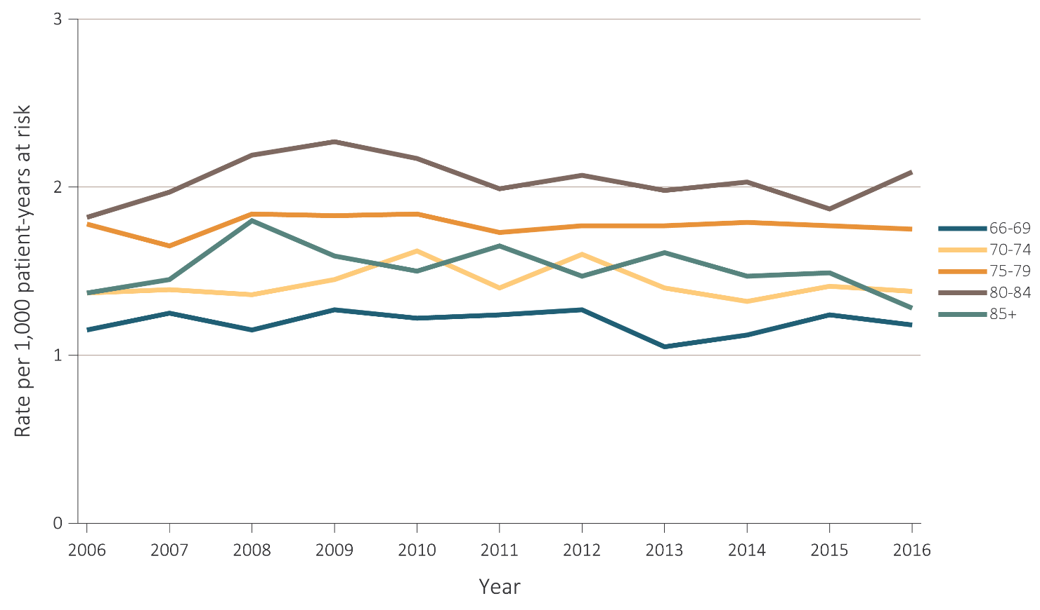
vol 1 Figure 5.3 Unadjusted rates of hospitalization with AKI and AKI requiring dialysis, per 1,000 patient-years at risk, by age, 2006-2016
(b) Medicare (aged 66+) – rate of AKI requiring dialysis
Data Source: Special analyses, Medicare 5% sample and Optum Clinformatics™. (a) and (b) Age as of January 1 of specified year. All patient-years at risk for Medicare patients aged 66 and older who had both Medicare Parts A & B, no Medicare Advantage plan, no ESRD by first service date from Medical Evidence form, and were alive on January 1 of year shown. Censored at death, ESRD, end of Medicare Parts A & B participation, or switch to Medicare Advantage program. (c) All patient-years at risk for Optum Clinformatics™ commercial insurance patients aged 22 and older who were enrolled in the plan, did not have diagnoses of ESRD, and were alive on January 1 of year shown. Abbreviation: AKI, acute kidney injury; ESRD, end-stage renal disease.

Slide 8
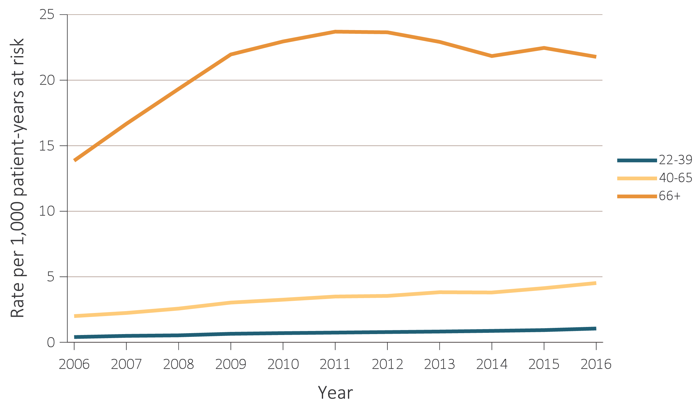
vol 1 Figure 5.3 Unadjusted rates of hospitalization with AKI and AKI requiring dialysis, per 1,000 patient-years at risk, by age, 2006-2016
(c) Optum Clinformatics™ (aged 22+) – rate of AKI
Data Source: Special analyses, Medicare 5% sample and Optum Clinformatics™. (a) and (b) Age as of January 1 of specified year. All patient-years at risk for Medicare patients aged 66 and older who had both Medicare Parts A & B, no Medicare Advantage plan, no ESRD by first service date from Medical Evidence form, and were alive on January 1 of year shown. Censored at death, ESRD, end of Medicare Parts A & B participation, or switch to Medicare Advantage program. (c) All patient-years at risk for Optum Clinformatics™ commercial insurance patients aged 22 and older who were enrolled in the plan, did not have diagnoses of ESRD, and were alive on January 1 of year shown. Abbreviation: AKI, acute kidney injury; ESRD, end-stage renal disease.

Slide 9
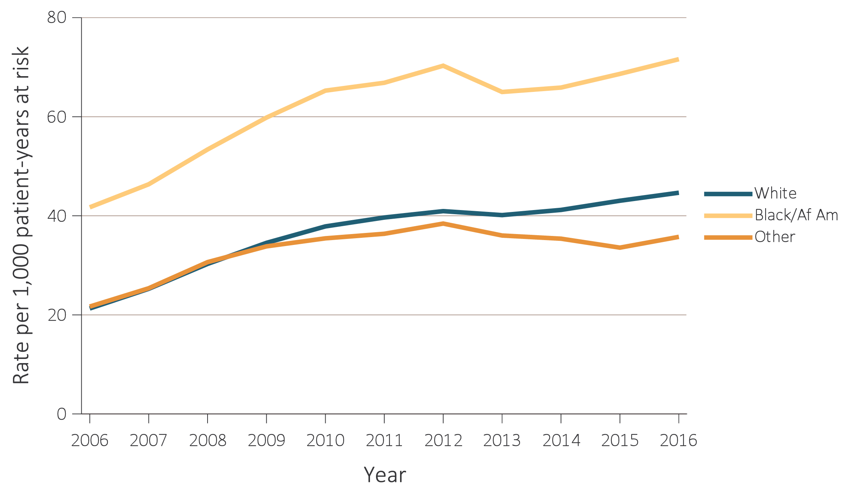
vol 1 Figure 5.4 Unadjusted rates of hospitalization with AKI, and AKI requiring dialysis, per 1,000 patient-years at risk, by race, 2006-2016
(a) Medicare (aged 66+) – rate of AKI
Data Source: Special analyses, Medicare 5% sample and Optum Clinformatics™. (a) and (b) All patient-years at risk for Medicare patients aged 66 and older who had both Medicare Parts A & B, no Medicare Advantage plan, no ESRD by first service date from Medical Evidence form, and were alive on January 1 of year shown. Censored at death, ESRD, end of Medicare Parts A & B participation, or switch to Medicare Advantage program. (c) All patient-years at risk for Optum Clinformatics™ commercial insurance patients aged 22 and older who were enrolled in the plan, did not have diagnoses of ESRD, and were alive on January 1 of year shown. Abbreviations: Af Am, African American; AKI, acute kidney injury; ESRD, end-stage renal disease.

Slide 10
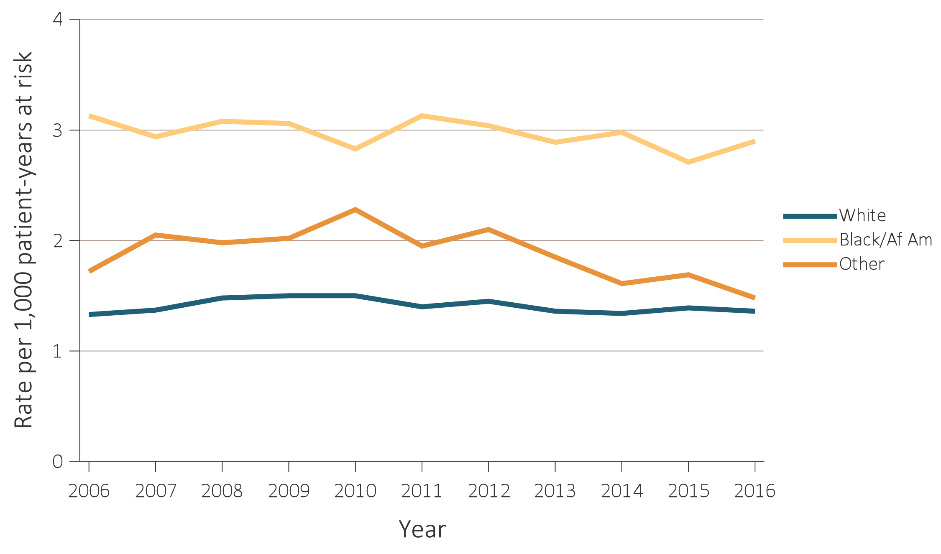
vol 1 Figure 5.4 Unadjusted rates of hospitalization with AKI, and AKI requiring dialysis, per 1,000 patient-years at risk, by race, 2006-2016
(b) Medicare (aged 66+) – rate of AKI requiring dialysis
Data Source: Special analyses, Medicare 5% sample and Optum Clinformatics™. (a) and (b) All patient-years at risk for Medicare patients aged 66 and older who had both Medicare Parts A & B, no Medicare Advantage plan, no ESRD by first service date from Medical Evidence form, and were alive on January 1 of year shown. Censored at death, ESRD, end of Medicare Parts A & B participation, or switch to Medicare Advantage program. (c) All patient-years at risk for Optum Clinformatics™ commercial insurance patients aged 22 and older who were enrolled in the plan, did not have diagnoses of ESRD, and were alive on January 1 of year shown. Abbreviations: Af Am, African American; AKI, acute kidney injury; ESRD, end-stage renal disease.

Slide 11
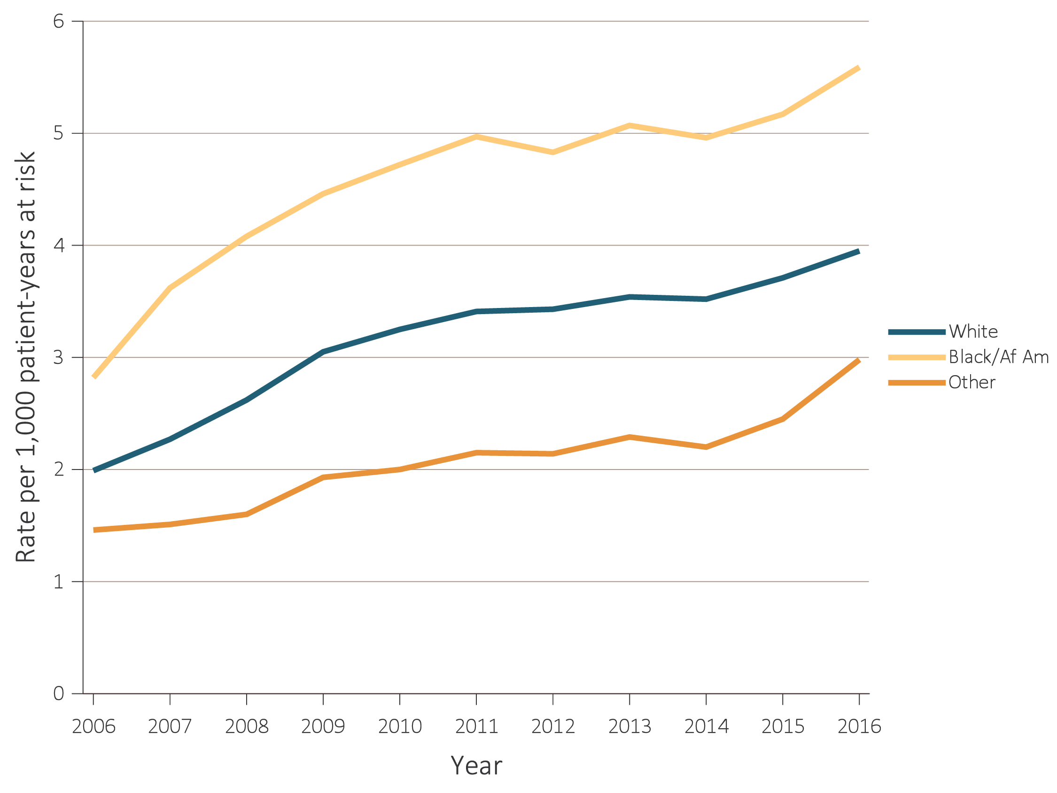
vol 1 Figure 5.4 Unadjusted rates of hospitalization with AKI, and AKI requiring dialysis, per 1,000 patient-years at risk, by race, 2006-2016
(c) Optum Clinformatics™ (aged 22+) – rate of AKI
Data Source: Special analyses, Medicare 5% sample and Optum Clinformatics™. (a) and (b) All patient-years at risk for Medicare patients aged 66 and older who had both Medicare Parts A & B, no Medicare Advantage plan, no ESRD by first service date from Medical Evidence form, and were alive on January 1 of year shown. Censored at death, ESRD, end of Medicare Parts A & B participation, or switch to Medicare Advantage program. (c) All patient-years at risk for Optum Clinformatics™ commercial insurance patients aged 22 and older who were enrolled in the plan, did not have diagnoses of ESRD, and were alive on January 1 of year shown. Abbreviations: Af Am, African American; AKI, acute kidney injury; ESRD, end-stage renal disease.

Slide 12
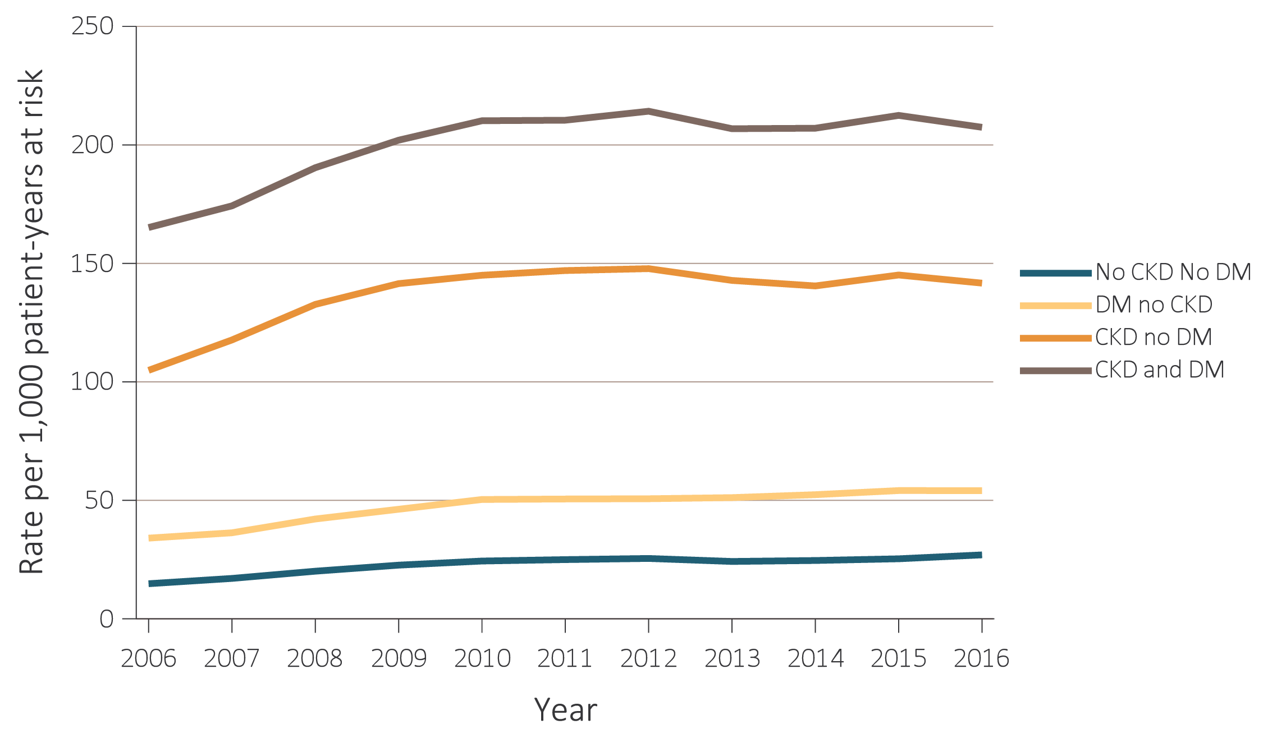
vol 1 Figure 5.5 Unadjusted rates of hospitalization with AKI, and AKI requiring dialysis, per 1,000 patient-years at risk, by CKD and DM, 2006-2016
(a) Medicare (aged 66+) – rate of AKI
Data Source: Special analyses, Medicare 5% sample and Optum Clinformatics™. (a) and (b) All patient-years at risk for Medicare patients aged 66 and older who had both Medicare Parts A & B, no Medicare Advantage plan, no ESRD by first service date from Medical Evidence form, and were alive on January 1 of year shown. Censored at death, ESRD, end of Medicare Parts A & B participation, or switch to Medicare Advantage program. (c) All patient-years at risk for Optum Clinformatics™ commercial insurance patients aged 22 and older who were enrolled in the plan, did not have diagnoses of ESRD, and were alive on January 1 of year shown. Abbreviations: AKI, acute kidney injury; CKD, chronic kidney disease; DM, diabetes mellitus; ESRD, end-stage renal disease.

Slide 13
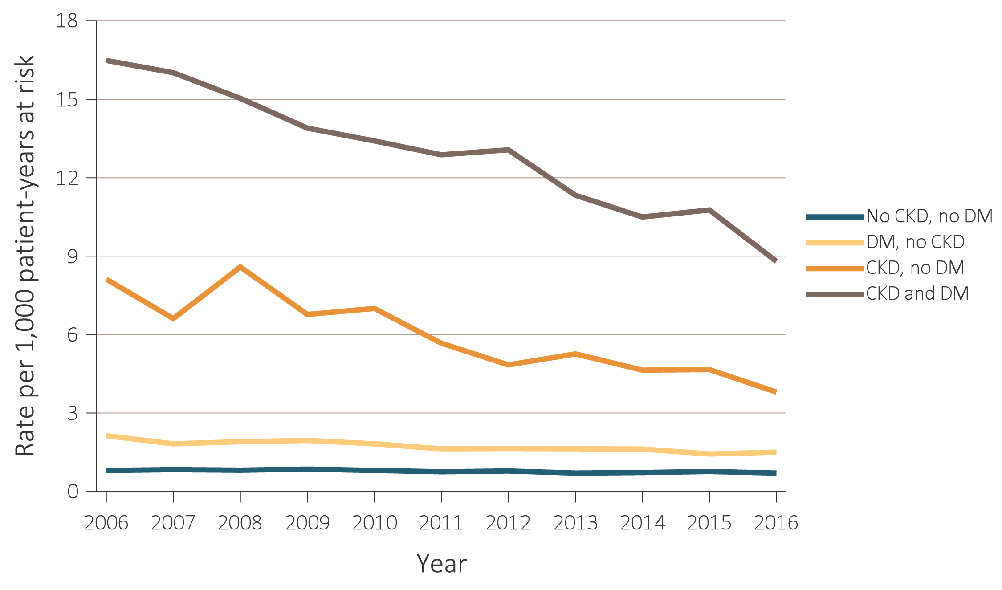
vol 1 Figure 5.5 Unadjusted rates of hospitalization with AKI, and AKI requiring dialysis, per 1,000 patient-years at risk, by CKD and DM, 2006-2016
(b) Medicare (aged 66+) – rate of AKI requiring dialysis
Data Source: Special analyses, Medicare 5% sample and Optum Clinformatics™. (a) and (b) All patient-years at risk for Medicare patients aged 66 and older who had both Medicare Parts A & B, no Medicare Advantage plan, no ESRD by first service date from Medical Evidence form, and were alive on January 1 of year shown. Censored at death, ESRD, end of Medicare Parts A & B participation, or switch to Medicare Advantage program. (c) All patient-years at risk for Optum Clinformatics™ commercial insurance patients aged 22 and older who were enrolled in the plan, did not have diagnoses of ESRD, and were alive on January 1 of year shown. Abbreviations: AKI, acute kidney injury; CKD, chronic kidney disease; DM, diabetes mellitus; ESRD, end-stage renal disease.

Slide 14
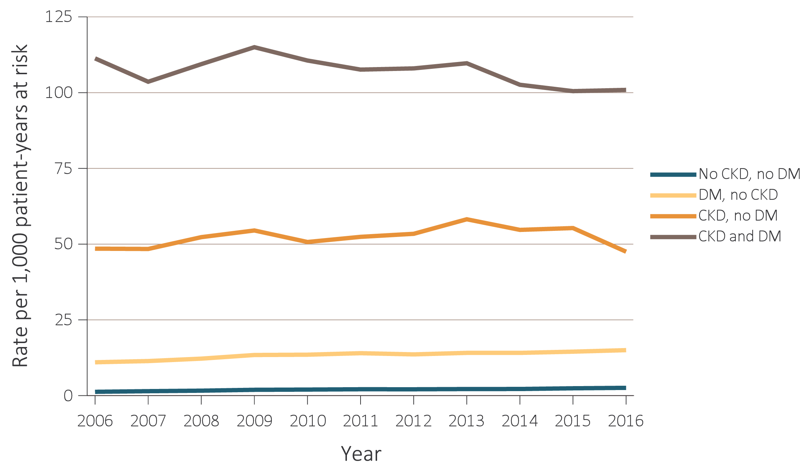
vol 1 Figure 5.5 Unadjusted rates of hospitalization with AKI, and AKI requiring dialysis, per 1,000 patient-years at risk, by CKD and DM, 2006-2016
(c) Optum Clinformatics™ (aged 22+) – rate of AKI
Data Source: Special analyses, Medicare 5% sample and Optum Clinformatics™. (a) and (b) All patient-years at risk for Medicare patients aged 66 and older who had both Medicare Parts A & B, no Medicare Advantage plan, no ESRD by first service date from Medical Evidence form, and were alive on January 1 of year shown. Censored at death, ESRD, end of Medicare Parts A & B participation, or switch to Medicare Advantage program. (c) All patient-years at risk for Optum Clinformatics™ commercial insurance patients aged 22 and older who were enrolled in the plan, did not have diagnoses of ESRD, and were alive on January 1 of year shown. Abbreviations: AKI, acute kidney injury; CKD, chronic kidney disease; DM, diabetes mellitus; ESRD, end-stage renal disease.

Slide 15
vol 1 Table 5.1 Characteristics of Medicare and Optum Clinformatics™ patients with at least one hospitalization, by age, sex, race, CKD, DM, and presence of AKI, 2016
 | Medicare (Age 66+) |  |  |  |  |  | Clinformatics™ (Age 22+)
 | Total | No AKI |  | Any AKI |  |  | Total | No AKI |  | Any AKI
 | N | N | % | N | % |  | N | N | % | N | %
Total | 238,839 | 179,641 | 75.2% | 59,198 | 24.8% |  | 304,907 | 281,791 | 92.4 | 23,116 | 7.6
Age
22-39 | — | — | — | — | — |  | 129,410 | 126,921 | 98.1 | 2,489 | 1.9
40-65 | — | — | — | — | — |  | 147,949 | 132,480 | 89.5 | 15,469 | 10.5
65+ | — | — | — | — | — |  | 27,548 | 22,390 | 81.3 | 5,158 | 18.7
66-69 | 39,652 | 31,974 | 80.6 | 7,678 | 19.4 |  | — | — | — | — | —
70-74 | 48,717 | 38,289 | 78.6 | 10,428 | 21.4 |  | — | — | — | — | —
75-79 | 44,691 | 34,005 | 76.1 | 10,686 | 23.9 |  | — | — | — | — | —
80-84 | 40,775 | 29,822 | 73.1 | 10,953 | 26.9 |  | — | — | — | — | —
85+ | 65,004 | 45,551 | 70.1 | 19,453 | 29.8 |  | — | — | — | — | —
Sex
Male | 103,628 | 74,289 | 71.7 | 29,339 | 28.3 |  | 108,157 | 93,743 | 86.7 | 14,414 | 13.3
Female | 135,211 | 105,352 | 77.9 | 29,859 | 22.1 |  | 196,750 | 188,048 | 95.6 | 8,702 | 4.4
Race & Ethnicity
White | 207,287 | 158,061 | 76.3 | 49,226 | 23.8 |  | 213,520 | 197,182 | 92.3 | 16,338 | 7.7
Black/African American | 19,096 | 12,347 | 64.7 | 6,749 | 35.3 |  | 30,737 | 27,564 | 89.7 | 3,173 | 10.3
Native American | 1,274 | 949 | 74.5 | 325 | 25.5 |  | — | — | — | — | —
Hispanic | — | — | — | — | — |  | 33,397 | 31,240 | 93.5 | 2,157 | 6.5
Asian | 3,186 | 2,264 | 71.1 | 922 | 28.9 |  | 12,882 | 12,422 | 96.4 | 460 | 3.6
Other | 7,996 | 6,020 | 75.3 | 1,976 | 24.7 |  | 14,371 | 13,383 | 93.1 | 988 | 6.9
Pre-existing comorbidities
No DM or CKD, prior year | 141,826 | 116,465 | 82.1 | 25,361 | 17.9 |  | 263,756 | 249,928 | 94.8 | 13,828 | 5.2
DM no CKD, prior year | 43,073 | 32,816 | 76.2 | 10,257 | 23.8 |  | 25,916 | 21,762 | 84.0 | 4,154 | 16.0
CKD no DM, prior year | 23,738 | 14,001 | 60.0 | 9,737 | 41.0 |  | 8,378 | 6,064 | 72.4 | 2,314 | 27.6
Both CKD & DM, prior year | 30,202 | 16,359 | 54.2 | 13,843 | 45.8 |  | 6,857 | 4,037 | 58.9 | 2,820 | 41.1
Data Source: Special analyses, Medicare 5% sample and Optum Clinformatics™. Medicare patients aged 66 and older who had both Medicare Parts A & B, no Medicare Advantage plan, no ESRD by first service date from Medical Evidence form, and were alive on January 1, 2016. Optum Clinformatics™ commercial insurance patients aged 22 and older who were enrolled in the plan, did not have diagnoses of ESRD, and were alive on January 1, 2016. AKI is defined by a diagnosis code anywhere in the hospitalization claim. — Data not available. Abbreviations: AKI, acute kidney injury; CKD, chronic kidney disease; DM, diabetes mellitus; ESRD, end-stage renal disease.

Slide 16
Table A. KDIGO definition and staging of Acute Kidney Injury (AKI)
Definition of AKI
An increase in serum creatinine (SCR) by >0.3mg/dL (>26.5 μmol/l) within 48 hours; or an increase in SCR to >1.5 times baseline, which is known or presumed to have occurred within the prior 7 days; or urine volume <0.5ml/kg/h for 6 hours.
Stage | Serum creatinine | Urine output
1 | 1.5–1.9 times baseline OR >0.3 mg/dL (>26.5 µmol/l) increase | <0.5 ml/kg/h for 6-12 hours
2 | 2.0–2.9 times baseline | <0.5 ml/kg/h for >12 hours
3 | 3.0 times baseline OR increase in SCR to >4.0 mg/dL (>353.6 µmol/l) OR initiation of renal replacement therapy OR, in patients <18 years, decrease in eGFR to <35 ml/min/1.73m² | <0.3 ml/kg/h for >24 hours OR anuria for >12 hours
Adapted from KDIGO (2012). Abbreviations: AKI, acute kidney injury; eGFR, estimated glomerular filtration rate; KDIGO, Kidney Disease Improving Global Outcomes; SCR, serum creatinine.

Slide 17
vol 1 Table 5.2 Characteristics of Veterans Affairs patients aged 22+ with at least one hospitalization, by age, sex, race, CKD, DM, presence and stage of AKI, defined by serum creatinine (KDIGO criteria), FY 2016
 | Total |  | No AKI |  |  | Any Stage AKI |  |  | Stage 1 |  | Stage 2 |  | Stage 3ª
 | N |  | N | % |  | N | % |  | N | % | N | % | N | %
Total | 301,876 |  | 225,090 | 74.6 |  | 76,786 | 25.4 |  | 64,601 | 21.4 | 2,455 | 0.8 | 9,730 | 3.2
Diagnosis of AKI
No | 249,650 |  | 213,229 | 85.4 |  | 36,421 | 14.6 |  | 32,379 | 13.0 | 1,045 | 0.4 | 2,997 | 1.2
Yes | 52,226 |  | 11,861 | 22.7 |  | 40,365 | 77.3 |  | 32,222 | 61.7 | 1,410 | 2.7 | 6,733 | 12.9
Age at this inpatient admission
22-39 | 12,166 |  | 11,106 | 91.3 |  | 1,060 | 8.7 |  | 899 | 7.4 | 47 | 0.4 | 114 | 0.9
40-59 | 51,418 |  | 41,857 | 81.4 |  | 9,561 | 18.6 |  | 7,786 | 15.1 | 446 | 0.9 | 1,329 | 2.6
60-65 | 48,075 |  | 36,306 | 75.5 |  | 11,769 | 24.5 |  | 9,637 | 20.0 | 466 | 1.0 | 1,666 | 3.5
66-69 | 50,086 |  | 36,503 | 72.9 |  | 13,583 | 27.1 |  | 11,163 | 22.3 | 482 | 1.0 | 1,938 | 3.9
70-74 | 57,804 |  | 42,384 | 73.3 |  | 15,420 | 26.7 |  | 13,166 | 22.8 | 431 | 0.7 | 1,823 | 3.2
75-79 | 26,928 |  | 18,981 | 70.5 |  | 7,947 | 29.5 |  | 6,798 | 25.2 | 181 | 0.7 | 968 | 3.6
80-84 | 21,662 |  | 14,712 | 67.9 |  | 6,950 | 32.1 |  | 5,945 | 27.4 | 172 | 0.8 | 833 | 3.8
85+ | 33,737 |  | 23,241 | 68.9 |  | 10,496 | 31.1 |  | 9,207 | 27.3 | 230 | 0.7 | 1,059 | 3.1
Sex
Male | 284,150 |  | 209,947 | 73.9 |  | 74,203 | 26.1 |  | 62,499 | 22.0 | 2,308 | 0.8 | 9,396 | 3.3
Female | 17,726 |  | 15,143 | 85.4 |  | 2,583 | 14.6 |  | 2,102 | 11.9 | 147 | 0.8 | 334 | 1.9
Race/ethnicity
Non-Hispanic White | 205,660 |  | 156,425 | 76.1 |  | 49,235 | 23.9 |  | 42,388 | 20.6 | 1,597 | 0.8 | 5,250 | 2.6
Non-Hispanic Black | 59,063 |  | 41,142 | 69.7 |  | 17,921 | 30.3 |  | 14,288 | 24.2 | 513 | 0.9 | 3,120 | 5.3
American Indian/Alaska Native | 1,923 |  | 1,490 | 77.5 |  | 433 | 22.5 |  | 354 | 18.4 | 17 | 0.9 | 62 | 3.2
Hispanic | 17,615 |  | 12,824 | 72.8 |  | 4,791 | 27.2 |  | 3,883 | 22.0 | 207 | 1.2 | 701 | 4.0
Asian | 2,905 |  | 2,143 | 73.8 |  | 762 | 26.2 |  | 627 | 21.6 | 12 | 0.4 | 123 | 4.2
Other/Unknown | 14,710 |  | 11,066 | 75.2 |  | 3,644 | 24.8 |  | 3,061 | 20.8 | 109 | 0.7 | 474 | 3.2
Had CKD before admission
No | 245,319 |  | 196,479 | 80.1 |  | 48,840 | 19.9 |  | 42,320 | 17.3 | 2,144 | 0.9 | 4,376 | 1.8
Yes | 56,557 |  | 28,611 | 50.6 |  | 27,946 | 49.4 |  | 22,281 | 39.4 | 311 | 0.5 | 5,354 | 9.5
Had hypertension before admission
No | 108,948 |  | 90,340 | 82.9 |  | 18,608 | 17.1 |  | 15,514 | 14.2 | 780 | 0.7 | 2,314 | 2.1
Yes | 192,928 |  | 134,750 | 69.8 |  | 58,178 | 30.2 |  | 49,087 | 25.4 | 1,675 | 0.9 | 7,416 | 3.8
Had diabetes before admission
No | 194,998 |  | 155,138 | 79.6 |  | 39,860 | 20.4 |  | 33,579 | 17.2 | 1,593 | 0.8 | 4,688 | 2.4
Yes | 106,878 |  | 69,952 | 65.5 |  | 36,926 | 34.5 |  | 31,022 | 29.0 | 862 | 0.8 | 5,042 | 4.7
Pre-admission CKD and diabetes status
Neither | 165,385 |  | 138,092 | 83.5 |  | 27,293 | 16.5 |  | 23,755 | 14.4 | 1,416 | 0.9 | 2,122 | 1.3
Diabetes only | 73,997 |  | 54,726 | 74.0 |  | 19,271 | 26.0 |  | 17,183 | 23.2 | 728 | 1.0 | 1,360 | 1.8
CKD only | 29,613 |  | 17,046 | 57.6 |  | 12,567 | 42.4 |  | 9,824 | 33.2 | 177 | 0.6 | 2,566 | 8.7
Diabetes & CKD | 32,881 |  | 15,226 | 46.3 |  | 17,655 | 53.7 |  | 13,839 | 42.1 | 134 | 0.4 | 3,682 | 11.2
Data Source: Special analyses, Veterans Health Administration data. Patients aged 22 and older with at least one hospitalization in fiscal year 2016. AKI defined by serum creatinine criteria as in KDIGO (2012), see Table A for details. ª Stage 3 includes those requiring dialysis. Diabetes and CKD determined by ICD-9-CM diagnosis codes. Excludes those with evidence of ESRD prior to admission by diagnosis and procedure codes. Abbreviations: AKI, acute kidney injury; CKD, chronic kidney disease; DM, diabetes mellitus; FY, federal fiscal year (October 1, 2015 to September 30, 2016).

Slide 18
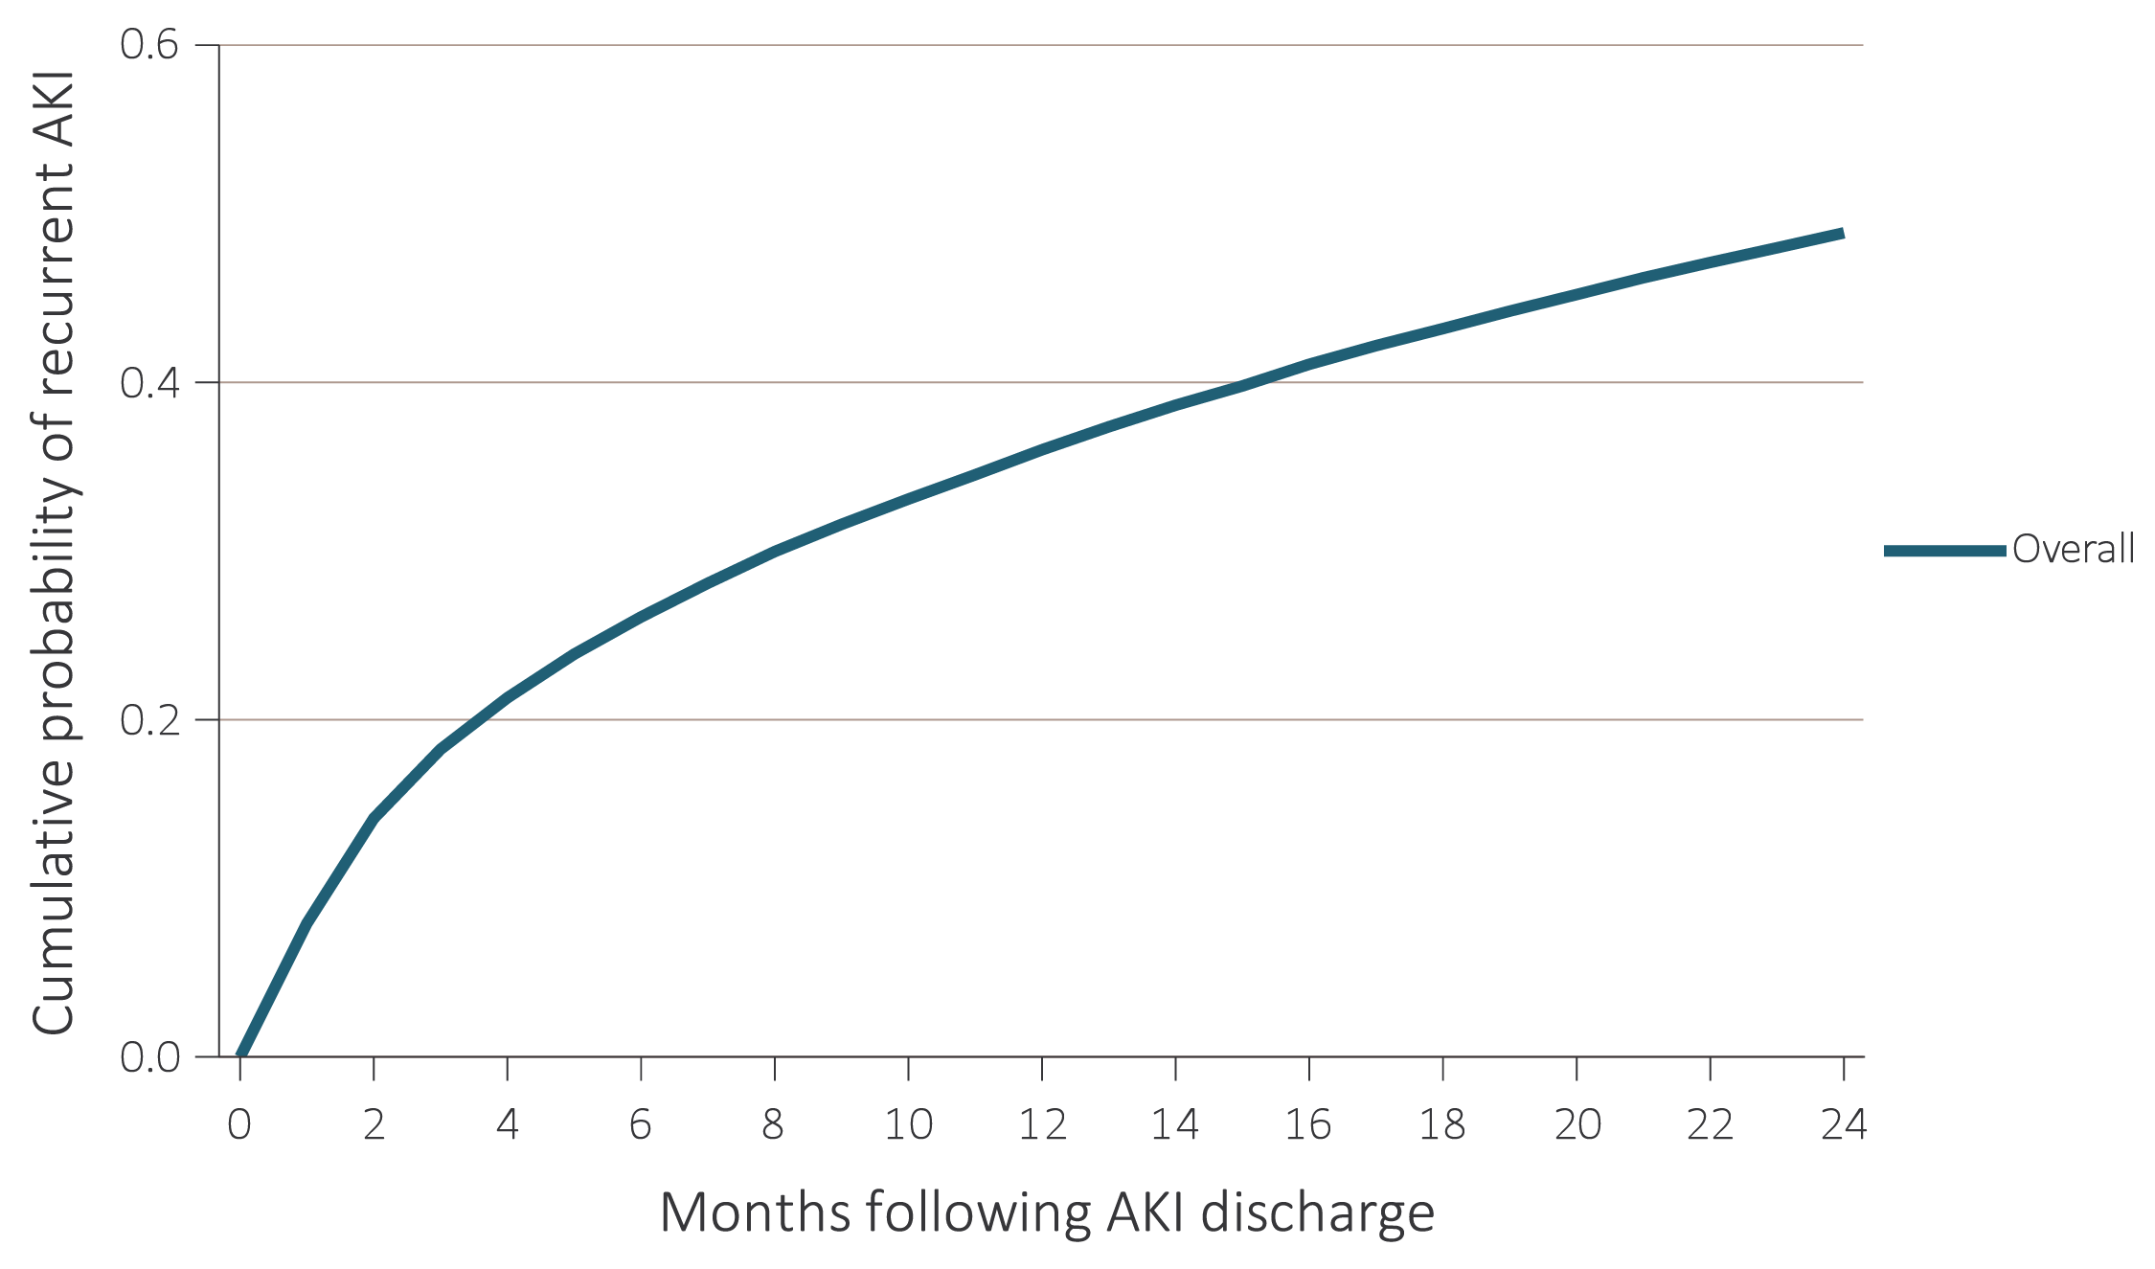
vol 1 Figure 5.6 Cumulative probability of a recurrent AKI hospitalization within two years of live discharge from first AKI hospitalization in 2014 for Medicare patients aged 66+, (a) overall, (b) by age, (c) by race, and (d) by CKD and DM
(a) Overall
Data Source: Special analyses, Medicare 5% sample. Age on January 1, 2014. Medicare patients aged 66 and older who had both Medicare Parts A & B, no Medicare Advantage plan, no ESRD by first service date from Medical Evidence form on 1/1/2014, and were discharged alive from an AKI hospitalization in 2014. Censored at death, ESRD, end of Medicare Parts A & B participation, or switch to Medicare Advantage program. Abbreviations: Af/Am, African American; AKI, acute kidney injury; CKD, chronic kidney disease; DM, diabetes mellitus; ESRD, end-stage renal disease.

Slide 19
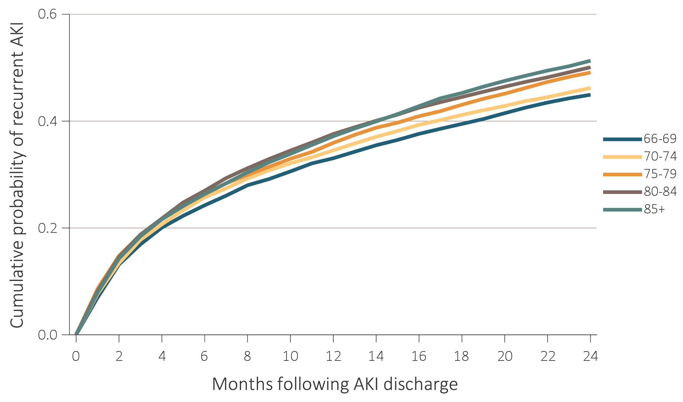
vol 1 Figure 5.6 Cumulative probability of a recurrent AKI hospitalization within two years of live discharge from first AKI hospitalization in 2014 for Medicare patients aged 66+, (a) overall, (b) by age, (c) by race, and (d) by CKD and DM
(b) Age
Data Source: Special analyses, Medicare 5% sample. Age on January 1, 2014. Medicare patients aged 66 and older who had both Medicare Parts A & B, no Medicare Advantage plan, no ESRD by first service date from Medical Evidence form on 1/1/2014, and were discharged alive from an AKI hospitalization in 2014. Censored at death, ESRD, end of Medicare Parts A & B participation, or switch to Medicare Advantage program. Abbreviations: Af/Am, African American; AKI, acute kidney injury; CKD, chronic kidney disease; DM, diabetes mellitus; ESRD, end-stage renal disease.

Slide 20
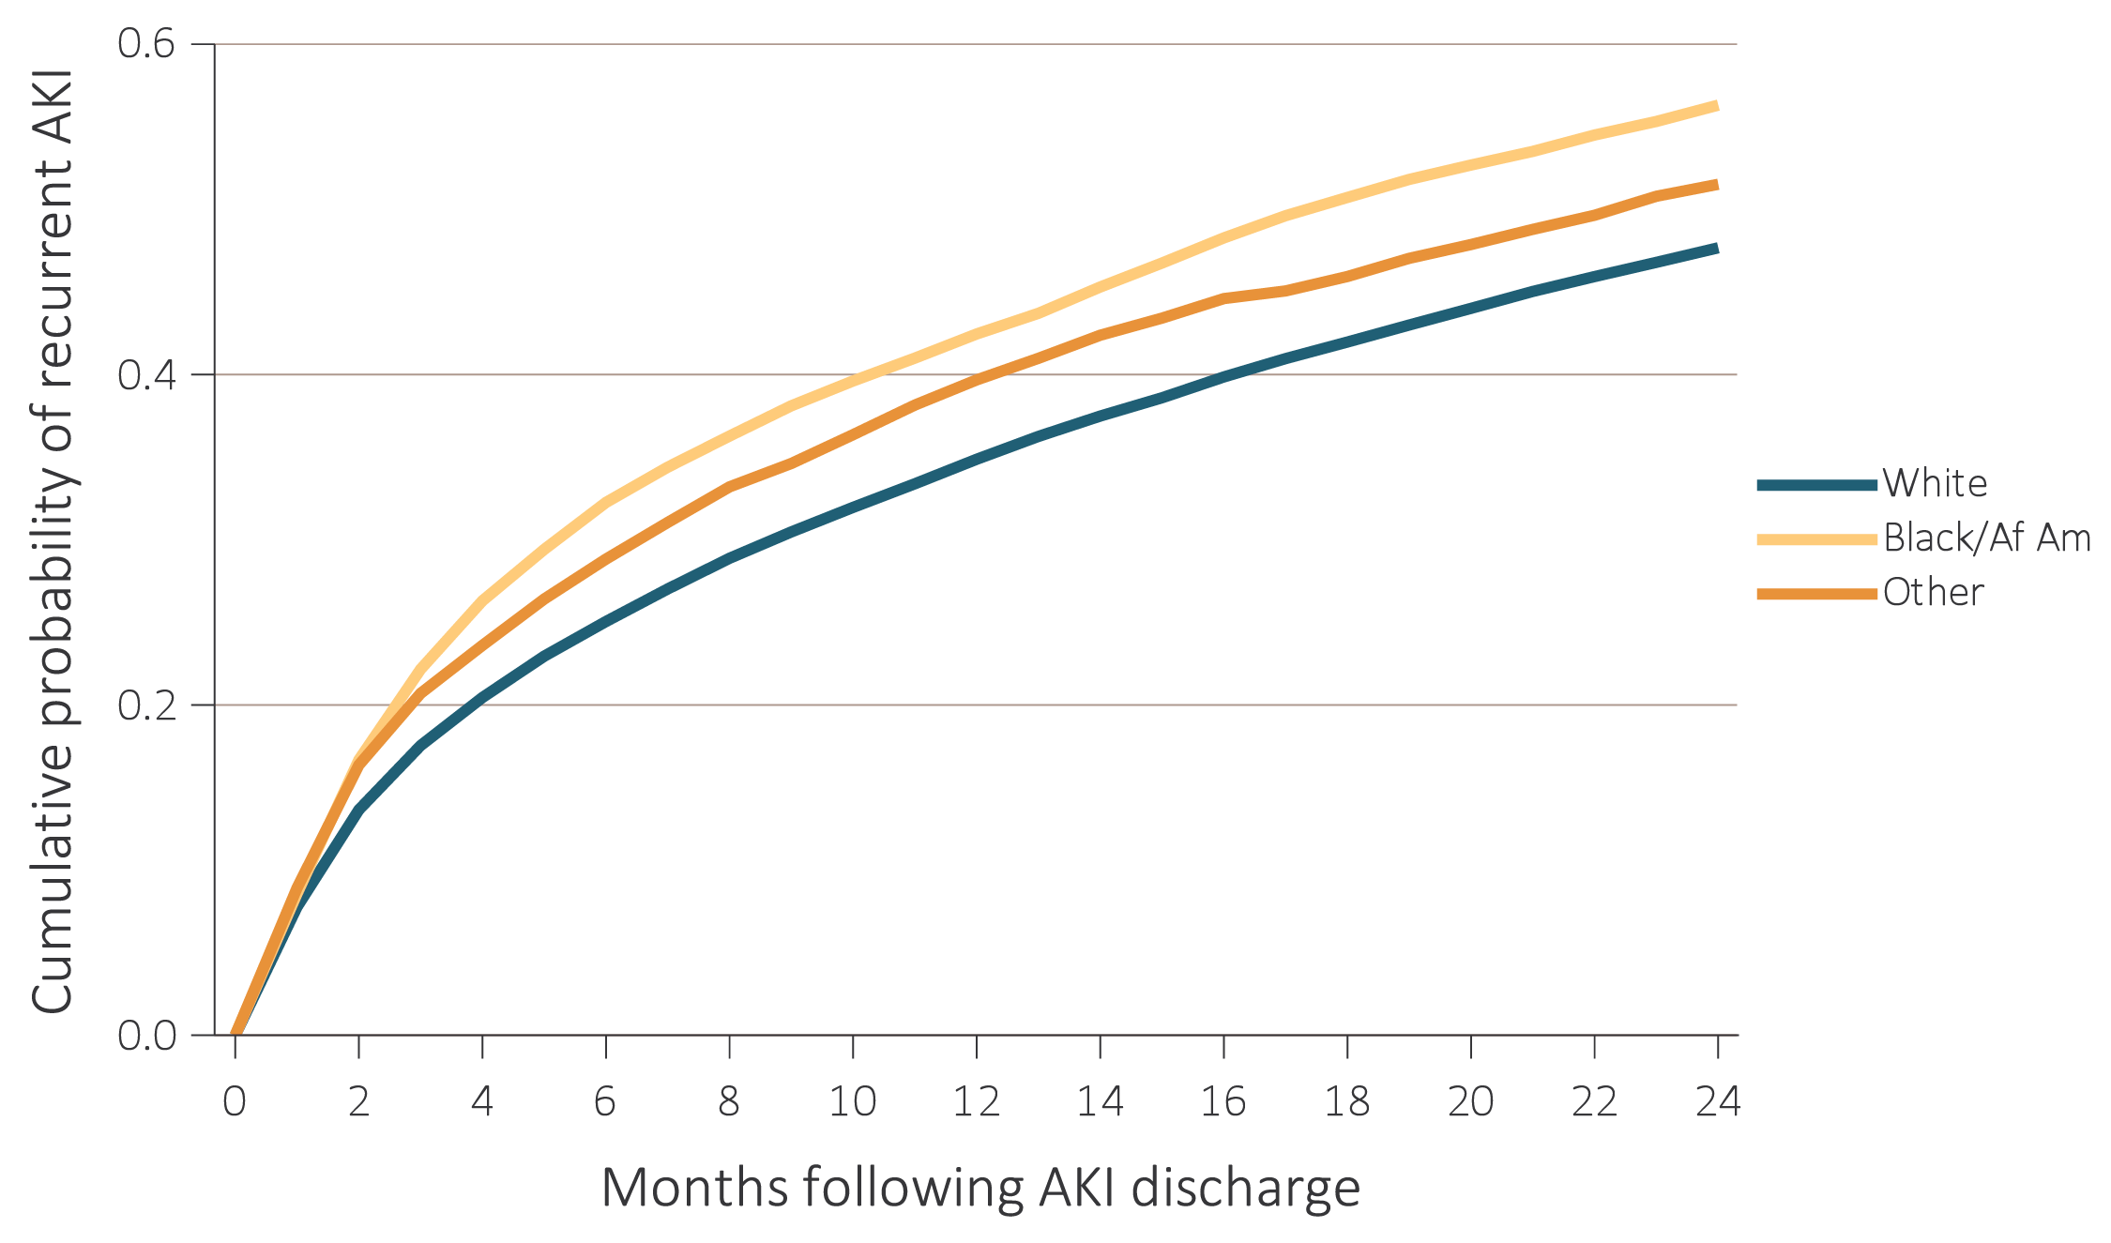
vol 1 Figure 5.6 Cumulative probability of a recurrent AKI hospitalization within two years of live discharge from first AKI hospitalization in 2014 for Medicare patients aged 66+, (a) overall, (b) by age, (c) by race, and (d) by CKD and DM
(c) Race
Data Source: Special analyses, Medicare 5% sample. Age on January 1, 2014. Medicare patients aged 66 and older who had both Medicare Parts A & B, no Medicare Advantage plan, no ESRD by first service date from Medical Evidence form on 1/1/2014, and were discharged alive from an AKI hospitalization in 2014. Censored at death, ESRD, end of Medicare Parts A & B participation, or switch to Medicare Advantage program. Abbreviations: Af/Am, African American; AKI, acute kidney injury; CKD, chronic kidney disease; DM, diabetes mellitus; ESRD, end-stage renal disease.

Slide 21
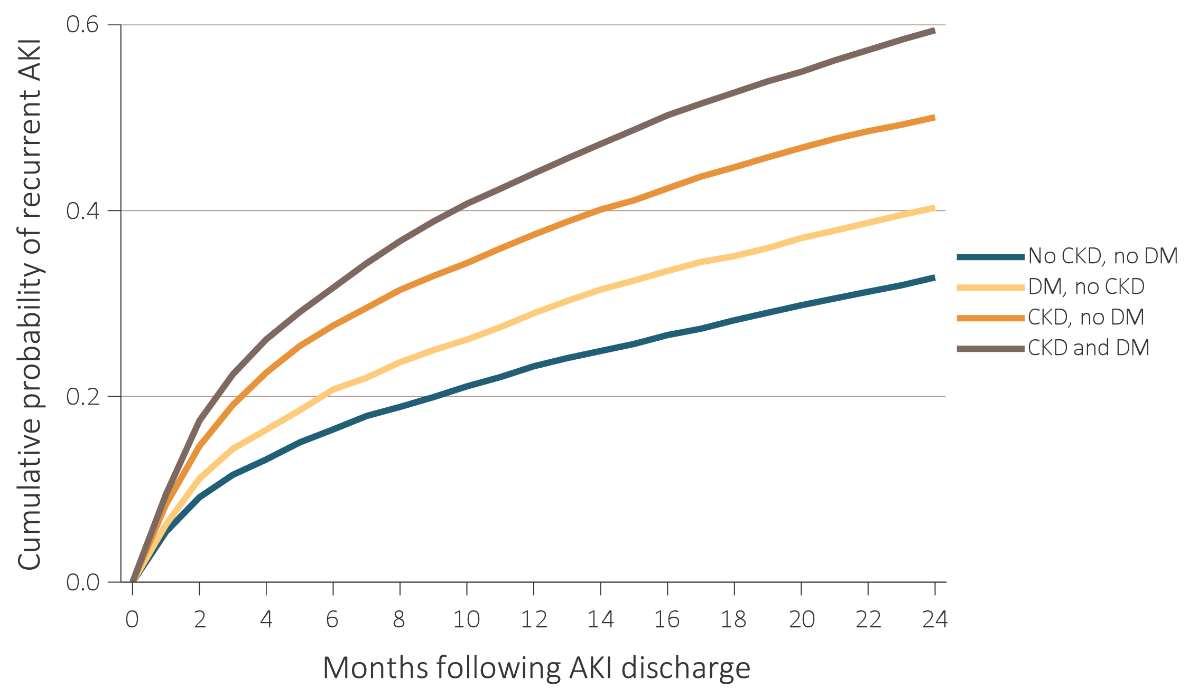
vol 1 Figure 5.6 Cumulative probability of a recurrent AKI hospitalization within two years of live discharge from first AKI hospitalization in 2014 for Medicare patients aged 66+, (a) overall, (b) by age, (c) by race, and (d) by CKD and DM
(d) CKD and DM
Data Source: Special analyses, Medicare 5% sample. Age on January 1, 2014. Medicare patients aged 66 and older who had both Medicare Parts A & B, no Medicare Advantage plan, no ESRD by first service date from Medical Evidence form on 1/1/2014, and were discharged alive from an AKI hospitalization in 2014. Censored at death, ESRD, end of Medicare Parts A & B participation, or switch to Medicare Advantage program. Abbreviations: Af/Am, African American; AKI, acute kidney injury; CKD, chronic kidney disease; DM, diabetes mellitus; ESRD, end-stage renal disease.

Slide 22
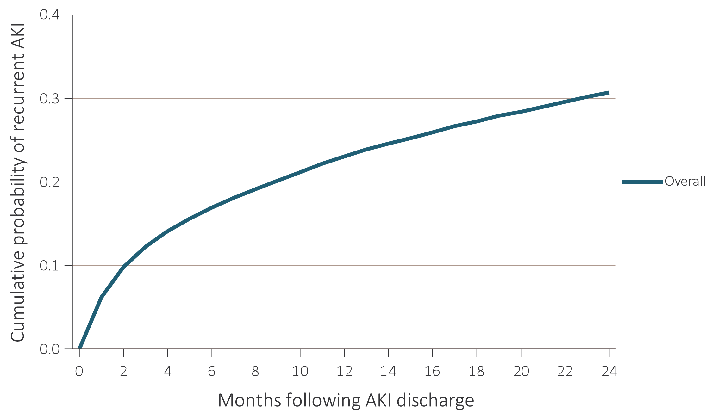
vol 1 Figure 5.7 Cumulative probability of a recurrent AKI hospitalization within two years of live discharge from first AKI hospitalization in 2014 for Optum Clinformatics™ patients aged 22+, (a) overall, (b) by age, (c) by race, and (d) by CKD and DM
(a) Overall
Data Source: Special analyses, Optum Clinformatics™. Age as of January, 2014. Optum Clinformatics™ commercial insurance patients aged 22 and older who were enrolled in the plan, did not have diagnoses of ESRD on January 1, 2014, and were discharged alive from an AKI hospitalization in 2014. Censored at death, ESRD diagnosis, or plan disenrollment. Abbreviations: Af/Am, African American; AKI, acute kidney injury; CKD, chronic kidney disease; DM, diabetes mellitus; ESRD, end-stage renal disease.

Slide 23
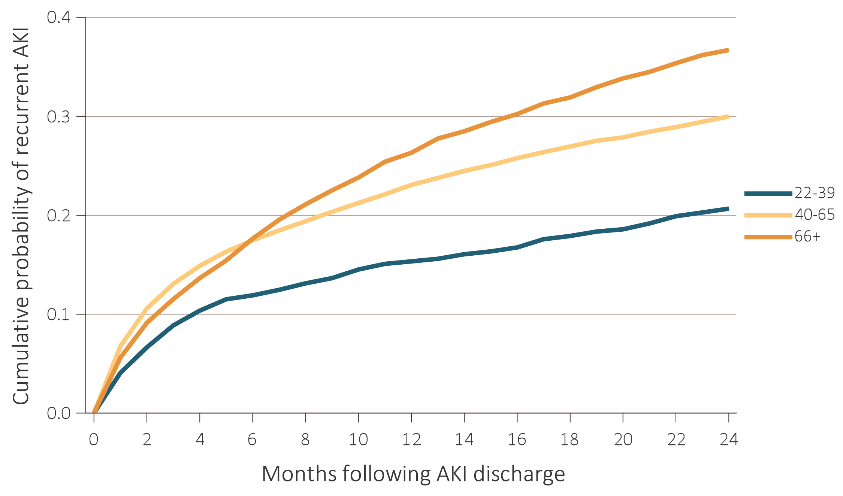
vol 1 Figure 5.7 Cumulative probability of a recurrent AKI hospitalization within two years of live discharge from first AKI hospitalization in 2014 for Optum Clinformtics™ patients aged 22+, (a) overall, (b) by age, (c) by race, and (d) by CKD and DM
(b) Age
Data Source: Special analyses, Optum Clinformatics™. Age as of January, 2014. Optum Clinformatics™ commercial insurance patients aged 22 and older who were enrolled in the plan, did not have diagnoses of ESRD on January 1, 2014, and were discharged alive from an AKI hospitalization in 2014. Censored at death, ESRD diagnosis, or plan disenrollment. Abbreviations: Af/Am, African American; AKI, acute kidney injury; CKD, chronic kidney disease; DM, diabetes mellitus; ESRD, end-stage renal disease.

Slide 24
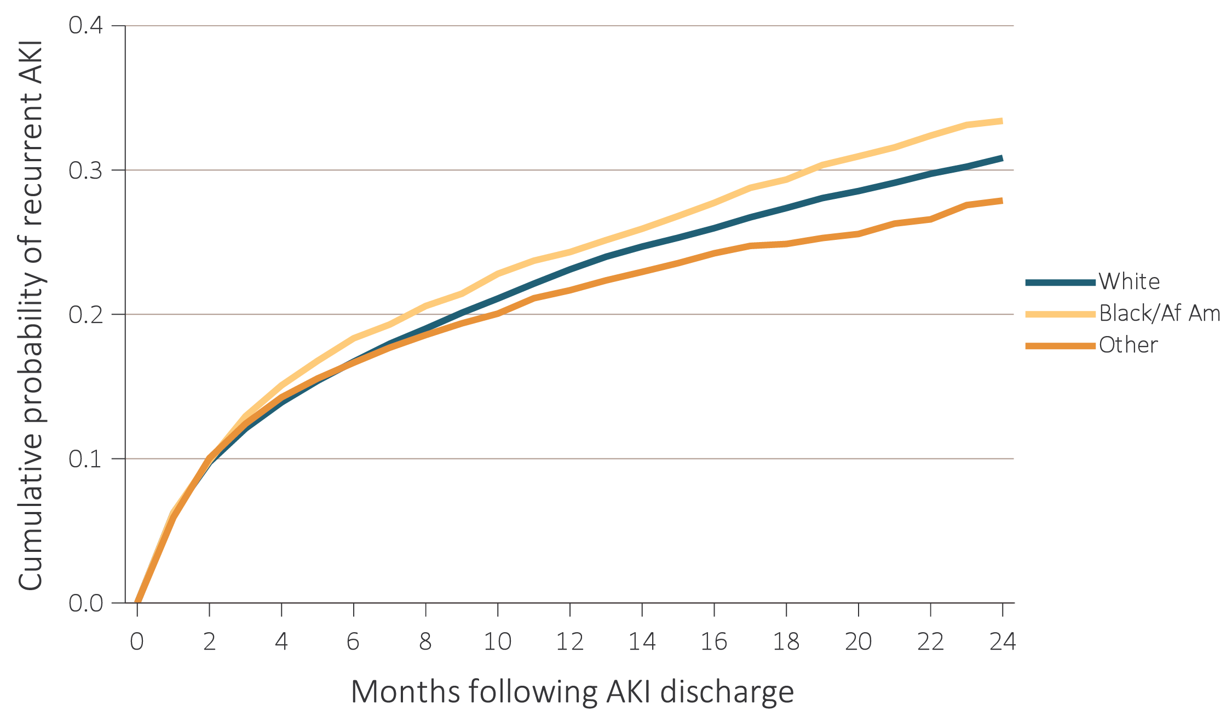
vol 1 Figure 5.7 Cumulative probability of a recurrent AKI hospitalization within two years of live discharge from first AKI hospitalization in 2014 for Optum Clinformatics™ patients aged 22+, (a) overall, (b) by age, (c) by race, and (d) by CKD and DM
(c) Race
Data Source: Special analyses, Optum Clinformatics™. Age as of January, 2014. Optum Clinformatics™ commercial insurance patients aged 22 and older who were enrolled in the plan, did not have diagnoses of ESRD on January 1, 2014, and were discharged alive from an AKI hospitalization in 2014. Censored at death, ESRD diagnosis, or plan disenrollment. Abbreviations: Af/Am, African American; AKI, acute kidney injury; CKD, chronic kidney disease; DM, diabetes mellitus; ESRD, end-stage renal disease.

Slide 25
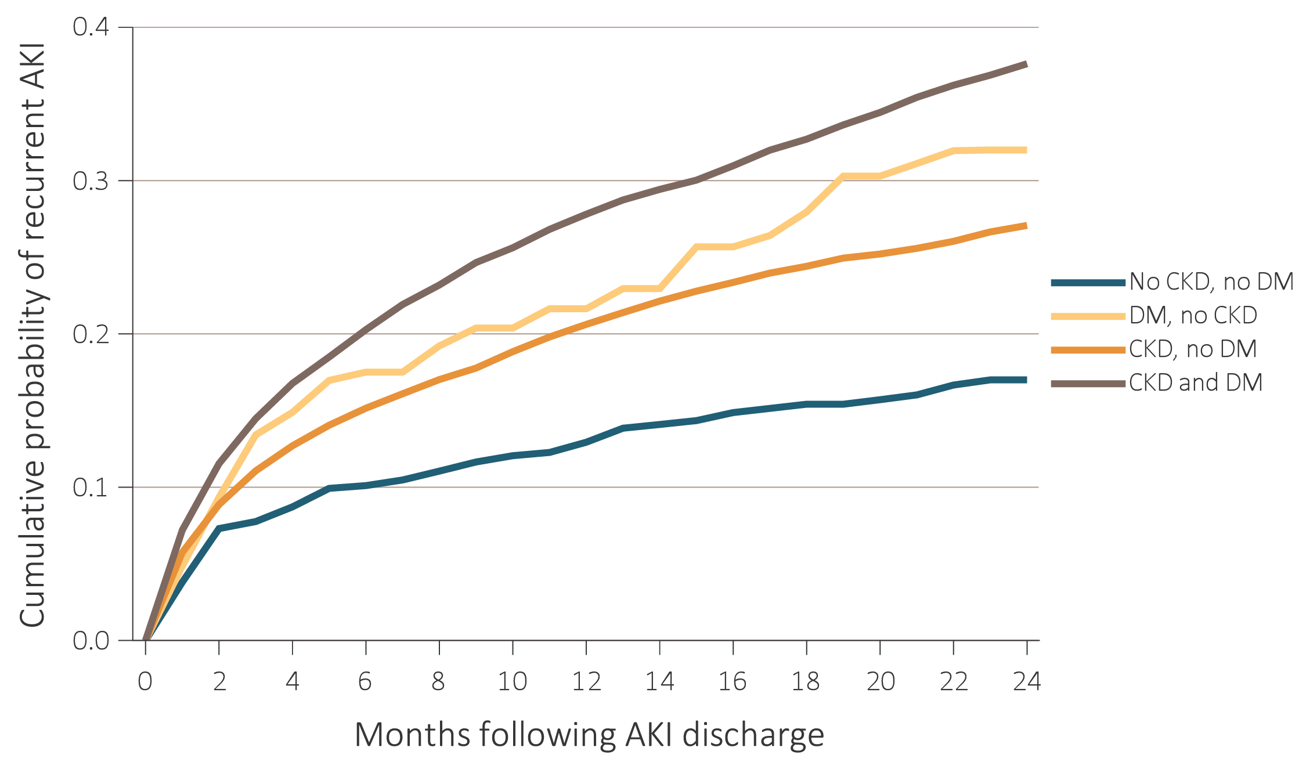
vol 1 Figure 5.7 Cumulative probability of a recurrent AKI hospitalization within two years of live discharge from first AKI hospitalization in 2014 for Optum Clinformatics™ patients aged 22+, (a) overall, (b) by age, (c) by race, and (d) by CKD and DM
(d) CKD and DM
Data Source: Special analyses, Optum Clinformatics™. Age as of January, 2014. Optum Clinformatics™ commercial insurance patients aged 22 and older who were enrolled in the plan, did not have diagnoses of ESRD on January 1, 2014, and were discharged alive from an AKI hospitalization in 2014. Censored at death, ESRD diagnosis, or plan disenrollment. Abbreviations: Af/Am, African American; AKI, acute kidney injury; CKD, chronic kidney disease; DM, diabetes mellitus; ESRD, end-stage renal disease.

Slide 26
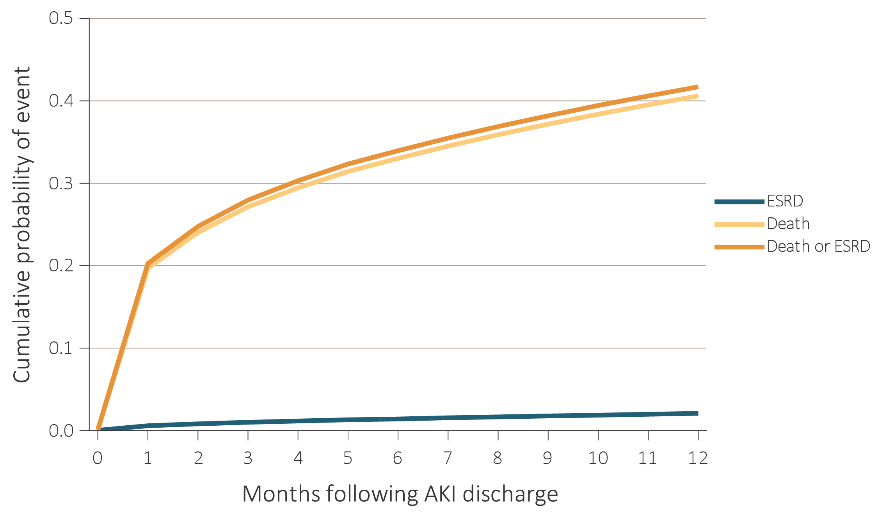
vol 1 Figure 5.8 Cumulative probability of death-censored ESRD, death, and the composite of death or ESRD within one year of live discharge from first AKI hospitalization occurring in 2014-2015
(a) Medicare (aged 66+)
Data Source: Special analyses, Medicare 5% sample. (a) Medicare patients aged 66 and older who had both Medicare Parts A & B, no Medicare Advantage plan, no ESRD by first service date from Medical Evidence form, and were discharged alive from a first AKI hospitalization in 2014 or 2015. (b) All patient-years at risk for Optum Clinformatics™ commercial insurance patients aged 22 and older who were enrolled in the plan, did not have diagnoses of ESRD, and were alive on January of year shown. All models censored at the end of Medicare Parts A & B participation, switch to Medicare Advantage program, or 365 days after AKI discharge. Model for ESRD also was censored at death. Model for death was not censored at the start of ESRD. Abbreviations: AKI, acute kidney injury; ESRD, end-stage renal disease.

Slide 27
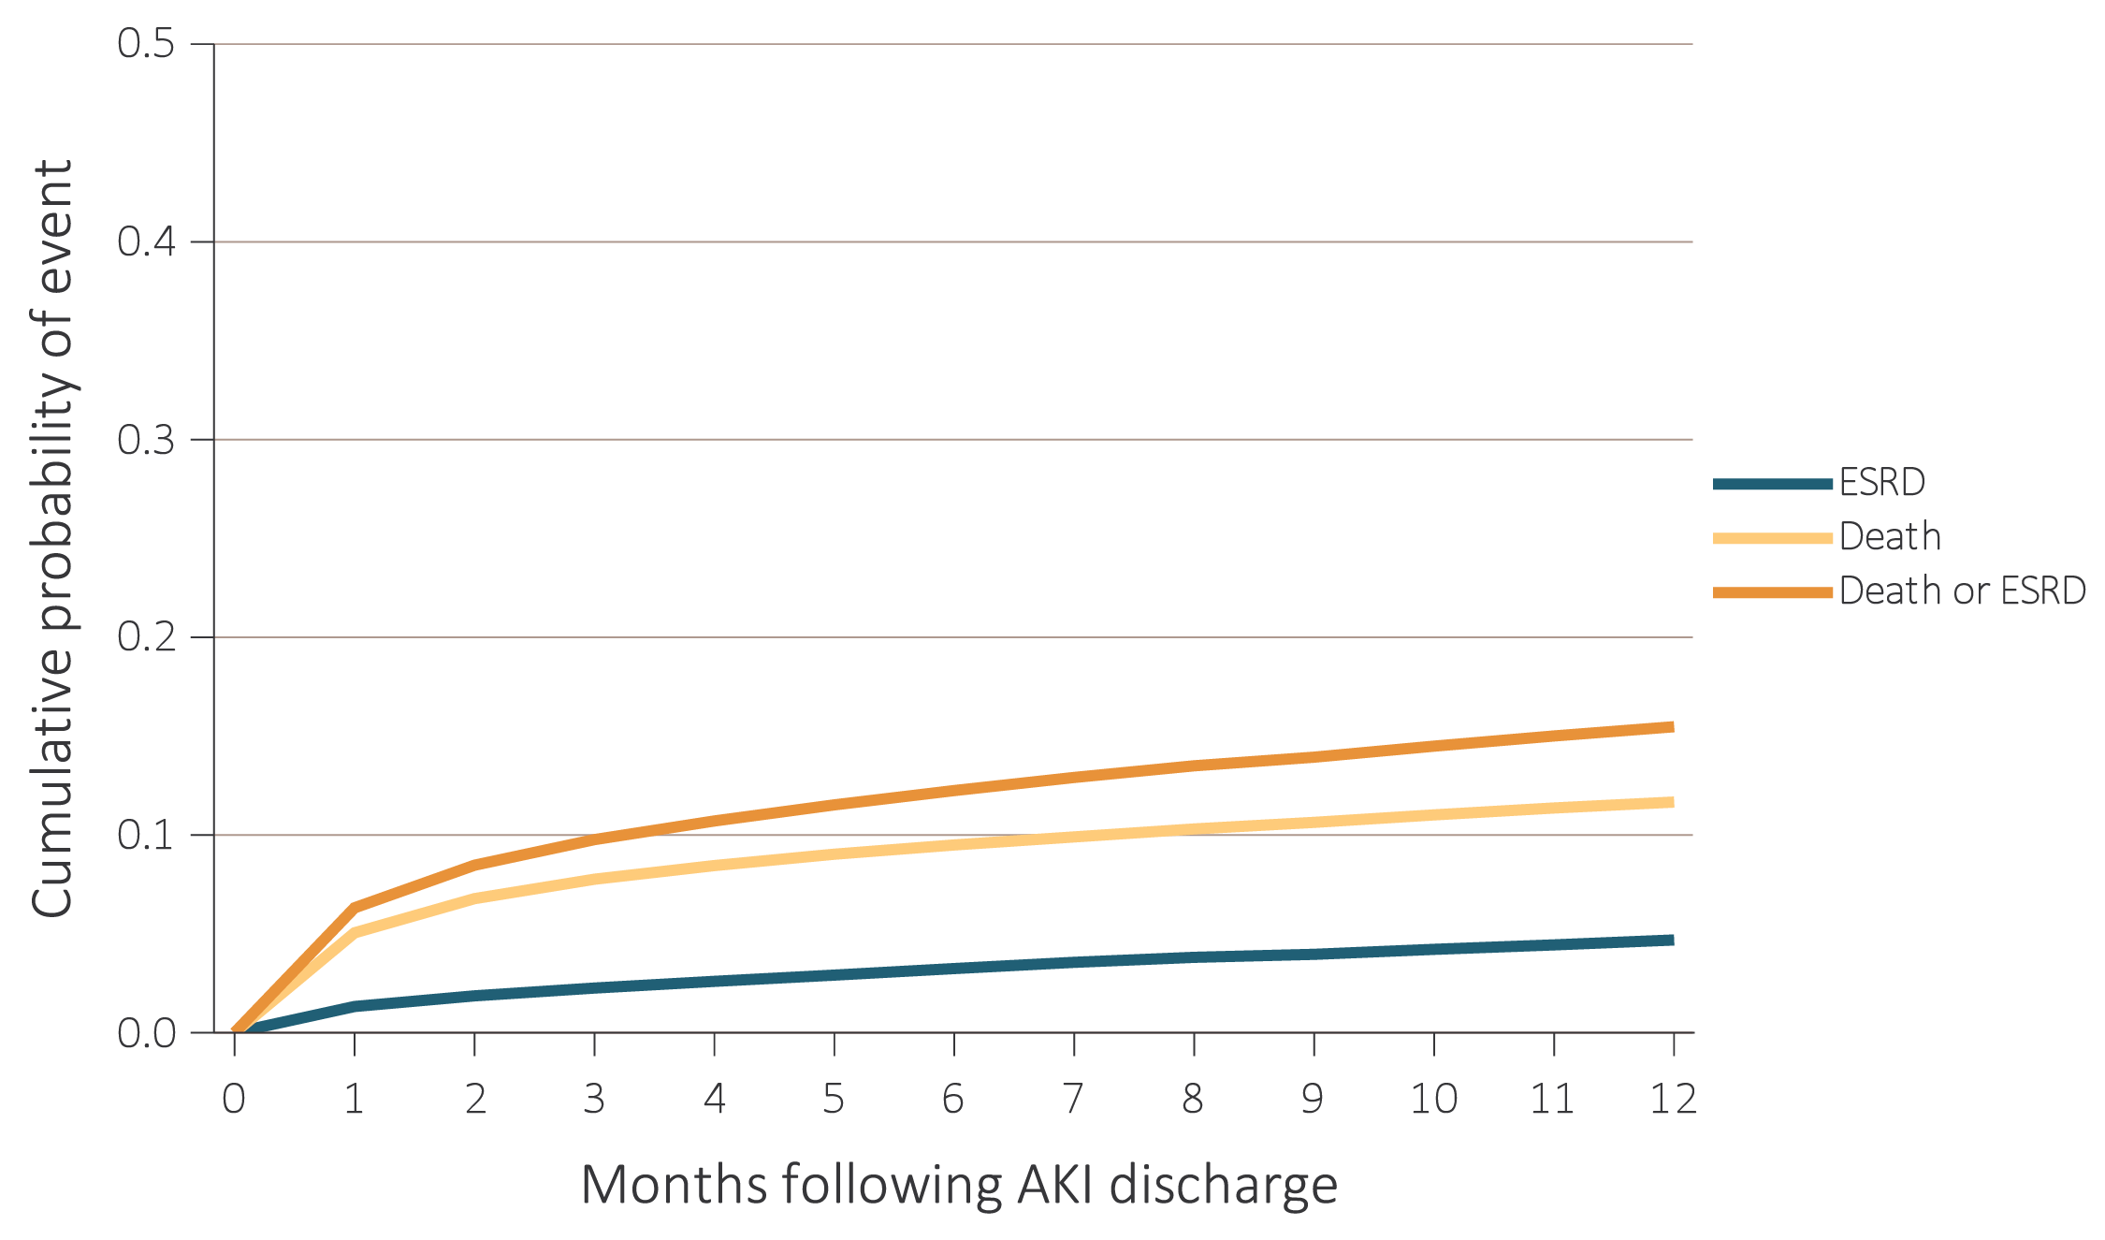
vol 1 Figure 5.8 Cumulative probability of death-censored ESRD, death, and the composite of death or ESRD within one year of live discharge from first AKI hospitalization occurring in 2014-2015
(b) Optum Clinformatics™ (aged 22+)
Data Source: Special analyses, Medicare 5% sample. (a) Medicare patients aged 66 and older who had both Medicare Parts A & B, no Medicare Advantage plan, no ESRD by first service date from Medical Evidence form, and were discharged alive from a first AKI hospitalization in 2014 or 2015. (b) All patient-years at risk for Optum Clinformatics™ commercial insurance patients aged 22 and older who were enrolled in the plan, did not have diagnoses of ESRD, and were alive on January of year shown. All models censored at the end of Medicare Parts A & B participation, switch to Medicare Advantage program, or 365 days after AKI discharge. Model for ESRD also was censored at death. Model for death was not censored at the start of ESRD. Abbreviations: AKI, acute kidney injury; ESRD, end-stage renal disease.

Slide 28
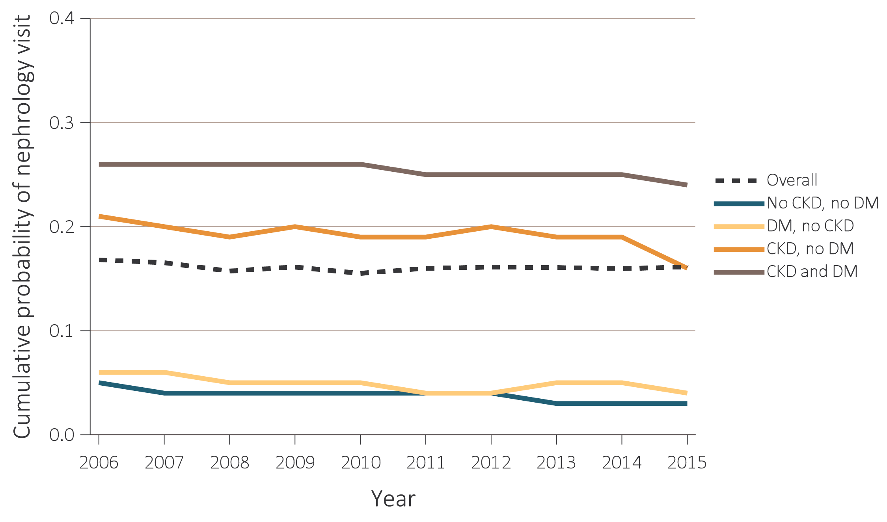
vol 1 Figure 5.9 Cumulative probability of a claim for an outpatient nephrology visit within six months of live discharge from first AKI hospitalization, overall and by CKD and DM, 2006-2015
Data Source: Special analyses, Medicare 5% sample and Optum Clinformatics™. (a) Medicare patients aged 66 and older who had both Medicare Parts A & B, no Medicare Advantage plan, no ESRD by first service date from Medical Evidence form on January 1 of year shown and were discharged alive from a first AKI hospitalization during the year. Censored at death, ESRD, end of Medicare Parts A & B participation, or switch to Medicare Advantage program. Physician visits are from physician/supplier claims with provider specialty codes for nephrology (39) and claim source indicating an outpatient setting. (b) Optum Clinformatics™ commercial insurance patients aged 22 and older who were enrolled in the plan, did not have diagnoses of ESRD, and were discharged alive from an AKI hospitalization in the year shown. Censored at death, ESRD, or plan disenrollment. Provider specialty of “nephrologist” used to identify nephrology visits. Abbreviations: AKI, acute kidney injury; CKD, chronic kidney disease; DM, diabetes mellitus; ESRD, end-stage renal disease.

Slide 29
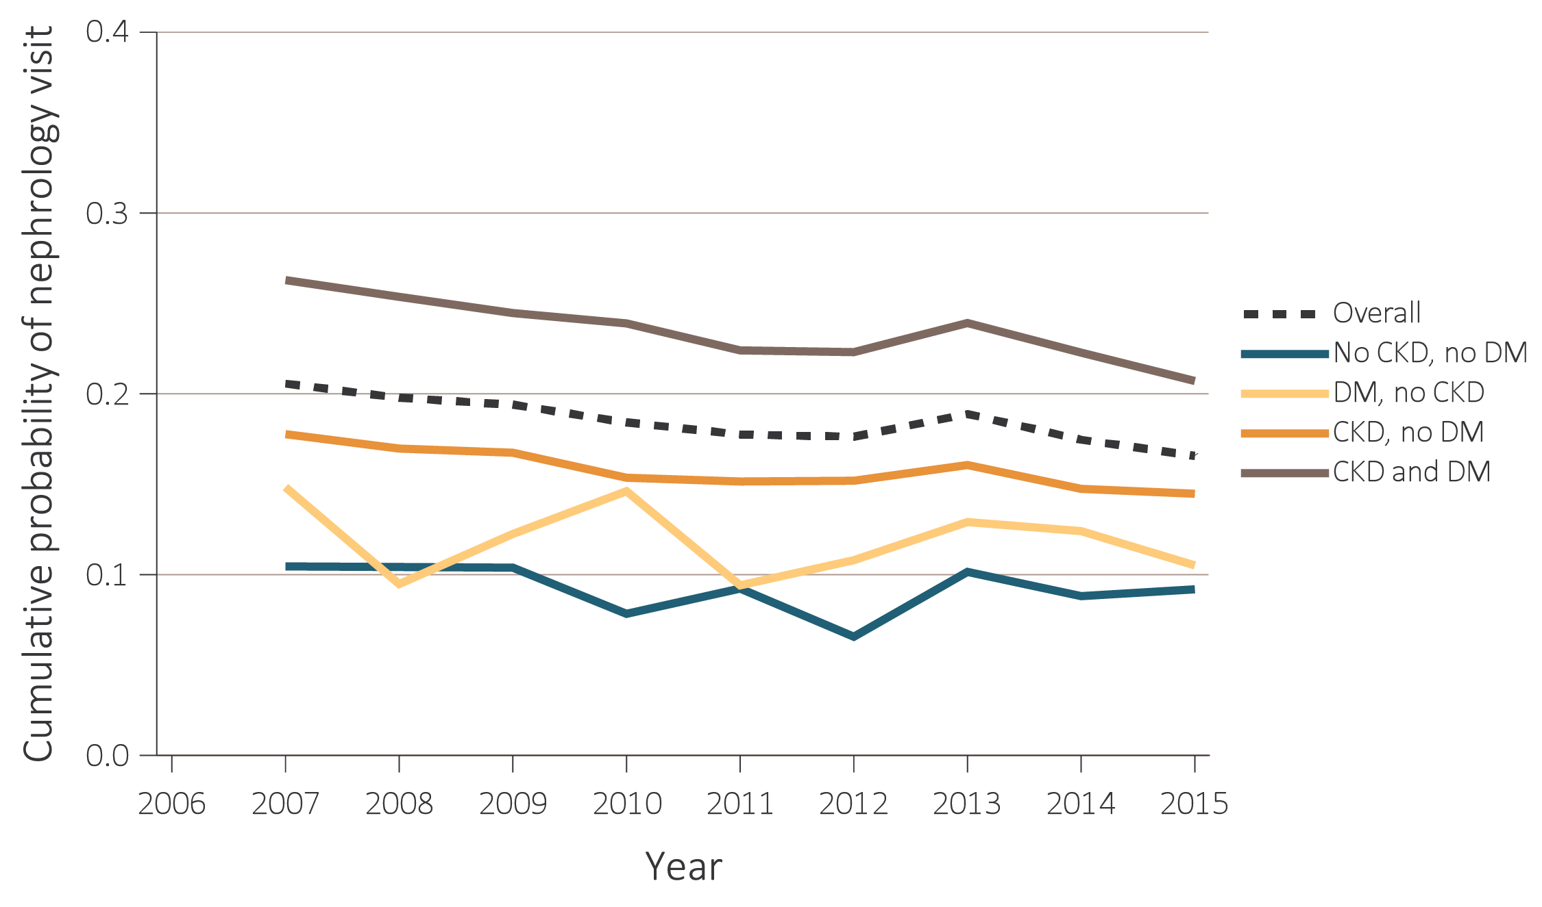
vol 1 Figure 5.9 Cumulative probability of a claim for an outpatient nephrology visit within six months of live discharge from first AKI hospitalization, overall and by CKD and DM, 2006-2015
Data Source: Special analyses, Medicare 5% sample and Optum Clinformatics™. (a) Medicare patients aged 66 and older who had both Medicare Parts A & B, no Medicare Advantage plan, no ESRD by first service date from Medical Evidence form on January 1 of year shown and were discharged alive from a first AKI hospitalization during the year. Censored at death, ESRD, end of Medicare Parts A & B participation, or switch to Medicare Advantage program. Physician visits are from physician/supplier claims with provider specialty codes for nephrology (39) and claim source indicating an outpatient setting. (b) Optum Clinformatics™ commercial insurance patients aged 22 and older who were enrolled in the plan, did not have diagnoses of ESRD, and were discharged alive from an AKI hospitalization in the year shown. Censored at death, ESRD, or plan disenrollment. Provider specialty of “nephrologist” used to identify nephrology visits. Abbreviations: AKI, acute kidney injury; CKD, chronic kidney disease; DM, diabetes mellitus; ESRD, end-stage renal disease.

Slide 30
Table B. ICD-9-CM and ICD-10-CM codes for Chronic Kidney Disease (CKD) stages
ICD-9-CM codeª | ICD-10-CM code | Stage
585.1 | N18.1 | CKD, Stage 1
585.2 | N18.2 | CKD, Stage 2 (mild)
585.3 | N18.3 | CKD, Stage 3 (moderate)
585.4 | N18.4 | CKD, Stage 4 (severe)
585.5 | N18.5 | CKD, Stage 5 (excludes 585.6/N18.6: Stage 5, requiring chronic dialysis)
CKD stage-unspecified |  | For these analyses, identified by multiple codes including ICD-9-CM code 585.9, 250.4x, 403.9x & others and ICD-10-CM code N18.9, E11.29, I12.9 & others
ª For analyses in this chapter, CKD stage estimates require at least one occurrence of a stage-specific code, and the last available CKD stage in a given year was used. ^{b} In USRDS analyses, patients with ICD-9-CM code 585.6 or ICD-10-CM code N18.6 & with no ESRD 2728 form or other indication of end-stage renal disease (ESRD) are considered to have code 585.5/N18.5. ICD-10-CM codes became effective on October 1, 2015.

Slide 31
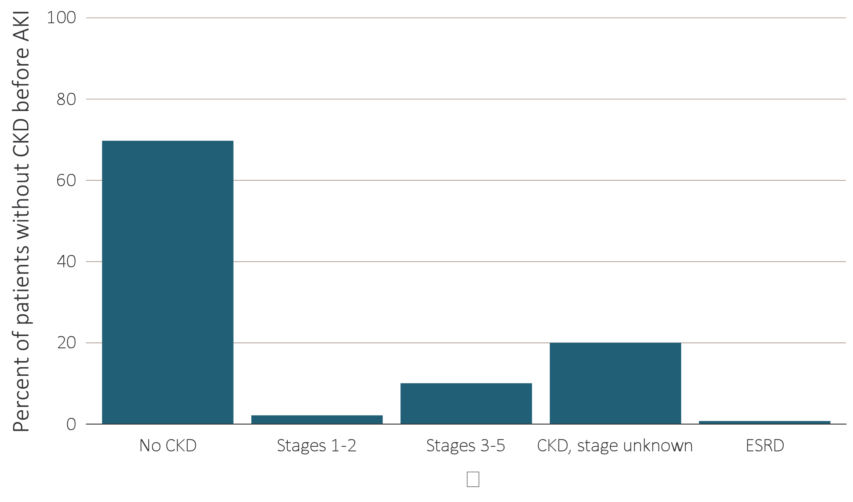
vol 1 Figure 5.10 Renal status one year following discharge from AKI hospitalization in 2014-2015, among surviving patients without kidney disease prior to AKI hospitalization, by CKD stage and ESRD status
Data Source: Special analyses, Medicare 5% sample. (a) Medicare patients aged 66 and older who had both Medicare Parts A & B, no Medicare Advantage plan, did not have ESRD, were discharged alive from a first AKI hospitalization in 2014 or 2015, and did not have any claims with a diagnosis of CKD in the 365 days prior to the AKI. (b) Optum Clinformatics™ commercial insurance patients aged 22 and older who were enrolled in the plan, did not have diagnoses of ESRD, and were discharged alive from an AKI hospitalization in 2014 or 2015, and did not have any claims with a diagnosis of CKD in the 365 days prior to the AKI. Renal status after AKI determined from claims between discharge from AKI hospitalization and 365 days after discharge. Stage determined by 585.x claim closest to 365 days after discharge; ESRD by first service date on Medical Evidence form. Abbreviations: AKI, acute kidney injury; CKD, chronic kidney disease; ESRD, end-stage renal disease.

Slide 32
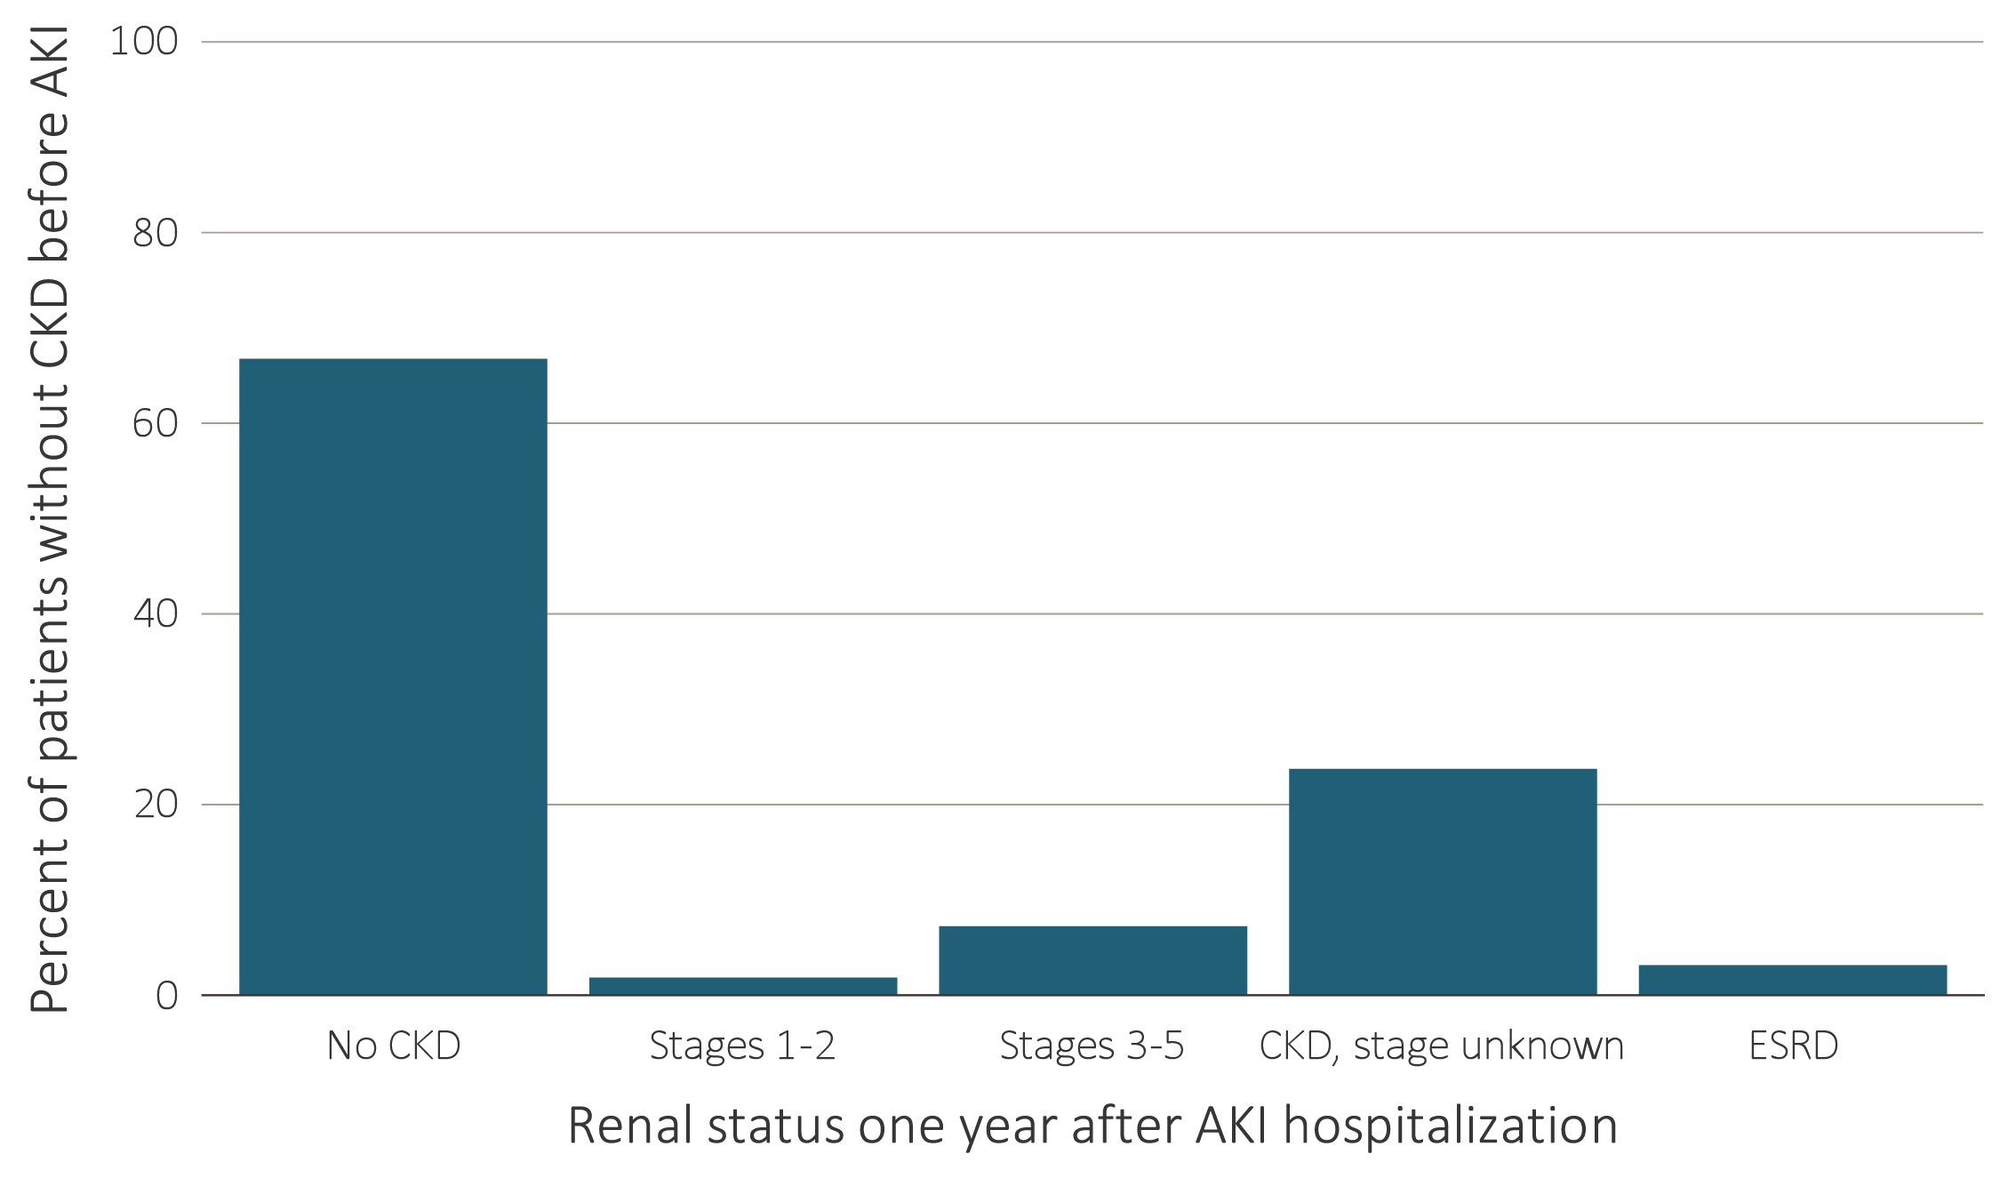
vol 1 Figure 5.10 Renal status one year following discharge from AKI hospitalization in 2014-2015, among surviving patients without kidney disease prior to AKI hospitalization, by CKD stage and ESRD status
Data Source: Special analyses, Medicare 5% sample. (a) Medicare patients aged 66 and older who had both Medicare Parts A & B, no Medicare Advantage plan, did not have ESRD, were discharged alive from a first AKI hospitalization in 2014 or 2015, and did not have any claims with a diagnosis of CKD in the 365 days prior to the AKI. (b) Optum Clinformatics™ commercial insurance patients aged 22 and older who were enrolled in the plan, did not have diagnoses of ESRD, and were discharged alive from an AKI hospitalization in 2014 or 2015, and did not have any claims with a diagnosis of CKD in the 365 days prior to the AKI. Renal status after AKI determined from claims between discharge from AKI hospitalization and 365 days after discharge. Stage determined by 585.x claim closest to 365 days after discharge; ESRD by first service date on Medical Evidence form. Abbreviations: AKI, acute kidney injury; CKD, chronic kidney disease; ESRD, end-stage renal disease.

Slide 33
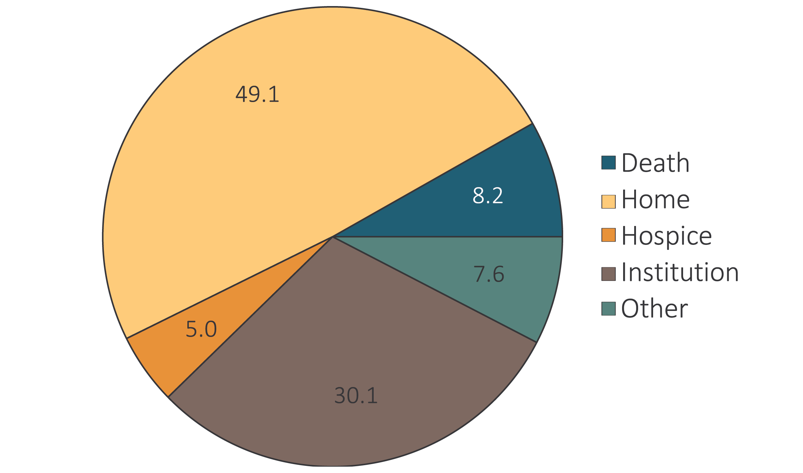
vol 1 Figure 5.11 Hospital discharge status of first hospitalization for Medicare patients aged 66+ (a) with diagnosis of AKI during stay, and (b) without diagnosis of AKI during stay, 2016
(a) With diagnosis of AKI during stay
Data Source: Special analyses, Medicare 5% sample. Medicare patients aged 66 and older who had both Medicare Parts A & B, no Medicare Advantage plan, did not have ESRD on January 1 of 2016, had a first hospitalization in 2016, and were not admitted to the acute care hospital from a skilled nursing facility. Institution includes short-term skilled nursing facilities, rehabilitation hospitals, and long-term care facilities. Home also includes patients receiving home health care services. Abbreviations: AKI, acute kidney injury; ESRD, end-stage renal disease.

Slide 34
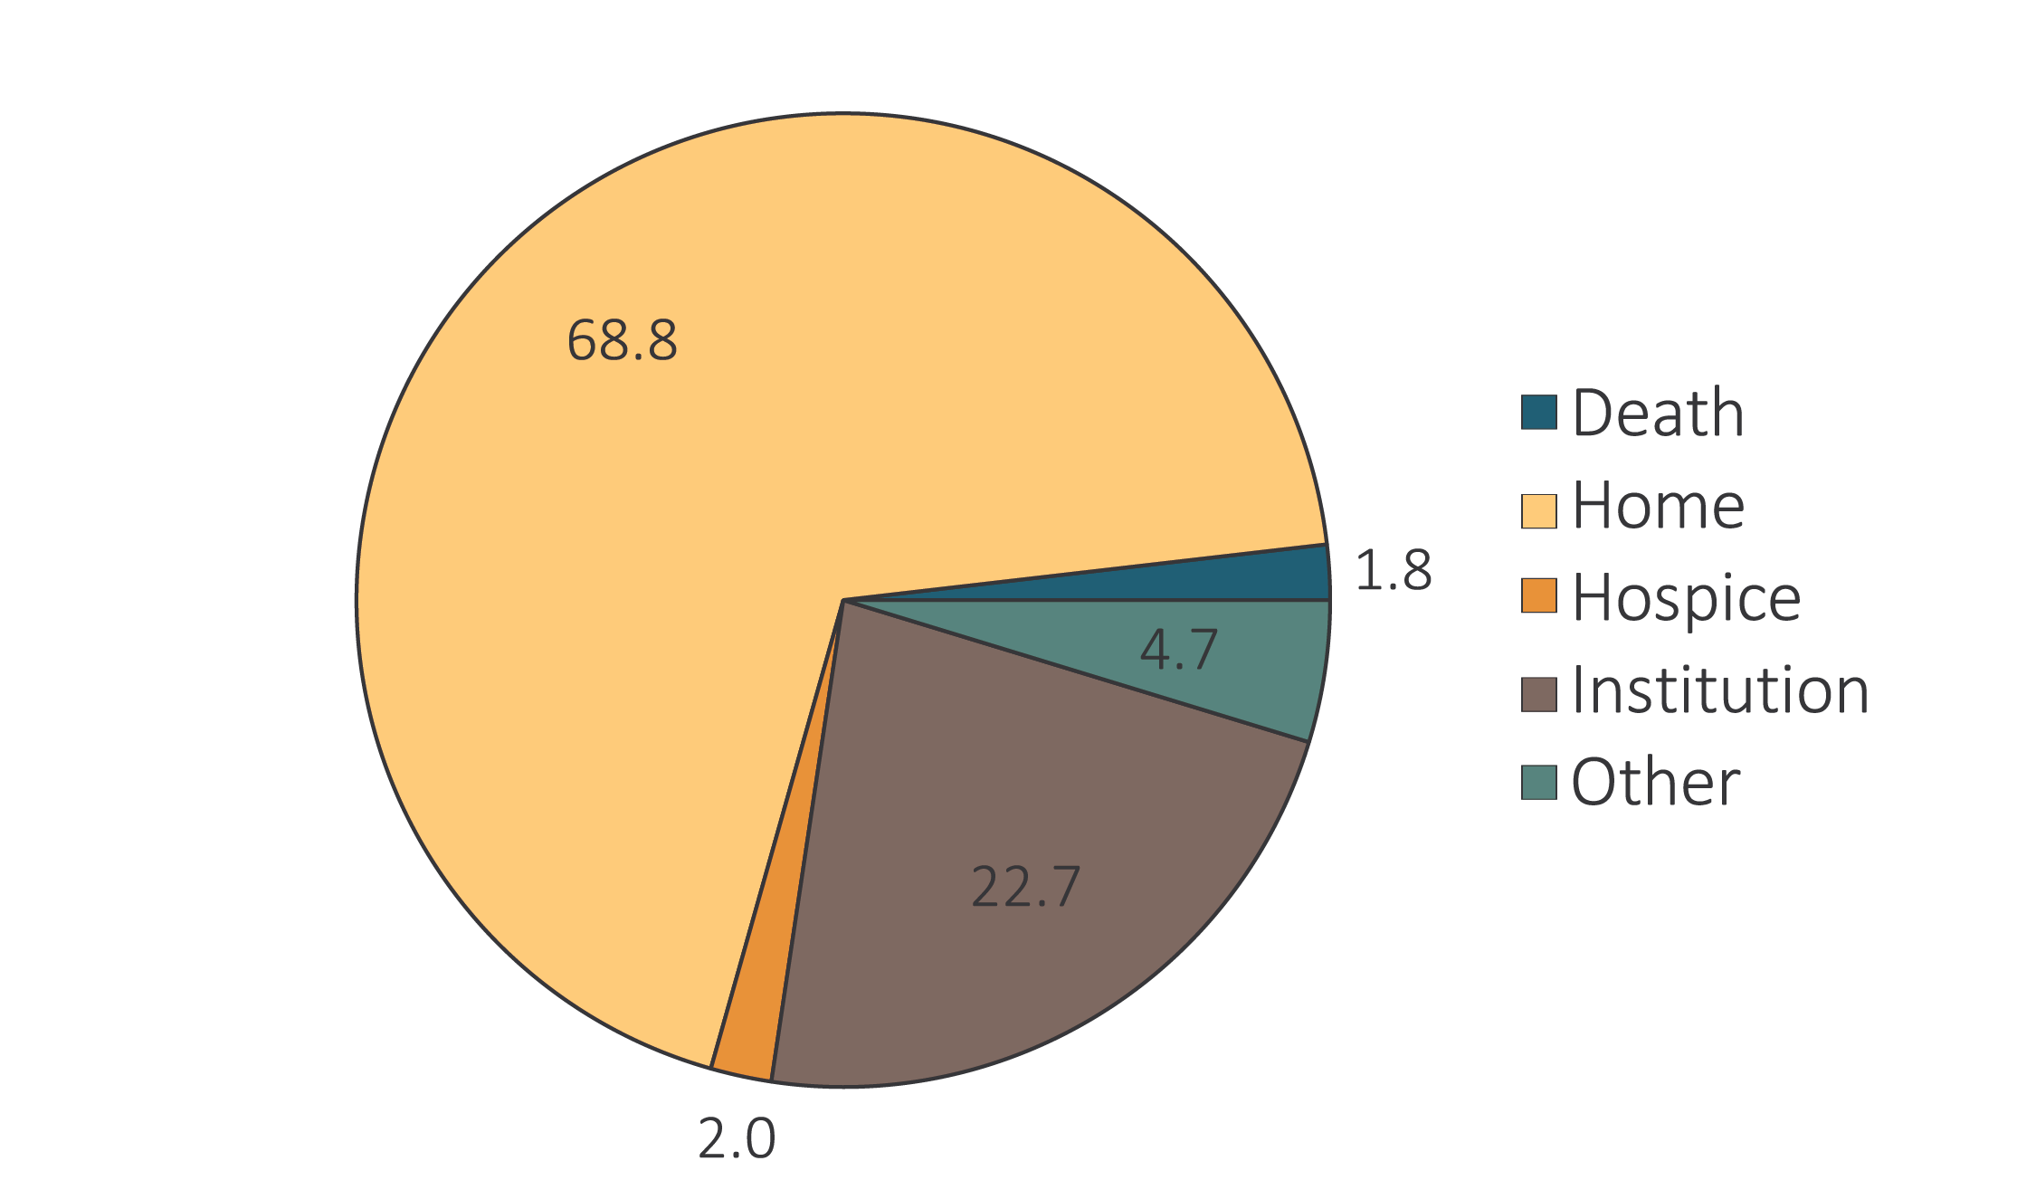
vol 1 Figure 5.11 Hospital discharge status of first hospitalization for Medicare patients aged 66+ (a) with diagnosis of AKI during stay, and (b) without diagnosis of AKI during stay, 2016
(b) Without diagnosis of AKI during stay
Data Source: Special analyses, Medicare 5% sample. Medicare patients aged 66 and older who had both Medicare Parts A & B, no Medicare Advantage plan, did not have ESRD on January 1 of 2016, had a first hospitalization in 2016, and were not admitted to the acute care hospital from a skilled nursing facility. Institution includes short-term skilled nursing facilities, rehabilitation hospitals, and long-term care facilities. Home also includes patients receiving home health care services. Abbreviations: AKI, acute kidney injury; ESRD, end-stage renal disease.

