Slide 1
2018 Annual Data Report
Volume 1: Chronic Kidney Disease
Chapter 9: Transition of Care in Chronic Kidney Disease
2018 Annual Data Report Volume 1 CKD, Chapter 9

Slide 2
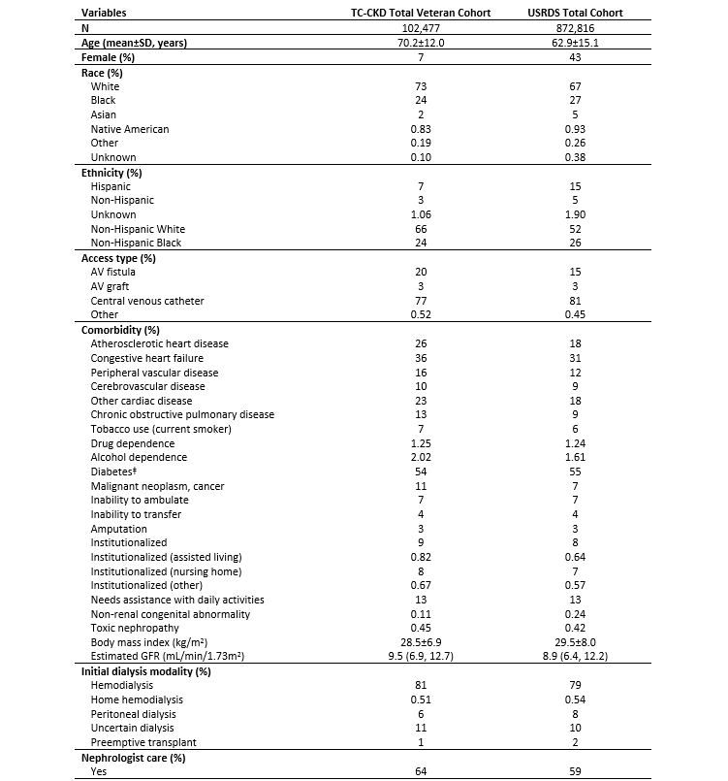
vol 1 Table 9.1 Baseline characteristics of 102,477 incident ESRD veterans compared to all 872,816 USRDS patients who transitioned to ESRD between 10/1/2007 and 3/31/2015 (For gender decomposed components, see Tables 9.2 and 9.3)
Data source: VHA, CMS, and USRDS ESRD Databases. ^{ǂ}Diabetes is presence of any of the following: Diabetes, currently on insulin; Diabetes, without medications; Diabetes, on oral medications; Diabetic, retinopathy. Abbreviations: AV, arteriovenous; ESRD, end-stage renal disease; GFR, glomerular filtration rate; kg, kilogram; m, meters; mL, milliliters; min, minute.

Slide 3
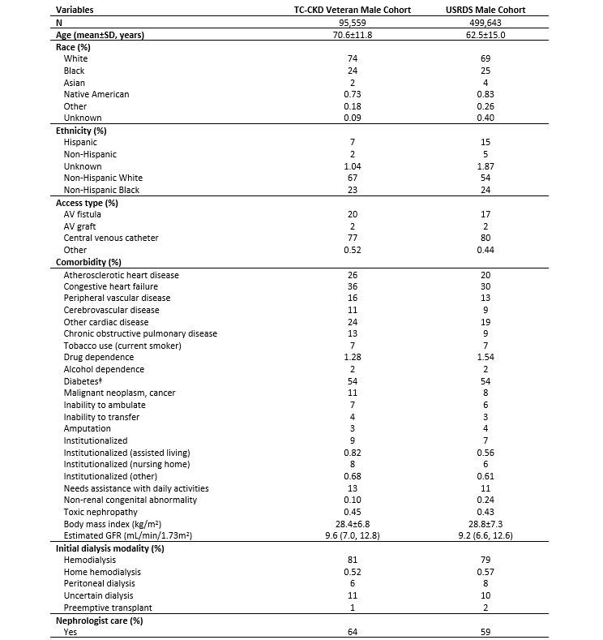
vol 1 Table 9.2 Baseline characteristics of 95,559 male incident ESRD veterans compared to all 499,643 USRDS males who transitioned to ESRD between 10/1/2007 and 3/31/2015
Data source: VHA, CMS, and USRDS ESRD Databases. ^{ǂ}Diabetes is presence of any of the following: Diabetes, currently on insulin; Diabetes, without medications; Diabetes, on oral medications; Diabetic, retinopathy. Abbreviations: AV, arteriovenous; ESRD, end-stage renal disease; GFR, glomerular filtration rate; kg, kilogram; m, meters; mL, milliliters; min, minute.

Slide 4
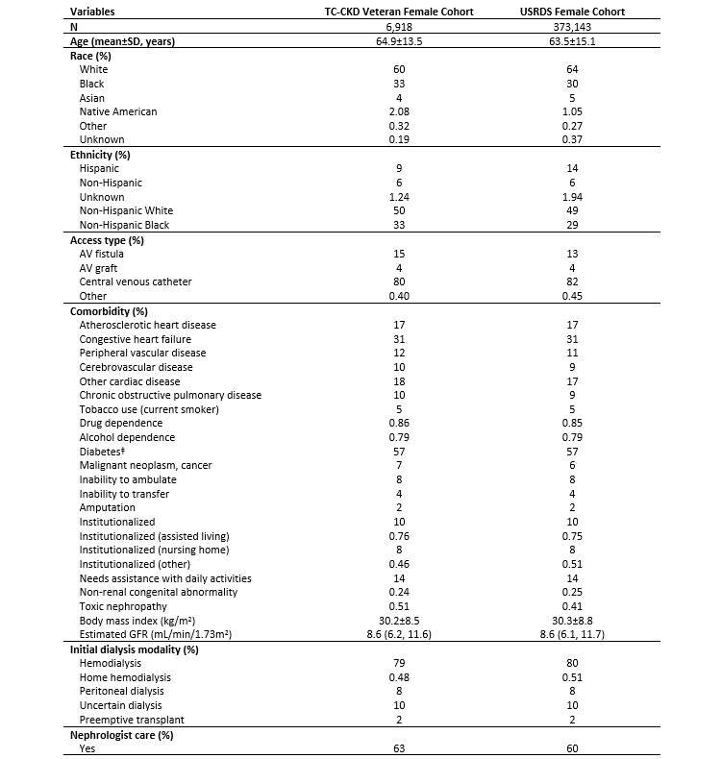
vol 1 Table 9.3 Baseline characteristics of 6,918 female incident ESRD veterans compared to all 373,143 USRDS females who transitioned to ESRD between 10/1/2007 and 3/31/2015 (For decomposition of female incident ESRD veterans across incident years, see Table 9.4)
Data source: VHA, CMS, and USRDS ESRD Databases. ^{ǂ}Diabetes is presence of any of the following: Diabetes, currently on insulin; Diabetes, without medications; Diabetes, on oral medications; Diabetic, retinopathy. Abbreviations: AV, arteriovenous; : ESRD, end-stage renal disease; GFR, glomerular filtration rate; kg, kilogram; m, meters; mL, milliliters; min, minute.

Slide 5
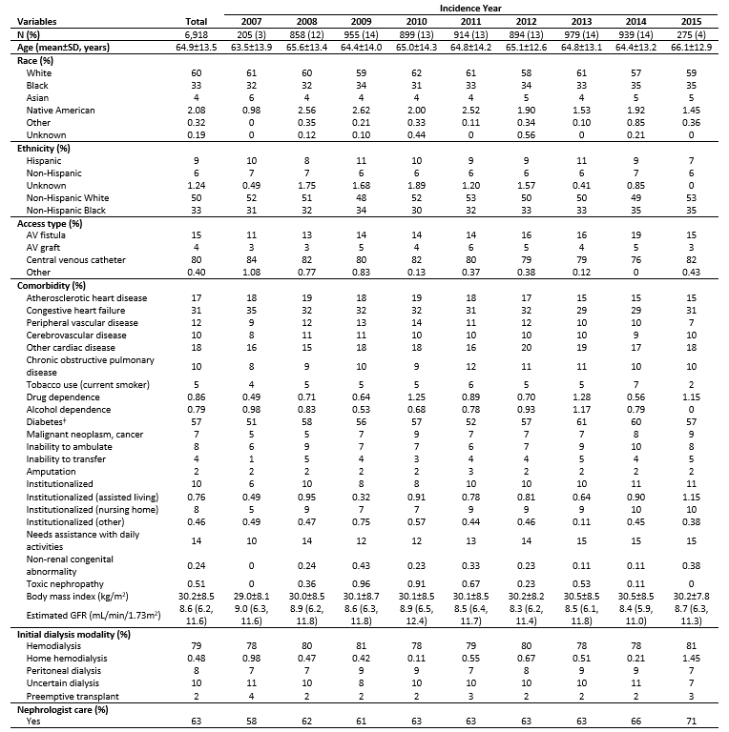
vol 1 Table 9.4 Baseline characteristics of 6,918 female incident ESRD veterans who transitioned to ESRD between 10/1/2007 and 3/31/2015 according to incidence year at transition to ESRD
Data source: VHA, CMS, and USRDS ESRD Databases. ^{ǂ}Diabetes is presence of any of the following: Diabetes, currently on insulin; Diabetes, without medications; Diabetes, on oral medications; Diabetic, retinopathy; Abbreviations: AV, arteriovenous; ESRD, end-stage renal disease; GFR, glomerular filtration rate; kg, kilogram; m, meters; mL, milliliters; min, minute.

Slide 6
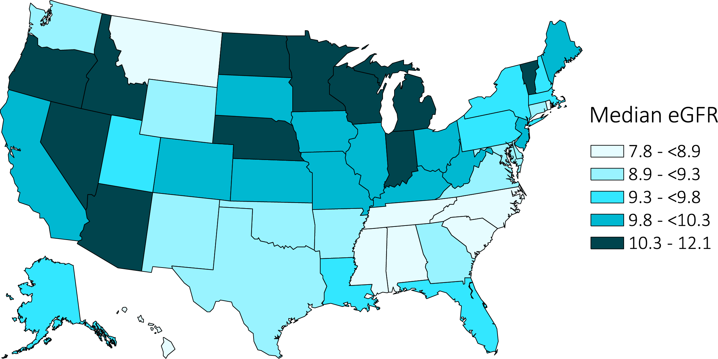
vol 1 Figure 9.1 Median estimated glomerular filtration rate (eGFR) at transition among 99,614 incident ESRD veterans across the United States, 10/1/2007-3/31/2015 (For gender decomposed components, see Figures 9.2 and 9.3) (For decomposition according to cause of ESRD, see Figures 9.4 and 9.5)
Data source: USRDS ESRD Database. Abbreviations: ESRD, end-stage renal disease; eGFR, estimated glomerular filtration rate.

Slide 7
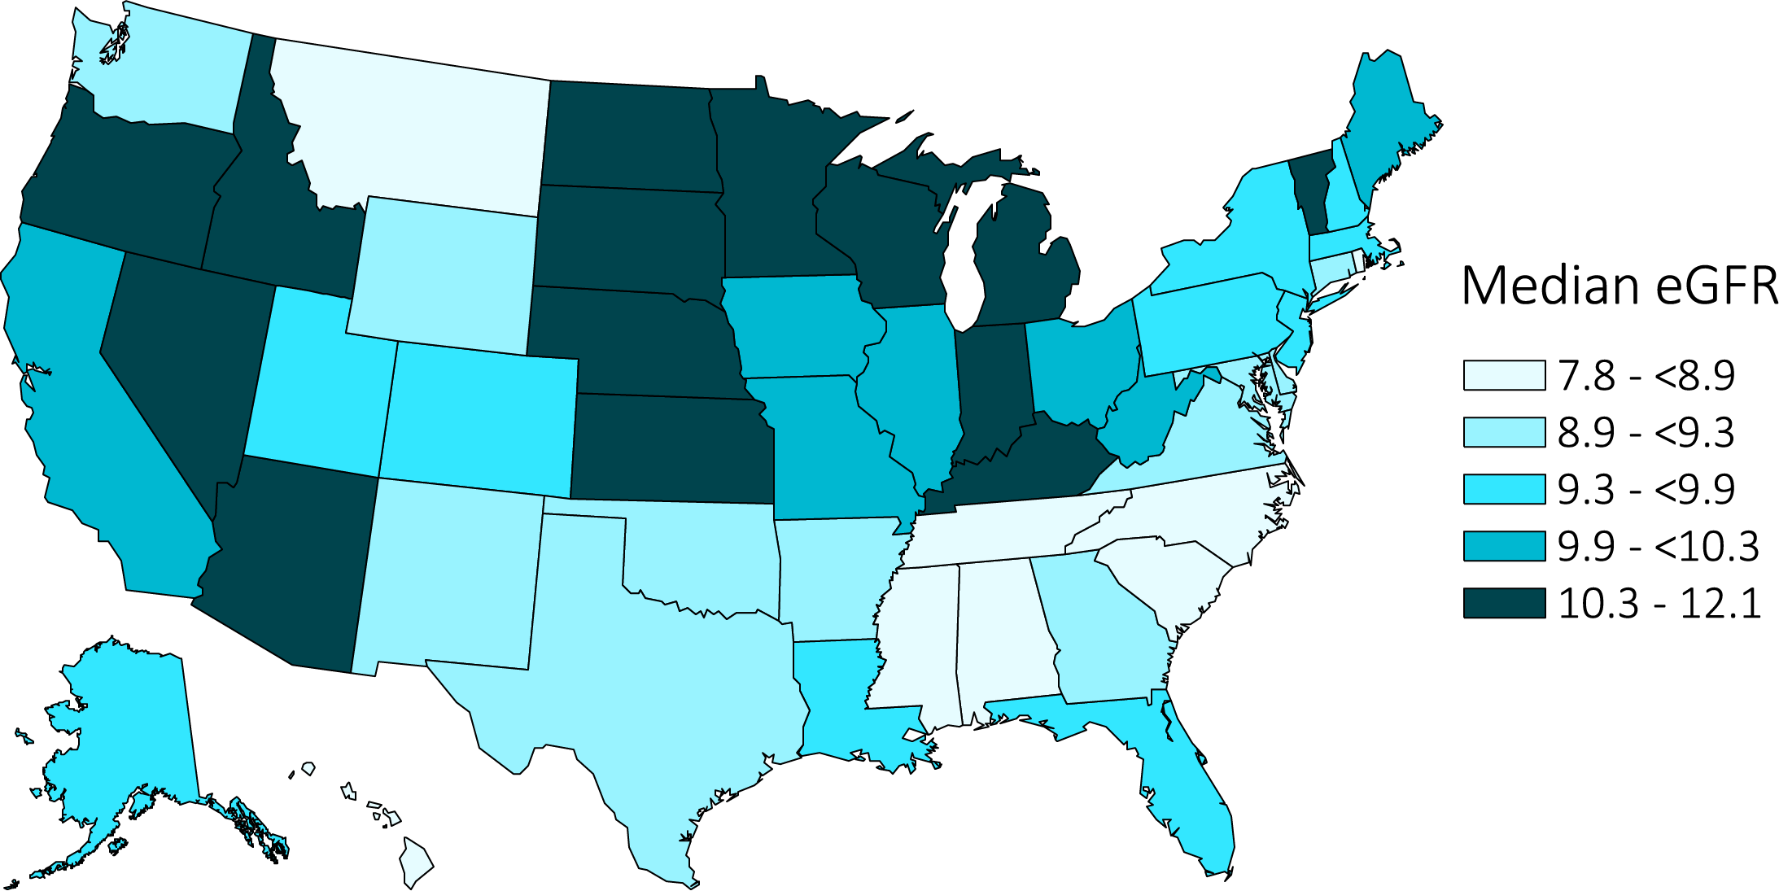
vol 1 Figure 9.2 Median estimated glomerular filtration rate (eGFR) at transition among 92,894 male incident ESRD veterans across the United States, 10/1/2007-3/31/2015
Data source: USRDS ESRD Database. Abbreviations: ESRD, end-stage renal disease; eGFR, estimated glomerular filtration rate.

Slide 8
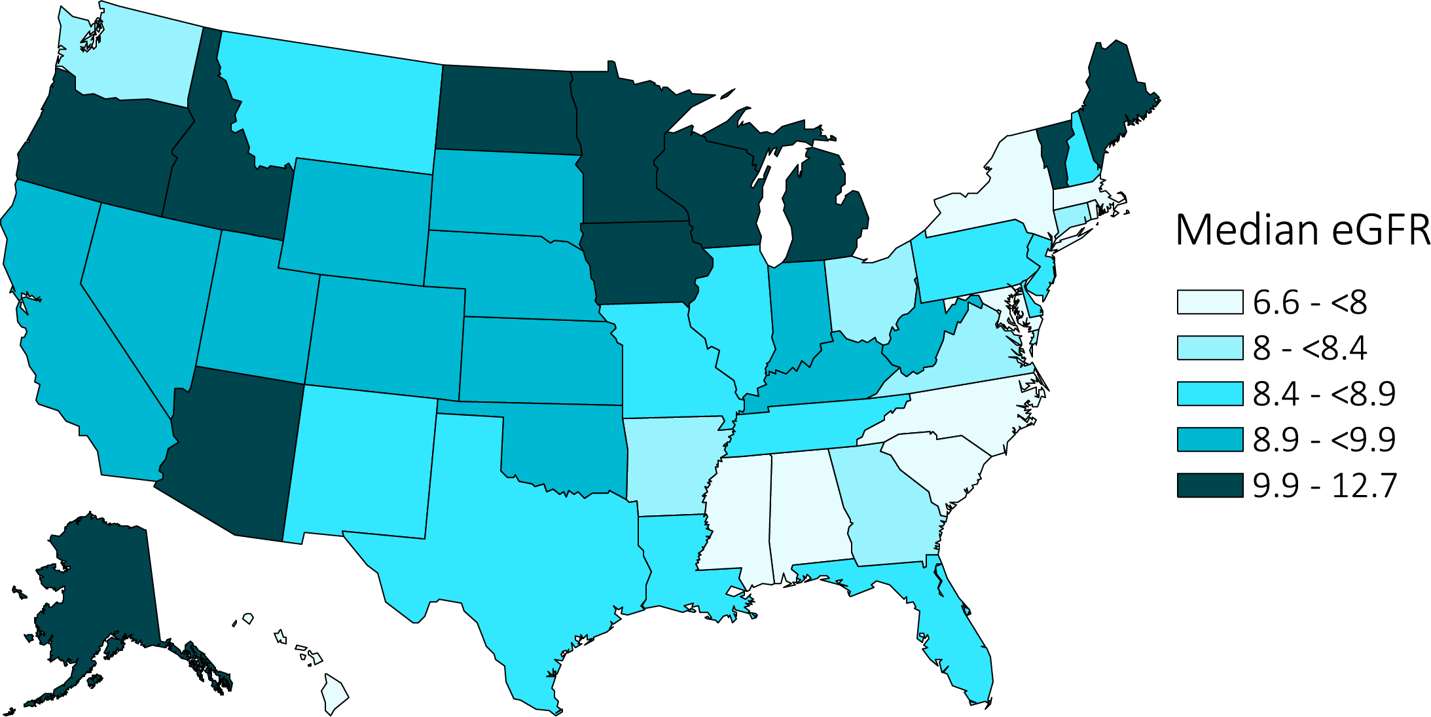
vol 1 Figure 9.3 Median estimated glomerular filtration rate (eGFR) at transition among 6,720 female incident ESRD veterans across the United States, 10/1/2007-3/31/2015
Data source: USRDS ESRD Database. Abbreviations: ESRD, end-stage renal disease; eGFR, estimated glomerular filtration rate.

Slide 9
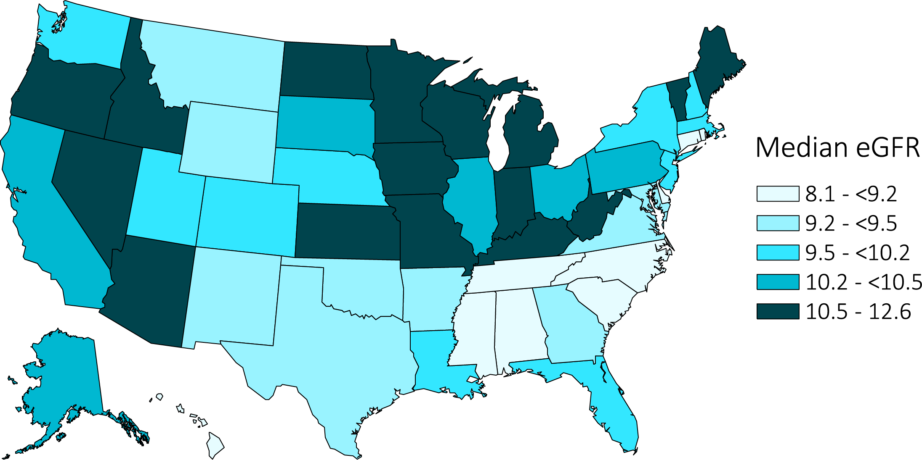
vol 1 Figure 9.4 Median estimated glomerular filtration rate (eGFR) at transition among 43,062 incident ESRD veterans with diabetes as the primary cause of ESRD across the United States, 10/1/2007-3/31/2015
Data source: USRDS ESRD Database. Abbreviations: ESRD, end-stage renal disease; eGFR, estimated glomerular filtration rate.

Slide 10
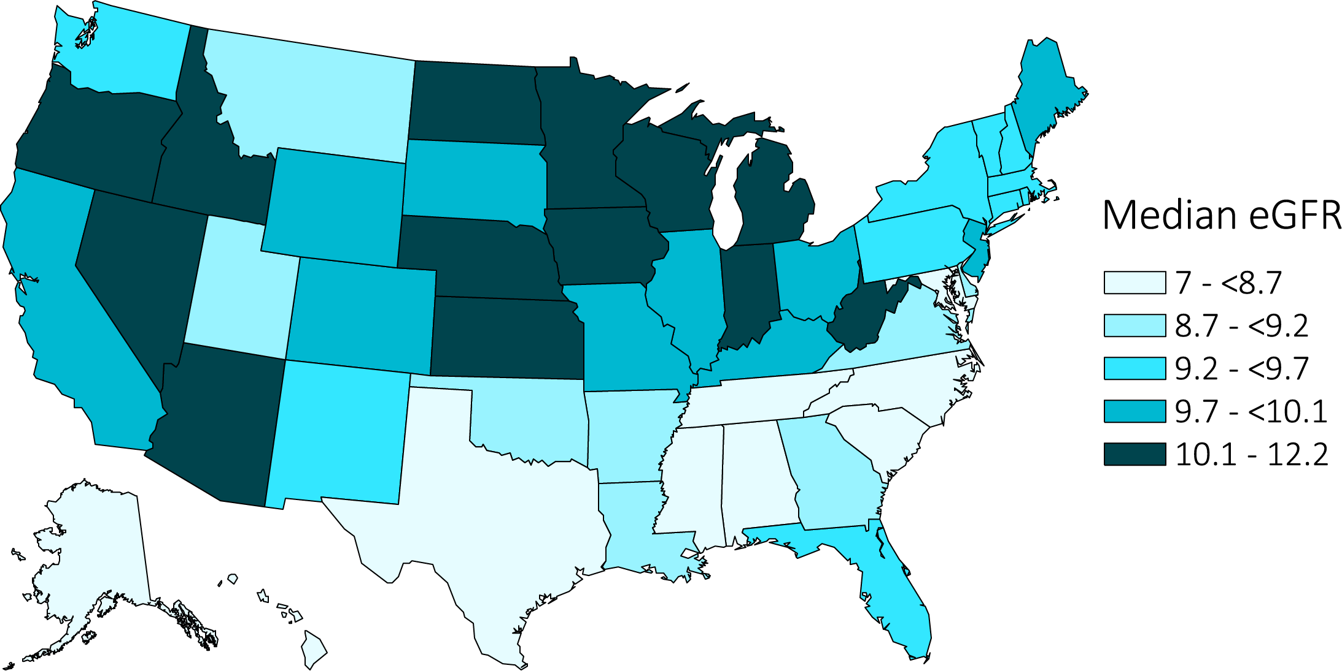
vol 1 Figure 9.5 Median estimated glomerular filtration rate (eGFR) at transition among 32,273 incident ESRD veterans with hypertension as the primary cause of ESRD across the United States, 10/1/2007-3/31/2015
Data source: USRDS ESRD Database. Abbreviations: ESRD, end-stage renal disease; eGFR, estimated glomerular filtration rate.

Slide 11
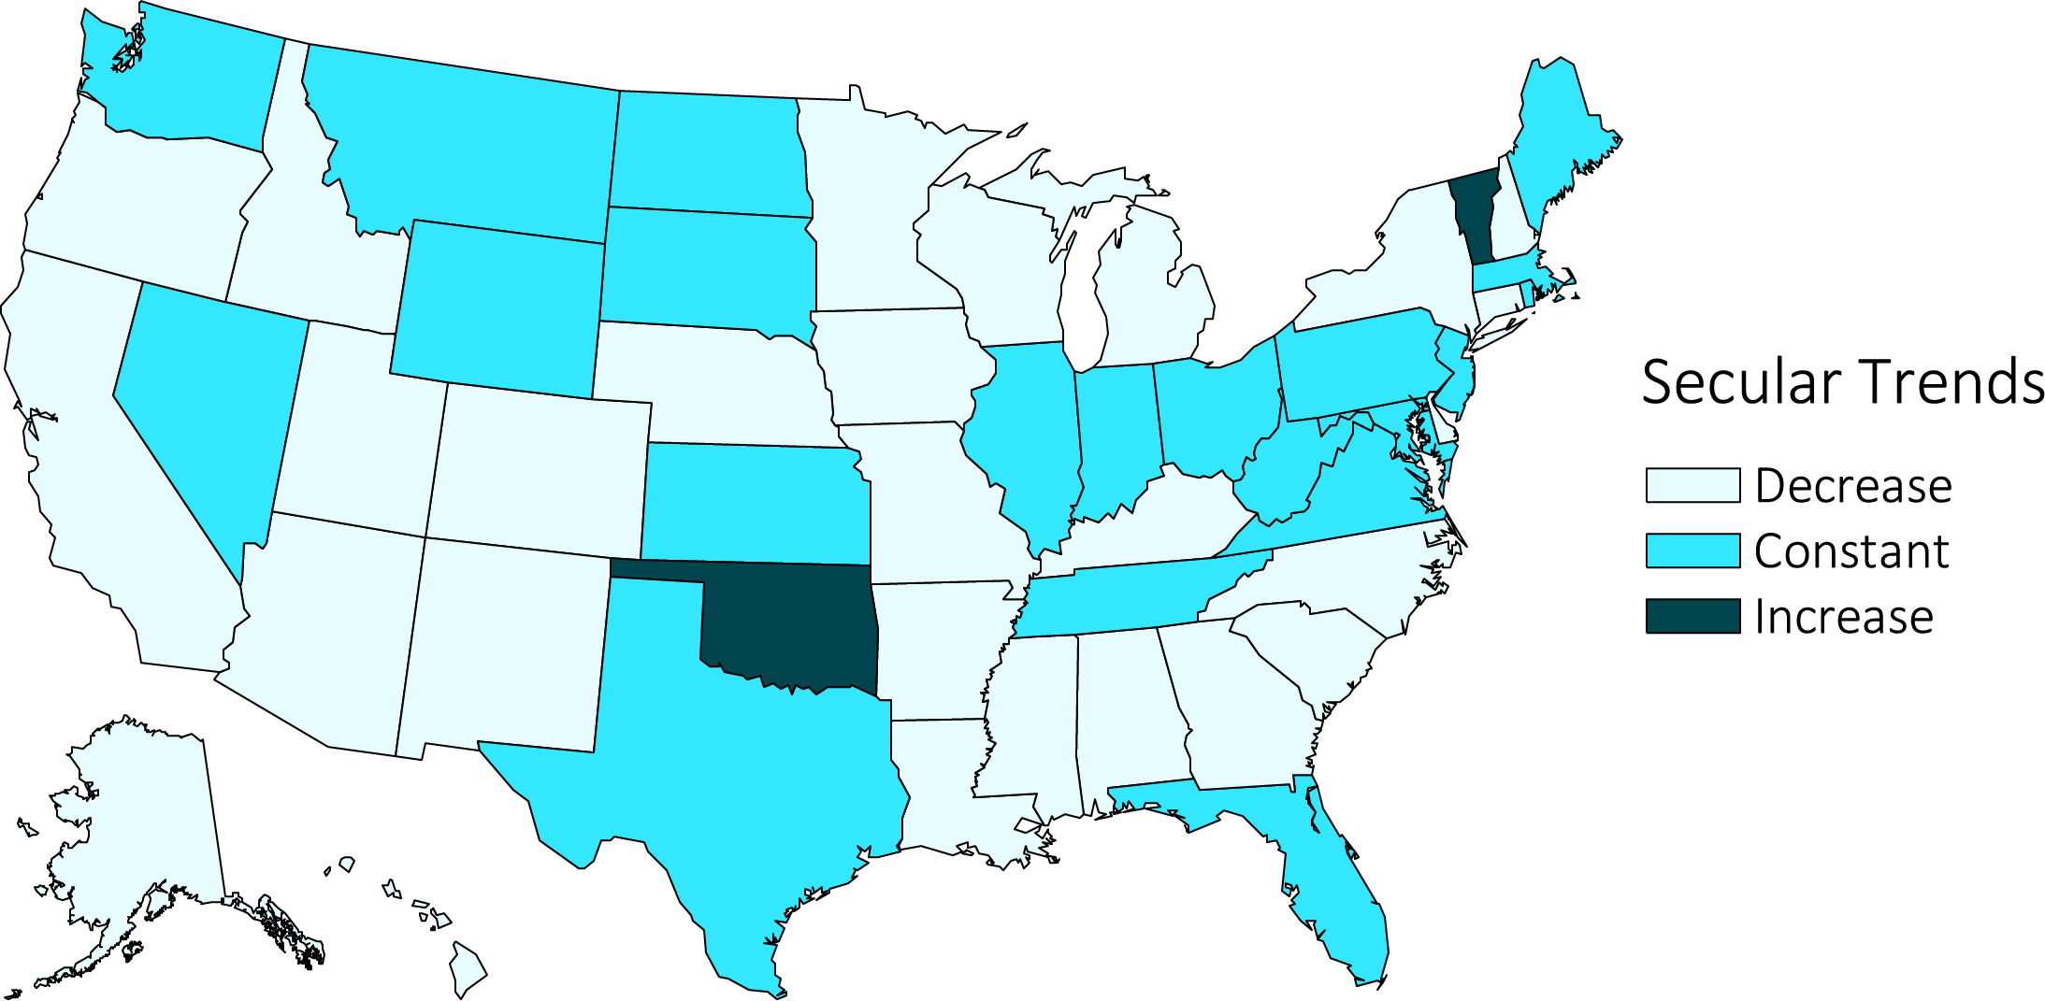
vol 1 Figure 9.6 Distribution of secular trends of median estimated glomerular filtration rates (eGFR) between 10/1/2007-3/31/2015 among 99,614 incident ESRD veterans across the United States
Data source: USRDS ESRD Database. Decrease: ≤-0.01; Constant: <-0.01 to ≤0.01; Increase: >0.01 (mL/min/1.73m² per year). Abbreviation: ESRD, end-stage renal disease.

Slide 12
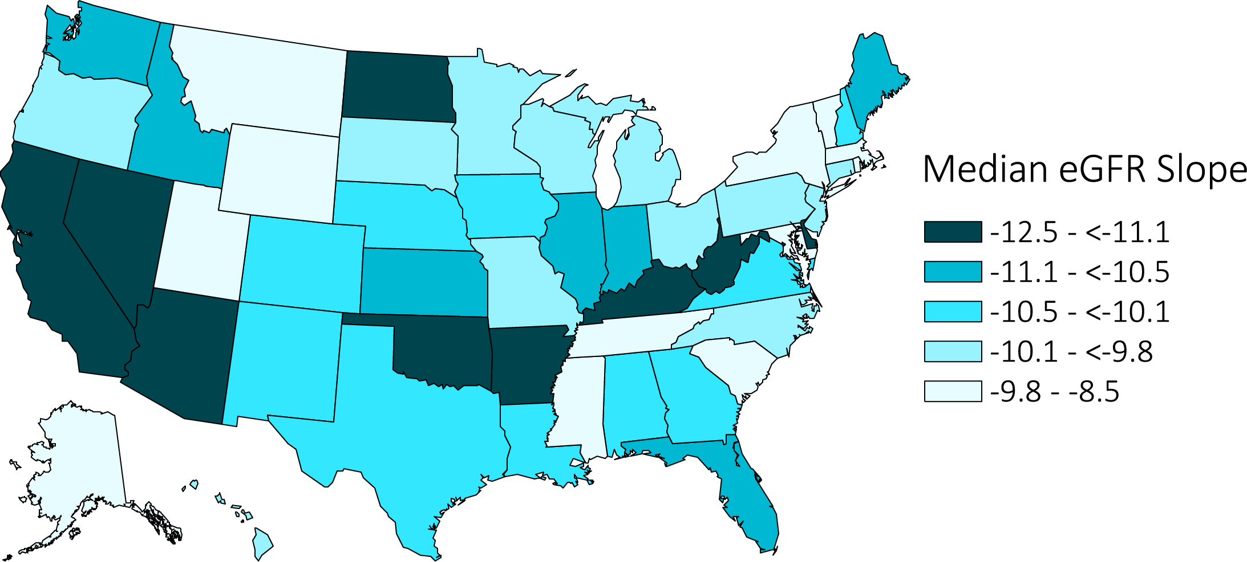
vol 1 Figure 9.7 Median estimated glomerular filtration rate (eGFR) slope in the one-year prelude (prior to transition) among 29,277 incident ESRD veterans across the United States, 10/1/2007-3/31/2015 (For decomposition according to cause of ESRD, see Figures 9.8 and 9.9)
Data source: VHA and USRDS ESRD Databases. Abbreviations: ESRD, end-stage renal disease; eGFR, estimated glomerular filtration rate.

Slide 13
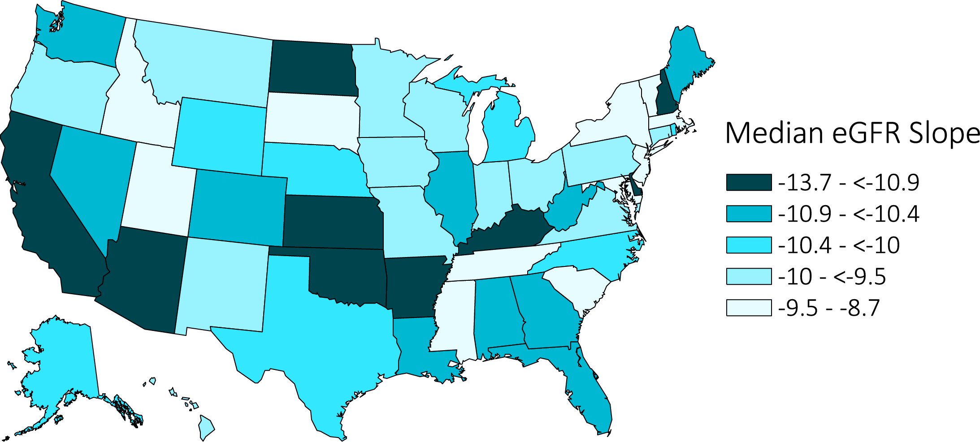
vol 1 Figure 9.8 Median estimated glomerular filtration rate (eGFR) slope in the one-year prelude (prior to transition) among 14,349 incident ESRD veterans with diabetes as the cause of ESRD across the United States, 10/1/2007-3/31/2015
Data source: VHA and USRDS ESRD Databases. Abbreviations: ESRD, end-stage renal disease; eGFR, estimated glomerular filtration rate.

Slide 14
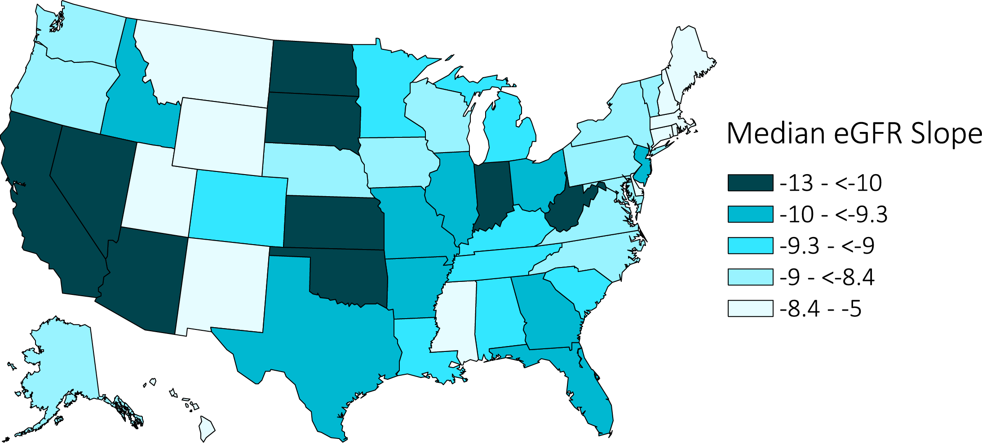
vol 1 Figure 9.9 Median pre-ESRD estimated glomerular filtration rate (eGFR) slope in the one-year prelude (prior to transition) among 7,845 incident ESRD veterans with hypertension as the cause of ESRD across the United States, 10/1/2007-3/31/2015
Data source: VHA and USRDS ESRD Databases. Abbreviations: ESRD, end-stage renal disease; eGFR, estimated glomerular filtration rate.

Slide 15
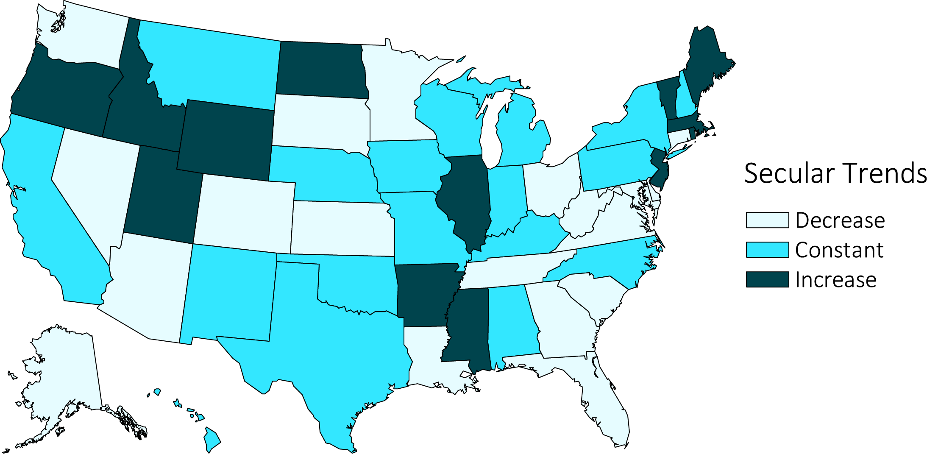
vol 1 Figure 9.10 Distribution of secular trends of diabetes (%) as the primary cause of ESRD between 10/1/2007-3/31/2015 among 102,477 incident ESRD veterans across the United States
Data source: USRDS ESRD Database. Decrease: ≤-0.01; Constant: <-0.01 to ≤0.01; Increase: >0.01 (% per year). Abbreviation: ESRD, end-stage renal disease.

Slide 16
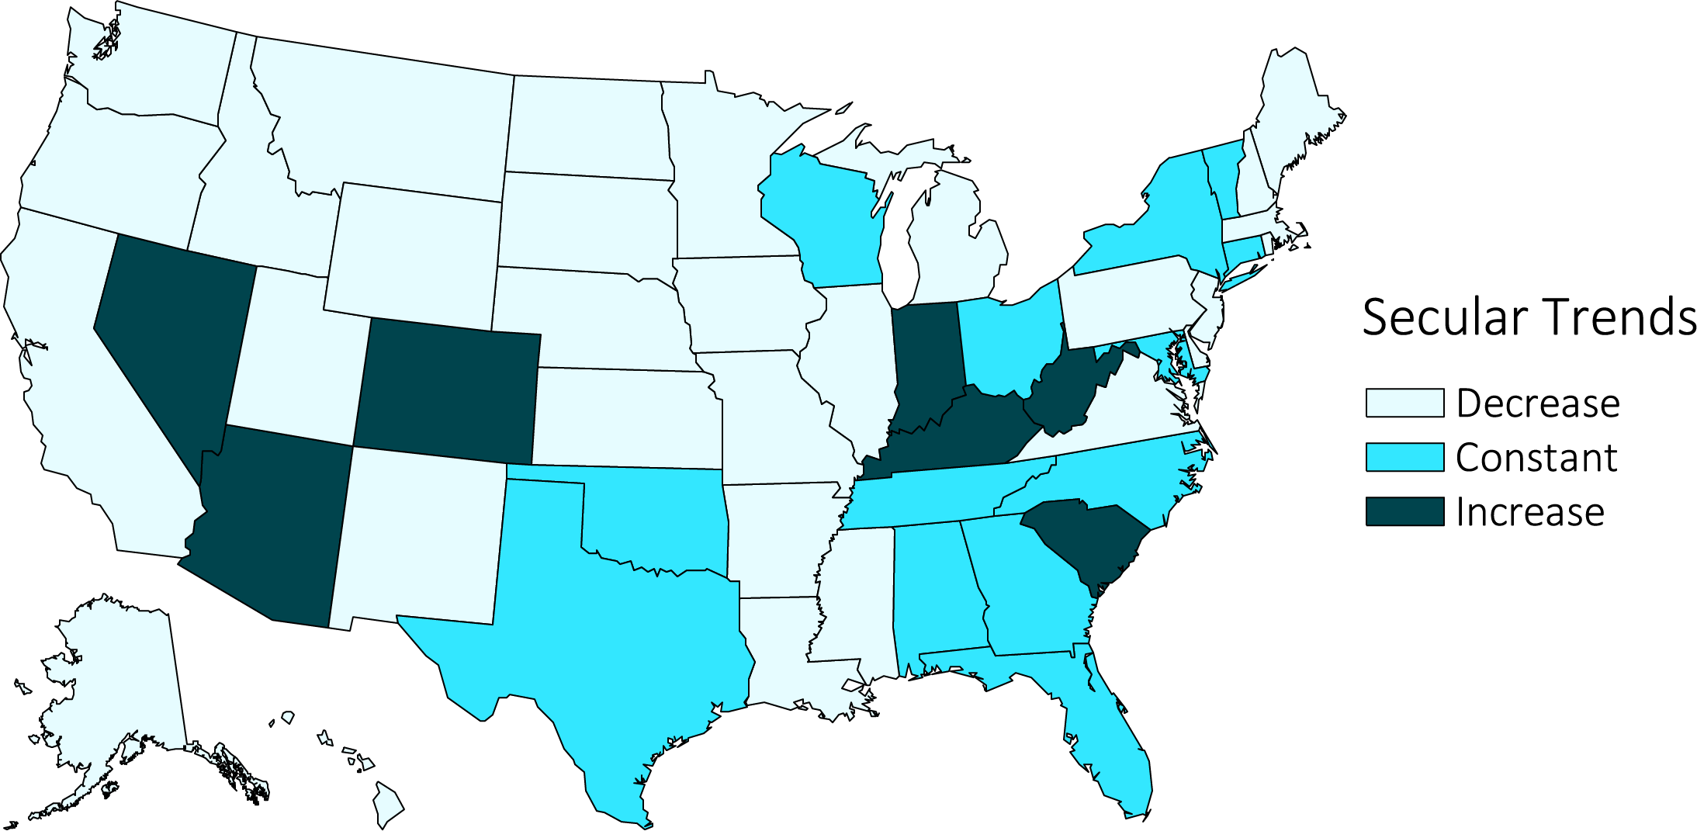
vol 1 Figure 9.11 Distribution of secular trends of hypertension (%) as the primary cause of ESRD among 102,477 incident ESRD veterans across the United States, 10/1/2007-3/31/2015
Data source: USRDS ESRD Database. Decrease: ≤-0.01; Constant: <-0.01 to ≤0.01; Increase: >0.01 (% per year). Abbreviation: ESRD, end-stage renal disease.

Slide 17
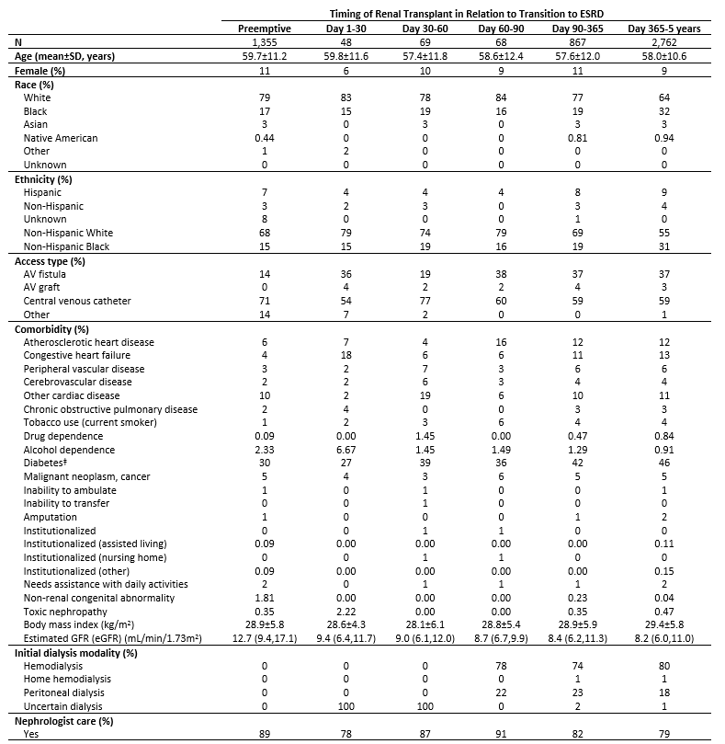
vol 1 Table 9.5 Baseline characteristics of 5,169 incident ESRD veterans who received a kidney transplant at or after ESRD transition between 10/1/2007 and 9/1/2015, according to timing of kidney transplant
Data source: VHA, CMS, and USRDS ESRD Databases. ^{ǂ}Diabetes is presence of any of the following: Diabetes, currently on insulin; Diabetes, without medications; Diabetes, on oral medications; Diabetic, retinopathy; Data source: USRDS ESRD Database. Abbreviations: AV, arteriovenous; ESRD, end-stage renal disease; eGFR, estimated glomerular filtration rate; kg, kilogram; m, meters; mL, milliliter; min, minute.

Slide 18
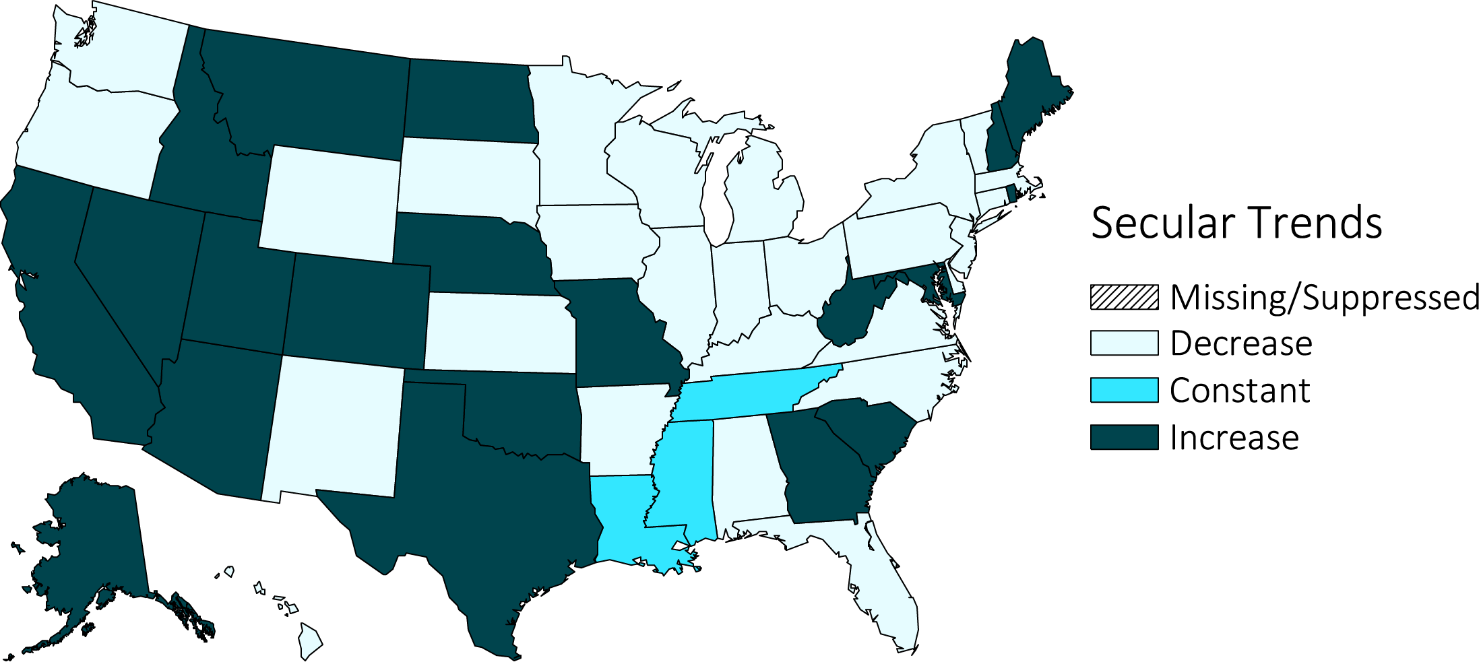
vol 1 Figure 9.12 Secular trends in the distribution of preemptive kidney transplant rates among 1,319 incident ESRD veterans across the United States between 10/1/2007-12/31/2014
Data source: USRDS ESRD Database. Decrease: ≤-0.01; Constant: <-0.01 to ≤0.01; Increase: >0.01 (% per year). Abbreviation: ESRD, end-stage renal disease.

Slide 19
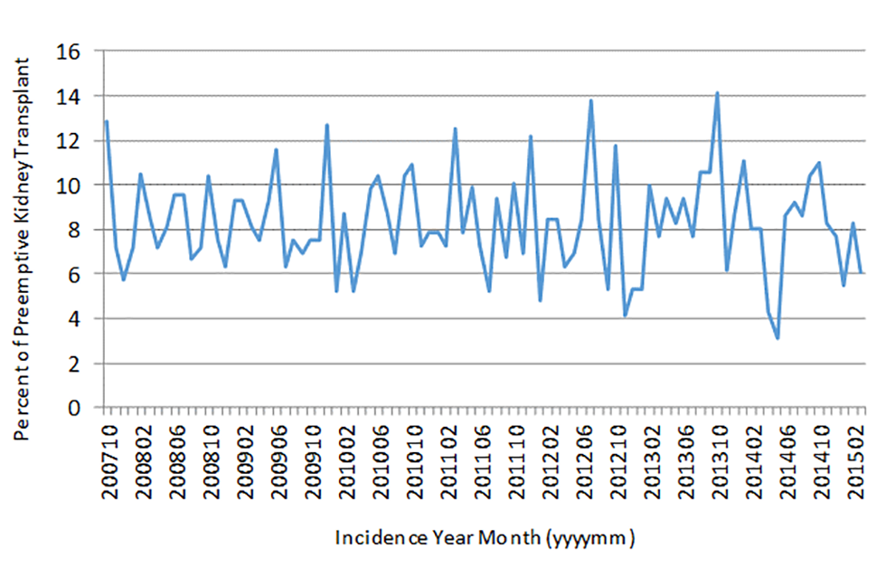
vol 1 Figure 9.13 Seasonal variations across secular trends in the percent of kidney transplants among 1,355 incident ESRD veterans who received a preemptive kidney transplant between 10/1/2007 and 3/31/2015*
(a) Percent of patients for each month per fiscal year over 7.5 years
Data source: USRDS ESRD Database. For Fiscal Year 14/15, percent was based on the averaged total number of preemptive transplants of previous 7 fiscal years. *Values for 10 or fewer patients are suppressed. Abbreviation: ESRD, end-stage renal disease.

Slide 20
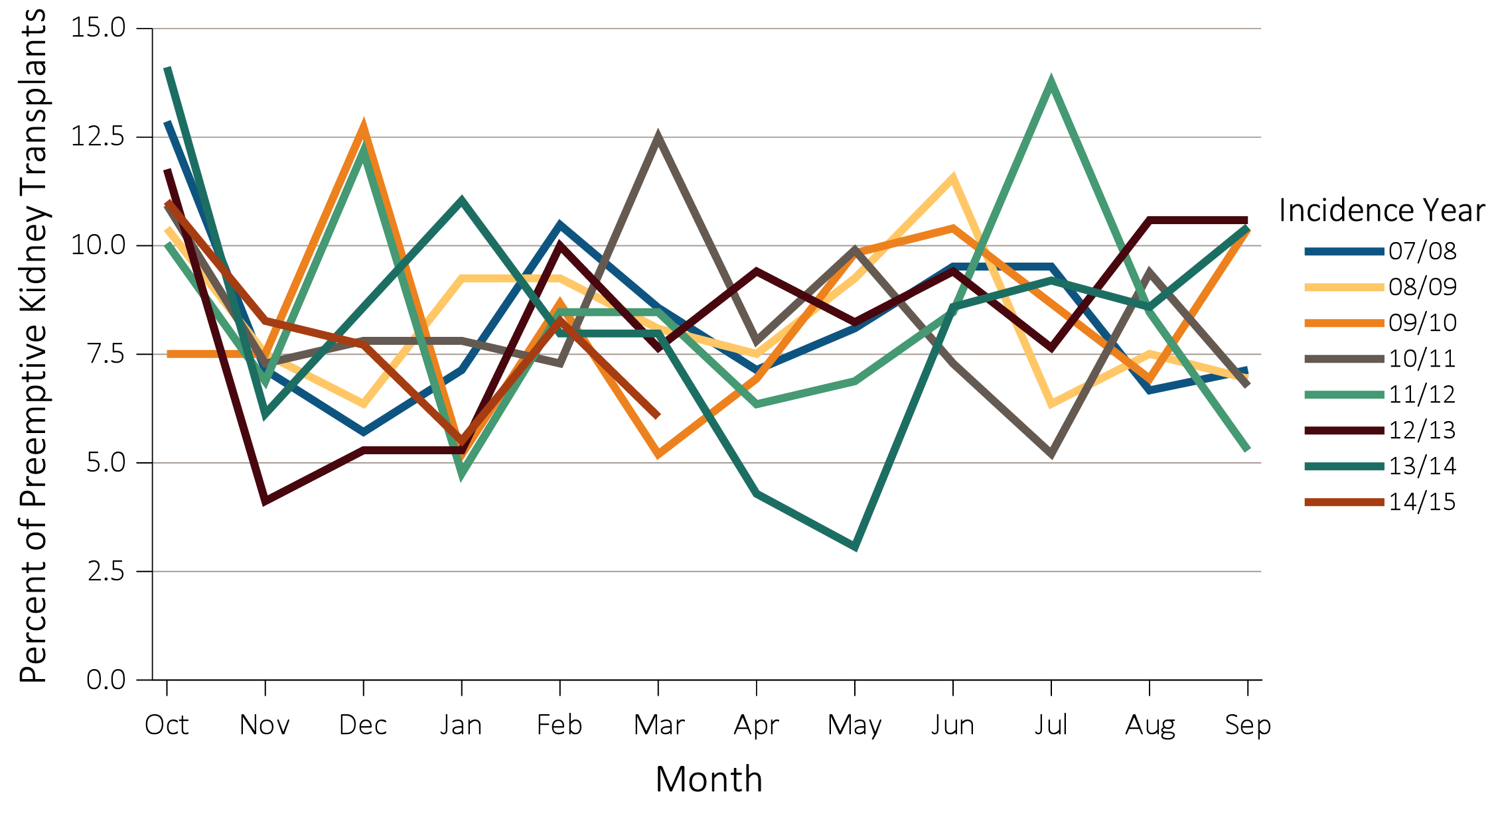
vol 1 Figure 9.13 Seasonal variations across secular trends in the percent of kidney transplants among 1,355 incident ESRD veterans who received a preemptive kidney transplant between 10/1/2007 and 3/31/2015*
(b) Percent of patients for each month per fiscal year stratified by fiscal year
Data source: USRDS ESRD Database. For Fiscal Year 14/15, percent was based on the averaged total number of preemptive transplants of previous 7 fiscal years. *Values for 10 or fewer patients are suppressed. Abbreviation: ESRD, end-stage renal disease.

Slide 21
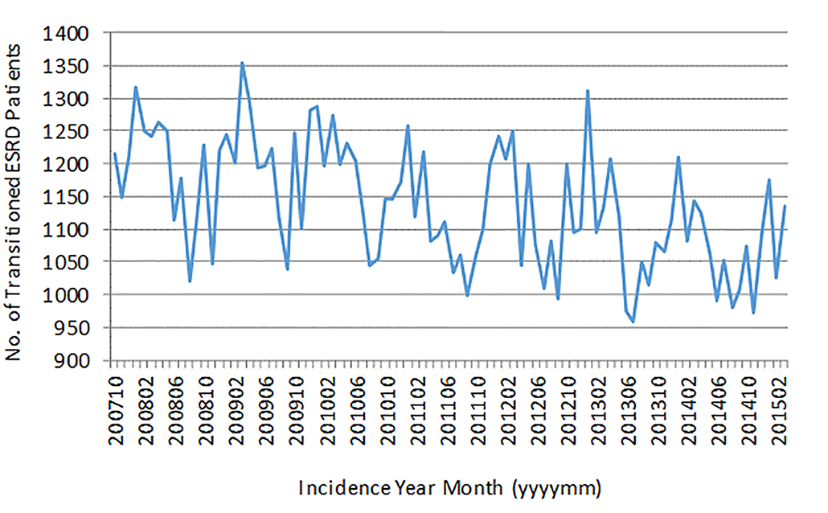
vol 1 Figure 9.14 Seasonal variations across secular trends in the frequency of transition to ESRD in 102,477 veterans between 10/1/2007-3/31/2015
(a) Frequency of patients transitioned to ESRD per month over 7.5 years
Data source: USRDS ESRD Database. Abbreviations: ESRD, end-stage renal disease; No., number.

Slide 22
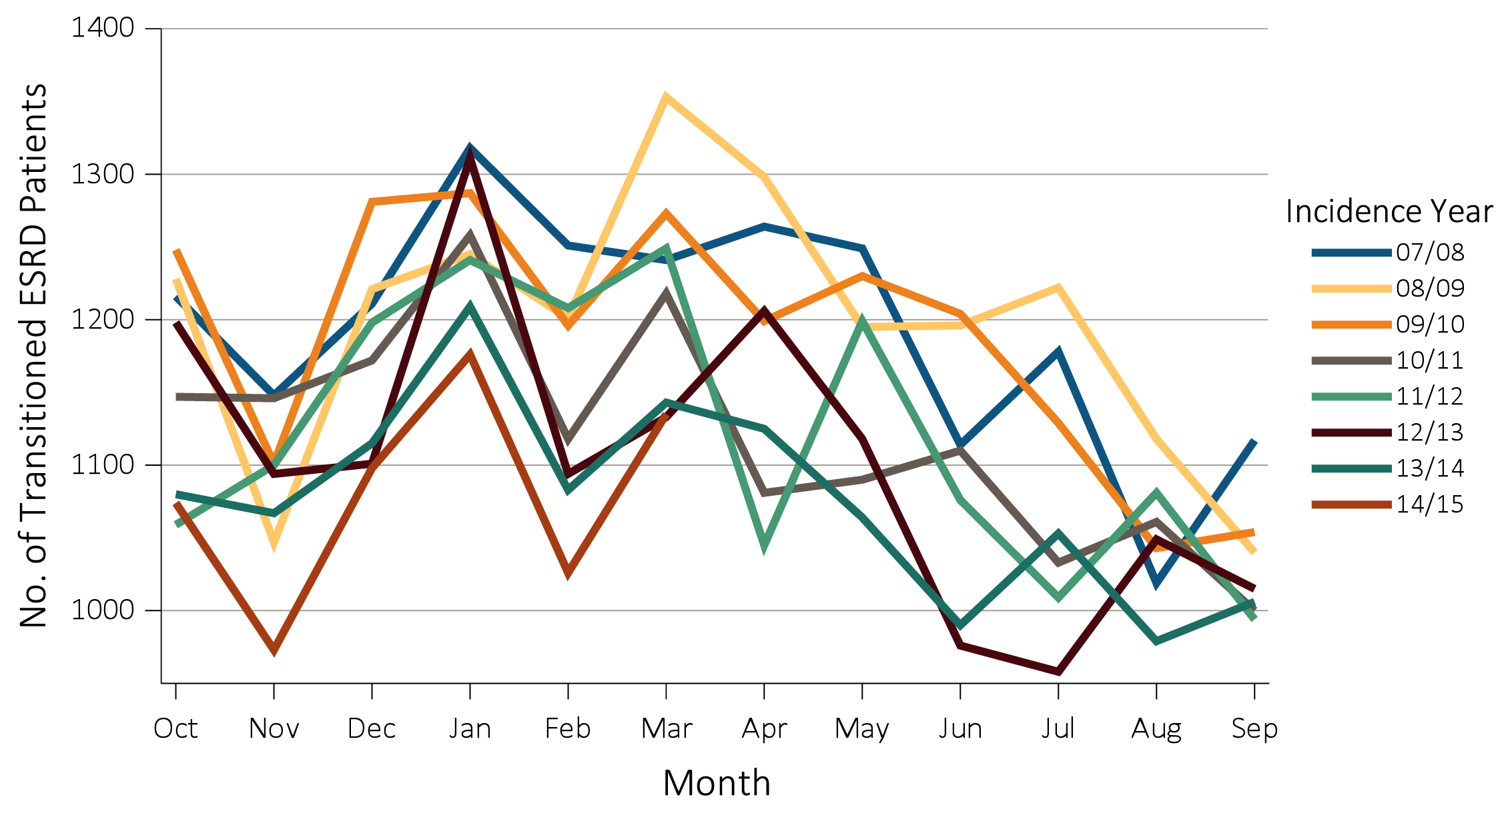
vol 1 Figure 9.14 Seasonal variations across secular trends in the frequency of transition to ESRD in 102,477 veterans between 10/1/2007-3/31/2015
(b) Frequency of patients transitioned to ESRD per month stratified by fiscal year
Data source: USRDS ESRD Database. Abbreviations: ESRD, end-stage renal disease; No., number.

Slide 23
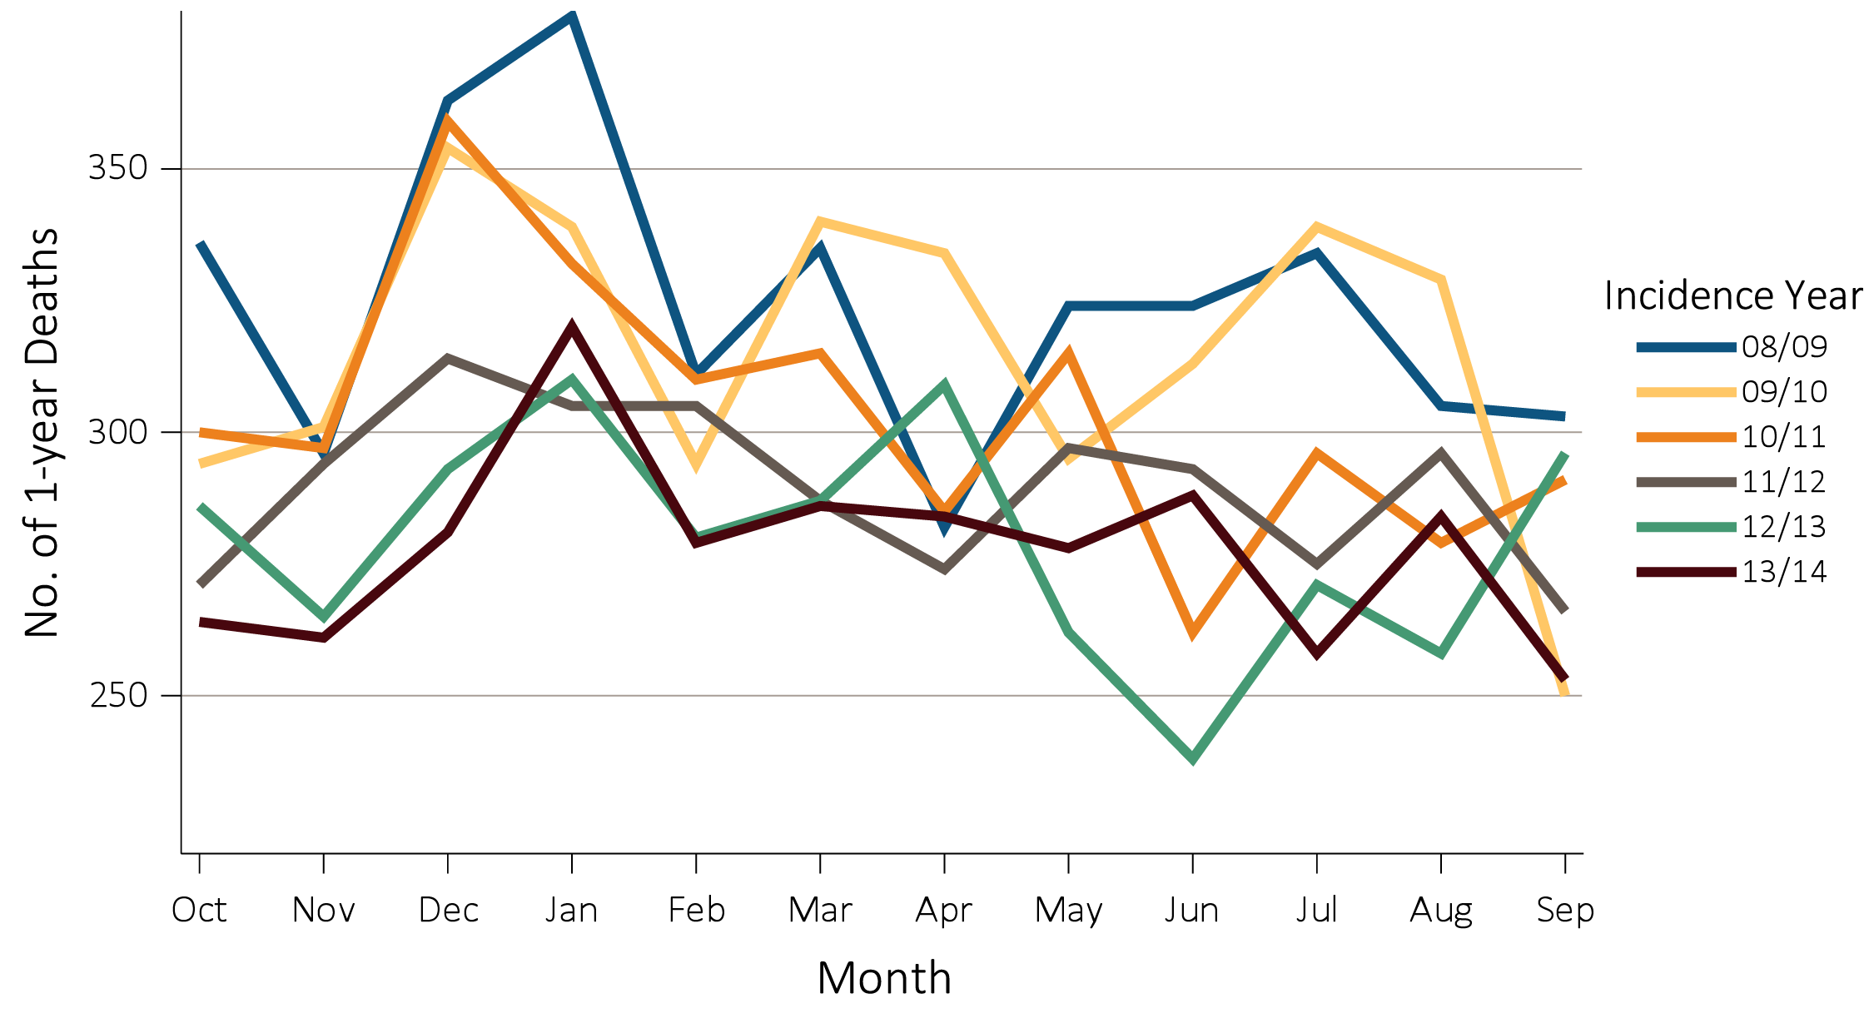
vol 1 Figure 9.15 Seasonal variations across secular trends for the one-year all-cause mortality frequency among 21,483 incident ESRD veterans who transitioned to ESRD between 10/1/2007-9/1/2014 and died between 10/1/2008 and 9/1/2014
Data source: USRDS ESRD Database. Abbreviations: ESRD, end-stage renal disease; No., number.

Slide 24
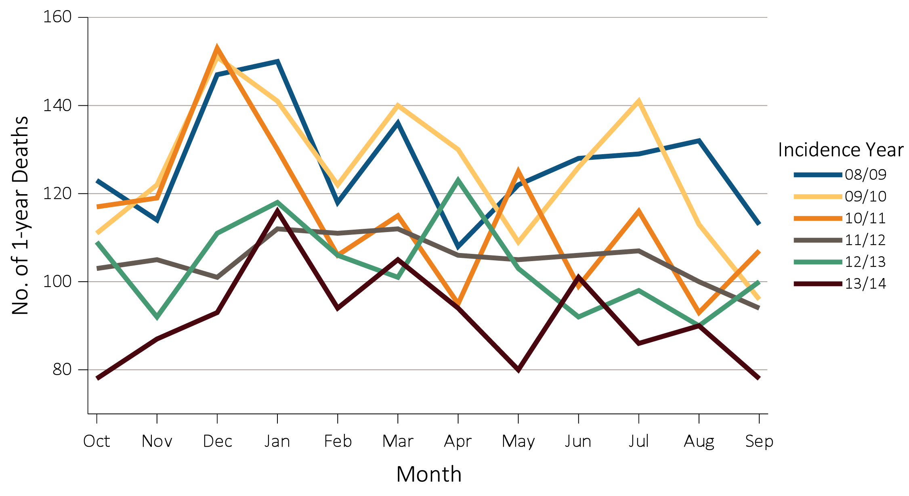
vol 1 Figure 9.16 Seasonal variations across secular trends for the one-year cardiovascular mortality frequency among 8,004 incident ESRD veterans who transitioned to ESRD between 10/1/2007-8/1/2013 and died from cardiovascular related causes between 10/1/2008 and 09/30/2014.
Data source: USRDS ESRD Database.
States of the United States of America.
Abbreviations: ESRD, end-stage renal disease; and No., number.

Slide 25
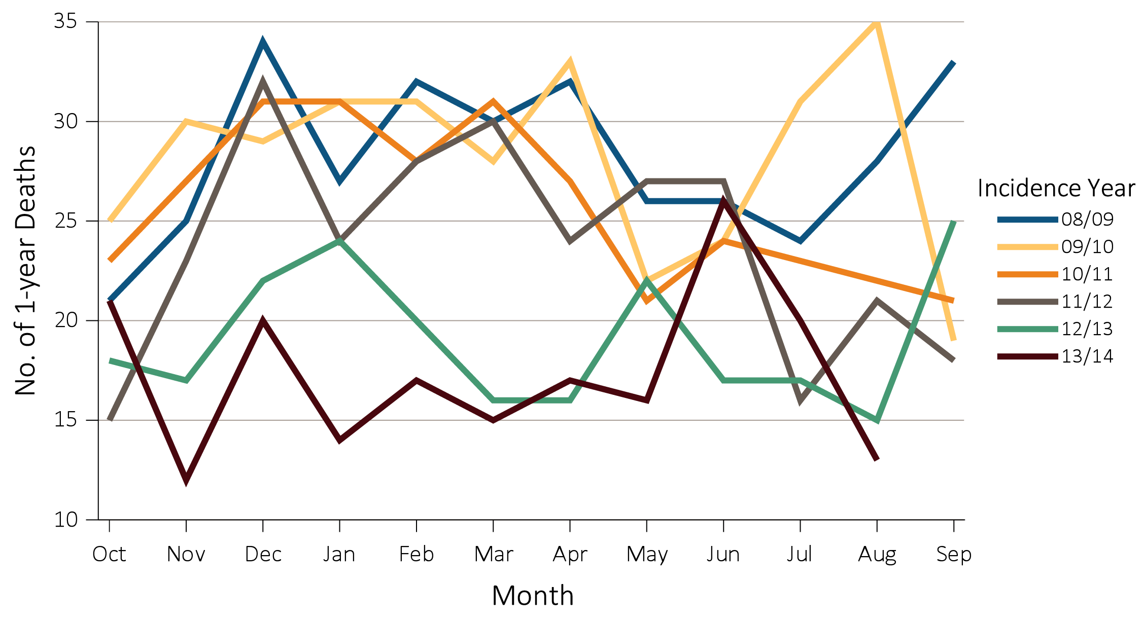
vol 1 Figure 9.17 Seasonal variations across secular trends for the one-year infection-related mortality frequency among 1,690 incident ESRD veterans who transitioned to ESRD between 10/1/2007-8/1/2013 and died from infection-related causes between 10/1/2008 and 8/31/2014*
Data source: USRDS ESRD Database. *Values for 10 or fewer patients are suppressed. Abbreviations: ESRD, end-stage renal disease; No., number.

Slide 26
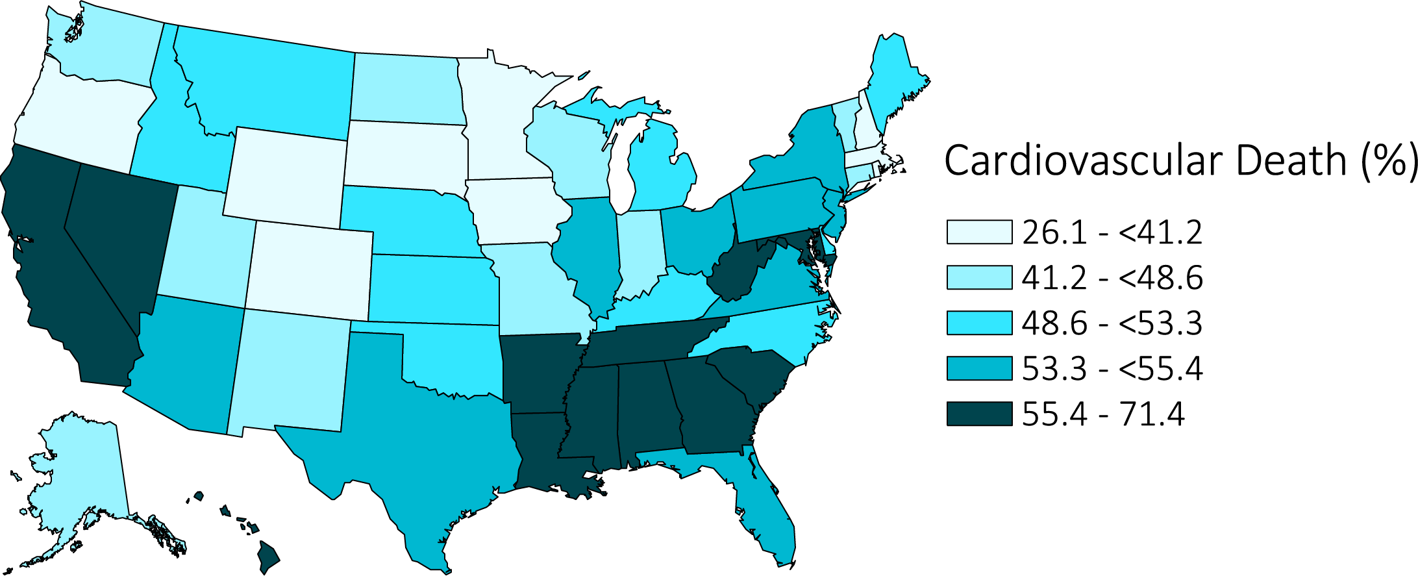
vol 1 Figure 9.18 Distribution of proportion of deaths in the first year post-transition to ESRD and between 10/1/2007-8/1/2015 attributed to cardiovascular causes among 18,492 incident ESRD veterans across the United States 10/1/2007-3/31/2015
Data source: VHA, CMS, and USRDS ESRD Databases. Abbreviation: ESRD, end-stage renal disease.

Slide 27
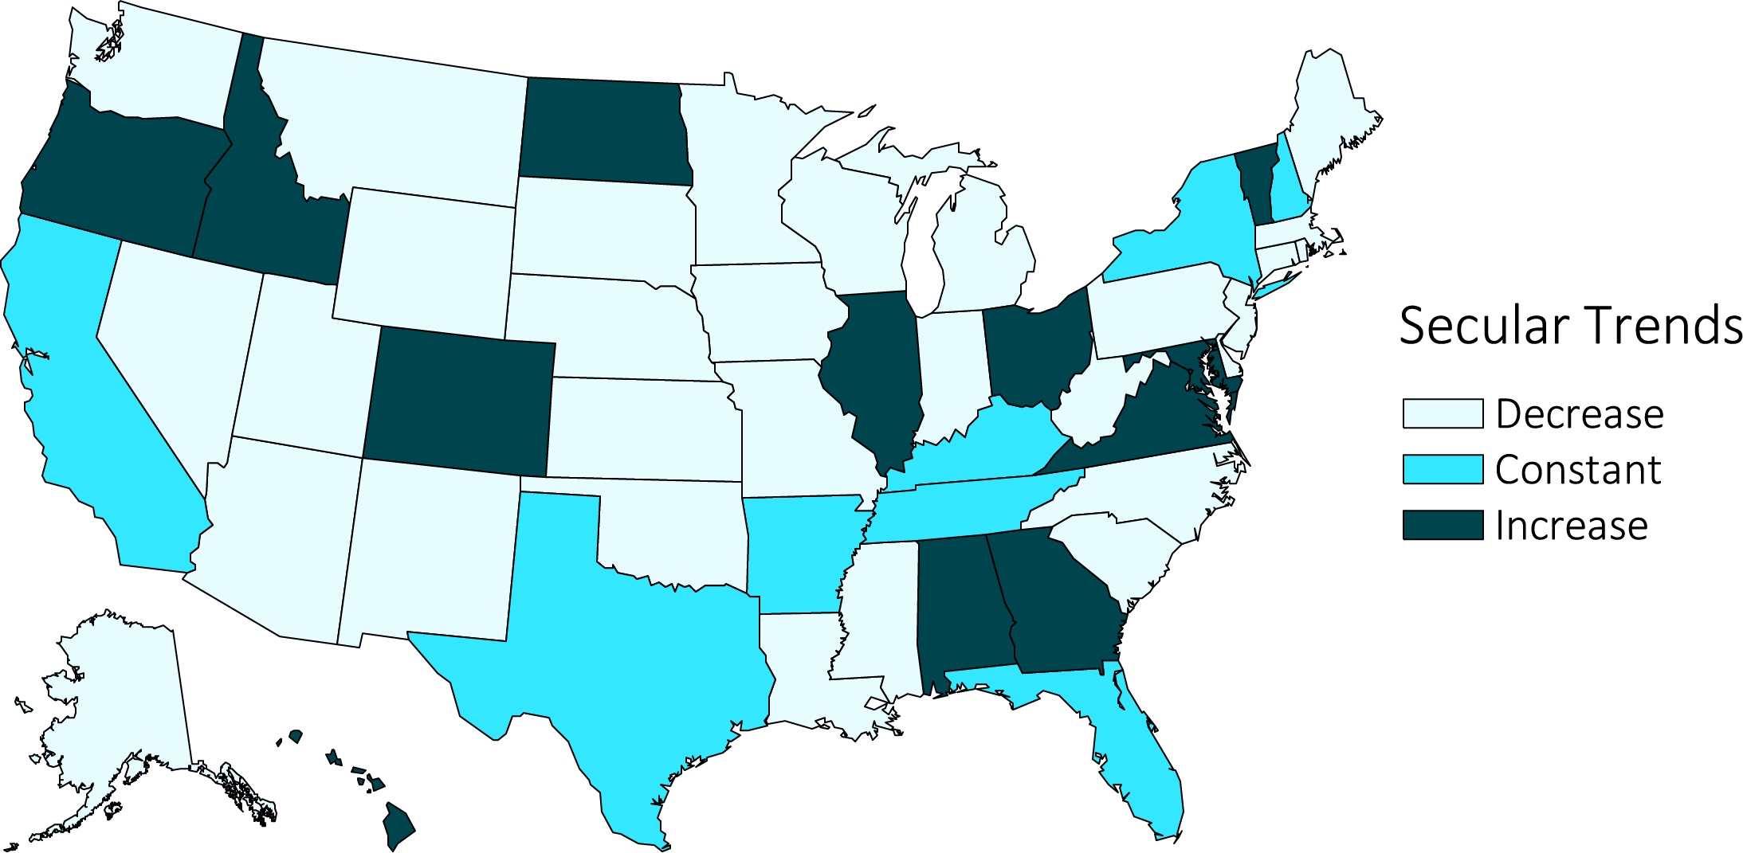
vol 1 Figure 9.19 Secular trends in the proportion of deaths in the first year post-transition to ESRD attributed to cardiovascular causes among 18,492 incident ESRD veterans who died between 10/1/2007-8/1/2015 and transitioned to ESRD across the United States, 10/1/2007-3/31/2015
Data source: VHA, CMS, and USRDS ESRD Databases. Decrease: ≤-0.01; Constant: <-0.01 to ≤0.01; Increase: >0.01 (% per year). Abbreviation: ESRD, end-stage renal disease.

Slide 28
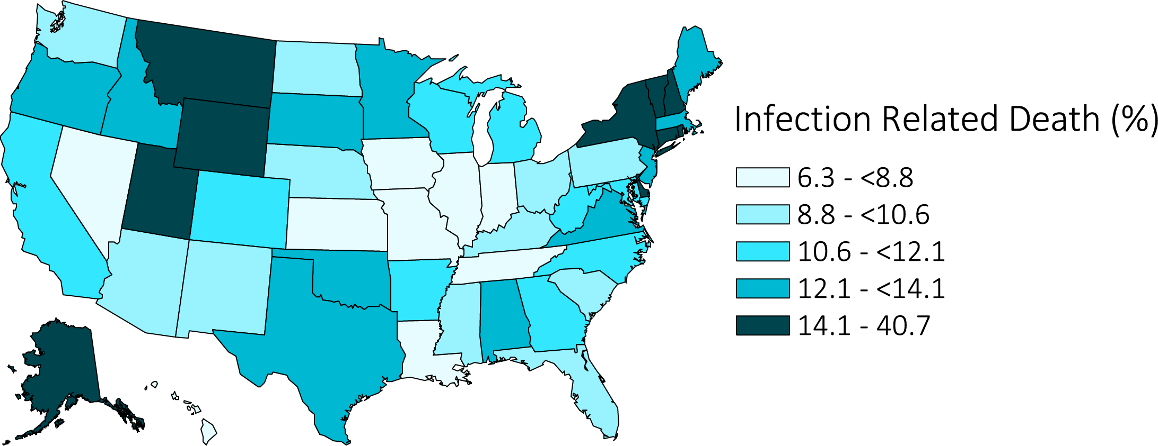
vol 1 Figure 9.20 Distribution of proportion of deaths in the first year post-ESRD transition attributed to infection-related causes among 18,492 incident ESRD veterans who died between 10/1/2007-8/1/2015 and transitioned to ESRD across the United States, 10/1/2007-3/31/2015
Data source: VHA, CMS, and USRDS ESRD Databases. Abbreviation: ESRD, end-stage renal disease.

Slide 29
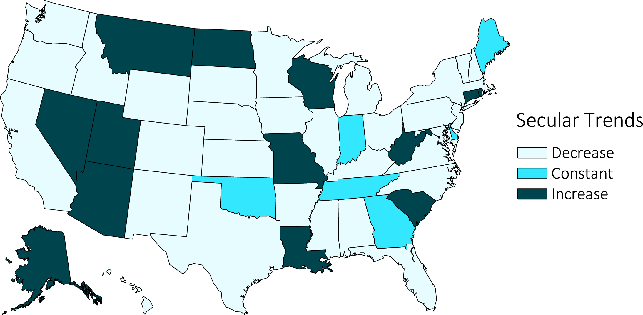
vol 1 Figure 9.21 Secular trends in the proportion of deaths in the first year post-ESRD transition attributed to infection-related causes among 18,492 incident ESRD veterans who died between 10/1/2007-8/1/2015 and transitioned to ESRD across the United States, 10/1/2007-3/31/2015
Data source: VHA, CMS, and USRDS ESRD Databases. Decrease: ≤-0.01; Constant: <-0.01 to ≤0.01; Increase: >0.01 (% per year). Abbreviation: ESRD, end-stage renal disease.

Slide 30
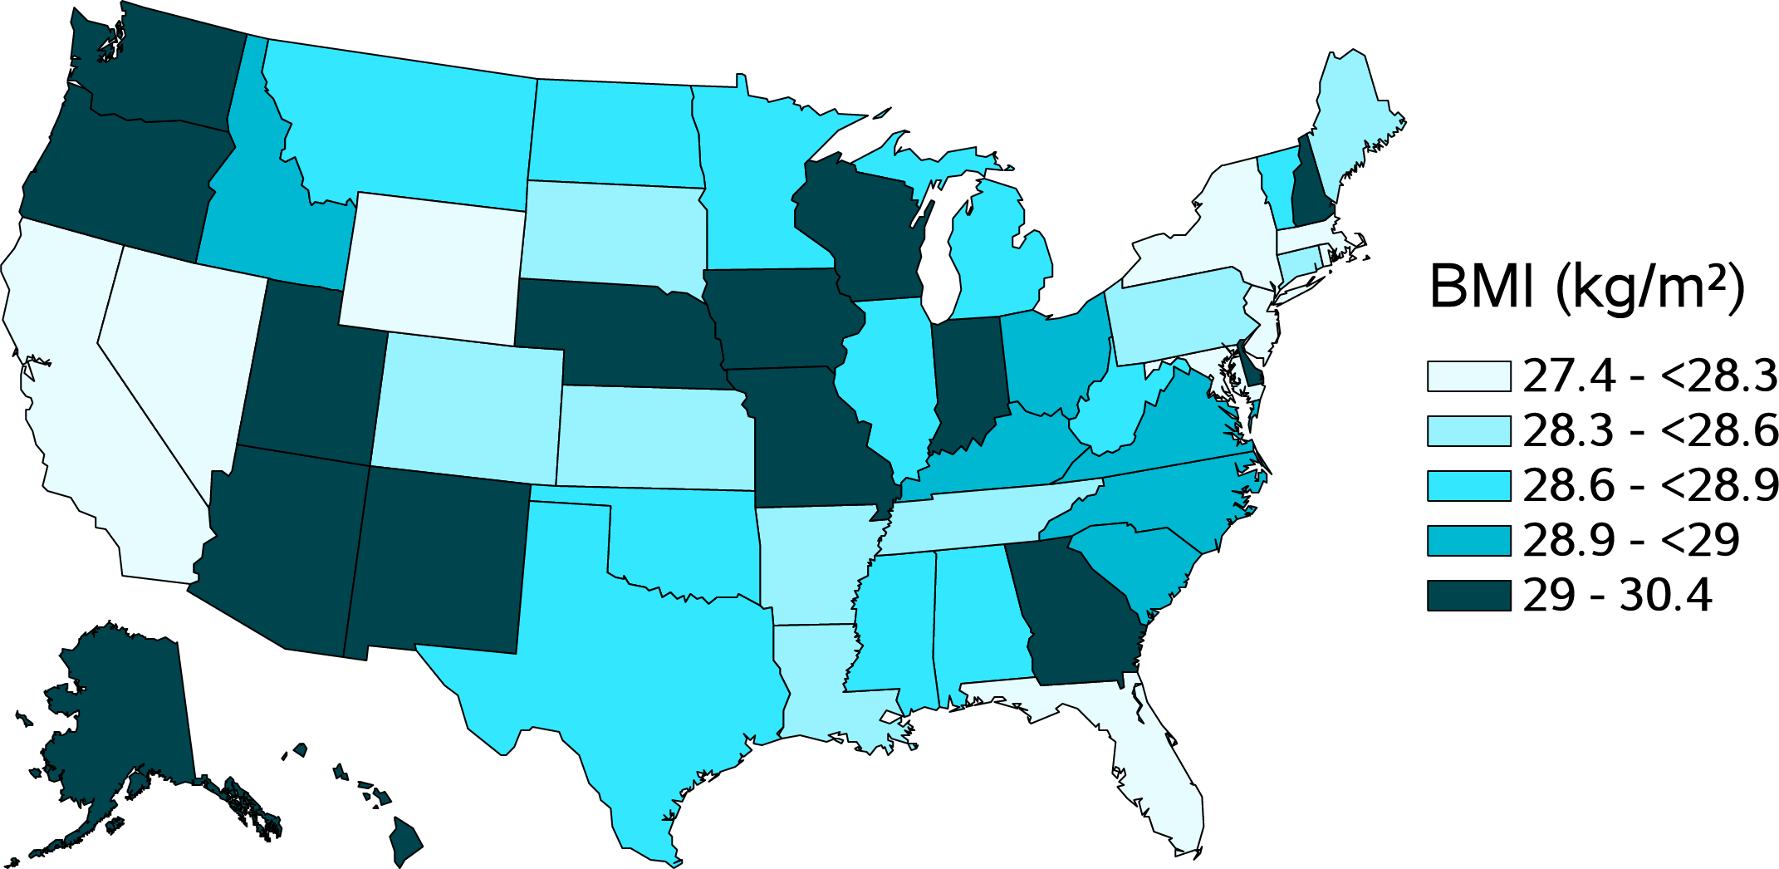
vol 1 Figure 9.22 Distribution of mean body mass index (BMI) levels at transition to ESRD among 98,701 incident ESRD veterans across the United States, 10/1/2007-3/31/2015
Data source: USRDS ESRD Database. Abbreviations: ESRD, end-stage renal disease; BMI, body mass index; kg, kilogram; m, meter.

Slide 31
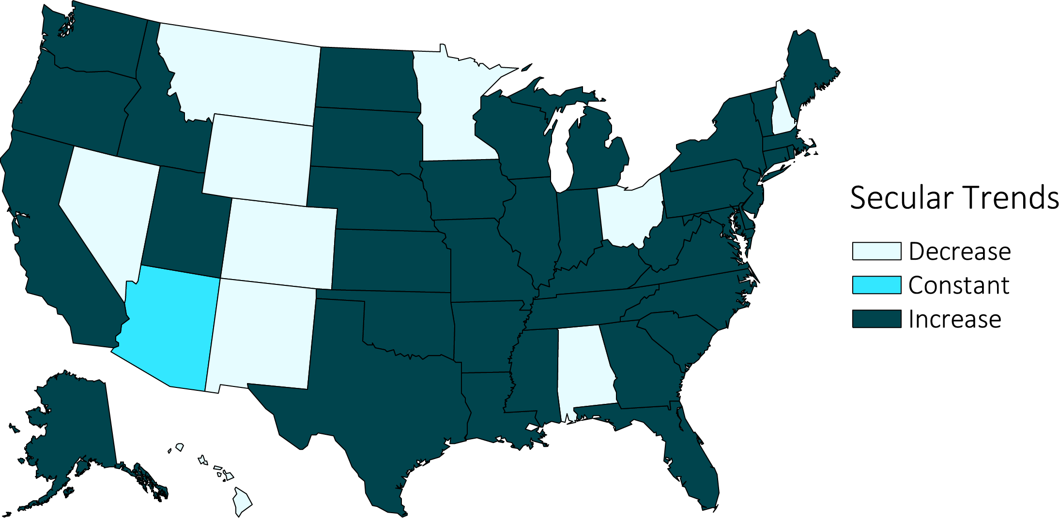
vol 1 Figure 9.23 Secular trends in the mean body mass index (BMI) level among 98,701 incident ESRD veterans across the United States, 10/1/2007-3/31/2015 (For decomposition by racial/ethnic categories, see Figures 9.25, 9.27, and 9.29)
Data source: USRDS ESRD Database. Decrease: ≤-0.01; Constant: <-0.01 to ≤0.01; Increase: >0.01 (kg/m² per year). Abbreviations: ESRD, end-stage renal disease; BMI, body mass index; kg, kilogram; m, meter.

Slide 32
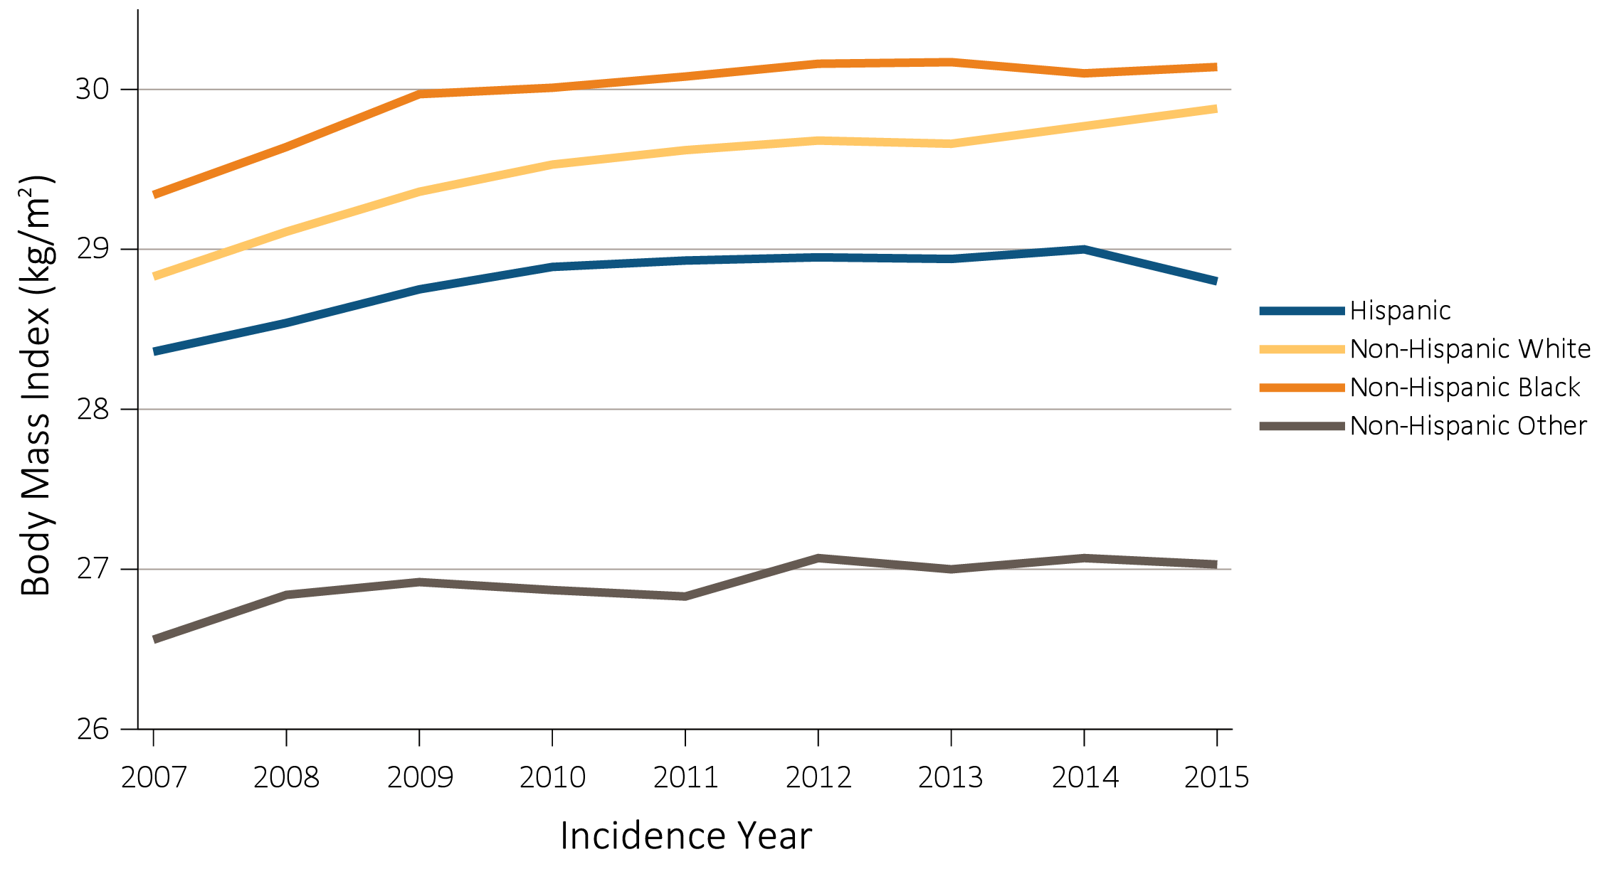
vol 1 Figure 9.24 Secular trends in mean body mass index (BMI) across racial/ethnic groups in 98,704 veterans and 838,511 total USRDS patients transitioning to ESRD, 10/1/2007-3/31/2015
(a) USRDS cohort
Data source: USRDS ESRD Database. Abbreviations: ESRD, end-stage renal disease; kg, kilogram; m, meter.

Slide 33
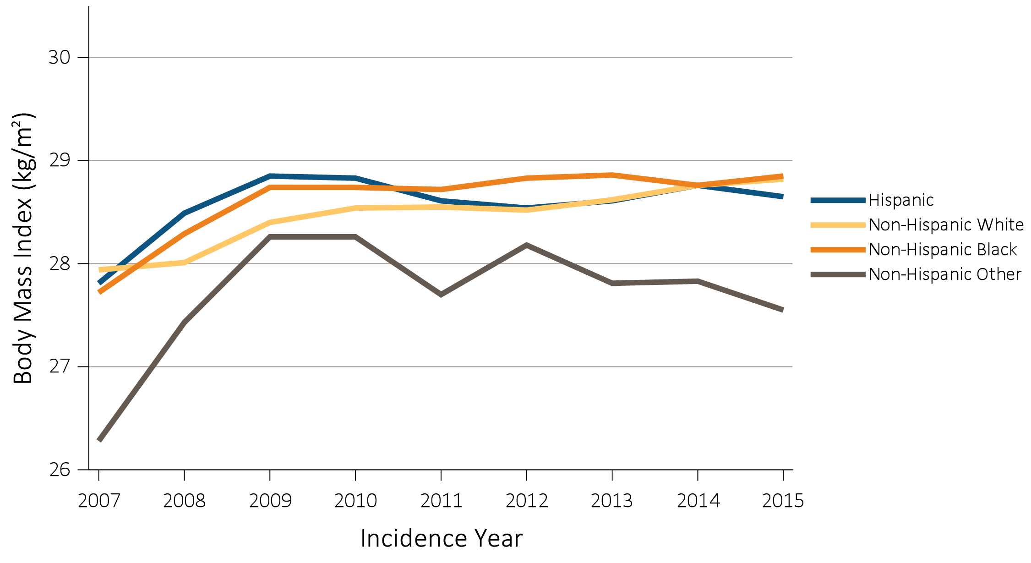
vol 1 Figure 9.24 Secular trends in mean body mass index (BMI) across racial/ethnic groups in 98,704 veterans and 838,511 total USRDS patients transitioning to ESRD, 10/1/2007-3/31/2015
(b) TC-CKD cohort

Slide 34
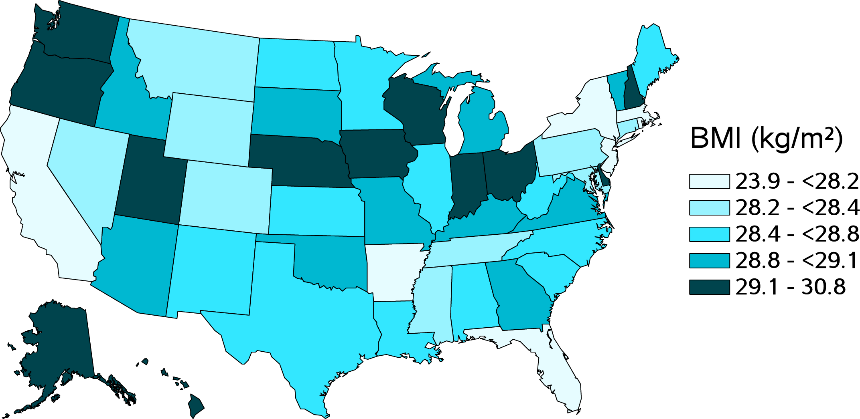
vol 1 Figure 9.25 Distribution of mean body mass index (BMI) levels at transition to ESRD among 64,289 Non-Hispanic White incident ESRD veterans across the United States, 10/1/2007-3/31/2015
Data source: USRDS ESRD Database. Abbreviations: ESRD, end-stage renal disease; BMI, body mass index; kg, kilogram; m, meter.

Slide 35
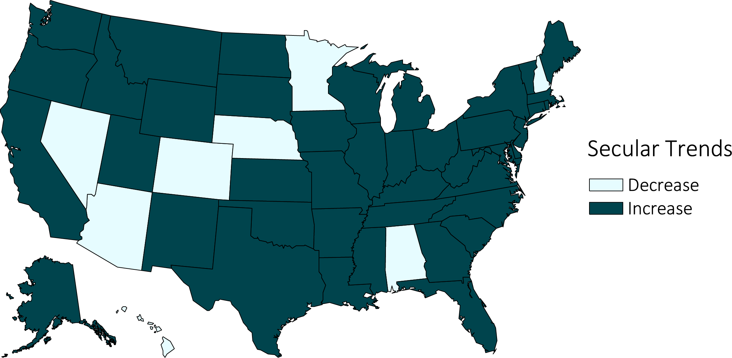
vol 1 Figure 9.26 Secular trends in the mean body mass index (BMI) level among 64,289 Non-Hispanic White incident ESRD veterans across the United States, 10/1/2007-3/31/2015
Data source: USRDS ESRD Database. Decrease: ≤-0.01; Constant: <-0.01 to ≤0.01; Increase: >0.01 (kg/m² per year). Abbreviations: ESRD, end-stage renal disease; BMI, body mass index; kg, kilogram; m, meter.

Slide 36
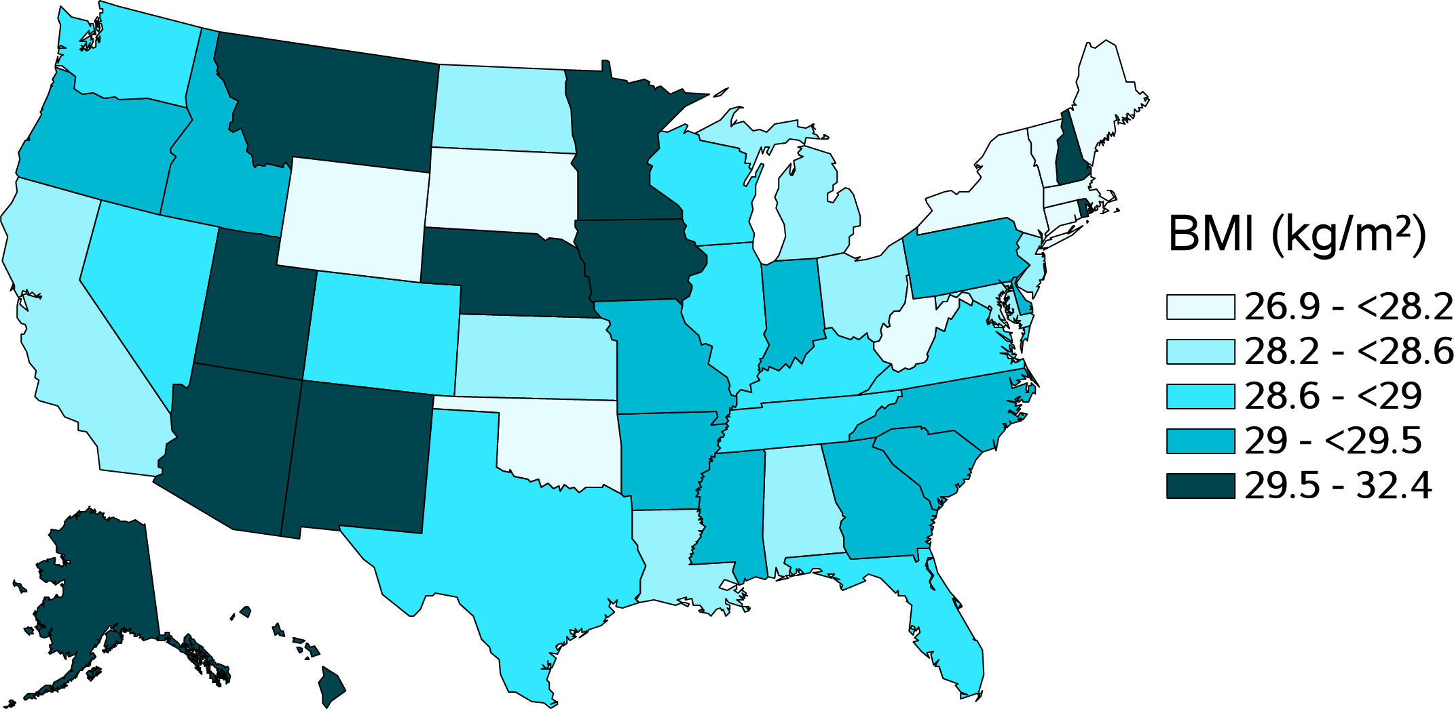
vol 1 Figure 9.27 Distribution of mean body mass index (BMI) levels at transition to ESRD among 24,543 Non-Hispanic Black incident ESRD veterans across the United States, 10/1/2007-3/31/2015
Data source: USRDS ESRD Database. Abbreviations: ESRD, end-stage renal disease; BMI, body mass index; kg, kilogram; m, meter.

Slide 37
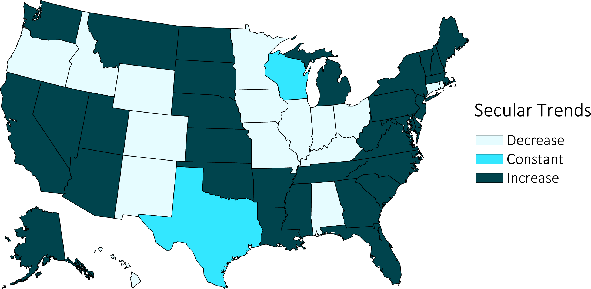
vol 1 Figure 9.28 Secular trends in the mean body mass index (BMI) level among 24,543 Non-Hispanic Black incident ESRD veterans across the United States, 10/1/2007-3/31/2015
Data source: USRDS ESRD Database. Decrease: ≤-0.01; Constant: <-0.01 to ≤0.01; Increase: >0.01 (kg/m² per year). Abbreviations: ESRD, end-stage renal disease; BMI, body mass index; kg, kilogram; m, meter.

Slide 38
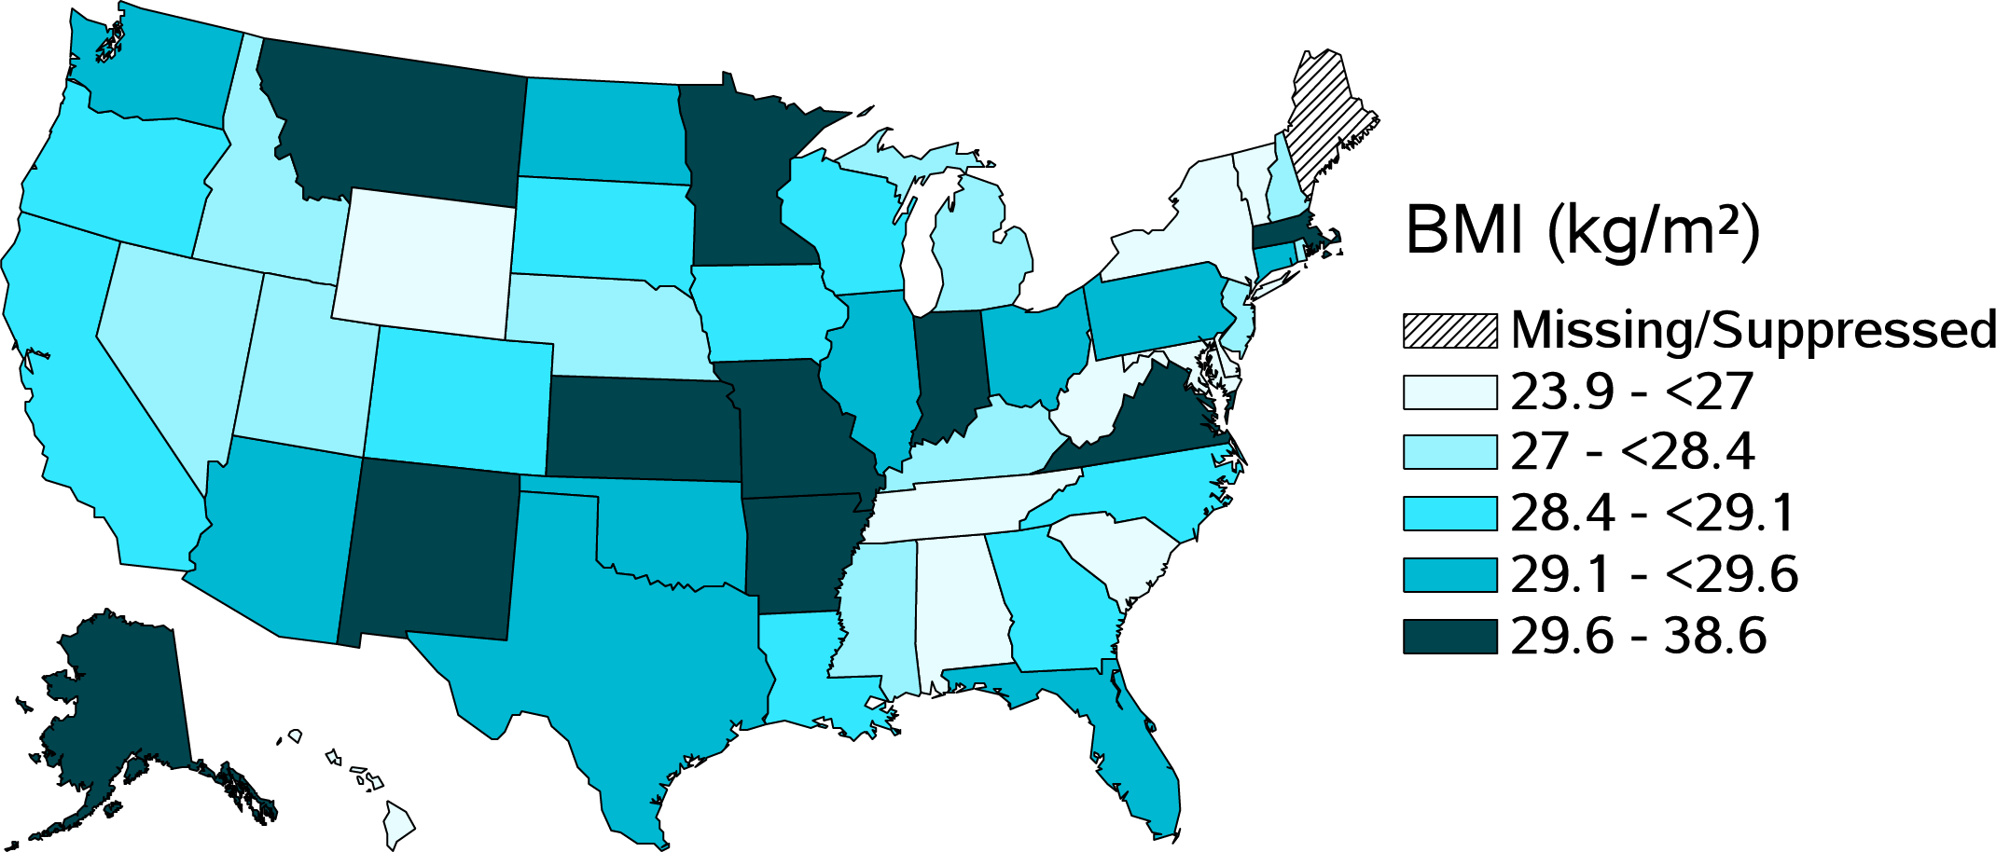
vol 1 Figure 9.29 Distribution of mean body mass index (BMI) levels at transition to ESRD among 6,412 Hispanic incident ESRD veterans across the United States, 10/1/2007-3/31/2015
Data source: USRDS ESRD Database. Abbreviations: ESRD, end-stage renal disease; BMI, body mass index; kg, kilogram; m, meter.

Slide 39
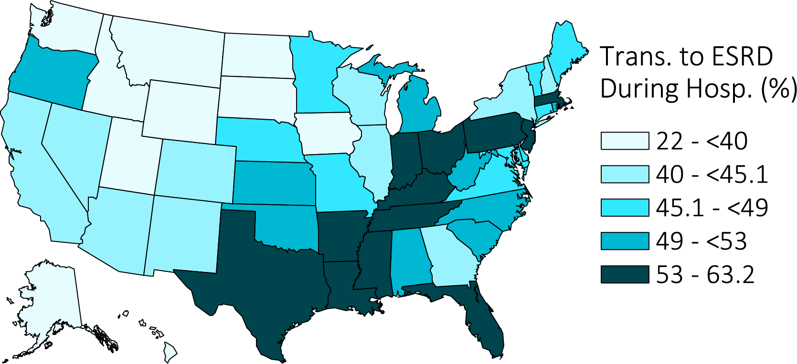
vol 1 Figure 9.30. Distribution of proportion of veterans transitioning to ESRD during a Hospitalization Admission among 102,477 incident ESRD veterans across the United States, 10/1/2007-3/31/2015
Data source: VHA, CMS, and USRDS ESRD Databases. Abbreviations: ESRD, end-stage renal disease; Trans., transition; Hosp., hospitalization.

Slide 40
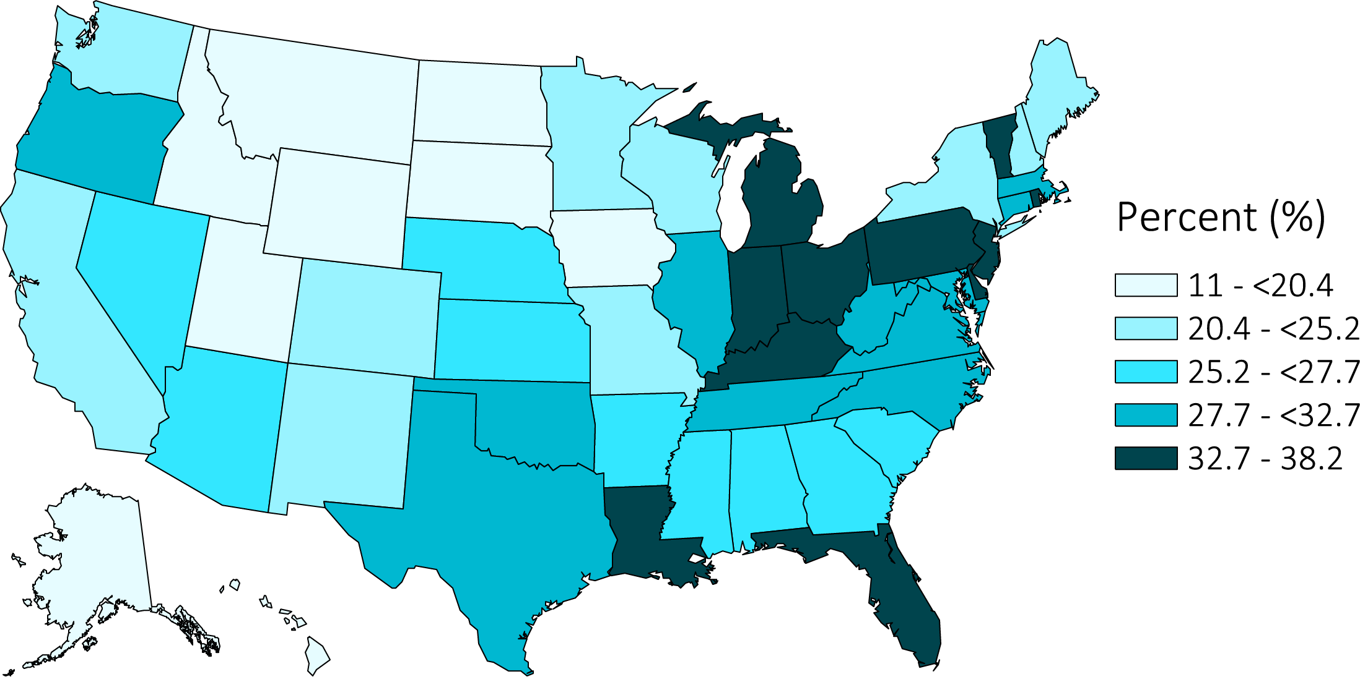
vol 1 Figure 9.31 Distribution of proportion of veterans with a hospitalization for acute kidney injury in the year prior to transition across the United States among 84,799 incident ESRD veterans with information in the year prior to transition, 10/1/2007-3/31/2015
Data source: VHA, CMS, and USRDS ESRD Databases. Abbreviation: ESRD, end-stage renal disease.

Slide 41
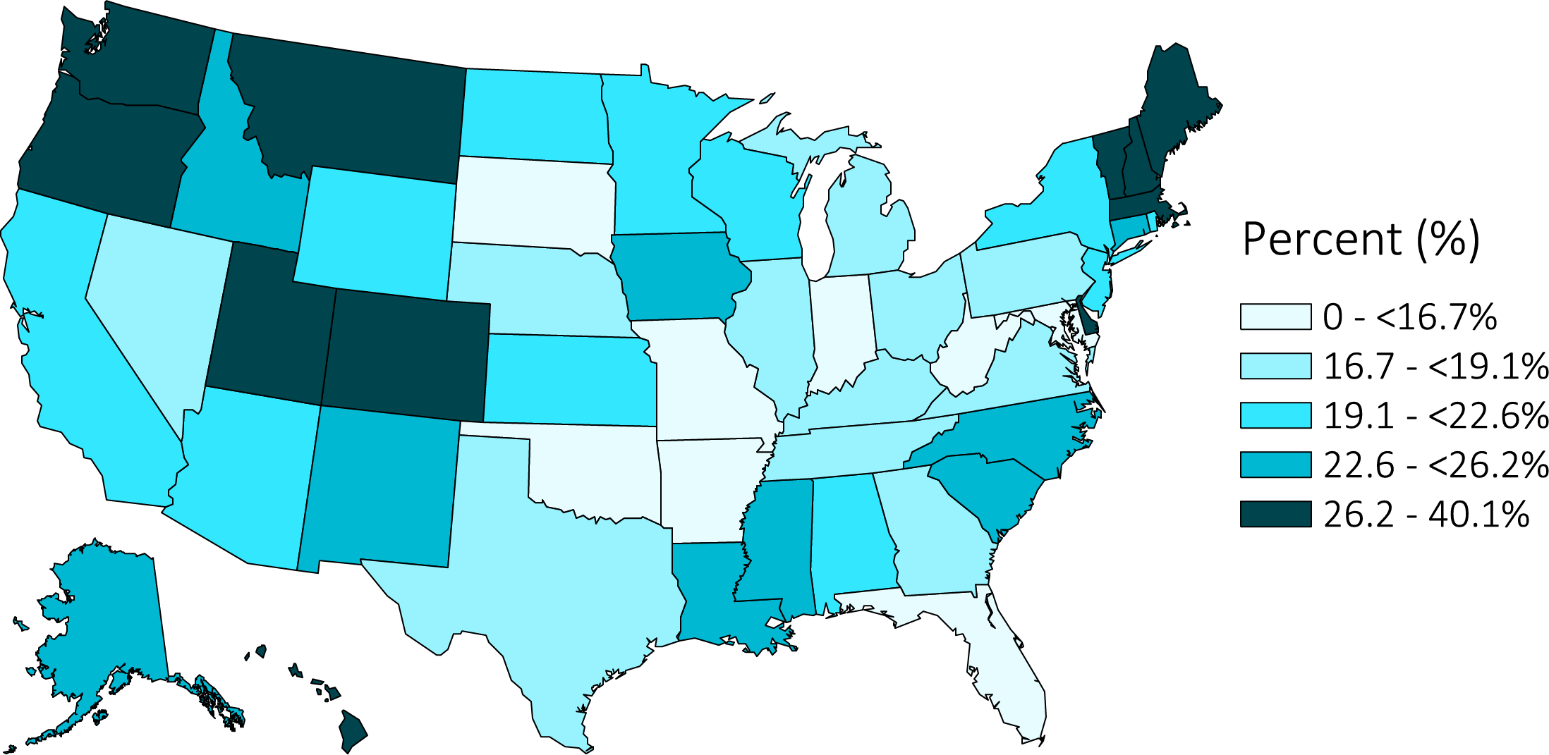
vol 1 Figure 9.32 Distribution of proportion of veterans with an AV fistula as initial access type across the United States among 102,477 incident ESRD veterans, 10/1/2007-3/31/2015
Data source: USRDS ESRD Database. Abbreviations: ESRD, end-stage renal disease; AV, arteriovenous.

Slide 42
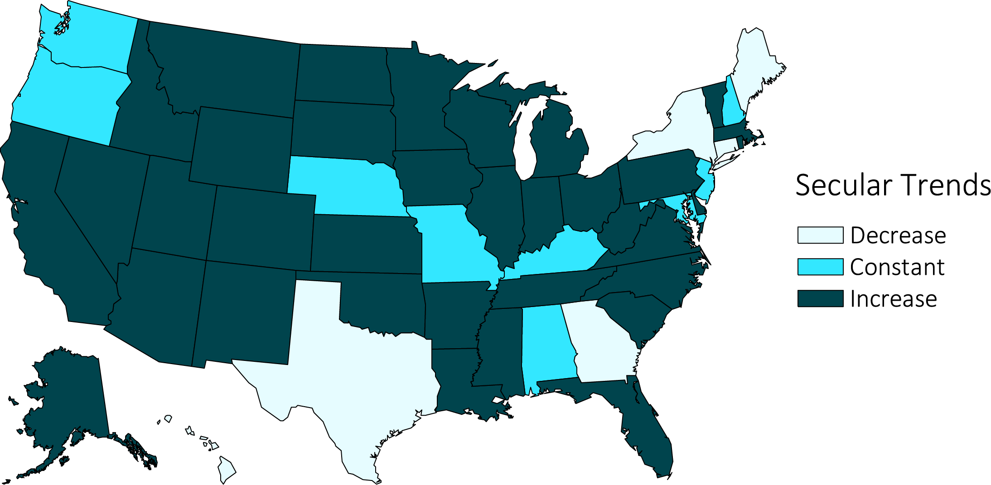
vol 1 Figure 9.33 Secular trends in the proportion of veterans with an AV fistula as initial access type across the United States among 102,477 incident ESRD veterans, between 10/1/2007-3/31/2015
Data source: USRDS ESRD Database. Decrease: ≤-0.01; Constant: <-0.01 to ≤0.01; Increase: >0.01 (% per year). Abbreviations: ESRD, end-stage renal disease; AV, arteriovenous.

Slide 43
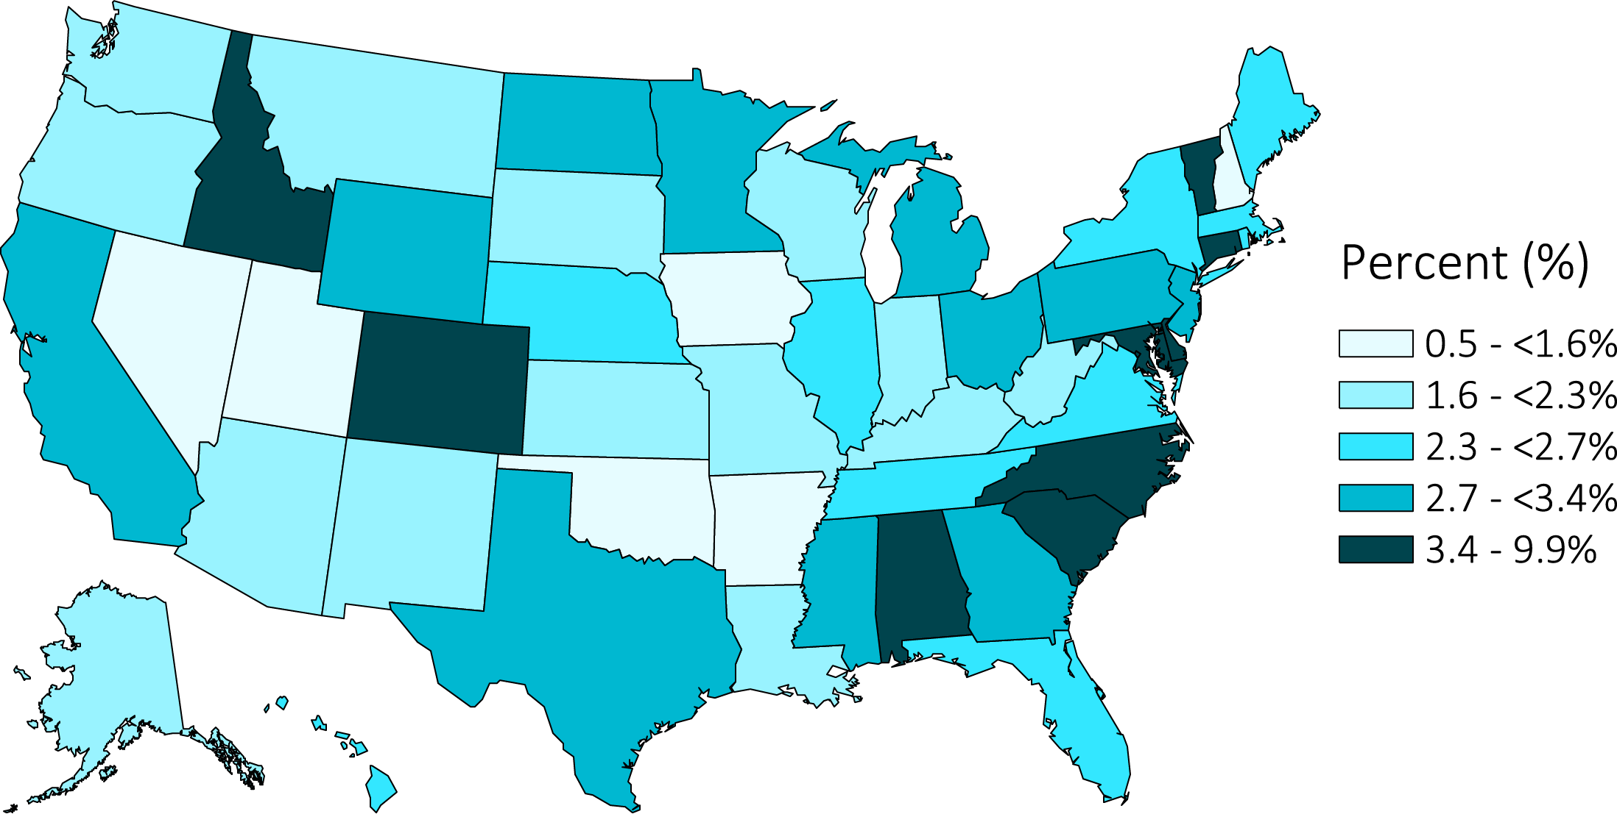
vol 1 Figure 9.34 Distribution of proportion of veterans with an AV graft as initial access type across the United States among 102,477 incident ESRD veterans, 10/1/2007-3/31/2015
Data source: USRDS ESRD Database. Abbreviations: ESRD, end-stage renal disease; AV, arteriovenous.

Slide 44
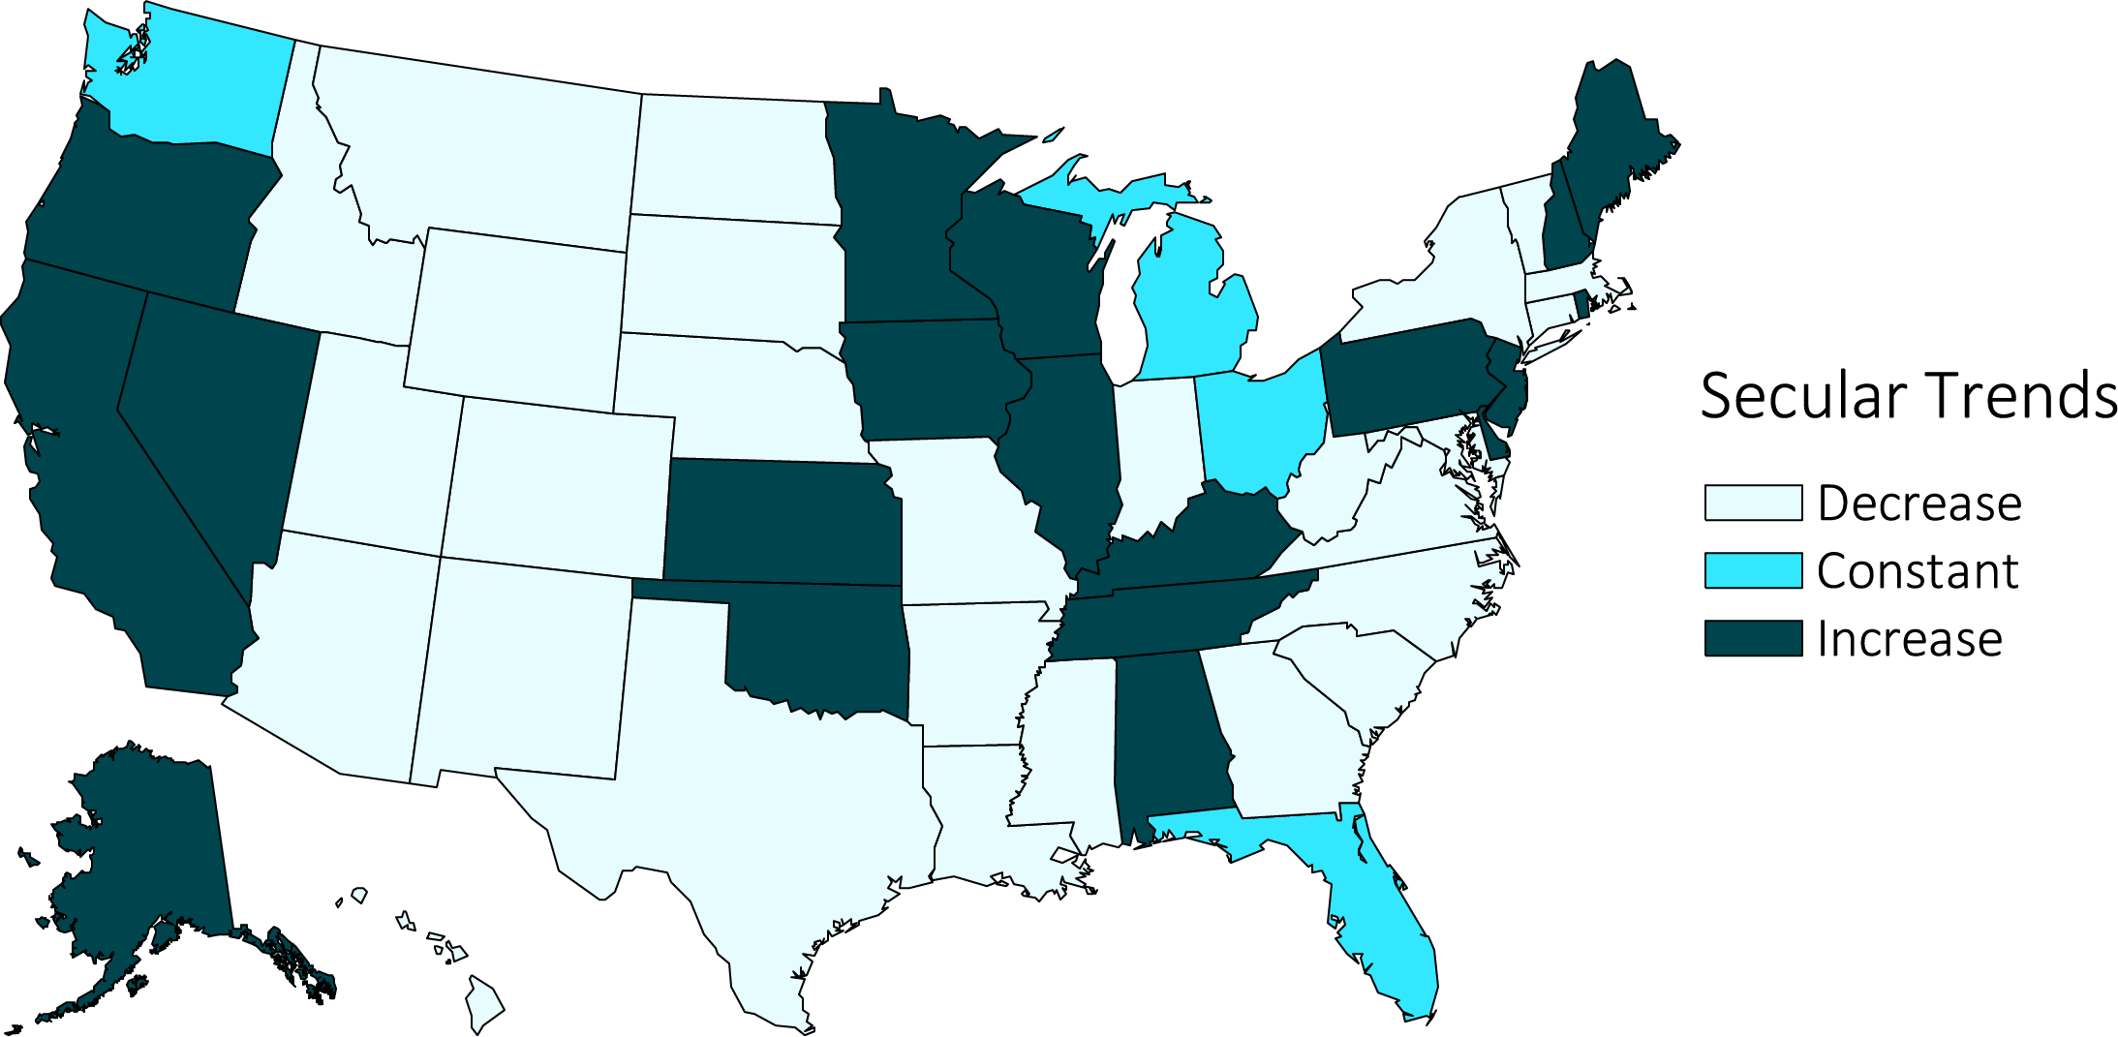
vol 1 Figure 9.35 Secular trends in the proportion of veterans with an AV graft as initial access type across the United States among 102,477 incident ESRD veterans, between 10/1/2007-3/31/2015
Data source: USRDS ESRD Database. Decrease: ≤-0.01; Constant: <-0.01 to ≤0.01; Increase: >0.01 (% per year). Abbreviations: ESRD, end-stage renal disease; AV, arteriovenous.

Slide 45
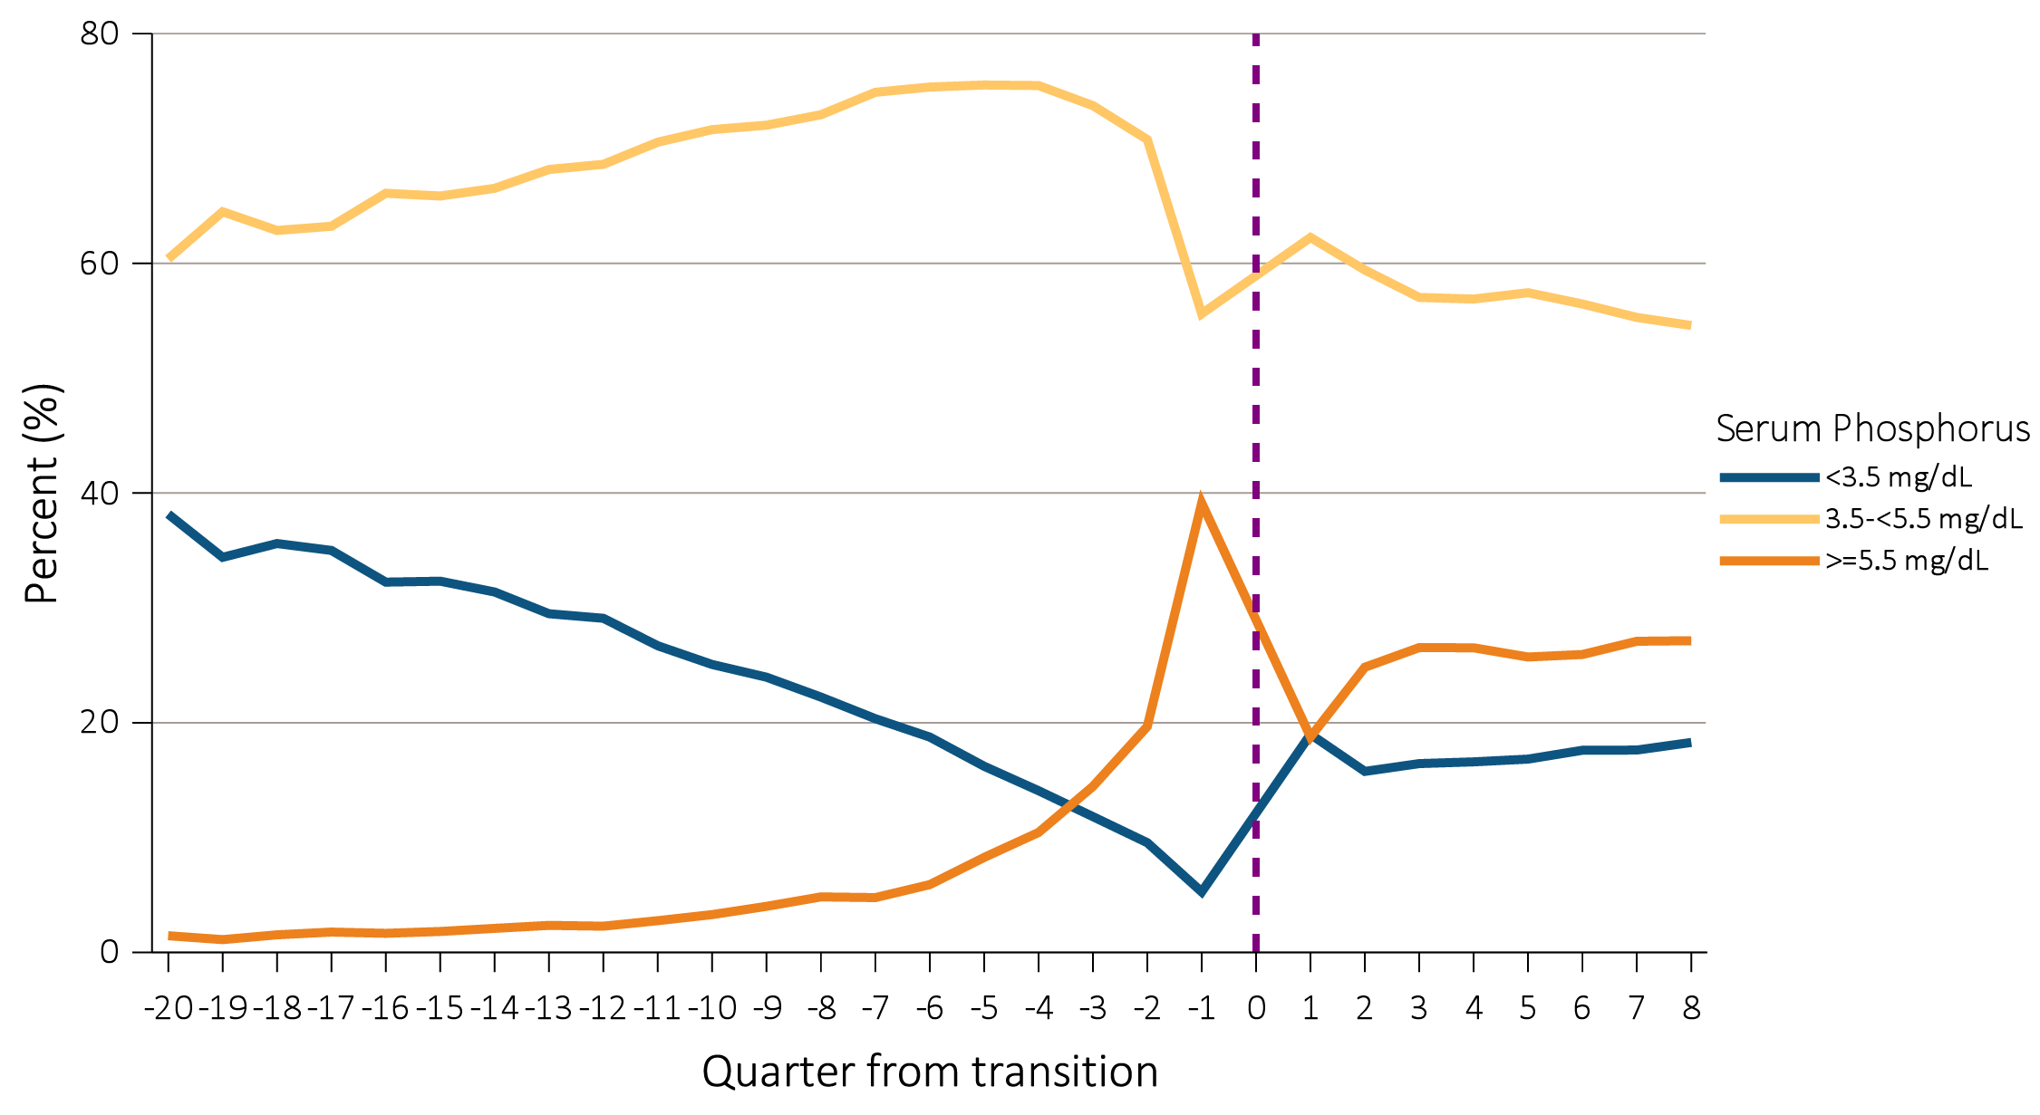
vol 1 Figure 9.36 Trend in serum phosphorus level categories up to 5 years prior and 2 years post-transition in 36,621 veterans who transitioned to ESRD during 10/1/2007-3/31/2015
Data source: VHA data. Abbreviations: ESRD, end-stage renal disease; mg/dL, milligrams per deciliter.

Slide 46
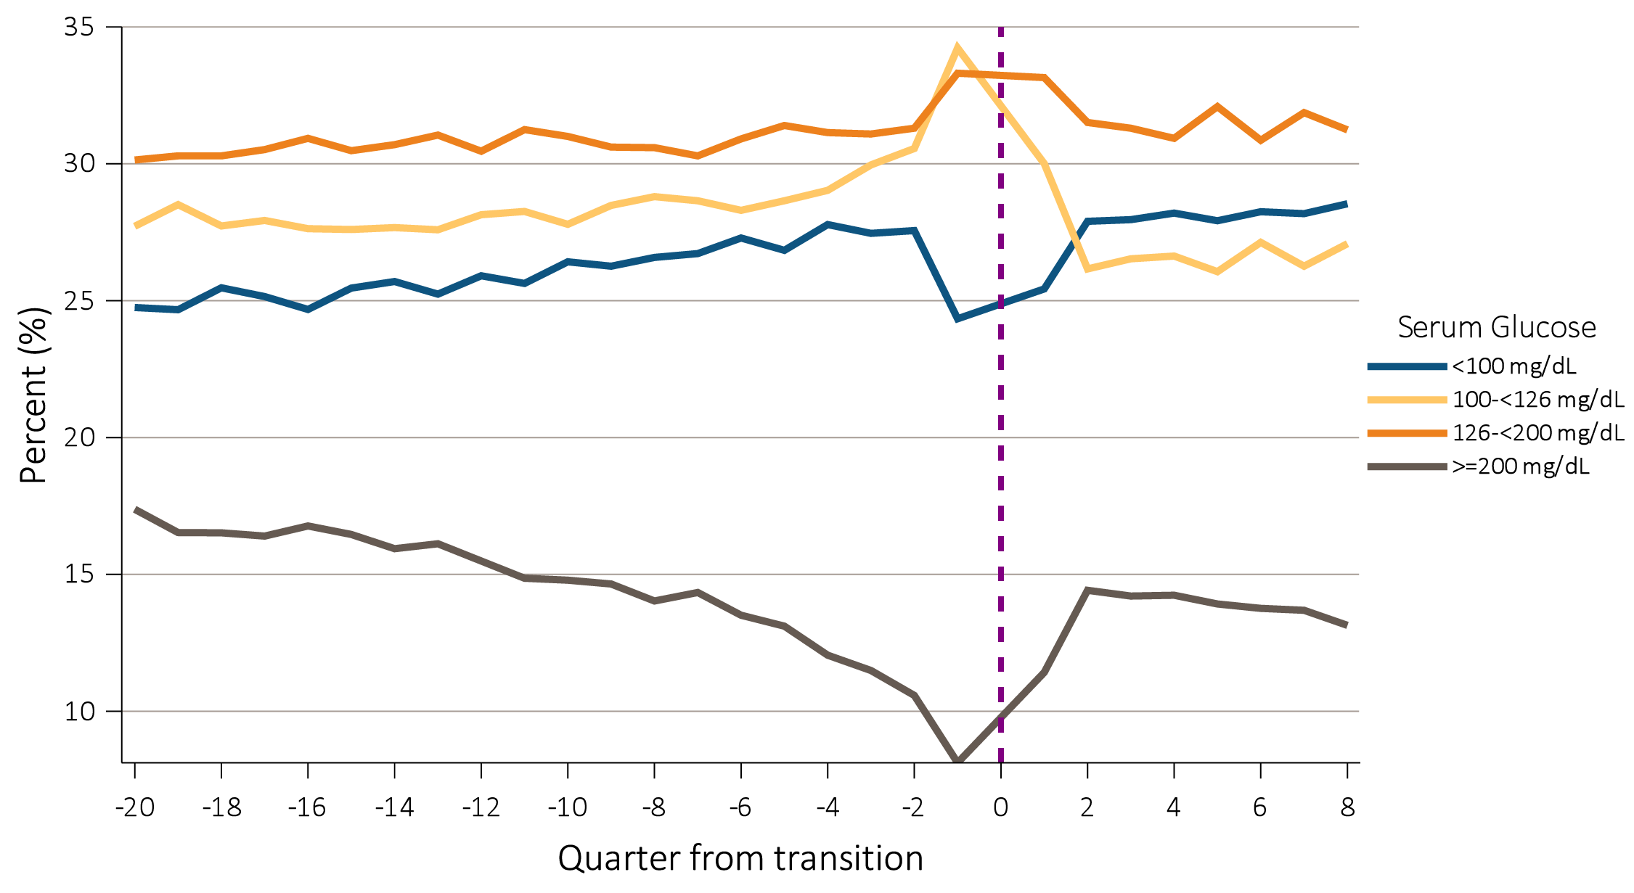
vol 1Figure 9.37 Trend in serum glucose level categories up to 5 years prior and 2 years post-transition in 61,730 veterans who transitioned to ESRD during 10/1/2007-3/31/2015
Data source: VHA data. Abbreviations: ESRD, end-stage renal disease; mg/dL, milligrams per deciliter.

Slide 47
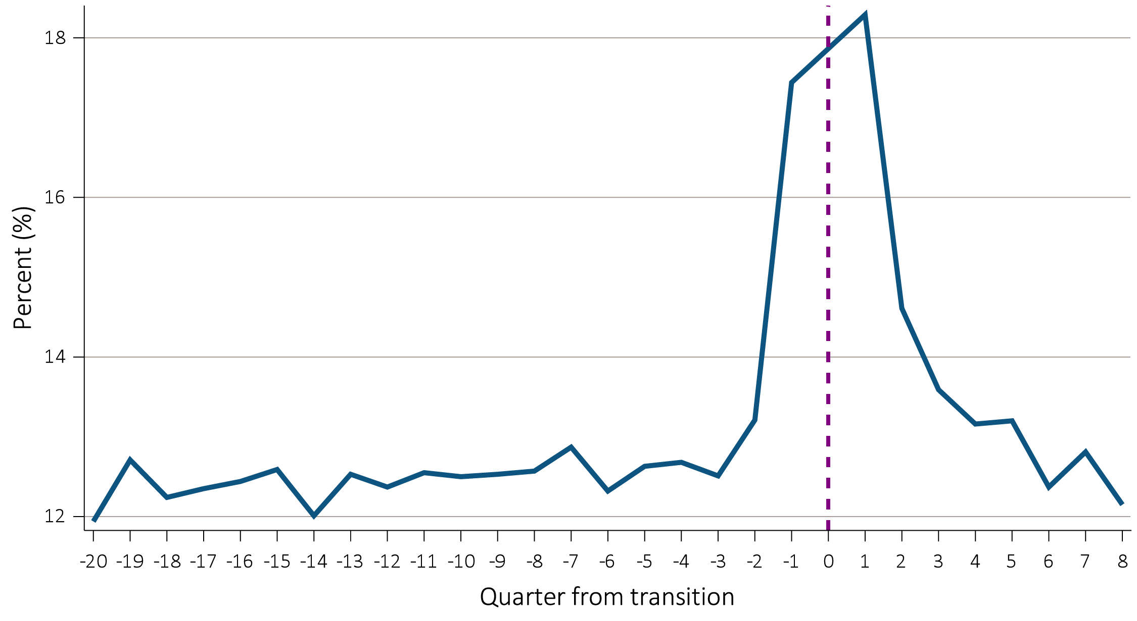
vol 1 Figure 9.38 Trend in proportion of U.S. veteran patients with serum white blood cell count >10 x 10³/µL up to 5 years prior and 2 years post-transition in 60,036 veterans who transitioned to ESRD during 10/1/2007-3/31/2015
Data source: VHA data. Abbreviations: ESRD, end-stage renal disease; µL, microliter.

Slide 48
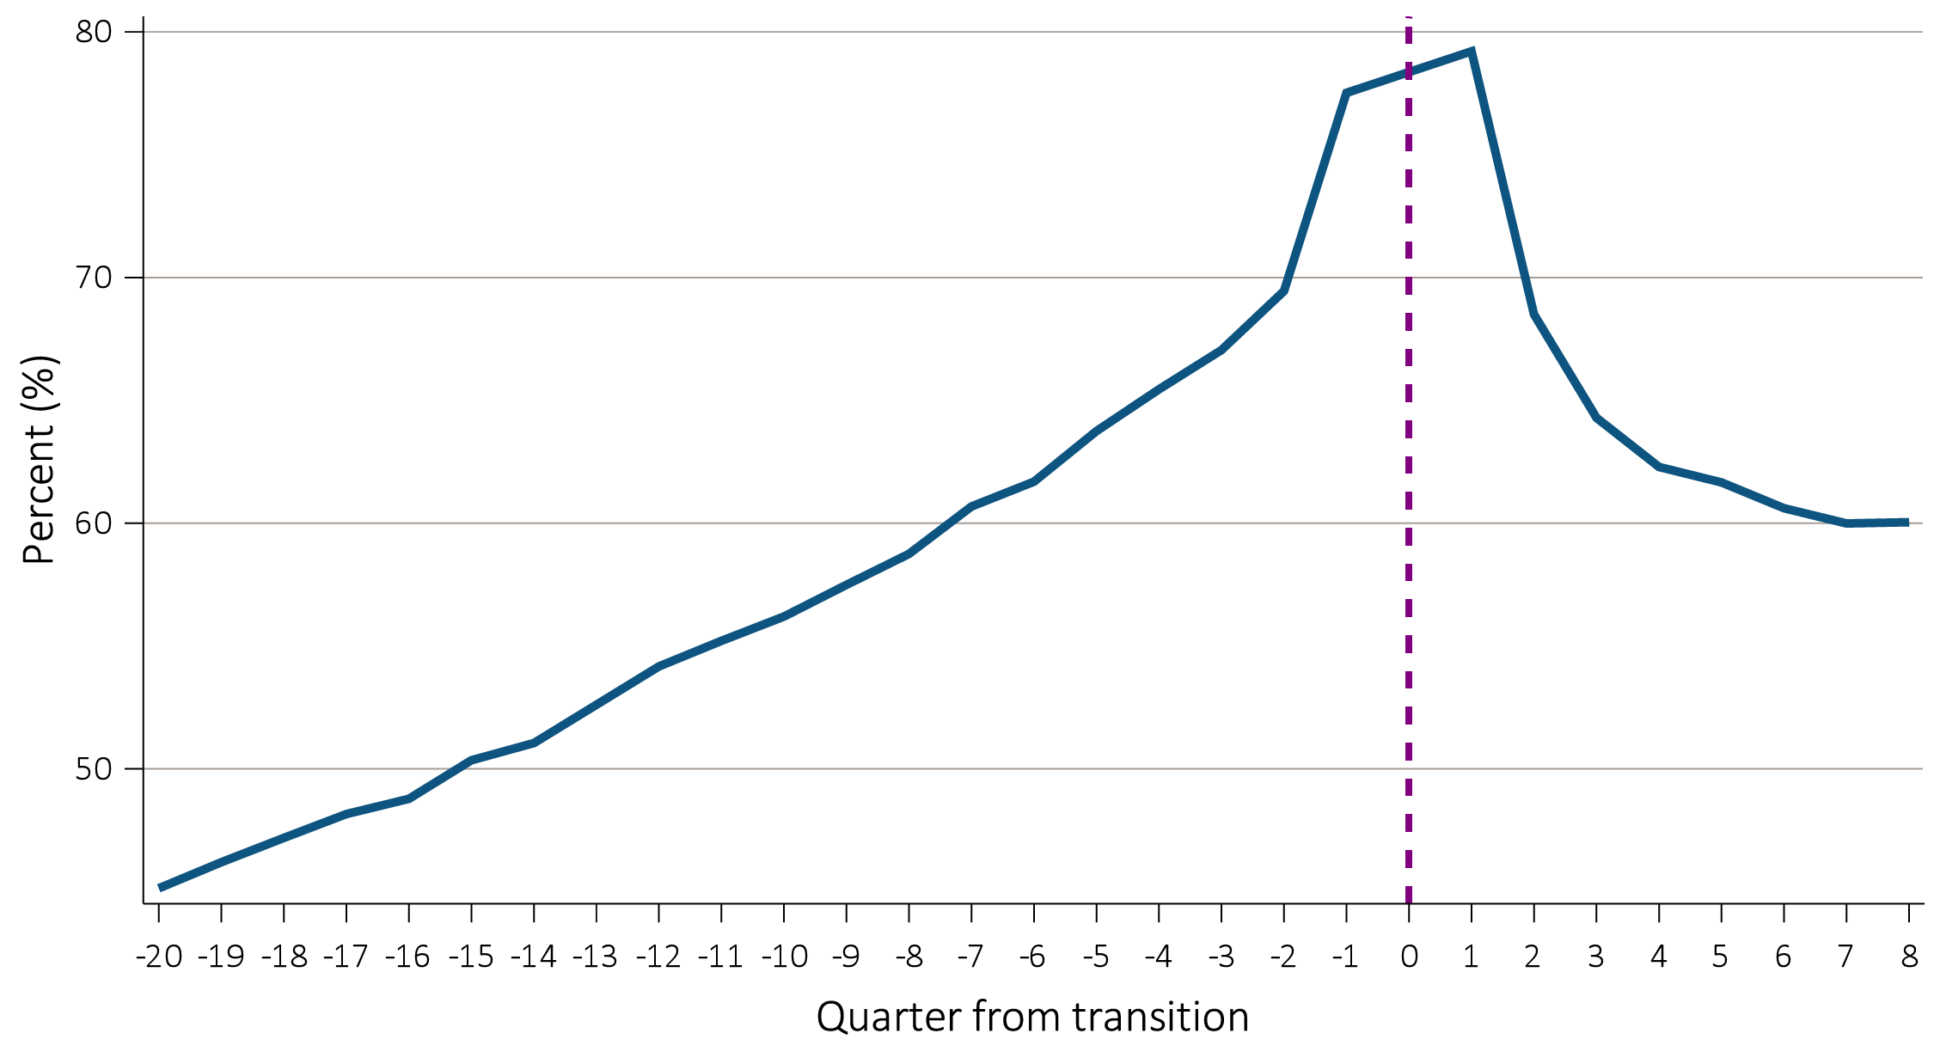
vol 1 Figure 9.39 Trend in proportion of U.S. veteran patients with serum albumin <3.8 g/dL up to 5 years prior and 2 years post-transition in 58,854 veterans who transitioned to ESRD during 10/1/2007-3/31/2015
Data source: VHA data. Abbreviations: ESRD, end-stage renal disease; g/dL, grams per deciliter.

Slide 49
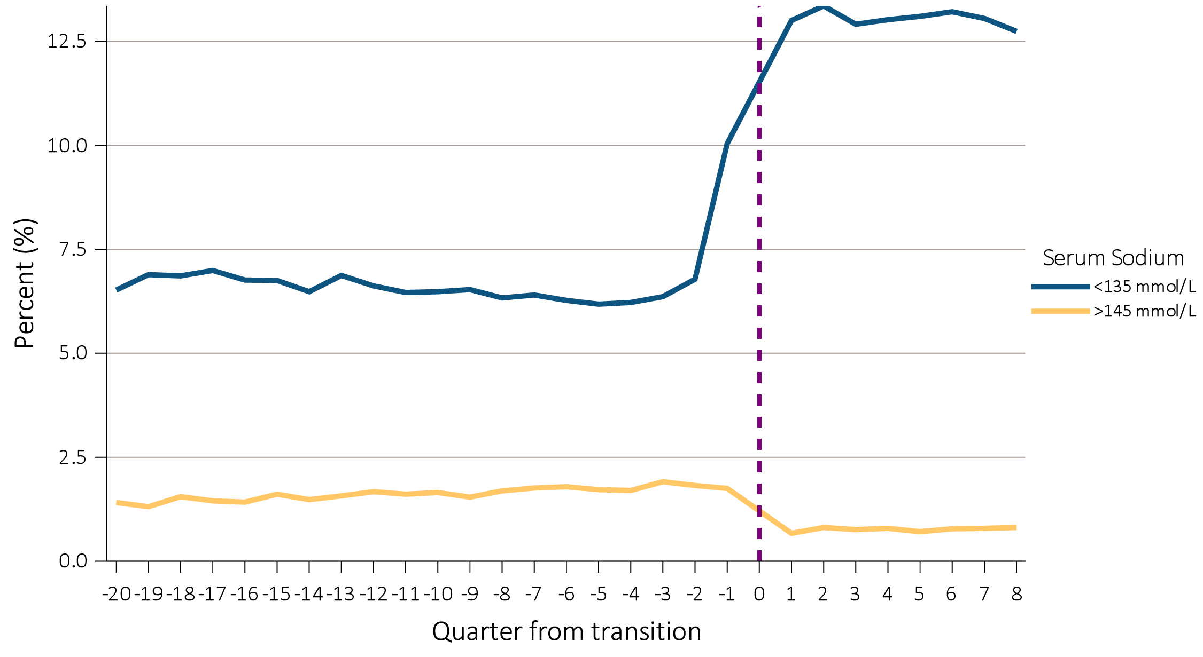
vol 1 Figure 9.40 Trend in serum sodium categories up to 5 years prior and 2 years post-transition in 61,990 veterans who transitioned to ESRD during 10/1/2007-3/31/2015
Data source: VHA data. Abbreviations: ESRD, end-stage renal disease; mmol/L, millimoles per liter.

Slide 50
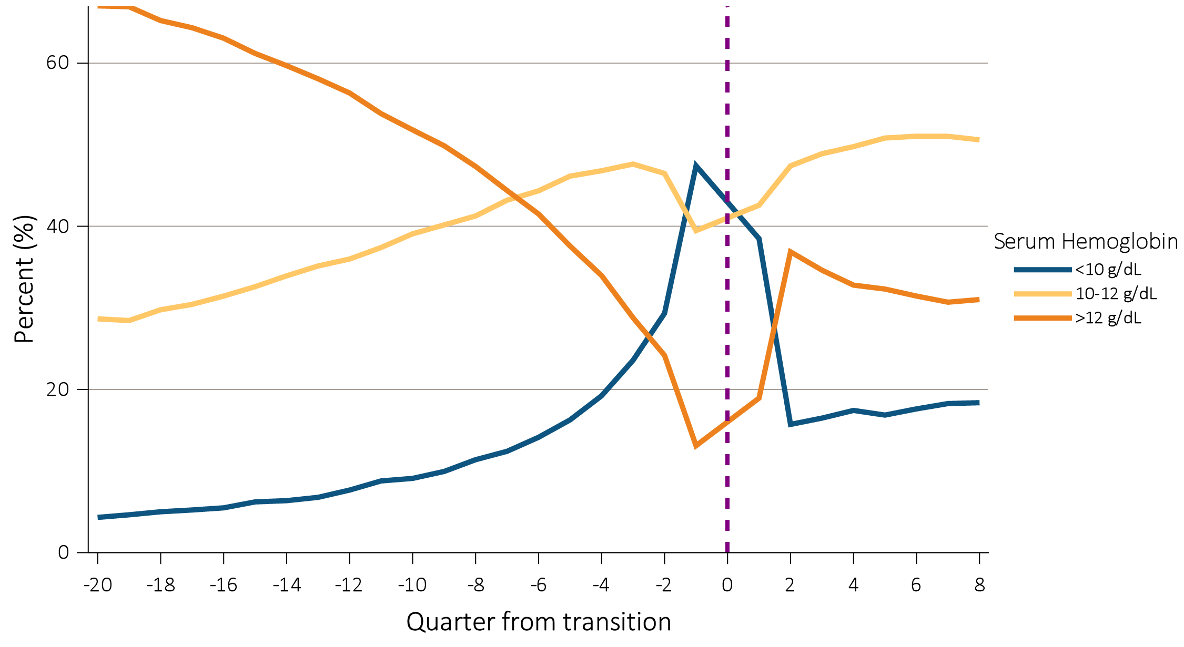
vol 1 Figure 9.41 Trend in serum hemoglobin categories up to 5 years prior and 2 years post-transition in 59,946 veterans who transitioned to ESRD during 10/1/2007-3/31/2015
Data source: VHA data. Abbreviations: ESRD, end-stage renal disease; g/dL, grams per deciliter.

Slide 51
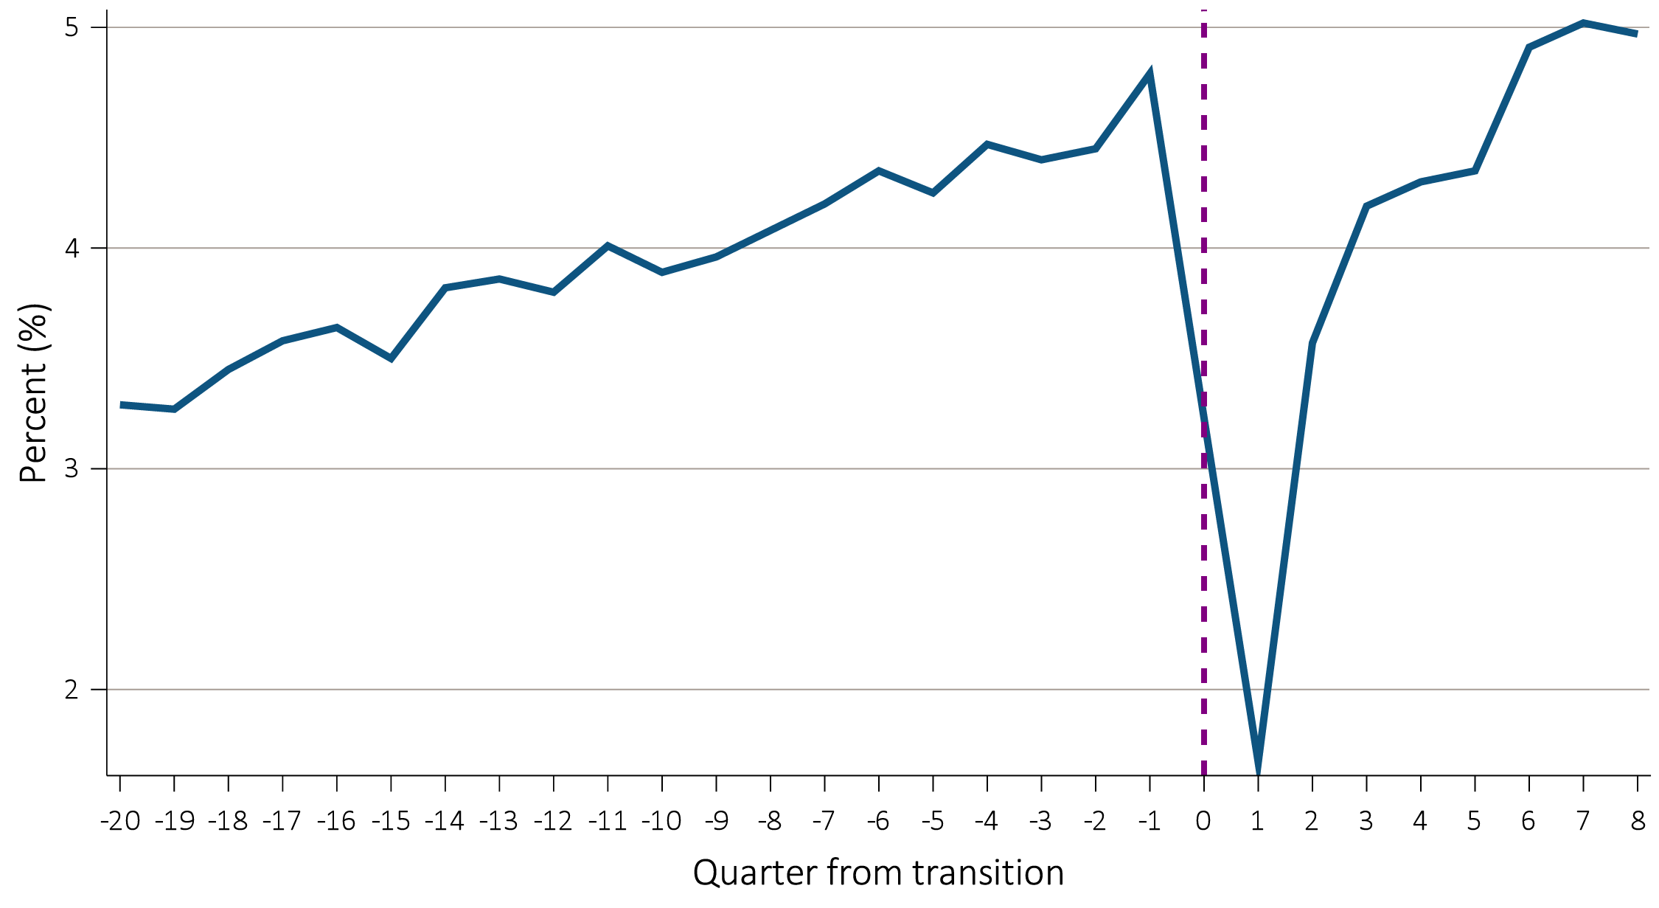
vol 1 Figure 9.42 Trend in proportion of U.S. veteran patients with serum potassium ≥5.5 mEq/L for up to 5 years prior and 2 years post-transition in 61,934 veterans who transitioned to ESRD during 10/1/2007-3/31/2015
Data source: VHA data. Abbreviations: ESRD, end-stage renal disease; mEq/L, milliequivalent per liter.

Slide 52
vol 1 Figure 9.43 Trend in proportion of U.S. veteran patients with serum cholesterol ≥200 mg/dL for up to 5 years prior and 2 years post-transition in 59,562 veterans who transitioned to ESRD during 10/1/2007-3/31/2015
Data source: VHA data. Abbreviations: ESRD, end-stage renal disease; mg/dL, milligrams per deciliter.

Slide 53
vol 1 Figure 9.44 Trend in proportion of U.S. veteran patients with uric acid >7 mg/dL for up to 5 years prior and 2 years post-transition in 31,276 veterans who transitioned to ESRD during 10/1/2007-3/31/2015
Data source: VHA data. Abbreviations: ESRD, end-stage renal disease; mg/dL, milligrams per deciliter.

Slide 54
vol 1 Figure 9.45 Prescribed dialyzable (a) and non-dialyzable (b) beta blockers to incident ESRD veterans who transitioned to ESRD during 10/1/2007-3/31/2015, with data up to -36 months prior to transition (prelude) and up to +36 months after transition (vintage) (data were abstracted from 84,004 veterans)
Data source: VHA data, CMS Medicare Inpatient and Outpatient data. Abbreviations: ESRD, end-stage renal disease; mo, months.

Slide 55
vol 1 Figure 9.46 Distribution in the mean pain score across the United States among 44,903 incident ESRD veterans, 10/1/2007-3/31/2015
Data source: VHA data. Abbreviation: ESRD, end-stage renal disease.

Slide 56
vol 1 Figure 9.47 Secular trends in the mean pain score across the United States among 44,903 incident ESRD veterans, 10/1/2007-3/31/2015
Data source: USRDS ESRD Database. Decrease: ≤-0.01; Constant: <-0.01 to ≤0.01; Increase: >0.01 (score per year). Abbreviation: ESRD, end-stage renal disease.

Slide 57
vol 1 Figure 9.48 Trend in proportion of patients in pain score categories with data up to -36 months prior to transition (prelude) and up to +36 months after transition (vintage) in 66,042 veterans who transitioned to ESRD during 10/1/2007-3/31/2015
Data source: VHA data. Abbreviation: ESRD, end-stage renal disease

Slide 58
vol 1 Figure 9.49 Prescribed opioids in incident ESRD veterans who transitioned to ESRD during 10/1/2007-3/31/2015, with data up to -36 months prior to transition (prelude) and up to +36 months after transition (vintage) (data were abstracted from 84,004 veterans)
Data source: VHA data, CMS Medicare Inpatient and Outpatient data. Abbreviations: ESRD, end-stage renal disease; mo, months.

Slide 59
vol 1 Figure 9.50 Secular trends in proportion of patients with an opioid prescription in the 6 months prior to ESRD transition in incident ESRD veterans who transitioned to ESRD during 10/1/2007-3/31/2015
Data source: CMS and VHA ESRD Databases. Abbreviation: ESRD, end-stage renal disease.

Slide 60
vol 1 Figure 9.51 Proportion of patients with an opioid prescription in the 6 months prior to ESRD transition across the United States in incident ESRD veterans who transitioned to ESRD during 10/1/2007-3/31/2015
Data source: VHA data, CMS Medicare Inpatient and Outpatient data. Abbreviation: ESRD, end-stage renal disease.

Slide 61
vol 1 Figure 9.52 Secular trends in the proportion of patients with an opioid prescription in the 6 months prior to ESRD transition across the United States in incident ESRD veterans who transitioned to ESRD during 10/1/2007-3/31/2015
Data source: USRDS ESRD Database. Decrease: ≤-0.01; Constant: <-0.01 to ≤0.01; Increase: >0.01 (% per year). Abbreviation: ESRD, end-stage renal disease.

Slide 62
vol 1 Table 9.6 Demographic characteristics of the Kaiser Permanente Southern California member population compared to the 2010 U.S. census and California populations
 | KPSC (%) | U.S. census 2010 (%) | California 2010 (%)
Sex
Male | 48.2 | 49.2 | 49.7
Female | 51.8 | 50.8 | 50.3
Age
Under 5 years | 5.8 | 6.5 | 6.8
5-17 years | 19.1 | 17.5 | 18.6
18 to 24 years | 8.7 | 9.9 | 10.5
25 to 44 years | 26.1 | 26.6 | 28.2
45 to 64 years | 28.2 | 26.4 | 24.9
65 years and over | 12.1 | 13.0 | 11.4
Ethnicity
Hispanic | 37.6 | 16.3 | 37.6
Non-Hispanic | 53.0 | 83.7 | 62.4
Unknown | 9.4 | ^ | ^
Race
White | 47.7 | 76.2 | 40.1
Black/African American | 9.8 | 14.6 | 5.8
American Indian/Alaska Native | 0.4 | 0.9 | 0.4
Asian | 9.1 | 5.6 | 12.8
Native Hawaiian/Pacific Islander | 1.0 | 0.2 | 0.3
Other/Multirace | 5.1 | 2.5 | 2.8
Unknown | 26.3 | ^ | ^
Data source: Kaiser Permanente Southern California Electronic Health Records, U.S. Census Bureau. Active KPSC Members (all medical centers) on June 30, 2010. Abbreviation: KPSC, Kaiser Permanente Southern California. ^Data not available.

Slide 63
vol 1 Table 9.7 Crude and age- and sex-adjusted incidence rates among Kaiser Permanente Southern California members who transitioned to ESRD between 1/1/2007 and 12/31/2016
Data source: Kaiser Permanente Southern California Electronic Health Records, U.S. Census Bureau. The 2010 U.S. Census was used as the standard population. Abbreviations: ESRD, end-stage renal disease; KP-SC, Kaiser Permanente Southern California.

Slide 64
vol 1 Figure 9.53 Trend of initial dialysis access type used among the 11,927 KP-SC incident dialysis patients who transitioned to ESRD during 1/1/2007-12/31/2016
Data source: Kaiser Permanente Southern California Electronic Health Records. Abbreviations: KP-SC, Kaiser Permanente Southern California; ESRD, end-stage renal disease; HD, hemodialysis; PD, peritoneal dialysis.

Slide 65
vol 1 Figure 9.54 Seasonal trend among 11,927 KP-SC incident dialysis patients who transitioned to ESRD during 1/1/2007-12/31/2016
Data source: Kaiser Permanente Southern California Electronic Health Records. Abbreviations: KP-SC, Kaiser Permanente Southern California; ESRD, end-stage renal disease; Jan, January; Feb, February; Mar, March; Apr, April; Jun, June; Jul, July; Aug, August; Sep, September; Oct, October; Nov, November; Dec, December.

Slide 66
vol 1 Figure 9.55 Annualized unadjusted mortality of the 11,927 KP-SC incident dialysis patients who transitioned to ESRD during 1/1/2007-12/31/2016 and were followed for up to 24 months
Data source: Kaiser Permanente Southern California Electronic Health Records. Abbreviations: ESRD, end-stage renal disease; KP-SC, Kaiser Permanente Southern California.

Slide 67
vol 1 Table 9.8 Number of hospitalizations pre- and post-transition among the 11,927 KP-SC incident dialysis patients during 1/1/2007-12/31/2016
Hospitalization pre-transition | Hospitalization post-transition
Yes N=8,019 (73.1%) | Yes N=4,956 (61.8%)
 | No N=3,063 (38.2%)
No N=3,908 (26.9%) | Yes N=1,391 (35.6%)
 | No N=2,517 (64.4%)
Data source: Kaiser Permanente Southern California Electronic Health Records. Abbreviation: KP-SC, Kaiser Permanente Southern California.
.

Slide 68
vol 1 Table 9.9 Comparison of hospitalizations for heart failure and acute kidney injury for KP-SC incident dialysis patients who died at two months vs. alive more than 12 months after ESRD transition
 | Patients died at two months (N=427) | Patients died between 2 months and 12 months (N=1,174) | Patients survived more than 12 months (N=10,326)
 | N (%) | N (%) | N (%)
Hospitalization in 6 months prior to ESRD transition | 382 (89.5) | 1,006 (85.7) | 6,013 (58.2)
Primary cause of hospitalization in 6 months prior to ESRD transition
Heart failure | 122 (28.6) | 275 (23.4) | 1,142 (11.1)
Acute kidney injury | 165 (38.6) | 380 (32.4) | 2,004 (19.4)
Hospitalization related diagnosis in 6 months prior to ESRD transition
Heart failure | 235 (55.0) | 589 (50.2) | 2,724 (26.4)
Acute kidney injury | 327 (76.6) | 802 (68.3) | 4,019 (38.9)
Data source: Kaiser Permanente Southern California Electronic Health Records. Abbreviations: KP-SC, Kaiser Permanente Southern California; ESRD, end-stage renal disease.

Slide 69
vol 1 Figure 9.56 Selected (a) comorbid conditions for calculation of the (b) Charlson Comorbidity Index, prior to transition to ESRD in 11,927 KP-SC incident dialysis patients during 1/1/2007-12/31/2016
(a) Comorbid conditions
Data source: Kaiser Permanente Southern California Electronic Health Records. ªExcludes renal disease (not ESRD). Abbreviations: HF, heart failure; compl, complications; COPD, chronic obstructive pulmonary disease; CVD, cerebrovascular disease; dz, disease; ESRD, end-stage renal disease; Kaiser Permanente Southern California; MI, myocardial infarction; Mod, moderate; PVD, peripheral vascular disease; PUD, peptic ulcer disease; sev, severe.

Slide 70
vol 1 Figure 9.56 Selected (a) comorbid conditions for calculation of the (b) Charlson Comorbidity Index, prior to transition to ESRD in 11,927 KP-SC incident dialysis patients during 1/1/2007-12/31/2016
(b) Charlson Comorbidity Index scoreª
Data source: Kaiser Permanente Southern California Electronic Health Records. ªExcludes renal disease (not ESRD). Abbreviations: HF, heart failure; compl, complications; COPD, chronic obstructive pulmonary disease; CVD, cerebrovascular disease; dz, disease; ESRD, end-stage renal disease; Kaiser Permanente Southern California; MI, myocardial infarction; Mod, moderate; PVD, peripheral vascular disease; PUD, peptic ulcer disease; sev, severe.

Slide 71
vol 1 Figure 9.57 Trend in serum creatinine level during the prelude (pre-ESRD) period over 20 quarters among 11,927 KP-SC patients who transitioned to dialysis during 1/1/2007-12/31/2016
Data source: Kaiser Permanente Southern California Electronic Health Records. Abbreviations: ESRD, end-stage renal disease; KP-SC, Kaiser Permanente Southern California; mg/dL, milligrams per deciliter; p, percentile.

Slide 72
vol 1 Figure 9.58 Trend in eGFR during the prelude (pre-ESRD) period over 20 quarters among 11,927 KP-SC patients who transitioned to dialysis during 1/1/2007-12/31/2016
Data source: Kaiser Permanente Southern California Electronic Health Records. Abbreviations: eGFR; estimated glomerular filtration rate; ESRD, end-stage renal disease; KP-SC, Kaiser Permanente Southern California; mL/min/1.73m², milliliter per minute per 1.73 meters squared; p, percentile.

Slide 73
vol 1 Figure 9.59 Trends in eGFRª during the prelude (pre-ESRD) period over 20 quarters among 11,927 KP-SC patients who transitioned to dialysis during 1/1/2007-12/31/2016, stratified by age-at-incidence
Data source: Kaiser Permanente Southern California Electronic Health Records. ªMedian eGFR. Abbreviations: eGFR; estimated glomerular filtration rate; ESRD, end-stage renal disease; KP-SC, Kaiser Permanente Southern California; mL/min/1.73m², milliliter per minute per 1.73 meters squared.

Slide 74
vol 1 Figure 9.60 Trends in eGFRª during the prelude (pre-ESRD) period over 20 quarters among 11,927 KP-SC patients who transitioned to dialysis during 1/1/2007-12/31/2016, stratified by cause of ESRD
Data source: Kaiser Permanente Southern California Electronic Health Records. ªMedian eGFR. Abbreviations: eGFR; estimated glomerular filtration rate; ESRD, end-stage renal disease; KP-SC, Kaiser Permanente Southern California; mL/min/1.73m², milliliter per minute per 1.73 meters squared.

Slide 75
vol 1 Figure 9.61 Trend in hemoglobin levels (g/dL) over 8 quarters each in the prelude (pre-ESRD) and vintage (post-ESRD) periods among 11,927 KP-SC patients who transitioned to dialysis during 1/1/2007-12/31/2016
Data source: Kaiser Permanente Southern California Electronic Health Records. Abbreviations: ESRD, end-stage renal disease; KP-SC, Kaiser Permanente Southern California; HGB, hemoglobin; g/dL, grams per deciliter; p, percentile.

Slide 76
vol 1 Figure 9.62 Trend in hemoglobin A1C levels (%) over 8 quarters each in the prelude (pre-ESRD) and vintage (post-ESRD) periods among 11,927 KP-SC patients who transitioned to dialysis during 1/1/2007-12/31/2016
Data source: Kaiser Permanente Southern California Electronic Health Records. Abbreviations: ESRD, end-stage renal disease; KP-SC, Kaiser Permanente Southern California; Hgb, hemoglobin; p, percentile.

Slide 77
vol 1 Figure 9.63 Trend in phosphorus levels (mg/dL) over 8 quarters each in the prelude (pre-ESRD) and vintage (post-ESRD) periods among 11,927 KP-SC patients who transitioned to dialysis during 1/1/2007-12/31/2016
Data source: Kaiser Permanente Southern California Electronic Health Records. Abbreviations: ESRD, end-stage renal disease; KP-SC, Kaiser Permanente Southern California; mg/dL, milligrams per deciliter; p, percentile.

Slide 78
vol 1 Figure 9.64 Trend in parathyroid hormone levels (pg/mL) over 8 quarters each in the prelude (pre-ESRD) and vintage (post-ESRD) periods among 11,927 KP-SC patients who transitioned to dialysis during 1/1/2007-12/31/2016
Data source: Kaiser Permanente Southern California Electronic Health Records. Abbreviations: ESRD, end-stage renal disease; KP-SC, Kaiser Permanente Southern California; PTH, parathyroid hormone; pg/dL, picograms per deciliter; p, percentile.

Slide 79
vol 1 Figure 9.65 Trend in albumin levels (g/dL) over 8 quarters each in the prelude (pre-ESRD) and vintage (post-ESRD) periods among 11,927 KP-SC patients who transitioned to dialysis during 1/1/2007-12/31/2016
Data source: Kaiser Permanente Southern California Electronic Health Records. Abbreviations: ESRD, end-stage renal disease; KP-SC, Kaiser Permanente Southern California; g/dL, grams per deciliter; p, percentile.

