Slide 1

2018 Annual Data Report
Volume 2: End-Stage Renal Disease
Chapter 3:
Vascular Access

Slide 2
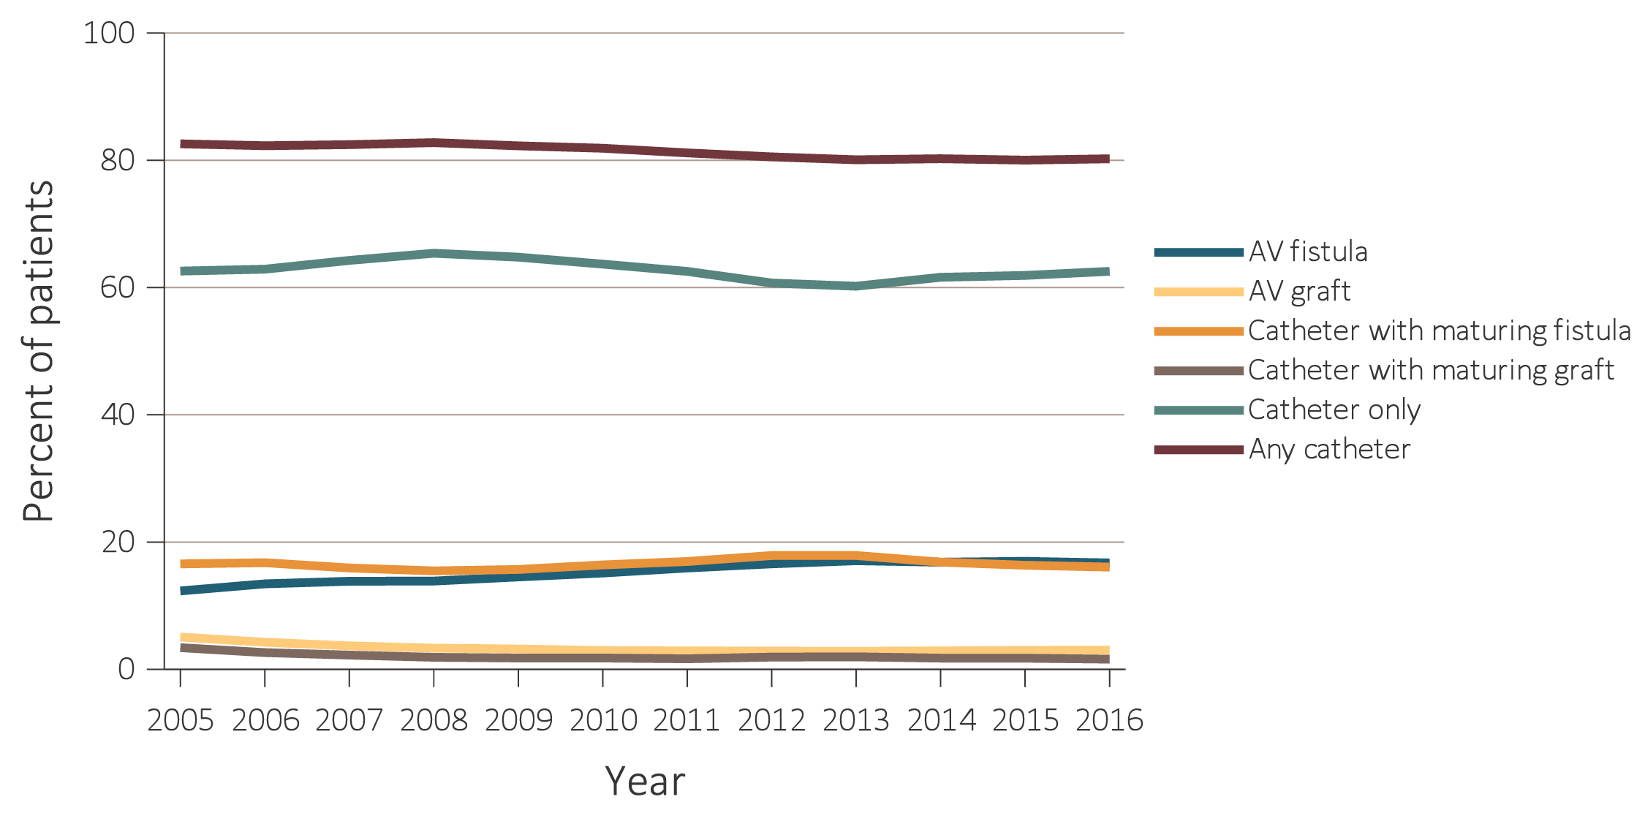
vol 2 Figure 3.1 Vascular access use at hemodialysis initiation, from the ESRD Medical Evidence form (CMS 2728), 2005-2016
Data Source: Special analyses, USRDS ESRD Database. ESRD patients initiating hemodialysis in 2005-2016. Abbreviations: AV, arteriovenous; CMS, Centers for Medicare & Medicaid; ESRD, end-stage renal disease.

Slide 3
vol 2 Table 3.1 Vascular access used at hemodialysis initiation by patient characteristics from the ESRD Medical Evidence form (CMS 2728), 2016
 | AV fistula | AV graft | Catheter with maturing fistula | Catheter with maturing graft | Catheter only
All | 16.7 | 3.0 | 16.1 | 1.6 | 62.5
Age
0-21 | 7.1 | 0.9 | 9.7 | 0.1 | 82.2
22-44 | 13.4 | 1.8 | 16.3 | 1.2 | 67.4
45-64 | 16.9 | 2.8 | 17.2 | 1.6 | 61.4
65-74 | 18.0 | 3.2 | 16.4 | 1.5 | 60.9
75+ | 16.6 | 3.7 | 14.0 | 1.9 | 63.7
Sex
Male | 18.3 | 2.3 | 16.6 | 1.3 | 61.5
Female | 14.7 | 4.0 | 15.4 | 2.0 | 63.9
Race
White | 17.3 | 2.4 | 15.7 | 1.4 | 63.2
Black/African American | 14.7 | 4.5 | 16.7 | 2.3 | 61.8
American Indian or Alaska Native | 18.5 | 2.6 | 19.9 | 0.8 | 58.2
Asian | 19.8 | 3.4 | 16.8 | 1.6 | 58.3
Other or Multiracial | 18.2 | 3.1 | 16.1 | 1.1 | 61.4
Ethnicity
Hispanic | 14.7 | 1.9 | 16.2 | 1.2 | 66.1
Non-Hispanic | 17.1 | 3.2 | 16.1 | 1.7 | 62
Race/Ethnicity
Non-Hispanic White | 18.0 | 2.6 | 15.6 | 1.4 | 62.4
Non-Hispanic Black/African American | 14.7 | 4.6 | 16.7 | 2.3 | 61.8
Primary Cause of ESRD
Diabetes | 17.4 | 3.2 | 18.3 | 1.7 | 59.4
Hypertension | 17.0 | 3.3 | 15.5 | 1.6 | 62.7
Glomerulonephritis | 17.5 | 2.4 | 14.1 | 1.7 | 64.3
Cystic kidney | 38.0 | 4.6 | 13.2 | 1.1 | 43
Other urologic | 14.4 | 2.0 | 13.5 | 1.3 | 68.9
Other cause | 9.0 | 1.8 | 10.1 | 1.4 | 77.7
Unknown/Missing | 9.6 | 2.3 | 8.6 | 0.8 | 78.7
Comorbidities
Diabetes | 16.5 | 3.1 | 17.4 | 1.7 | 61.3
Congestive heart failure | 12.3 | 2.6 | 16.9 | 1.7 | 66.4
Atherosclerotic heart disease | 16.1 | 3.1 | 17.5 | 1.7 | 61.6
Cerebrovascular disease | 14.9 | 3.4 | 16.5 | 2.0 | 63.2
Peripheral vascular disease | 13.9 | 2.8 | 18.1 | 1.8 | 63.4
Hypertension | 17.3 | 3.1 | 16.5 | 1.6 | 61.5
Other cardiac disease | 13.7 | 2.5 | 15.9 | 1.7 | 66.3
Data Source: Special analyses, USRDS ESRD Database. Abbreviations: AV, arteriovenous; CMS, Centers for Medicare & Medicaid; ESRD, end-stage renal disease.

Slide 4
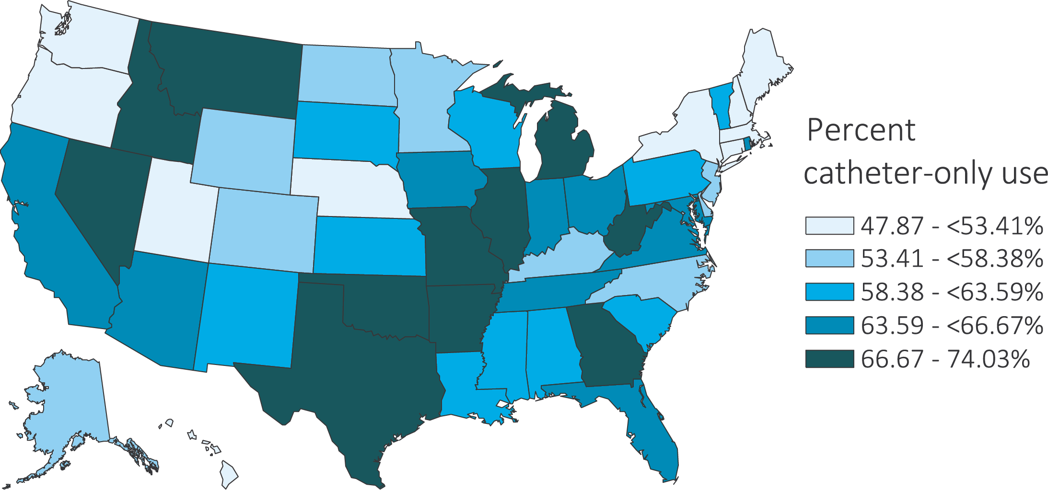
vol 2 Figure 3.2 Geographic variation in percentage of catheter-only use at hemodialysis initiation, from the ESRD Medical Evidence form (CMS 2728), 2016
Data Source: Special analyses, USRDS ESRD Database. Abbreviations: CMS, Centers for Medicare & Medicaid; ESRD, end-stage renal disease.

Slide 5
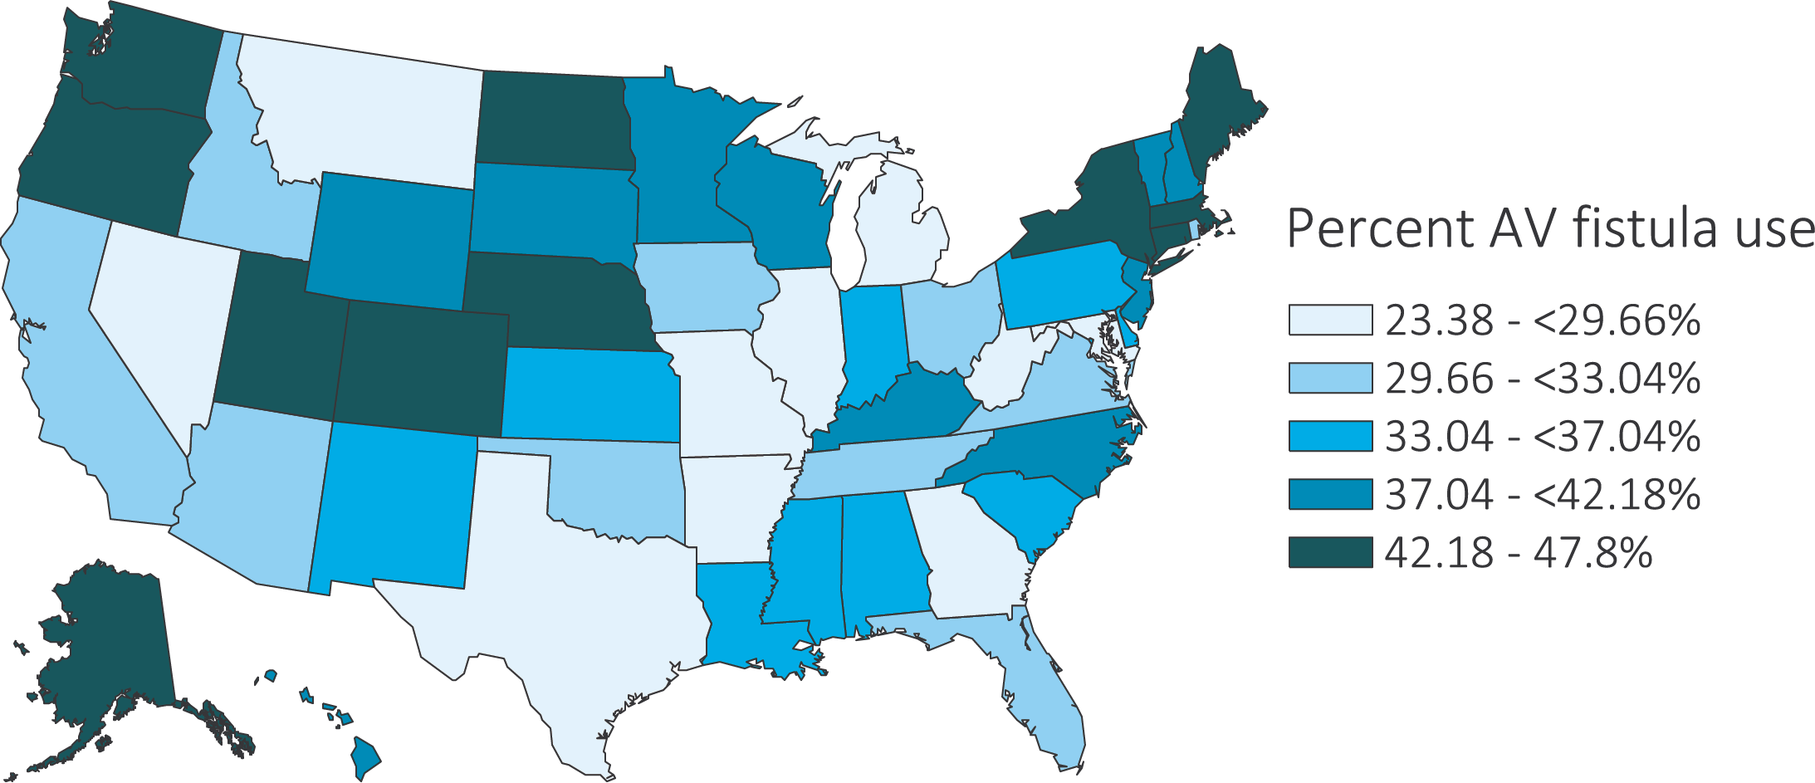
vol 2 Figure 3.3 Geographic variation in percentage of AV fistula use at hemodialysis initiation, from the ESRD Medical Evidence form (CMS 2728), 2016
Data Source: Special analyses, USRDS ESRD Database. AV fistula use includes not only AV fistulas, but also catheters with a maturing fistula. Abbreviations: AV, arteriovenous; CMS, Centers for Medicare & Medicaid; ESRD, end-stage renal disease.

Slide 6
vol 2 Table 3.2 Distribution of type of vascular access in use among prevalent hemodialysis patients in 2017, from CROWNWeb data, May 2017
 | AV fistula | AV graft | Catheter
All | 64.5 | 16.6 | 18.9
Age
0-21 | 44.0 | 6.8 | 49.3
22-44 | 66.2 | 13.6 | 20.2
45-64 | 66.6 | 15.5 | 18.0
65-74 | 63.9 | 17.4 | 18.7
75+ | 60.9 | 19.4 | 19.7
Sex
Male | 70.4 | 12.6 | 17.0
Female | 56.7 | 21.9 | 21.4
Race
White | 67.3 | 12.8 | 19.9
Black/African American | 59.1 | 23.1 | 17.8
American Indian or Alaska Native | 75.8 | 10.1 | 14.1
Asian | 68.4 | 15.6 | 16.0
Other or Multiracial | 62.3 | 12.9 | 24.8
Ethnicity
Hispanic | 70.3 | 13.4 | 16.3
Non-Hispanic | 63.3 | 17.3 | 19.4
Race/Ethnicity
Non-Hispanic White | 65.8 | 12.6 | 21.6
Non-Hispanic Black/African-American | 59.1 | 23.2 | 17.7
Primary Cause of ESRD
Diabetes | 65.1 | 16.2 | 18.7
Hypertension | 64.5 | 17.4 | 18.1
Glomerulonephritis | 66.4 | 16.8 | 16.8
Cystic kidney | 70.6 | 14.3 | 15.1
Other urologic | 62.9 | 15.5 | 21.6
Other cause | 58.5 | 16.2 | 25.3
Unknown/Missing | 59.6 | 15.8 | 24.6
Data Source: Special analyses, USRDS ESRD Database. CROWNWeb data, catheter = any catheter use; fistula and graft use shown are without the use of a catheter. Abbreviations: AV, arteriovenous; CROWNWeb, Consolidated Renal Operations in a Web-enabled Network; CROWNWeb, Consolidated Renal Operations in a Web-enabled Network; ESRD, end-stage renal disease.

Slide 7
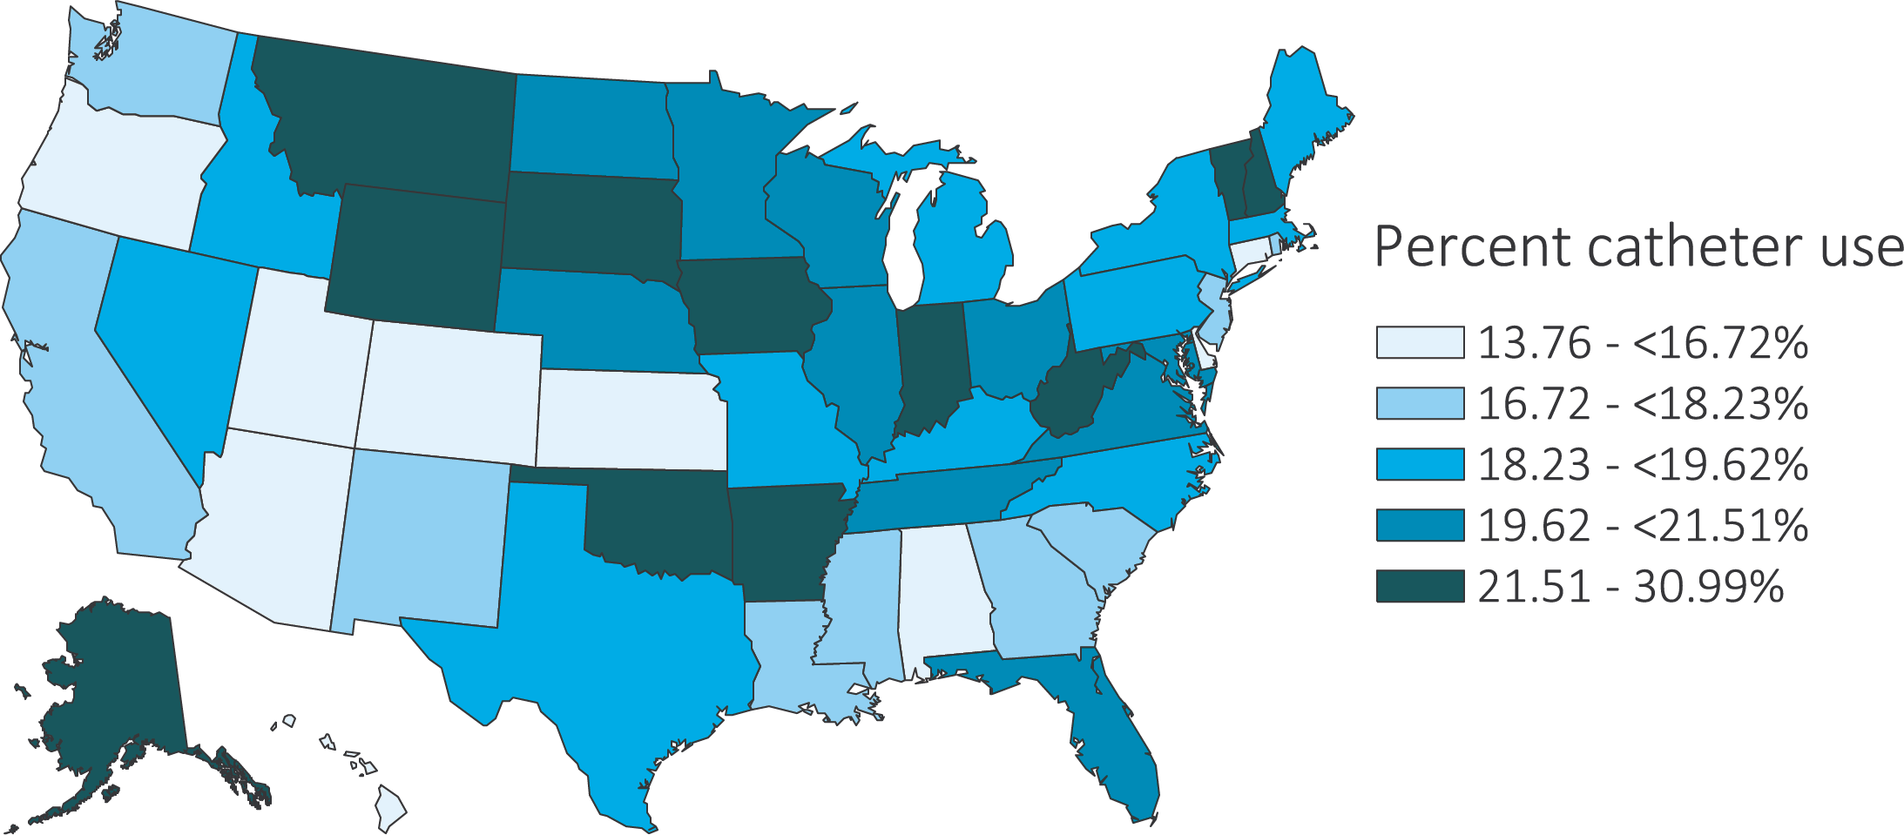
vol 2 Figure 3.4 Geographic variation in percentage catheter use among prevalent hemodialysis patients by Health Service Area, from CROWNWeb data, May 2017
Data Source: Special analyses, USRDS ESRD Database. Abbreviation: CROWNWeb, Consolidated Renal Operations in a Web-enabled Network; ESRD, end-stage renal disease.

Slide 8
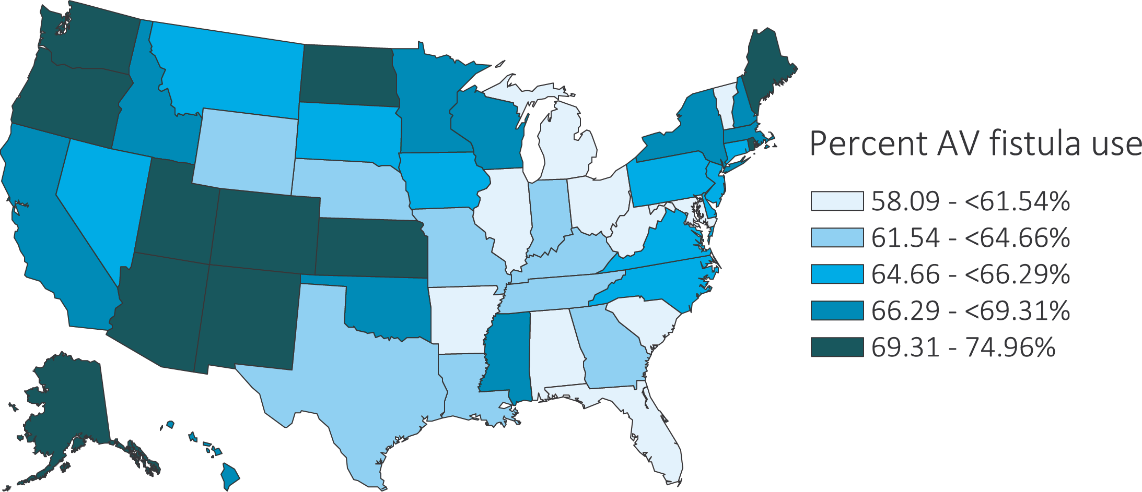
vol 2 Figure 3.5 Geographic variation in percentage AV fistula use among prevalent hemodialysis patients by Health Service Area, from CROWNWeb data, May 2017
Data Source: Special analyses, USRDS ESRD Database. Abbreviations: AV, arteriovenous; CROWNWeb, Consolidated Renal Operations in a Web-enabled Network; ESRD, end-stage renal disease.

Slide 9
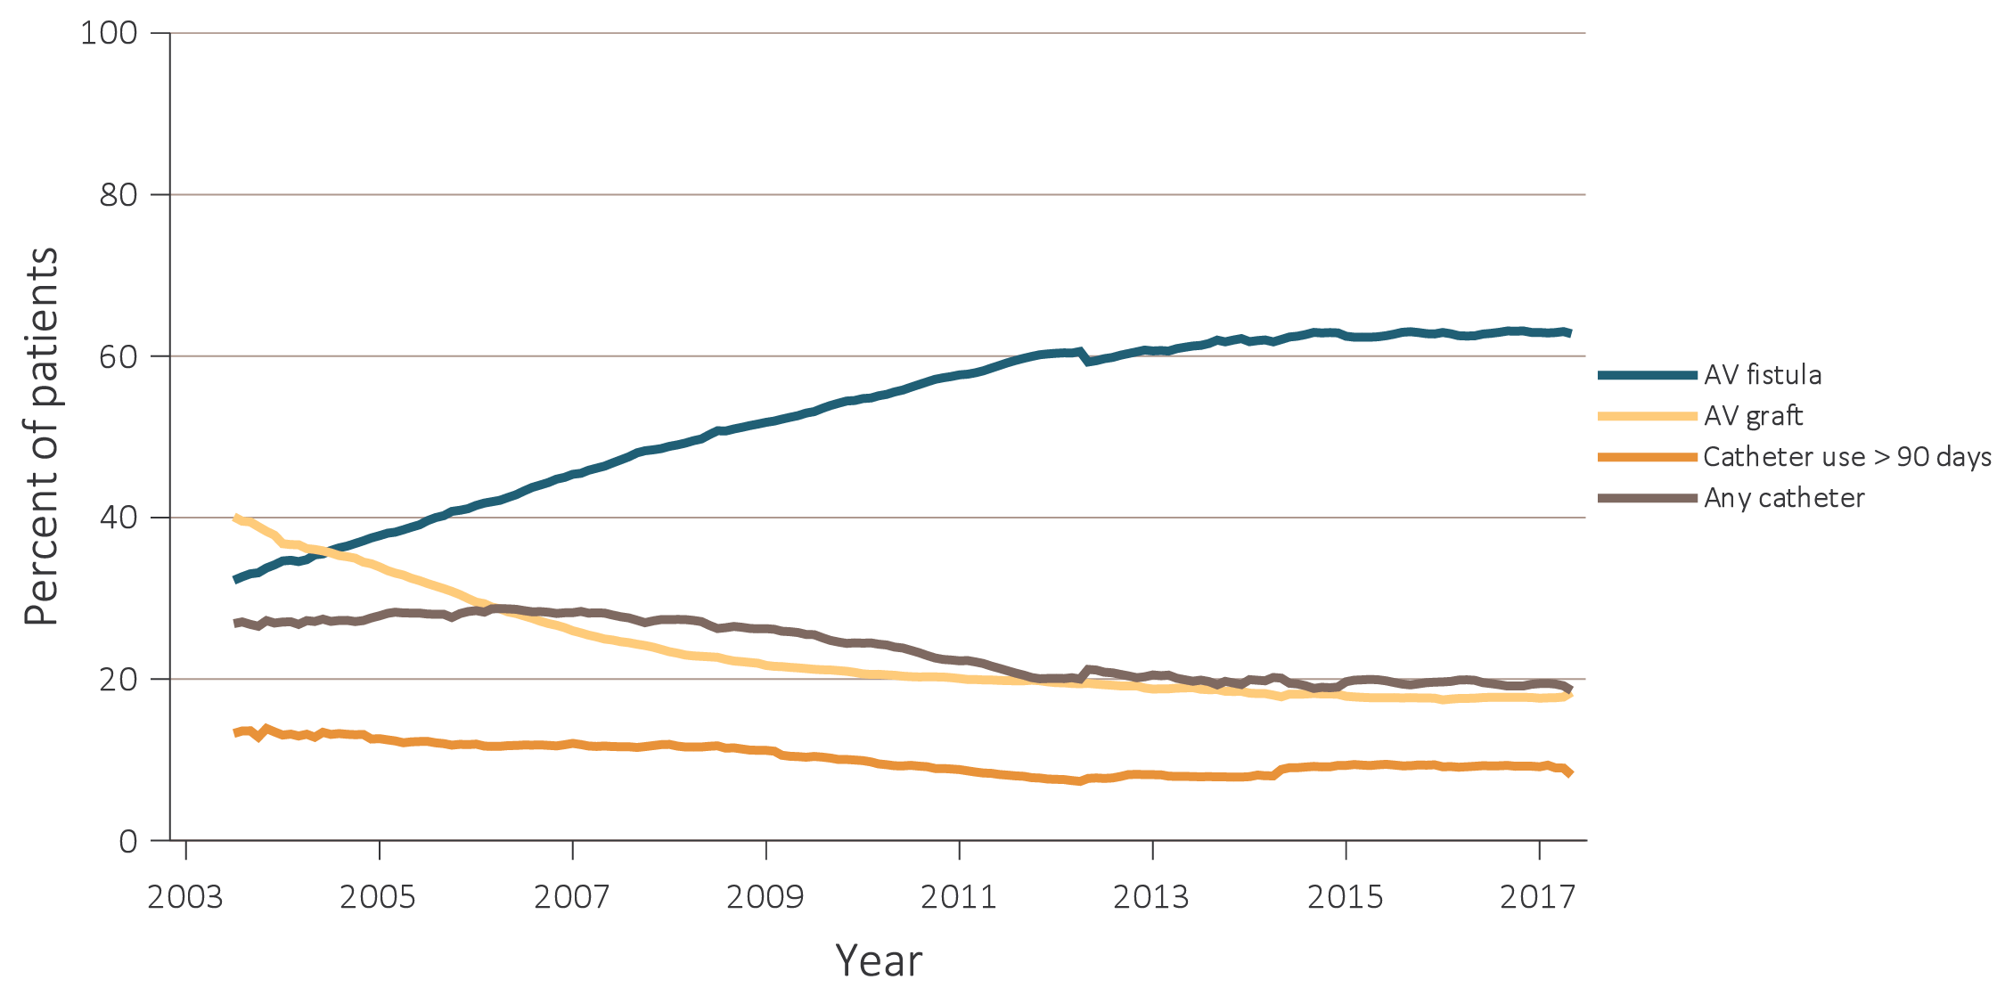
vol 2 Figure 3.6 Trends in vascular access type use among ESRD prevalent patients, 2003-2017
Data Source: Special analyses, USRDS ESRD Database and Fistula First data. Fistula First data reported from July 2003 through April 2012, CROWNWeb data are reported from June 2012 through May 2017. Abbreviations: AV, arteriovenous; CROWNWeb, Consolidated Renal Operations in a Web-enabled Network; ESRD, end-stage renal disease.

Slide 10
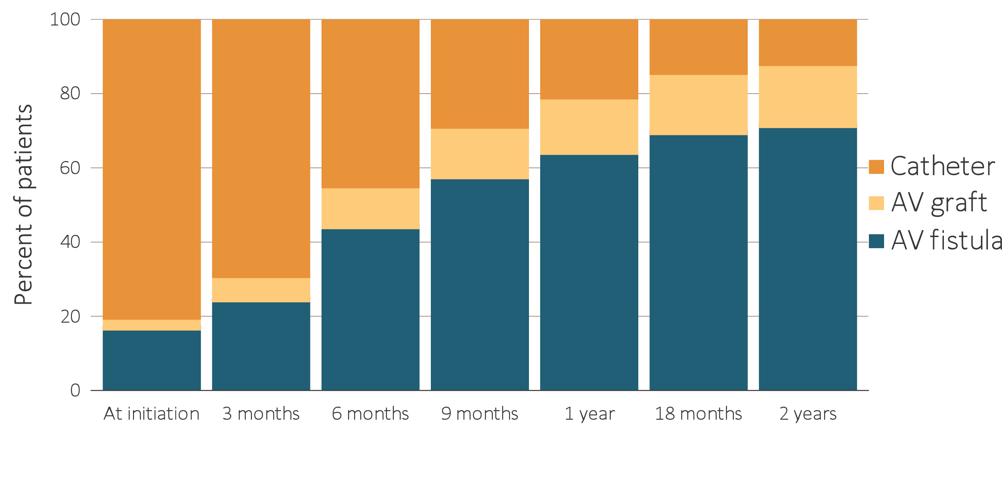
vol 2 Figure 3.7 Change in type of vascular access during the first year of dialysis among patients starting ESRD via hemodialysis in 2013 quarterly: (a) type of vascular access in use (cross-sectional), and (b) longitudinal changes in vascular access use and other outcomes, ESRD Medical Evidence form (CMS 2728) and CROWNWeb, 2013-2017
Data Source: Special analyses, USRDS ESRD Database. Data from January 1, 2014 to May 30, 2017: (a) Medical Evidence form (CMS 2728) at initiation and CROWNWeb for subsequent time periods. (b) ESRD patients initiating hemodialysis (N =104,102). Patients with a maturing AV fistula / AV graft with a catheter in place were classified as having a catheter. Abbreviations: AV, arteriovenous; CMS, Centers for Medicare & Medicaid; CROWNWeb, Consolidated Renal Operations in a Web-enabled Network; ESRD, end-stage renal disease.

Slide 11
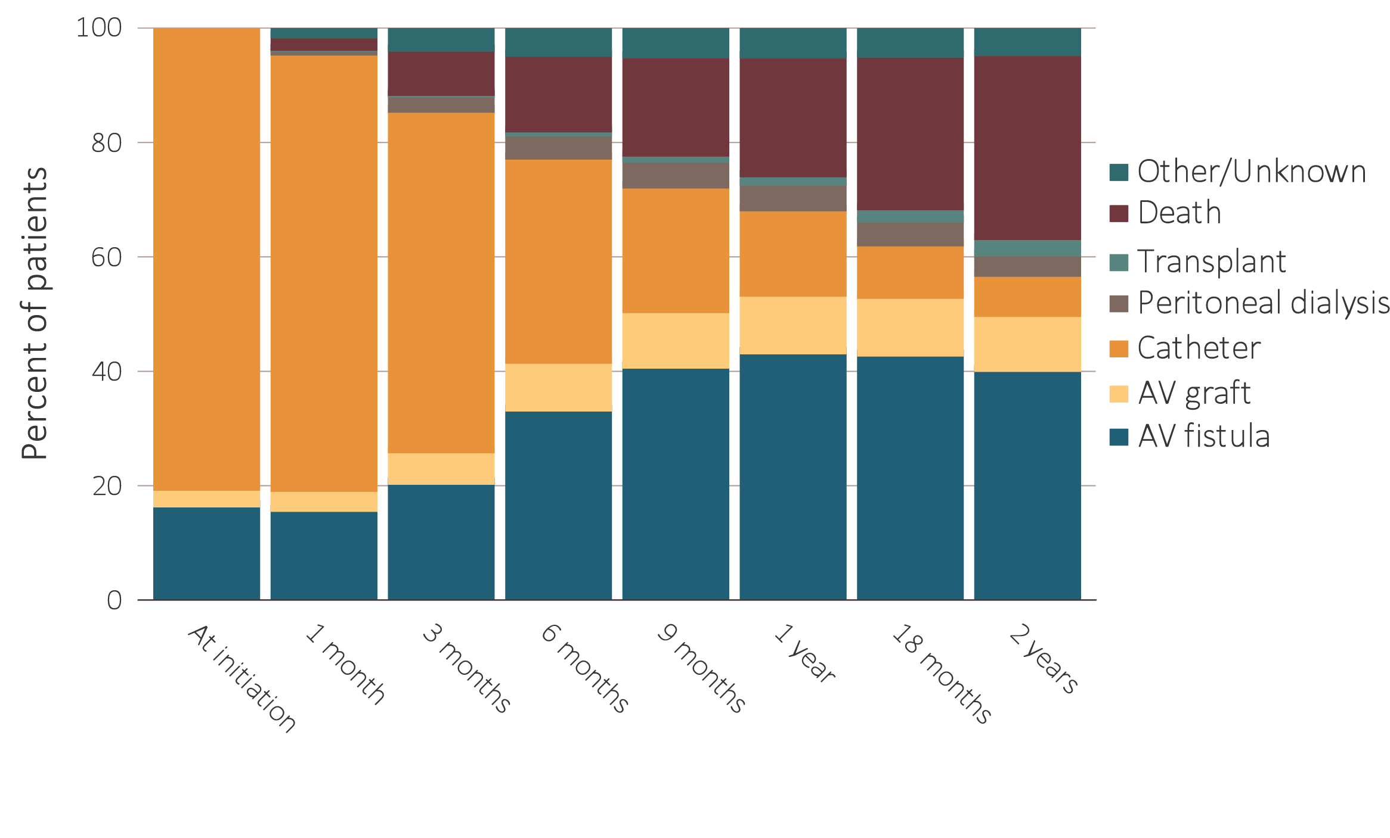
vol 2 Figure 3.7 Change in type of vascular access during the first year of dialysis among patients starting ESRD via hemodialysis in 2013 quarterly: (a) type of vascular access in use (cross-sectional), and (b) longitudinal changes in vascular access use and other outcomes, ESRD Medical Evidence form (CMS 2728) and CROWNWeb, 2013-2017
(b) Longitudinal changes in vascular access use and other outcomes
Data Source: Special analyses, USRDS ESRD Database. Data from January 1, 2014 to May 30, 2017: (a) Medical Evidence form (CMS 2728) at initiation and CROWNWeb for subsequent time periods. (b) ESRD patients initiating hemodialysis (N =104,102). Patients with a maturing AV fistula / AV graft with a catheter in place were classified as having a catheter. Abbreviations: AV, arteriovenous; CMS, Centers for Medicare & Medicaid; CROWNWeb, Consolidated Renal Operations in a Web-enabled Network; ESRD, end-stage renal disease.

Slide 12
vol 2 Table 3.3 Cross-sectional distributions of vascular access use, quarterly during the first two years of hemodialysis, among patients new to hemodialysis in 2013, by age group, from the ESRD Medical Evidence form (CMS 2728) and CROWNWeb, 2013-2017
Age | Access type | Time
 |  | At initiation | 3 months | 6 months | 9 months | 1 year | 18 months | 2 years
0-21 | AV fistula | 6.2 | 12.0 | 32.4 | 40.9 | 47.5 | 53.0 | 55.0
 | AV graft | 0.7 | 0.8 | 1.6 | 3.7 | 3.8 | 4.8 | 5.0
 | Catheter | 93.0 | 87.2 | 66.0 | 55.3 | 48.7 | 42.2 | 40.1
22-44 | AV fistula | 13.9 | 21.4 | 44.1 | 58.4 | 66.0 | 72.1 | 74.1
 | AV graft | 1.9 | 4.4 | 7.6 | 10.0 | 10.8 | 12.1 | 12.7
 | Catheter | 84.3 | 74.1 | 48.3 | 31.7 | 23.2 | 15.9 | 13.2
45-64 | AV fistula | 16.6 | 24.5 | 45.1 | 59.4 | 66.2 | 71.9 | 73.9
 | AV graft | 2.8 | 5.6 | 9.5 | 11.8 | 13.1 | 14.4 | 14.8
 | Catheter | 80.6 | 69.9 | 45.4 | 28.8 | 20.7 | 13.7 | 11.2
65-74 | AV fistula | 18.4 | 26.2 | 45.4 | 58.6 | 64.9 | 69.6 | 71.5
 | AV graft | 3.1 | 6.6 | 11.4 | 14.1 | 15.5 | 17.0 | 17.6
 | Catheter | 78.5 | 67.2 | 43.3 | 27.3 | 19.5 | 13.4 | 10.9
75+ | AV fistula | 17.0 | 24.1 | 41.5 | 53.5 | 59.3 | 64.3 | 66.0
 | AV graft | 3.4 | 8.9 | 14.9 | 18.0 | 19.7 | 20.7 | 21.0
 | Catheter | 79.6 | 66.9 | 43.6 | 28.5 | 21.0 | 15.0 | 13.0
Data Source: Special analyses, USRDS ESRD Database. Medical Evidence form (CMS 2728) at initiation and CROWNWeb for subsequent time periods. Abbreviations: AV, arteriovenous; CMS, Centers for Medicare & Medicaid; CROWNWeb, Consolidated Renal Operations in a Web-enabled Network; ESRD, end-stage renal disease.

Slide 13
vol 2 Table 3.4 Cross-sectional distributions of vascular access use, quarterly during the first two years of hemodialysis among patients new to hemodialysis in 2013, by race, from the ESRD Medical Evidence form (CMS-2728) and CROWNWeb, 2013-2017
Race/Ethnicity | Access type | Time
 |  | At initiation | 3 months | 6 months | 9 months | 1 year | 18 months | 2 years
White | AV fistula | 17.4 | 25.6 | 45.9 | 59.7 | 66.4 | 72.0 | 74.0
 | AV graft | 2.4 | 5.4 | 9.4 | 11.7 | 12.7 | 13.6 | 14.0
 | Catheter | 80.3 | 69.0 | 44.8 | 28.6 | 20.9 | 14.4 | 12.0
Black/African American | AV fistula | 15.3 | 21.4 | 39.3 | 51.9 | 58.2 | 63.2 | 65.1
 | AV graft | 4.2 | 9.2 | 15.0 | 18.3 | 20.2 | 22.0 | 22.6
 | Catheter | 80.5 | 69.4 | 45.8 | 29.7 | 21.6 | 14.9 | 12.3
American Indian or Alaska Native | AV fistula | 16.0 | 25.9 | 53.8 | 67.8 | 75.1 | 79.4 | 79.8
 | AV graft | 2.0 | 4.0 | 6.8 | 8.3 | 9.4 | 9.9 | 10.6
 | Catheter | 81.9 | 70.1 | 39.4 | 23.9 | 15.5 | 10.7 | 9.6
Asian | AV fistula | 19.5 | 28.2 | 50.2 | 63.2 | 70.4 | 75.7 | 77.1
 | AV graft | 3.0 | 7.0 | 10.6 | 12.4 | 13.1 | 14.5 | 15.1
 | Catheter | 77.5 | 64.8 | 39.2 | 24.4 | 16.5 | 9.8 | 7.8
Native Hawaiian or Pacific Islander | AV fistula | 17.4 | 21.9 | 43.3 | 59.2 | 67.2 | 73.2 | 77.4
 | AV graft | 2.4 | 4.9 | 8.6 | 10.5 | 12.5 | 14.1 | 13.9
 | Catheter | 80.2 | 73.3 | 48.1 | 30.3 | 20.4 | 12.7 | 8.8
Other or Multiracial | AV fistula | 14.5 | 20.0 | 40.7 | 60.3 | 65.1 | 71.4 | 71.1
 | AV graft | 3.9 | 5.6 | 11.3 | 11.4 | 11.8 | 14.3 | 14.2
 | Catheter | 81.6 | 74.4 | 48.0 | 28.3 | 23.1 | 14.3 | 14.7
Hispanic | AV fistula | 14.0 | 22.1 | 43.7 | 59.1 | 66.3 | 72.8 | 75.4
 | AV graft | 2.1 | 5.0 | 8.9 | 11.3 | 12.6 | 13.7 | 14.3
 | Catheter | 84.0 | 72.8 | 47.4 | 29.6 | 21.1 | 13.4 | 10.4
Non-Hispanic | AV fistula | 17.4 | 24.9 | 44.2 | 57.3 | 63.7 | 68.8 | 70.5
 | AV graft | 3.1 | 6.8 | 11.4 | 14.1 | 15.5 | 16.8 | 17.3
 | Catheter | 79.6 | 68.3 | 44.3 | 28.6 | 20.8 | 14.4 | 12.2
Non-Hispanic White | AV fistula | 18.3 | 26.6 | 46.5 | 59.8 | 66.3 | 71.5 | 73.3
 | AV graft | 2.5 | 5.5 | 9.5 | 11.8 | 12.8 | 13.7 | 13.9
 | Catheter | 79.2 | 67.9 | 44.0 | 28.4 | 20.9 | 14.8 | 12.7
Non-Hispanic Black/African American | AV fistula | 15.3 | 21.5 | 39.3 | 52.0 | 58.3 | 63.2 | 65.1
 | AV graft | 4.2 | 9.2 | 15.0 | 18.4 | 20.2 | 22.0 | 22.6
 | Catheter | 80.5 | 69.3 | 45.6 | 29.6 | 21.5 | 14.8 | 12.2
Data Source: Special analyses, USRDS ESRD Database. Medical Evidence form (CMS 2728) at initiation and CROWNWeb for subsequent time periods. Abbreviations: AV, arteriovenous; CMS, Centers for Medicare & Medicaid; CROWNWeb, Consolidated Renal Operations in a Web-enabled Network; ESRD, end-stage renal disease.

Slide 14
vol 2 Table 3.5 Cross-sectional distributions of vascular access use, quarterly during the first two years of hemodialysis among patients new to hemodialysis in 2013, by sex, from the ESRD Medical Evidence form (CMS 2728) and CROWNWeb, 2013-2017
Sex | Access type | Time
 |  | At initiation | 3 months | 6 months | 9 months | 1 year | 18 months | 2 years
Male | AV fistula | 18.3 | 27.7 | 50.0 | 64.0 | 70.6 | 75.5 | 77.2
 | AV graft | 2.2 | 5.1 | 8.6 | 10.6 | 11.5 | 12.4 | 12.8
 | Catheter | 79.4 | 67.2 | 41.4 | 25.5 | 17.9 | 12.1 | 10.0
Female | AV fistula | 14.8 | 20.0 | 36.2 | 49.0 | 55.5 | 61.3 | 63.4
 | AV graft | 3.8 | 8.5 | 14.4 | 17.8 | 19.7 | 21.5 | 22.2
 | Catheter | 81.4 | 71.5 | 49.5 | 33.2 | 24.8 | 17.2 | 14.4
Data Source: Special analyses, USRDS ESRD Database. Medical Evidence form (CMS 2728) at initiation and CROWNWeb for subsequent time periods. Abbreviations: AV, arteriovenous; CMS, Centers for Medicare & Medicaid; CROWNWeb, Consolidated Renal Operations in a Web-enabled Network; ESRD, end-stage renal disease.

Slide 15
vol 2 Table 3.6 Odds ratios and 95% confidence intervals from logistic regression models of AV fistula use at hemodialysis initiation, and AV fistula or graft use at hemodialysis initiation, from the CMS 2728, 2016
Predictors | AV fistula use at initiation |  |  |  | AV fistula or graft use at initiation
 | Odds ratio | 95% confidence interval |  |  | Odds ratio | 95% confidence interval
 |  | Lower bound | Upper bound |  |  | Lower bound | Upper bound
Pre-ESRD nephrology care
0 months | 0.05 | 0.05 | 0.06 |  | 0.07 | 0.06 | 0.07
>0 - <6 months | 0.27 | 0.26 | 0.29 |  | 0.29 | 0.27 | 0.30
6 - 12 months | 0.61 | 0.59 | 0.64 |  | 0.63 | 0.60 | 0.65
>12 months | Ref. |  |  |  | Ref
Unknown | 0.21 | 0.20 | 0.22 |  | 0.21 | 0.20 | 0.23
Age 0-21 | 0.31 | 0.23 | 0.41 |  | 0.29 | 0.22 | 0.38
22-44 | 0.85 | 0.80 | 0.91 |  | 0.80 | 0.75 | 0.85
45-64 | Ref. |  |  |  | Ref.
65-74 | 0.98 | 0.94 | 1.02 |  | 1.00 | 0.97 | 1.05
75+ | 0.85 | 0.81 | 0.89 |  | 0.93 | 0.89 | 0.97
Sex Female | 0.74 | 0.72 | 0.77 |  | 0.86 | 0.83 | 0.89
Male | Ref. |  |  |  | Ref.
Race
White | Ref. |  |  |  | Ref.
Black/African American | 0.94 | 0.91 | 0.99 |  | 1.14 | 1.09 | 1.18
American Indian or Alaska Native | 1.01 | 0.86 | 1.20 |  | 1.04 | 0.88 | 1.22
Asian | 1.07 | 0.98 | 1.16 |  | 1.08 | 0.99 | 1.17
Other or Multiracial | 0.97 | 0.84 | 1.13 |  | 0.98 | 0.85 | 1.13
Ethnicity Hispanic | 0.97 | 0.92 | 1.03 |  | 0.94 | 0.89 | 1.00
Non-Hispanic | Ref. |  |  |  | Ref
Diabetes as cause of ESRD | 0.96 | 0.92 | 0.99 |  | 0.98 | 0.95 | 1.01
Facility census < 20 | Ref. |  |  |  | Ref.
20-50 | 0.89 | 0.85 | 0.92 |  | 0.88 | 0.85 | 0.91
51-100 | 0.79 | 0.72 | 0.85 |  | 0.74 | 0.69 | 0.80
101-200 | 0.59 | 0.38 | 0.91 |  | 0.58 | 0.39 | 0.86
>200 | 0.43 | 0.25 | 0.74 |  | 0.36 | 0.22 | 0.60
ESRD network (vs. average network)
1 CT, ME, MA, NH, RI, VT | 1.28 | 1.18 | 1.38 |  | 1.29 | 1.20 | 1.39
2 NY | 1.17 | 1.10 | 1.25 |  | 1.15 | 1.08 | 1.22
3 NJ, PR, VI | 0.77 | 0.71 | 0.84 |  | 0.82 | 0.76 | 0.89
4 DE, PA | 1.04 | 0.96 | 1.12 |  | 1.03 | 0.96 | 1.10
5 VA, WV, MD, DC | 0.98 | 0.91 | 1.05 |  | 0.99 | 0.92 | 1.05
6 GA, NC, SC | 0.89 | 0.84 | 0.94 |  | 0.86 | 0.82 | 0.91
7 FL | 0.71 | 0.66 | 0.76 |  | 0.71 | 0.67 | 0.76
8 AL, MS, TN | 0.96 | 0.89 | 1.03 |  | 0.97 | 0.91 | 1.04
9 IN, KY, OH | 0.89 | 0.84 | 0.95 |  | 0.89 | 0.84 | 0.94
10 IL | 0.91 | 0.83 | 0.99 |  | 0.94 | 0.87 | 1.02
11 MN, MI, ND, SD, WI | 0.90 | 0.84 | 0.96 |  | 0.89 | 0.84 | 0.95
12 IA, KS, MO, NE | 0.86 | 0.78 | 0.93 |  | 0.83 | 0.77 | 0.90
13 AR, LA, OK | 1.02 | 0.94 | 1.10 |  | 0.94 | 0.87 | 1.01
14 TX | 0.73 | 0.69 | 0.78 |  | 0.73 | 0.69 | 0.78
15 AZ, CO, NV, NM, UT, WY | 1.32 | 1.22 | 1.41 |  | 1.26 | 1.17 | 1.34
16 AK, ID, MT, OR, WA | 1.39 | 1.27 | 1.51 |  | 1.42 | 1.31 | 1.54
17 AS, GU, MP, HI, Northern CA | 1.42 | 1.32 | 1.52 |  | 1.57 | 1.47 | 1.68
18 Southern CA | 1.18 | 1.11 | 1.26 |  | 1.15 | 1.08 | 1.22
Data Source: Special analyses, USRDS ESRD Database. For more on ESRD networks: http://www.cms.gov/About-CMS/Agency-Information/ RegionalOffices/RegionalMap.html. Abbreviations: AV, arteriovenous; CMS, Centers for Medicare & Medicaid; ESRD, end-stage renal disease.

Slide 16
vol 2 Table 3.7 Distribution of number of days between AV fistula placement and first successful use*, overall and by patient characteristics, for new AV fistulas created in 2014-2015 (excludes patients not yet ESRD when fistula was placed), from Medicare claims and CROWNWeb, 2014-2017
 | Total AV fistula placements | Percentage of failed placements | Number of days between AV fistula placement and first use
 |  |  | Average | Median | 25th percentile | 75th percentile
Overall | 86,848 | 38.9 | 120 | 108 | 73 | 156
Age
0-21 | 345 | 32.2 | 123 | 106 | 76 | 148
22-44 | 9,698 | 35.4 | 116 | 104 | 69 | 150
45-64 | 32,284 | 37.2 | 119 | 106 | 71 | 156
65-74 | 24,697 | 39.4 | 123 | 112 | 76 | 159
75+ | 19,824 | 42.7 | 121 | 109 | 76 | 156
Race
White | 54,415 | 37.9 | 121 | 109 | 75 | 155
Black/African American | 27,154 | 42.0 | 120 | 108 | 70 | 160
American Indian or Alaska Native | 1,109 | 31.6 | 123 | 113 | 78 | 153
Asian | 2,980 | 32.8 | 113 | 104 | 67 | 146
Native Hawaiian or Pacific Islander | 905 | 33.4 | 126 | 110 | 73 | 172
Other or Multiracial | 241 | 38.2 | 114 | 103 | 44 | 153
Unknown | 44 | 34.1 | 139 | 121 | 76 | 196
Ethnicity
Hispanic | 12,340 | 33.8 | 117 | 105 | 73 | 150
Non-Hispanic | 73,952 | 39.7 | 121 | 109 | 73 | 157
Race/Ethnicity
Non-Hispanic White | 42,406 | 39.1 | 122 | 110 | 76 | 157
Non-Hispanic Black/African American | 26,657 | 41.9 | 120 | 108 | 70 | 159
Sex
Male | 49,393 | 34.2 | 116 | 105 | 71 | 148
Female | 37,455 | 45.1 | 128 | 115 | 76 | 169
Primary Cause of ESRD
Diabetes | 40,722 | 38.8 | 123 | 111 | 75 | 160
Hypertension | 25,986 | 38.7 | 119 | 108 | 73 | 155
Glomerulonephritis | 7,621 | 36.8 | 113 | 103 | 66 | 148
Cystic kidney | 1,489 | 36.5 | 113 | 104 | 68 | 148
Other urologic | 1,259 | 35.7 | 119 | 107 | 73 | 156
Other cause | 7,554 | 42.5 | 118 | 107 | 73 | 153
Unknown cause | 2217 | 40.6 | 119 | 106 | 69 | 155
Data Source: Special analyses, USRDS ESRD Database. *Fistulas placed between June 1, 2014 and May 31, 2016, with follow-up through May 2017; follow-up is censored at one year after fistula placement date; date of first use was the date the given access was first reported in CROWNWeb to be in use in a particular patient. Abbreviations: AV, arteriovenous; CROWNWeb, Consolidated Renal Operations in a Web-enabled Network; ESRD, end-stage renal disease.

