Slide 1
2018 Annual Data Report
Volume 2: End-Stage Renal Disease
Chapter 4: Hospitalizations, Readmissions, Emergency Department Visits, and Observation Stays

Slide 2
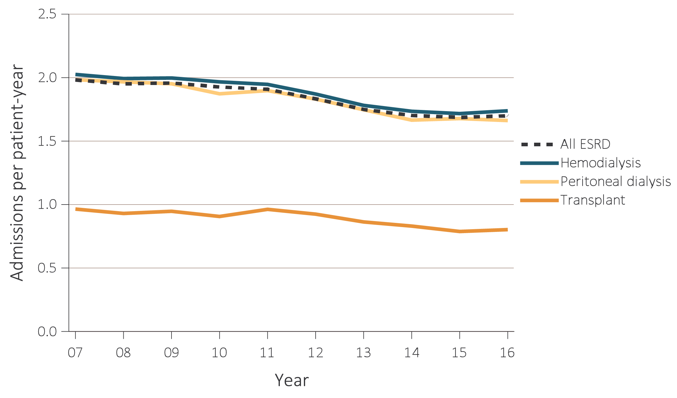
vol 2 Figure 4.1 Adjusted hospitalization rates for ESRD patients, by treatment modality, 2007-2016
Data Source: Special analyses, USRDS ESRD Database. Period prevalent ESRD patients; adjusted for age, sex, race, ethnicity, primary cause of kidney failure, and vintage; standard population: ESRD patients, 2011. Abbreviation: ESRD, end-stage renal disease.

Slide 3
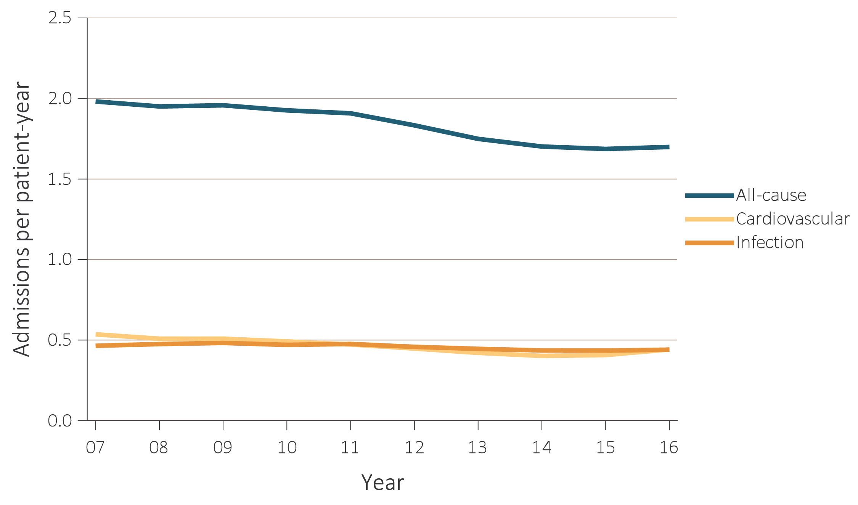
vol 2 Figure 4.2 Adjusted all-cause & cause-specific hospitalization rates for ESRD patients, by treatment modality, 2007-2016
(a) All ESRD
Data Source: Special analyses, USRDS ESRD Database. Period prevalent ESRD patients; adjusted for age, sex, race, ethnicity, primary cause of kidney failure, and vintage; standard population: ESRD patients, 2011. Abbreviation: ESRD, end-stage renal disease.

Slide 4
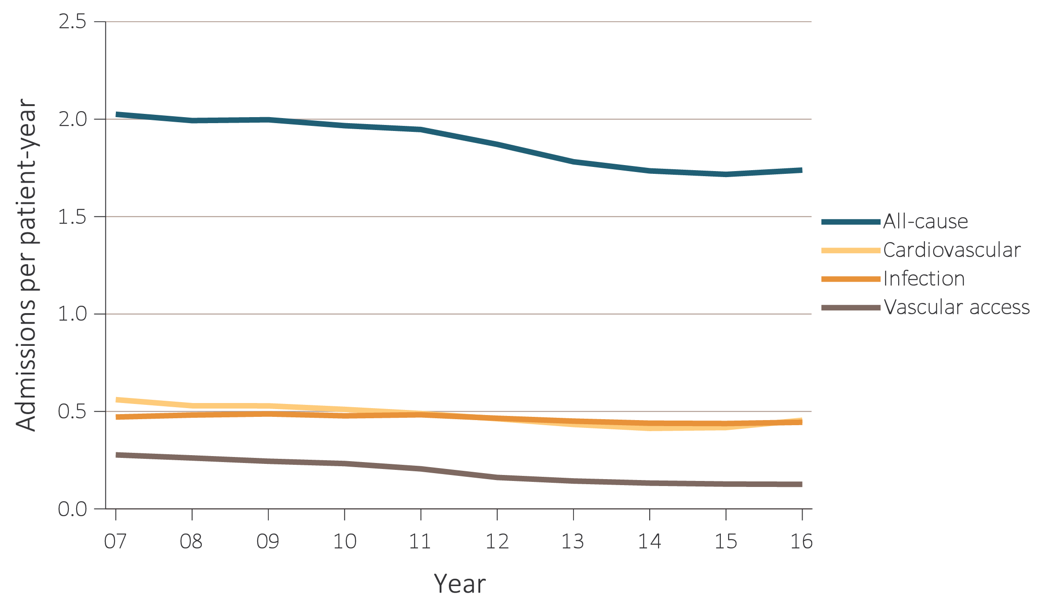
vol 2 Figure 4.2 Adjusted all-cause & cause-specific hospitalization rates for ESRD patients, by treatment modality, 2007-2016
(b) Hemodialysis
Data Source: Special analyses, USRDS ESRD Database. Period prevalent ESRD patients; adjusted for age, sex, race, ethnicity, primary cause of kidney failure, and vintage; standard population: ESRD patients, 2011. Abbreviation: ESRD, end-stage renal disease.

Slide 5
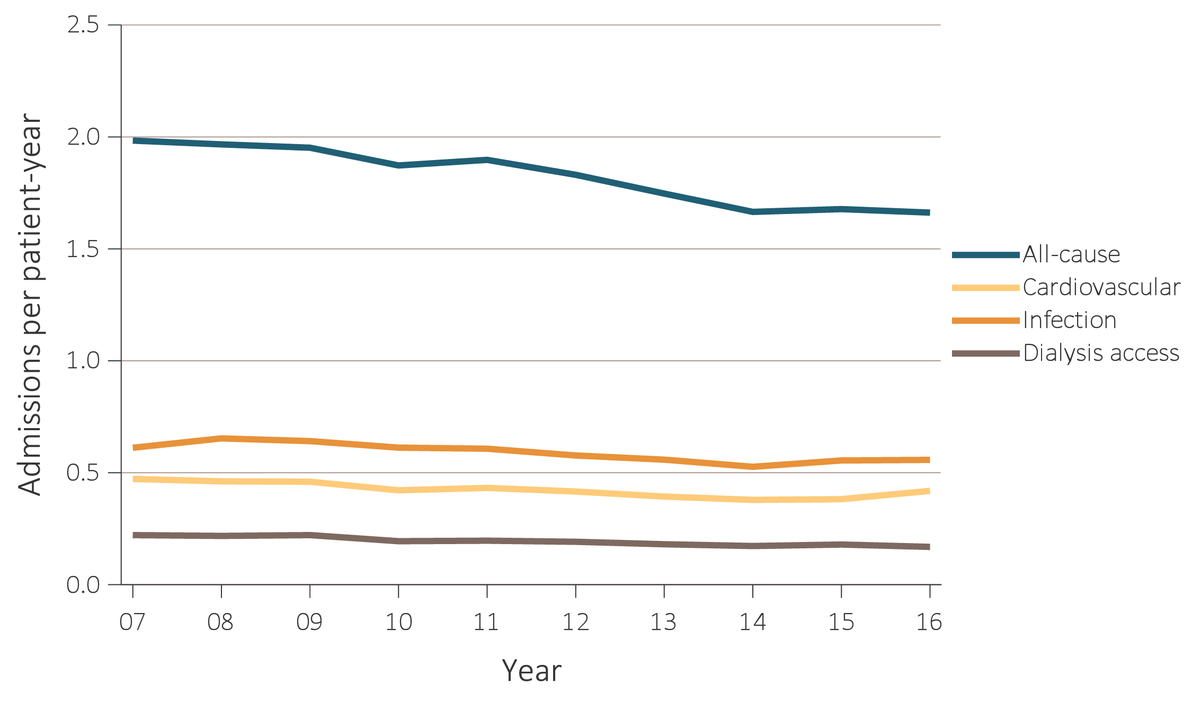
vol 2 Figure 4.2 Adjusted all-cause & cause-specific hospitalization rates for ESRD patients, by treatment modality, 2007-2016
(c) Peritoneal dialysis
Data Source: Special analyses, USRDS ESRD Database. Period prevalent ESRD patients; adjusted for age, sex, race, ethnicity, primary cause of kidney failure, and vintage; standard population: ESRD patients, 2011. Abbreviation: ESRD, end-stage renal disease.

Slide 6
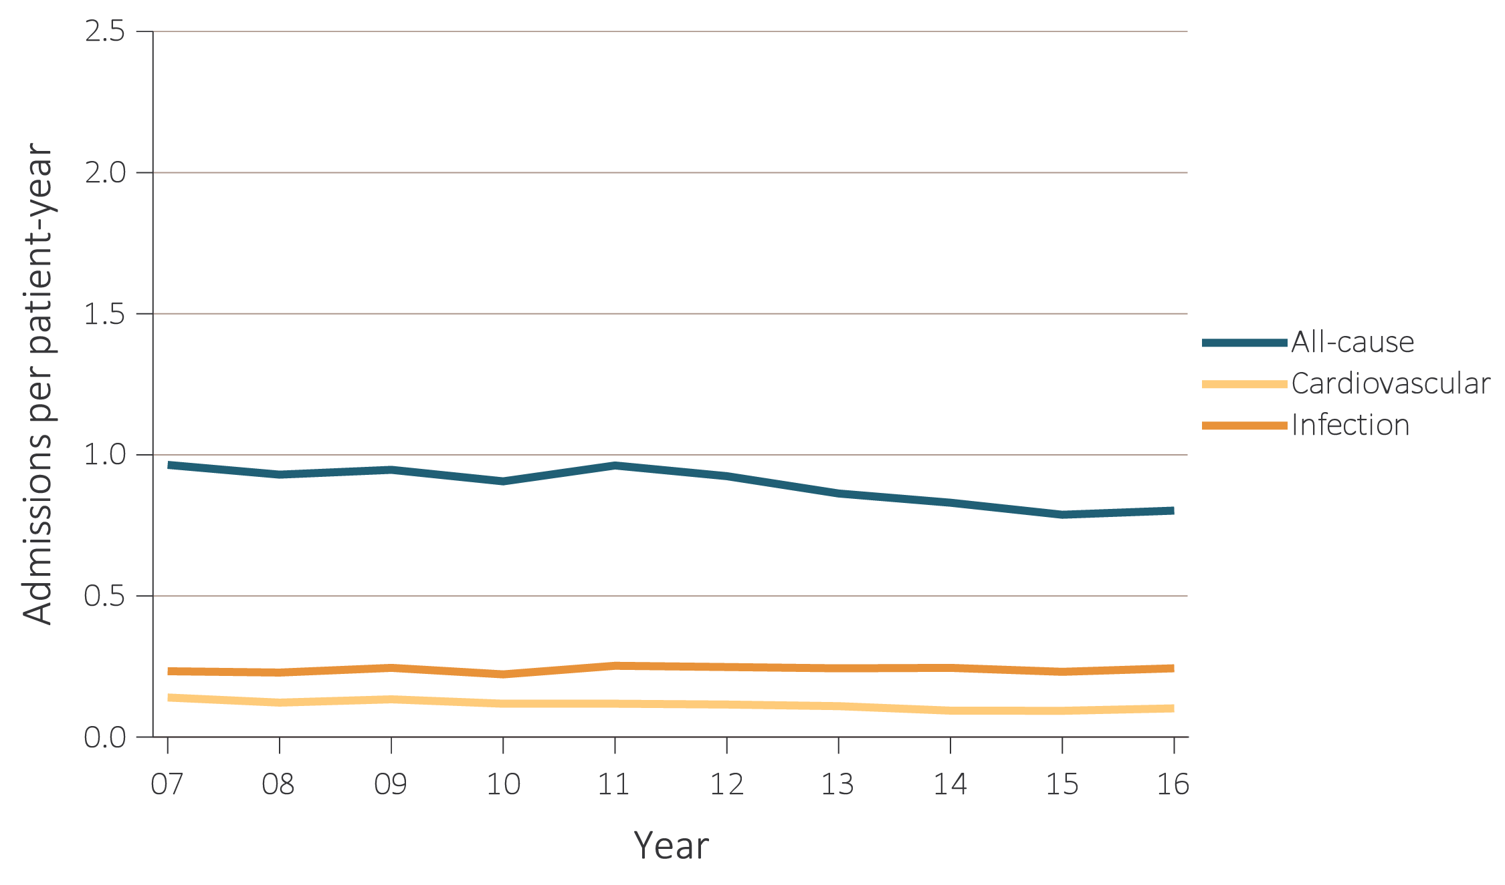
vol 2 Figure 4.2 Adjusted all-cause & cause-specific hospitalization rates for ESRD patients, by treatment modality, 2007-2016
(d) Transplant
Data Source: Special analyses, USRDS ESRD Database. Period prevalent ESRD patients; adjusted for age, sex, race, ethnicity, primary cause of kidney failure, and vintage; standard population: ESRD patients, 2011. Abbreviation: ESRD, end-stage renal disease.

Slide 7
vol 2 Table 4.1 Adjusted rates of all-cause & cause-specific hospitalization per patient-year for adult hemodialysis patients, 2007-2016
 | All | Cardiovascular | Any infection | Vascular access infection
2007-2008 | 1.99 | 0.53 | 0.48 | 0.26
2009-2010 | 1.97 | 0.51 | 0.48 | 0.23
2011-2012 | 1.87 | 0.46 | 0.46 | 0.16
2013-2014 | 1.74 | 0.41 | 0.44 | 0.13
2015-2016 | 1.74 | 0.46 | 0.44 | 0.13
2015-2016, by patient characteristics
Age
22-44 | 1.98 | 0.43 | 0.46 | 0.16
45-64 | 1.71 | 0.44 | 0.43 | 0.12
65-74 | 1.71 | 0.47 | 0.44 | 0.11
75+ | 1.75 | 0.48 | 0.47 | 0.12
Sex
Male | 1.60 | 0.43 | 0.42 | 0.11
Female | 1.92 | 0.48 | 0.48 | 0.15
Race
White | 1.76 | 0.45 | 0.47 | 0.12
Black/African American | 1.75 | 0.47 | 0.42 | 0.14
American Indian or Alaska Native | 1.50 | 0.32 | 0.46 | 0.07
Asian | 1.21 | 0.33 | 0.32 | 0.09
Native Hawaiian or Pacific Islander | 1.29 | 0.33 | 0.38 | 0.10
Other or Multiracial | 1.52 | 0.40 | 0.44 | 0.13
Ethnicity
Hispanic | 1.56 | 0.41 | 0.42 | 0.12
Non-Hispanic | 1.78 | 0.47 | 0.45 | 0.13
Non-Hispanic White | 1.88 | 0.48 | 0.50 | 0.12
Non-Hispanic Black/African American | 1.76 | 0.47 | 0.42 | 0.14
Cause of renal failure
Diabetes | 1.95 | 0.51 | 0.50 | 0.13
Hypertension | 1.61 | 0.46 | 0.38 | 0.12
Glomerulonephritis | 1.51 | 0.38 | 0.38 | 0.12
Other cause | 1.70 | 0.38 | 0.47 | 0.13
Vintage
<1 year | 1.81 | 0.46 | 0.50 | 0.14
1-<2 years | 1.73 | 0.45 | 0.43 | 0.11
2-<5 years | 1.72 | 0.46 | 0.42 | 0.10
5+ years | 1.73 | 0.45 | 0.45 | 0.14
Data Source: Special analyses, USRDS ESRD Database. Period prevalent hemodialysis patients aged 22 & older; adjusted for age, sex, race, ethnicity, primary cause of kidney failure, and vintage; standard population: ESRD patients, 2011. See Vol. 2, ESRD Analytical Methods for principal ICD-9-CM and ICD-10-CM diagnosis codes included in each cause of hospitalization category. Abbreviation: ESRD, end-stage renal disease.

Slide 8
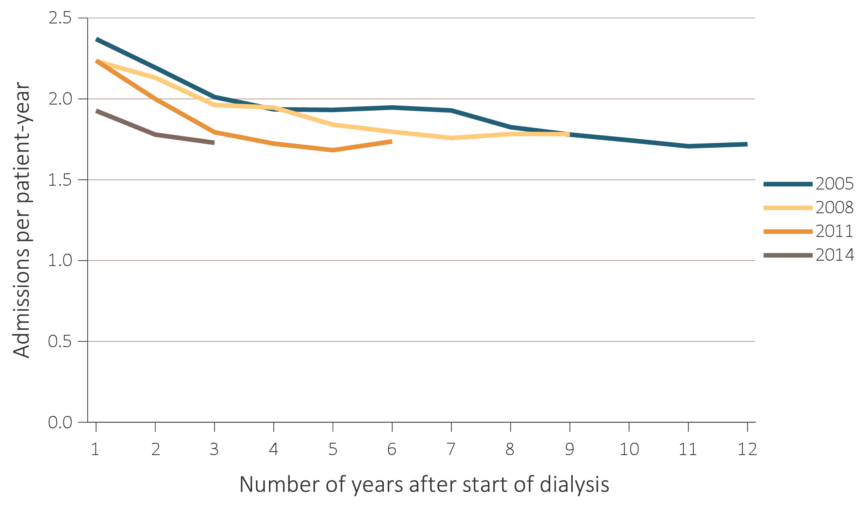
vol 2 Figure 4.3 Adjusted all-cause hospitalization rates by treatment modality and number of years after start of dialysis, for cohorts of incident patients in 2005, 2008, 2011, and 2014
(a) Hemodialysis patients
Data Source: Special analyses, USRDS ESRD Database. Period prevalent ESRD patients, adjusted for age, sex, race, ethnicity, primary cause of kidney failure; standard population: ESRD patients, 2011. Abbreviation: ESRD, end-stage renal disease.

Slide 9
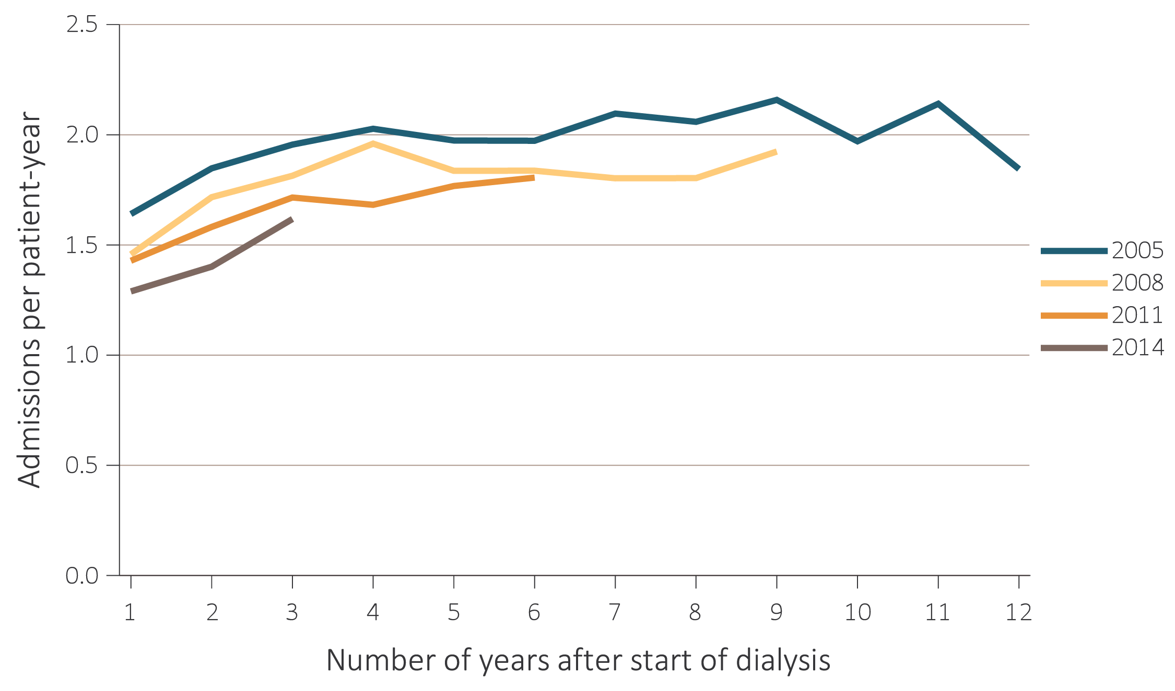
vol 2 Figure 4.3 Adjusted all-cause hospitalization rates by treatment modality and number of years after start of dialysis, for cohorts of incident patients in 2005, 2008, 2011, and 2014
(b) Peritoneal dialysis patients
Data Source: Special analyses, USRDS ESRD Database. Period prevalent ESRD patients, adjusted for age, sex, race, ethnicity, primary cause of kidney failure; standard population: ESRD patients, 2011. Abbreviation: ESRD, end-stage renal disease.

Slide 10
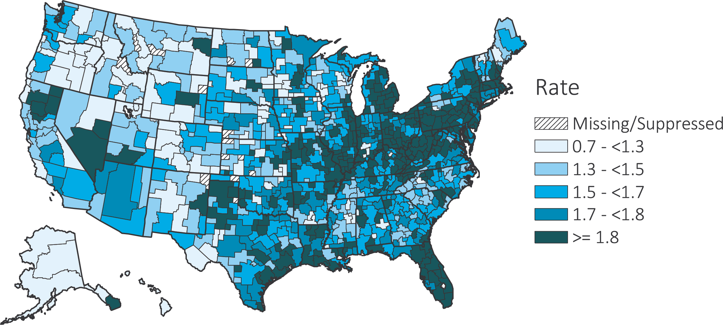
vol 2 Figure 4.4 Map of the hospitalization rates of ESRD, by Health Service Area, in the U.S. population, 2013-2016
(a) Unadjusted
Data Source: Special analyses, USRDS ESRD Database. Period prevalent ESRD patients; adjusted for age, sex, race, ethnicity, primary cause of kidney failure, and vintage; standard population: ESRD patients, 2011. Abbreviation: ESRD, end-stage renal disease.

Slide 11
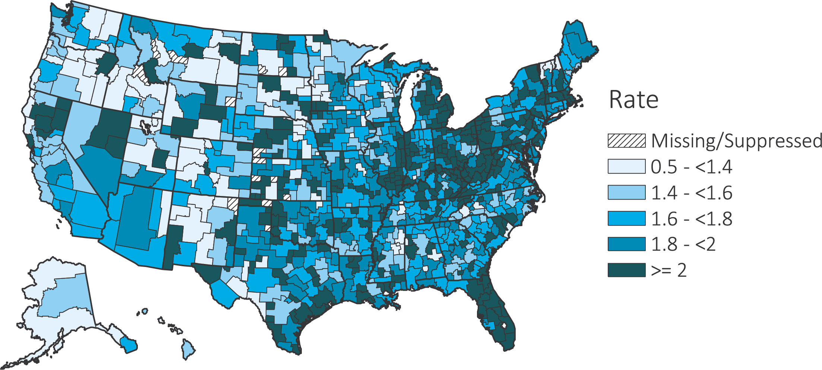
vol 2 Figure 4.4 Map of the hospitalization rates of ESRD, by Health Service Area, in the U.S. population, 2013-2016
(b) Adjusted
Data Source: Special analyses, USRDS ESRD Database. Period prevalent ESRD patients; adjusted for age, sex, race, ethnicity, primary cause of kidney failure, and vintage; standard population: ESRD patients, 2011. Abbreviation: ESRD, end-stage renal disease.

Slide 12
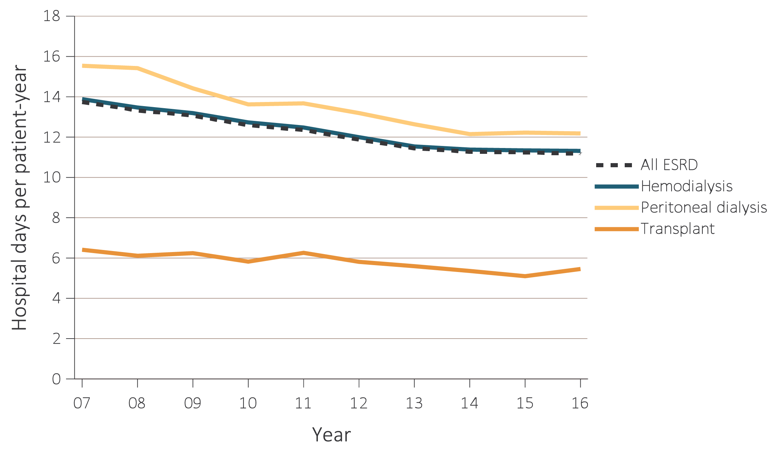
vol 2 Figure 4.5 Adjusted hospital days for ESRD patients, by treatment modality, 2007-2016
Data Source: Special analyses, USRDS ESRD Database. Period prevalent ESRD patients; adjusted for age, sex, race, ethnicity, primary cause of kidney failure, and vintage; standard population: ESRD patients, 2011. Abbreviation: ESRD, end-stage renal disease.

Slide 13
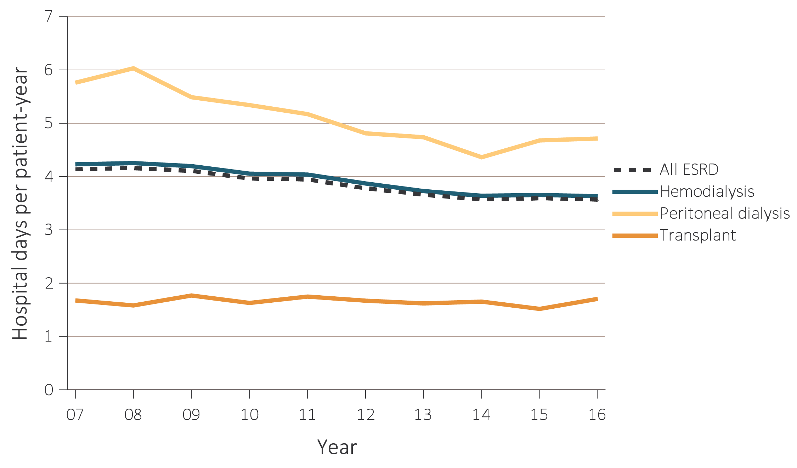
vol 2 Figure 4.6 Adjusted hospital days for infection & cardiovascular causes, for ESRD patients by their treatment modality, 2007-2016
Data Source: Special analyses, USRDS ESRD Database. Period prevalent ESRD patients, adjusted for age, sex, race, ethnicity, primary cause of kidney failure, and vintage; standard population: ESRD patients, 2011. Abbreviation: ESRD, end-stage renal disease.

Slide 14
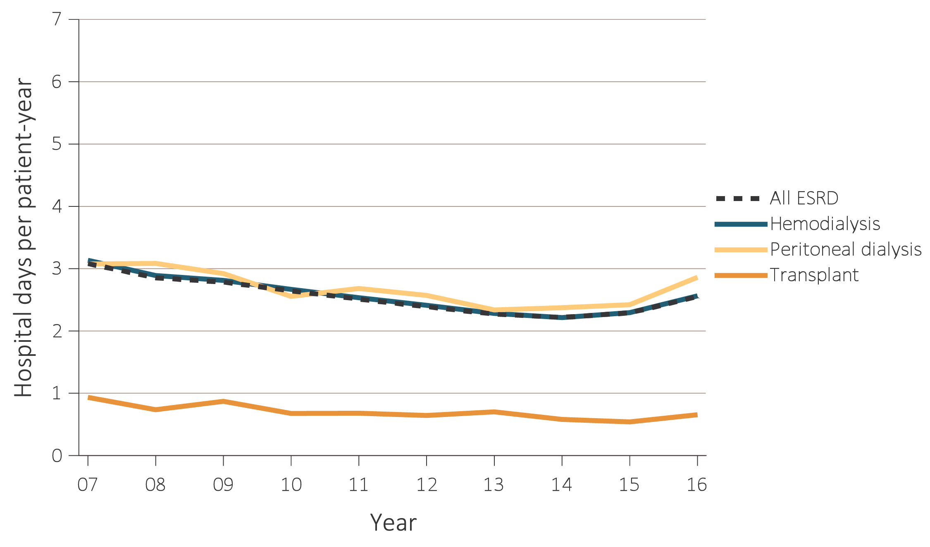
vol 2 Figure 4.6 Adjusted hospital days for infection & cardiovascular causes, for ESRD patients by their treatment modality, 2007-2016
(b) Cardiovascular
Data Source: Special analyses, USRDS ESRD Database. Period prevalent ESRD patients, adjusted for age, sex, race, ethnicity, primary cause of kidney failure, and vintage; standard population: ESRD patients, 2011. Abbreviation: ESRD, end-stage renal disease.

Slide 15
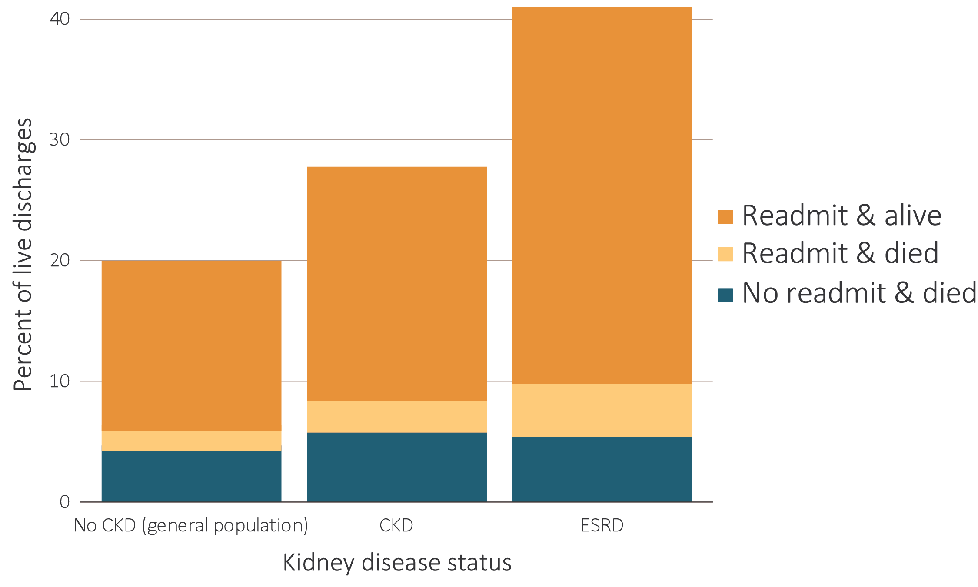
vol 2 Figure 4.7 Proportion of patients aged 66 & older discharged alive from the hospital who were either readmitted or died within 30 days of discharge, by kidney disease status, 2016
Data Source: Special analyses, USRDS ESRD Database and Medicare 5% sample. January 1, 2016 point prevalent Medicare patients aged 66 & older on December 31, 2016. For general Medicare: January 1, 2016 point prevalent, Medicare patients aged 66 & older, discharged alive from an all-cause index hospitalization between January 1, 2016, and December 1, 2016, unadjusted. CKD determined using claims for 2016. Abbreviations: CKD, chronic kidney disease; ESRD, end-stage renal disease; readmit, readmission.

Slide 16
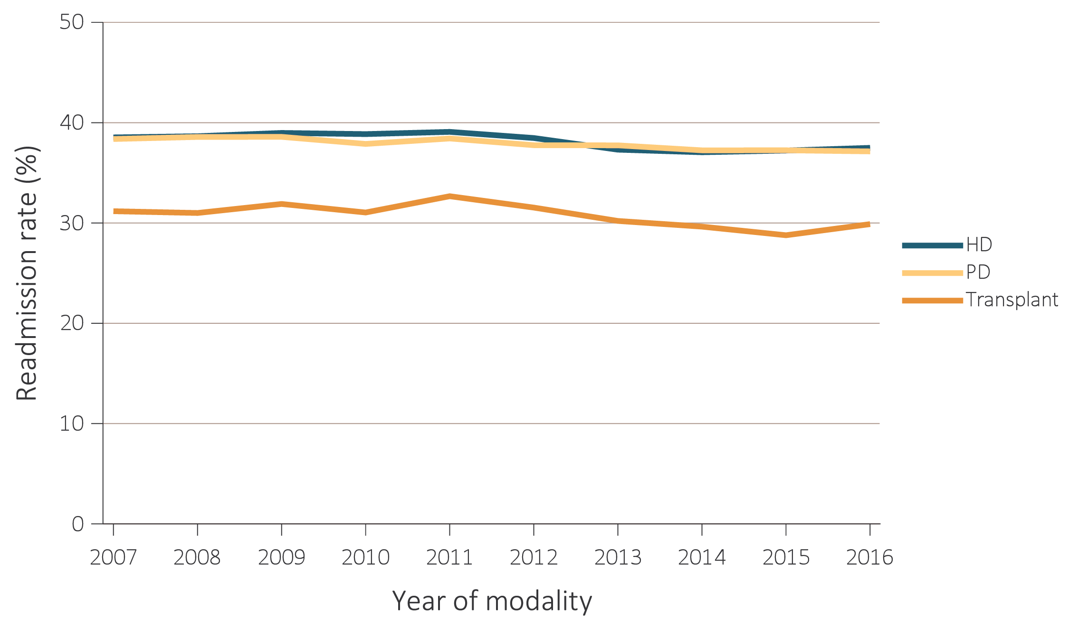
vol 2 Figure 4.8 Proportion of ESRD patients readmitted within 30 days, by treatment modality, 2007-2016
Data Source: Special analyses, USRDS ESRD Database. Abbreviations: ESRD, end-stage renal disease; HD, hemodialysis; PD, peritoneal dialysis.

Slide 17
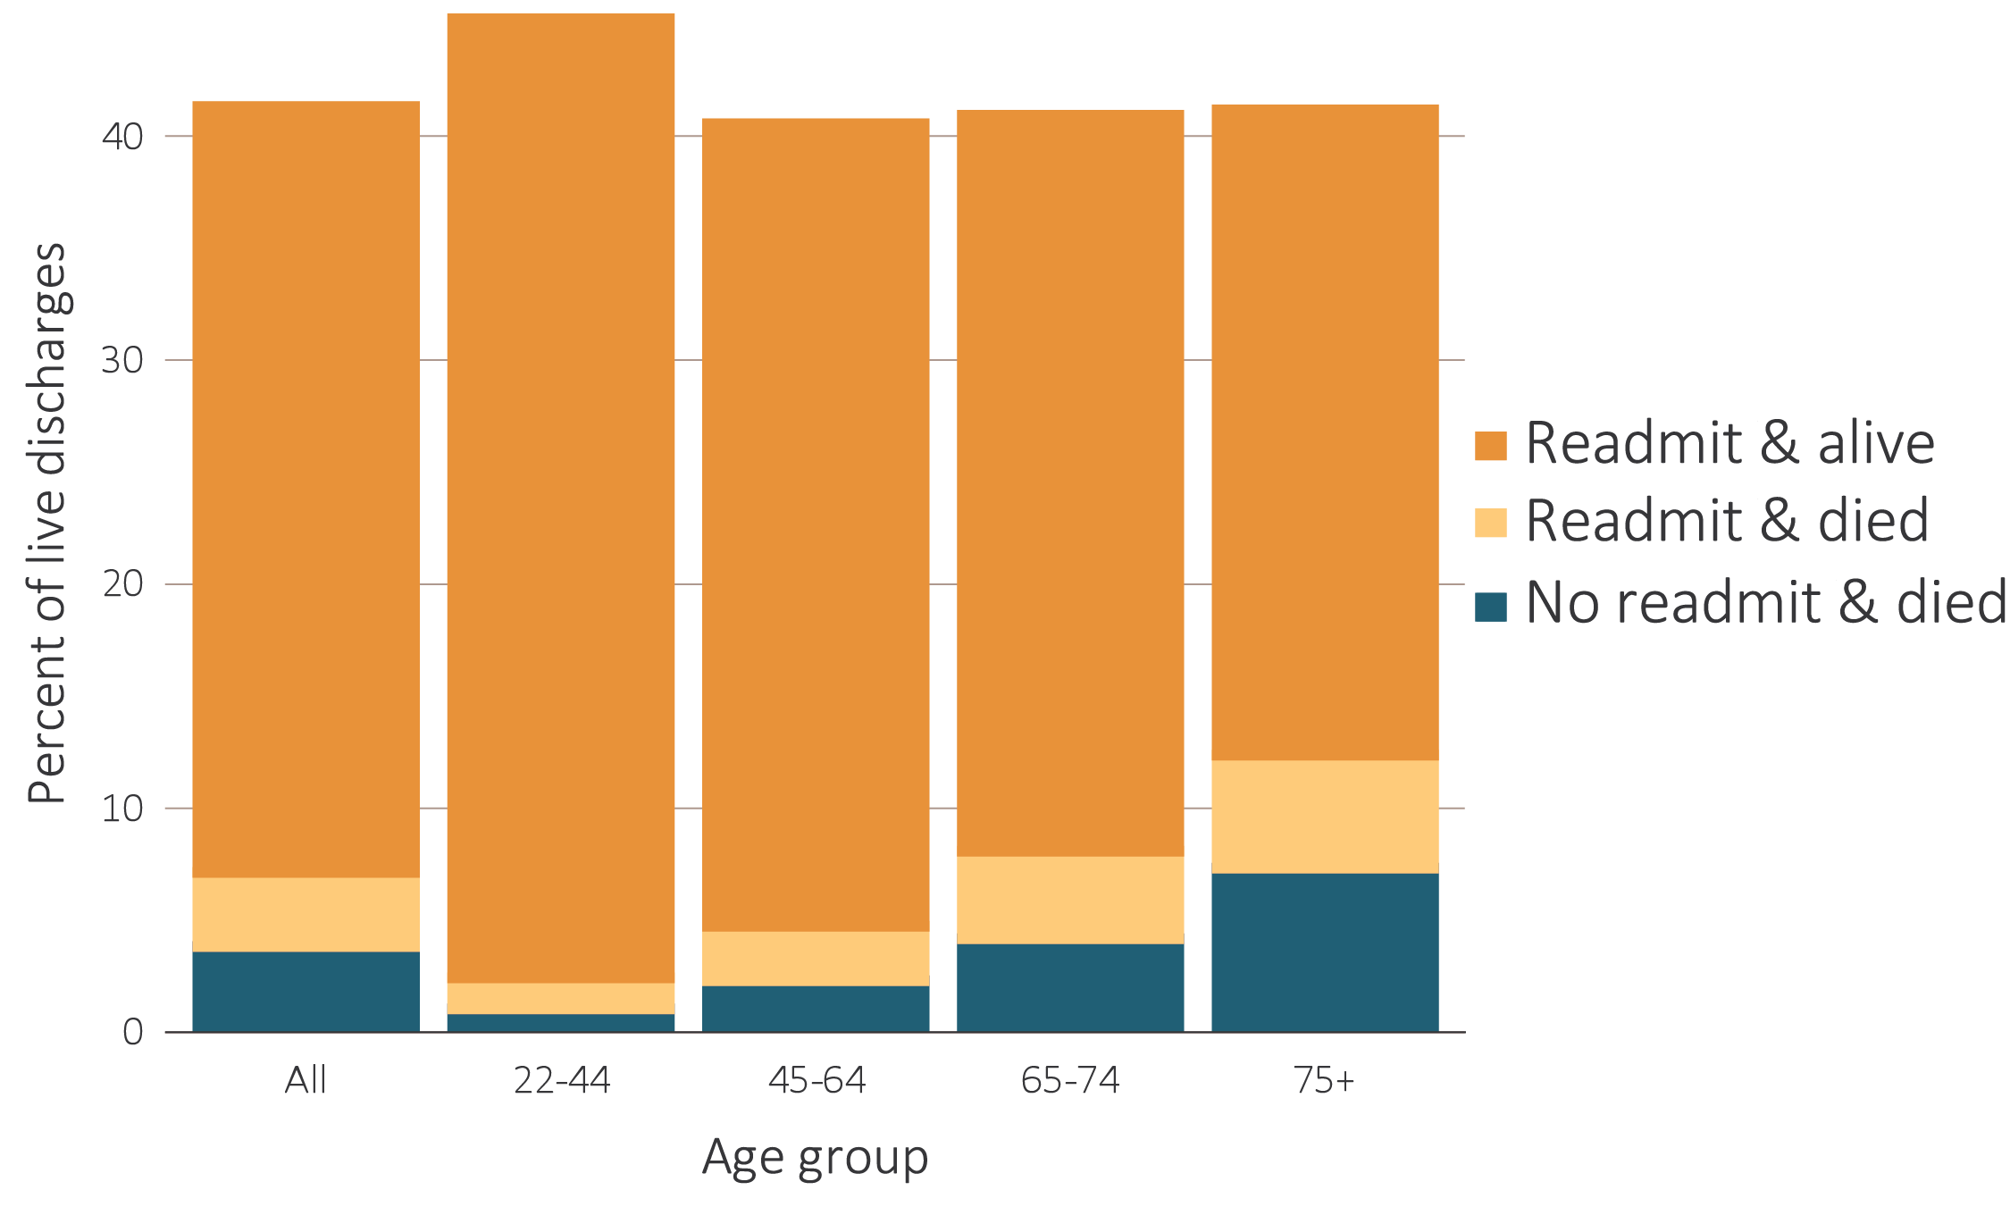
vol 2 Figure 4.9 Proportion of hemodialysis patients discharged alive from the hospital who either were readmitted or died within 30 days of discharge, by demographic characteristics, 2016
(a) By age
Data Source: Special analyses, USRDS ESRD Database. Period prevalent hemodialysis patients, all ages, 2016, unadjusted. Patients less than age 22 are not represented as a group due to insufficient sample size. Includes live hospital discharges from January 1 to December 1, 2016. Cause-specific hospitalizations are defined by principal ICD-10-CM codes. See Vol. 2, ESRD Analytical Methods for principal ICD-10-CM diagnosis codes included in each cause of hospitalization category. Af Am, African American; AI, American Indian; AN, Alaska Native; NH, Native Hawaiian; NH Black/Af Am, Non-Hispanic Black/African American; NH White, Non-Hispanic White; Other, other, multiracial, or unidentified race; PI, Pacific Islander; readmit, readmission.

Slide 18
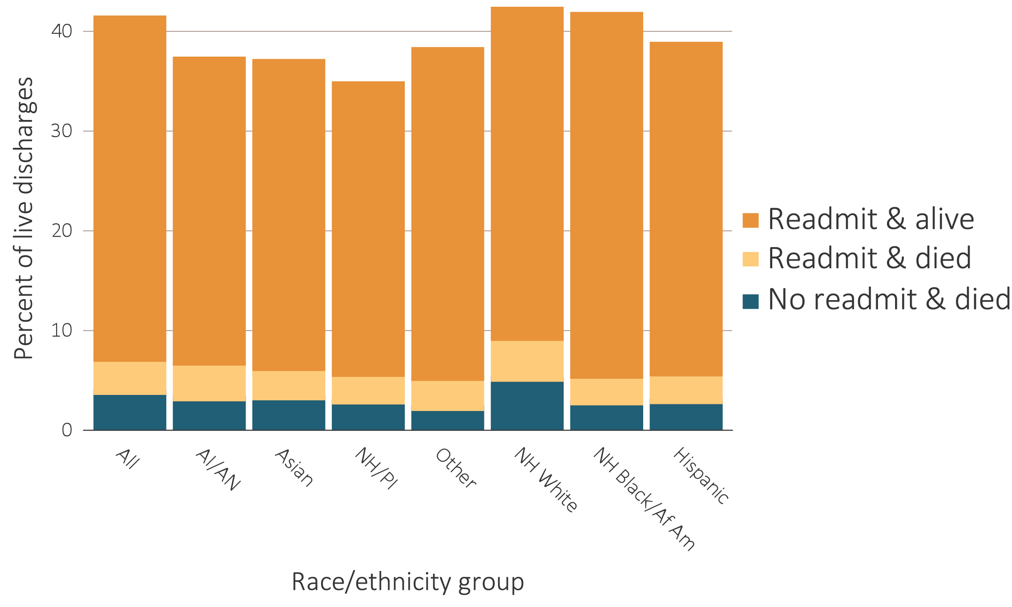
vol 2 Figure 4.9 Proportion of hemodialysis patients discharged alive from the hospital who either were readmitted or died within 30 days of discharge, by demographic characteristics, 2016
(b) By race/ethnicity
Data Source: Special analyses, USRDS ESRD Database. Period prevalent hemodialysis patients, all ages, 2016, unadjusted. Patients less than age 22 are not represented as a group due to insufficient sample size. Includes live hospital discharges from January 1 to December 1, 2016. Cause-specific hospitalizations are defined by principal ICD-10-CM codes. See Vol. 2, ESRD Analytical Methods for principal ICD-10-CM diagnosis codes included in each cause of hospitalization category. Af Am, African American; AI, American Indian; AN, Alaska Native; NH, Native Hawaiian; NH Black/Af Am, Non-Hispanic Black/African American; NH White, Non-Hispanic White; Other, other, multiracial, or unidentified race; PI, Pacific Islander; readmit, readmission.

Slide 19
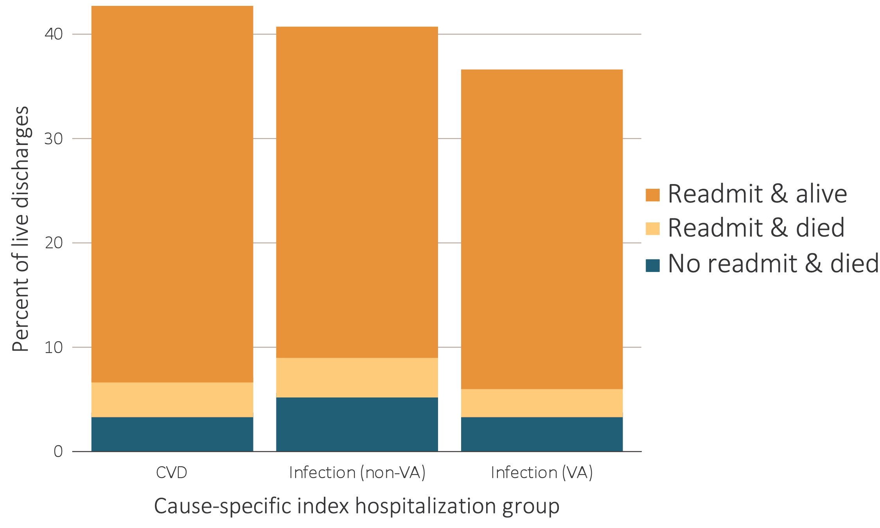
vol 2 Figure 4.10 Proportion of hemodialysis patients discharged alive that either were readmitted or died within 30 days of discharge, by cause of index hospitalization, 2016
Data Source: Special analyses, USRDS ESRD Database. Period prevalent hemodialysis patients, all ages, 2016, unadjusted. Includes live hospital discharges from January 1 to December 1, 2016. Cause-specific hospitalizations are defined by principal ICD-10-CM codes. See Vol. 2, ESRD Analytical Methods for principal ICD-10-CM diagnosis codes included in each cause of hospitalization category. Abbreviations: CVD, cardiovascular disease; readmit, readmission; VA, vascular access.

Slide 20
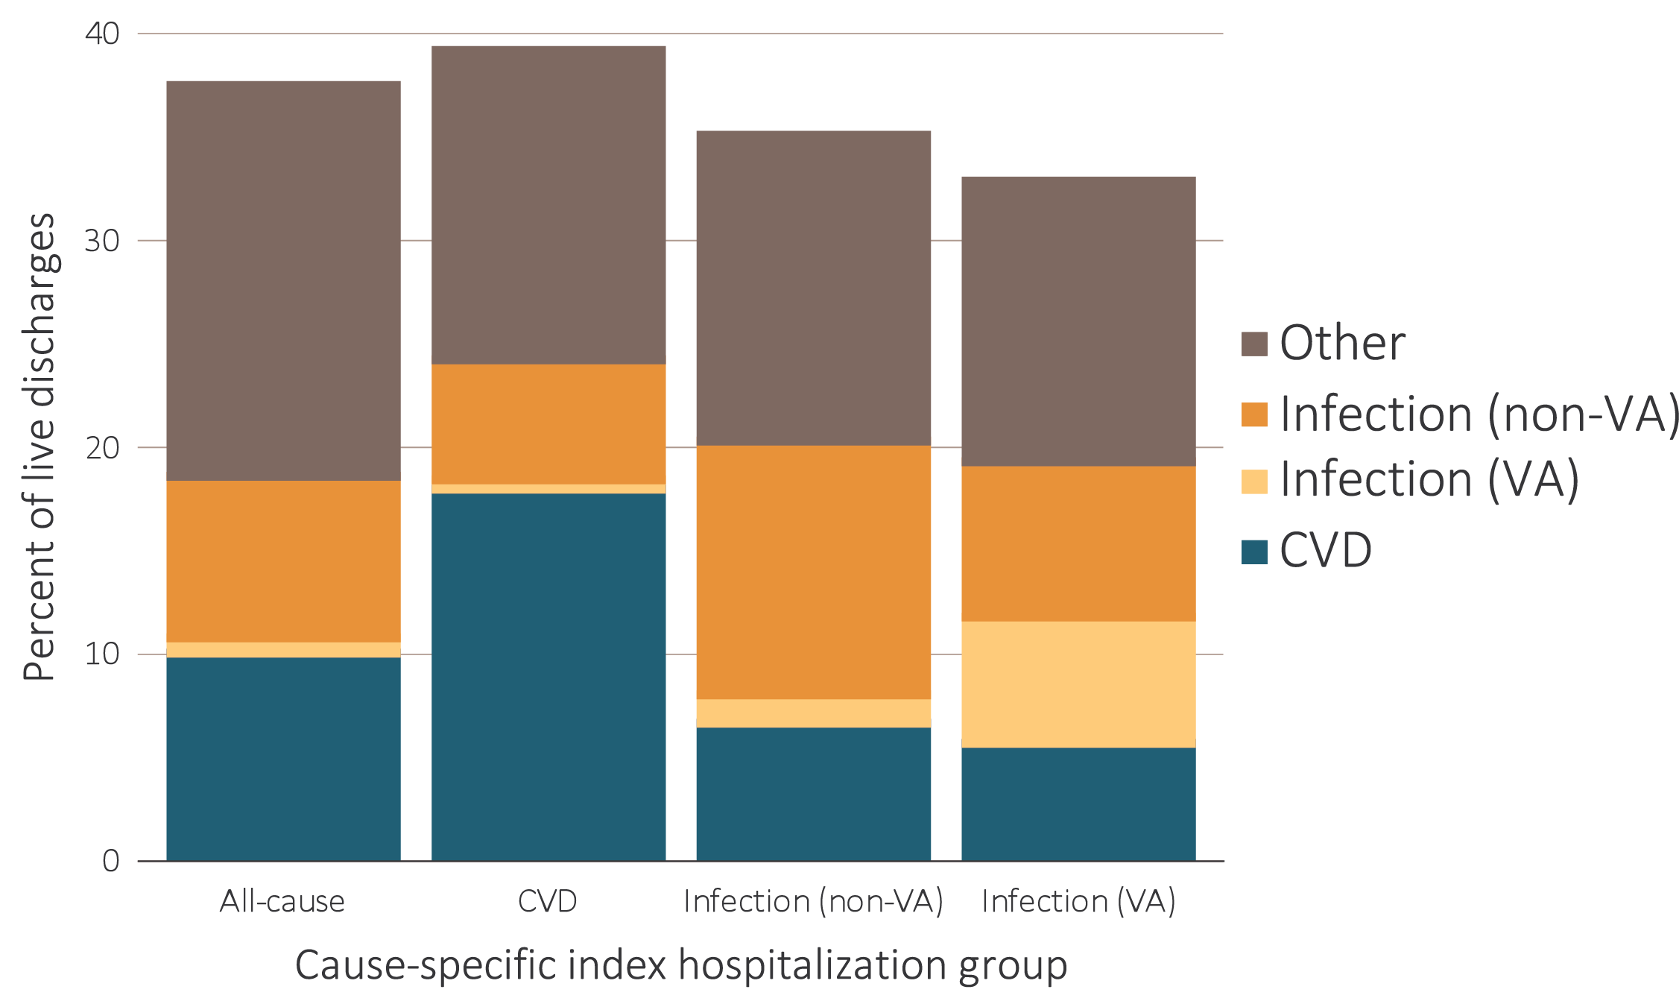
vol 2 Figure 4.11 Proportion of hemodialysis patients with cause-specific readmissions within 30 days of discharge, by cause of index hospitalization, 2016
Data Source: Special analyses, USRDS ESRD Database. Period prevalent hemodialysis patients, all ages, 2016, unadjusted. Includes live hospital discharges from January 1 to December 1, 2016. Cause-specific hospitalizations are defined by principal ICD-10-CM codes. See Vol. 2, ESRD Analytical Methods for principal ICD-10-CM diagnosis codes included in each cause of hospitalization category. Abbreviations: CVD, cardiovascular disease; VA, vascular access.

Slide 21
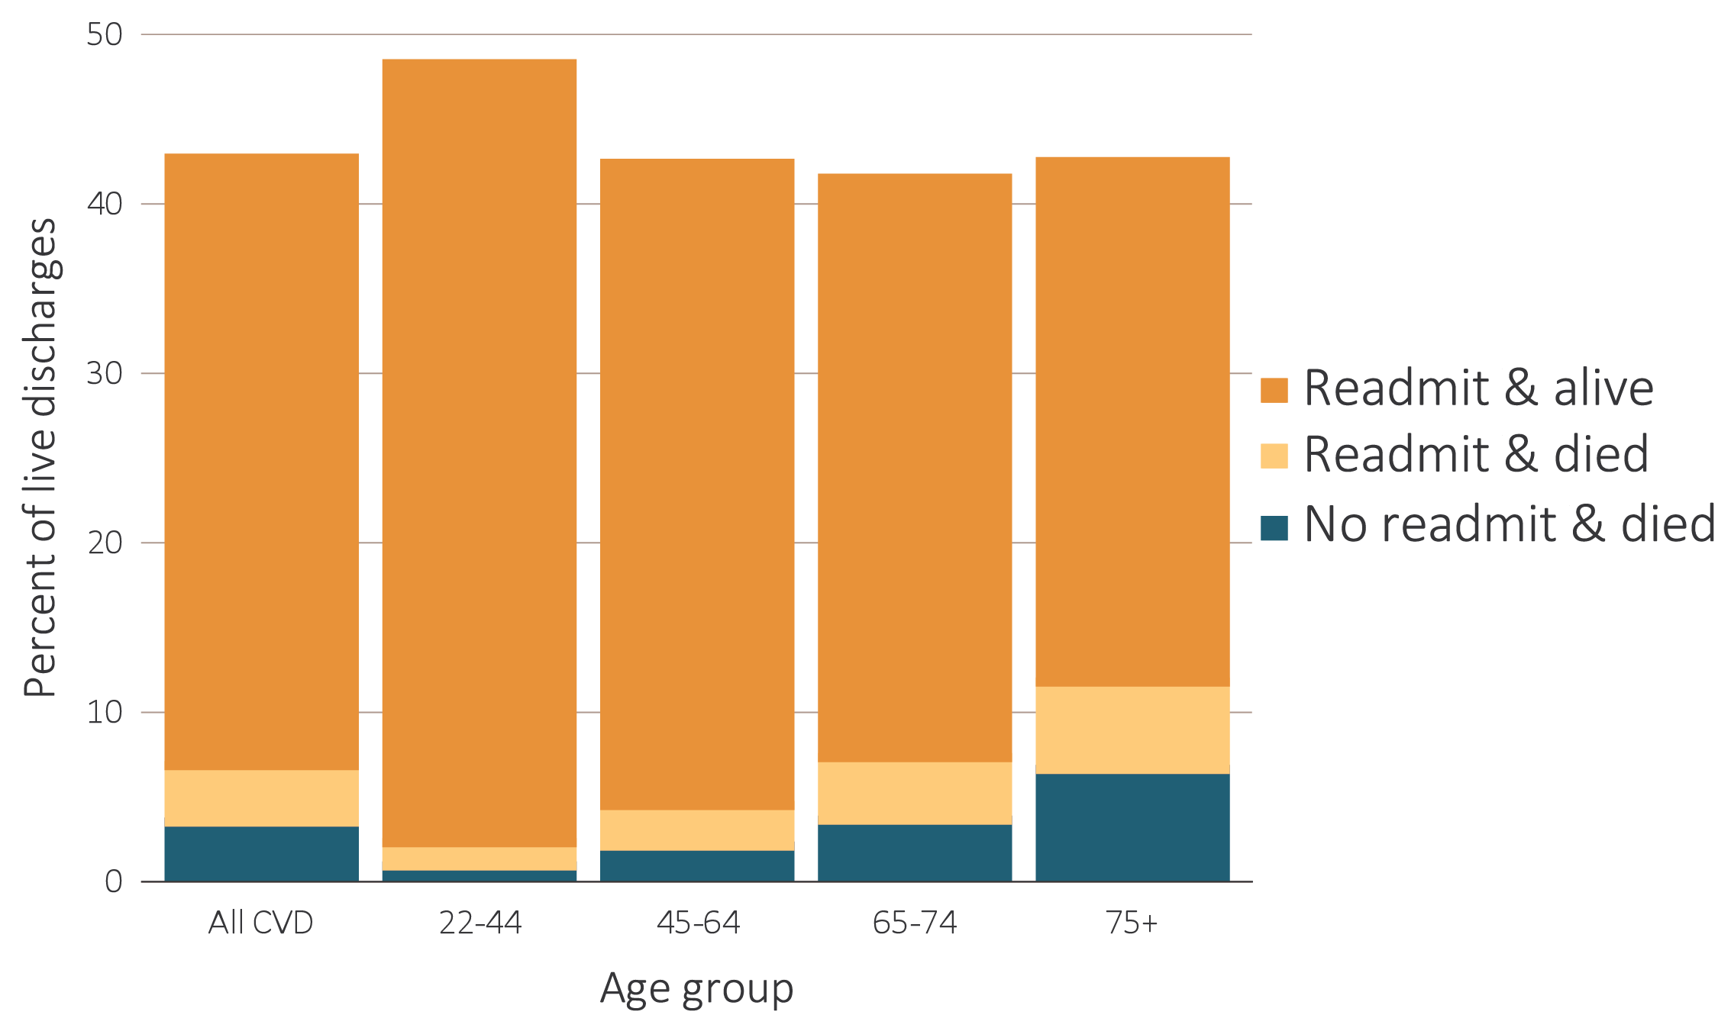
vol 2 Figure 4.12 Proportion of hemodialysis patients discharged alive who were either readmitted or died within 30 days of discharge for (a) cardiovascular index hospitalization and (b) infection index hospitalization, by age, 2016
(a) Cardiovascular index hospitalization
Data Source: Special analyses, USRDS ESRD Database. Period prevalent hemodialysis patients, all ages, 2016, unadjusted. Patients less than age 22 are not represented as a group due to insufficient sample size. Includes live hospital discharges from January 1 to December 1, 2016. Cause-specific hospitalizations are defined by principal ICD-10-CM codes. See Vol. 2, ESRD Analytical Methods for principal ICD-10-CM diagnosis codes included in each cause of hospitalization category. Abbreviation: readmit, readmission.

Slide 22
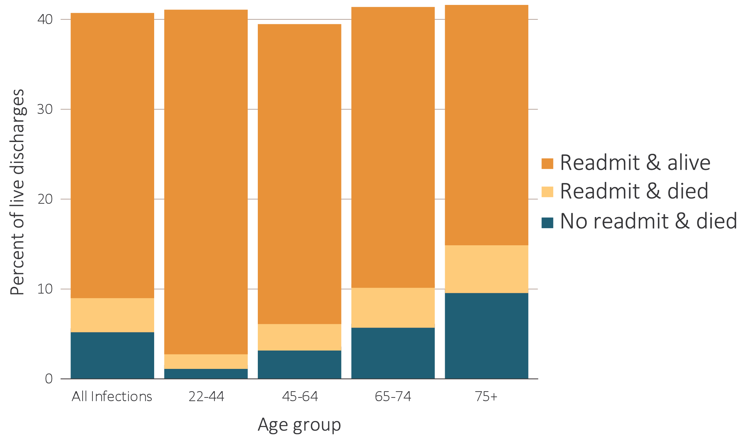
vol 2 Figure 4.12 Proportion of hemodialysis patients discharged alive who were either readmitted or died within 30 days of discharge for (a) cardiovascular index hospitalization and (b) infection index hospitalization, by age, 2016
(b) Infection index hospitalization
Data Source: Special analyses, USRDS ESRD Database. Period prevalent hemodialysis patients, all ages, 2016, unadjusted. Patients less than age 22 are not represented as a group due to insufficient sample size. Includes live hospital discharges from January 1 to December 1, 2016. Cause-specific hospitalizations are defined by principal ICD-10-CM codes. See Vol. 2, ESRD Analytical Methods for principal ICD-10-CM diagnosis codes included in each cause of hospitalization category. Abbreviation: readmit, readmission.

Slide 23
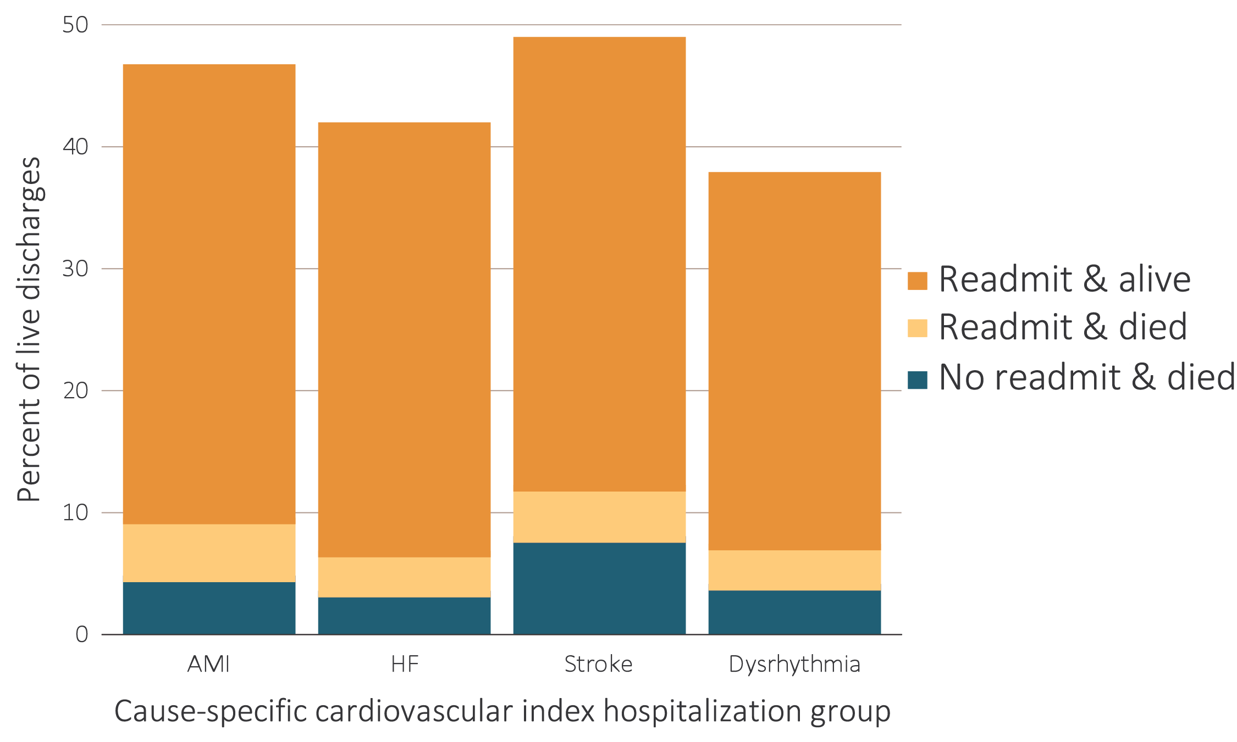
vol 2 Figure 4.13 Proportion of hemodialysis patients discharged alive who were either readmitted or died within 30 days of discharge for cardiovascular index hospitalization, by cause-specific cardiovascular index hospitalization, 2016
Data Source: Special analyses, USRDS ESRD Database. Period prevalent hemodialysis patients, all ages, 2016, unadjusted. Includes live hospital discharges from January 1 to December 1, 2016. Cause-specific hospitalizations are defined by principal ICD-10-CM codes. See Vol. 2, ESRD Analytical Methods for principal ICD-10-CM diagnosis codes included in each cause of hospitalization category. Abbreviations: AMI, acute myocardial infarction; HF, heart failure; readmit, readmission.

Slide 24
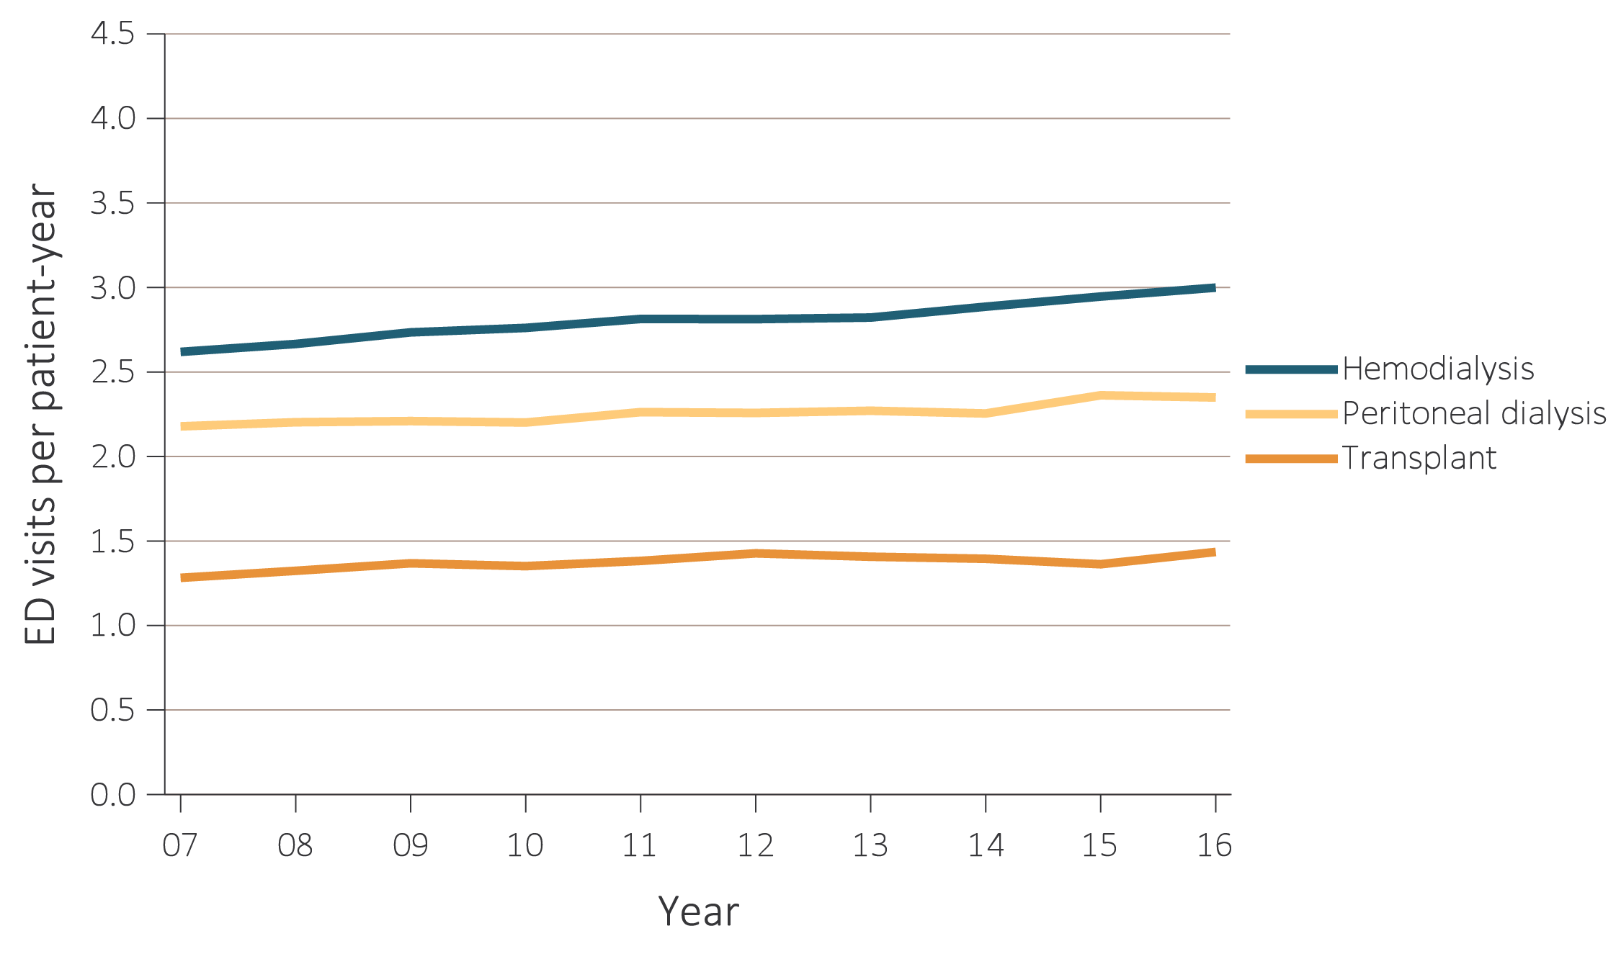
vol 2 Figure 4.14 Unadjusted ED visit rates for ESRD patients, by treatment modality, 2007-2016
Data Source: Special analyses, USRDS ESRD Database. Abbreviations: ED, emergency department; ESRD, end-stage renal disease.

Slide 25
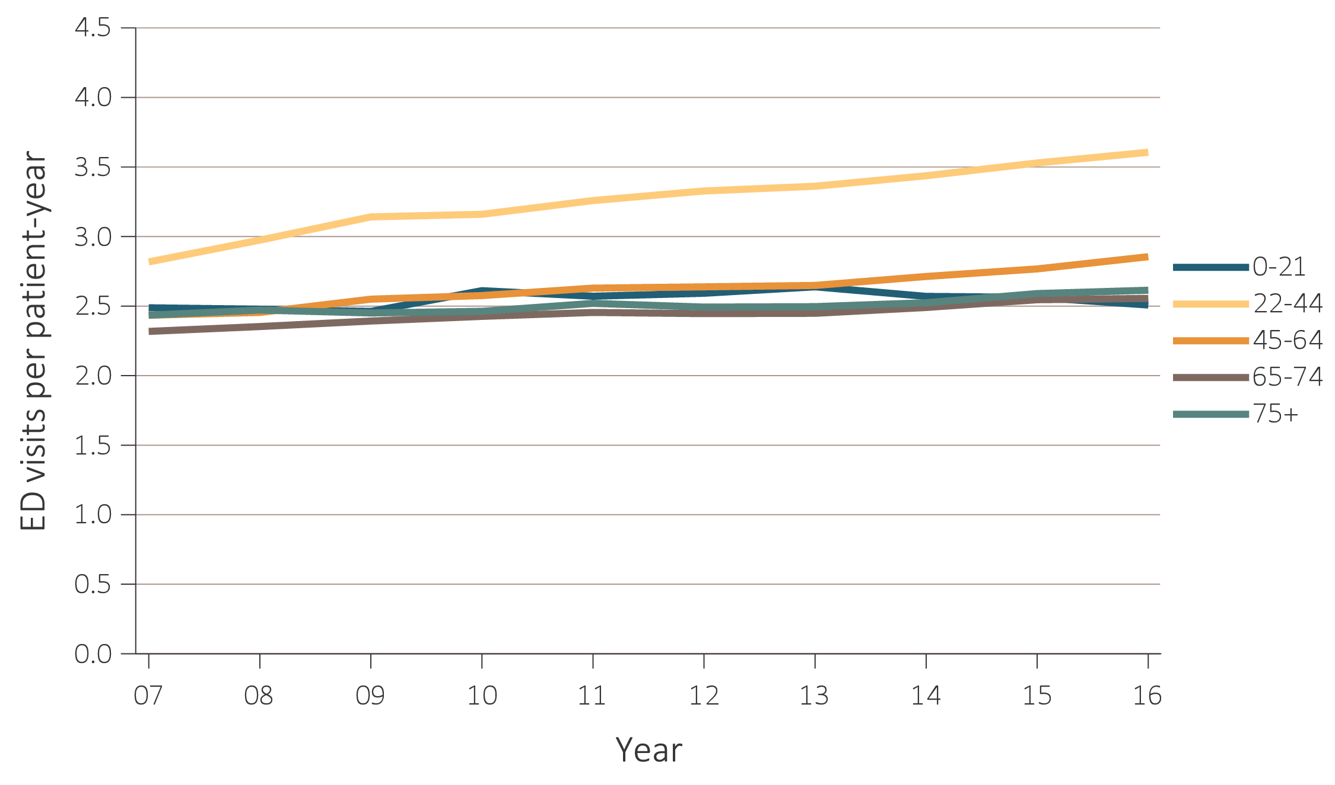
vol 2 Figure 4.15 Unadjusted ED visit rates for ESRD patients, by age group and treatment modality, 2007-2016
(a) All ESRD
Data Source: Special analyses, USRDS ESRD Database. Abbreviations: ED, emergency department; ESRD, end-stage renal disease; HD, hemodialysis; PD, peritoneal dialysis.

Slide 26
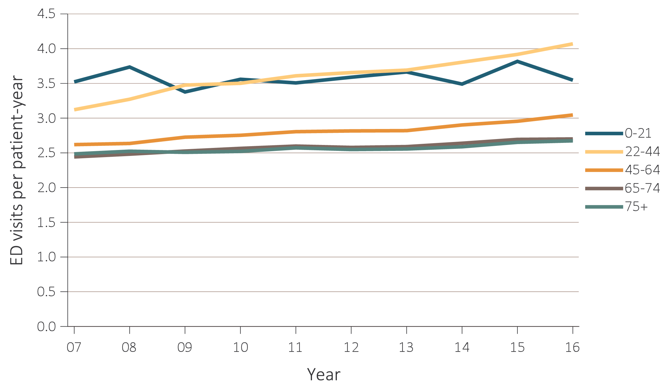
vol 2 Figure 4.15 Unadjusted ED visit rates for ESRD patients, by age group and treatment modality, 2007-2016
(b) Hemodialysis

Slide 27
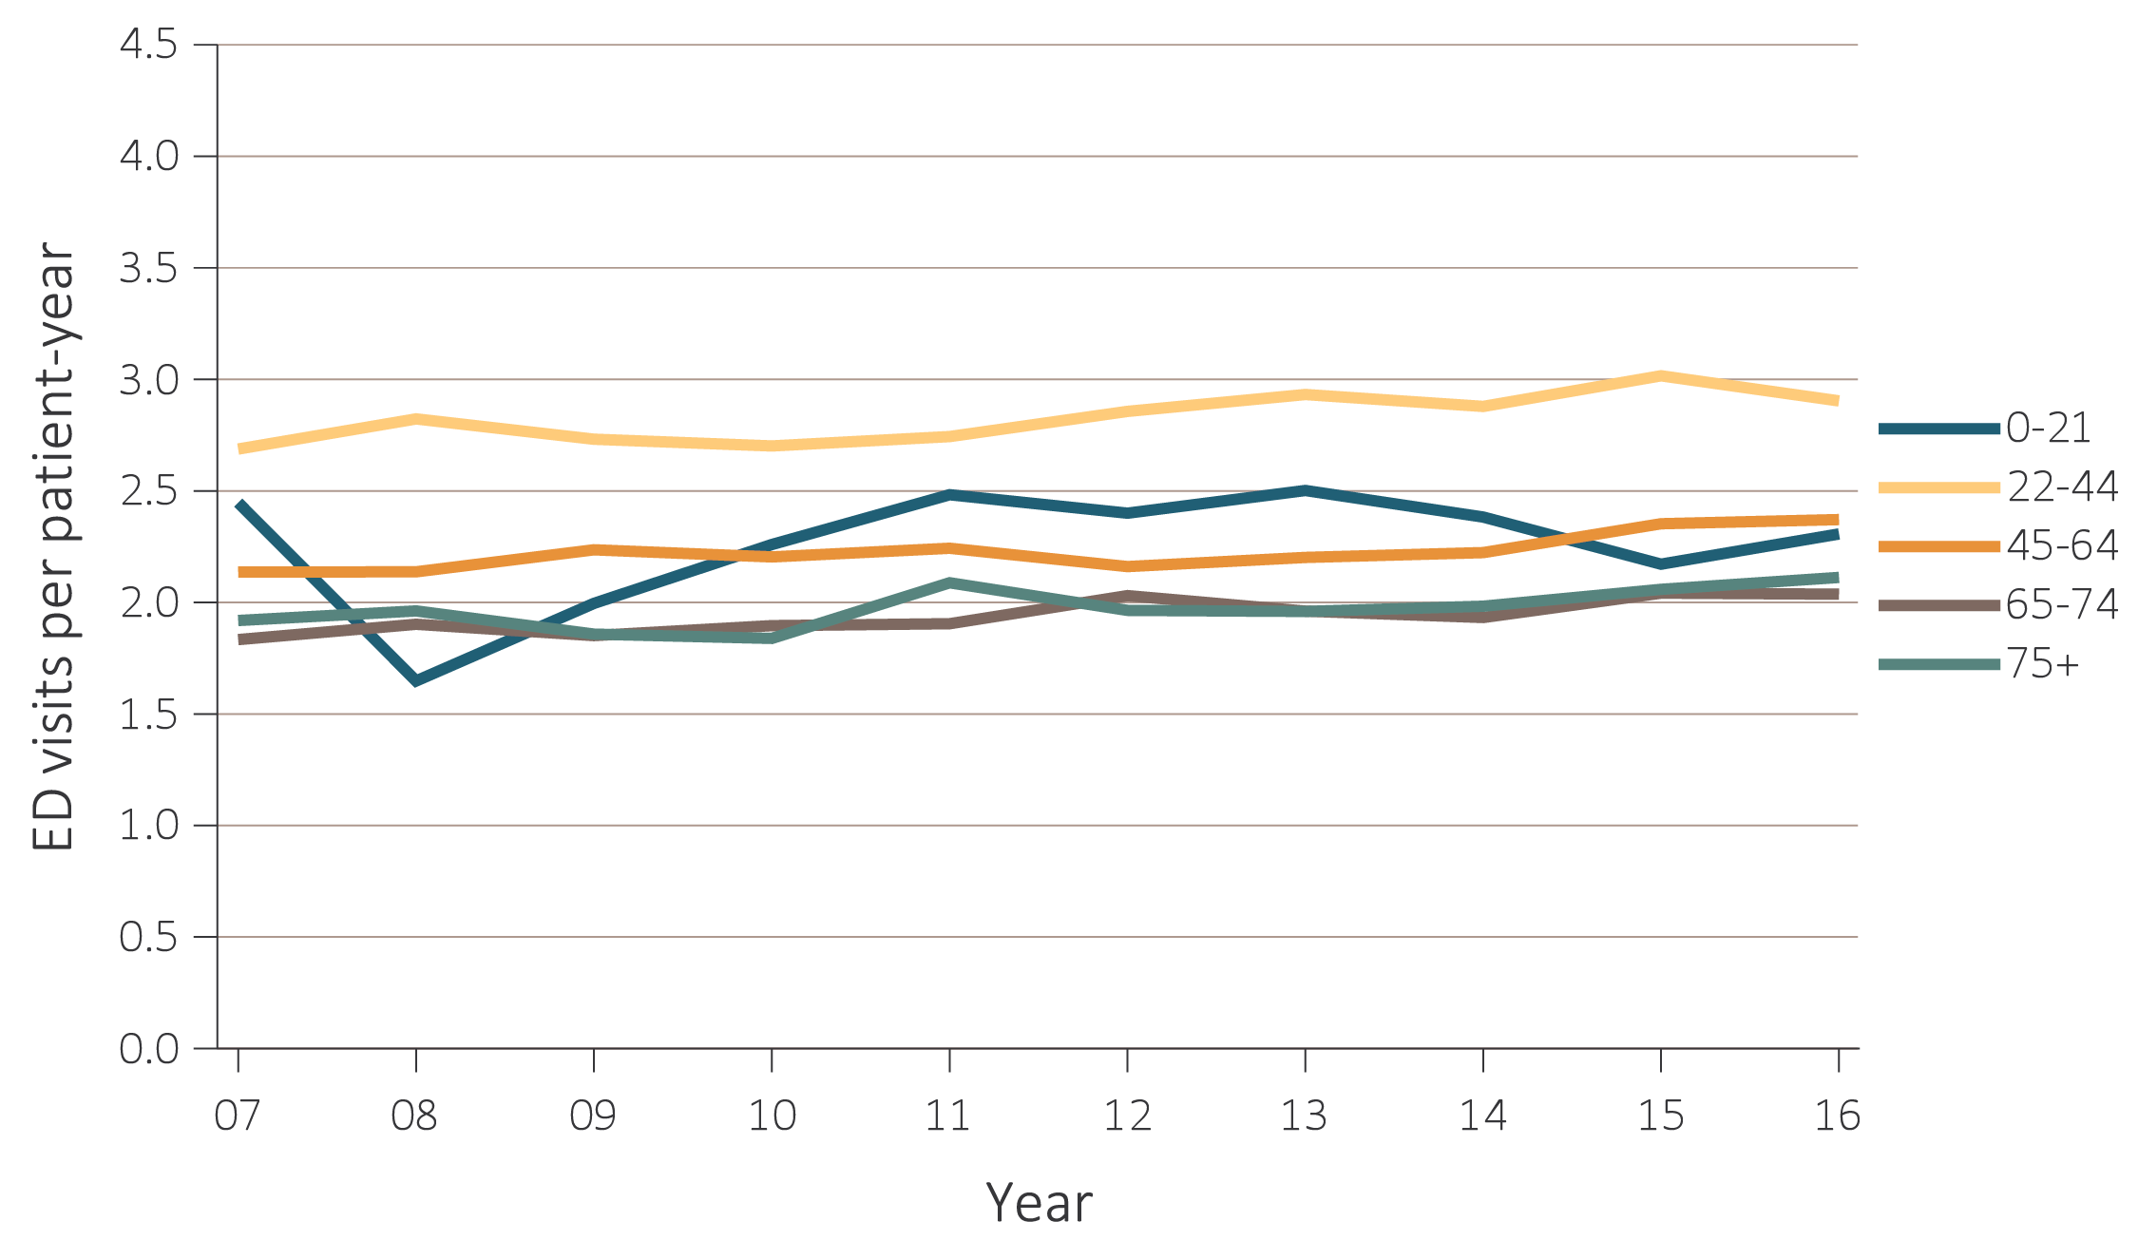
vol 2 Figure 4.15 Unadjusted ED visit rates for ESRD patients, by age group and treatment modality, 2007-2016
(c) Peritoneal dialysis

Slide 28
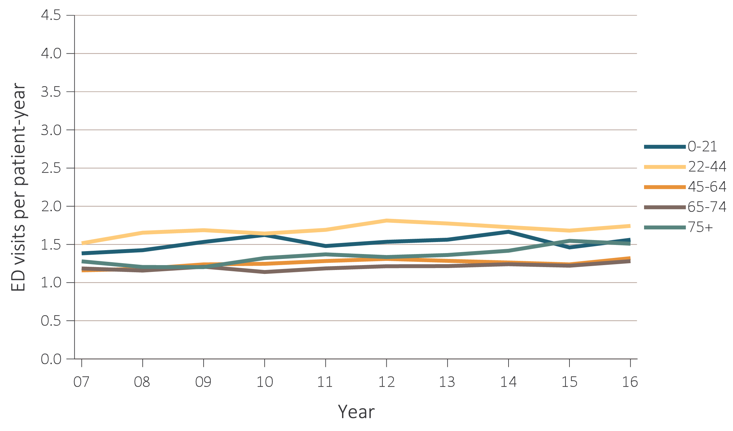
vol 2 Figure 4.15 Unadjusted ED visit rates for ESRD patients, by age group and treatment modality, 2007-2016
(d) Transplant

Slide 29
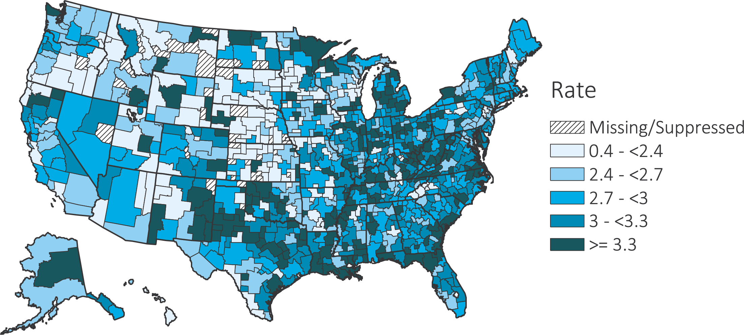
vol 2 Figure 4.16 Map of the ED visit rates of ESRD, by Health Service Area, in the U.S. population, 2016
Data Source: Special analyses, USRDS ESRD Database. Abbreviations: ED, emergency department; ESRD, end-stage renal disease.

Slide 30
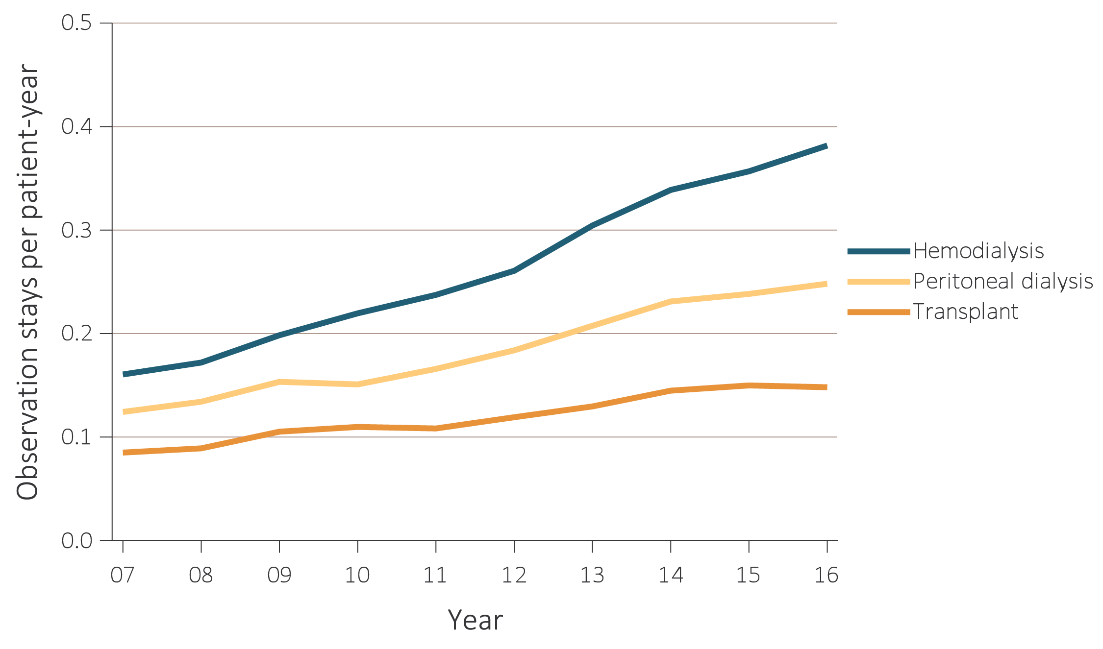
vol 2 Figure 4.17 Unadjusted observation stay rates for ESRD patients, by treatment modality, 2007-2016
Data Source: Special analyses, USRDS ESRD Database. Abbreviation: ESRD, end-stage renal disease.

Slide 31
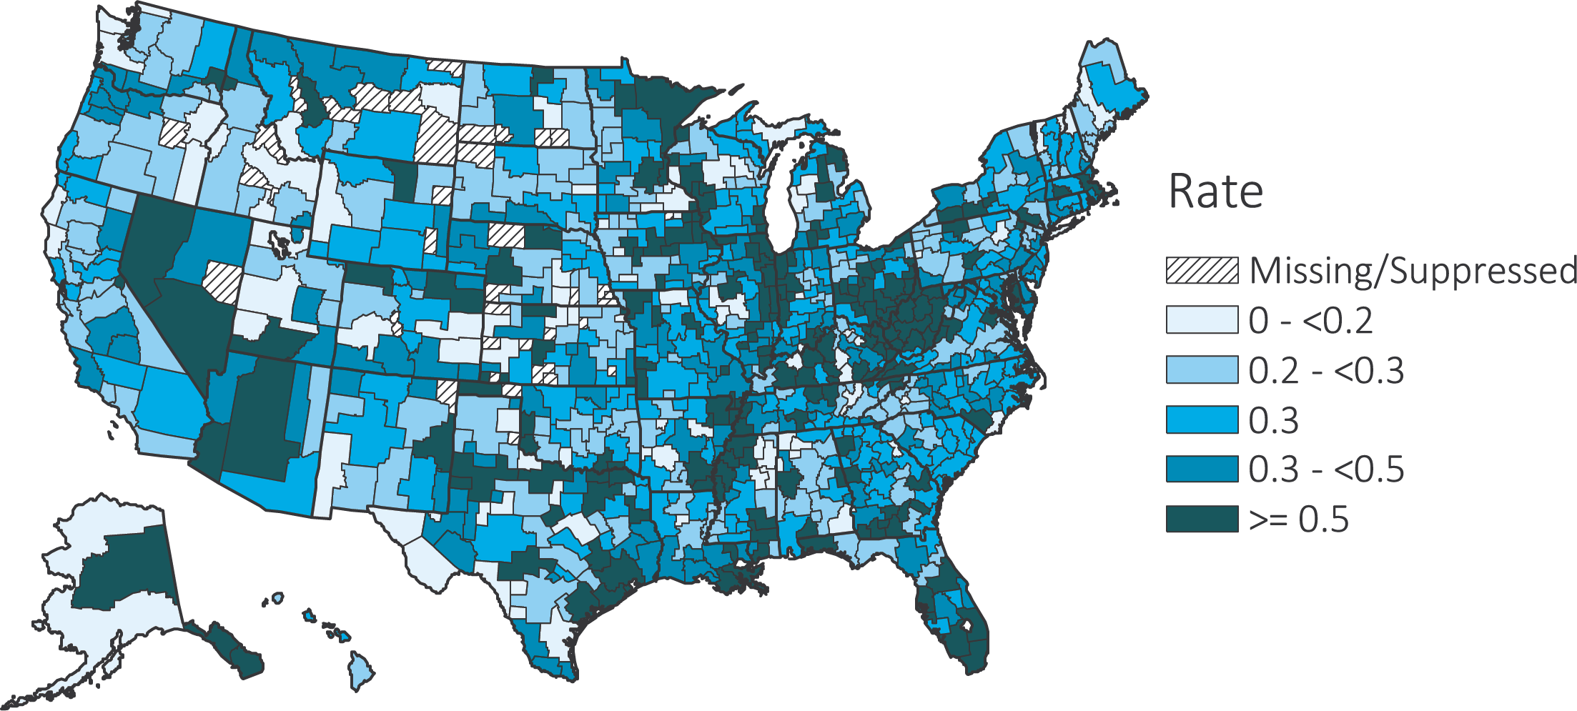
vol 2 Figure 4.18 Map of unadjusted observation stay rates of ESRD, by Health Service Area, in the U.S. population, 2016
Data Source: Special analyses, USRDS ESRD Database. Abbreviation: ESRD, end-stage renal disease.

Slide 32
vol 2 Table 4.2 Top Ten Most Common Principal Diagnosis Clinical Classifications for Patients with ESRD, by Service Type, 2016
Hospitalization (n = 870,783) |  | Readmission (n = 168,002) |  | ED with Admission (n = 487,492) |  | ED w/o Admission (n = 562,078) |  | Observation Stay (n = 124,223)
Septicemia (except in labor) | 9.3% | Septicemia (except in labor) | 8.6% | Septicemia (except in labor) | 9.2% | Nonspecific chest pain | 6.0% | Nonspecific chest pain | 13.0%
Complication of device; implant or graft | 9.2% | Complication of device; implant or graft | 8.5% | Complication of device; implant or graft | 7.6% | Chronic kidney disease | 5.5% | Hypertension with complications and secondary hypertension | 9.4%
Hypertension with complications and secondary hypertension | 8.2% | Hypertension with complications and secondary hypertension | 7.4% | Hypertension with complications and secondary hypertension | 6.8% | Complication of device; implant or graft | 5.4% | Complication of device; implant or graft | 9.0%
Diabetes mellitus with complications | 5.1% | Fluid and electrolyte disorders | 5.6% | Fluid and electrolyte disorders | 5.8% | Hypertension with complications and secondary hypertension | 5.2% | Fluid and electrolyte disorders | 6.5%
Fluid and electrolyte disorders | 4.5% | Diabetes mellitus with complications | 5.0% | Congestive heart failure; nonhypertensive | 4.5% | Abdominal pain | 4.5% | Chronic kidney disease | 4.6%
Congestive heart failure; nonhypertensive | 4.4% | Congestive heart failure; nonhypertensive | 4.5% | Diabetes mellitus with complications | 4.4% | Other lower respiratory disease | 3.5% | Other lower respiratory disease | 3.4%
Pneumonia (except that caused by tuberculosis or sexually transmitted disease) | 3.5% | Complications of surgical procedures or medical care | 4.0% | Pneumonia (except that caused by tuberculosis or sexually transmitted disease) | 4.1% | Diabetes mellitus with complications | 3.0% | Diabetes mellitus with complications | 3.3%
Complications of surgical procedures or medical care | 3.1% | Other nervous system disorders | 3.0% | Acute myocardial infarction | 2.5% | Superficial injury; contusion | 2.9% | Syncope | 2.4%
Respiratory failure; insufficiency; arrest (adult) | 2.6% | Pneumonia (except that caused by tuberculosis or sexually transmitted disease) | 2.9% | Complications of surgical procedures or medical care | 2.5% | Fluid and electrolyte disorders | 2.8% | Deficiency and other anemia | 2.2%
Acute myocardial infarction | 2.6% | Respiratory failure; insufficiency; arrest (adult) | 2.8% | Respiratory failure; insufficiency; arrest (adult) | 2.4% | Other connective tissue disease | 2.7% | Abdominal pain | 2.2%
Data Source: Special analyses, USRDS ESRD Database. Abbreviations: ED, emergency department; ESRD, end-stage renal disease.

