Slide 1
2018 Annual Data Report
Volume 2: End-Stage Renal Disease
Chapter 5:
Mortality

Slide 2
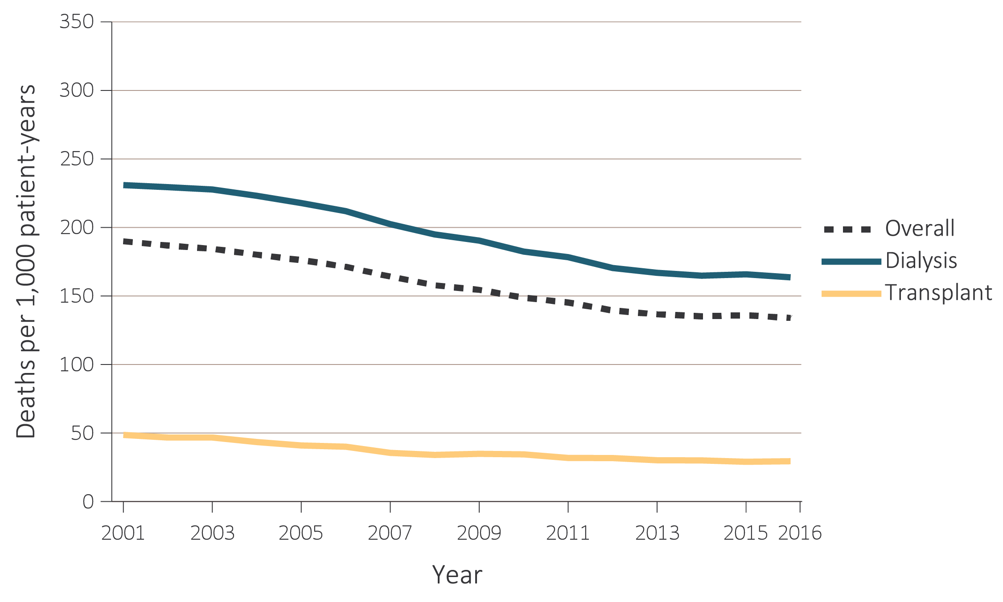
vol 2 Figure 5.1 Adjusted all-cause mortality by treatment modality (a) overall, dialysis, and transplant, and (b) hemodialysis and peritoneal dialysis, for period-prevalent patients, 2001-2016
Data Source: Reference Tables H.2_adj, H.4_adj, H.8_adj, H.9_adj, and H.10_adj; and special analyses, USRDS ESRD Database. Adjusted for age, sex, race, ethnicity, primary diagnosis and vintage. Reference population: period prevalent ESRD patients, 2011. Abbreviations: ESRD, end-stage renal disease; HD, hemodialysis; PD, peritoneal dialysis.

Slide 3
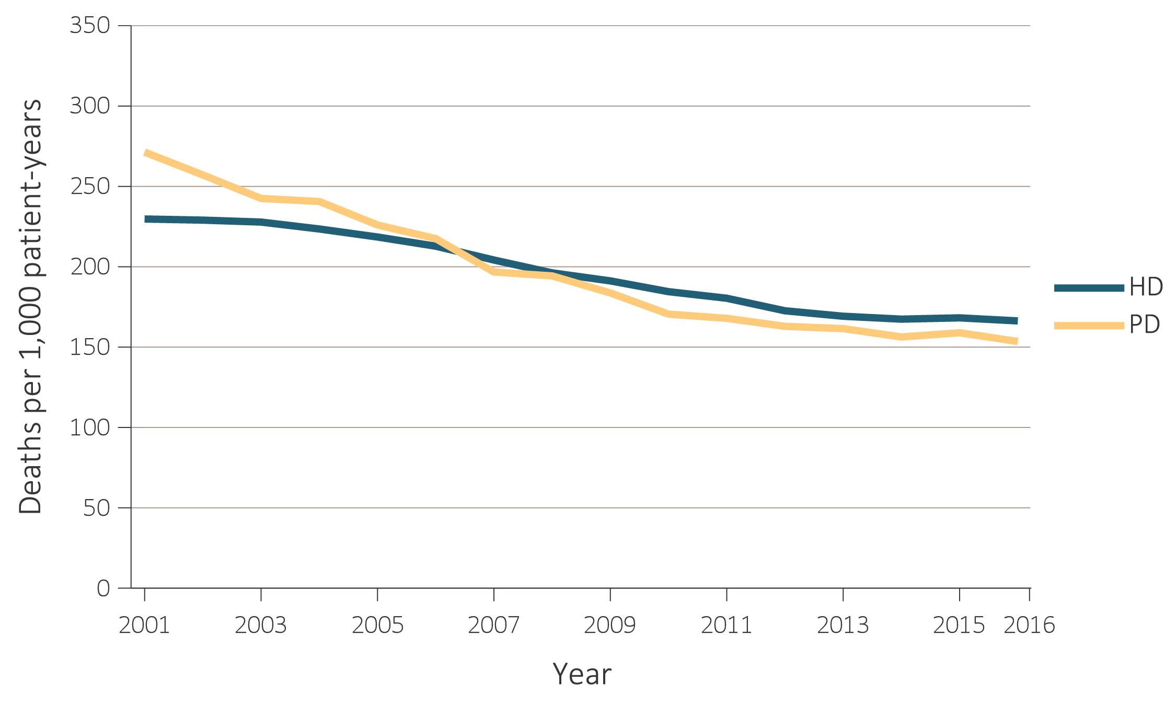
vol 2 Figure 5.1 Adjusted all-cause mortality by treatment modality (a) overall, dialysis, and transplant, and (b) hemodialysis and peritoneal dialysis, for period-prevalent patients, 2001-2016
Data Source: Reference Tables H.2_adj, H.4_adj, H.8_adj, H.9_adj, and H.10_adj; and special analyses, USRDS ESRD Database. Adjusted for age, sex, race, ethnicity, primary diagnosis and vintage. Reference population: period prevalent ESRD patients, 2011. Abbreviations: ESRD, end-stage renal disease; HD, hemodialysis; PD, peritoneal dialysis.

Slide 4
vol 2 Table 5.1 Unadjusted and adjusted all-cause mortality by ESRD network and modality, 2014-2016
 |  | Deaths per 1,000 patient-years
 |  | Total ESRD |  | Hemodialysis |  | Peritoneal dialysis |  | Transplant
Network | States* in Network | Adjusted | Unadjusted | Adjusted | Unadjusted | Adjusted | Unadjusted | Adjusted | Unadjusted
13 | AR, LA, OK | 152.2 | 149.6 | 190.2 | 190.8 | 163.4 | 137.9 | 31.8 | 33.9
8 | AL, MS, TN | 148.8 | 147.8 | 183.1 | 186.2 | 174.0 | 139.8 | 35.5 | 37.5
9 | IN, KY, OH | 146.2 | 164.0 | 179.4 | 220.3 | 164.9 | 159.8 | 33.3 | 38.9
14 | TX | 143.1 | 134.1 | 174.1 | 169.5 | 162.4 | 122.6 | 30.1 | 29.3
3 | NJ, PR | 141.2 | 142.4 | 178.1 | 192.0 | 158.8 | 122.5 | 29.7 | 32.3
6 | NC, SC, GA | 139.3 | 136.4 | 171.7 | 172.5 | 158.6 | 121.3 | 30.3 | 33.1
7 | FL | 139.0 | 149.6 | 176.2 | 198.2 | 153.5 | 132.8 | 28.4 | 33.6
5 | MD, DC, VA, WV | 133.7 | 134.9 | 170.7 | 182.4 | 156.3 | 135.2 | 30.8 | 32.3
4 | DE, PA | 132.8 | 144.9 | 167.7 | 201.7 | 154.5 | 143.6 | 29.8 | 36.8
10 | IL | 131.8 | 135.5 | 168.8 | 188.7 | 160.7 | 136.4 | 28.4 | 32.0
12 | IA, KS, MO, NE | 131.5 | 139.5 | 170.4 | 203.8 | 160.4 | 162.0 | 27.8 | 32.4
11 | MI, MN, ND, SD, WI | 130.4 | 136.9 | 167.4 | 203.5 | 154.7 | 144.4 | 31.3 | 37.5
2 | NY | 128.0 | 132.6 | 157.7 | 178.2 | 145.8 | 145.2 | 28.2 | 32.3
18 | S. CA | 125.9 | 120.7 | 152.4 | 156.0 | 132.2 | 101.0 | 26.0 | 27.2
16 | AK, ID, MT, OR, WA | 124.8 | 126.8 | 156.8 | 187.4 | 140.4 | 131.9 | 28.9 | 33.2
17 | N. CA, HI, GU, AS | 124.5 | 119.6 | 157.2 | 162.2 | 130.3 | 104.3 | 25.8 | 28.5
1 | CT, MA, ME, NH, RI, VT | 123.5 | 129.9 | 156.0 | 197.6 | 154.7 | 138.2 | 29.0 | 32.5
15 | AZ, CO, NV, NM, UT, WY | 121.3 | 123.4 | 156.2 | 173.2 | 140.4 | 121.6 | 28.0 | 32.7
 | Overall | 134.3 | 136.9 | 167.6 | 184.1 | 153.7 | 130.7 | 29.5 | 33.1
Data Source: Special analyses, USRDS ESRD Database. Adjusted (age, sex, race, ethnicity, vintage, and primary diagnosis) all-cause mortality among 2014-2016 period prevalent patients. Reference population: period prevalent ESRD patients, 2011. * Includes 50 states, Washington, D.C. (DC), Puerto Rico (PR), Guam (GU), American Samoa (AS), U.S. Virgin Islands, and Northern Mariana Islands. Northern and Southern California (CA) split into Networks 17 and 18. Abbreviations: ESRD, end-stage renal disease; N, Northern; S, Southern.

Slide 5
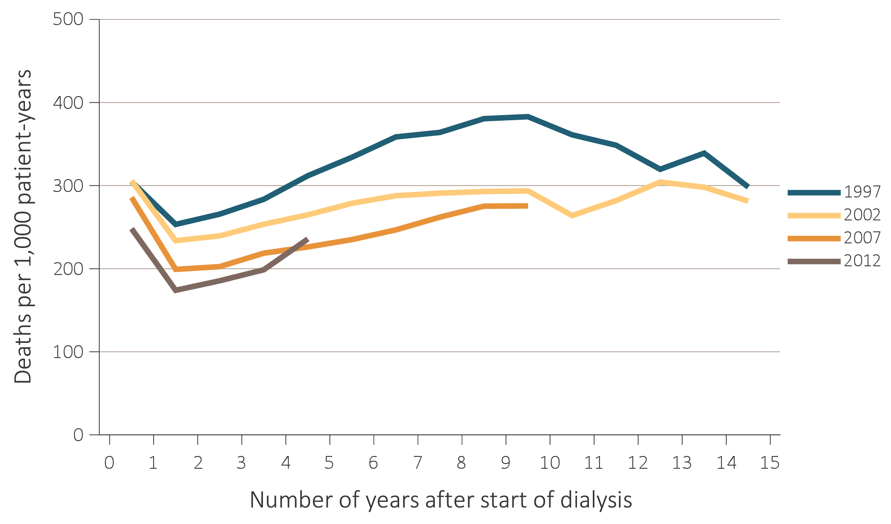
vol 2 Figure 5.2 Adjusted all-cause mortality by treatment modality, cohort (year of ESRD onset), and number of years after start of dialysis among incident (a) hemodialysis patients and (b) peritoneal dialysis patients, 1997, 2002, 2007, and 2012
Data Source: Special analyses, USRDS ESRD Database. Adjusted for age, sex, race, and primary diagnosis. Reference population: period prevalent ESRD patients, 2011. Abbreviation: ESRD, end-stage renal disease.

Slide 6
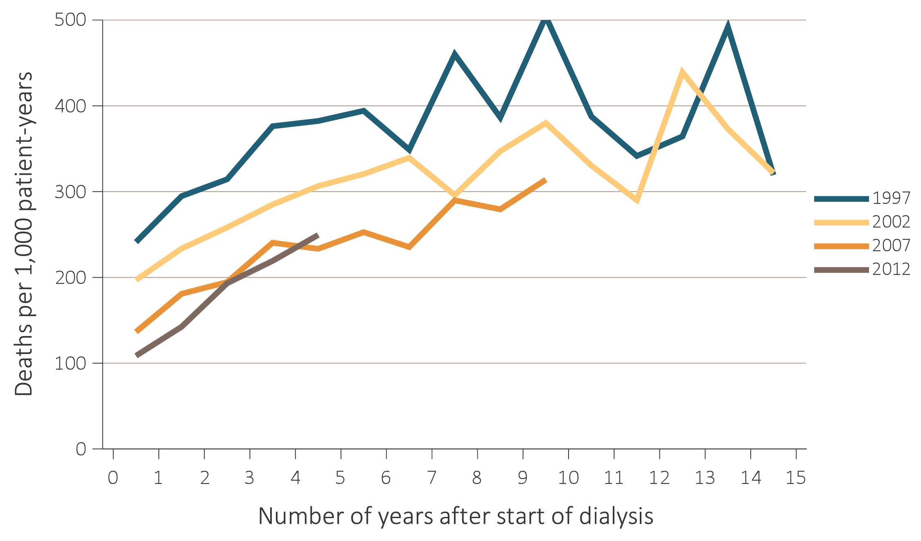
vol 2 Figure 5.2 Adjusted all-cause mortality by treatment modality, cohort (year of ESRD onset), and number of years after start of dialysis among incident (a) hemodialysis patients and (b) peritoneal dialysis patients, 1997, 2002, 2007, and 2012
Data Source: Special analyses, USRDS ESRD Database. Adjusted for age, sex, race, and primary diagnosis. Reference population: period prevalent ESRD patients, 2011. Abbreviation: ESRD, end-stage renal disease.

Slide 7
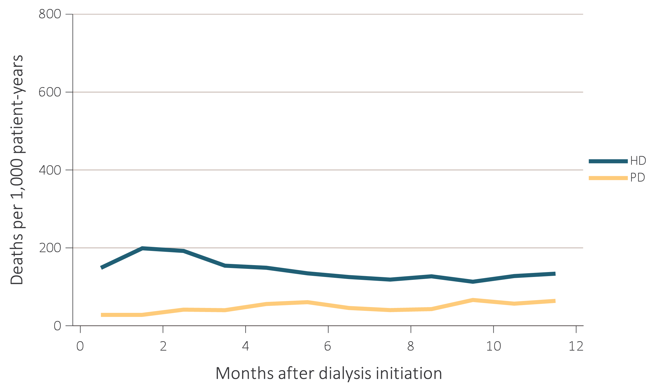
vol 2 Figure 5.3 Adjusted mortality by treatment modality and number of months after treatment initiation among ESRD patients (a) under age 65 and (b) aged 65 and over, 2015
Data Source: Special analyses, USRDS ESRD Database. Adjusted (age, race, sex, ethnicity, and primary diagnosis) mortality among 2015 incident ESRD patients during the first year of therapy. Reference population: incident ESRD patients, 2011. Abbreviations: ESRD, end-stage renal disease; HD, hemodialysis; PD, peritoneal dialysis.

Slide 8
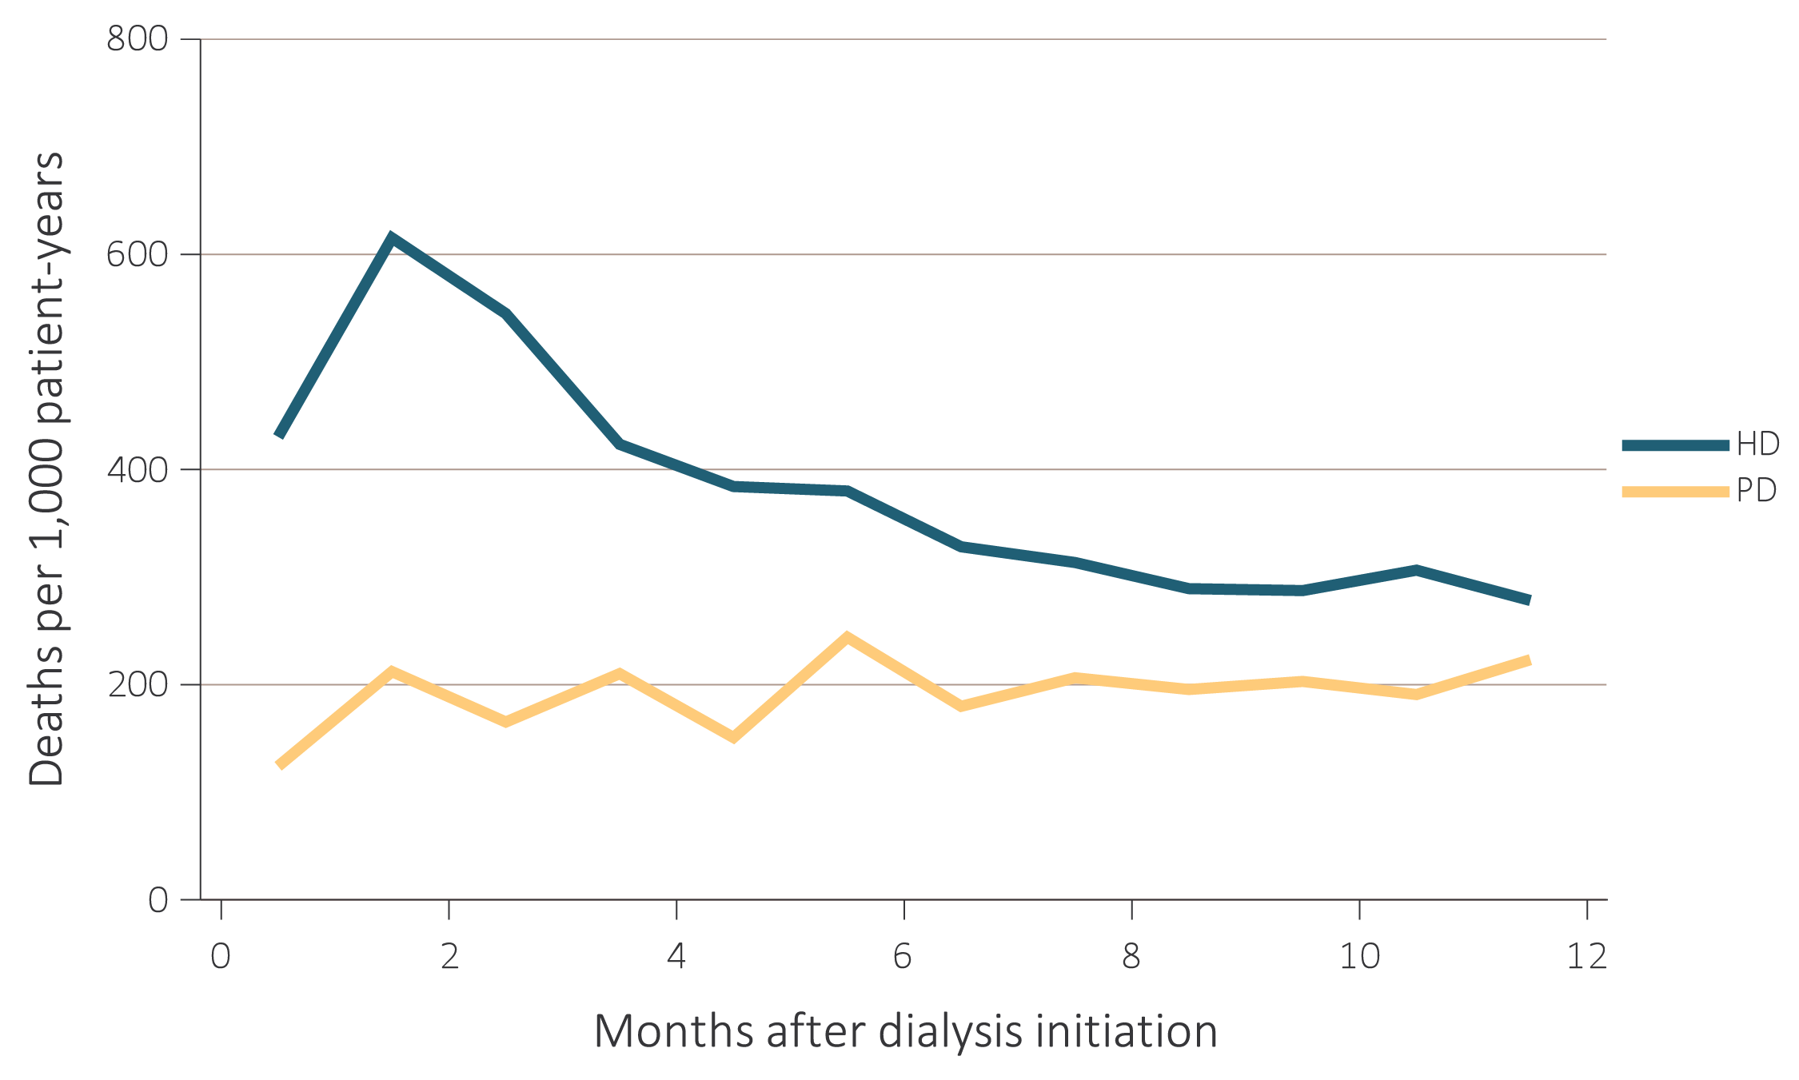
vol 2 Figure 5.3 Adjusted mortality by treatment modality and number of months after treatment initiation among ESRD patients (a) under age 65 and (b) aged 65 and over, 2015
Data Source: Special analyses, USRDS ESRD Database. Adjusted (age, race, sex, ethnicity, and primary diagnosis) mortality among 2015 incident ESRD patients during the first year of therapy. Reference population: incident ESRD patients, 2011. Abbreviations: ESRD, end-stage renal disease; HD, hemodialysis; PD, peritoneal dialysis.

Slide 9
vol 2 Table 5.2 Adjusted all-cause mortality (a) by age and race, and (b) by age and sex, among ESRD patients, 2016
Age | Race | ESRD | Dialysis | Transplant
0-21 | White | 8 | 26 | 3
 | Black/African American | 19 | 36 | 4
 | Other | 9 | 14 | 9
22-44 | White | 34 | 66 | 8
 | Black/African American | 45 | 56 | 10
 | Other | 16 | 31 | 3
45-64 | White | 113 | 162 | 31
 | Black/African American | 102 | 116 | 33
 | Other | 80 | 108 | 22
65-74 | White | 217 | 257 | 71
 | Black/African American | 182 | 197 | 70
 | Other | 146 | 170 | 54
75+ | White | 387 | 407 | 123
 | Black/African American | 295 | 303 | 99
 | Other | 262 | 273 | 81
Data Source: Special analyses, USRDS ESRD Database. (a) Adjusted (race and primary diagnosis) all-cause mortality among 2015 period prevalent patients. (b) Adjusted (sex and primary diagnosis) all-cause mortality among 2015 period prevalent patients. Reference population: period prevalent ESRD patients, 2011. Abbreviation: ESRD, end-stage renal disease.

Slide 10
vol 2 Table 5.2 Adjusted all-cause mortality (a) by age and race, and (b) by age and sex, among ESRD patients, 2016
Age | Sex | ESRD | Dialysis | Transplant
0-21 | Male | 10 | 26 | 3
 | Female | 15 | 33 | 5
22-44 | Male | 38 | 58 | 9
 | Female | 45 | 70 | 9
45-64 | Male | 100 | 137 | 32
 | Female | 100 | 135 | 30
65-74 | Male | 195 | 239 | 71
 | Female | 188 | 223 | 66
75+ | Male | 364 | 388 | 121
 | Female | 339 | 356 | 118
Data Source: Special analyses, USRDS ESRD Database. (a) Adjusted (race and primary diagnosis) all-cause mortality among 2015 period prevalent patients. (b) Adjusted (sex and primary diagnosis) all-cause mortality among 2015 period prevalent patients. Reference population: period prevalent ESRD patients, 2011. Abbreviation: ESRD, end-stage renal disease.

Slide 11
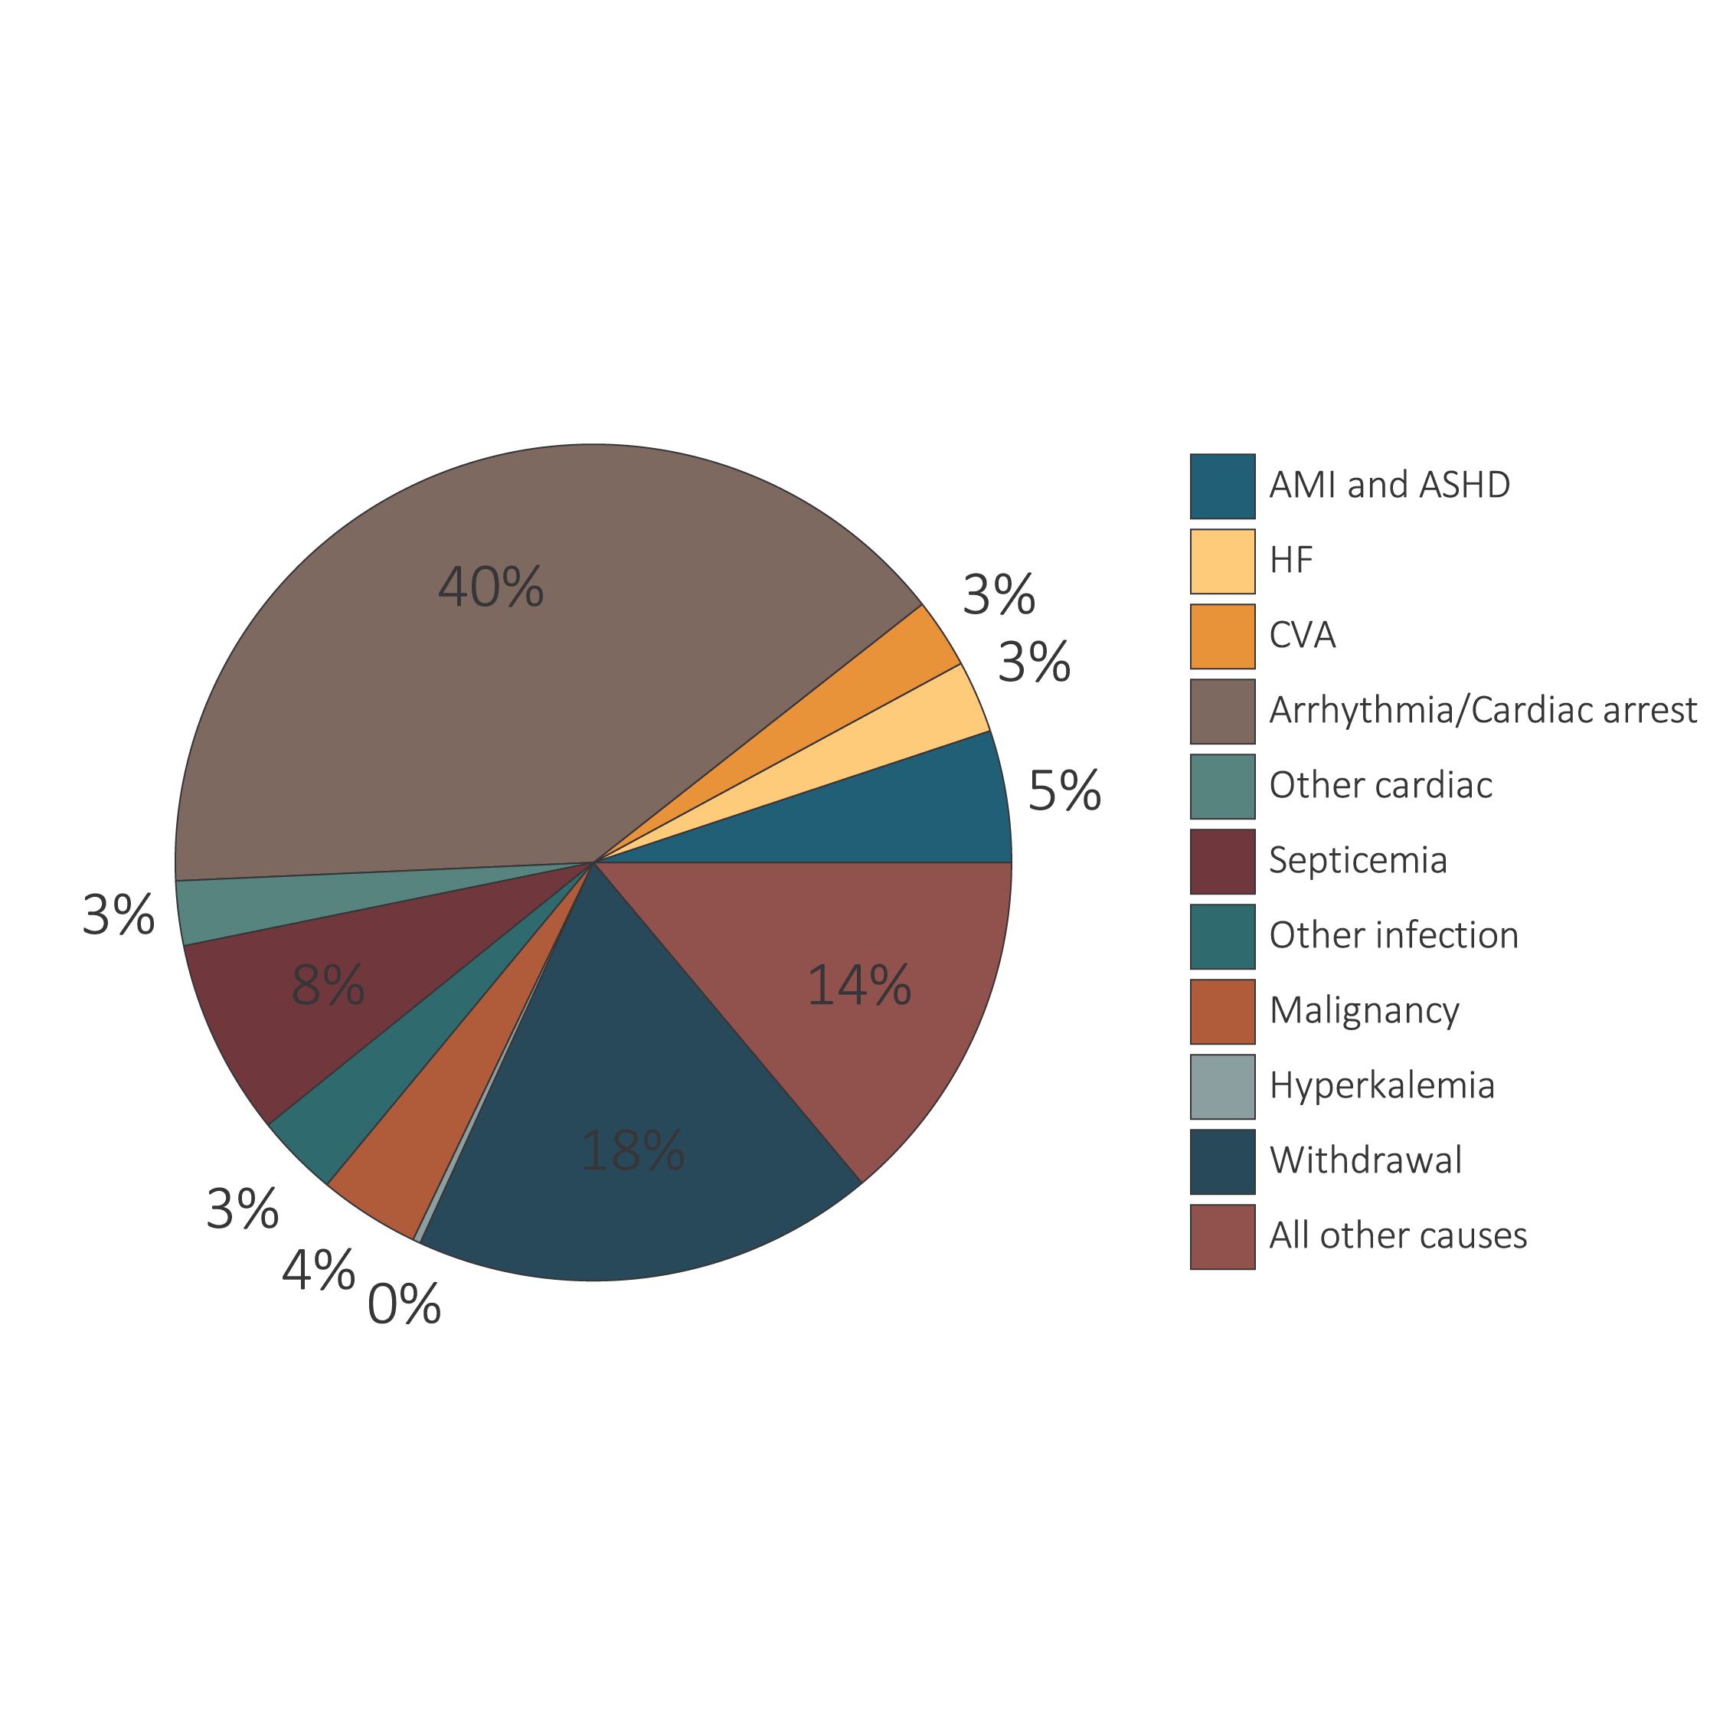
vol 2 Figure 5.4 Unadjusted percentages of deaths in 2015 by cause, with and without missing data, by modality among dialysis patients and transplant recipients

Slide 12
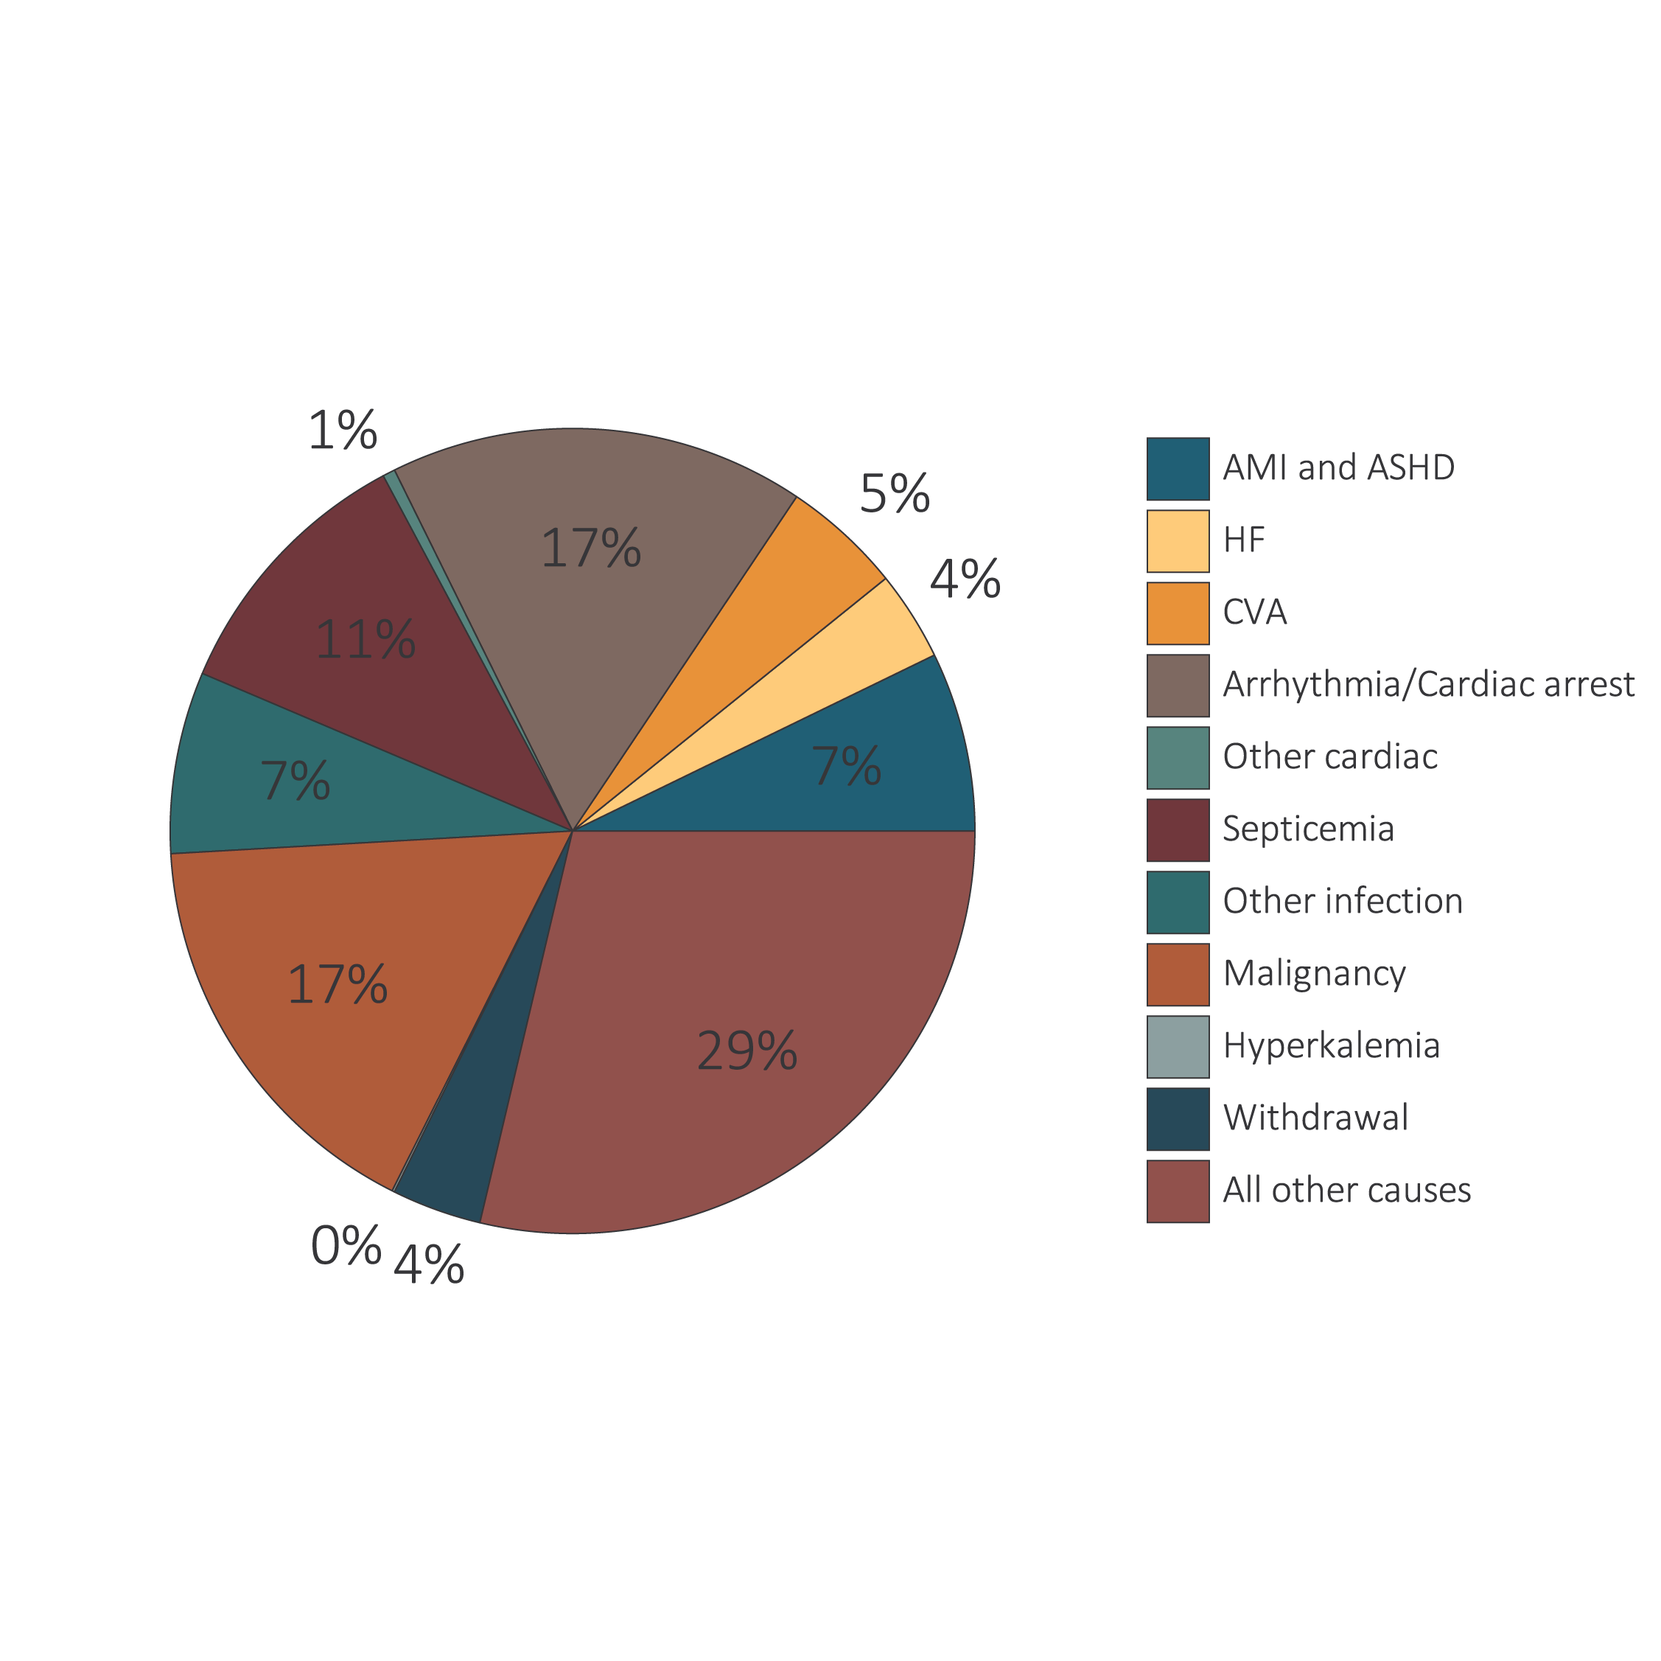
vol 2 Figure 5.4 Unadjusted percentages of deaths in 2015 by cause, with and without missing data, by modality among dialysis patients and transplant recipients
Data Source: Special analysis using Reference Table H.12_Dialysis and H.12_Tx. Mortality among 2015 prevalent patients. (a) Dialysis patients, denominator excludes missing/unknown causes of death. (b) Transplant recipients, denominator excludes missing/unknown causes of death. (c) Dialysis patients, denominator includes missing/unknown causes of death. (d) Transplant recipients, denominator includes missing/unknown causes of death. Abbreviations: AMI, acute myocardial infarction; ASHD, atherosclerotic heart disease; CHF, congestive heart failure; CVA, cerebrovascular accident.

Slide 13
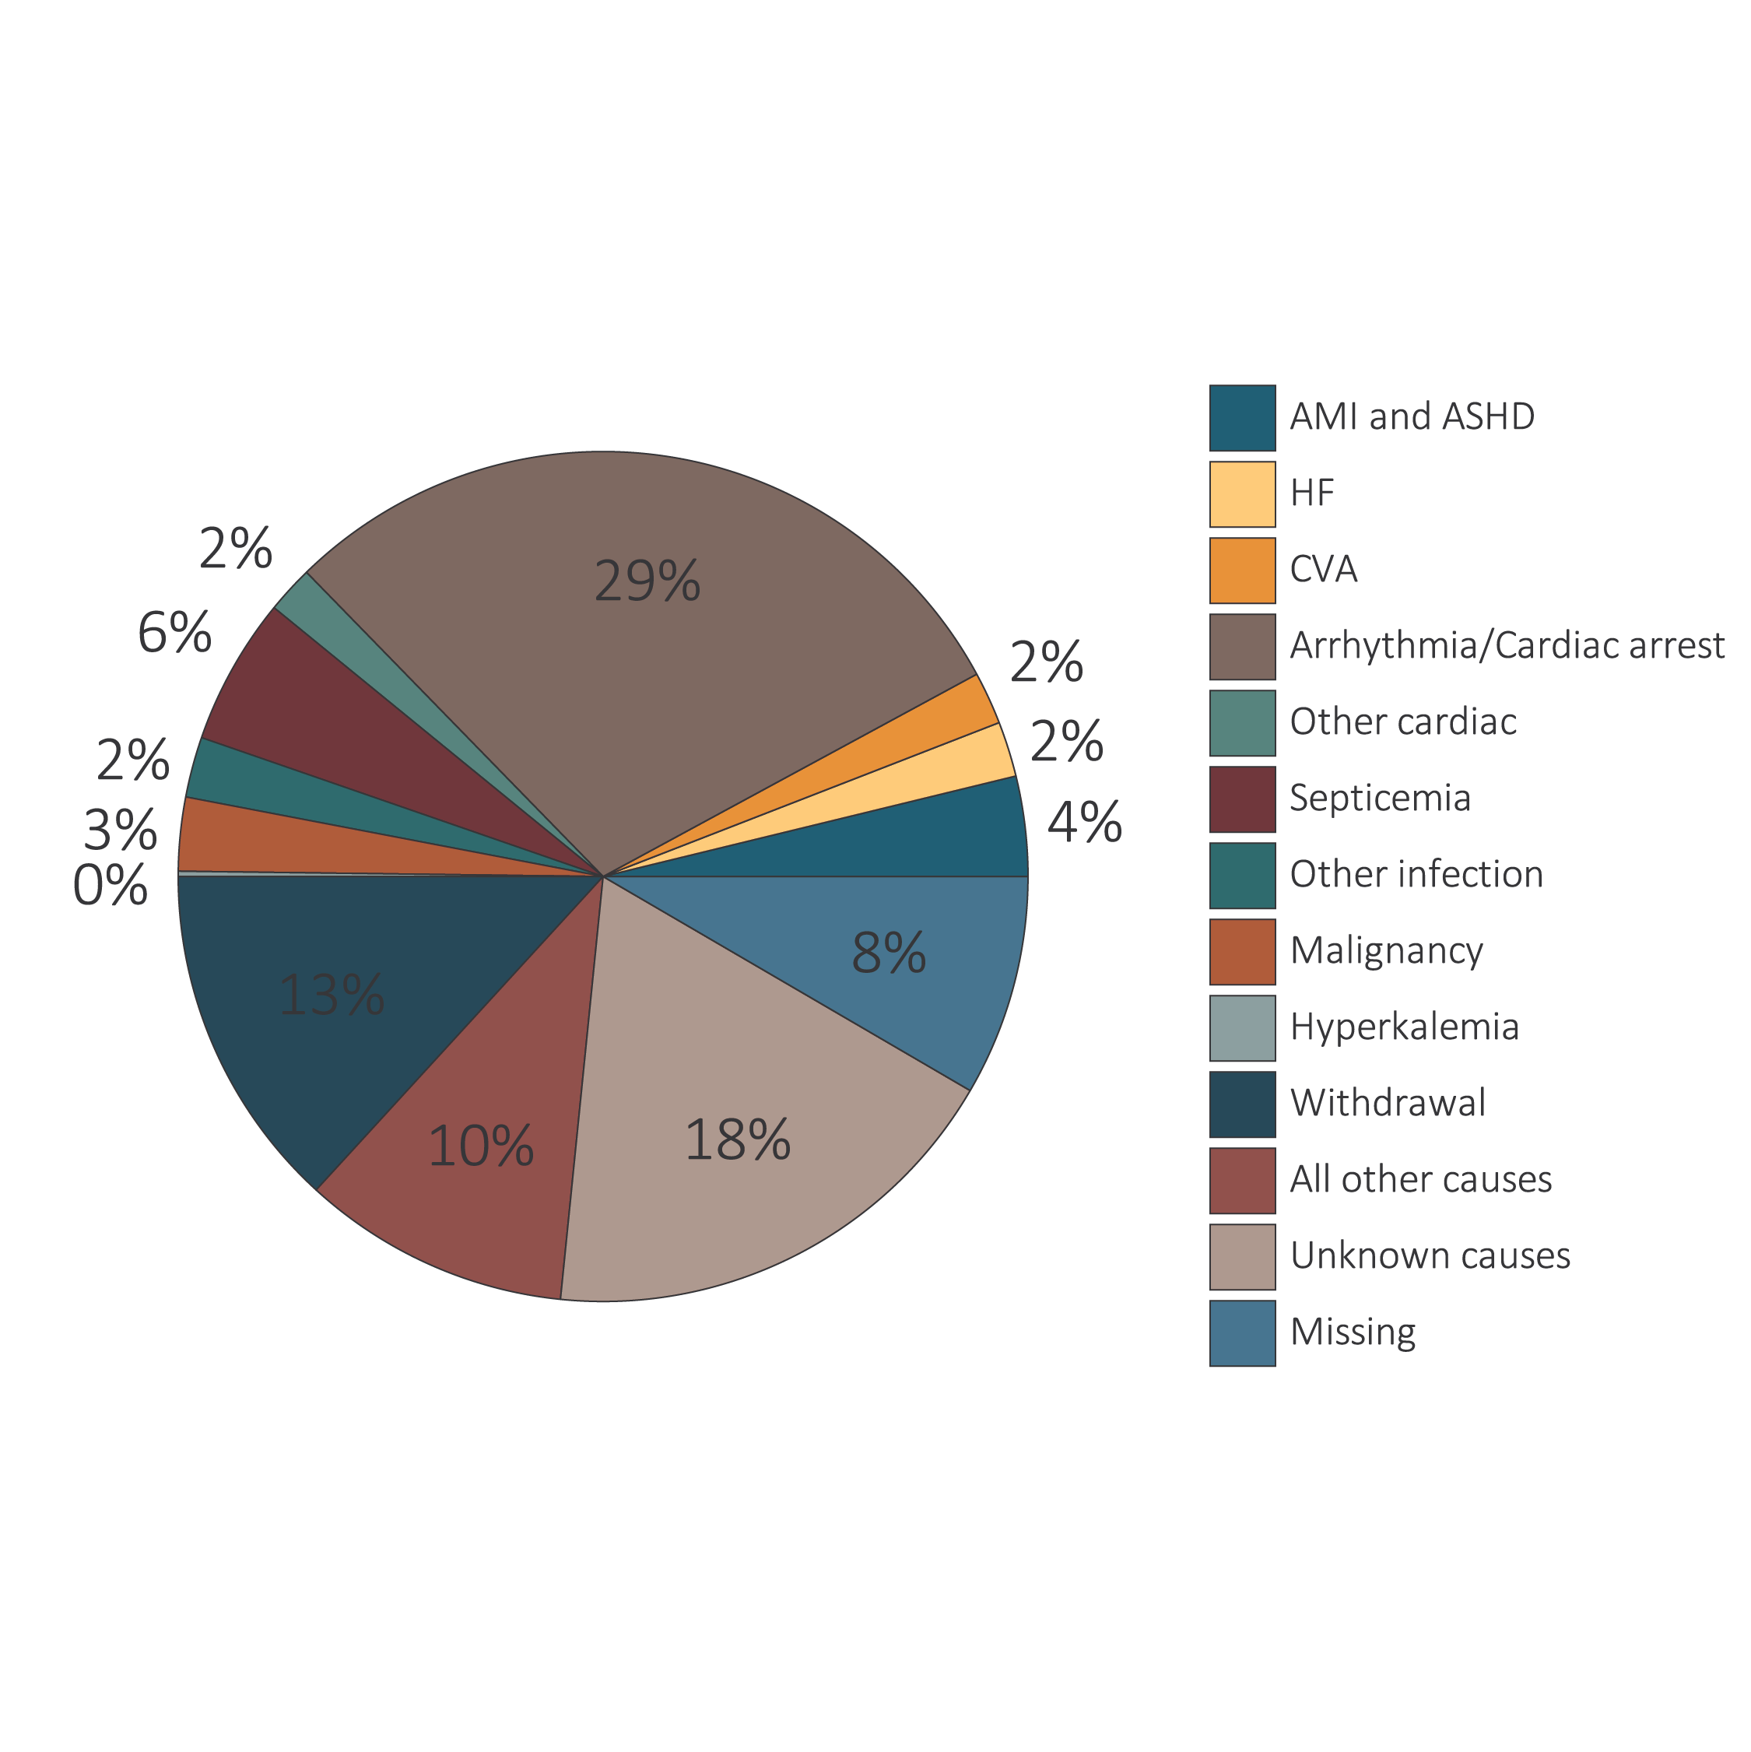
vol 2 Figure 5.4 Unadjusted percentages of deaths in 2015 by cause, with and without missing data, by modality among dialysis patients and transplant recipients

Slide 14
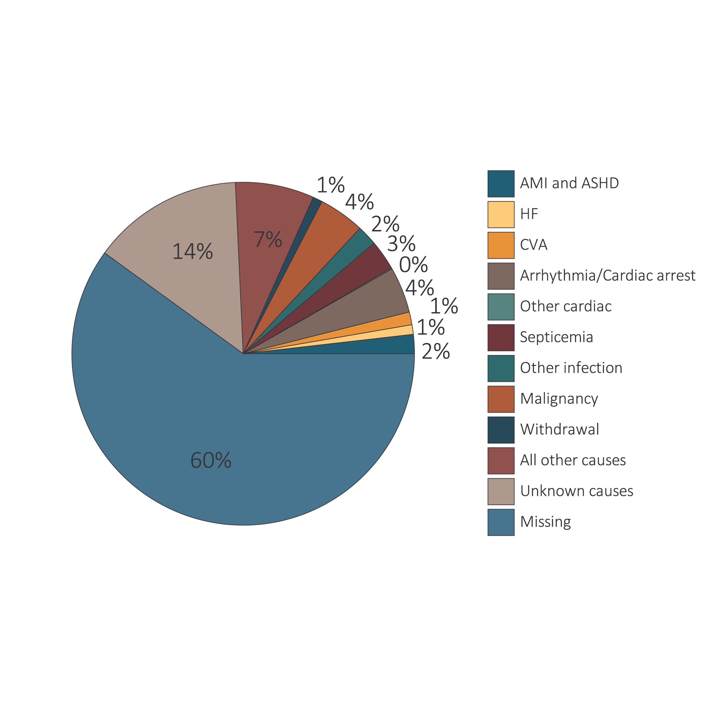
vol 2 Figure 5.4 Unadjusted percentages of deaths in 2015 by cause, with and without missing data, by modality among dialysis patients and transplant recipients

Slide 15
vol 2 Table 5.3 Adjusted survival by treatment modality and incident cohort year (year of ESRD onset)
 | 3 months (%) | 12 months (%) | 24 months (%) | 36 months (%) | 60 months (%)
Hemodialysis
2003 | 91.0 | 74.8 | 61.8 | 51.4 | 36.6
2005 | 91.2 | 75.4 | 62.7 | 53.0 | 38.6
2007 | 91.6 | 76.3 | 64.2 | 54.6 | 40.0
2009 | 91.8 | 77.5 | 65.7 | 56.2 | 41.6
2011 | 92.1 | 78.3 | 66.8 | 57.4 | 42.0
Peritoneal dialysis
2003 | 96.3 | 83.9 | 69.0 | 57.7 | 42.9
2005 | 96.5 | 85.6 | 72.2 | 61.6 | 45.7
2007 | 96.9 | 87.5 | 74.8 | 64.5 | 48.8
2009 | 97.4 | 87.8 | 76.6 | 66.7 | 51.5
2011 | 97.7 | 89.7 | 79.0 | 69.5 | 52.1
Deceased-donor transplant
2003 | 95.7 | 89.9 | 84.5 | 79.5 | 69.2
2005 | 95.6 | 89.7 | 84.9 | 80.3 | 71.0
2007 | 96.7 | 92.2 | 88.1 | 83.7 | 73.3
2009 | 96.7 | 92.0 | 88.2 | 84.0 | 75.1
2011 | 97.1 | 93.9 | 90.4 | 86.4 | 76.8
Living-donor transplant
2003 | 98.1 | 95.3 | 91.3 | 86.9 | 77.9
2005 | 98.2 | 95.2 | 91.7 | 88.2 | 80.3
2007 | 99.0 | 97.0 | 94.3 | 91.0 | 83.5
2009 | 98.9 | 97.1 | 94.4 | 91.1 | 84.1
2011 | 98.9 | 96.3 | 94.3 | 91.2 | 84.1
Data Source: Reference Tables I.1_adj-I.36_adj. Adjusted survival probabilities, from day one, in the ESRD population. Reference population: incident ESRD patients, 2011. Adjusted for age, sex, race, Hispanic ethnicity, and primary diagnosis. Abbreviation: ESRD, end-stage renal disease.

Slide 16
vol 2 Table 5.4 Expected remaining lifetime (years) by age, sex, and treatment modality of prevalent dialysis patients, prevalent transplant patients (2016), and the general U.S. population (2015), based on USRDS data and the National Vital Statistics Report (2015)
 | ESRD patients 2016 |  |  |  | General U.S. population 2015
 | Dialysis |  | Transplant
Age | Male | Female | Male | Female | Male | Female
0-14 | 23.3 | 20.9 | 60.3 | 59.3 | 70.6 | 75.4
15-19 | 21.4 | 18.7 | 47.6 | 49.1 | 59.6 | 64.3
20-24 | 18.5 | 15.8 | 43.7 | 45.2 | 54.9 | 59.4
25-29 | 16.0 | 14.0 | 39.6 | 41.1 | 50.2 | 54.6
30-34 | 14.1 | 12.7 | 35.3 | 37.1 | 45.6 | 49.8
35-39 | 12.4 | 11.4 | 31.2 | 33.1 | 41.0 | 45.0
40-44 | 11.0 | 10.2 | 27.4 | 29.1 | 36.5 | 40.3
45-49 | 9.3 | 8.7 | 23.6 | 25.2 | 32.0 | 35.7
50-54 | 7.9 | 7.6 | 20.0 | 21.7 | 27.7 | 31.2
55-59 | 6.7 | 6.6 | 16.8 | 18.2 | 23.7 | 26.8
60-64 | 5.6 | 5.7 | 14.0 | 15.2 | 19.9 | 22.7
65-69 | 4.6 | 4.8 | 11.4 | 12.5 | 16.3 | 18.6
70-74 | 3.8 | 4.1 | 9.3 | 10.1 | 12.9 | 14.8
75-79 | 3.3 | 3.6 | 7.6ª | 8.3ª | 9.8 | 11.4
80-84 | 2.7 | 3.0 |  |  | 7.2 | 8.4
85+ | 2.2 | 2.4 |  |  | 3.8 | 4.4
Data Source: Reference Table H.13; special analyses, USRDS ESRD Database; and National Vital Statistics Report. “Table 3. Life expectancy at selected ages, by race and Hispanic origin, and sex: United States, 2015 (2017).” Expected remaining lifetimes (years) of the general U.S. population and of period prevalent dialysis and transplant patients. ªCell values combine ages 75+. Abbreviation: ESRD, end-stage renal disease.

Slide 17
vol 2 Table 5.5 Adjusted mortality (deaths per 1,000 patient-years) by age, sex, treatment modality, and comorbidity among ESRD patients and the general Medicare population, 2015
Age | Sex | Dialysis | Transplant | All Medicare | Cancer | Diabetes | CHF | CVA/TIA | AMI
65-74 | Male | 225 | 65 | 28 | 72 | 41 | 111 | 74 | 90
 | Female | 211 | 54 | 18 | 65 | 30 | 97 | 58 | 100
75+ | Male | 345 | 129 | 88 | 131 | 106 | 223 | 156 | 182
 | Female | 316 | 111 | 81 | 131 | 99 | 221 | 148 | 187
Data Source: Special analyses, USRDS ESRD Database and Medicare 5% sample. Adjusted for race. Medicare data limited to patients with at least one month of Medicare eligibility in 2015. Reference population: Medicare patients, 2015. Abbreviations: AMI, acute myocardial infarction; CHF, heart failure; CMS, Centers for Medicare & Medicaid Services; CVA/TIA, cerebrovascular accident/transient ischemic attack; ESRD, end-stage renal disease.

Slide 18
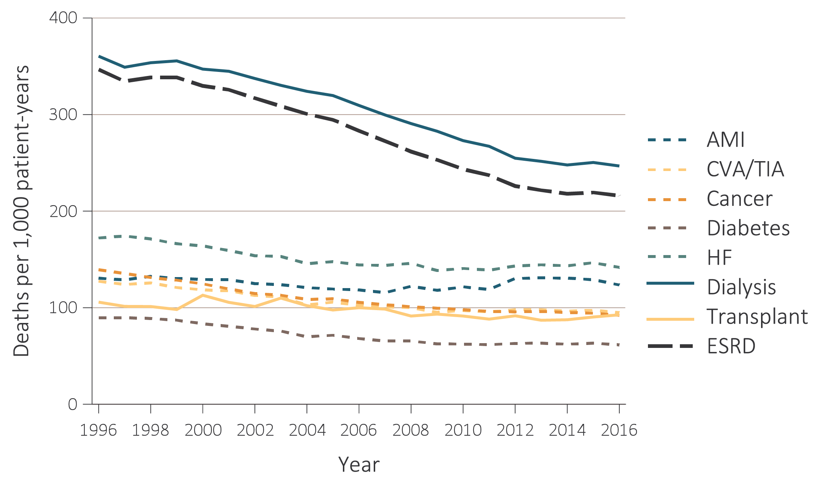
vol 2 Figure 5.5 Adjusted mortality (deaths per 1,000 patient-years) by calendar year, treatment modality, and comorbidity among ESRD patients and comorbidity-specific Medicare populations aged 65 & older, 1996-2016
Data Source: Special analyses, USRDS ESRD Database and Medicare 5% sample. Unadjusted and adjusted (sex and race) mortality rates starting with the January 1 point prevalent sample in the ESRD and general populations, aged 65 and older (per 1,000 patient-years at risk). Reference population: period prevalent ESRD patients, 2012. Abbreviations: AMI, acute myocardial infarction; CHF, congestive heart failure; CVA/TIA, cerebrovascular accident/transient ischemic attack; ESRD, end-stage renal disease.

