Slide 1
2018 Annual Data Report
Volume 2: End-Stage Renal Disease
Chapter 10: Prescription Drug Coverage in
Patients with ESRD

Slide 2
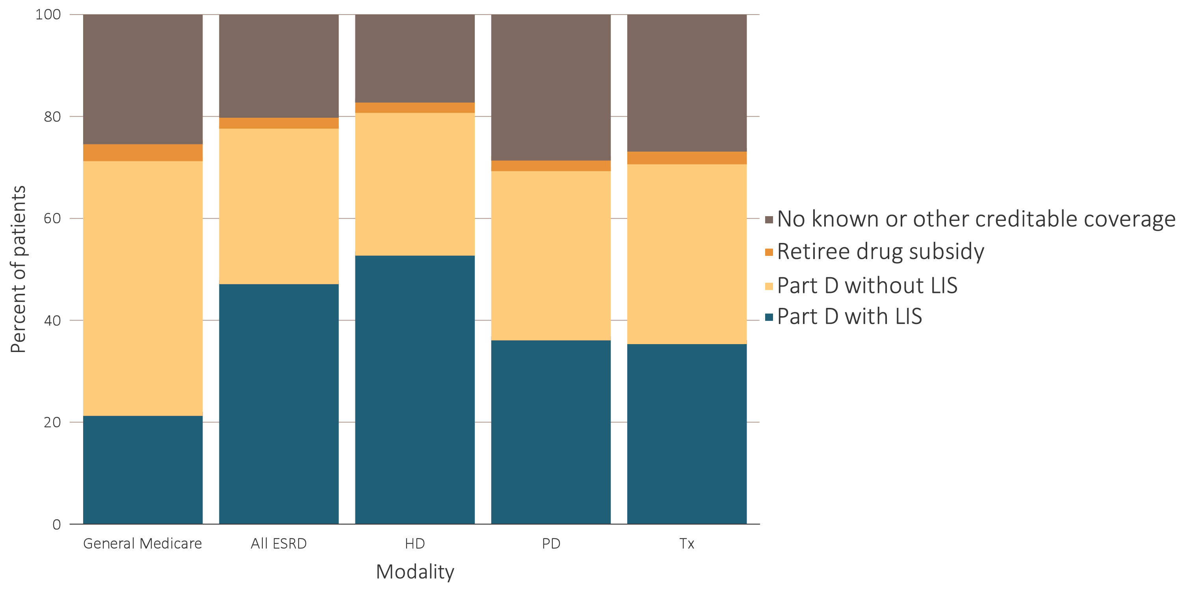
vol 2 Figure 10.1 Sources of prescription drug coverage in Medicare ESRD enrollees, by population, 2016
Data source: 2016 Medicare Data, point prevalent Medicare enrollees alive on January 1, 2016. Abbreviations: ESRD, end-stage renal disease; HD, hemodialysis; LIS, Low-income Subsidy; Part D, Medicare Part D prescription drug coverage; PD, peritoneal dialysis; Tx, kidney transplant.

Slide 3
vol 2 Table 10.1 Percentage of general Medicare & ESRD patients enrolled in Part D
 | General Medicare (%) | All ESRD (%) | Hemodialysis (%) | Peritoneal dialysis (%) | Transplant (%)
2011 | 60.1 | 69.3 | 73.3 | 61.2 | 59.0
2012 | 61.8 | 71.3 | 75.2 | 63.5 | 61.4
2013 | 67.2 | 75.2 | 78.9 | 67.2 | 66.0
2014 | 69.1 | 76.5 | 79.9 | 68.6 | 68.2
2015 | 70.4 | 77.3 | 80.6 | 69.2 | 69.7
2016 | 71.6 | 78.0 | 81.1 | 69.7 | 71.0
Data source: 2016 Medicare Data, point prevalent Medicare enrollees alive on January 1, 2016. Abbreviations: ESRD, end-stage renal disease; HD, hemodialysis; LIS, Low-income Subsidy; Part D, Medicare Part D prescription drug coverage; PD, peritoneal dialysis; Tx, kidney transplant.

Slide 4
vol 2 Table 10.2 Medicare Part D parameters for defined standard benefit, 2011 & 2016
 | 2011 | 2016
Deductible | $310 | $360
After the deductible is met, the beneficiary pays 25% of total prescription costs up to the initial coverage limit.
Initial coverage limit | $2,840 | $3,310
The coverage gap (“donut hole”) begins at this point.
The beneficiary pays 100% of their prescription costs up to the out-of-pocket threshold
Out-of-pocket threshold | $4,550 | $4,850
The total out-of-pocket costs including the “donut hole”
Total covered Part D prescription out-of-pocket spending | $6,448 | $7,063
Catastrophic coverage begins after this point (including the coverage gap) *
Generic/preferred multi-source drug | $2.50 | $2.95
Other drugs | $6.30 | $7.40
2016 Example:
$360 (deductible)$320 (deductible) | $310 | $360
+(($3,310-$360)*25%)(initial coverage) +(($2,960-$320)*25%)(initial coverage) | $633 | $738
+(($7,063-$3,310)*100%)(coverage gap)+(($6,680-$2,960)*100%) (coverage gap) | $3,608 | $3,753
Total | $4,550 | $4,850
(maximum out-of-pocket costs prior to catastrophic coverage, excluding plan premium)
Data Source: Table adapted from http://www.q1medicare.com/PartD-The-2016-Medicare-Part-D-Outlook.php. *The catastrophic coverage amount is the greater of 5% of medication cost or the values shown in the chart above. In 2016, beneficiaries were charged $2.95 for those generic or preferred multisource drugs with a retail price less than $59 and 5% for those with a retail price over $59. For brand name drugs, beneficiaries paid $7.40 for those drugs with a retail price less than $148 and 5% for those with a retail price over $148. In 2016, beneficiaries received a 50% discount on brand name drugs from manufacturers plus 5% coverage from their Part D plans; plans also paid 42% of generic drug costs in the gap. Abbreviation: Part D, Medicare prescription drug coverage benefit.

Slide 5
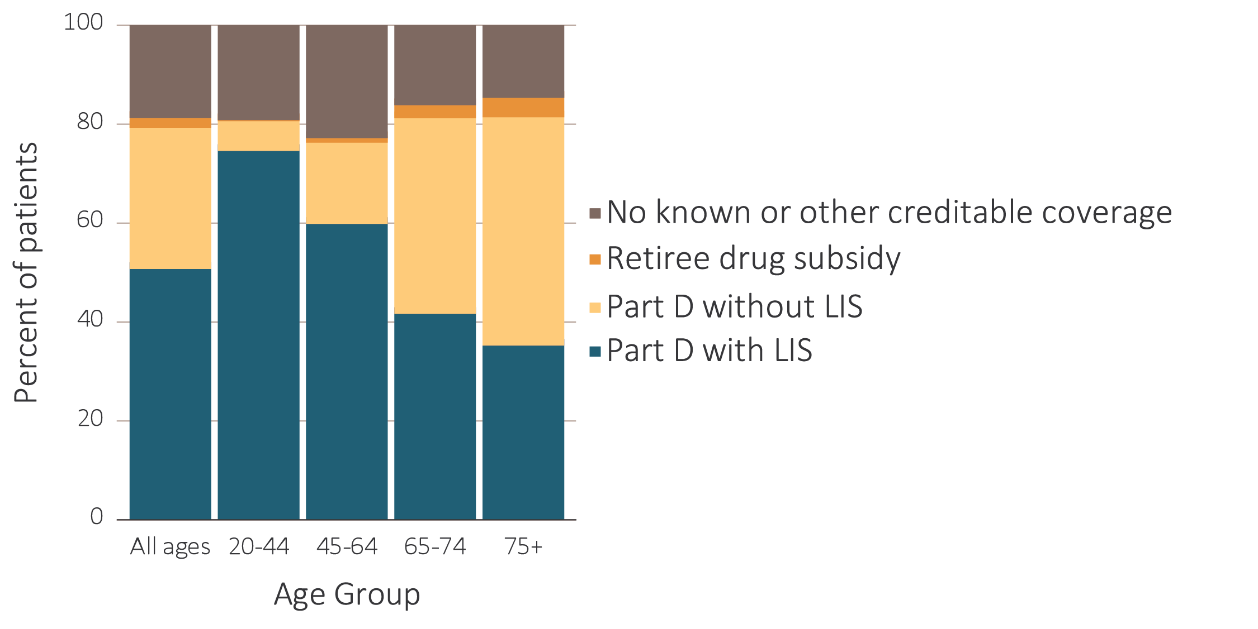
vol 2 Figure 10.2 Sources of prescription drug coverage in Medicare ESRD enrollees, by age & modality, 2016
Data source: 2016 Medicare Data, point prevalent Medicare enrollees alive on January 1, 2016. Abbreviations: ESRD, end-stage renal disease; LIS, Low-income Subsidy; Part D, Medicare Part D prescription drug coverage. ESRD patients aged under 20 were not presented. Abbreviations: ESRD, end-stage renal disease; Part D, Medicare Part D prescription drug coverage; LIS, Low-income Subsidy.

Slide 6
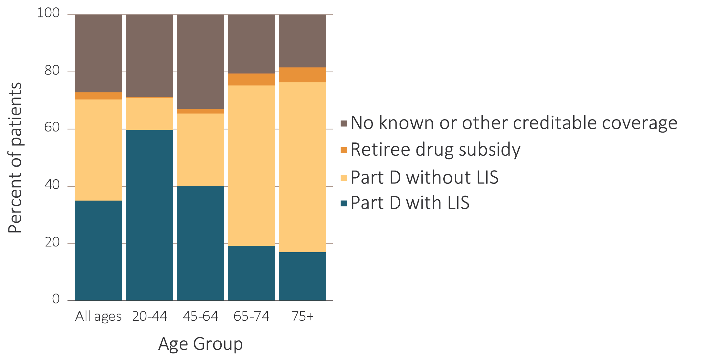
vol 2 Figure 10.2 Sources of prescription drug coverage in Medicare ESRD enrollees, by age & modality, 2016
Data source: 2016 Medicare Data, point prevalent Medicare enrollees alive on January 1, 2016. Abbreviations: ESRD, end-stage renal disease; LIS, Low-income Subsidy; Part D, Medicare Part D prescription drug coverage. ESRD patients aged under 20 were not presented. Abbreviations: ESRD, end-stage renal disease; Part D, Medicare Part D prescription drug coverage; LIS, Low-income Subsidy.

Slide 7
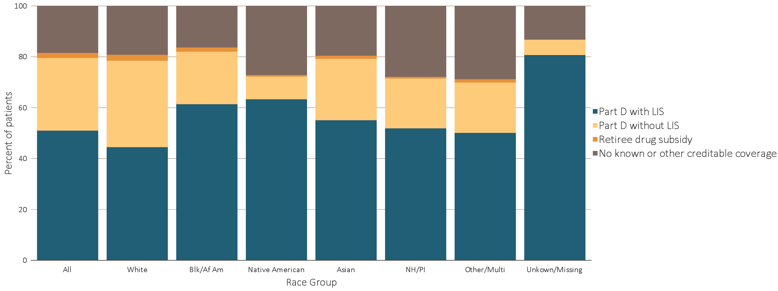
vol 2 Figure 10.3 Sources of prescription drug coverage in Medicare ESRD enrollees, by race/ethnicity & modality, 2016
Data source: 2016 Medicare Data, point prevalent Medicare enrollees alive on January 1, 2016. Abbreviations: Blk/Af Am, Black or African American; ESRD, end-stage renal disease; LIS, Low-income Subsidy; Part D, Medicare Part D prescription drug coverage.

Slide 8
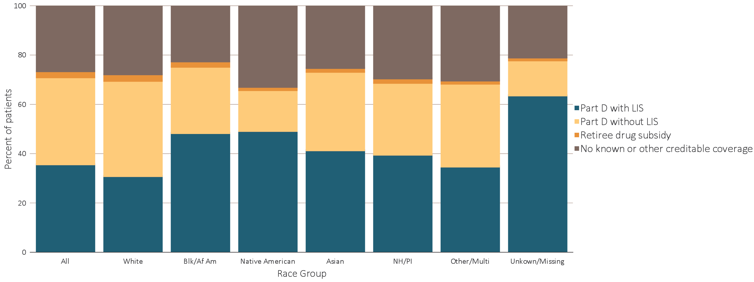
vol 2 Figure 10.3 Sources of prescription drug coverage in Medicare ESRD enrollees, by race/ethnicity & modality, 2016
Data source: 2016 Medicare Data, point prevalent Medicare enrollees alive on January 1, 2016. Abbreviations: Blk/Af Am, Black or African American; ESRD, end-stage renal disease; LIS, Low-income Subsidy; Part D, Medicare Part D prescription drug coverage.

Slide 9
vol 2 Table 10.3 Percentage of Medicare Part D enrollees with the Low-income Subsidy, by age & race, 2016
 | General Medicare (%) | All ESRD (%) | Hemodialysis (%) | Peritoneal dialysis (%) | Transplant (%)
All | 30.2 | 60.9 | 65.5 | 52.3 | 50.3
White
All ages | 23.6 | 53.4 | 58.2 | 45.6 | 44.5
20-44 | 88.5 | 88.3 | 91.7 | 88.3 | 82.5
45-64 | 51.7 | 70.8 | 76.6 | 64.1 | 57.5
65-74 | 14.4 | 39.0 | 48.1 | 23.4 | 20.9
75+ | 17.8 | 33.3 | 37.0 | 16.6 | 17.8
Black/African American
All ages | 56.3 | 73.3 | 75.4 | 68.9 | 64.3
20-44 | 93.0 | 92.7 | 94.2 | 91.2 | 88.1
45-64 | 74.9 | 80.9 | 83.4 | 74.1 | 70.5
65-74 | 41.2 | 58.2 | 62.5 | 40.4 | 39.2
75+ | 47.2 | 57.6 | 59.7 | 36.0 | 37.5
Native American/Alaska Native
All ages | 67.1 | 85.3 | 88.1 | 82.4 | 74.8
20-44 | 93.8 | 95.2 | 97.1 | 95.8 | 86.1
45-64 | 81.3 | 90.0 | 91.4 | 89.3 | 84.8
65-74 | 54.3 | 75.0 | 81.0 | 46.5 | 56.2
75+ | 55.6 | 74.7 | 78.8 | 64.3 | 56.5
Asian
All ages | 61.8 | 66.6 | 71.9 | 54.1 | 56.5
20-44 | 90.7 | 87.5 | 91.0 | 85.7 | 83.2
45-64 | 65.1 | 72.4 | 77.6 | 59.2 | 65.0
65-74 | 52.5 | 56.9 | 65.4 | 39.4 | 42.8
75+ | 69.9 | 64.7 | 69.1 | 47.5 | 41.8
Hawaiian Native/Pacific Islander
All ages | NA | 70.6 | 73.9 | 60.5 | 57.6
20-44 | NA | 90.2 | 91.5 | 89.7 | 85.6
45-64 | NA | 78.5 | 82.0 | 63.6 | 63.3
65-74 | NA | 57.4 | 62.0 | 39.7 | 44.7
75+ | NA | 60.5 | 63.6 | 53.2 | 36.6
Other/multiple race
All ages | 29.9 | 61.5 | 72.5 | 65.4 | 50.9
20-44 | 86.9 | 85.2 | 93.4 | 94.1 | 76.8
45-64 | 47.2 | 68.4 | 82.9 | 78.6 | 53.3
65-74 | 20.9 | 47.5 | 60.8 | 31.6 | 38.4
75+ | 32.2 | 45.9 | 53.5 | 22.2 | 36.4
Unknown/missing
All ages | 28.9 | 86.9 | 94.0 | 81.5 | 81.7
20-44 | 91.6 | 94.8 | 97.7 | 100.0 | 96.7
45-64 | 28.9 | 87.7 | 92.8 | 72.7 | 80.3
65-74 | 18.9 | 71.5 | 89.5 | 50.0 | 66.1
75+ | 83.1 | 93.8 | 100.0 | NA | 100.0
Data source: 2016 Medicare data, point prevalent Medicare enrollees alive on January 1, 2016. Abbreviations: ESRD, end-stage renal disease; LIS, Low-income Subsidy; Part D, Medicare Part D prescription drug coverage. ESRD patients aged under 20 were not presented

Slide 10
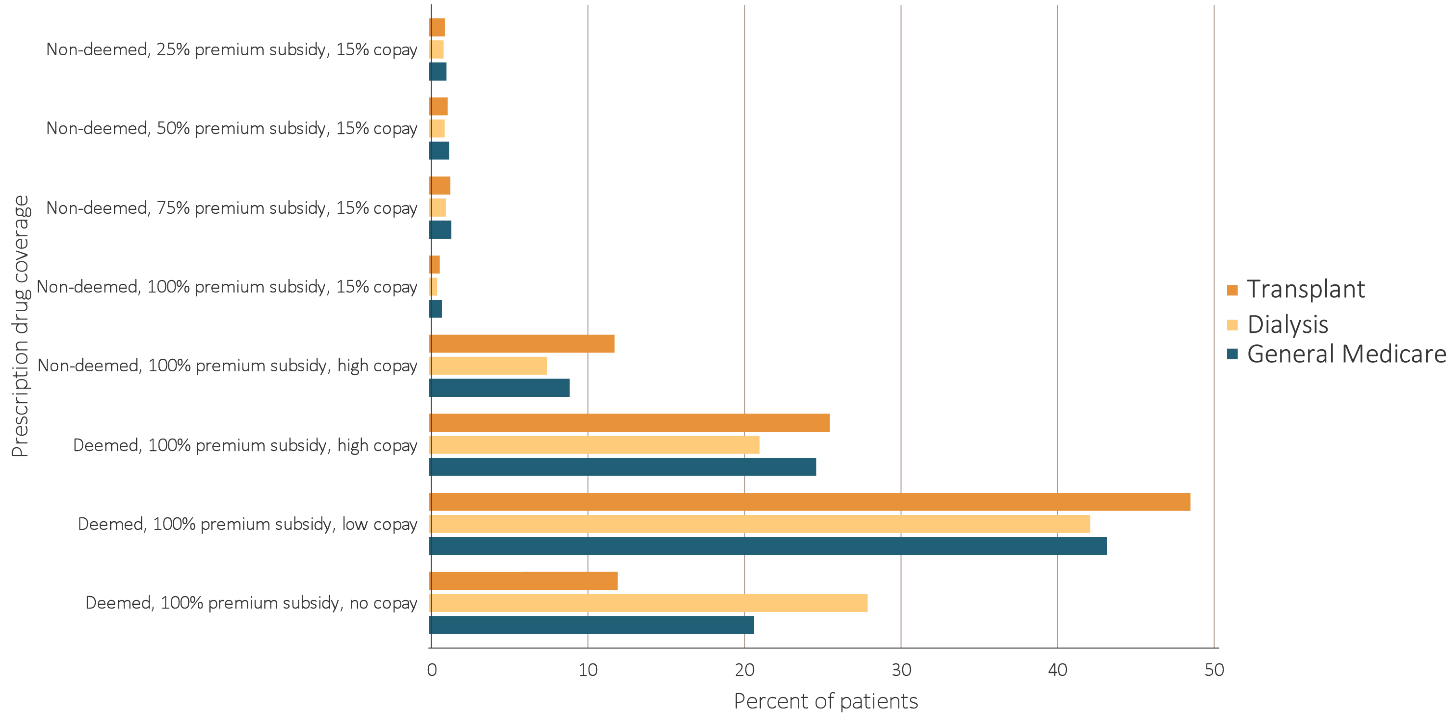
vol 2 Figure 10.4 Distribution of Low-income Subsidy categories in Part D general Medicare & ESRD patients, 2016
Data source: 2016 Medicare data, point prevalent Medicare enrollees alive on January 1, 2016. Abbreviations: ESRD, end-stage renal disease; Part D, Medicare Part D prescription drug coverage.

Slide 11
vol 2 Table 10.4 Total estimated Medicare Part D spending for enrollees, in billions, 2011-2016
 | General Medicare |  | All ESRD |  | Hemodialysis |  | Peritoneal Dialysis |  | Transplant
Year | Medicare spending (in billions) | Medicare spending (PPPY) | Medicare spending (in billions) | Medicare spending (PPPY) | Medicare spending (in billions) | Medicare spending (PPPY) | Medicare spending (in billions) | Medicare spending (PPPY) | Medicare spending (in billions) | Medicare spending (PPPY)
2011 | $46.0 | $2,691 | $1.8 | $7,417 | $1.4 | $8,080 | $0.1 | $8,006 | $0.3 | $5,348
2012 | $40.1 | $2,594 | $2.0 | $7,873 | $1.6 | $8,647 | $0.1 | $8,433 | $0.3 | $5,522
2013 | $52.1 | $2,586 | $2.3 | $8,316 | $1.8 | $9,155 | $0.1 | $8,665 | $0.3 | $5,881
2014 | $58.1 | $2,831 | $2.7 | $9,601 | $2.1 | $10,464 | $0.2 | $9,669 | $0.4 | $7,274
2015 | $63.4 | $3,027 | $3.2 | $11,387 | $2.5 | $12,583 | $0.2 | $11,826 | $0.5 | $8,057
2016 | $68.8 | $3,122 | $3.7 | $12,740 | $2.9 | $14,383 | $0.2 | $13,082 | $0.5 | $8,089
Data source: 2011-2016 Medicare data, period prevalent Medicare enrollees alive on January 1, excluding those in Medicare Advantage Part D plans and Medicare secondary payer, using as-treated actuarial model (see ESRD Methods chapter for analytical methods). Part D spending represents the sum of the Medicare covered amount and the Low-income Subsidy amount. Abbreviations: ESRD, end-stage renal disease; Part D, Medicare Part D prescription drug coverage; PPPY, per person per year.

Slide 12
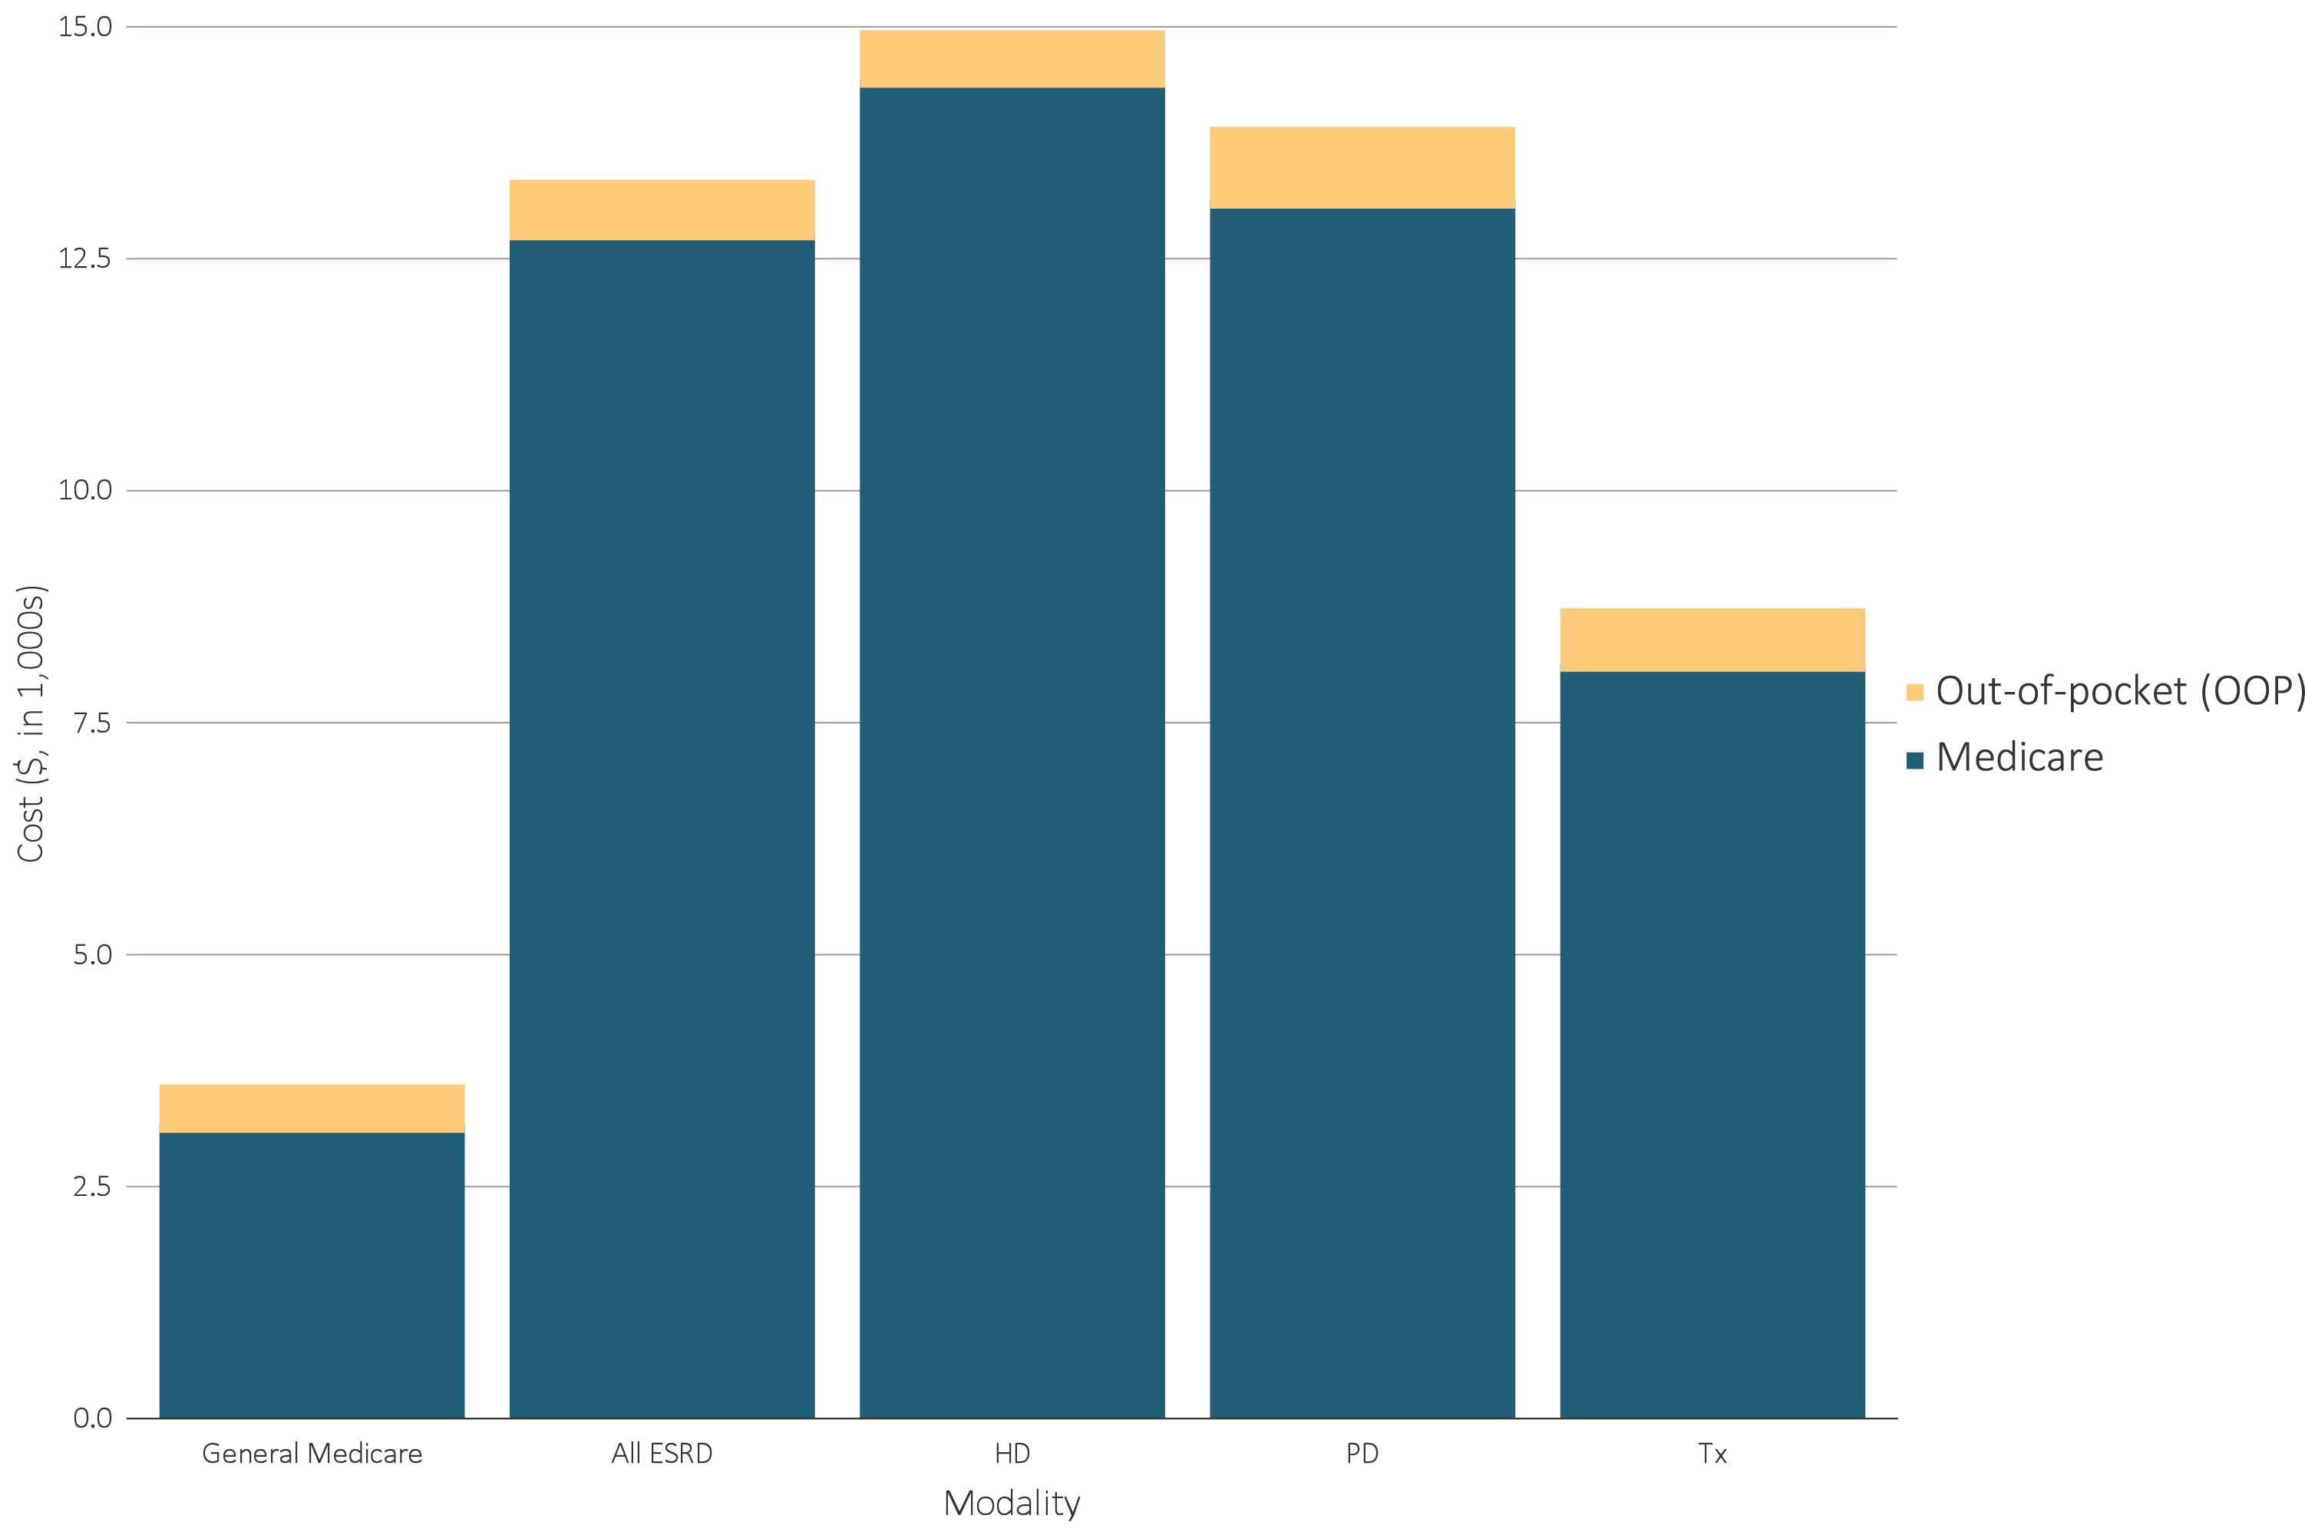
vol 2 Figure 10.5 Per person per year insurance & out-of-pocket costs for enrollees, 2016
Data source: Medicare Part D claims for Part D enrollees with traditional Medicare (Parts A & B). Costs are per person per year for calendar year 2016, using as-treated actuarial model (see ESRD Methods chapter for analytical methods). Medicare Part D spending represents the sum of the Medicare covered amount and the Low-income Subsidy amount. Abbreviations: ESRD, end-stage renal disease; Part D, Medicare Part D prescription drug coverage.

Slide 13
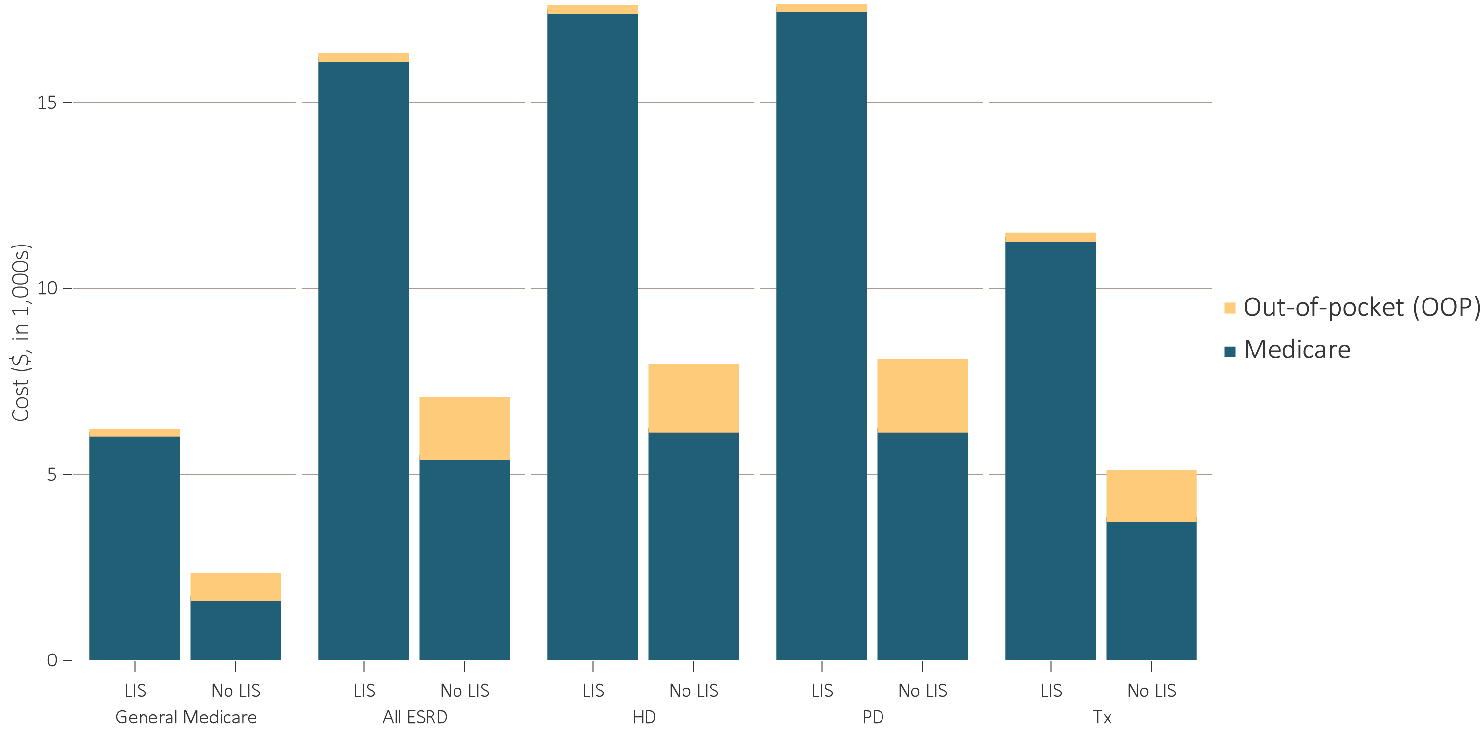
vol 2 Figure 10.5 Per person per year insurance & out-of-pocket costs for enrollees, 2016
(b) Medicare by Low-income Subsidy status
Data source: Medicare Part D claims for Part D enrollees with traditional Medicare (Parts A & B). Costs are per person per year for calendar year 2016, using as-treated actuarial model (see ESRD Methods chapter for analytical methods). Medicare Part D spending represents the sum of the Medicare covered amount and the Low-income Subsidy amount. Abbreviations: ESRD, end-stage renal disease; Part D, Medicare Part D prescription drug coverage.

Slide 14
vol 2 Table 10.5 Per person per year Medicare Part D spending for enrollees, 2016
 | General ($) |  |  | All ESRD ($) |  |  | Hemodialysis ($) |  |  | Peritoneal dialysis ($) |  |  | Transplant ($)
 | Part D with LIS | Part D without LIS |  | Part D with LIS | Part D without LIS |  | Part D with LIS | Part D without LIS |  | Part D with LIS | Part D without LIS |  | Part D with LIS | Part D without LIS
Age
All | 6,087 | 1,670 |  | 16,153 | 5,460 |  | 17,440 | 6,191 |  | 17,495 | 6,192 |  | 11,321 | 3,788
20-44 | 6,134 | 2,745 |  | 16,410 | 4,899 |  | 18,782 | 6,341 |  | 18,069 | 5,650 |  | 10,413 | 3,191
45-64 | 8,028 | 2,895 |  | 17,484 | 6,364 |  | 18,943 | 7,406 |  | 18,080 | 6,452 |  | 11,856 | 4,239
65-74 | 5,212 | 1,585 |  | 14,807 | 5,674 |  | 15,700 | 6,606 |  | 15,241 | 6,622 |  | 11,163 | 3,893
75+ | 4,497 | 1,558 |  | 12,095 | 4,413 |  | 12,759 | 4,808 |  | 12,079 | 5,236 |  | 8,146 | 2,784
Sex
Male | 6,161 | 1,819 |  | 16,452 | 5,519 |  | 17,751 | 6,156 |  | 18,541 | 6,419 |  | 11,833 | 4,027
Female | 6,035 | 1,560 |  | 15,811 | 5,370 |  | 17,091 | 6,246 |  | 16,562 | 5,849 |  | 10,639 | 3,429
Race
White | 6,214 | 1,650 |  | 15,624 | 5,320 |  | 17,167 | 6,140 |  | 17,672 | 6,312 |  | 10,861 | 3,667
Black/African American | 6,415 | 2,062 |  | 17,068 | 5,949 |  | 17,985 | 6,338 |  | 17,098 | 5,504 |  | 12,492 | 4,459
Native American/Alaska Native | 5,082 | 3,071 |  | 10,539 | 5,050 |  | 10,771 | 5,677 |  | 13,301 | 4,464 |  | 8,969 | 2,999
Asian | 5,137 | 1,283 |  | 15,767 | 5,457 |  | 17,277 | 6,294 |  | 19,176 | 6,809 |  | 10,491 | 3,709
Native Hawaiian/Pacific-Islander | NA | NA |  | 16,751 | 4,524 |  | 17,739 | 4,949 |  | 17,168 | 5,372 |  | 10,981 | 3,219
Other race | 5,345 | 1,601 |  | 14,552 | 4,552 |  | 16,145 | 7,059 |  | 16,651 | 5,468 |  | 11,564 | 3,011
Unknown/missing | 4,730 | 1,579 |  | 16,472 | 6,723 |  | 19,646 | 9,259 |  | 23,122 | 13,923 |  | 9,618 | 5,954
Data source: Medicare Part D claims. Costs are per person per year for calendar year 2016, using as-treated actuarial model (see ESRD Methods chapter for analytical methods). Part D spending represents the sum of the Medicare covered amount and the Low-income Subsidy amount. Abbreviations: ESRD, end-stage renal disease; LIS, Low-income Subsidy; Part D, Medicare Part D prescription drug coverage.

Slide 15
vol 2 Table 10.6 Top 15 drug classes received by ESRD cohorts, by modality, 2016
 | Hemodialysis |  | Peritoneal dialysis |  | Transplant
Rank | Drug class | % | Drug class | % | Drug class | %
1 | Ion-removing agents | 71.5 | Ion-removing agents | 61.9 | Antibacterials | 73.9
2 | Β-Adrenergic blocking agents | 64.1 | Β-Adrenergic blocking agents | 61.5 | β-Adrenergic blocking agents | 63.0
3 | Antibacterials | 57.9 | Antibacterials | 58.7 | Antiulcer agents and acid suppressants | 58.8
4 | Analgesics and antipyretics | 57.3 | Lipid-lowering agents | 48.5 | Lipid-lowering agents | 56.8
5 | Lipid-lowering agents | 51.0 | Calcium-channel blocking agents | 48.1 | Calcium-channel blocking agents | 50.7
6 | Calcium-channel blocking agents | 48.2 | Analgesics and antipyretics | 46.4 | Analgesics and antipyretics | 48.2
7 | Renin-angiotensin-aldosterone system inhibitors | 46.3 | Renin-angiotensin-aldosterone system inhibitors | 44.1 | Adrenals | 47.1
8 | Antiulcer agents and acid suppressants | 37.9 | Antiulcer agents and acid suppressants | 39.8 | Antidiabetic agents | 39.0
9 | Antidiabetic agents | 36.9 | Diuretics | 35.5 | Renin-angiotensin-aldosterone system inhibitors | 35.7
10 | Anticonvulsants | 32.7 | Antidiabetic agents | 33.6 | Diuretics | 33.3
11 | Hypotensive agents | 32.4 | Anti-infectives | 32.9 | Psychotherapeutic agents | 25.2
12 | Psychotherapeutic agents | 32.2 | Psychotherapeutic agents | 28.2 | Diabetic consumables | 24.6
13 | Cinacalcet | 31.9 | Hypotensive agents | 27.4 | Antivirals | 24.4
14 | Antithrombotic agents | 31.0 | Cinacalcet | 26.7 | Anticonvulsants | 22.7
15 | Anxiolytics, sedatives, and hypnotics | 25.1 | Anticonvulsants | 25.0 | Antithrombotic agents | 20.2
Data source: Medicare Part D claims. Ion-removing agents include phosphate-binding agents, potassium-binding agents, etc. Hypotension agents include alpha-2-agonist and vasodilators. Diabetic consumables refer to blood glucose test strips, blood glucose meters/sensors, lancets, needles, pen needles, etc. Abbreviations: ESRD, end-stage renal disease; LIS, Low-income Subsidy; Part D, Medicare Part D prescription drug coverage.

Slide 16
vol 2 Table 10.7 Top 15 drug classes received by different ESRD cohorts, by modality and Medicare Part D spending, 2016
 | Hemodialysis |  |  | Peritoneal Dialysis |  |  | Transplant
Rank | Drug class | spending (in millions) | % | Drug class | spending (in millions) | % | Drug class | spending (in millions) | %
1 | Ion-removing Agents | $1,145.3 | 39.8% | Ion-removing Agents | $94.3 | 41.3% | Antivirals | $124.7 | 26.5%
2 | Cinacalcet | $701.3 | 24.4% | Cinacalcet | $51.7 | 22.6% | Antidiabetic Agents | $86.1 | 18.3%
3 | Antidiabetic Agents | $214.1 | 7.4% | Antidiabetic Agents | $23.0 | 10.1% | Cinacalcet | $56.0 | 11.9%
4 | Antivirals | $183.5 | 6.4% | Antivirals | $14.6 | 6.4% | Immunosuppressive Agents | $22.3 | 4.7%
5 | Antineoplastic Agents | $71.9 | 2.5% | Antineoplastic Agents | $5.6 | 2.5% | Adrenocortical Insufficiency | $12.2 | 2.6%
6 | Vasodilating Agents | $34.0 | 1.2% | Antilipemic Agents | $3.1 | 1.4% | Antilipemic Agents | $11.8 | 2.5%
7 | Caloric Agents | $32.1 | 1.1% | Antiulcer Agents and Acid Suppressants | $2.1 | 0.9% | Antiulcer Agents and Acid Suppressants | $10.1 | 2.1%
8 | Antilipemic Agents | $31.5 | 1.1% | Antibacterials | $1.8 | 0.8% | Serums | $9.5 | 2.0%
9 | Analgesics and Antipyretics | $30.8 | 1.1% | Vasodilating Agents | $1.7 | 0.8% | Antineoplastic Agents | $8.5 | 1.8%
10 | Antiulcer Agents and Acid Suppressants | $29.4 | 1.0% | Analgesics and Antipyretics | $1.6 | 0.7% | Hematopoietic Agents | $8.0 | 1.7%
11 | Anticonvulsants | $29.2 | 1.0% | Anticonvulsants | $1.6 | 0.7% | Antibacterials | $7.8 | 1.7%
12 | Antibacterials | $26.1 | 0.9% | Antithrombotic Agents | $1.4 | 0.6% | Anticonvulsants | $7.0 | 1.5%
13 | Anti-inflammatory Agents | $23.5 | 0.8% | Pituitary | $1.3 | 0.6% | Antithrombotic Agents | $6.5 | 1.4%
14 | Antithrombotic Agents | $22.5 | 0.8% | Disease-modifying Antirheumatic Agents | $1.2 | 0.5% | Analgesics and Antipyretics | $6.0 | 1.3%
15 | Psychotherapeutic Agents | $21.8 | 0.8% | Anti-inflammatory Agents | $1.2 | 0.5% | Psychotherapeutic Agents | $5.8 | 1.2%
Data source: Medicare Part D claims. Medicare Part D spending represents the sum of the Medicare covered amount and the Low-income Subsidy amount. Ion-removing agents include phosphate-binding agents, potassium-binding agents, etc. Hypotension agents include alpha-2-agonists and vasodilators. Diabetic consumables refer to blood glucose test strips, blood glucose meters/sensors, lancets, needles, pen needles, etc. Abbreviations: ESRD, end-stage renal disease; Part D, Medicare Part D prescription drug coverage.

Slide 17
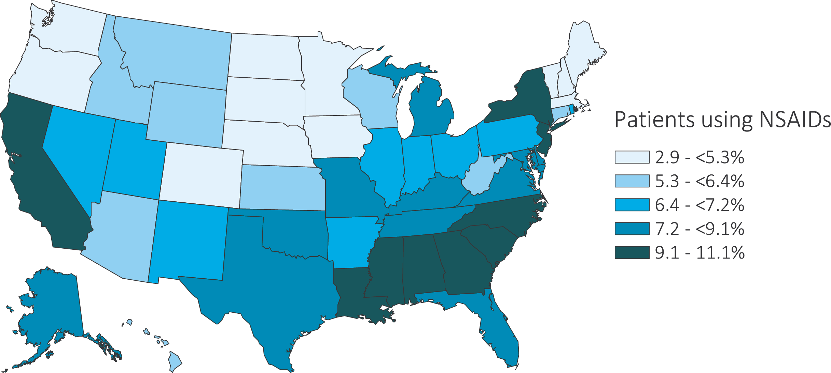
vol 2 Table 10.6 Estimated utilization rate of prescription NSAIDs by state, Medicare ESRD patients, 2016
Data source: Medicare Part D claims. ESRD patients with Medicare Part D stand-alone prescription drug plans. Abbreviations: ESRD, end-stage renal disease; Part D, Medicare Part D prescription drug coverage; NSAIDs, nonsteroidal anti-inflammatory agents. NSAID filled under Medicare Part D represent a fraction of actual NSAID use.

Slide 18
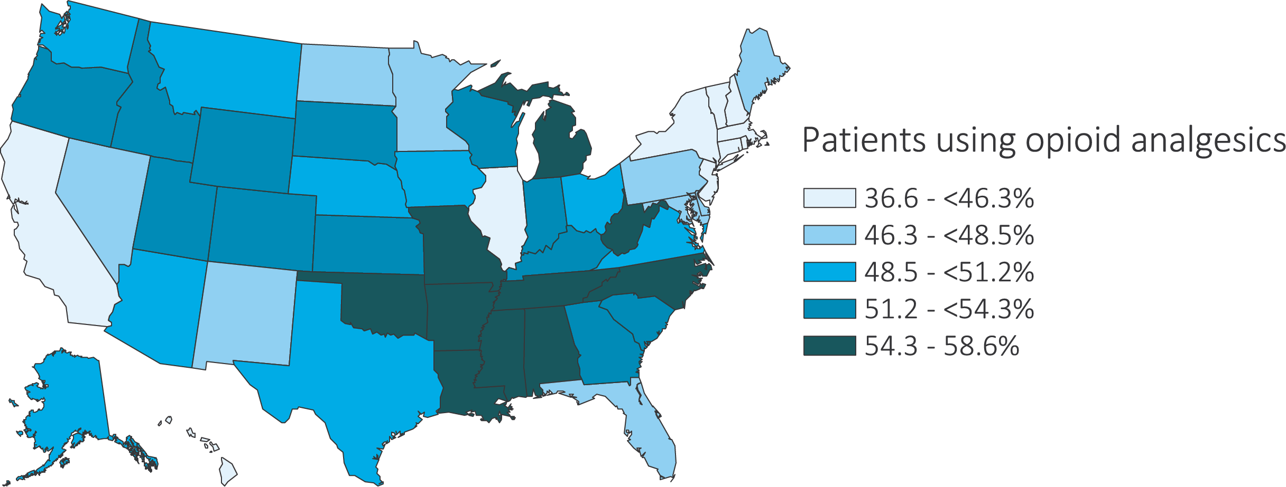
vol 2 Figure 10.7 Estimated utilization rate of opioid analgesics by state, Medicare ESRD Patients, 2016
Data source: Medicare Part D claims. ESRD patients with Medicare Part D stand-alone prescription drug plans. Abbreviation: ESRD, end-stage renal disease.

Slide 19
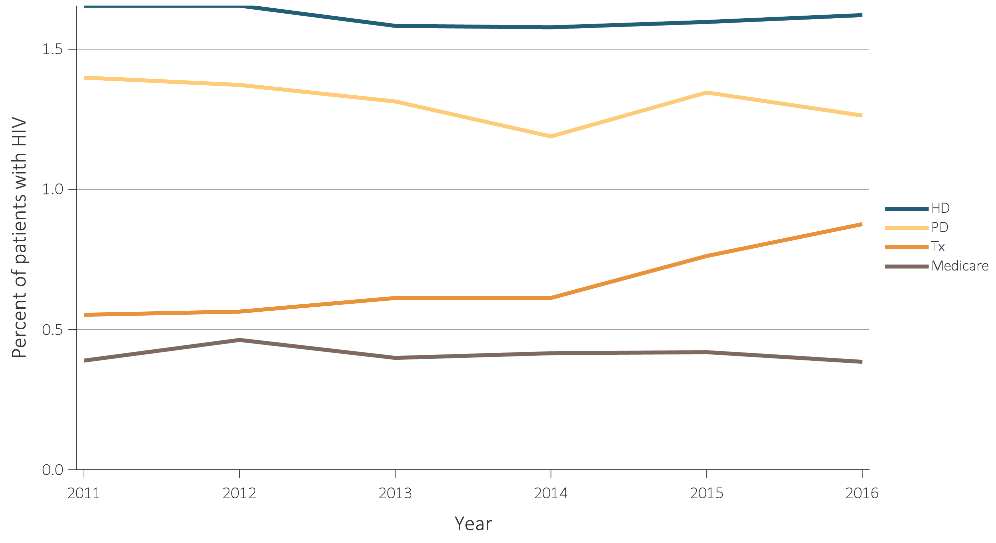
vol 2 Figure 10.8 Estimated prevalence of HIV and HCV in Medicare Part D enrollees, by ESRD modality, 2011-2016
(a) HIV
Data source: 2016 Medicare Data, point prevalent Medicare enrollees alive on January 1, 2016. Abbreviations: ESRD, end-stage renal disease; HD, hemodialysis; Part D, Medicare Part D prescription drug coverage; PD, peritoneal dialysis; Tx, kidney transplant.

Slide 20
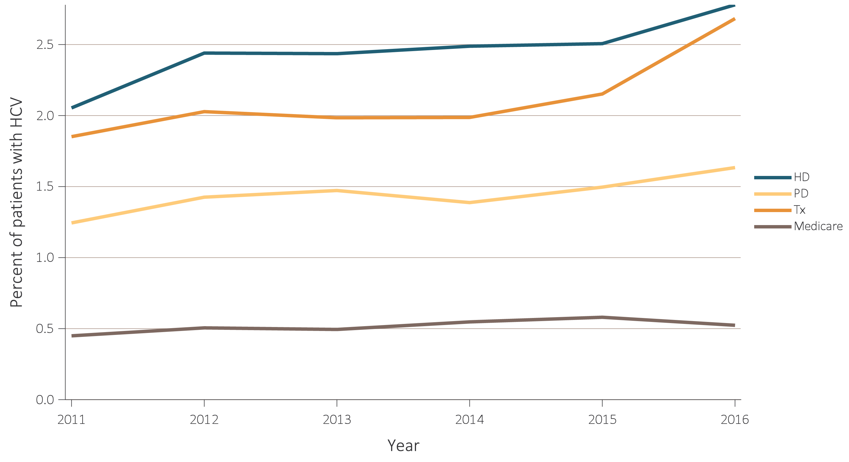
vol 2 Figure 10.8 Estimated prevalence of HIV and HCV in Medicare Part D enrollees, by ESRD modality, 2011-2016
(b) HCV
Data source: 2016 Medicare Data, point prevalent Medicare enrollees alive on January 1, 2016. Abbreviations: ESRD, end-stage renal disease; HD, hemodialysis; Part D, Medicare Part D prescription drug coverage; PD, peritoneal dialysis; Tx, kidney transplant.

Slide 21
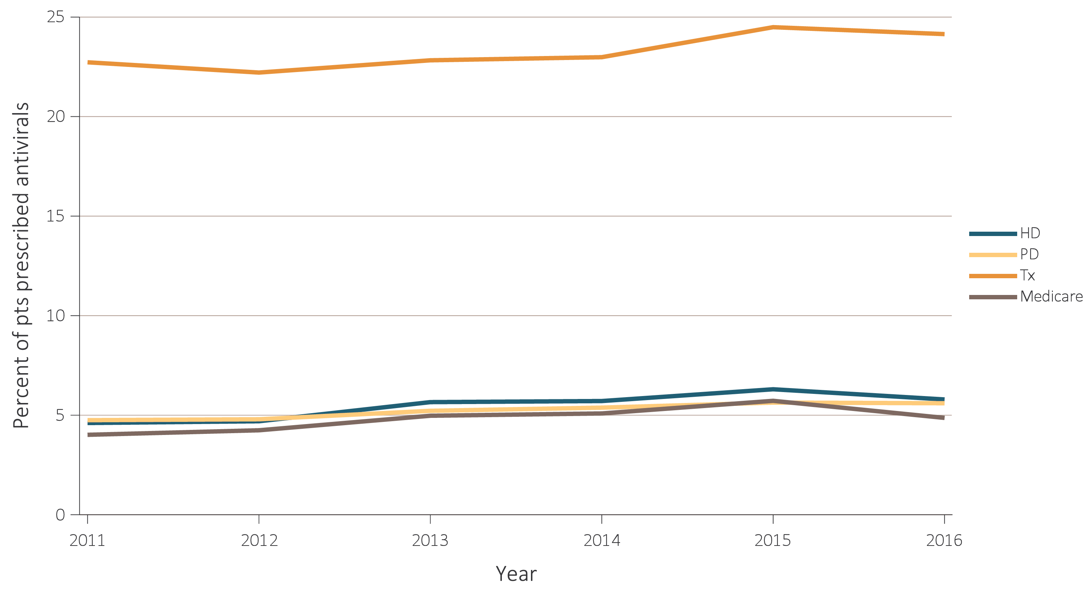
vol 2 Figure 10.9 Estimated utilization rate of prescription antivirals in Medicare Part D enrollees, by ESRD modality, 2011-2016
(a) All antivirals
Data source: 2016 Medicare Data, point prevalent Medicare enrollees alive on January 1, 2016. Abbreviations: ESRD, end-stage renal disease; HD, hemodialysis; Part D, Medicare Part D prescription drug coverage; PD, peritoneal dialysis; Tx, kidney transplant.

Slide 22
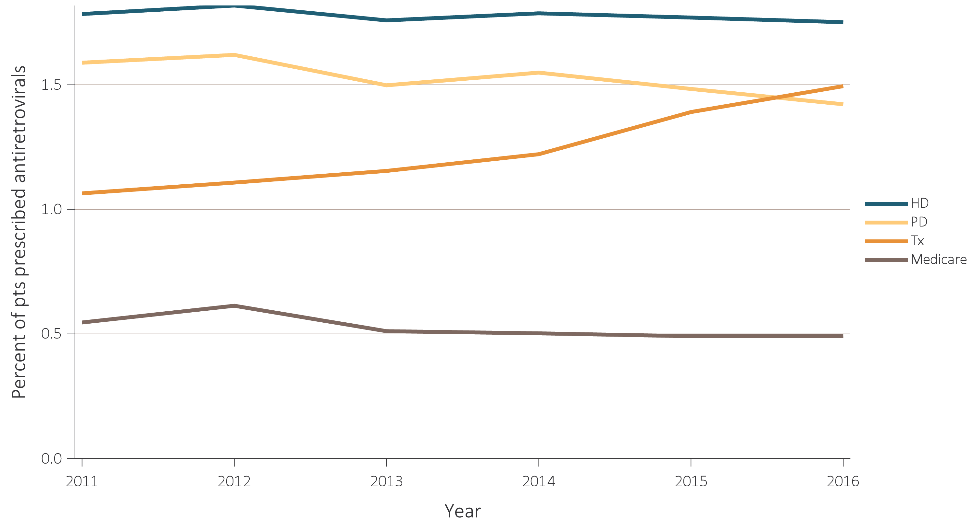
vol 2 Figure 10.9 Estimated utilization rate of prescription antivirals in Medicare Part D enrollees, by ESRD modality, 2011-2016
(b) Antiretrovirals
Data source: 2016 Medicare Data, point prevalent Medicare enrollees alive on January 1, 2016. Abbreviations: ESRD, end-stage renal disease; HD, hemodialysis; Part D, Medicare Part D prescription drug coverage; PD, peritoneal dialysis; Tx, kidney transplant.

Slide 23
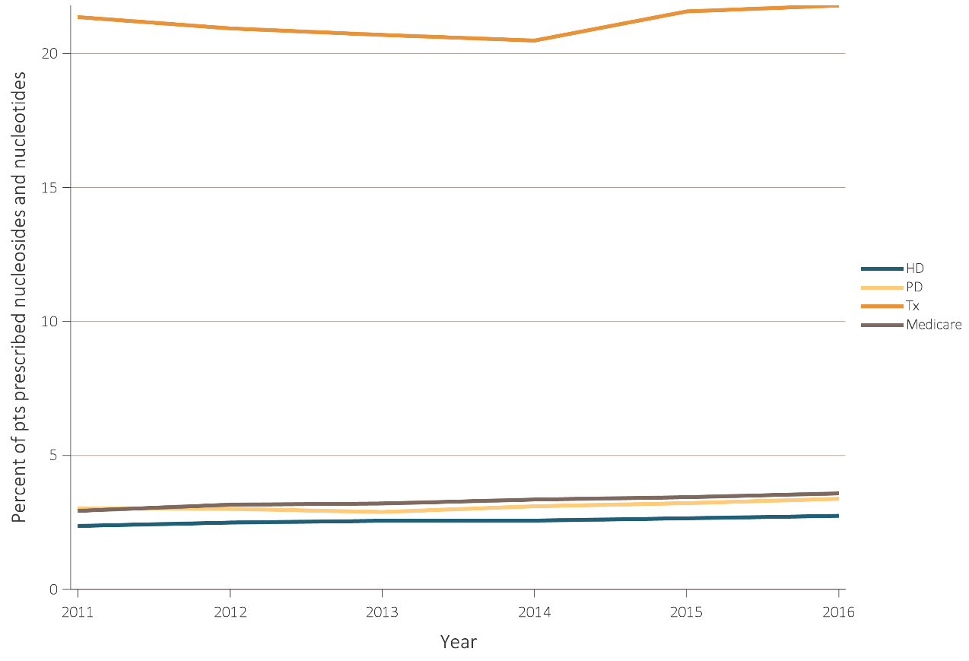
vol 2 Figure 10.9 Estimated utilization rate of prescription antivirals in Medicare Part D enrollees, by ESRD modality, 2011-2016
(c) Nucleosides and nucleotides
Data source: 2016 Medicare Data, point prevalent Medicare enrollees alive on January 1, 2016. Abbreviations: ESRD, end-stage renal disease; HD, hemodialysis; Part D, Medicare Part D prescription drug coverage; PD, peritoneal dialysis; Tx, kidney transplant.

Slide 24
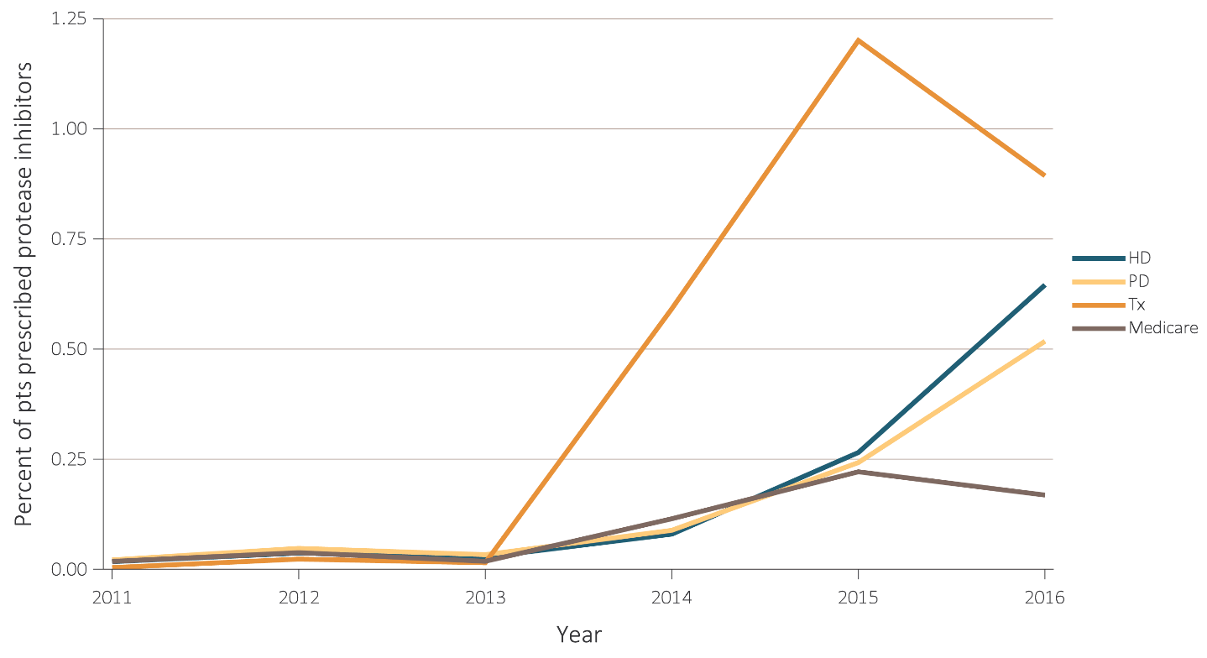
vol 2 Figure 10.9 Estimated utilization rate of prescription antivirals in Medicare Part D enrollees, by ESRD modality, 2011-2016
(d) Protease inhibitors
Data source: 2016 Medicare Data, point prevalent Medicare enrollees alive on January 1, 2016. Abbreviations: ESRD, end-stage renal disease; HD, hemodialysis; Part D, Medicare Part D prescription drug coverage; PD, peritoneal dialysis; Tx, kidney transplant.

Slide 25
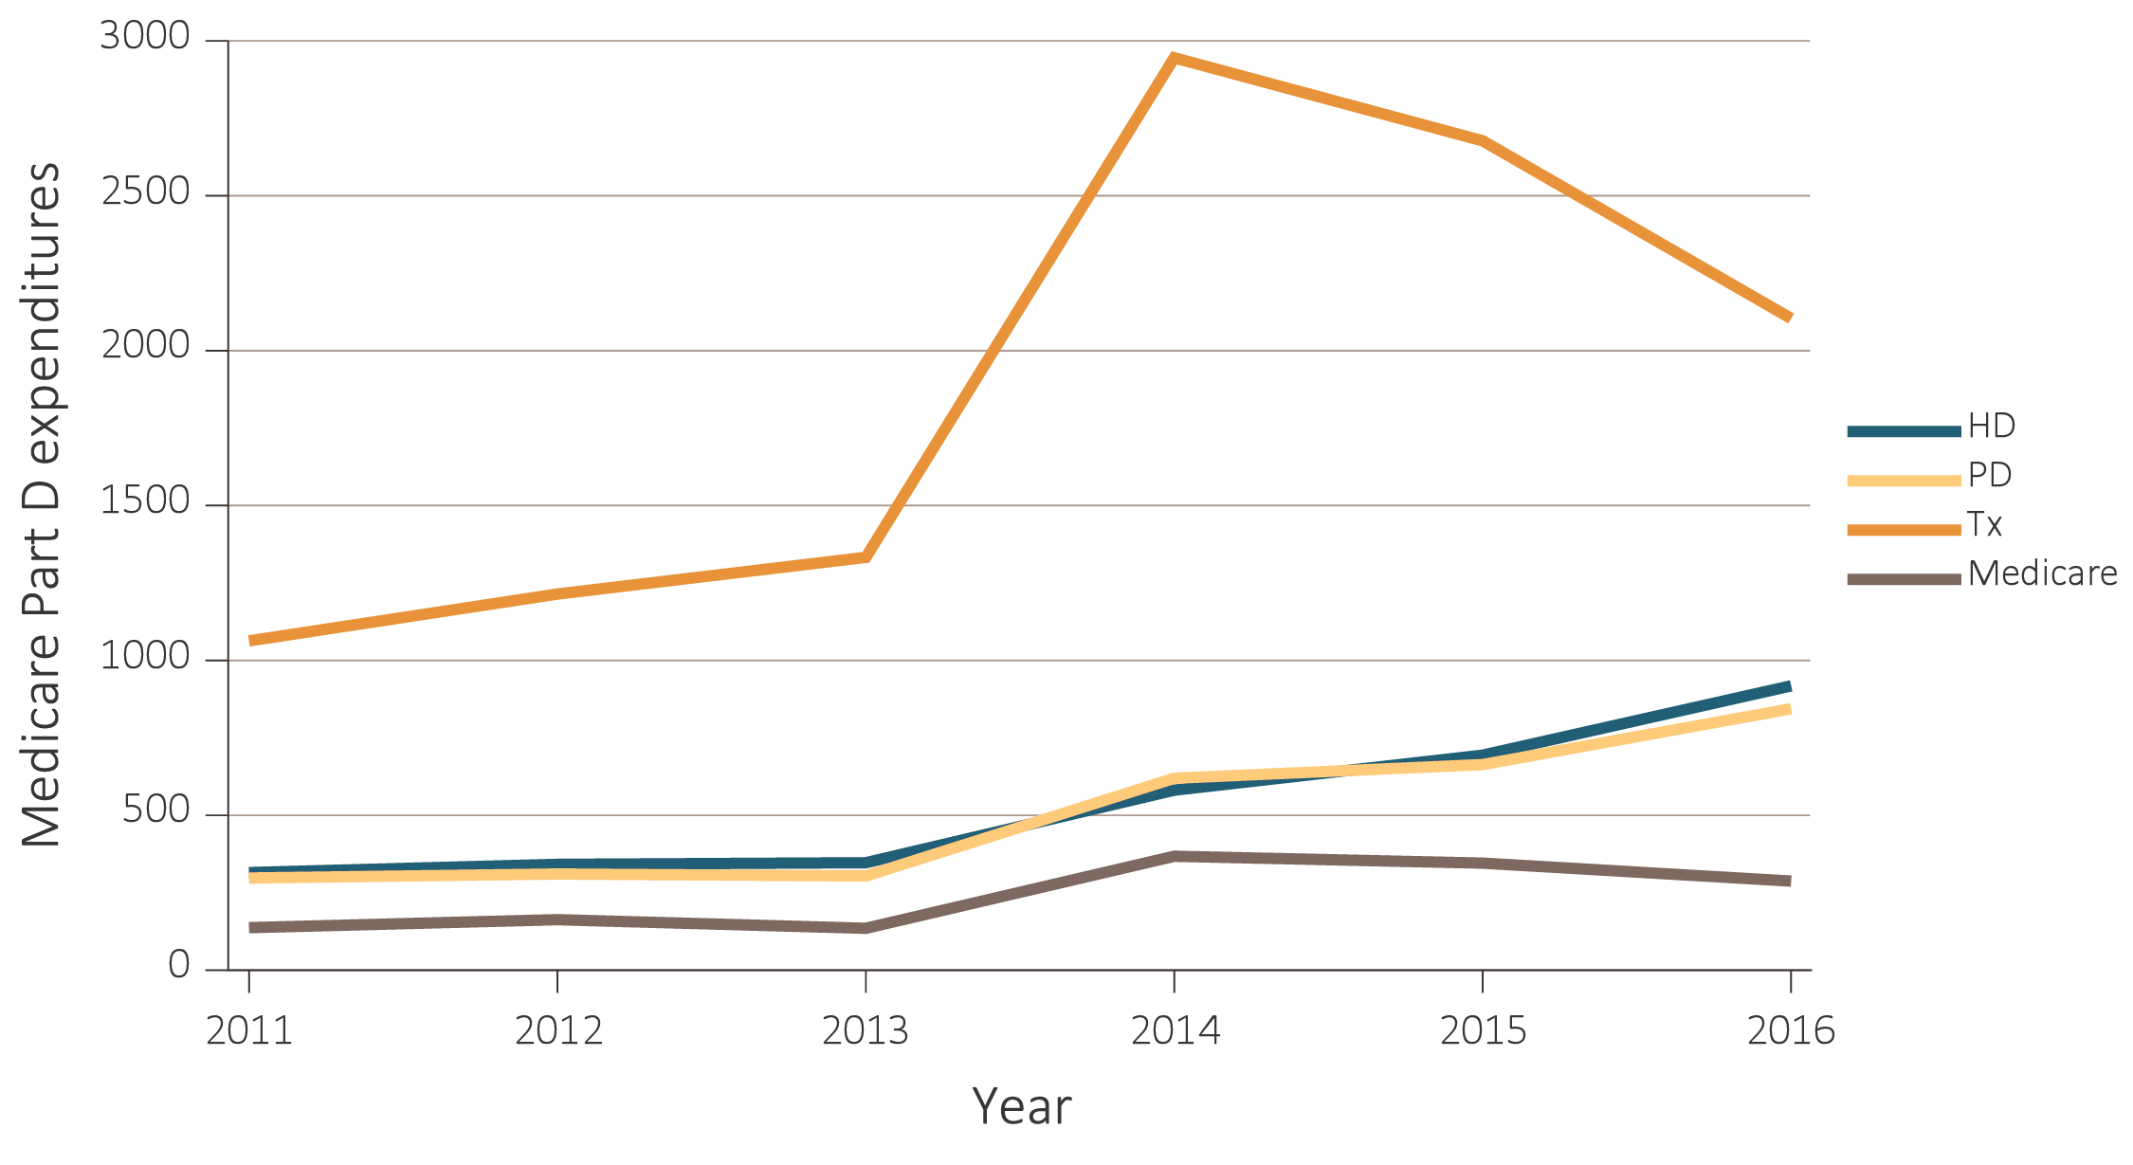
vol 2 Figure 10.10 Estimated utilization rate of prescription antivirals in Medicare Part D enrollees, by ESRD modality, 2011-2016
Data source: 2016 Medicare Data, point prevalent Medicare enrollees alive on January 1, 2016. Abbreviations: ESRD, end-stage renal disease; HD, hemodialysis; Part D, Medicare Part D prescription drug coverage; PD, peritoneal dialysis; Tx, kidney transplant.

Slide 26
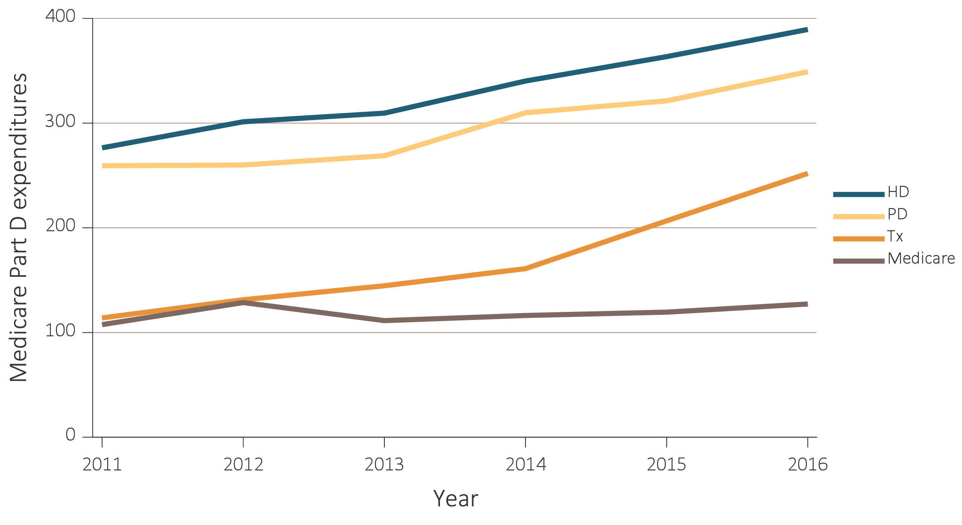
vol 2 Figure 10.10 Estimated utilization rate of prescription antivirals in Medicare Part D enrollees, by ESRD modality, 2011-2016
Data source: 2016 Medicare Data, point prevalent Medicare enrollees alive on January 1, 2016. Abbreviations: ESRD, end-stage renal disease; HD, hemodialysis; Part D, Medicare Part D prescription drug coverage; PD, peritoneal dialysis; Tx, kidney transplant.

Slide 27
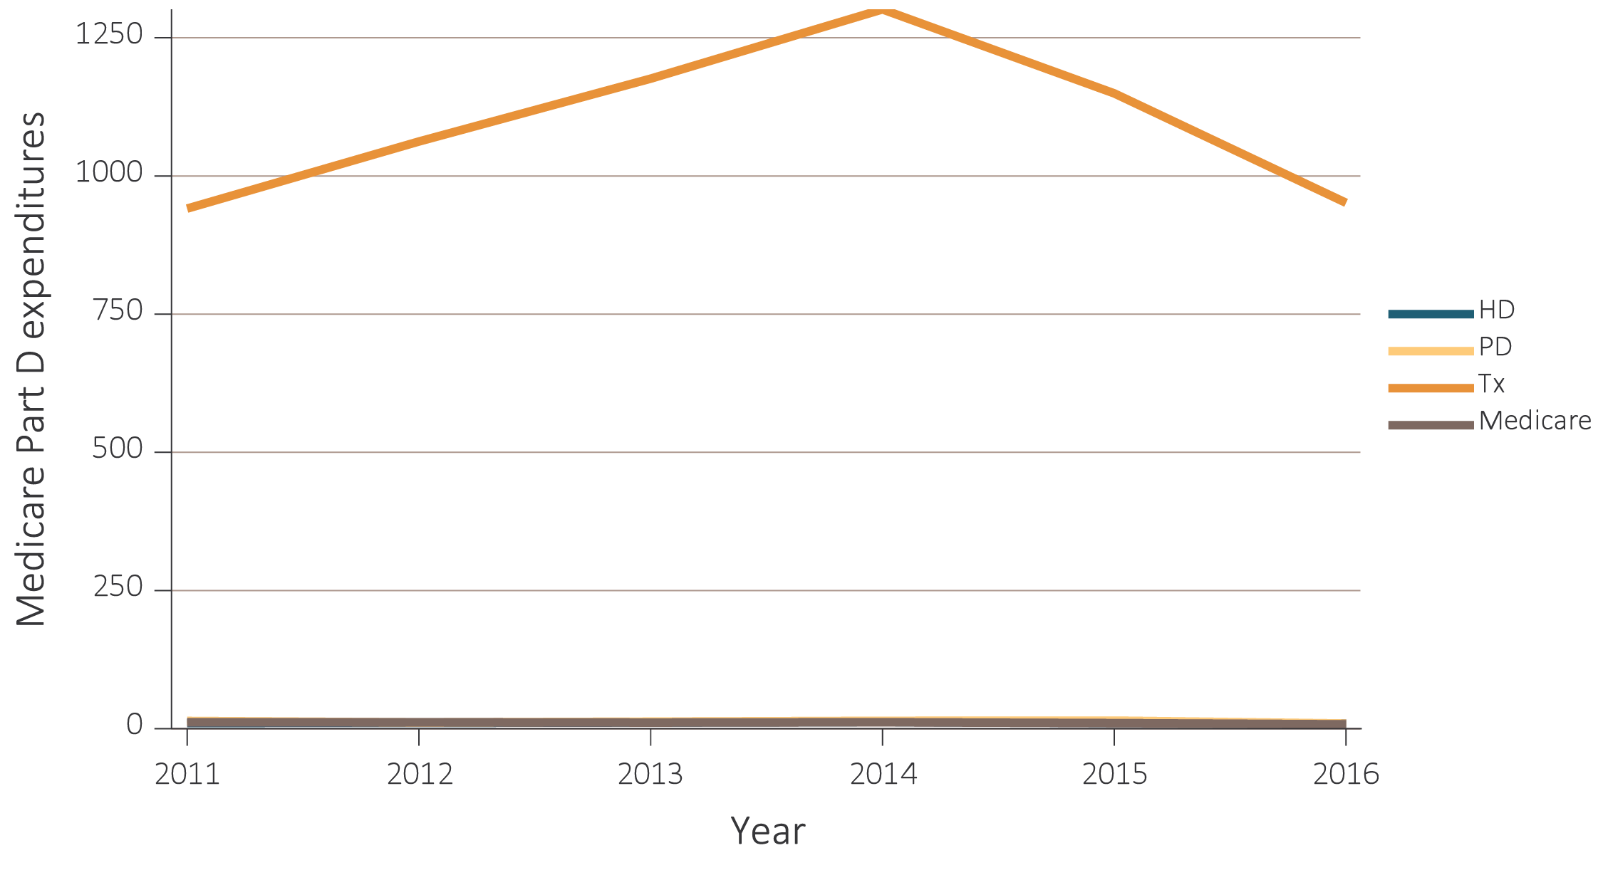
vol 2 Figure 10.10 Estimated utilization rate of prescription antivirals in Medicare Part D enrollees, by ESRD modality, 2011-2016
Data source: 2016 Medicare Data, point prevalent Medicare enrollees alive on January 1, 2016. Abbreviations: ESRD, end-stage renal disease; HD, hemodialysis; Part D, Medicare Part D prescription drug coverage; PD, peritoneal dialysis; Tx, kidney transplant.

Slide 28
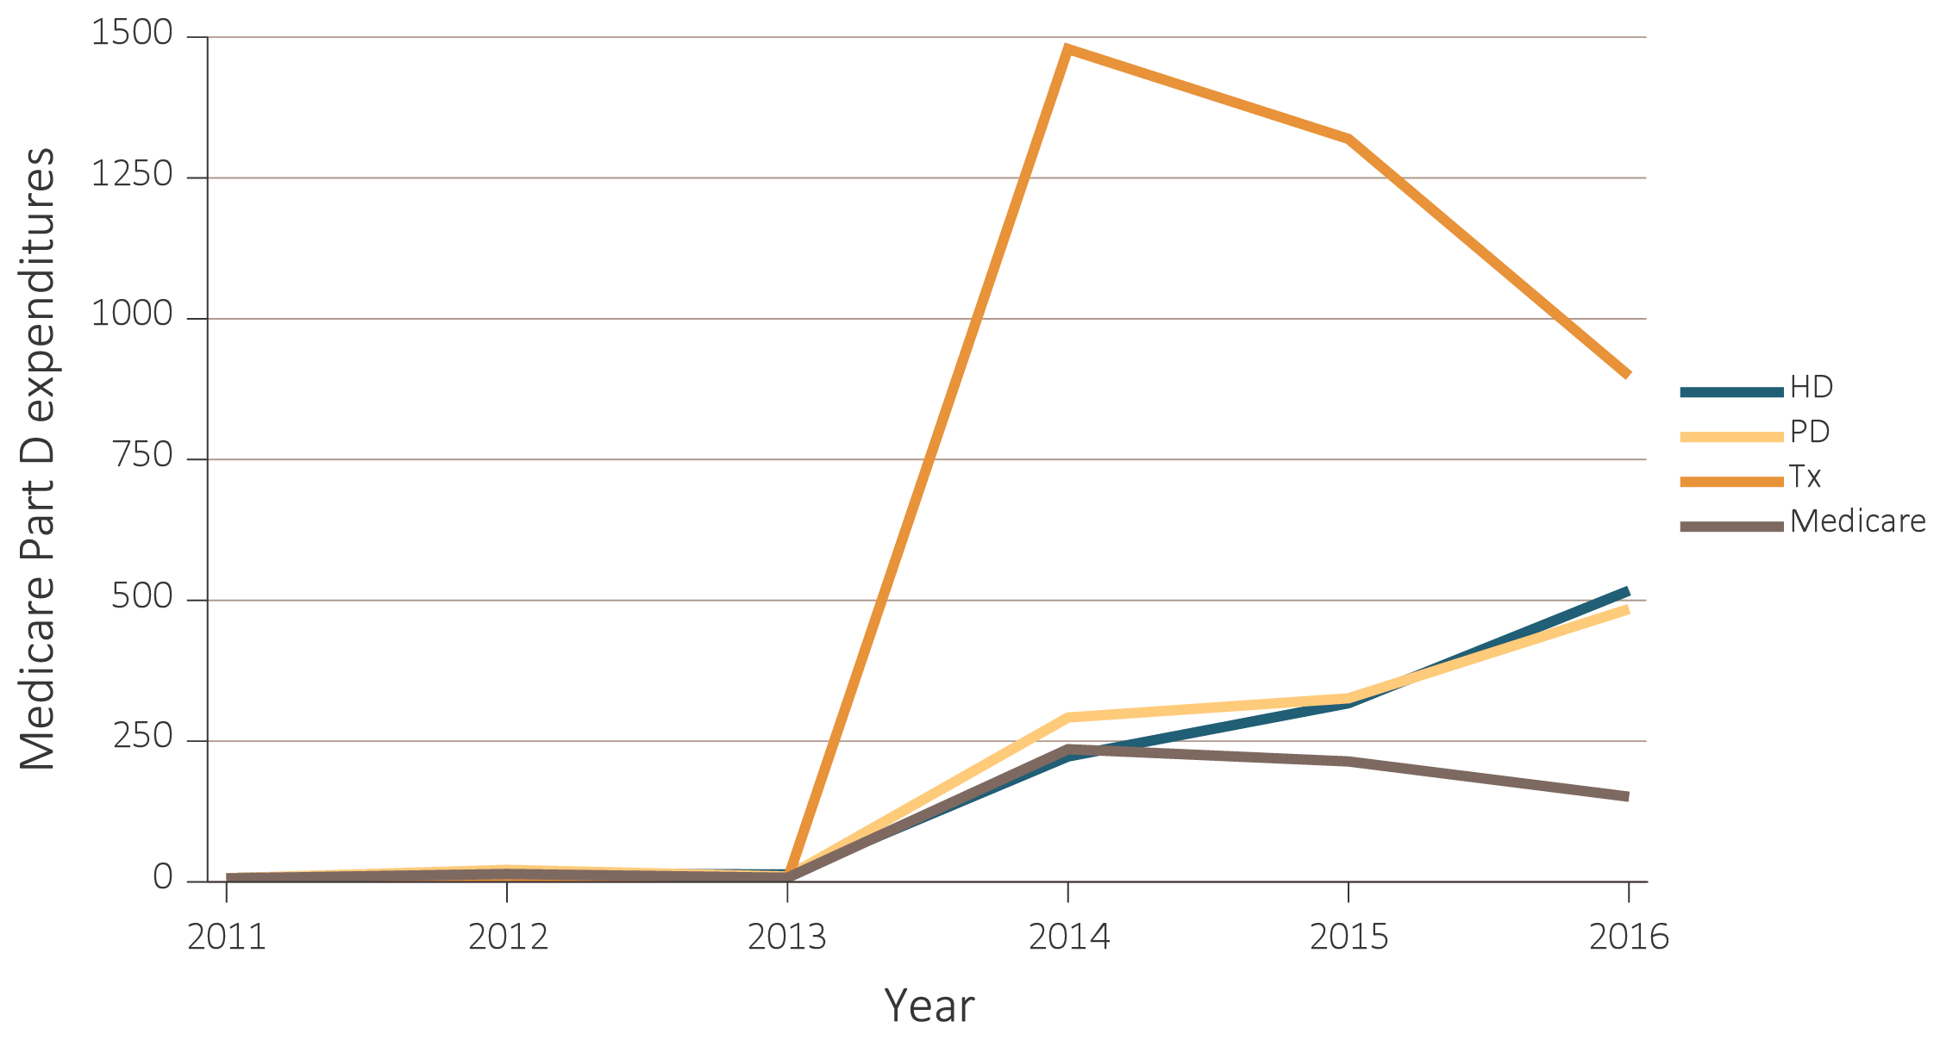
vol 2 Figure 10.10 Estimated utilization rate of prescription antivirals in Medicare Part D enrollees, by ESRD modality, 2011-2016
Data source: 2016 Medicare Data, point prevalent Medicare enrollees alive on January 1, 2016. Abbreviations: ESRD, end-stage renal disease; HD, hemodialysis; Part D, Medicare Part D prescription drug coverage; PD, peritoneal dialysis; Tx, kidney transplant.

