Slide 1
2018 Annual Data Report
Volume 2: End-Stage Renal Disease

Slide 2
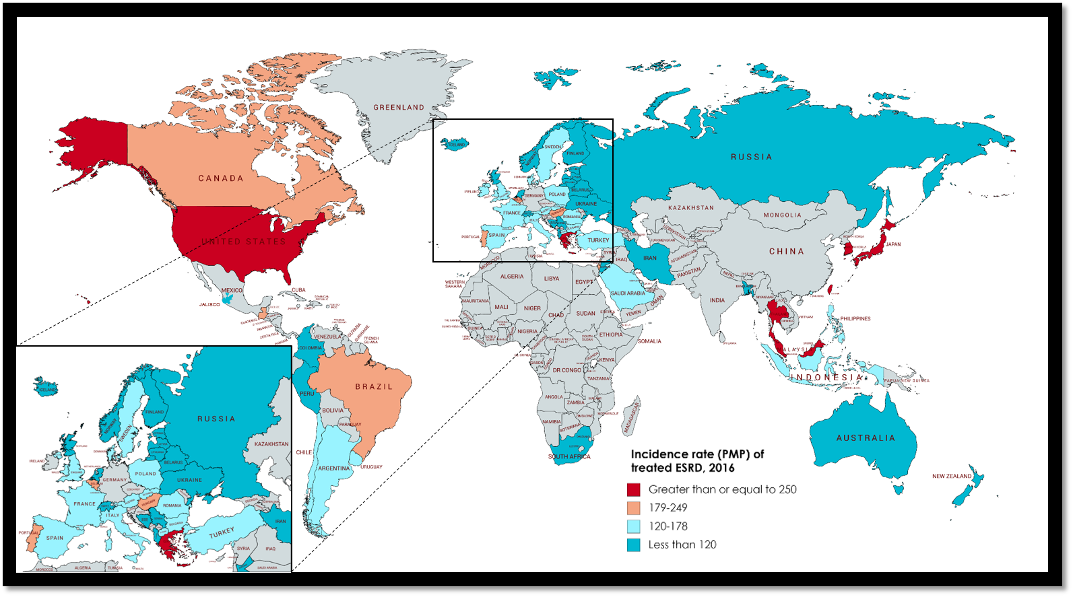
vol 2 Figure 11.1 Geographic variation in the incidence rate of treated ESRD (per million population), by country, 2016
Data source: Special analyses, USRDS ESRD Database. Data presented only for countries from which relevant information was available. Data unavailable for countries pictured above in gray. All rates are unadjusted. Data for Belarus from 43 of 51 RRT centers. Data for Canada exclude Quebec. Data for France exclude Martinique. Data for Guatemala exclude pediatric ESRD patients and patients receiving non-institutional RRT. Data for Indonesia represent the West Java region. Data for Italy representative of 35% (7 out of 19 regions) of ESRD patient population. Japan includes dialysis patients only. Data from Latvia representative of 80% of ESRD patient population. Data for Serbia approx. 30% less than reported in 2015 due to incomplete reporting. United Kingdom: England, Wales, Northern Ireland (Scotland data reported separately). Abbreviation: ESRD, end-stage renal disease. NOTE: Data collection methods vary across countries, suggesting caution in making direct comparisons.

Slide 3
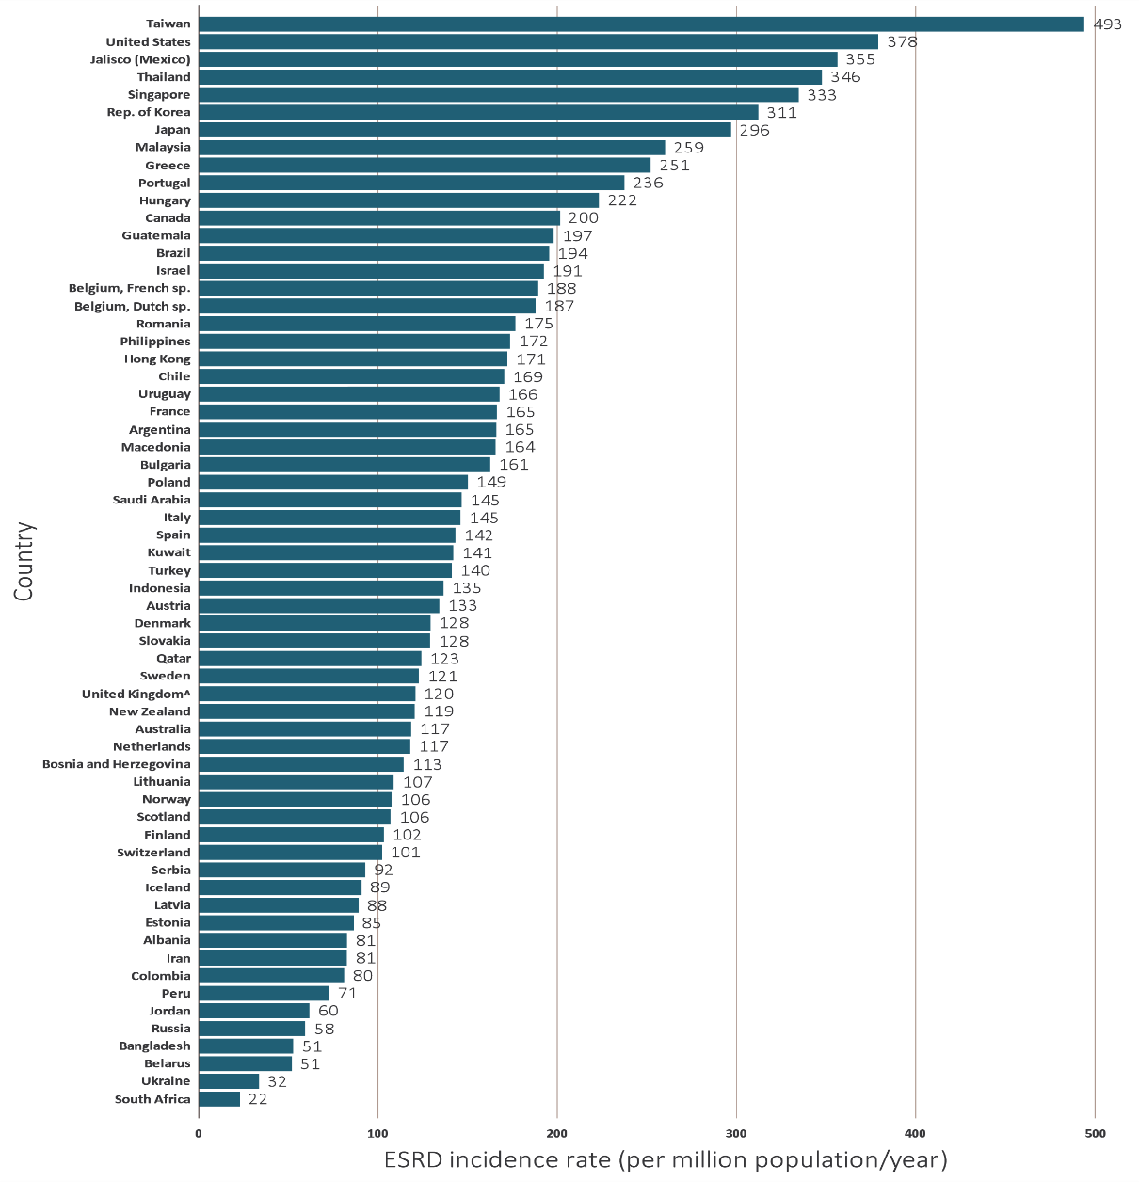
vol 2 Figure11.2 Incidence rate of treated ESRD (per million population), by country, 2016
Data source: Special analyses, USRDS ESRD Database. Data presented only for countries from which relevant information was available. All rates are unadjusted. Data for Belarus from 43 of 51 RRT centers. Data for Canada exclude Quebec. Data for France exclude Martinique. Data for Guatemala exclude pediatric ESRD patients and patients receiving non-institutional RRT. Data for Indonesia represent the West Java region. Data for Italy representative of 35% (7 out of 19 regions) of ESRD patient population. Japan includes dialysis patients only. Data from Latvia representative of 80% of ESRD patient population. Data for Serbia approx. 30% less than reported in 2015 due to incomplete reporting. United Kingdom^: England, Wales, Northern Ireland (Scotland data reported separately). Abbreviations: ESRD, end-stage renal disease; sp., speaking. NOTE: Data collection methods vary across countries, suggesting caution in making direct comparisons.

Slide 4
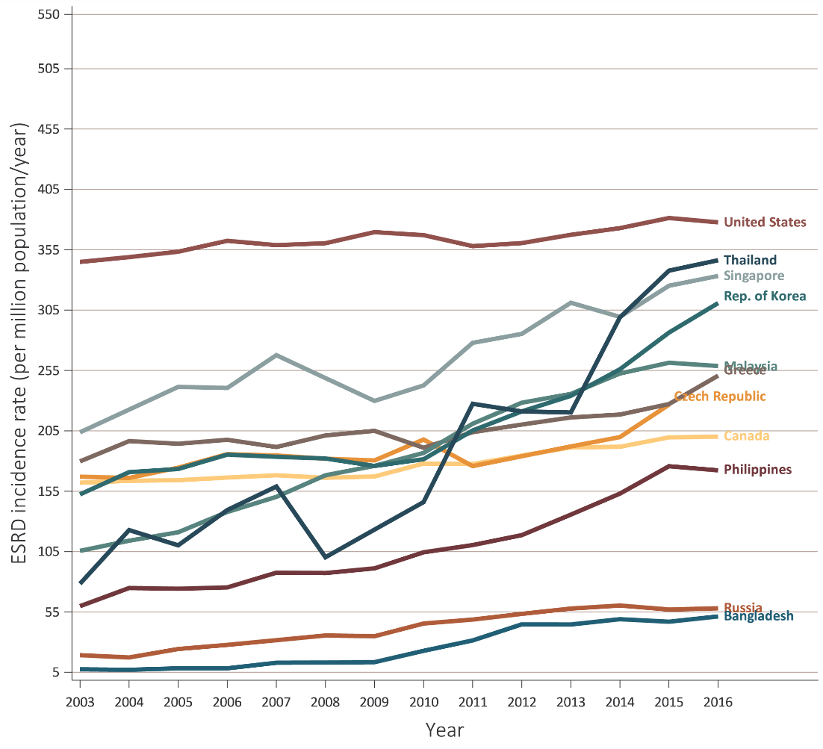
vol 2 Figure 11.3 Trends in the incidence rate of treated ESRD (per million population/year), by country, 2003-2016
(a) Ten countries having the highest percent increase in ESRD incidence rate in 2003-2004 versus that in 2015-2016, plus the United States
Data source: Special analyses, USRDS ESRD Database. Data presented only for countries from which relevant information were available. All rates are unadjusted. (a) Ten countries having the highest percentage rise in 2015-2016 versus that in 2003-2004, plus the United States. (b) Estimates derived from linear regression. Abbreviation: ESRD, end-stage renal disease. NOTE: Data collection methods vary across countries, suggesting caution in making direct comparisons.

Slide 5
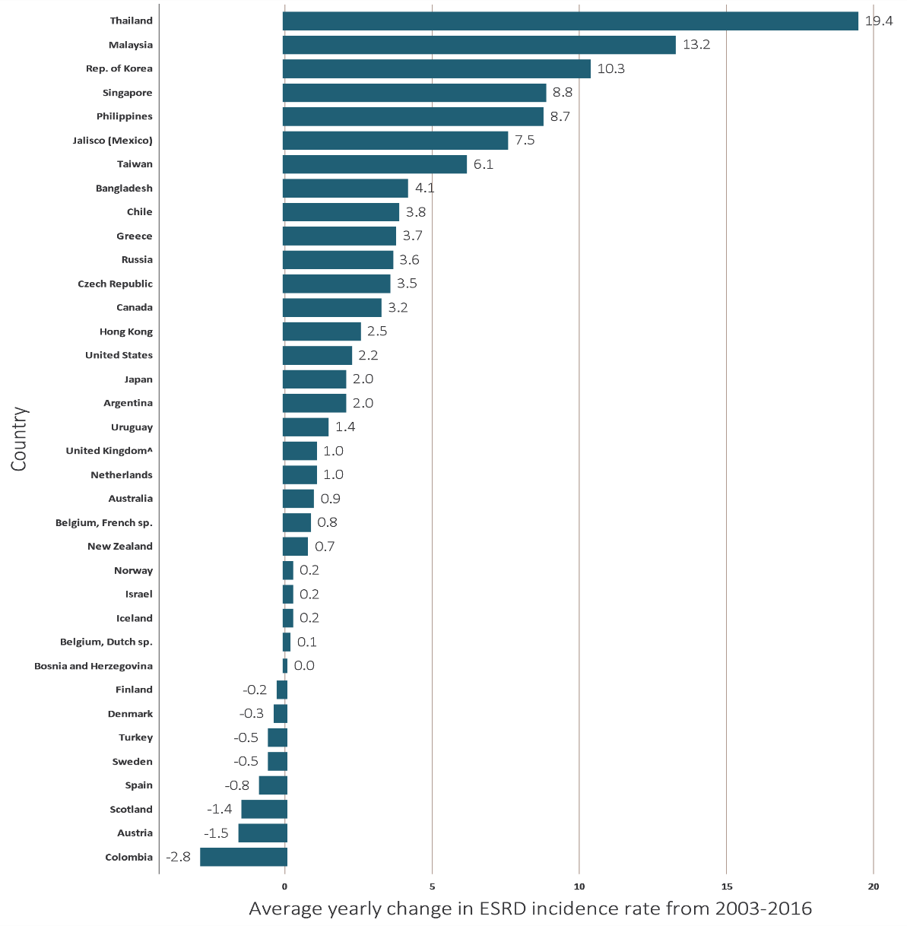
vol 2 Figure 11.3 Trends in the incidence rate of treated ESRD (per million population/year), by country, 2003-2016
(b) Average yearly change in the treated ESRD incidence rate from 2003-2016
Data source: Special analyses, USRDS ESRD Database. Data presented only for countries from which relevant information were available. All rates are unadjusted. (a) Ten countries having the highest percentage rise in 2015-2016 versus that in 2003-2004, plus the United States. (b) Estimates derived from linear regression. Abbreviation: ESRD, end-stage renal disease. NOTE: Data collection methods vary across countries, suggesting caution in making direct comparisons.

Slide 6
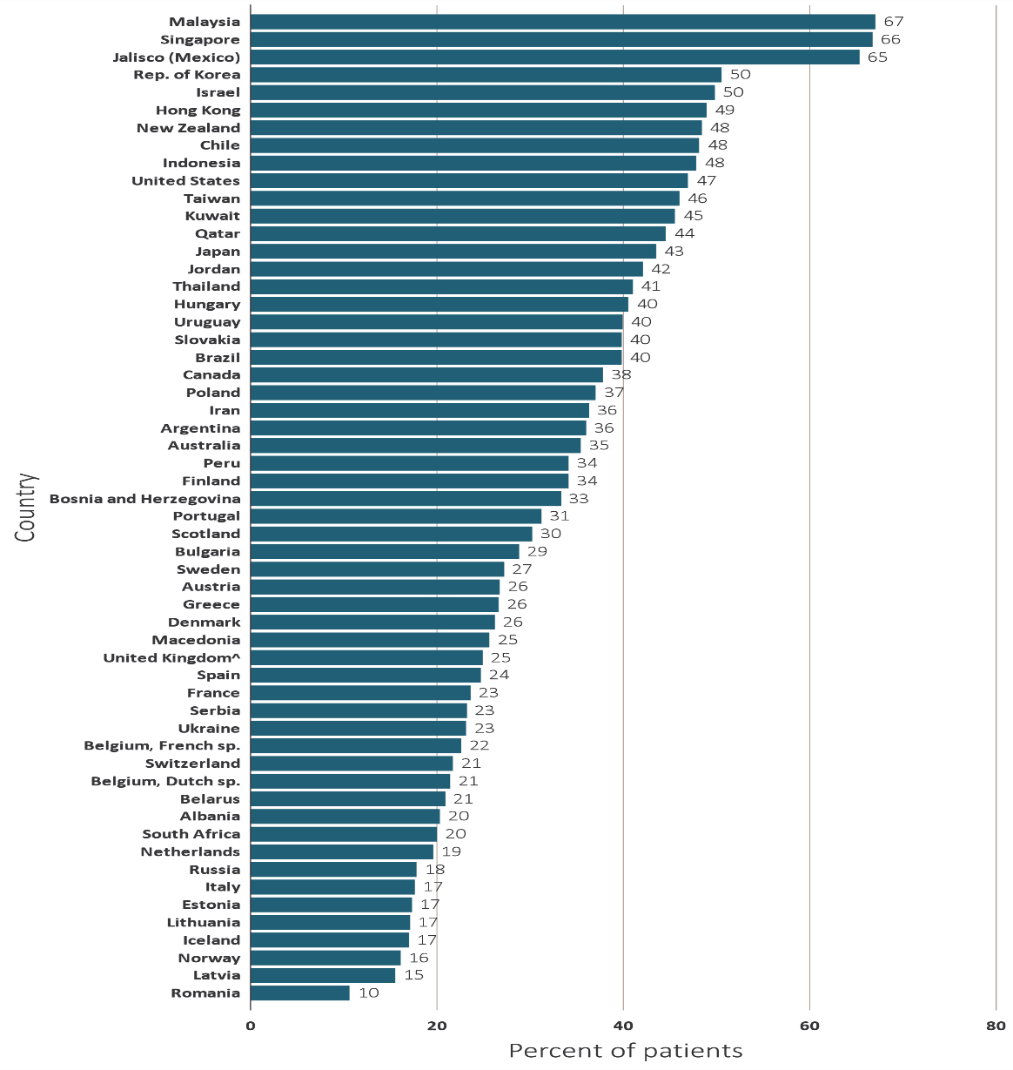
vol 2 Figure 11.4 Incidence of treated ESRD due to diabetes as the assigned primary cause of ESRD cause, by country, 2016
(a) Percentage of incident ESRD patients
Data source: Special analyses, USRDS ESRD Database. Data presented only for countries from which relevant information were available. Data for Belarus from 43 of 51 RRT centers. Data for Canada exclude Quebec. Data for France exclude Martinique. Data for Indonesia represent the West Java region. Data for Italy representative of 35% (7 out of 19 regions) of ESRD patient population. Japan includes dialysis patients only. Data from Latvia representative of 80% of ESRD patient population. Data for Serbia approx. 30% less than reported in 2015 due to incomplete reporting. United Kingdom^: England, Wales, Northern Ireland (Scotland data reported separately). Abbreviations: ESRD, end-stage renal disease; sp., speaking. NOTE: Data collection methods vary across countries, suggesting caution in making direct comparisons.

Slide 7
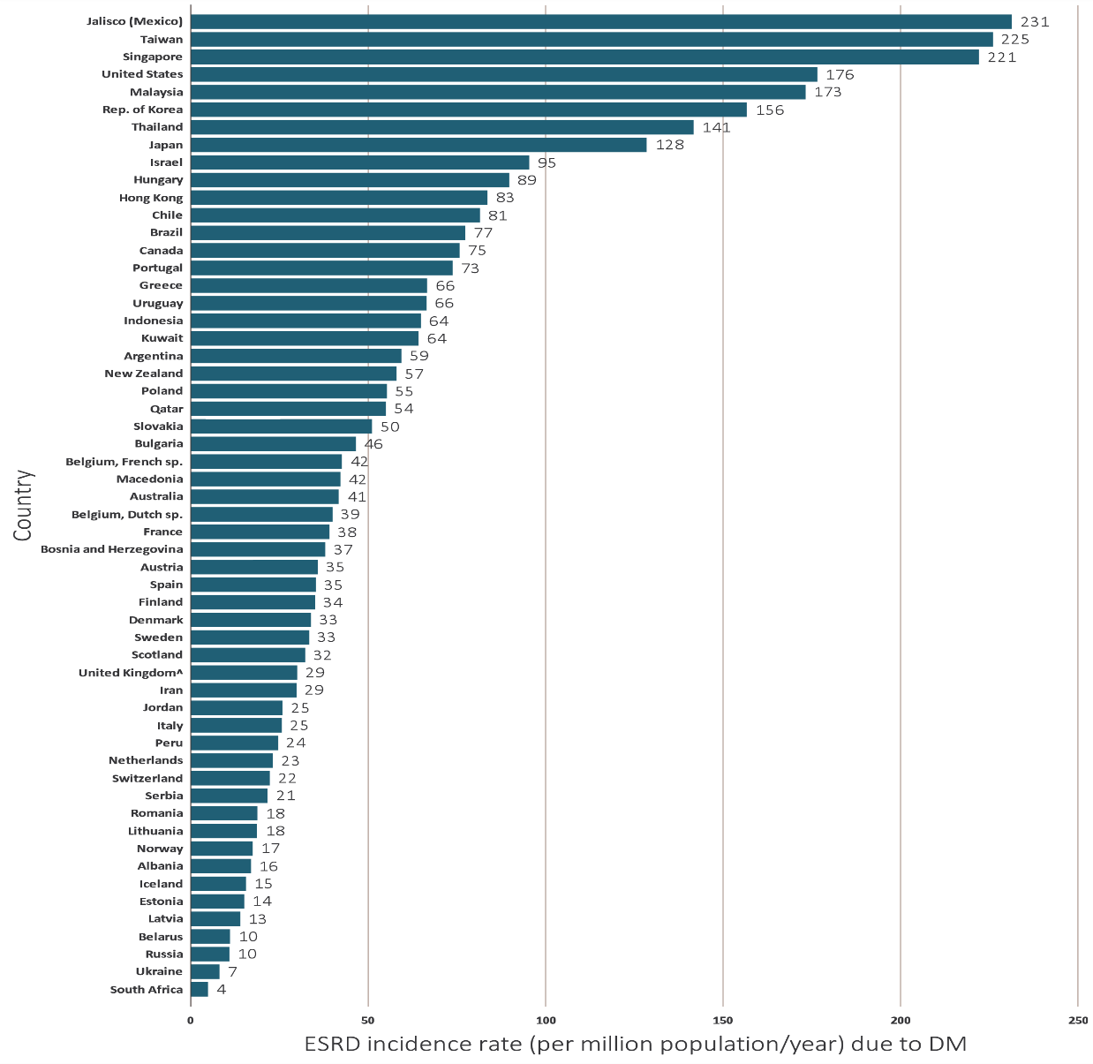
vol 2 Figure 11.4 Incidence of treated ESRD due to diabetes as the assigned primary cause of ESRD cause, by country, 2016
(b) Incidence rate of treated ESRD (per million population)
Data source: Special analyses, USRDS ESRD Database. Data presented only for countries from which relevant information were available. Data for Belarus from 43 of 51 RRT centers. Data for Canada exclude Quebec. Data for France exclude Martinique. Data for Indonesia represent the West Java region. Data for Italy representative of 35% (7 out of 19 regions) of ESRD patient population. Japan includes dialysis patients only. Data from Latvia representative of 80% of ESRD patient population. Data for Serbia approx. 30% less than reported in 2015 due to incomplete reporting. United Kingdom^: England, Wales, Northern Ireland (Scotland data reported separately). Abbreviations: ESRD, end-stage renal disease; sp., speaking. NOTE: Data collection methods vary across countries, suggesting caution in making direct comparisons.

Slide 8
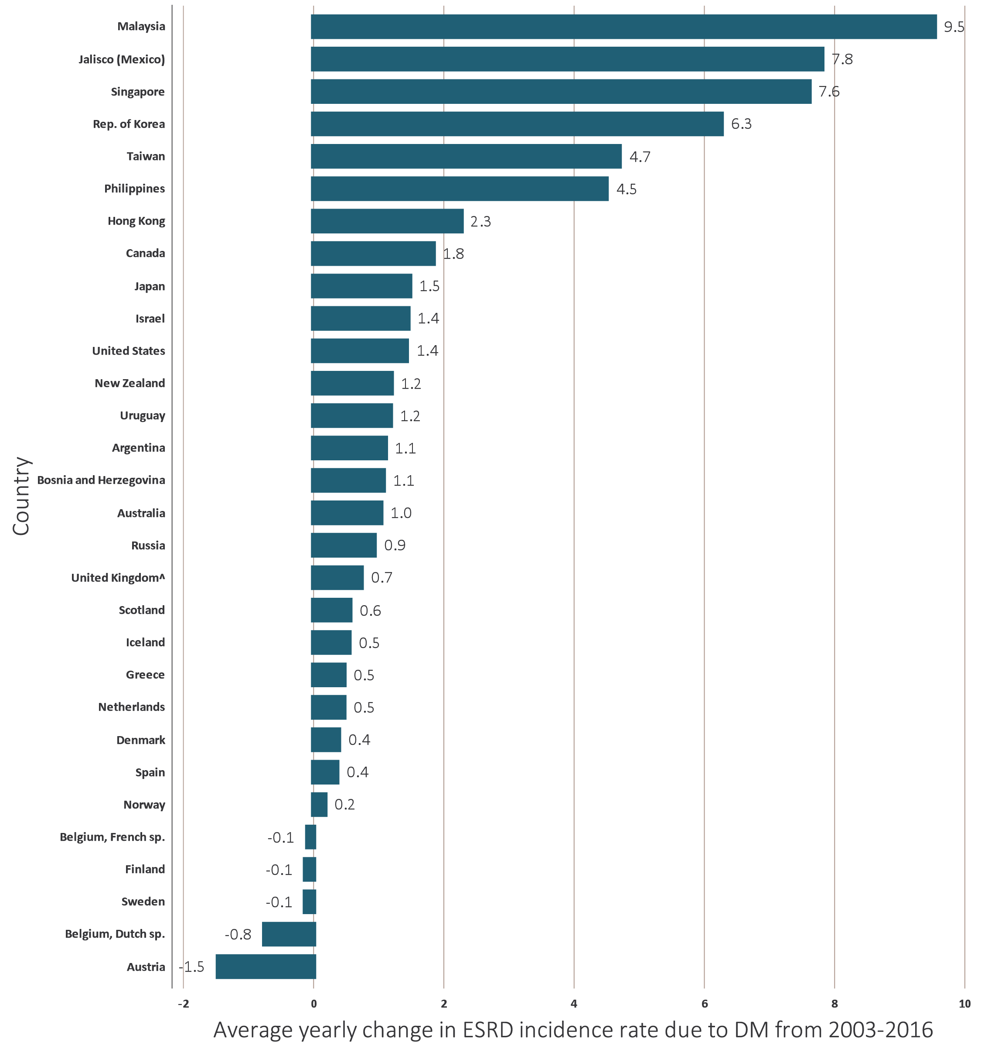
vol 2 Figure 11.5 Average yearly change in the incidence rate of treated ESRD due to diabetes as the assigned primary ESRD cause (per million population/year), by country, 2003-2016
Data source: Special analyses, USRDS ESRD Database. Data presented only for countries from which relevant information were available. Estimates derived from linear regression. Abbreviation: ESRD, end-stage renal disease. NOTE: Data collection methods vary across countries, suggesting caution in making direct comparisons.

Slide 9
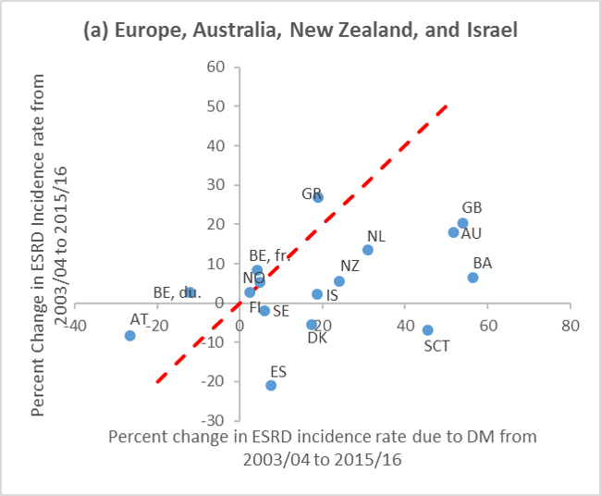
vol 2 Figure 11.6 Country-level correlation of the percentage change in ESRD incidence with the percentage change in ESRD incidence due to diabetes, from 2003-2016, with countries displayed by region
Data source: Special analyses, USRDS ESRD Database. Data presented only for countries from which relevant information was available. Reference line (in red) represents 1:1 ratio of percentage change in ESRD incidence rate due to diabetes and percentage change in ESRD incidence rate from 2003-2004 to2015-2016. Countries listed in order of lowest to highest percentage change in ESRD incidence due to diabetes in each panel. (a) Europe, Australia, New Zealand, and Israel: (-27-57%) Austria (AT), Belgium, Du. speaking (BE, du.), Finland (FI), Belgium, fr.speaking (BE, fr.), Norway (NO), Sweden (SE), Spain (ES), Denmark (DK), Israel (IS), Greece (GR), New Zealand (NZ), Netherlands (NL), Scotland (SCT), Australia (AU), United Kingdom (GB), and Bosnia and Herzegovina (BA); (b) North and Latin America: (2-45%) Uruguay (UY), United States (US), Argentina (AG) Canada (CA), Jalisco (Mexico, MX-JAL); (c) Asia and Russia: (18-360%) Japan (JP), Taiwan (TW), Hong Kong (HK), Singapore (SG), Rep. of Korea (KR), Malaysia (MY), Philippines (PH), Russia (RU). Abbreviation: ESRD, end-stage renal disease. NOTE: Data collection methods vary across countries, suggesting caution in making direct comparisons.

Slide 10
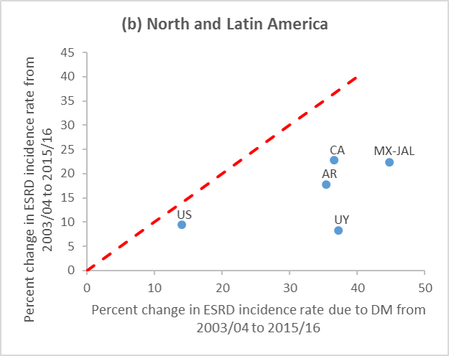
vol 2 Figure 11.6 Country-level correlation of the percentage change in ESRD incidence with the percentage change in ESRD incidence due to diabetes, from 2003-2016, with countries displayed by region
Data source: Special analyses, USRDS ESRD Database. Data presented only for countries from which relevant information was available. Reference line (in red) represents 1:1 ratio of percentage change in ESRD incidence rate due to diabetes and percentage change in ESRD incidence rate from 2003-2004 to2015-2016. Countries listed in order of lowest to highest percentage change in ESRD incidence due to diabetes in each panel. (a) Europe, Australia, New Zealand, and Israel: (-27-57%) Austria (AT), Belgium, Du. speaking (BE, du.), Finland (FI), Belgium, fr.speaking (BE, fr.), Norway (NO), Sweden (SE), Spain (ES), Denmark (DK), Israel (IS), Greece (GR), New Zealand (NZ), Netherlands (NL), Scotland (SCT), Australia (AU), United Kingdom (GB), and Bosnia and Herzegovina (BA); (b) North and Latin America: (2-45%) Uruguay (UY), United States (US), Argentina (AG) Canada (CA), Jalisco (Mexico, MX-JAL); (c) Asia and Russia: (18-360%) Japan (JP), Taiwan (TW), Hong Kong (HK), Singapore (SG), Rep. of Korea (KR), Malaysia (MY), Philippines (PH), Russia (RU). Abbreviation: ESRD, end-stage renal disease. NOTE: Data collection methods vary across countries, suggesting caution in making direct comparisons.

Slide 11
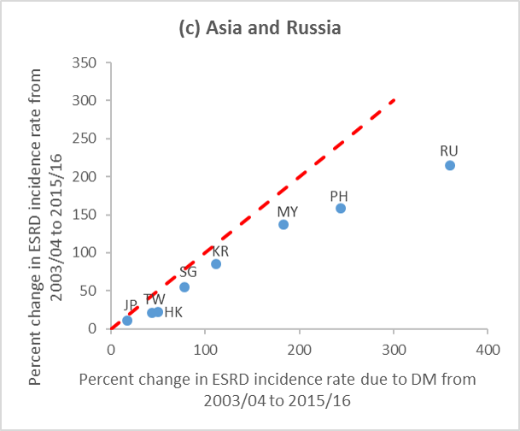
vol 2 Figure 11.6 Country-level correlation of the percentage change in ESRD incidence with the percentage change in ESRD incidence due to diabetes, from 2003-2016, with countries displayed by region
Data source: Special analyses, USRDS ESRD Database. Data presented only for countries from which relevant information was available. Reference line (in red) represents 1:1 ratio of percentage change in ESRD incidence rate due to diabetes and percentage change in ESRD incidence rate from 2003-2004 to2015-2016. Countries listed in order of lowest to highest percentage change in ESRD incidence due to diabetes in each panel. (a) Europe, Australia, New Zealand, and Israel: (-27-57%) Austria (AT), Belgium, Du. speaking (BE, du.), Finland (FI), Belgium, fr.speaking (BE, fr.), Norway (NO), Sweden (SE), Spain (ES), Denmark (DK), Israel (IS), Greece (GR), New Zealand (NZ), Netherlands (NL), Scotland (SCT), Australia (AU), United Kingdom (GB), and Bosnia and Herzegovina (BA); (b) North and Latin America: (2-45%) Uruguay (UY), United States (US), Argentina (AG) Canada (CA), Jalisco (Mexico, MX-JAL); (c) Asia and Russia: (18-360%) Japan (JP), Taiwan (TW), Hong Kong (HK), Singapore (SG), Rep. of Korea (KR), Malaysia (MY), Philippines (PH), Russia (RU). Abbreviation: ESRD, end-stage renal disease. NOTE: Data collection methods vary across countries, suggesting caution in making direct comparisons.

Slide 12
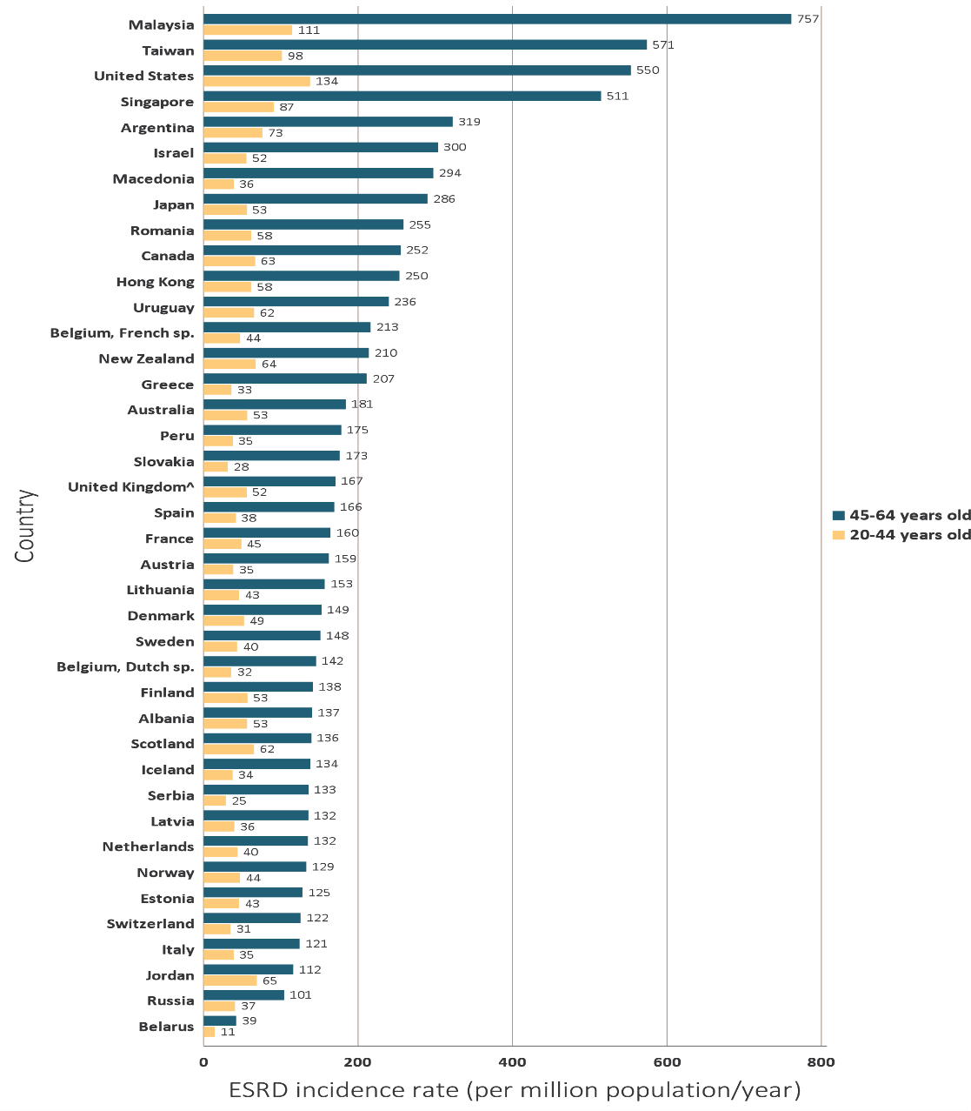
vol 2 Figure 11.7 Incidence rate of treated ESRD (per million population/year), by age group and country, 2016
(a) 20-44 and 45-64 years old
Data source: Special analyses, USRDS ESRD Database. Data presented only for countries from which relevant information was available. Data for Belarus from 43 of 51 RRT centers. Data for Canada exclude Quebec. Data for France exclude Martinique. Data for Indonesia represent the West Java region. Data for Italy representative of 35% (7 out of 19 regions) of ESRD patient population. Japan includes dialysis patients only. Data from Latvia representative of 80% of ESRD patient population. Data for Serbia approx. 30% less than reported in 2015 due to incomplete reporting. United Kingdom^: England, Wales, Northern Ireland (Scotland data reported separately). For graph (a), data for Spain include patients 15-64 years old, and data for the United States include patients 22-64 years old. Abbreviations: ESRD, end-stage renal disease; sp., speaking. NOTE: Data collection methods vary across countries, suggesting caution in making direct comparisons.

Slide 13
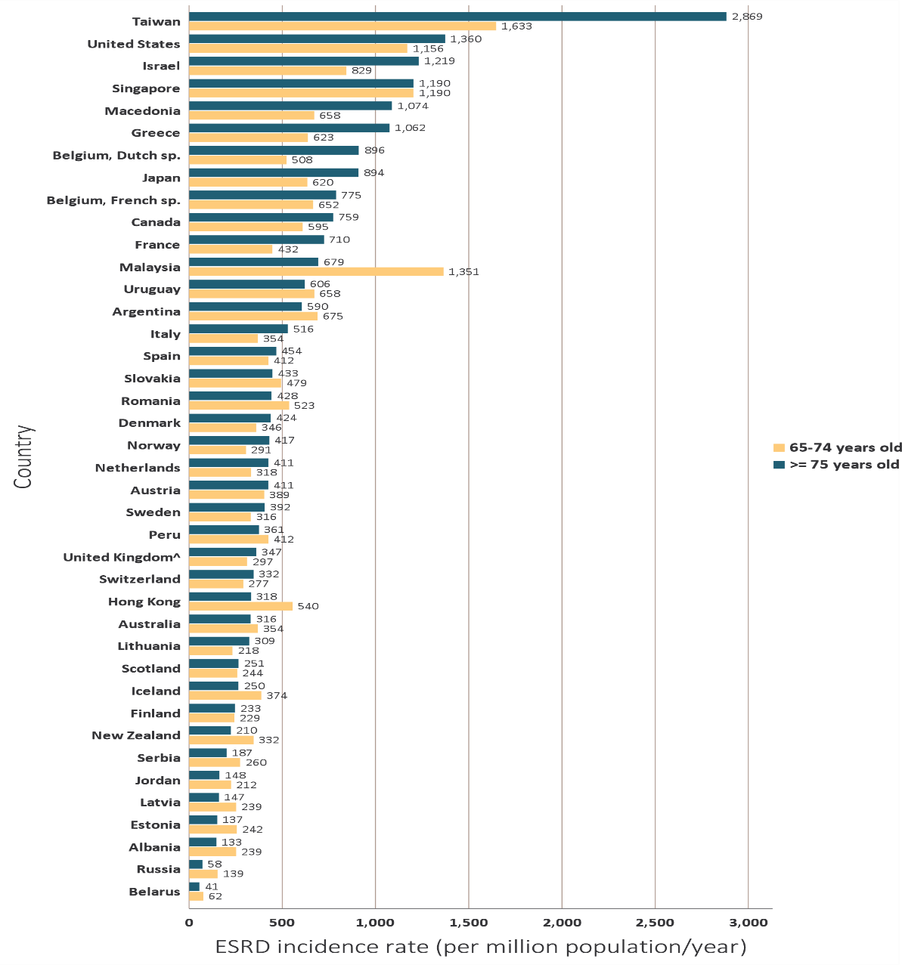
vol 2 Figure 11.7 Incidence rate of treated ESRD (per million population/year), by age group and country, 2016
(b) 65-74 and ≥75 years old
Data source: Special analyses, USRDS ESRD Database. Data presented only for countries from which relevant information was available. Data for Belarus from 43 of 51 RRT centers. Data for Canada exclude Quebec. Data for France exclude Martinique. Data for Indonesia represent the West Java region. Data for Italy representative of 35% (7 out of 19 regions) of ESRD patient population. Japan includes dialysis patients only. Data from Latvia representative of 80% of ESRD patient population. Data for Serbia approx. 30% less than reported in 2015 due to incomplete reporting. United Kingdom^: England, Wales, Northern Ireland (Scotland data reported separately). For graph (a), data for Spain include patients 15-64 years old, and data for the United States include patients 22-64 years old. Abbreviations: ESRD, end-stage renal disease; sp., speaking. NOTE: Data collection methods vary across countries, suggesting caution in making direct comparisons.

Slide 14
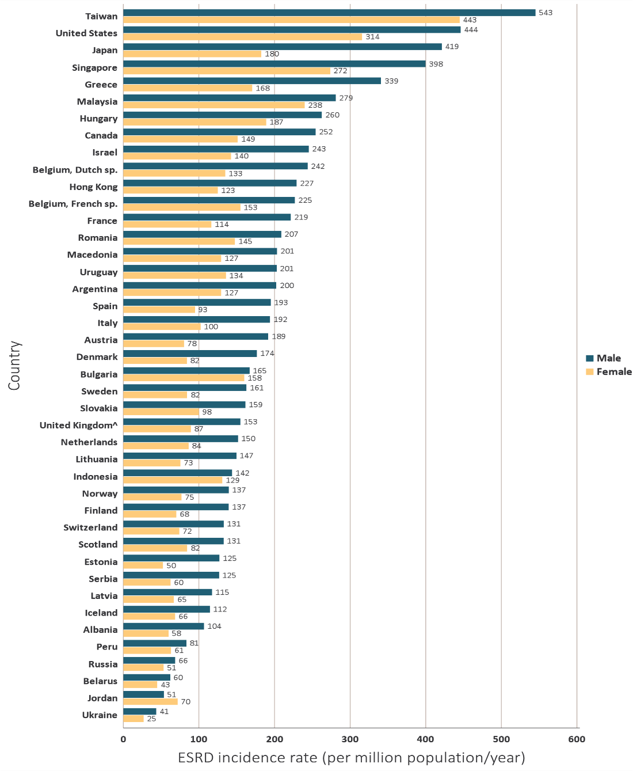
vol 2 Figure 11.8 Incidence rate of treated ESRD (per million population/year), by sex and country, 2016
Data source: Special analyses, USRDS ESRD Database. Data presented only for countries from which relevant information was available. Data for Belarus from 43 of 51 RRT centers. Data for Canada exclude Quebec. Data for France exclude Martinique. Data for Indonesia represent the West Java region. Data for Italy representative of 35% (7 out of 19 regions) of ESRD patient population. Japan includes dialysis patients only. Data from Latvia representative of 80% of ESRD patient population. Data for Serbia approx. 30% less than reported in 2015 due to incomplete reporting. United Kingdom^: England, Wales, Northern Ireland (Scotland data reported separately). Abbreviations: ESRD, end-stage renal disease; sp., speaking. NOTE: Data collection methods vary across countries, suggesting caution in making direct comparisons.

Slide 15
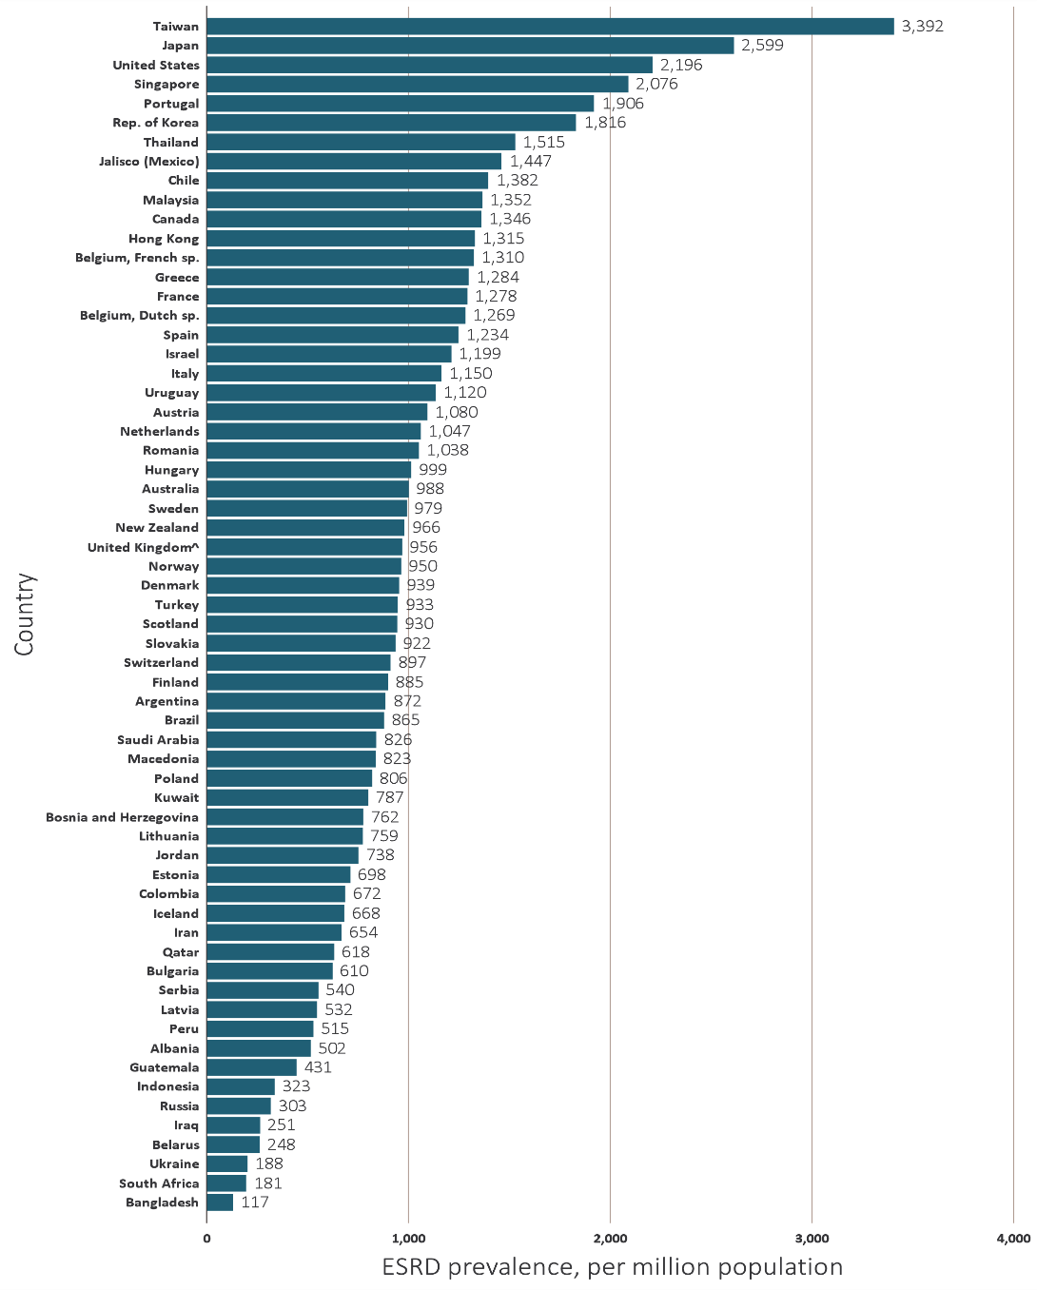
vol 2 Figure 11.9 Prevalence of treated ESRD (per million population), by country, 2016
Data source: Special analyses, USRDS ESRD Database. Data presented only for countries from which relevant information was available. Data for Belarus from 43 of 51 RRT centers. Data for Canada exclude Quebec. Data for France exclude Martinique. Data for Guatemala exclude pediatric ESRD patients and patients receiving non-institutional RRT. Data for Indonesia represent the West Java region. Data for Italy representative of 35% (7 out of 19 regions) of ESRD patient population. Data from Latvia representative of 80% of ESRD patient population. Prevalent functioning graft data for Slovakia only available for prevalent transplant patients. United Kingdom^: England, Wales, Northern Ireland (Scotland data reported separately). Abbreviations: ESRD, end-stage renal disease; sp., speaking. NOTE: Data collection methods vary across countries, suggesting caution in making direct comparisons.

Slide 16
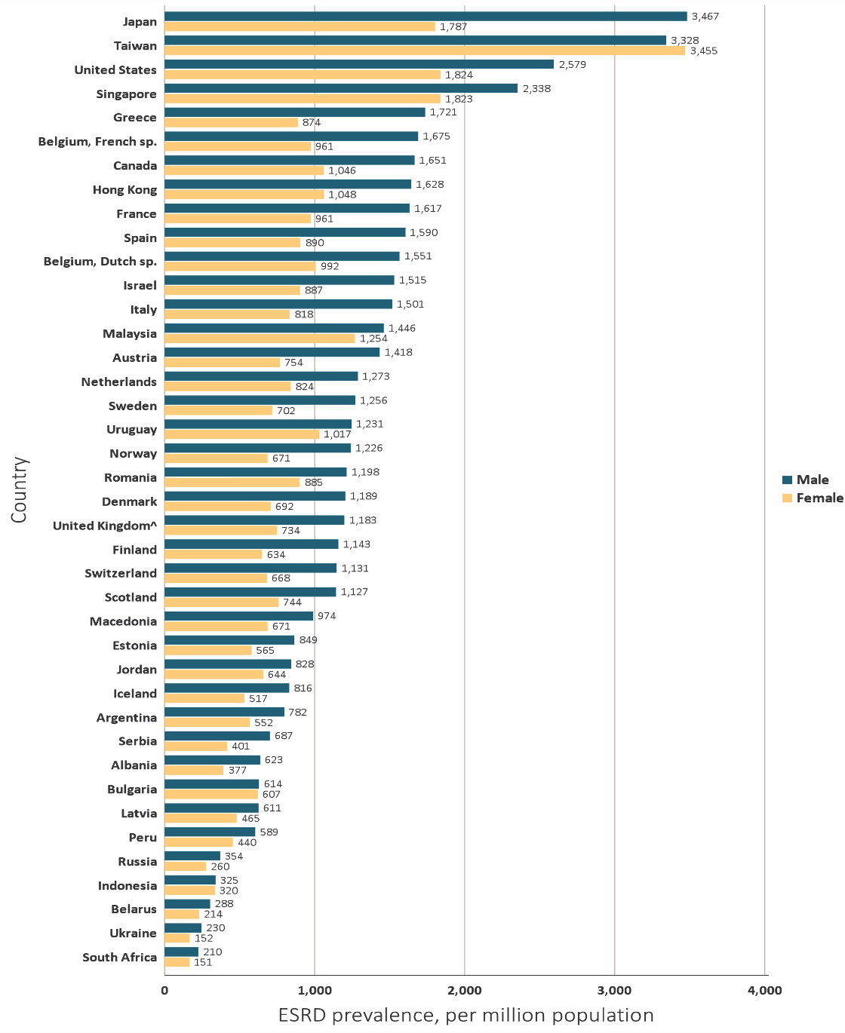
vol 2 Figure 11.10 Prevalence of treated ESRD (per million population), by sex and country, 2016
Data source: Special analyses, USRDS ESRD Database. Data presented only for countries from which relevant information was available. Data for Belarus from 43 of 51 RRT centers. Data for Canada exclude Quebec. Data for France exclude Martinique. Data for Indonesia represent the West Java region. Data for Italy representative of 35% (7 out of 19 regions) of ESRD patient population. Data from Latvia representative of 80% of ESRD patient population. Prevalent functioning graft data for Slovakia only available for prevalent transplant patients. United Kingdom^: England, Wales, Northern Ireland (Scotland data reported separately). Abbreviations: ESRD, end-stage renal disease; sp., speaking. NOTE: Data collection methods vary across countries, suggesting caution in making direct comparisons.

Slide 17
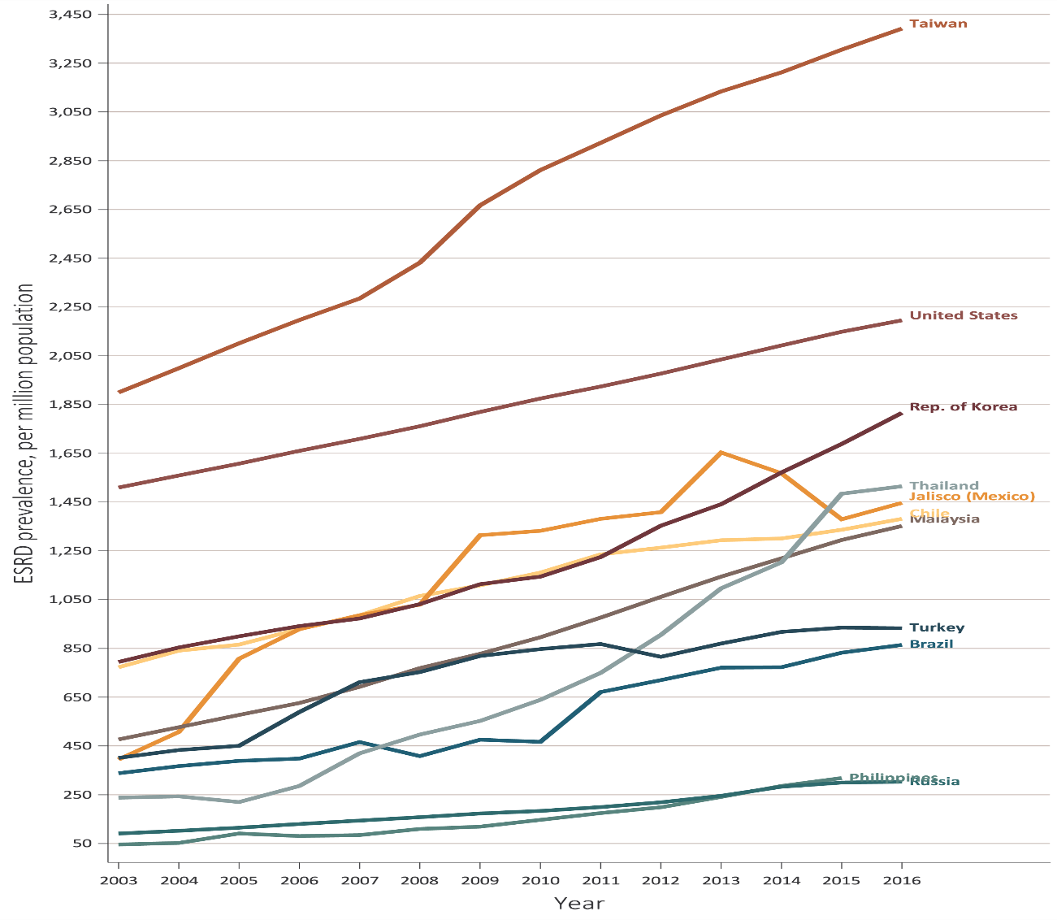
vol 2 Figure 11.11 Trends in the prevalence of treated ESRD (per million population), by country, 2003-2016
(a) Ten countries having the highest percentage rise in ESRD prevalence rate in 2003-2004 versus that in 2015-2016, plus the United States
Data source: Special analyses, USRDS ESRD Database. (a)Ten countries having the highest percentage rise in ESRD prevalence: 2015-2016 versus that in 2003-2004, plus the United States ESRD prevalence is unadjusted. United States is shown for comparison purposes. (b) Estimates derived from linear regression. Abbreviation: ESRD, end-stage renal disease. NOTE: Data collection methods vary across countries, suggesting caution in making direct comparisons.

Slide 18
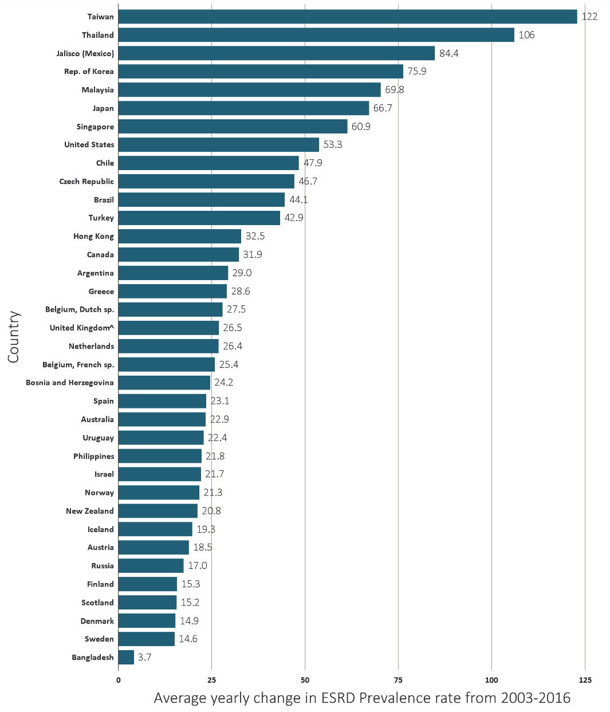
vol 2 Figure 11.11 Trends in the prevalence of treated ESRD (per million population), by country, 2003-2016
(b) Average yearly change in ESRD prevalence rate from 2003-2016
Data source: Special analyses, USRDS ESRD Database. (a)Ten countries having the highest percentage rise in ESRD prevalence: 2015-2016 versus that in 2003-2004, plus the United States ESRD prevalence is unadjusted. United States is shown for comparison purposes. (b) Estimates derived from linear regression. Abbreviation: ESRD, end-stage renal disease. NOTE: Data collection methods vary across countries, suggesting caution in making direct comparisons.

Slide 19
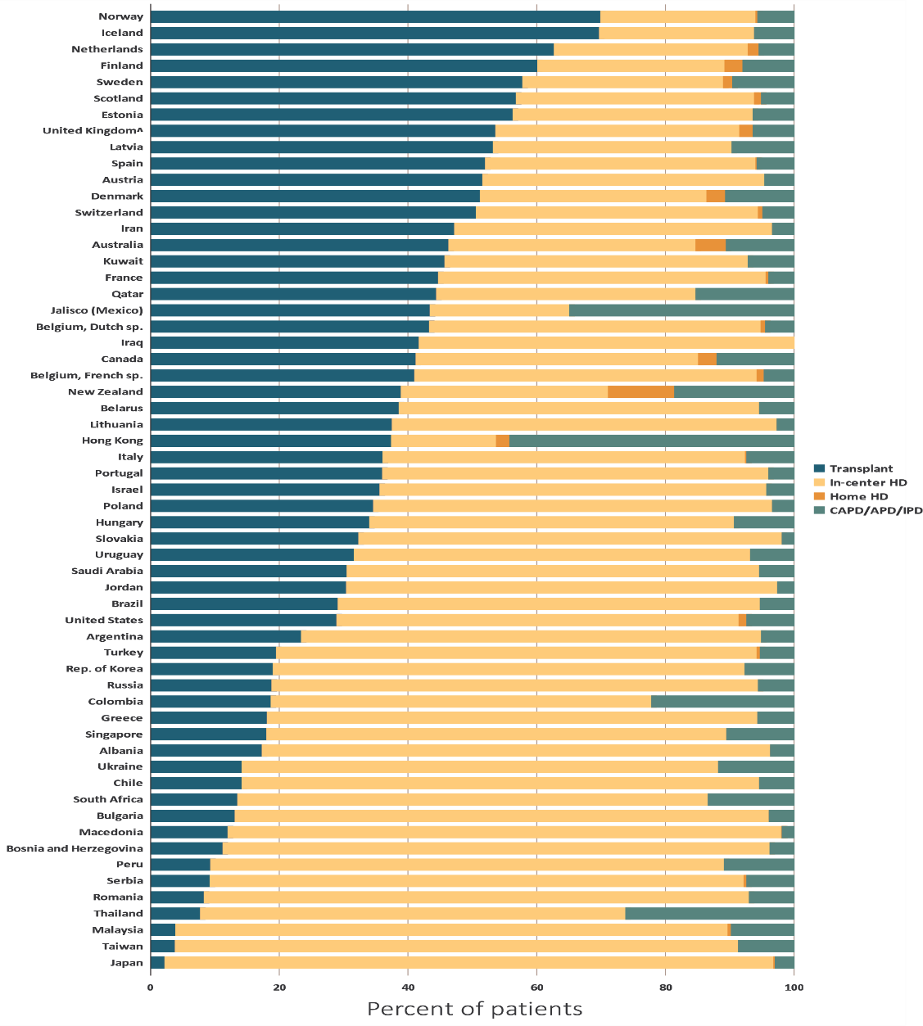
vol 2 Figure 11.12 Percentage distribution of type of renal replacement therapy modality used by ESRD patients, by country, in 2016
Data source: Special analyses, USRDS ESRD Database. Data presented only for countries from which relevant information was available. Denominator is calculated as the sum of patients receiving HD, PD, Home HD, or treated with a functioning transplant; does not include patients with other/unknown modality. Data for Belarus from 43 of 51 RRT centers. Data for Canada exclude Quebec. Data for France exclude Martinique. Data for Indonesia represent the West Java region. Data for Italy representative of 35% (7 out of 19 regions) of ESRD patient population. Data from Latvia representative of 80% of ESRD patient population. Prevalent functioning graft data for Slovakia only available for prevalent transplant patients. United Kingdom^: England, Wales, Northern Ireland (Scotland data reported separately). Abbreviations: CAPD, continuous ambulatory peritoneal dialysis; APD, automated peritoneal dialysis; IPD, intermittent peritoneal dialysis; ESRD, end-stage renal disease; HD, hemodialysis; PD, peritoneal dialysis; sp., speaking. NOTE: Data collection methods vary across countries, suggesting caution in making direct comparisons.

Slide 20
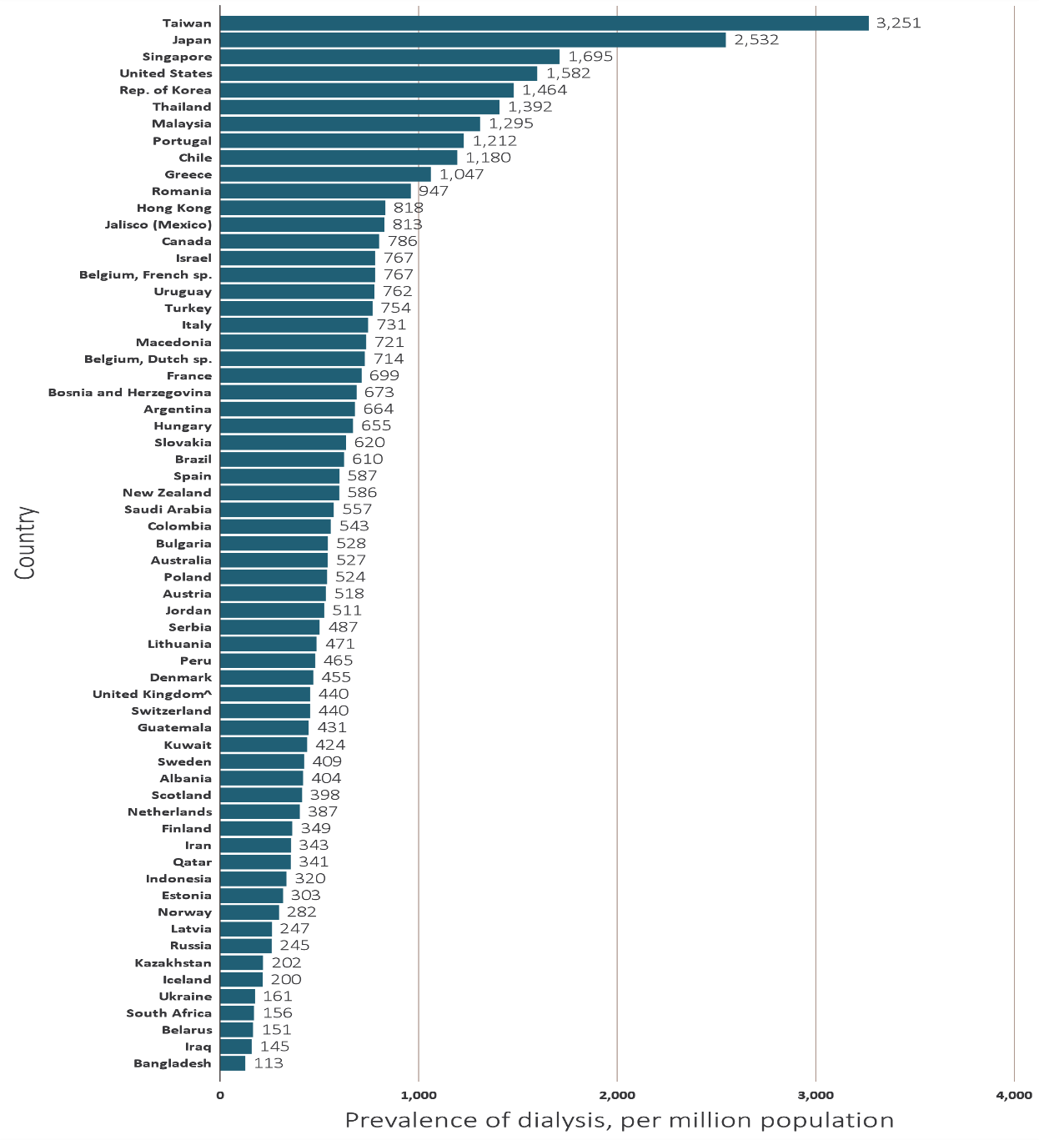
vol 2 Figure 11.13 Prevalence of dialysis (per million population), by country, 2016
Data source: Special analyses, USRDS ESRD Database. Data presented only for countries from which relevant information was available. ESRD prevalence is unadjusted and reflects prevalence at the end of 2016. Data for Belarus from 43 of 51 RRT centers. Data for Canada exclude Quebec. Data for France exclude Martinique. Data for Guatemala exclude pediatric ESRD patients and patients receiving non-institutional RRT. Data for Indonesia represent the West Java region. Data for Italy representative of 35% (7 out of 19 regions) of ESRD patient population. Data from Latvia representative of 80% of ESRD patient population. United Kingdom^: England, Wales, Northern Ireland (Scotland data reported separately). Abbreviation: sp., speaking. NOTE: Data collection methods vary across countries, suggesting caution in making direct comparisons.

Slide 21
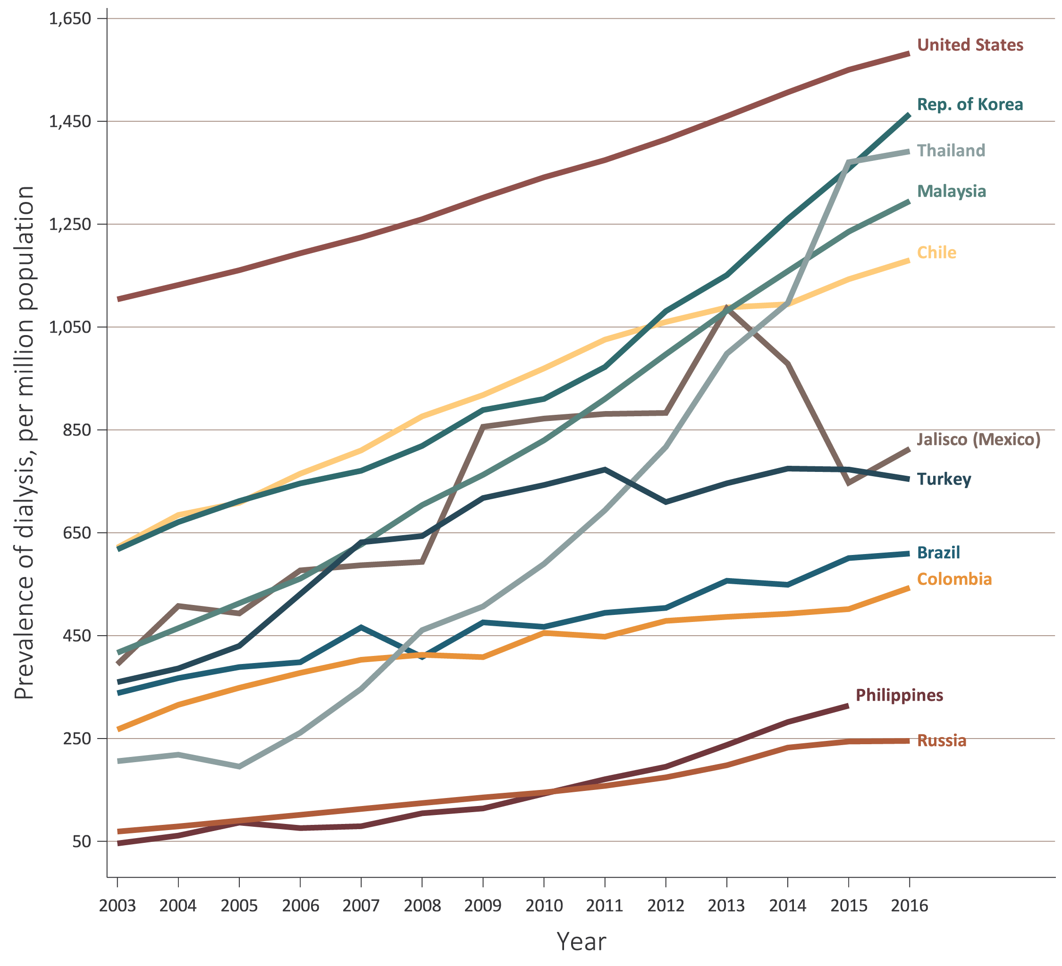
vol 2 Figure 11.14 Trends in the prevalence of dialysis (per million population), by country, 2003-2016
(a) Ten countries having the highest percentage rise in dialysis prevalence rate in 2003-2004 versus that in 2015-2016, plus the United States
Data source: Special analyses, USRDS ESRD Database. (a) Ten countries having the highest percentage rise in dialysis prevalence: 2015-2016 versus that in 2003-2004, plus the United States. The prevalence is unadjusted and reflects prevalence of dialysis at the end of each year. (b) Estimates derived from linear regression. Abbreviation: ESRD, end-stage renal disease. NOTE: Data collection methods vary across countries, suggesting caution in making direct comparisons.

Slide 22
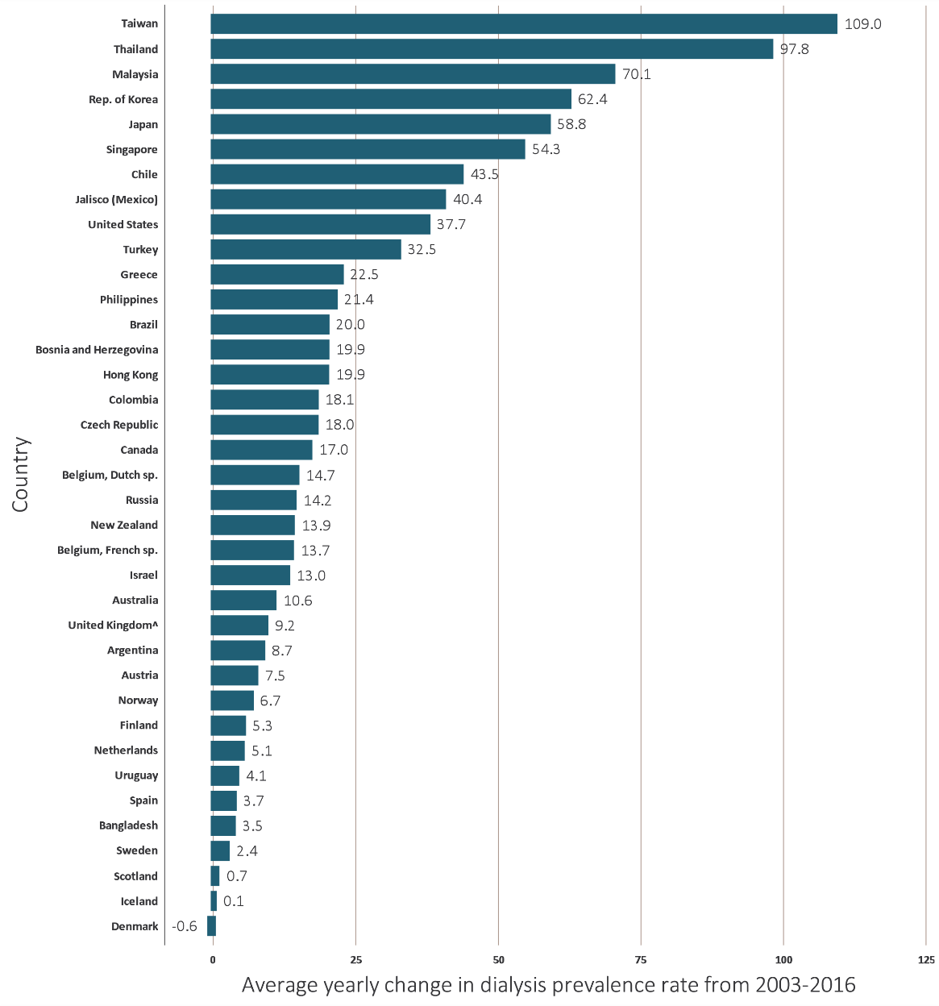
vol 2 Figure 11.14 Trends in the prevalence of dialysis (per million population), by country, 2003-2016
(b) Average yearly change in dialysis prevalence rate from 2003-2016
Data source: Special analyses, USRDS ESRD Database. (a) Ten countries having the highest percentage rise in dialysis prevalence: 2015-2016 versus that in 2003-2004, plus the United States. The prevalence is unadjusted and reflects prevalence of dialysis at the end of each year. (b) Estimates derived from linear regression. Abbreviation: ESRD, end-stage renal disease. NOTE: Data collection methods vary across countries, suggesting caution in making direct comparisons.

Slide 23
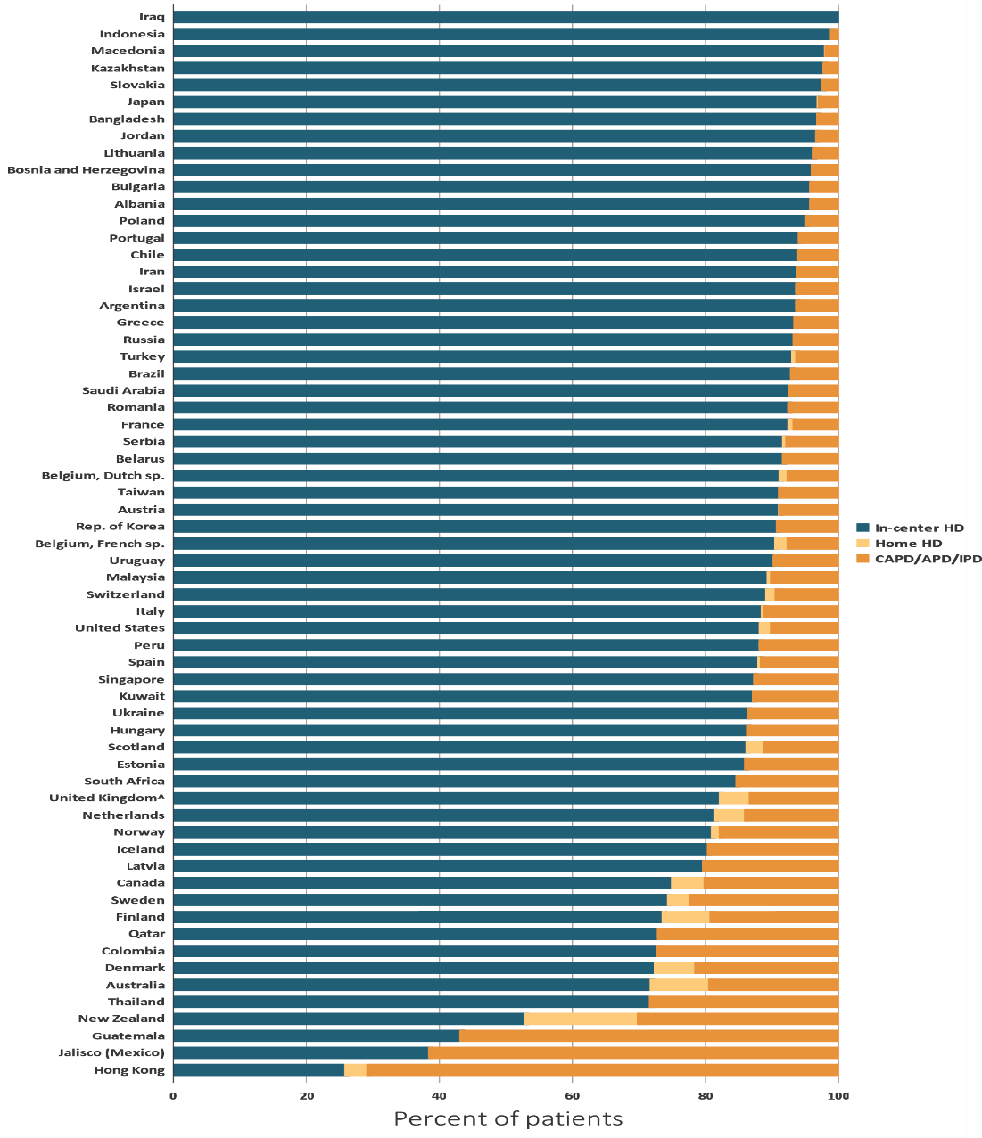
vol 2 Figure 11.15 Distribution of the percentage of prevalent dialysis patients using in-center HD, home HD, or peritoneal dialysis (CAPD/APD/IPD), 2016
Data source: Special analyses, USRDS ESRD Database. Data presented only for countries from which relevant information was available. Denominator was calculated as the sum of patients receiving HD, PD, Home HD; does not include patients with other/unknown modality. Data for Belarus from 43 of 51 RRT centers. Data for Canada exclude Quebec. Data for France exclude Martinique. Data for Guatemala exclude pediatric ESRD patients and patients receiving non-institutional RRT. Data for Indonesia represent the West Java region. Data for Italy representative of 35% (7 out of 19 regions) of ESRD patient population. Data from Latvia representative of 80% of ESRD patient population. United Kingdom^: England, Wales, Northern Ireland (Scotland data reported separately). Abbreviations: CAPD, continuous ambulatory peritoneal dialysis; APD, automated peritoneal dialysis; IPD, intermittent peritoneal dialysis. NOTE: Data collection methods vary across countries, suggesting caution in making direct comparisons.

Slide 24
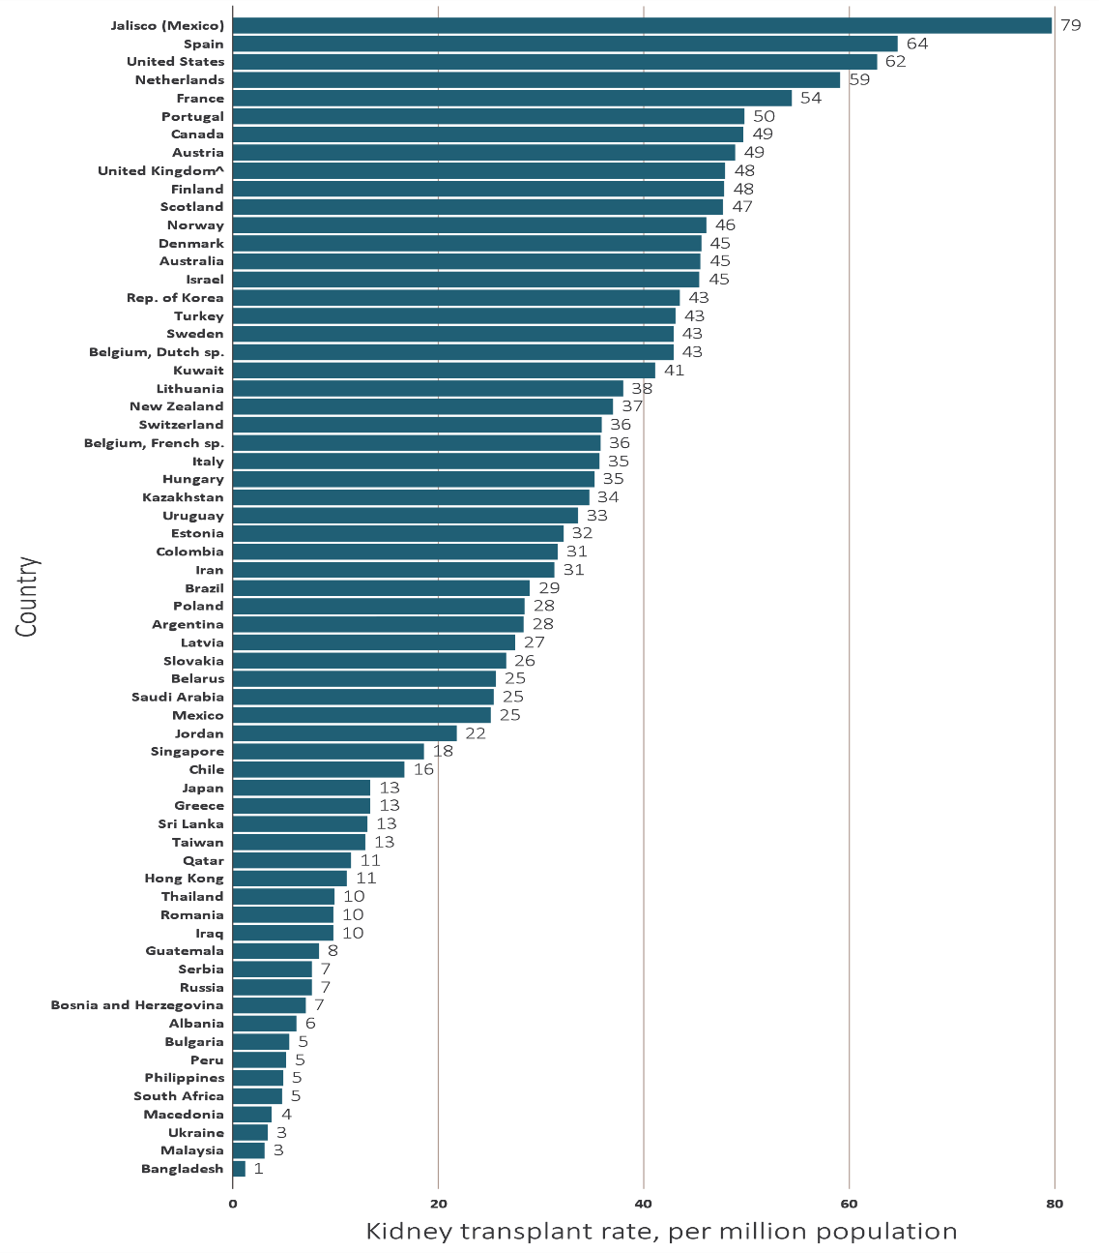
vol 2 Figure 11.16 Kidney transplantation rate, by country, 2016
(a) Per Million Population
Data source: Special analyses, USRDS ESRD Database. Data presented only for countries from which relevant information was available. All rates are unadjusted. Data for Belarus from 43 of 51 RRT centers. Data for Canada exclude Quebec. Data for France exclude Martinique. Data for Guatemala exclude pediatric ESRD patients and patients receiving non-institutional RRT. Data for Indonesia represent the West Java region. Data for Italy representative of 35% (7 out of 19 regions) of ESRD patient population. Overall transplantation rate for Mexico presented in addition to the rate for the Jalisco region of Mexico only. Data for Sri Lanka is from seven government hospitals. United Kingdom^: England, Wales, Northern Ireland (Scotland data reported separately). Abbreviation: sp., speaking. NOTE: Data collection methods vary across countries, suggesting caution in making direct comparisons.

Slide 25
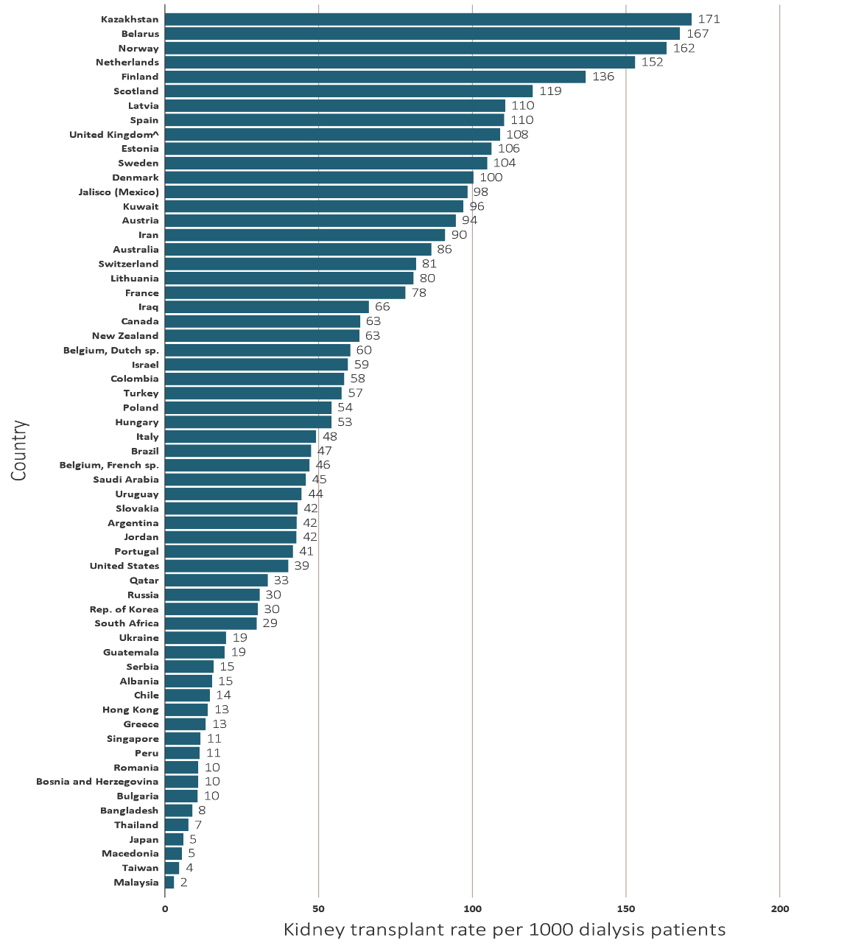
vol 2 Figure 11.16 Kidney transplantation rate, by country, 2016
(b) Per 1,000 Dialysis Patients
Data source: Special analyses, USRDS ESRD Database. Data presented only for countries from which relevant information was available. All rates are unadjusted. Data for Belarus from 43 of 51 RRT centers. Data for Canada exclude Quebec. Data for France exclude Martinique. Data for Guatemala exclude pediatric ESRD patients and patients receiving non-institutional RRT. Data for Indonesia represent the West Java region. Data for Italy representative of 35% (7 out of 19 regions) of ESRD patient population. Overall transplantation rate for Mexico presented in addition to the rate for the Jalisco region of Mexico only. Data for Sri Lanka is from seven government hospitals. United Kingdom^: England, Wales, Northern Ireland (Scotland data reported separately). Abbreviation: sp., speaking. NOTE: Data collection methods vary across countries, suggesting caution in making direct comparisons.

Slide 26
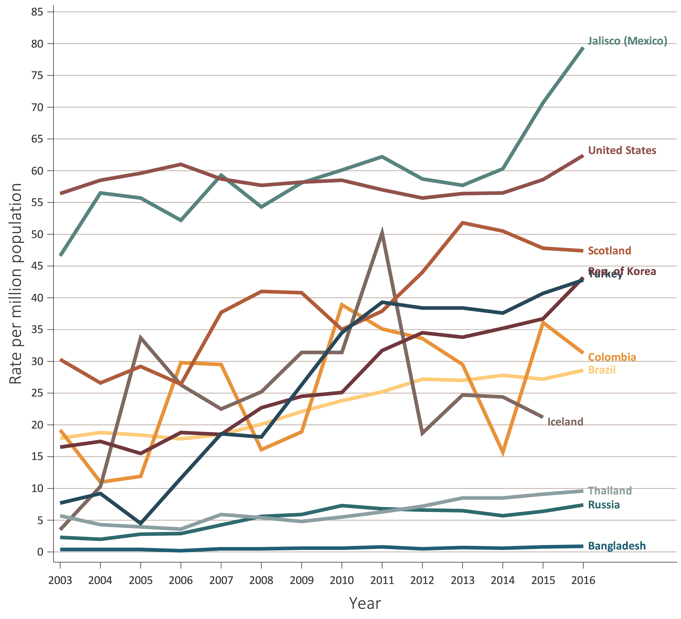
vol 2 Figure 11.17 Trends in kidney transplantation rates (per million population), by country, 2016
(a) Ten countries having the highest percentage rise in kidney transplantation rate in 2003-2004 versus that in 2015-2016, plus the United States
Data source: Special analyses, USRDS ESRD Database. (a) Ten countries having the highest percentage rise in kidney transplantation rate: 2015-2016 versus that in 2003-2004, plus the United States. All rates are unadjusted. (b) Estimates derived from linear regression. Abbreviations: ESRD, end-stage renal disease. NOTE: Data collection methods vary across countries, suggesting caution in making direct comparisons.

Slide 27
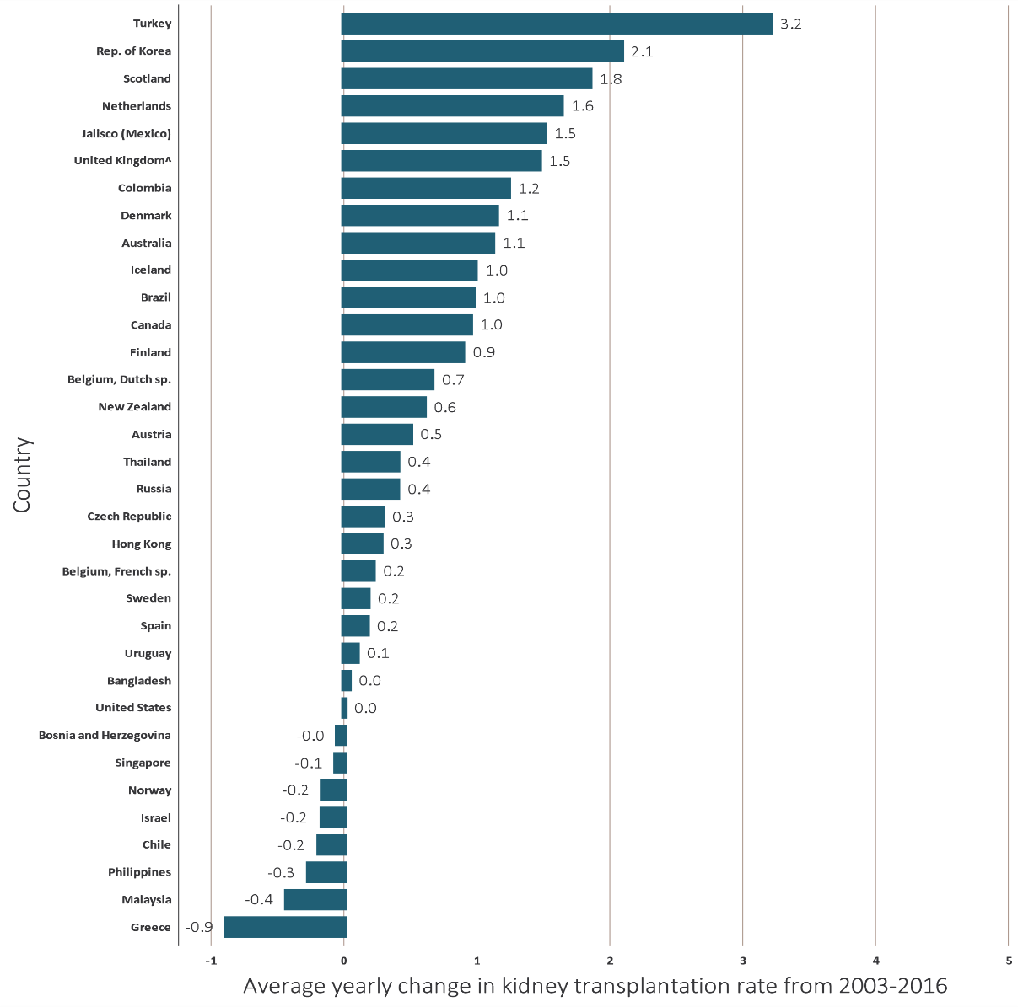
vol 2 Figure 11.17 Trends in kidney transplantation rates (per million population), by country, 2016
(b) Average yearly change in kidney transplantation rate from 2003-2016
Data source: Special analyses, USRDS ESRD Database. (a) Ten countries having the highest percentage rise in kidney transplantation rate: 2015-2016 versus that in 2003-2004, plus the United States. All rates are unadjusted. (b) Estimates derived from linear regression. Abbreviations: ESRD, end-stage renal disease. NOTE: Data collection methods vary across countries, suggesting caution in making direct comparisons.

Slide 28
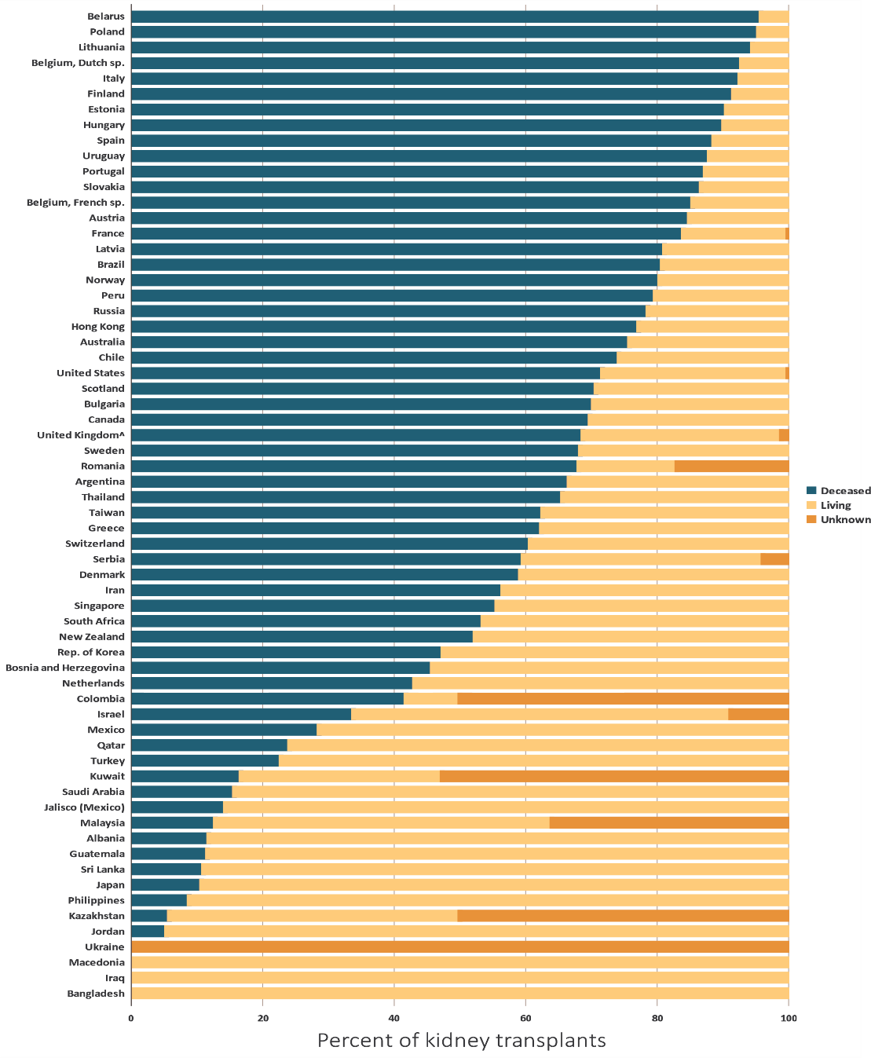
vol 2 Figure 11.18 Distribution of the percentage of kidney transplantations by kidney donor type and country, 2016
Data source: Special analyses, USRDS ESRD Database. Data presented only for countries from which relevant information was available. Denominator is calculated as the sum of deceased, living-donor, and unknown transplants. Data for Belarus from 43 of 51 RRT centers. Data for Canada exclude Quebec. Data for France exclude Martinique. Data for Guatemala exclude pediatric ESRD patients and patients receiving non-institutional RRT. Data for Indonesia represent the West Java region. Data for Italy representative of 35% (7 out of 19 regions) of ESRD patient population. Overall transplantation rate for Mexico presented in addition to the rate for the Jalisco region of Mexico only. Data for Sri Lanka is from seven government hospitals. United Kingdom^: England, Wales, Northern Ireland (Scotland data reported separately). Abbreviation: ESRD, end-stage renal disease. NOTE: Data collection methods vary across countries, suggesting caution in making direct comparisons.

Slide 29
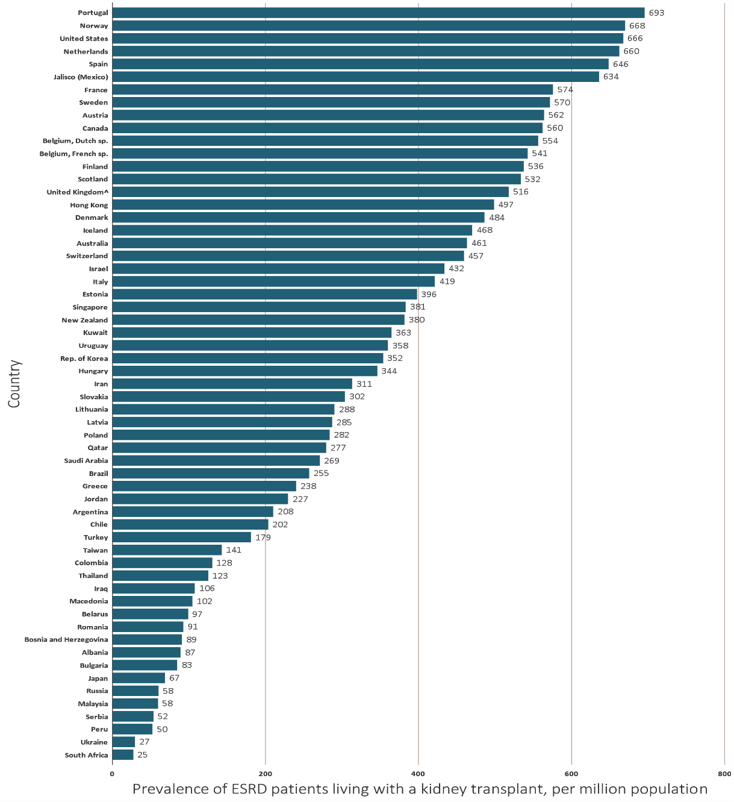
vol 2 Figure 11.19 Prevalence of treated ESRD patients with a functioning kidney transplant, per million population, by country, 2016
Data source: Special analyses, USRDS ESRD Database. Data presented only for countries from which relevant information was available. The prevalence is unadjusted. Data for Belarus from 43 of 51 RRT centers. Data for Canada exclude Quebec. Data for France exclude Martinique. Data for Indonesia represent the West Java region. Data for Italy representative of 35% (7 out of 19 regions) of ESRD patient population. Prevalent functioning graft data for Slovakia only available for prevalent transplant patients. United Kingdom^: England, Wales, Northern Ireland (Scotland data reported separately). Abbreviations: ESRD, end-stage renal disease; sp., speaking. NOTE: Data collection methods vary across countries, suggesting caution in making direct comparisons.

Slide 30
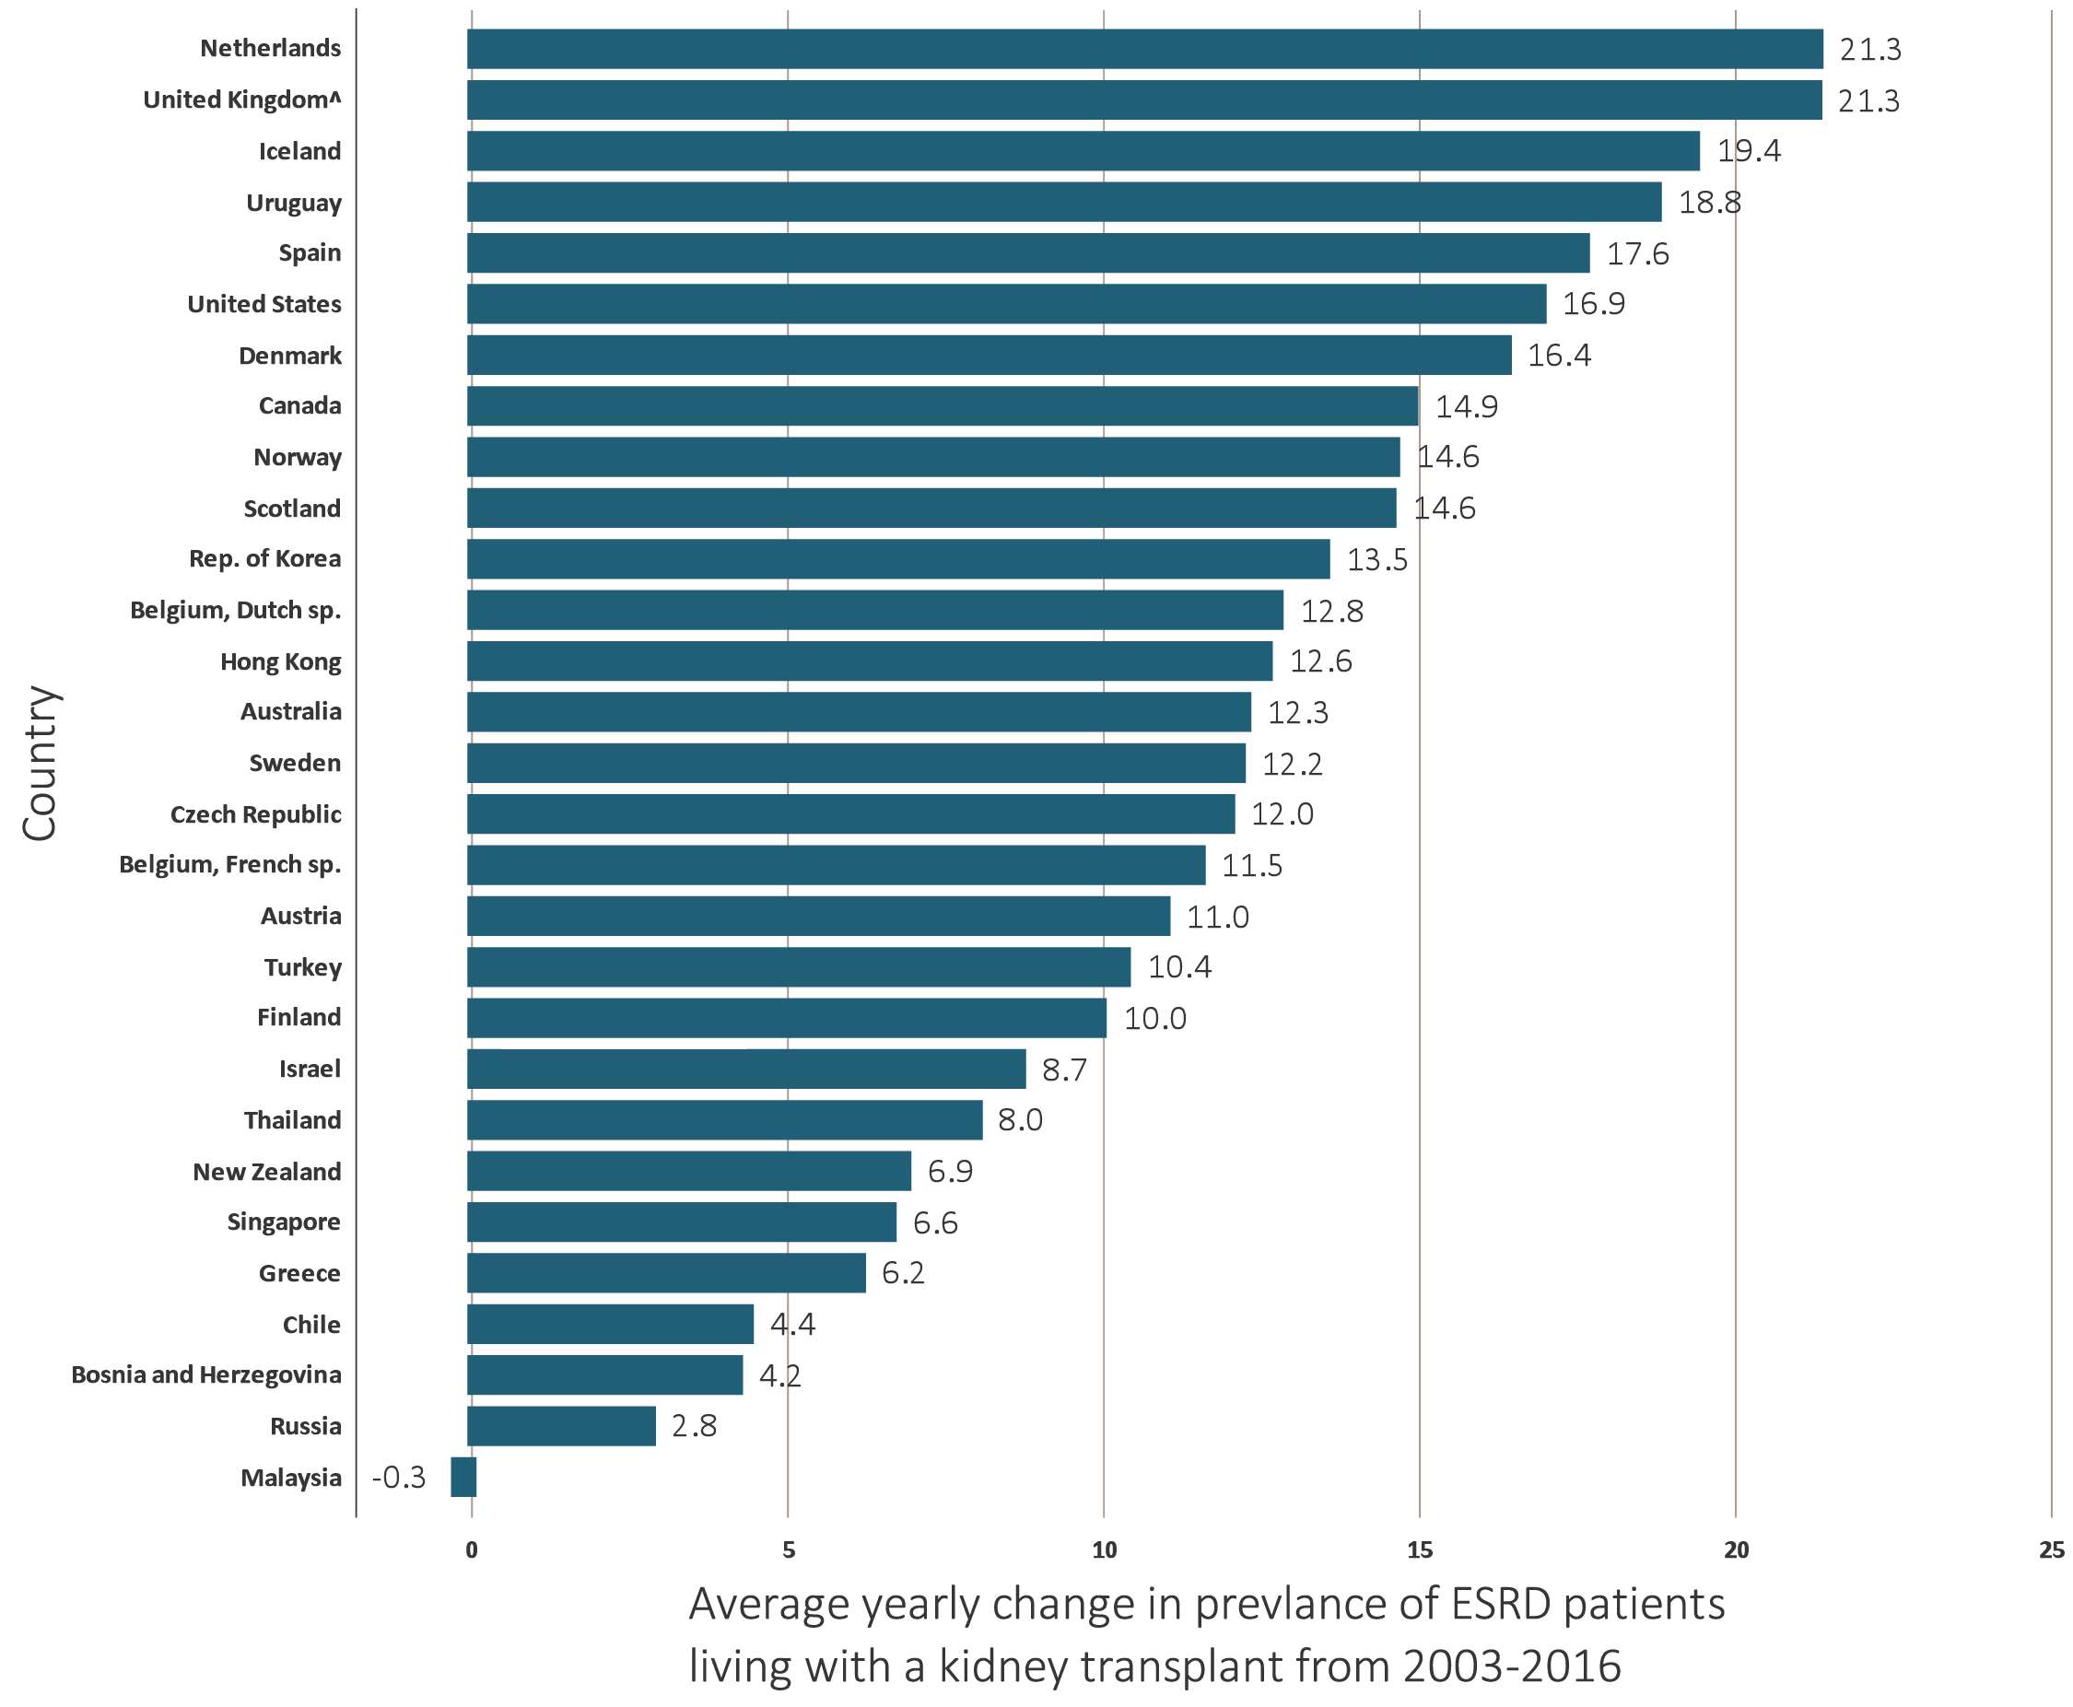
vol 2 Figure 11.20 Trends in the prevalence of treated ESRD patients with a functioning kidney transplant, by country, 2003-2016
Data source: Special analyses, USRDS ESRD Database. Estimates derived from linear regression. Abbreviations: ESRD, end-stage renal disease. NOTE: Data collection methods vary across countries, suggesting caution in making direct comparisons.

