Slide 1
2018 Annual Data Report
Volume 2: End-Stage Renal Disease
Chapter 12: End-of-life Care for Patients
with ESRD: 2000-2015

Slide 2
vol 2 Table 12.1 Characteristics of decedents with ESRD by death year, 2000-2015
 | 2000 | 2003 | 2006 | 2009 | 2012 | 2015 | Total
n | 72,794 | 82,414 | 87,521 | 89,866 | 91,773 | 99,868 | 1,397,039
% | 5.2 | 5.9 | 6.3 | 6.4 | 6.6 | 7.2
Age (mean) | 67.49 (13.73) | 67.94 (13.79) | 68.46 (13.78) | 68.73 (13.65) | 69.21 (13.37) | 69.27 (13.06) | 68.60 (13.58)
Age category
0-19 | 0.18 | 0.19 | 0.16 | 0.12 | 0.10 | 0.08 | 0.13
20-44 | 6.78 | 6.11 | 5.46 | 5.06 | 4.38 | 4.13 | 5.22
45-64 | 28.75 | 29.38 | 29.90 | 29.92 | 29.54 | 28.75 | 29.38
65-74 | 29.19 | 27.32 | 26.02 | 26.70 | 27.71 | 29.50 | 27.54
75-84 | 27.65 | 28.26 | 28.31 | 27.05 | 26.32 | 26.08 | 27.37
≥85 | 7.46 | 8.74 | 10.14 | 11.16 | 11.95 | 11.47 | 10.36
Missing |  | 0.00 | 0.00 | 0.00 |  |  | 0
Race*
White | 65.95 | 65.78 | 67.07 | 67.52 | 68.68 | 68.78 | 67.37
Black | 28.15 | 28.14 | 27.67 | 27.12 | 26.14 | 26.04 | 27.17
American Indian or Alaska Native | 1.23 | 1.12 | 1.08 | 1.14 | 1.02 | 0.94 | 1.07
Asian | 2.24 | 2.34 | 2.46 | 2.63 | 2.90 | 3.10 | 2.61
Native Hawaiian or Pacific Islander | 0.55 | 0.66 | 0.78 | 0.82 | 0.78 | 0.84 | 0.75
Other or Multiracial | 1.68 | 1.82 | 0.86 | 0.67 | 0.37 | 0.22 | 0.92
Hispanic
Hispanic | 10.11 | 11.04 | 11.21 | 11.76 | 12.86 | 13.13 | 11.69
Non-Hispanic White | 52.87 | 54.72 | 55.40 | 55.18 | 55.50 | 55.72 | 55.18
Non-Hispanic Black/African American | 23.90 | 26.80 | 26.67 | 26.24 | 25.23 | 25.49 | 25.96
Non-Hispanic Others | 5.19 | 5.16 | 5.53 | 5.89 | 5.85 | 5.28 | 5.49
Unknown | 7.93 | 2.28 | 1.19 | 0.92 | 0.56 | 0.39 | 1.67
Sex
Female | 47.83 | 46.86 | 45.77 | 44.27 | 43.60 | 43.07 | 45.12
Male | 52.17 | 53.13 | 54.20 | 55.71 | 56.39 | 56.93 | 54.86
Missing | 0.00 | 0.01 | 0.03 | 0.02 | 0.00 | 0.01 | 0.02
Last treatment modality
Hemodialysis | 86.72 | 88.47 | 88.92 | 89.03 | 87.82 | 87.45 | 88.28
Peritoneal dialysis | 7.38 | 5.86 | 4.89 | 4.31 | 5.1 | 5.87 | 5.39
Transplant | 4.66 | 4.71 | 5.05 | 5.54 | 6.12 | 6.37 | 5.39
Missing | 1.25 | 0.96 | 1.14 | 1.13 | 0.95 | 0.31 | 0.94
Medicare Parts A & B as ESRD payer for last 3-months of life (Yes) | 73.46 | 75.09 | 73.59 | 69.33 | 67.25 | 62.16 | 70.19
Data Source: Special analyses, USRDS ESRD Database. Denominator is all decedents. Abbreviation: ESRD, end-stage renal disease. * Race does not add up to 100%, because "unknown" category is not presented in this table.

Slide 3
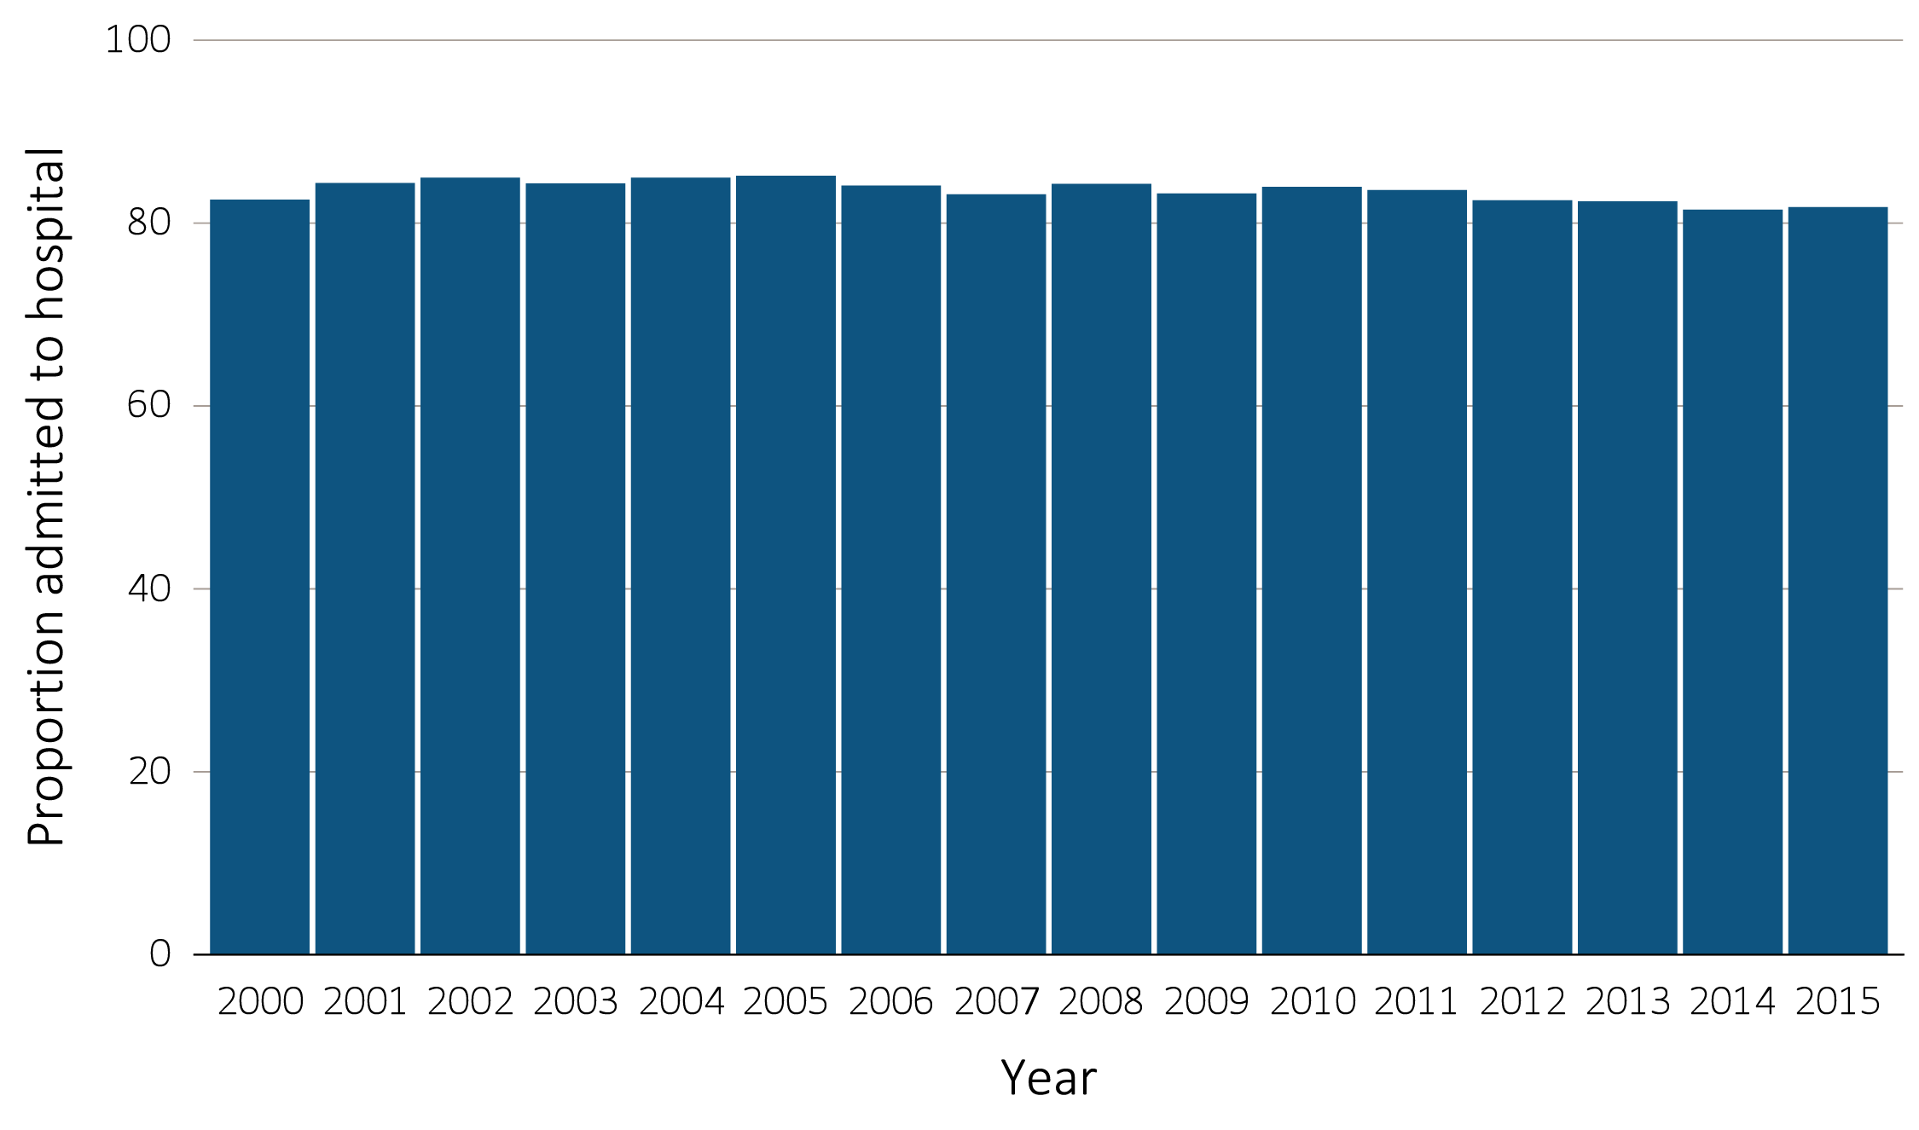
vol 2 Figure 12.1 Hospital admission during the last 90 days of life among Medicare beneficiaries with ESRD, 2000-2015
Data Source: Special analyses, USRDS ESRD Database. Denominator is all decedents with Medicare Parts A and B throughout the last 90 days of life. Includes hospital stays in both short- and long-stay hospitals. Abbreviation: ESRD, end-stage renal disease.

Slide 4
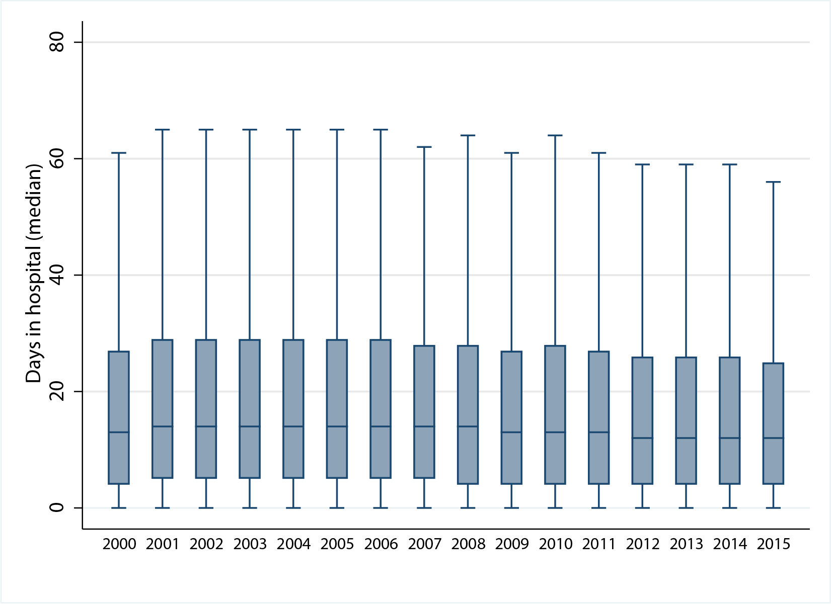
vol 2 Figure 12.2 Days spent in the hospital during the last 90 days of life among Medicare beneficiaries with ESRD, 2000-2015
Data Source: Special Analyses, USRDS ESRD Database. Denominator is all decedents with Medicare Parts A and B throughout the last 90 days of life who were admitted to the hospital at least once. Includes hospital stays in both short- and long-stay hospitals. Explanation of box plot: The lower border of the box is the first quartile and the upper border is the third quartile of the distribution, the length of the box is the interquartile range and the line in the middle of the box is the median value. The whiskers (vertical lines above and below each box) extend from the lowest value of the distribution that is ≥ the first quartile minus 1.5 times the interquartile range at the bottom to the highest value of the distribution that is ≤ the third quartile plus 1.5 times the interquartile range at the top. Values outside this range (outliers) are not plotted. Abbreviation: ESRD, end-stage renal disease.

Slide 5
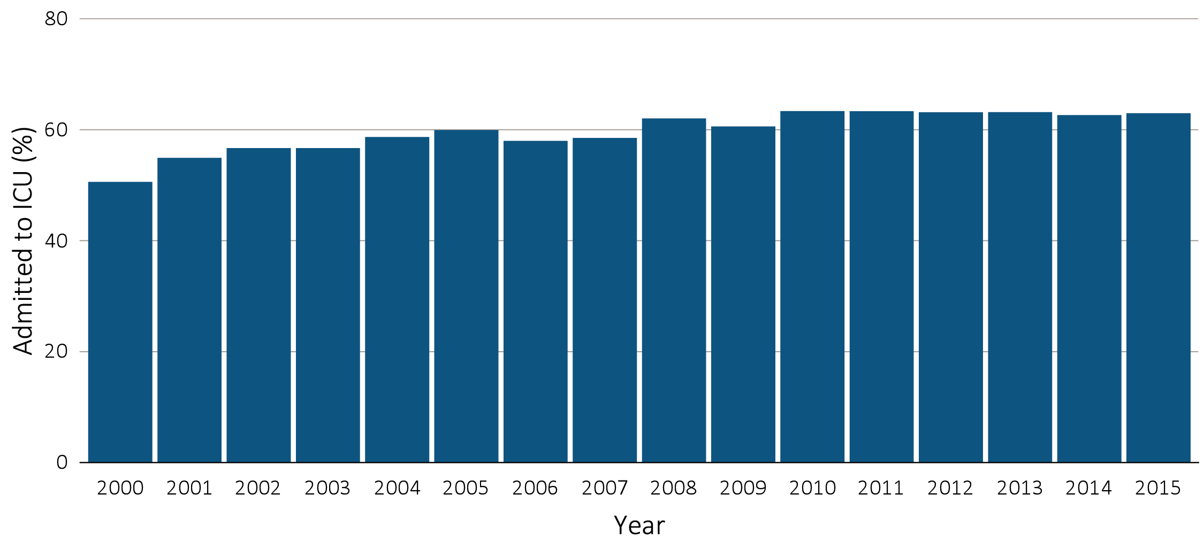
vol 2 Figure 12.3 ICU admission during the last 90 days of life among Medicare beneficiaries with ESRD overall, and by age, race, ethnicity, sex, and modality, 2000-2015
(a) ICU admission by year, overall
Data Source: Special Analyses, USRDS ESRD Database. Denominator is all decedents with Medicare Parts A and B throughout the last 90 days of life. ICU admission was identified using ICU revenue center codes in Medicare Institutional claims. Abbreviations: ESRD, end-stage renal disease; ICU, Intensive care unit.

Slide 6
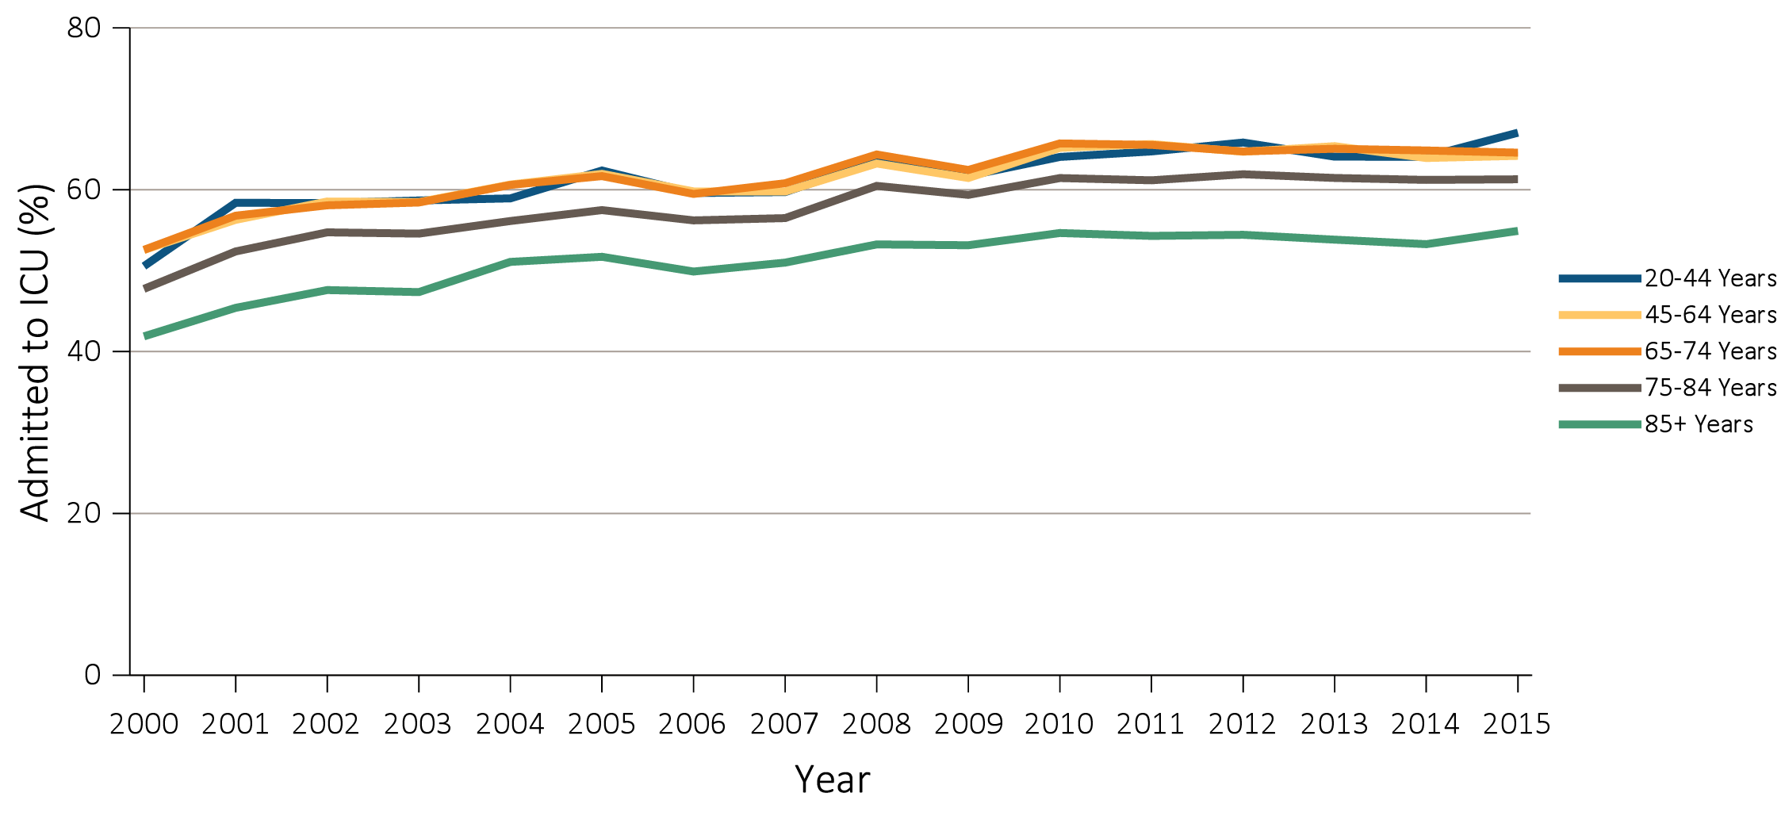
vol 2 Figure 12.3 ICU admission during the last 90 days of life among Medicare beneficiaries with ESRD overall, and by age, race, ethnicity, sex, and modality, 2000-2015
(b) ICU admission by age
Data Source: Special Analyses, USRDS ESRD Database. Denominator is all decedents with Medicare Parts A and B throughout the last 90 days of life. ICU admission was identified using ICU revenue center codes in Medicare Institutional claims. Abbreviations: ESRD, end-stage renal disease; ICU, Intensive care unit.

Slide 7
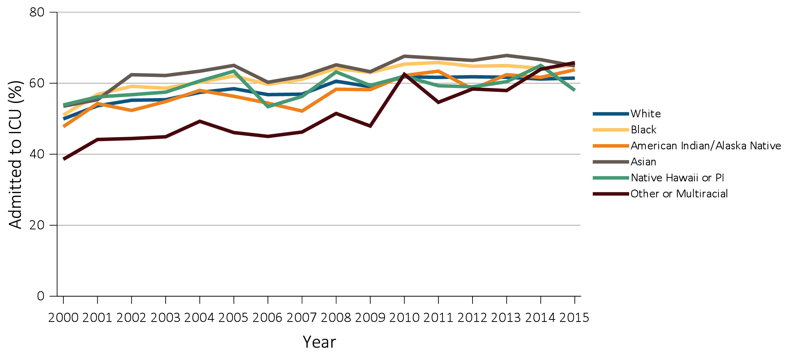
vol 2 Figure 12.3 ICU admission during the last 90 days of life among Medicare beneficiaries with ESRD overall, and by age, race, ethnicity, sex, and modality, 2000-2015
(c) ICU admission by race
Data Source: Special Analyses, USRDS ESRD Database. Denominator is all decedents with Medicare Parts A and B throughout the last 90 days of life. ICU admission was identified using ICU revenue center codes in Medicare Institutional claims. Abbreviations: ESRD, end-stage renal disease; ICU, Intensive care unit.

Slide 8
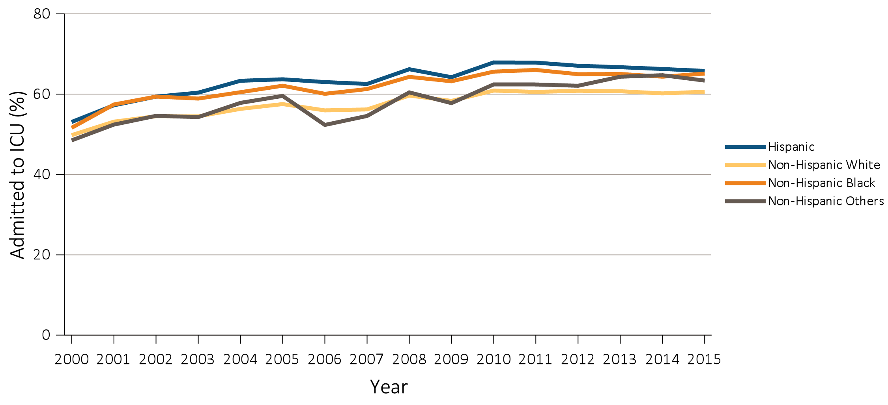
vol 2 Figure 12.3 ICU admission during the last 90 days of life among Medicare beneficiaries with ESRD overall, and by age, race, ethnicity, sex, and modality, 2000-2015
(d) ICU admission by ethnicity
Data Source: Special Analyses, USRDS ESRD Database. Denominator is all decedents with Medicare Parts A and B throughout the last 90 days of life. ICU admission was identified using ICU revenue center codes in Medicare Institutional claims. Abbreviations: ESRD, end-stage renal disease; ICU, Intensive care unit.

Slide 9
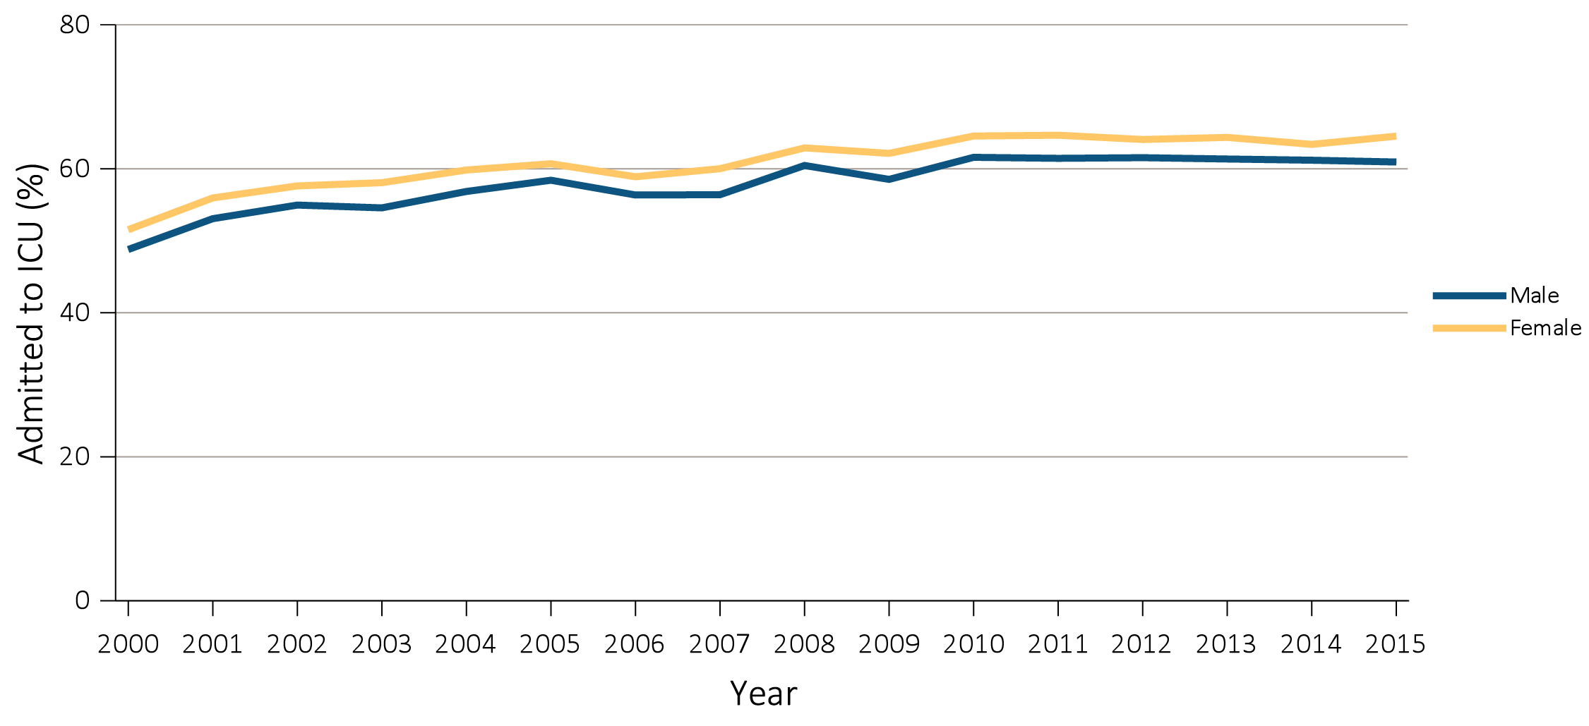
vol 2 Figure 12.3 ICU admission during the last 90 days of life among Medicare beneficiaries with ESRD overall, and by age, race, ethnicity, sex, and modality, 2000-2015
(e) ICU admission by sex
Data Source: Special Analyses, USRDS ESRD Database. Denominator is all decedents with Medicare Parts A and B throughout the last 90 days of life. ICU admission was identified using ICU revenue center codes in Medicare Institutional claims. Abbreviations: ESRD, end-stage renal disease; ICU, Intensive care unit.

Slide 10
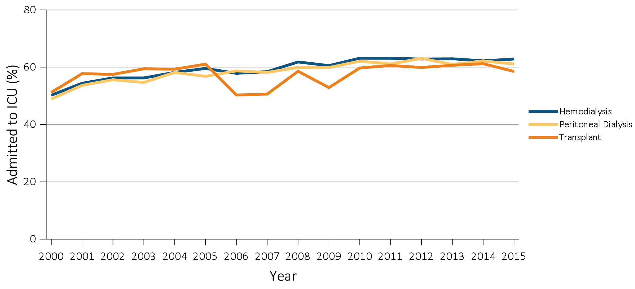
vol 2 Figure 12.3 ICU admission during the last 90 days of life among Medicare beneficiaries with ESRD overall, and by age, race, ethnicity, sex, and modality, 2000-2015
(f) ICU admission by modality
Data Source: Special Analyses, USRDS ESRD Database. Denominator is all decedents with Medicare Parts A and B throughout the last 90 days of life. ICU admission was identified using ICU revenue center codes in Medicare Institutional claims. Abbreviations: ESRD, end-stage renal disease; ICU, Intensive care unit.

Slide 11
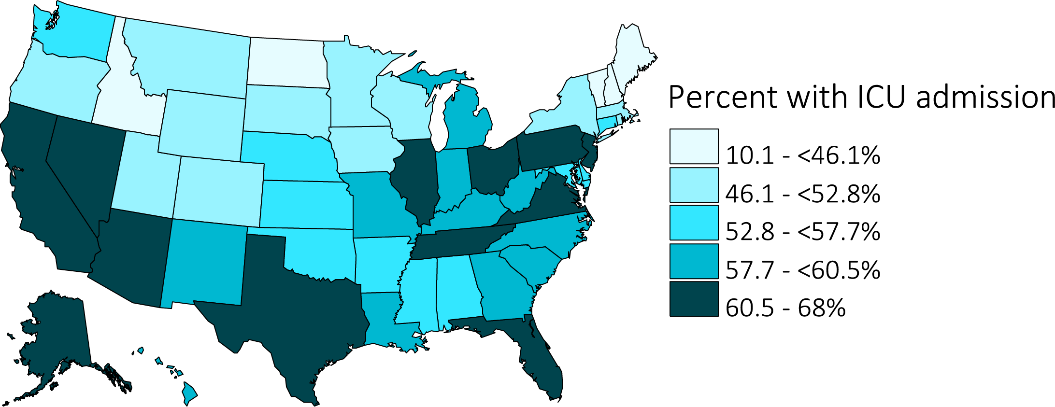
vol 2 Figure 12.3 ICU admission during the last 90 days of life among Medicare beneficiaries with ESRD overall, and by age, race, ethnicity, sex, and modality, 2000-2015
(g) ICU admission by state of residence
Data Source: Special Analyses, USRDS ESRD Database. Denominator is all decedents with Medicare Parts A and B throughout the last 90 days of life. ICU admission was identified using ICU revenue center codes in Medicare Institutional claims. Abbreviations: ESRD, end-stage renal disease; ICU, Intensive care unit.

Slide 12
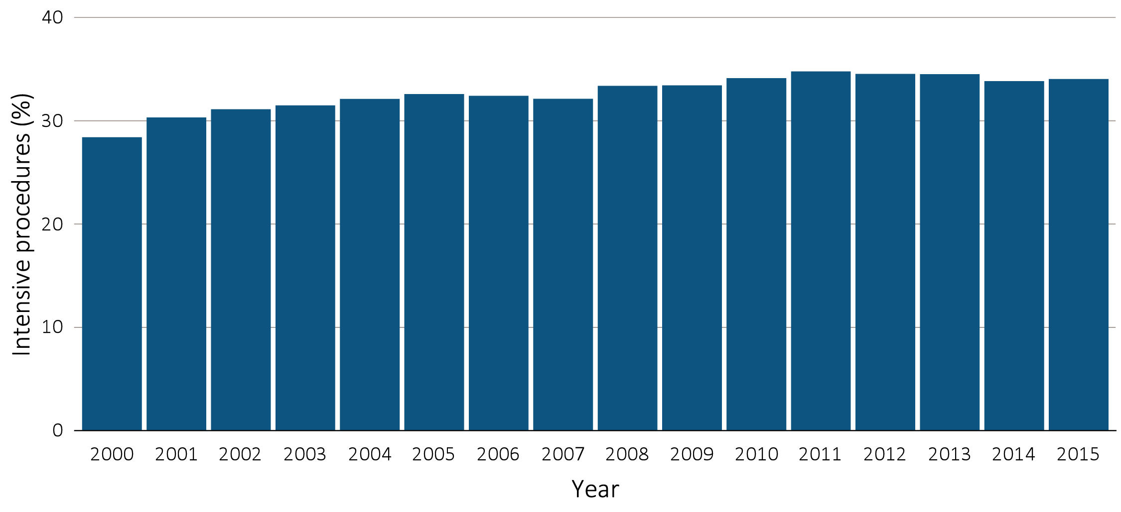
vol 2 Figure 12.4 Intensive procedures during the last 90 days of life among Medicare beneficiaries with ESRD overall, and by age, race, ethnicity, sex, and modality, 2000-2015
Intensive procedures by sub-type and year, overall
Data Source: Special analyses, USRDS ESRD Database. Denominator population is all decedents with Medicare Parts A and B throughout the last 90 days of life. Intensive procedures were identified by ICD-9 procedure code search of Medicare Institutional claims from short- and long-stay hospitals. The yellow line in panel (a) denotes the percentage of patients who were intubated or received mechanical ventilation. Abbreviation: ESRD, end-stage renal disease.

Slide 13
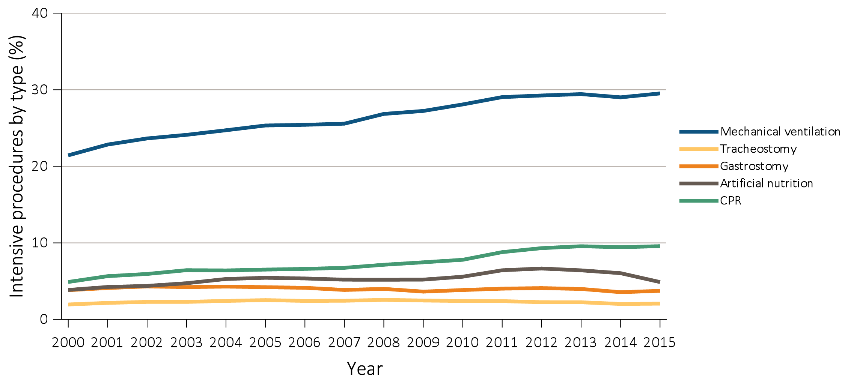
vol 2 Figure 12.4 Intensive procedures during the last 90 days of life among Medicare beneficiaries with ESRD overall, and by age, race, ethnicity, sex, and modality, 2000-2015
(b) Intensive procedures by type
Data Source: Special analyses, USRDS ESRD Database. Denominator population is all decedents with Medicare Parts A and B throughout the last 90 days of life. Intensive procedures were identified by ICD-9 procedure code search of Medicare Institutional claims from short- and long-stay hospitals. The yellow line in panel (a) denotes the percentage of patients who were intubated or received mechanical ventilation. Abbreviation: ESRD, end-stage renal disease.

Slide 14
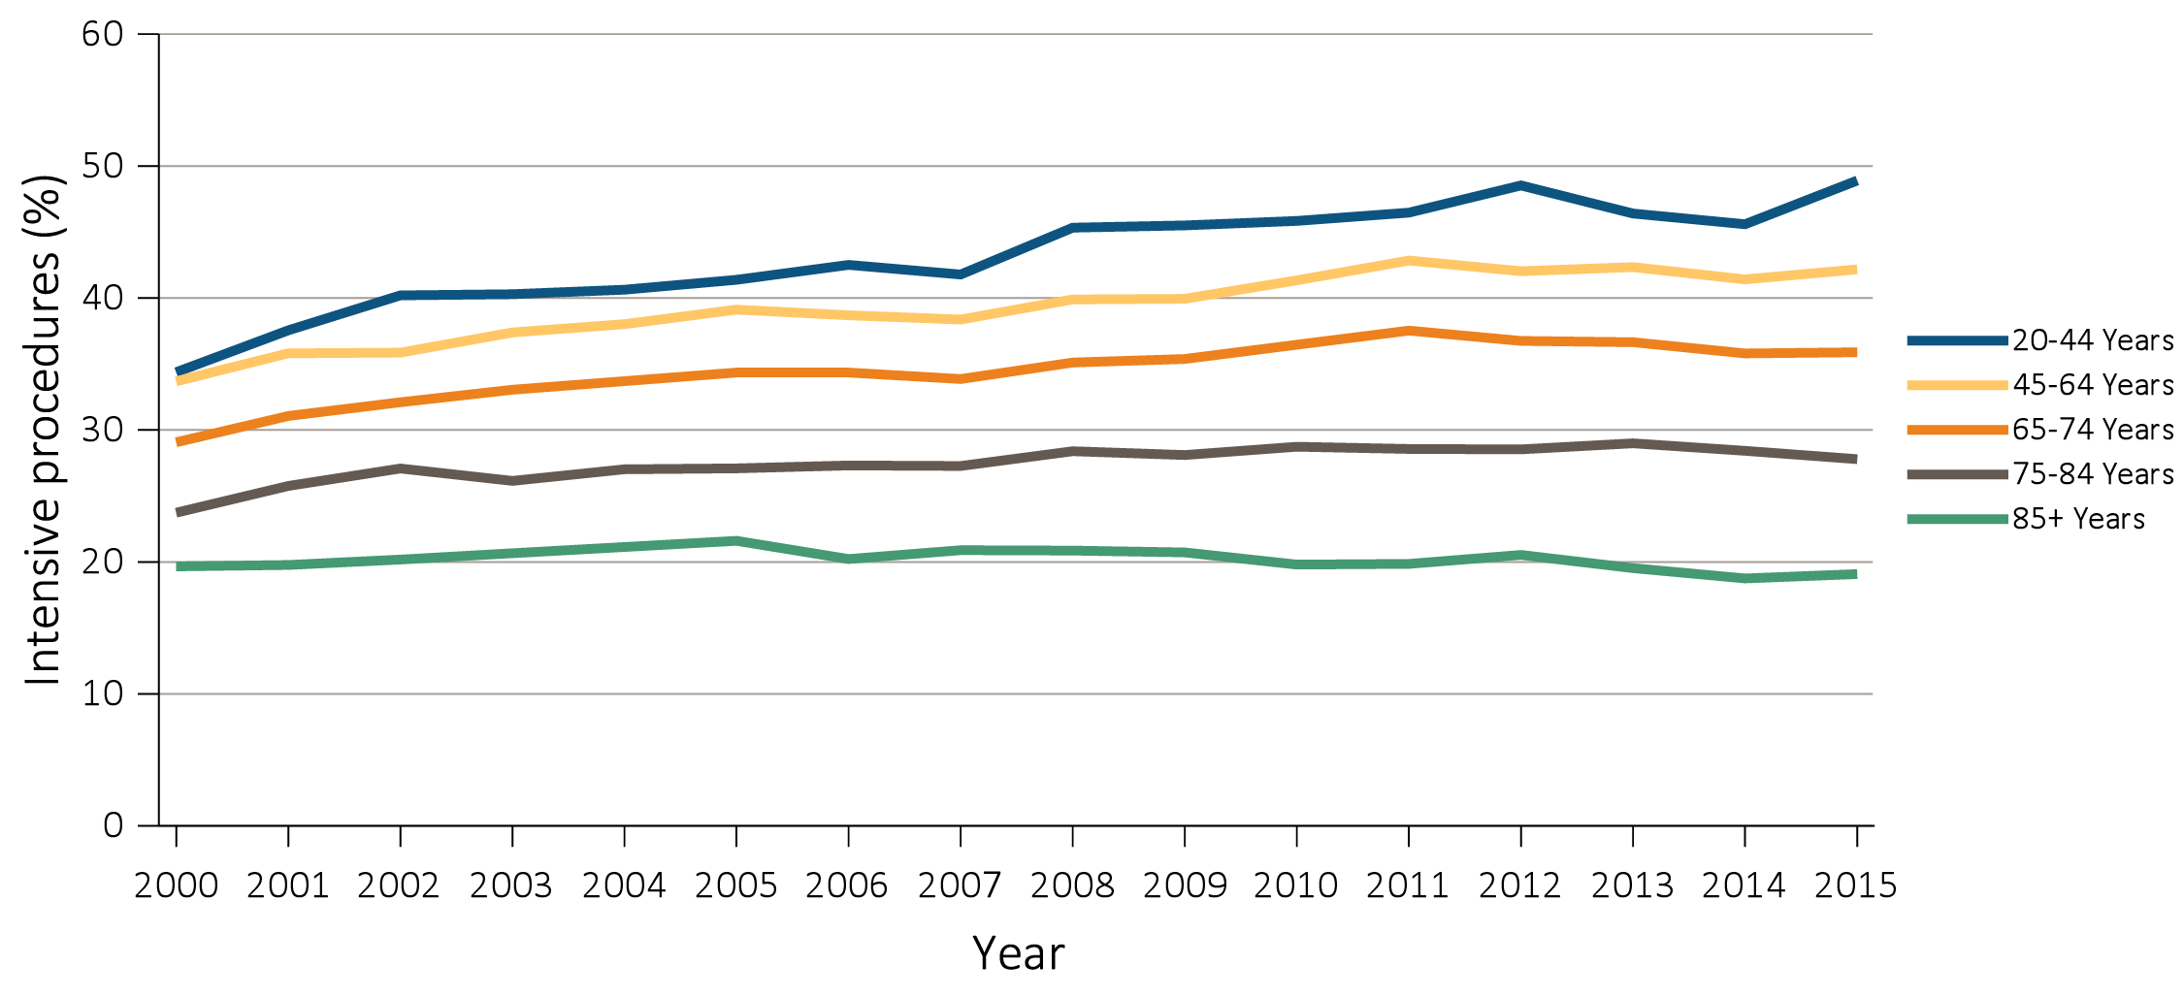
vol 2 Figure 12.4 Intensive procedures during the last 90 days of life among Medicare beneficiaries with ESRD overall, and by age, race, ethnicity, sex, and modality, 2000-2015
(c) Intensive procedures by age
Data Source: Special analyses, USRDS ESRD Database. Denominator population is all decedents with Medicare Parts A and B throughout the last 90 days of life. Intensive procedures were identified by ICD-9 procedure code search of Medicare Institutional claims from short- and long-stay hospitals. The yellow line in panel (a) denotes the percentage of patients who were intubated or received mechanical ventilation. Abbreviation: ESRD, end-stage renal disease.

Slide 15
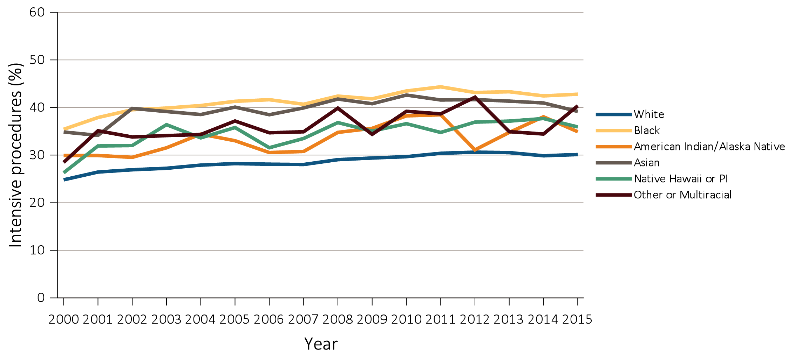
vol 2 Figure 12.4 Intensive procedures during the last 90 days of life among Medicare beneficiaries with ESRD overall, and by age, race, ethnicity, sex, and modality, 2000-2015
(d) Intensive procedures by race
Data Source: Special analyses, USRDS ESRD Database. Denominator population is all decedents with Medicare Parts A and B throughout the last 90 days of life. Intensive procedures were identified by ICD-9 procedure code search of Medicare Institutional claims from short- and long-stay hospitals. The yellow line in panel (a) denotes the percentage of patients who were intubated or received mechanical ventilation. Abbreviation: ESRD, end-stage renal disease.

Slide 16
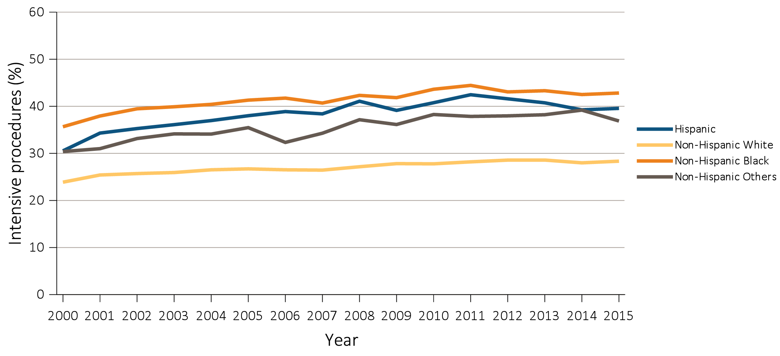
vol 2 Figure 12.4 Intensive procedures during the last 90 days of life among Medicare beneficiaries with ESRD overall, and by age, race, ethnicity, sex, and modality, 2000-2015
(e) Intensive procedures by ethnicity
Data Source: Special analyses, USRDS ESRD Database. Denominator population is all decedents with Medicare Parts A and B throughout the last 90 days of life. Intensive procedures were identified by ICD-9 procedure code search of Medicare Institutional claims from short- and long-stay hospitals. The yellow line in panel (a) denotes the percentage of patients who were intubated or received mechanical ventilation. Abbreviation: ESRD, end-stage renal disease.

Slide 17
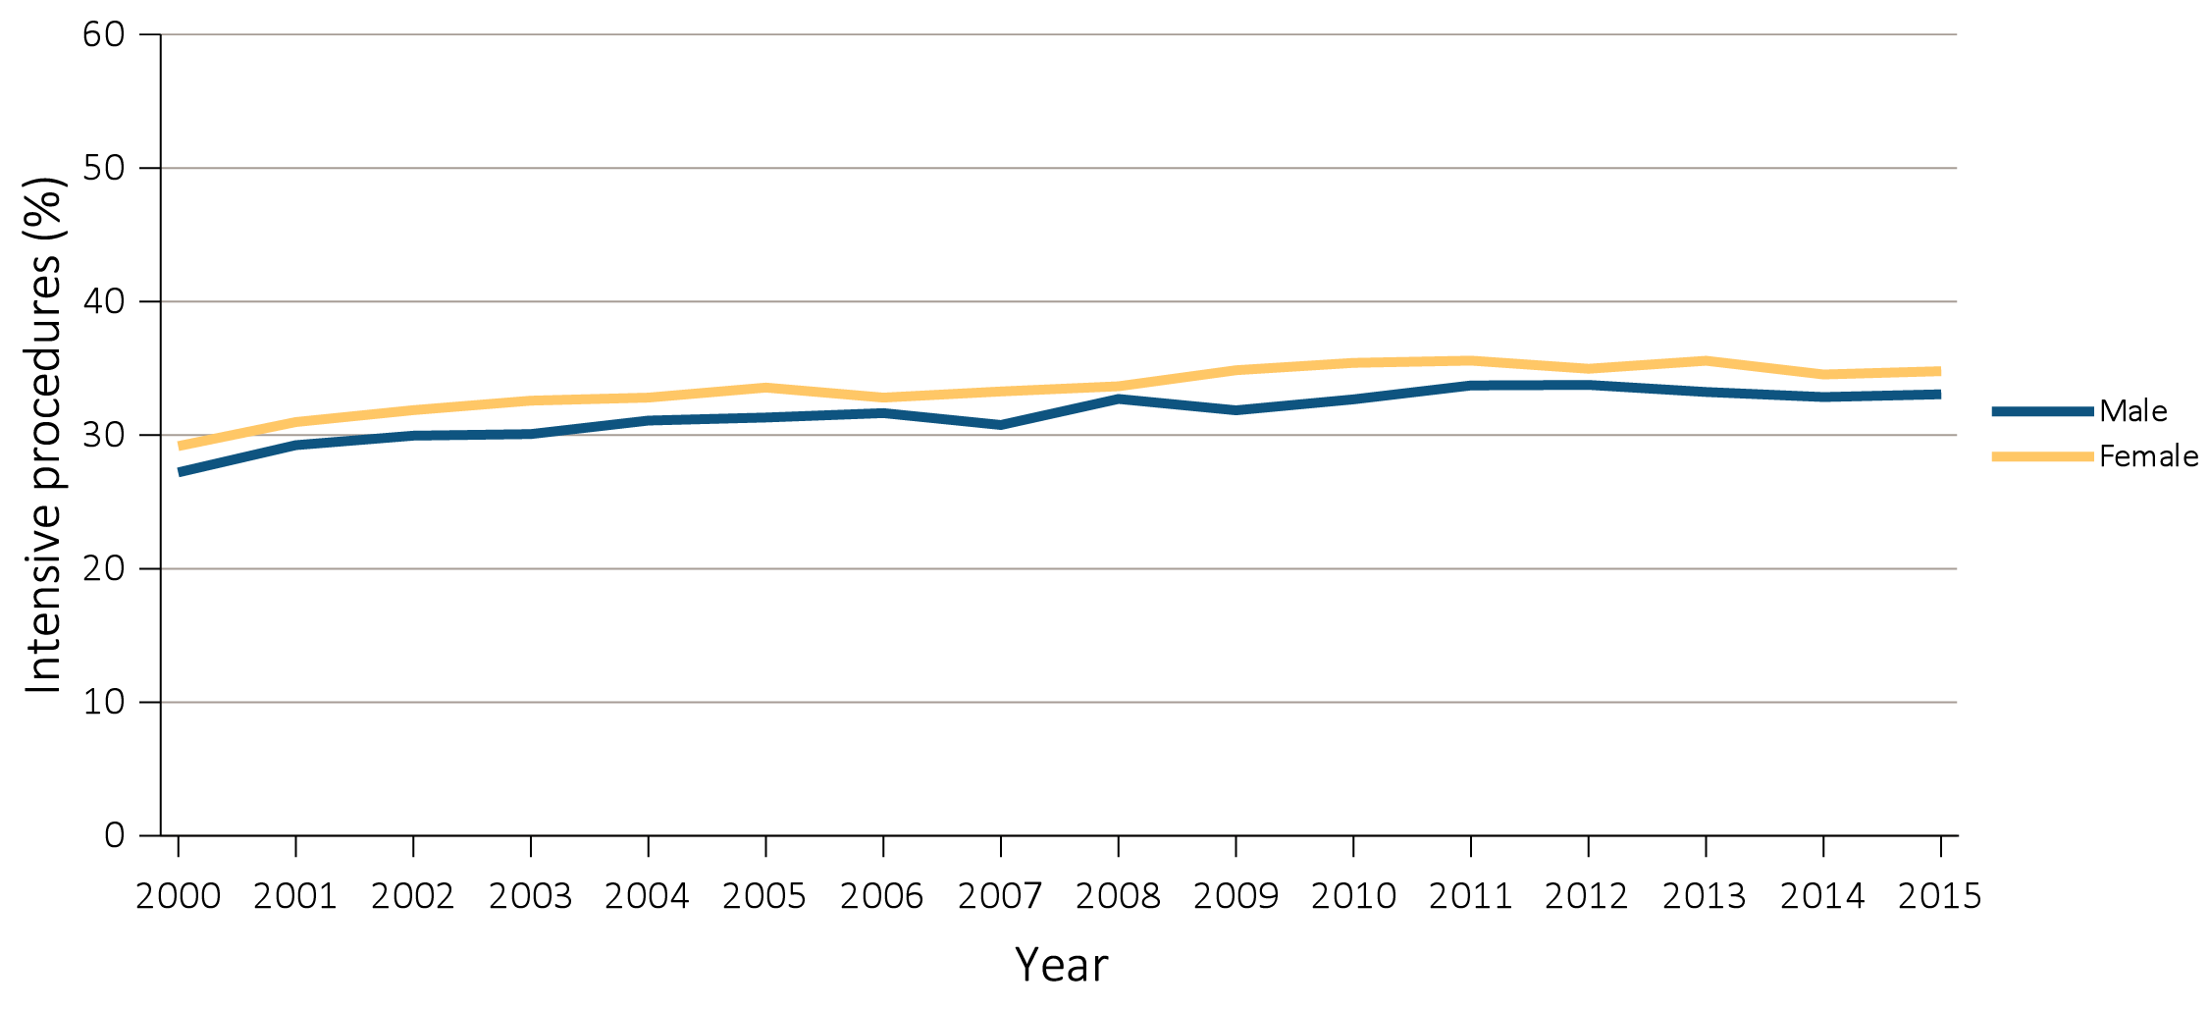
vol 2 Figure 12.4 Intensive procedures during the last 90 days of life among Medicare beneficiaries with ESRD overall, and by age, race, ethnicity, sex, and modality, 2000-2015
(f) Intensive procedures by sex
Data Source: Special analyses, USRDS ESRD Database. Denominator population is all decedents with Medicare Parts A and B throughout the last 90 days of life. Intensive procedures were identified by ICD-9 procedure code search of Medicare Institutional claims from short- and long-stay hospitals. The yellow line in panel (a) denotes the percentage of patients who were intubated or received mechanical ventilation. Abbreviation: ESRD, end-stage renal disease.

Slide 18
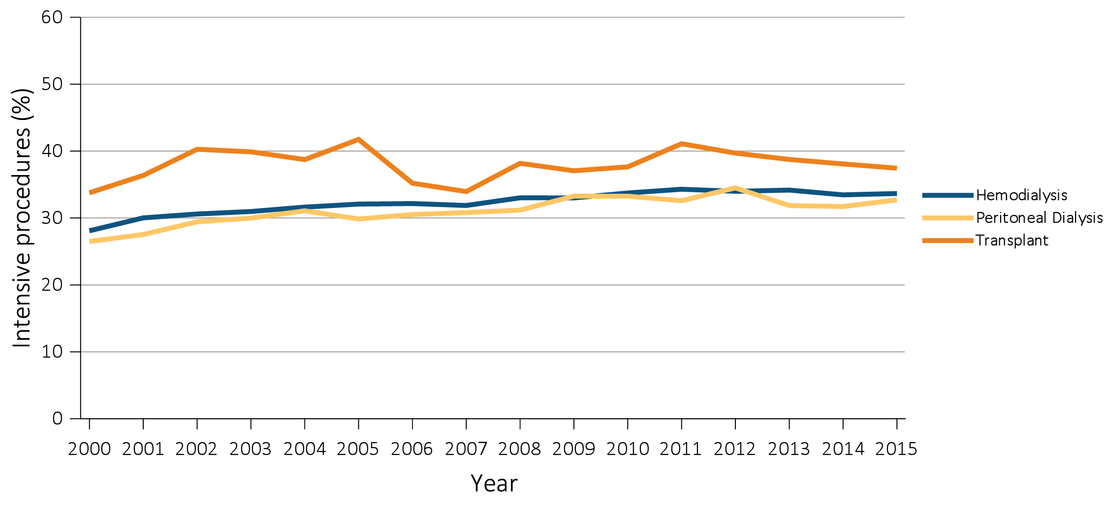
vol 2 Figure 12.4 Intensive procedures during the last 90 days of life among Medicare beneficiaries with ESRD overall, and by age, race, ethnicity, sex, and modality, 2000-2015
(g) Intensive procedures by modality
Data Source: Special analyses, USRDS ESRD Database. Denominator population is all decedents with Medicare Parts A and B throughout the last 90 days of life. Intensive procedures were identified by ICD-9 procedure code search of Medicare Institutional claims from short- and long-stay hospitals. The yellow line in panel (a) denotes the percentage of patients who were intubated or received mechanical ventilation. Abbreviation: ESRD, end-stage renal disease.

Slide 19
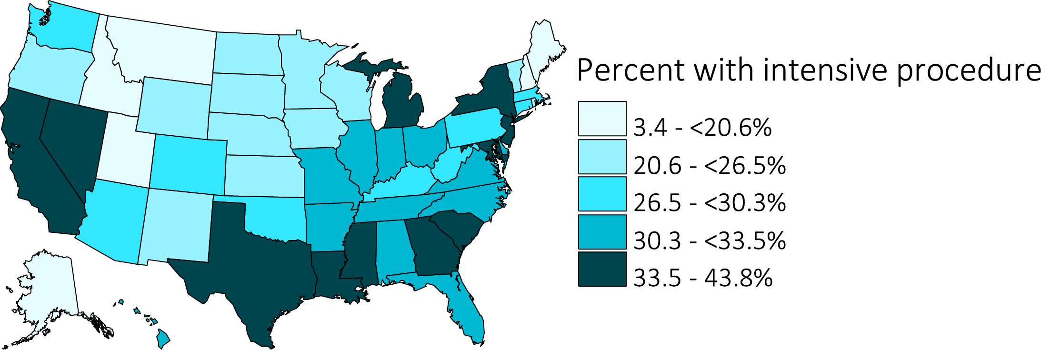
vol 2 Figure 12.4 Intensive procedures during the last 90 days of life among Medicare beneficiaries with ESRD overall, and by age, race, ethnicity, sex, and modality, 2000-2015
(h) Intensive procedures by state of residence
Data Source: Special analyses, USRDS ESRD Database. Denominator population is all decedents with Medicare Parts A and B throughout the last 90 days of life. Intensive procedures were identified by ICD-9 procedure code search of Medicare Institutional claims from short- and long-stay hospitals. The yellow line in panel (a) denotes the percentage of patients who were intubated or received mechanical ventilation. Abbreviation: ESRD, end-stage renal disease.

Slide 20
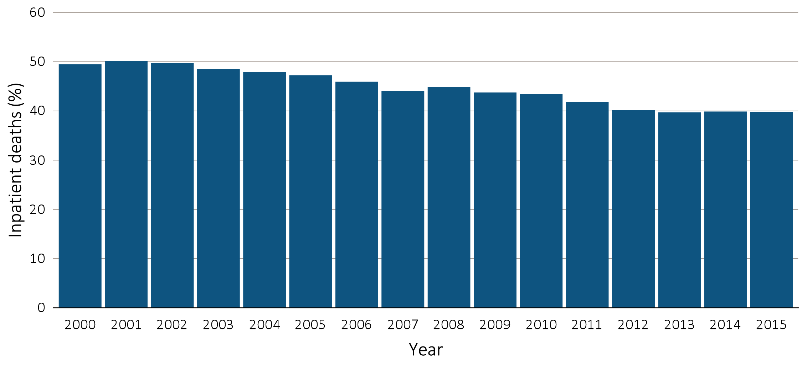
vol 2 Figure 12.5 Inpatient deaths among Medicare beneficiaries with ESRD overall, and by age, race, ethnicity, sex, and modality, 2000-2015
Inpatient deaths by year, overall
Data Source: Special Analyses, USRDS ESRD Database. Denominator population is all decedents with Medicare Parts A and B throughout the last 90 days of life. Includes deaths occurring in short- and long-stay hospitals. Does not include observation stays. Abbreviation: ESRD, end-stage renal disease.

Slide 21
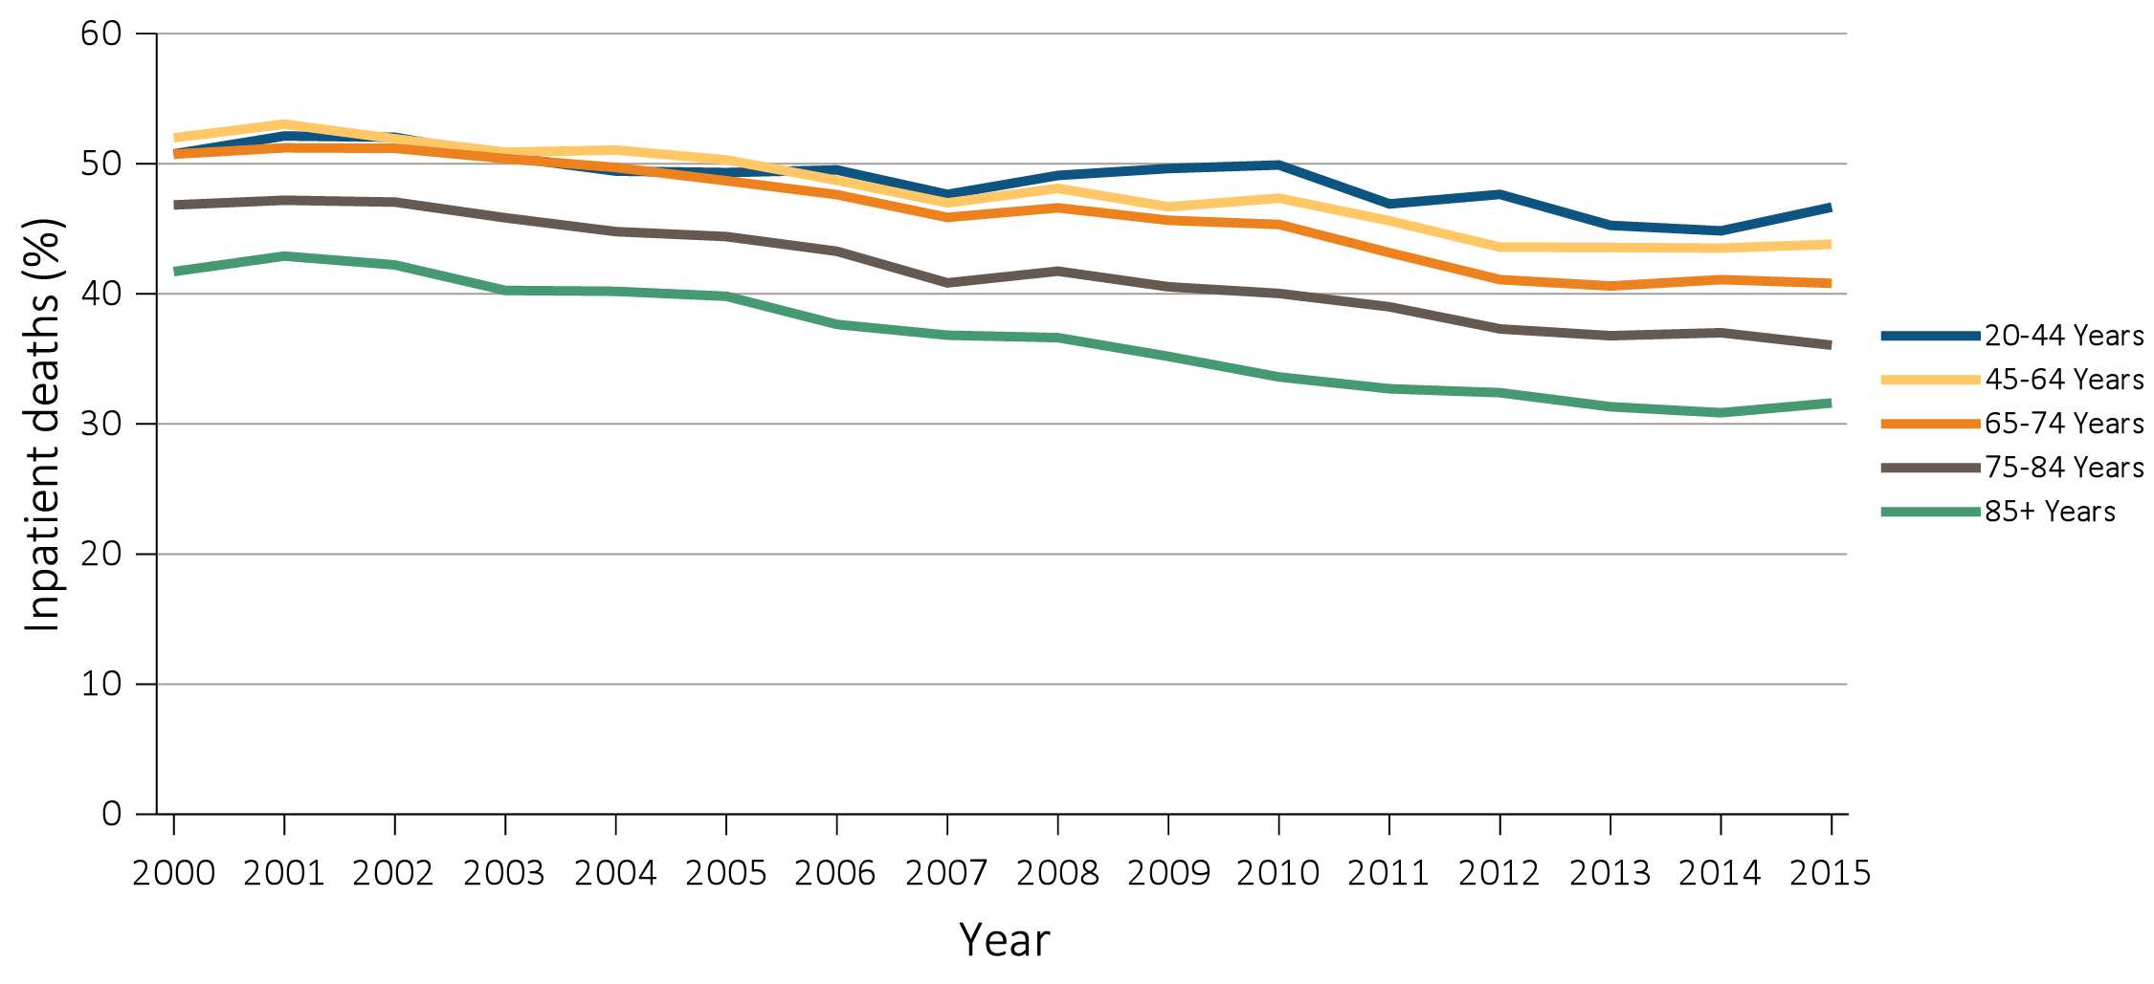
vol 2 Figure 12.5 Inpatient deaths among Medicare beneficiaries with ESRD overall, and by age, race, ethnicity, sex, and modality, 2000-2015
(b) Inpatient deaths by age
Data Source: Special Analyses, USRDS ESRD Database. Denominator population is all decedents with Medicare Parts A and B throughout the last 90 days of life. Includes deaths occurring in short- and long-stay hospitals. Does not include observation stays. Abbreviation: ESRD, end-stage renal disease.

Slide 22
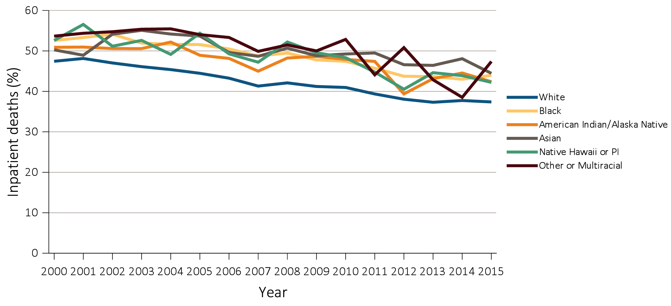
vol 2 Figure 12.5 Inpatient deaths among Medicare beneficiaries with ESRD overall, and by age, race, ethnicity, sex, and modality, 2000-2015
(c) Inpatient deaths by race
Data Source: Special Analyses, USRDS ESRD Database. Denominator population is all decedents with Medicare Parts A and B throughout the last 90 days of life. Includes deaths occurring in short- and long-stay hospitals. Does not include observation stays. Abbreviation: ESRD, end-stage renal disease.

Slide 23
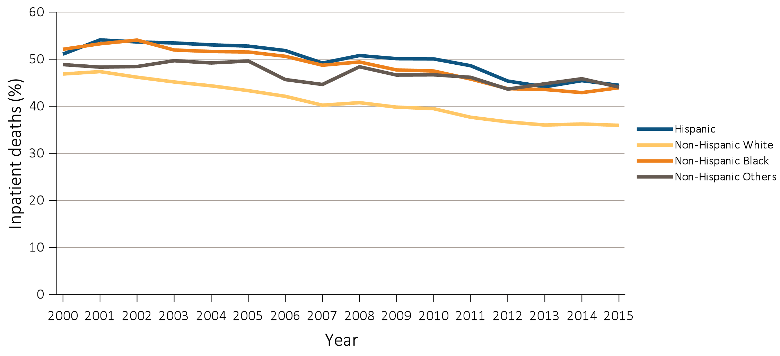
vol 2 Figure 12.5 Inpatient deaths among Medicare beneficiaries with ESRD overall, and by age, race, ethnicity, sex, and modality, 2000-2015
(d) Inpatient deaths by ethnicity
Data Source: Special Analyses, USRDS ESRD Database. Denominator population is all decedents with Medicare Parts A and B throughout the last 90 days of life. Includes deaths occurring in short- and long-stay hospitals. Does not include observation stays. Abbreviation: ESRD, end-stage renal disease.

Slide 24
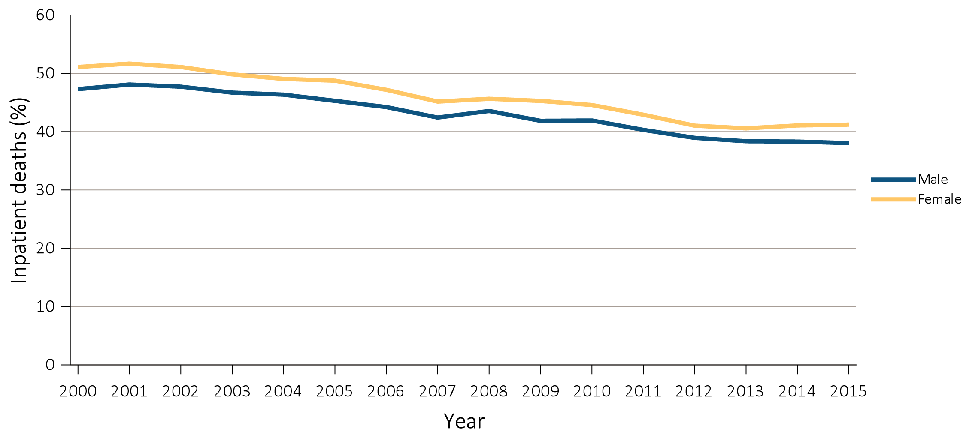
vol 2 Figure 12.5 Inpatient deaths among Medicare beneficiaries with ESRD overall, and by age, race, ethnicity, sex, and modality, 2000-2015
(e) Inpatient deaths by sex
Data Source: Special Analyses, USRDS ESRD Database. Denominator population is all decedents with Medicare Parts A and B throughout the last 90 days of life. Includes deaths occurring in short- and long-stay hospitals. Does not include observation stays. Abbreviation: ESRD, end-stage renal disease.

Slide 25
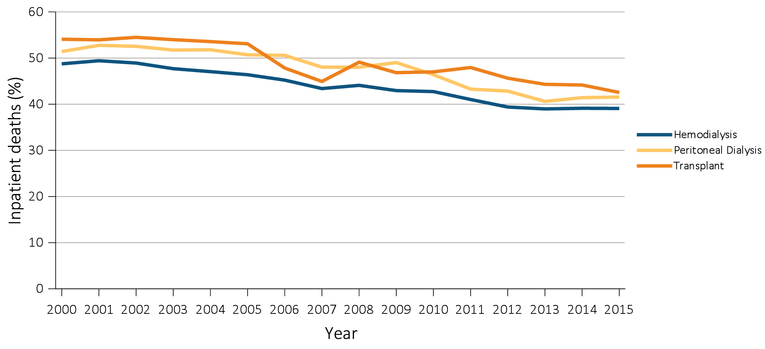
vol 2 Figure 12.5 Inpatient deaths among Medicare beneficiaries with ESRD overall, and by age, race, ethnicity, sex, and modality, 2000-2015
(f) Inpatient deaths by modality
Data Source: Special Analyses, USRDS ESRD Database. Denominator population is all decedents with Medicare Parts A and B throughout the last 90 days of life. Includes deaths occurring in short- and long-stay hospitals. Does not include observation stays. Abbreviation: ESRD, end-stage renal disease.

Slide 26
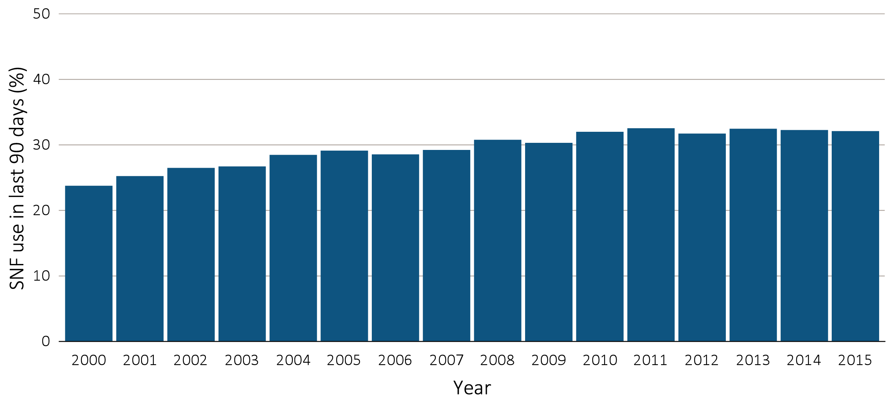
vol 2 Figure 12.6 Skilled nursing facility utilization among Medicare beneficiaries with ESRD overall, and by age, race, ethnicity, sex, and modality, 2000-2015
Skilled nursing facility utilization by year, overall
Data Source: Special Analyses, USRDS ESRD Database. Denominator population is all decedents with Medicare Parts A and B throughout the last 90 days of life. Abbreviations: ESRD, end-stage renal disease; SNF, skilled nursing facility.

Slide 27
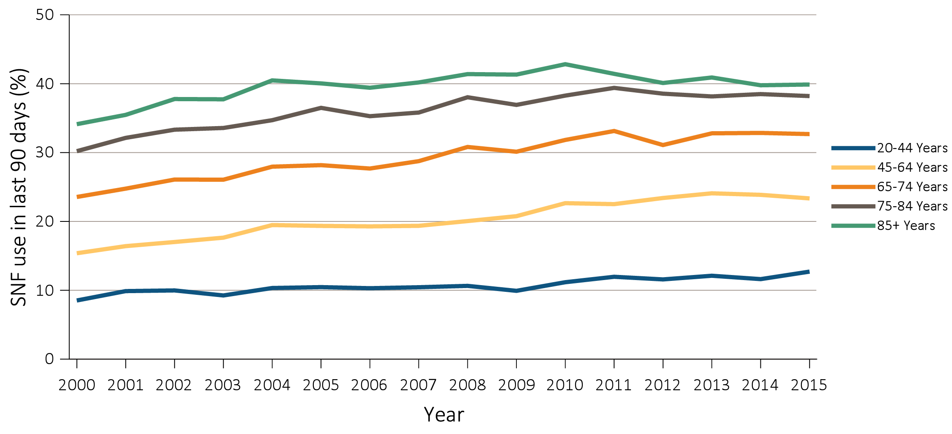
vol 2 Figure 12.6 Skilled nursing facility utilization among Medicare beneficiaries with ESRD overall, and by age, race, ethnicity, sex, and modality, 2000-2015
(b) Skilled nursing facility utilization by age
Data Source: Special Analyses, USRDS ESRD Database. Denominator population is all decedents with Medicare Parts A and B throughout the last 90 days of life. Abbreviations: ESRD, end-stage renal disease; SNF, skilled nursing facility.

Slide 28
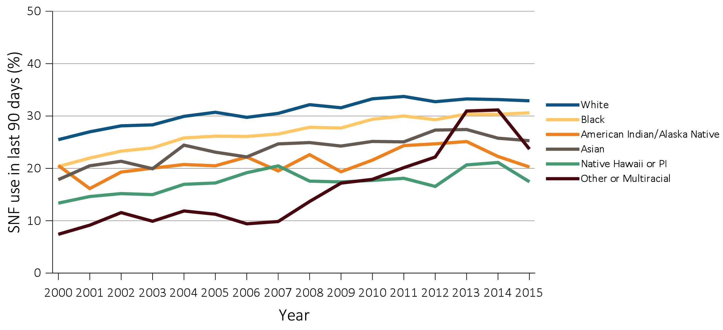
vol 2 Figure 12.6 Skilled nursing facility utilization among Medicare beneficiaries with ESRD overall, and by age, race, ethnicity, sex, and modality, 2000-2015
(c) Skilled nursing facility utilization by race
Data Source: Special Analyses, USRDS ESRD Database. Denominator population is all decedents with Medicare Parts A and B throughout the last 90 days of life. Abbreviations: ESRD, end-stage renal disease; SNF, skilled nursing facility.

Slide 29
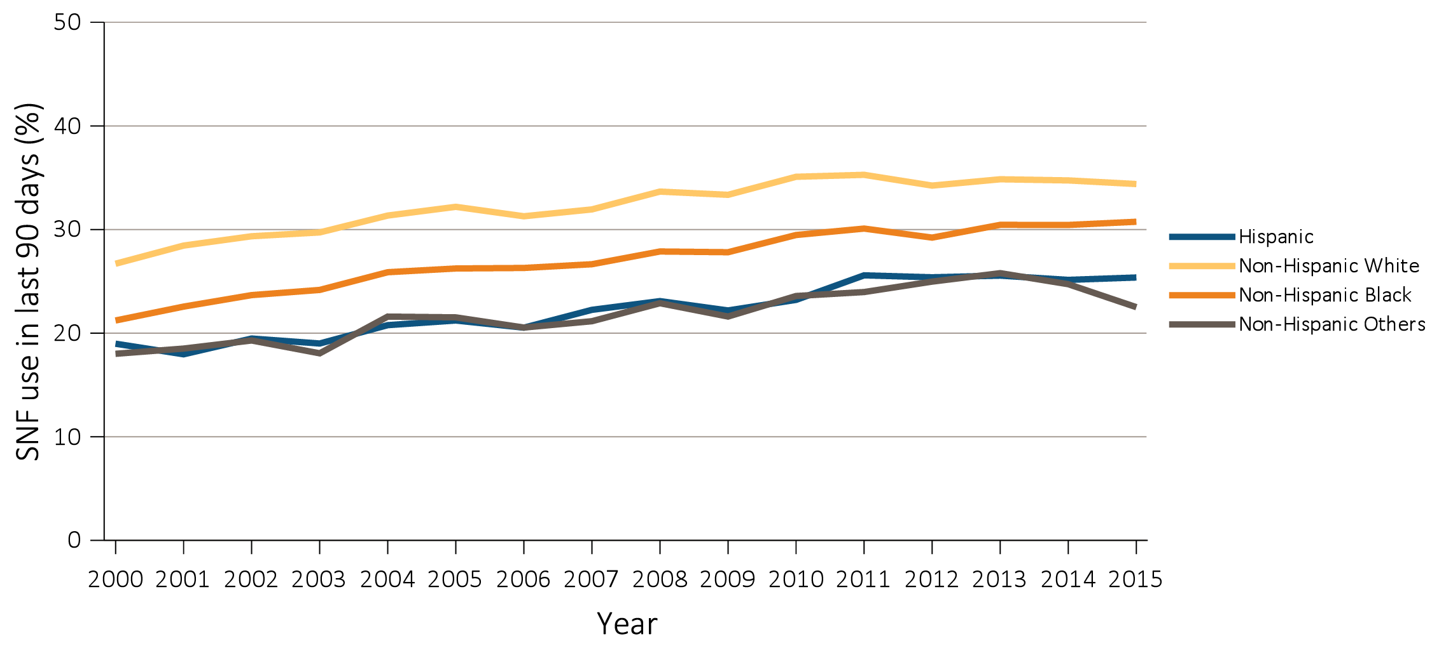
vol 2 Figure 12.6 Skilled nursing facility utilization among Medicare beneficiaries with ESRD overall, and by age, race, ethnicity, sex, and modality, 2000-2015
(d) Skilled nursing facility utilization by ethnicity
Data Source: Special Analyses, USRDS ESRD Database. Denominator population is all decedents with Medicare Parts A and B throughout the last 90 days of life. Abbreviations: ESRD, end-stage renal disease; SNF, skilled nursing facility.

Slide 30
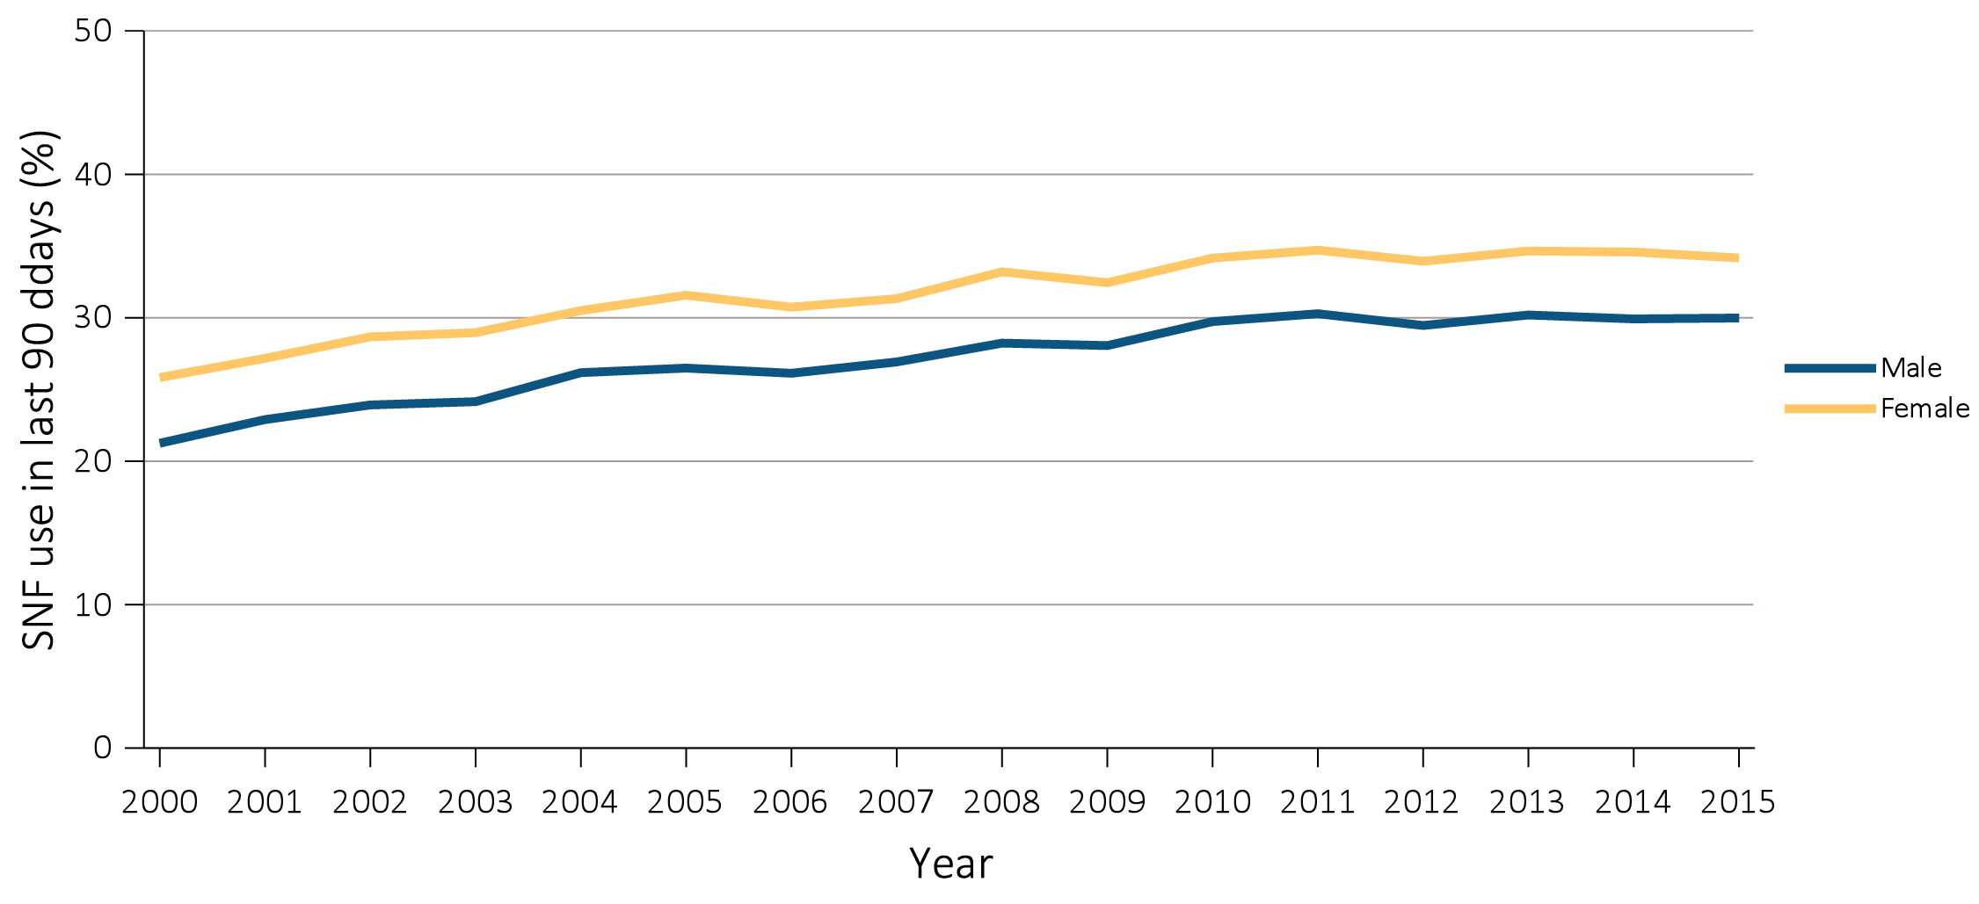
vol 2 Figure 12.6 Skilled nursing facility utilization among Medicare beneficiaries with ESRD overall, and by age, race, ethnicity, sex, and modality, 2000-2015
(e) Skilled nursing facility utilization by sex
Data Source: Special Analyses, USRDS ESRD Database. Denominator population is all decedents with Medicare Parts A and B throughout the last 90 days of life. Abbreviations: ESRD, end-stage renal disease; SNF, skilled nursing facility.

Slide 31
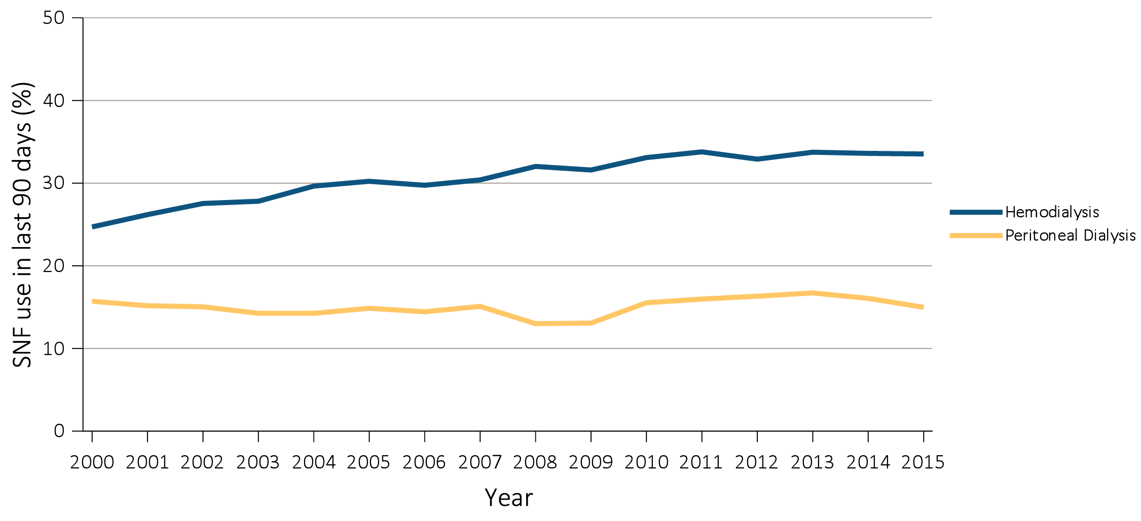
vol 2 Figure 12.6 Skilled nursing facility utilization among Medicare beneficiaries with ESRD overall, and by age, race, ethnicity, sex, and modality, 2000-2015
(f) Skilled nursing facility utilization by modality
Data Source: Special Analyses, USRDS ESRD Database. Denominator population is all decedents with Medicare Parts A and B throughout the last 90 days of life. Abbreviations: ESRD, end-stage renal disease; SNF, skilled nursing facility.

Slide 32
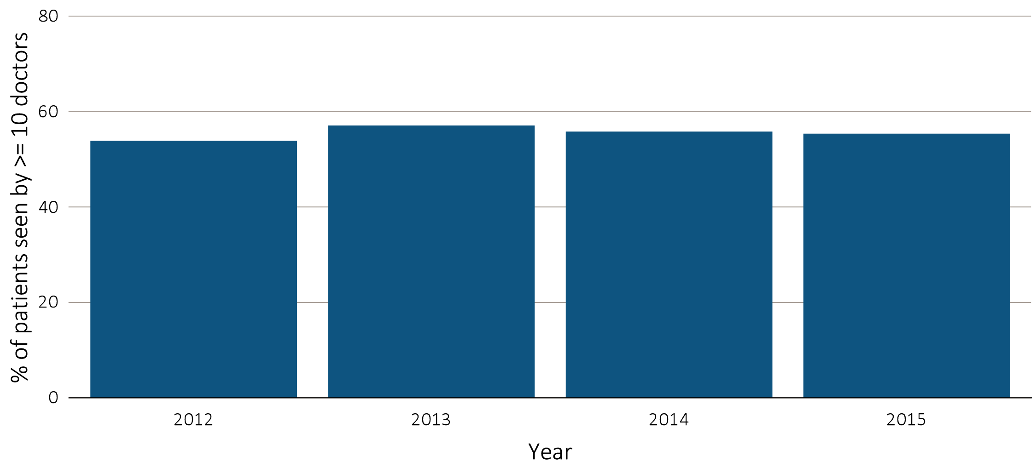
vol 2 Figure 12.7 Percentage of Medicare beneficiaries with ESRD seen by 10 or more physicians in the last 90 days of life, overall, and by age, race, ethnicity, sex, and modality, 2012-2015
(a) Percentage seen by 10 or more physicians by year
Data Source: Special Analyses, USRDS ESRD Database. Denominator population is all decedents with Medicare Parts A and B throughout the last 90 days of life who died between 2012 and 2015. Abbreviation: ESRD, end-stage renal disease.

Slide 33
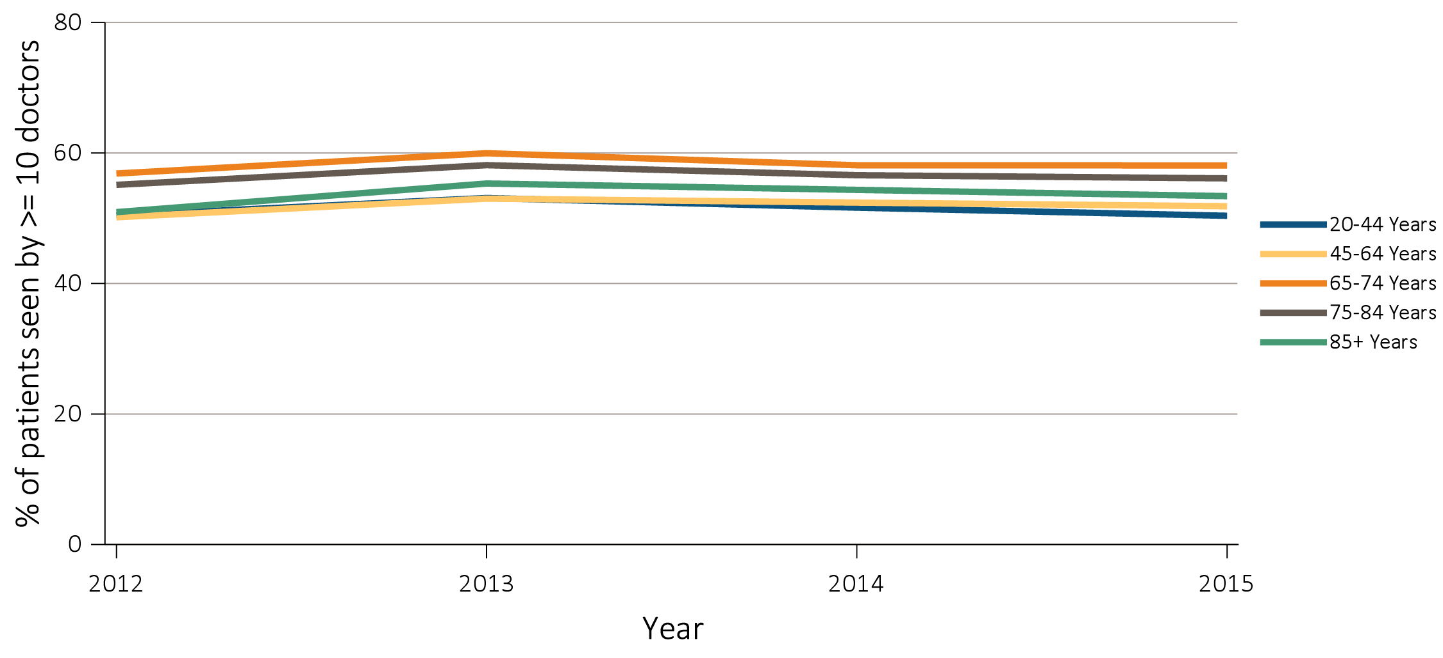
vol 2 Figure 12.7 Percentage of Medicare beneficiaries with ESRD seen by 10 or more physicians in the last 90 days of life, overall, and by age, race, ethnicity, sex, and modality, 2012-2015
(b) Percentage seen by 10 or more physicians by age
Data Source: Special Analyses, USRDS ESRD Database. Denominator population is all decedents with Medicare Parts A and B throughout the last 90 days of life who died between 2012 and 2015. Abbreviation: ESRD, end-stage renal disease.

Slide 34
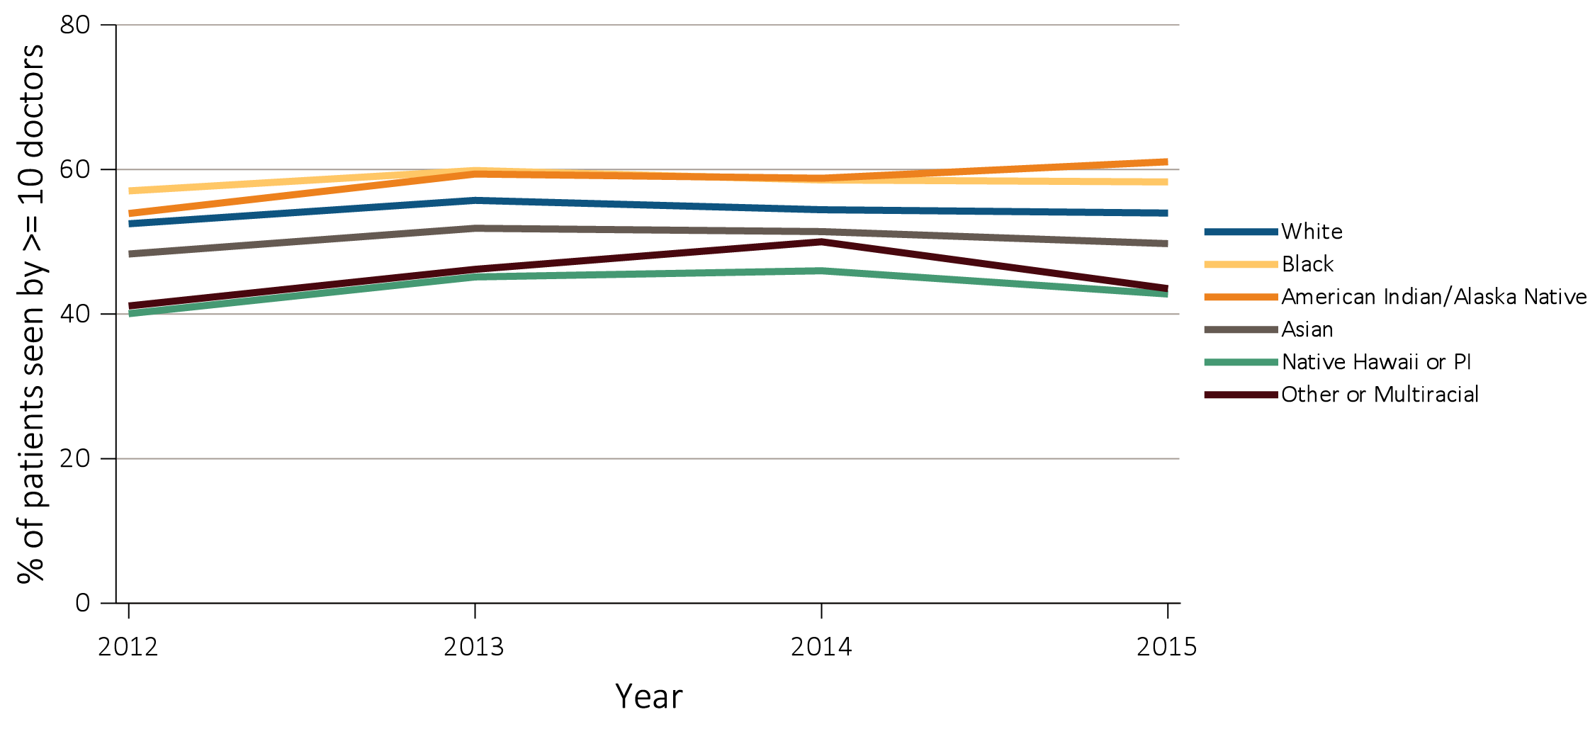
vol 2 Figure 12.7 Percentage of Medicare beneficiaries with ESRD seen by 10 or more physicians in the last 90 days of life, overall, and by age, race, ethnicity, sex, and modality, 2012-2015
(c) Percentage seen by 10 or more physicians by race
Data Source: Special Analyses, USRDS ESRD Database. Denominator population is all decedents with Medicare Parts A and B throughout the last 90 days of life who died between 2012 and 2015. Abbreviation: ESRD, end-stage renal disease.

Slide 35
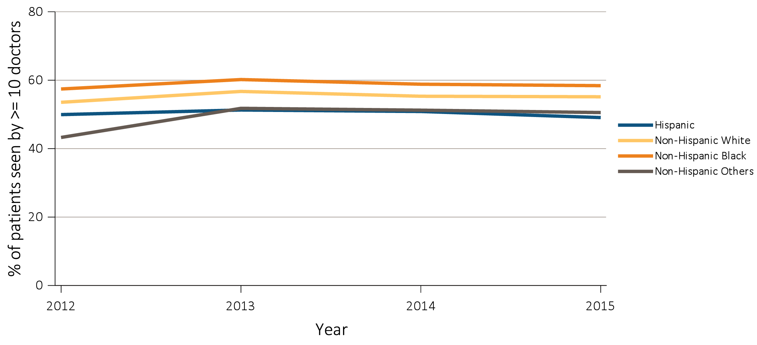
vol 2 Figure 12.7 Percentage of Medicare beneficiaries with ESRD seen by 10 or more physicians in the last 90 days of life, overall, and by age, race, ethnicity, sex, and modality, 2012-2015
(d) Percentage seen by 10 or more physicians by ethnicity
Data Source: Special Analyses, USRDS ESRD Database. Denominator population is all decedents with Medicare Parts A and B throughout the last 90 days of life who died between 2012 and 2015. Abbreviation: ESRD, end-stage renal disease.

Slide 36
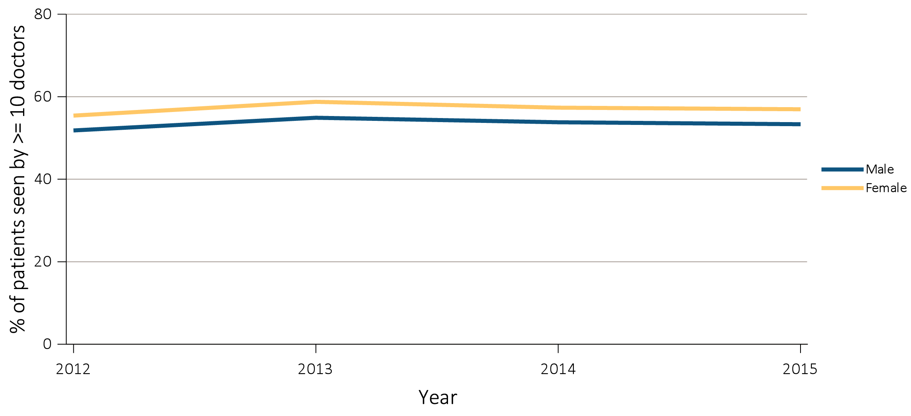
vol 2 Figure 12.7 Percentage of Medicare beneficiaries with ESRD seen by 10 or more physicians in the last 90 days of life, overall, and by age, race, ethnicity, sex, and modality, 2012-2015
(e) Percentage seen by 10 or more physicians by sex
Data Source: Special Analyses, USRDS ESRD Database. Denominator population is all decedents with Medicare Parts A and B throughout the last 90 days of life who died between 2012 and 2015. Abbreviation: ESRD, end-stage renal disease.

Slide 37
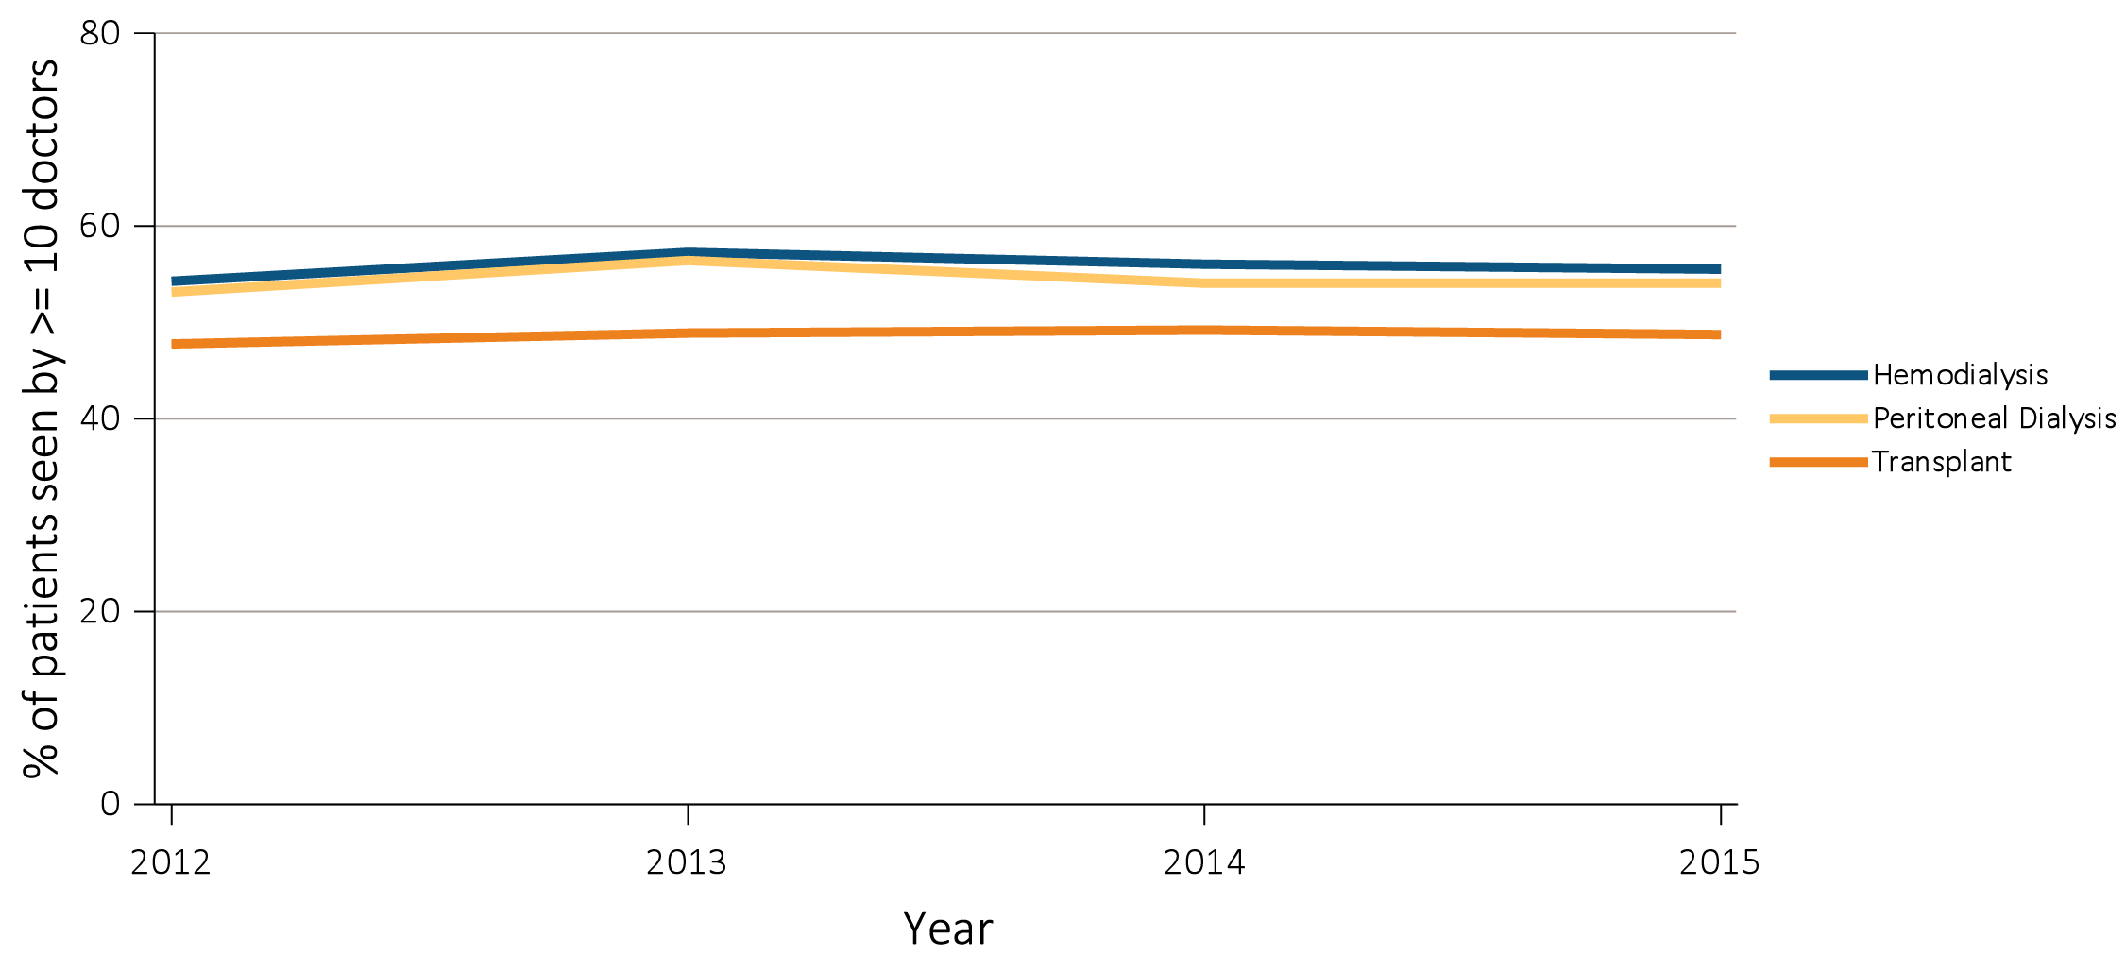
vol 2 Figure 12.7 Percentage of Medicare beneficiaries with ESRD seen by 10 or more physicians in the last 90 days of life, overall, and by age, race, ethnicity, sex, and modality, 2012-2015
(f) Percentage seen by 10 or more physicians by modality
Data Source: Special Analyses, USRDS ESRD Database. Denominator population is all decedents with Medicare Parts A and B throughout the last 90 days of life who died between 2012 and 2015. Abbreviation: ESRD, end-stage renal disease.

Slide 38
vol 2 Figure 12.7 Percentage of Medicare beneficiaries with ESRD seen by 10 or more physicians in the last 90 days of life, overall, and by age, race, ethnicity, sex, and modality, 2012-2015
(g) Percentage seen by 10 or more physicians by state of residence
Data Source: Special Analyses, USRDS ESRD Database. Denominator population is all decedents with Medicare Parts A and B throughout the last 90 days of life who died between 2012 and 2015. Abbreviation: ESRD, end-stage renal disease.

Slide 39
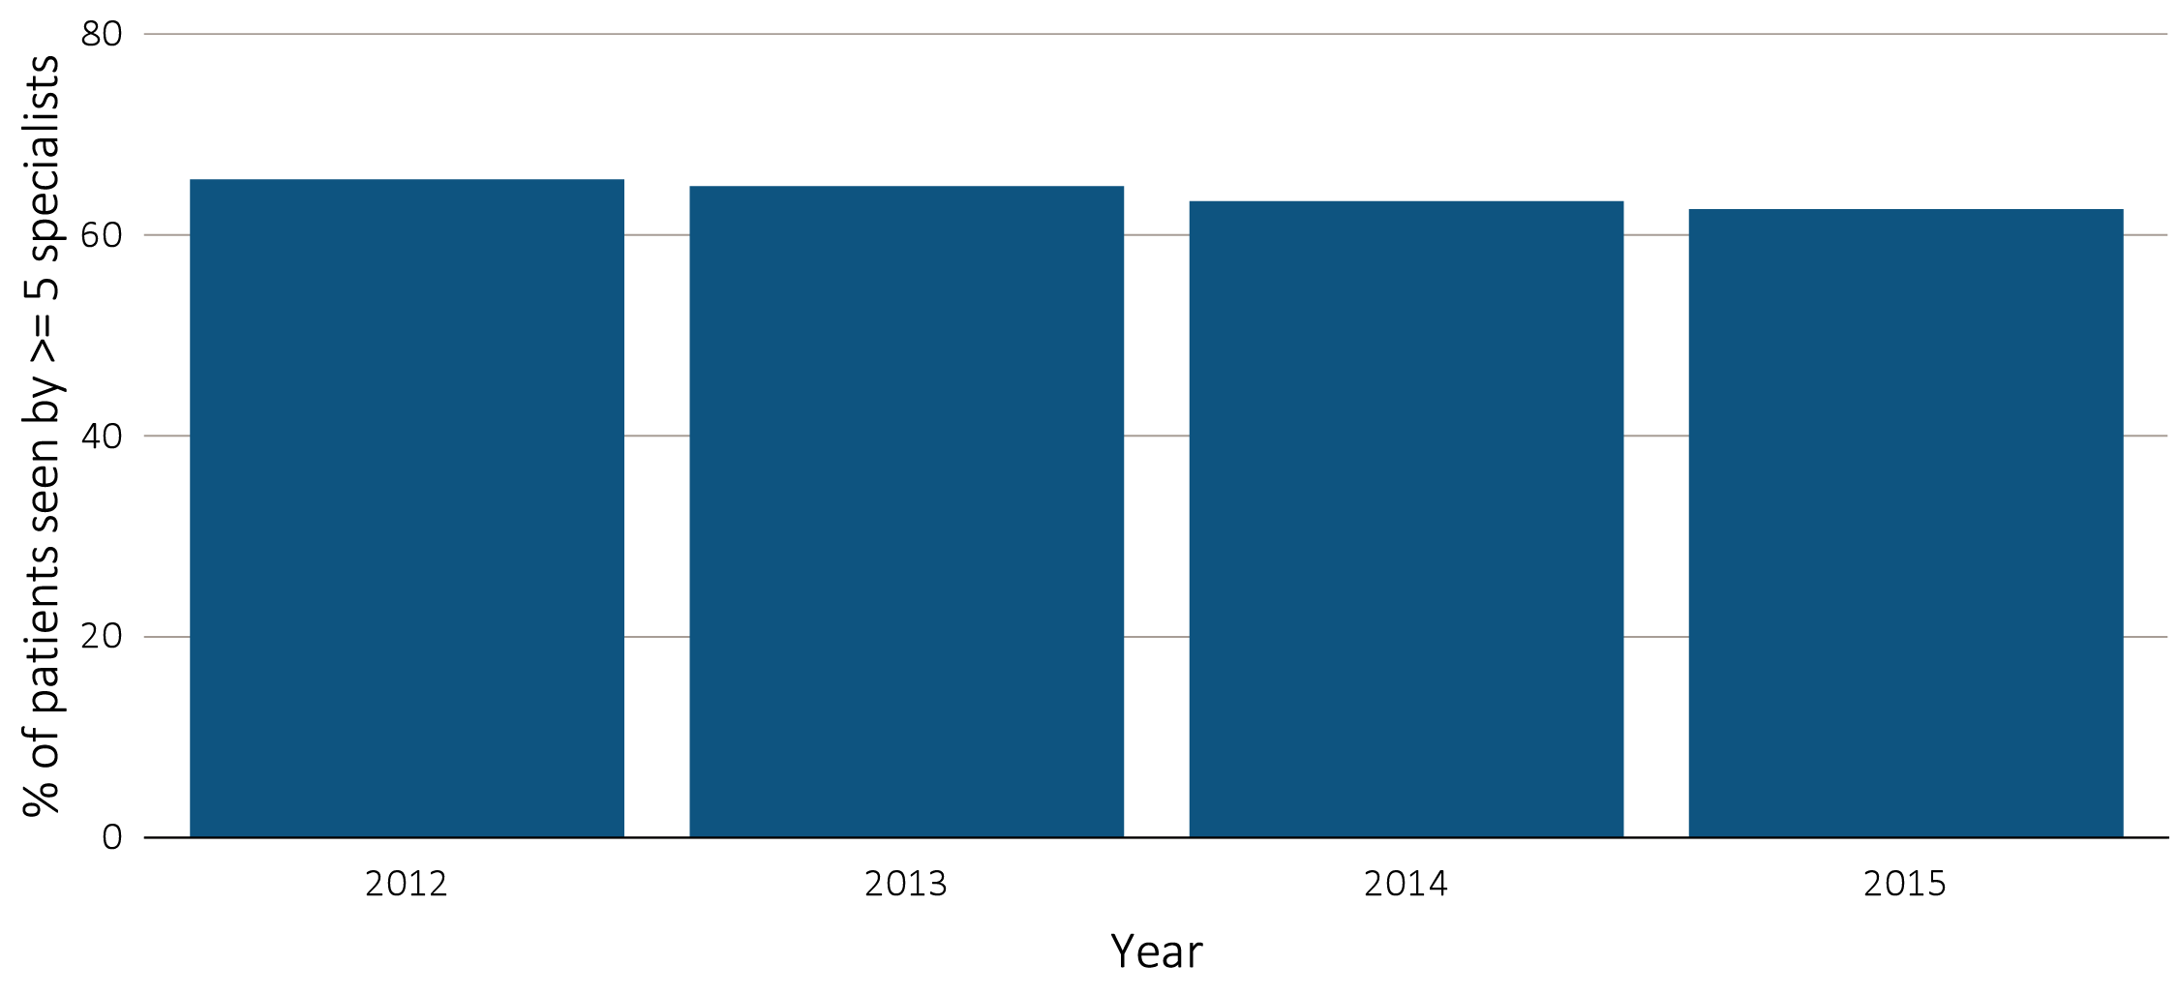
vol 2 Figure 12.8 Percentage of Medicare beneficiaries with ESRD seen by 5 or more medical specialties in the last 90 days of life, overall, and by age, race, ethnicity, sex, and modality, 2012-2015
(a) Percentage seen by 5 or more medical specialties by year, overall
Data Source: Special Analyses, USRDS ESRD Database. Denominator population is all decedents with Medicare Parts A and B throughout the last 90 days of life who died between 2012 and 2015. Abbreviation: ESRD, end-stage renal disease

Slide 40
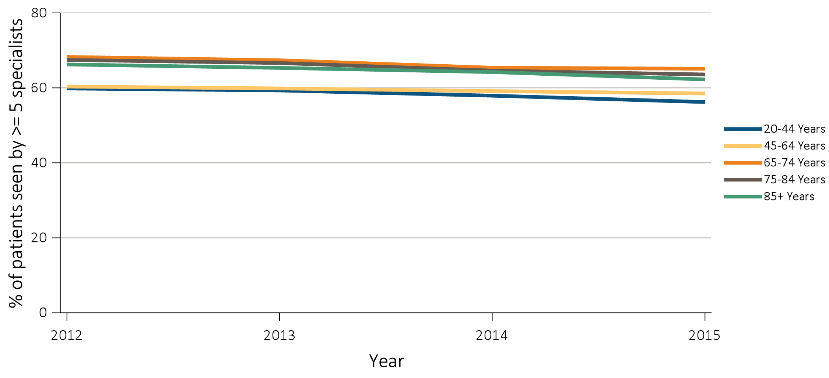
vol 2 Figure 12.8 Percentage of Medicare beneficiaries with ESRD seen by 5 or more medical specialties in the last 90 days of life, overall, and by age, race, ethnicity, sex, and modality, 2012-2015
(b) Percentage seen by 5 or more medical specialties by age
Data Source: Special Analyses, USRDS ESRD Database. Denominator population is all decedents with Medicare Parts A and B throughout the last 90 days of life who died between 2012 and 2015. Abbreviation: ESRD, end-stage renal disease

Slide 41
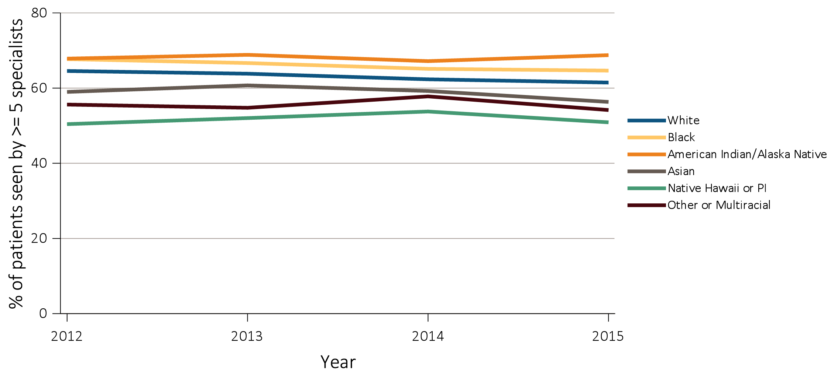
vol 2 Figure 12.8 Percentage of Medicare beneficiaries with ESRD seen by 5 or more medical specialties in the last 90 days of life, overall, and by age, race, ethnicity, sex, and modality, 2012-2015
(c) Percentage seen by 5 or more medical specialties by race
Data Source: Special Analyses, USRDS ESRD Database. Denominator population is all decedents with Medicare Parts A and B throughout the last 90 days of life who died between 2012 and 2015. Abbreviation: ESRD, end-stage renal disease

Slide 42
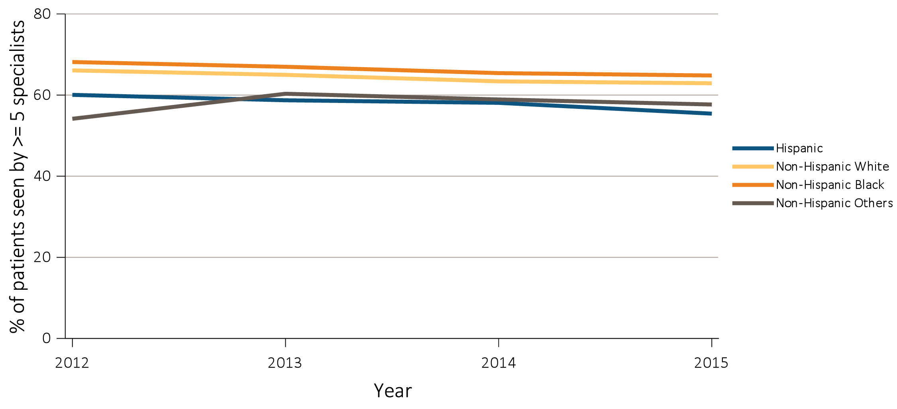
vol 2 Figure 12.8 Percentage of Medicare beneficiaries with ESRD seen by 5 or more medical specialties in the last 90 days of life, overall, and by age, race, ethnicity, sex, and modality, 2012-2015
(d) Percentage seen by 5 or more medical specialties by ethnicity
Data Source: Special Analyses, USRDS ESRD Database. Denominator population is all decedents with Medicare Parts A and B throughout the last 90 days of life who died between 2012 and 2015. Abbreviation: ESRD, end-stage renal disease

Slide 43
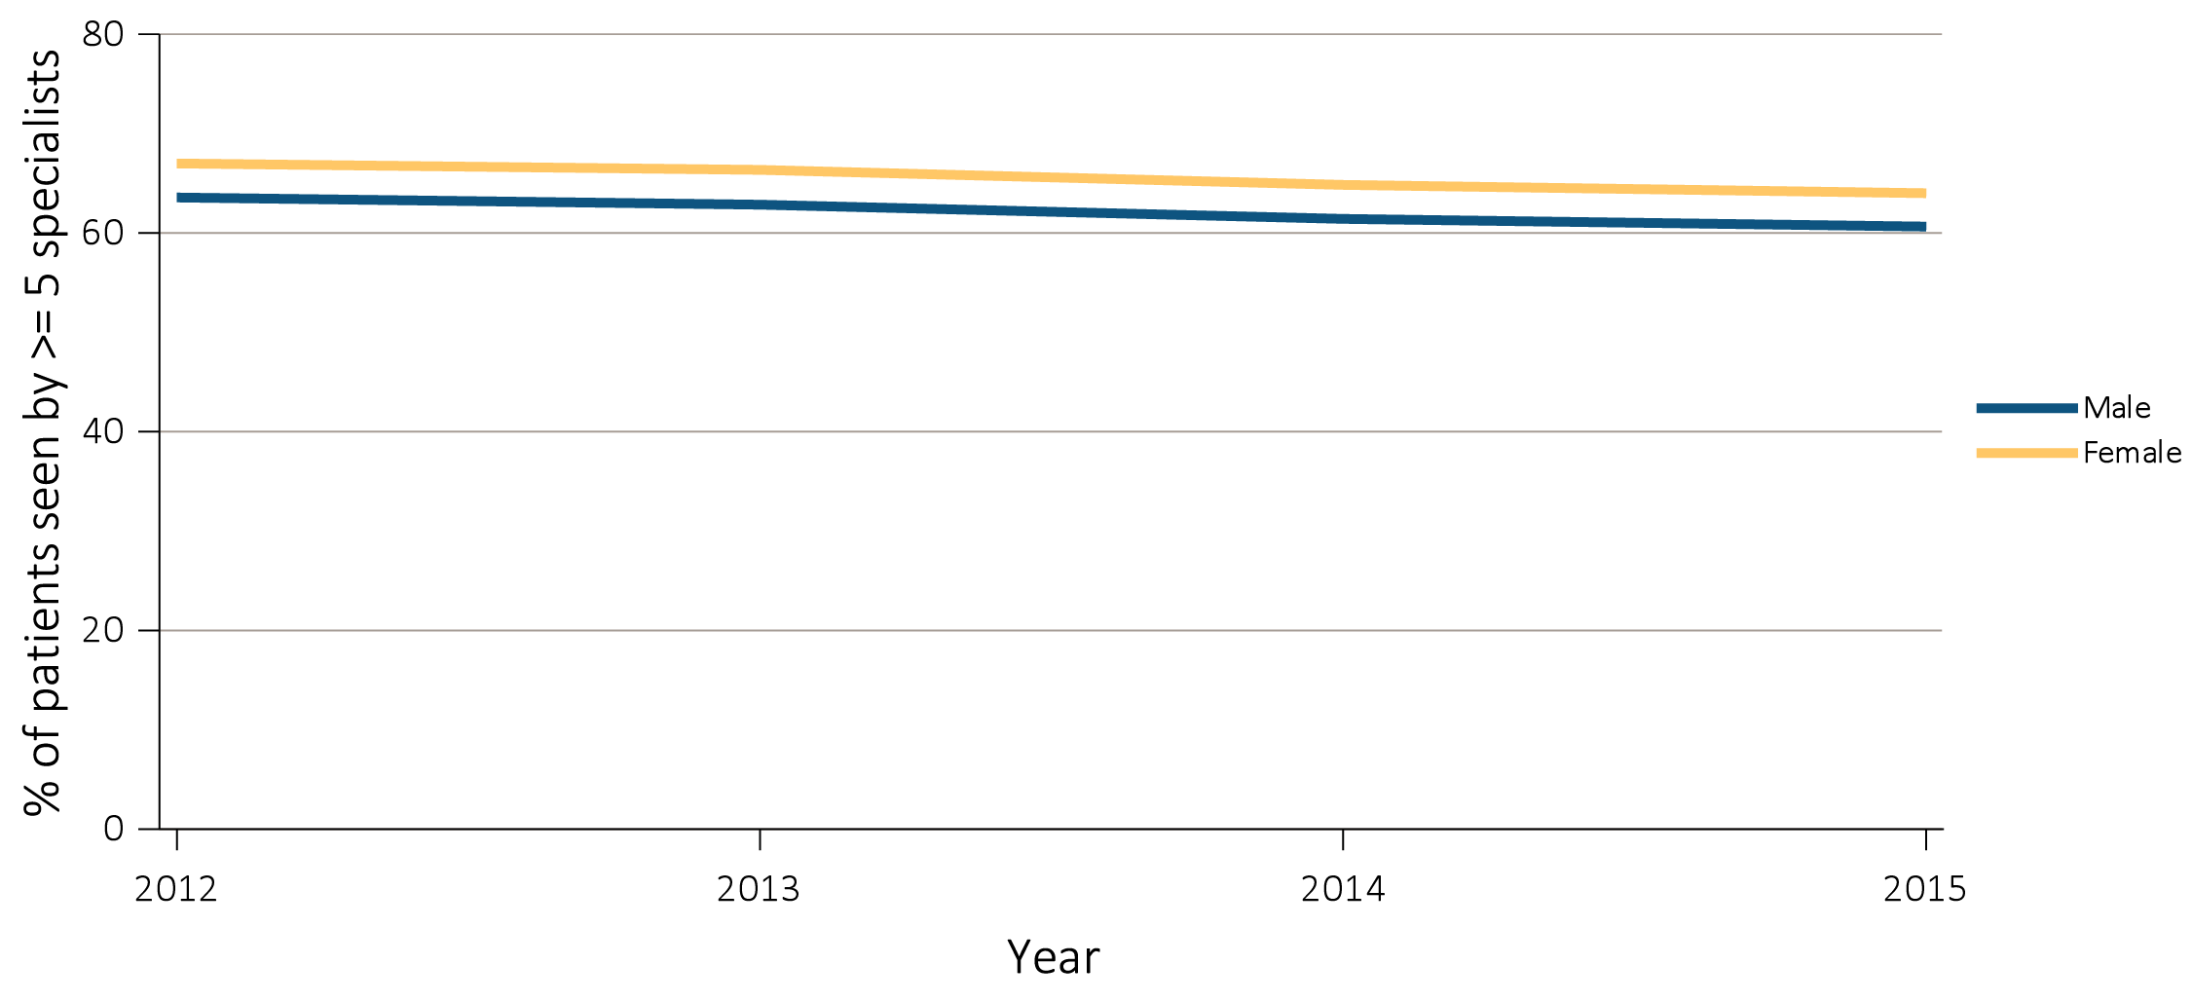
vol 2 Figure 12.8 Percentage of Medicare beneficiaries with ESRD seen by 5 or more medical specialties in the last 90 days of life, overall, and by age, race, ethnicity, sex, and modality, 2012-2015
(e) Percentage seen by 5 or more medical specialties by sex
Data Source: Special Analyses, USRDS ESRD Database. Denominator population is all decedents with Medicare Parts A and B throughout the last 90 days of life who died between 2012 and 2015. Abbreviation: ESRD, end-stage renal disease

Slide 44
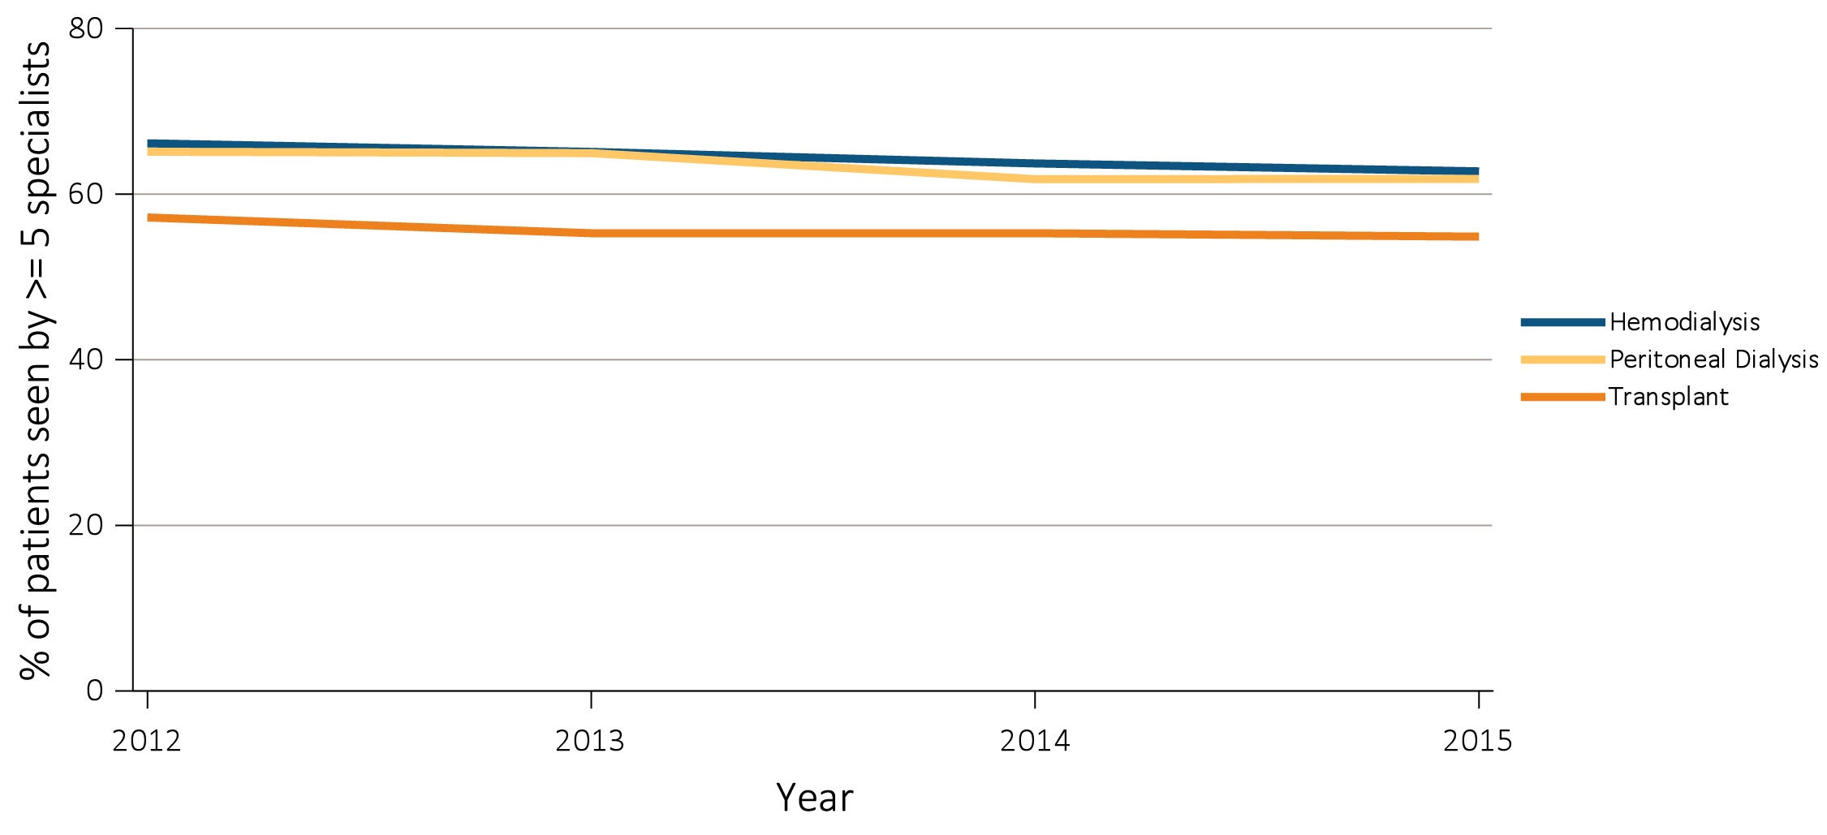
vol 2 Figure 12.8 Percentage of Medicare beneficiaries with ESRD seen by 5 or more medical specialties in the last 90 days of life, overall, and by age, race, ethnicity, sex, and modality, 2012-2015
(f) Percentage seen by 5 or more medical specialties by modality
Data Source: Special Analyses, USRDS ESRD Database. Denominator population is all decedents with Medicare Parts A and B throughout the last 90 days of life who died between 2012 and 2015. Abbreviation: ESRD, end-stage renal disease

Slide 45
vol 2 Figure 12.8 Percentage of Medicare beneficiaries with ESRD seen by 5 or more medical specialties in the last 90 days of life, overall, and by age, race, ethnicity, sex, and modality, 2012-2015
(g) Percentage seen by 5 or more medical specialties by state of residence
Data Source: Special Analyses, USRDS ESRD Database. Denominator population is all decedents with Medicare Parts A and B throughout the last 90 days of life who died between 2012 and 2015. Abbreviation: ESRD, end-stage renal disease

Slide 46
vol 2 Table 12.2 Percent of patients seen by a specialist and median number of visits in the last 90 days of life, from 2012 to 2015
Specialty | % of patients seen by specialist | Mean number of visits in last 90 days
Nephrology | 67% | 14.8
Diagnostic radiology | 66% | 13.3
Internal medicine | 63% | 17.0
Emergency medicine | 59% | 4.5
Cardiology | 55% | 8.6
Family practice | 33% | 6.6
Pulmonary disease | 31% | 8.9
Anesthesiology | 27% | 4.5
General surgery | 25% | 5.0
Pathology | 25% | 3.6
Data Source: Special Analyses, USRDS ESRD Database. Denominator population is all decedents with Medicare Parts A and B throughout the last 90 days of life who died between 2012 and 2015. Abbreviation: ESRD, end-stage renal disease.

Slide 47
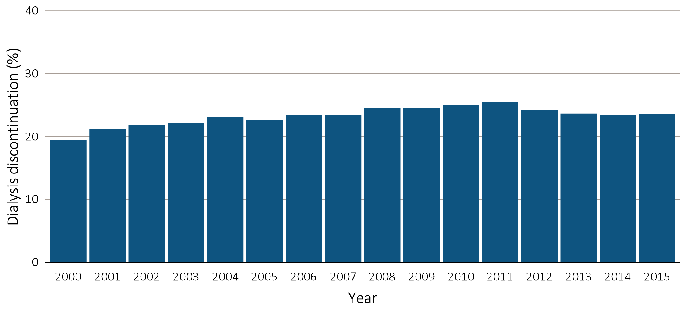
vol 2 Figure 12.9 Dialysis discontinuation before death among decedents overall, and by age, race, ethnicity, sex, and modality, 2000-2015
Dialysis discontinuation by year, overall
Data Source: Special analyses, USRDS ESRD Database. Denominator population is all patients with complete data on dialysis discontinuation from the CMS ESRD Death Notification form (CMS 2746) whose last modality was listed as dialysis. Abbreviation: ESRD, end-stage renal disease.

Slide 48
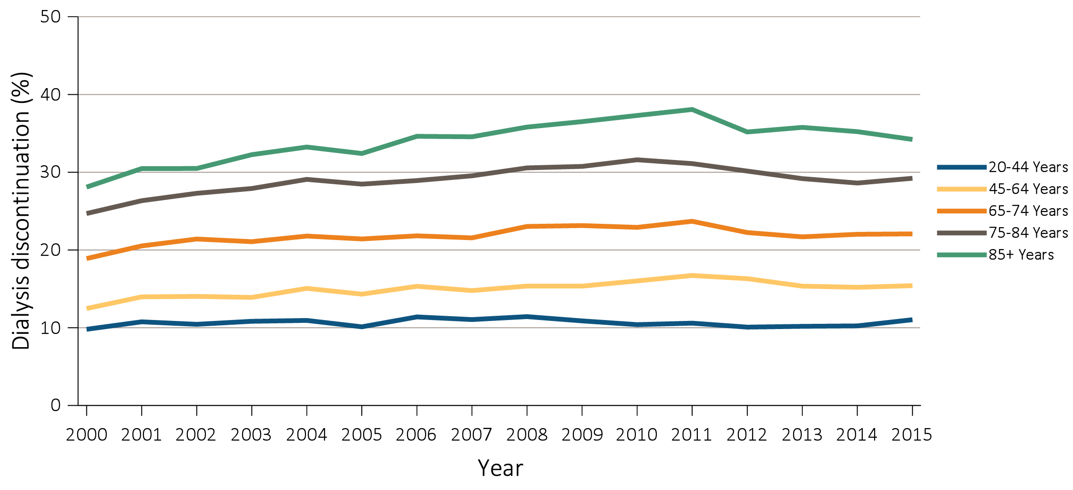
vol 2 Figure 12.9 Dialysis discontinuation before death among decedents overall, and by age, race, ethnicity, sex, and modality, 2000-2015
(b) Dialysis discontinuation by age
Data Source: Special analyses, USRDS ESRD Database. Denominator population is all patients with complete data on dialysis discontinuation from the CMS ESRD Death Notification form (CMS 2746) whose last modality was listed as dialysis. Abbreviation: ESRD, end-stage renal disease.

Slide 49
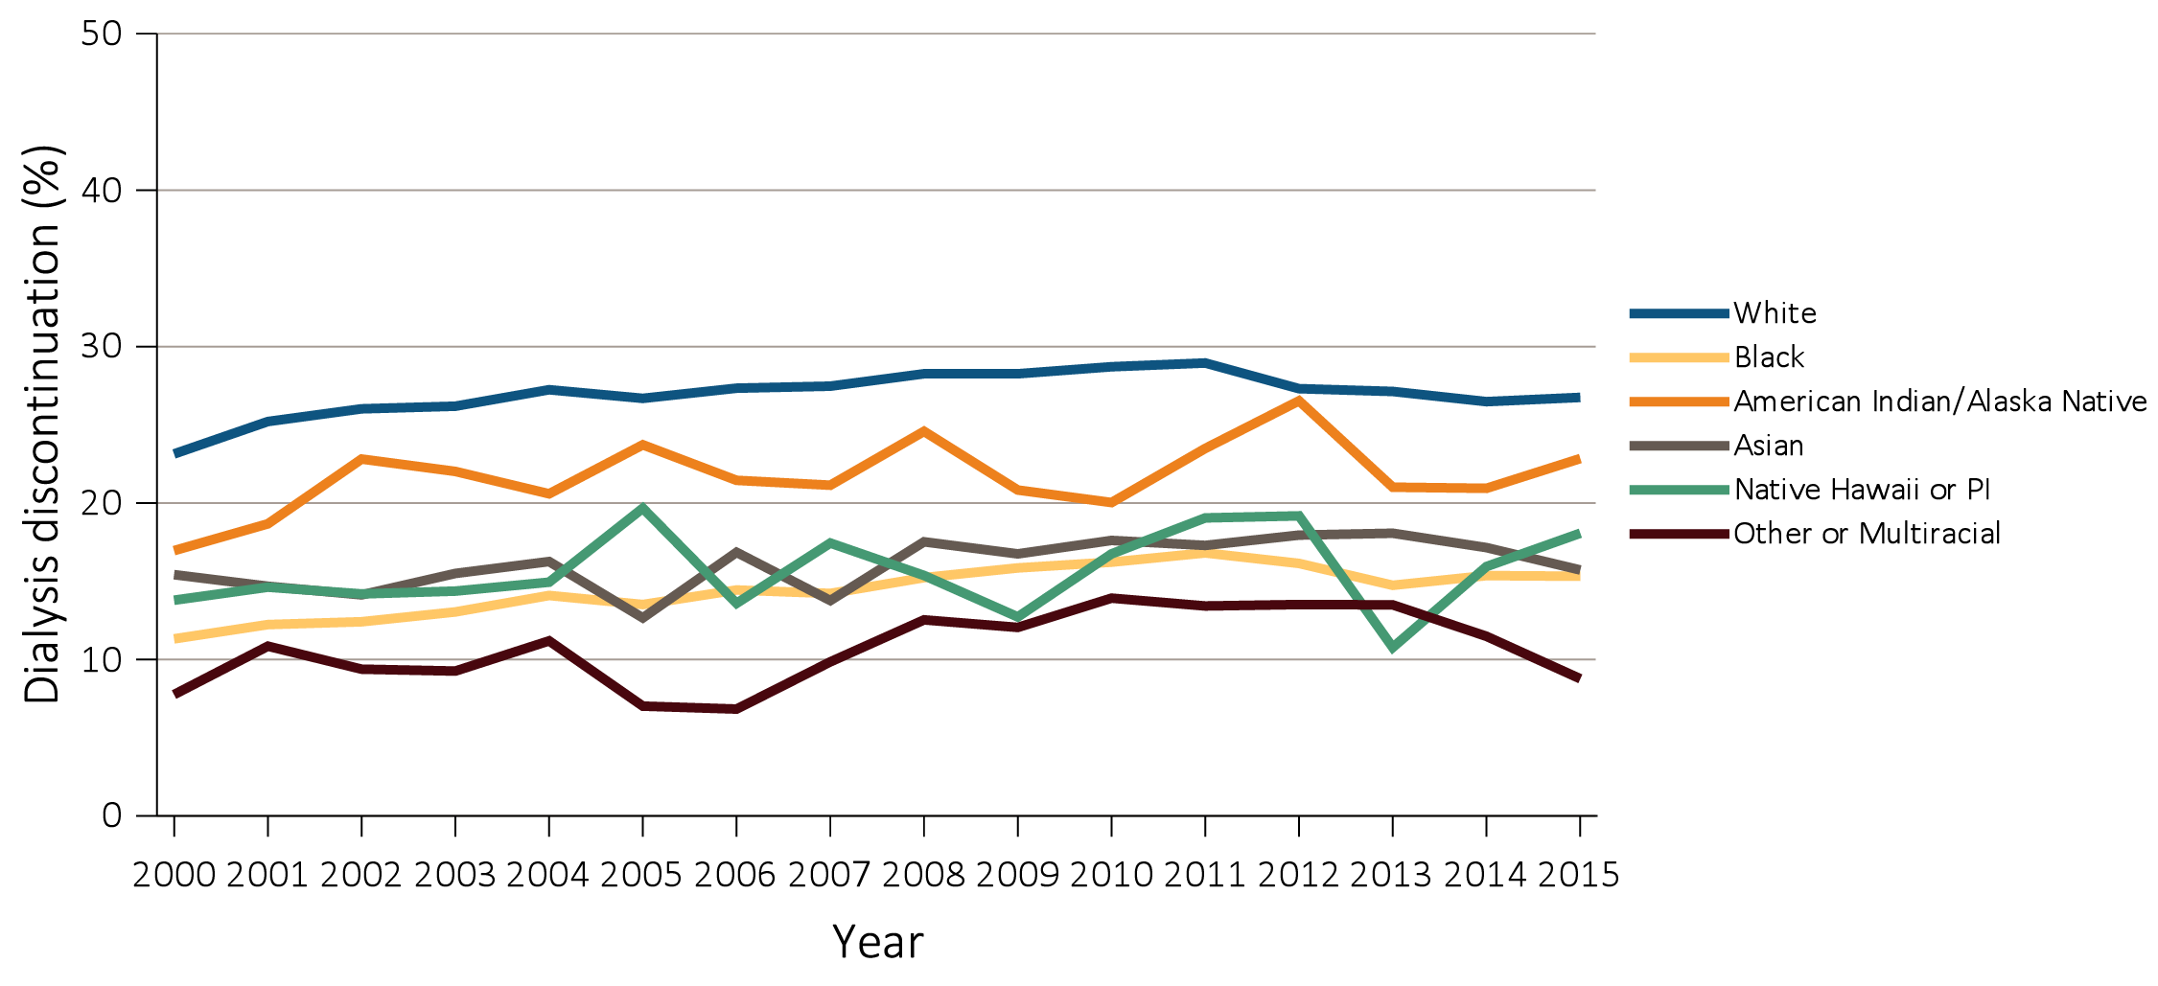
vol 2 Figure 12.9 Dialysis discontinuation before death among decedents overall, and by age, race, ethnicity, sex, and modality, 2000-2015
(c) Dialysis discontinuation by race
Data Source: Special analyses, USRDS ESRD Database. Denominator population is all patients with complete data on dialysis discontinuation from the CMS ESRD Death Notification form (CMS 2746) whose last modality was listed as dialysis. Abbreviation: ESRD, end-stage renal disease.

Slide 50
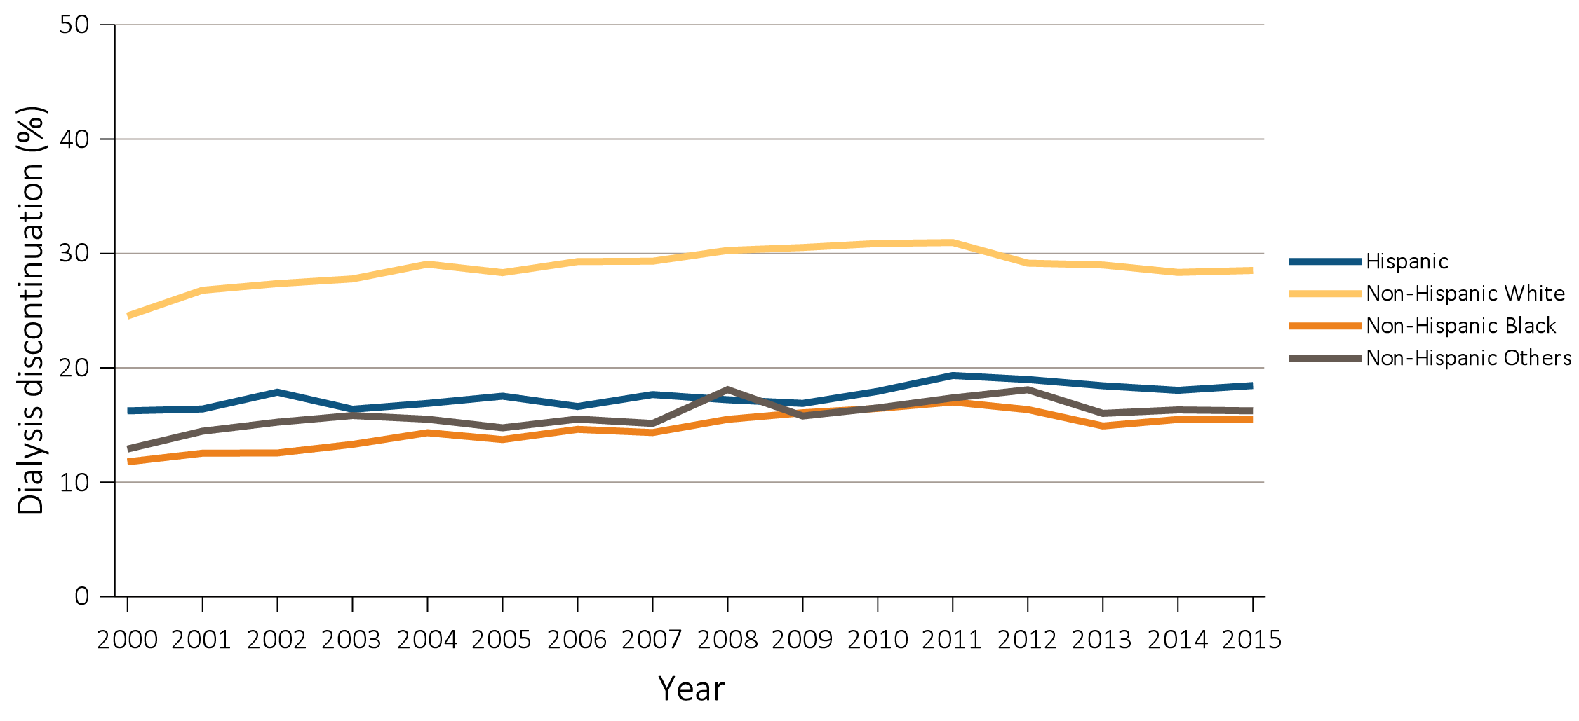
vol 2 Figure 12.9 Dialysis discontinuation before death among decedents overall, and by age, race, ethnicity, sex, and modality, 2000-2015
(d) Dialysis discontinuation by ethnicity
Data Source: Special analyses, USRDS ESRD Database. Denominator population is all patients with complete data on dialysis discontinuation from the CMS ESRD Death Notification form (CMS 2746) whose last modality was listed as dialysis. Abbreviation: ESRD, end-stage renal disease.

Slide 51
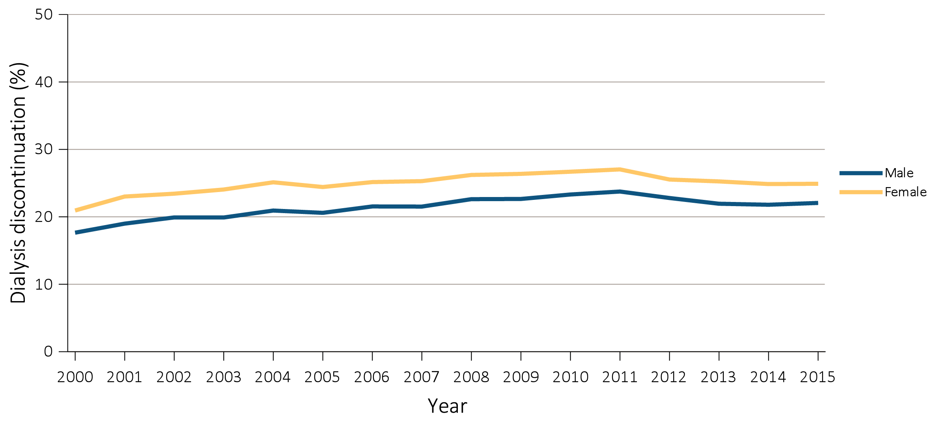
vol 2 Figure 12.9 Dialysis discontinuation before death among decedents overall, and by age, race, ethnicity, sex, and modality, 2000-2015
(e) Dialysis discontinuation by sex
Data Source: Special analyses, USRDS ESRD Database. Denominator population is all patients with complete data on dialysis discontinuation from the CMS ESRD Death Notification form (CMS 2746) whose last modality was listed as dialysis. Abbreviation: ESRD, end-stage renal disease.

Slide 52
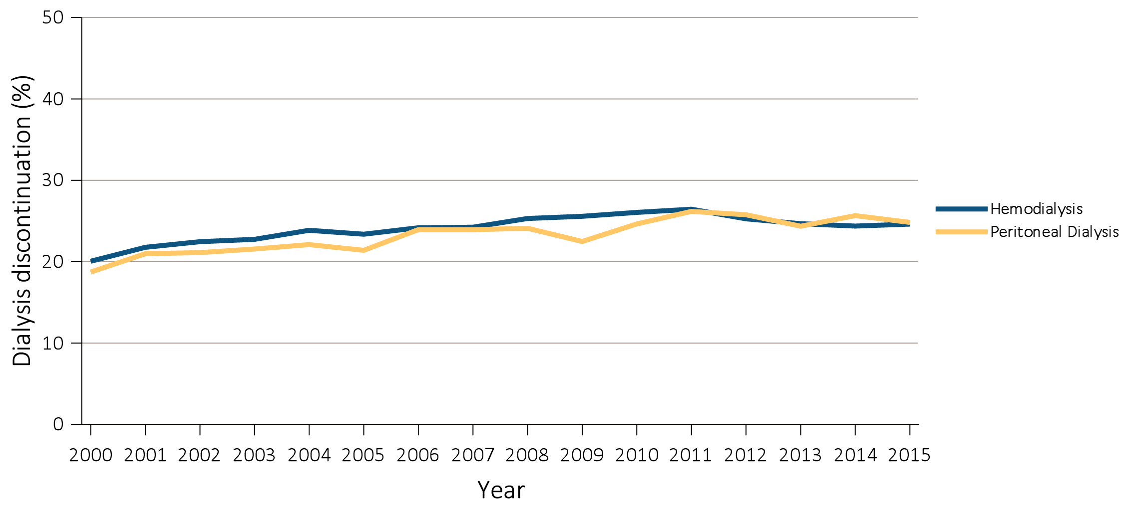
vol 2 Figure 12.9 Dialysis discontinuation before death among decedents overall, and by age, race, ethnicity, sex, and modality, 2000-2015
(f) Dialysis discontinuation by modality
Data Source: Special analyses, USRDS ESRD Database. Denominator population is all patients with complete data on dialysis discontinuation from the CMS ESRD Death Notification form (CMS 2746) whose last modality was listed as dialysis. Abbreviation: ESRD, end-stage renal disease.

Slide 53
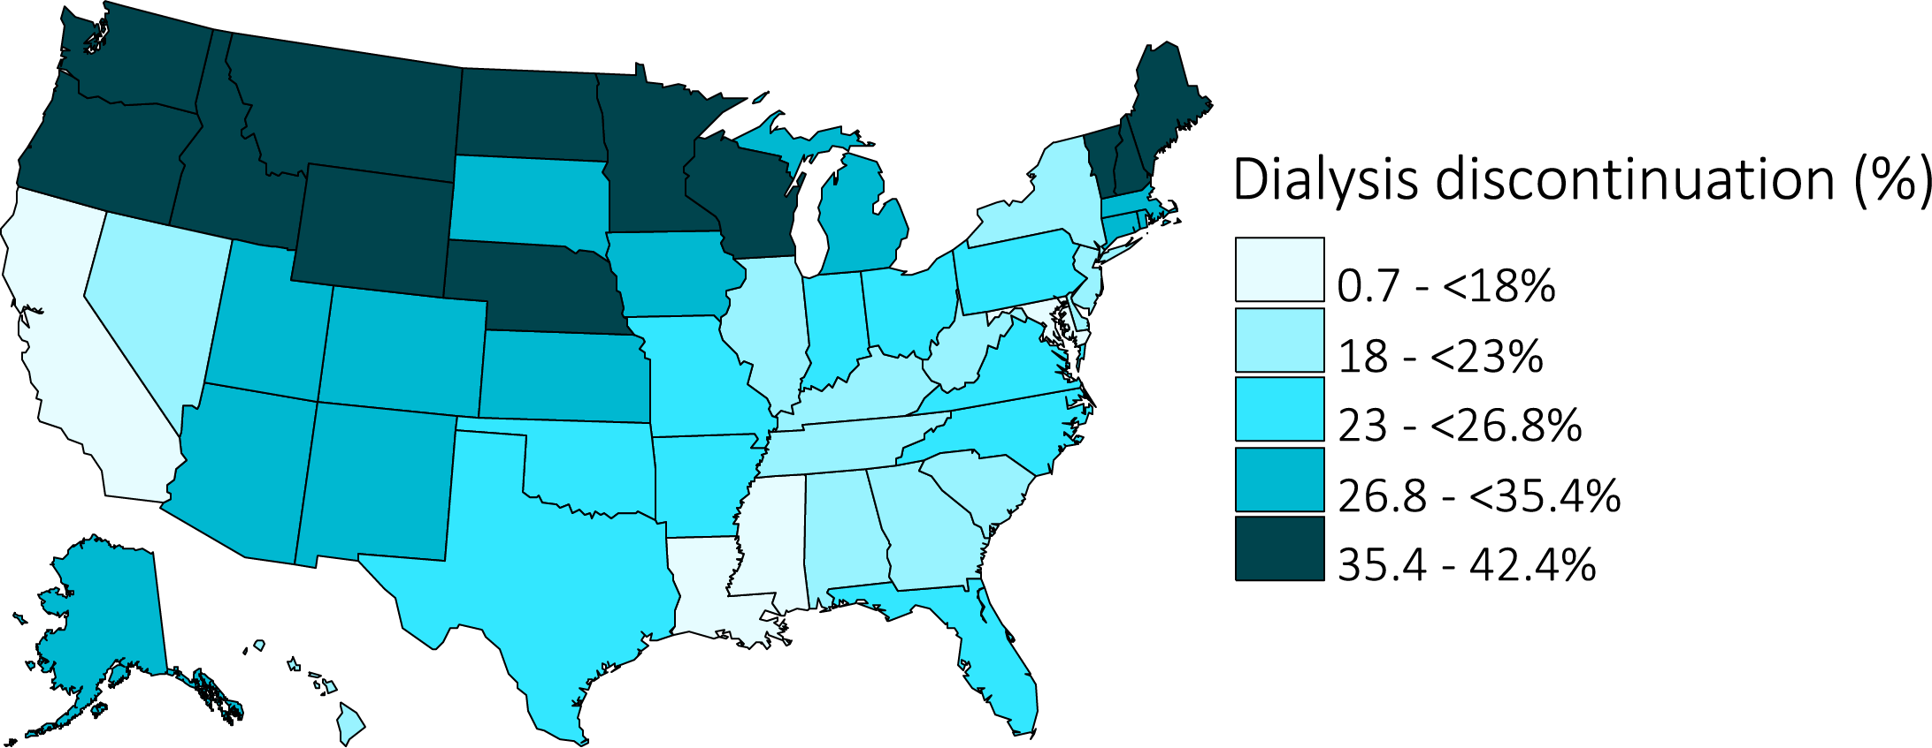
vol 2 Figure 12.9 Dialysis discontinuation before death among decedents overall, and by age, race, ethnicity, sex, and modality, 2000-2015
(g) Dialysis discontinuation by state of residence
Data Source: Special analyses, USRDS ESRD Database. Denominator population is all patients with complete data on dialysis discontinuation from the CMS ESRD Death Notification form (CMS 2746) whose last modality was listed as dialysis. Abbreviation: ESRD, end-stage renal disease.

Slide 54
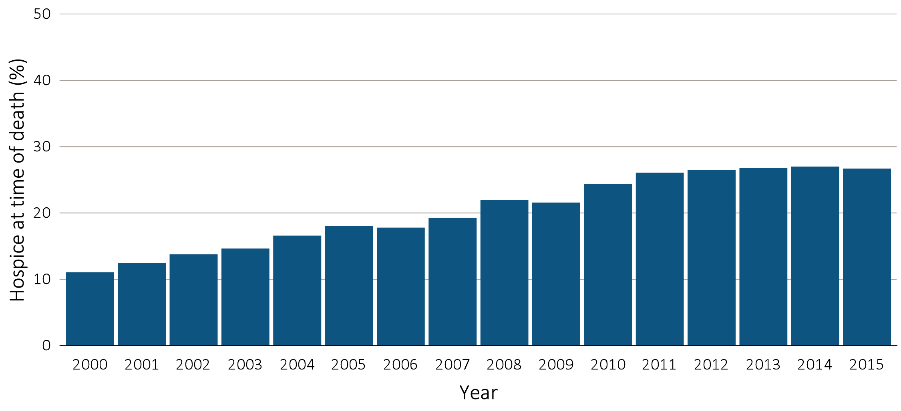
vol 2 Figure 12.10 Hospice utilization at the time of death among Medicare beneficiaries with ESRD overall, and by age, race, ethnicity, sex, modality, and whether dialysis was discontinued, 2000-2015
(a) Hospice utilization by year, overall
Data Source: Special Analyses, USRDS ESRD Database. Denominator population is all decedents with Medicare Parts A and B throughout the last 90 days of life. Receipt of hospice care at the time of death was defined as having a claim in the Hospice SAF (HCFASAF=S) on or after the date of death or Discharge Status from hospice=40, 41, or 42. Abbreviation: ESRD, end-stage renal disease.

Slide 55
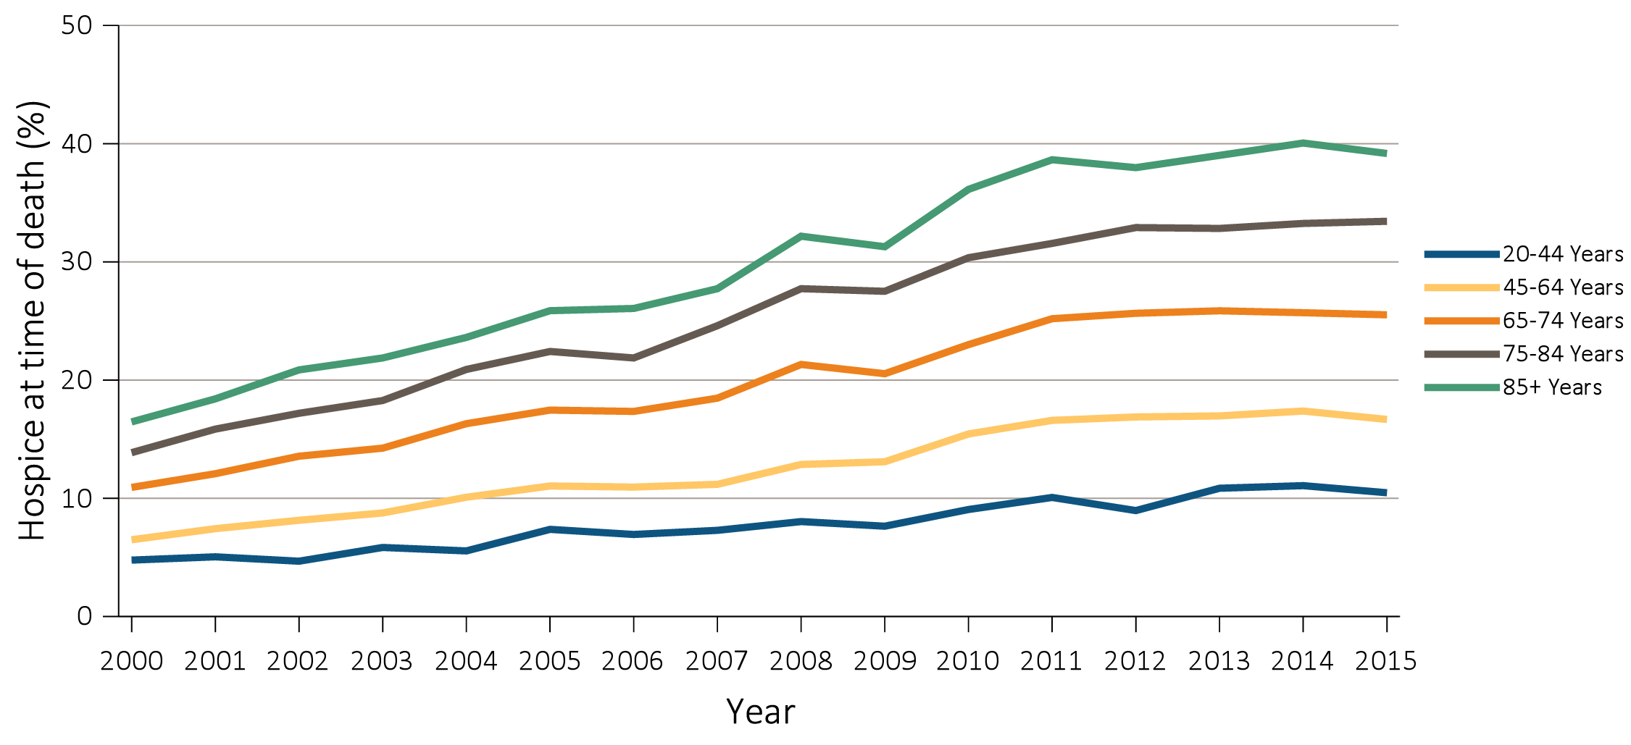
vol 2 Figure 12.10 Hospice utilization at the time of death among Medicare beneficiaries with ESRD overall, and by age, race, ethnicity, sex, modality, and whether dialysis was discontinued, 2000-2015
(b) Hospice utilization by age
Data Source: Special Analyses, USRDS ESRD Database. Denominator population is all decedents with Medicare Parts A and B throughout the last 90 days of life. Receipt of hospice care at the time of death was defined as having a claim in the Hospice SAF (HCFASAF=S) on or after the date of death or Discharge Status from hospice=40, 41, or 42. Abbreviation: ESRD, end-stage renal disease.

Slide 56
vol 2 Figure 12.10 Hospice utilization at the time of death among Medicare beneficiaries with ESRD overall, and by age, race, ethnicity, sex, modality, and whether dialysis was discontinued, 2000-2015
(c) Hospice utilization by race
Data Source: Special Analyses, USRDS ESRD Database. Denominator population is all decedents with Medicare Parts A and B throughout the last 90 days of life. Receipt of hospice care at the time of death was defined as having a claim in the Hospice SAF (HCFASAF=S) on or after the date of death or Discharge Status from hospice=40, 41, or 42. Abbreviation: ESRD, end-stage renal disease.

Slide 57
vol 2 Figure 12.10 Hospice utilization at the time of death among Medicare beneficiaries with ESRD overall, and by age, race, ethnicity, sex, modality, and whether dialysis was discontinued, 2000-2015
(d) Hospice utilization by ethnicity
Data Source: Special Analyses, USRDS ESRD Database. Denominator population is all decedents with Medicare Parts A and B throughout the last 90 days of life. Receipt of hospice care at the time of death was defined as having a claim in the Hospice SAF (HCFASAF=S) on or after the date of death or Discharge Status from hospice=40, 41, or 42. Abbreviation: ESRD, end-stage renal disease.

Slide 58
vol 2 Figure 12.10 Hospice utilization at the time of death among Medicare beneficiaries with ESRD overall, and by age, race, ethnicity, sex, modality, and whether dialysis was discontinued, 2000-2015
(e) Hospice utilization by sex
Data Source: Special Analyses, USRDS ESRD Database. Denominator population is all decedents with Medicare Parts A and B throughout the last 90 days of life. Receipt of hospice care at the time of death was defined as having a claim in the Hospice SAF (HCFASAF=S) on or after the date of death or Discharge Status from hospice=40, 41, or 42. Abbreviation: ESRD, end-stage renal disease.

Slide 59
vol 2 Figure 12.10 Hospice utilization at the time of death among Medicare beneficiaries with ESRD overall, and by age, race, ethnicity, sex, modality, and whether dialysis was discontinued, 2000-2015
(f) Hospice utilization by modality
Data Source: Special Analyses, USRDS ESRD Database. Denominator population is all decedents with Medicare Parts A and B throughout the last 90 days of life. Receipt of hospice care at the time of death was defined as having a claim in the Hospice SAF (HCFASAF=S) on or after the date of death or Discharge Status from hospice=40, 41, or 42. Abbreviation: ESRD, end-stage renal disease.

Slide 60
vol 2 Figure 12.10 Hospice utilization at the time of death among Medicare beneficiaries with ESRD overall, and by age, race, ethnicity, sex, modality, and whether dialysis was discontinued, 2000-2015
(g) Hospice utilization by whether patients discontinued dialysis before death
Data Source: Special Analyses, USRDS ESRD Database. Denominator population is all decedents with Medicare Parts A and B throughout the last 90 days of life. Receipt of hospice care at the time of death was defined as having a claim in the Hospice SAF (HCFASAF=S) on or after the date of death or Discharge Status from hospice=40, 41, or 42. Abbreviation: ESRD, end-stage renal disease.

Slide 61
vol 2 Figure 12.10 Hospice utilization at the time of death among Medicare beneficiaries with ESRD overall, and by age, race, ethnicity, sex, modality, and whether dialysis was discontinued, 2000-2015
(h) Hospice Utilization by state of residence
Data Source: Special Analyses, USRDS ESRD Database. Denominator population is all decedents with Medicare Parts A and B throughout the last 90 days of life. Receipt of hospice care at the time of death was defined as having a claim in the Hospice SAF (HCFASAF=S) on or after the date of death or Discharge Status from hospice=40, 41, or 42. Abbreviation: ESRD, end-stage renal disease.

Slide 62
vol 2 Figure 12.11 Costs in the (a) last 30 days of life, and (b) last 7 days of life in relation to timing of hospice care, 2000-2015
(a) Last 30 days of life
Data Source: Special Analyses, USRDS ESRD Database. Denominator population is all decedents with Medicare Parts A and B throughout the last 90 days of life exclusive of those patients without any costs during the last 30 days of life and those with negative costs. Date of the first claim in the Hospice SAF (HCFASAF=S) within the last 90 days of life is taken as the date of first receipt of hospice services. Timing of hospice referral in relation to death was categorized as 0-2 days, 3-5 days 6-14 days and 15-90 days). Explanation of box plot: the lower border of the box is the first quartile and the upper border is the third quartile of the distribution, the length of the box is the interquartile range, and the line in the middle of the box is the median value. The whiskers extend from the lowest value of the distribution that is ≥ the first quartile minus 1.5 times the interquartile range at the bottom to the highest value of the distribution that is ≤ the third quartile plus 1.5 times the interquartile range at the top. Values outside this range (outliers) are not plotted. Abbreviation: ESRD, end-stage renal disease.

Slide 63
vol 2 Figure 12.11 Costs in the (a) last 30 days of life, and (b) last 7 days of life in relation to timing of hospice care, 2000-2015
(b) Last 7 days of life
Data Source: Special Analyses, USRDS ESRD Database. Denominator population is all decedents with Medicare Parts A and B throughout the last 90 days of life exclusive of those patients without any costs during the last 30 days of life and those with negative costs. Date of the first claim in the Hospice SAF (HCFASAF=S) within the last 90 days of life is taken as the date of first receipt of hospice services. Timing of hospice referral in relation to death was categorized as 0-2 days, 3-5 days 6-14 days and 15-90 days). Explanation of box plot: the lower border of the box is the first quartile and the upper border is the third quartile of the distribution, the length of the box is the interquartile range, and the line in the middle of the box is the median value. The whiskers extend from the lowest value of the distribution that is ≥ the first quartile minus 1.5 times the interquartile range at the bottom to the highest value of the distribution that is ≤ the third quartile plus 1.5 times the interquartile range at the top. Values outside this range (outliers) are not plotted. Abbreviation: ESRD, end-stage renal disease.

