Slide 1
2019 Annual Data Report
Chapter 2: Transition of Care in Chronic Kidney Disease
2019 Annual Data Report Chapter 2 TCCKD

Slide 2
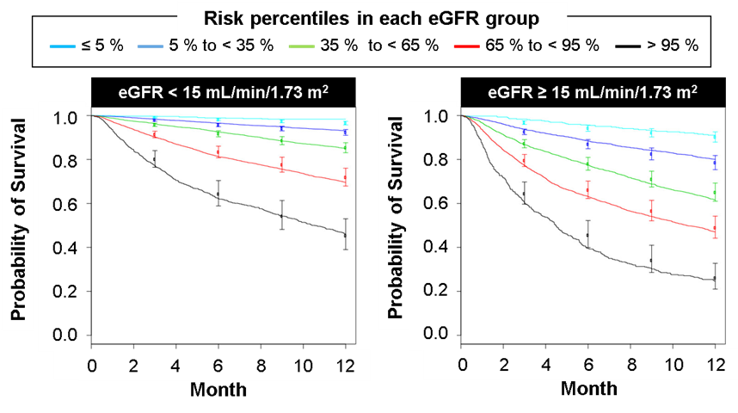
vol 1 Figure 1. Observed Kaplan-Meier survival curves during the first year of dialysis and predicted survival at months 3, 6, 9, and 12 across five risk score categories in 35,878 US veterans with last eGFR before initiation of dialysis of <15 mL/min/1.73m², 15 mL/min/1.73 m², or ≥15 mL/min/1.73 m² in the development VA cohort
Survival curves (solid lines) were based on Kaplan-Meier estimates. Points and bars represent means and 95% CIs of predicted survival for the risk score categories. Cutoff points were selected at 5th, 35th, 65th, and 95th percentiles in respective strata of eGFR. Abbreviations: eGFR, estimated glomerular filtration rate; m, meter; min, minute; mL, milliliter; VA, Veterans Affairs.
2019 Annual Data Report Chapter 2 TCCKD

Slide 3
vol 1 Figure 2. Associations of dialysis provider (VHA vs. non-VHA) at dialysis initiation with 1-year post-ESRD all-cause mortality and hospitalization in 68,727 veterans who transitioned to ESRD during 10/1/2007-3/31/2014
Hazard ratios and incidence rate ratios with 95% confidence intervals are presented for all-cause mortality and hospitalization, respectively. Model 1: unadjusted; Model 2: age, sex, race, ethnicity, marital status, geographic region, year of dialysis initiation, and service-connected status; Model 3: Model 2 plus comorbidities (heart disease, liver disease, chronic obstructive pulmonary disease, diabetes, cancer, depression, post-traumatic stress disorder, and homelessness), Charlson Comorbidity Index, socioeconomic status income category, tobacco use, drug and alcohol dependence, BMI (kg/m²) and eGFR at dialysis initiation, distance from patient to dialysis provider zip code, and dialysis access type.
Abbreviations: BMI, body mass index; eGFR, estimated glomerular filtration rate; ESRD, end stage renal disease; kg, kilogram; m, meter; VHA, Veterans Health Administration.
2019 Annual Data Report Chapter 2 TCCKD

Slide 4
vol 1 Figure 3. Associations of inpatient vs. outpatient hemodialysis transition with post-ESRD all-cause mortality in 48,261 veterans who transitioned to ESRD during 10/1/2007-09/30/2011
Hazard ratios with 95% confidence intervals are presented for all-cause mortality. Multivariable model: age, gender, race, individual comorbid conditions (history of diabetes mellitus, myocardial infraction, congestive heart failure, peripheral vascular disease, cerebrovascular disease, dementia, chronic lung disease, liver disease and malignancies), Charlson Comorbidity Index, medications (angiotensin converting enzyme inhibitors of angiotensin receptor blockers, statins, erythropoietin, and active and nutritional vitamin D), last eGFR, hemoglobin level prior to hemodialysis start, and the number and average length of hospitalizations during prelude period.
2019 Annual Data Report Chapter 2 TCCKD

Slide 5
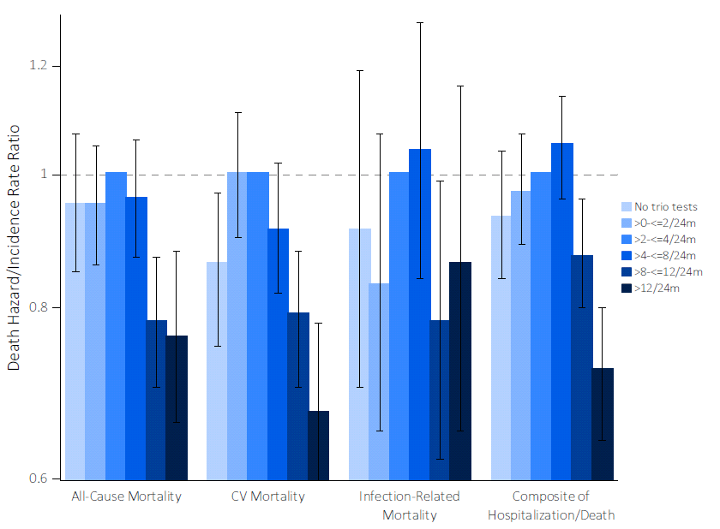
vol 1 Figure 4. Associations of the frequency of combined laboratory tests with post-ESRD all-cause mortality in 23,089 veterans who transitioned to ESRD during 10/1/2007-9/30/2011
Hazard ratios with 95% confidence intervals are presented for all-cause, CV and infection related mortality, and incidence rate ratios with 95% confidence intervals are presented for the composite hospitalization and death outcome. Multivariable model: baseline age, race, gender, baseline blood pressure, blood pressure variability assessed during the 2-year prelude period, per capita income, marital status, VA service connection percentage, comorbid conditions assessed from ICD-9 codes recorded at inpatient and outpatient encounters during the entire available pre-ESRD period [CV disease, cerebrovascular disease, hypertension, congestive heart failure, dementia, rheumatologic disease, malignancy, depression, liver disease, chronic lung disease, diabetes, HIV and CCI] and, medication adherence measured during the 2-year prelude period (PDC, medication possession ratio and persistence), baseline eGFR (first outpatient eGFR at the beginning of the prelude period) and prelude eGFR slope.
Abbreviations: CCI, Charlson Comorbidity Index; eGFR, estimated glomerular filtration rate; ESRD, end stage renal disease; HIV, human immunodeficiency virus; ICD-9, International Classification of Diseases, Ninth Revision; PDC, proportion of days covered; VA, Veterans Affairs.
2019 Annual Data Report Chapter 2 TCCKD

Slide 6
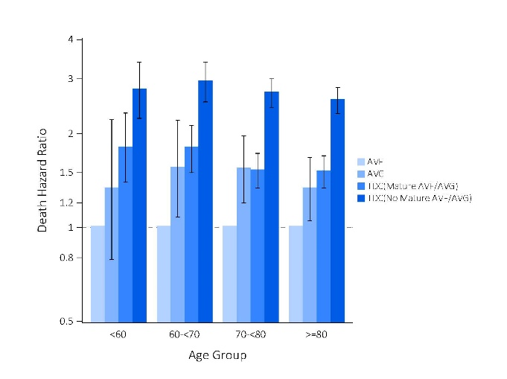
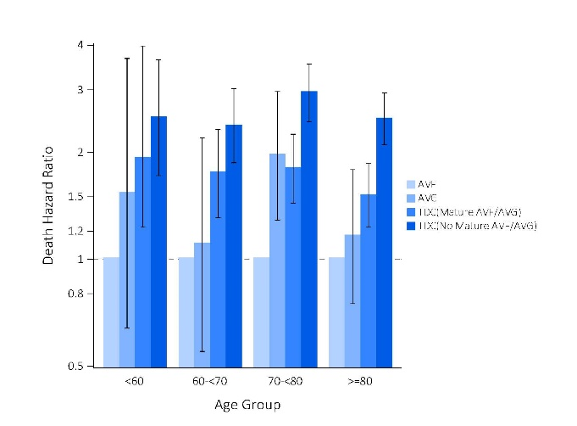
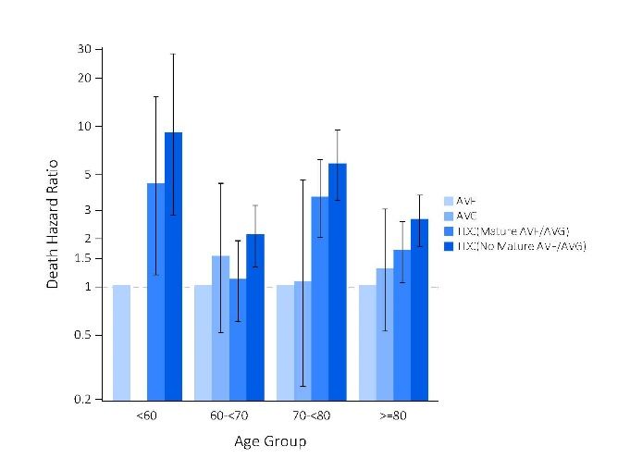
vol 1 Figure 5. Associations of vascular access type (AVF, AVG, and TDC with and without a maturing AVF/AVG) at dialysis initiation with 1-year post-ESRD (a) all-cause, (b) cardiovascular, and (c) infection related mortality in pre-specified age subgroups of 46,786 veterans who transitioned to ESRD during 10/1/2007-9/30/2011
(A)
(B)
(C)
Sub-hazard ratios with 95% confidence intervals are presented for all-cause, cardiovascular and infection related mortality. Sub-hazard ratios are not shown for infection related deaths in the <60 years old age group due to the very low number of events. Multivariable model: age, gender, race, comorbid conditions (history of diabetes mellitus, myocardial infarction, congestive heart failure, peripheral vascular disease, cerebrovascular disease, dementia, chronic lung disease, liver disease and malignancies), and for the Charlson comorbidity index as an omnibus measure of illness.
Abbreviations: AVF, arteriovenous fistula; AVG, arteriovenous graft; ESRD, end stage renal disease; TDC, tunneled catheter; VA, Veterans Affairs.
2019 Annual Data Report Chapter 2 TCCKD

Slide 7
vol 1 Figure 6. Associations of access type at dialysis initiation with 6-month post-ESRD all-cause mortality among three treatment groups (PD, HD with AVF/AVG, and HD with catheter) in 5,373 KP-SC incident dialysis patients who transitioned to ESRD during 01/01/2002-03/31/2015
Hazard ratios with 95% confidence intervals are presented for all-cause mortality. Model 1: unadjusted; Model 2: age, sex, and race/ethnicity; and Model 3: Model 2 plus eGFR prior to transition, diabetes, heart failure, acute kidney injury, inpatient transition, bicarbonate level, and albumin.
Abbreviations: AVF, arteriovenous fistula; AVG, arteriovenous graft; eGFR, estimated glomerular filtration rate; ESRD, end stage renal disease; HD, hemodialysis; KP-SC, Kaiser Permanente Southern California; PD, peritoneal dialysis.
2019 Annual Data Report Chapter 2 TCCKD

Slide 8
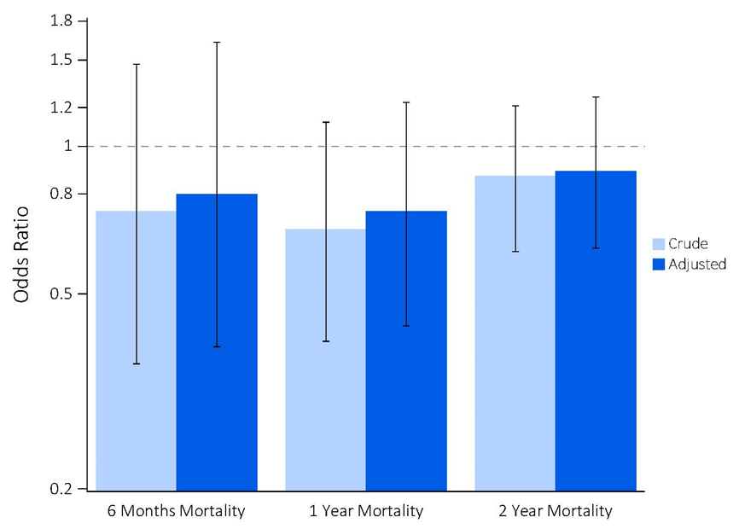
vol 1 Figure 7. Among the propensity-matched cohorts, crude and adjusted odds ratio of mortality in peritoneal dialysis (PD) versus hemodialysis (HD) at 6 months, 1 year, or 2 years among 2,094 patients transitioning to ESRD between 01/01/2002 – 03/31/2015
Adjusted odds ratios accounted for age, sex, and race/ethnicity.
2019 Annual Data Report Chapter 2 TCCKD

Slide 9
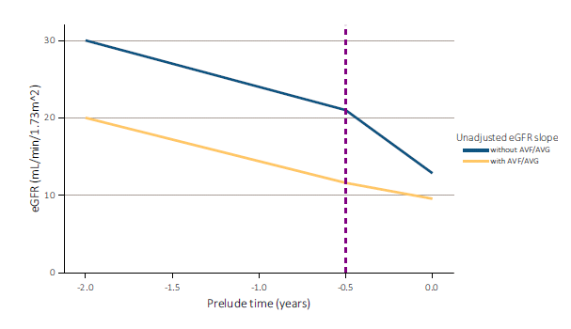
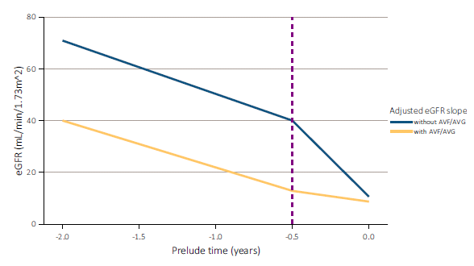
vol 1 Figure 8. (A) Unadjusted and (B) adjusted eGFR slopes before and after arteriovenous fistula (AVF)/ arteriovenous graft (AVG) creation in patients with AVF/AVG, in contrast to non-AVF/AVG patients, in 3,026 patients from 10/01/2007 – 9/30/2011
(A)
(B)
Model adjustment: eGFR slopes were estimated from (A) unadjusted and (B) multivariable-adjusted mixed-effects models. Models were adjusted for fixed (age, sex, race, diabetes mellitus and Charlson comorbidity index) and time-dependent confounders (systolic BP and angiotensin-converting enzyme inhibitors/angiotensin receptor blockers use).
2019 Annual Data Report Chapter 2 TCCKD

Slide 10
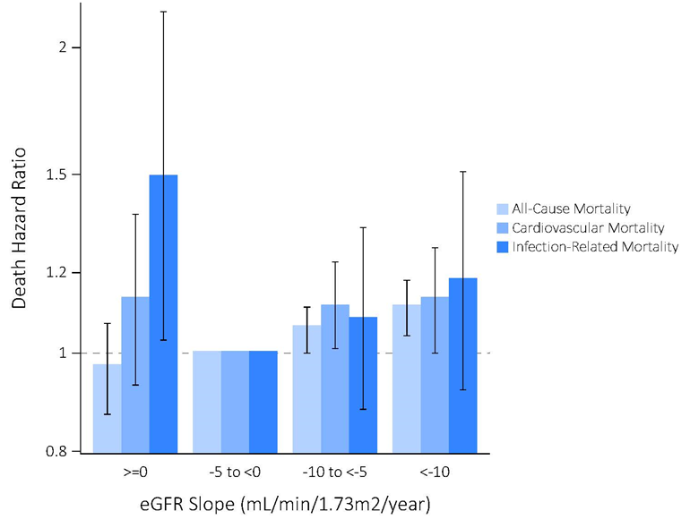
vol 1 Figure 9. Associations of pre-ESRD eGFR slopes (≥0, -5-<0 [ref.], -10-<-5, and <-10 mL/min/1.73 m²/year) with post-ESRD all-cause, cardiovascular, and infection related mortality in 18,874 veterans who transitioned to ESRD during 10/01/2007-9/30/2011
Death hazard ratios with 95% confidence intervals are presented for all-cause, cardiovascular and infection related mortality. Model 1: age, sex, race/ethnicity and marital status; Model 2: Model1 plus body mass index, diabetes mellitus, hypertension, Charlson Comorbidity Index score, and last eGFR before dialysis initiation; and Model 3: Model 2 plus medications (angiotensin-converting enzyme inhibitors or angiotensin receptor blockers; b-blockers; calcium channel blockers; vasodilators; loop, thiazide, and potassium-sparing diuretics; statins; active vitamin D analogues; phosphate binders [calcium acetate, sevelamer, or lanthanum]; nonsteroidal anti-inflammatory drugs; sodium bicarbonate; and erythropoiesis-stimulating agents).
Abbreviations: eGFR, estimated glomerular filtration rate; ESRD, end stage renal disease; m, meter; min, minute; mL, milliliter; ref, reference.
2019 Annual Data Report Chapter 2 TCCKD

Slide 11
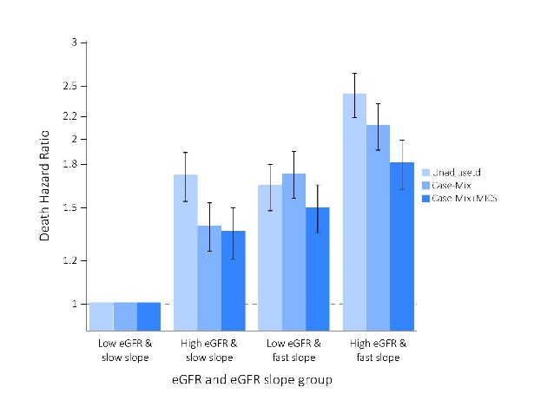
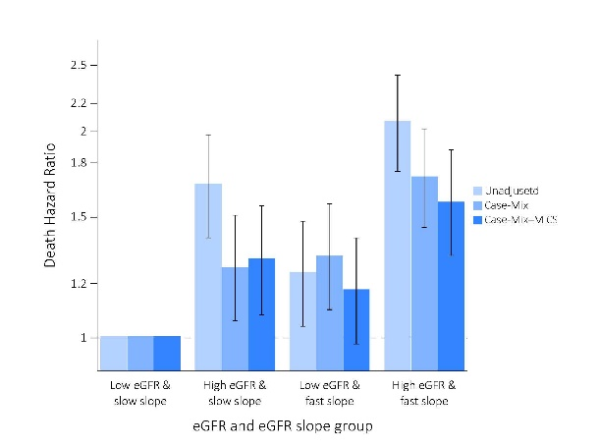
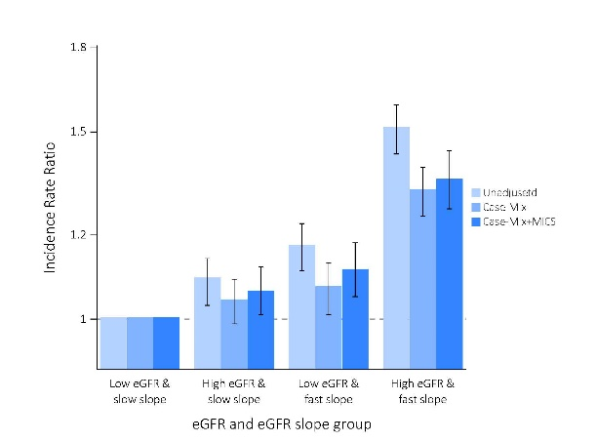
vol 1 Figure 10. Association of combined 31-day prelude eGFR and 12-month eGFR slope with 12-month (A) all-cause mortality, (B) cardiovascular mortality, (C) and 12-month hospitalization incidence rate ratio
(A)
(B)
(C)
Model 1, unadjusted; Model 2 (Casemix): time interval between the last eGFR measurement and transition date, age, sex, race, ethnicity, incidence year, marital status, Charlson comorbidity index, diabetes, ischemic heart disease (ISHD), myocardial infarction, congestive heart failure (CHF), cerebrovascular disease, and chronic obstructive pulmonary disease (COPD); Model 3 (Casemix+MICS): Model 2 plus baseline measurements of bicarbonate, blood urea nitrogen, hemoglobin, albumin, phosphorus, calcium, potassium, BMI, and systolic and diastolic blood pressure.
Abbreviations: eGFR = estimated glomerular filtration rate; prelude = pre-ESRD; MICS = malnutrition-inflammation cachexia syndrome.
2019 Annual Data Report Chapter 2 TCCKD

Slide 12
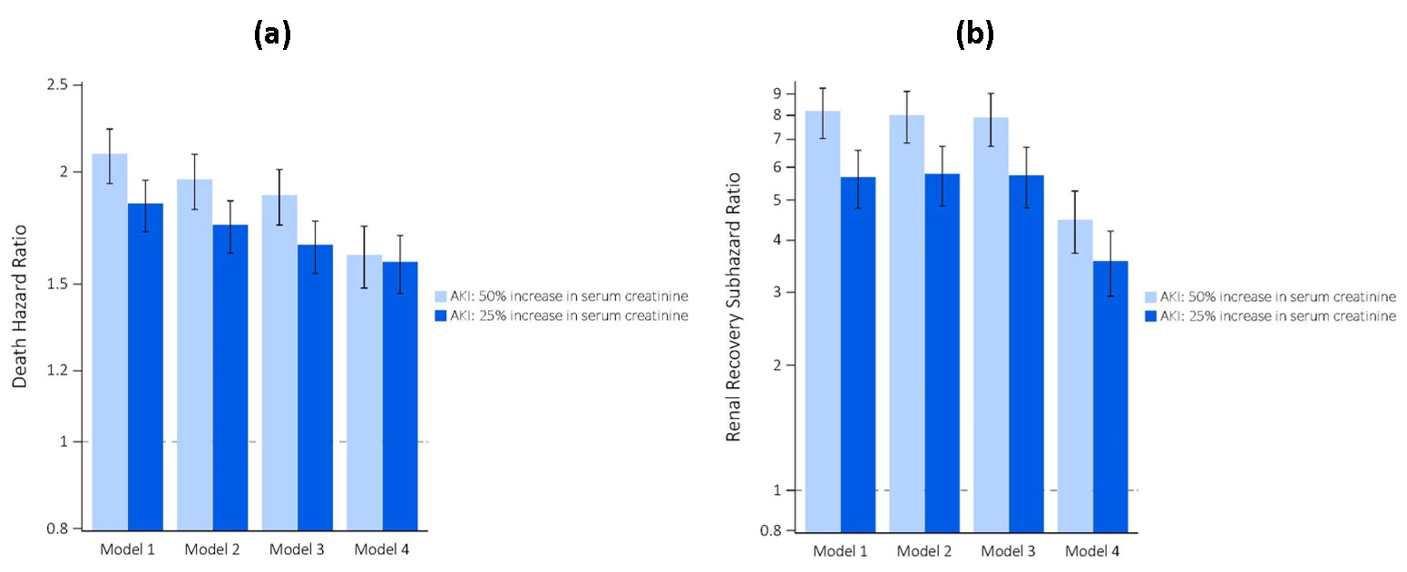
vol 1 Figure 11. A) Mortality hazard ratios associated with AKI defined as 50% and 25% increase in serum creatinine compared to expected serum creatinine B) Renal recovery subhazard ratios associated with AKI defined as 50% increase in serum creatinine compared to expected serum creatinine
model 1: adjusted for demographics (age, sex, race/ethnicity, marital status and income); model 2: additionally adjusted for comorbidities (diabetes, malignancy, liver diseases, hypertension, ischemic heart disease, congestive heart failure, peripheral vascular disease, cerebrovascular disease, dementia, chronic pulmonary disease, connective tissue disease, peptic ulcer disease, anemia, atrial fibrillation, depression, hyperlipidemia) and BMI; model 3: additionally adjusted for medications (anticoagulants, aspirin, digitalis, beta-blockers, alpha-blockers, CCBs, antianginals, statins, vasodilators, thiazide diuretics, loop diuretics, potassium-sparing diuretics, ACEIs/ARBs and antidiabetic agents), procedure type (single versus multivessel); model 4: additionally adjusted for baseline blood hemoglobin, serum albumin, eGFR and systolic and diastolic blood pressure.
2019 Annual Data Report Chapter 2 TCCKD

Slide 13
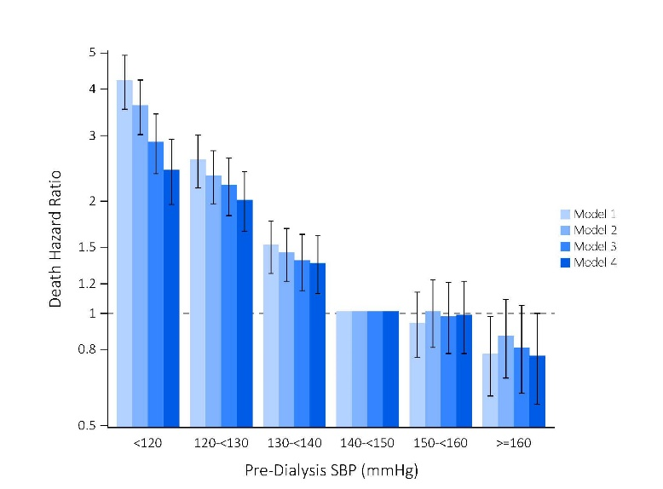
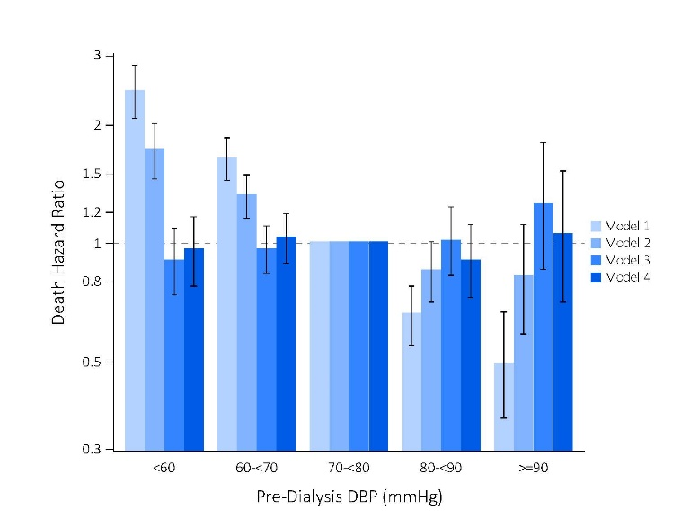
vol 1 Figure 12. Adjusted hazard ratios for all-cause mortality in the first 3 months after dialysis initiation by categories of (A) pre-dialysis SBP and (B) pre-dialysis DBP among 17,729 veterans transitioning to dialysis between 10/ 1/2007 - 09/30/2011
(A)
(B)
Model 1, unadjusted; model 2, adjusted for age, sex, race/ethnicity, and marital status; model 3 additionally accounted for comorbidities (cardiovascular disease, congestive heart failure [CHF], peripheral vascular disease, lung disease, diabetes mellitus, liver disease, and Charlson comorbidity index), and body mass index (BMI) (and SBP for the associations with pre-dialysis DBP) averaged over the one-year pre-dialysis period, eGFR slope, and last eGFR before dialysis initiation; model 4 additionally included medications (angiotensin-converting enzyme inhibitors/angiotensin receptor blockers, β-blockers, calcium channel blockers, vasodilators, diuretics, statins, and erythropoiesis-stimulating agents), cardiovascular medication adherence, and type of vascular access (arteriovenous fistula, arteriovenous graft, or catheter).
2019 Annual Data Report Chapter 2 TCCKD

Slide 14
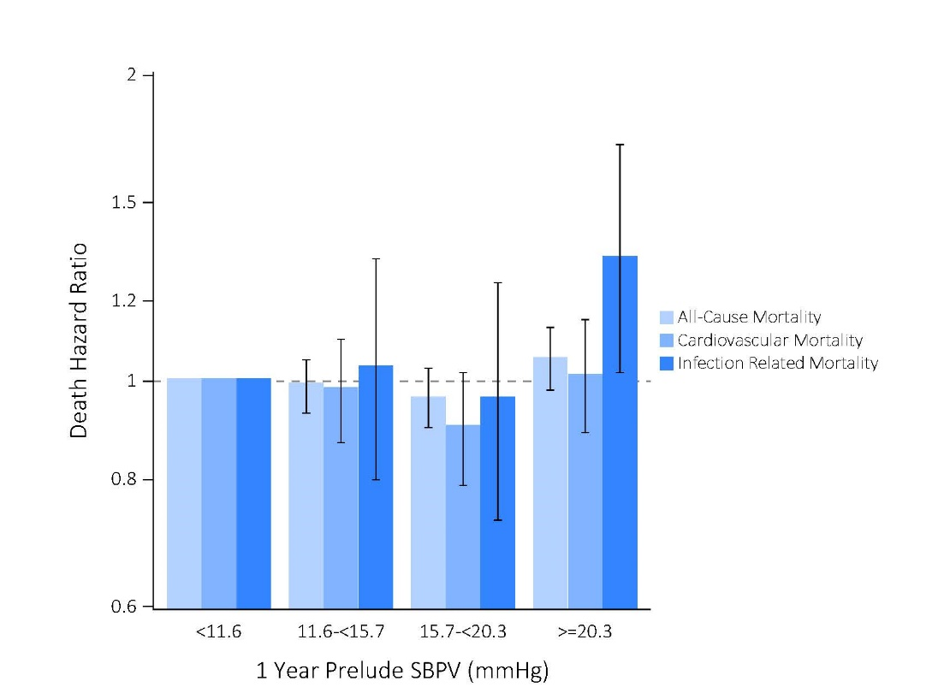
vol 1 Figure 13. Associations of 1-year pre-ESRD SBP visit-to-visit variability with (A) all-cause, (B) cardiovascular and (C) infection-related mortality after dialysis initiation in 17,729 patients from 10/01/2007 - 9/30/2011
The lowest quartile of SBPV was the reference group. Models were as follows: model 1 was adjusted for age, sex, race/ethnicity and marital status; model 2 additionally accounted for comorbidities (hypertension, cardiovascular disease, congestive heart failure, peripheral vascular disease, lung disease, diabetes mellitus, liver disease, and Charlson comorbidity index) and SBP, BMI, and estimated glomerular filtration rate averaged over the 1-year prelude period; and model 3 additionally included medications (angiotensin-converting enzyme inhibitors/angiotensin receptor blockers, b-blockers, calcium-channel blockers, vasodilators, diuretics, statins, and erythropoietin-stimulating agents), cardiovascular medication adherence, and type of vascular access (arteriovenous fistula, arteriovenous graft, or catheter).
2019 Annual Data Report Chapter 2 TCCKD

Slide 15
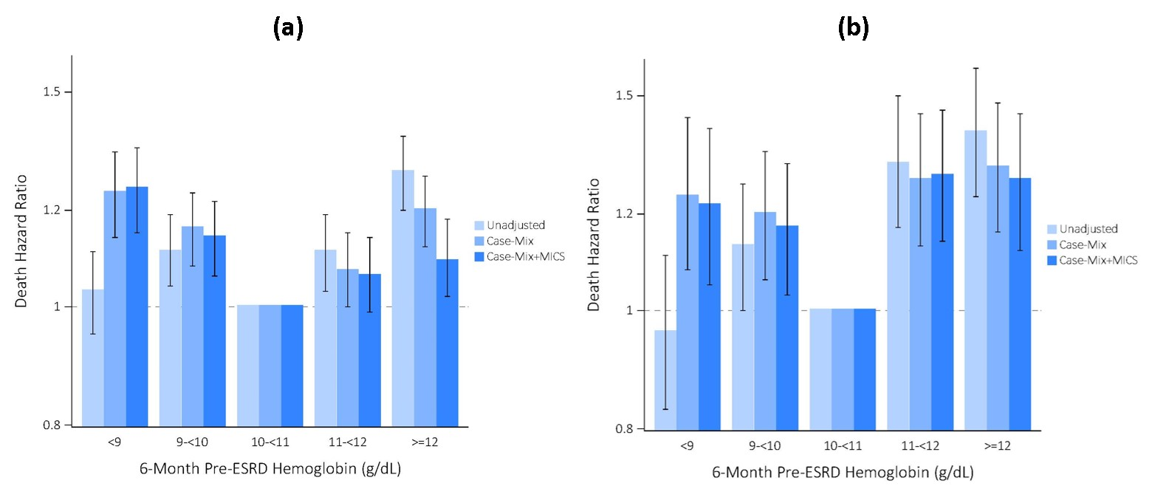
vol 1 Figure 14. Associations of 6-month pre-ESRD hemoglobin with 1-year post-ESRD (a) all-cause and (b) cardiovascular mortality in 31,472 veterans who transitioned to ESRD during 10/1/2007-3/31/2014
Model 1: unadjusted; Model 2 (Case-Mix): age, gender, race, ethnicity, marital status, Charlson Comorbidity Index, atrial fibrillation, hyperlipidemia, ischemic heart disease, myocardial infarction, congestive heart failure, peripheral vascular disease, cerebrovascular disease, chronic obstructive pulmonary disease, peptic ulcer disease, liver disease, diabetes mellitus, cancer, and primary cause of ESRD; Model 3 (Casemix+MICS): Model 2 plus last eGFR prior to transition and baseline laboratory measures of bicarbonate, albumin, calcium, phosphorus, white blood cell count, alkaline phosphatase, BMI, and ever use of oral or intravenous (IV) iron and ESA in the 6-month pre-ESRD period.
Abbreviations: BMI, body mass index; dL, deciliter; eGFR, estimated glomerular filtration rate; ESA, erythropoietin stimulating agent; ESRD, end stage renal disease; g, gram; MICS, malnutrition inflammation complex syndrome.
2019 Annual Data Report Chapter 2 TCCKD

Slide 16
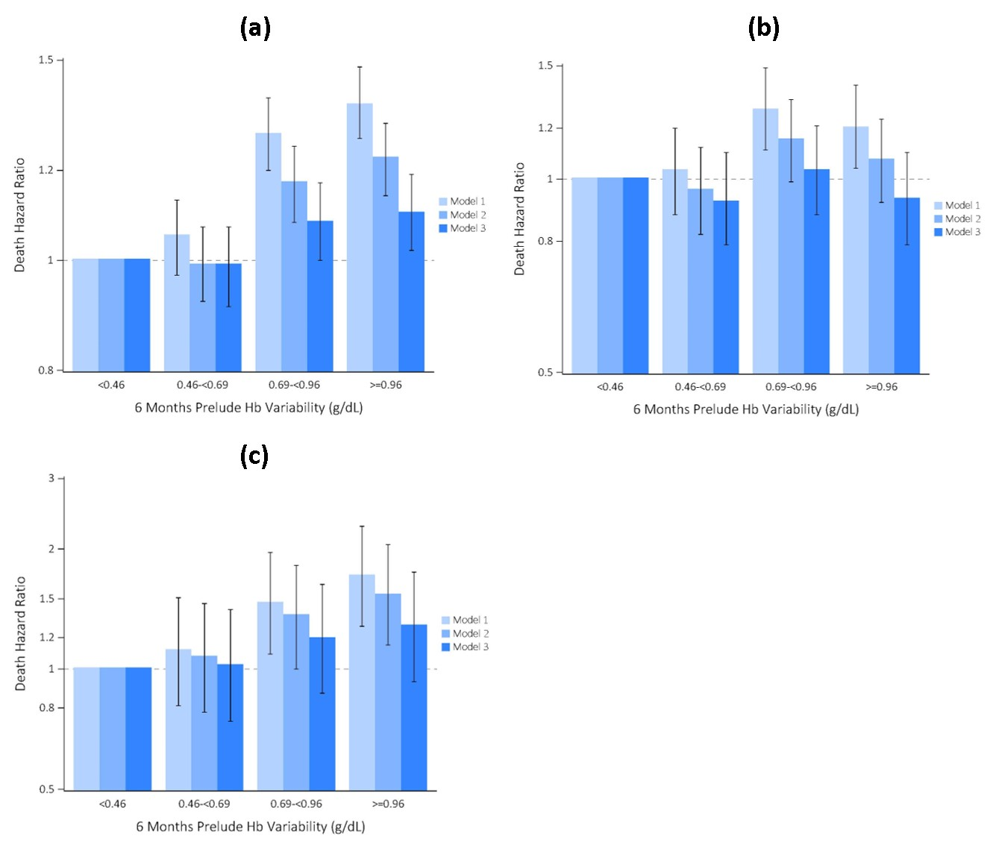
vol 1 Figure 15. Associations of 6-month pre-ESRD hemoglobin variability with post-ESRD (a) all-cause, (b) cardiovascular, and (c) infection related mortality in 11,872 veterans who transitioned to ESRD during 10/1/2007-9/30/2011
Death hazard ratios with 95% confidence intervals are presented for all-cause, cardiovascular and infection related mortality. Model 1: age, sex, race/ethnicity, and marital status; Model 2: Model 1 plus comorbidities (diabetes mellitus, cardiovascular disease, CHF, peripheral vascular disease, lung disease, peptic ulcer disease, liver disease, malignancy, and HIV/AIDS), Charlson Comorbidity Index, and cumulative length of hospitalization during the six-month prelude period as an indicator of sickness; and Model 3: Model 2 plus medications (ESAs, intravenous or oral iron, vitamin D analogs, ACEIs/ARBs, antiplatelet agents, and warfarin), eGFR, type of vascular access (arteriovenous fistula, arteriovenous graft, or catheter), baseline Hb, change in Hb, and number of Hb measurements over the six-month prelude period.
Abbreviations: Hb, hemoglobin; CHF, congestive heart failure; eGFR, estimated glomerular filtration rate; ESA, erythropoietin stimulating agent; ESRD, end stage renal disease
2019 Annual Data Report Chapter 2 TCCKD

Slide 17
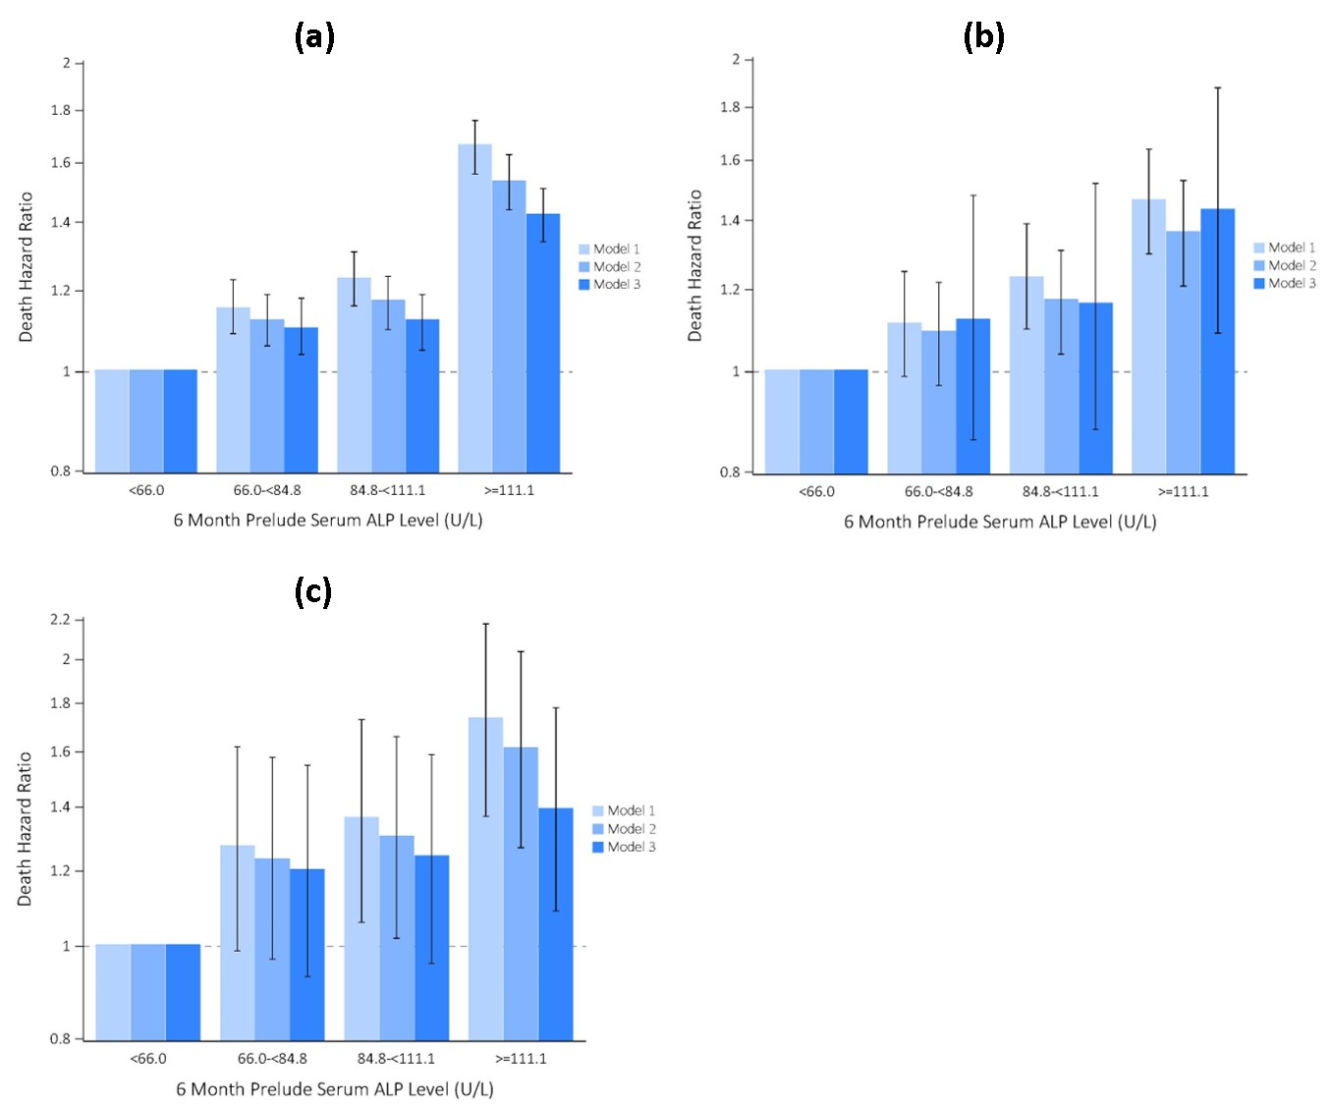
vol 1 Figure 16 Associations of 6-month pre-ESRD alkaline phosphatase with post-ESRD (a) all-cause, (b) cardiovascular, and (c) infection related mortality in 17,732 veterans who transitioned to ESRD during 10/1/2007-9/30/2011
The lowest quartile of serum ALP was the reference group. Models were as follows: model 1 was adjusted for age, sex, race/ethnicity and marital status; model 2 was additionally accounted for comorbidities (cardiovascular disease, congestive heart failure, peripheral vascular disease, dementia, lung disease, diabetes mellitus, liver disease, malignancy and Charlson Comorbidity Index); and model 3 additionally included medications (vitamin D analogs, phosphate binders, angiotensin-converting enzyme inhibitors/angiotensin receptor blockers, statins, bicarbonate and erythropoietin stimulating agents), eGFR and serum albumin averaged over the 6-month prelude period, and type of vascular access (arteriovenous fistula, arteriovenous graft or catheter).
2019 Annual Data Report Chapter 2 TCCKD

Slide 18
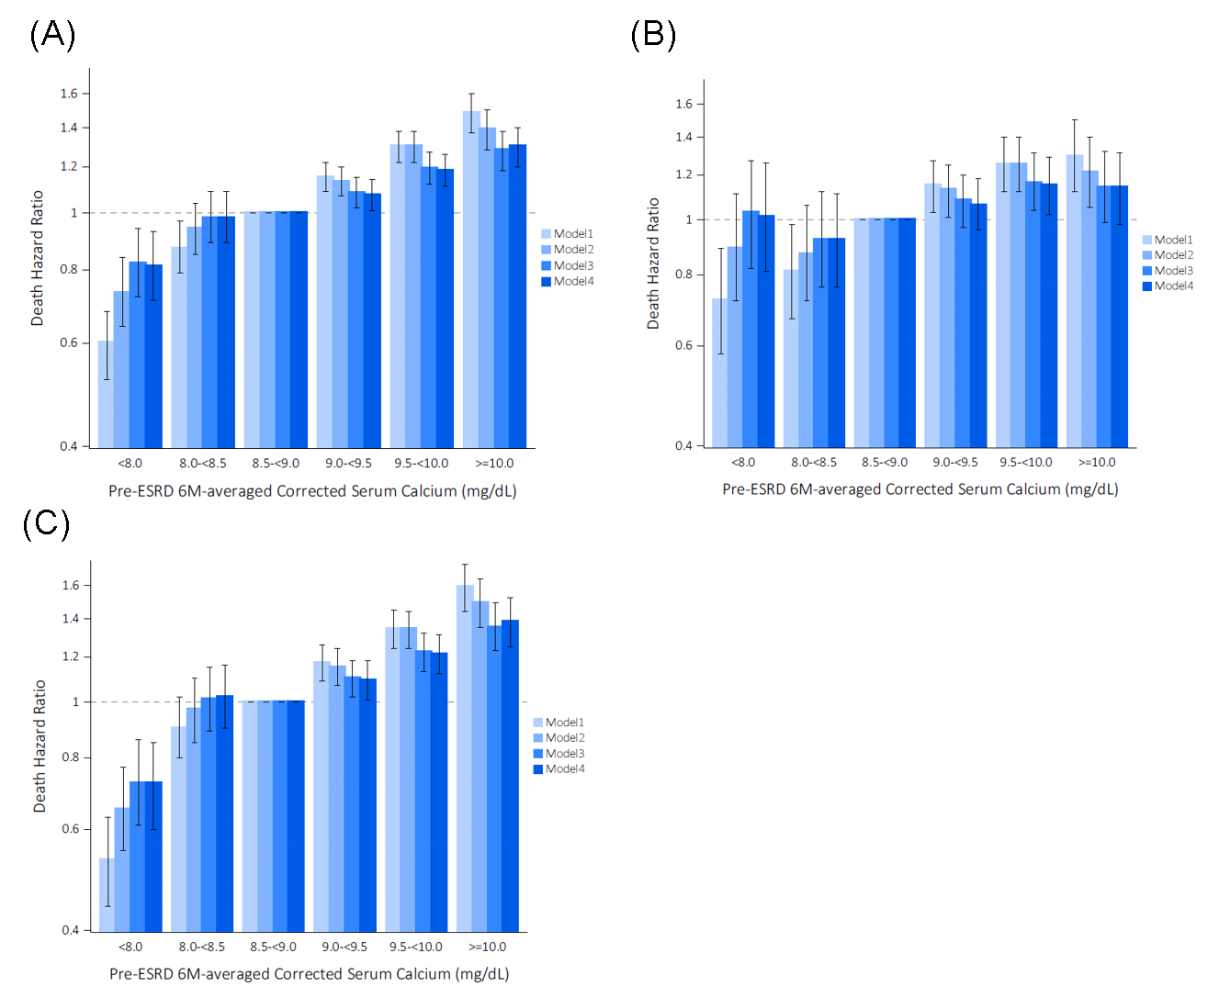
vol 1 Figure 17. Associations of 6-month pre-ESRD serum calcium with post-ESRD (a) all-cause, (b) cardiovascular, and (c) infection related mortality in 21,826 veterans who transitioned to ESRD during 10/1/2007-3/31/2014
Model 1: unadjusted; model 2: included age, sex, race, ethnicity, and marital status; model 3: included all covariates in model 2 plus Charlson comorbidity index, diabetes, prior history of ischemic heart disease, congestive heart failure, atrial fibrillation, cerebrovascular disease, chronic pulmonary disease, depression, and cancer, serum albumin, body mass index, and estimated GFR; model 4: included all covariates in model 3 plus baseline medications, which were composed of calcium supplements, active vitamin D, nutritional vitamin D (either ergocalciferol or cholecalciferol), calcium‐containing phosphate binders, erythropoiesis‐stimulating agents, RAAS inhibitors, sodium bicarbonate, and loop and/or thiazide diuretics.
2019 Annual Data Report Chapter 2 TCCKD

Slide 19
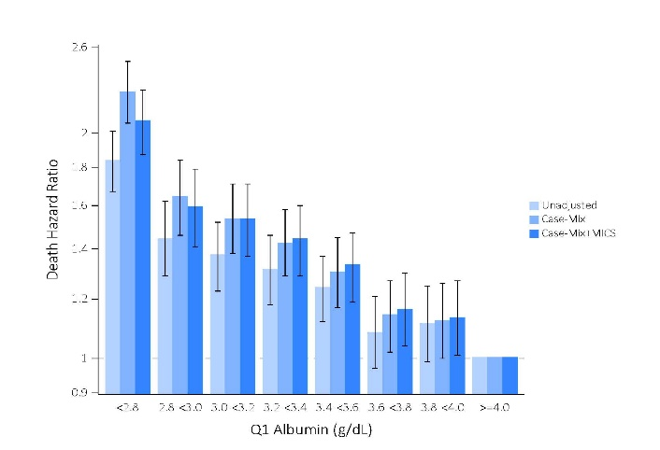
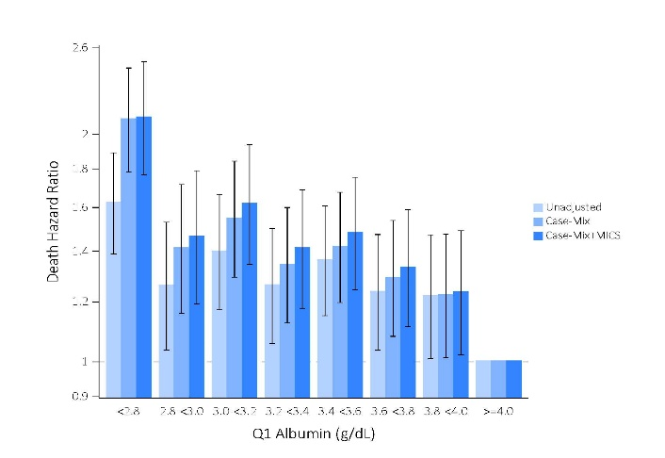
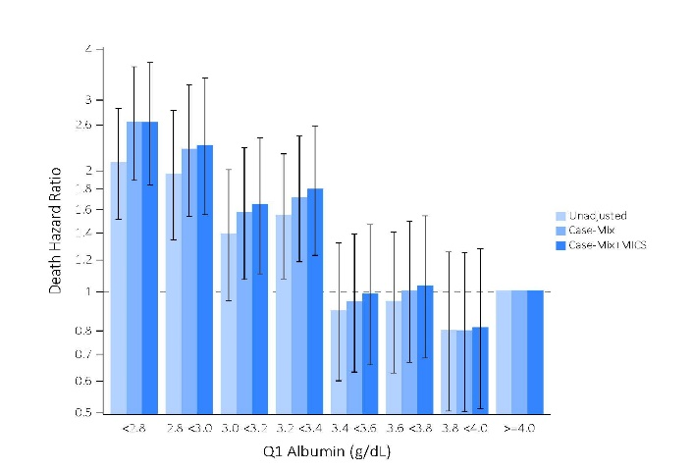
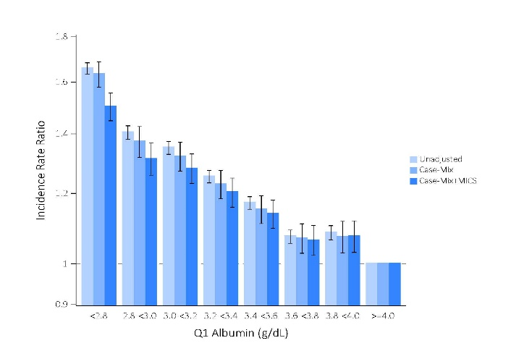
vol 1 Figure 18. Associations of 3-month pre-ESRD serum albumin with post-ESRD (a) all-cause, (b) cardiovascular, (c) infection related mortality, and (d) hospitalization in 29,124 veterans who transitioned to ESRD during 10/1/2007-3/31/2015
A)
B)
C)
D)
Model 1, unadjusted; Model 2 (Casemix): age, sex, race, ethnicity, marital status, Charlson Comorbidity Index (CCI), anemia, atrial fibrillation depression, hyperlipidemia, ischemic heart disease, myocardial infarction, congestive heart failure, peripheral vascular disease, cerebrovascular disease, dementia, chronic pulmonary disease, connective tissue disease (rheumatic disease), peptic ulcer disease, paraplegia and hemiplegia, AIDS and HIV, liver disease, diabetes mellitus, cancer and primary cause of ESRD; Model 3 (Casemix+MICS): Model 2 plus base- line laboratory measures of hemoglobin, bicarbonate, phosphorus, white blood cell count, alkaline phosphatase, body mass index, potassium, cholesterol, eGFR, and corrected calcium.
2019 Annual Data Report Chapter 2 TCCKD

Slide 20
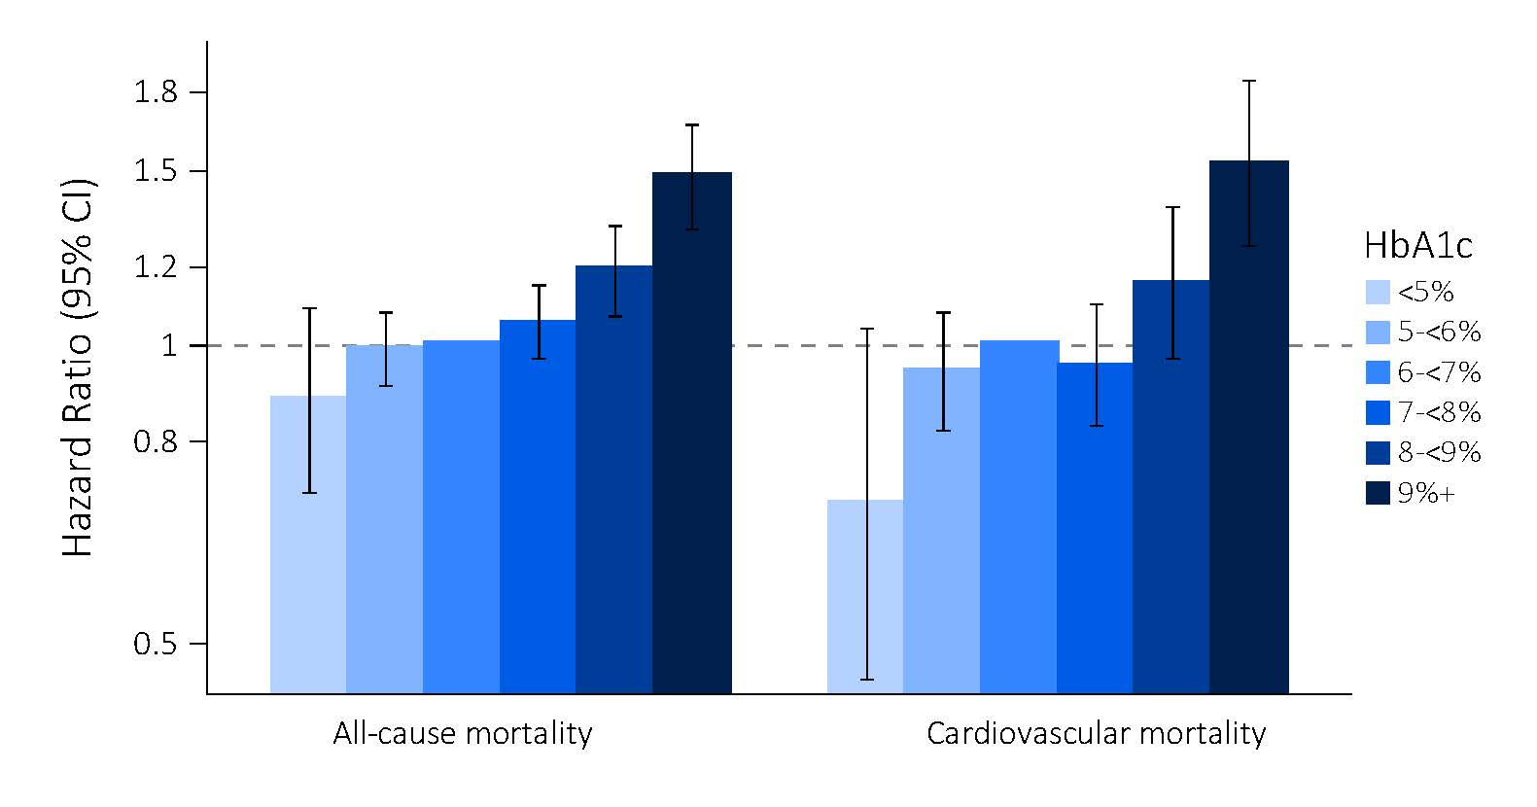
vol 1 Figure 19. Adjusted hazard ratios for (A) all-cause and (B) cardiovascular mortality after transition to dialysis across categories of pre-end stage renal disease (ESRD) mean hemoglobin A1c (HbA1c) levels averaged over the 1-year prelude period (the time prior to transition to ESRD) (reference: HbA1c 6-<7%) in 17,819 patients from 10/01/2007 – 9/30/2011
Associations of pre-end stage renal disease (ESRD) mean hemoglobin A1c (HbA1c) levels averaged over the 1-year prelude period (categorized as <5%, 5% to <6%, 6% to <7%, 7% to <8%, 8% to <9%, and ≥9%) with (A) all-cause and (B) cardiovascular mortality after transition to dialysis are shown in 17,819 patients from 10/2007 to 9/2011. HbA1c levels of 6-<7% were the reference group. Models were adjusted for case-mix covariates, which included patient’s calendar quarter of dialysis initiation to account for secular changes in care over time, age, sex, race, ethnicity, cause of ESRD, Charlson Comorbidity Index (CCI), diabetes, congestive heart failure (CHF), and cerebrovascular disease (CVD).
2019 Annual Data Report Chapter 2 TCCKD

Slide 21
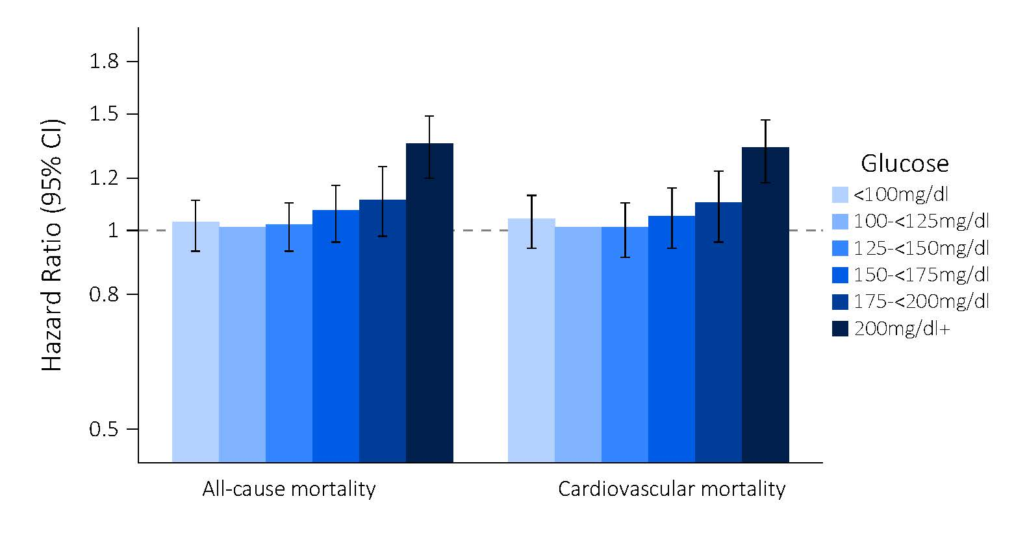
vol 1 Figure 20. Adjusted hazard ratios for (A) all-cause and (B) cardiovascular mortality after transition to dialysis across categories of pre-end stage renal disease (ESRD) mean random glucose levels averaged over the 1-year prelude period (the time prior to transition to ESRD) (reference: random glucose 100-<125mg/dl) in 17,121 patients with diabetes from 10/01/2007 – 9/30/2011
Associations of pre-end stage renal disease (ESRD) mean random glucose levels averaged over the 1-year prelude period (categorized as <100, 100 to <125, 125 to <150, 150 to <175, 175 to <200, and ≥200 mg/dL) with (A) all-cause and (B) cardiovascular mortality after transition to dialysis are shown in 17,121 patients with diabetes from 10/2007 to 9/2011. Random glucose levels 100-<125mg/dl were the reference group. Models were adjusted for case-mix covariates, which included patient’s calendar quarter of dialysis initiation to account for secular changes in care over time, age, sex, race, ethnicity, cause of ESRD, Charlson Comorbidity Index (CCI), diabetes, congestive heart failure (CHF), and cerebrovascular disease (CVD).
2019 Annual Data Report Chapter 2 TCCKD

Slide 22
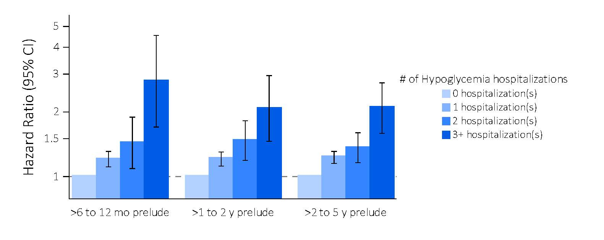
vol 1 Figure 21. Associations between frequency of pre-ESRD hypoglycemia-related hospitalization events over varying prelude intervals (the time prior to transition to ESRD) with post-ESRD all-cause mortality risk (reference: no hypoglycemia-related hospitalizations) in patients transitioning to dialysis from 10/01/2007 - 9/30/2011
Associations between frequency of pre-ESRD hypoglycemia-related hospitalization events (categorized 1, 2, 3, and ≥3 hypoglycemia-related hospitalizations) over >6-12 month, >1-2 year and >2-5 year prelude intervals with post-ESRD all-cause mortality in patients transitioning to dialysis from 10/2007 to 9/2011. The >6-12 month, >1-2 year, and >2-5 year prelude cohorts were comprised of 30,992, 30,156, and 28,729 patients. Patients who did not experience any hypoglycemia-related hospitalizations served as the reference group. Models were adjusted for patient’s calendar quarter of dialysis therapy initiation to account for secular changes in care over time, age at dialysis therapy initiation, sex, race, and ethnicity.
2019 Annual Data Report Chapter 2 TCCKD

Slide 23
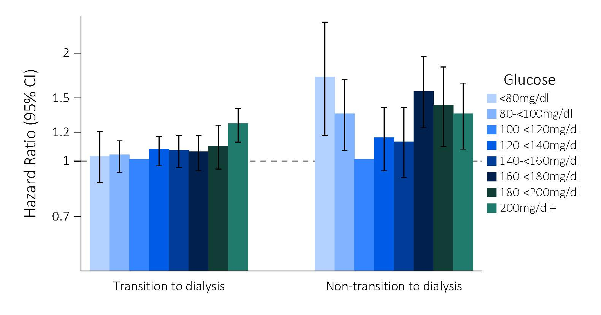
vol 1 Figure 22. Associations of glycemic status, defined by mean random blood glucose (reference: 100-<120 mg/dl) averaged over a 1-year period with all-cause mortality (A) after transitioning to dialysis over 2007-2011 (Transition Cohort) compared with (B) patients in a one-to-one matched cohort of CKD patients with diabetes who did not transition to dialysis (Non-Transition Cohort)
Associations of glycemic status, defined by mean random blood glucose (reference: 100-<120 mg/dl) averaged over a 1-year period (categorized as <80, 80-<100, 100-<120, 120-<140, 140-<160, 160-<180, 180-<200, and ≥200 mg/dl) with all-cause mortality (A) after transitioning to dialysis over 2007-2011 (Transition Cohort, N=17,121) compared with (B) patients in a one-to-one matched cohort of CKD patients with diabetes who did not transition to dialysis (Non-Transition Cohort, N=8711). Mean glucose levels of 100-<120 mg/dl were the reference group. In the Transition Cohort, models were adjusted for patient’s calendar quarter of dialysis initiation to account for secular changes in care over time, age, sex, race, ethnicity, cause of ESRD, Charlson Comorbidity Index (CCI) score, diabetes, congestive heart failure (CHF), cerebrovascular disease (CVD), residential region, initial dialysis modality, and body mass index. In the Non-Transition Cohort, models were adjusted for patient’s study entry quarter, age, sex, race, ethnicity, CCI score, diabetes, CHF, CVD, residential region and body mass index
2019 Annual Data Report Chapter 2 TCCKD

Slide 24
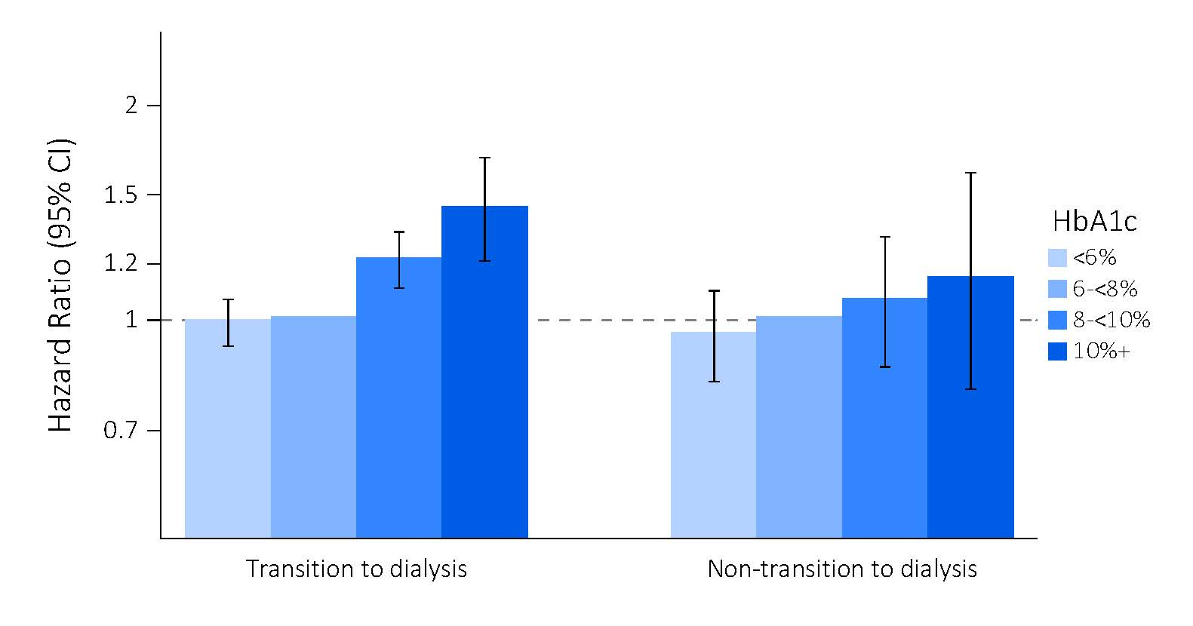
vol 1 Figure 23. Associations of glycemic status, defined by mean hemoglobin A1c (HbA1c) (reference: 6-<8%) averaged over a 1-year period with all-cause mortality (A) after transitioning to dialysis over 2007-2011 (Transition Cohort) compared with (B) patients in a one-to-one matched cohort of CKD patients with diabetes who did not transition to dialysis (Non-Transition Cohort)
Associations of glycemic status, defined by hemoglobin A1c (HbA1c) (reference: 6-<8%) over a 1-year period (categorized as <6, 6-<8, 8-<10, and ≥10%) with all-cause mortality (A) after transitioning to dialysis over 2007-2011 (Transition Cohort, N=17,189) compared with (B) patients in a one-to-one matched cohort of CKD patients with diabetes who did not transition to dialysis (Non-Transition Cohort, N=10,848). Mean HbA1c levels of 6-<8% were the reference group. In the Transition Cohort, models were adjusted for patient’s calendar quarter of dialysis initiation to account for secular changes in care over time, age, sex, race, ethnicity, cause of ESRD, Charlson Comorbidity Index (CCI) score, diabetes, congestive heart failure (CHF), cerebrovascular disease (CVD), residential region, initial dialysis modality, and body mass index. In the Non-Transition Cohort, models were adjusted for patient’s study entry quarter, age, sex, race, ethnicity, CCI score, diabetes, CHF, CVD, residential region and body mass index.
2019 Annual Data Report Chapter 2 TCCKD

Slide 25
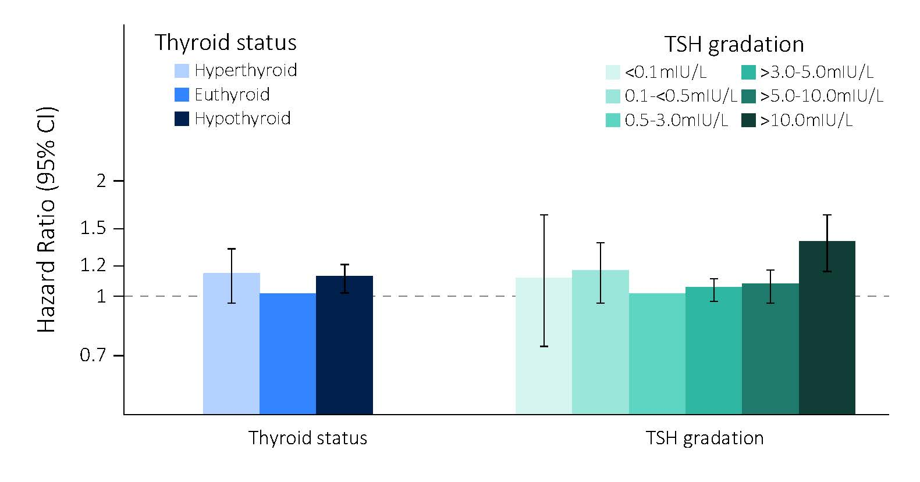
vol 1 Figure 24. Adjusted hazard ratios for all-cause after transition to dialysis across categories of pre-end stage renal disease (ESRD) thyroid status defined by serum thyrotropin (TSH) levels over the 2-year prelude period (the time prior to transition to ESRD) in 19,860 patients transitioning to dialysis from 10/01/2007 - 9/30/2011
Associations of pre-end stage renal disease (ESRD) thyroid status defined by serum thyrotropin (TSH) levels averaged over the 2-year prelude period in 19,860 patients transitioning to dialysis from 10/2007 to 9/2011. Panel (A) shows thyroid status defined as hyper-, eu-, and hypothyroidism (ref: euthyroidism). Panel (B) shows finer gradations of serum TSH, categorized as overt hyperthyroid range (<0.1 mIU/L), subclinical hyperthyroid range (0.1 to <0.5 mIU/L), low-normal (0.5 to 3.0mIU/L), high-normal (>3.0 to 5.0 mIU/L), subclinical hypothyroid range (>5.0 to 10.0 mIU/L) and overt hypothyroid range TSH levels (>10.0 mIU/L) (reference: serum TSH 0.5 to 3.0 mIU/L). Models were adjusted for case-mix covariates, which included patient’s calendar quarter of dialysis initiation to account for secular changes in care over time, age, sex, race, ethnicity, cause of ESRD, Charlson Comorbidity Index (CCI) score, congestive heart failure (CHF), cerebrovascular disease (CVD), coronary artery disease (CAD), hypertension and hyperlipidemia.
2019 Annual Data Report Chapter 2 TCCKD

Slide 26
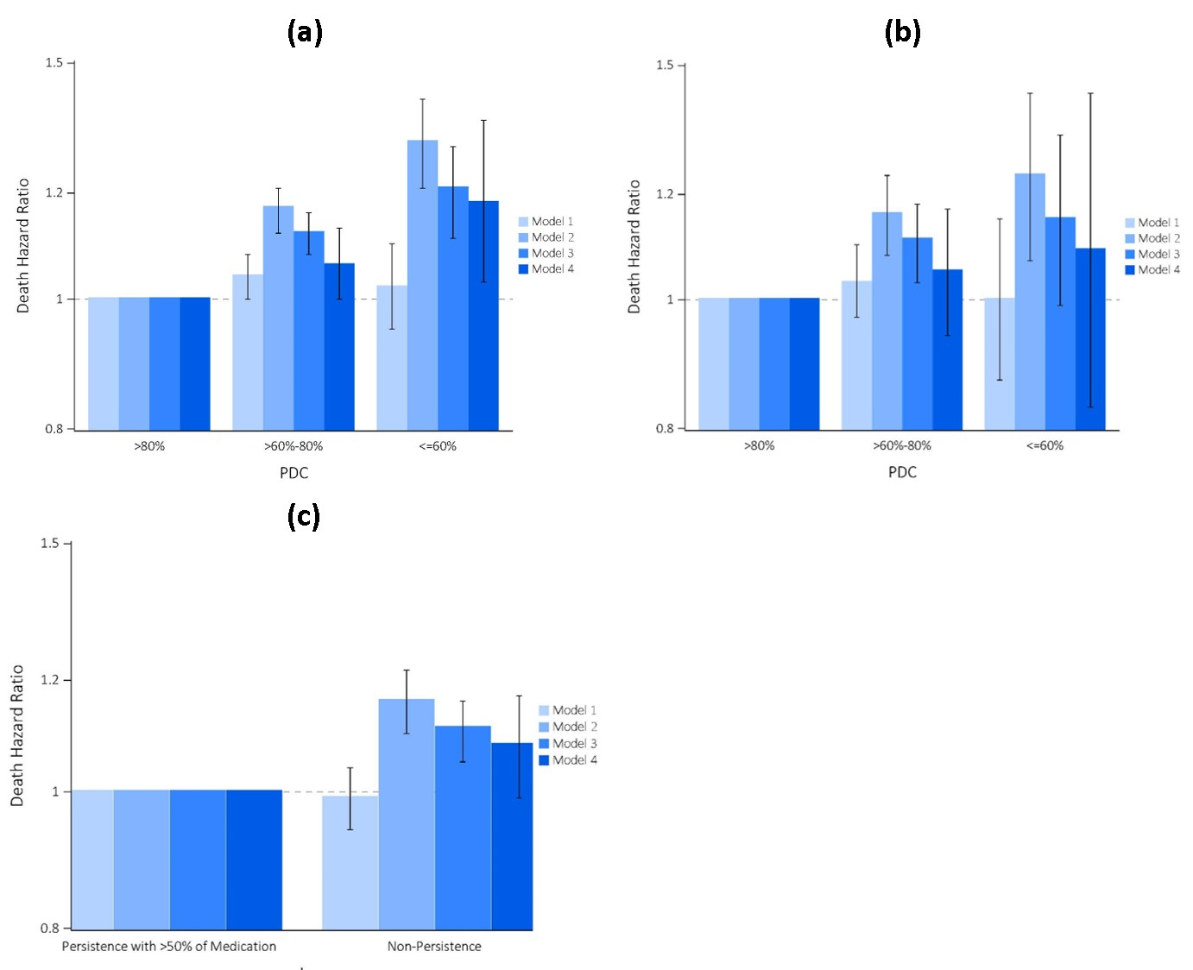
vol 1 Figure 25. Associations of cardiovascular medication adherence (ascertained by proportion of days covered, medication possession ratio, and persistence with drug therapy from pharmacy records) over a 1-year period before transition to dialysis with all-cause and cardiovascular mortality in 32,348 veterans who transitioned to dialysis during 10/1/2007-9/30/2011
Death hazard ratios with 95% confidence intervals are presented for all-cause and cardiovascular mortality. Model1: unadjusted; Model 2: age, sex, race/ethnicity, marital status, and ZIP code; Model 3: Model 2 plus comorbid conditions (diabetes mellitus, congestive heart failure, cardiovascular/cerebrovascular disease, depression, anxiety, and Charlson Comorbidity Index), and vascular access type; and Model 4: Model 3 plus blood/serum hemoglobin, bicarbonate, albumin, urea nitrogen, and last eGFR.
Abbreviations: eGFR, estimated glomerular filtration rate; ESRD, end stage renal disease; PDC, proportion of days covered.
2019 Annual Data Report Chapter 2 TCCKD

Slide 27
vol 1 Figure 26. Associations of statin therapy (vs. no statin therapy) use over a 1-year period before transition to dialysis with 1-year post-ESRD all-cause and cardiovascular mortality and hospitalization in 47,720 veterans who transitioned to ESRD during 10/1/2007-3/31/2014
Death hazard ratios and incidence rate ratios with 95% confidence intervals are presented for all-cause and cardiovascular mortality, and hospitalization, respectively. Multivariable model: age, sex, race, and ethnicity, as well as the following comorbidities: Charlson Comorbidity Index, diabetes mellitus, atherosclerotic cardiovascular disease (defined as the presence of myocardial infarction, peripheral vascular disease, or ischemic heart disease), atrial fibrillation, congestive heart failure, and cerebrovascular disease.
Abbreviations: ESRD, end stage renal disease.
2019 Annual Data Report Chapter 2 TCCKD

Slide 28
vol 1 Figure 27. Associations of continuation (vs. discontinuation) of statin therapy over a 1-year period before transition to dialysis with 1-year post-ESRD all-cause and cardiovascular mortality in 14,298 veterans who transitioned to ESRD during 10/1/2007-3/31/2014
Hazard ratios with 95% confidence intervals are presented for all-cause and cardiovascular mortality. Multivariable model: age, sex, race, ethnicity, Deyo Charlson Comorbidity Index, presence of diabetes, atherosclerotic cardiovascular disease (defined as presence of myocardial infarction, peripheral vascular disease, or ischemic heart disease), atrial fibrillation, congestive heart failure, and cerebrovascular disease.
Abbreviations: ESRD, end stage renal disease.
2019 Annual Data Report Chapter 2 TCCKD

Slide 29
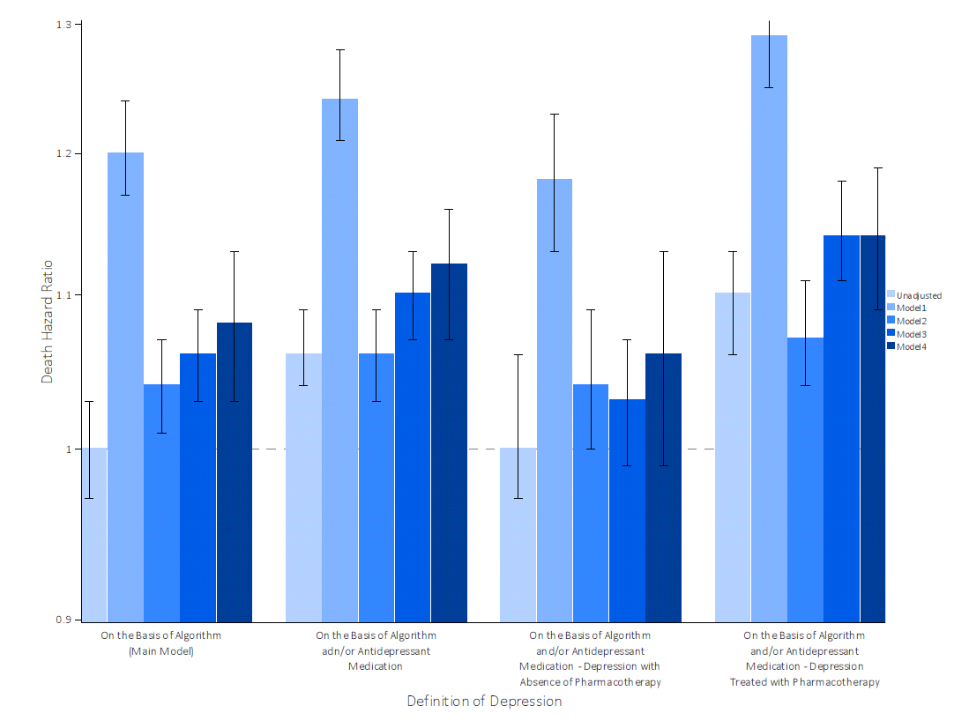
vol 1 Figure 28. Associations of pre-ESRD depression (ascertained by combinations of diagnosis or antidepressant medication prescription) with all-cause mortality in 45,076 veterans who transitioned to ESRD during 10/1/2007-9/30/2011
Model 1: age, sex, race/ethnicity, and marital status; model 2: comorbidities (dementia, myocardial infarction, congestive heart failure, peripheral vascular disease, connective tissue disease, lung disease, peptic ulcer disease, HIV, diabetes mellitus, stroke/paraplegia, liver disease, malignancy, and hypertension), type of vascular access (arteriovenous fistula, arteriovenous graft, or catheter), eGFR slope before ESRD initiation, post-traumatic stress disorder, substance abuse, and numbers of mental health care and emergency department visits in the last year; model 3 (main model): medications (phosphorous binder, active vitamin D, angiotensin-converting enzyme inhibitors/angiotensin receptor blockers, bicarbonate, β-blockers, calcium channel blockers, vasodilators, diuretics, statins, and erythropoietin stimulating agents); model 4: blood hemoglobin, serum albumin, income, and cardiovascular medication adherence.
2019 Annual Data Report Chapter 2 TCCKD

Slide 30
vol 1 Figure 29. Associations of pre-ESRD dementia with all-cause mortality in 45,076 veterans who transitioned to ESRD during 10/1/2007-9/30/2011
logistic regression model: age, gender, race/ethnicity, marital status, comorbidities at baseline (myocardial infarction, congestive heart failure (CHF), peripheral vascular disease, cerebrovascular disease, paraplegia/hemiplegia, lung disease, rheumatic disease, peptic ulcer disease, HIV/AIDS, malignancy, liver disease, diabetes, hypertension), and medications at baseline (statins, vasodilatators, renin-angiotensin-aldosterone system (RAAS) blockers, phosphate binders, erythropoietin stimulating agents (ESAs), diuretics, calcium channel blockers, bicarbonates, beta-blockers, active Vitamin D)
2019 Annual Data Report Chapter 2 TCCKD

Slide 31
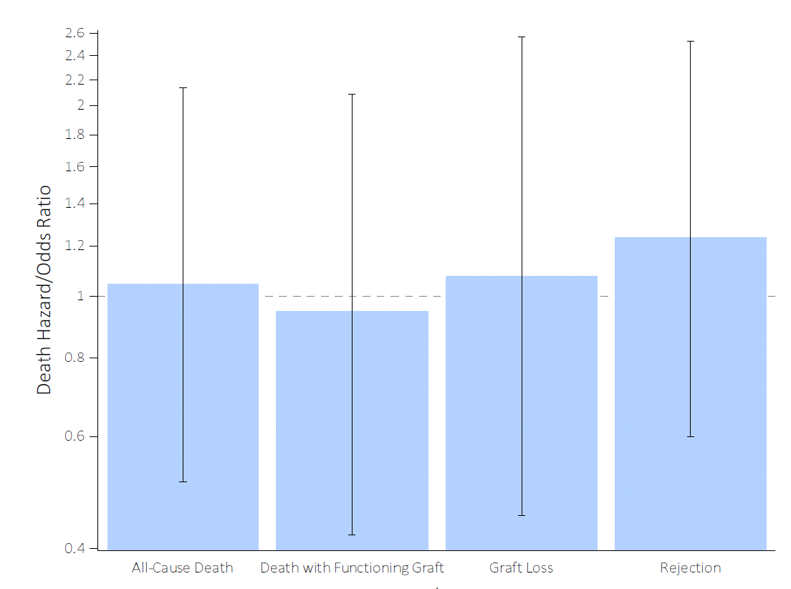
vol 1 Figure 30. Associations of pre-kidney transplant psychosis or mania post-transplant outcomes 442 veterans who received a kidney transplant between 10/1/2007-9/30/2014
Models were created using cox proportional regression, competing risks regression and logistic regression in the propensity-matched cohort. Hazard ratios with 95% confidence intervals are presented for all-cause death, subhazard ratio with 95% confidence intervals are presented for death with functioning graft and graft loss, and odds ratios with 95% confidence intervals are presented for rejection.
2019 Annual Data Report Chapter 2 TCCKD

Slide 32
vol 1 Figure 31. Associations of pre-kidney transplant post-traumatic stress disorder (PTSD) post-transplant outcomes 442 veterans who received a kidney transplant between 10/1/2007-9/30/2015
Multivariate models adjusted for the following variables: age at transplant, gender, race/ethnicity, service connection, marital status, income, smoking status, type of transplant donor (deceased vs living), type of dialysis modality, Charlson Comorbidity Index (CCI), presence of comorbidities (peripheral vascular disease, cerebrovascular disease, dementia, peptic ulcer disease, malignancy, liver disease, diabetes, depression), and medication use (phosphorus binders, active vitamin D (native or active), renin‐angiotensin‐aldosterone system inhibitors, alpha‐ blockers, β‐blockers, calcium channel blockers, vasodilators, insulin, diuretics, statins, antianginals, anticoagulants, thrombolytic, aspirin, digitalis, and erythropoietin‐stimulating agents).
2019 Annual Data Report Chapter 2 TCCKD

